Slide 1
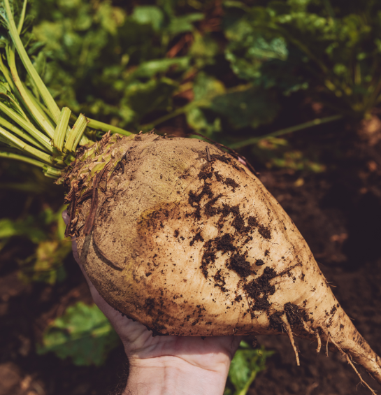
Data driven ML-based modeling for infestation level prediction of the sugar beet weevil
L. Bernadó⁽¹⁾, F. Cerqueira⁽²⁾, P. Thiele⁽¹⁾, M. Dokal⁽³⁾, M. Seiter⁽³⁾, J. Lampert⁽¹⁾, E. Molin⁽²⁾
⁽¹⁾ AIT Austrian Institute of Technology GmbH, Center for Digital Safety & Security, Vienna, Austria ⁽²⁾ AIT Austrian Institute of Technology GmbH, Center for Health & Bioresources, Tulln, Austria ⁽³⁾ AGRANA Research & Innovation Center, Tulln, Austria

Slide 2
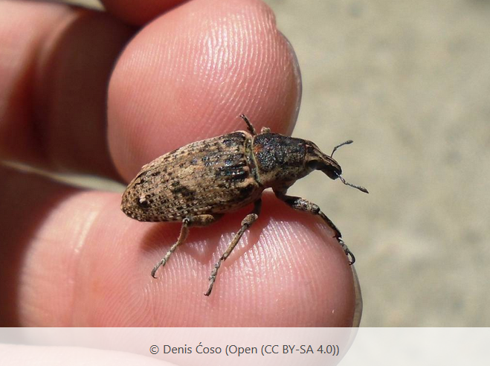
Data driven ML-based modeling for infestation level prediction of the sugar beet weevil
Crop monitoring
Screening data
Crops historical data
Predictive model
Soil microbiome
Soil data
Geo-temporal data
Soil diversity
Crops and meteorological historical data
Soil composition data
Weather data
Soil chemical data

Slide 3
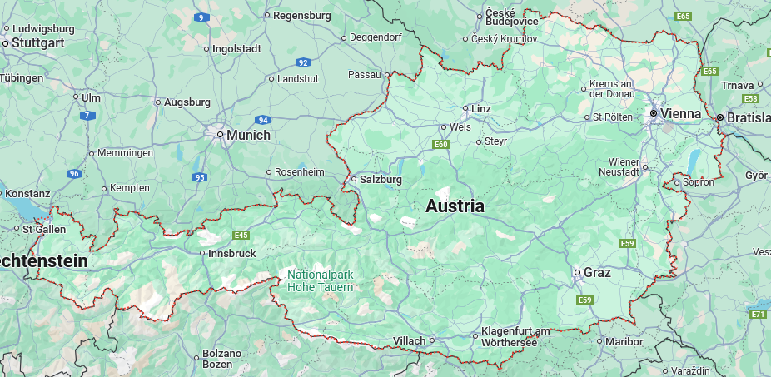
Data driven ML-based modeling for infestation level prediction of the sugar beet weevil
Affected area

Slide 4
Data driven ML-based modeling for infestation level prediction of the sugar beet weevil
Grid overlay
to create a basis layer where infestation levels are predicted per Lat/Lon pair

Slide 5
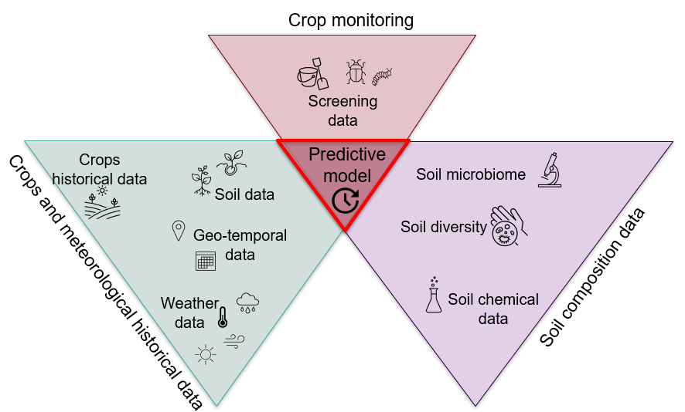
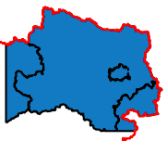
Data driven ML-based modeling for infestation level prediction of the sugar beet weevil
We want to predict (year₊₁)the probability of infestation at each grid location
Based on data for year of reported infestation (year₀) and the previous year of infestation (year₋₁)
Field location Mask (Geodata, year₊₁)
Only relevant in the vicinity of the planned crops
Population spreading
(Geodata, year₀)
Taking into account the location and the intensity of infestation
p_{infestation_level}
(Weather data, year₀@field₀,year₋₁@field₋₁)
Using historical infestation level and weather data
p_{presence}
(Screening data, year₀)
Using screening data from crops
p_{presence}
(Microbiome data, year₀)
Using soil diversity and microbiome data
p_{presence}
(Soil data)
Using soil composition data (open repository and site measurements)

Slide 6
Results and supplementary material
Dr. LAURA BERNADÓ and Dr. JASMIN LAMPERT Data Science & Artificial Intelligence Center for Digital Safety & Security
AIT Austrian Institute of Technology GmbH Giefinggasse 4 | 1210 Vienna | Austria M +43 664 8251480 laura.bernado@ait.ac.at | www.ait.ac.at

Slide 7
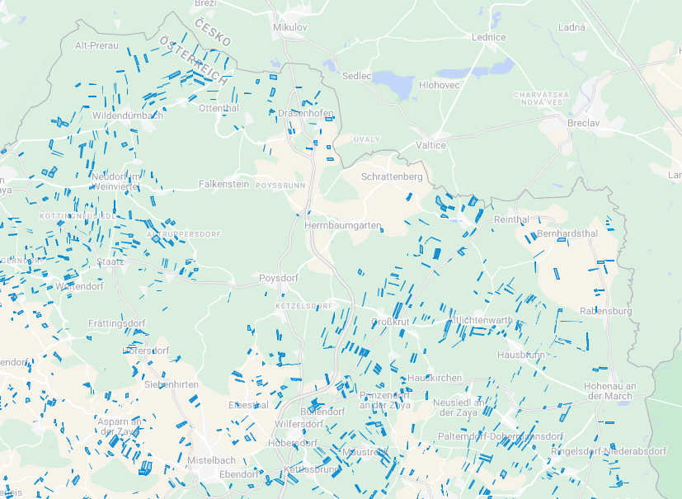
Data driven ML-based modeling for infestation level prediction of the sugar beet weevil
Aim: predict the probability of the infestation at each grid location for (year₊₁) based on data:
for the year of reported infestation (year₀)
for the previous year of infestation (year₋₁)
Field location Mask (Geodata, year₊₁)
Population spreading
(Geodata, year₀)
p_{infestation_level}
(Weather data, year₀@field₀,year₋₁@field₋₁)
p_{presence}
(Screening data, year₀)
p_{presence}
(Microbiome data, year₀)
p_{presence}
(Soil data)

Slide 8
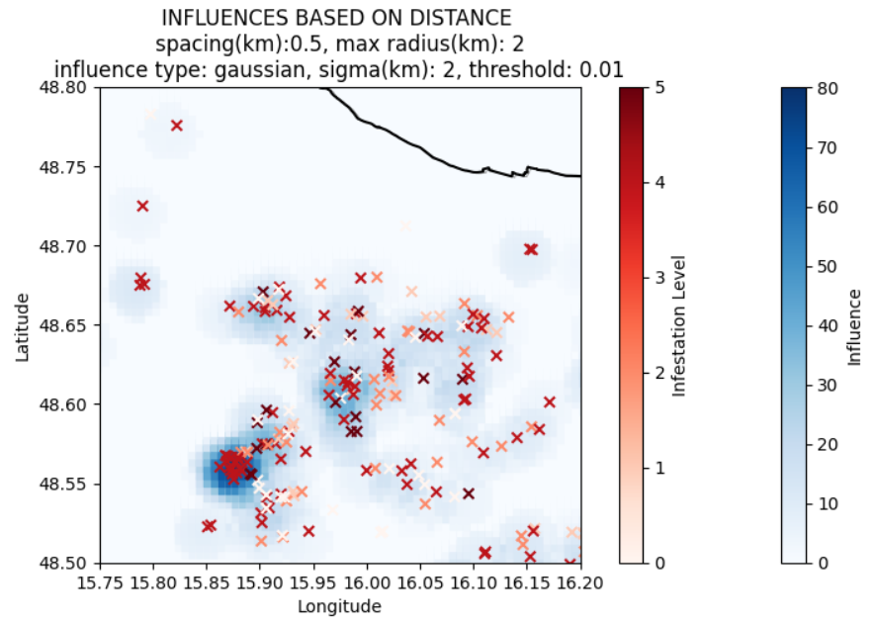
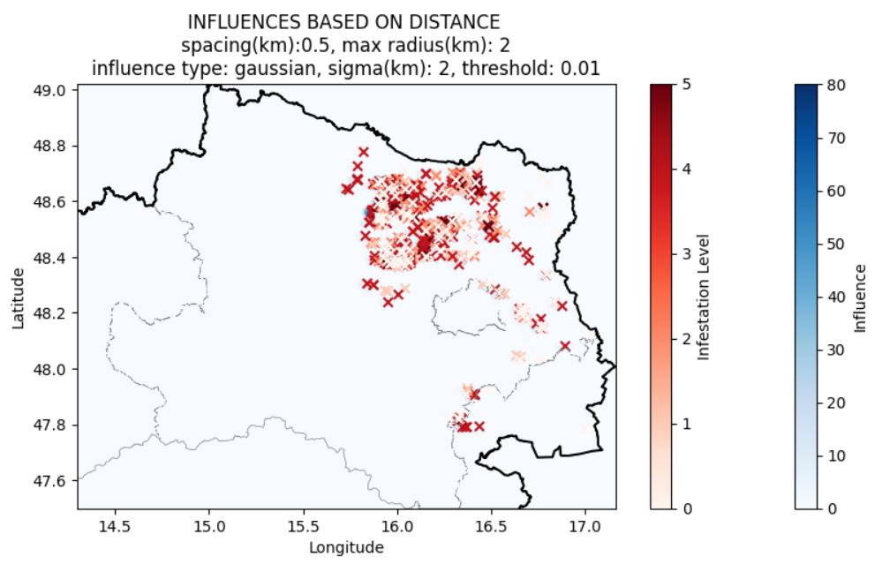
Data driven ML-based modeling for infestation level prediction of the sugar beet weevil
Aim: predict the probability of the infestation at each grid location for (year₊₁) based on data:
for the year of reported infestation (year₀)
for the previous year of infestation (year₋₁)
Field location Mask (Geodata, year₊₁)
Population spreading
(Geodata, year₀)
p_{infestation_level}
(Weather data, year₀@field₀,year₋₁@field₋₁)
p_{presence}
(Screening data, year₀)
p_{presence}
(Microbiome data, year₀)
On-going:
Influence normalization
Influence parametrization
Clustering
p_{presence}
(Soil data)

Slide 9
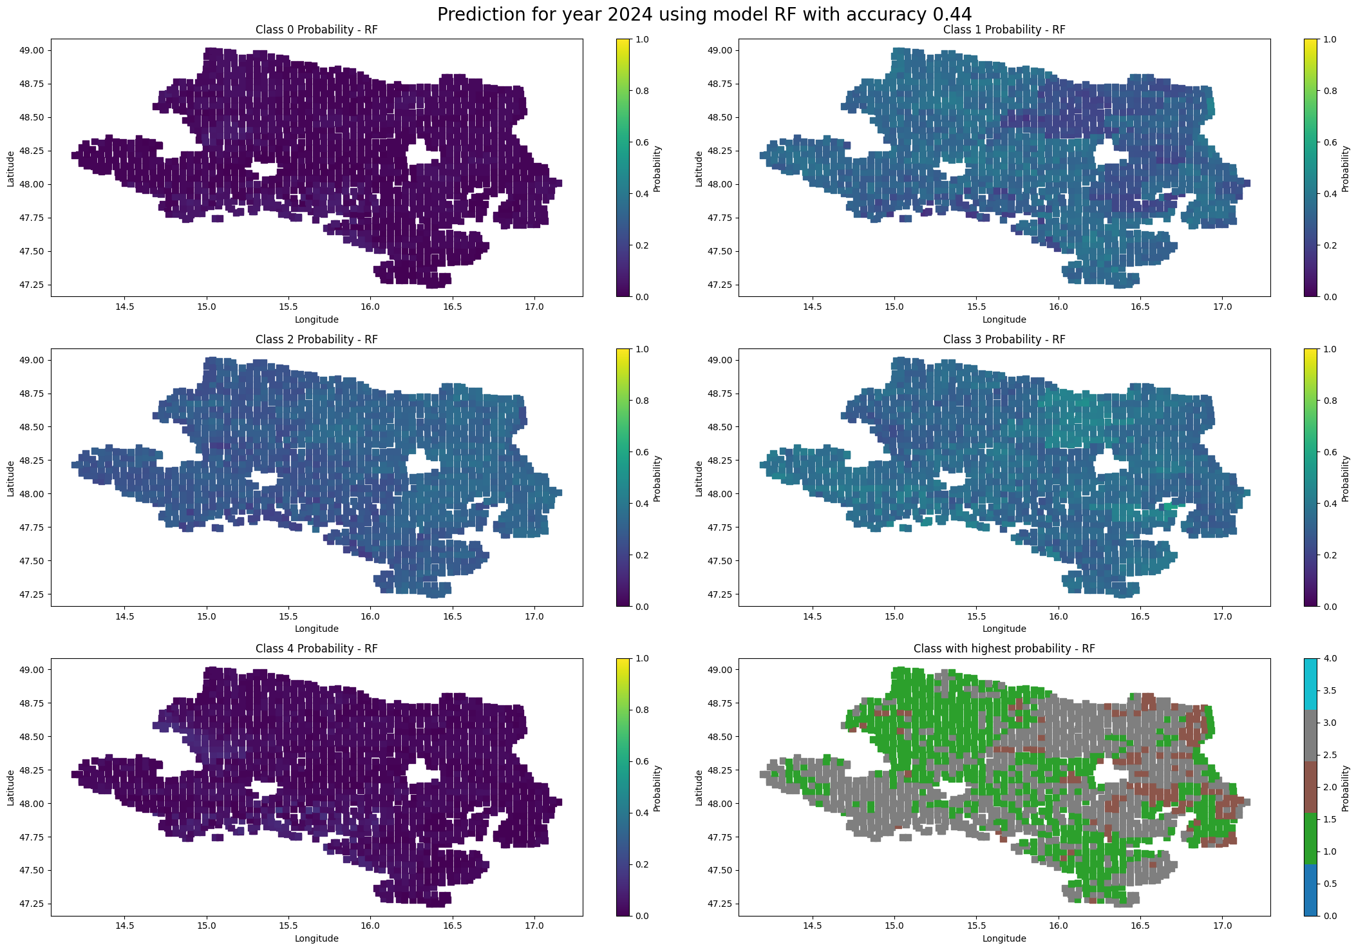
Data driven ML-based modeling for infestation level prediction of the sugar beet weevil
Aim: predict the probability of the infestation at each grid location for (year₊₁) based on data:
for the year of reported infestation (year₀)
for the previous year of infestation (year₋₁)
Random Forest
Field location Mask (Geodata, year₊₁)
Population spreading
(Geodata, year₀)
p_{infestation_level}
(Weather data, year₀@field₀,year₋₁@field₋₁)
4 – severe
3 – strong
2 – middle
1 – light
0 – not affected
p_{presence}
(Screening data, year₀)
p_{presence}
(Microbiome data, year₀)
p_{presence}
(Soil data)

Slide 10
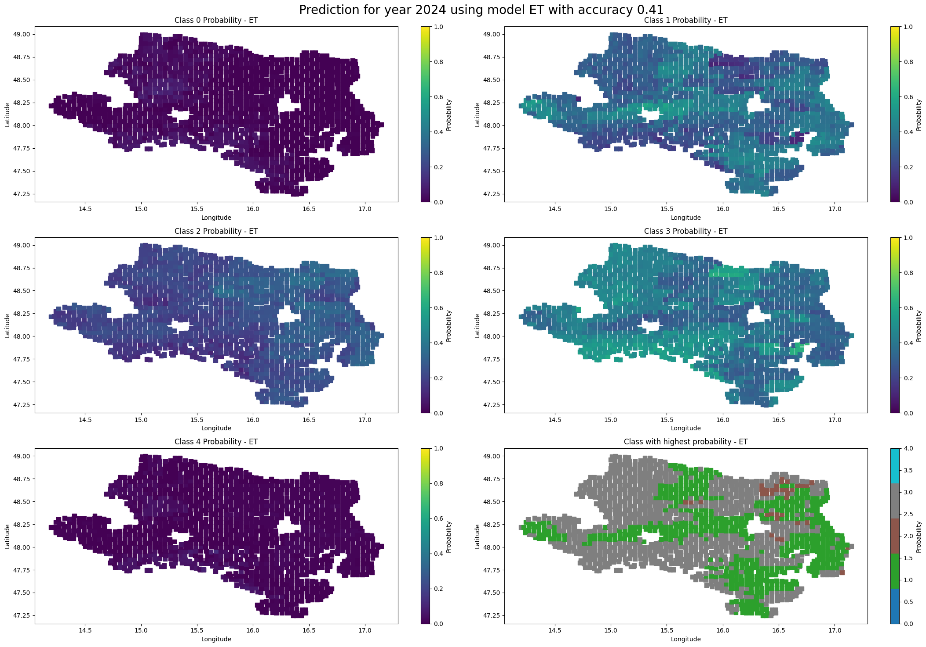
Data driven ML-based modeling for infestation level prediction of the sugar beet weevil
Aim: predict the probability of the infestation at each grid location for (year₊₁) based on data:
for the year of reported infestation (year₀)
for the previous year of infestation (year₋₁)
Extra-trees classifier
Field location Mask (Geodata, year₁)
Population spreading
(Geodata, year₀)
p_{infestation_level}
(Weather data, year₀@field₀,year₋₁@field₋₁)
4 – severe
3 – strong
2 – middle
1 – light
0 – not affected
p_{presence}
(Screening data, year₀)
p_{presence}
(Microbiome data, year₀)
p_{presence}
(Soil data)

Slide 11
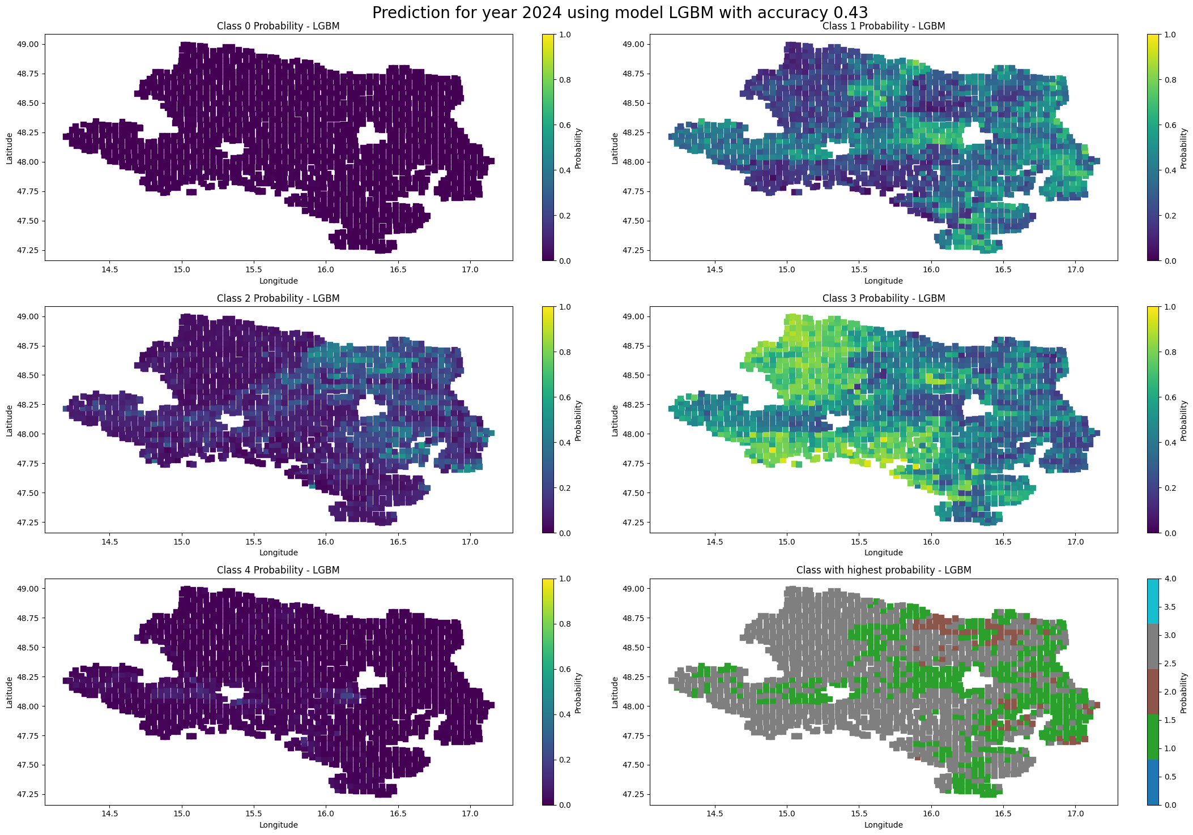
Data driven ML-based modeling for infestation level prediction of the sugar beet weevil
Aim: predict the probability of the infestation at each grid location for (year₊₁) based on data:
for the year of reported infestation (year₀)
for the previous year of infestation (year₋₁)
Light-weight Gradient Booster Machine
Field location Mask (Geodata, year₁)
Population spreading
(Geodata, year₀)
p_{infestation_level}
(Weather data, year₀@field₀,year₋₁@field₋₁)
4 – severe
3 – strong
2 – middle
1 – light
0 – not affected
p_{presence}
(Screening data, year₀)
p_{presence}
(Microbiome data, year₀)
p_{presence}
(Soil data)

Slide 12
Data driven ML-based modeling for infestation level prediction of the sugar beet weevil
5
2
Geo-temporal dependency and the movement of beetles
ZzZz
Geolocation of planted fields in year₋₁
Infestation level (based on ploughed area)
Weather data @ coord. field year₋₁
Soil data @ coord. field year₋₁
Year₋₁
3
ZzZz
Geolocation of planted fields in year₀
Infestation level (based on ploughed area)
Weather data @ coord. field year₀
Soil data @ coord. field year₀
Year₀
ZzZz
2
Geolocation of planted fields in year₁
Geolocation of planted fields in year₀
Weather data @ coord. field year₁
Weather data @ coord. field year₀
Infestation data @ coord. field year₀
Soil data @ coord. field year₁
Soil data @ coord. field year₀
Larvae counting @ coord. field year₀
ZzZz
Year₁

