Slide 1
Politécnico Castelo Branco
Polytechnic University
FUTURE CLIMATIC WATER BALANCE PROSPECTS UNDER CLIMATE CHANGE SCENARIOS IN THE VISO-QUERIDAS AQUIFER, PORTUGAL
Sabrina Formigoni^{1,*}, Teresa Albuquerque², Catarina Silva³, Natalia Roque², Fulvio Celico⁴, Marco D’Oria¹
¹ Department of Engineering and Architecture, University of Parma, Parma, Italy
² Department of Civil Engineering, Polytechnic Institute of Castelo Branco, Castelo Branco, Portugal
³ Department of Geology, University of Lisbon, Lisbon, Portugal
⁴ Department of Chemistry, Life Sciences and Environmental Sustainability, University of Parma, Parma, Italy
*sabrina.formigoni@studenti.unipr.it
DOI:
https://doi.org/10.5194/egusphere-egu25-11620

Slide 2
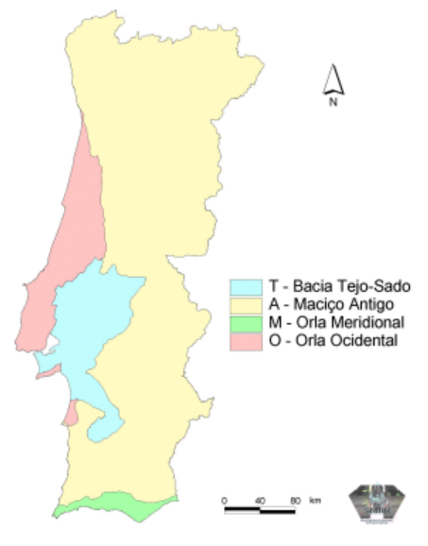
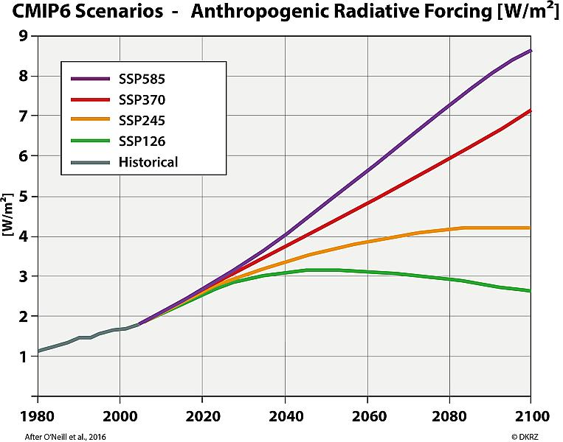
RESEARCH AIM
ASSESS THE SPATIAL AND TEMPORAL EVOLUTION OF THE CLIMATIC WATER BALANCE IN THE VISO-QUERIDAS AQUIFER (PORTUGAL) UNDER DIFFERENT CLIMATE CHANGE SCENARIOS
CONSEGUENZE
PROCEDIMENTO DELLA TESI
«FUTURE CLIMATIC WATER BALANCE PROSPECTS UNDER CLIMATE CHANGE SCENARIOS IN THE VISO-QUERIDAS AQUIFER, PORTUGAL»

Slide 3
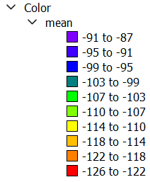
METHODOLOGICAL SUMMARY
CONNECTION BETWEEN WATER RESOURCES AND CLIMATE CHANGE
CONSEGUENZE
Historical and future climate data
1. COLLECTION OF DATA
PROCEDIMENTO DELLA TESI
AUGUST SSP5-85 2090
2. COMPUTATION OF BALANCE
Thornthwaite equation
3. GEOSTATISTICAL ANALYSIS
Sequential Gaussian Simulations
4. INTERPRETATION OF RESULTS
Decreasing trend in recharge
5. ZONING OF CRITICAL AREAS
Clustering of low climatic water balance
«FUTURE CLIMATIC WATER BALANCE PROSPECTS UNDER CLIMATE CHANGE SCENARIOS IN THE VISO-QUERIDAS AQUIFER, PORTUGAL»

