Slide 1

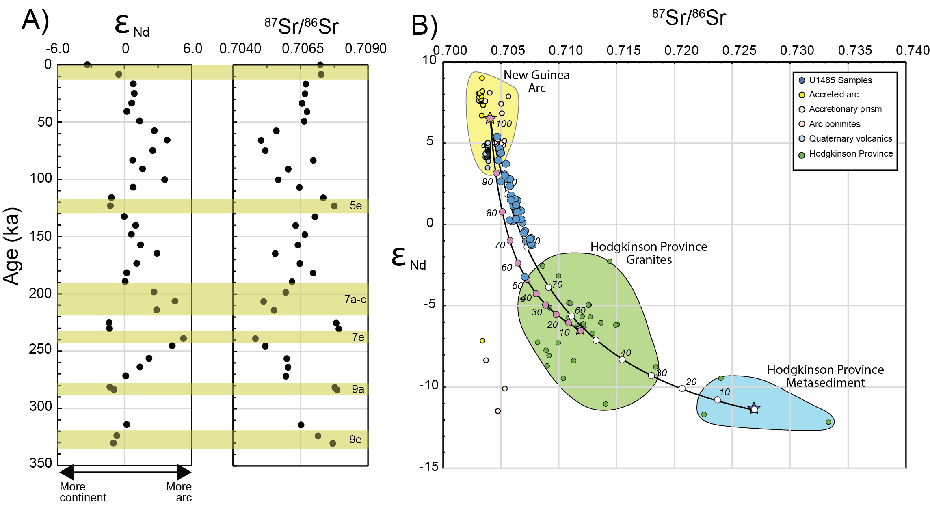
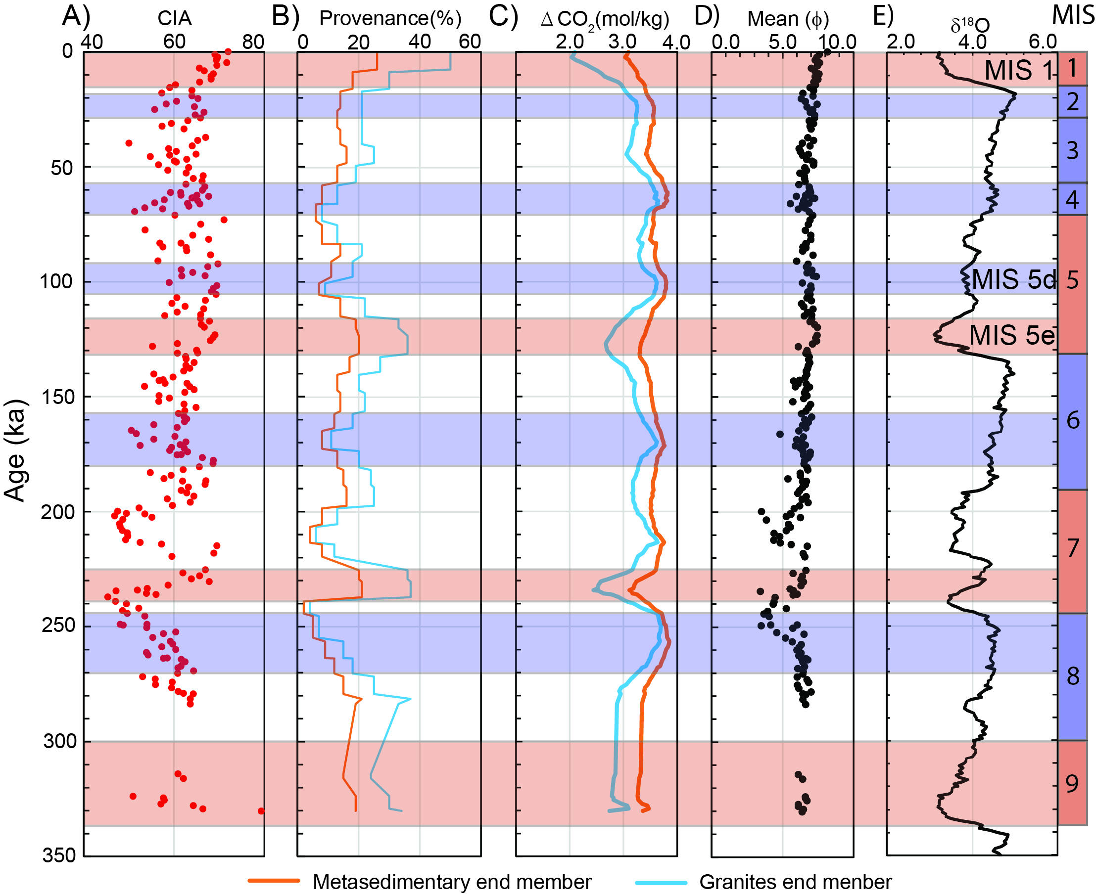
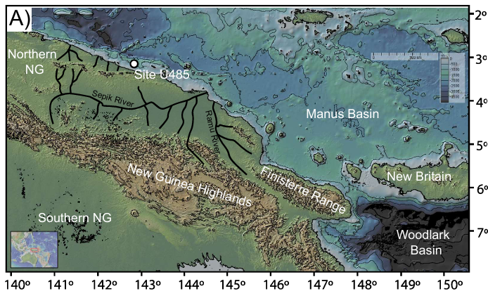
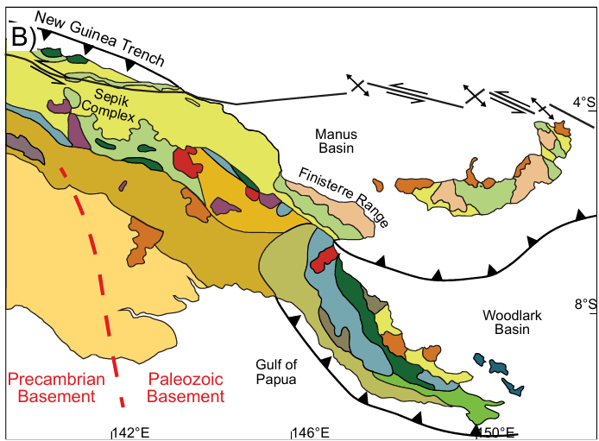
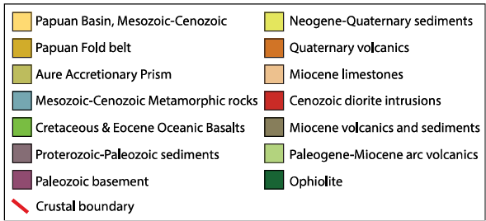
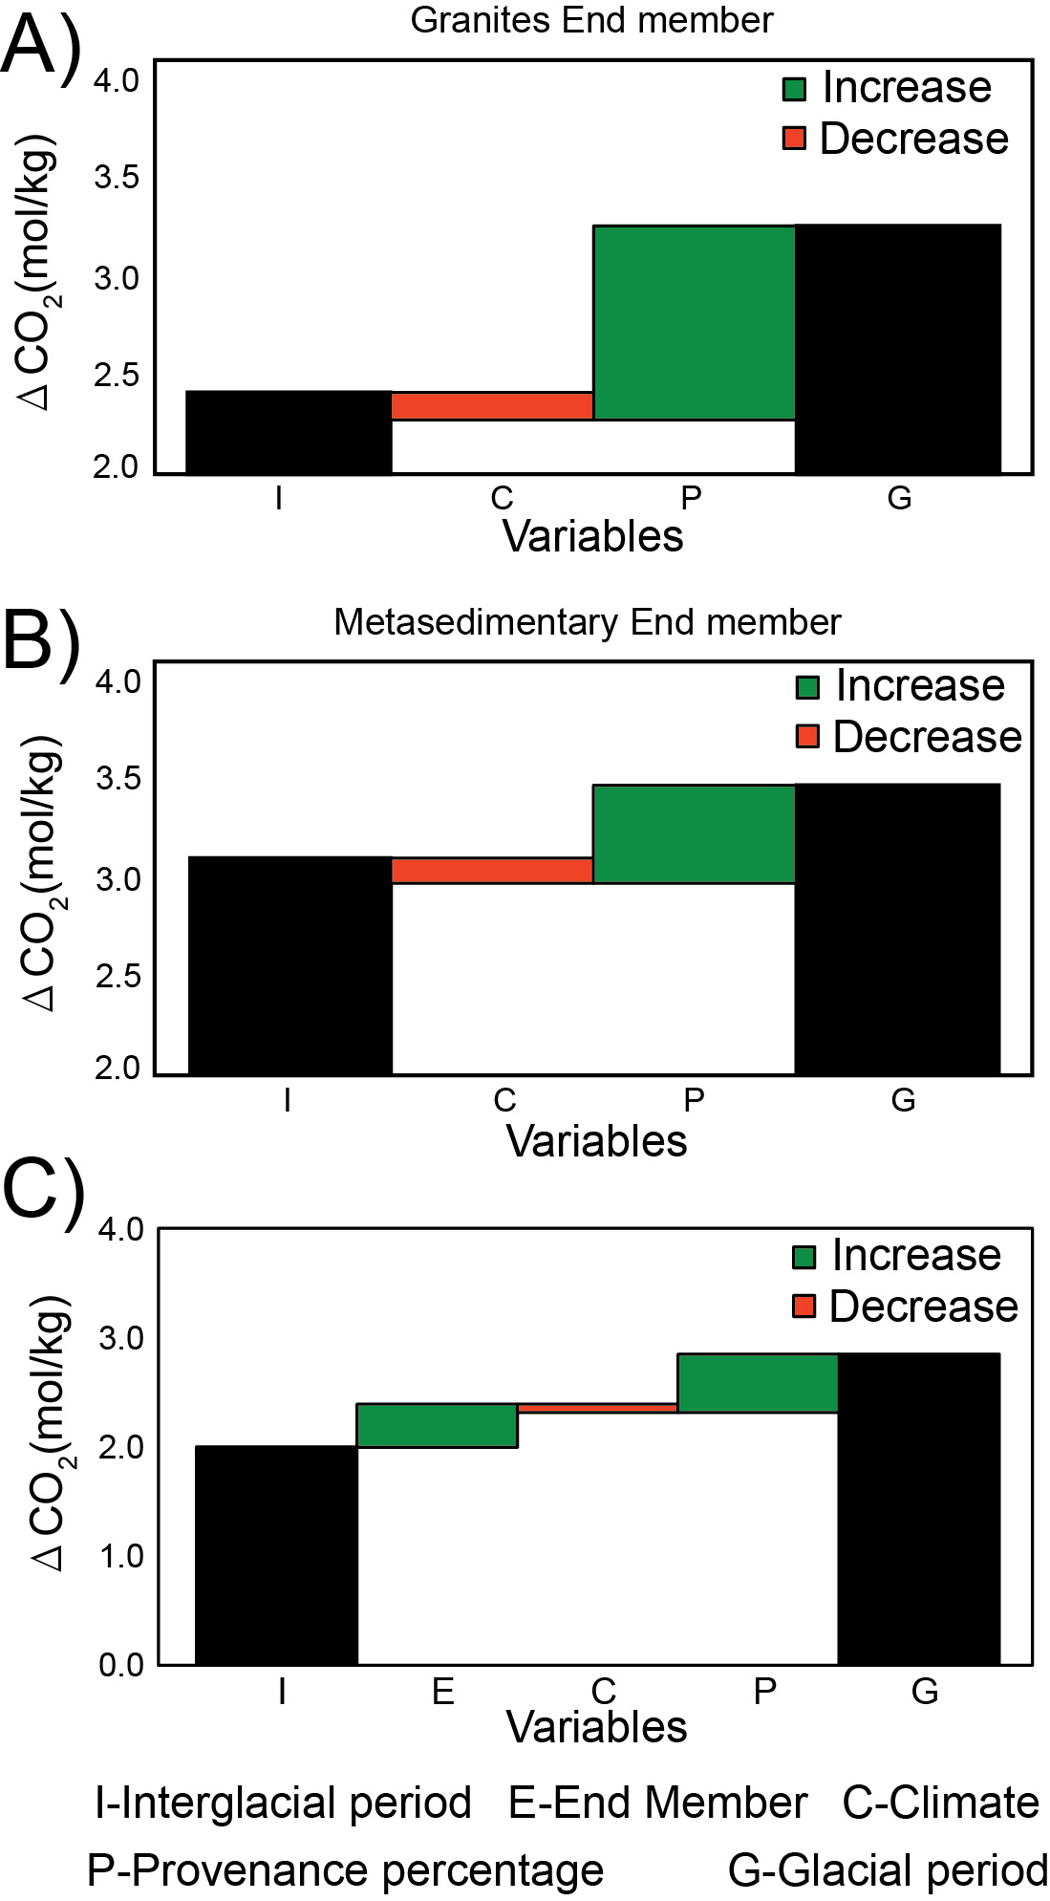
Decrease CO₂ consumption from chemical weathering during warmer climates in North New Guinea
Yifan Du¹, Peter D. Clift^{1,2}
1. Department of Earth Sciences, University College London, London, WC1E 6BT, UK
2. Institute of Marine and Environmental Sciences, University of Szczecin, Mickiewicza 16, 70-383 Szczecin, Poland
Overview
Chemical weathering in low-latitude orogenic belts has been linked to long-term changes in global climate. New Guinea represents an important potential influence over the consumption of atmospheric CO₂ and global climate because of its large size, rapid erosion, and strong mafic composition.
A new sediment record documenting erosion in northern New Guinea since 300 ka shows that stronger rainfall during interglacial times erodes more accreted continental crust than mafic arc crust. Although sediment is altered more during interglacial periods, this change in provenance results in a greater impact on the amount of CO₂ consumed per unit weight. Thus, silicate weathering is less efficient at removing CO₂ when the global climate is warmer, leaving more greenhouse gas in the atmosphere. New Guinea’s climatically modulated erosion thus acts as an amplifier of global climate variations on orbital timescales.
Cross plot of Nd and Sr isotope compositions for samples together with bedrock analyses from the GEOROC database
Sampling and Methods
246 samples of muddy siltstone were taken from cores recovered at IODP Site U1485, located ~200 km west of the mouth of the Sepik River, ~19 km offshore the northern coast of Papua New Guinea and 1145 m below sea level (mbsl). Age control is based on a matrix of nannofossil and foraminifer assemblages. The samples were analyzed for grain size, major and trace element geochemistry, Sr and Nd isotope composition and clay mineralogy to define the provenance and changing character and intensity of chemical alteration of sediment sources.
Bathymetric, topographic and geologic maps of eastern New Guinea and surrounding regions. Base map generated by GeoMapApp; Bedrock map modified from Davies (2012).
Temporal evolution in chemical weathering proxies and benthic foraminifer oxygen isotope values from Westerhold et al. (2020) as a proxy for ocean temperature.
Results
New Guinea ΔCO₂ values range as low as ~1.0 mol/kg in the present day and ~240 ka, assuming the granite end member model and ~2.3 mol/kg with the metasedimentary end member. Maximum ΔCO2 values are estimated at ~260 ka, 100 ka, and 60 ka and are ~3.4 and 3.7 mol/kg respectively for granite and metasedimentary continental end members. These values are high compared to Himalayan sediments and reflect the dominant, mafic source rock compositions. This implies that weathering of New Guinea has been removing three to four times more CO₂ from the atmosphere per unit weight of sediment than erosion in mainland Asia. Surprisingly, the result implies that CO₂ consumption decreased during warmer interglacial periods when faster rates of alteration would be expected to result in more chemical weathering.
Stronger alteration would imply higher CO₂ consumption if erosion rates were constant and coherent with the variations in the CIA. However, the impact of stronger alteration on ΔCO2 values is modest. Instead, the contribution linked to provenance change is dominant.
Stronger rain during interglacial periods penetrated deeper into the Highlands and increased erosion from continental source rocks located at high elevations, which negatively impacted CO₂ consumption from silicate weathering. Chemical weathering of the mafic arc-ophiolite units was greater during glacial times, resulting in stronger CO₂ consumption. There is positive feedback between global climate and chemical weathering in New Guinea whereby reduced CO₂ consumption due to weathering during interglacial times helped maintain high levels of CO₂ and thus higher temperatures.
Waterfall plot of weathering controlling factors.
Acknowledgements
This work has been submitted to Chemical Geology. The work was supported by funds from the Charles T McCord Jr Chair in Petroleum Geology at LSU and Wolfson Fellowship at the Royal Society (UK). Samples were provided from the International Ocean Discovery Program. Thanks to Sophie Vincent (LSU) for her help in sample processing and analysis.

