Slide 1
Influence of continental configurations on the thermal structure of the mantle
Oliver Henke-Seemann, Lena Noack
Freie Universität Berlin

Slide 2
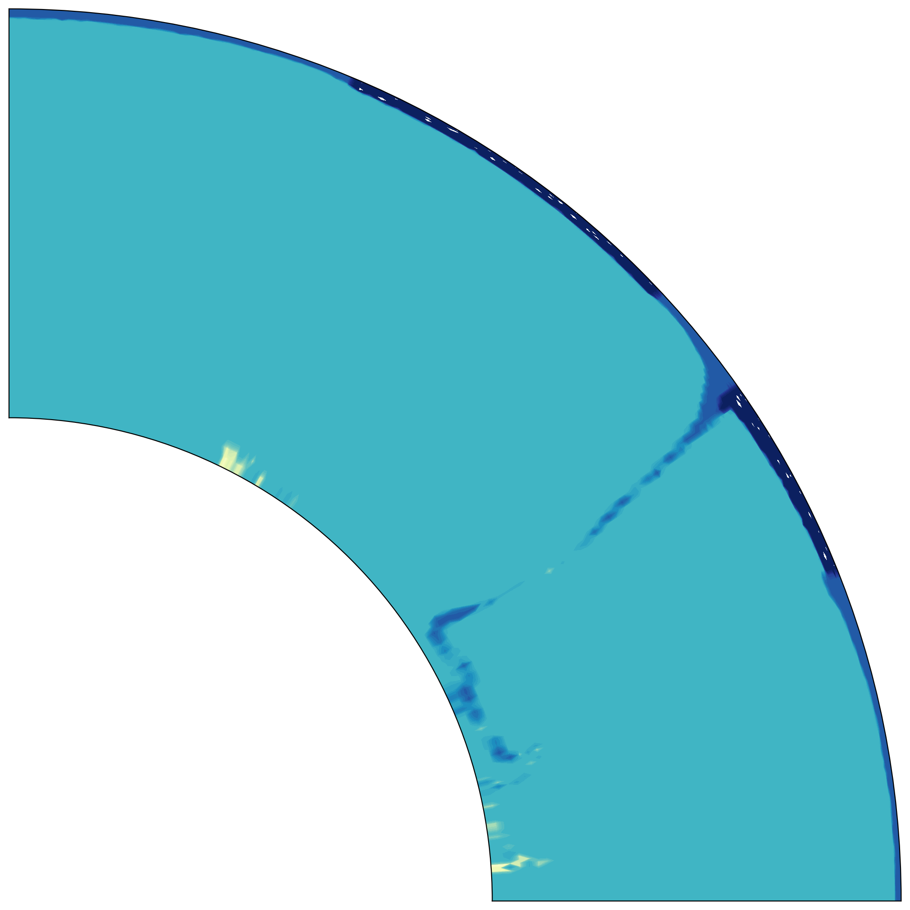
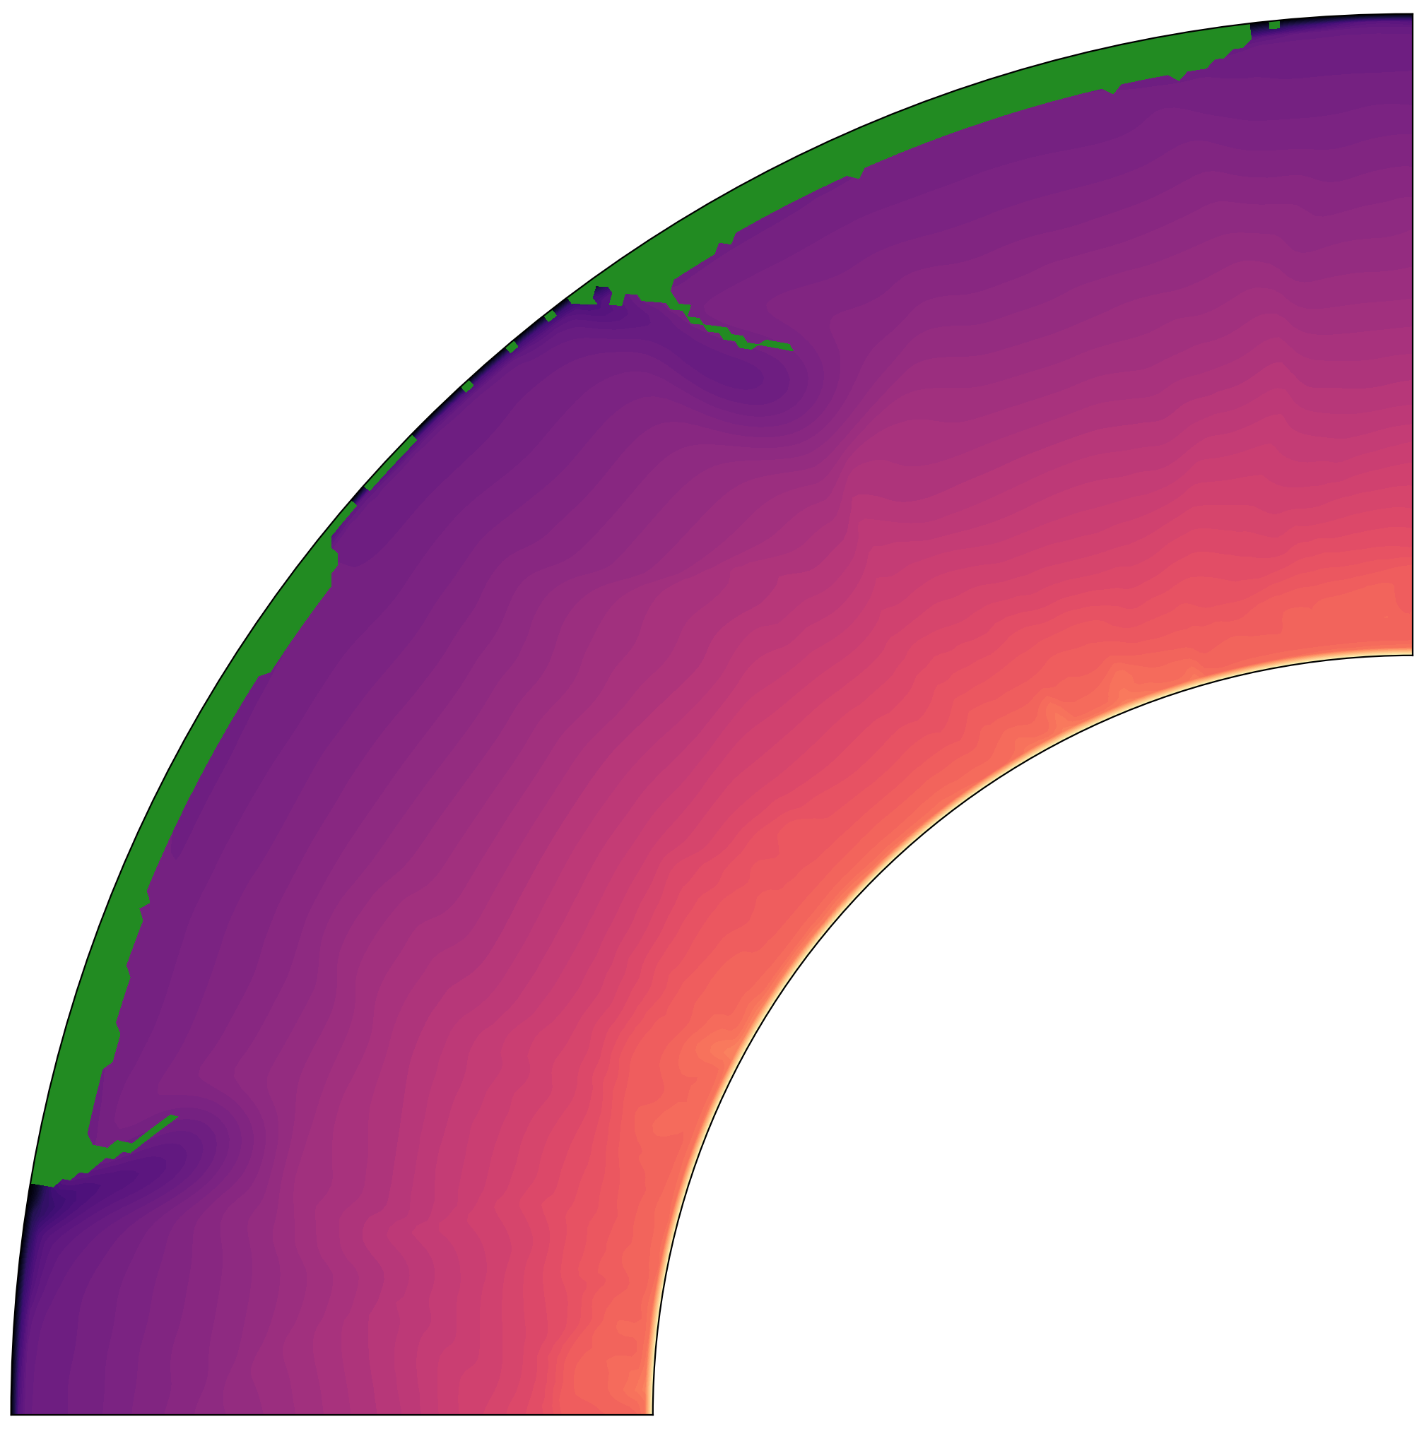
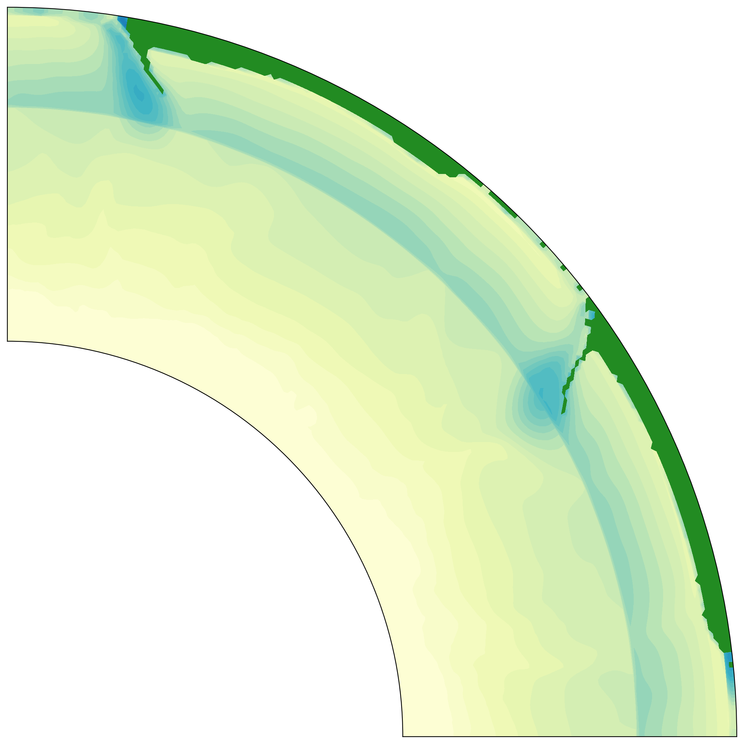
Influence of continental configurations on the thermal structure of the mantle
after Olson et al., 2014
How do break-up and formation influence the thermal structure at the CMB?

Slide 3
Influence of continental configurations on the thermal structure of the mantle
Motivation
Results
Geomagnetic reversals
Supercontinent Cycle
Model Setup
prev
next
Home →

Slide 4
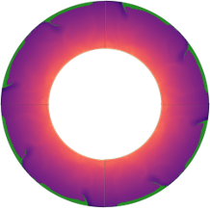
after Olson et al., 2014

Slide 5
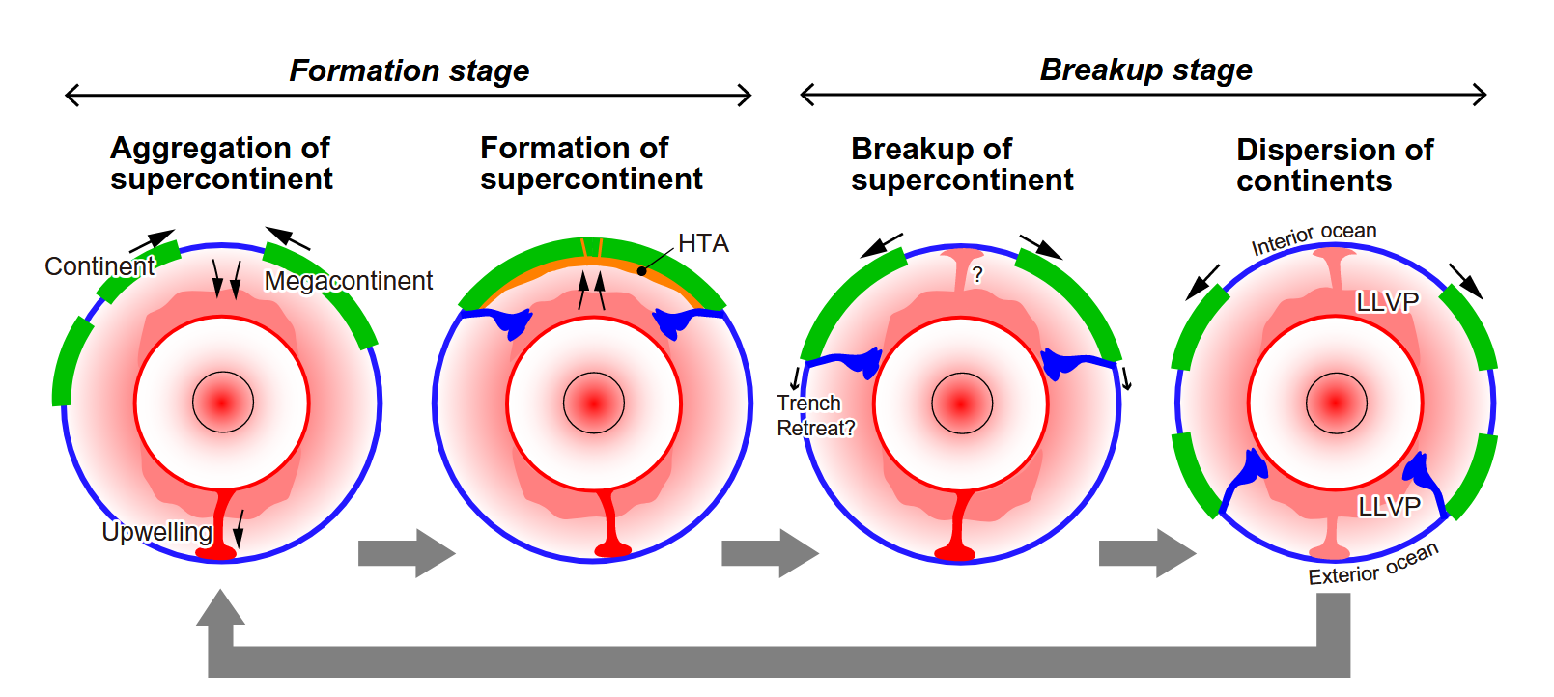
Yoshida, 2023

Slide 6
Dynamic Models & Rheology

Slide 7
Pseudoplastic Rheology
$$η_{y}$$
$$η_{diff}(T)=η_{ref}exp⁡\left(\frac{E}{T+T_{0}}\right)$$
$$η_{y}=min \left\{η,η_{y}\right\}$$
$$η_{diff}$$
$$η_{y}=\frac{σ_{y}(z)}{{\dot{ε}}_{II}}$$

Slide 8
Pseudoplastic Rheology
$$η_{diff}(T)=η_{ref}exp⁡\left(\frac{E}{T+T_{0}}\right)$$
continental material (C=1)
$$η_{y}=\frac{σ_{y}(z)}{{\dot{ε}}_{II}}$$
$$η_{y}$$
$$η_{y}=min \left\{η,η_{y}\right\}$$
$$η_{diff}$$
Add prefactors introduced in (e.g. Rolf & Tackley, 2012):
mantle (C=0)
$$η_{diff}\left(T,C\right)=η_{diff}(T) ∗exp⁡\left(log⁡(Δη_{C}\right)C$$
$$σ_{y}\left(z,C\right)=σ_{y}\left(z\right)∗exp⁡\left(log⁡(Δσ_{Y}\right)C$$

Slide 9
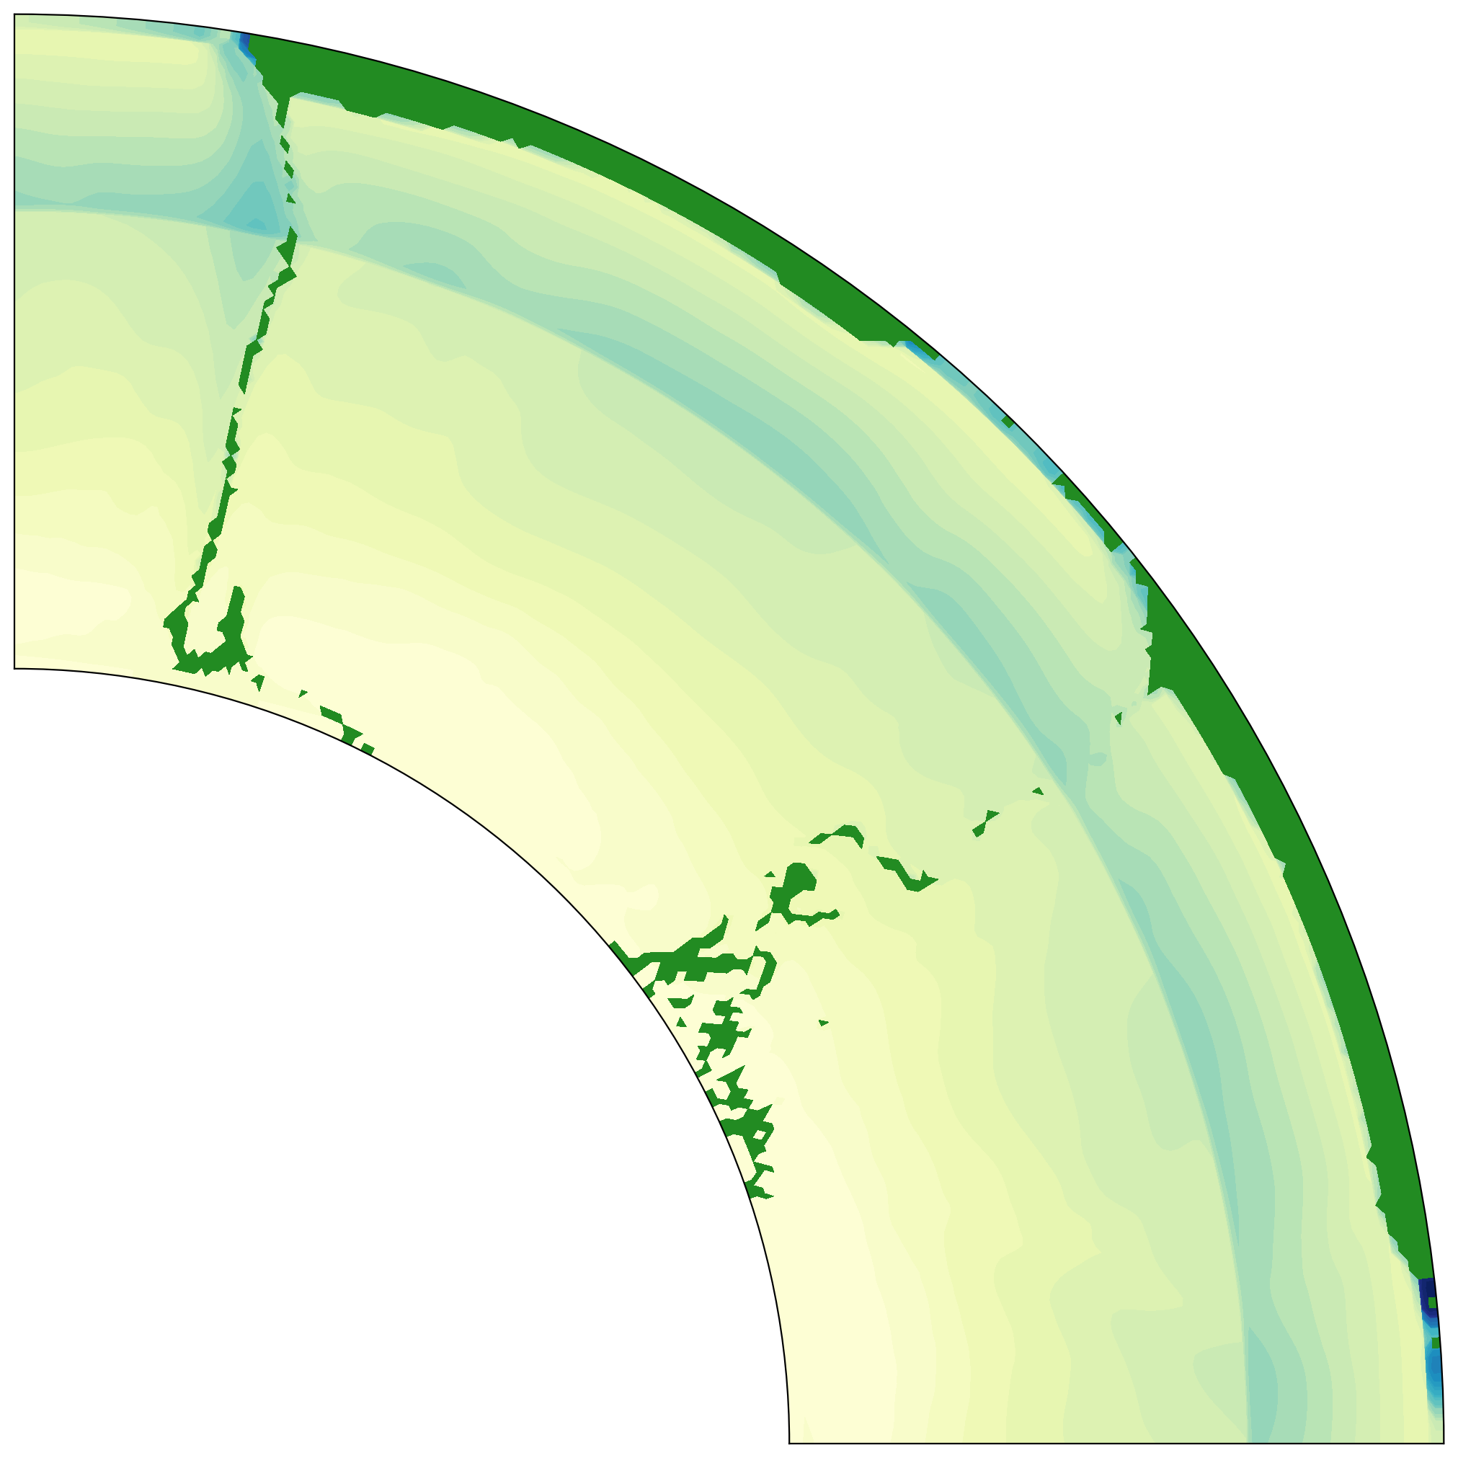
Subduction starts dynamically at continental boundaries
Material spreads across CMB
Continents stay stable
But do not drift in these models

Slide 10
Supercontinent Formation
Experiments

Slide 11
weak zone
oceanic crust & continental

Slide 12
weak zone
oceanic crust & continental

Slide 13
weak zone
$$η_{weak}=1e19$$
oceanic crust & continental
$$η_{oc}=1e22$$
$$η_{cont}=1e23$$
Isoviscous mantle ($η_{ref}=1e21$)

Slide 14
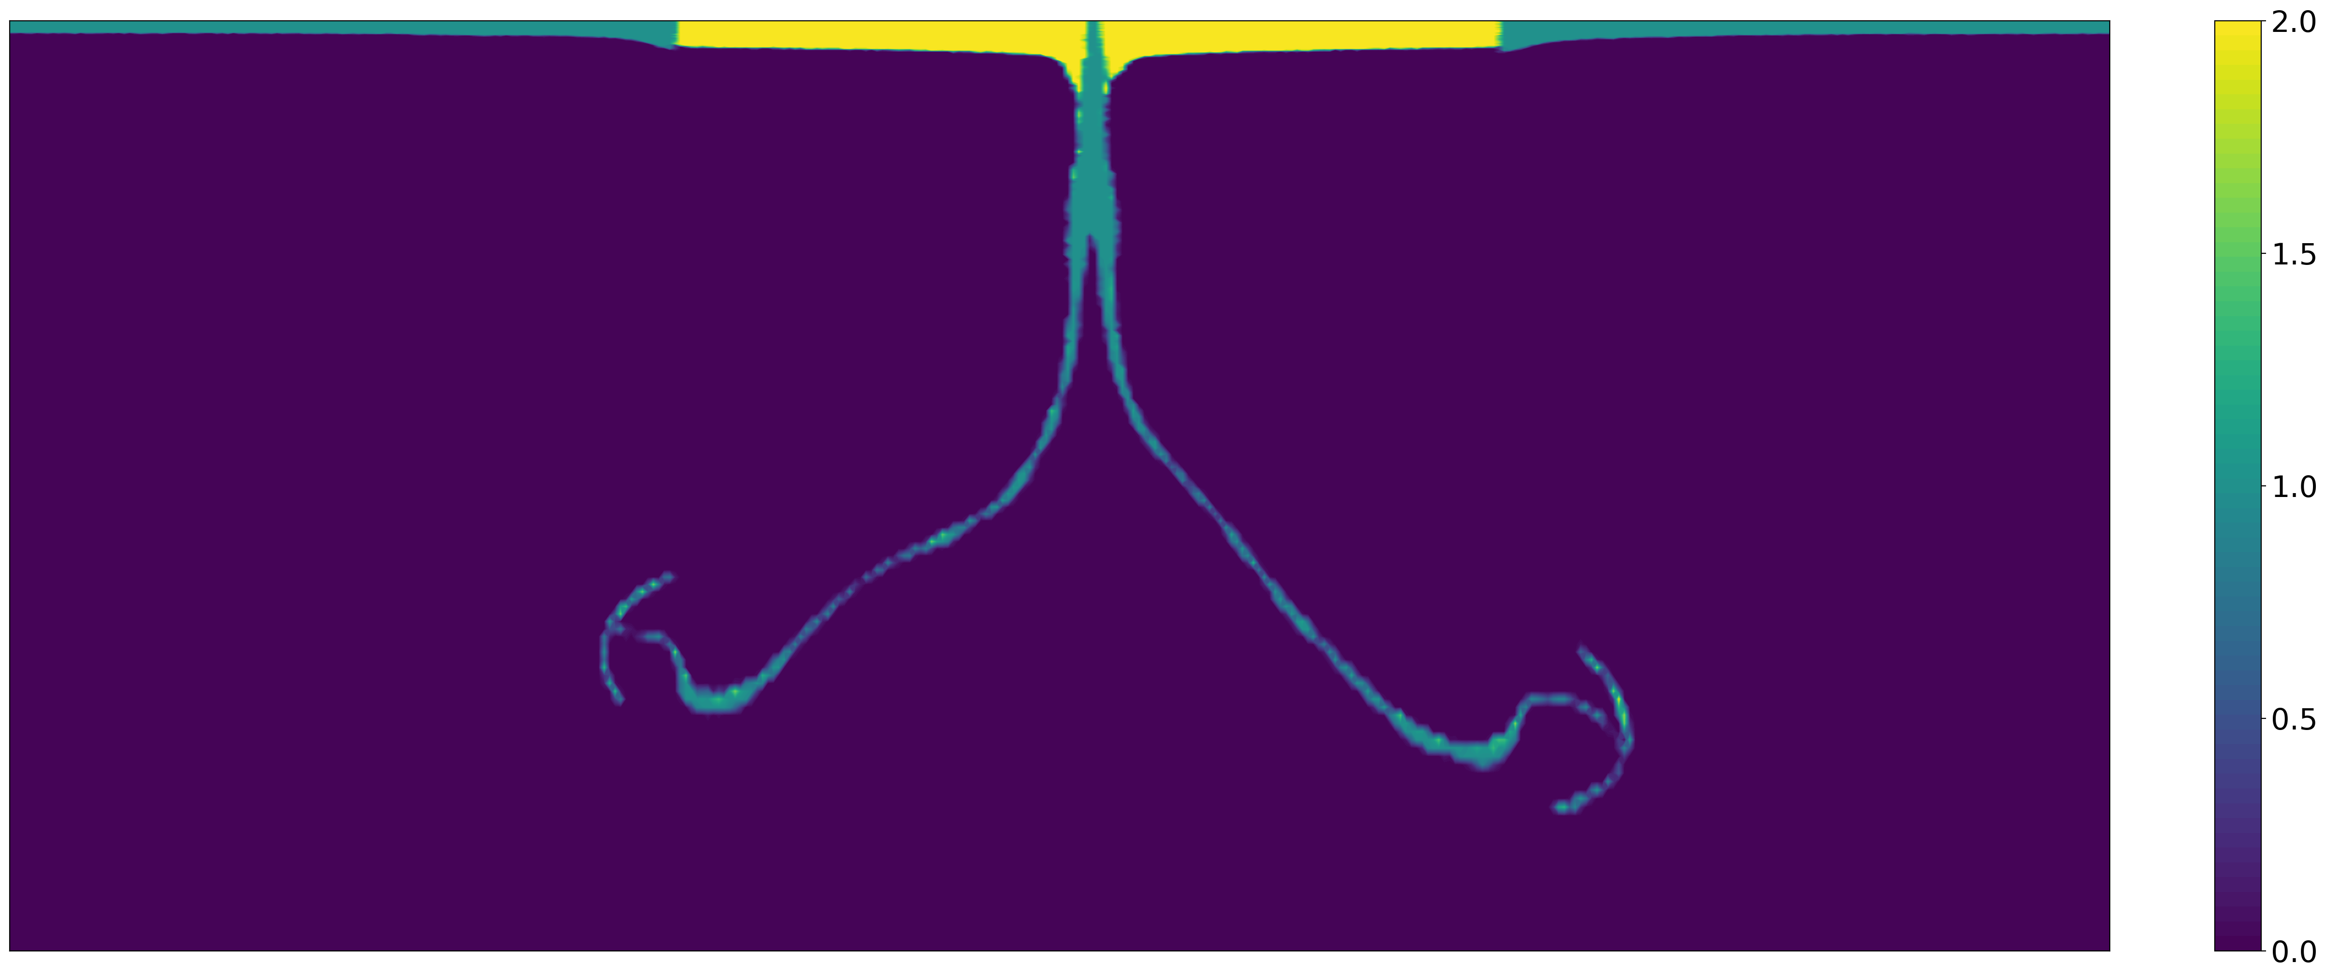
One Weak Zone
Two Weak Zones
Additional Weak zone accelerates collision (but not too significantly)
Tests with temperature dependent viscosity needed

Slide 15
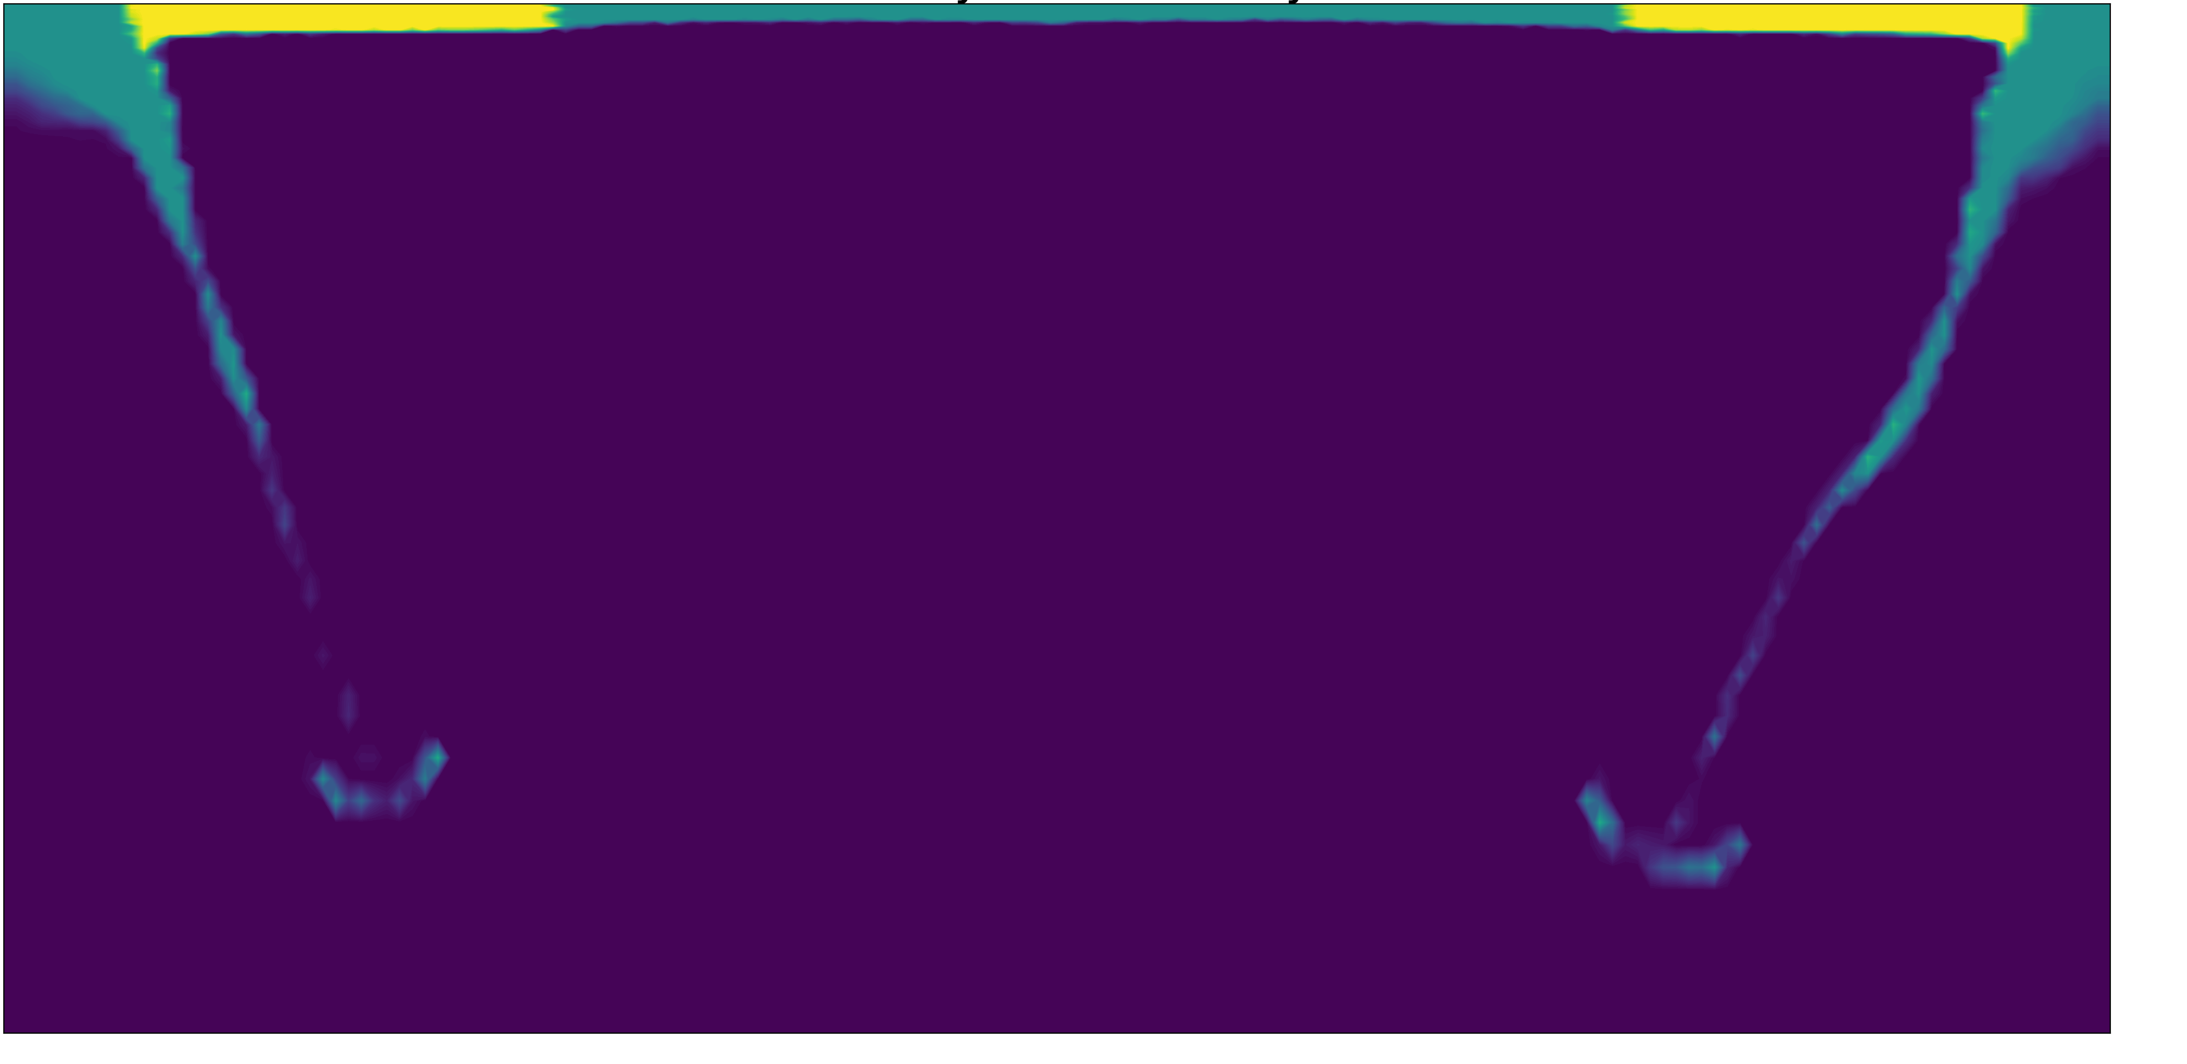
Weak Zone on outer boundaries
Trench retreat towards domain outer boundaries
Possibly a valid mechanism to disperse continent
e.g. by introducing weak zone in the middle and bounderies of a continent)

Slide 16
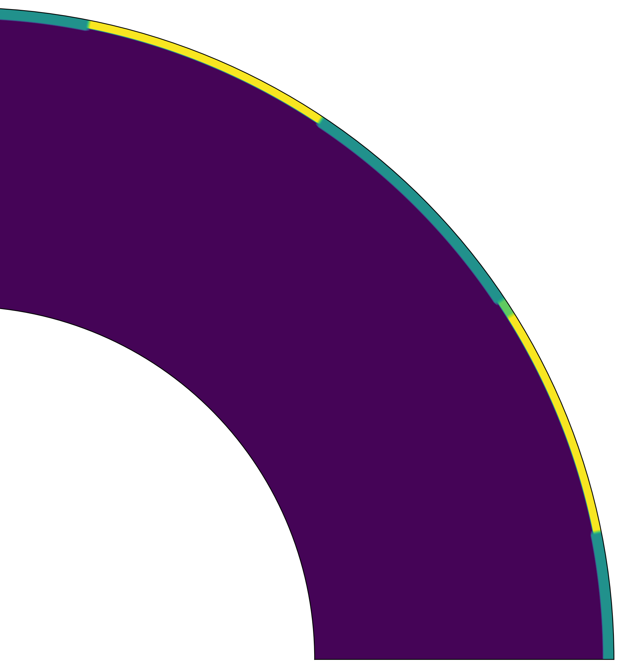
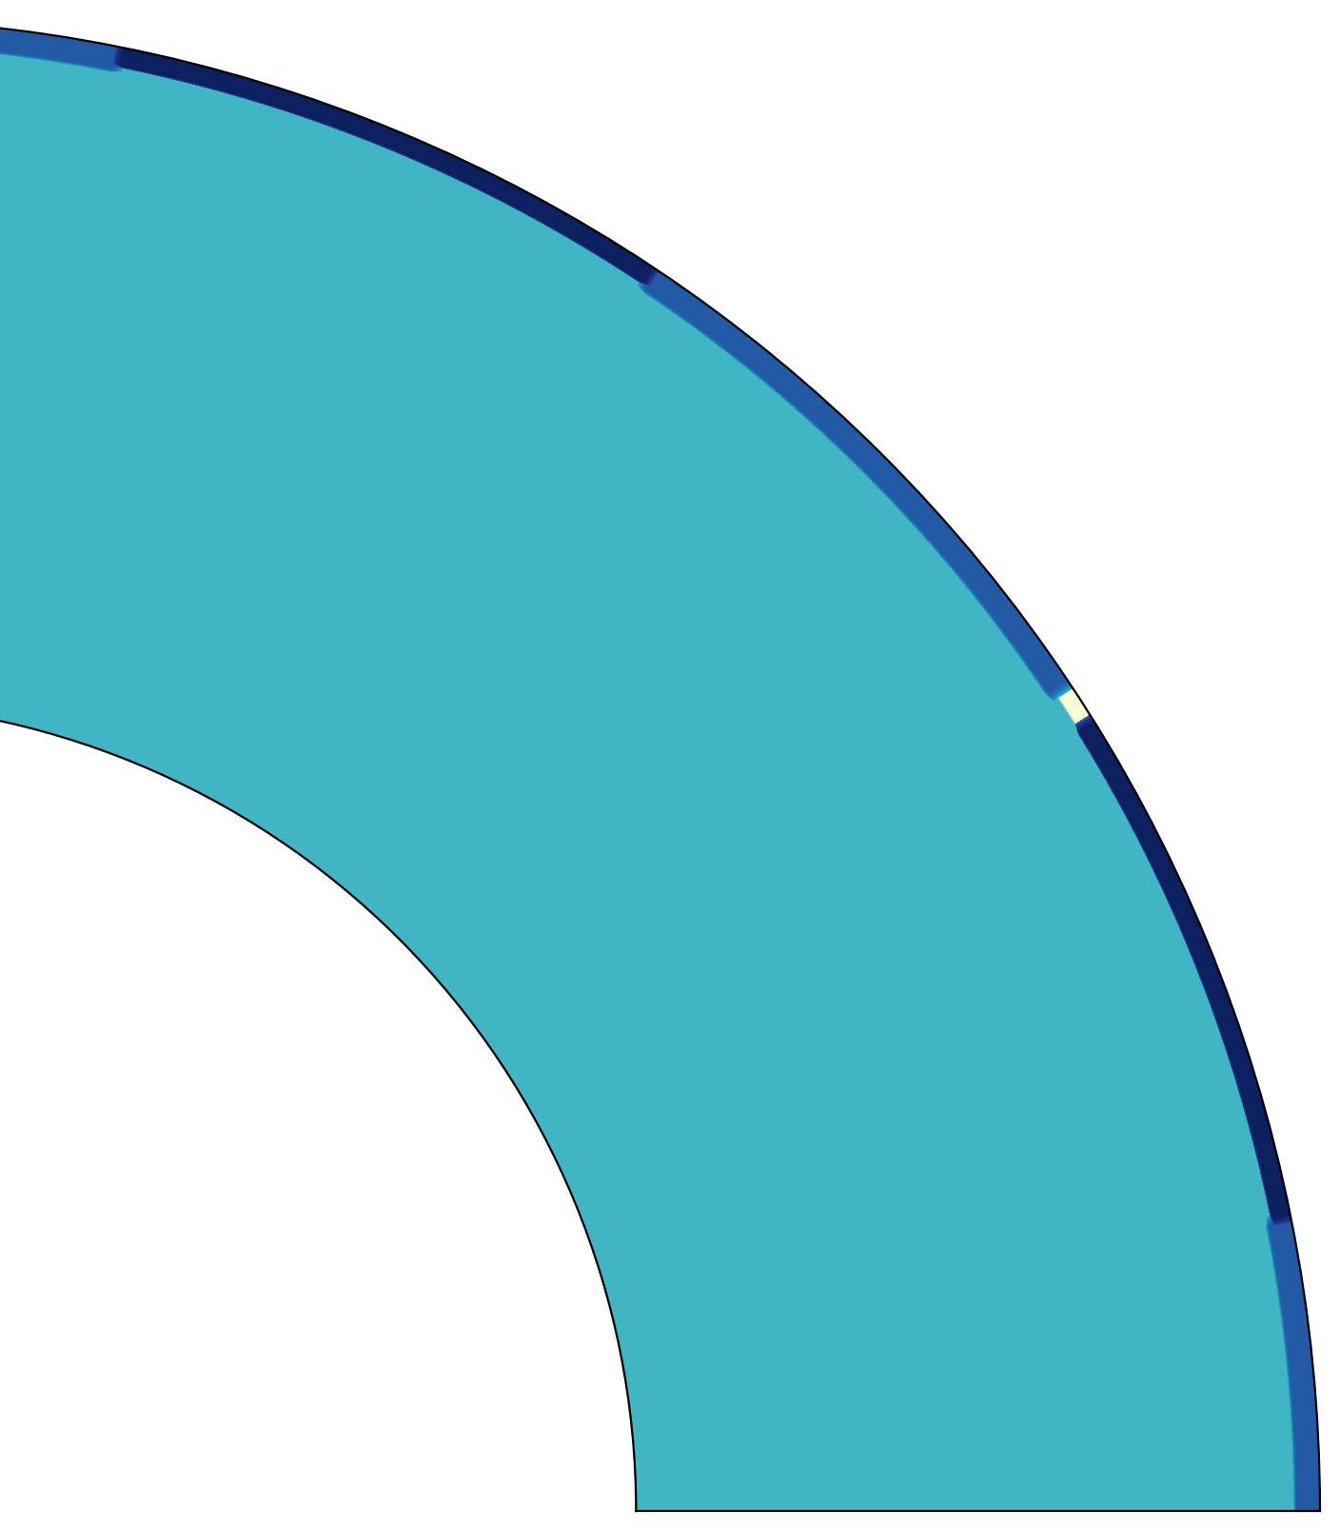
The same setup with 2D cylinder geometry geometry
→ Two continents
→ Single weak zone at inner edge of one continent

Slide 17
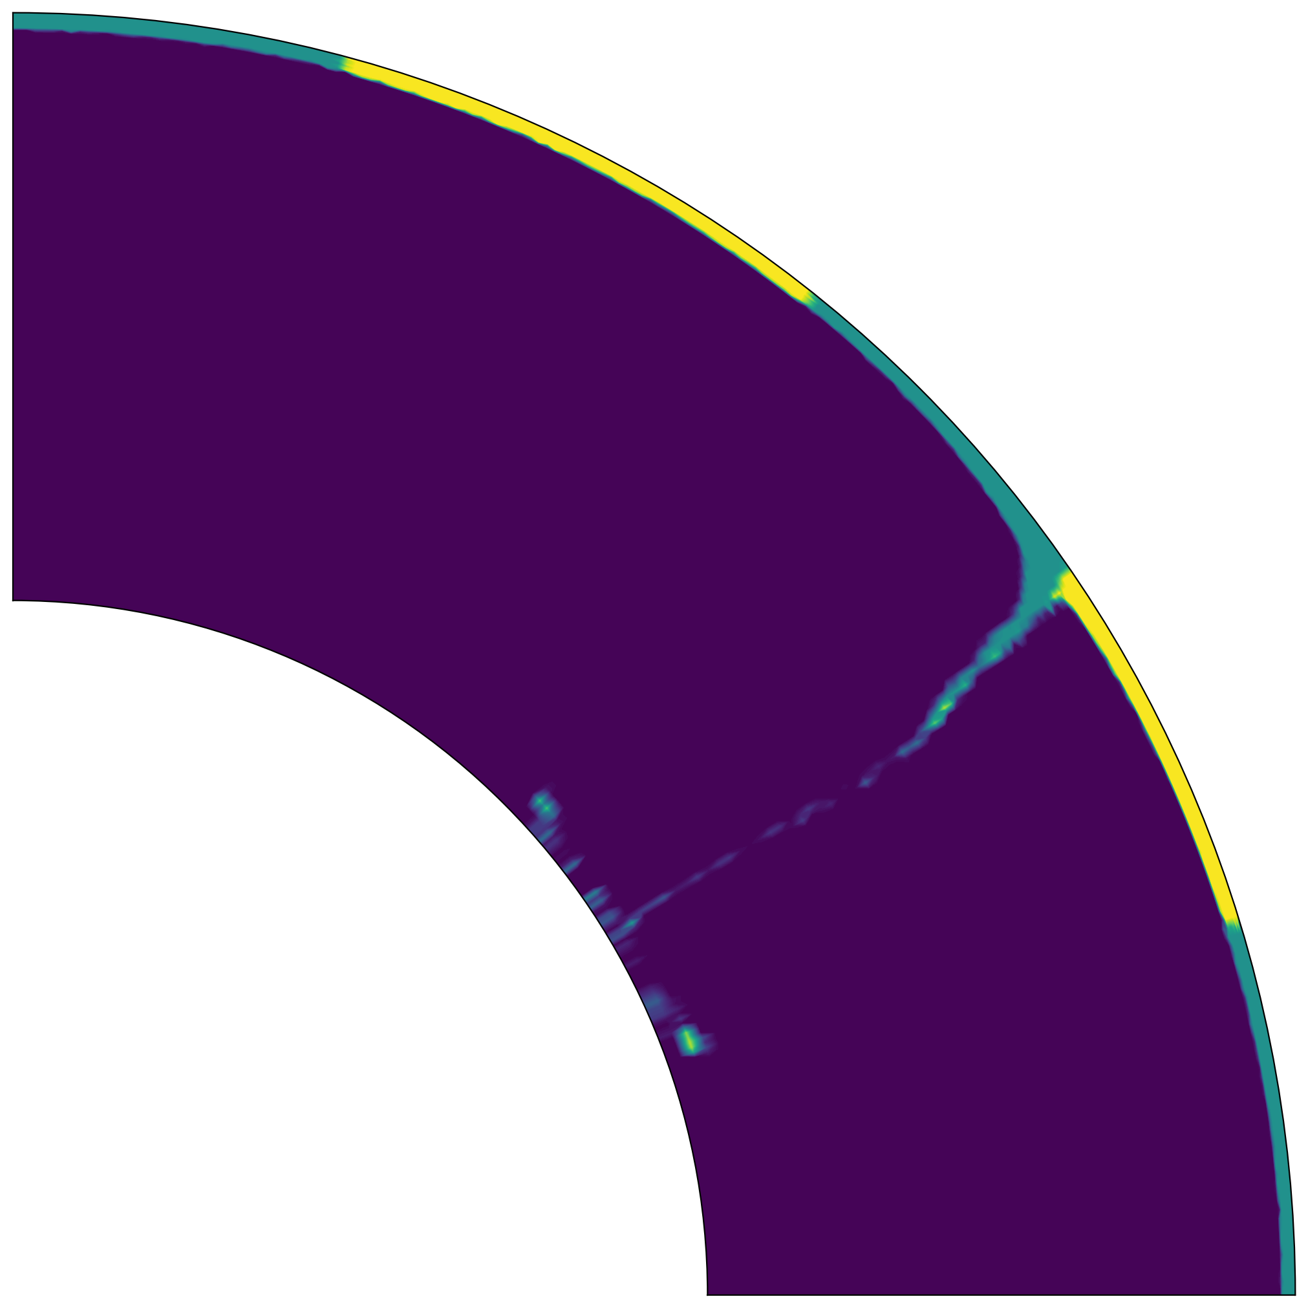
Initiation of subduction at weak zone
Towards collision
Slab reaches CMB

Slide 18
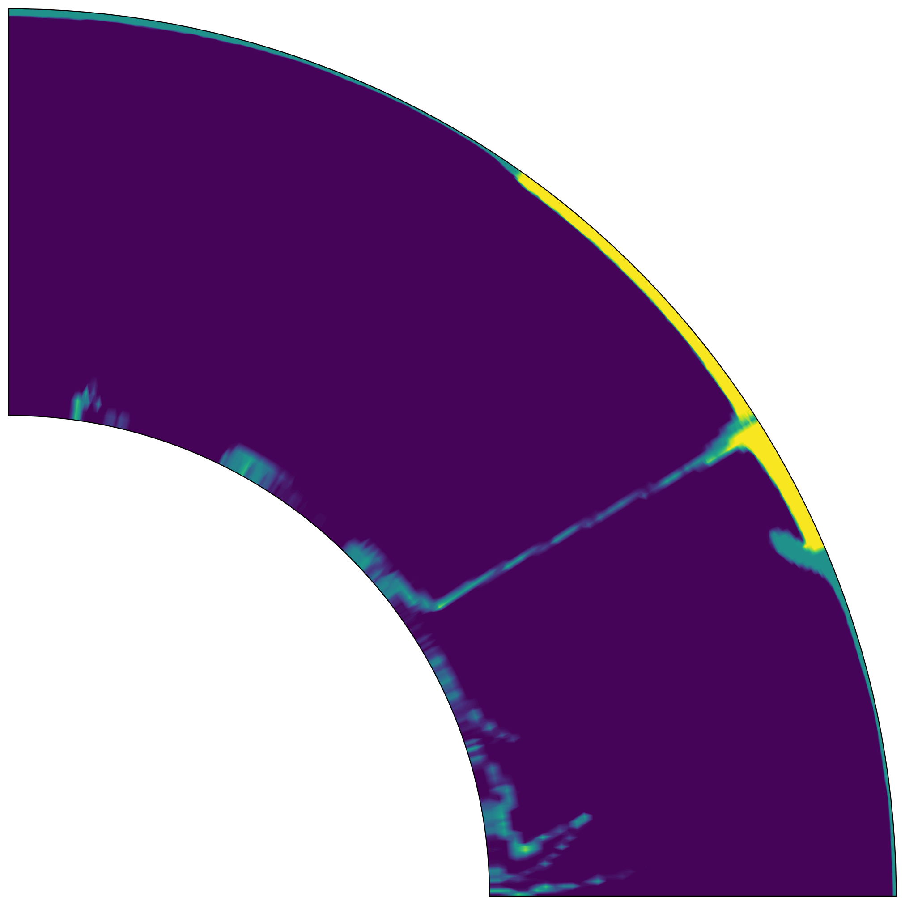
Subducted material spreads across CMB
Continental collision and
start of new subduction

Slide 19
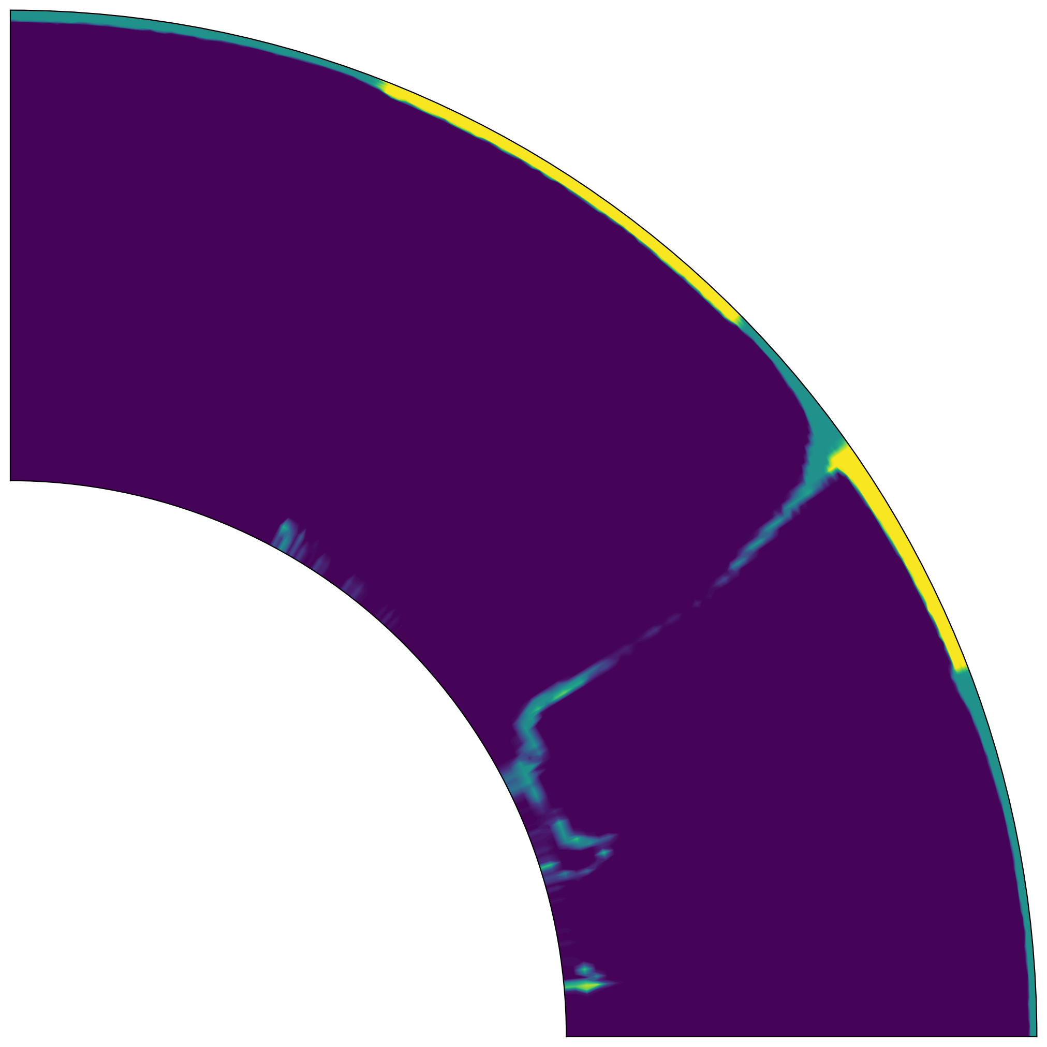
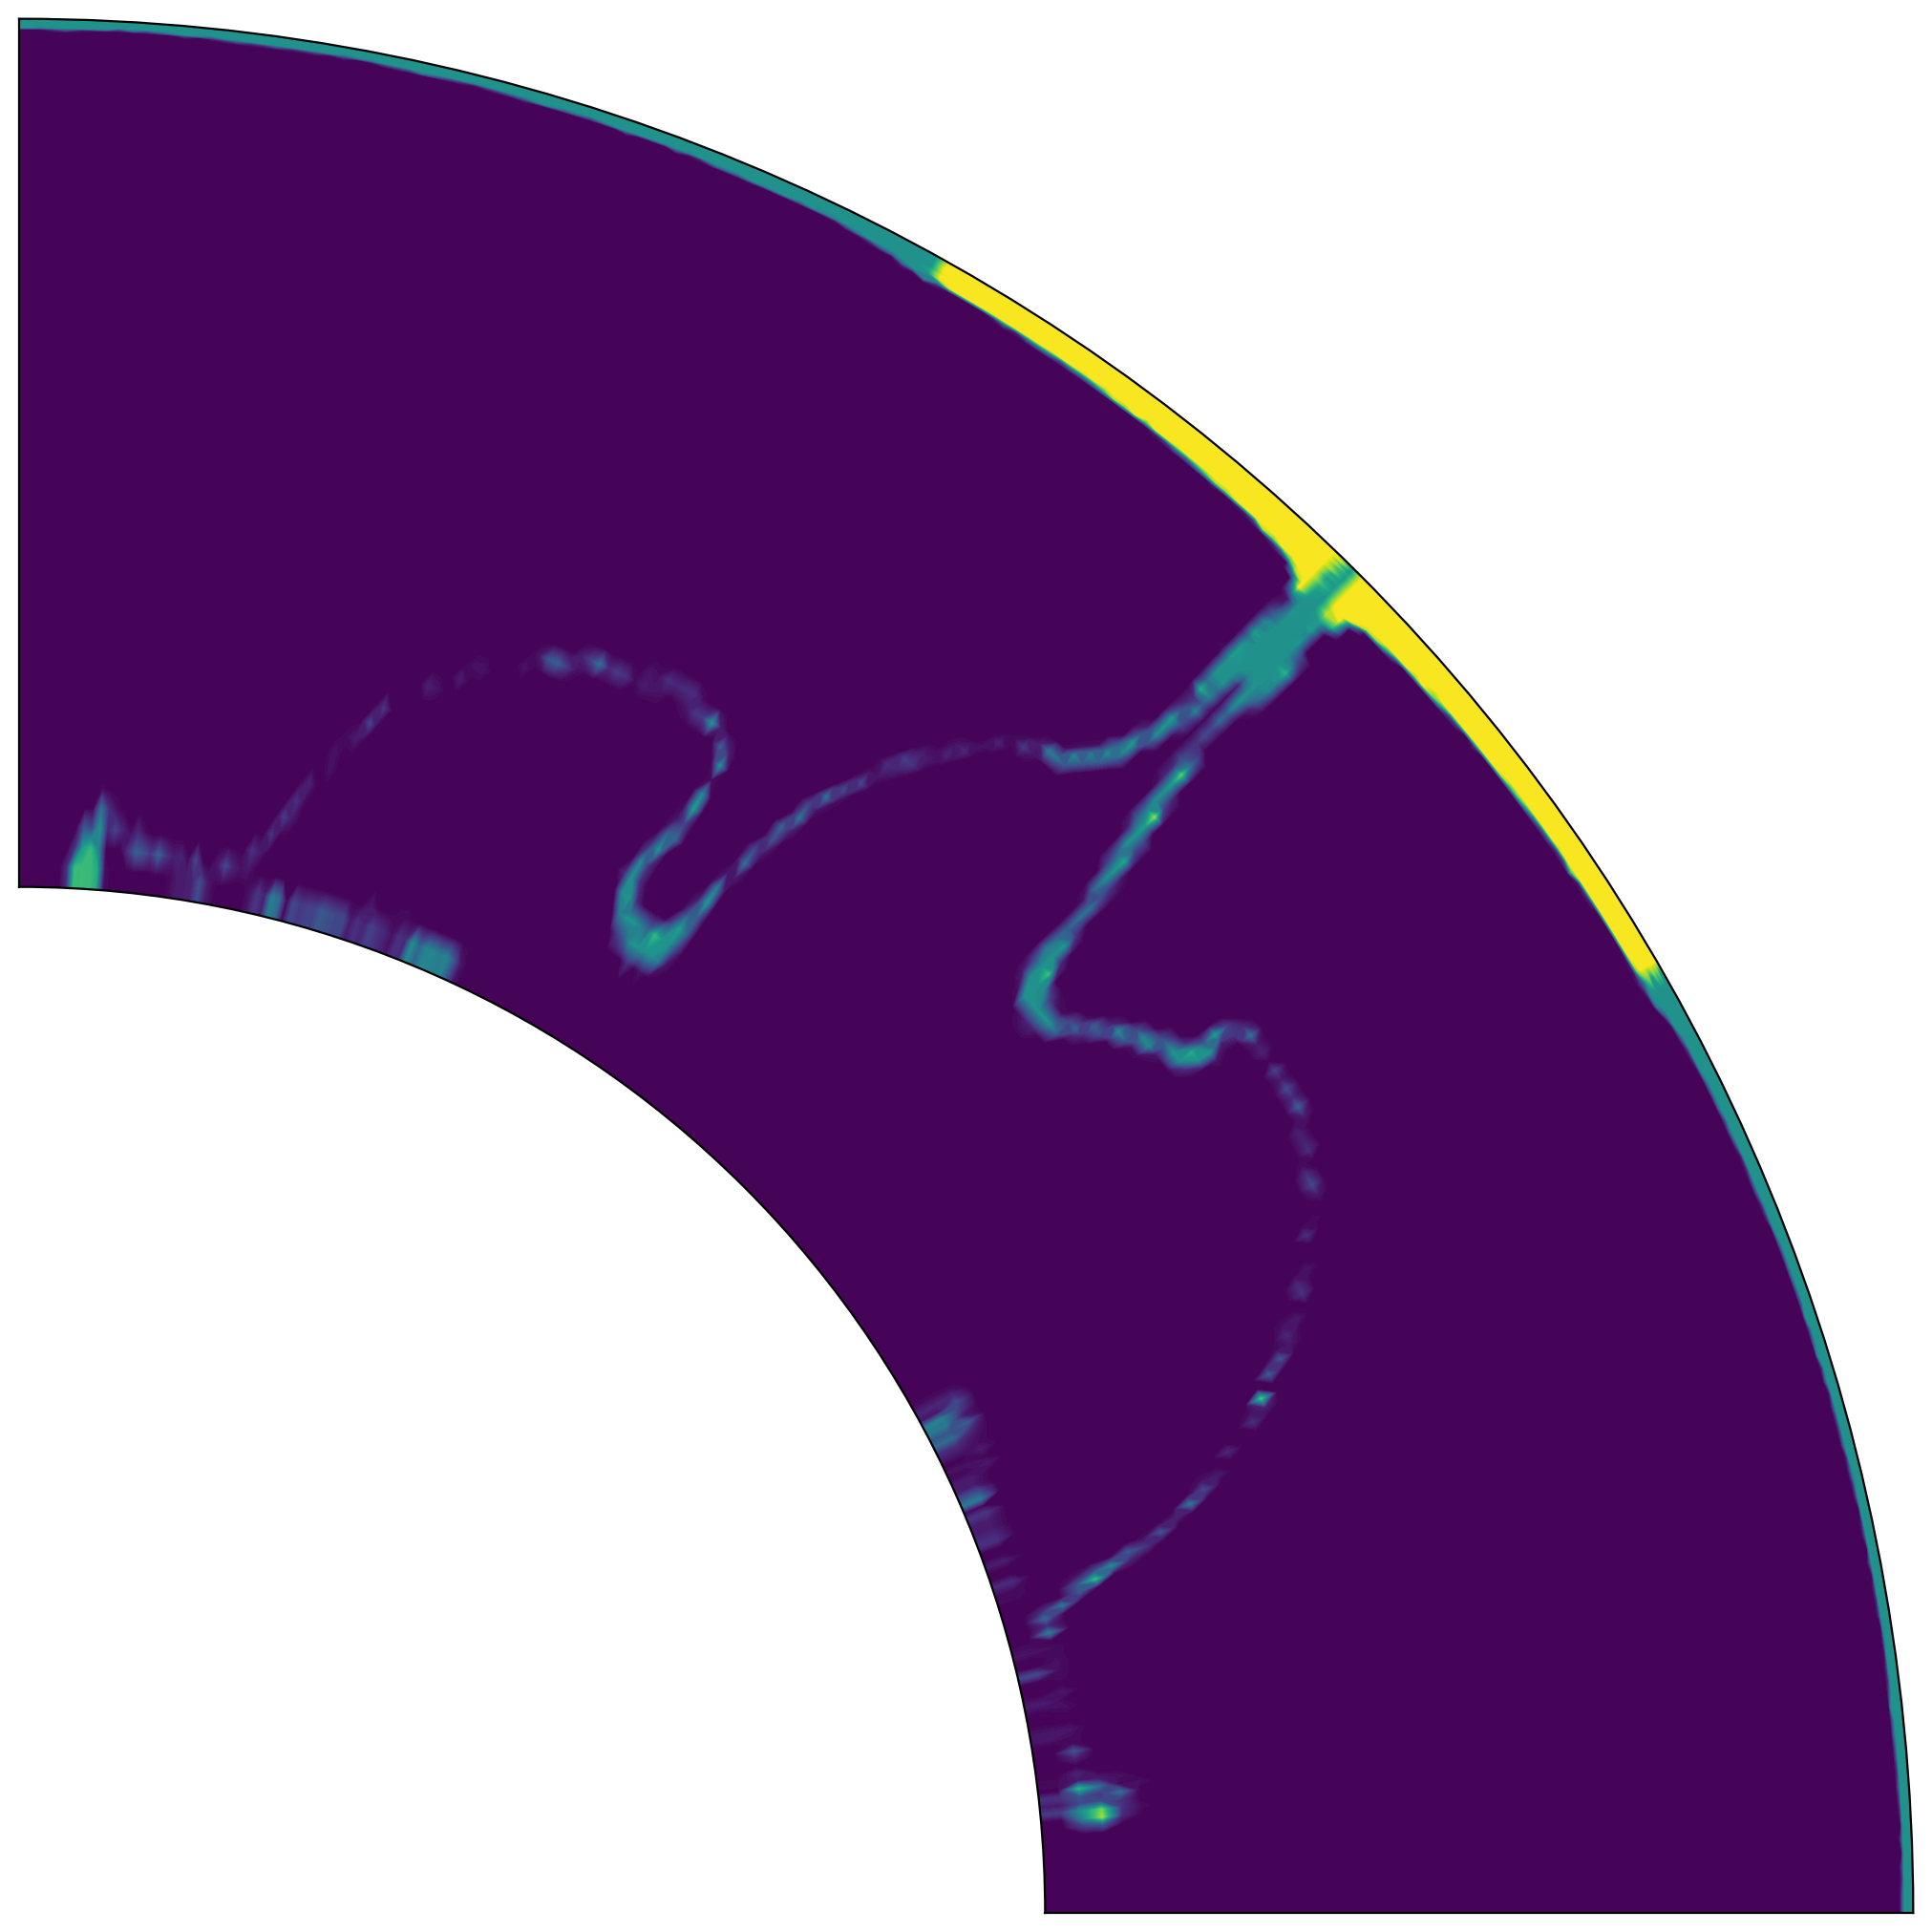
One Weak Zone
Two Weak Zones
Similar results to cartesian
Second weak zone accelerates collision
But not significantly

Slide 20
Next steps:
→ Mechanisms to enable supercontinent cycle
→ Thermochemical convection

Slide 21
Influence of cycle steps on thermal structure?
What‘s the timescale of these effects?
(relation to structure at CMB, therefore Geodynamo?)

