Slide 1
Developing a data-driven global ocean model at ECMWF
rachel.furner@ecmwf.int
Rachel Furner, Rilwan Adewoyin, Mario Santa Cruz, Sara Hahner, Sarah Keeley, Kristian Mogensen, Lorenzo Zampieri, and many others

Slide 2
Fundamental set up

Slide 3
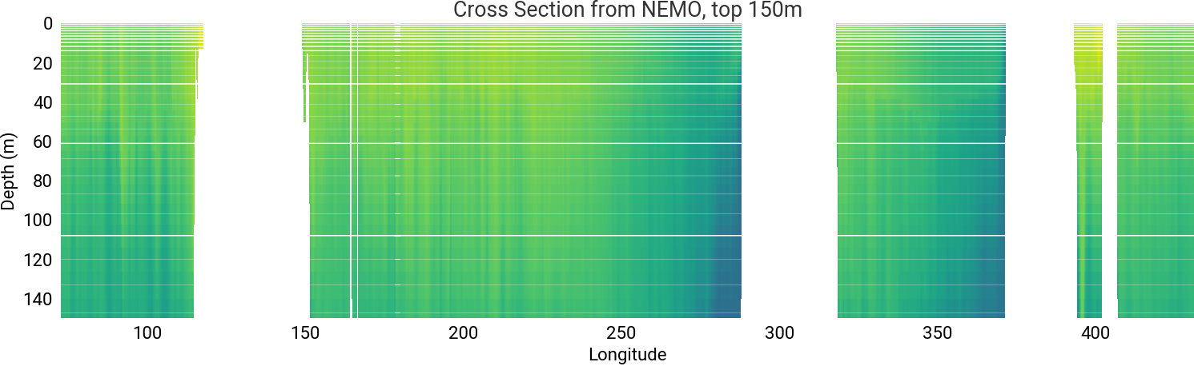
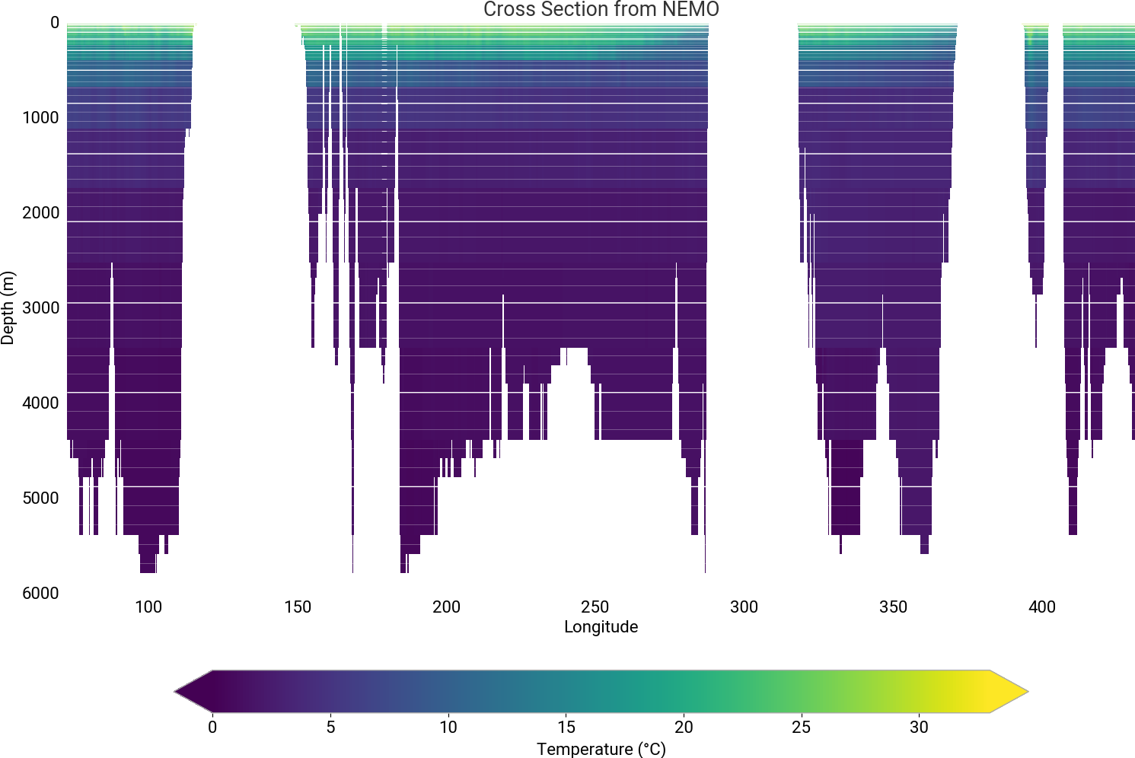
Training data
Training data comes from ORAS6 (ECMWF ocean reanalysis product)
Training period 2001-2010
Validation period 2011, test period 2012
Ocean variables: Temperature, salinity, eastward and northward velocity from 23 vertical levels, sea surface height
Sea Ice variables: Sea-ice concentration, volume, salinity, albedo, eastward and northward velocity, snow volume over ice, salt flux into sea
Forcing: River runoff, 10m winds, 2m temperature, 2m dewpoint temperature, atmospheric mean sea level pressure, short wave and long wave radiation, precipitation
Static inputs: Bathymetry, cos & sin of longitude and latitude, cos & sin of Julien day and time of day, cos of zenith angle
Notes:
Plot shows temperature for a cross section at 20.5 South. Faint white lines show 75 NEMO (physical model) levels, bold white lines show the 23 levels taken for the ML model.
Upper plot shows a zoom in of the surface 150m

Slide 4
24 hour timestepping
Two consecutive (24 hour apart) fields used to predict next
During training
t-24
t-18
t-12
t-6
t
t+6
t+12
t+18
t+24
t+48
Step n
Step n+1
During inference
t-24
t-18
t-12
t-6
t
t+6
t+12
t+18
t+24
t+48
IN_{p,f}
IN_{p,f}
IN_{f}
IN/OUT_{p}
OUT_{p}
Notes:
–

Slide 5
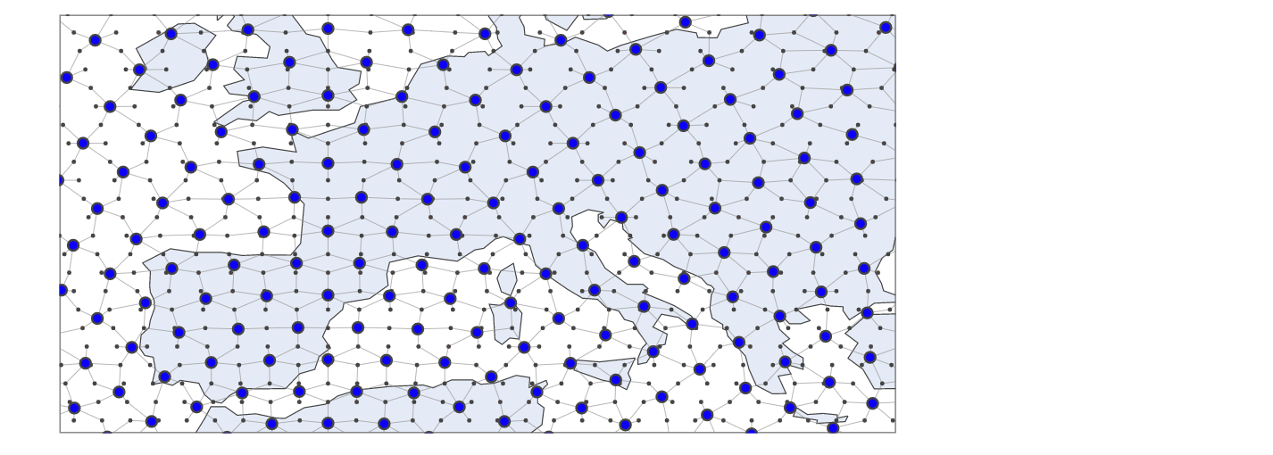
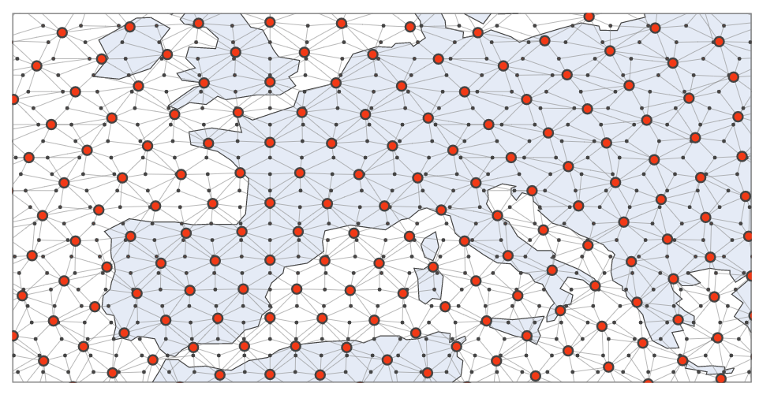
Model design
Encoder – processor – decoder design
Dataset at ~1 degree resolution with ~2 degree processor resolution
Graph attention encoder
Processor
Graph attention decoder
ORAS6@1º to latent space@2º
Changeable
Latent space@2º to ORAS6@1º
Image from Lang, Simon, et al. "AIFS--ECMWF's data-driven forecasting system." arXiv preprint arXiv:2406.01465 (2024).

Slide 6
Impact of processor choice

Slide 7
Comparing different processors
1. Sliding window transformer, as used in AIFS
2. Graph neural network - Multiscale graph, no attention mechanism
3. Graph transformer – Multiscale graph, with attention
Notes:
For sliding window transformer, the attention covers latitude bands, with variation dependant upon latitude of the grid point chosen.
For multiscale graph with attention, the attention pattern varies based on which (how many) of the graph meshes the point exists on – on the left the point is on all levels of the multi-mesh, on the right the point only exists on the fine resolution mutli-mesh

Slide 8
2 month animation of temperature ~2.6m depth (3rd level)
Sliding window transformer
Graph Neural Network
Graph Transformer
Notes:
Prediction on the left, truth in the middle, errors on the right

Slide 9
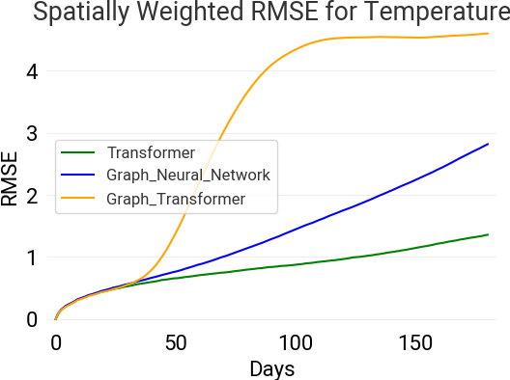
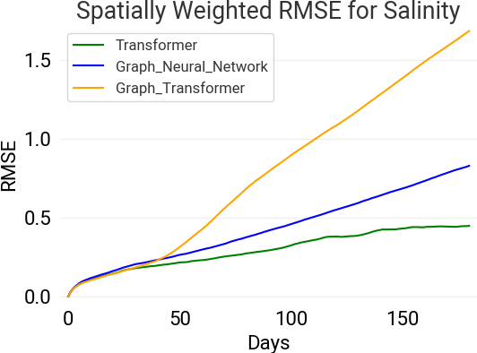
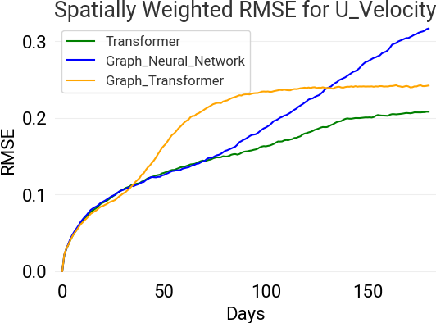
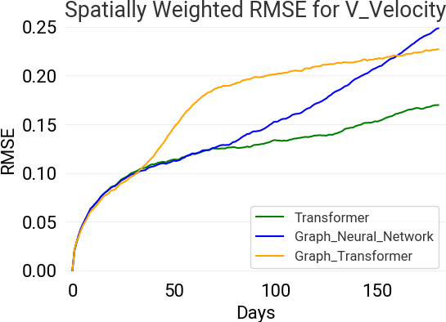
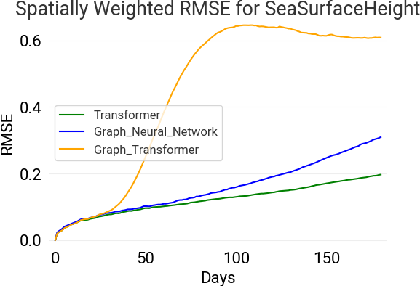
RMS over all grid points, 6 month timeseries

Slide 10
Impact of loss scaling based on increments
Notes:
Run with transformer (AIFS style)

Slide 11
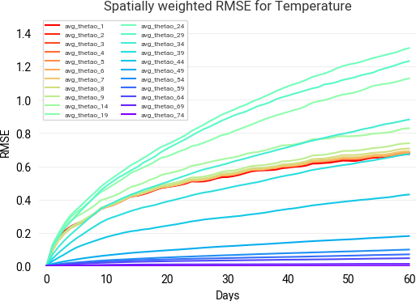
Performance over depth
Largest errors in the mid levels, very low errors at depth

Slide 12
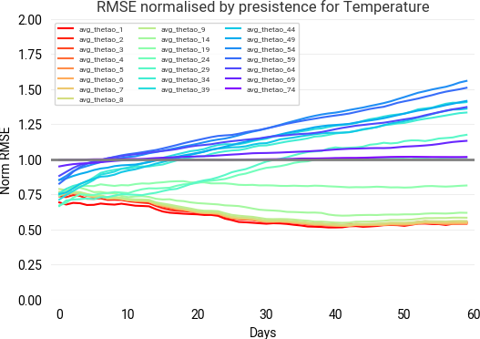
Performance over depth
Notes:
However, by scaling the rms with a baseline of a persistence forecast we see that the low RMS scores at depth are due to the ease of this forecast problem.
And while absolute RMS errors here are small, these errors can be more impactful.

Slide 13
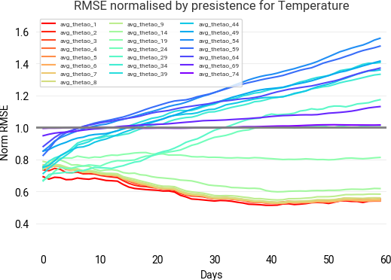
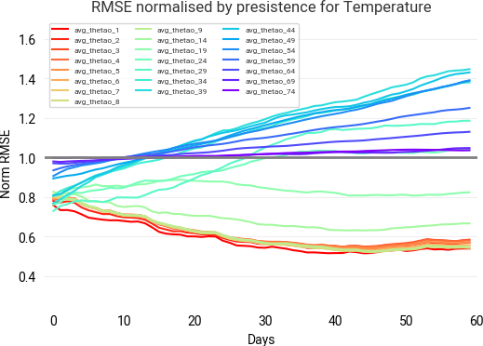
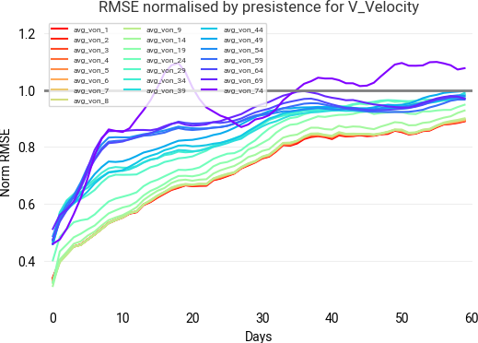
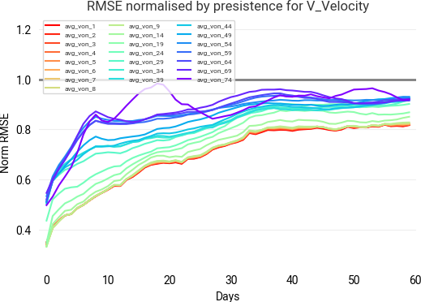
Impact of scaling
Standard model
Tendency scaling model
Temperature
Velocity (Northward)
Notes:
We improve performace at depth when we scale

Slide 14
Summary and future plans
Choice of architecture impacts performance on sub-seasonal timescales (and beyond)
Predicting changes in the deep ocean is, in one sense, very easy... but beating persistence v difficult
Scaling the loss function by the tendency improves performance in slow changing variables – here at depth
Future work:
Assess sensitivity to vertical resolution
Move to coupled model set up
Increase horizontal resolution and compare to operational models and other data-driven models
And lots more!

Slide 15
Training on ORAS6 reanalysis dataset
ORAS6 will be used as ocean forcing for ERA6

