Slide 1
Global Framework for Cholrophyll-a Monitoring in Inland Lakes: Integrating Remote Sensing, Machine Learning, and Databases (Achievements and Challenges)
Aung Chit Moe ^{1,2*}, Khim Cathleen Saddi ^{1,2}, Domenico Miglino¹ , Ruodan Zhuang ¹, Jorge Saavedra Navarro ¹, Salvatore Manfreda ^{1,2}
¹ Department of Civil Engineering and Environmental (DICEA), University of Naples Federico II, Naples, Italy;
² Istituto Scuola Superiore Pavia (IUSS Pavia), Pavia, Italy;
³ Department of Civil Engineering and Architecture, Ateneo de Naga University, Naga, Philippines;
* Corresponding author: aungchit.moe@unina.it
^{Hydrological Science}
^{(Session HS1.2.1)}
Innovative Technologies and Approaches in Hydrological Monitoring
(PICO spot A, PICOA.6, EGU25-12047)
^{Thursday, 01 May 2025}
^{Vienna, Austria}
Scan abstract here
Notes:
1

Slide 2
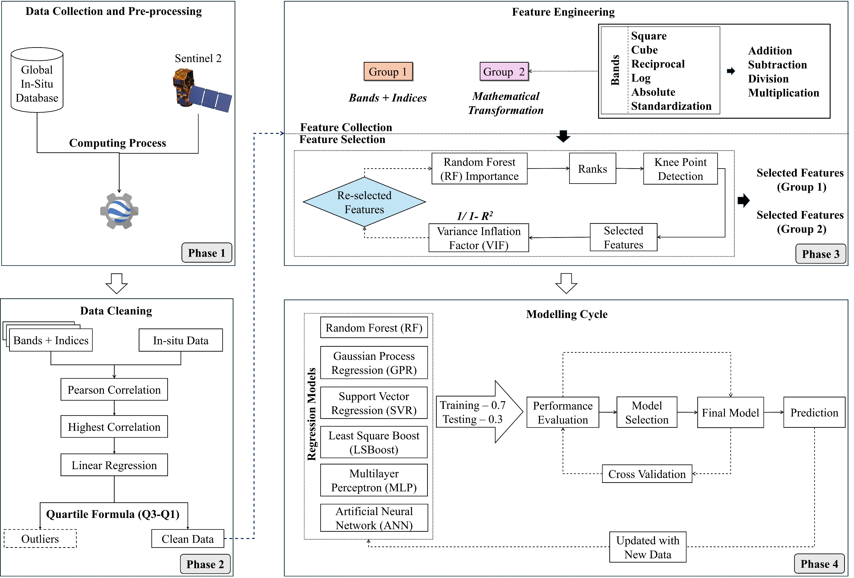
Global Framework for Cholrophyll-a Monitoring in Inland Lakes: Integrating Remote Sensing, Machine Learning, and Databases (Achievements and Challenges)
Challenges
Importance of in situ data, and Challenges in data availability and gaps.
Challenges in transfer applications of models.
Challenges in reliability and accuracy of global scale models .
Needs for enhancement of data quality.
Needs for foundational framework for improving global scale monitoring
01/05/2025
Session HS1.2.1, PICO spot A, PICOA.6, EGU25-12047
2

Slide 3
Global Framework for Cholrophyll-a Monitoring in Inland Lakes: Integrating Remote Sensing, Machine Learning, and Databases (Achievements and Challenges)
01/05/2025
Session HS1.2.1, PICO spot A, PICOA.6, EGU25-12047
3

Slide 4
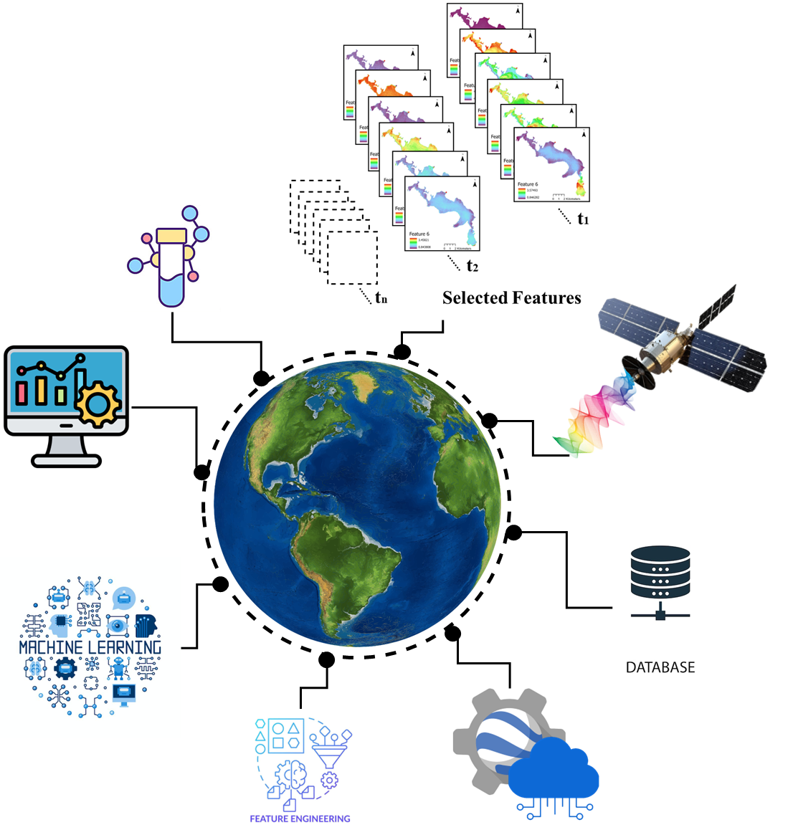
Global Framework for Cholrophyll-a Monitoring in Inland Lakes: Integrating Remote Sensing, Machine Learning, and Databases (Achievements and Challenges)
Home Page
Research Foundation
Methodology
Results
Discussion
01/05/2025
Session HS1.2.1, PICO spot A, PICOA.6, EGU25-12047
4

Slide 5
Research Foundation
Methodology
Results
Discussion
Home Page
Monitoring System
Address
1
Main Challenges
Time Consumption
Labour Intensity
Spatio-Tempo Consistency
Field Measurement
Nutrient Overload
Address
Eutrophication
Main Challenges
Lack of In-Situ Data
Inconsistent Overlap of Satellite-In-Situ Data
Low Model Transferability (Global)
Data Quality (Cleaning + Feature Assessment)
Inland Lakes
2
Empirical Approach (Remote Sensing + Machine Learning)
Water Resource Management
01/05/2025
Session HS1.2.1, PICO spot A, PICOA.6, EGU25-12047
5

Slide 6
Research Foundation
Methodology
Results
Discussion
Home Page
Goal
Framework for global Chla prediction.
Focus
Extract and select key remote sensing features.
Ensure high-quality, compiled data.
Train and validate machine learning models.
Test for global transferability using external data.
Outcome
Robust global prediction model for diverse water bodies.
Capture linear/ non-linear feature → water quality relationships.
Compiled satellite-in-situ datasets.
Foundational framework for future enhancement.
01/05/2025
Session HS1.2.1, PICO spot A, PICOA.6, EGU25-12047
6

Slide 7
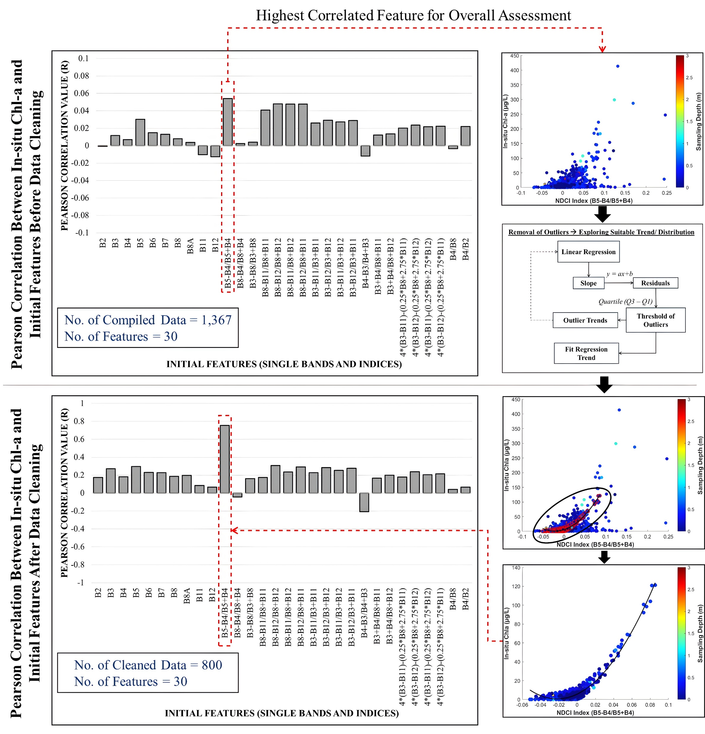
Research Foundation
Methodology
Results
Discussion
Home Page
30 features
19,670 features
01/05/2025
Session HS1.2.1, PICO spot A, PICOA.6, EGU25-12047
7

Slide 8
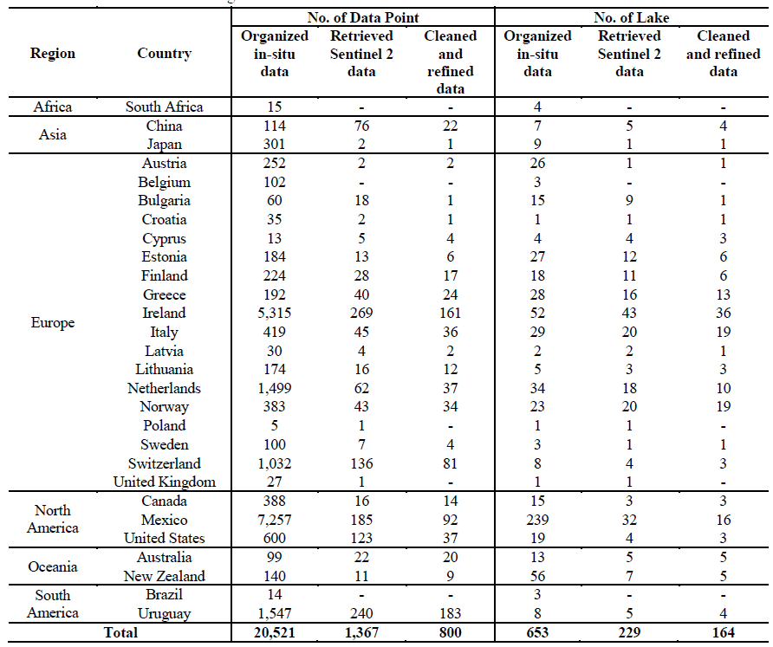
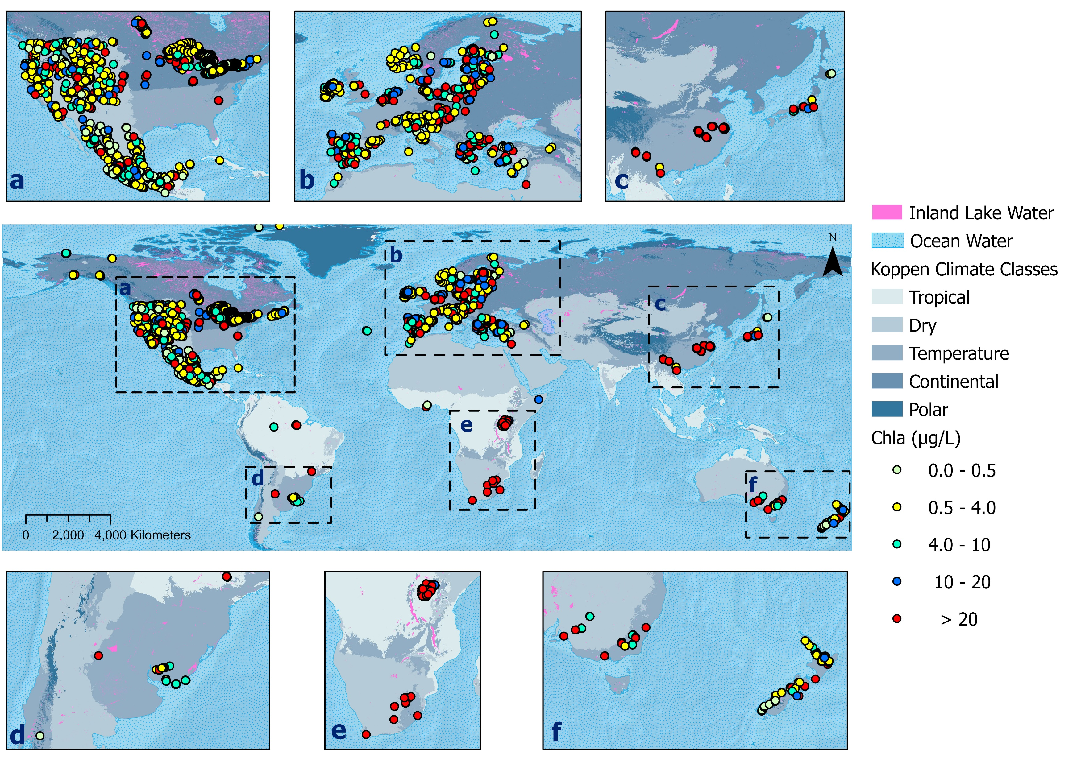
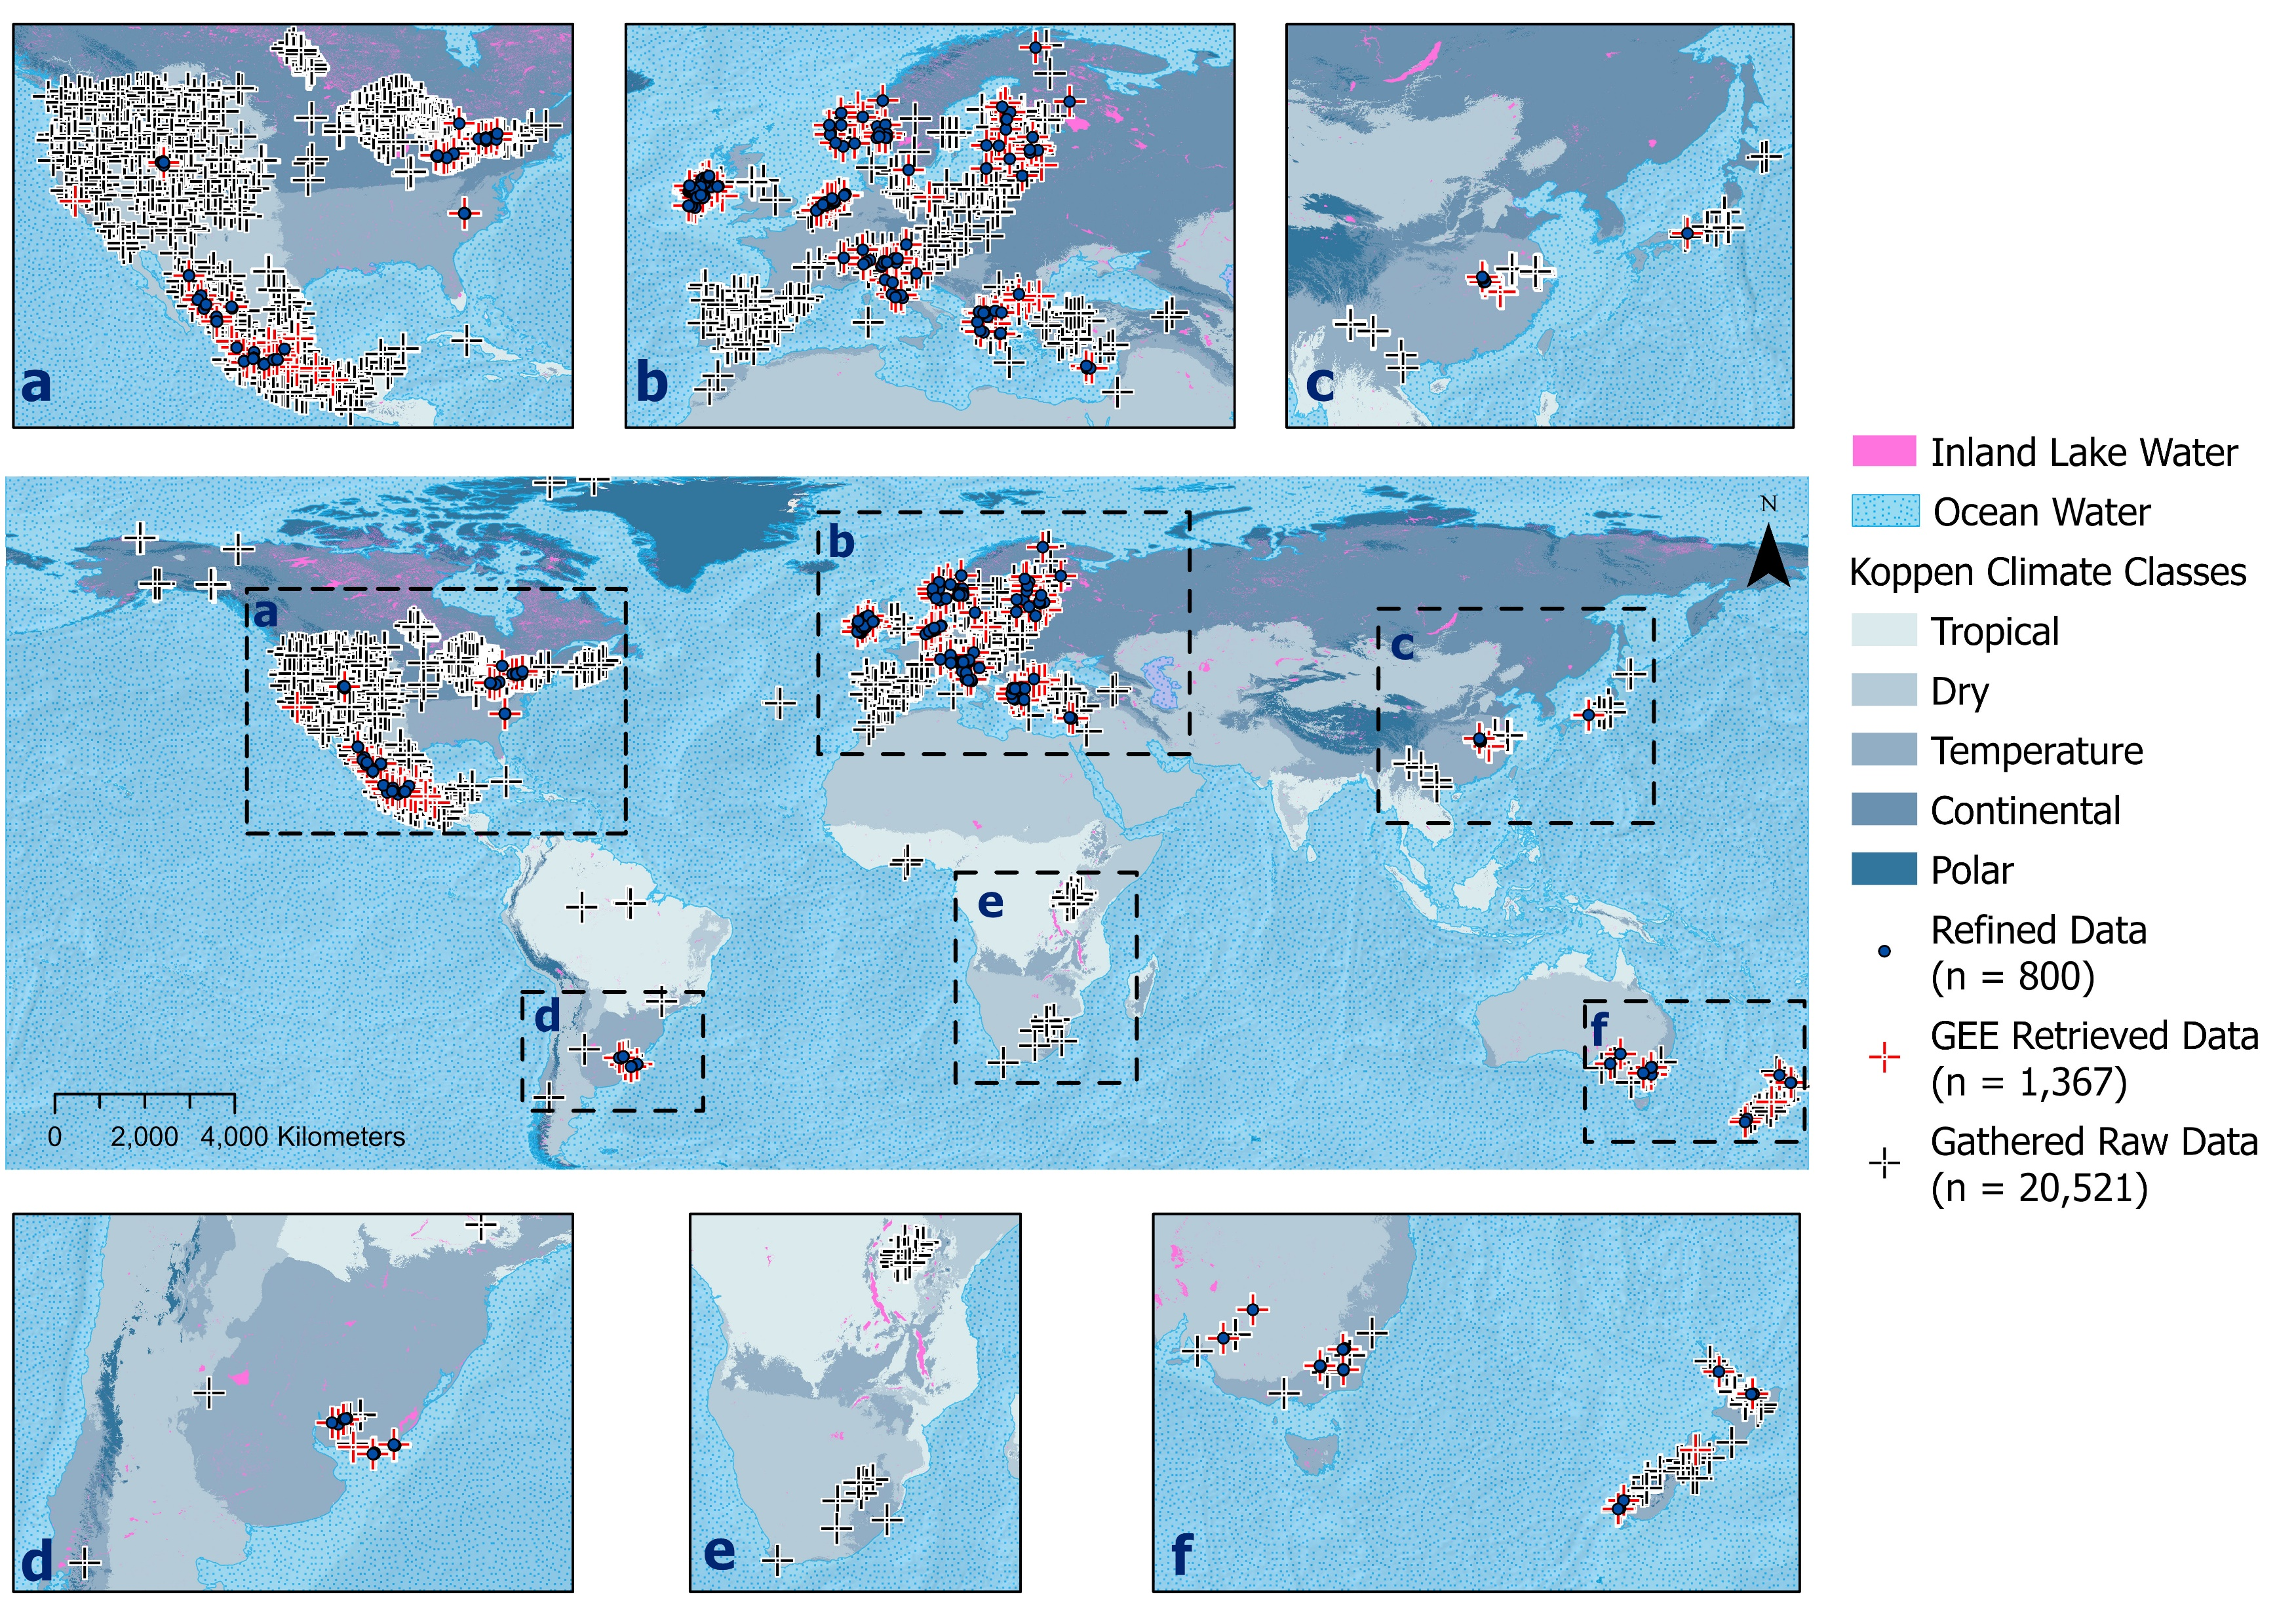
Research Foundation
Methodology
Results
Discussion
Home Page
01/05/2025
Session HS1.2.1, PICO spot A, PICOA.6, EGU25-12047
8
Notes:
8

Slide 9
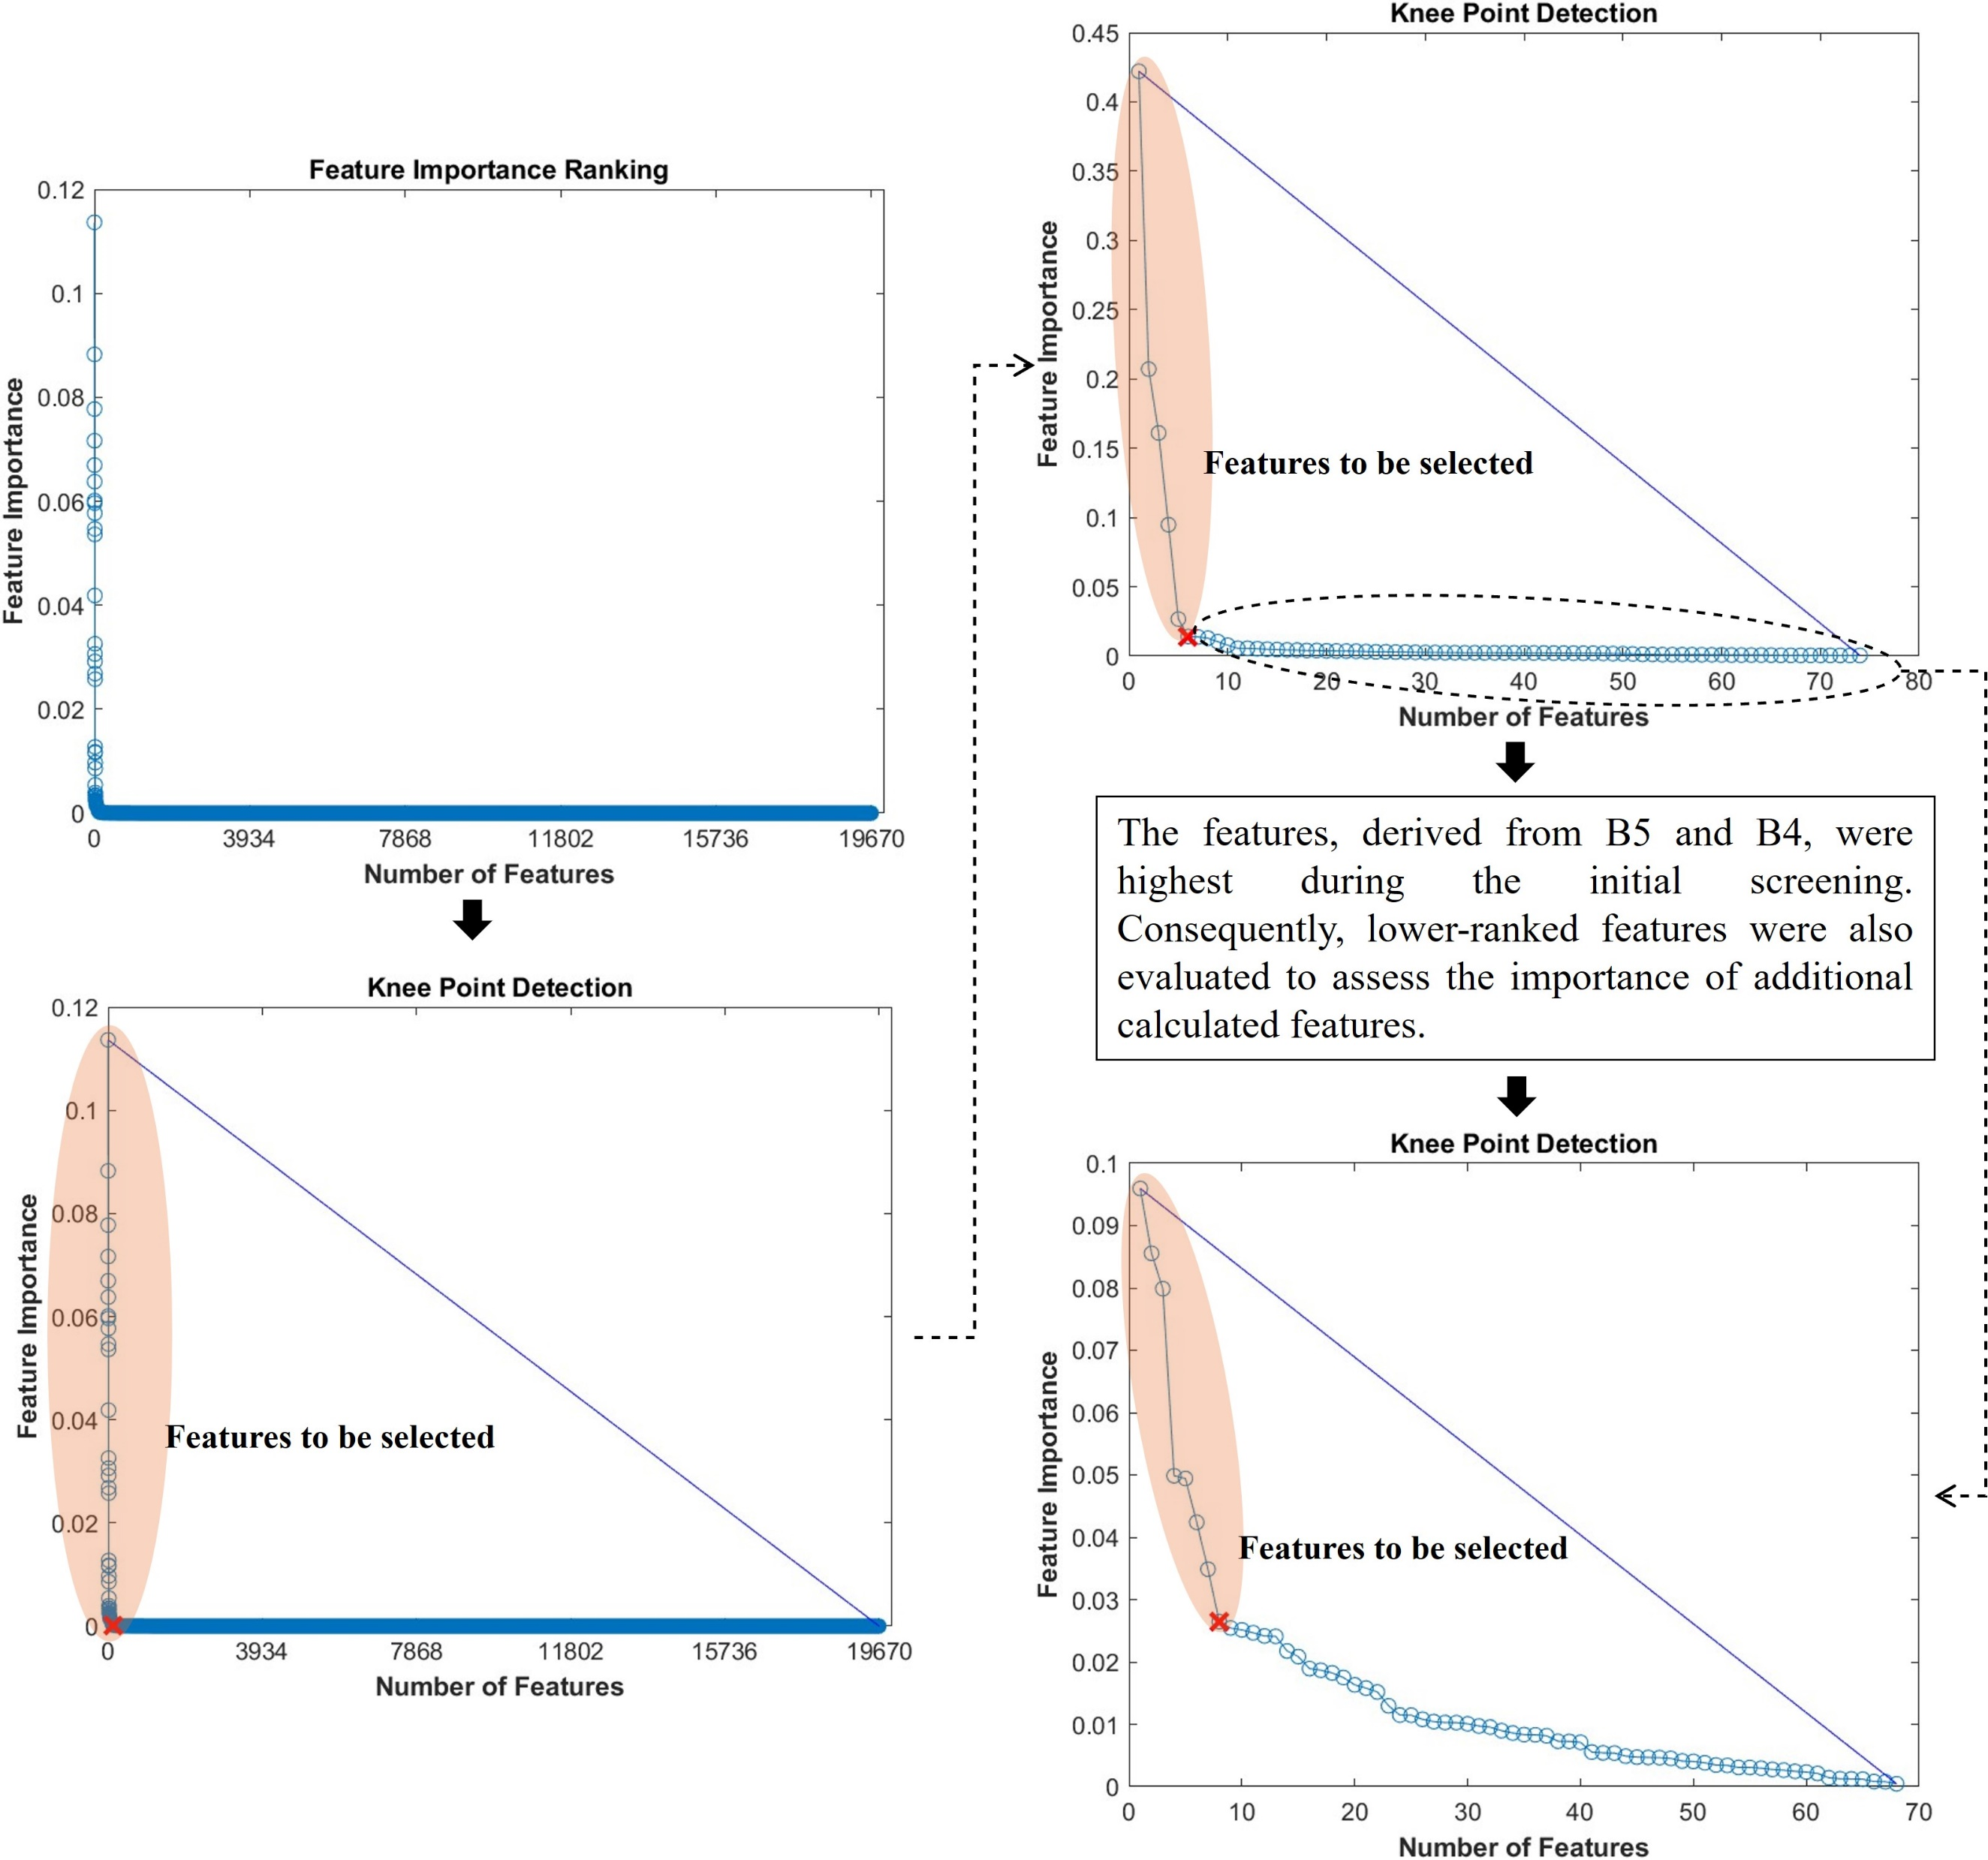
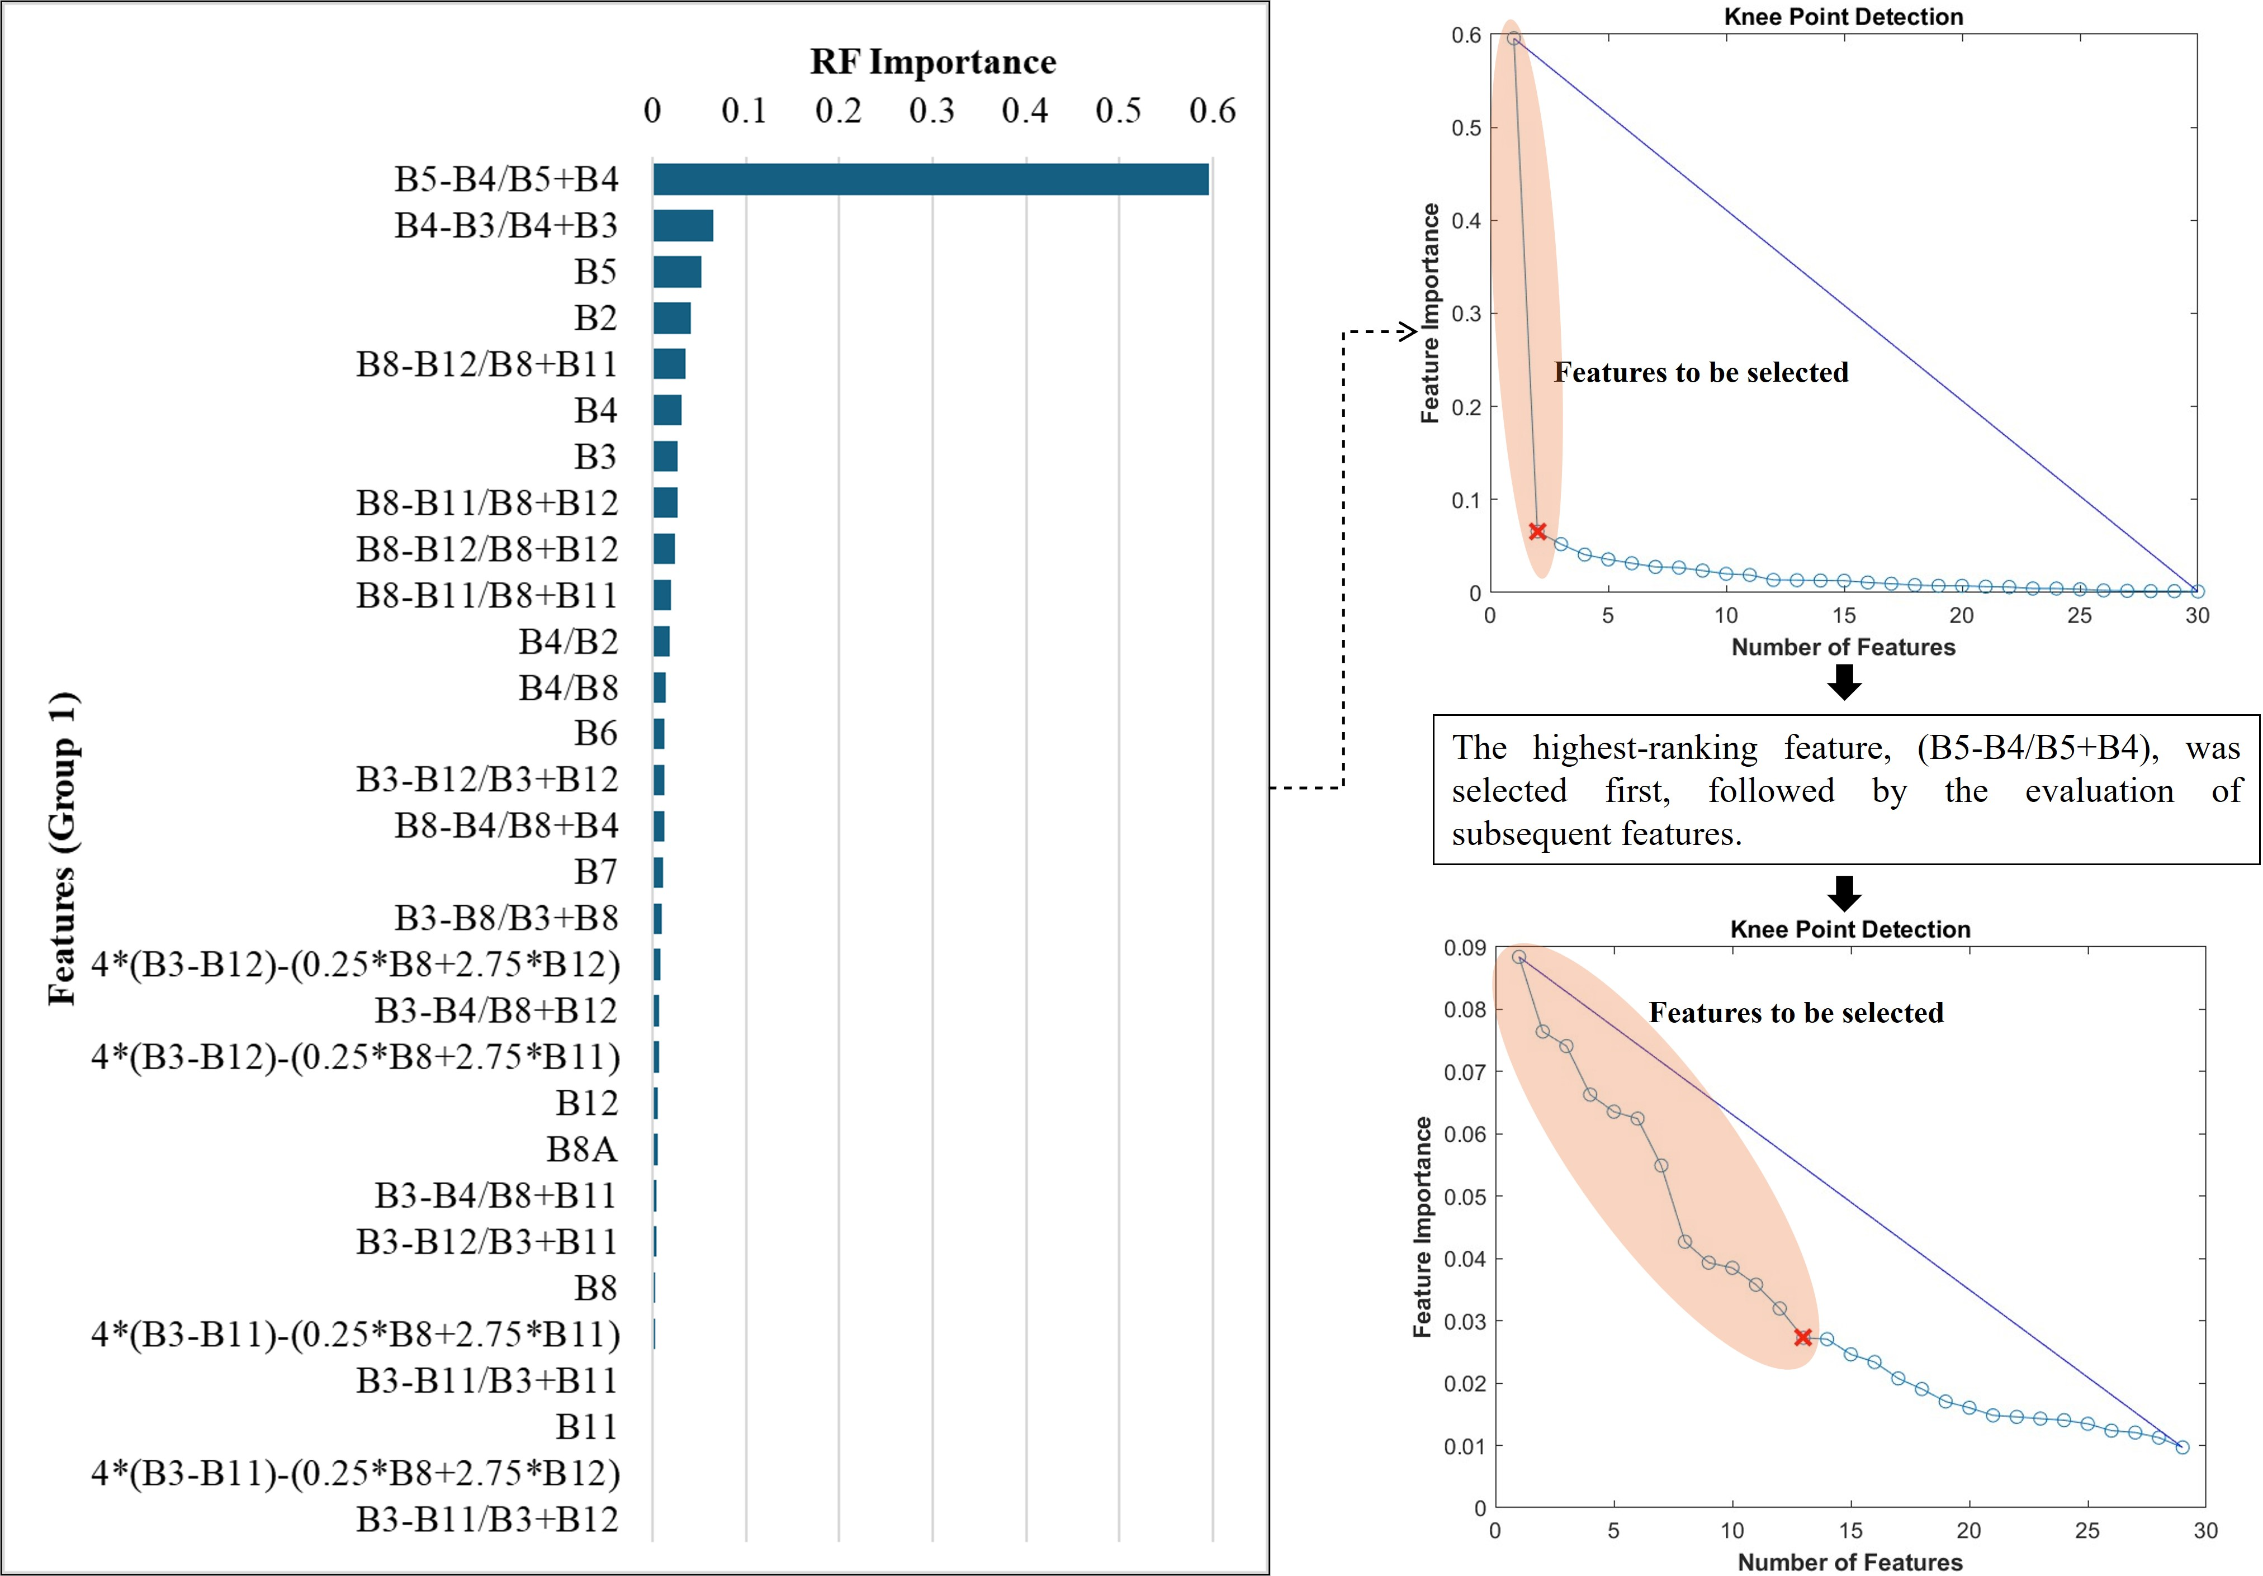
Research Foundation
Methodology
Results
Discussion
Home Page
Group 1
Group 2
RF Importance & Knee Point Detection
01/05/2025
Session HS1.2.1, PICO spot A, PICOA.6, EGU25-12047
9

Slide 10
Research Foundation
Methodology
Results
Discussion
Home Page
01/05/2025
Session HS1.2.1, PICO spot A, PICOA.6, EGU25-12047
10

Slide 11
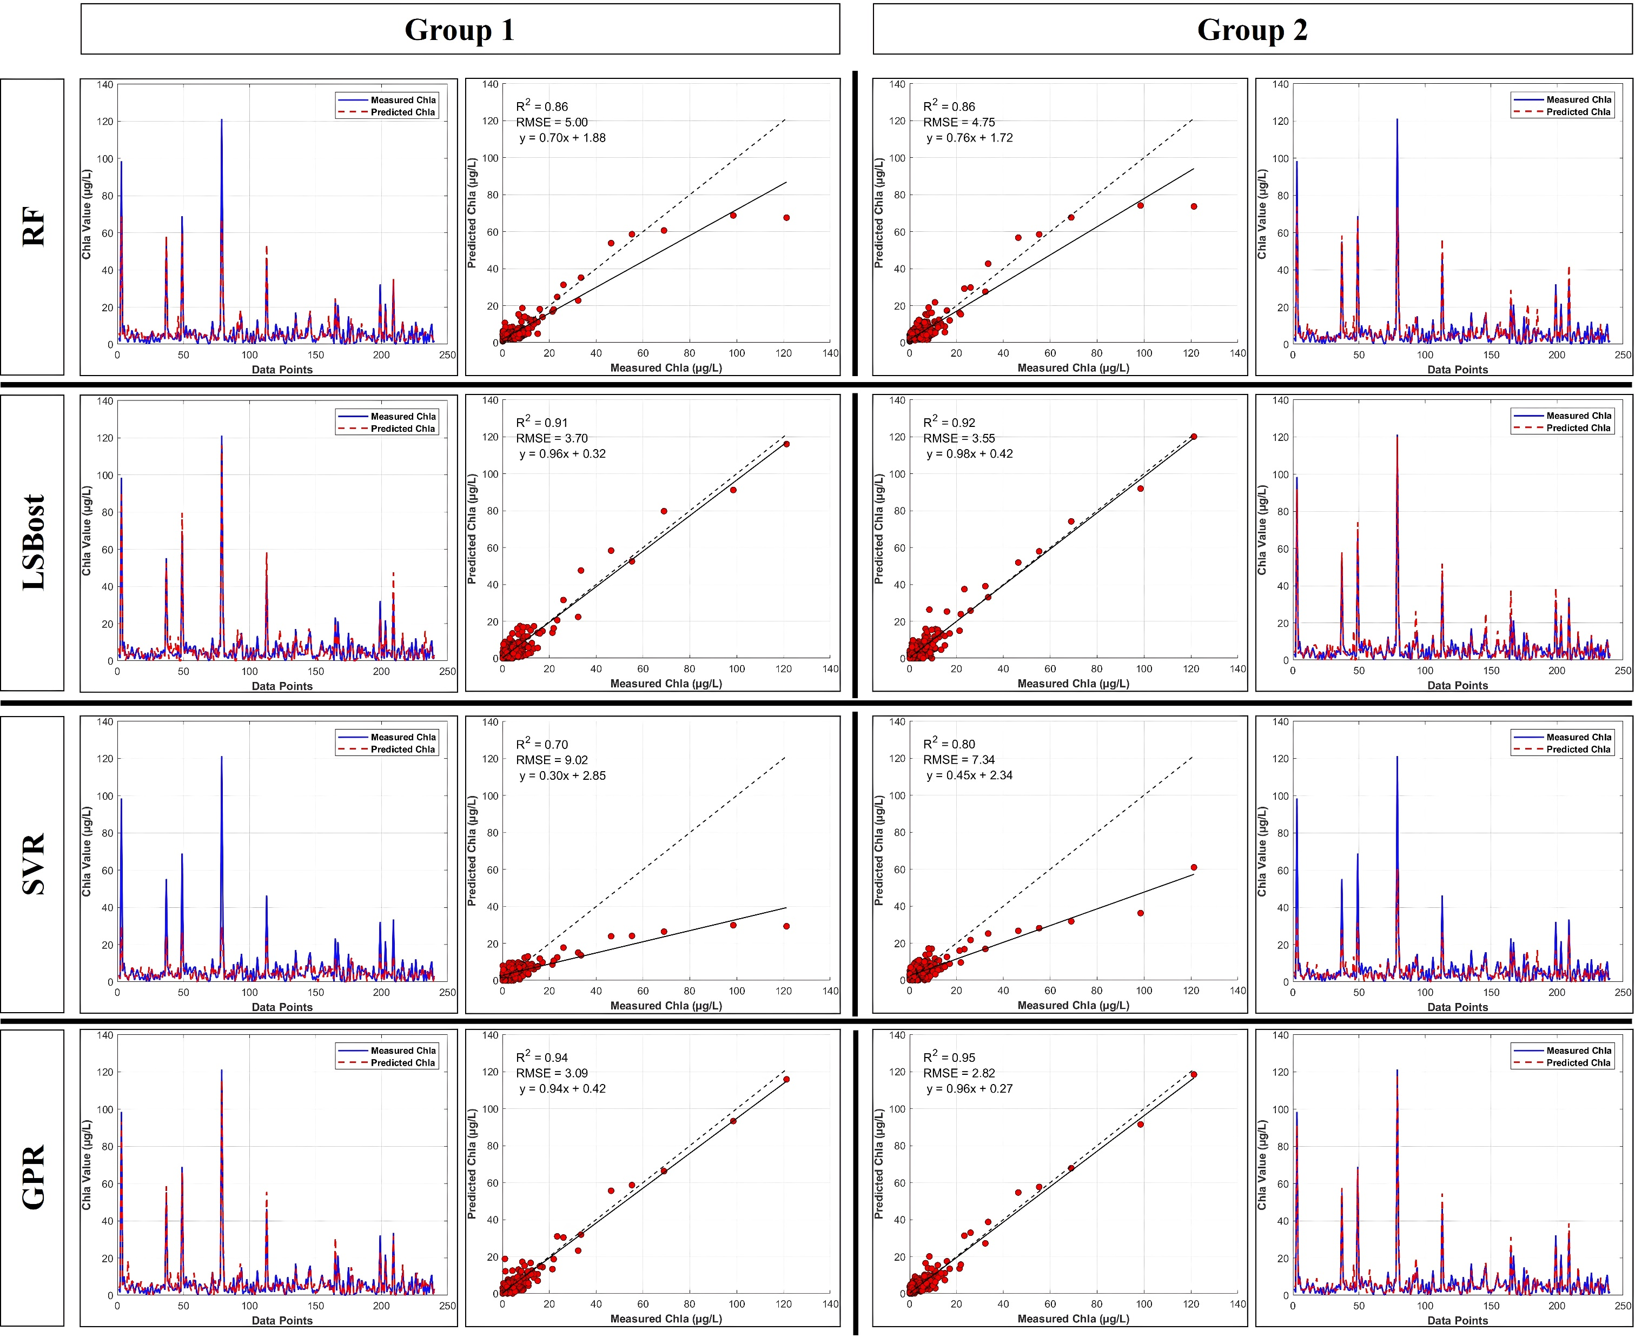
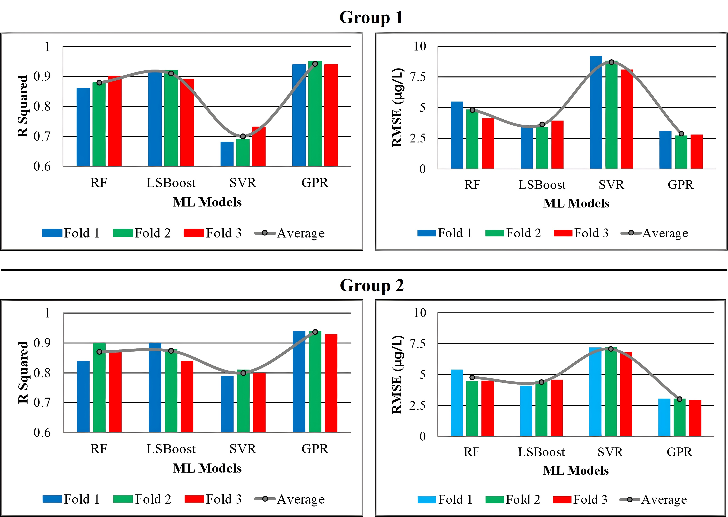
Research Foundation
Methodology
Results
Discussion
Home Page
Overall Validation
Cross-validation
01/05/2025
Session HS1.2.1, PICO spot A, PICOA.6, EGU25-12047
11

Slide 12
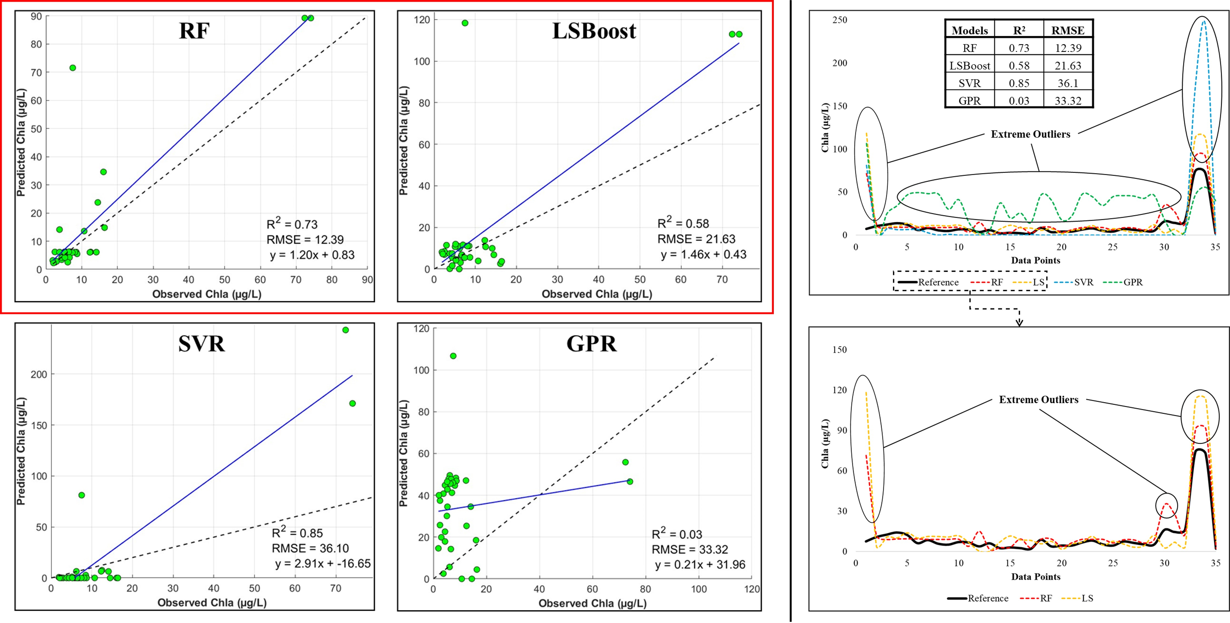
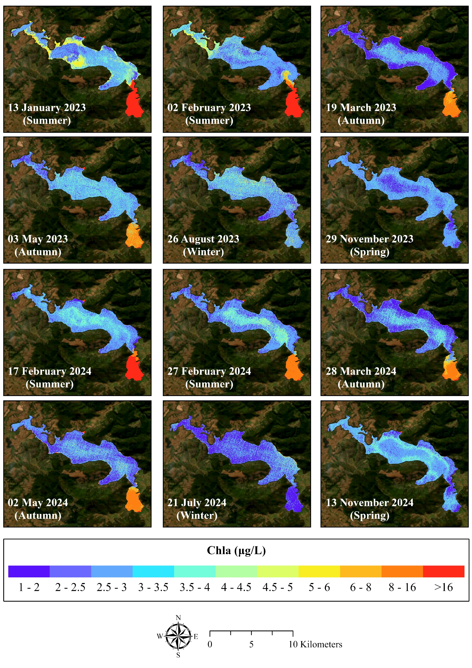
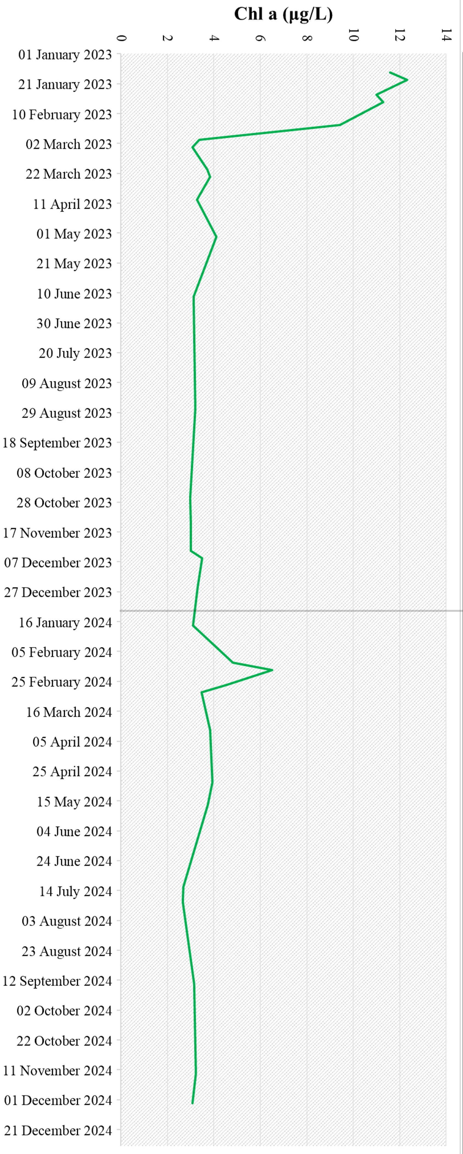
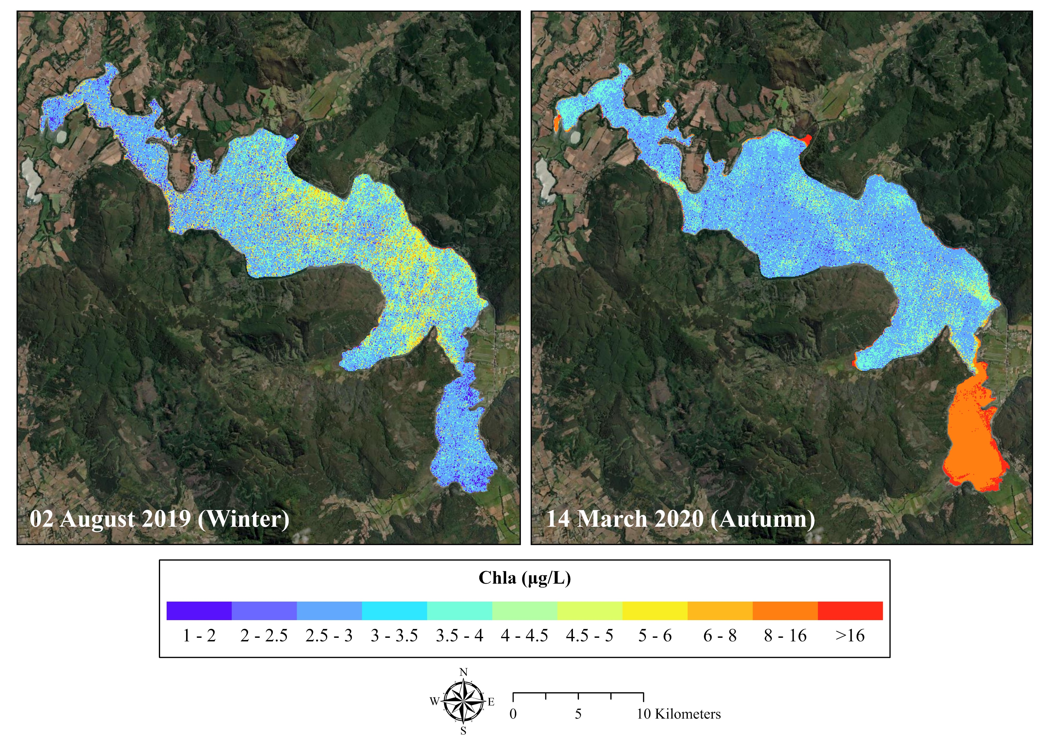
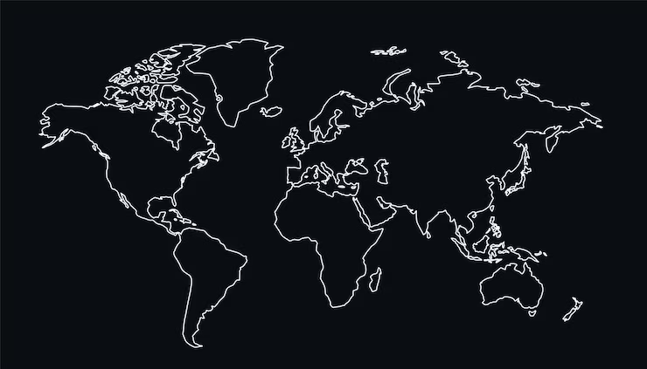
Research Foundation
Methodology
Results
Discussion
Home Page
Validation To External Lake
Experiment on Spatio-tempo Prediction
01/05/2025
Session HS1.2.1, PICO spot A, PICOA.6, EGU25-12047
12

Slide 13
Research Foundation
Methodology
Results
Discussion
Home Page
Data Bias: Mostly from Europe, America, China; lacks global balance.
Image Processing: Atmospheric interference, processing errors.
Key Features: Red & Red Edge bands for Chla.
Models: RF best; SVR weak; Group 1 more consistent.
Transfer Learning: Seasonal trends matched reference lake.
Trends (2023–2024): Higher Chla in summer, upstream.
Future Work: Better correction, broader validation, landscape factors.
01/05/2025
Session HS1.2.1, PICO spot A, PICOA.6, EGU25-12047
13

Slide 14
Research Foundation
Methodology
Results
Discussion
Home Page
Under Peer Review
Scan Pre-print Draft (Before Peer Review Process)
01/05/2025
Session HS1.2.1, PICO spot A, PICOA.6, EGU25-12047
14

