Slide 1
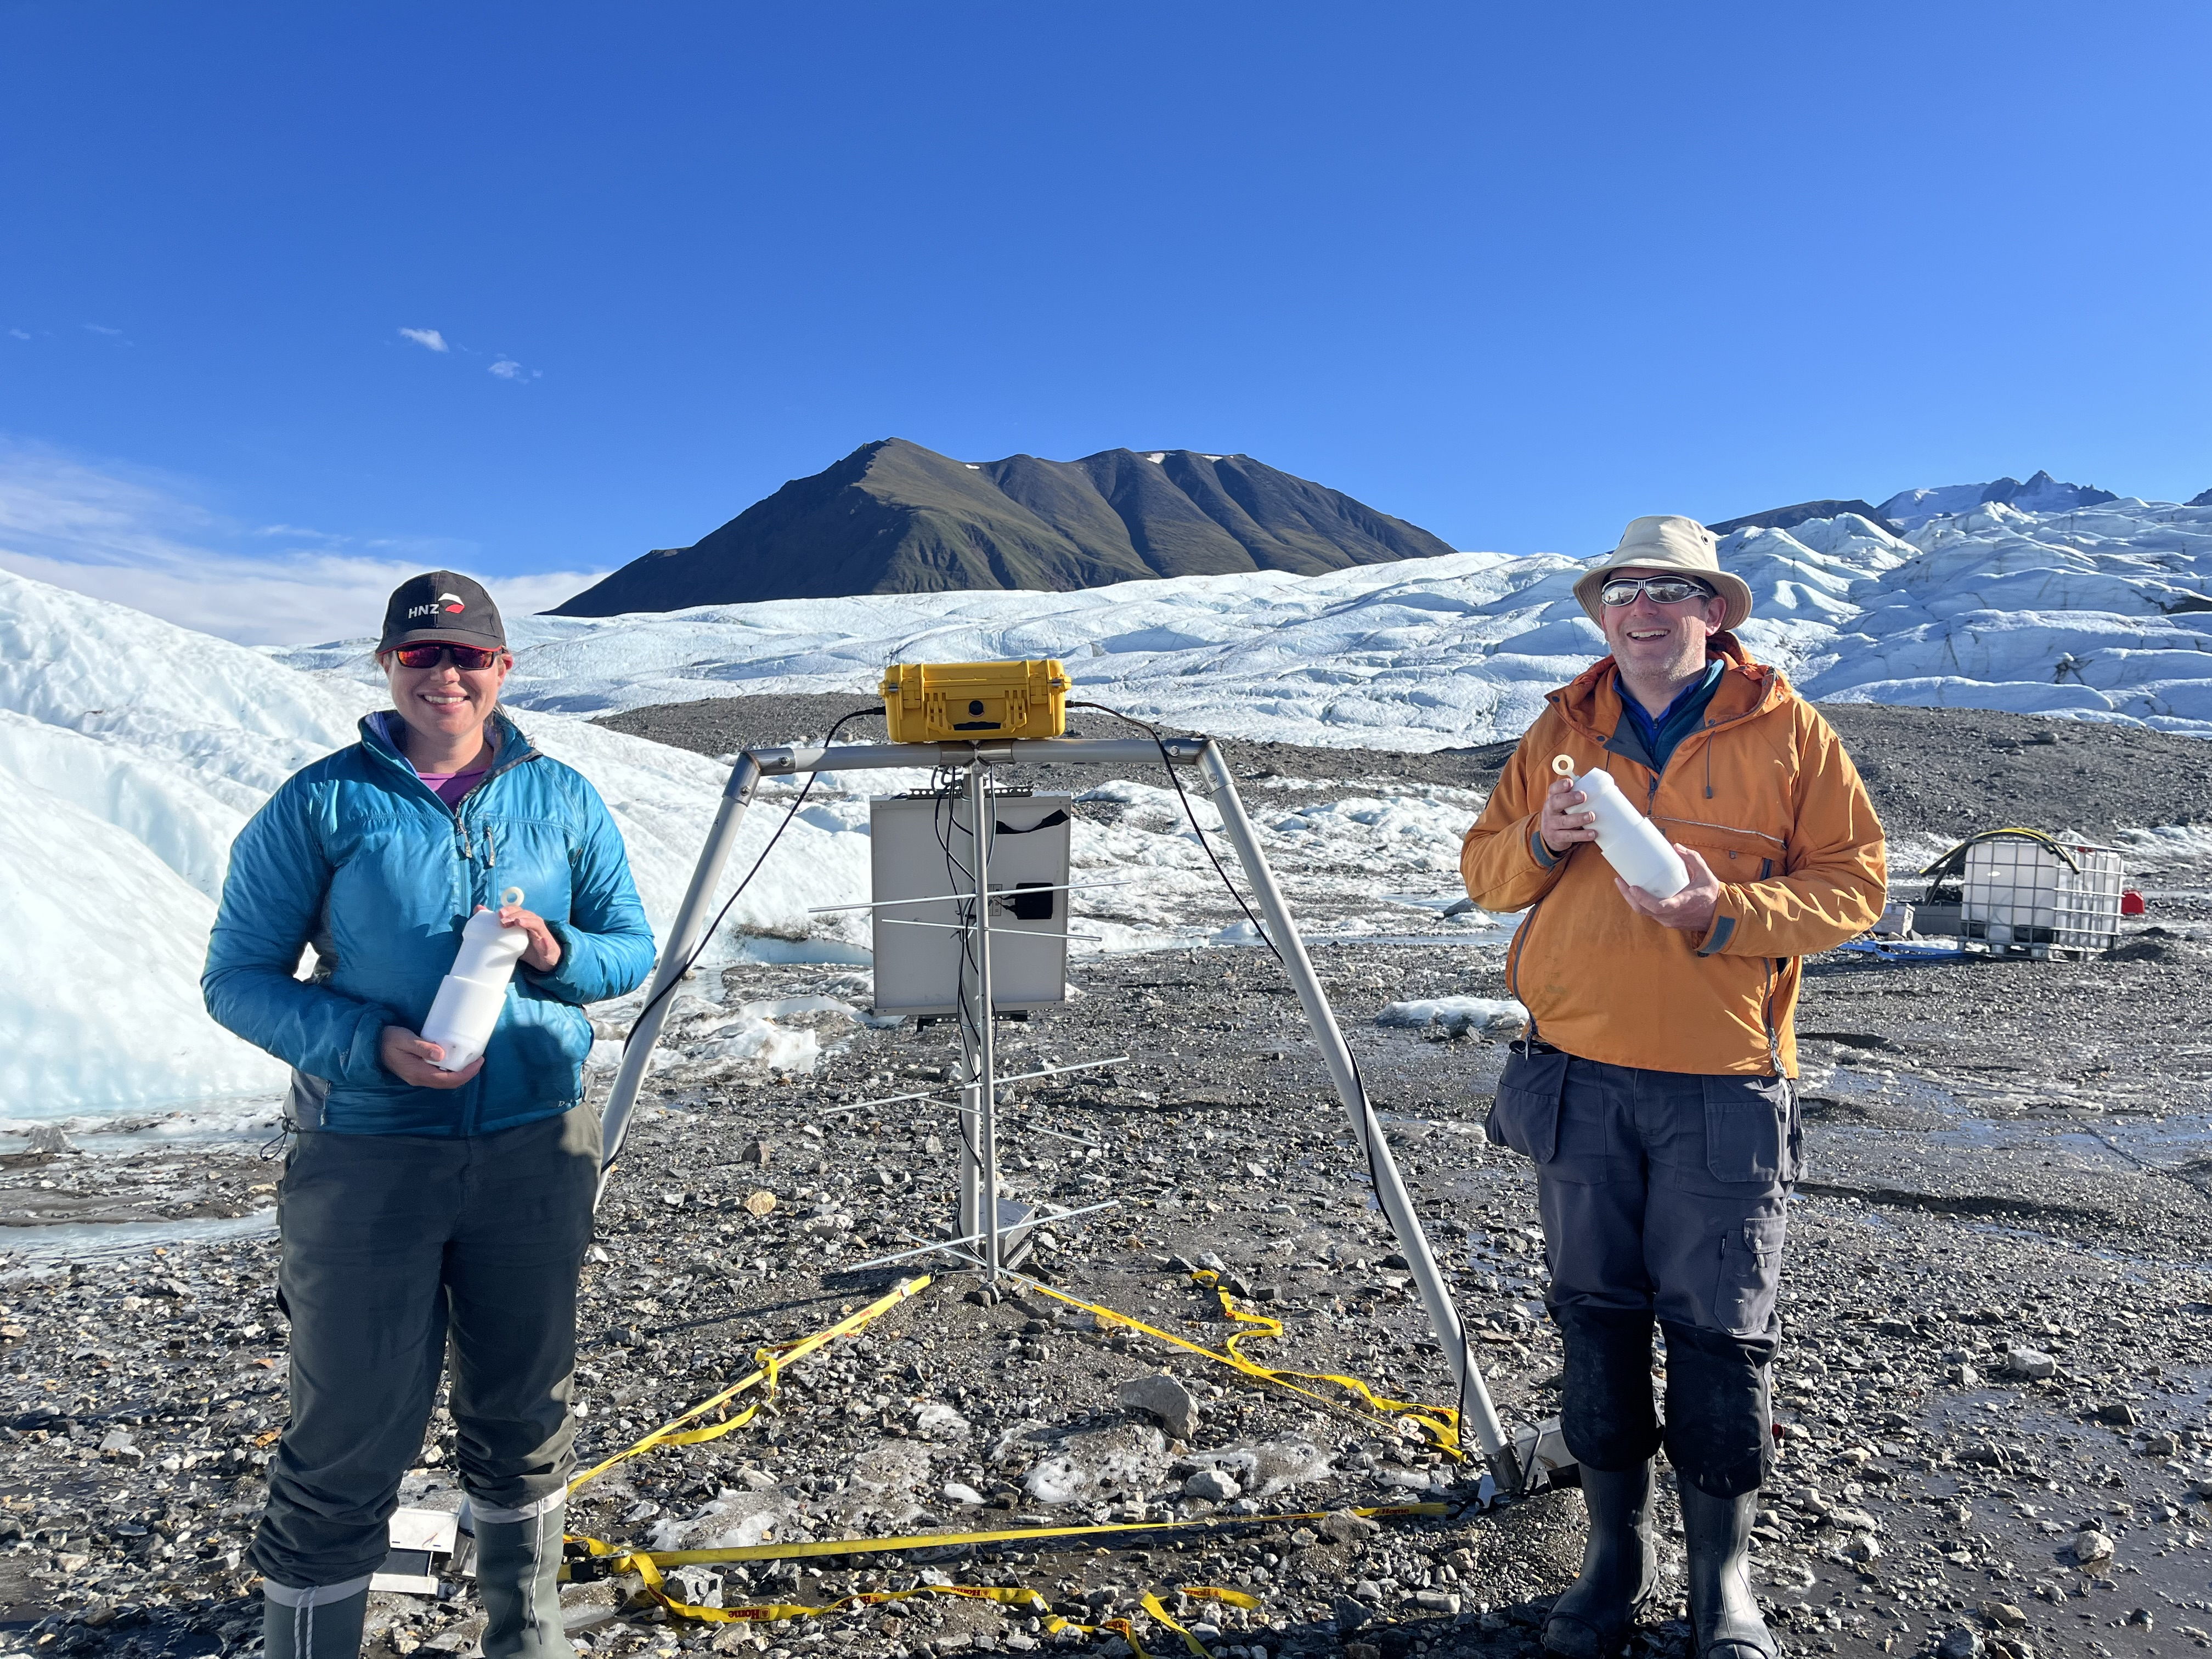
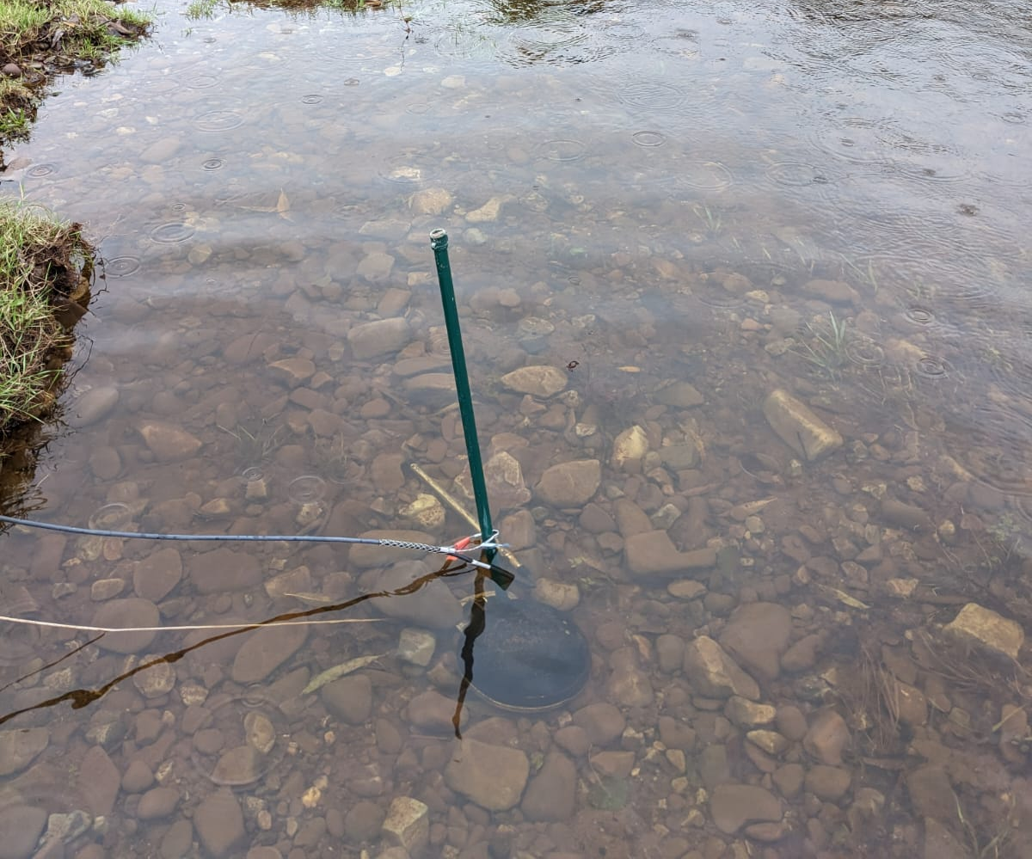
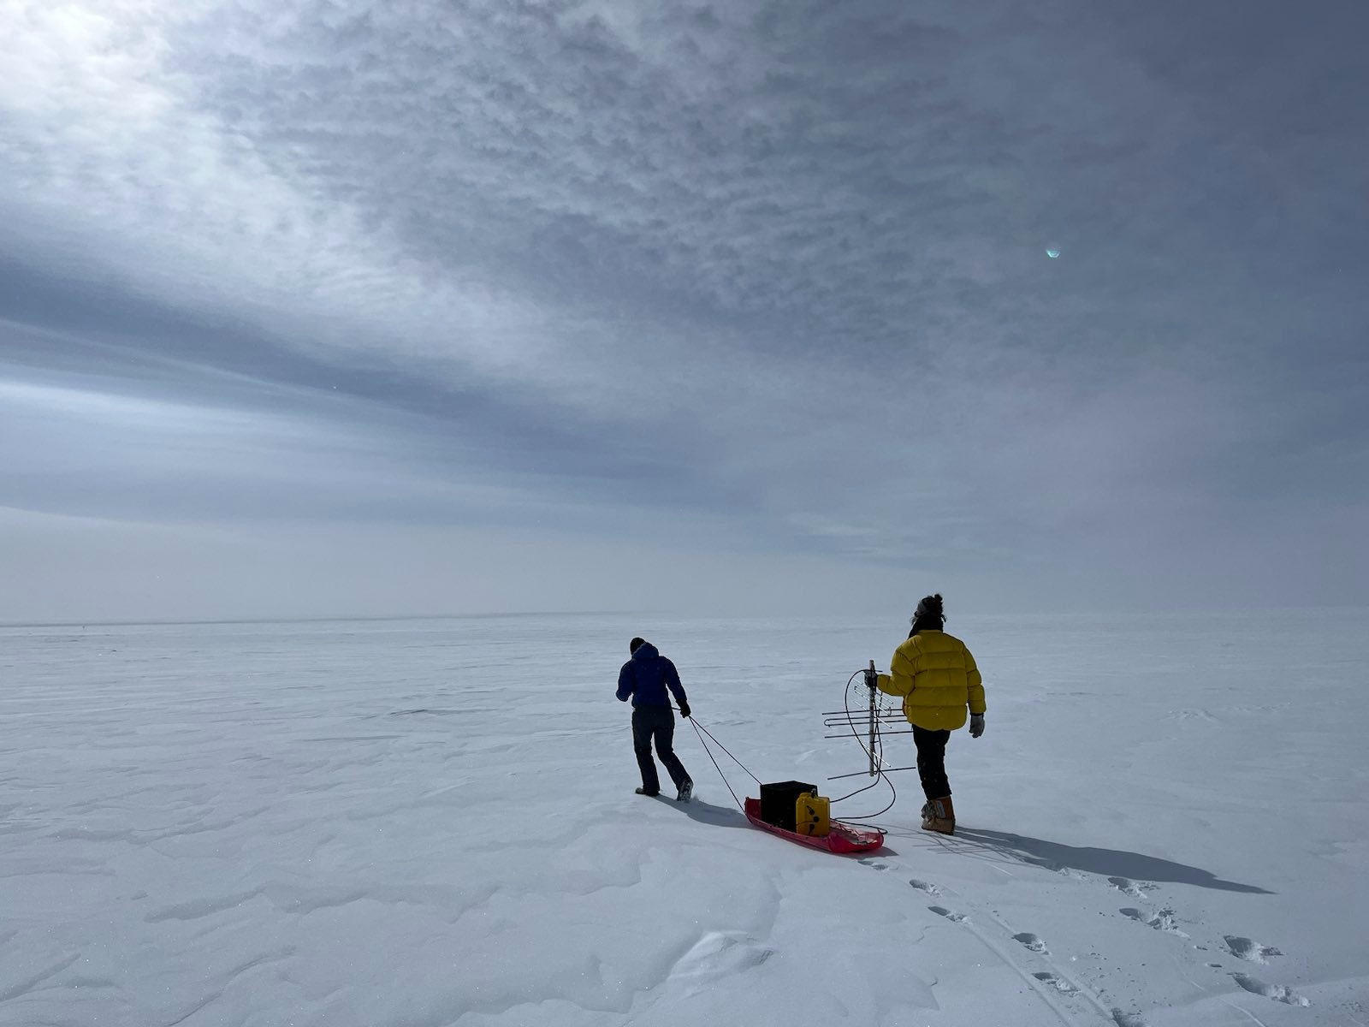
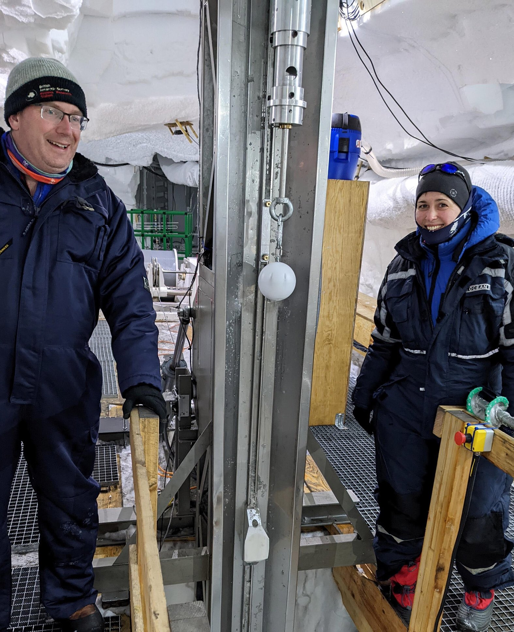
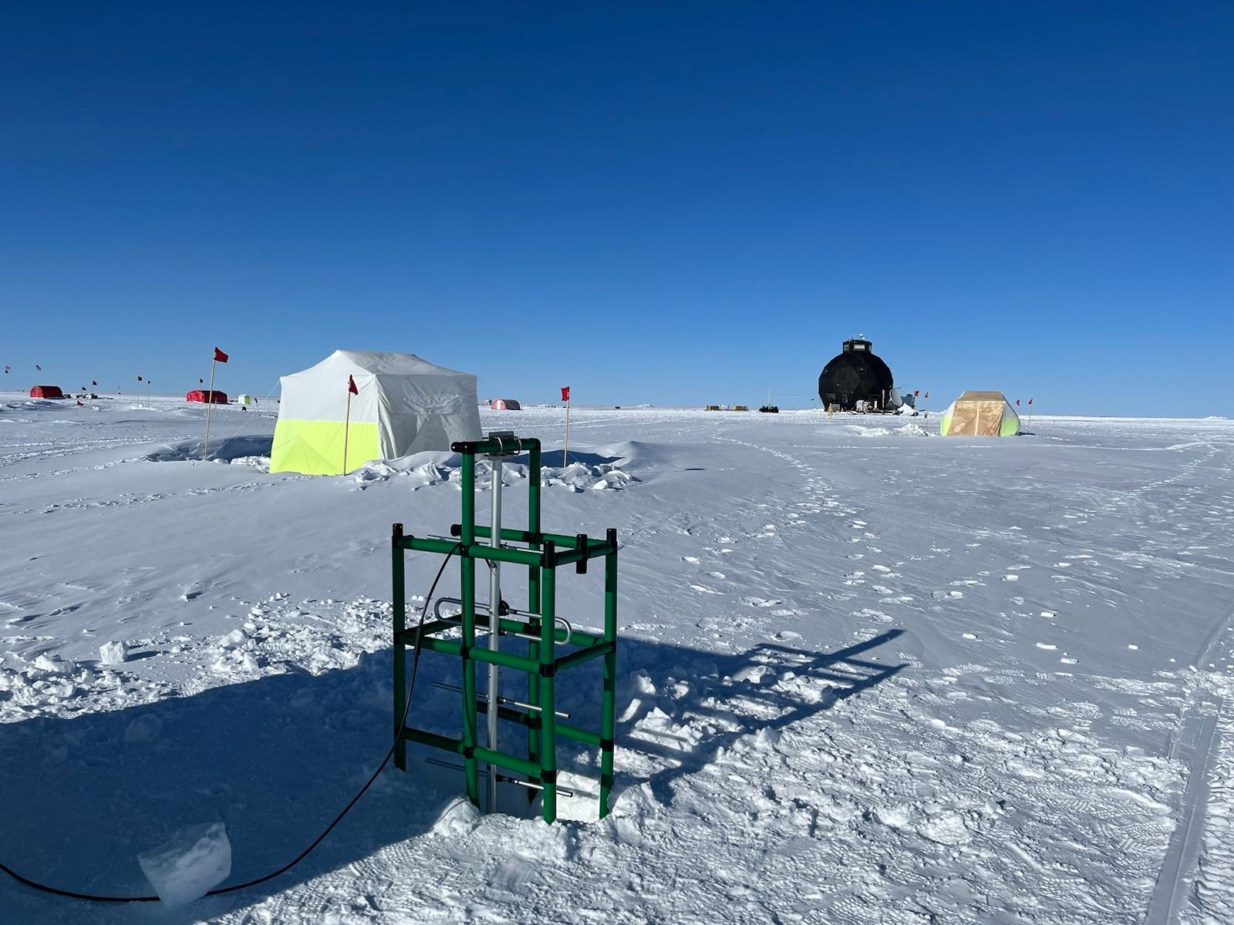
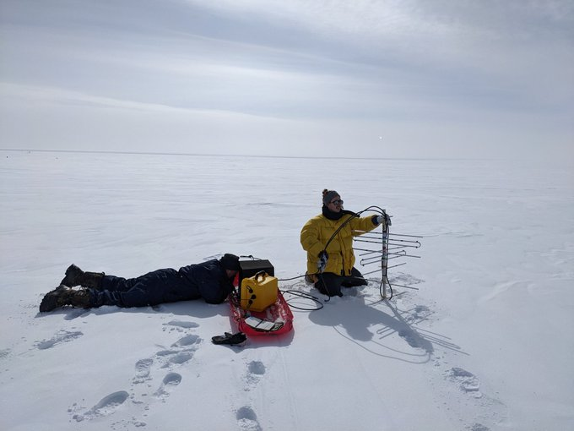
School of Earth & Environmental Sciences — Ysgol Gwyddorau'r Ddaear a'r Amgylchedd
Cryoegg, Cryowurst and Hydrobean: wireless instruments for glaciology and hydrology
Mike Prior-Jones¹, Jonathan Hawkins¹, Lisa Craw¹, Liz Bagshaw², Christine Dow³, Allan Mason-Jones⁴, Hashem Alnader⁵, Elle von Benzon¹, Luke Copland⁶, Dorthe Dahl-Jensen^{7,8}, Josh James⁹, Stephen Livingstone¹⁰, Brittany Main³, Sarah Mann¹, Matt Peacey², Roo Perkins¹, and Sophia Rahn⁵
¹School of Earth & Environmental Sciences, Cardiff University; ²School of Geographical Sciences, University of Bristol; ³Department of Geography and Environmental Management, University of Waterloo; ⁴School of Engineering, Cardiff University;
⁵ formerly of Faculty of Engineering, University of Waterloo; ⁶Dept. of Geography, Environment & Geomatics, University of Ottawa, ⁷Nils Bohr Institute, Copenhagen University; ⁸Faculty of Environment, Earth & Resources, University of Manitoba;
⁹PDR Design, Cardiff; ¹⁰School of Geography and Planning, University of Sheffield.
Overall aims
Cryowurst: ice dynamics
We aim to provide new insights into our changing environment through new technology
Low-cost, low-power electronics and convenient wireless and satellite communications allow us to retrieve data live from remote locations
Reduces risk, publication lag, and carbon footprint as fewer field visits are required
This instrumentation will be released as open-source hardware to make it easy for others to use, understand, and modify
Cryowurst measures conditions in glacier boreholes
Aims to forecast glacier surges which can destroy infrastructure
Measures temperature, borehole tilt, water pressure and electrical conductivity
Provides insight into glacier motion in real time
Tested on Donjek Glacier in Yukon, Canada
Provides hourly data for 10 years
Cryoegg: subglacial hydrology
Cryoegg is deployed in the water channels underneath glaciers and ice sheets
Data provides insight into ice sheet motion – will help predict sea level rise
Measures temperature, water pressure and electrical conductivity
Tested in Greenland and Switzerland
Proven to work through 2.5km of ice
Provides hourly data for >1 year
Successful deployment in moulins for ~9 months
Hydrobean: river pollution
Hydrobean is a low-cost river monitoring system
Intended for citizen science groups – easy to use
Measures temperature, pressure, and electrical conductivity (EC)
Both temperature and EC can signal pollution – polluted water may be warm, or contain a lot of dissolved chemicals (high EC)
Runs for months on 4 x AA batteries
Live data delivered via mobile phone or satellite
Designed in partnership with PDR Design
Tested in rivers in Wales and south-west England
Future plans
Large receiving antenna for use in deep ice: the antenna is 2m long and partly buried in the snow. We can receive the Cryoegg signal from 2km down!
Measurement campaigns in Greenland in August 2025 and summer 2026
New instrument for measuring snow conditions (patent pending)
New low-cost instrument for small, shallow boreholes in snow and ice
Refine and improve existing designs and release as open source
Move towards larger-scale manufacturing and spin-out company
Testing Cryoegg in the East Greenland Ice Core Project borehole
Portable receiving station for use on smaller glaciers
We thank the following for their support:
Future Leaders Fellowship [Prior-Jones: MR/V022237/1 ]
New Investigator Grant
[Bagshaw: EP/R03530X/1]
Research Wales Innovation Fund:
Innovation for All grant [Bagshaw / Prior-Jones]

