Slide 1
Swiss water quality: extending CAMELS-CH with data on isotopes, water quality and atmospheric chemistry
Ursula Schönenberger, Thiago M do Nascimento
Marvin Höge, Sandra Pool, Rosi Siber, Martina Kauzlaric, Pascal Horton, Marius Floriancic, Maria Staudinger, Florian Storck, Päivi Rinta, Jan Seibert, and Fabrizio Fenicia
Navigation
Back here
For(back)wards
?
Go to content

Slide 2
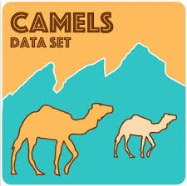
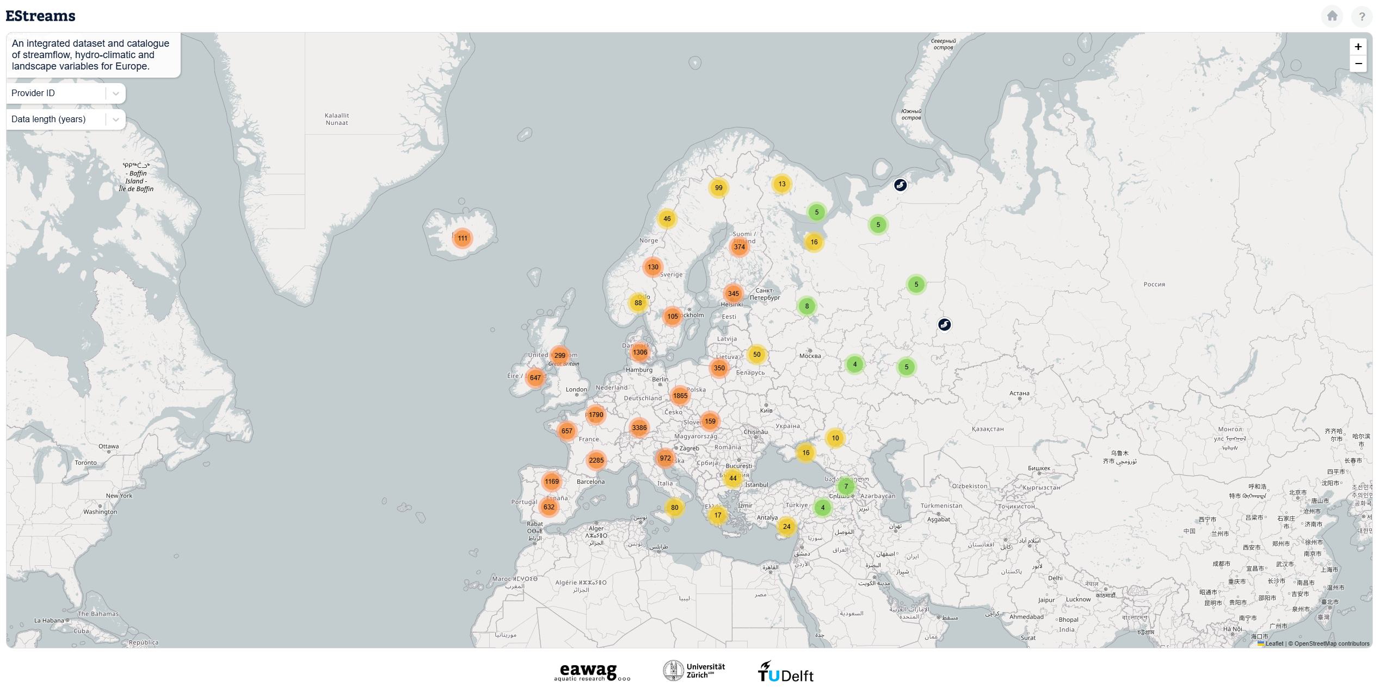
Background information
Recently many large-sample hydrology datasets have been available worldwide
Typically these datasets “only” cover hydro-climatic variables and catchment properties.
There is still a lack in the availability of consistent data related to water quality.
Yet, many studies have highlighted the importance of integrating LSH datasets with water quality data.
www.estreams.eawag.ch
?

Slide 3
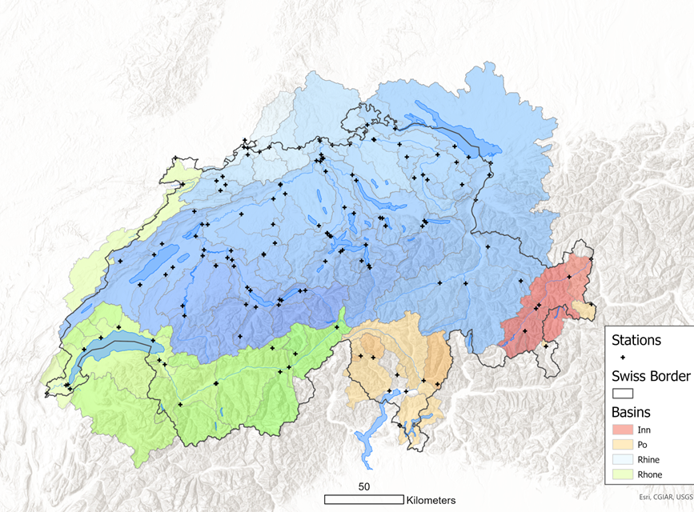
Introducing CAMELS-CH-Chem
A dataset of up 40 water quality parameters for 115 Swiss catchments.
The dataset covers the period of 1981-2020 (same as CAMELS-CH).
Daily and hourly time-series of temperature, dissolved oxygen, pH, and electrical conductivity.
Monthly-to-annual time-series of isotopes, crop types, livestock units and atmospheric deposition data.
Distribution of the streamflow stations and their respective catchment boundaries in the background.
?

Slide 4
Content
Background information
Introducing CAMELS-CH-Chem
Methods
Data records
Folder structure
Dataset overview
Technical validation
Final remarks
Contact information
CAMELS-CH-Chem preprint
Distribution of the streamflow stations and their respective catchment boundaries in the background.
?

Slide 5
Methods
We introduce three data types
Stream water chemistry
Stream water isotopes
Catchment aggregated data
Distribution of the streamflow stations and their respective catchment boundaries in the background.
?

Slide 6
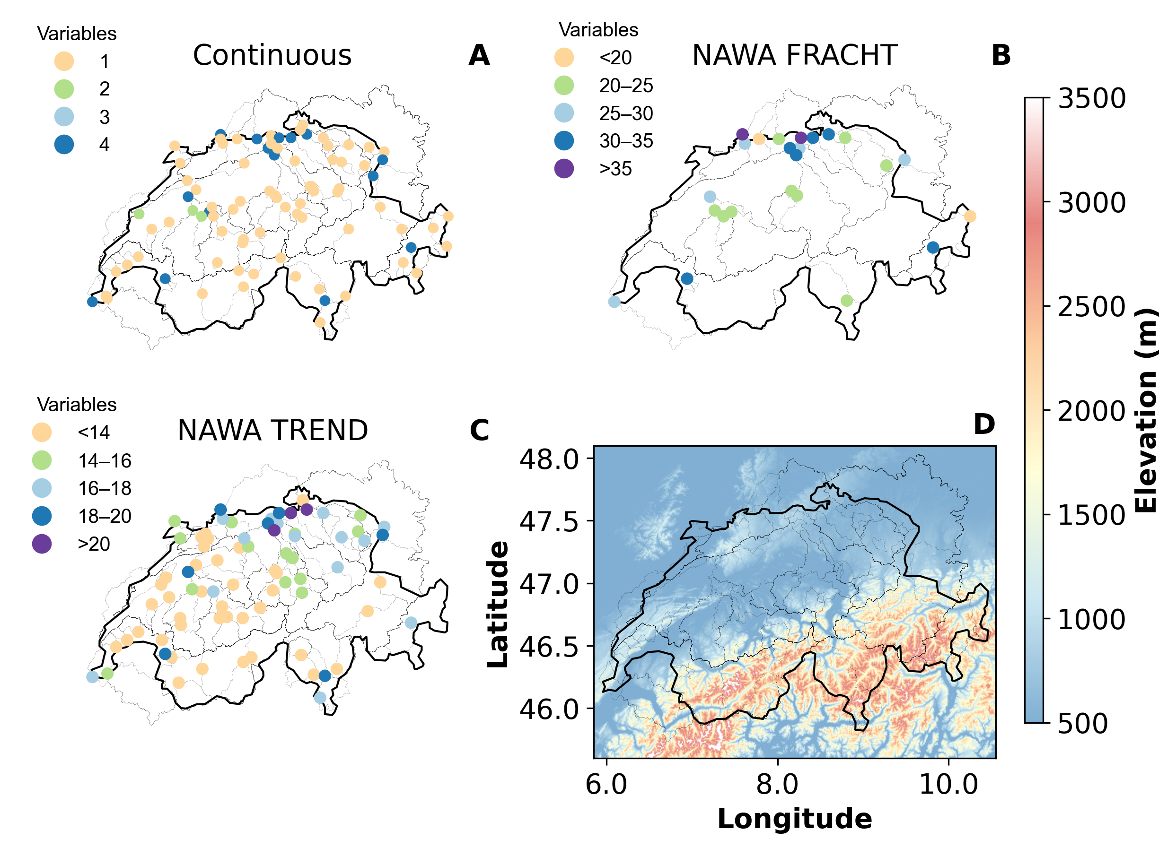
Methods
Stream water chemistry data
Continuous measurement (sensors) data: hourly and daily from 1980-2020.
NAWA FRACHT: (bi)monthly measurements.
NAWA TREND: one sample per month.
Distribution of the streamflow stations with dots representing the number of available variables.
?

Slide 7
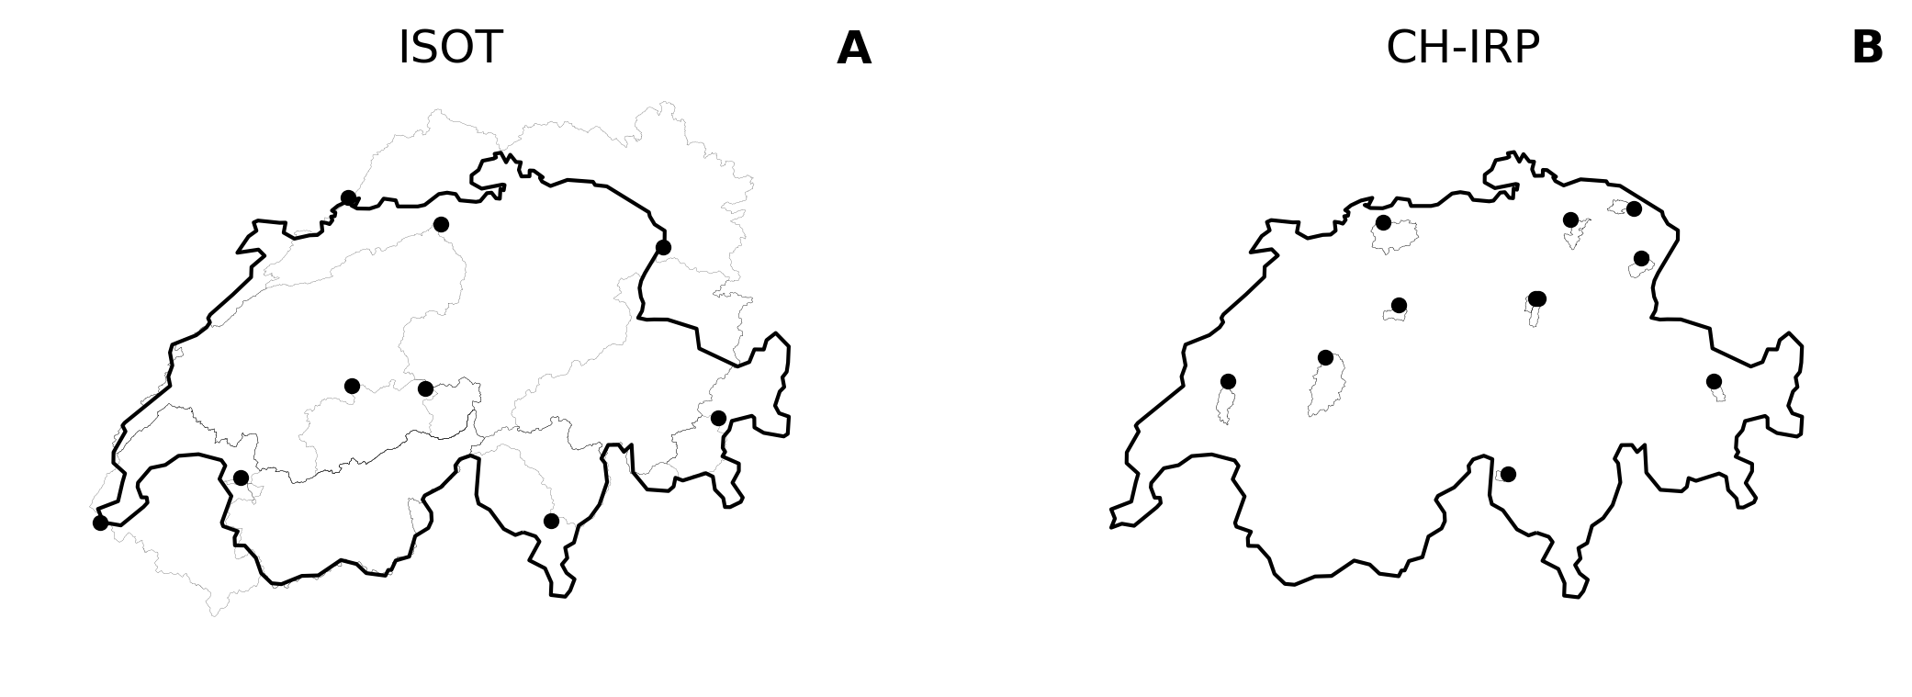
Methods
Stream water isotopes
Stream water measurements of deuterium and oxygen-18.
(Bi)monthly time series from the ISOT (1990-2020) and CH-IRP (2010-2020) datasets.
Spatial distribution of the measurement locations with stream water isotopes data available in CAMELS-CH-Chem encompassing (a) ISOT (9 gauges) data and (b) CH-IRP (12 gauges).
?

Slide 8
Methods
Catchment aggregated data
Annual atmospheric deposition of nitrogen (1990-2020).
Annual crop types and livestock unit data (1980-2020).
Monthly rainwater isotopes data from 2007 to 2020.
Distribution of the streamflow stations and their respective catchment boundaries in the background.
?

Slide 9
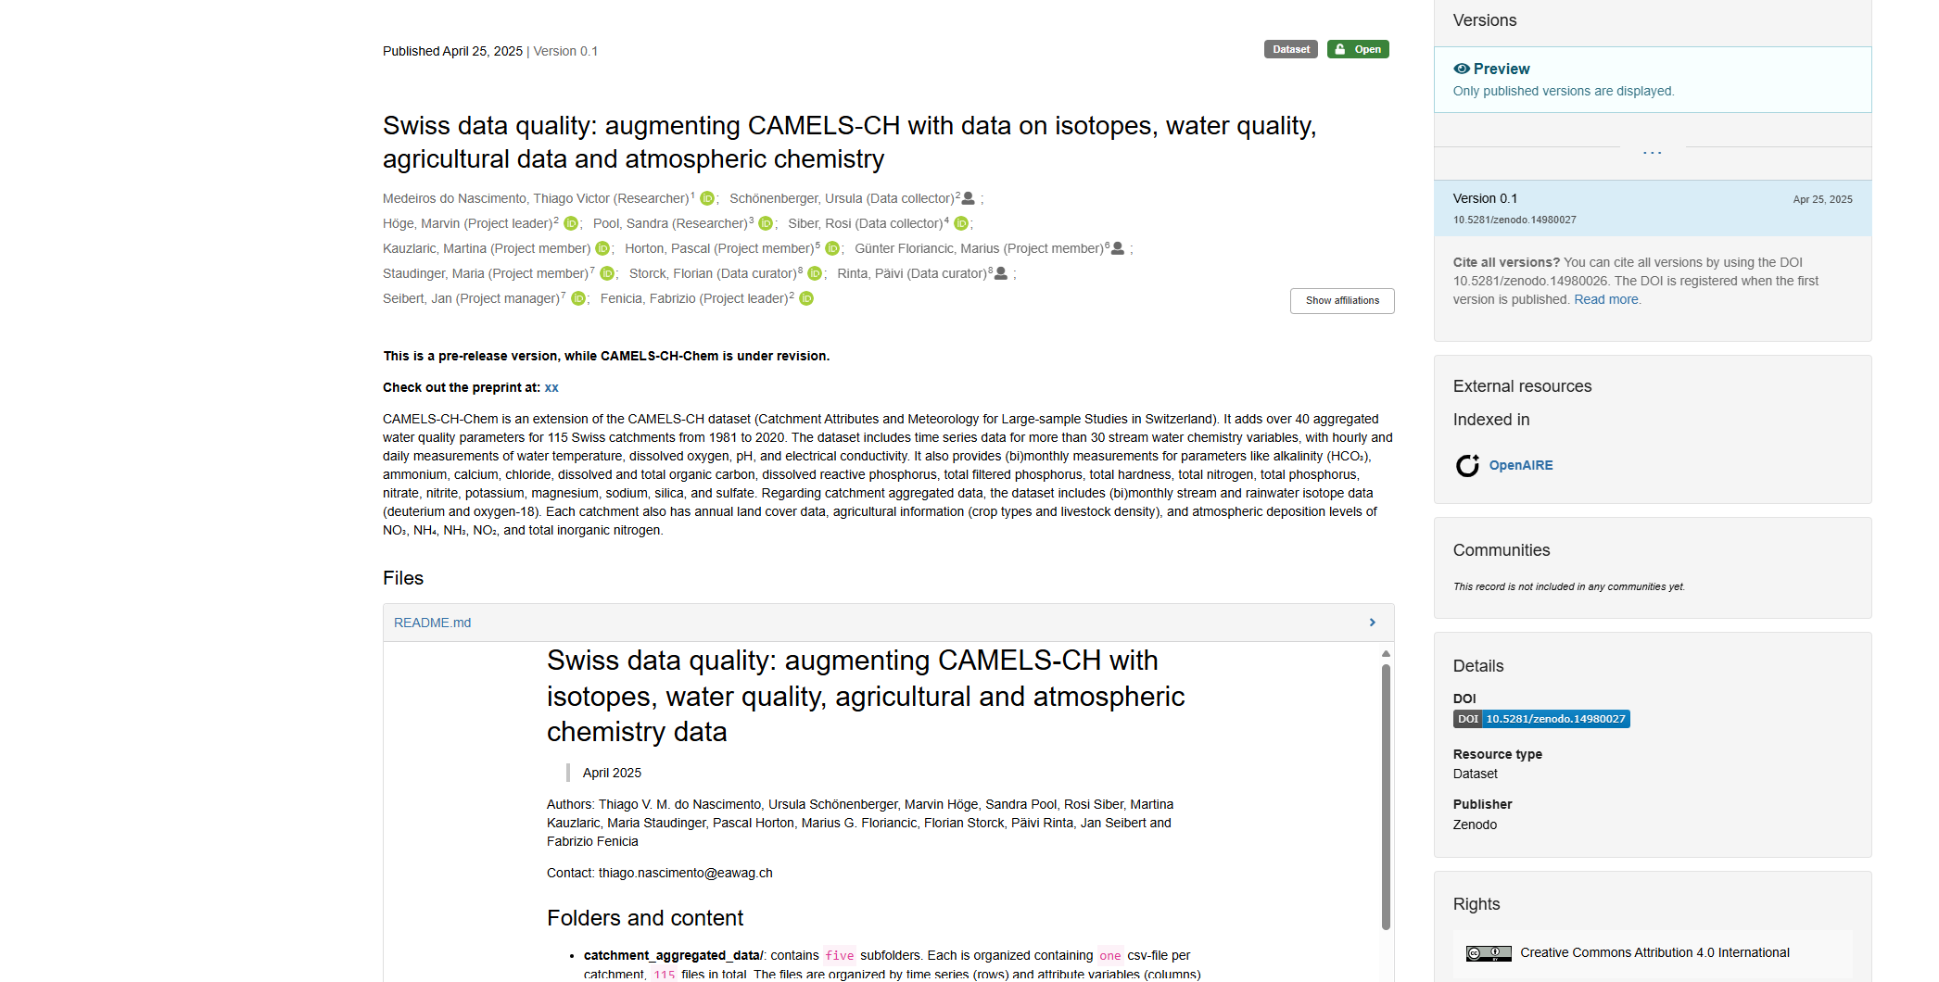
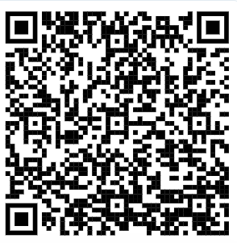
Data records
Folder structure
catchment_aggregated_data
gauges_metadata
shapefiles
stream_water_chemistry
stream_water_isotopes
README.md file
Zenodo repository
Screenshot with the overview of the Zenodo repository where the dataset is stored.
?

Slide 10
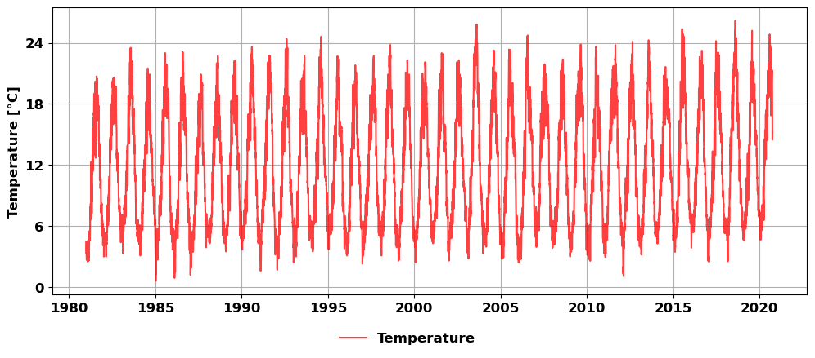
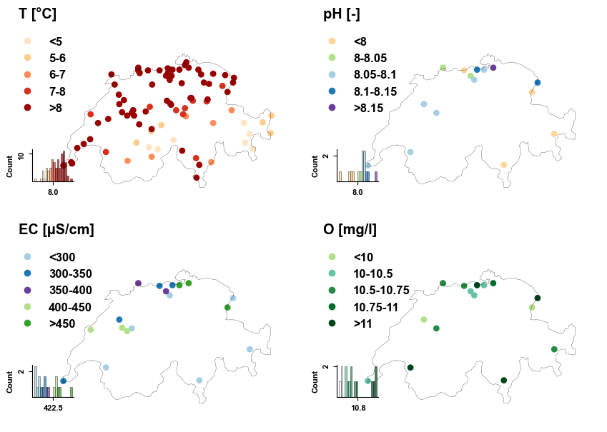
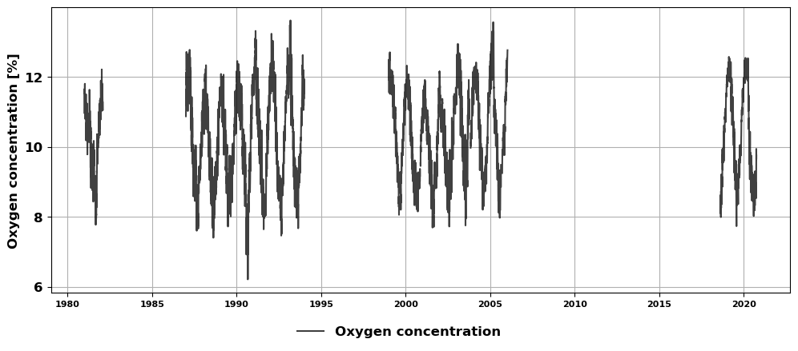
Data records
Example of spatial distribution of the long term mean of four variables available as continuous data.
Example of daily time series for two variables available as continuous data.
?

Slide 11
Technical validation
But how trustworthy is the data?
?

Slide 12
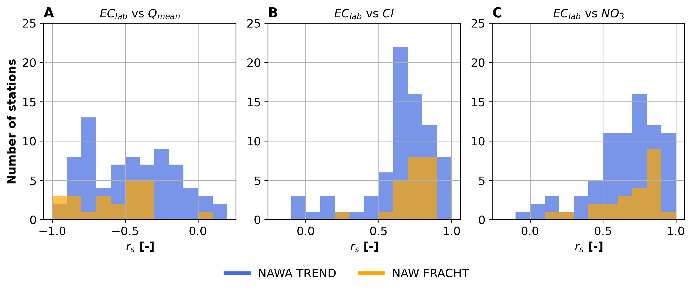
Technical validation
Electrical conductivity correlation to major ions
We expected EC to be negatively correlated to discharge.
Also, strong correlation between EC and major ions.
Our results confirmed both hypothesis.
Histograms of the correlations between EC and different variables for two data sources used in CAMELS-CH-Chem.
?

Slide 13
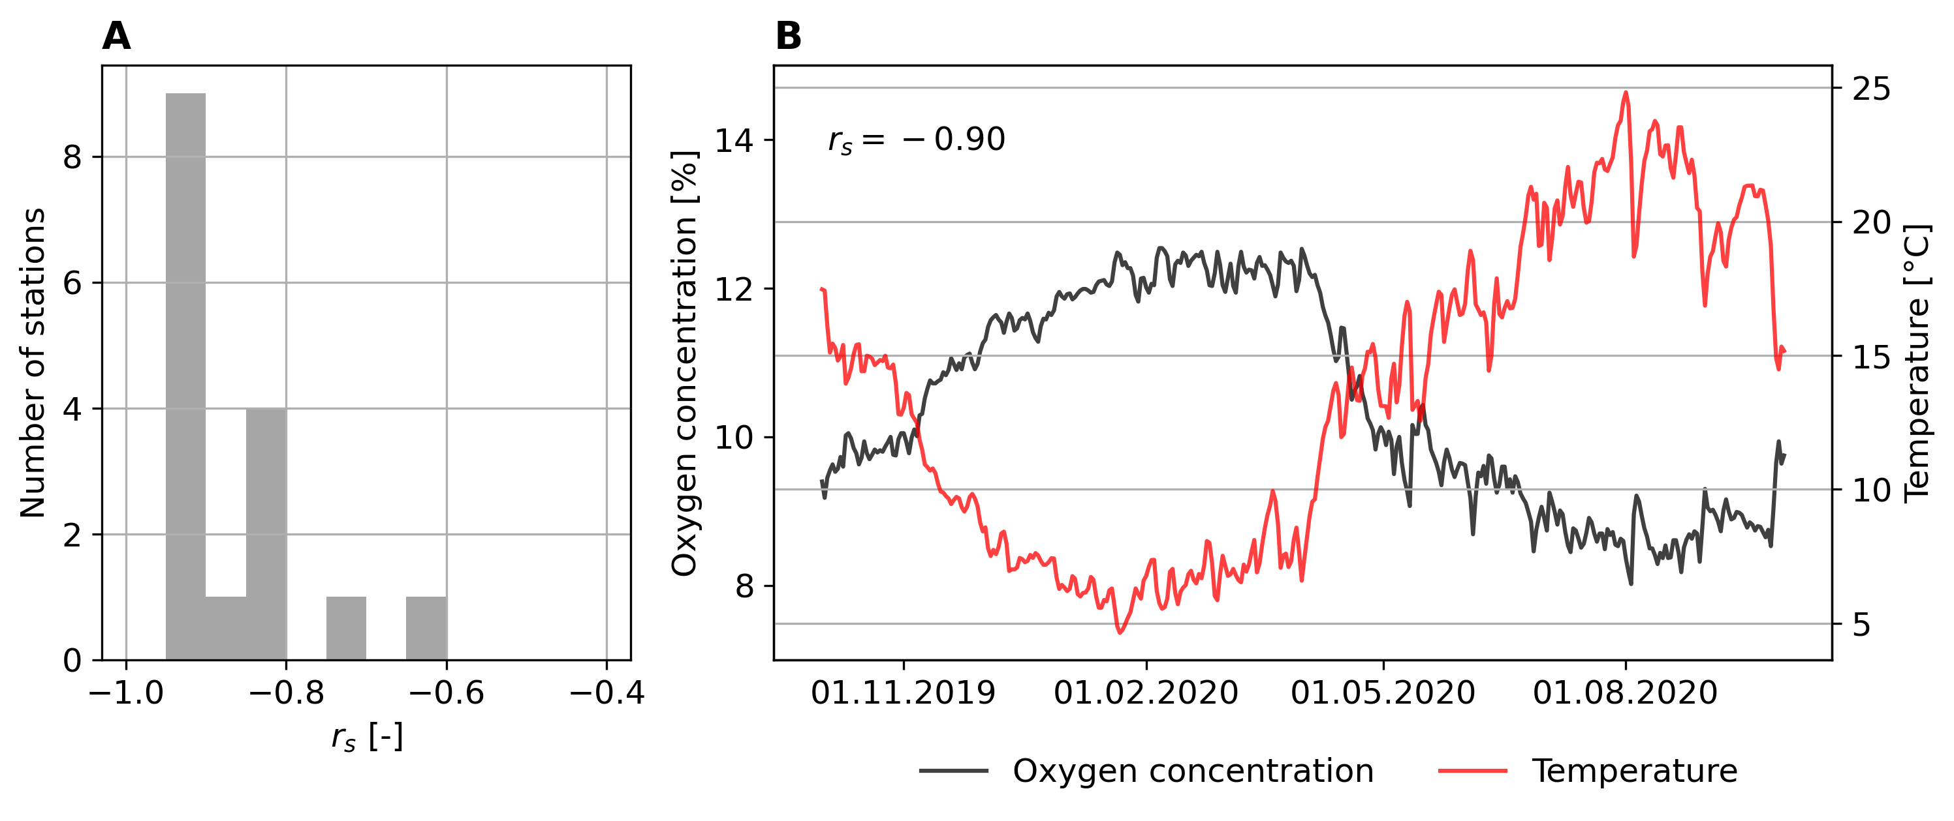
Technical validation
Dissolved oxygen concentration and temperature
We expected from literature to have oxygen concentration negatively correlated to temperature.
Minimum correlation found for one station (-0.60).
(A) Histogram of the correlations between oxygen concentration and temperature and (B) Time series for one gauge used as example.
?

Slide 14
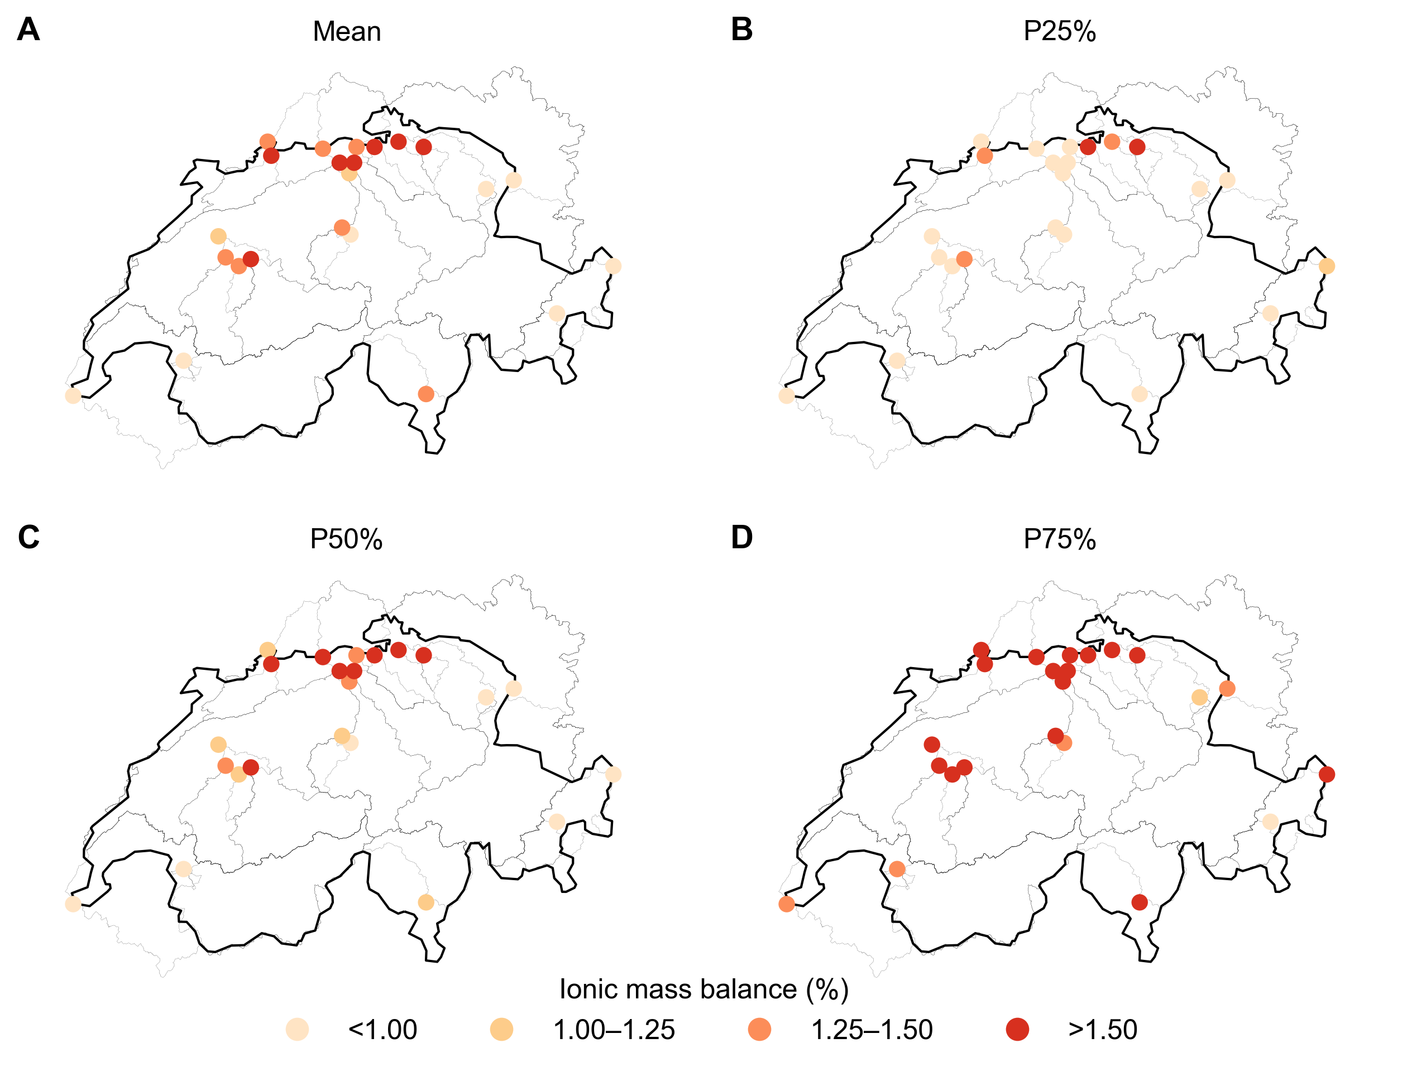
Technical validation
Ionic mass balance for the NAWA FRACHT stations
All 24 stations presented their 75th below 4.3%.
The results attest the good quality of the NAWA FRACHT data.
?

Slide 15
Technical validation
Isotopes measurements against the Global Meteoric Water Line
ISOT
CH-IRP
?

Slide 16
Final outlook
Currently the second CAMELS augmentation with water quality data
The current dataset covers up to 40 water quality variables for 115 Swiss catchments and up to 40 years.
The dataset is already released and the accompany paper is currently a preprint.
The dataset offers a seaming less option for hypothesis testing in the field of LSH.
Coming soon: CAMELS-CH high-resolution (hourly streamflow time series).
CAMELS-CH-Chem preprint
?

Slide 17
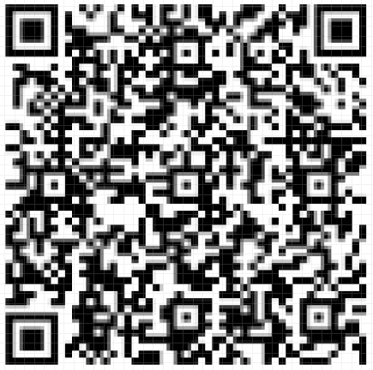
Contact information
Thiago Nascimento
E-mail: thiago.nascimento@eawag.ch
GitHub: thiagovmdon
Projects
Development of large-sample hydrology datasets
Improving our understanding of dominant landscape and climatic drivers in streamflow processes
Main publications
do Nascimento, T.V.M. et al. EStreams: An integrated dataset and catalogue of streamflow, hydro-climatic and landscape variables for Europe. Nature Scientific Data 11, 879 (2024). https://doi.org/10.1038/s41597-024-03706-1
do Nascimento, T. V. M. et al. Impacts of large-scale irrigation and climate change on groundwater quality and the hydrological cycle: A case study of the Alqueva irrigation scheme and the Gabros de Beja aquifer system. Sci. Total Environ. 907, 168151.(2023). https://doi.org/10.1016/j.scitotenv.2023.168151
do Nascimento, T.V.M. et al. Monthly Streamflow Modeling Based on Self-Organizing Maps and Satellite-Estimated Rainfall Data. Water Resour Manage 36, 2359–2377 (2022). https://doi.org/10.1007/s11269-022-03147-8
CAMELS-CH-Chem preprint
?

