Slide 1
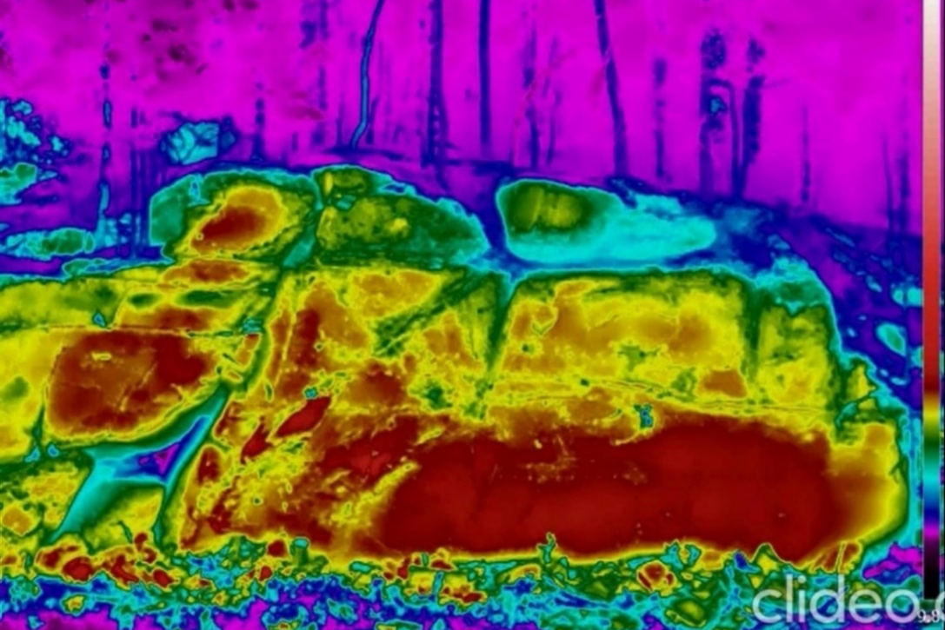
NH3.4 | PICO3.10 | EGU25-1216 | ECS |
Investigating Cooling Rate Indices:
An InfraRed Thermography Study at the
Požáry Field Laboratory, Czech Republic
Marco Loche, Ondřej Racek, Matěj Petružálek, Jan Blahůt & Gianvito Scaringi |
marco.loche@natur.cuni.cz | Institute of Rock Structure and Mechanics,
Czech Academy of Sciences & Faculty of Science, Charles University | The Geohazards Group |
Vienna, 28.04.2025 |

Slide 2
Introduction | PICO3.10 | EGU25-1216 | ECS |
2
The physical characterisation of rock samples remains fundamental for identifying potential instability in rock masses prone to landslides.
InfraRed Thermography (IRT) has emerged for
its potential to shed light onto physical properties
of rock masses.
Indeed, Land Surface Temperature (LST) has been identified as a proxy for properties such as porosity and parameters such as the compressive strength.
(Loche et al, 2024. Infrared thermography reveals weathering hotspots at the Požáry field laboratory)

Slide 3
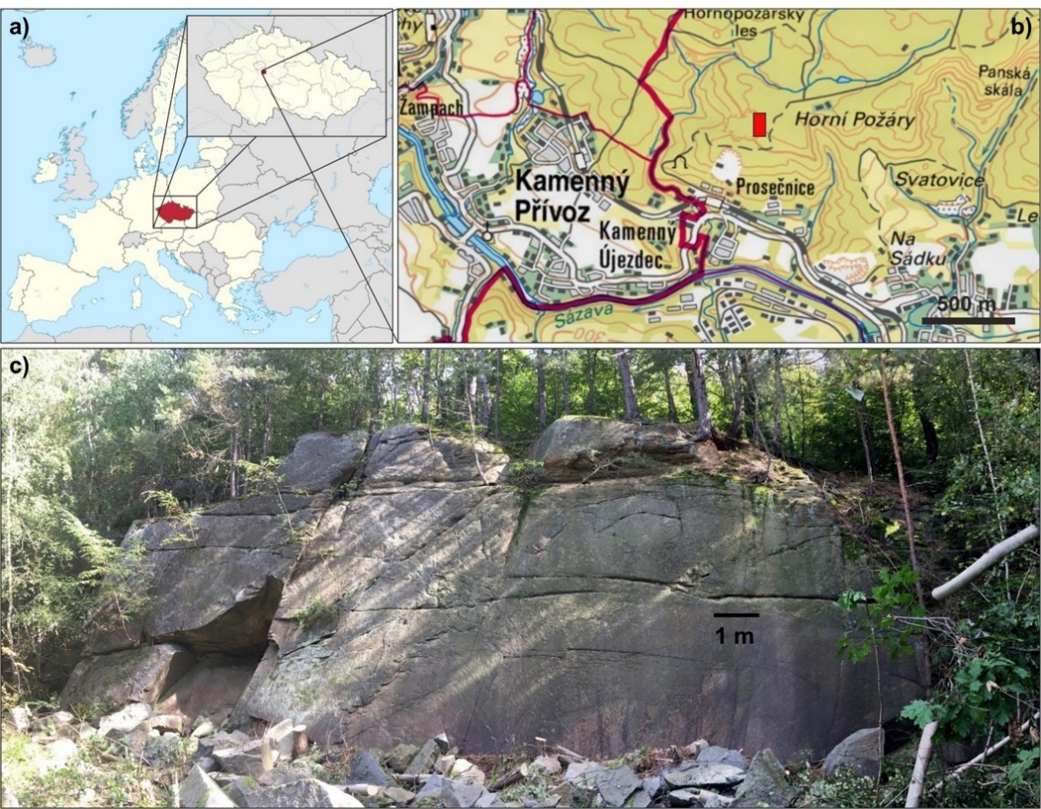
Study area | PICO3.10 | EGU25-1216 | ECS |
3
Požáry field laboratory:
a) Location of the study area in Czech Republic.
b) Požáry Test Site is a former granodiorite quarry, identified by the red rectangle.
c) Overview of the west-facing rock wall.

Slide 4
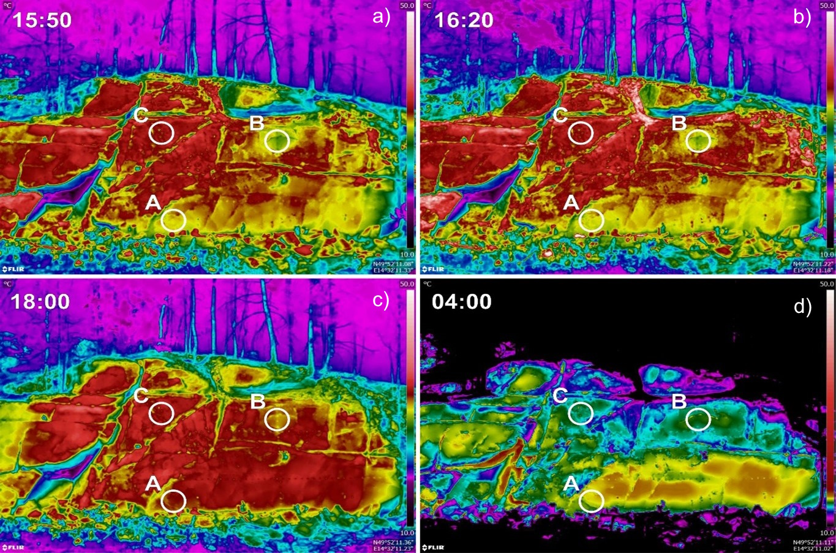
Field experimental evidence | PICO3.10 | EGU25-1216 | ECS |
4
IRT suggests diverse rock behaviours:
Thermograms were recorded at the slope scale where substantial thermal anomalies appeared.
ROIs were selected based on the visual anomalies of the acquired images.

Slide 5
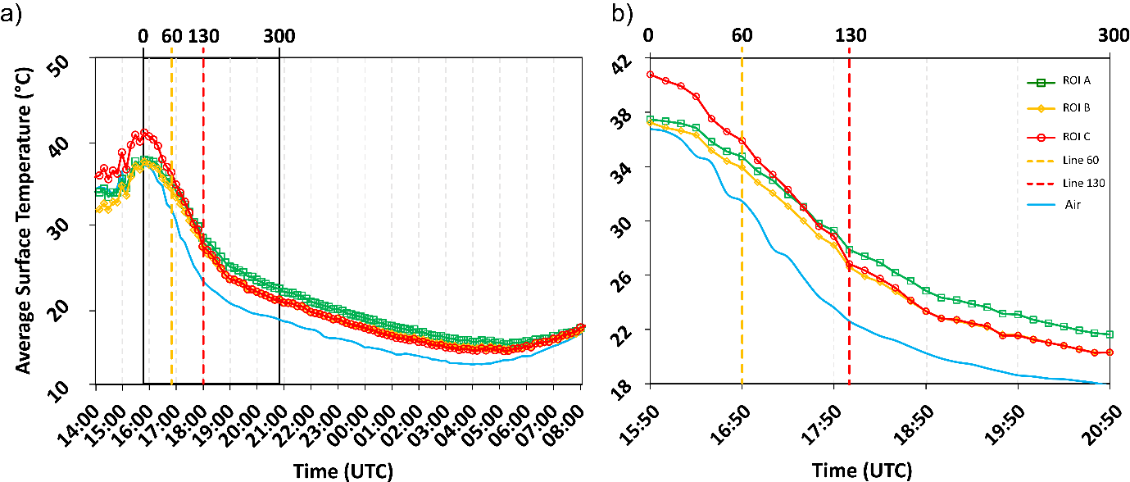
Field experimental evidence | PICO3.10 | EGU25-1216 | ECS |
5
Cooling patterns:
a) Cooling phase of the three ROIs (A, B, C) after the peak temperature (15:50) till the lowest temperature.
b) Detail of the first five hours (300 min) of the cooling phase and the time of the inflection point for all the ROIs, reached at 18:00.

Slide 6
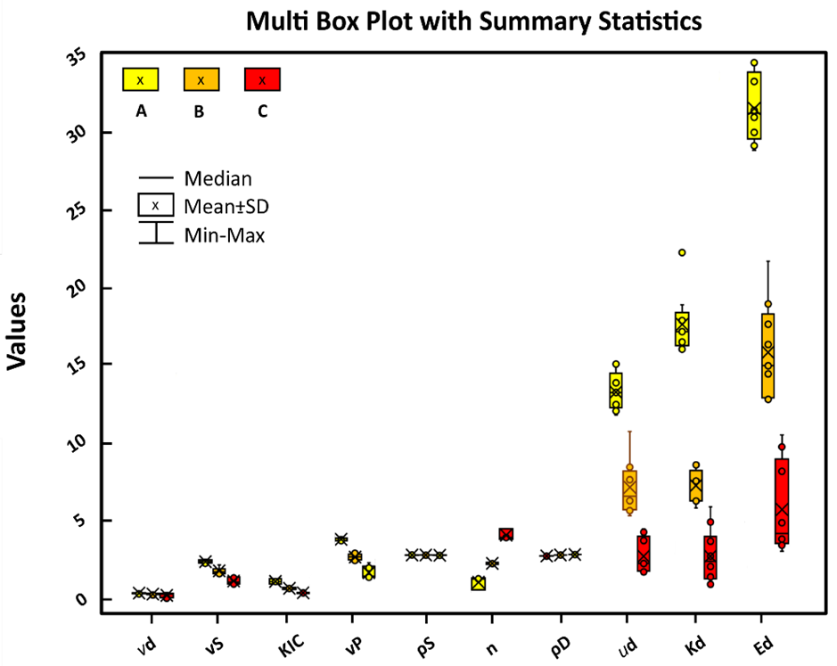
Laboratory experimental evidence | PICO3.10 | EGU25-1216 | ECS |
6
Physical and mechanical properties of the samples confirm the diverse thermal behaviours:
In the table, the mean values (µ) are presented together with corresponding relative standard deviations (σ), where available, expressed as a percentage of the mean value. Grain density (ρS); dry density (ρD); total porosity (n); P-wave velocity (vP); shear wave velocity (vS); Young moduli (Ed); Poisson ratio (vd); Shear moduli (ud); Bulk moduli (Kd); mode I fracture toughness (KIC).
Sample | A |  | B |  | C
 | µ | σ (%) | µ | σ (%) | µ | σ (%)
ρS (g/cm³) | 2.667 | 0.1 | 2.662 | 0.1 | 2.649 | 0.2
ρD (g/cm³) | 2.639 |  | 2.608 |  | 2.550
n (%) | 0.90 |  | 1.69 |  | 3.75
vP (km/s) | 3.650 | 2.9 | 2.510 | 8.6 | 1.494 | 26.1
vS (km/s) | 2.234 | 4.7 | 1.633 | 12.0 | 0.987 | 21.5
Ed (GPa) | 31.6 | 6.8 | 15.8 | 19.9 | 5.6 | 52.7
vd | 0.20 | 19.9 | 0.13 | 47.1 | 0.06 | 284
uD (GPa) | 13.2 | 9.4 | 7.1 | 24.8 | 2.6 | 43.8
Kd (GPa) | 17.6 | 11.3 | 7.2 | 14.8 | 2.6 | 69.9
K_{IC} (MPa) | 0.90 | 18.4 | 0.45 | 14.2 | 0.16 | 16.1
The boxplots visualise the mean values and standard deviations.

Slide 7
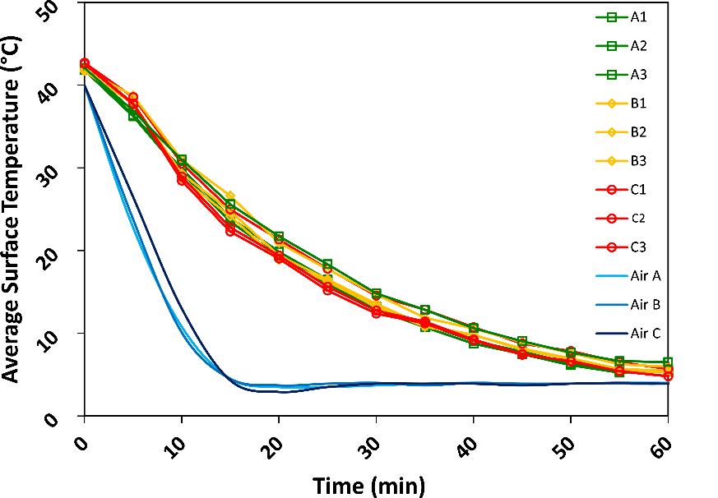
Laboratory experimental evidence | PICO3.10 | EGU25-1216 | ECS |
7
Cooling patterns:
IRT time-lapse monitoring of cooling phases of cored samples collected at the ROIs and analysed in a climate chamber. Air A, B and C refer to the chamber’s air temperature throughout the three distinct experiments.

Slide 8
Methodology | PICO3.10 | EGU25-1216 | ECS |
8
Mathematical background:
To quantitatively assess the thermal dynamics of the ROIs, we used the CRI, which quantifies the change in mean temperature (∆T, °C) per unit of time (∆t, min). Higher CRI values correspond to more rapid cooling of the rock mass for a given time interval, as summarised in Eq. (1): CRI = ∆T/∆t (1)
The laboratory experiments were interpreted through linear relationships. To validate the robustness of these relationships, a Bayesian regression analysis was conducted. Subsequently, a linear regression model was established employing CRI values from the laboratory as predictors for porosity, as delineated in Eq. (2):
µn = β1 Xi + β0 (2)

Slide 9
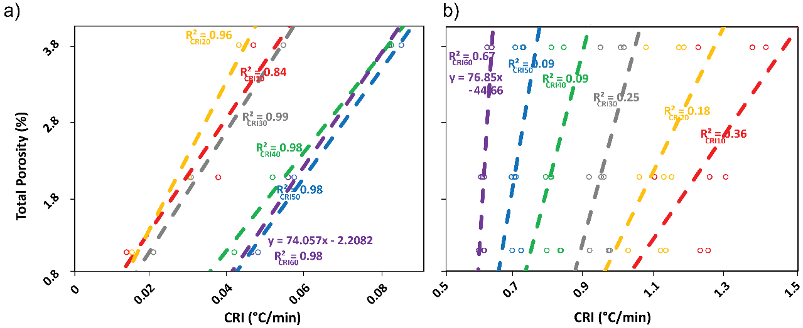
Are cooling rates in field and laboratory related? | PICO3.10 | EGU25-1216 | ECS |
9
Results of cooling rate indices vs. porosity for different time intervals:
a) Linear regression model for field.
b) Linear regression model for laboratory.

Slide 10
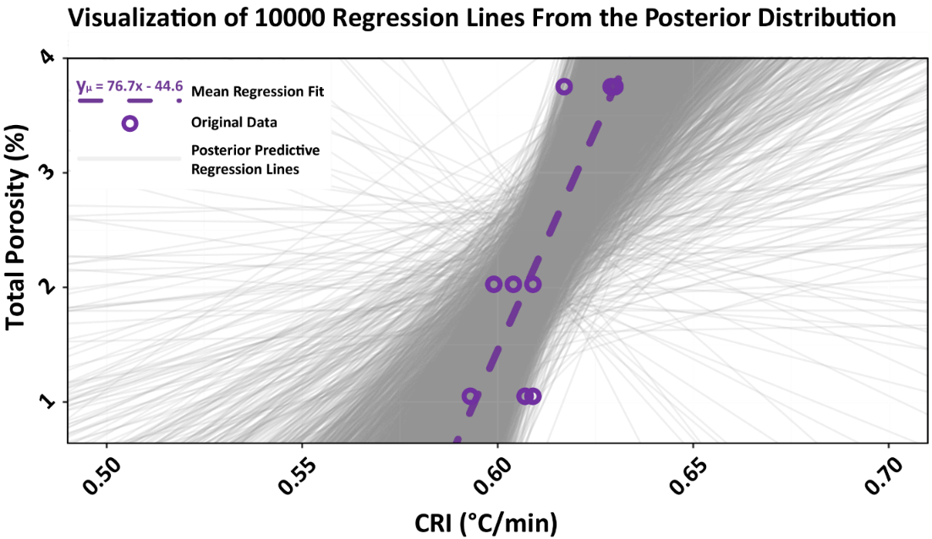
Results of laboratory experimental evidence | PICO3.10 | EGU25-1216 | ECS |
10
10,000 regressions, one for each simulation from the posterior distribution:
We used a Bayesian analysis to show that there is not a single prediction from a model for a given observation, but rather distributions of predictions.

Slide 11
Results of laboratory experimental evidence | PICO3.10 | EGU25-1216 | ECS |
11

Slide 12
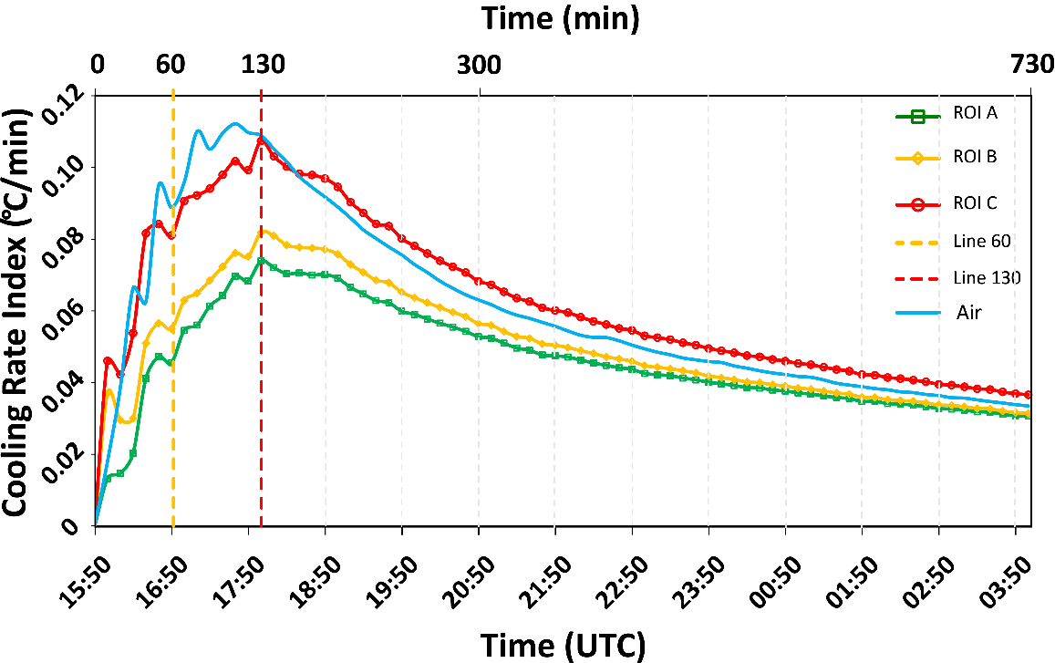
Results of field experimental evidence | PICO3.10 | EGU25-1216 | ECS |
12
Cooling patterns:
Changes in CRIs, computed on a 10-min basis from the beginning of the cooling (15:50) at the different ROIs. The red-coloured dashed line shows the ITW or inflection point after which the use of CRI progressively yielded useful and comparable information in the field.

Slide 13
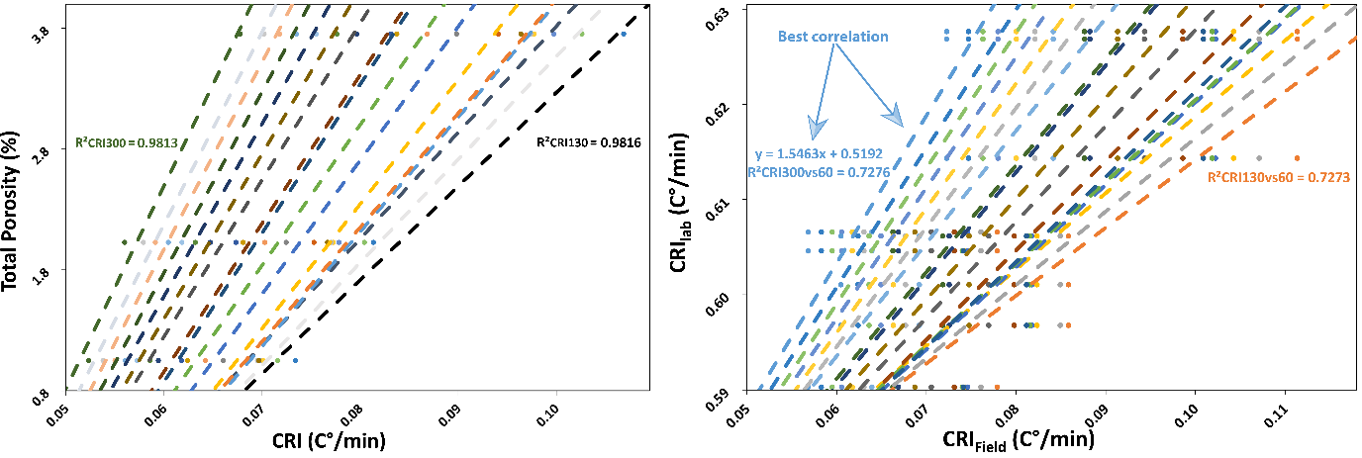
Results of field experimental evidence | PICO3.10 | EGU25-1216 | ECS |
13
Cooling patterns:
a) Linear regressions of CRIs and porosity in the field. It corresponds to the values along time series CRI(t) from t = 130 min to t = 300 m after peak of temperature.
b) Comparison of field and laboratory results in the 130–300 min interval for the field. The best correlation was found between CRIlab60min and CRIfield300min. CRI for laboratory samples is computed uniformly for t = 60 min, which revealed the best correlation.

Slide 14
Results of field experimental evidence | PICO3.10 | EGU25-1216 | ECS |
14
Mathematical analysis:
We illustrated the relationship that closely aligns CRIfield and CRIlab, as described by the following equation (Eq. 3):
ce = 1.55 x CRIfield300min + 0.52 (3)
Using ce and substituting the value of CRIfield300min, we can use ce in the reference equation for CRIlab60min (Eq. 4).
n (%) = 76.86 x CRI60min - 44.66 (4)

Slide 15
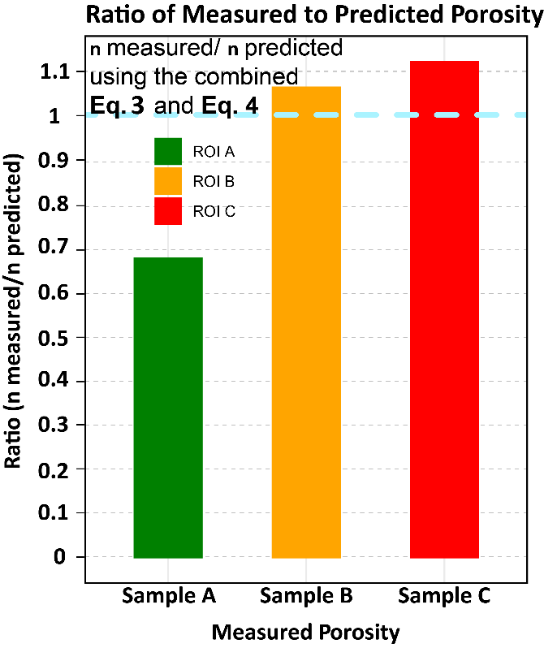
Reasonable prediction? | PICO3.10 | EGU25-1216 | ECS |
15
Performance of measure porosity in the field and predicted porosity from the method proposed (nmeasured / npredicted) using a combination of Eqs. (3) and (4).
The performance is plotted as a ratio, and values close to the unit represent predictions fitting the input values.

Slide 16
Conclusions | PICO3.10 | EGU25-1216 | ECS |
16
What we understood:
This study proposes some highlights about the potential of Infrared Thermography (IRT) in identifying weathered sectors within a rock mass.
The definition of the Informative Time Window (ITW) was crucial in narrowing down the interval of informativity.
The study’s findings align with other authors' suggestions, encouraging summer surveys, significant temperature gradients, and variable ITW.
The introduction of a “comparison equation” (ce) played a key role in normalising the results, accommodating differing temperatures and confined spaces, thus enhancing the predictive capacity of Eq. (4) for estimating porosity within the studied ROIs.
(Loche et al, 2024. Infrared thermography reveals weathering hotspots at the Požáry field laboratory)

Slide 17
Remarks | PICO3.10 | EGU25-1216 | ECS |
17
We are working on:
The definition of ITW for a longer period after the inflection has a rigorous mathematical basis, established by the progressively linear decrease of CRI values
However, it is important to emphasize that these findings are specific to the rock type and test site at Požáry, Czech Republic.
The authors encourage the application of this method in diverse locations and lithologies to uncover additional empirical correspondences between temperature (cooling phase) and mechanical properties.

Slide 18
References | PICO3.10 | EGU25-1216 | ECS |
18
Loche M, Scaringi G (2005). Assessing the Influence of Temperature on Slope Stability in a Temperate Climate: A Nationwide Spatial Probability Analysis in Italy. Environmental Modelling & Software, 183, p.106217.
Loche M, Scaringi G (2023). Temperature and shear-rate effects in two pure clays: Possible implications for clay landslides. Results in Engineering, 20, p.101647.
Loche M (2024). Infrared thermography reveals weathering hotspots at the Požáry field laboratory. Scientific Reports, 14(1), p.14682.
Loche M, Scaringi G, Blahůt J, Hartvich F (2022). Investigating the potential of infrared thermography to inform on physical and mechanical properties of soils for geotechnical engineering. Remote Sensing, 14(16), p.4067.
Loche M, Scaringi G, Yunus AP, Catani F, Tanyaş H, Frodella W, Fan X, Lombardo L (2022). Surface temperature controls the pattern of post-earthquake landslide activity. Scientific Reports, 12(1), p.988.
Scaringi G, Loche M (2022). A thermo-hydro-mechanical approach to soil slope stability under climate change. Geomorphology, 401, p.108108.
Loche M, Scaringi G, Blahůt J, et al. (2021). An infrared thermography approach to evaluate the strength of a rock cliff. Remote Sensing, 13(7), p.1265.

