Slide 1



How sensitive are hydroclimatic simulations to changes in land use?
Mariana Castaneda Gonzalez, Siavash Pouryousefi Markhali, Béatrice Turcotte, Annie Poulin, Jean-Luc Martel, Richard Arsenault, François Brissette, Olivier Asselin, and Richard Turcotte
Notes:
Historical changes in land use have shown different effects on climatic and hydrological processes across spatial and temporal scales. Among these, snow accumulation, snowmelt, and evapotranspiration are key processes sensitive to land use changes that can directly influence streamflow production at the catchment scale

Slide 2
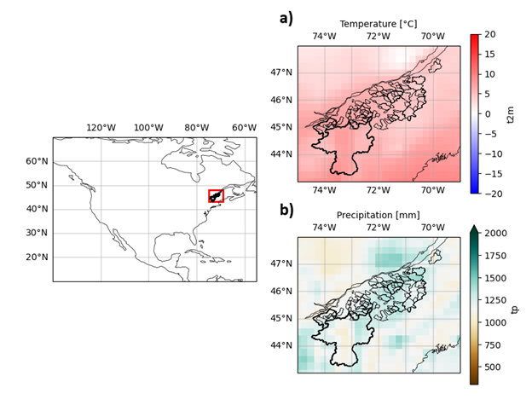
Study Area
Locations of the 89 study catchments and their mean annual climatology estimated from the ERA5 reanalysis. The right panels show the mean annual temperature (panel a) and mean total annual precipitation (panel b) over the study area. Two southern catchments selected for further analysis are identified with bold outlines
Notes:
Historical changes in land use have shown different effects on climatic and hydrological processes across spatial and temporal scales. Among these, snow accumulation, snowmelt, and evapotranspiration are key processes sensitive to land use changes that can directly influence streamflow production at the catchment scale

Slide 3
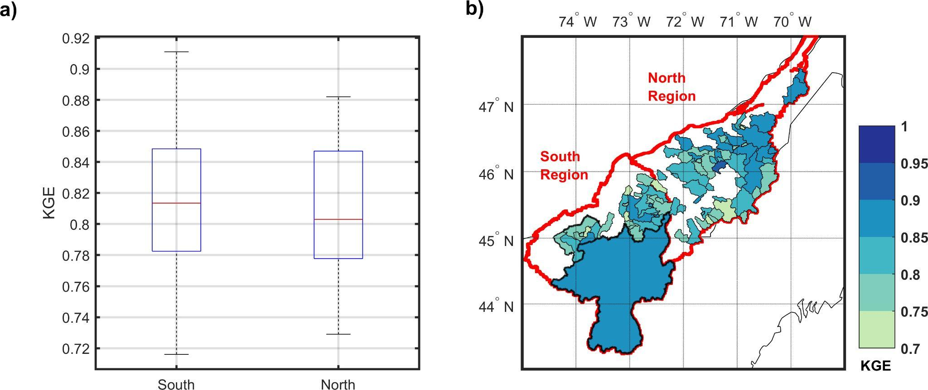
HYDROTEL – hydrological model performance
Overall, the 89 catchments display a good hydrological modelling performance with all KGE-values above 0.7
KGE values estimated over the full time series of the studied catchments
Notes:
Historical changes in land use have shown different effects on climatic and hydrological processes across spatial and temporal scales. Among these, snow accumulation, snowmelt, and evapotranspiration are key processes sensitive to land use changes that can directly influence streamflow production at the catchment scale

Slide 4
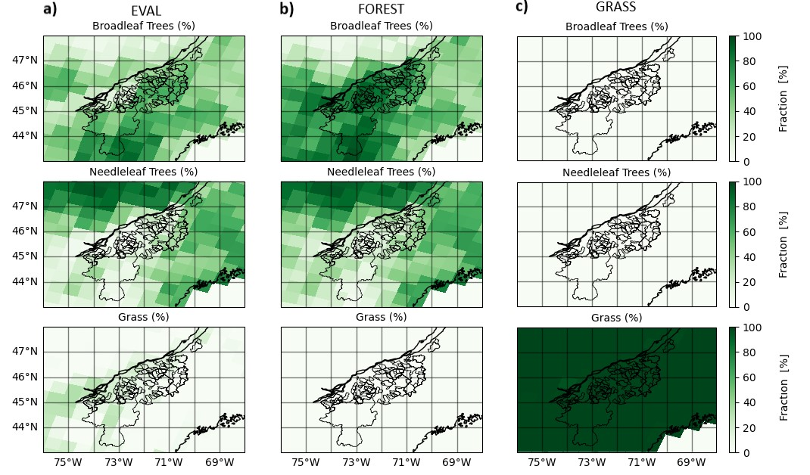
CRCM5 simulations
Overall, the EVAL maps (first column) show that the catchments are mainly characterized by forests, notably broadleaf. The three simulations were produced following the European LUCAS project’s protocol and were involved in a comparison of the impact of afforestation (GRASS) and reforestation (FOREST) results from different RCMs over a European domain and a North-American domain (Asselin et al., 2022).
Vegetation fraction (%) of each CRCM5-CLASS simulation. Column a) refers to the EVAL simulation, column b) refers to the FOREST simulation and column c) refers to the GRASS simulation.
Notes:
Historical changes in land use have shown different effects on climatic and hydrological processes across spatial and temporal scales. Among these, snow accumulation, snowmelt, and evapotranspiration are key processes sensitive to land use changes that can directly influence streamflow production at the catchment scale

Slide 5
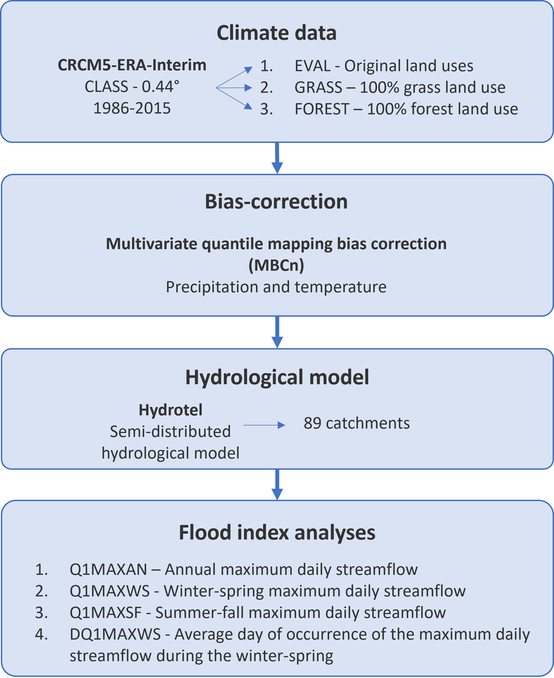
Methodology
Overall Methodology
Notes:
Historical changes in land use have shown different effects on climatic and hydrological processes across spatial and temporal scales. Among these, snow accumulation, snowmelt, and evapotranspiration are key processes sensitive to land use changes that can directly influence streamflow production at the catchment scale

Slide 6
Flood indices
Q1MAXAN: This index consists of the annual maximum daily streamflow (m³/s). This index is calculated for different return periods, namely, 2-,5-,10-,20-, 100-, and 350-year return periods, using the Log-Pearson type III distribution. This index has been normalized by each catchment's mean annual streamflow to facilitate analysis and comparison between different catchments.
Q1MAXWS: This index consists of the winter-spring maximum daily streamflow (m³/s). The months of December through May are considered to estimate the maximum values. This index is calculated for different return periods, namely, 2-,5-,10-,20-, 100-, and 350-year return periods, using the Log-Pearson type III distribution. This index has been normalized by each catchment's mean winter-spring streamflow to facilitate analysis and comparison between different catchments.
Q1MAXSF: This index consists of the summer-fall maximum daily streamflow (m³/s). The months of June through November are considered to estimate the maximum values. This index is calculated for different return periods, namely, 2-,5-,10-,20-, 100-, and 350-year return periods, using the Log-Pearson type III distribution. This index has been normalized by each catchment's mean summer-fall streamflow to facilitate analysis and comparison between different catchments.
DQ1MAXWS: This index consists of the average day of occurrence of the maximum daily streamflow during the winter-spring period. The number of days is estimated from January 1st.
Notes:
Historical changes in land use have shown different effects on climatic and hydrological processes across spatial and temporal scales. Among these, snow accumulation, snowmelt, and evapotranspiration are key processes sensitive to land use changes that can directly influence streamflow production at the catchment scale

Slide 7
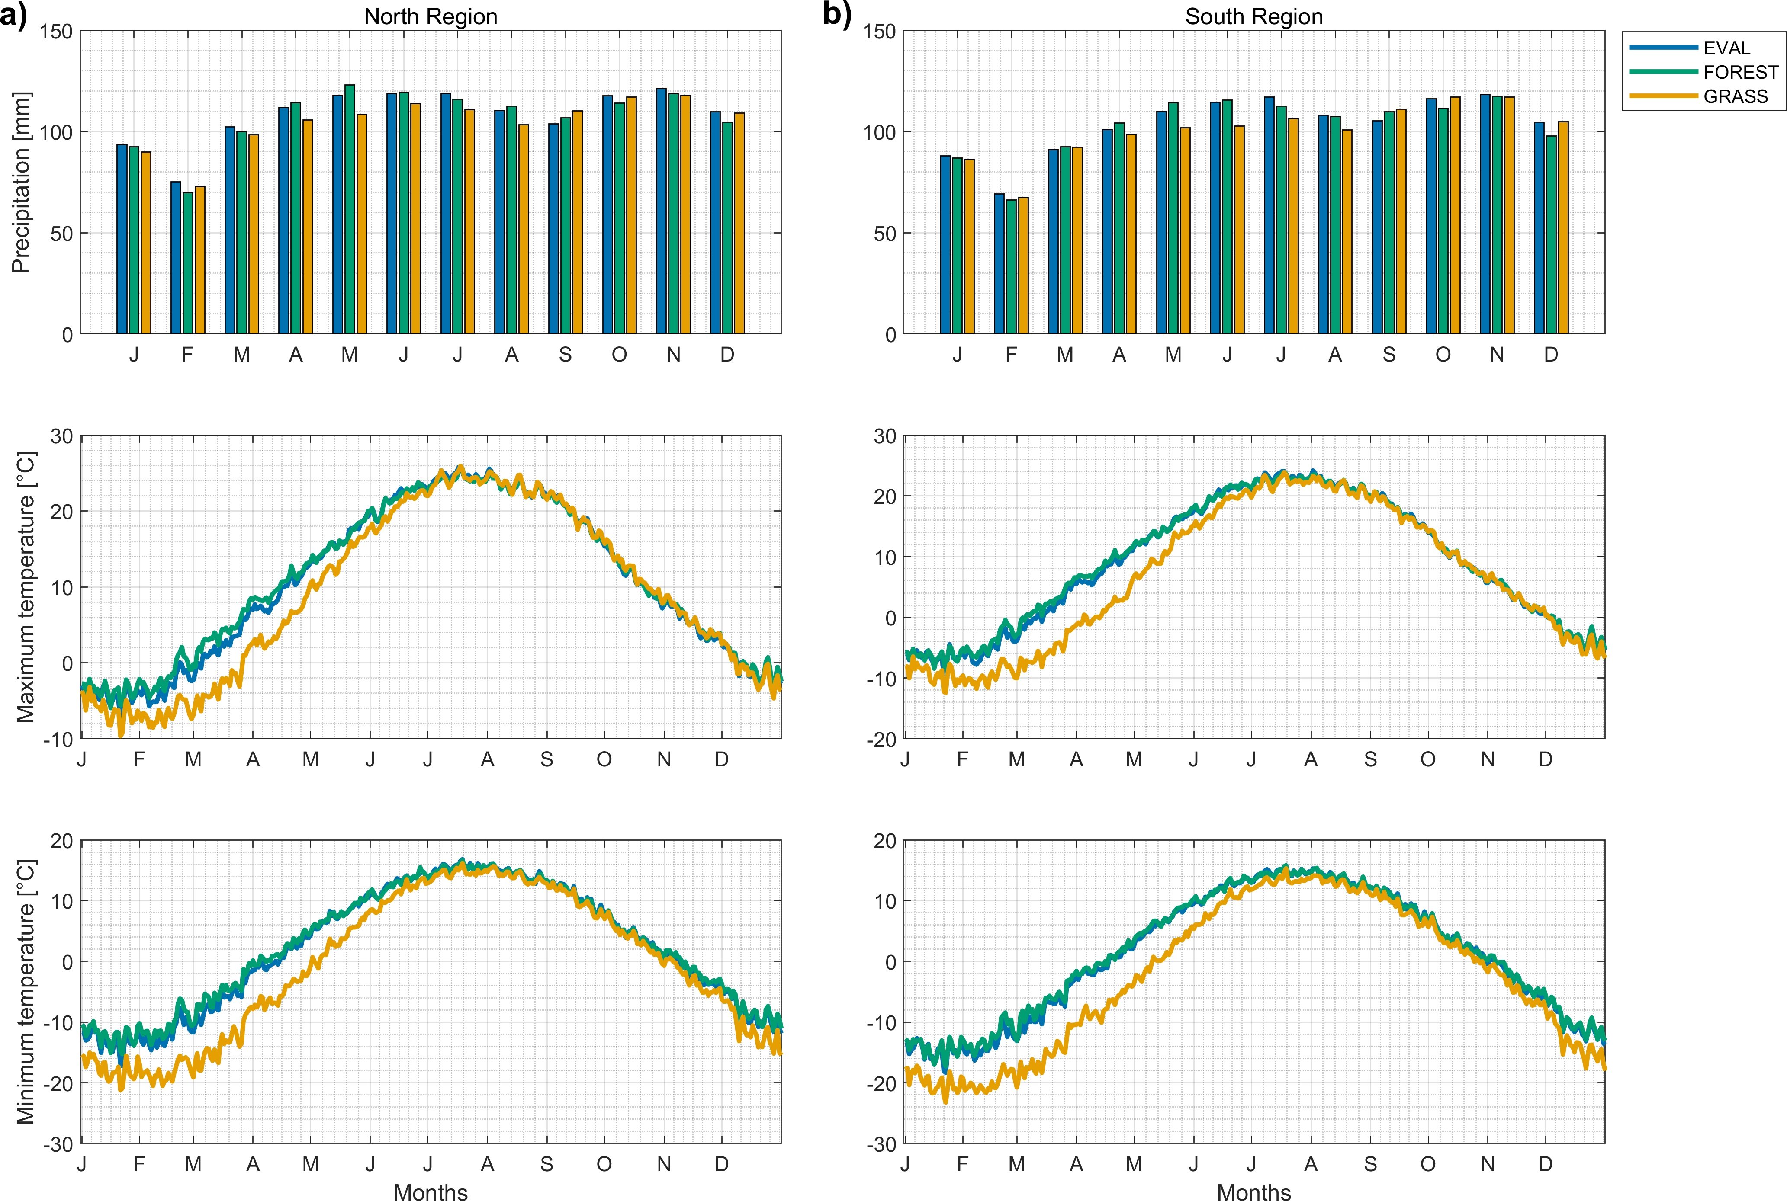
Climate simulations at the regional scale
As reported by Asselin et al. (2022), the GRASS simulation leads to reduced temperatures in winter and spring due to the high increase in surface albedo from the snow cover
The winter time warming of FOREST simulation is primarily due to the reduction in surface albedo as a result of snow-masking of evergreen needleleaf forests (Asselin et al. 2022, Davin 2020).
The FOREST simulation leads to increased evapotranspiration, more importantly over the broadleaf forests, which in turn increases precipitation with respect to the GRASS simulation
Mean climatology of then
Notes:
Historical changes in land use have shown different effects on climatic and hydrological processes across spatial and temporal scales. Among these, snow accumulation, snowmelt, and evapotranspiration are key processes sensitive to land use changes that can directly influence streamflow production at the catchment scale

Slide 8
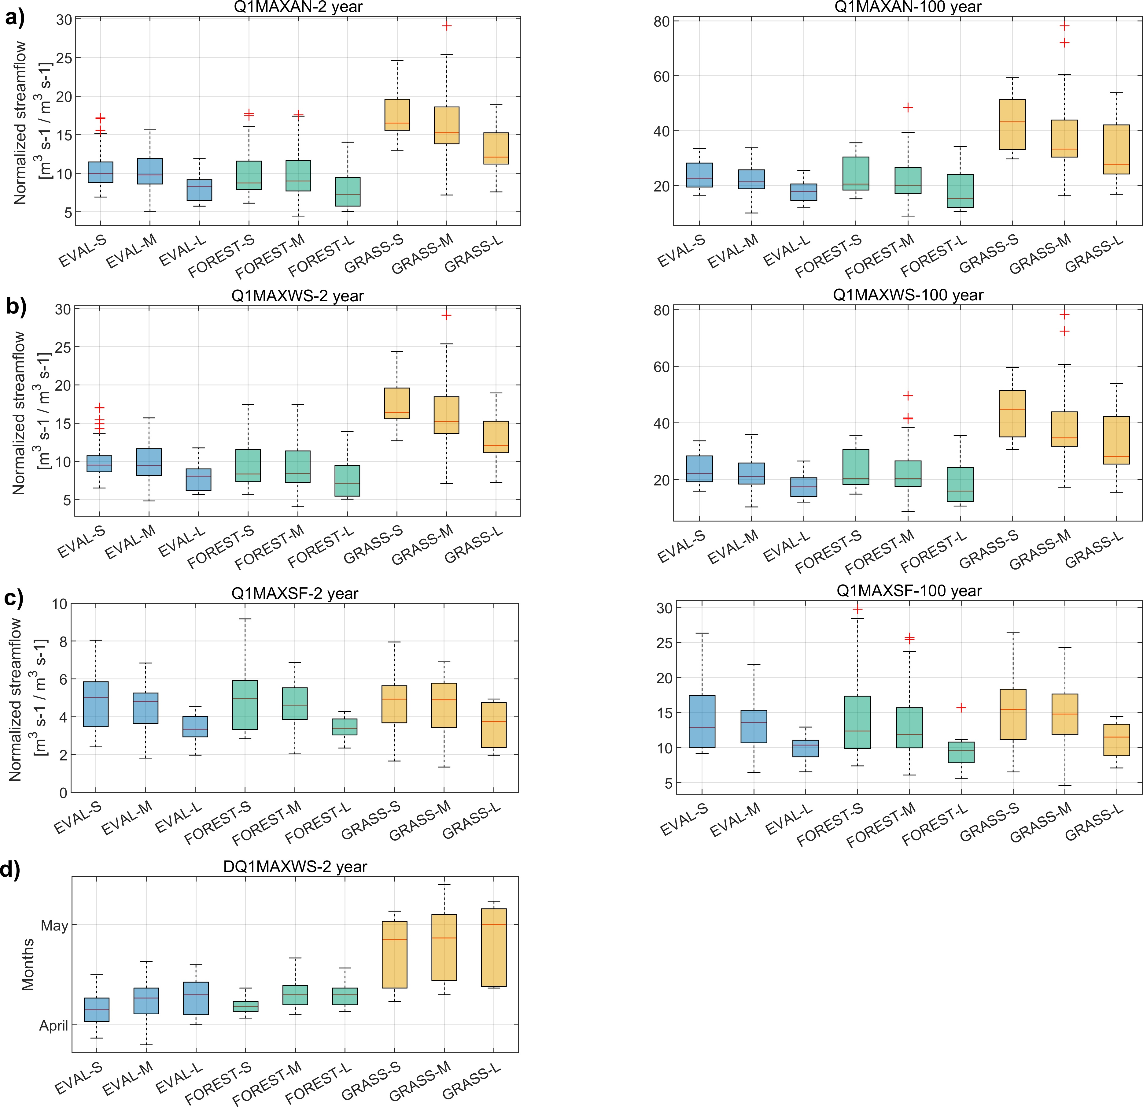
Streamflow indices analysis
Flood indices estimated for the EVAL, GRASS, and FOREST CRCM5-CLASS simulations for the small (-S), medium (-M), and large (-L) catchment groups. The normalized 2- and 100-year return periods for the annual maximum daily streamflow (Q1MAXAN; panel a), winter-spring maximum daily streamflow (Q1MAXWS; panel b), summer-fall maximum daily streamflow (Q1MAXSF; panel c), and the average day of occurrence of the maximum daily winter-spring streamflow (DQ1MAXWS; panel d) are shown
Notes:
Historical changes in land use have shown different effects on climatic and hydrological processes across spatial and temporal scales. Among these, snow accumulation, snowmelt, and evapotranspiration are key processes sensitive to land use changes that can directly influence streamflow production at the catchment scale

Slide 9
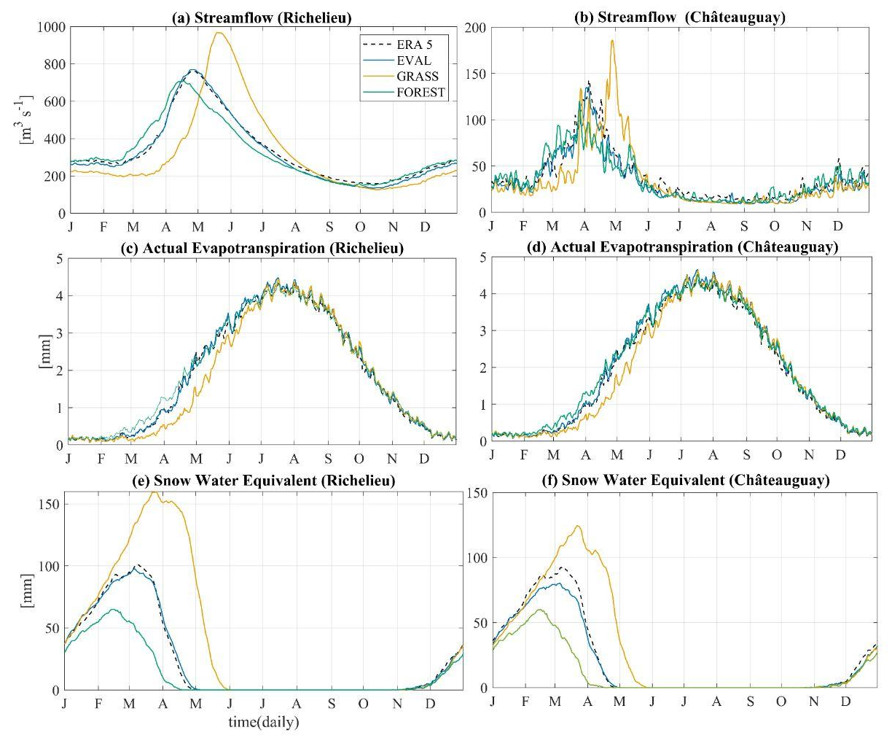
Hydrological simulations : Annual evaluation
Mean annual variation of hydrological variables for Richelieu (left) and Chateauguay (right): a and b) Streamflow, c and d) Actual Evapotranspiration (AET), e and f) Snow Water Equivalent (SWE).
Notes:
Historical changes in land use have shown different effects on climatic and hydrological processes across spatial and temporal scales. Among these, snow accumulation, snowmelt, and evapotranspiration are key processes sensitive to land use changes that can directly influence streamflow production at the catchment scale

Slide 10
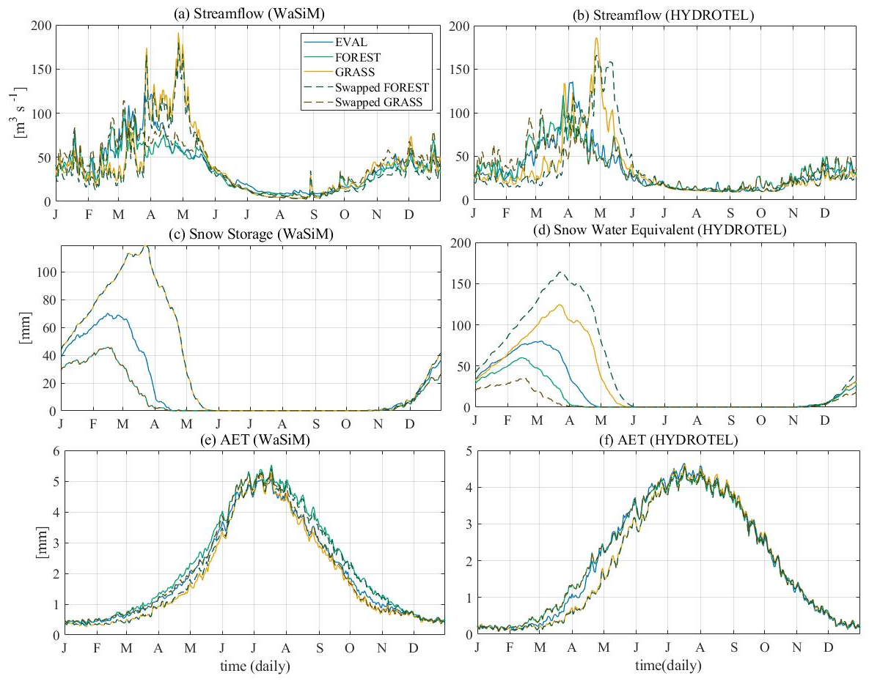
Hydrological model differences
Comparing mean annual variation of hydrological variables for the Châteauguay catchment using WaSiM and HYDROTEL : a and b) streamflow, c and d) snow storage (WaSiM) and snow water equivalent (HYDROTEL) , e and f) actual evapotranspiration.
Hydrological models showed varying levels of sensitivity to land use.
Notes:
Historical changes in land use have shown different effects on climatic and hydrological processes across spatial and temporal scales. Among these, snow accumulation, snowmelt, and evapotranspiration are key processes sensitive to land use changes that can directly influence streamflow production at the catchment scale

Slide 11
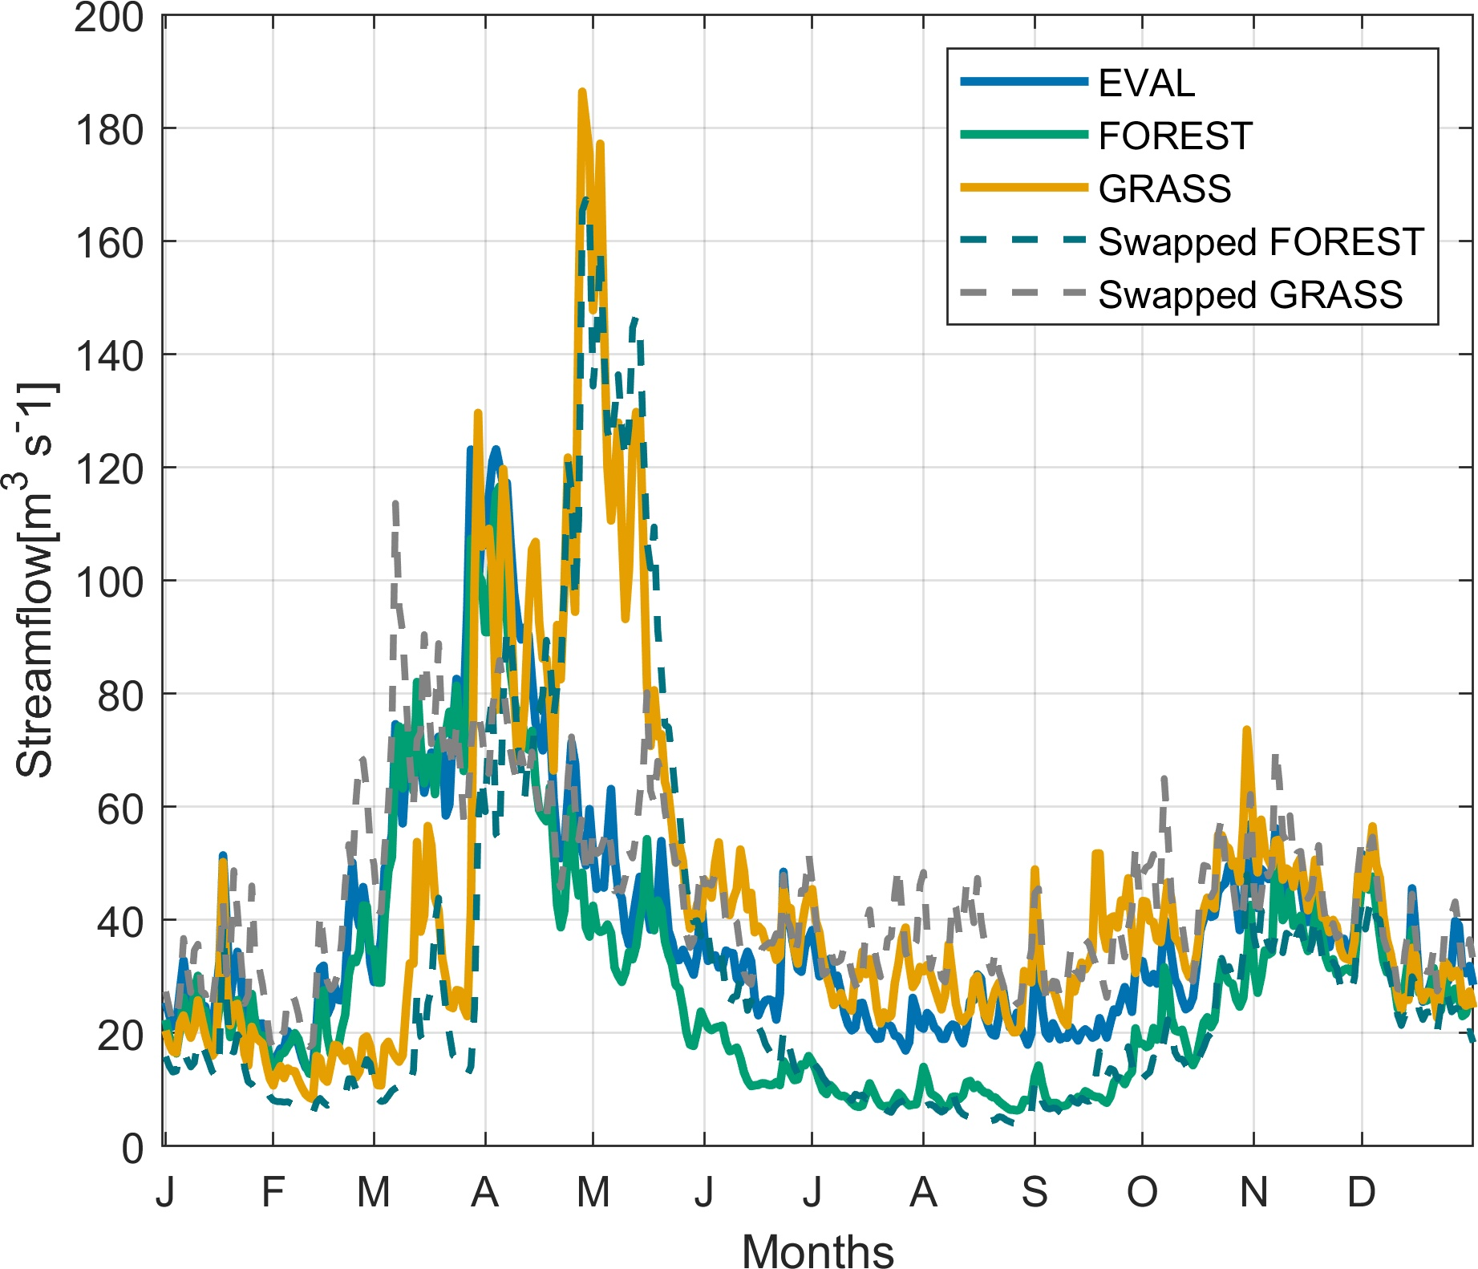
Hydrological model differences
Comparing mean annual hydrographs for the Châteauguay catchment using a modified GR4J.
RCM-simulated land use changes had a greater impact on streamflow than those simulated by hydrological models
Notes:
Historical changes in land use have shown different effects on climatic and hydrological processes across spatial and temporal scales. Among these, snow accumulation, snowmelt, and evapotranspiration are key processes sensitive to land use changes that can directly influence streamflow production at the catchment scale

Slide 12
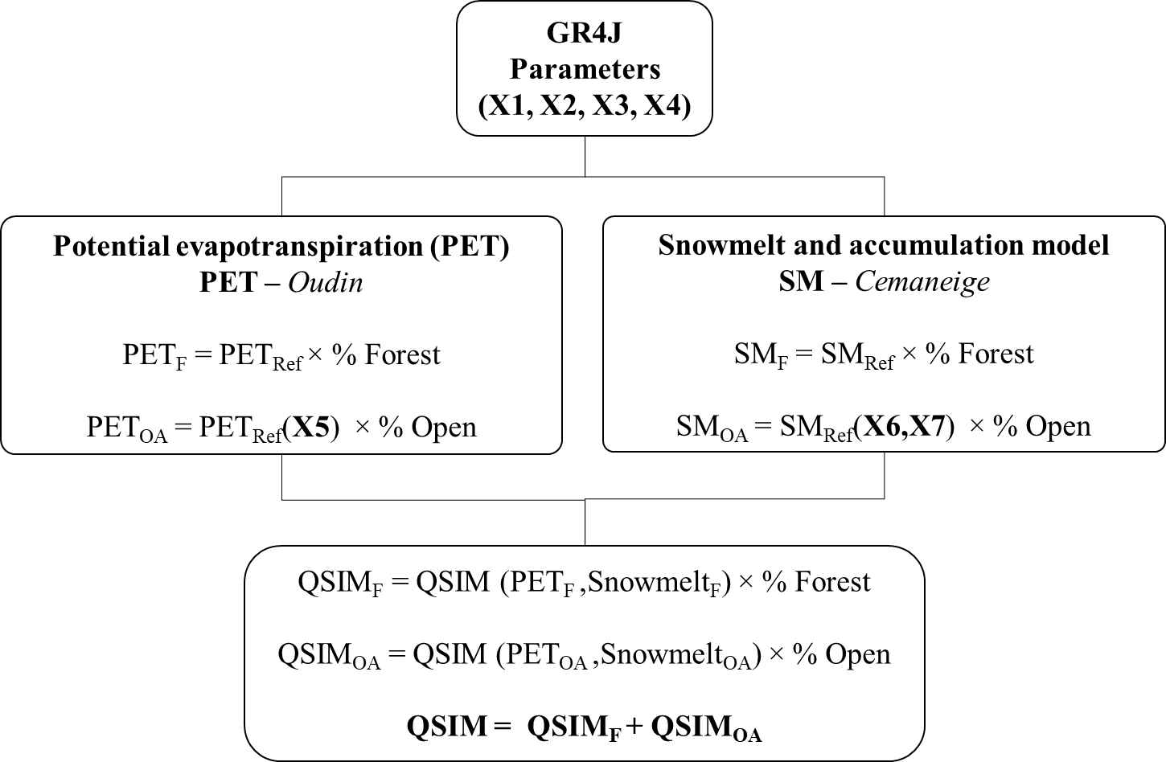
Lumped model
Notes:
Historical changes in land use have shown different effects on climatic and hydrological processes across spatial and temporal scales. Among these, snow accumulation, snowmelt, and evapotranspiration are key processes sensitive to land use changes that can directly influence streamflow production at the catchment scale

Slide 13
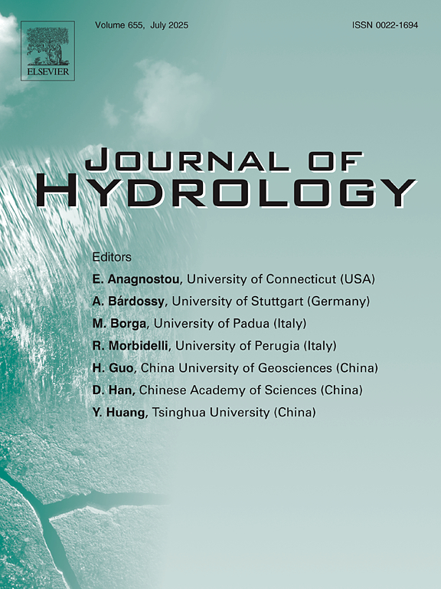

Thank you!
Stay tuned!
Impacts of severe land use changes on the hydrology of Eastern North American catchments
Questions or comments?
Email: mariana.castaneda-gonzalez@etsmtl.ca
Notes:
Historical changes in land use have shown different effects on climatic and hydrological processes across spatial and temporal scales. Among these, snow accumulation, snowmelt, and evapotranspiration are key processes sensitive to land use changes that can directly influence streamflow production at the catchment scale

