Slide 1





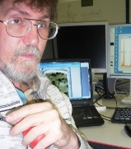

VS Sobolev Institute of
Geology and Mineralogy
SB RAS
Enstitute of Earth
Crust SB RAS
Ca, Mn, Na admixtures in pyropes as indicator of the diamond grade in kimberlites
Alexander Ivanov¹, Vladimir Zinchenko², Igor Ashchepkov³, and Sergey Kostrovitsky⁴
1 – EMRESS Catherine II St. Petersburg Mining University ;
2 – CATOCA Mining Society
3 -VS Sobolev Institute of Geology and Mineralogy SB RAS
4 - Institute of Earth Crust SB RAS
2025 – Vienna EGU 2025

Slide 2
Triangular diagrams of pyrope compositions for minor elements – Mn, Na, Ti in wt% are proposed to assess the diamond grade of kimberlite pipes.
. Basing on group cluster analysis, diagrams are constructed for pyropes from high-diamondiferous (>1 ct/t) (Fig.1), poor and non-diamondiferous kimberlites (<0.1 ct/t) (Fig.2) of Yakutia and Angola. Oval areas correspond to peridotite, eclogitic, and websterite mantle paragenesis (Sobolev, 1971), the diameter of the analytical point is proportional to the CaO content. In highly diamondiferous kimberlites (Fig. 1), pyropes of peridotite dominating and eclogitic and websterite associations are equally present. Trends in their compositions overlap in the ratios of Na2O, MnO and TiO₂ in all CG
Pyropes of diamond-poorly kimberlites (Fig. 2) do not show such overlap, and for each of their CG they are isolated or have a predominance of one paragenesis over another.
Discussion. The presence of pyrope CGs from different deep sources indicates the hybridization of the proto-kimberlite melt, which assimilated the rocks of the peridotite, eclogite, and websterite "layers" of the mantle. This explains the high diamond content of kimberlites, which assimilated diamonds from these three deep sources. In poor diamondiferous kimberlites, pyropes of various paragenesis are extremely unevenly represented, which is due to the weak interaction of the melt with the "layers" of diamondiferous eclogites and websterites. The catalytic role of Ti, Na, and Mn in the process of diamond formation was pointed out by V.A. Milashev (Milashev, 1994) and J. Gurney (Gurney et al., 1994). Pyropes of highly diamondiferous kimberlites are characterized by a short TiO2 trend and a fairly long Na₂O trend (Fig. 1). Pyropes of poorly diamondiferous kimberlites, on the contrary, are distinguished by a long or unexpressed TiO₂ trend and a limited Na₂O (Fig. 2)
Conclusions. The revealed regularities in the distribution of impurity elements in pyropes from kimberlites of different degrees of diamond content are confirmed by diagrams with an MgO-MnO "diamond window", where most of the pyrope grains of highly diamondiferous pipes fall (Figs. 1 and 2). They can be used to assess the diamondiferous potential of kimberlites based on mineralogical and geochemical criteria.

Slide 3
Fig. 1. Diagrams for elements -admixtures in pyrope compositions from highly diamondiferous kimberlites of the Mir, Dachnaya (Yakutia) and Luele (Angola) pipes: G1-G12 – Dawson's chemical-genetic CG (Dawson et al., 1975); the diameter of the analytical point is proportional to the CaO content; the MgO-MnO diagrams demonstrate the Mg-Mn region of the "diamond window" – a dotted rectangle (Ivanov, 2015).

Slide 4
Fig. 2. Diagrams for minor elements -admixtures in pyrope compositions from poor diamondiferous kimberlites of the Toluopskaya (Yakutia), Shandongu and Luache 033 (Angola) pipes: symbols are in Fig.1.

Slide 5
In accordance with the previously published criteria for the diamond content of kimberlites [1], pyrope compositions from non-diamondiferous kimberlites do not fall into the center of the temperature target (MgO = 20% and MnO = 0.4%) and they did not form simultaneously with diamonds. Based on the graphical analysis of the presented diagrams, an additional criterion for assessing the industrial diamond content of kimberlites is proposed using triangular diagrams demonstrating not only the distribution of pyropes in kimberlites by the content of basic oxides in their composition, but also taking into account the content of amixtures in pyropes
elements Mn, Na and Ti.
1. Ivanov A. S. A New Criterion of Kimberlite Diamond Content. Proceedings of the XII All-Russian (with international participation) Fersman session. KSC RAS, Apatity, pp. 268-270, 2015.

Slide 6
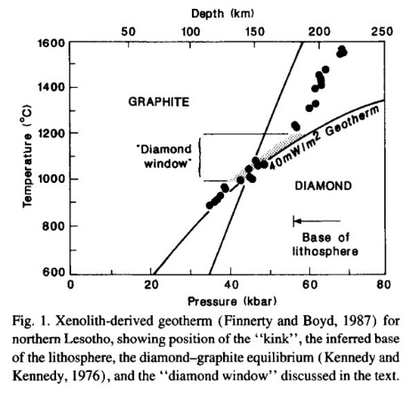
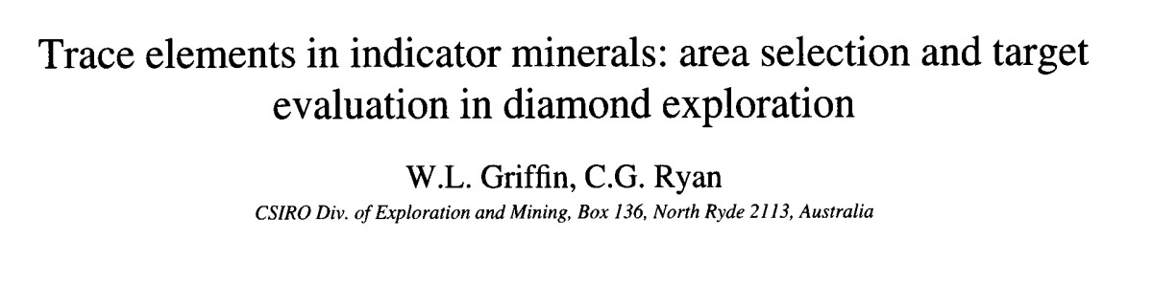
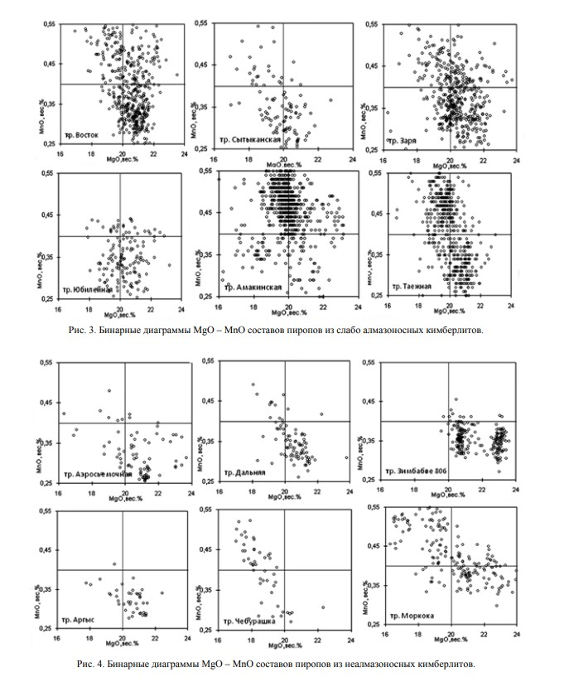
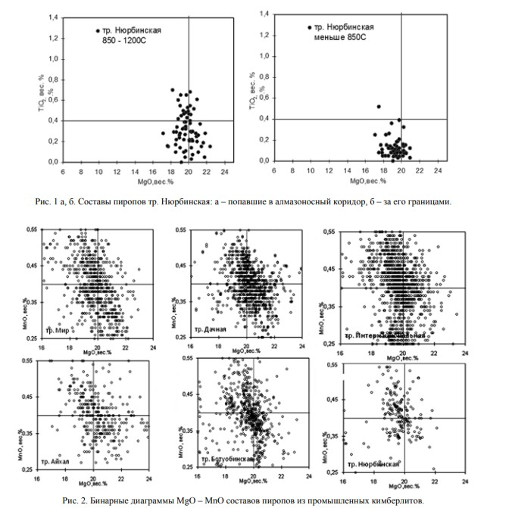

Slide 7
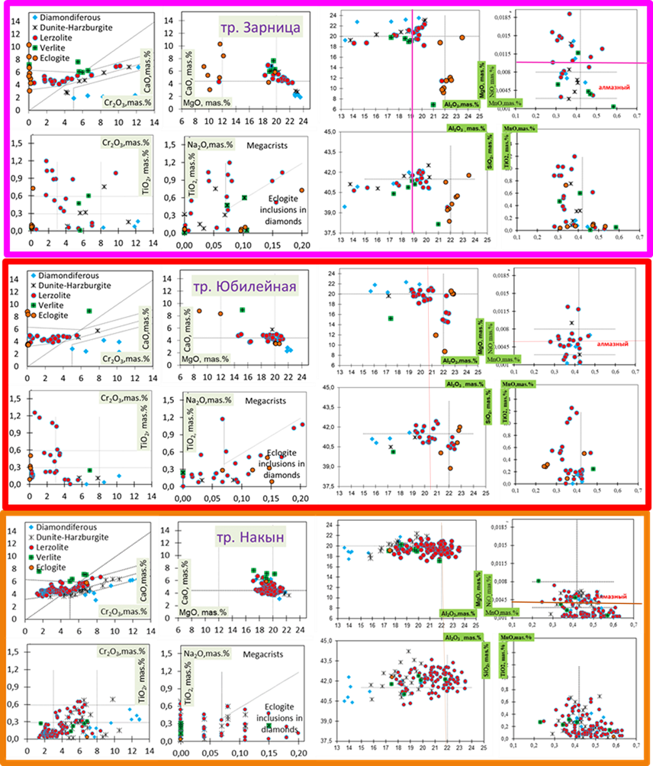
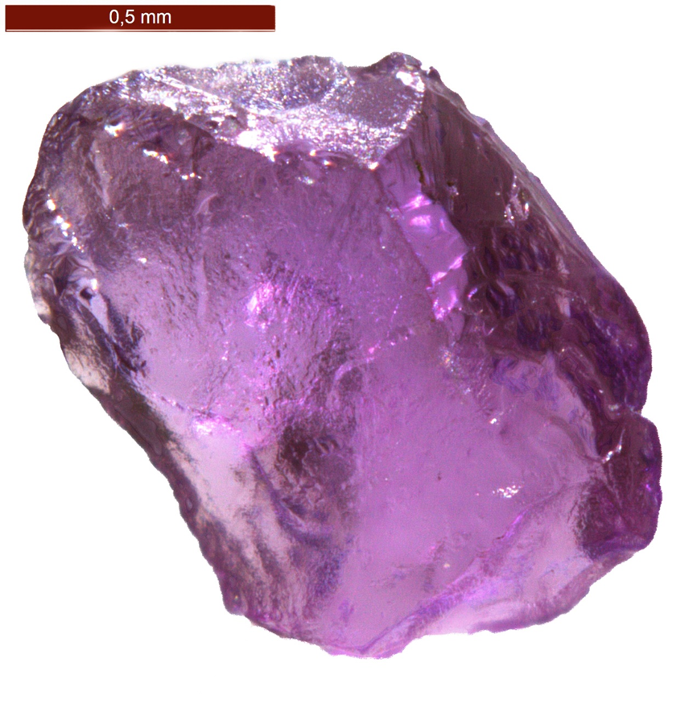
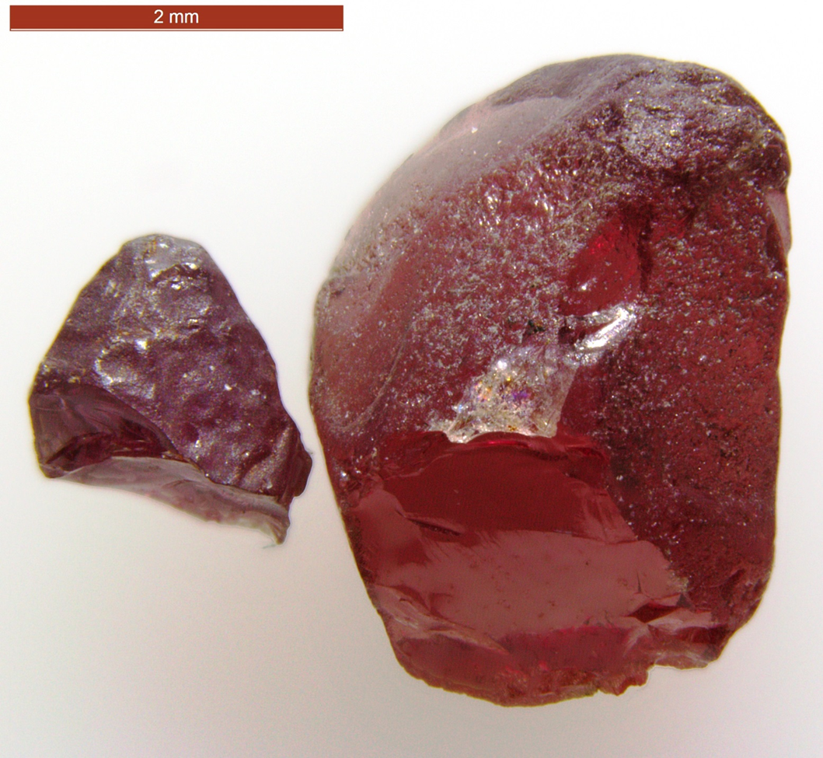
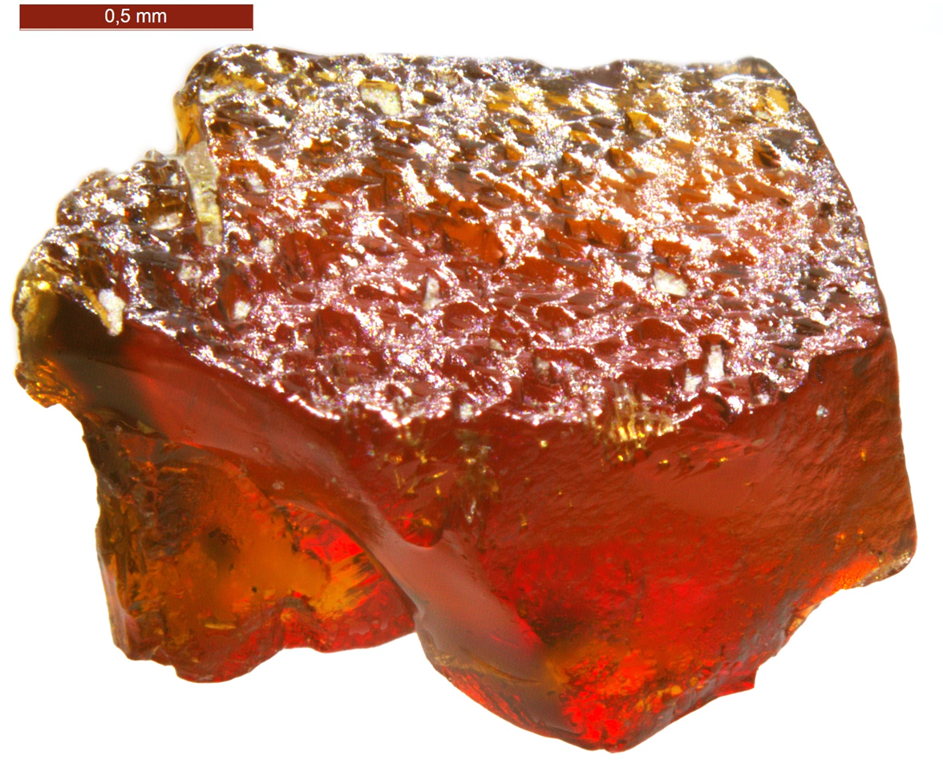
Zarnitsa
Yubeleinaya
Nakynskaya

Slide 8
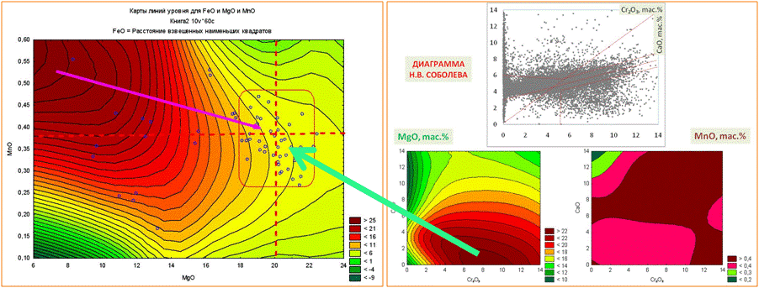
At the intersection of 20% MgO and MnO, about 0.4% (there is a barrier to the PT parameters of diamond formation) like bees at a flower, the average values of 60 KG pyrope compositions of the data bank of compositions around the world are climbing (projecting)
(more than 100,000 microprobe determinations).
The graphs show the final region-point of metasamatotic transformations, at which carbon was squeezed out of the eclogite and websterite layers and mass recrystallization of IMCs and also crystallization of diamonds.
With graphs, we tried to explain the projection into this area
compositions of pyropes from most productive kimberlites.

Slide 9
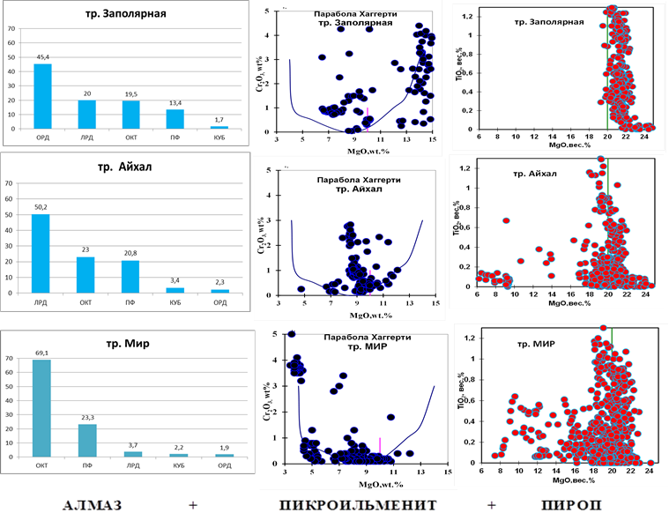
Histograms (%) of diamond shapes and binary diagrams with MgO on the X-axis for pyrope and picroilmenite compositions of three kimberlite fields
Zapolyarnaya
Aykhal
Mir
DIAMOND
Pyrope
Pyrcoilmenite

Slide 10
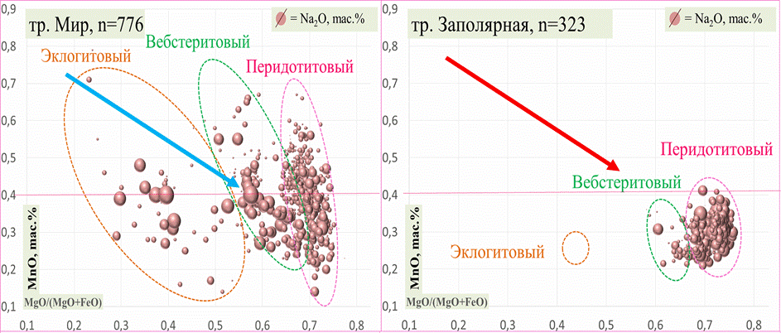
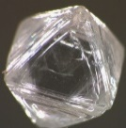

In the diagrams (SLIDE 3) of diamondiferous kimberlites, the mean values for impurity elements in each cluster have similar ratios and similar distributions, which indicates probable hybridization and mixing during the interaction of deep peridotite-protokimberlite melt with websterite and eclogite substrates. In this case, a joint melt is formed. The ratios during melt mixing for the impurity elements in all pyrope CG become the same, probably optimal for the safety of the transported diamonds.
Mir
Zapolyarnaya
Websteritic
Peridotitic
Eclogitic
Peridotitic
Websteritic
Eclogitic

Slide 11
pipe Toluopskaya
Statistical parameters of pyrope compositions
Mir pipe
Group cluster analysis of pyrope compositions according to Pearson and their correlations
matrices of elements in the order of their group ratios. Green – elements
predominant in peridotite and orage - eclogitic paragenesis

Slide 12
Diamondiferous kimberlites are characterized by an integral trend, which overlaps in terms of similar ratios of sodium, manganese and titanium in all cluster groups (CG) - pyropes [2]. Pyrope compositions from non-diamondiferous kimberlites do not show such overlap (Fig. 1a); Trends for each cluster group of pyrope compositions are isolated or the predominance of one paragenesis over others is recorded, which is not typical for similar parameters not only of pressure and temperature, but also of pyrope ratios in the total proto-kimberlite melt, which not only transported diamonds to the surface during the formation of kimberlite pipes, but was also responsible for the preservation of diamonds, including large and expensive crystals.
2. Dawson J.B., Stephens W.E. Statistical classification of garnets from kimberlites and xenoliths. J. Geol. 1975. Vol. 83. № 5. P. 589-607

Slide 13
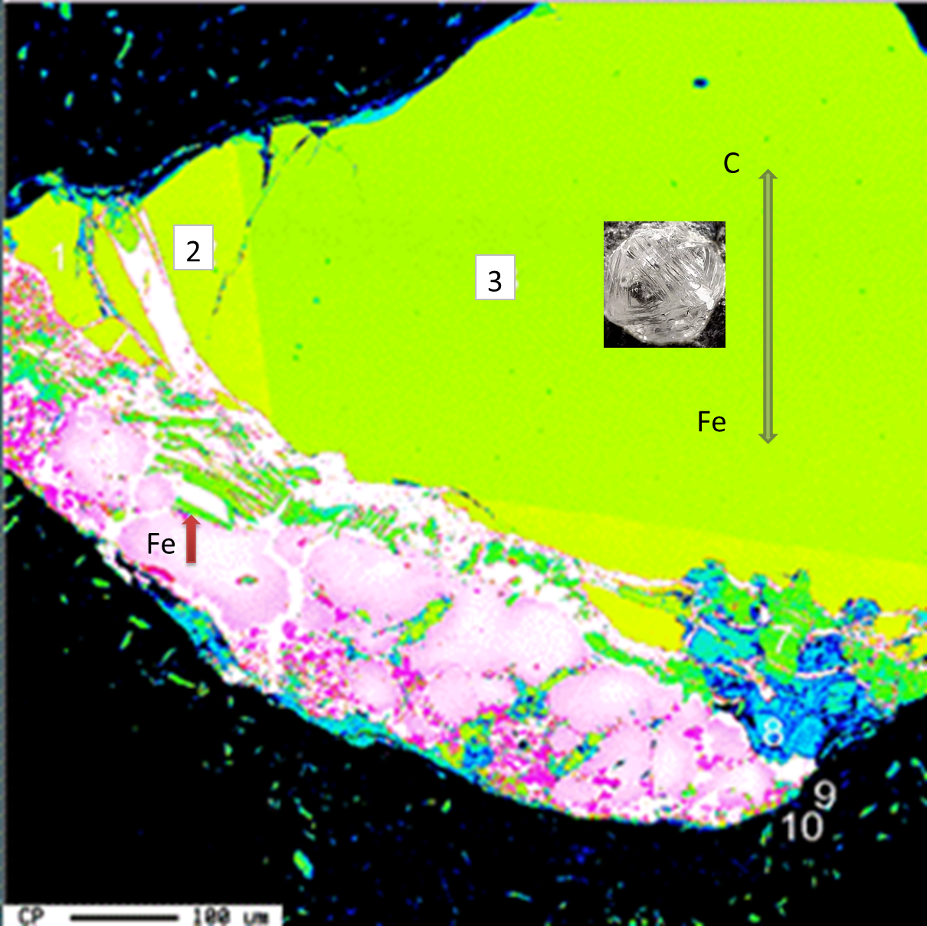
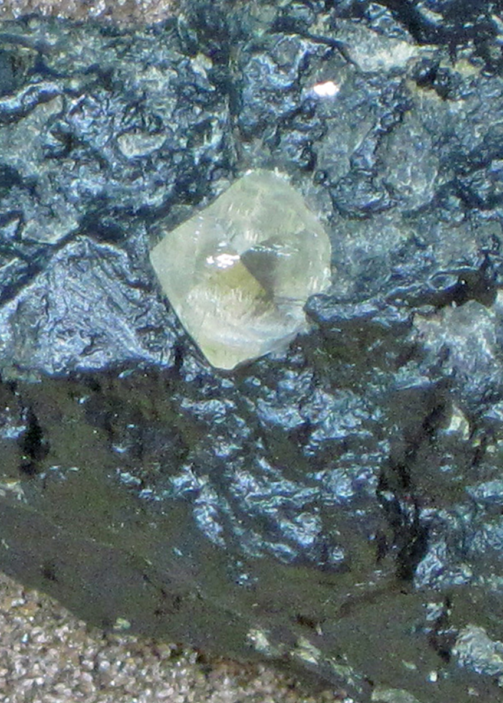
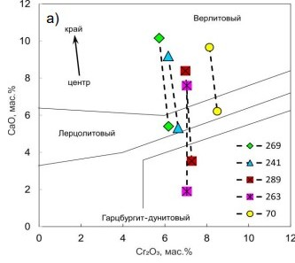
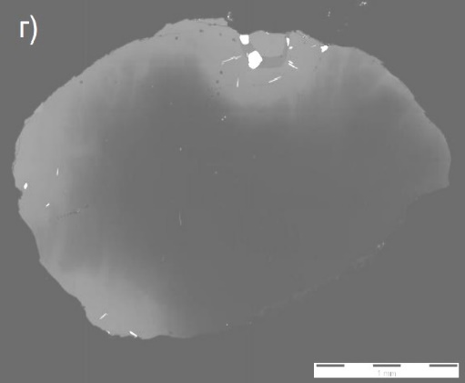
A.S. Ivanov
The presence of ilmenite in the borders around pyrope is a characteristic feature of inclusions of sheared ilmenite-bearing lerzolites, which are very rare in kimberlites, Such inclusions are known in the Dalnaya, Sytykanskaya and Udachnaya pipes (Garanin et al., 1984), but nowhere in them is there any mention of the zonality of garnet and ilmenite
In the process of capturing by a deep peridotite (proto-cyberlite) melt of less deep layers and lenses - websterites and eclogites, which took place when the PT parameters decreased, the process of recrystallization or it can be called hybridization, which was accompanied by the release of carbon from more ferruginous melts, which occurred at the PT parameters corresponding to favorable conditions for the preservation of diamonds or even the growth of outer shells on individual crystals that were captured proto-cyberlite deep melts from the mantle substrate.
D.I. Rezvukhin

Slide 14
Dawson J.B., Stephens W.E. Statistical classification of garnets from kimberlites and xenoliths. J. Geol. 1975. Vol. 83. № 5. P. 589-607
Grifin W.L., Ryan C.G. Trace elements in indicator minerals: Area selection and target evaluation in diamond exploration. J. Geochem. Explor. , Vol. 53, P. 311-357.
Ivanov A. S. 2015. A New Criterion of Kimberlite Diamond Content. Proceedings of the XII All-Russian (with international participation) Fersman session. KSC RAS, Apatity, pp. 268-270,
Milashev V.A. 1994. Environment and processes of formation of natural diamonds. "Nedra", St. Petersburg, 142 p.
Sobolev N.V. 1994. On the mineralogical criteria of diamond content of kimberlites. 1971. №3. – P. 70-80 J. J. Gurney, R. O. Moore. Geochemical correlation between kimberlite minerals and Kalahari Craton diamonds, Journal. Russian Geology and Geophysics, pp. 12 – 24,

Slide 15
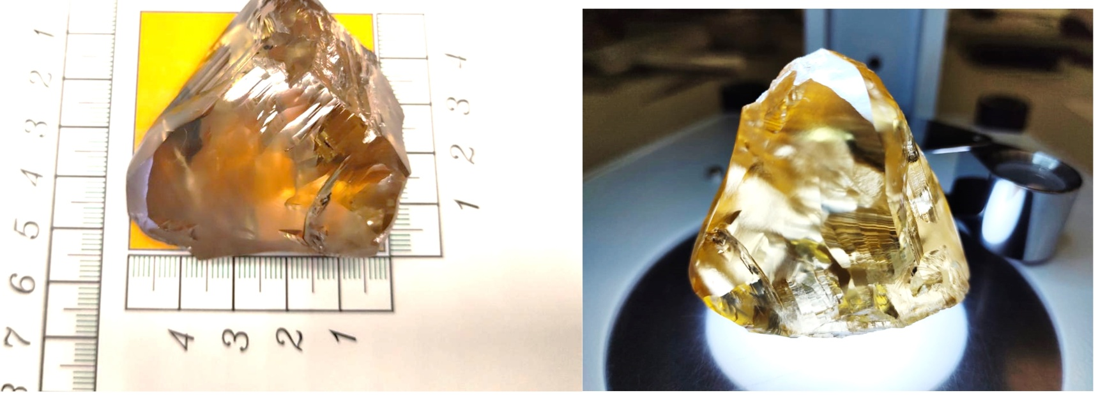
Conclusions
It is assumed that there is a high probability of releasing excess carbon from the more ferruginous fractions of the melt. The increased content of carbon, which dissolved and intensively concentrated in the melt, in turn, provided favorable conditions for the preservation of diamonds. The PT parameters in this ratio and melt mixing corresponded to the diamond corridor. Diagrams, taking into account the content of impurities in pyropes, can undoubtedly be used as an additional criterion for assessing the diamond content of kimberlites during prospecting and exploration for diamonds.
THANK YOU FOR YOUR ATTENTION

