Slide 1
Multi-Scale Wavelet Analysis of Okavango River discharge time series at the Mohembo station upstream the Okavango Delta, Botswana
Otlaadisa Tafilaª,
Seifeddine Joma ^{b}, David Labat ^{c}, Rakesh Kumar^{d}, Ditiro. B. Moalafhi^{e}, Eric Yanksonª, Michael. Rode^{b}
ªNamibia University of Science and Technology, Windhoek, Namibia
^{b}Helmholtz Centre for Environmental Research-UFZ
^{c}Université Toulouse, France
^{d}Shri Mata Vaishno Devi University, India
^{e}Botswana University of Agriculture and Natural Resources, Gaborone, Botswana
28 April 2025
Vienna, Austria
28 April 2025

Slide 2
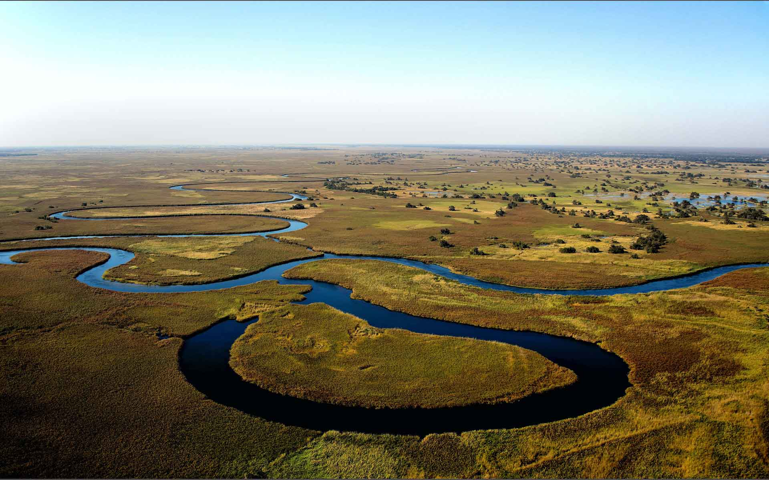
Navigating the Okavango: An Introduction
Main and specific Objectives
Methodology
Results and Discussions
Transboundary implications
Conclusion
Outline
01

Slide 3
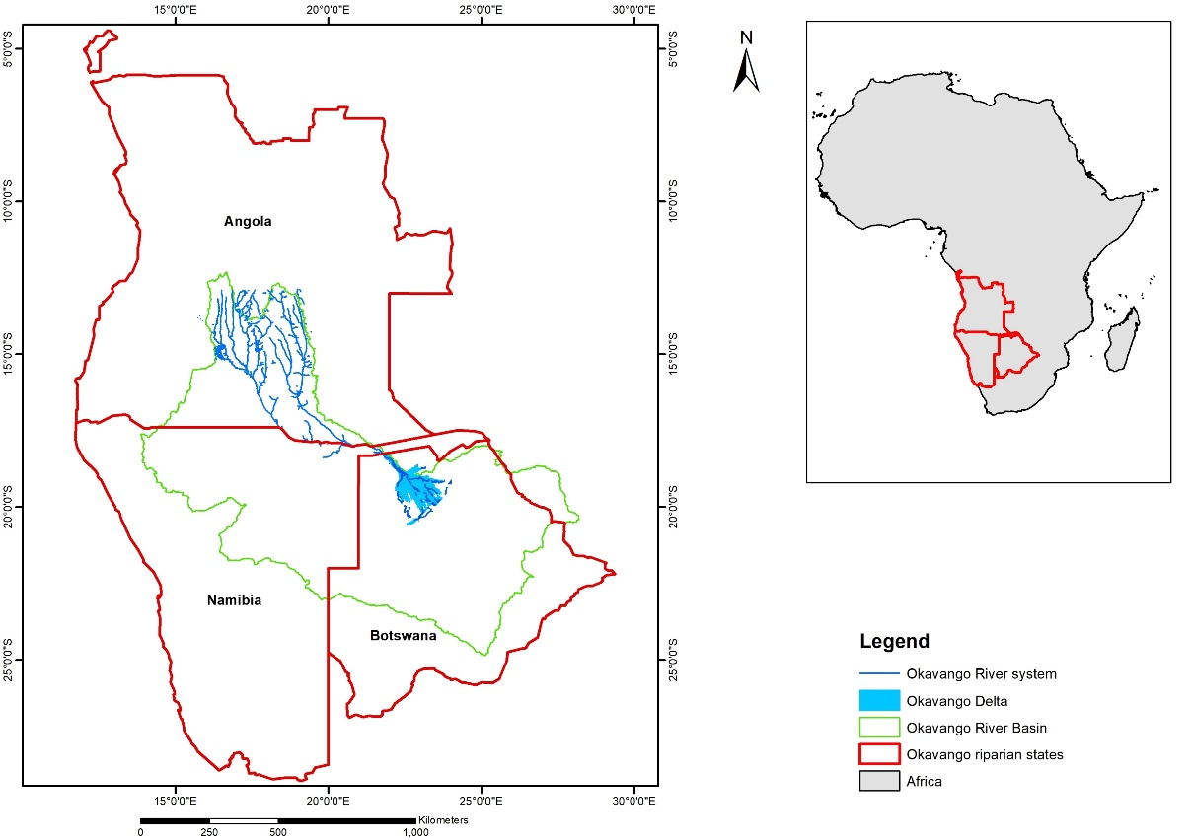
Introduction
Main and specific Objectives
Methodology
Results and Discussions
Conclusion
Transboundary implications
Geographical scope
(Okavango River system - 3 riparian states)
Delta in northwestern Botswana
~30 000 km² (Bauer et al., 2006)
Source of water: Angolan highlands, precipitation
Deltaic important facts:
Endorheic delta
UNESCO World heritage site (UNESCO 2014)
Wetland of international importance – 1997 Ramsar Convention (Turpie et al., 2006).
Figure 1. Geographical scope of the Okavango river basin
02

Slide 4
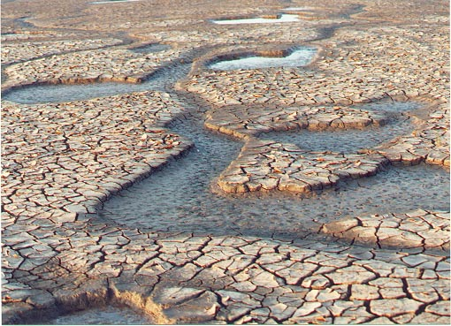
Introduction
Main and specific Objectives
Methodology
Results and Discussions
Conclusion
Transboundary implications
Impacts: Climate change & Human interventions/ hypothetical)
Drier future conditions envisioned due to climate change (Milzow et al., 2010).
Water abstractions upstream (Angola & Namibia) of the OD for irrigation.
Possible damming in Angola, mainly to generate hydroelectricity (Mendelsohn et al., 2021).
Water diversions for portable water use. E.g., to Windhoek and other parts of central Namibia where there is dire water shortage (Olivieri et al.,2022, Yankson, 2022).
Bulk potable water supply for communities along the river system is envisaged to rapidly increase.
Challenge: Upstream retained flow due to some of this possible interruptions has the potential to disrupt hydrological connectivity in the downstream deltaic ecosystem.
03

Slide 5
Introduction
Main and specific Objectives
Methodology
Results and Discussions
Conclusion
Transboundary implications
The study aims to detect and understand temporal variability of Okavango river flow (panhandle inflow) across multiple time scales.
Decompose a signal of the Mohembo discharge time-series and present various temporal patterns and frequencies at multiple resolutions.
1
1
2
Determine the spatial dependance of discharge patterns to precipitation in the upstream Angolan highlands.
2
04

Slide 6
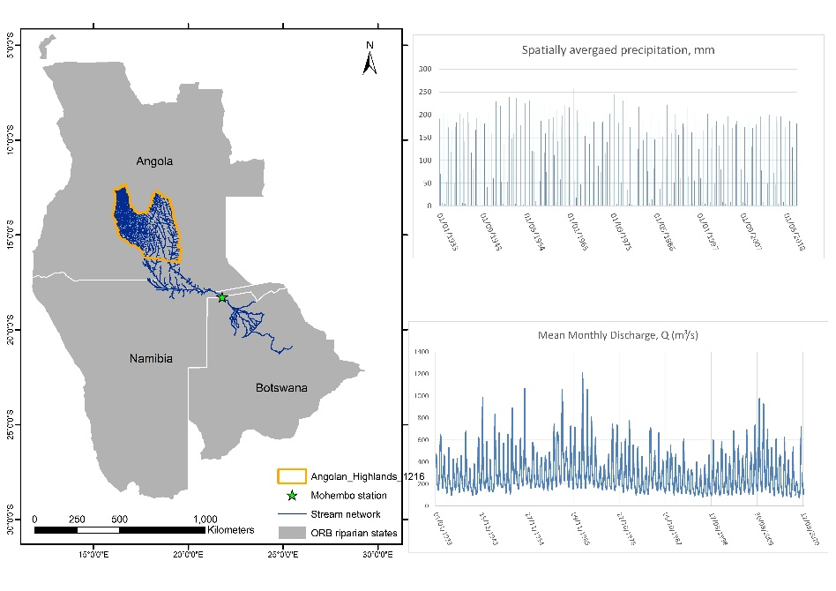
Introduction
Main and specific Objectives
Methodology
Results and Discussions
Conclusion
Transboundary implications
Wavelet analysis
Wavelet decomposition
Wavelet power spectrum
Global wavelet power spectrum
Precipitation
Decomposed time series patterns at:
Intra-annual
Annual
Long-term scales
Daubechies mother wavelet, Daub20
Multi-scale pairwise Wavelet coherence analysis
discharge
05

Slide 7
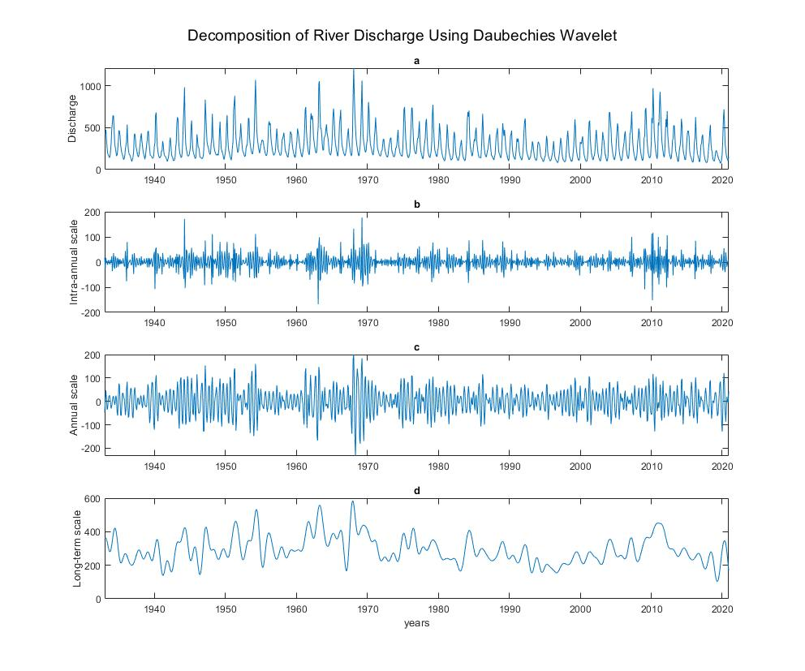
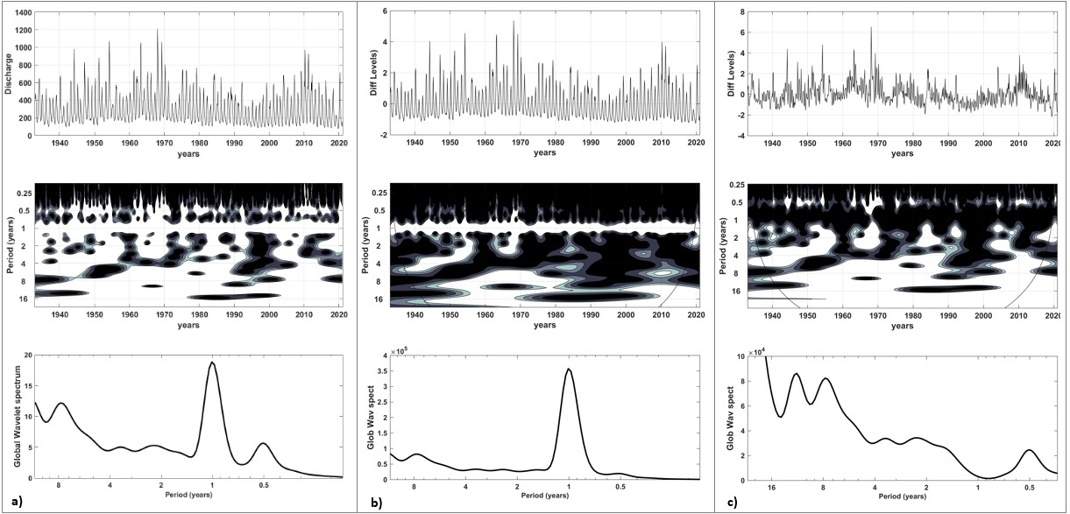
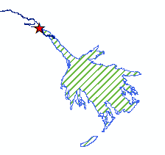
Introduction
Main and specific Objectives
Methodology
Results and Discussions
Conclusion
Transboundary implications
1. Wavelet analysis of river discharge time-series
a
Decomposition of River discharge using Daubechies wavelet
b
c
d
High frequency components: one-year cycles (a and b)
Low frequency components (long term trends – multi-year cyclic periodicities)
Key flow patterns
Short term: dry/wet seasonal dynamics
Medium trends: El Niño/La Niña impacts
Long-term: climate change trends
06

Slide 8
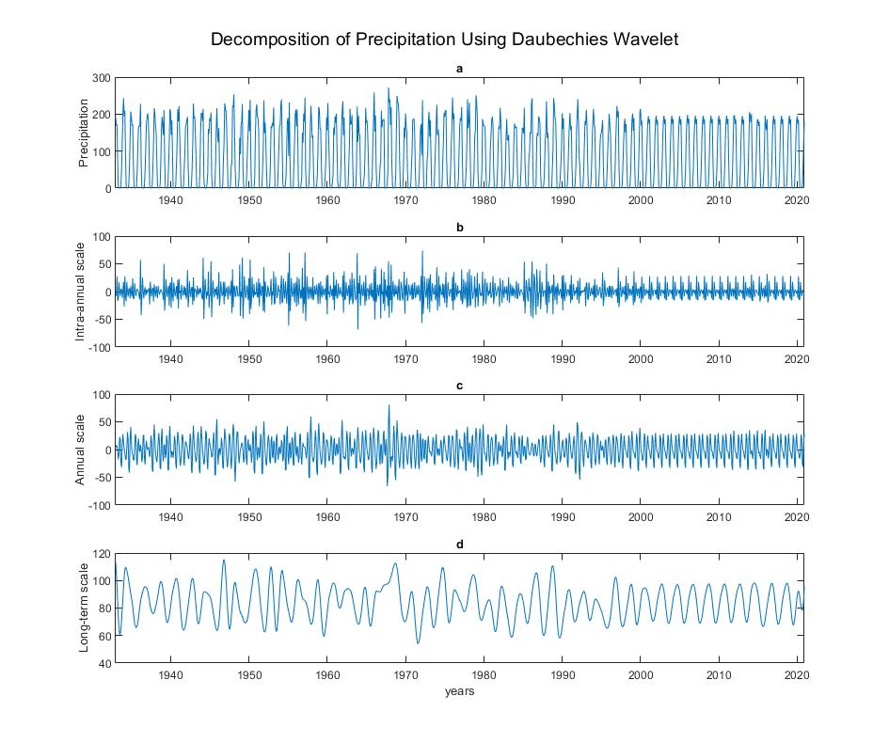
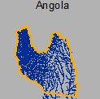
Introduction
Main and specific Objectives
Methodology
Results and Discussions
Conclusion
Transboundary implications
2. Wavelet analysis of precipitation time-series
Spatially averaged precipitation Climate Research Unit precipitation product: (Copernicus Climate Change Service, 2021)
07

Slide 9
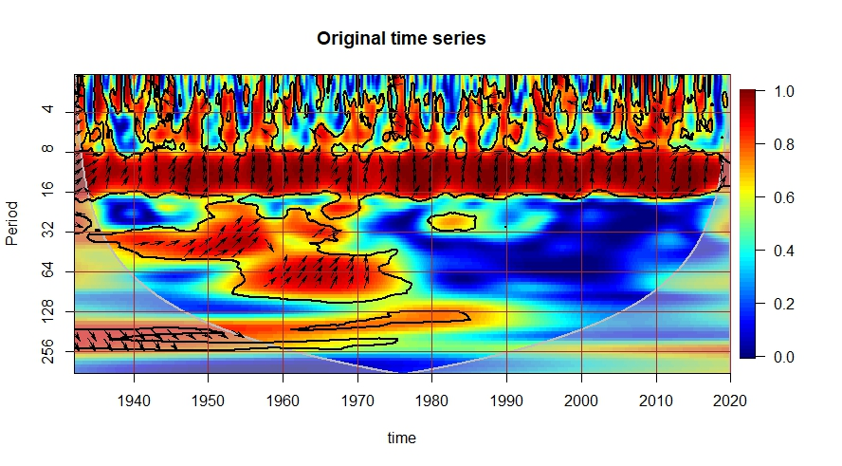
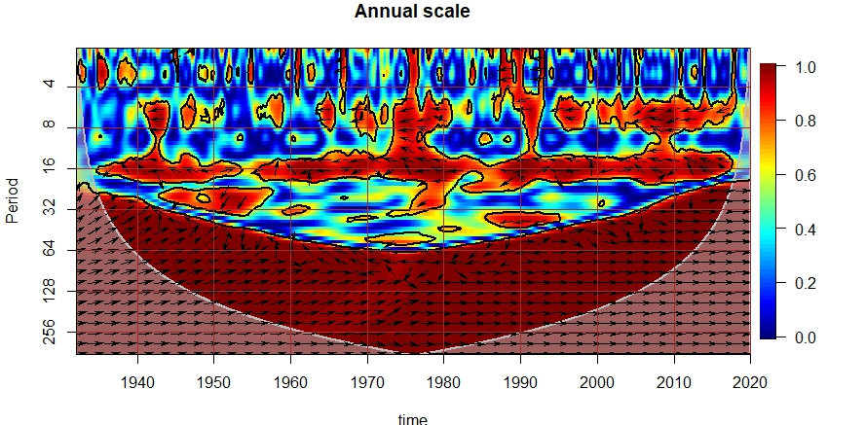
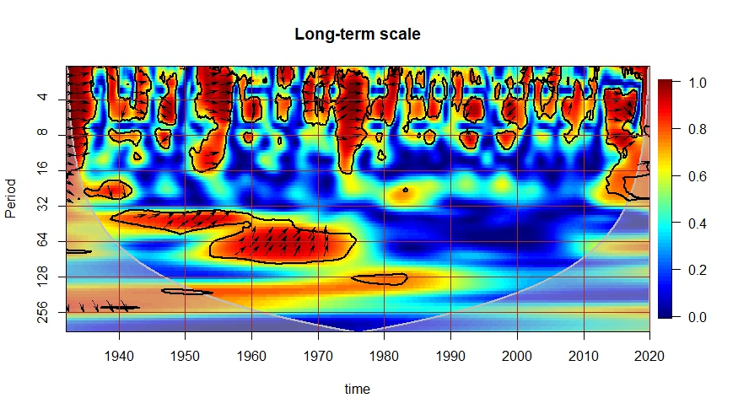
Introduction
Main and specific Objectives
Methodology
Results and Discussions
Conclusion
Transboundary implications
3. Wavelet coherence analysis of Precipitation - River discharge time-series
Figure showing heatmap highlighting patterns and correlation strengths between precipitation in the upstream Angolan highlands and river discharge at the start of the Okavango Delta panhandle across different timescales between 1933 and 2020.
Unstable coherence in very short periods of less than 4 months
Consistent band of coherence between 8 and 16 months: low temporal variability between the two signals
08

Slide 10
Introduction
Main and specific Objectives
Methodology
Results and Discussions
Conclusion
Transboundary implications
The wavelet analysis revealed multiple periodicities in the Okavango River discharge, including semi-annual (0.5 year), annual (1 year), and multi-year (8-10 year) cycles. The annual cycle was the most dominant and persistent pattern across all temporal scales analyzed.
There has been a general decline in peak river discharge volumes over the past 50 years compared to earlier decades, with fewer extreme flow events observed in recent times. This suggests a shift in the hydrological regime that may impact water availability downstream.
Wavelet coherence analysis showed strong correlation between upstream precipitation and downstream river discharge at short to medium timescales (8-16 months). However, the coherence has weakened in recent decades for longer periods, indicating potential changes in the precipitation-discharge relationship that could affect long-term water supply to the Okavango Delta.
09

Slide 11
Introduction
Main and specific Objectives
Methodology
Results and Discussions
Conclusion
Transboundary implications
Precipitation in the Angolan highlands serve as a critical recharge mechanism for surface water systems in the downstream such as the Okavango Delta
The seasonality of precipitation (Angola) and river discharge has significant impacts on water budgets in downstream. Precipitation and discharge are intercepted along the riparian states.
After assessing the river discharge and precipitation patterns and coherence:
Identified variabilities such as ‘flow loss’ may necessitate revisions to existing transboundary water agreements and management strategies.
This study, therefore, contributes to understanding inflow and precipitation patterns vital fostering for collaborative and adaptive water resources management as conditions are continuously evolving.
10

Slide 12
Bauer, P., Gumbricht, T., & Kinzelbach, W. (2006). A regional coupled surface water/groundwater model of the Okavango Delta, Botswana. Water Resources Research, 42(4).
Daubechies, I. (1992). Ten lectures on wavelets. Society for industrial and applied mathematics.
Mendelsohn, J., Murray-Hudson, M., & Thomson, G. C. (2021). A river in trouble. Conservation Namibia. https://conservationnamibia.com/articles/cn2021-river-in-trouble.php.
Milzow, C., Burg, V., & Kinzelbach, W. (2010). Estimating future ecoregion distributions within the Okavango Delta Wetlands based on hydrological simulations and future climate and development scenarios. Journal of hydrology, 381(1-2), 89-100.
Olivieri, F., Koop, S. H. A., Van Leeuwen, K., & Hofman, J. (2022). Enhancing governance capacity to ensure a long-term water supply: the case of Windhoek, Namibia. Sustainability, 14(4), 2387.
Turpie, J., Barnes, J., Arntzen, J., Nherera, B., Lange, G.-M., & Buzwani, B. (2006). Economic value of the Okavango Delta, Botswana, and implications for management. International Union for Conservation of Nature, Directorate of Environmental Affairs and the Okavango Delta Management Project.
UNESCO. (2014). Convention concerning the protection of the World cultural and natural heritage: decisions adopted by the World Heritage Committee at its 38th session. https://whc.unesco.org/archive/2014/whc14-38com-16en.pdf
Yankson, E. (2022). Assessing the Implications of Planning Policy Innovation for Urban Drought Resilience: The Case of Water Supply in Windhoek, Namibia. Proceedings of the 58th ISOCARP World Planning Congress. https://doi.org/10.47472/DWCTAQRE
References
11

Slide 13
Thank you
Otlaadisa Tafila
PhD. Candidate, Spatial Science (NUST, Namibia)
Email: tafilaota@gmail.com
Cell: +267 72 741 337

