Slide 1
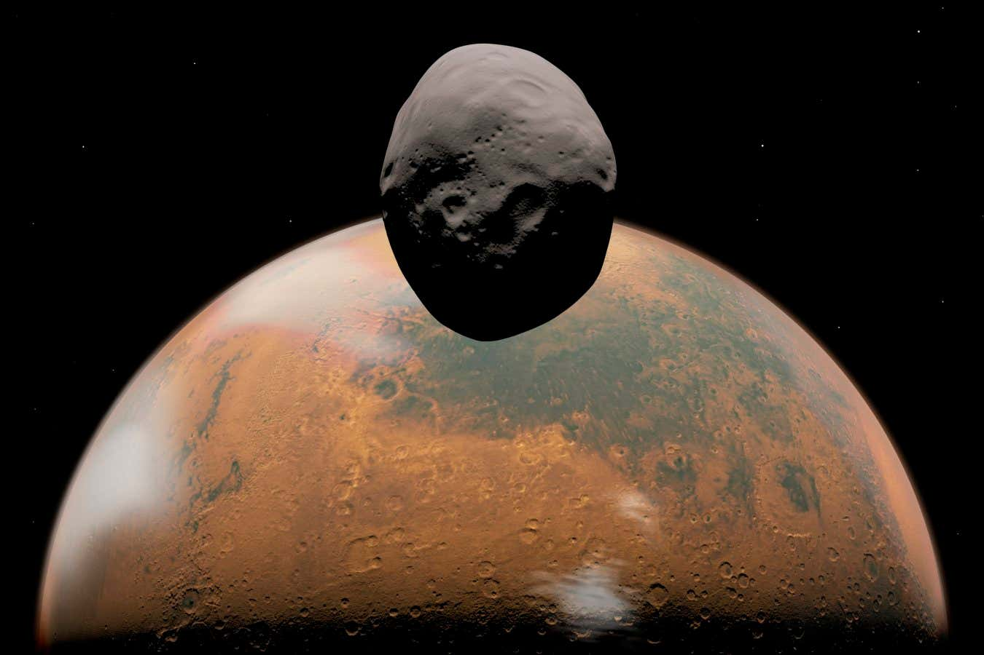


Determining a good Phobos simulant: An analysis of CHNS-bearing content based on spectral similarities between Phobos, Tagish Lake, and CM chondritic meteorites
SUPPLEMENTARY MATERIALS
To insert image; please click on the picture icon and choose the image you would like. Then send the image behind (right hand click to find options)
https://www.newscientist.com/article/mg26535290-800-why-we-must-investigate-phobos-the-solar-systems-strangest-object/
Bianka Petra Munday (Royal Holloway University of London, Department of Earth Sciences) Dr Queenie Hoi Shan Chan (Royal Holloway University of London, Department of Earth Sciences)
Dr Yoko Kebukawa (Institute of Science Tokyo, Department of Earth and Planetary Sciences)
Notes:
Same as the slide before but without an image

Slide 2
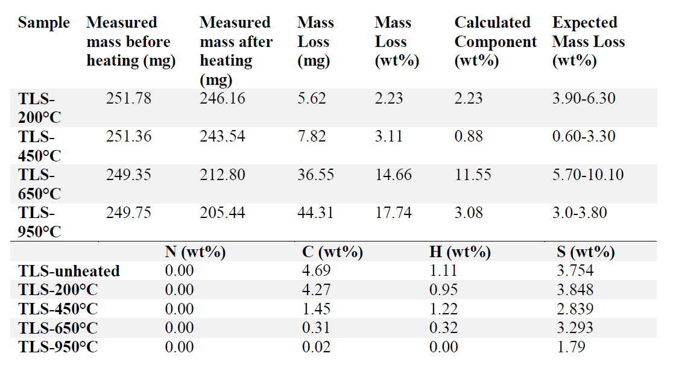
S1: Raw mass loss data
Table 3 – Upper panel: Heating experiment (10-hour duration) observed mass loss compared to expected mass loss according to TGA results pertaining to Tagish Lake from previous literature (Gilmour et al., 2019; Yesiltas et al., 2022). Observed mass loss calculated as 𝑚𝑎𝑠𝑠 𝑙𝑜𝑠𝑠 (𝑚𝑔)𝑜𝑟𝑖𝑔𝑖𝑛𝑎𝑙 𝑚𝑎𝑠𝑠 (𝑚𝑔)∗100. Lower panel: CHNS concentrations of TLS at heating stages 20-950°C following elemental analysis.

Slide 3
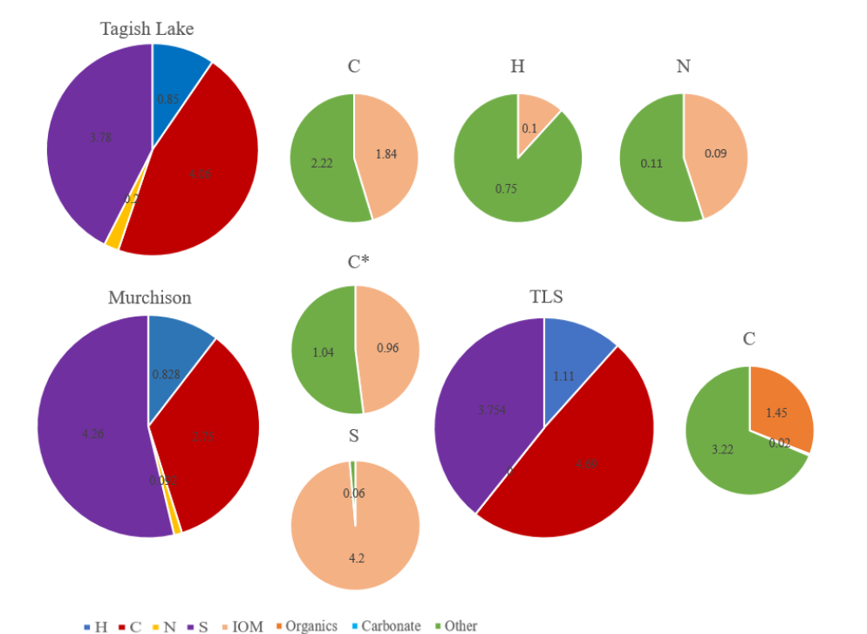
S2: Elemental Analysis
***fix Murchison ratio charts to CHN
Elemental abundance in UTPS-TB (TLS) sample compared with Tagish Lake and Murchison
N content inaccuracy
C insoluble organic matter inaccuracy
Elemental analysis of C, H and N in TLS, Tagish Lake (Alexander et al., 2014; Braukmuller at al., 2018) and Murchison (Vacher et al., 2020; Alexander et al., 2021) and their relative wt % abundances in insoluble organic matter, carbonate, and other compositional fractions. Data marked * from Alexander et al. (2017).

Slide 4
S3: Elemental analysis uncertainties
 | C [%] | H [%] | N [%] | S [%]
ST4 | 9.18 | 1.516 | 0.55 | 3.516
ST4 | 9.21 | 1.484 | 0.56 | 3.643
ST4 | 9.14 | 1.487 | 0.58 | 4.158
ST4 | 9.16 | 1.398 | 0.49 | 3.748
Mean value | 9.17 | 1.471 | 0.54 | 3.766
Deviation | 0.03 | 0.051 | 0.04 | 0.278
EA uncertainties based on in-house soil reference standards

Slide 5
S4: Elemental analysis reference standards
 | C [%] | H [%] | N [%] | S [%]
ST2-450C | 3.16 | 0.436 | 0.00 | 0.312
ST2-450C | 3.24 | 0.371 | 0.00 | 0.275
ST2-450C | 3.16 | 0.145 | 0.00 | 0.291
Mean value | 3.19 | 0.317 | 0.00 | 0.292
Deviation | 0.04 | 0.153 | 0.00 | 0.018
Elemental analysis uncertainties based on in-house soil reference standards heated at 450°C

Slide 6
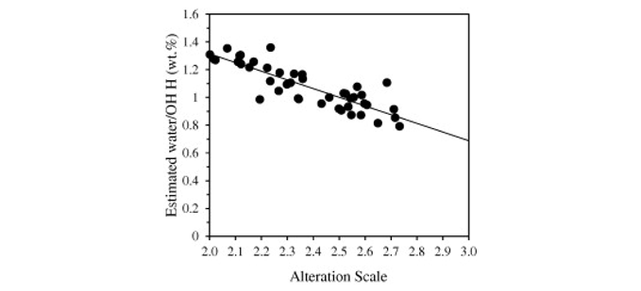
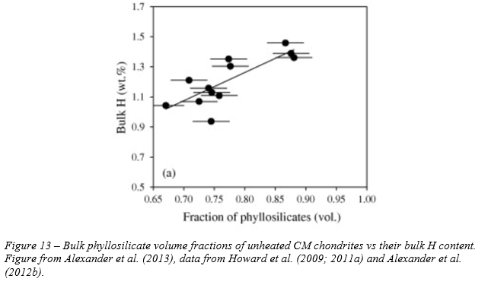
S5: CM chondrite correlations
Figure 13 – Correlation between estimated water H content of unheated CM chondrites and their classifications based on Rubin et al. (2007) scale, but using the bulk H isotopic compositions from Alexander et al. (2013) Table 2.
Low H and H₂O content → pristine
Measured H content (1.1 wt%) correlates to ~0.71 phyllosilicates volume → aligns with expected phyllosilicate component
Figure 15 – Bulk phyllosilicate volume fractions of unheated CM chondrites vs their bulk H content. Figure from Alexander et al. (2013), data from Howard et al. (2009; 2011a) and Alexander et al. (2012b).

Slide 7
S6: Proposed organic recipes
If Phobos has high aqueous alteration:
Organic content | Suggested simulant concentration (ng g-1)
β-alanine | 400
Glycine | 600
Butanoic acid | 7000
Propanoic acid | 9000
Napthalene | 50
Organic recipes based on Tagish Lake amino acid, carboxyl and PAH concentrations
Tagish Lake compositionally heterogeneous due to differential aqueous alteration thus 2 recipes proposed based on high or low degree of aqueous alteration scenarios on Phobos
Important to strike an elemental balance to ensure both mineralogical and organic accuracy
Organic content | Suggested simulant concentration (ng g-1)
β-alanine | 10
Glycine | 90
Butanoic acid | 1000
Propanoic acid | 4000
Napthalene | 40
If Phobos has low aqueous alteration:
Based on data from Simkus et al. (2019)

Slide 8
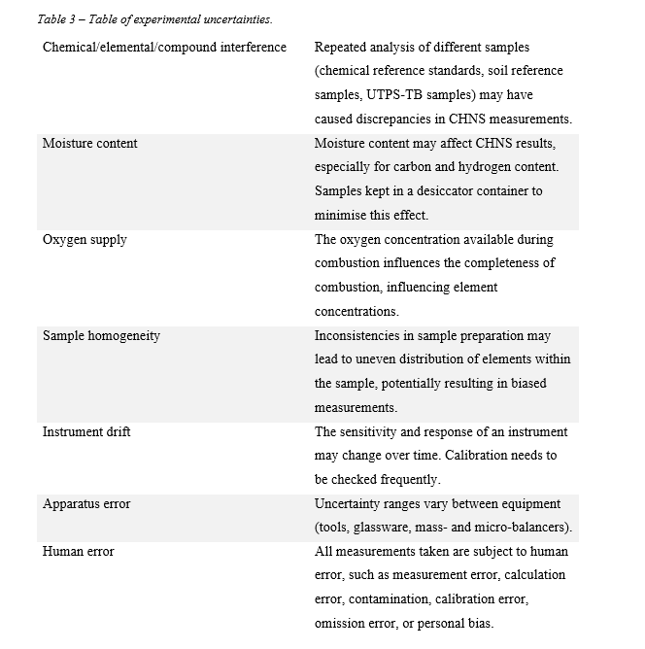
S7: Table of uncertainties
Table 3 – Table of experimental uncertainties

Slide 9
References
Alexander, C.M.O’D., Bowden, R., Fogel, M.L., Howard, K.T., Herd, C.D.K., Nittler, L.R. (2012b) The provenances of asteroids, and their contributions to the volatile inventories of the terrestrial planets. Science, v. 337, pp. 721-723. doi:10.1126/science.1223474
Alexander, C.M.O’D., Howard, K.T., Bowden, R., Fogel, M.L. (2013) The classification of CM and CR chondrites using bulk H, C and N abundances and isotopic compositions. Geochimica et Cosmochimica Acta, v. 123, pp. 244-260. doi:10.1016/j.gca.2013.05.019
Gilmour, C.M., Herd, C.D., Beck, P. (2019) Water Abundance in the Tagish Lake Meteorite from TGA and IR Spectroscopy: Evaluation of Aqueous Alteration. Meteoritics & Planetary Science, v. 54, pp. 1951-1972. doi:10.1111/maps.13362
Howard, K.T., Benedix, G.K., Bland, P.A., Cressey, G. (2009) Modal mineralogy of CM chondrites by X-ray diffraction (PSD-XRD): Part 1 : Total phyllosilicate abundance and the degree of aqueous alteration. Geochimica et Cosmochimica Acta, v. 75, pp. 2735-2751. doiL:10.1016/j.gca.2011.02.021
Howard, K.T., Benedix, G.K., Bland, P.A., Cressey, G. (2011) Modal mineralogy of CM chondrites by X-ray diffraction (PSD-XRD): Part 2. Degree, nature and settings of aqueous alteration. Geochimica et Cosmochimica Acta, v. 75, pp. 2735-2751. doiL:10.1016/j.gca.2011.02.021
Rubin, A.E., Trigo-Rodriguez, J.M., Huber, H., Wasson, J.T. (2007) Progressive aqueous alteration of CM carbonaceous chondrites. Geochimica et Cosmochimica Acta, v. 71, pp. 2361-2382. doi:10.1016/j.gca.2007.02.008
Simkus, D.N., Aponte, J.C., Elsila, J.E., Hilts, R.W., McLain, H.L., Herd, C.D.K. (2019) New insights into the heterogeneity of the Tagish Lake meteorite: Soluble organic compositions of variously altered specimens. Meteoritics & Planetary Science, v. 54, pp. 1283-1302. doi:10.1111/maps.13276
Yesiltas, M., Kebukawa, Y., Glotch, T.D., Zolensky, M., Fries, M., Aysal, N., Tukel, F.S. (2022) Compositional and spectroscopic investigation of three ungrouped carbonaceous chondrites. Meteoritics & Planetary Science, v. 57, pp. 1665-1687. doi:10.1111/maps.13893

