Slide 1
by: Peixoto, H., Jaboyedoff, M., and Derron, M.-H
Web GIS Application for Natural Hazards Risk Assessment
Based on Incomplete Data
Notes:
Good afternoon, everyone! My name is Hélder Peixoto, my presentation will focus on my master’s thesis in Earth sciences at the Joint Geneva and Lausanne School of Earth Sciences, named “WebGIS Application for Natural Hazards Risk Assessment based on Incomplete Data”, co-authored by Michel Jaboyedoff and Marc-Henri Derron from the Risk Group Institute of the University of Lausanne.

Slide 2
Introduction
Natural hazards cause fatalities and damage to buildings, agriculture, ecosystems and several infrastructures.
Countries like Switzerland are prone to natural hazards.
Damages ~300 million CHF per year.
1946-2015: 635 events, 1023 fatalities mainly in Alpine valleys.
Risk assessment is a critical discipline in today’s world.
In Switzerland:
EconoMe (Federal Office for the Environment)
Valdorisk (University of Lausanne)
Riskko (Vaud, Ticino, Fribourg and Jura)
Notes:
Natural hazards cause fatalities, injuries and damage to buildings and agriculture. Switzerland is prone to natural hazards which provoke damages on average of 300 millions CHF per year. In a 69 years period the federal institute for forest, snow and landscape, registered 635 events which caused 1023 fatalities, mainly in the Alpine region. With global warming being more pronounced in Alpine regions, Climate-related hazards are expected to grow in the coming years.

Slide 3
Motivation
Perform risk assessment even when the data is incomplete.
Incorporate exceedance probability curves at local level comparable to CAT models used by insurance companies.
Provide automatic access to hazards maps, exposed objects and vulnerabilities.
Leverage open-source technologies and open data.

Slide 4
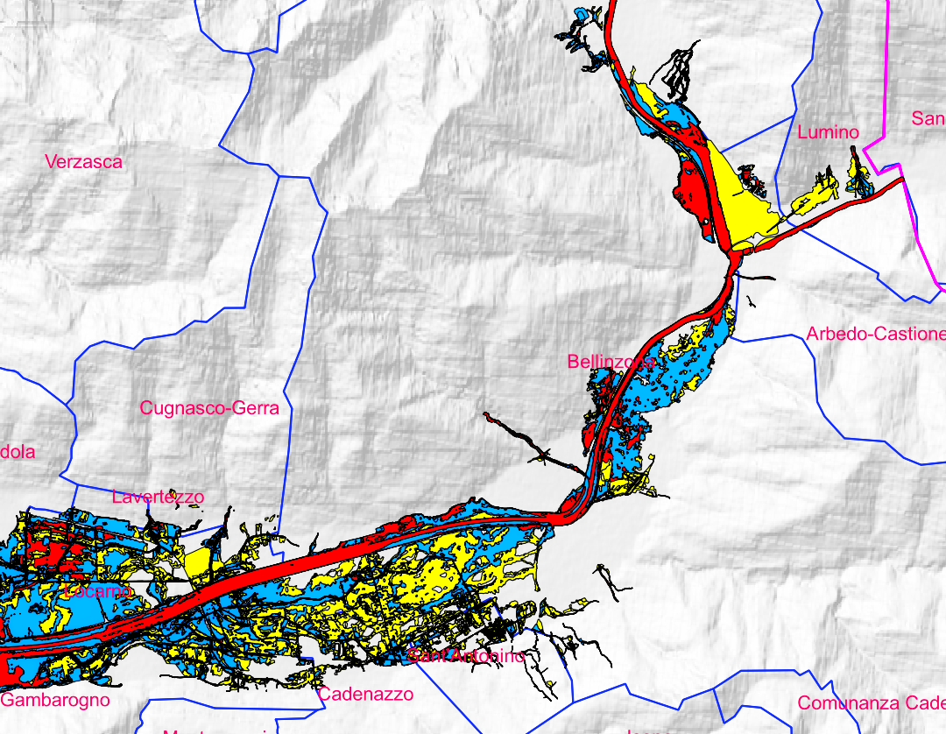
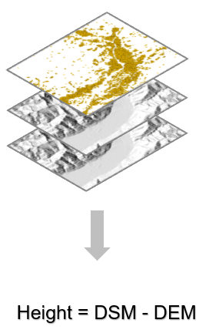
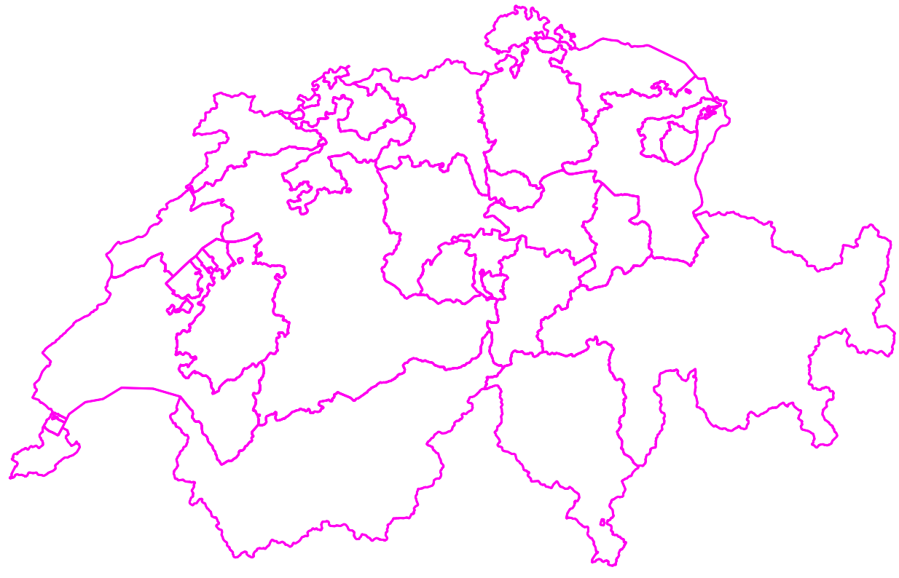
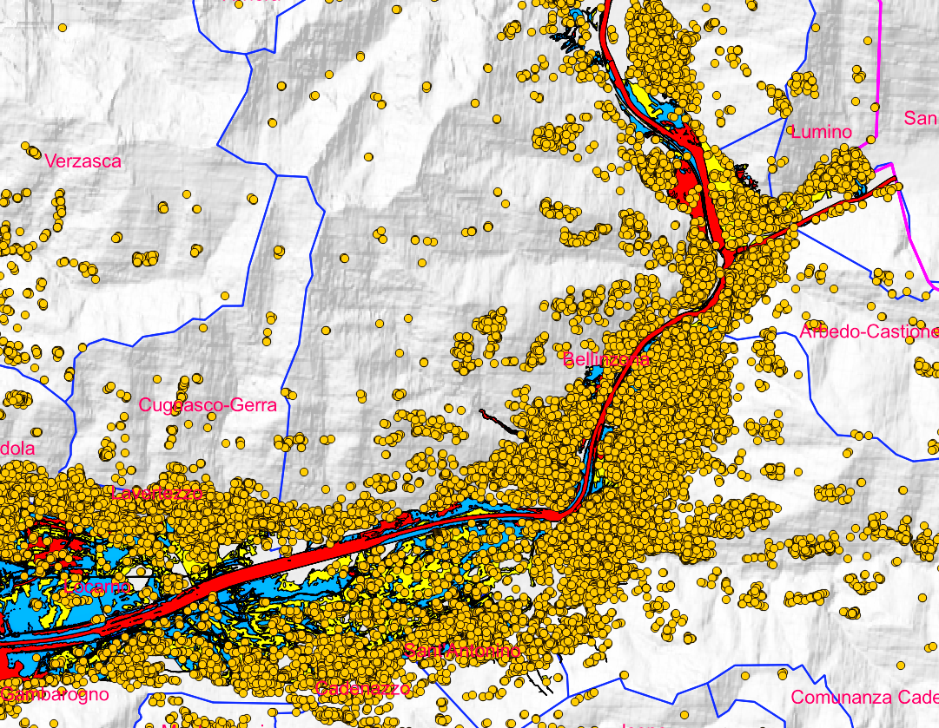
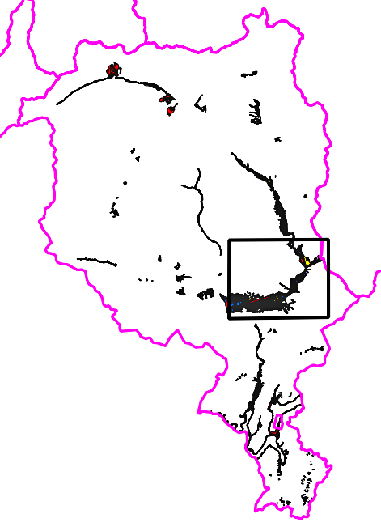
Materials and methods – open data
Hazard intensity
Rockfall (kJ)
Debris flow (m)
Buildings
Canton limits
High
> 300
> 2.0
Mean
30 – 300
0.5 – 2.0
Low
0 – 30
0 – 0.5
Sources: Swiss Federal Statistical Office: https://www.housing-stat.ch/fr/madd/public.html#acces_via_url | https://geodienste.ch/downloads/gefahrenkarten

Slide 5
Materials and methods – Risk estimation
$$R i, j \left(CHF/Year\right)=f j∗sPrAj∗V i,j∗W i \left(CHF\right)$$
$R i, j$ = Risk of an object $i$ for a hazard scenario $j$
$f j$ = Frequency of the scenario $j$
$sPrA j$ = Spatial probability of occurrence of scenario $j$
$Vi,j$ = Vulnerability of object $i$ for the intensity scenario $j$
$W i$ = Monetary value of the object $i$
Sources: Valdorisk/Riskko
Notes:
The risk estimation was calculated following the Swiss method and is the result of the product of:

Slide 6
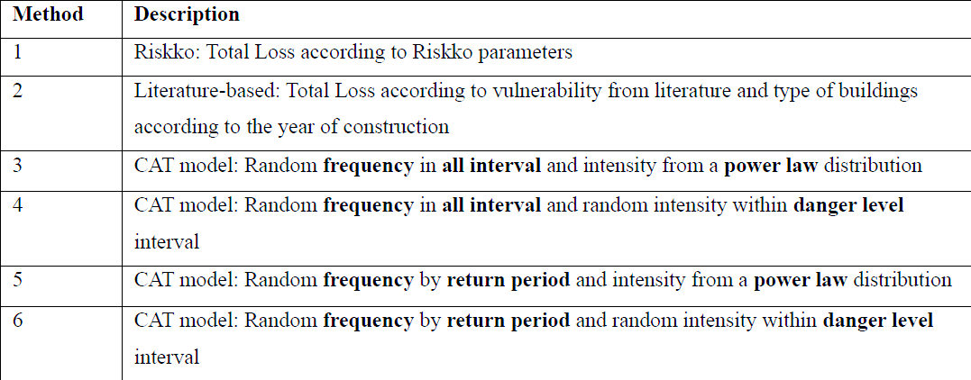
Materials and methods – Vulnerability assessment
Notes:
6 methods were developed to assess the buildings vulnerability. First method is based on the same values used by the Swiss Riskko application.
Second method is literature–based. Vulnerability according to the type of building assigned based on the year of construction.
Methods 3, 4, 5 and 6 are assessed using catastrophic models using the Monte Carlo simulation to add a probabilistic approach by generating random frequency and vulnerability values.

Slide 7
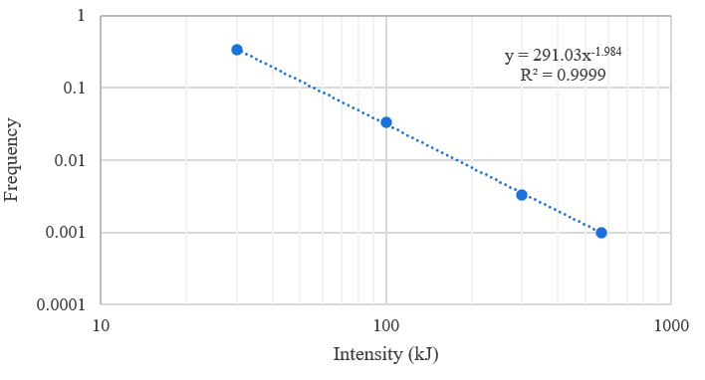
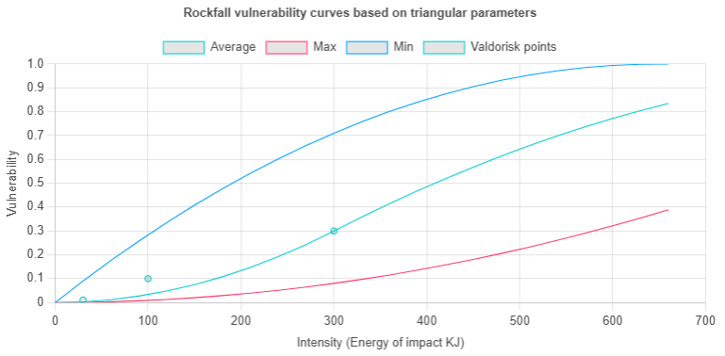
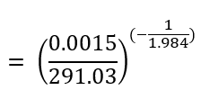
Materials and methods – Vulnerability (Catastrophe model / Monte Carlo simulation)
Triangular distribution
Power law distribution
3 parameters a=lowest; b = Highest; c = Most likely
RP =30
Random frequency
All interval
Random vulnerability
Min - Max
RP = 100
0,4
RP = 300
Low
Mean
High
Method 3
Random frequency [0.0010 – 0.3333]
= 0.0015
Intensity (kJ)
= 412,6 kJ
Example
Method | Frequency | Vulnerability
3 | 0,0015 | 0,4
Return Period | Danger Level
30 | Mean
Source: (Jaboyedoff, 2021)
Notes:
First, a power law distribution was created based on the frequency and related intensity, for rockfall and debris flow.
Second, the triangular distribution was used to construct max and min vulnerability curves based on 3 parameters obtained from expert opinion.
Here is an example of a scenario with a return period of 30 years with a mean intensity danger level.
For Method 3 random values were generated within all interval of frequency. The power law equation was used to compute the intensity and for that intensity, a vulnerability values is generated between min and max vulnerability curves.

Slide 8
Materials and methods – Vulnerability (Catastrophe model / Monte Carlo simulation)
Triangular distribution
Power law distribution
3 parameters a=lowest; b = Highest; c = Most likely
RP =30
Random frequency
All interval
RP = 100
Random vulnerability
Min - Max
RP = 300
0,2
Low
Mean
High
Method 4
150
Random frequency [0.0010 – 0.3333]
= 0.0015
Random intensity [100 – 300]
Example
Method | Frequency | Vulnerability
3 | 0,0015 | 0,4
4 | 0,0015 | 0,2
Return Period | Danger Level
30 | Mean
Source: (Jaboyedoff, 2021)
Notes:
Method 4, uses the same frequency as method 3 and randomize a frequency between min and max of danger level and for that frequency a vulnerability value is also randomized between min and max curves.

Slide 9
Materials and methods – Vulnerability (Catastrophe model / Monte Carlo simulation)
Triangular distribution
Power law distribution
3 parameters a=lowest; b = Highest; c = Most likely
Random Return Period
RP =30
RP = 100
Random vulnerability
Min - Max
RP = 300
0,1
Low
Mean
High
Method 5
Random frequency [0.033 – 0.3333]
= 0.1746
I$ntensity={\left(\frac{0,1746}{291.03}\right)}^{\left(\frac{1}{1.984}\right)}$
= 42
Example
Method | Frequency | Vulnerability
3 | 0,0150 | 0,4
4 | 0,0150 | 0,2
5 | 0,1746 | 0,1
Return Period | Danger Level
30 | Mean
Source: (Jaboyedoff, 2021)
Notes:
In Method 5 the frequency is generated within the intervals of the return period and uses the power law distribution to compute the intensity which is then used to randomize a vulnerability value.

Slide 10
Materials and methods – Vulnerability (Catastrophe model)
Triangular distribution
Power law distribution
3 parameters a=lowest; b = Highest; c = Most likely
Random Return Period
RP =30
RP = 100
0,5
Random vulnerability
Min - Max
RP = 300
Low
Mean
High
Method 6
250
Random frequency [0.033 – 0.3333]
= 0.1746
Random intensity [100 – 300]
Example
Method | Frequency | Vulnerability
3 | 0,0150 | 0,4
4 | 0,0150 | 0,2
5 | 0,1746 | 0,1
6 | 0,1746 | 0,5
Return Period | Danger Level
30 | Mean
Source: (Jaboyedoff, 2021)
Notes:
Method 6 uses the same frequency as method 5 and randomize a frequency between min and max of danger level and for that frequency a vulnerability value is also randomized between min and max curves.

Slide 11
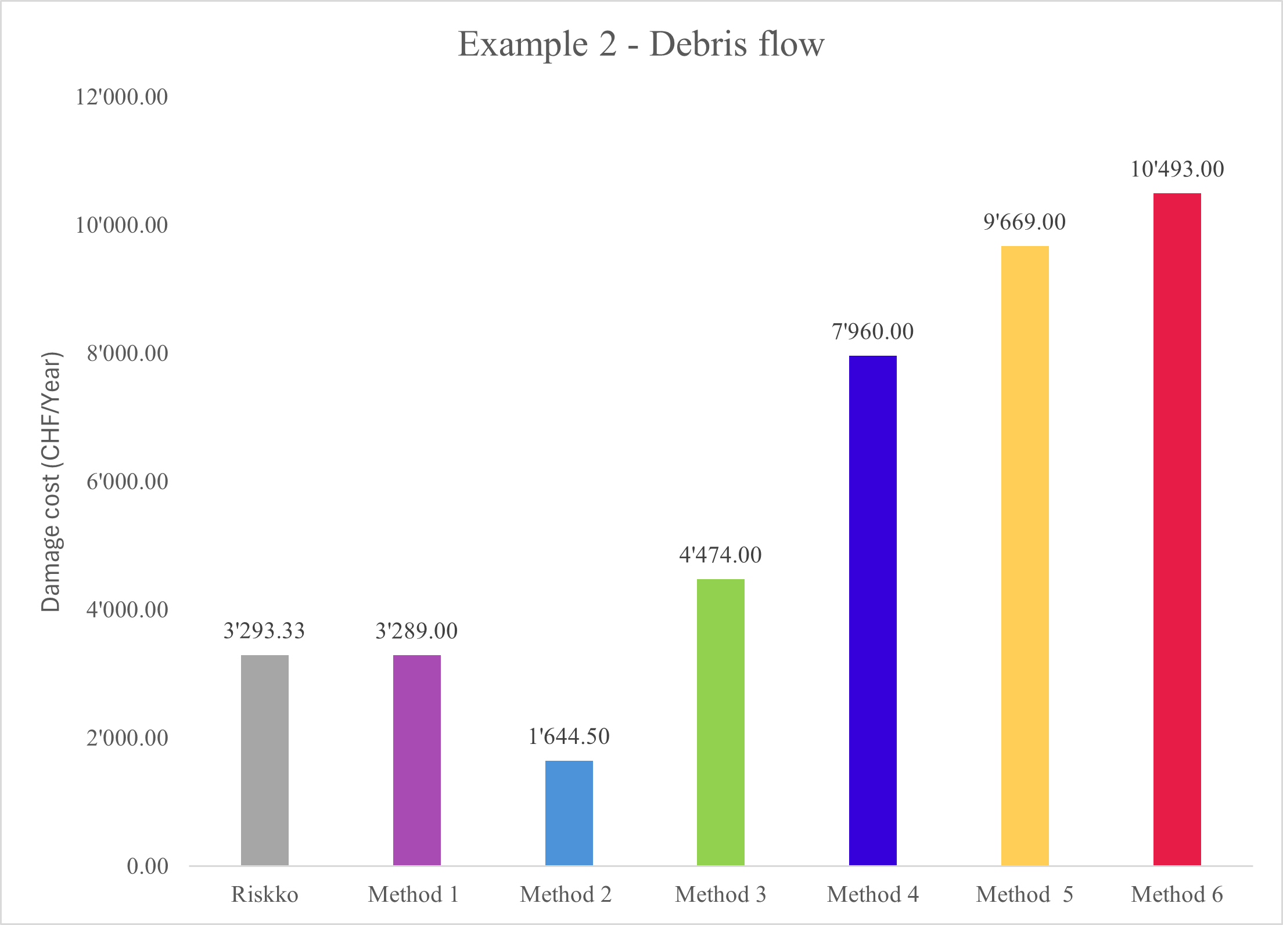
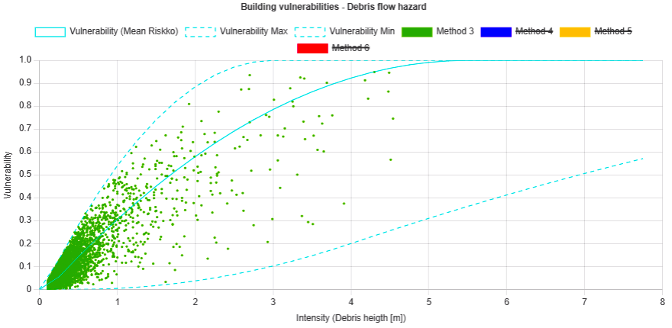
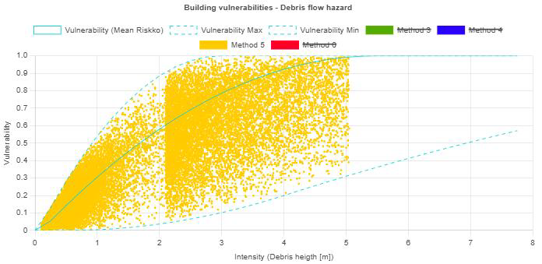
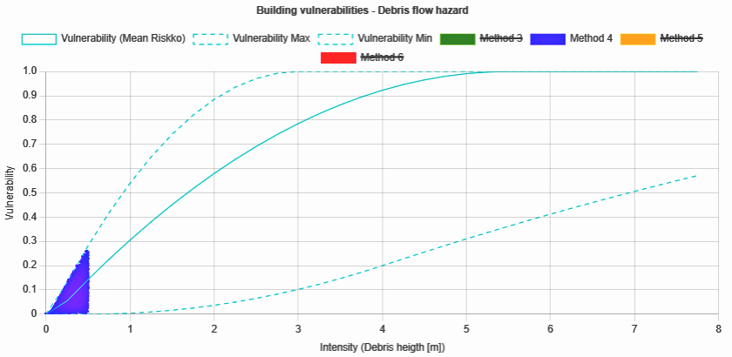
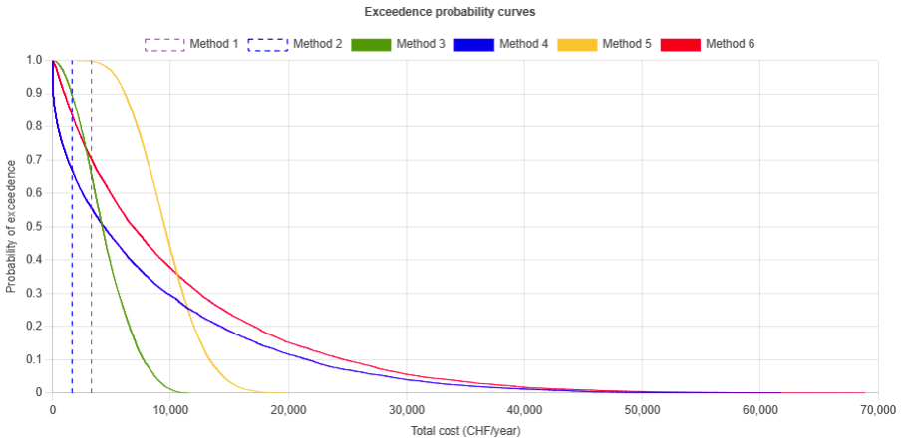
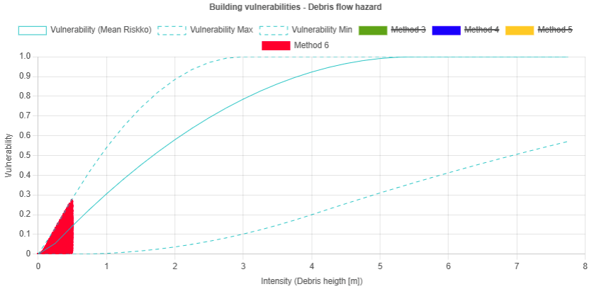
Results (Monte Carlo simulation)
Average values by method
1 building with 10’000 simulations (Debris flow)
Return Period | Danger Level
30 | Low
100 | Low
300 | Low
Method 3
Method 4
Method 5
Method 6
Vulnerability
Exceedance probability curves
Intensity (m)
Notes:
Or each building, the Monte Carlo approach with 10.000 simulations was used and here is the result for a building exposed to a debris flow hazard for 3 different return periods with low intensity danger level. Here are the vulnerability values generated with metho 3. Method 4, method 5, method 6.
The risk values are sorted in ascending order and plotted against their cumulative percentage resulting the exceedance probability curve.
Method 1 and 2 are plotted as vertical lines and the averages of all methods are plotted in a bar graph.

Slide 12
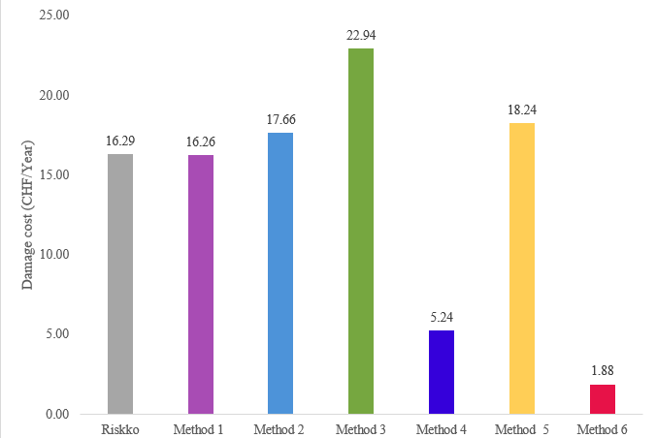
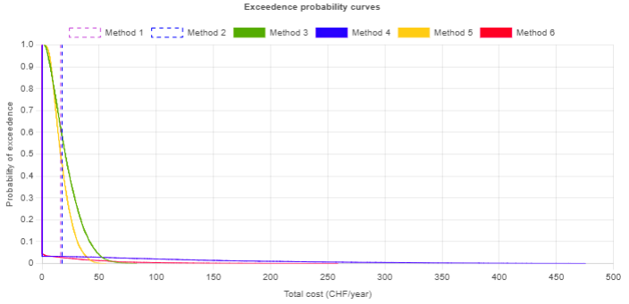
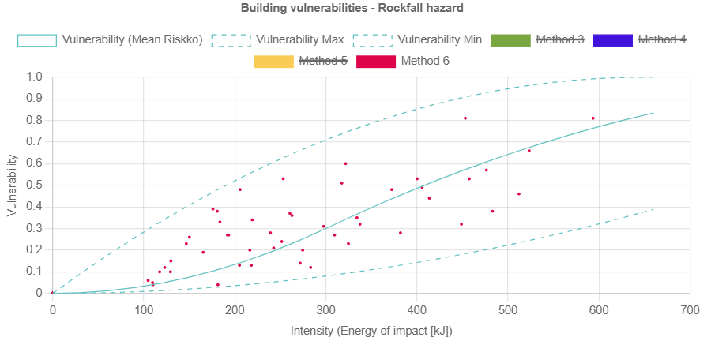
Results (Monte Carlo simulation)
Average values by method
1 building with 10’000 simulations (Rockfall)
Return Period | Danger Level
30 | Mean
100 | High
300 | High
Method 6
Vulnerability
Exceedance probability curves
Exceedance probability curves
Intensity (m)
Notes:
Or each building, the Monte Carlo approach with 10.000 simulations was used and here is the result for a building exposed to a debris flow hazard for 3 different return periods with low intensity danger level. Here are the vulnerability values generated with metho 3. Method 4, method 5, method 6.
The risk values are sorted in ascending order and plotted against their cumulative percentage resulting the exceedance probability curve.
Method 1 and 2 are plotted as vertical lines and the averages of all methods are plotted in a bar graph.

Slide 13
Conclusion & Future perspectives
Conclusion
The application adds probabilistic approaches which give more insight on the variability of the risk assessment
The probabilistic methods can provide more options to decision-makers when faced with scarcity of data
The application allows the user to select a geographical area of interest to perform an analysis
It automatically retrieves data from hazards maps and buildings
Future perspectives
Include evaluation of potential loss of life
Extend analysis to other hazards (flooding, avalanches, earthquakes, etc.)
Possibility to introduce building replacement cost
Export of PDF report with organized information and risk map

Slide 14
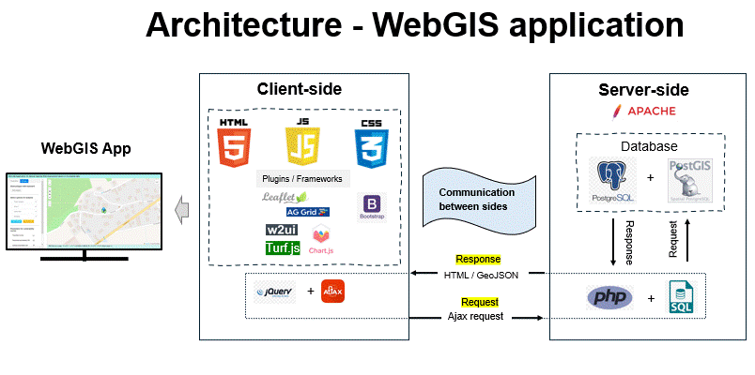
Hélder PEIXOTO helderasp@hotmail.com

