Slide 1
Stratospheric subtropical transport barriers: climatology, variability, and trends
Oksana Ivaniha (1), Marta Abalos (1), Natalia Calvo (1), Gabriele P. Stiller (2), Kasturi Shah (3), Sean Davis (4)
Department of Earth Physics and Astrophysics, Universidad Complutense de Madrid, Madrid, Spain
Karlsruhe Institute of Technology, IMK, P.O. Box 3640, 76021 Karlsruhe, Germany
Department of Applied Mathematics and Theoretical Physics, University of Cambridge, Wilberforce Road, Cambridge CB3 0WA
NOAA Chemical Sciences Laboratory, Boulder, CO, USA
Notes:
Greatings. I'm Oksana Ivaniha from the Universidad Complutense de Madrid, and today I’ll be presenting our work on stratospheric subtropical transport barriers, using a combined approach of model simulations and satellite observations. This study explores their climatology, interannual variability, and trends, focusing particularly on how different diagnostics capture these barriers and what they reveal about stratospheric transport processes.

Slide 2
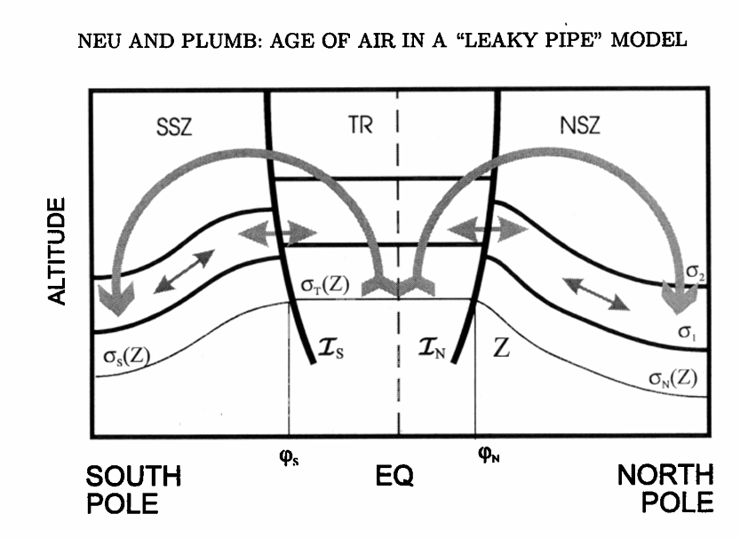
Subtropical transport barriers (STBs)
Chemical (or tracers based) metrics:
Long-lived tracers: N₂O, CH₄, and SF₆ (and AoA)
1-Sigma
Gradient Weighted Latitude (GWL)
Probability Distribution Functions (PDFs)
Dynamical metrics:
Residual Circulation Zero Crossing (𝑤* = 0)
Zonal Wind Zero Crossing (ū = 0)
Maximum Gradient of Equivalent Length (EQLEN)
Task: Analysis of STBs climatology, variability and trends using WACCM, ERA5 and satellite (MLS and MIPAS) data.
Notes:
Subtropical transport barriers are critical interfaces in the stratosphere that separate tropical upwelling regions from the dynamically active midlatitudes.
To capture the barries, we used both tracer-based and dynamical metrics, applying them consistently to WACCM simulations, ERA5 reanalysis, and satellite observations from Aura MLS and MIPAS.
The tracer-based metrics include:
1-sigma: where tracer values deviate 1 standard deviation from the tropical mean.
Gradient Weighted Latitude (GWL): which identifies the latitude of the strongest meridional gradients.
PDF: based on minima in the tracer concentration probability distribution function.
These diagnostics reveal integrated transport effects—combining advection, mixing, and circulation.
In contrast, dynamical metrics target isolated processes:
The zero crossing of residual vertical velocity (w)* reflects the boundary between upwelling and downwelling.
The zero zonal wind line (ū = 0) marks the transition zone for Rossby wave propagation.
Equivalent Length MaxGrad (EQLEN) identifies regions of suppressed mixing, using Equivalent Length gradients.
This dual approach lets us assess how these methods compare—and whether they track the same features under seasonal, interannual, and long-term changes.

Slide 3
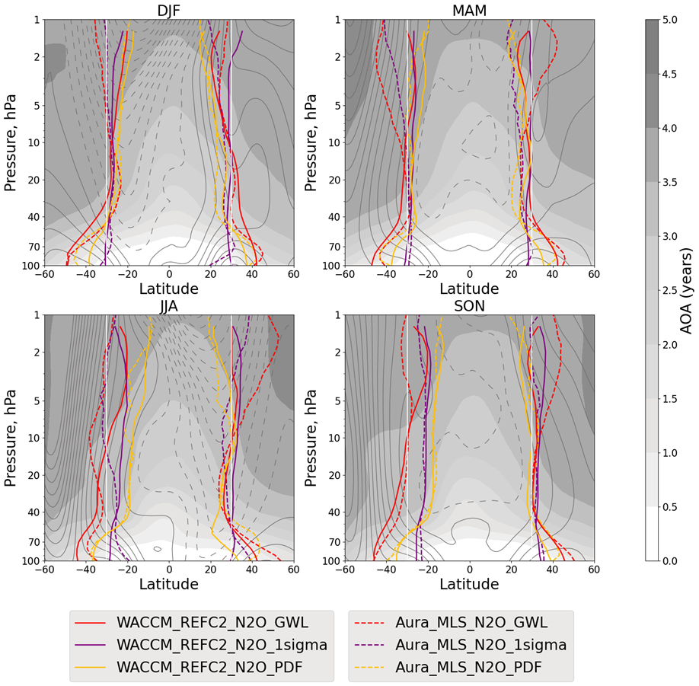
STB: Chemical metrics
Chemical STB is well defined between 50 and 5 hPa. Significant spread exists outside this pressure range.
Overall, there is a good agreement between WACCM and observations.
Boundaries display a seasonal shift toward the summer hemisphere.
In summer, the chemical boundaries are located over the maximum easterly winds, in the other seasons, they are located near the zero-wind line.
When using different tracers, the chemical metrics are robust in both observations and the model.
Notes:
The figure shows the 2004-2020 climatology of chemical (for N2O, defined before) subtropical barriers, along with AoA shading.
We found that tracer-based barriers are most robust between 50 and 5 hPa, the region we term the chemically coherent "tropical pipe".
Across seasons, these boundaries migrate toward the summer hemisphere, aligning with a core of easterly winds in summer and the zero-wind line in other seasons. What’s key is that different tracers provide consistent diagnostics in this range. The differences among different chemical metrics are bigger than among different tracers.
The model aligns well with observations below 10 hPa and above 70 hPa.
Discrepancies above 10 hPa are largely due to model limitations: for example, WACCM misses the SAO impact on the upper stratosphere.

Slide 4
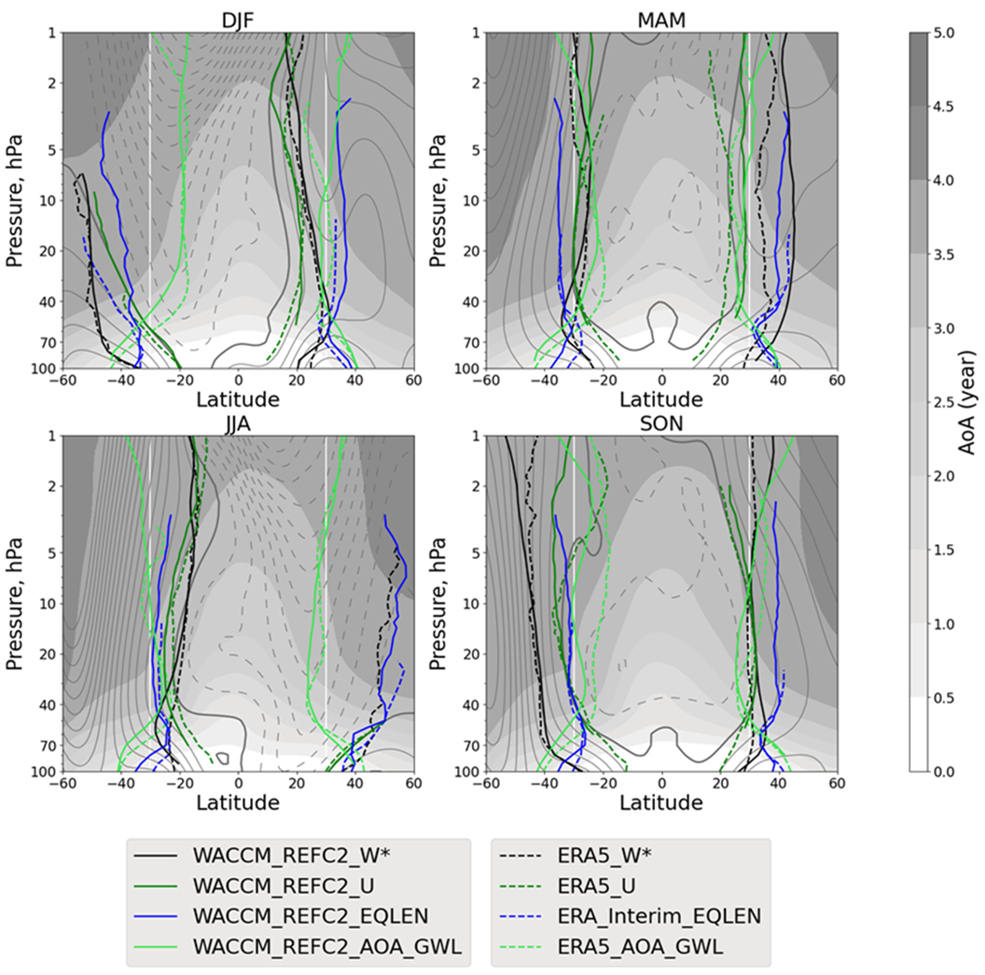
STB: Dynamical metrics
There is a larger spread among the dynamical metrics than among the chemical metrics.
Overall, there is a good agreement between WACCM and reanalysis.
Dynamical metrics display larger seasonal variability than chemical metrics and are not well-defined in the summer hemisphere.
The comparison of the dynamical metrics with the AoA metric highlights a discrepancy between tracer-based and dynamical STBs, which can reach up to 30° during summer.
Dynamical metrics reflect individual transport processes, while chemical metrics are related to the integrated net transport.
Notes:
On this slide, the figure is the same as previously, but for the dynamical metrics along with the chemical AoA metric.
Compared to chemical metrics, dynamical diagnostics show much more seasonal variability, and often break down in summer when winds turn easterly.
They also don't always track the tracer-defined barrier. For instance, the zero zonal wind line is undefined in the summer hemisphere due to easterlies, and the zero vertical wind is undefined near the equator because of the weak residual circulations.
This means that while dynamical metrics help us understand individual transport processes, they don’t always match the net transport patterns seen in tracer fields, especially during summer.

Slide 5
Impact of QBO on STB
In the winter hemisphere, the STB shifts towards the extratropics in the westerly QBO shear region (~50-20 hPa).
At higher levels, between approximately 15 and 2 hPa, STB shifts equatorward
This is due to the secondary residual circulation anomaly induced by QBO.
QBOE and QBOW shifts are opposite.
Latitude-pressure cross-sections of QBOE anomalies (QBOE composite minus climatology) for 2004-2020 of the STBs (tracer-based for N₂O)
Notes:
Next, we look at the QBO impact on subtropical barriers
The figure presented here shows latitude-pressure cross-sections of QBOE composite anomalies of subtropical barriers centered around +- 30 degrees, together with the QBOE composite anomalies of zonal wind (gray contours), residual circulation stream function (blue and red contours), and AoA QBOE composite (gray shading).
In the winter hemisphere, QBO easterlies strengthen the secondary meridional circulation. This induces poleward shifts in the barriers near 40 hPa, where younger air is advected into mid-latitudes. At higher levels—between 15 and 2 hPa—the residual circulation reverses, pulling older air equatorward and shifting the barriers toward the tropics.
These effects were clearly visible in both WACCM and observations and were consistent in all chemical metrics.

Slide 6
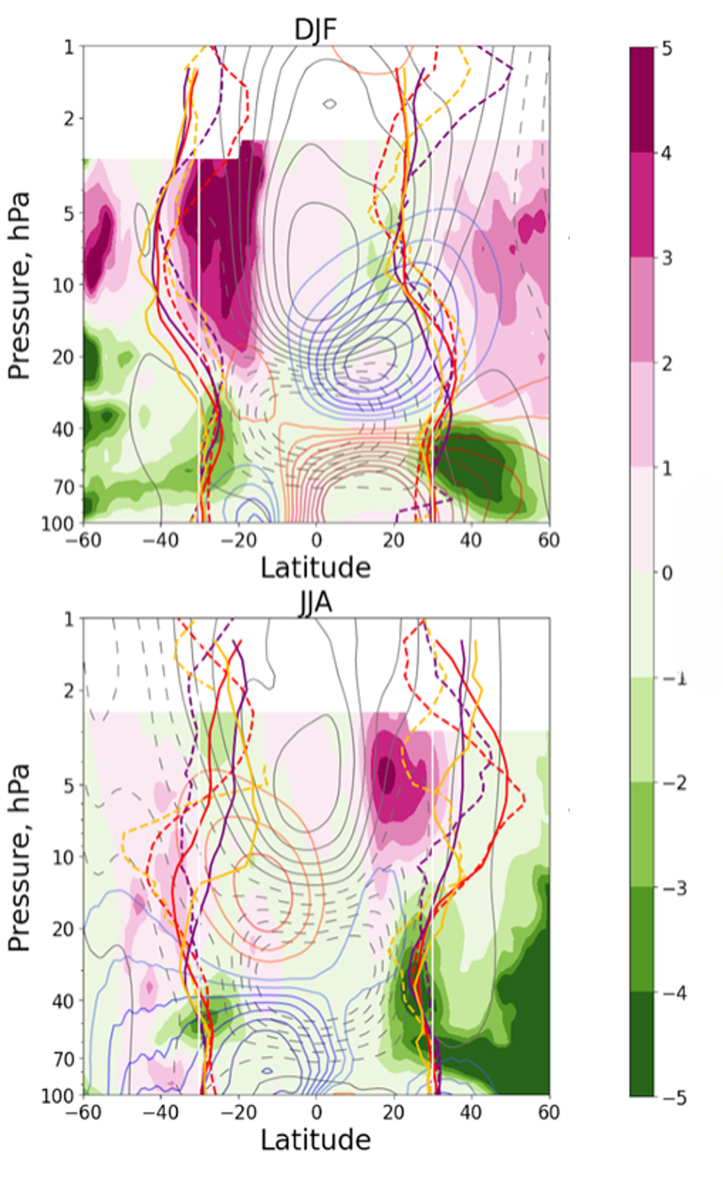
Impact of QBO on STB
The changes in summer hemisphere STBs are comparable in magnitude to those in the winter hemisphere and shift in the same direction.
This is linked to the increased mixing due to Rossby waves crossing the equator over the westerlies, as shown by the positive anomalies in effective diffusivity.
Overall, observational results for are largely consistent with the model simulations.
EQLEN PV
Notes:
Interestingly, in the summer hemisphere, barriers shifts were equally strong, but arose from a different mechanism: enhanced isentropic mixing.
Right Figure is similar to the left Figure but shows QBOE composited anomalies in equivalent length (EQLEN in shading). Positive EQLEN anomalies (pink shading) indicate increased contour elongation and mixing associated with enhanced wave breaking, while negative anomalies (green shading) suggest reduced mixing.
In the presence of QBO westerlies, Rossby waves can cross the equator, triggering mixing and flattening tracer gradients in the summer subtropics. This broadens the tracer transition zone and shifts the barriers poleward, even without a strong residual circulation anomaly.

Slide 7
Trends in STBs, 2004-2012
Southward shift of STB is observed in both hemispheres.
Observations
Notes:
Previous studies have found a significant southward shift of the tropical pipe during the early 21st century.
From 2004 to 2012, we also found a clear southward shift of the subtropical barriers in both hemispheres, as seen in tracer diagnostics from both MLS and MIPAS (down left panels).

Slide 8
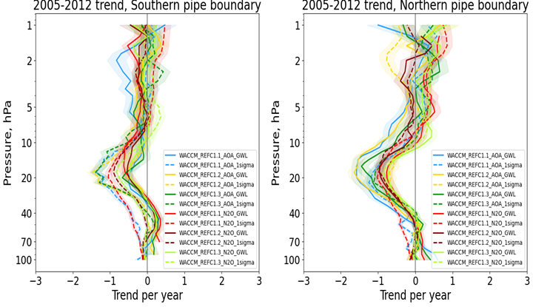
Trends in STBs, 2004-2012
Southward shift of STB is observed in both hemispheres.
WACCM with prescribed SST and QBO from observations can capture the trends, but they are smaller than in observations.
Observations
WACCM
Notes:
WACCM, with prescribed SSTs and QBO from observations, captures the direction of this trend but underestimates the amplitude (down-right panels).

Slide 9
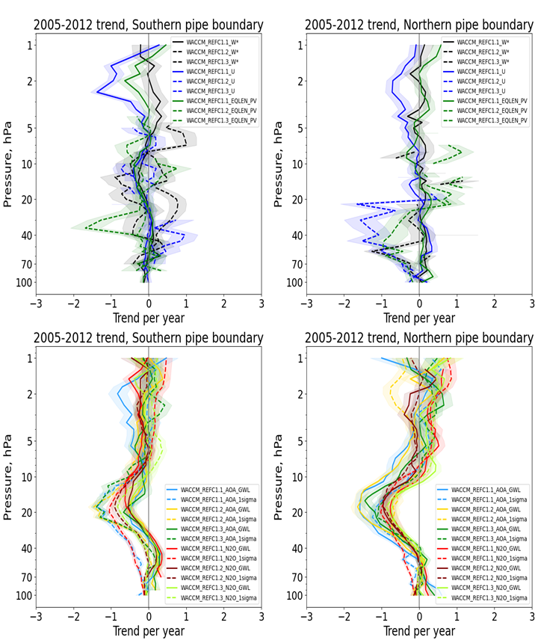
Trends in STBs, 2004-2012
Southward shift of STB is observed in both hemispheres.
WACCM with prescribed SST and QBO from observations can capture the trends, but they are smaller than in observations.
But these trends do not show up in the dynamical metrics
Notes:
These trends are not reflected in the dynamical metrics. This supports previous conclusions: chemical metrics integrate the full transport response, while dynamical ones are too localized to capture such long-term changes.
Moreover, this trend disappears over longer time periods, suggesting it is likely internal variability, not an externally forced climate signal.
The quantitative differences between observed and modeled trends may suggest additional variability not accounted for by the linear QBO or SST impacts.

Slide 10
Conclusions
Tracer-based metrics provide more robust and consistent diagnostics of subtropical transport barriers than dynamical metrics.
The QBO is the key driver of year-to-year STB variability, with residual circulation dominant in winter and mixing in summer.
Recent southward shifts in STBs from 2005 to 2012 are robust across datasets, are partially captured by models, and reflect internal variability.
Notes:
To conclude:
Tracer-based metrics provide the most robust and consistent diagnostics of subtropical transport barriers—especially below 10 hPa.
Dynamical metrics are valuable for understanding individual processes but are incomplete for trend detection.
The QBO is the key driver of year-to-year subtropical barriers from variability, with residual circulation dominant in winter and mixing in summer.
Recent southward shifts in subtropical barriers from 2004 to 2012 are real, robust across datasets, and partially captured by models, but disappear over longer timescales.
This work highlights the need for multi-metric and multi-dataset analyses to improve climate model evaluation and ensure reliable projections of future stratospheric transport.
Thank you for your attention.

