Slide 1
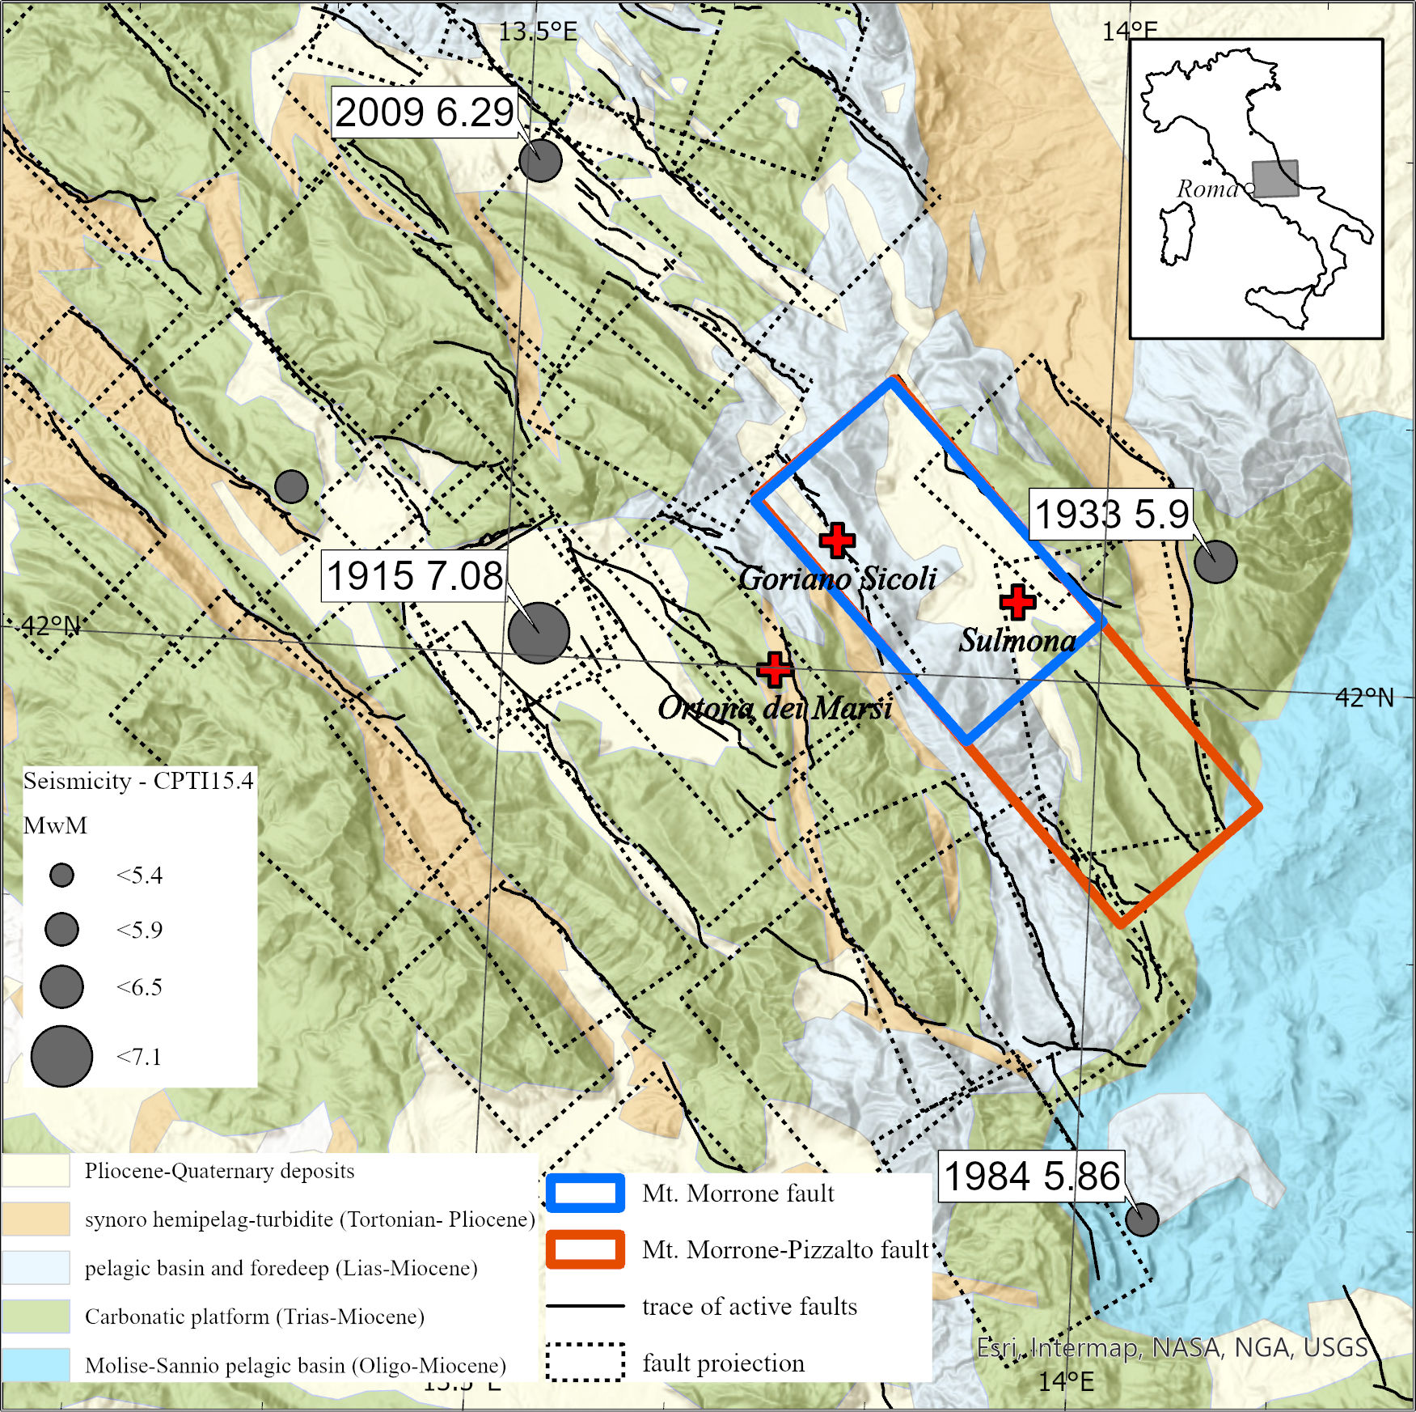
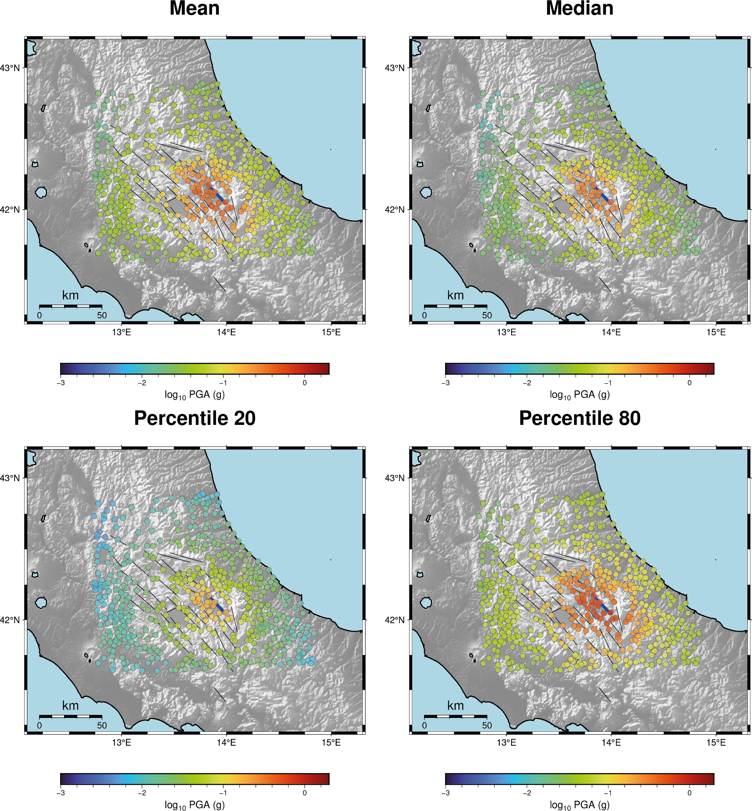
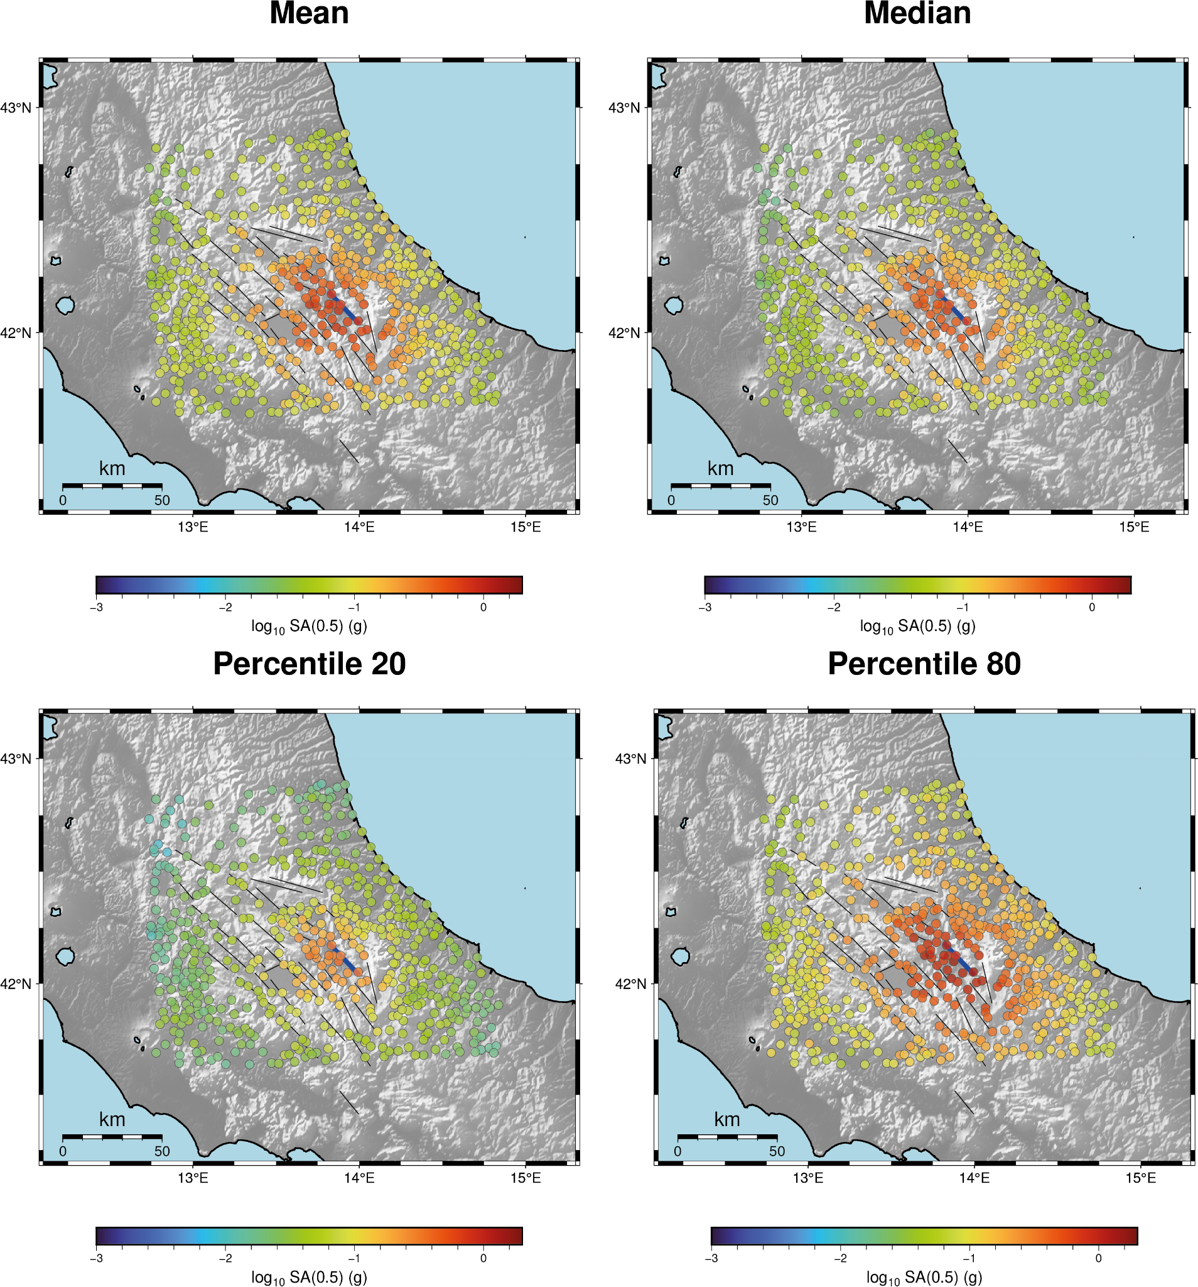
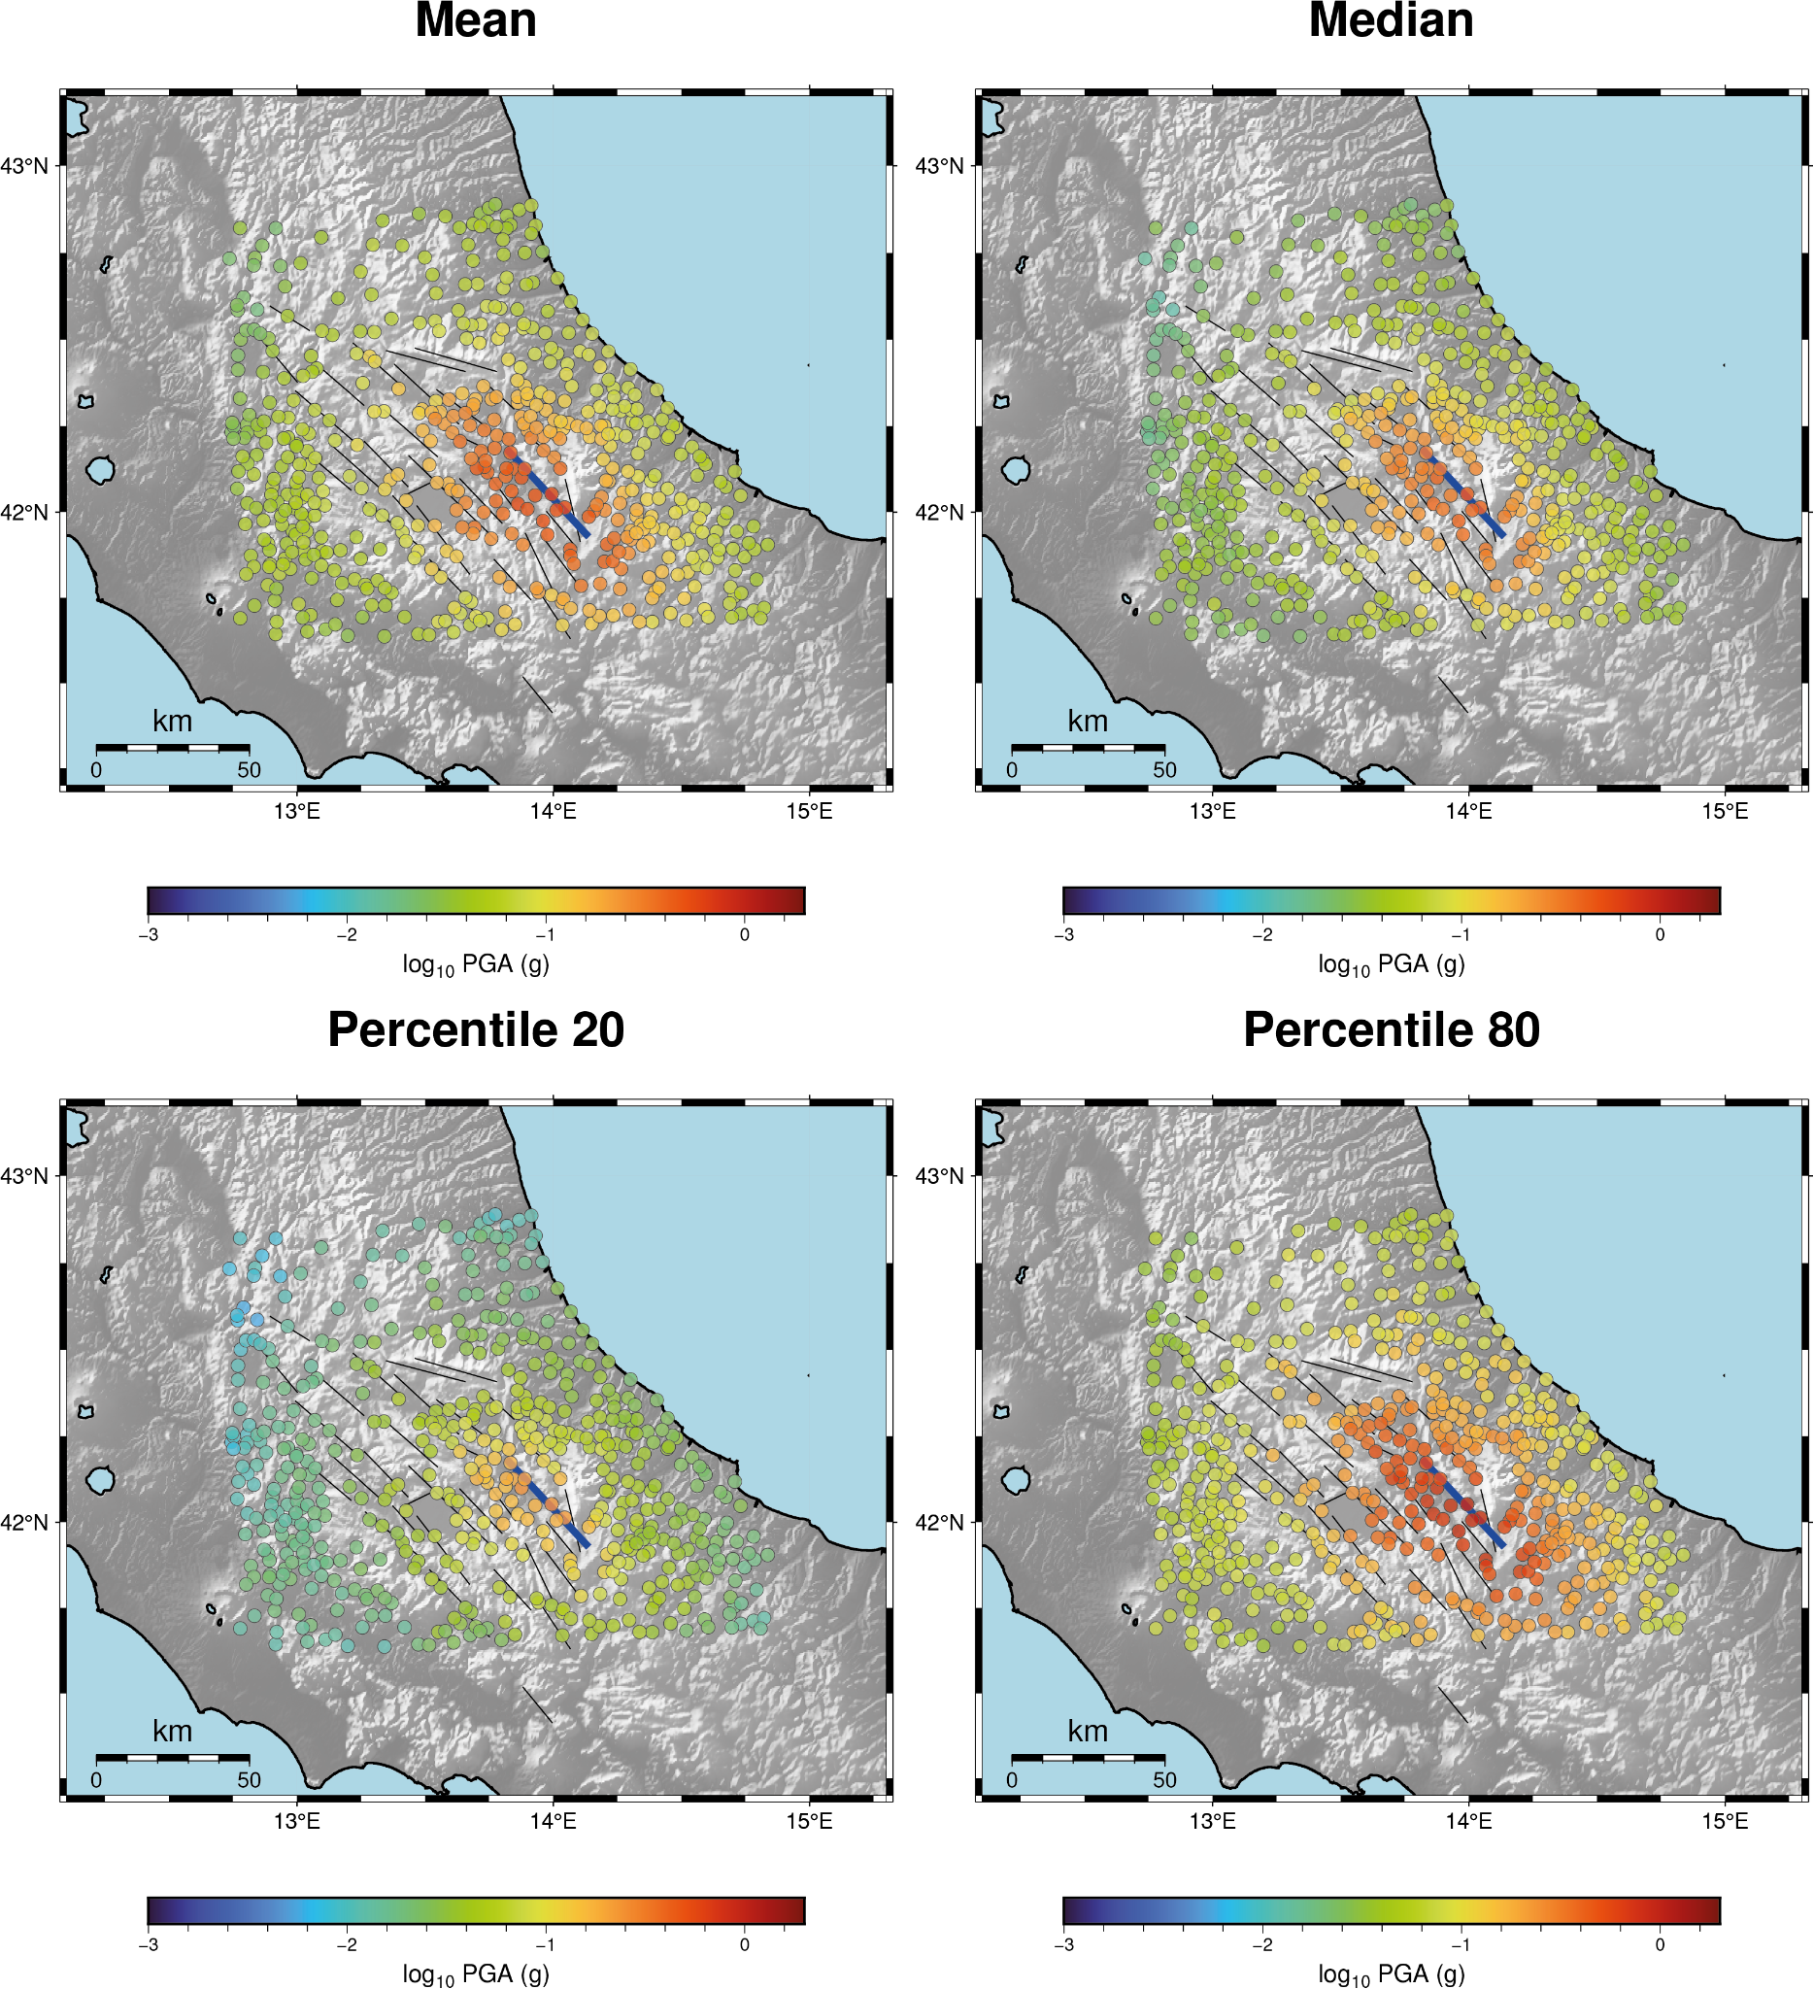
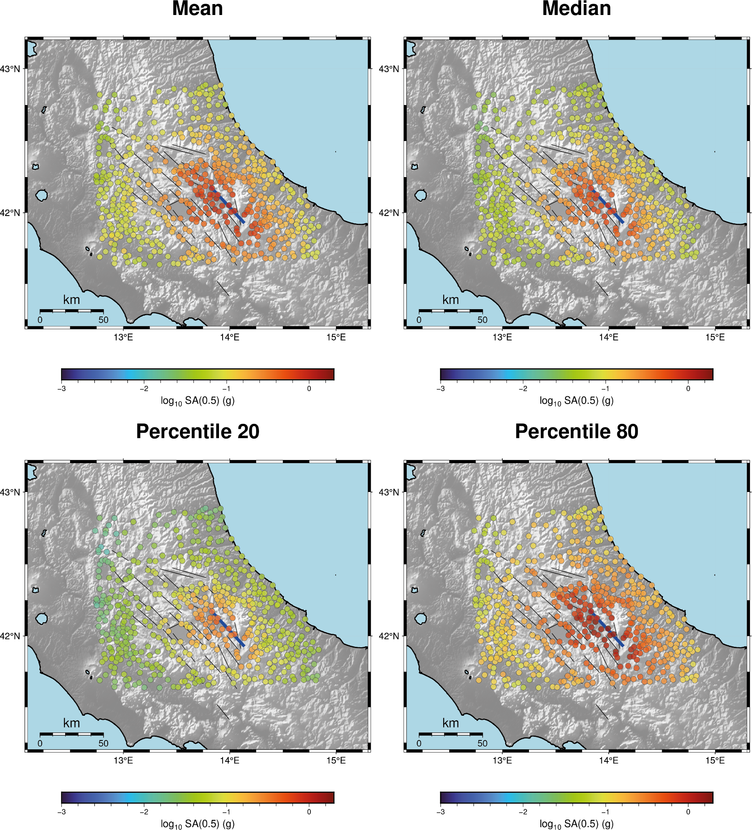
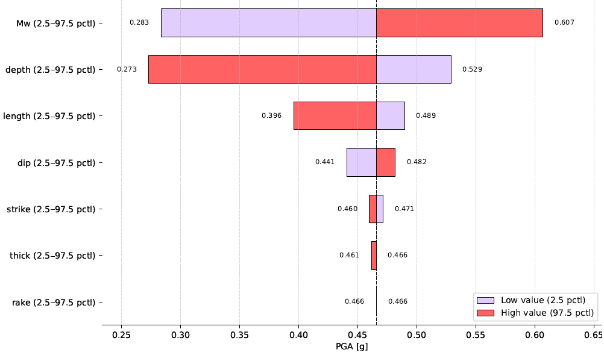
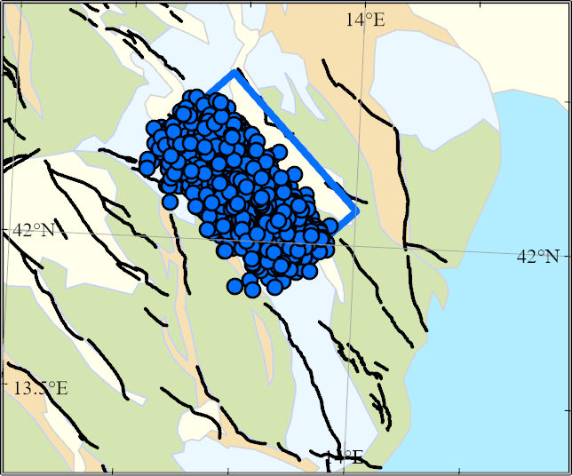
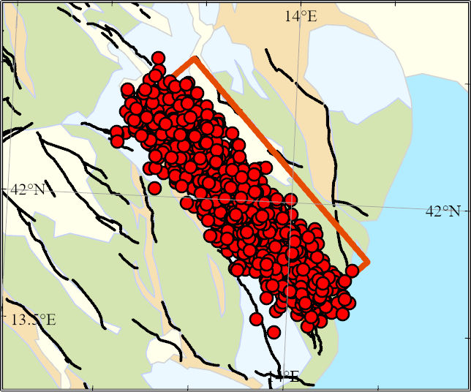
The Mt. Morrone seismotectonic source: analysis of fault model uncertainty for Ground Motion Prediction
Deborah Di Naccio¹ , Angela Stallone², Michele M. C. Carafa¹
1 Istituto Nazionale di Geofisica e Vulcanologia, L’Aquila, Italy; 2 Istituto Nazionale di Geofisica e Vulcanologia, Sezione di Bologna, Italy
INTRODUCTION
PROPAGATION OF SOURCE UNCERTAINTY TO GROUND MOTION ESTIMATES
Fault-based seismic hazard assessment relies critically on robust and accurate seismotectonic models to improve short-term and long-term forecasts. In this contribution, we focus on the Mt. Morrone active fault in the central Apennines (Carafa et al., 2020; 2022). This fault has a significant seismotectonic potential (Mw+6.7) but has remained silent over the past 1.8 kyr, posing relevant questions about its feature and associated hazards.
We explore the uncertainties affecting different components of the seismotectonic model, specifically comparing two alternative source scenarios: the single Mt. Morrone fault and the combined Mt. Morrone-Pizzalto fault system, which are in structural continuity.
To systematically address these uncertainties, we developed the HypoSmoothFault code, which generates multiple plausible source scenarios consistent with the considered fault models.
We assess the impact of seismic source uncertainty on ground-motion predictions (PGA and SA at various frequencies) using ProbShakemap. Specifically, we estimate PGA and SA values from the ground-motion model (GMM) by Lanzano et al. (2019) for 1,000 modeled rupture scenarios for the Mt. Morrone and Mt. Morrone-Pizzalto fault systems. To account for the inherent variability of the ground motion model, we generate 30 GMM realizations per Point of Interest (POI), resulting in 30,000 ground-motion fields at each POI.
Fig. A on the right shows main statistics of the predictive distributions for PGA and SA(0.5 s) for the Mt. Morrone (top) and Mt. Morrone-Pizzalto Fault system (bottom).
In Fig. B, we focus our analysis on three municipalities: Sulmona, situated on Quaternary continental deposits near the basin's eastern edge, and Goriano Sicoli and Ortona dei Marsi, both located on carbonate bedrock. Table 1 displays the p-value from the Kolmogorov-Smirnov test comparing the PGA and SA(0.5 s) distributions predicted by ProbShakemap for the Mt. Morrone single fault and the Mt. Morrone-Pizzalto fault system at the three municipalities. The test shows that the two distributions are significantly different across the three municipalities.
PGA
Mt. Morrone fault
SA(0.5s)
To propagate the model source uncertainty to ground motion prediction, we implement the ProbShakemap Python toolbox (Stallone et al., 2025). The resulting probabilistic seismic hazard assessment is applied across all municipalities within the Abruzzo region, with an in-depth analysis conducted on three municipalities exposed to seismic risk.
FAULT MODELS AND RUPTURE SCENARIOS
PGA
PGA
Mt. Morrone & Pizzalto faults
SA(0.5s)
The 3D characterization of active fault is inherently affected by uncertainties related to geometric and kinematic parameters as well as the seismic potential. To quantify these uncertainties systematically, we treat them in a probabilistic framework in which source parameters are described by smoothed boxcar probability density functions (PDFs).
Fault source model and associated uncertainties
dip
depth
thick
rake
Mt. Morrone fault
Mt. Morrone & Pizzalto faults
SA(0.5s)
length
strike
Mw
length
strike
Mw
We generate an ensemble of source scenarios by randomly sampling from these PDFs.
HypoSmoothFault Python code: Starting from a randomly selected upper midpoint of the fault surface, the code first samples along the fault thick, capturing the spatial uncertainty, then moves horizontally along the strike for half the fault length, identifying the upper tip of the fault plain. From this reference, the procedure continues along the strike for the full length and subsequently along the dip direction to the depth. The process is repeated to generate multiple realizations for the number of chosen fault plains. In our analysis, a total of 1000 scenarios.
This approach effectively accounts for and quantifies uncertainties, providing a comprehensive set of fault-ruptures models that reflect the complexity and variability inherent in the fault geometry and kinematics.
Fig. B - PGA (top) and SA(0.5s) (bottom) ProbShakemap predictive distributions at three municipalities: Sulmona, Goriano Sicoli and Ortona dei Marsi, for the Mt. Morrone single fault (orange) and the Mt. Morrone-Pizzalto fault system. Each distribution includes 30,000 ground motion fields (1,000 rupture scenarios x 30 realizations of the GMM by Lanzano et al., 2019).
Fig. A- Summary statistics (mean, median, 20th and 80th percentile) of the predictive distributions for PGA and SA(0.5 s) for the Mt. Morrone fault segment (top, thickened blue line in the figure) and the Mt. Morrone–Pizzalto fault system (bottom, thickened blue line in the figure). The other fault segments modeled for the area are shown as black lines.
 | Kolmogorov-Smirnov test p-value
 | SULMONA | GORIANO SICOLI | ORTONA DEI MARSI
PGA | 7.55e-96 | 4.59e-25 | 5.44e-100
SA(0.5s) | 1.54e-182 | 1.45e-63 | 2.67e-176
We conducted a sensitivity test on the PGA, as shown in the tornado Diagram in the left. For each parameter, we considered the 2.5, 50 and 97.5 pctls. The average model (50 pctl) is reported as dashed line.
Table 1 - p-values from the Kolmogorov-Smirnov test comparing the PGA and SA(0.5 s) distributions predicted by ProbShakemap for the Mt. Morrone single fault and the Mt. Morrone-Pizzalto fault system at three municipalities: Sulmona, Goriano Sicoli, and Ortona dei Marsi. At all sites, the distributions show very low compatibility.
Map of epicenters and 3D view of hypocenters for the two fault models.
CONCLUSIONS
REFERENCES
The 3D characterization of active faults, including geometric, kinematics, and seismic potential parameters, is crucial for accurate physics-based earthquake forecasts;
We introduced a rigorous probabilistic framework to systematically explore uncertainties related to the seismotectonic model (HypoSmoothFault Python code) and evaluate their impact on ground-motion predictions using ProbShakemap (Stallone et al., 2025);
Moving from a single fault rupture model to a multiple-fault model significantly affects the distributions of all Intensity measure types, as demonstrated by the Kolmogorov-Smirnov (K-S) test;
The influence of geometric, kinematics, and seismic potential parameters on PGA has also explored;
PGA and SA for the selected municipalities exhibit modal patterns, particularly at Sulmona and Goriano Sicoli, likely influenced by site effect.
Carafa, M.M.C., Di Naccio, D., Di Lorenzo, C., Kastelic, V., & Bird, P., (2022). A meta-analysis of fault slip rates across the central Apennines, Journal of Geophysical Research: Solid Earth, 127, e2021JB023252. https://doi.org/10.1029/2021JB023252.
Carafa, M. M. C., & Bird, P. (2016). Improving deformation models by discounting transient signals in geodetic data: 2. Geodetic data, stress directions,
and long-term strain rates in Italy. Journal of Geophysical Research: Solid Earth, 121, 5557–5575. https://doi.org/10.1002/2016JB013038.
Lanzano, G., Luzi, L., Pacor, F., Felicetta, C., Puglia, R., Sgobba, S., & D’Amico, M. (2019). A revised ground‐motion prediction model for shallow crustal earthquakes in Italy. Bulletin of the Seismological Society of America, 109(2), 525-540. https://doi.org/10.1785/0120180210
Stallone, A., Selva, J., Cordrie, L., Faenza, L., Michelini, A., Lauciani, V. (2025). ProbShakemap: A Python toolbox propagating source uncertainty to ground motion prediction for urgent computing applications. Computer and Geosciences, 195, 1057 48. https://doi.org/10.1016/j.cageo.2024.105748.

