Slide 1
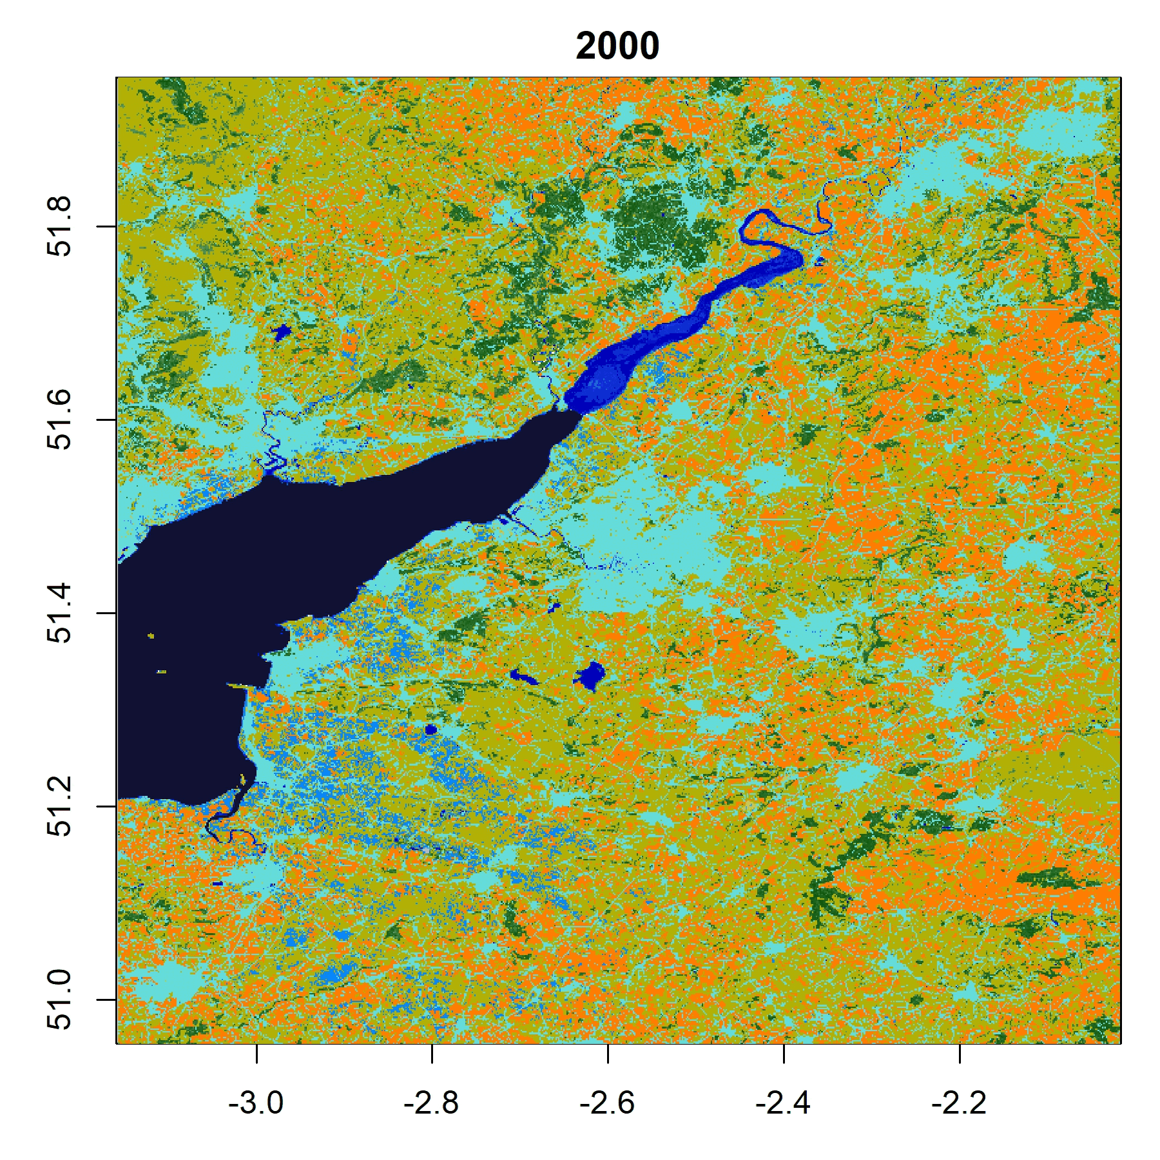
Interdisciplinary Probabilistic Downscaling
EGU25-12640
Land use representation design for Convection-Permitting Model Outputs
Weather Generator based on Generative AI
Potential Utility in Equitable,
Community-focused Climate Scenario-ing

