Slide 1
CASTLE
Contact: lorenza.cappellato@uniroma1.it
AIM
METHODOLOGY & RESULTS
LIMITATIONS
DATASETS
RESEARCH TEAM
FUTURE INSIGHTS
The PRIME Index
Prioritization of cultivated Regions IMpacted by drought in agriculturE

Slide 2
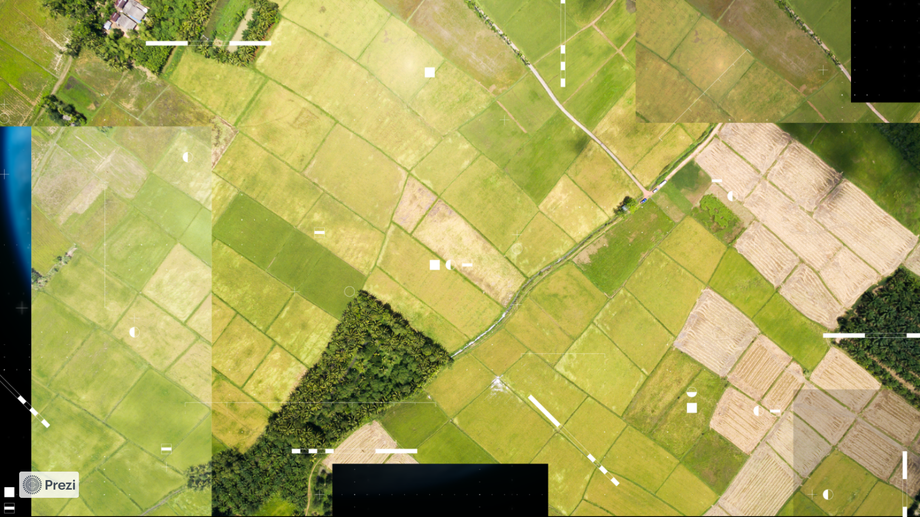
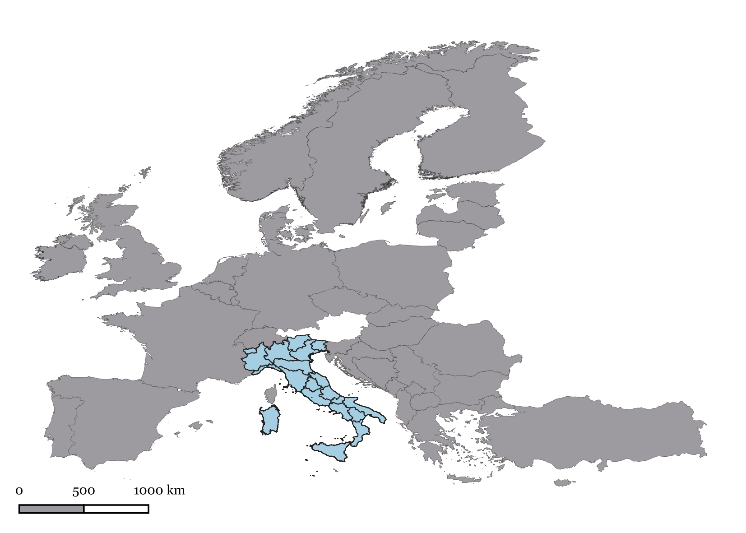
AIM
1. Evaluate the risk of agricultural drought using the Standardized Precipitation Evapotranspiration Index (SPEI), accurately calculated for each crop cultivated in Italy;
2. Identify the most vulnerable regions by classifying them according to a prioritization of intervention.
CASE STUDY: ITALY

Slide 3
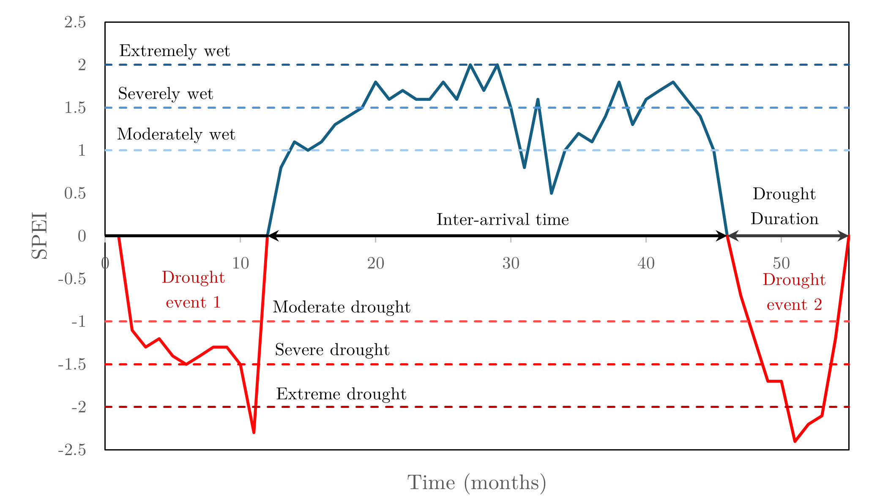
The SPEI Index
To objectively assess drought conditions in Italy, it is essential to use reliable indices capable of capturing both water deficits and their duration. Among the various indices available in the literature, the Standardized Precipitation Evapotranspiration Index (SPEI) was selected, as it simultaneously accounts for precipitation, evapotranspiration, and the severity of the water deficit.
Indeed, in the context of climate change, neglecting even one of these components can lead to significant inaccuracies in drought monitoring and forecasting.

Slide 4
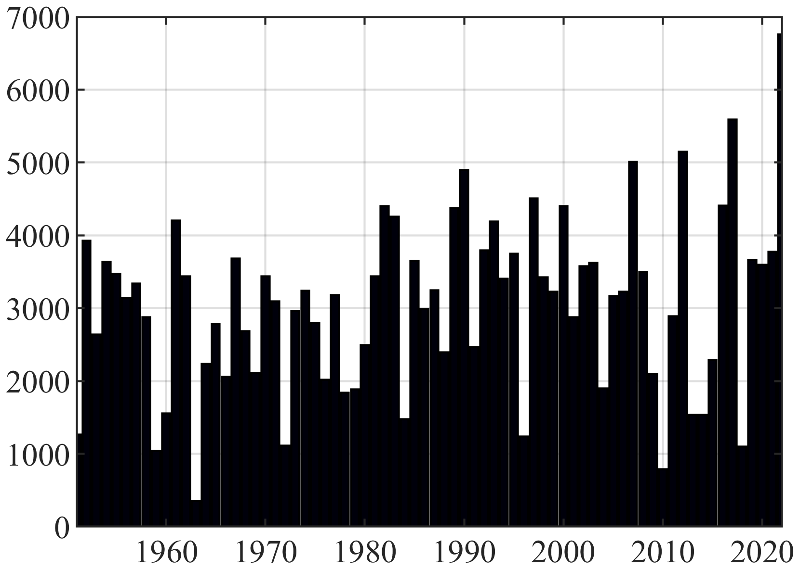
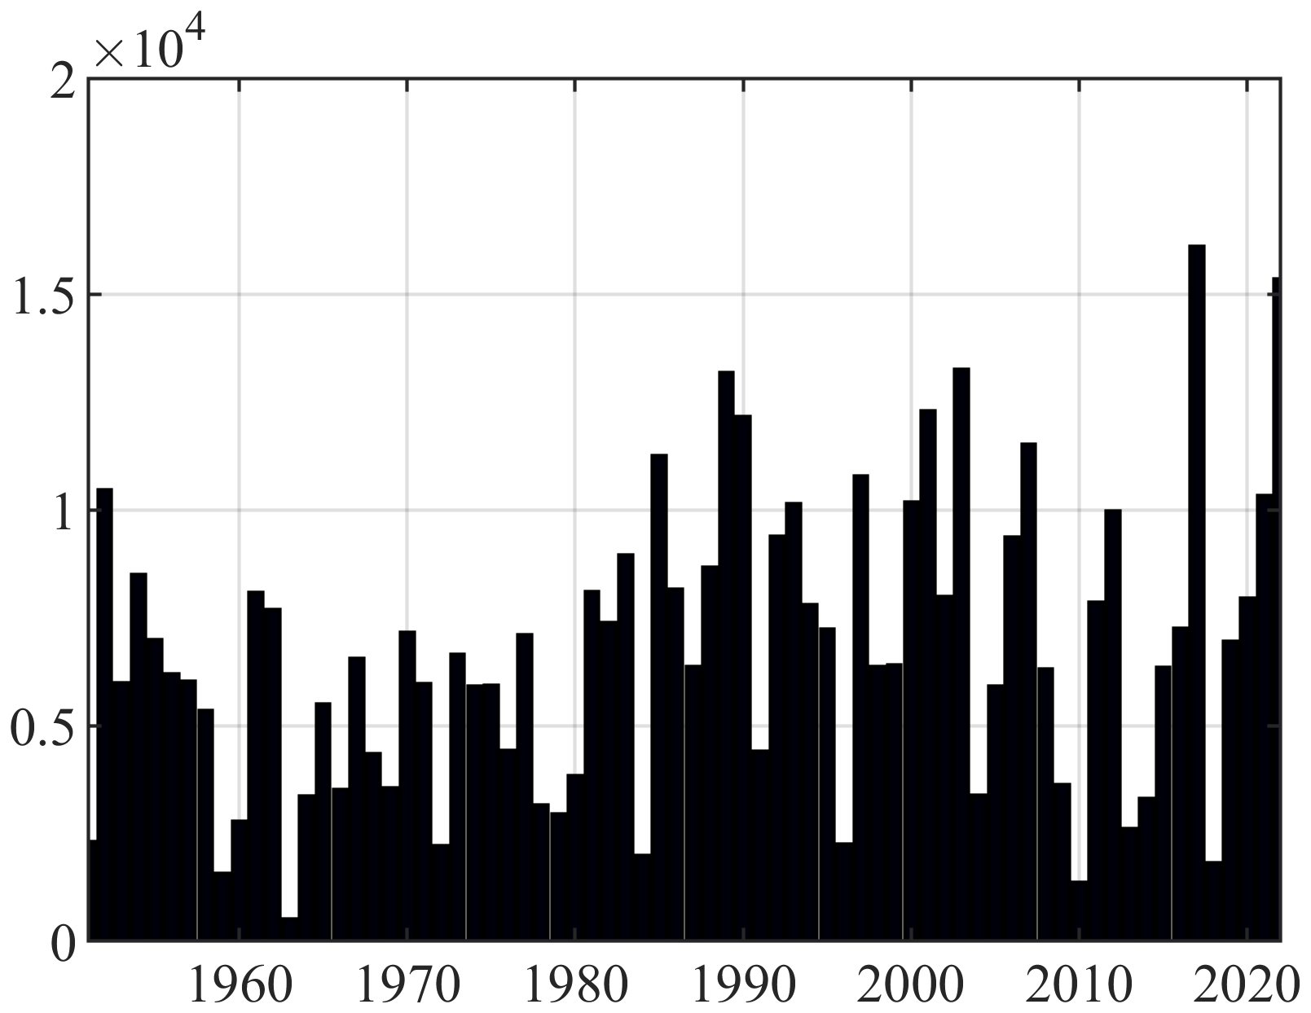
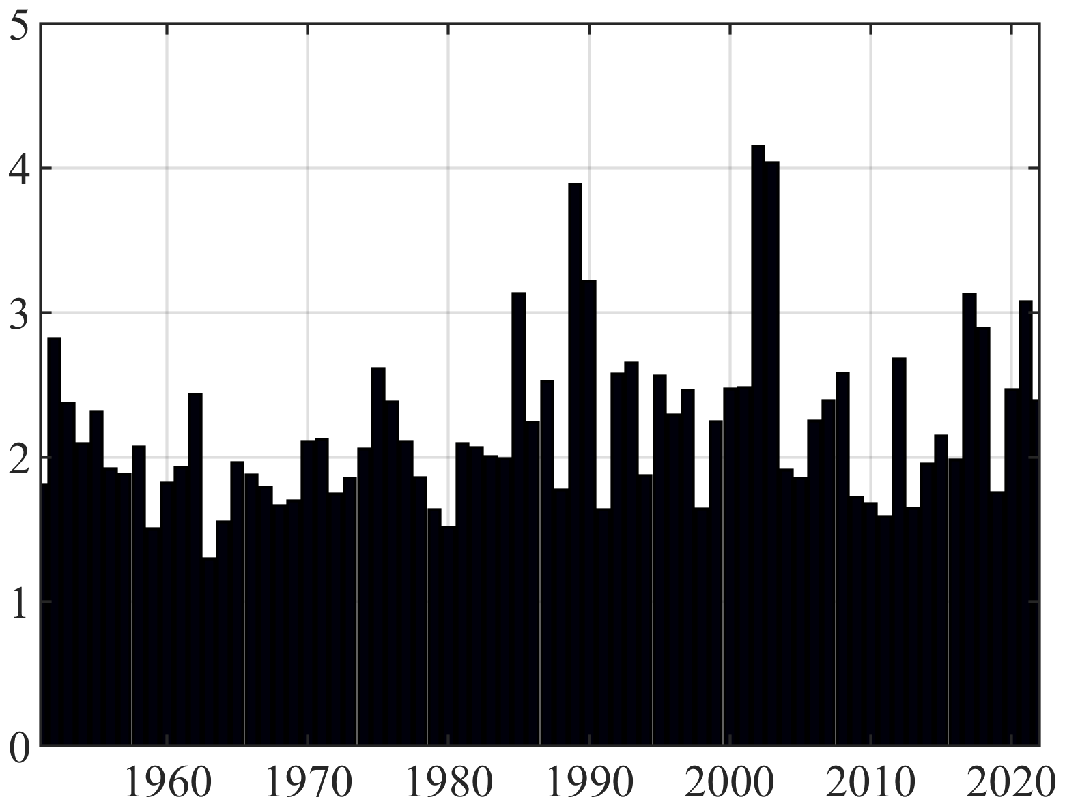
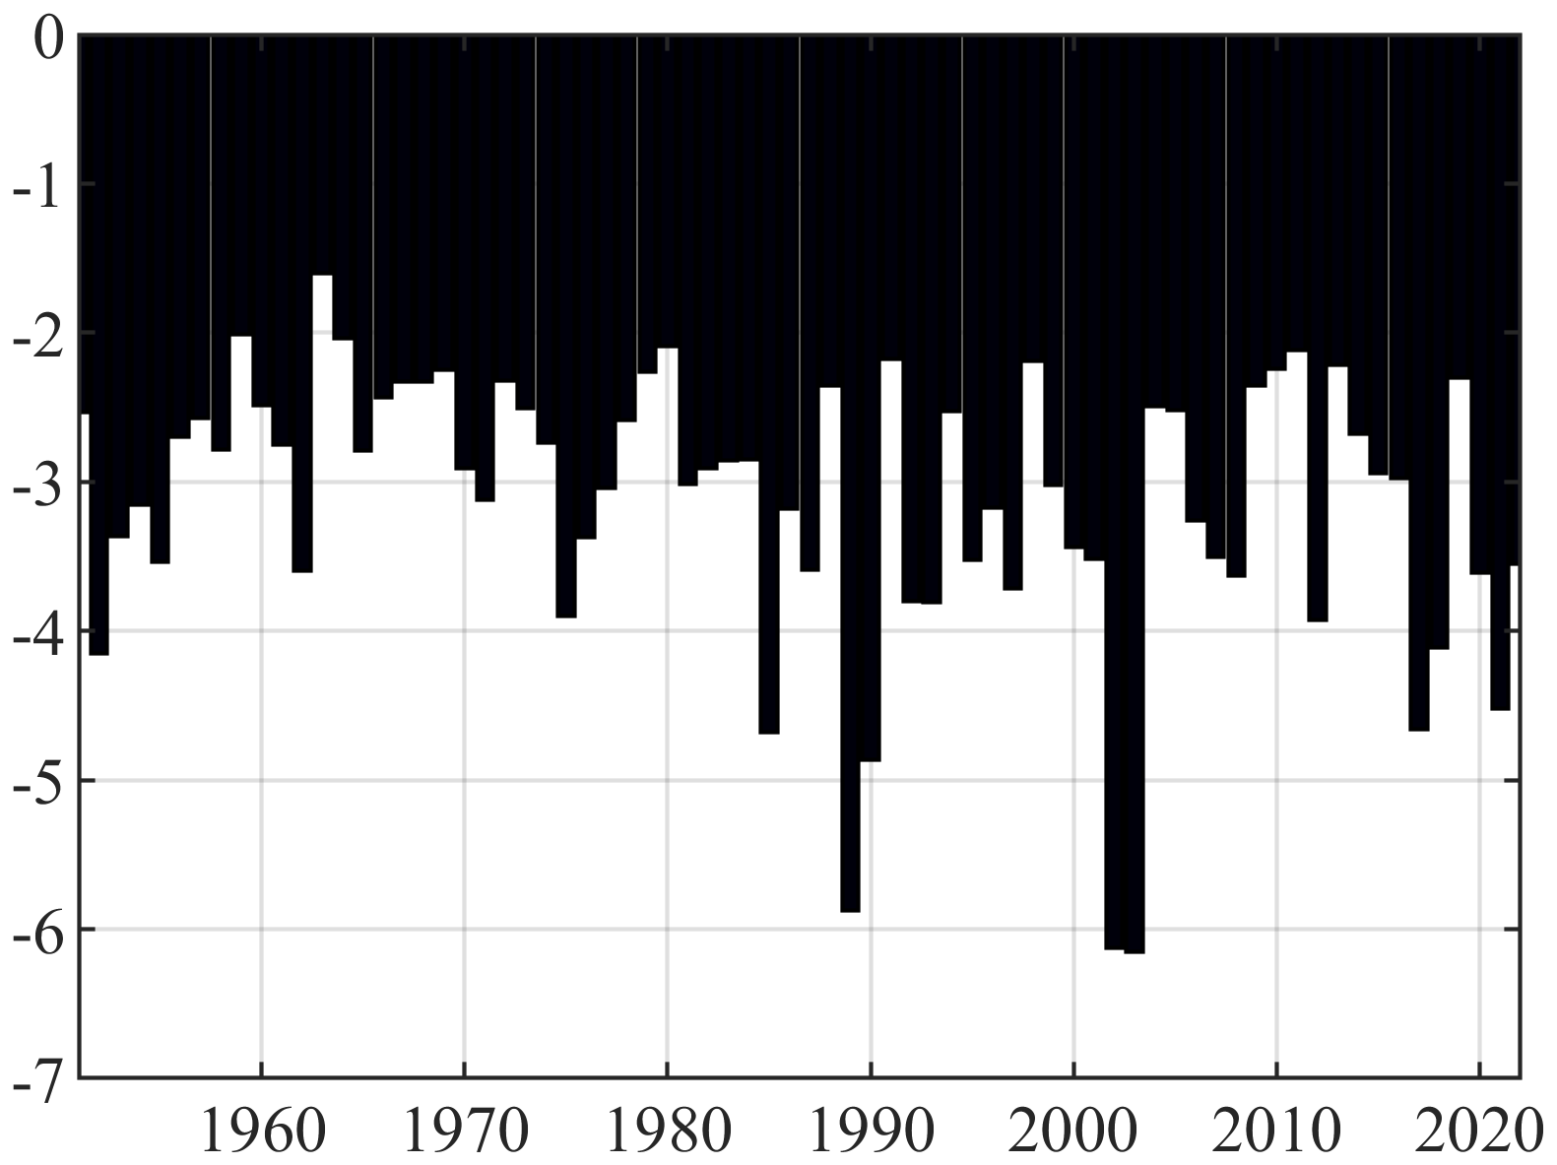
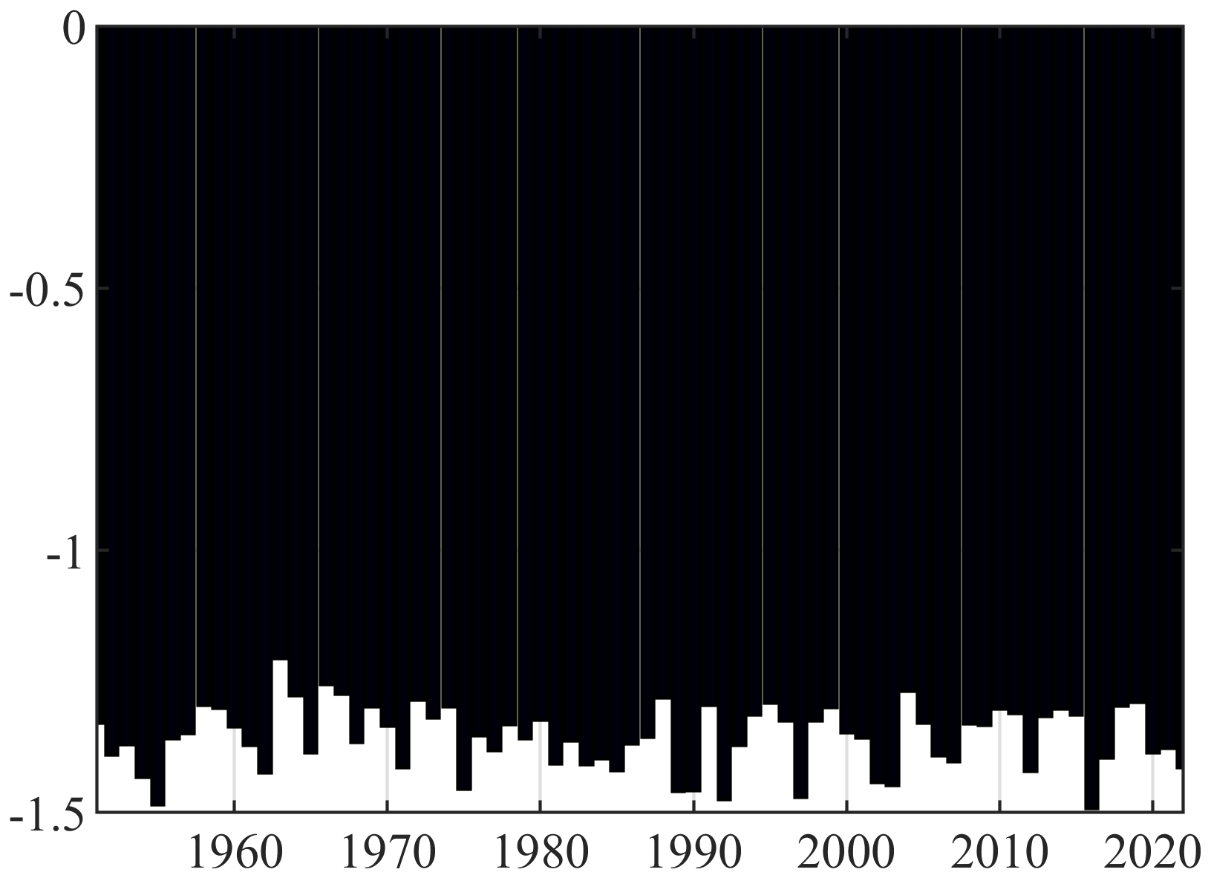
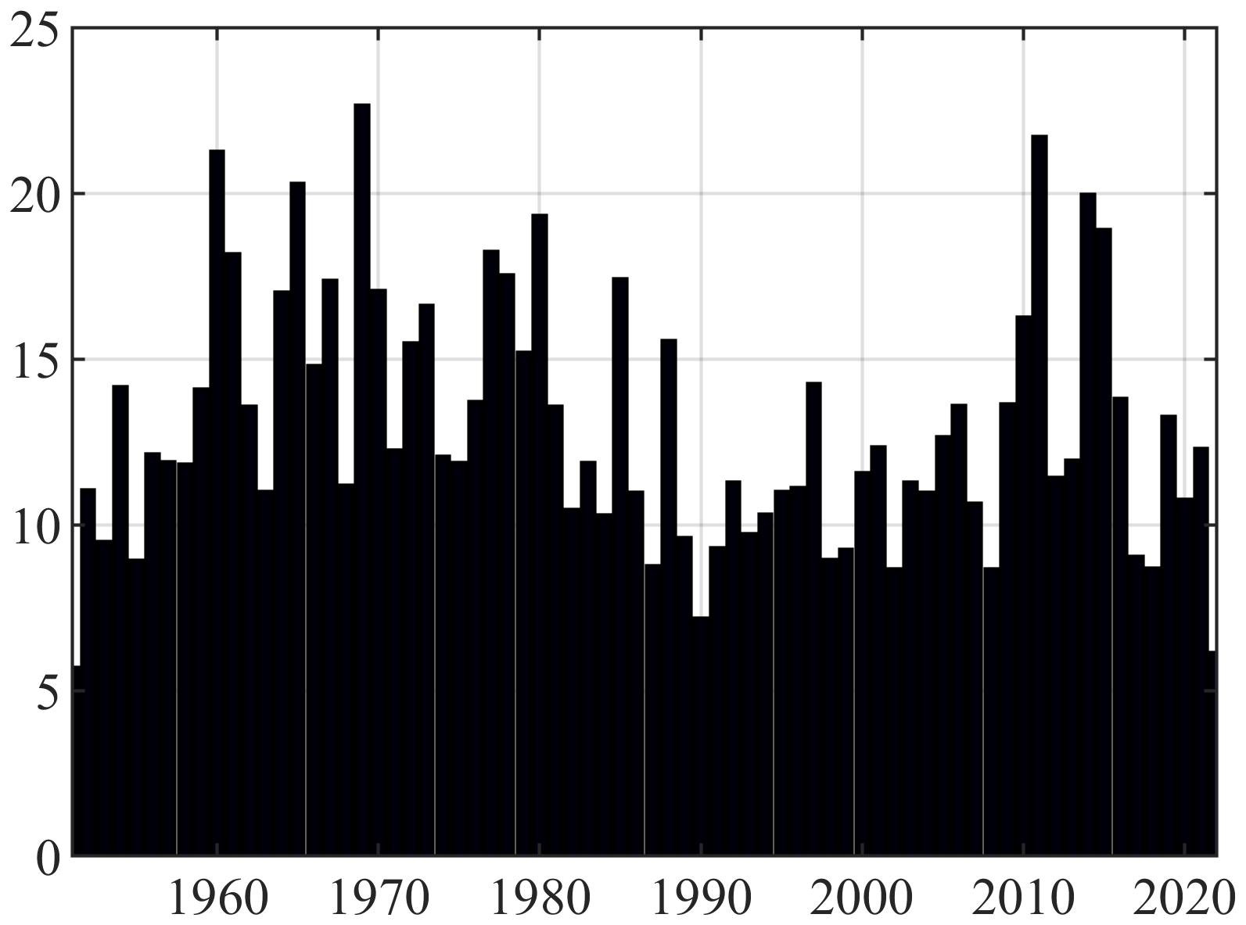
The national SPEI6 drought characteristics
Definition:
Sum of months in which the $SPEI ≤−1$threshold is exceeded.
Definition:
Represents the numerical count of drought events characterized by a $SPEI ≤−1$ value.
Definition:
Number of months for which the drought index is consecutively below the
$SPEI ≤−1$ threshold.
The SPEI-6 analysis shows more frequent, longer, and severe droughts, highlighting rising water stress across the region.
DROUGHT EVENTS
click here for plot
DROUGHT MONTHS
click here for plot
MEAN DURATION
click here for plot
Definition:
Sum of the integral area in time below $SPEI ≤−1$of each drought event.
Definition:
Ratio between severity and duration of the considered drought event.
Definition:
Number of non-drought months between two
consecutive drought events.
Turning the Tide: Tools for Crop survival
An operative tool guiding mitigation strategies to ensure crop yield results necessary.
MEAN SEVERITY
click here for plot
MEAN INTENSITY
click here for plot
MEAN INTERARRIVAL
click here for plot
Click here to go back to the definitions

Slide 5
METHODOLOGY
1. Computation of SPEI from 1951-2024;
2. Evaluate SPEI between sowing and harvesting months for each crop;
The proposed methodology is crop-specific, and combining the results across all crops enables the construction of the innovative PRIME Index.
3. Asses for each crop the frequency of exceedance for the $SPEI ≤−1$ threshold;
4. Integrate crop areal extension and economic value.

Slide 6
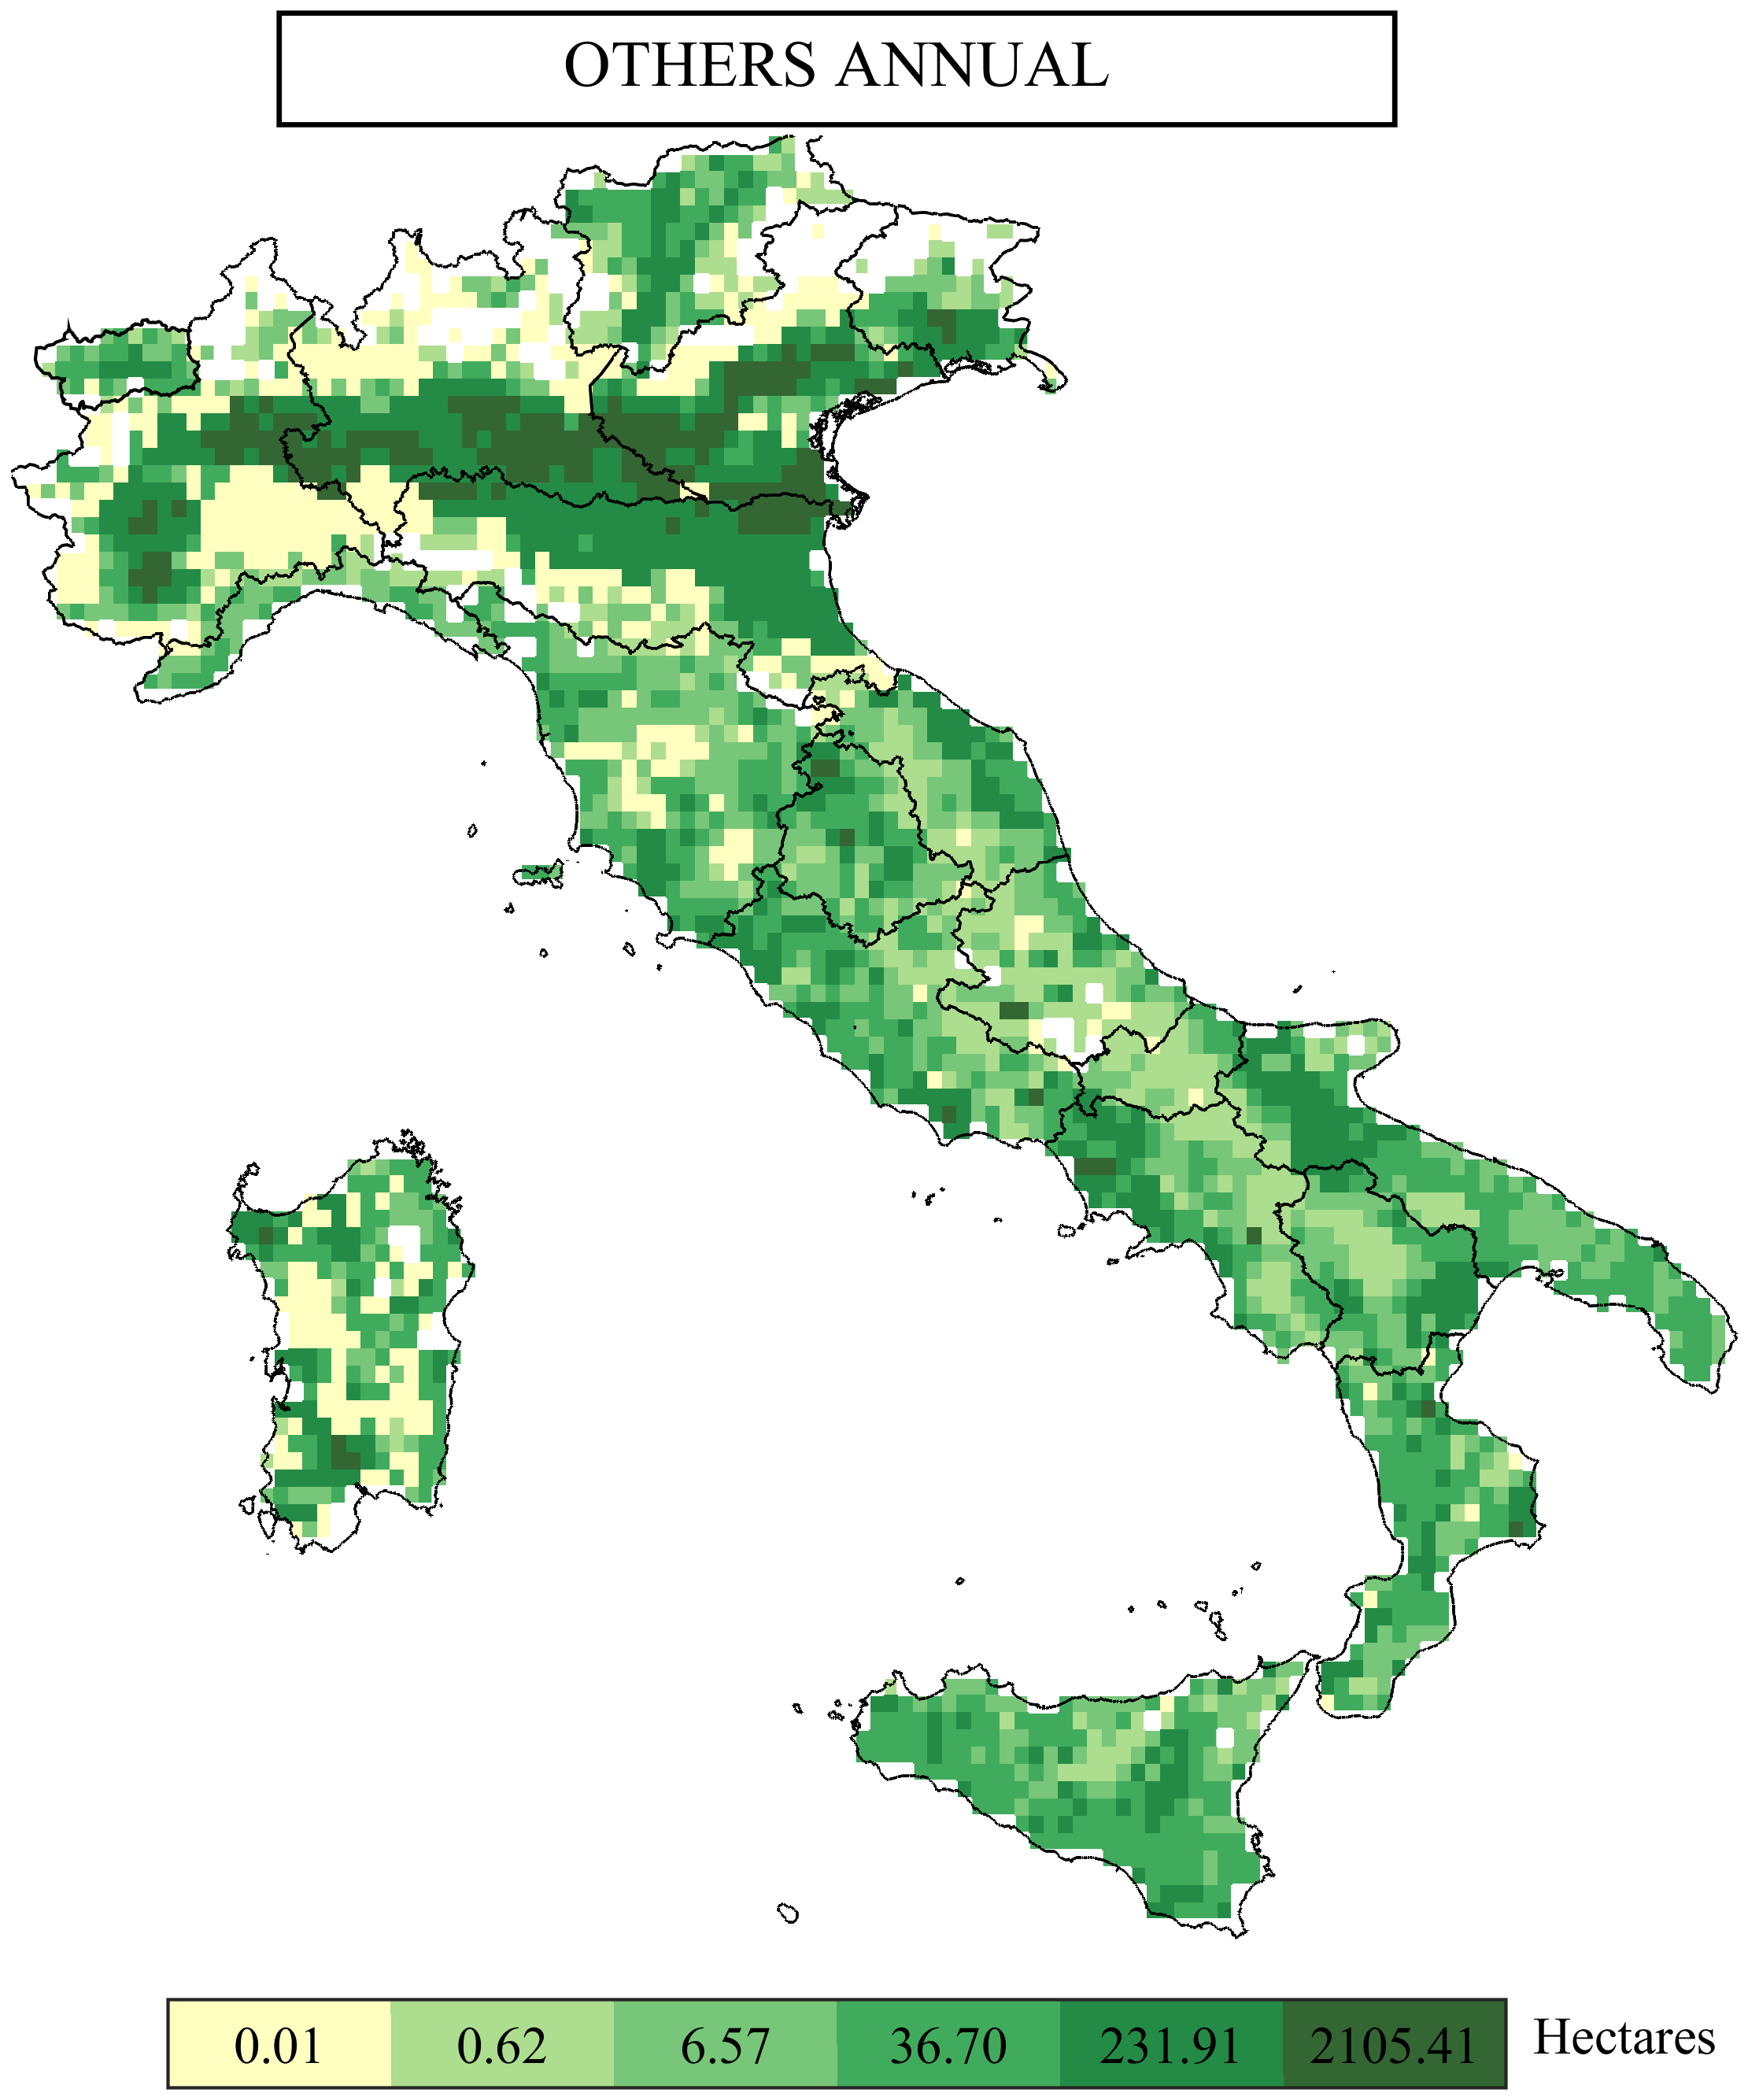
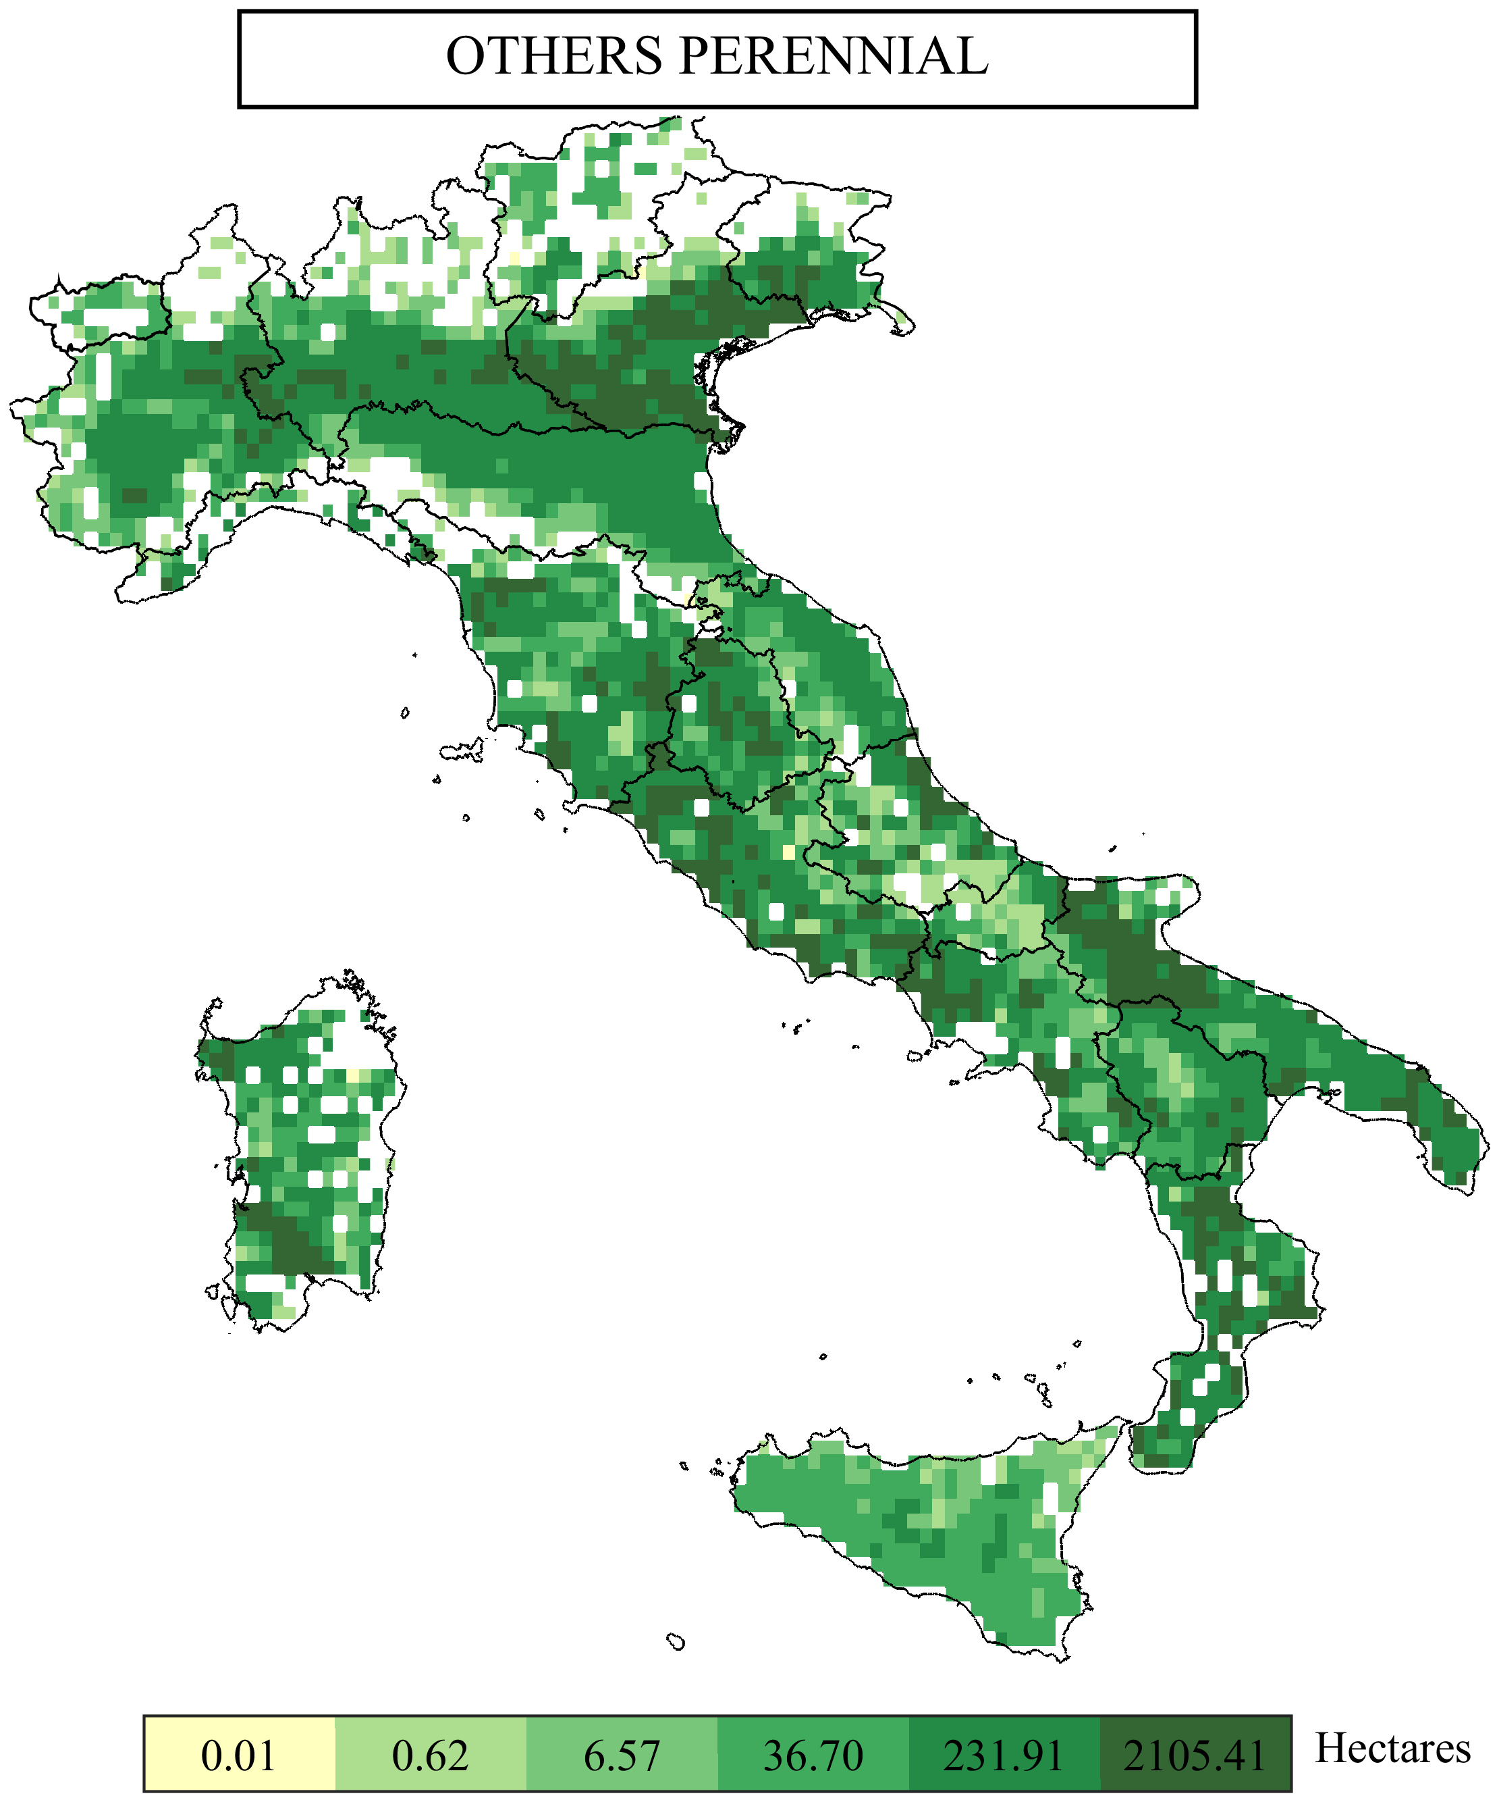
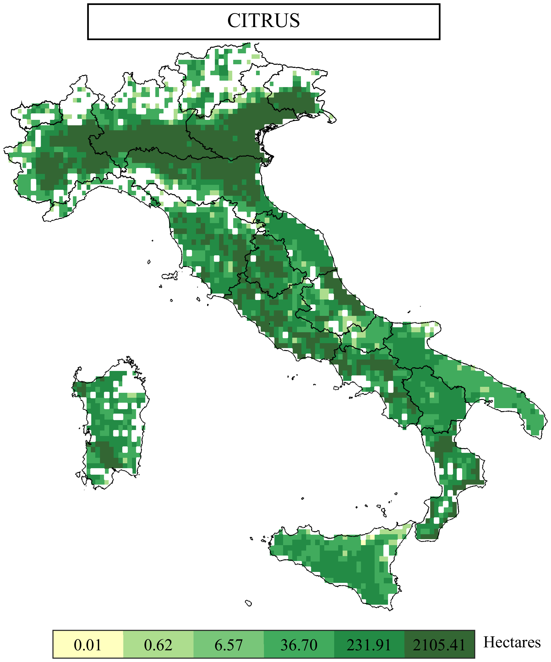
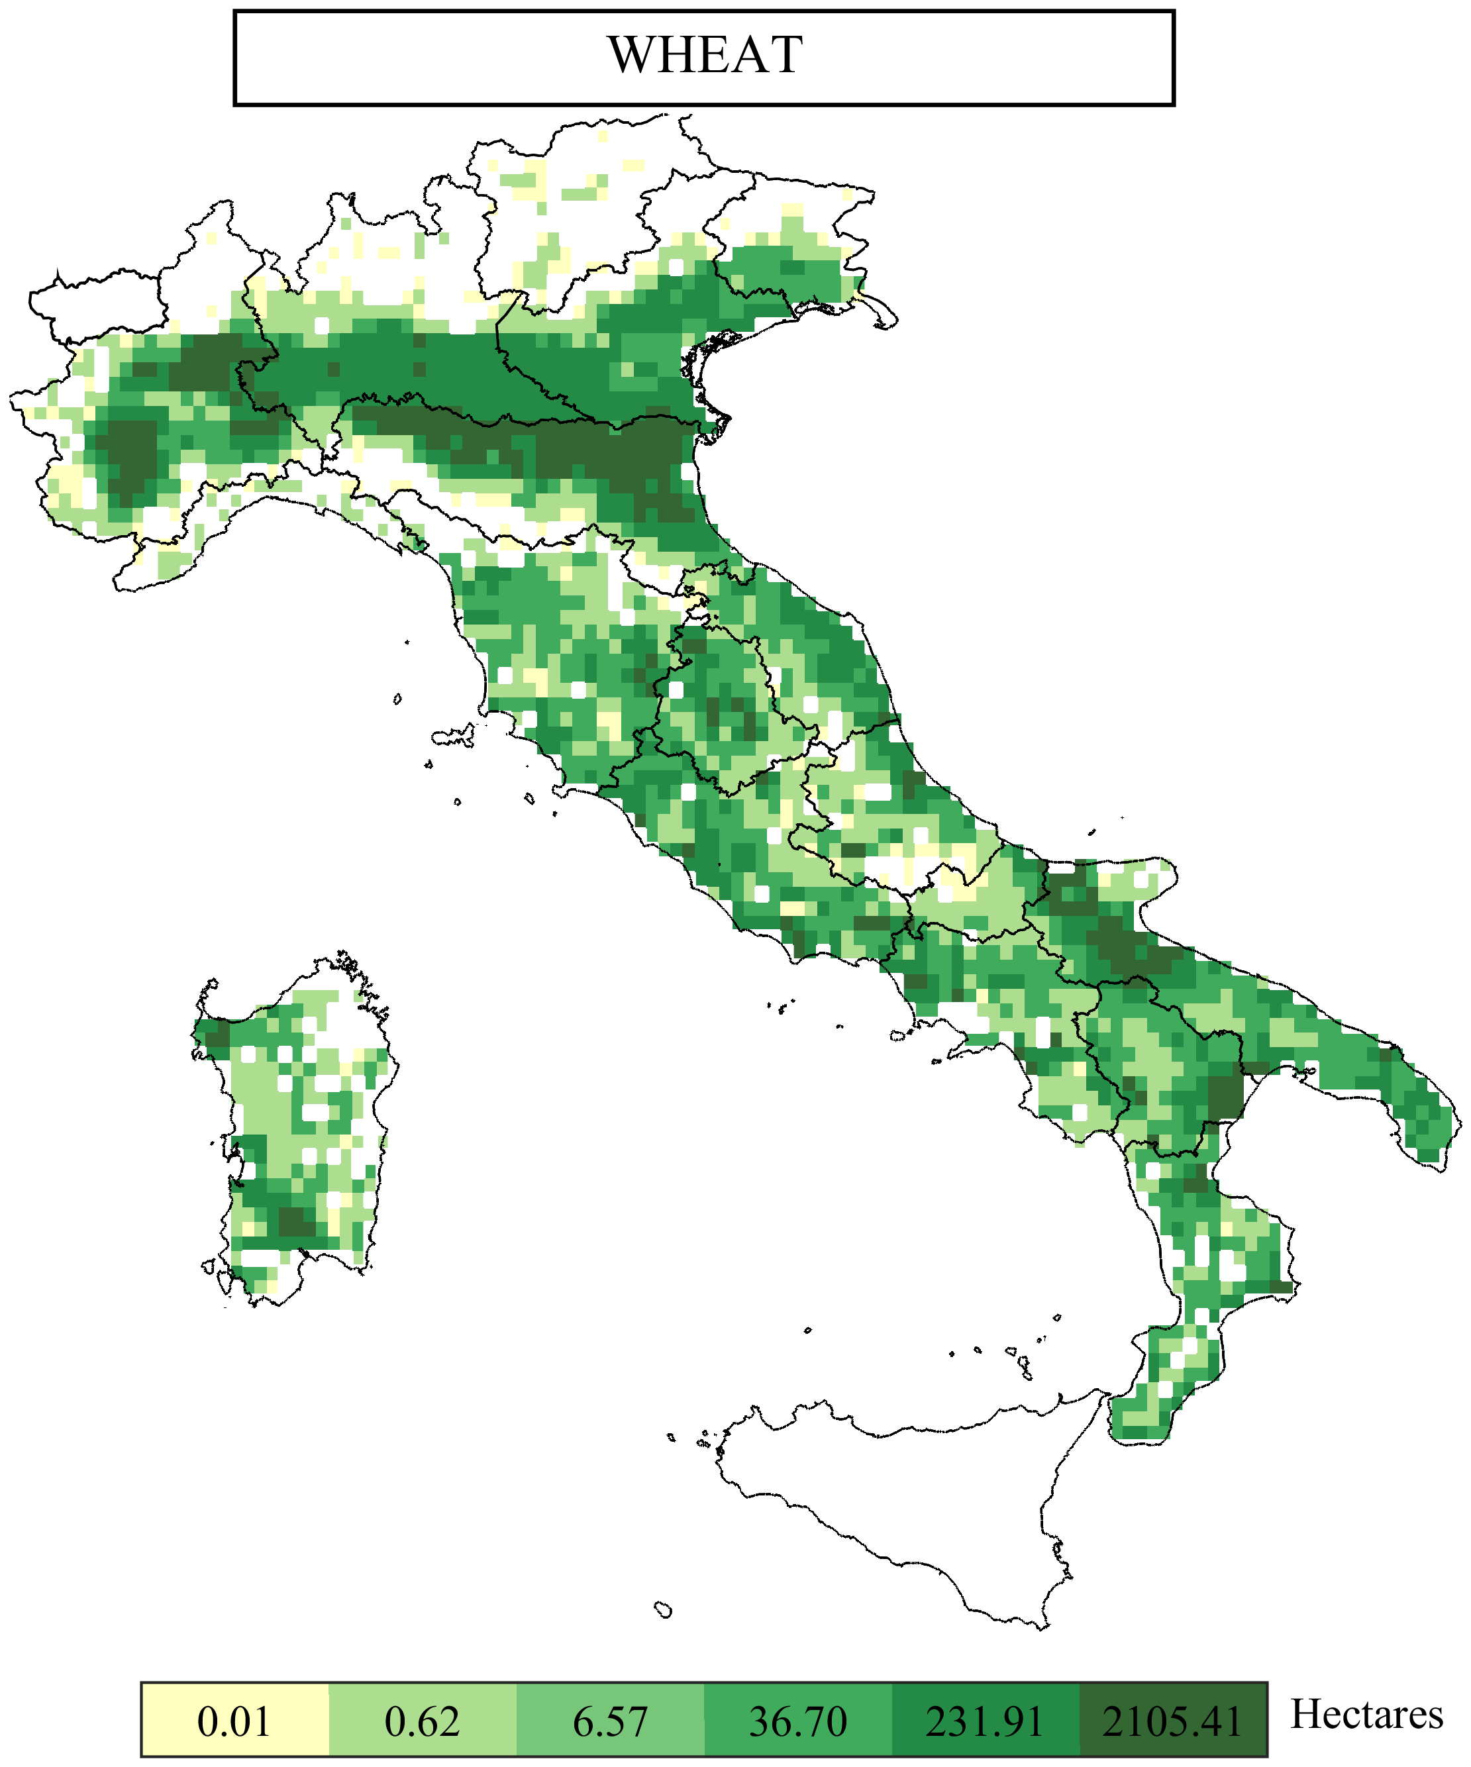
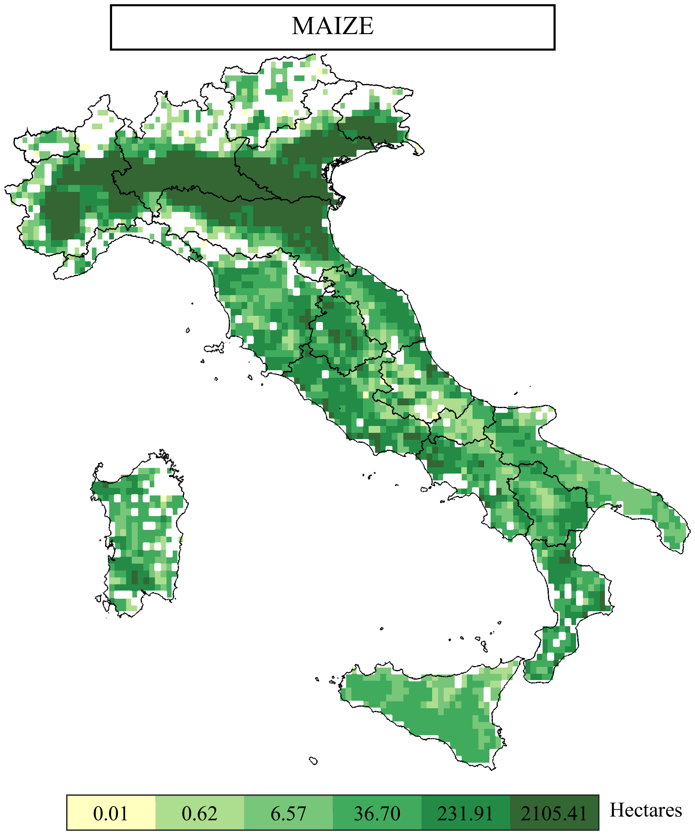
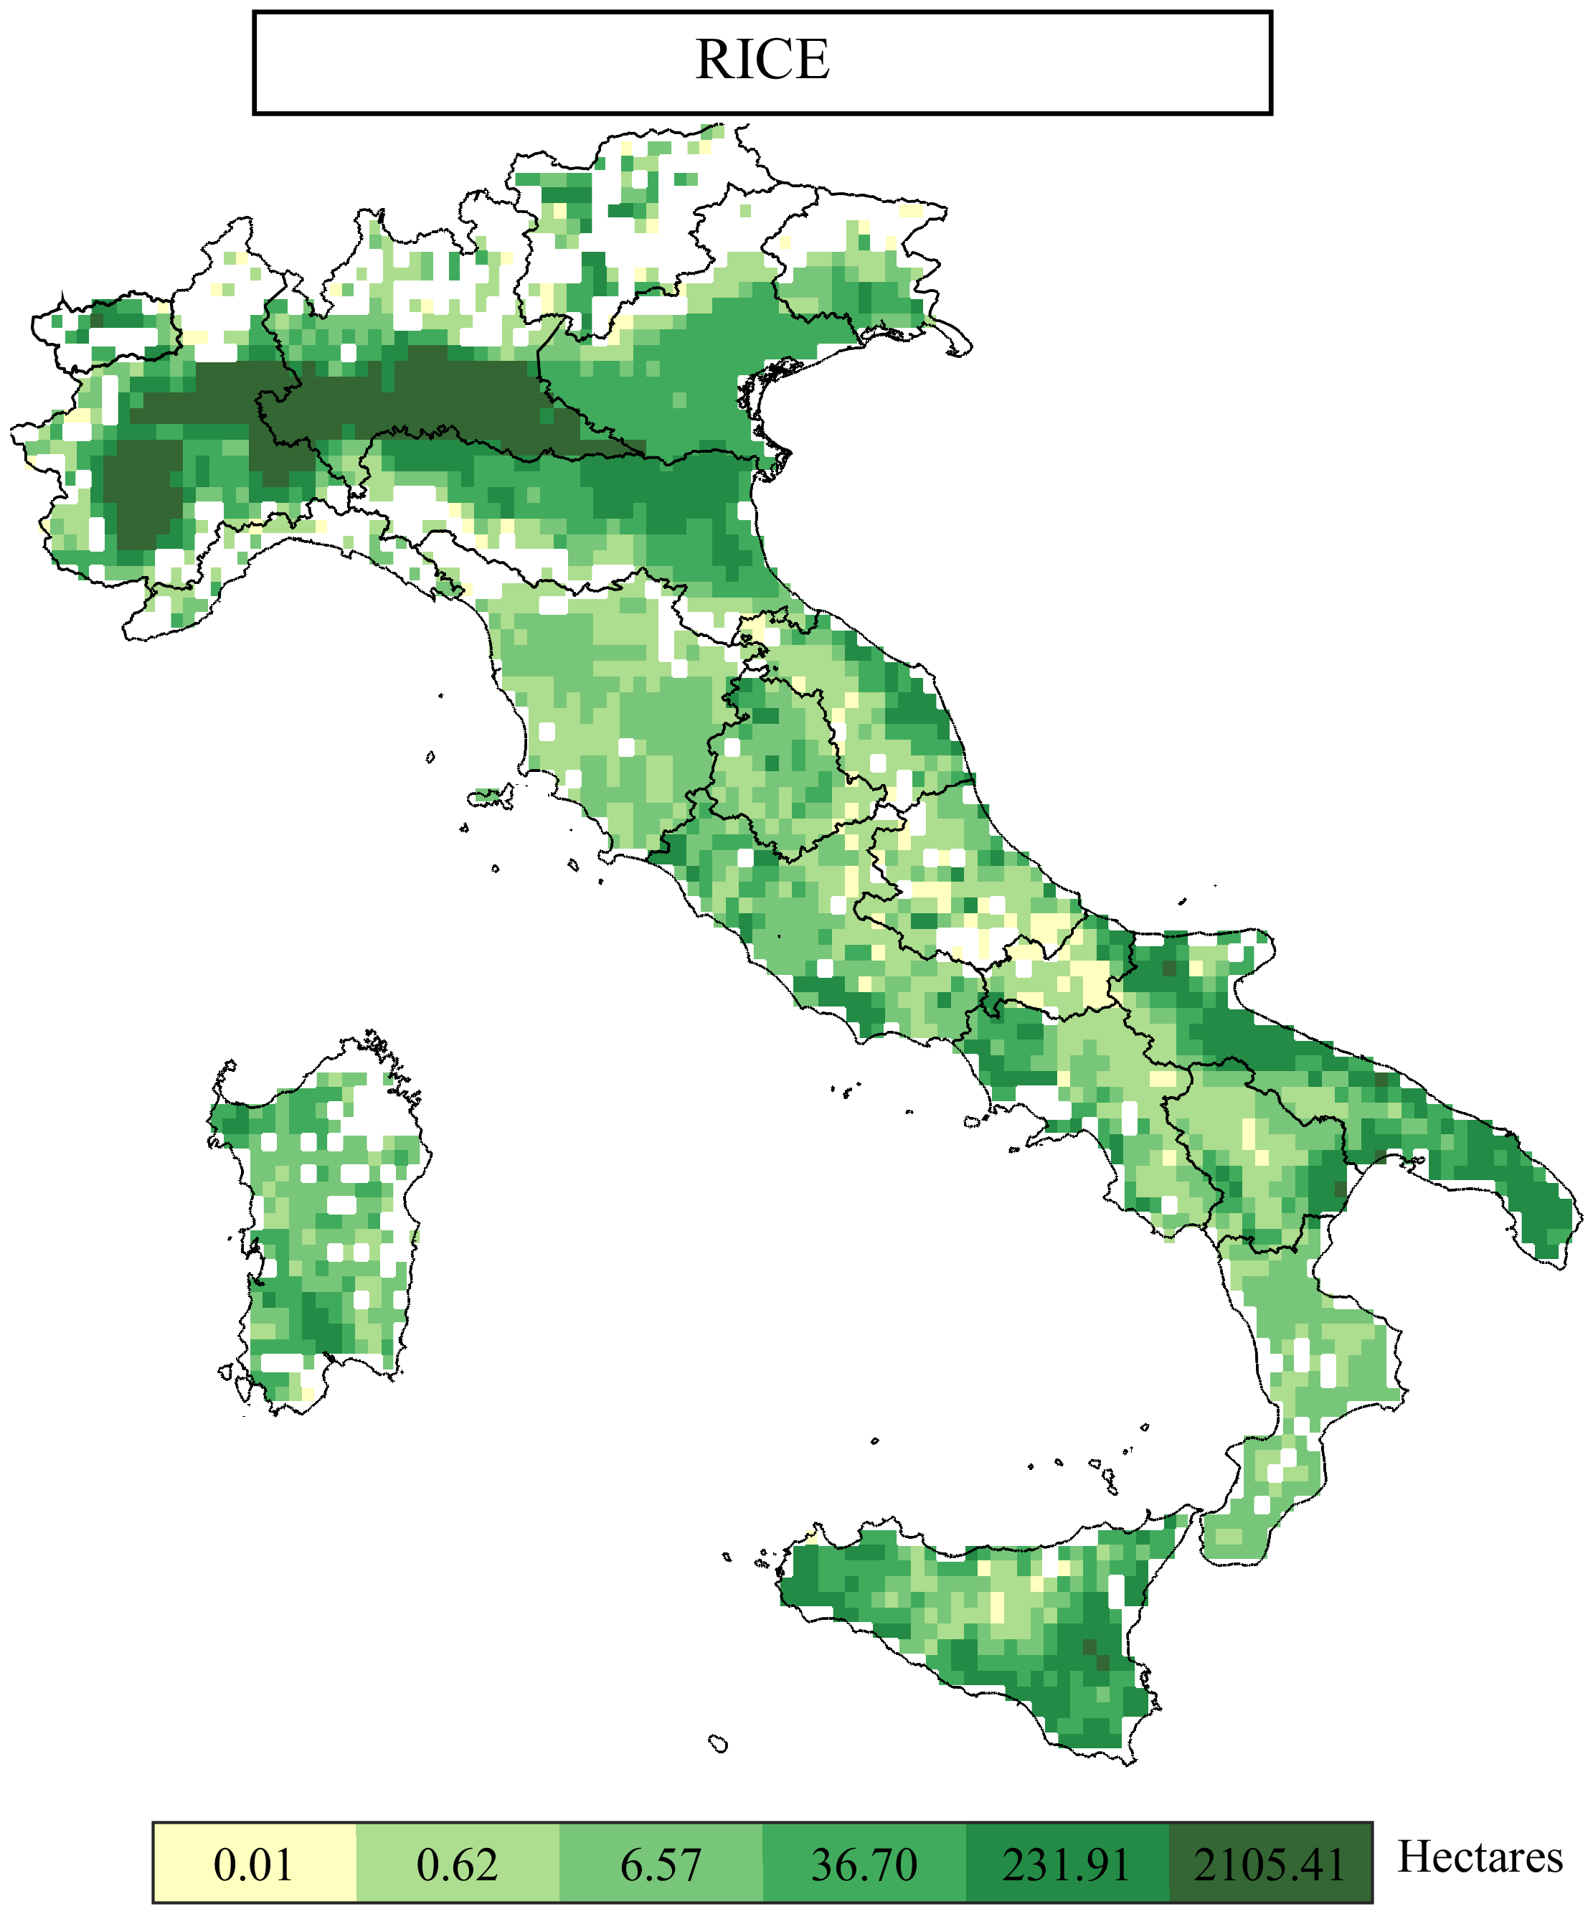
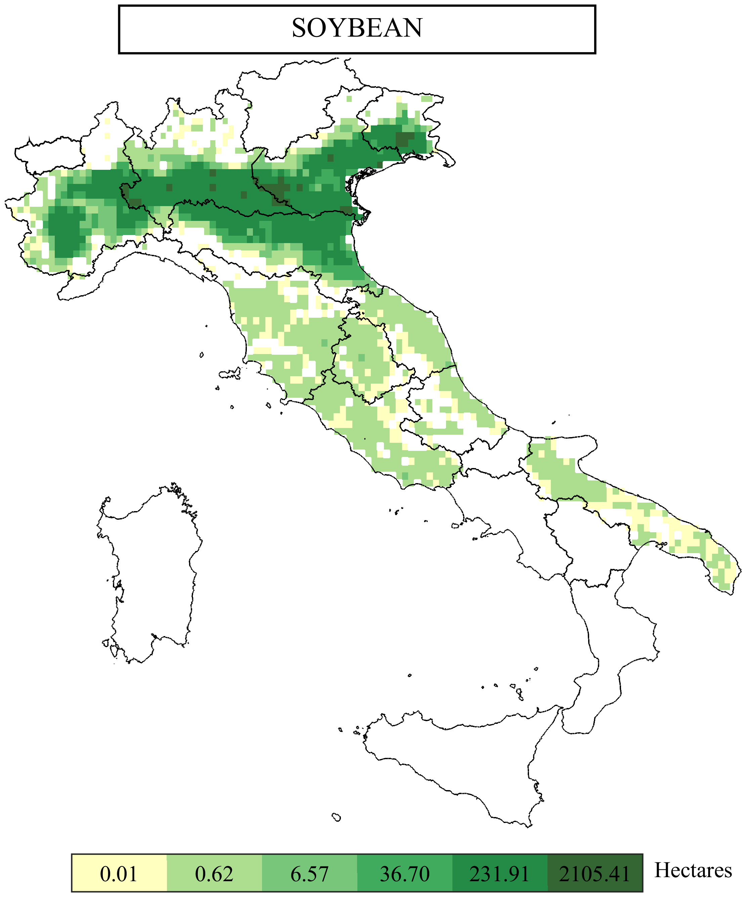
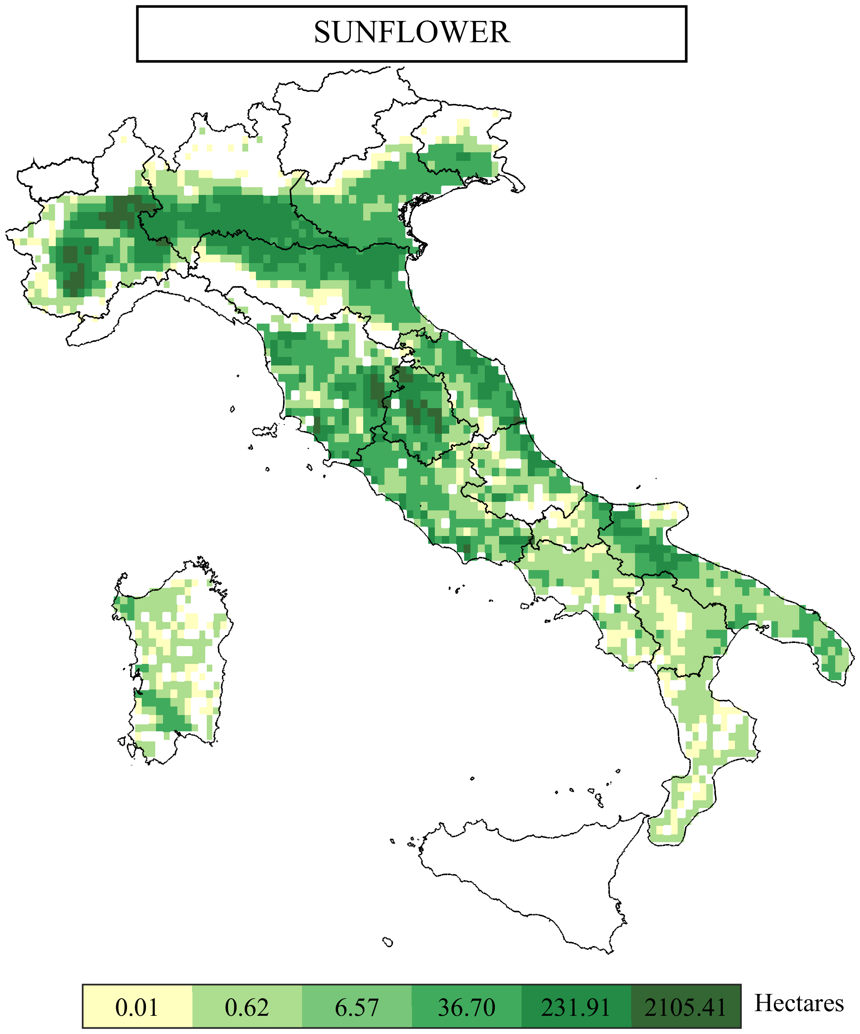
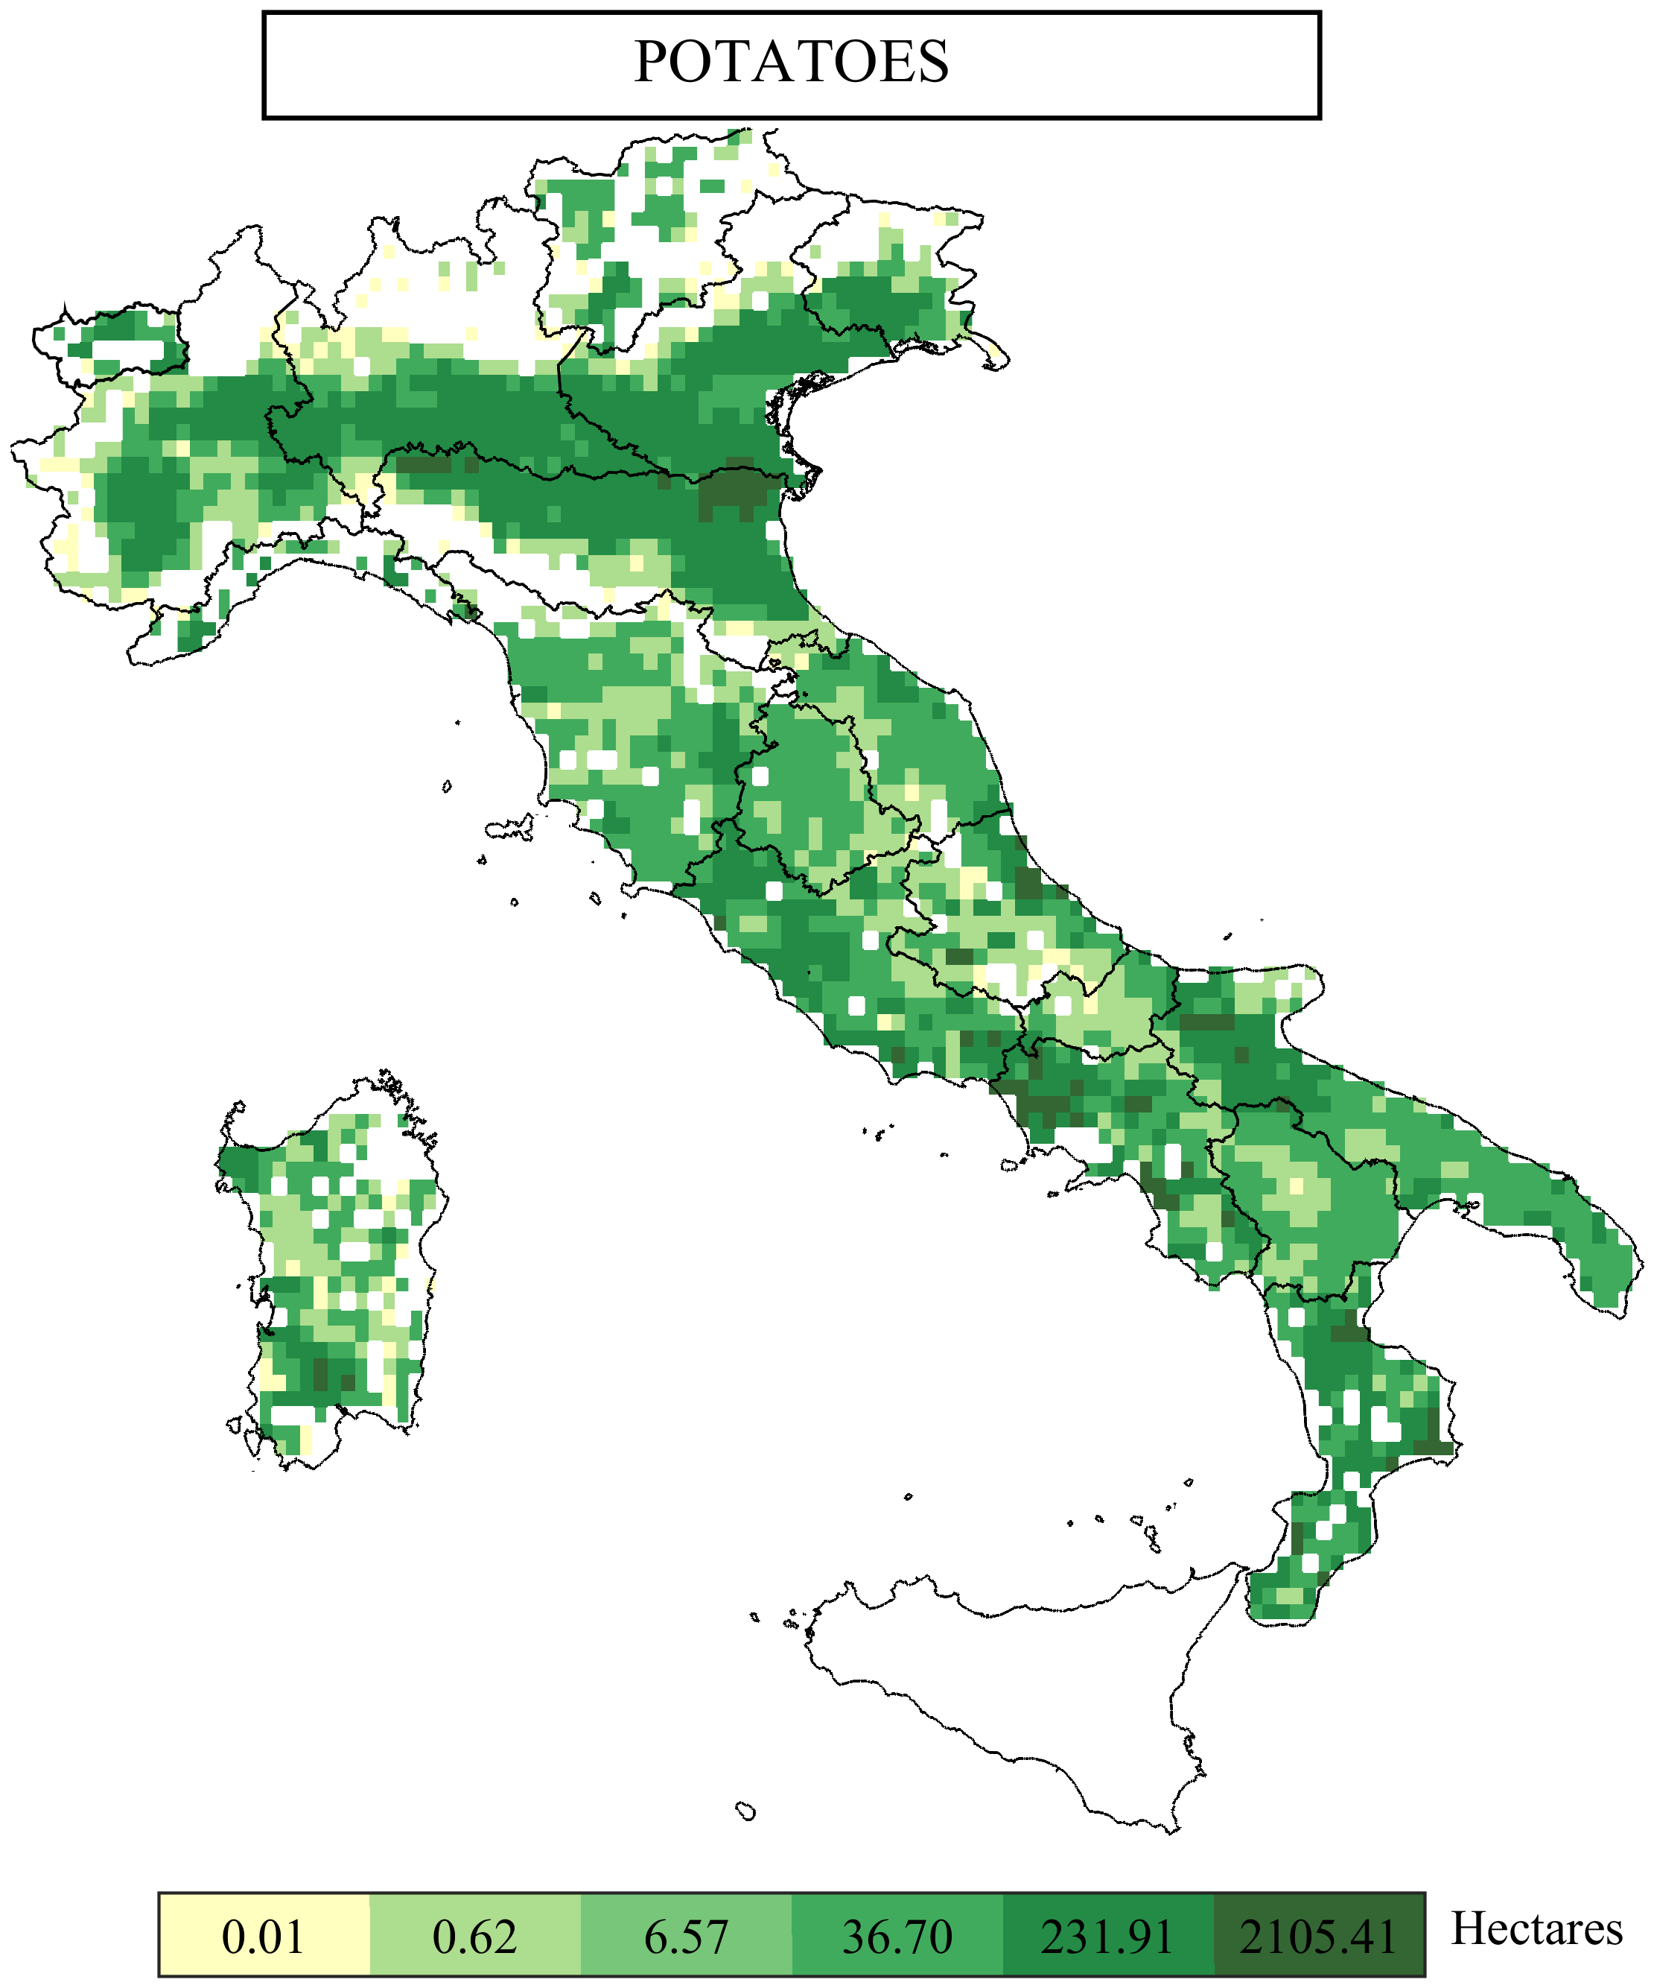
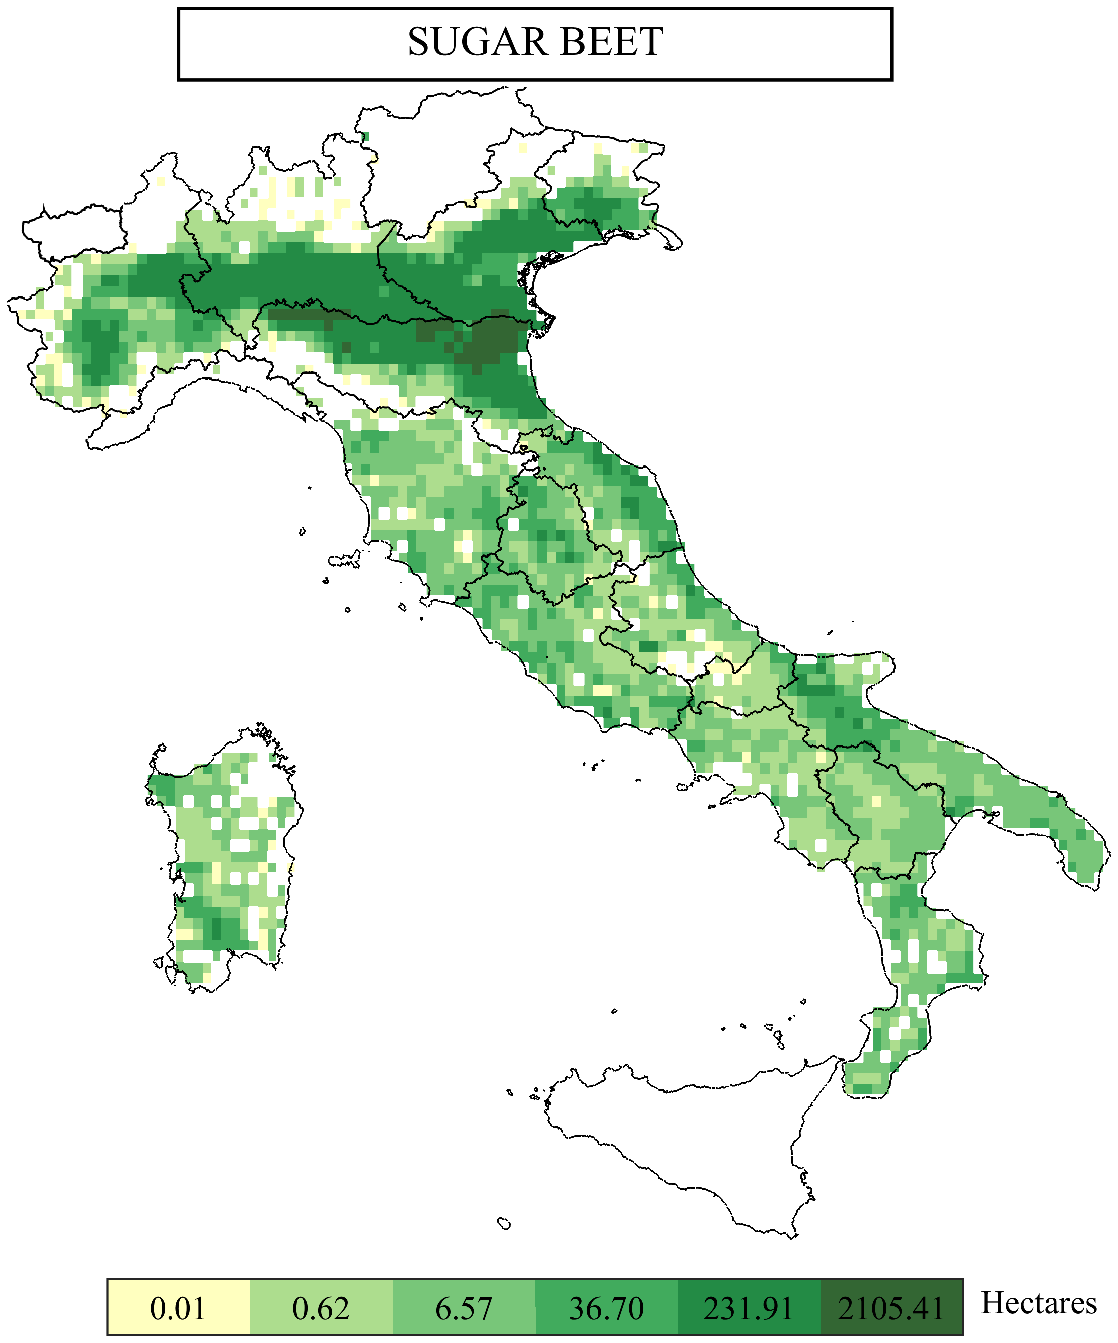
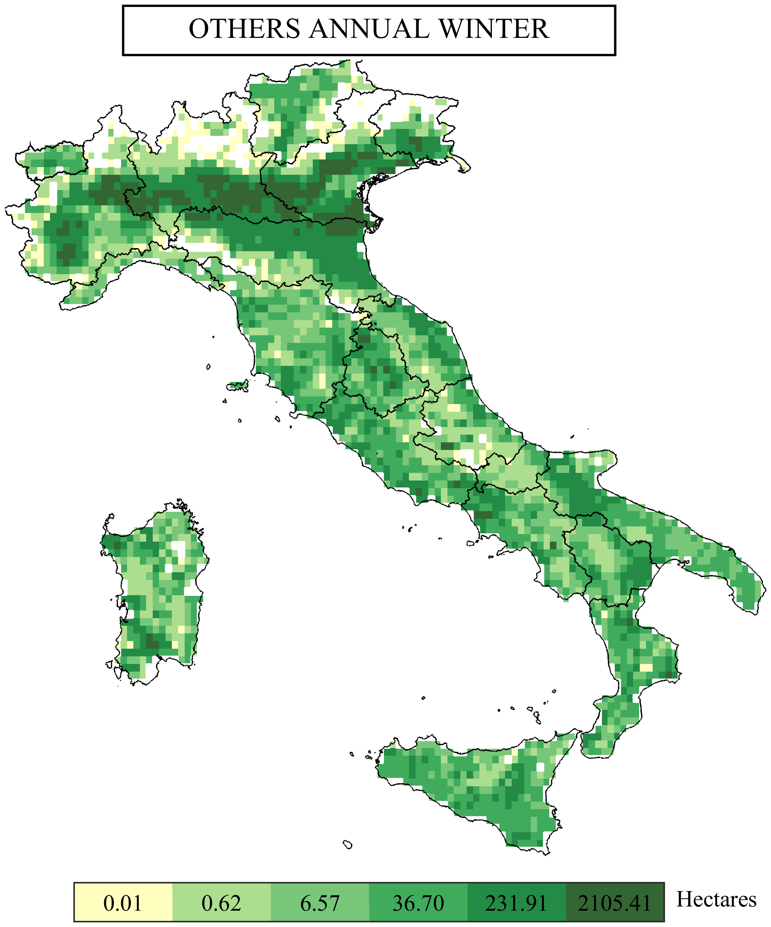
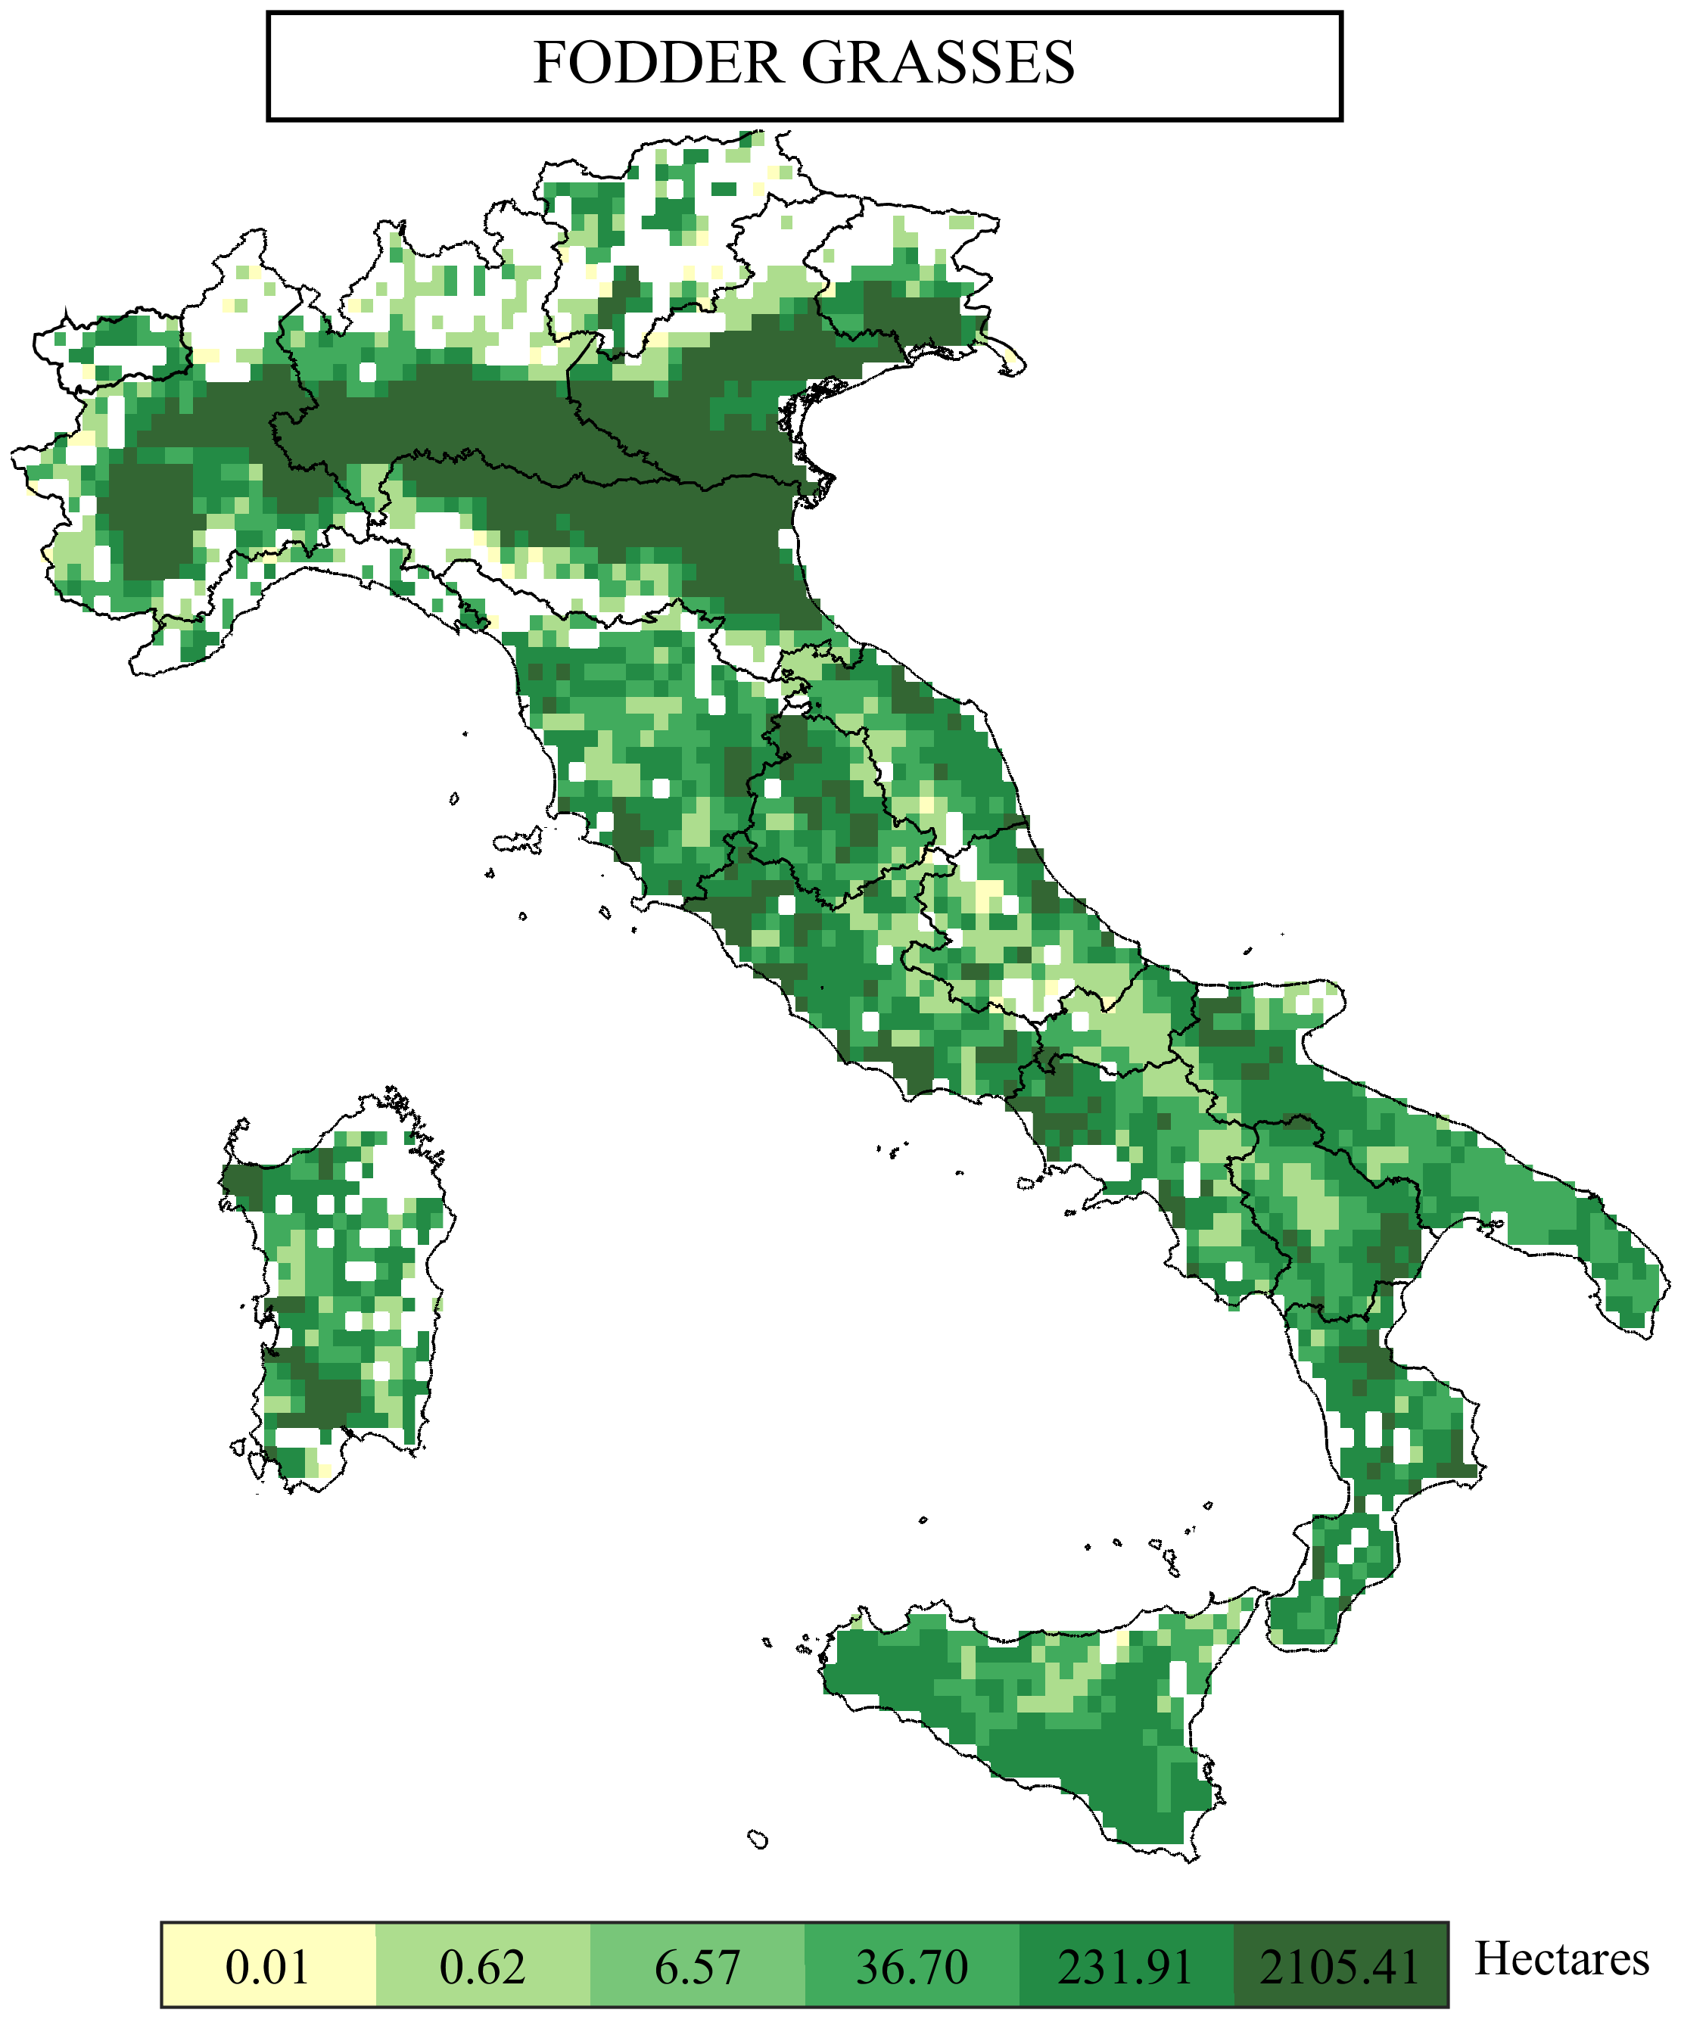
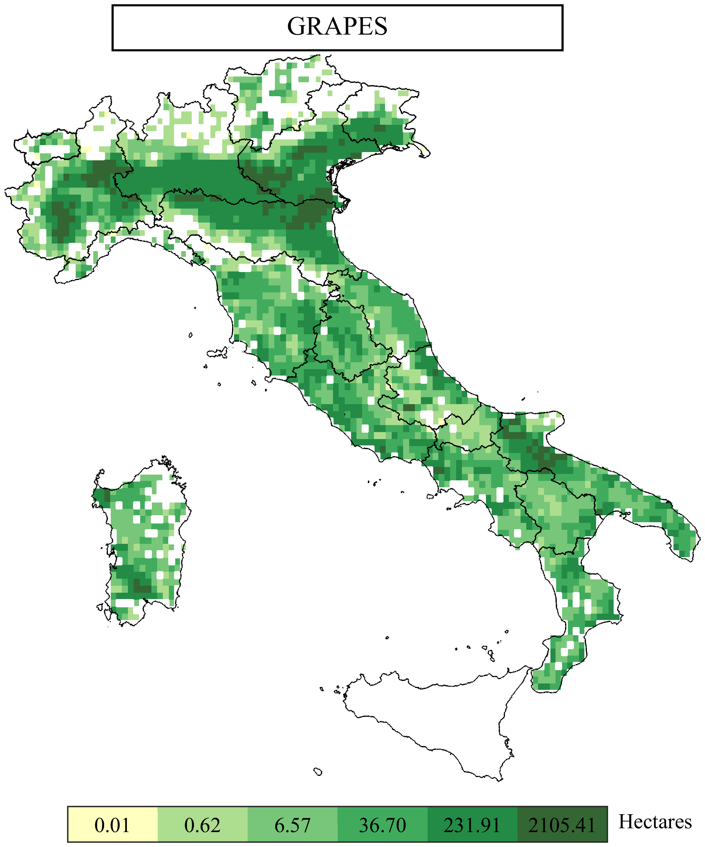
DATASETS
CROP OBSERVATIONS DATASET: MIRCA2000 (Sacks et al.)
HYDRO-CLIMATIC VARIABLES: ERA5-LAND
PLAY WITH THE DATASET:
Click ‘clear’ then choose crop to display areal extent.
CLEAR
WHEAT
MAIZE
MIN TEMPERATURE
MAX TEMPERATURE
LATITUDE
RICE
SOYBEAN
2M WIND SPEED
ELEVATION
NET RADIATION
SUNFLOWER
DEW TEMPERATURE
SURFACE PRESSURE
POTATOES
SUGAR BEET
CITRUS
GRAPES
OTHERS PERENNIAL
FODDER GRASSES
EVAPOTRANSPIRATION COMPUTATION:
Penmann-Monteith formulation
OTHERS ANNUAL
WHEAT WINTER
OTHERS ANNUAL W.

Slide 7
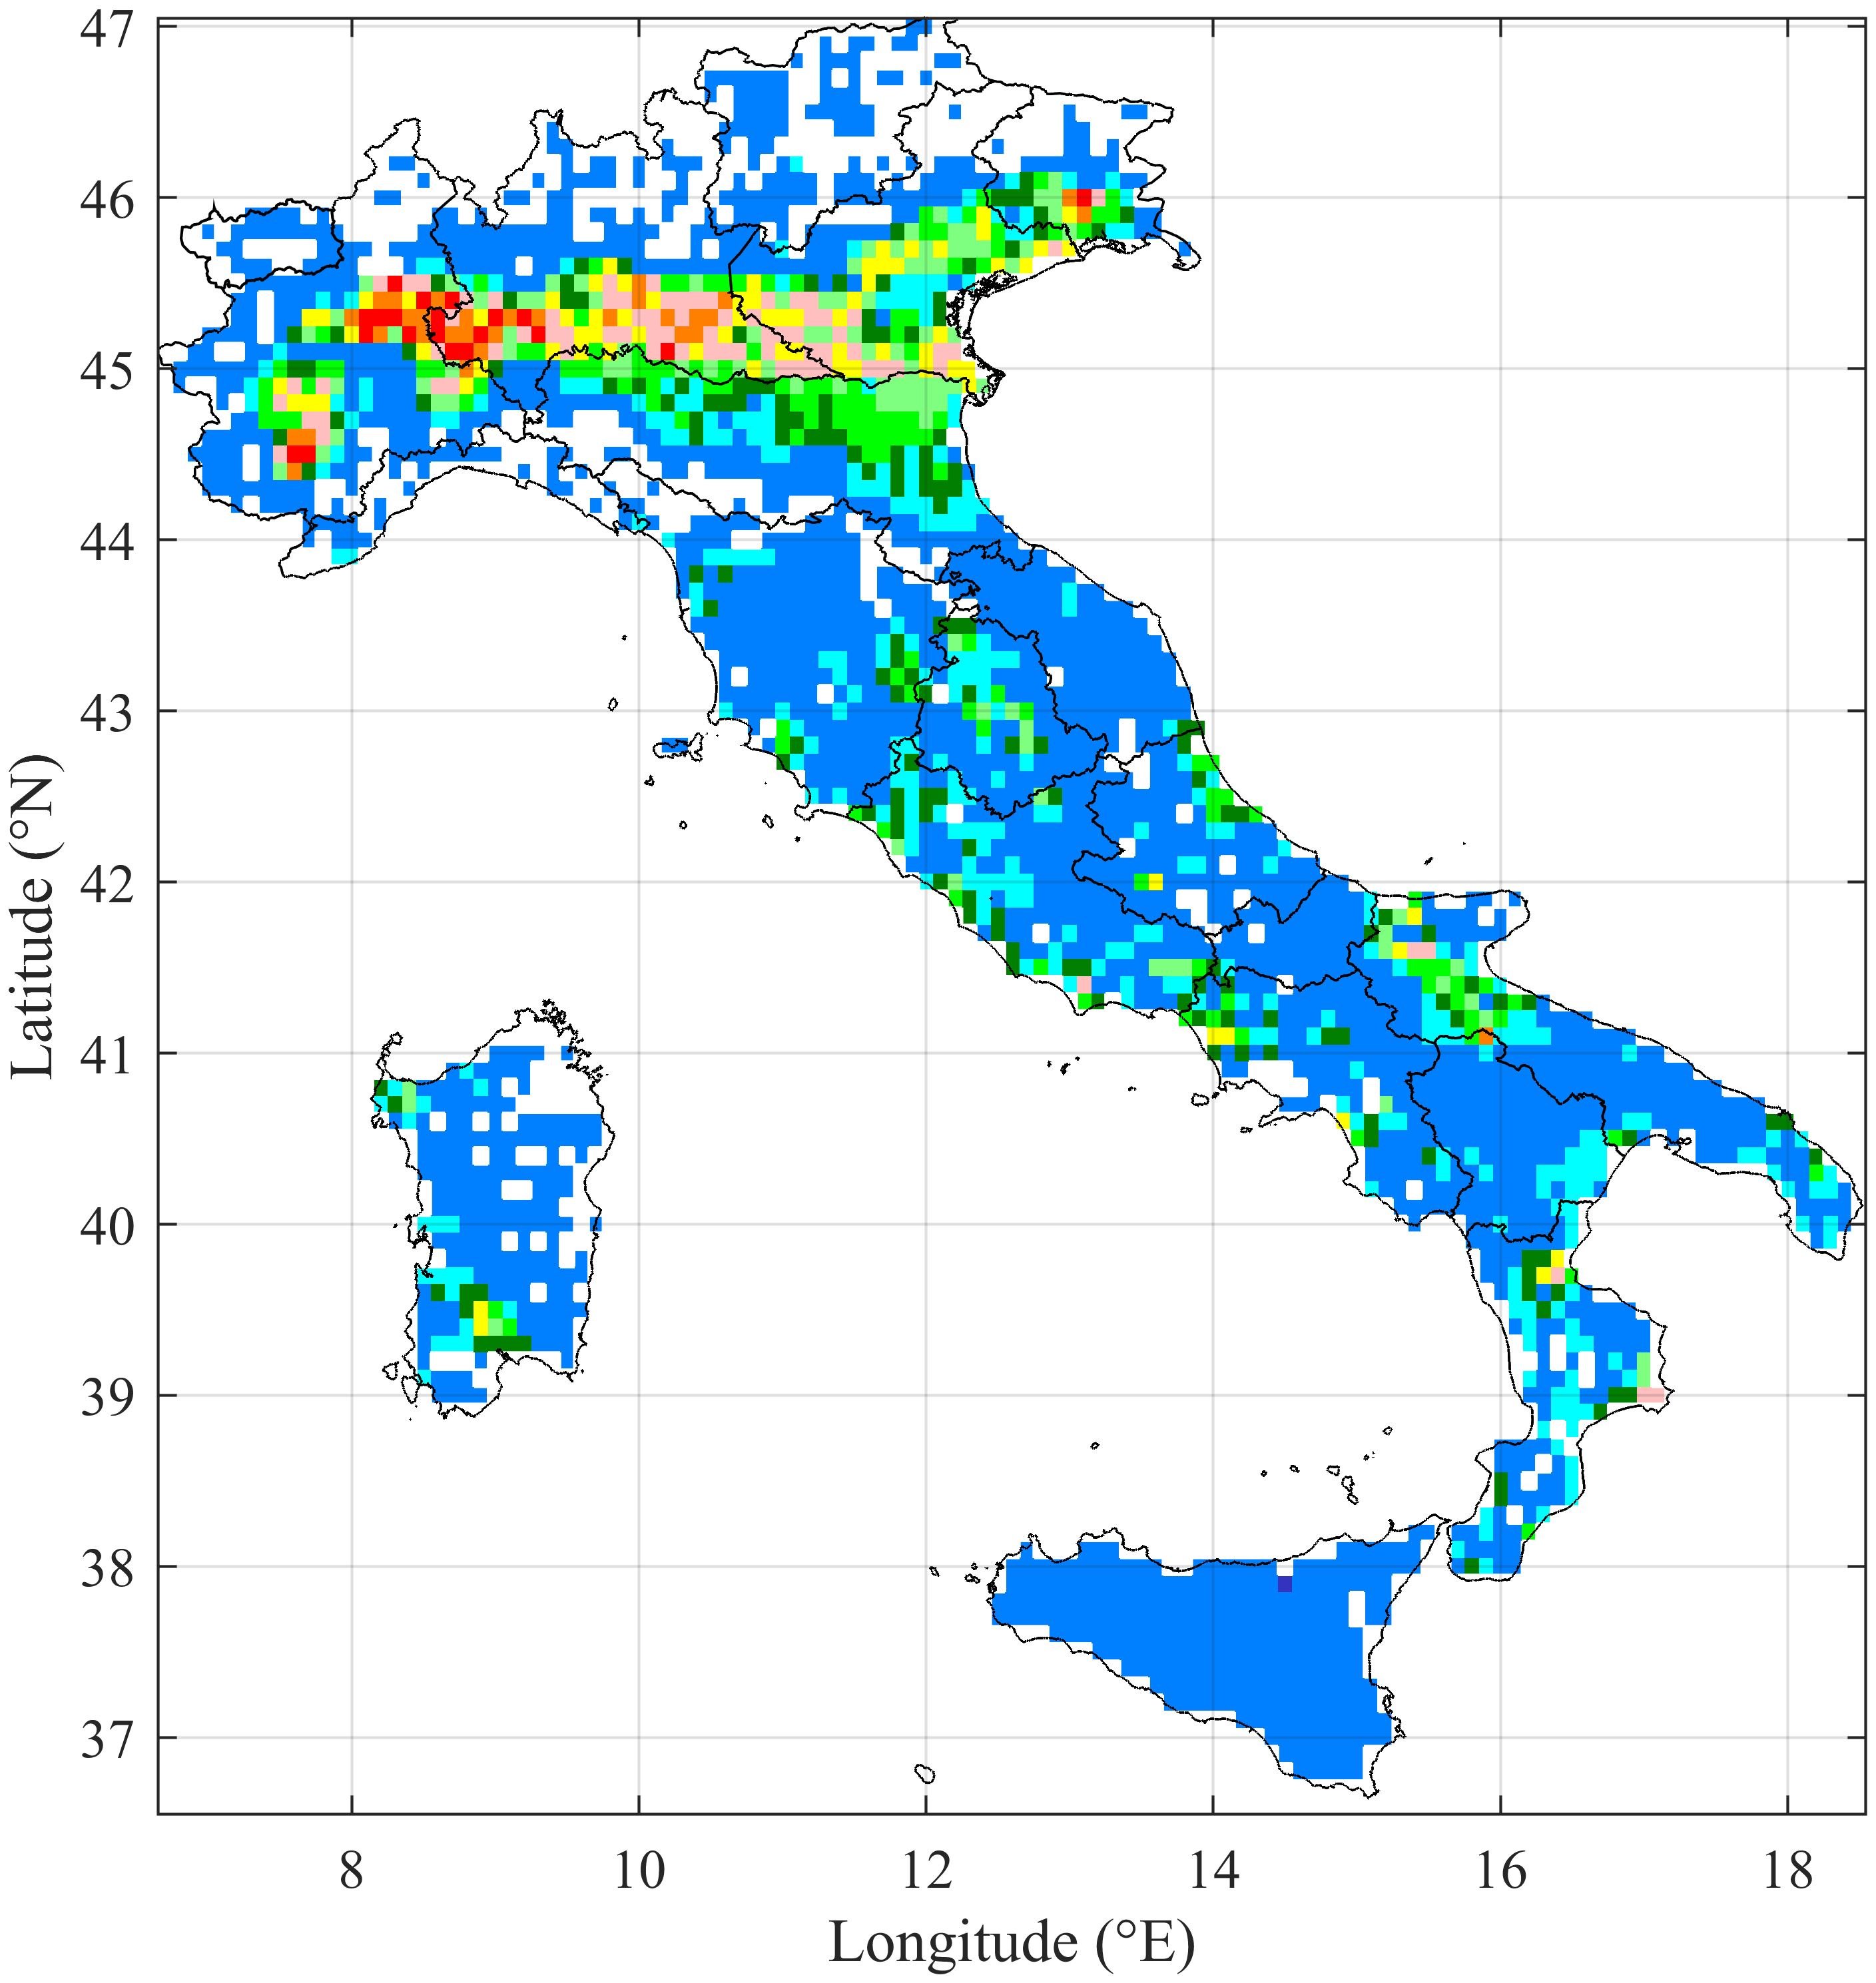
RESULTS
The PRIME Index
Prioritization of cultivated Regions IMpacted by drought in AgriculturE
The PRIME Index assigns values ranging from class 1 to class 10, where:
→ Class 10 indicates the highest intervention priority due to a combination of high exceedance frequency, crop density, and economic value;
→ Class 1 stands for the lowest urgency for action.
This classification enables targeted decision-making, ensuring that resources are allocated where they are most needed to mitigate the effects of agricultural drought.
10
9
8
7
6
5
4
3
2
1

Slide 8
LIMITATIONS
1. MIRCA2000 dataset does not reproduce the whole panorama of the crops cultivated in Italy;
2. This research has been carried out only for irrigated land, thereby excluding the rain-fed agricultural areas;
3. The analysis does not account for future climatic scenarios that could greatly modify the spatial variability of the PRIME Index.

Slide 9
FUTURE INSIGHTS
1. Extend this analysis beyond national borders;
2. Address the potential future water stress conditions caused by climate change;
3. Enhance the reliability of the index by incorporating annual crop-specific irrigation volumes
By refining and expanding this framework, we strive to provide a more comprehensive tool for policymakers and stakeholders, fostering proactive and data-driven adaptation strategies for a more sustainable agricultural future.

Slide 10
RESEARCH TEAM
CHOOSE AFFILIATION TO DISPLAY AUTHORS
LORENZA CAPPELLATO, PhD STUDENT
lorenza.cappellato@uniroma1.it
BENEDETTA MOCCIA, RESEARCHER
Benedetta.moccia@uniroma1.it
DAVIDE DANILO CHIARELLI, RESEARCHER
davidedanilo.chiarelli@polimi.it
ELENA RIDOLFI, ASSOCIATE PROFESSOR
elena.ridolfi@uniroma1.it
MARIA CRISTINA RULLI, FULL PROFESSOR
mariacristina.rulli@polimi.it
FABIO RUSSO, FULL PROFESSOR
fabio.russo@uniroma1.it
FRANCESCO NAPOLITANO, FULL PROFESSOR
francesco.napolitano@uniroma1.it

Slide 11
AIM
1. Evaluate the risk of agricultural drought using the Standardized Precipitation Evapotranspiration Index (SPEI), accurately calculated for each crop cultivated in Italy;
2. Identify the most vulnerable regions by classifying them according to a prioritization of intervention.
CASE STUDY: ITALY
DROUGHT INDEX: SPEI

Slide 12
The national SPEI6 drought characteristics
The SPEI-6 analysis shows more frequent, longer, and severe droughts, highlighting rising water stress across the region.
DROUGHT EVENTS
DROUGHT MONTHS
MEAN DURATION
Turning the Tide: Tools for Crop survival
An operative tool guiding mitigation strategies to ensure crop yield results necessary.
MEAN SEVERITY
MEAN INTENSITY
MEAN INTERARRIVAL

Slide 13
RESULTS
The PRIME Index
Prioritization of cultivated Regions IMpacted by drought in AgriculturE
The PRIME Index assigns values ranging from class 1 to class 10, where:
→ Class 10 indicates the highest intervention priority due to a combination of high exceedance frequency, crop density, and economic value;
→ Class 1 stands for the lowest urgency for action.
This classification enables targeted decision-making, ensuring that resources are allocated where they are most needed to mitigate the effects of agricultural drought.
10
9
8
7
6
5
4
3
2
1

Slide 14
CASTLE
Contact: lorenza.cappellato@uniroma1.it
THANK YOU and ENJOY EGU 2025!
The PRIME Index
Prioritization of cultivated Regions IMpacted by drought in agriculturE

