Slide 1
HOLOS-IE:
A System Model for Assessing Carbon Emissions and Balance in Agricultural Systems
Khalil M.I., B. Sen, M. Siddique, T. Chatzichristou, A. McPherson, S.A. Rakin, A. Shafi, J. Herron, R. Kröbel, B. Osborne and Rem Collier
University College Dublin, Ireland
Teagasc, Ireland; Agriculture and Agri-Food Canada and Prudence College Dublin, Ireland
Correspondence: ibrahim.khalil1@ucd.ie
Presented at the EGU General Assembly held in Vienna, Austria from 27 April–2 May 2025

Slide 2
Challenges
Agriculture: Complex, multi-faced, dynamic, having a large C footprint.
No single mitigation measure to make agriculture carbon-neutral by 2050.
Huge confusion about what to achieve and output uncertainty to bring confidence.
Profitability concern and no additional C credit benefits.
Limitations in measurements/monitoring & coordination among parties.
Models available are land-use/farmer-centric, and simple.
Methodologies are aimed at extensive areas and/or require long time scales.
Lack of a systems-based digital platform that considers:
alternative land use planning
circular bioeconomy
Biodiversity and ecosystem services
environmental reporting
decision-making and informing policy

Slide 3
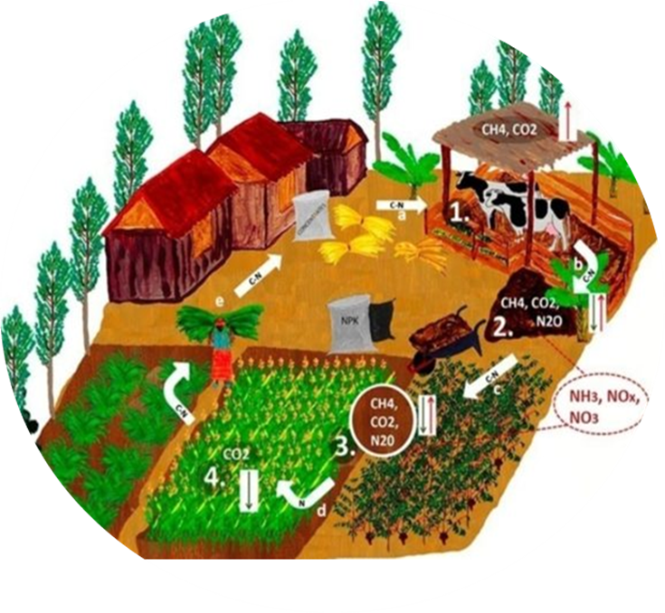
Why the agricultural system model?
Improved decision-making to optimise practices for sustainable agriculture.
Predict/forecast the impacts of climate change & other factors.
Guide resource management for efficient use of resources.
Identify potential risks/problems and help develop mitigation and adaptation strategies.
Inform the creation of effective agricultural policies.
A decision-making unit comprising the farm household, cropping, livestock system and agroforestry that transforms land, labour and energy into useful products.

Slide 4
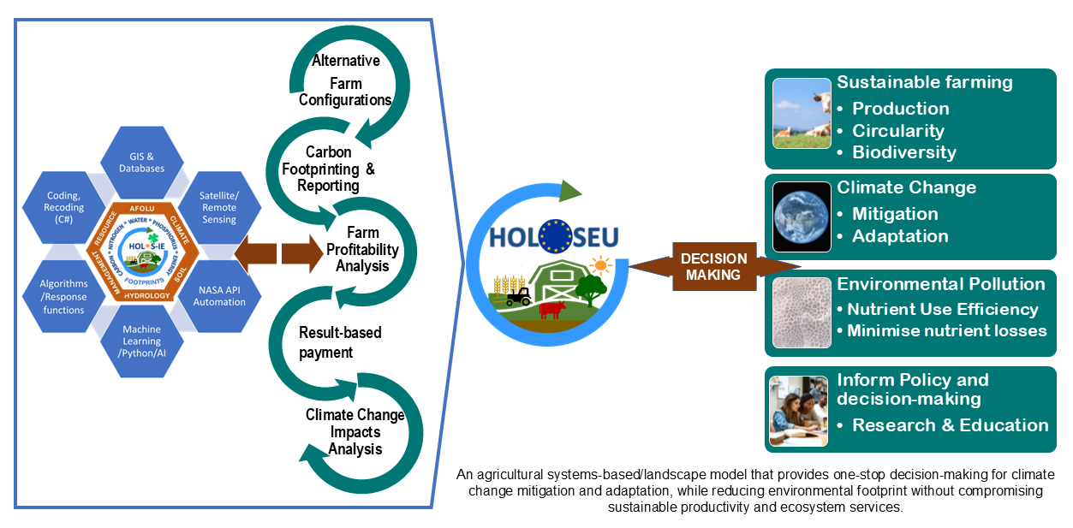
HOLOS-IE to HOLOSEU DEVELOPMENT AND DELIVERABLES

Slide 5
A few advantages of HOLOSIE/EU
Land parcel through farm to the national/regional level.
Mono to mixed cropping systems including agroforestry.
Alternative land use and management options.
GHG mitigation choices and offsetting.
Carbon credit and cost: benefit with potential for consideration of circularity.
Use default or own data and the file for further use and updating.
Potential for agrobiodiversity and soil health indices, and Agri-Food industries
Carbon footprinting potential for infrastructure including energy.

Slide 6
SOFTWARE
An Agricultural System Model
(Click the bottom-left button to run)

Slide 7
Test: land uses & management (HOLOSE-IE)
W30: Spring wheat only (full area: 30 ha)
WC30: Spring wheat + cover crop (full area: 30 ha)
S30: Grass (silage, full area: 30 ha) only
G30D: Grazed grass (30 ha) + dairy cow
W3G27D: Wheat (3 ha) + grazed grass (27 ha) + dairy cow
W3S3G24D: Wheat (3 ha) + silage (3 ha) + grazed grass (24 ha) + dairy cow
W3G24DA3: Wheat (3 ha) + grazed grass (24 ha) + dairy cow + agroforestry (3 ha)
W3M24N/2DA3: Wheat (3 ha) + mixed grass (rye + clover) with 50% N (organic/inorganic) fertilizer (24 ha) + dairy cow + agroforestry (3 ha)
W3M24N/2D0.9A3: Wheat (3 ha) + mixed grass with 50% N fertilizer (24 ha) + 10% fewer dairy cows + agroforestry (3 ha)

Slide 8
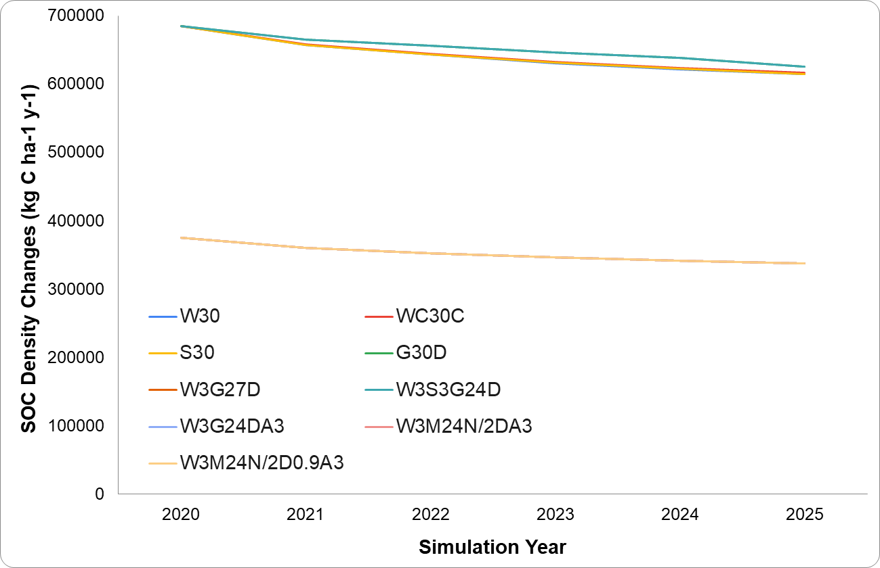
SOC Density Changes: HOLOSE-IE

Slide 9
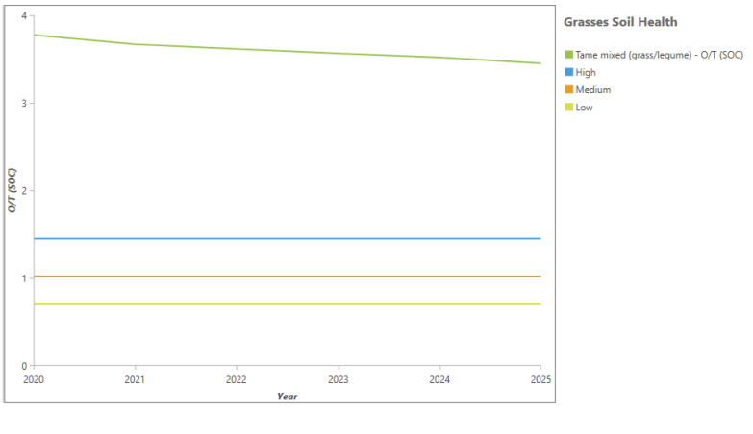
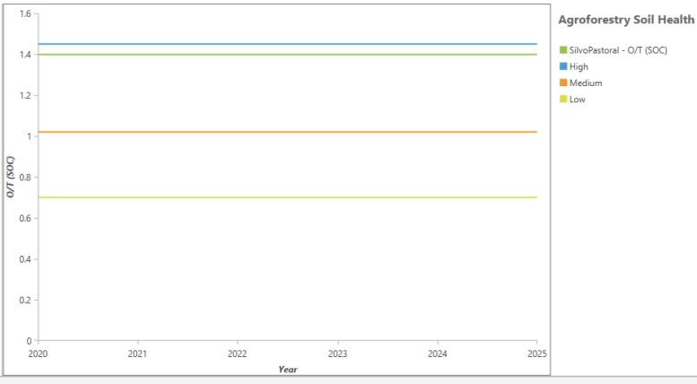
Soil Health indices: HOLOS-IE
O/T (Feeney et al., 2024), lacking across soil textural classes
Ratios of SOC density across soil textural classes (Liang et al. 2023)

Slide 10
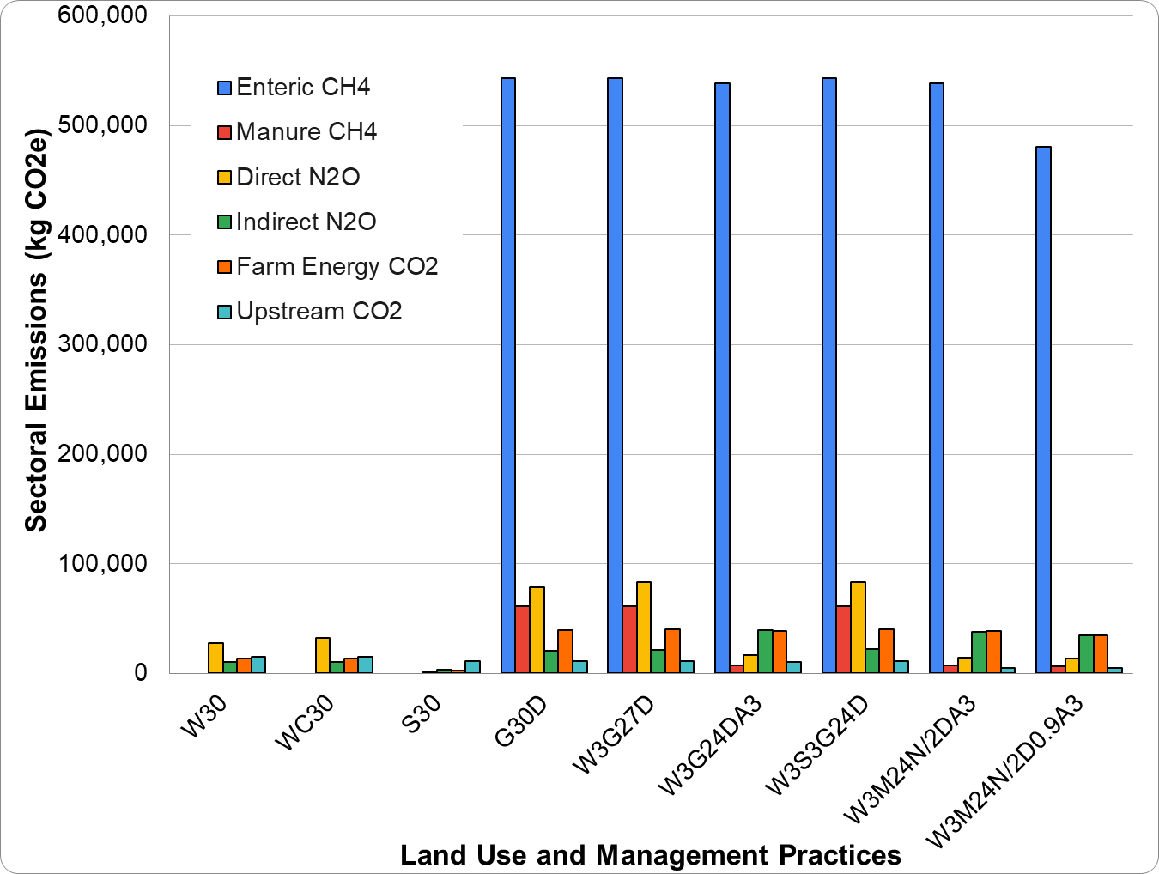
Sectoral Emissions: HOLOSE-IE

Slide 11
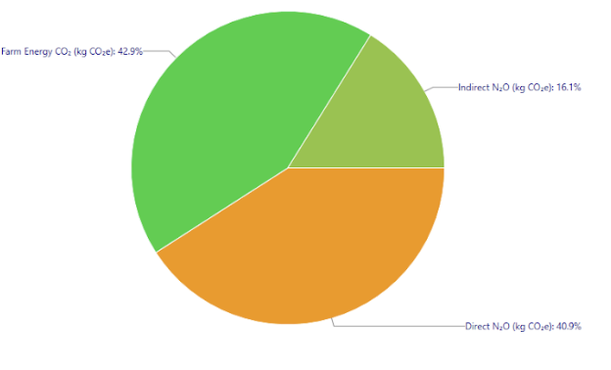
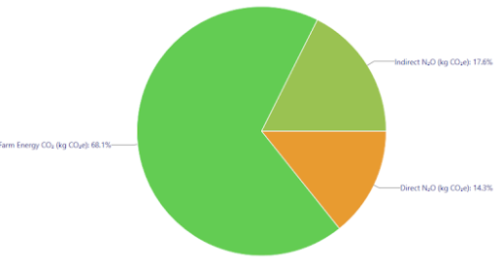
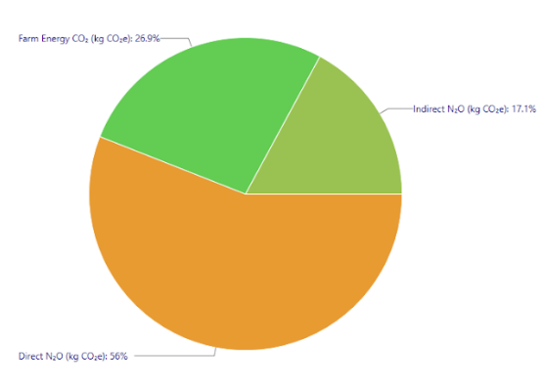
Sectoral contribution: HOLOSE-IE
W30
S30
W30C

Slide 12
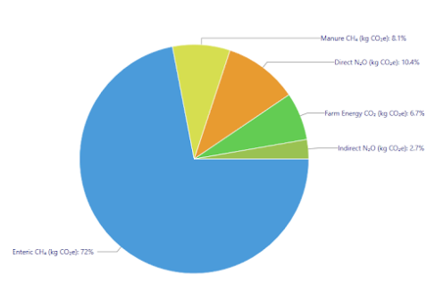
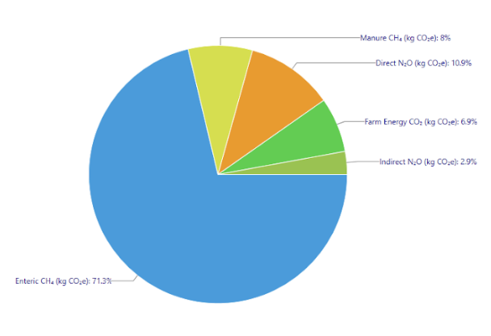
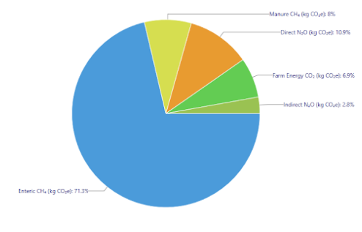
Sectoral contribution: HOLOSE-IE
G30D
W3S3G24D
W3G27D

Slide 13
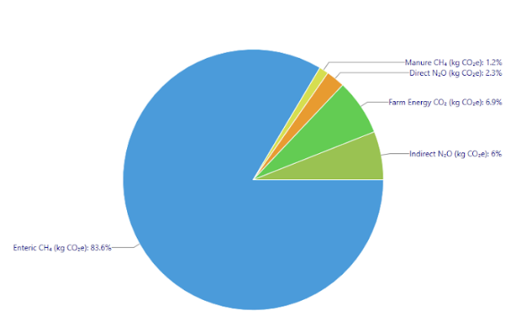
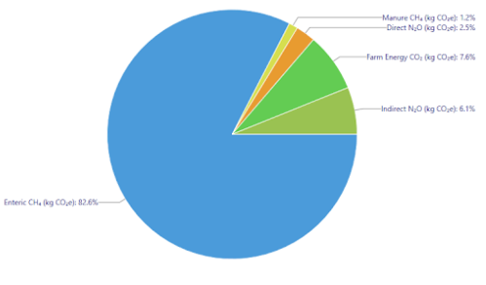
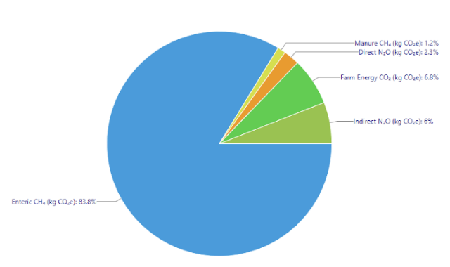
Sectoral contribution: HOLOSE-IE
W3G24DA3
W3M24N0.5D0.9A3
W3M24N0.5DA3

Slide 14
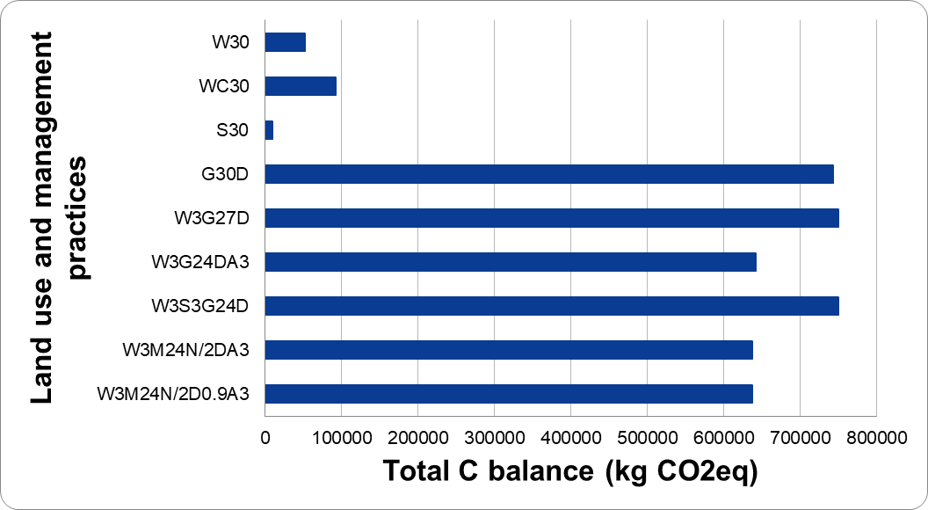
Total C balance: HOLOS-IE

Slide 15
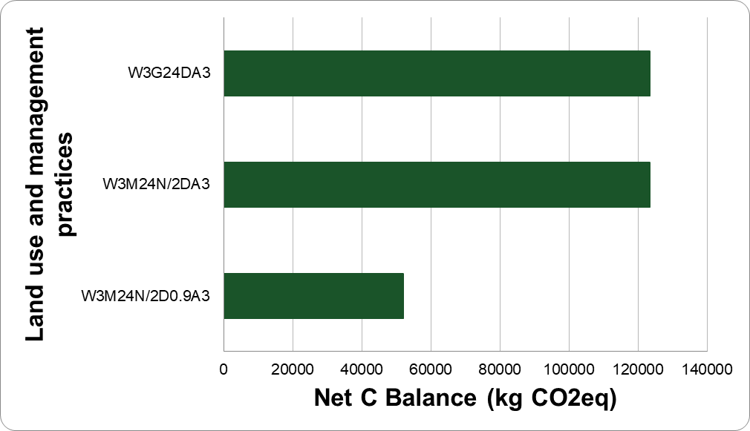
Net Carbon Balance: Agroforestry (holos-ie)

Slide 16
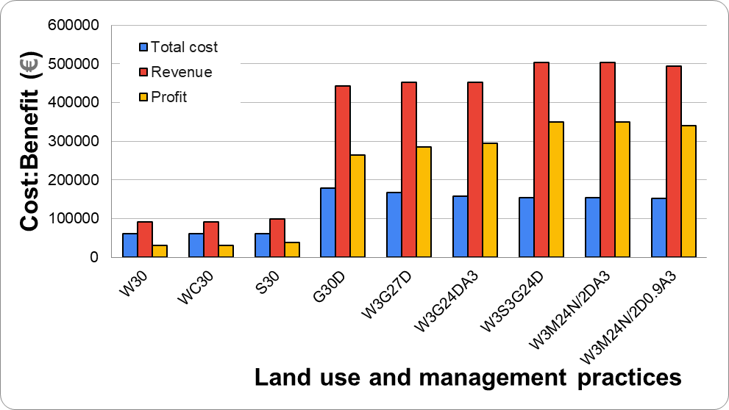
EconoMY: HOLOS-IE

Slide 17
CONCLUSIONS
Preliminary results. Validations and calibrations for improvement will be continued.
HOLOS-IE enables to provide sectoral outputs on GHGs, SOC, energy, soil & biomass carbon, soil health, and cost-benefit.
HOLOS-IE, leading to HOLOSEU, is to aid farms in achieving the potential of carbon neutrality and sustainability.
It establishes interconnections between agricultural system components, enabling accurate computations of total and net carbon balance.
It fosters planning opportunities for climate change mitigation and adaptation, enhances agroecosystem services, and promotes sustainable agricultural production.
Collaboration and partnership are welcome

Slide 18
ACKNOWLEDGMENTS
European Union’s Horizon 2020 Research and Innovation Programme
THANK YOU

