Slide 1
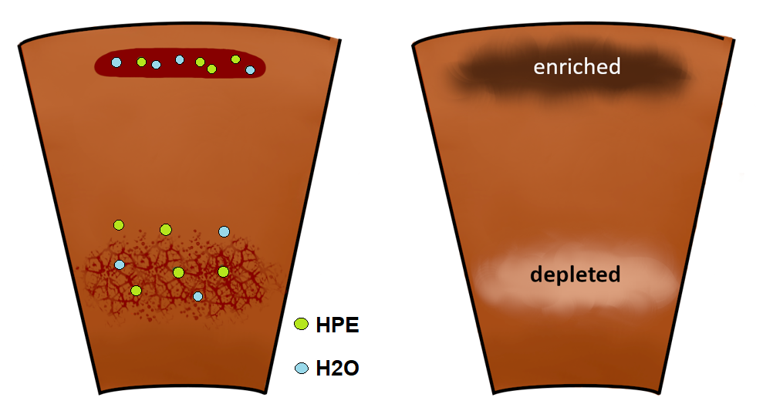
Trace element and volatile redistribution from mantle to crust in rocky planetary bodies
Navigation
Introduction
Significance of partitioning
calculations
Partition coefficient modeling
1D interior evolution model
Partition coefficient ranges
Impact on HPE partitioning
Impact on water redistribution
Partitioning in super-Earth
Water retained in super-Earths
Summary and Conclusion
Methods
Julia Schmidt and Lena Noack, Freie Universität Berlin
EGU conference 2025, Vienna
Abstract:
Results
Less water in mantle
More water in mantle
References

Slide 2
Par
Significance of partitioniong caluclations in interior evolution models (1)
Mineral/melt partition coefficients (D) determine the amount of redistributed elements from solid to melt
0-1 → incompatile with solid material (a lot of redistribution)
>1 → compatible with solid material
In most models, they are taken as constant. We investigate the effect if we take pressure, temperature, and composition into account.

Slide 3
Par
Significance of partitioniong caluclations in interior evolution models (2)
Heat-producing elements (HPE)
Water
→ ⁴⁰K, ²³⁵U, ²³⁸U, ²³²Th
Lowers the melting temperature of rocks
More H₂O in the crust → larger reservoir for outgassing
Higher HPE abundances → increase of temperature → faciliated melting due to radioactive decay
We focus on clinopyroxene/melt D modeling because:
It takes up most trace elements inside the Earth‘s upper mantle.
It has one of the largest D variations vor P-t-X conditions.

Slide 4
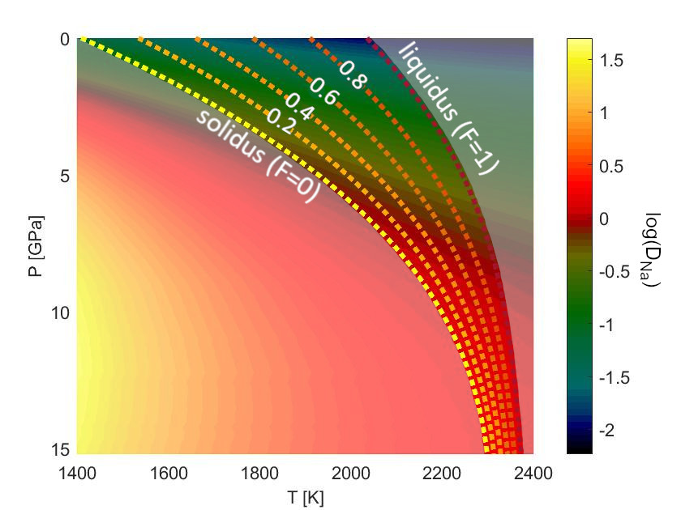
Par
Partition coefficient (D) modeling
Sodium partitioning between clinopyroxene/melt
Cpx/melt partition coefficient model that is based on Wood and Blundy (2014), using the scaling law that reaches higher pressures by Schmidt an Noack (2021)
Mantle mineralogy taken into account with bulk partition coefficient (D*)
Please find more information in the supplementary material.
Schmidt and Noack, 2021
Cerium exhibits similar redistribution behavior to H₂O (Aubaud et al., 2004 ; Hauri et al., 2006), and therefore functions here as a water analogue partitioning.
Publication
Open Source Code

Slide 5
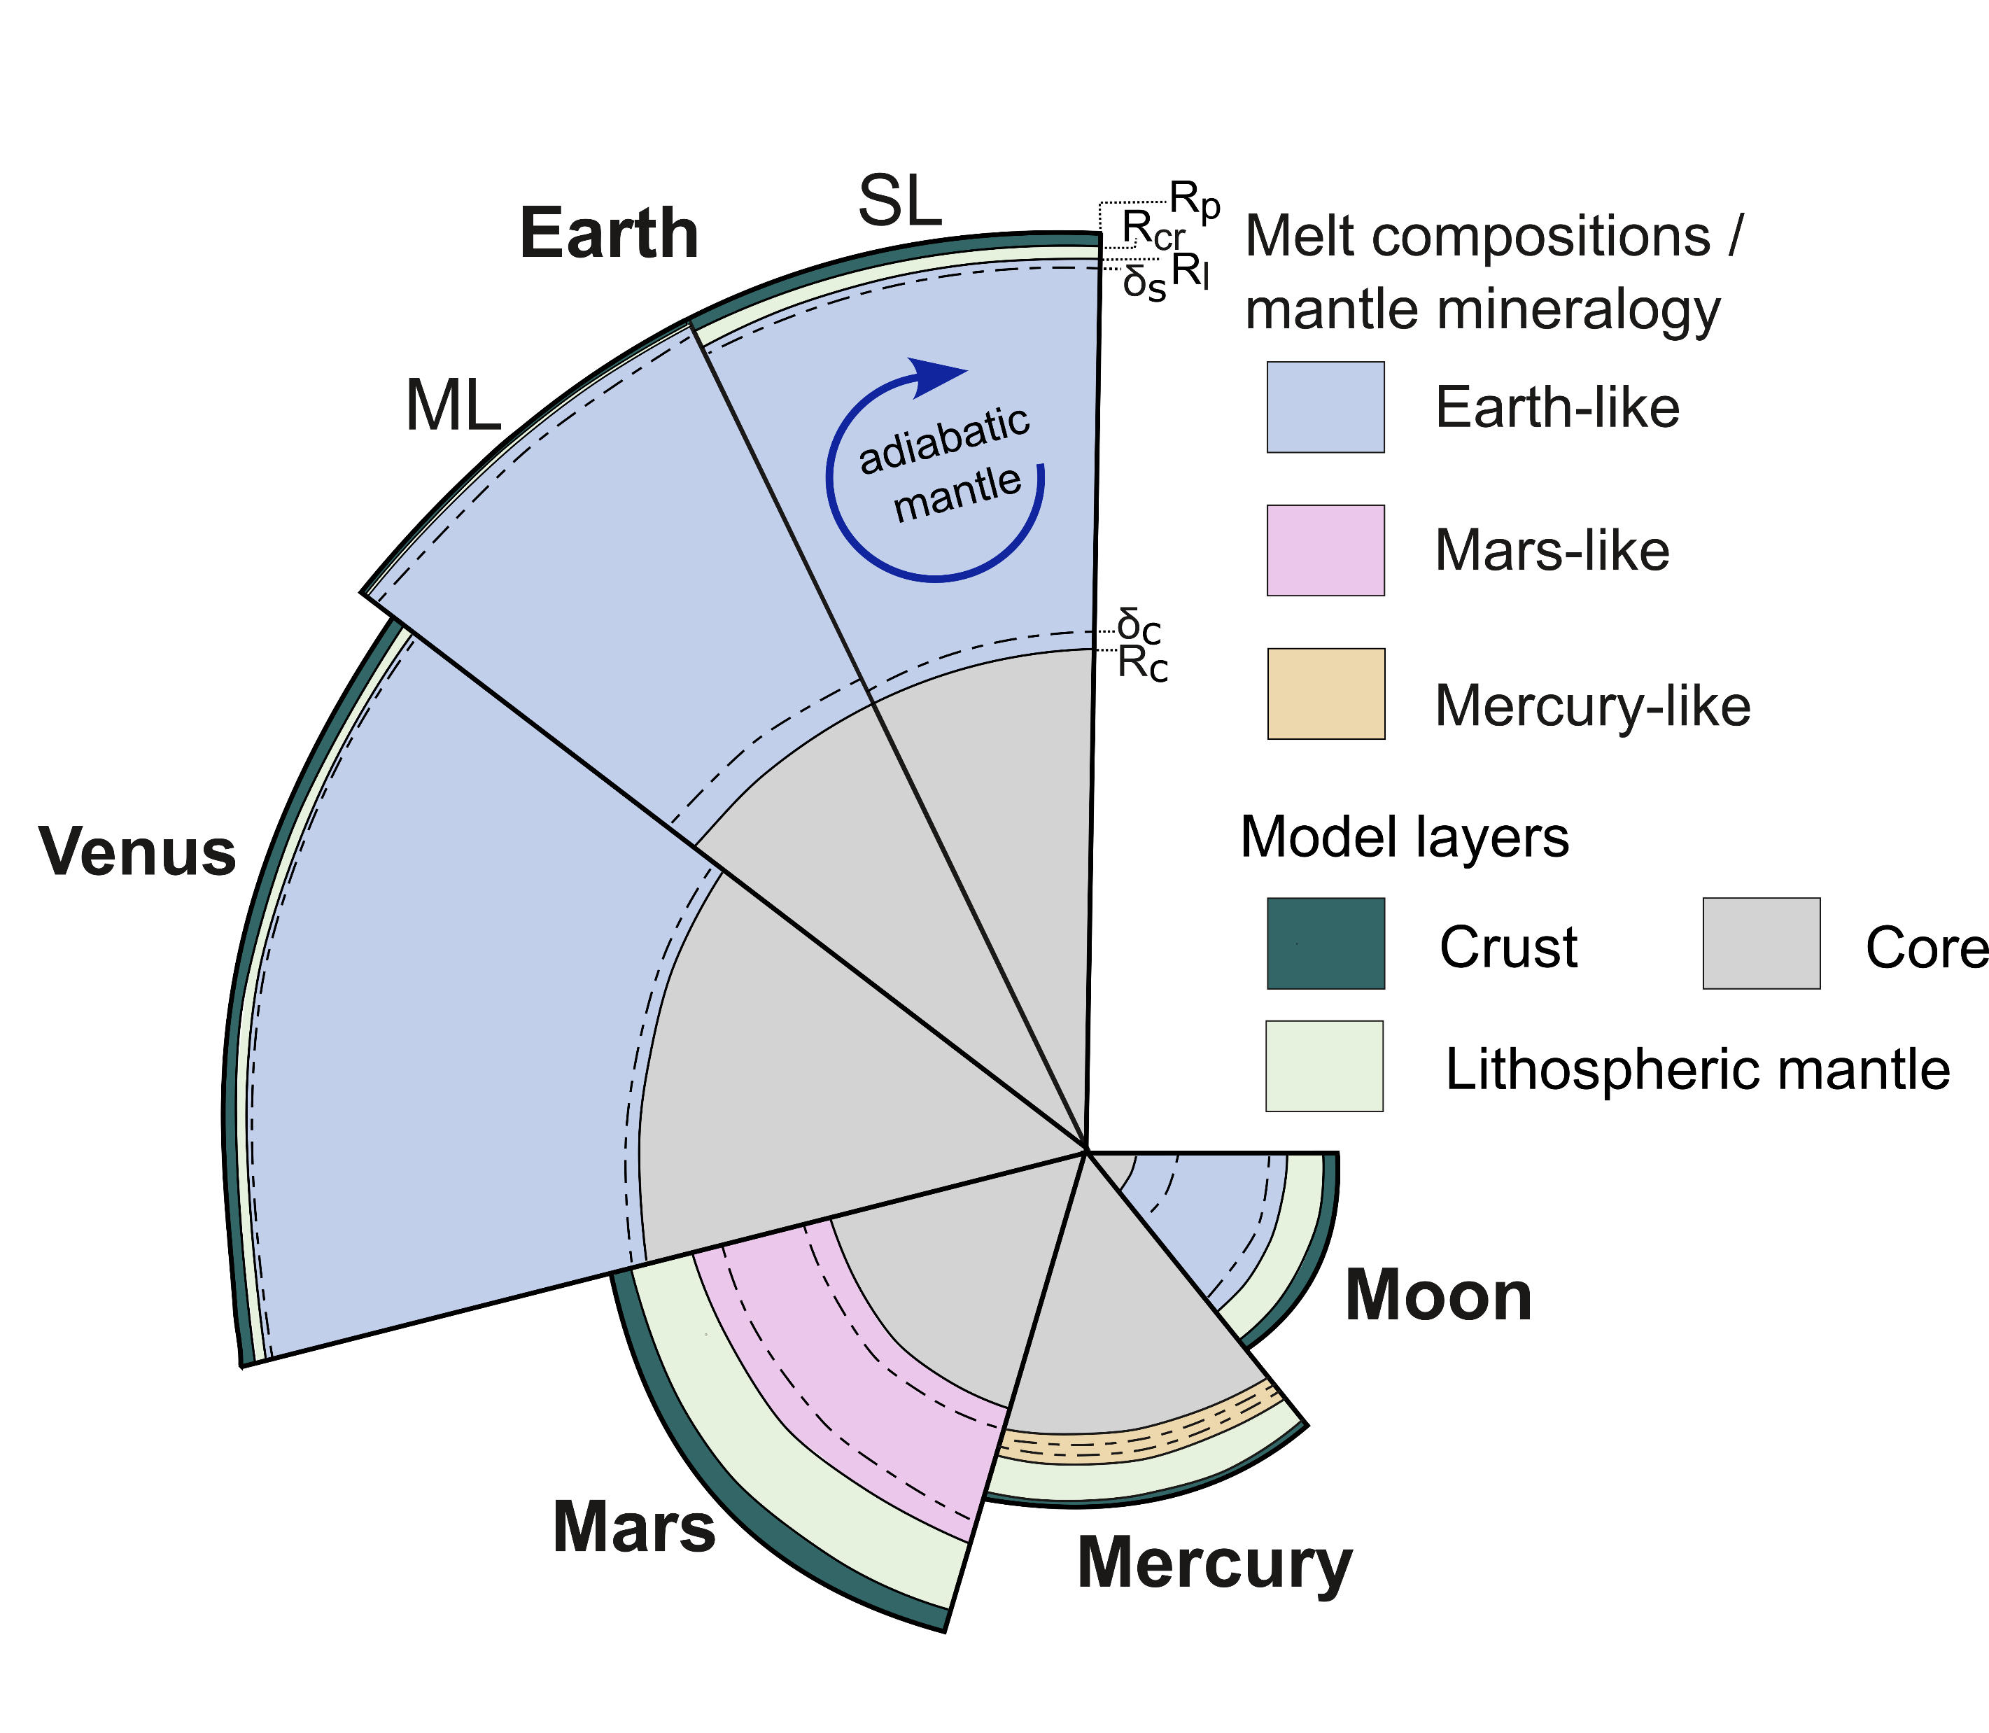
Par
1D interior evolution model
Model runs forward in time (over 4.5 Gyrs)
The starting point is after the magma ocean phase of a planet
Focus in thermal evolution, crust and lithsphere evolution and trace element redistribution
Eclogitization inhibits growth of crust
Stagnant lid and mobile lid
Schmidt et al. (in revision)

Slide 6
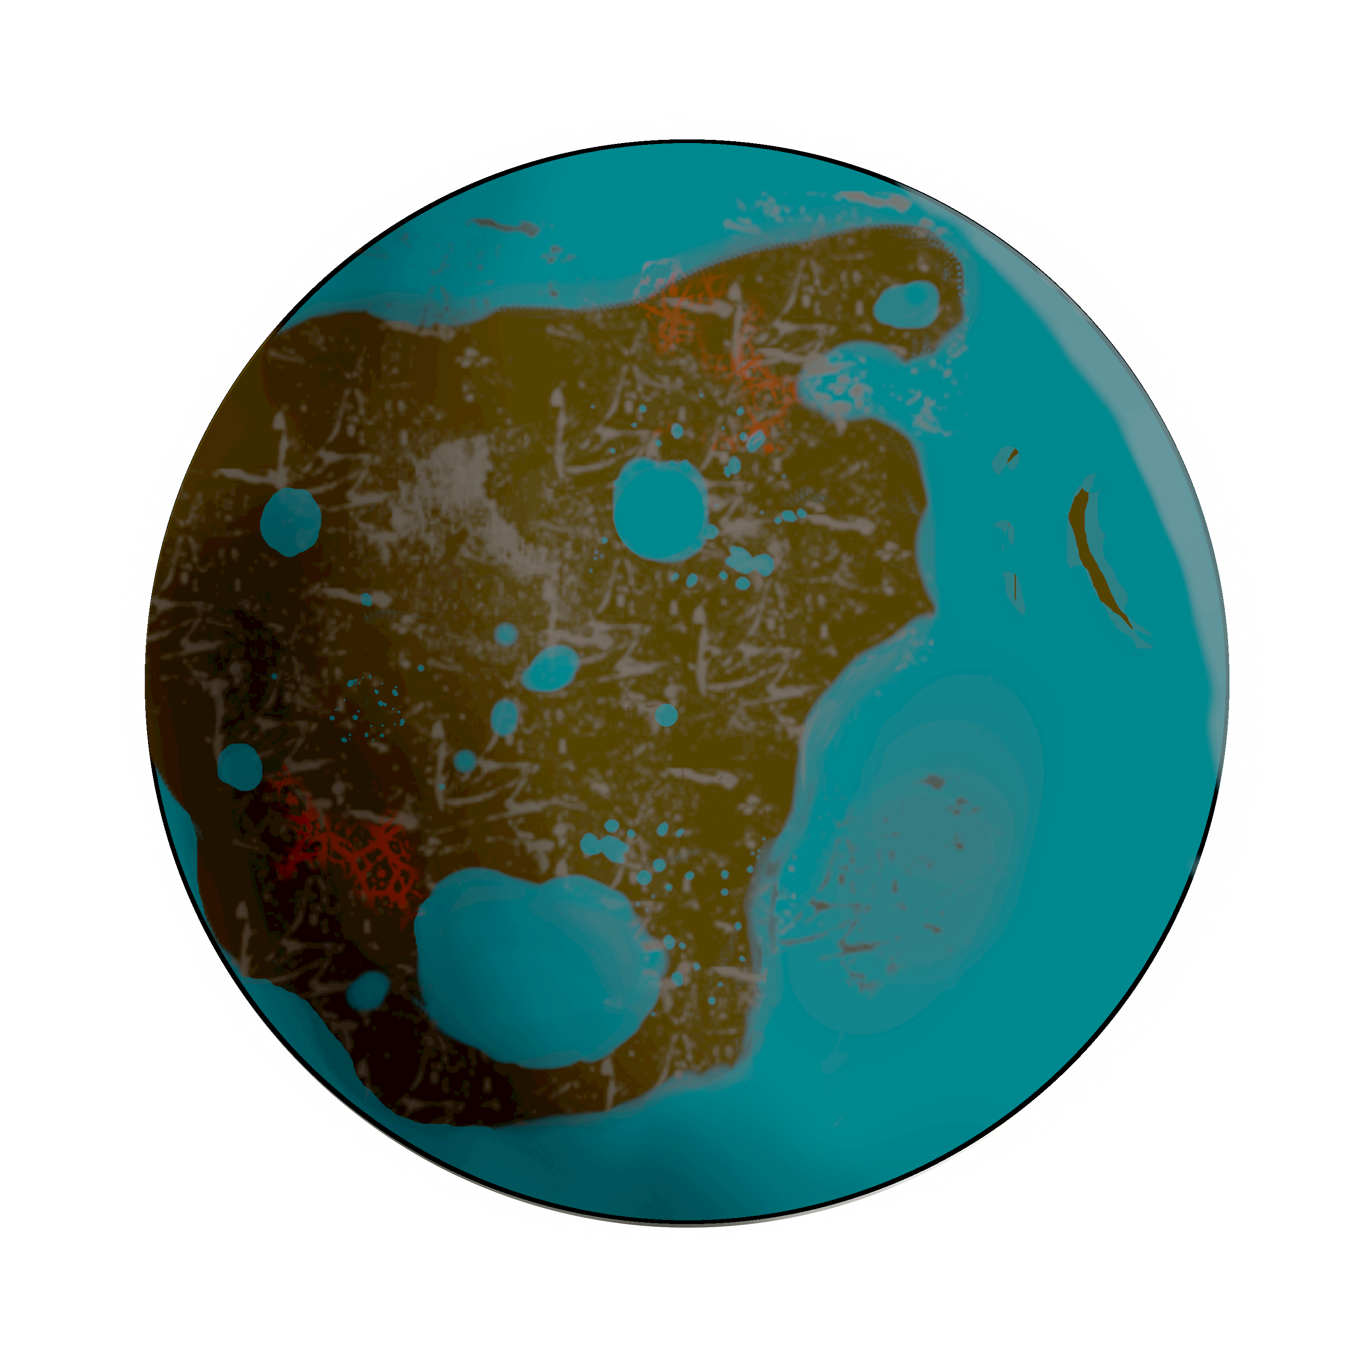
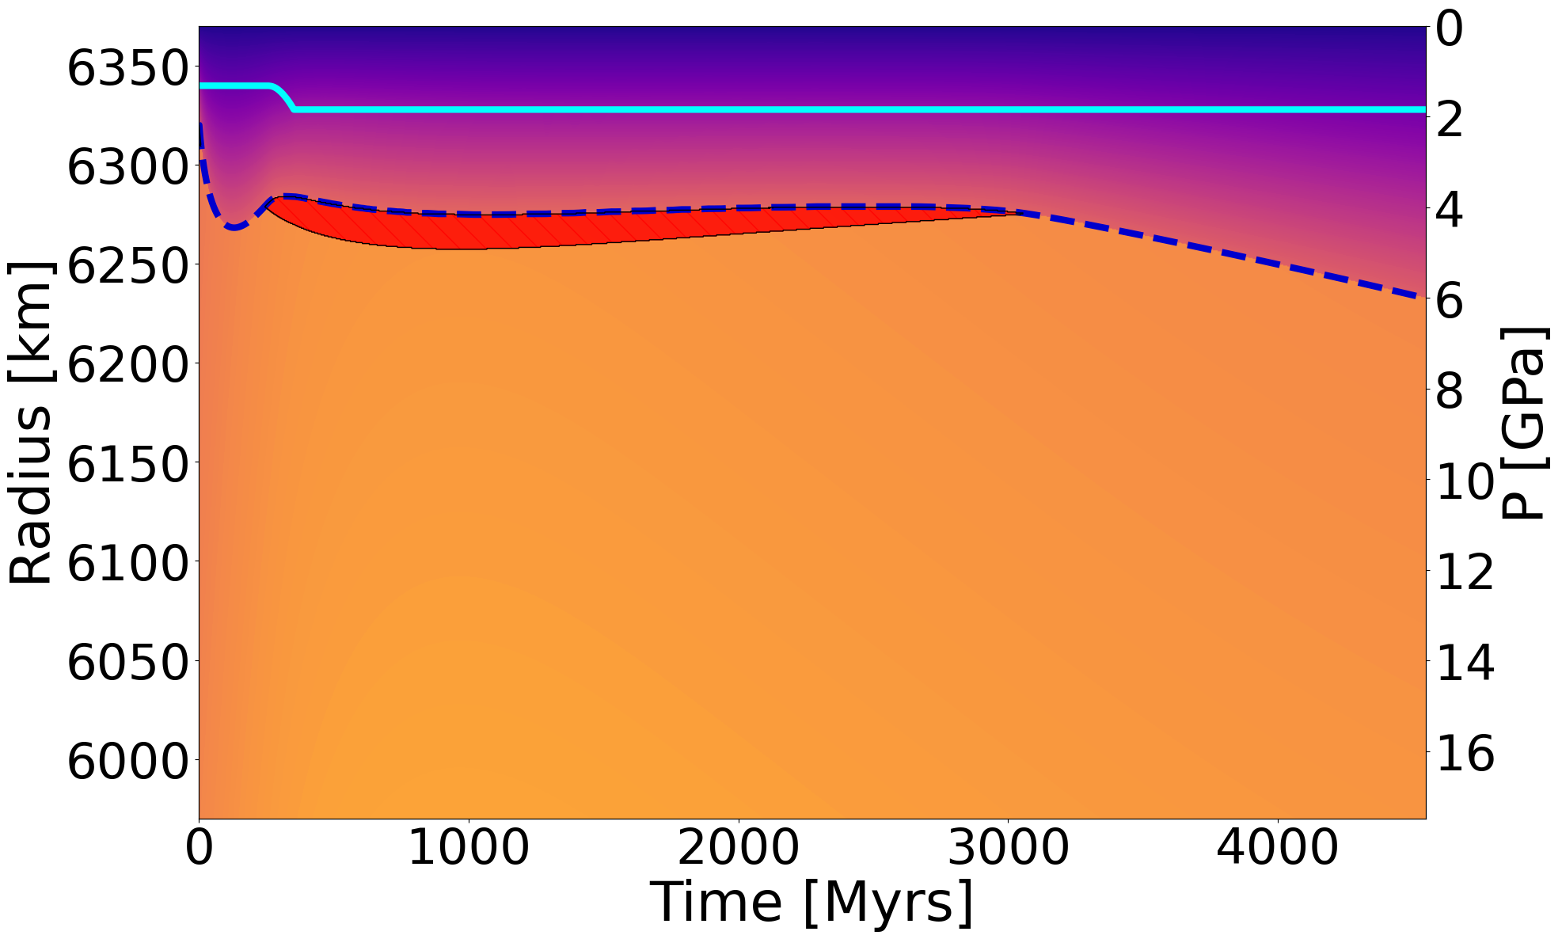
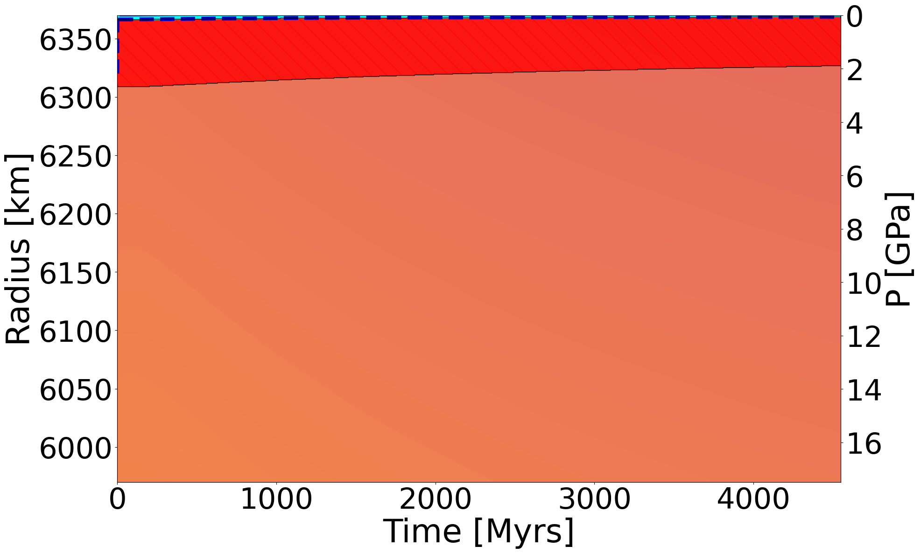
Par
Partition coefficient (D) ranges
Meltzone in SL Earth
D variations across planets and within a single planetary melt zone
Bulk mineral/melt partition coefficients
Meltzone in ML Earth
Schmidt et al. (in revision)
Comparison with D^{cpx/melt} results
Schmidt et al.
(in revision)
Comparison with Th and U results

Slide 7
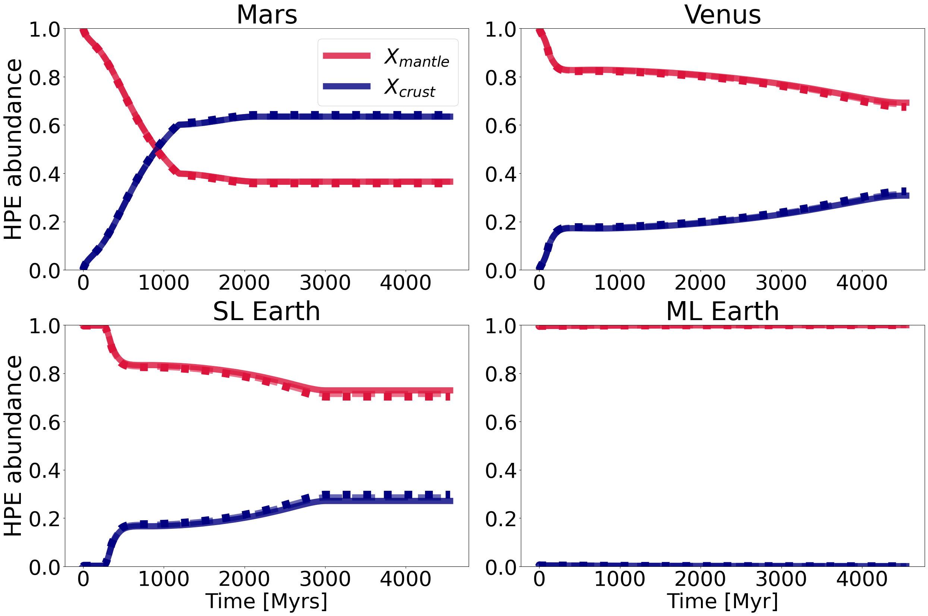
Par
Impact on HPE partitioning
P-T-X dependent partition coefficient only have a minimal effect on the distribution of HPE
P-T-X dependent: locally modeled partition coefficient
const.: constant partition coefficient, but taking literature values and mineralogy into account

Slide 8
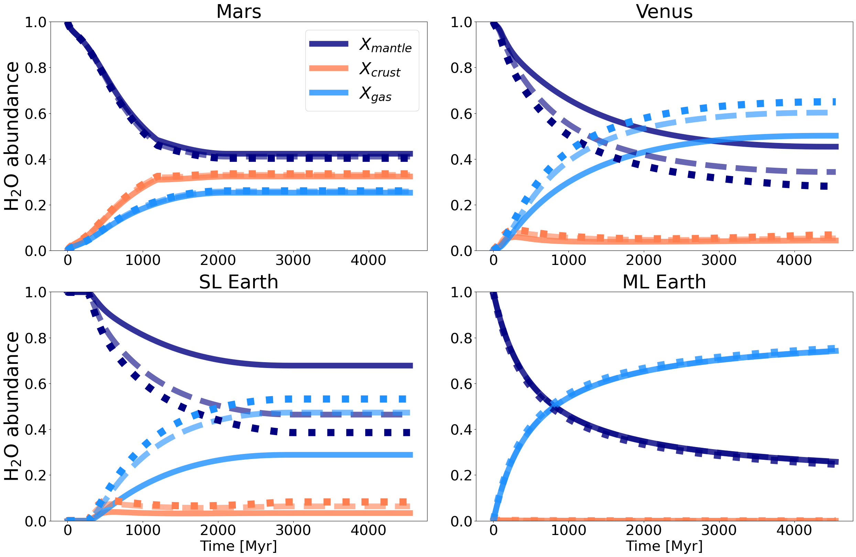
Par
Impact on water redistribution
For larger stagnant lid planets, more H₂O is retained in the mantle than expected compared to
constant or D=0.01 Ds!
P-T-X dependent: locally modeled partition coefficient
const.: constant partition coefficient, but taking literature values and mineralogy into account

Slide 9
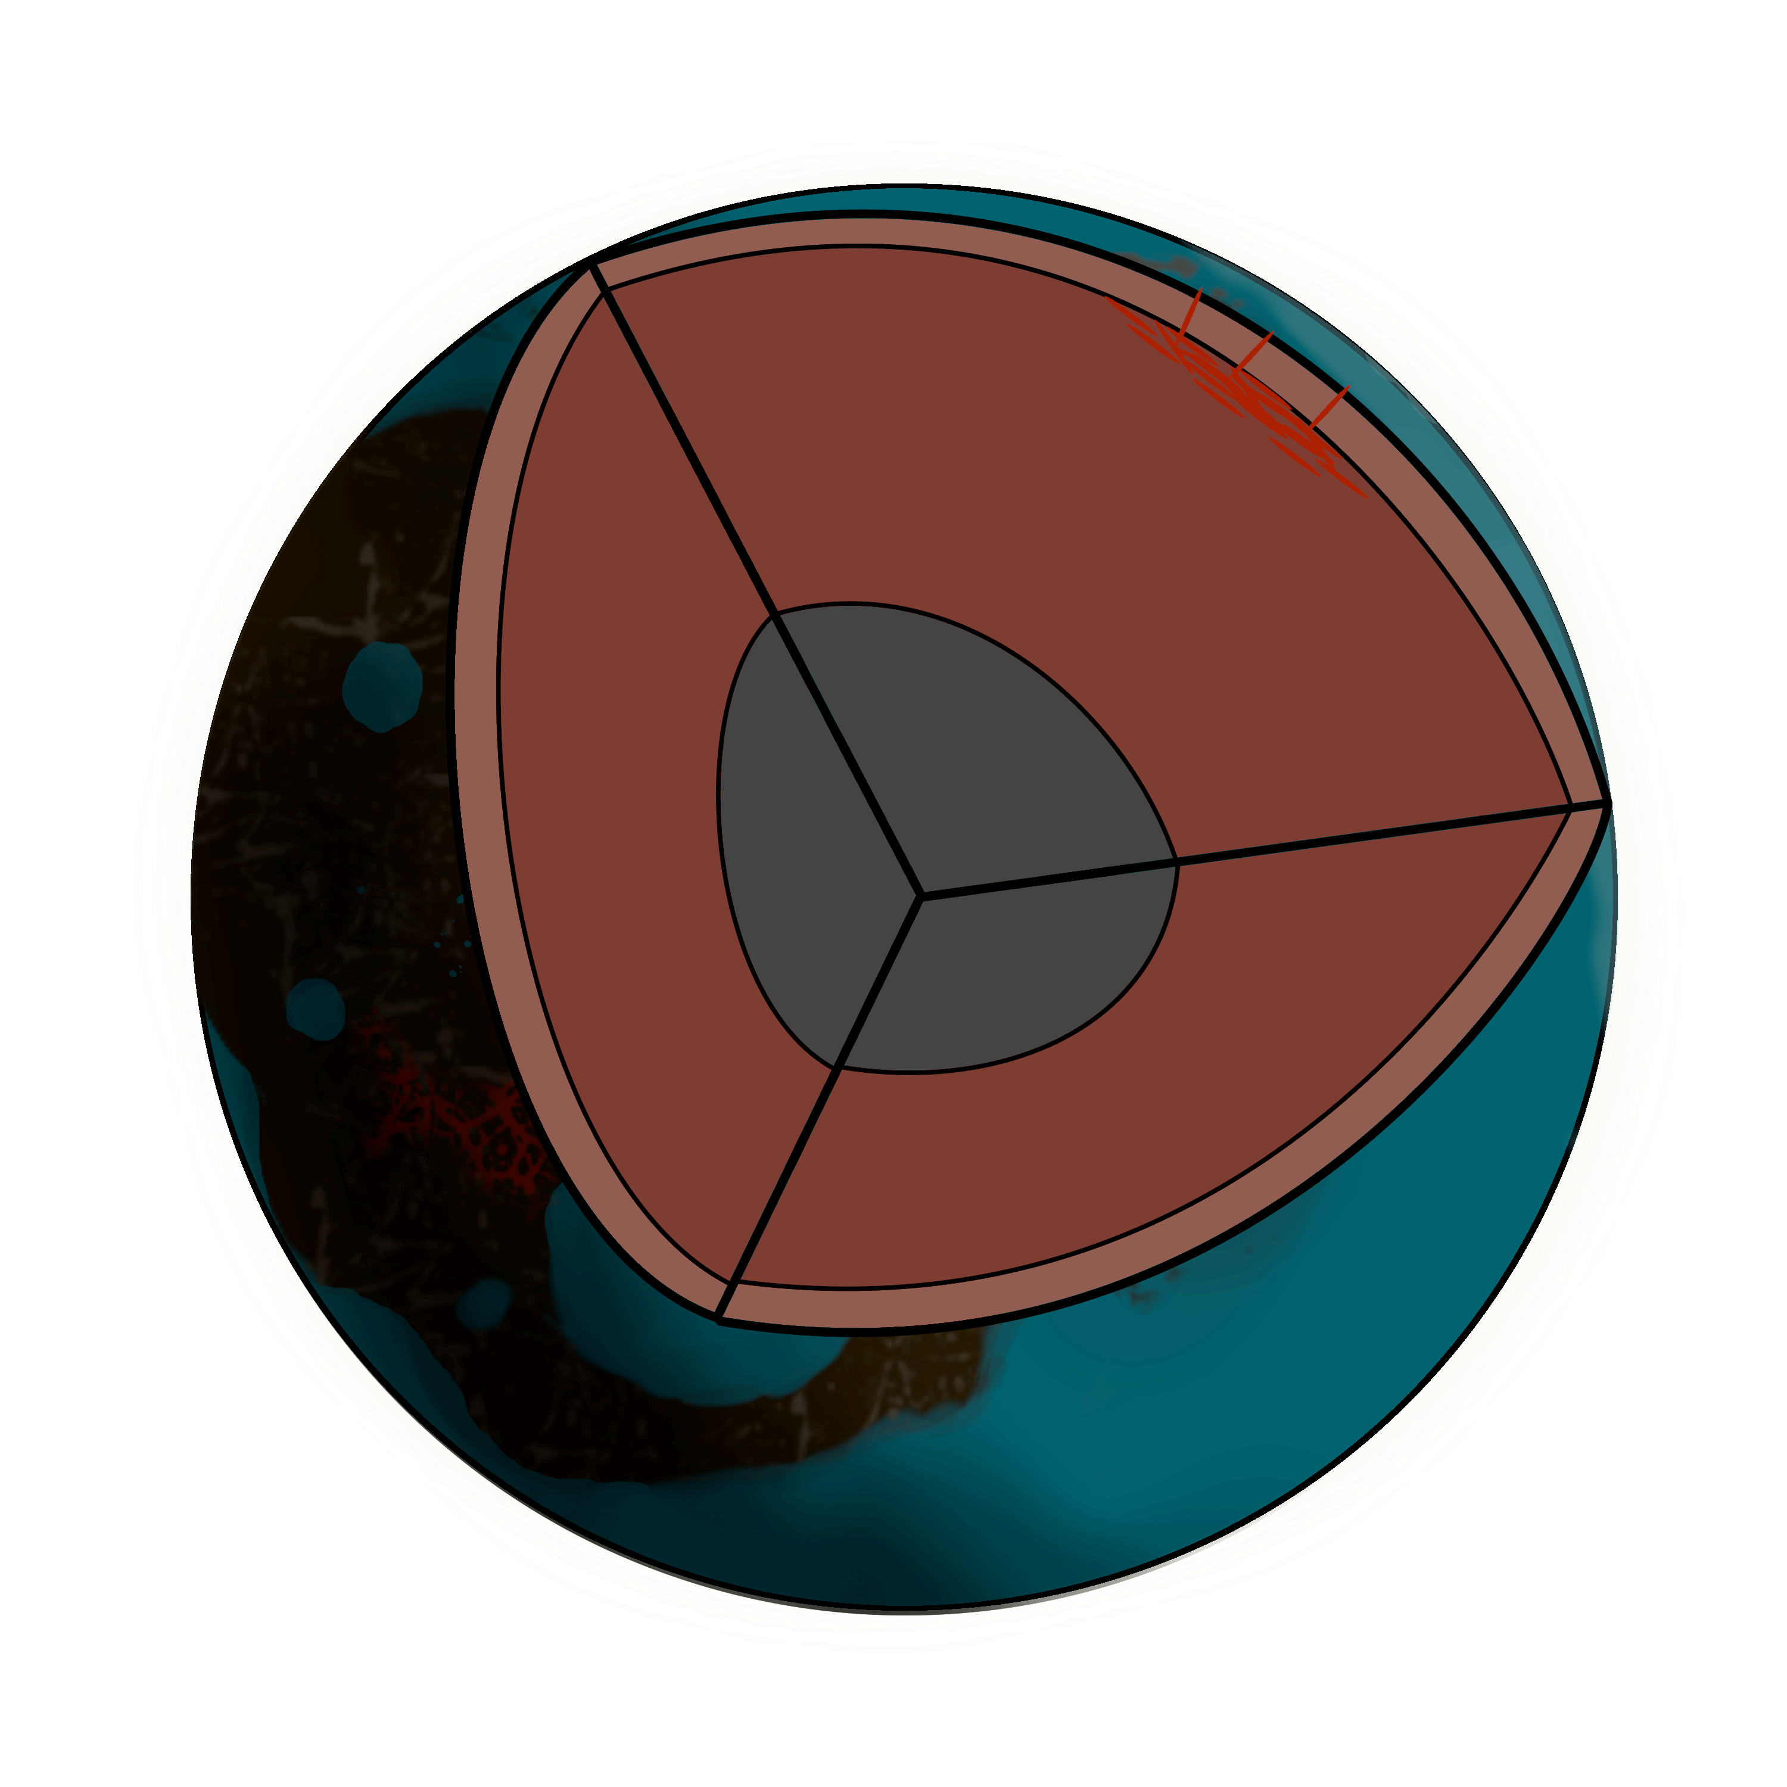
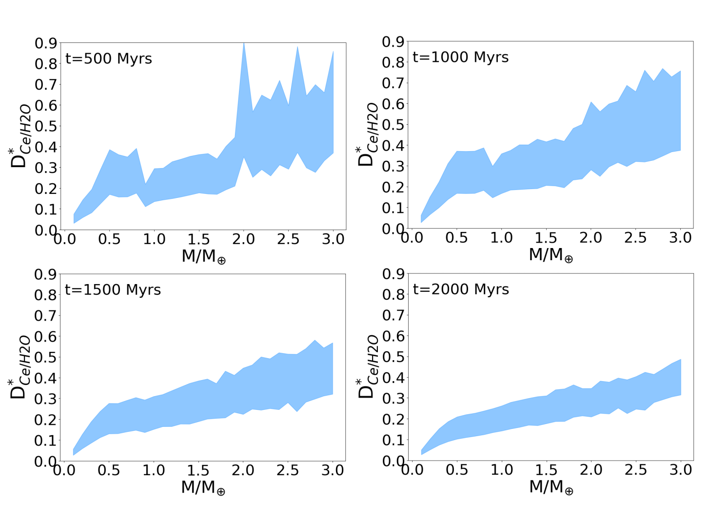
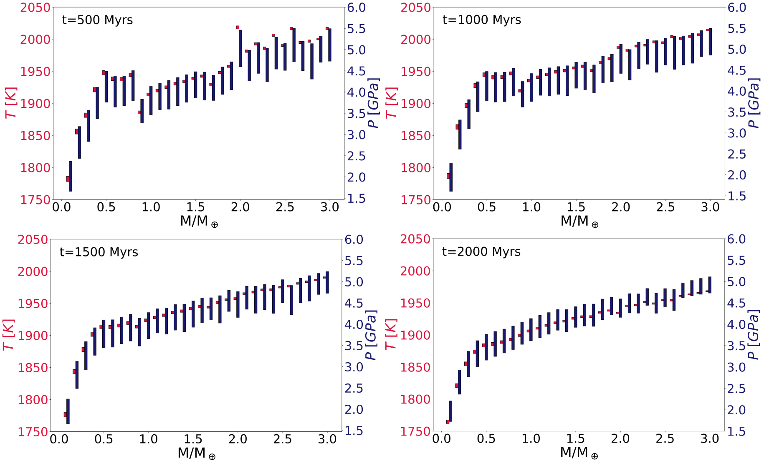
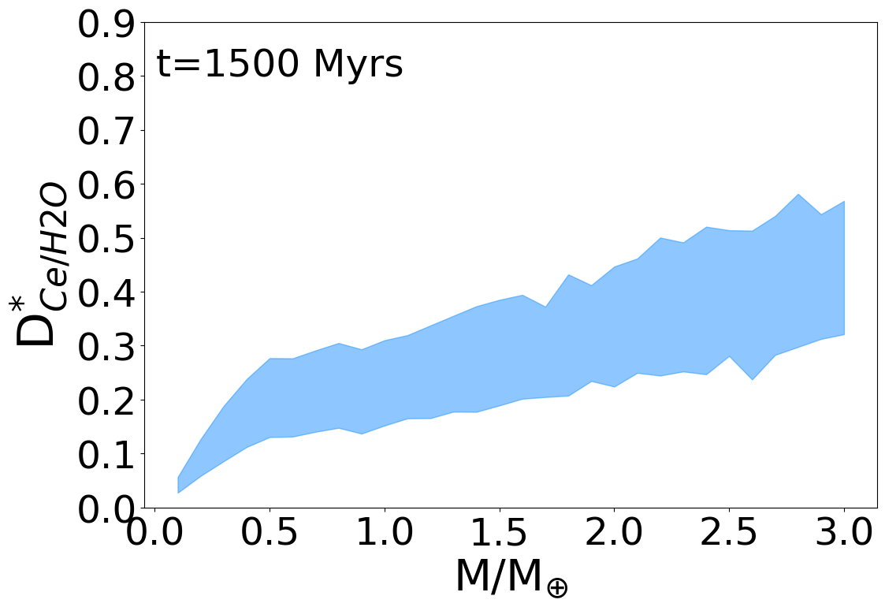
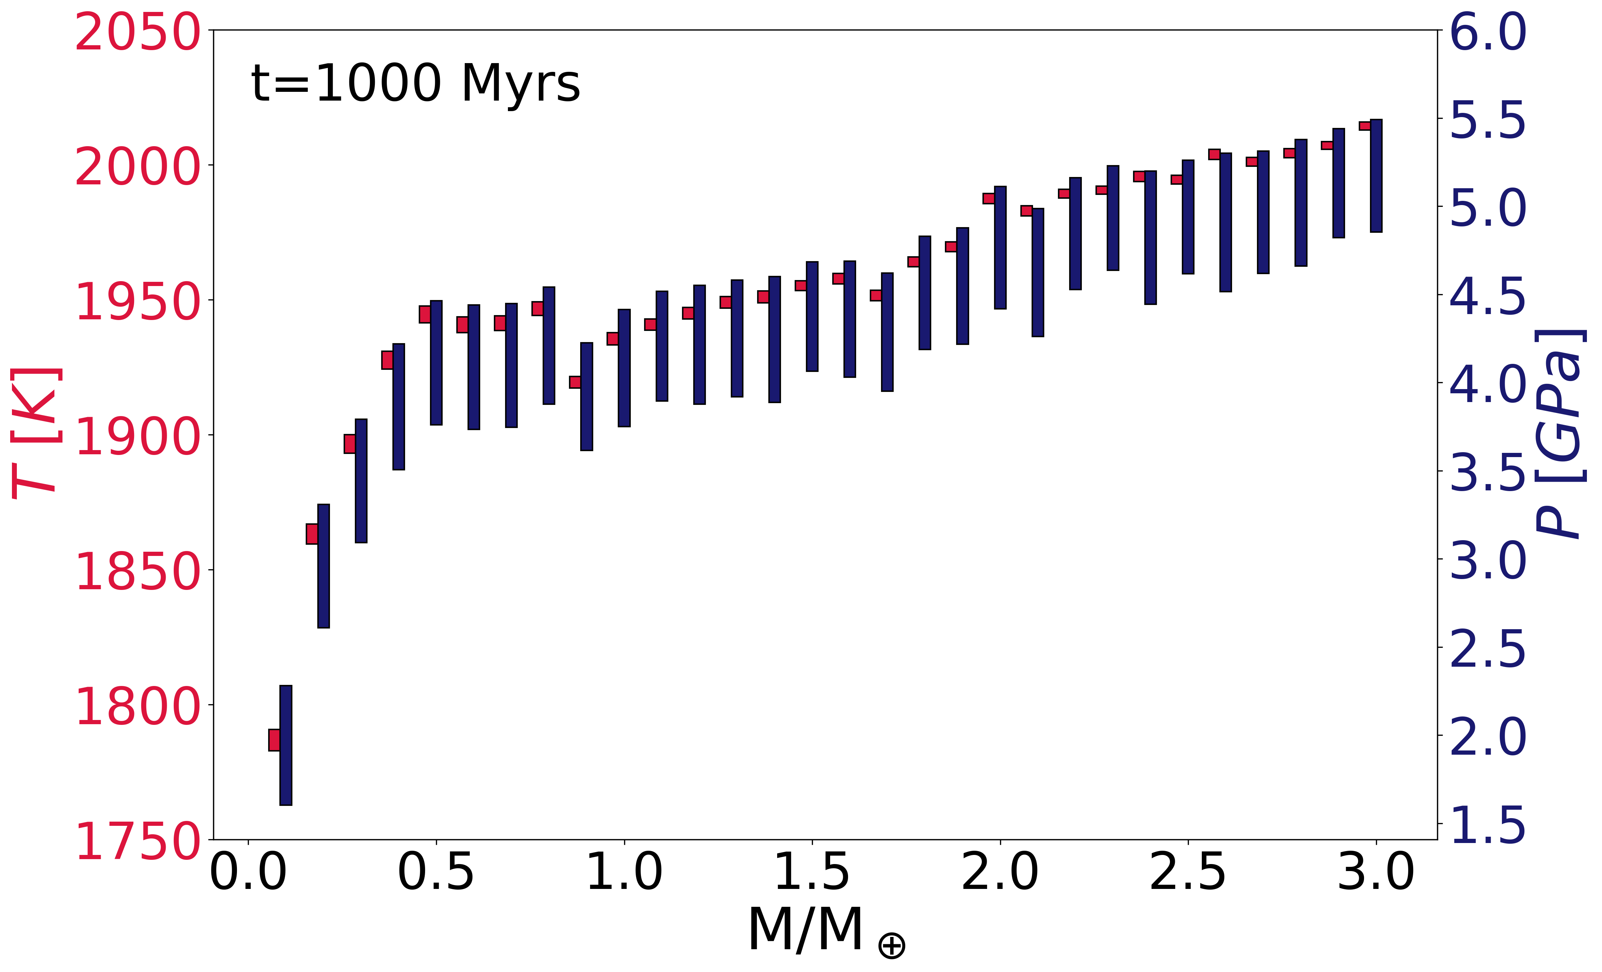
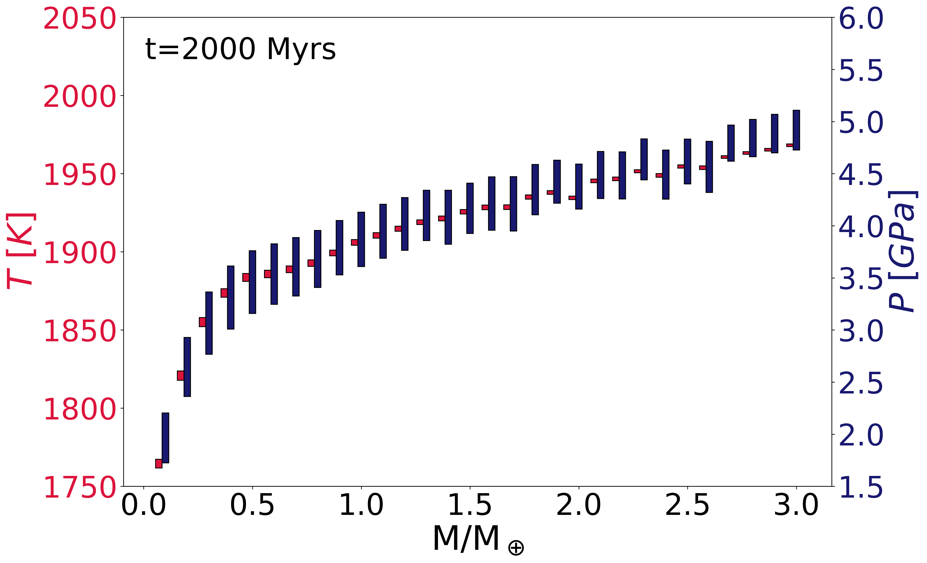
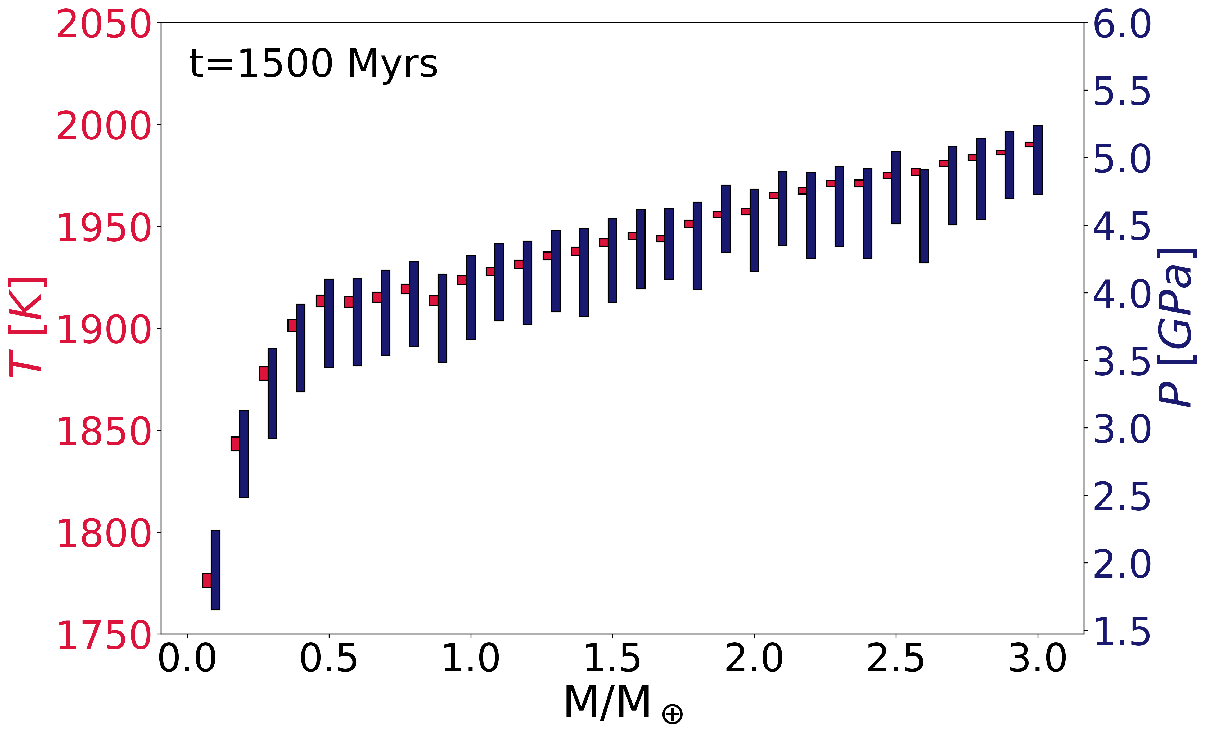
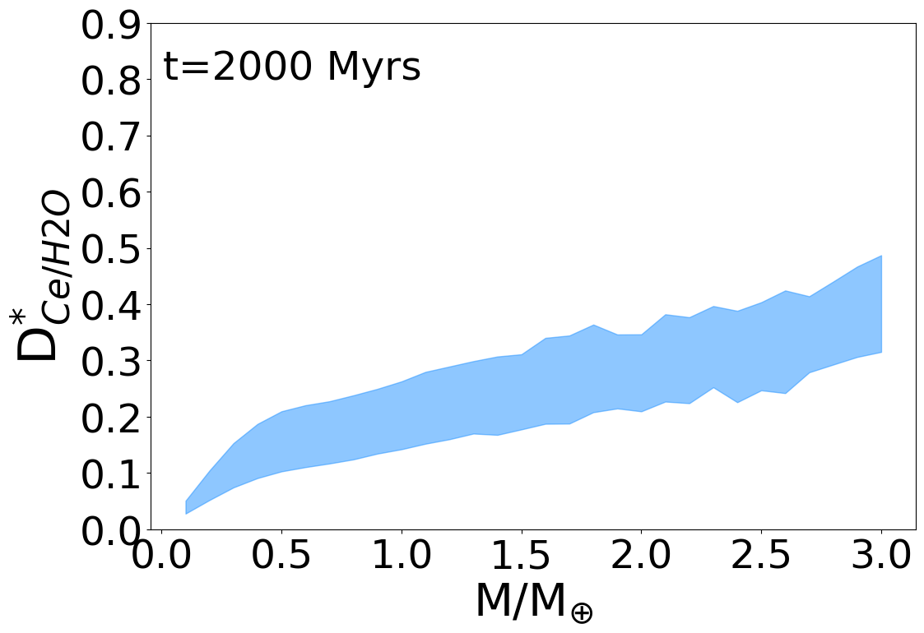
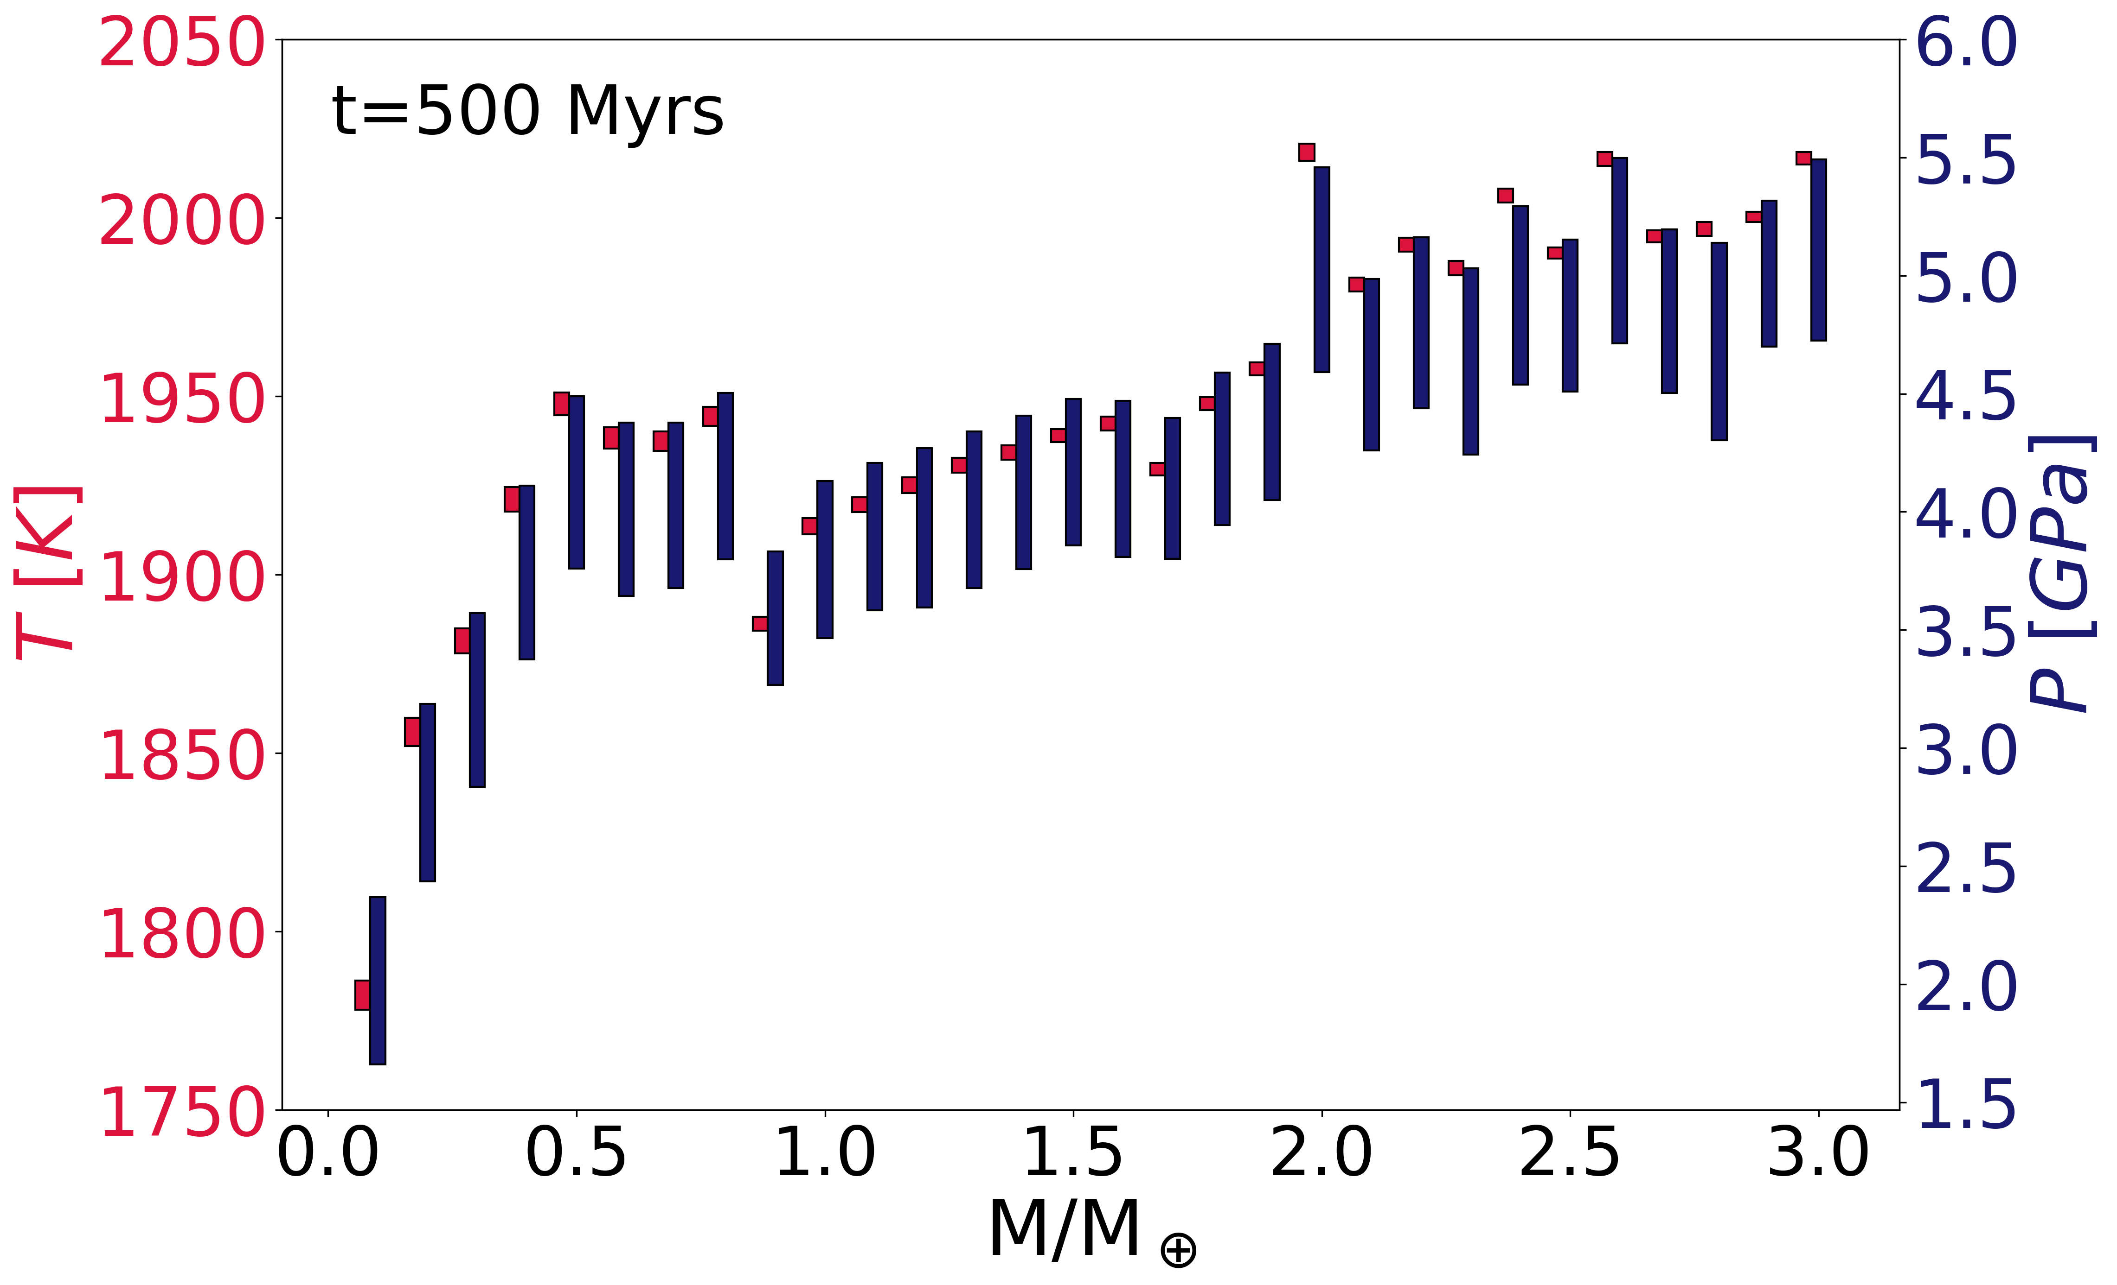
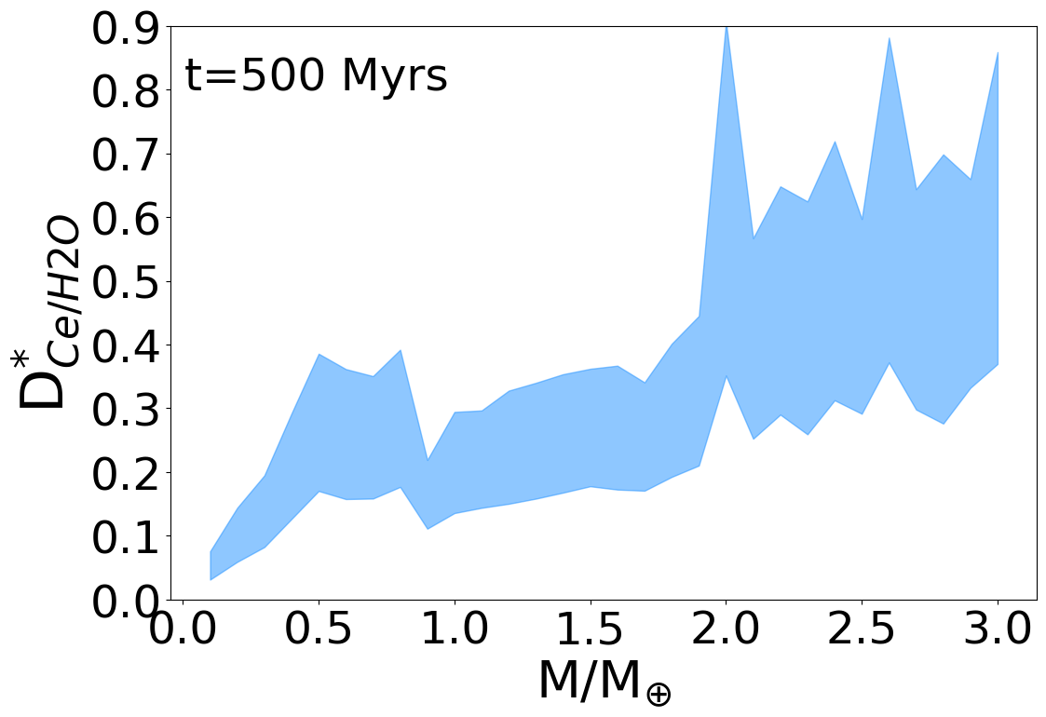
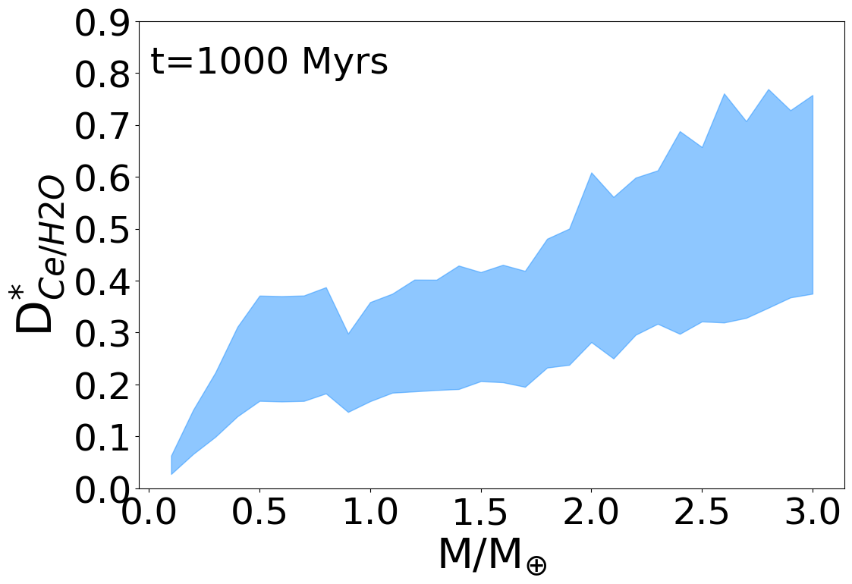
Par
Partitioning in super-Earths (and sub-Earths)
Meltzone conditions at different time steps
Increasing D*_{Ce/H2O} with rising P-T conditions
Click me
Click me
Click me
Preliminary, will be extended to 5 M_{E}
Find D^{cpx/melt} in supplementary material

Slide 10
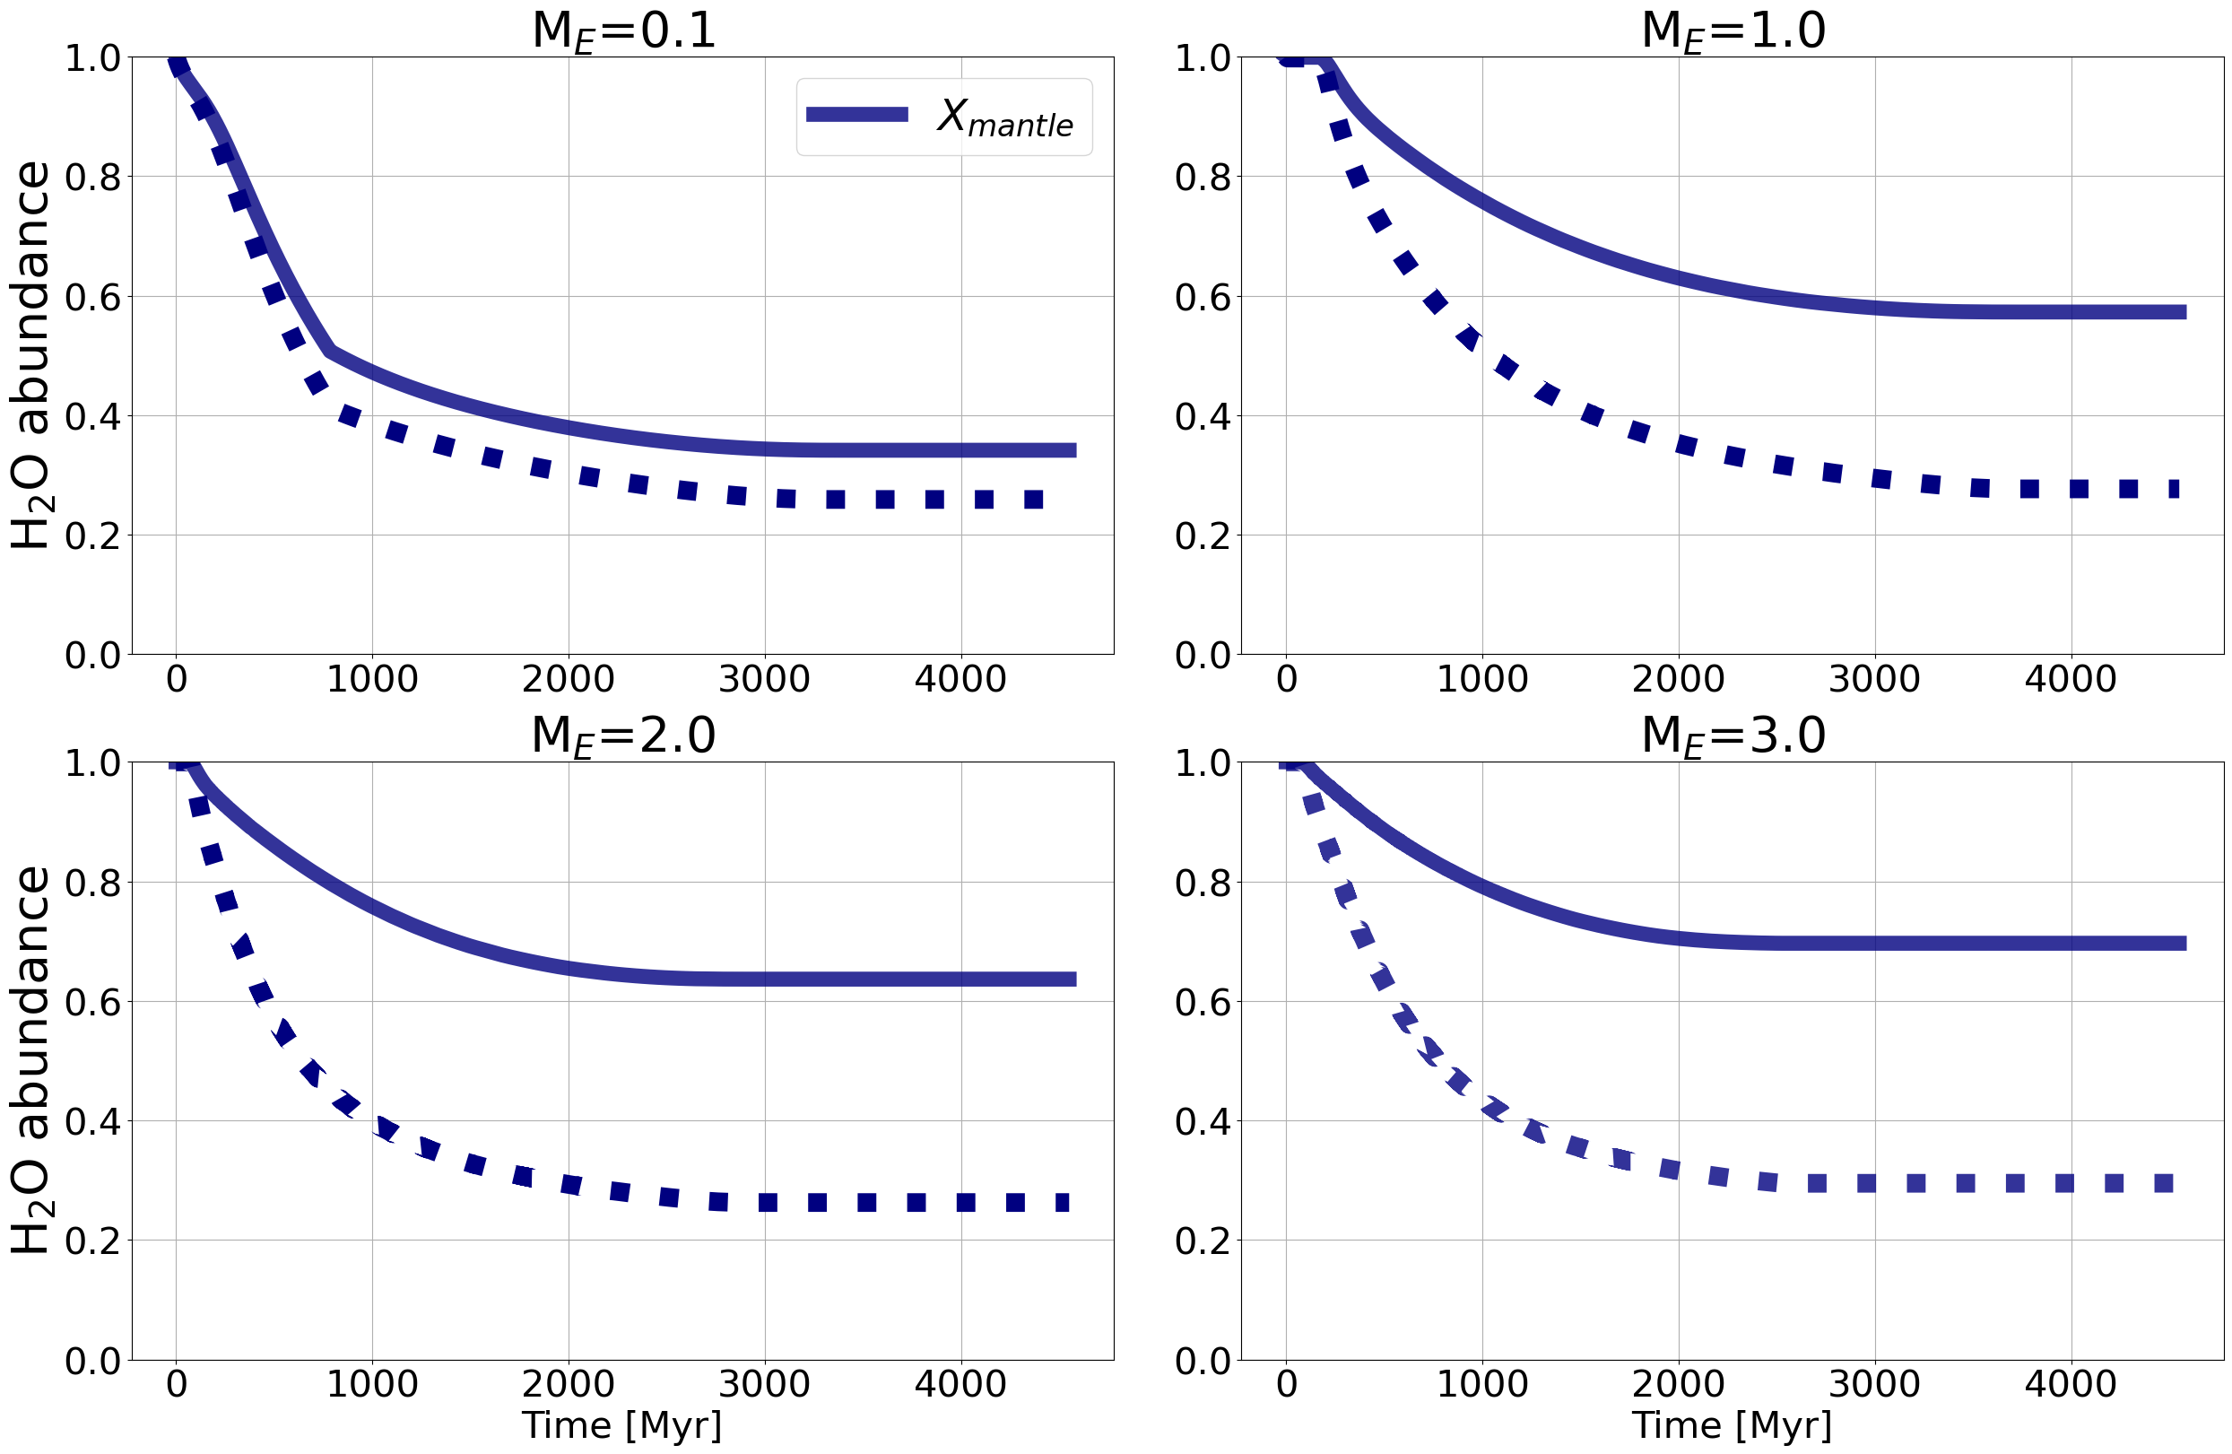
Par
Water retained in super-Earths
In higher mass planets, much less water is redistributed.
57%
34%
→ much more water is retained within the mantle!
63%
70%

Slide 11
Summary and Conclusion
Par
Partition coefficients of K and Ce (and H₂O are sensitive to pressure changes, Th and U (supplementary material) more sensitive to temperature changes
The HPE D calculation impacts their redistribution only minimally (extremely incompatible behavior)
H₂O-redistribution is impacted significantly
More water retained inside the mantles of higher-mass planets than expected
Abstract:

Slide 12
References
Par
Aubaud, C., Hauri, E. H., & Hirschmann, M. M. (2004). Hydrogen partition coefficients between nominally anhydrous minerals and basaltic melts. Geophysical Research Letters, 31(20).
Hauri, E. H., Gaetani, G. A., and Green, T. H. (2006). Partitioning of water during melting of the Earth’s upper mantle at H2O-undersaturated conditions. Earth and Planetary Science Letters, 248(3-4):715–734.
Wood, B. J., & Blundy, J. D. (2014). 3.11-Trace element partitioning: The influences of ionic radius, cation charge, pressure, and temperature. Treatise on geochemistry, 421-448.
Schmidt, J. M., & Noack, L. (2021) Clinopyroxene/Melt Partitioning: Models for Higher Upper Mantle Pressures Applied to Sodium and Potassium. International Journal On Advances in Systems and Measurements, 14:125–136.
Schmidt, J.M., Vulpius, S., Brachmann, C., and Noack, L.: Redistribution of trace elements from mantle to the crust in rocky solar system bodies, (in revision).
Schmidt and Noack: Planet mass controls the mineral/melt partitioning of trace elements in the upper mantle of rocky planets, In preparation.

Slide 13
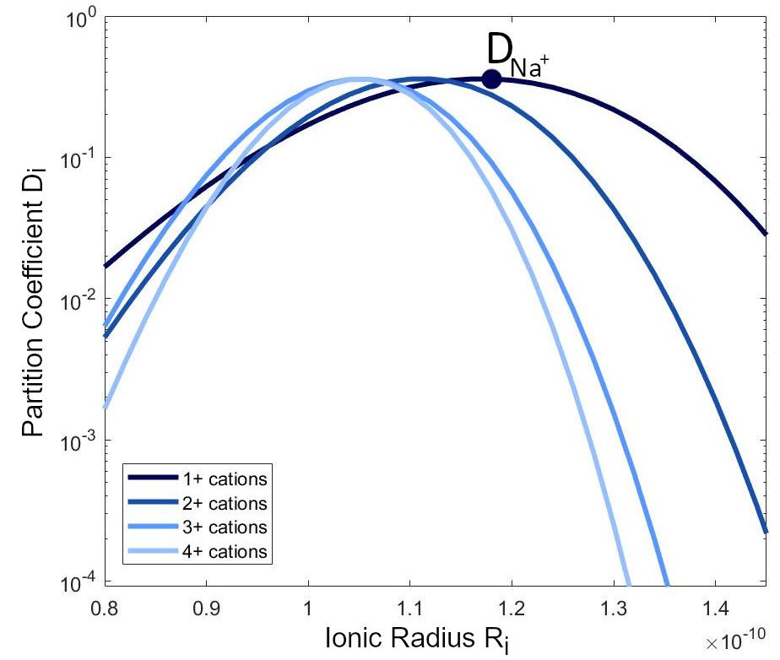
Supplementary: Partition coefficient modeling (1/2)
With the „lattice strain model“ you can determine the strain needed to fit an element into a mineral lattice. The higher the strain, the less the element fits into a mineral lattice site and the more incompatible the element is with the mineral of interest.
Model by Blundy et al. (1997):
log(D_{Na})
$$D_{i}= D_{0}∗exp\left[\frac{−4πE_{M2}N_{A}\left[\frac{r_{0}}{2}{\left(r_{0} −r_{i}\right)}^{2}+\frac{1}{3}{\left(r_{0} −r_{i}\right)}^{3}\right]}{RT}\right]$$
$D_{0}$ = Used as a reference to model other elements‘ partition coefficients. Here: $D_{0}$ = $D_{Na}$
The logarithmic relationship between partition coefficients of one charge and their dependence on the bulk modulus E and the lattice site radius R₀ allows us to calculate Ds for all trace elements.
Back

Slide 14
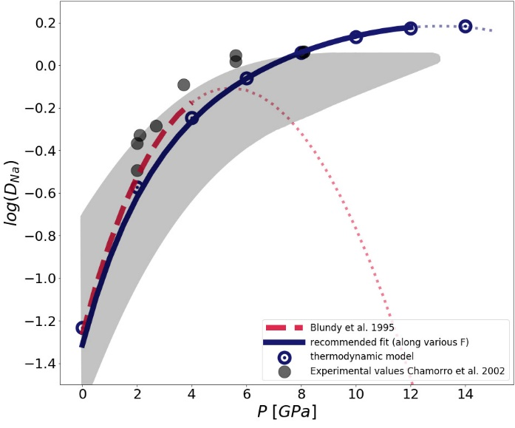
Supplementary: Partition coefficient modeling (2/2)
The older scaling law by Blundy and Wood (1995) is only suitable for pressures < 4 Gpa.
This is a problem because most mantle evolution codes need a model that is also suitable for higher pressures.
Based on a thermodynamic model, we parameterized a scaling law which is valid for higher pressures.
Saling law that is suitable for interior evolution models
$$D_{Na}=$$
$$exp\left(\frac{2183+2517P−157P^{2}}{T}−4.575−0.5149P+0.0475P^{2}\right)$$
Schmidt and Noack (2021)
The new scaling law fits very well to the thermodynamic model and the experimental literature data (gray shaded area).
It is suitable for P < 12 GPa.
Back

Slide 15
Supplementary: upper mantle mineralogies
Fixed literature mantle mineralogy for each planet in wt%
Planet | Olivine | Cpx | Opx | Garnet | Ref.
Earth/Moon/Venus | 61 | 10 | 15 | 14 | Pyrolite by Duffy and Anderson (1989)
Mars | 60 | 11 | 19.2 | 9.8 | Waenke and Dreibus (1988)
Mercury | 27.2 | 8.9 | 47.8 | 16 | Padovan et al 2014
Back

Slide 16
Par
Partition coefficient (D) ranges
D variations across planets and within a single planetary melt zone
Meltzone in SL Earth
clinopyroxene/melt
Bulk mineral/melt
Meltzone in ML Earth
Back

Slide 17
Par
U and Th Partitioning
clinopyroxene/melt
bulk mineral/melt
Meltzone in SL Earth
Back

