Slide 1
Garnet sand
Density
Given by the supplier: 3.9g/cm³.
Pycnometer tests result by Jia-Jun Hung(2020): 3.52g/cm³.
It has a relatively uniform particle size(Chou,2021).
Notes:
石柳沙
Density
Given by the supplier: 3.9g/cm3.
Pycnometer tests result by Jia-Jun Hung(2020): 3.52g/cm3.
It has a relatively uniform particle size(Chou,2021).

Slide 2
3D printer?
Width
40cm
Developed our machine
We have more freedom in determining the desired dimensions.
Make it easier to design and construct the suction system.
Length 70cm
Height
85cm
Length
31cm
The movement range of the tool.
The external dimensions of the sand box
Width
21cm
Height
25cm
Notes:
3D列印機
To developed our machine, we have more freedom in determining the desired dimensions and make it easier to design and construct the suction system.
The external dimensions of the sand box are length, width and height 312125 centimeter
沙箱 機器移動尺寸
The movement range of the tool.乘 times 公分centimeter
The external dimensions of the sand box
外: 31*21*25 內: 29*20*24.2
填積木
If the sand box is filled, it would be very heavy, so I used a 3D printer to print a few blocks to temporarily fill the bottom. Of course, if a deeper sand box is needed in the future, I can remove the 3D printed blocks.

Slide 3
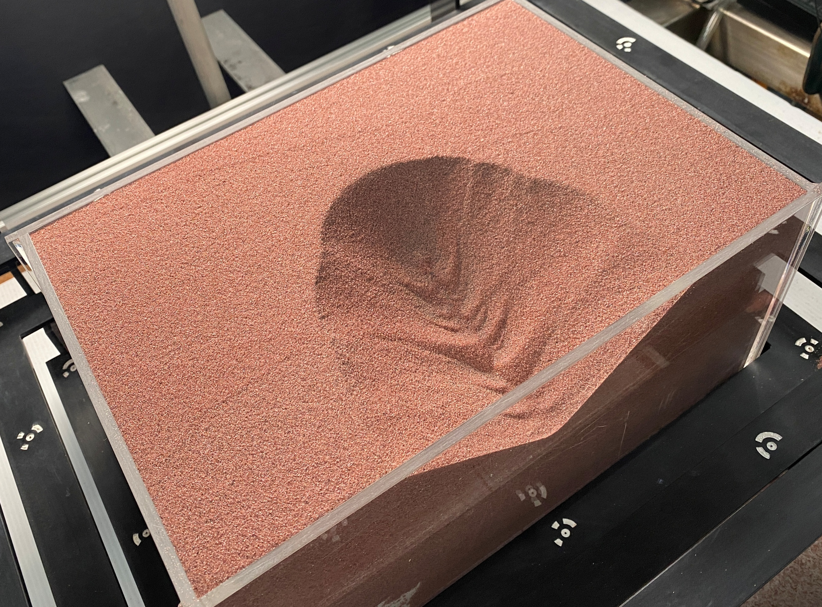
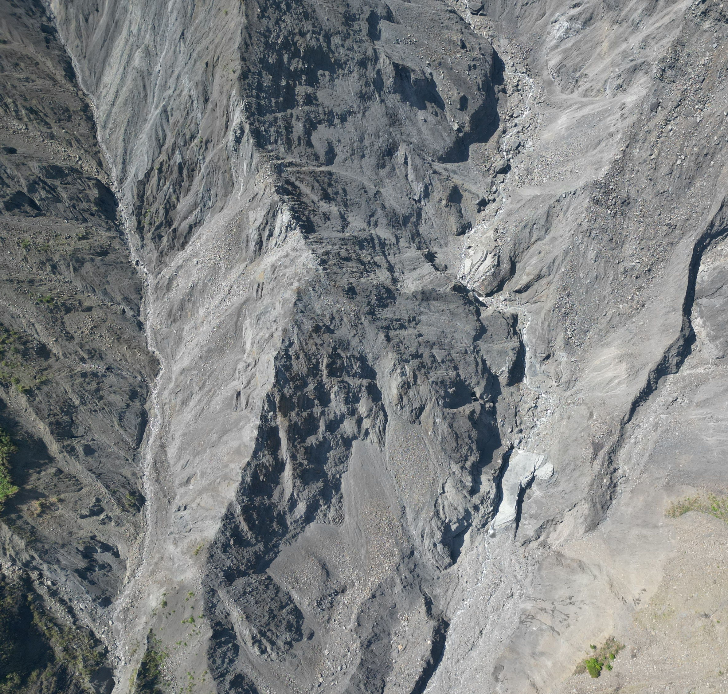
Ridge lines
Notes:
為甚麼用乾沙模擬
We want to use a simple laboratory setup to gain a deeper understanding of landslides induced by gradual river incision in mountainous regions.
The right-hand side figure is a part of landslide area in Putunpunas River.
We can see the topography is similar to the idealized experiment we set up.
實驗和現實哪裡像
The right-hand side figure is a part of landslide area in Putunpunas River.
We can see the topography is similar to the idealized experiment we set up.

Slide 4
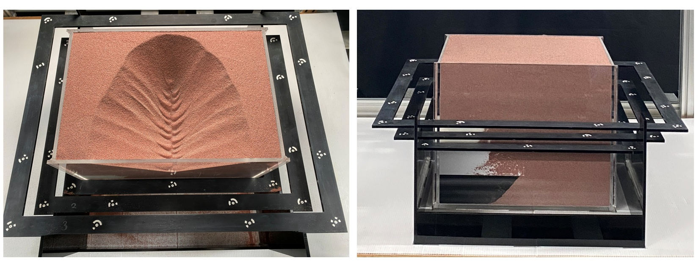
3D Model
Notes:
怎麼建模
The black one is our calibration tool, and the white ones are the markers, each with different coordinates.
E:\Meeting\20250404\Experiment\yzEllipse_75\Record

Slide 5
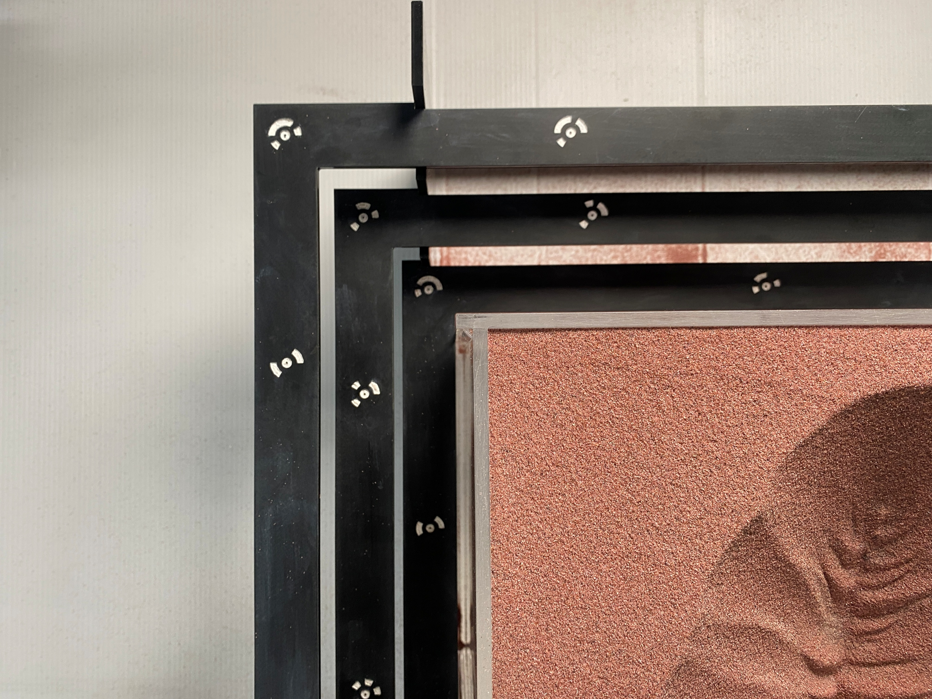
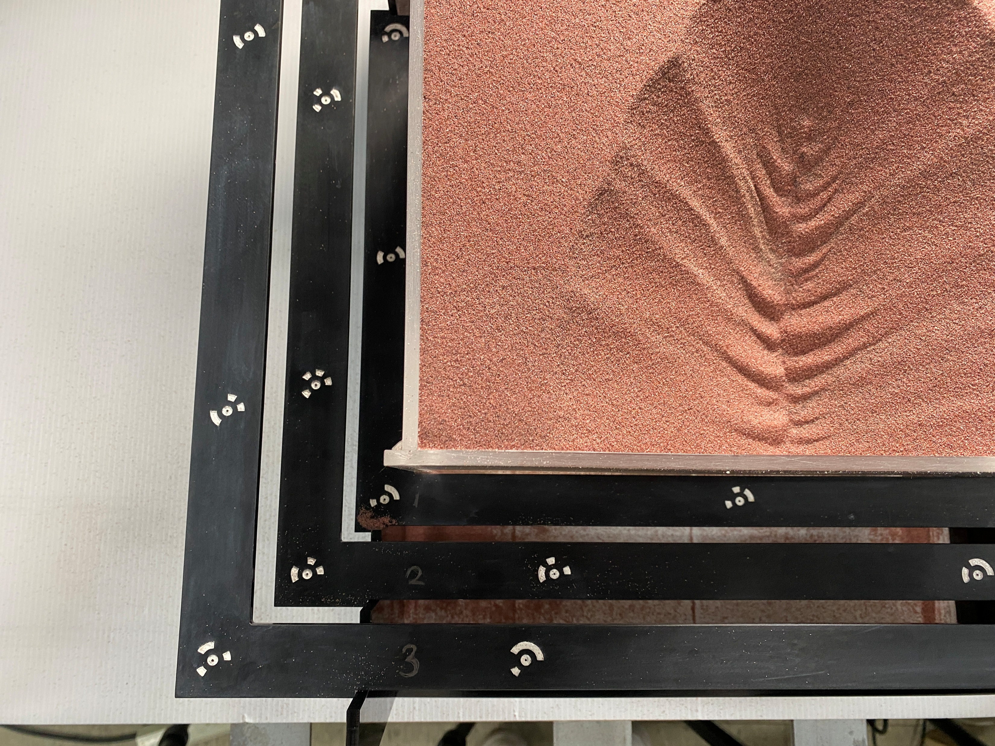
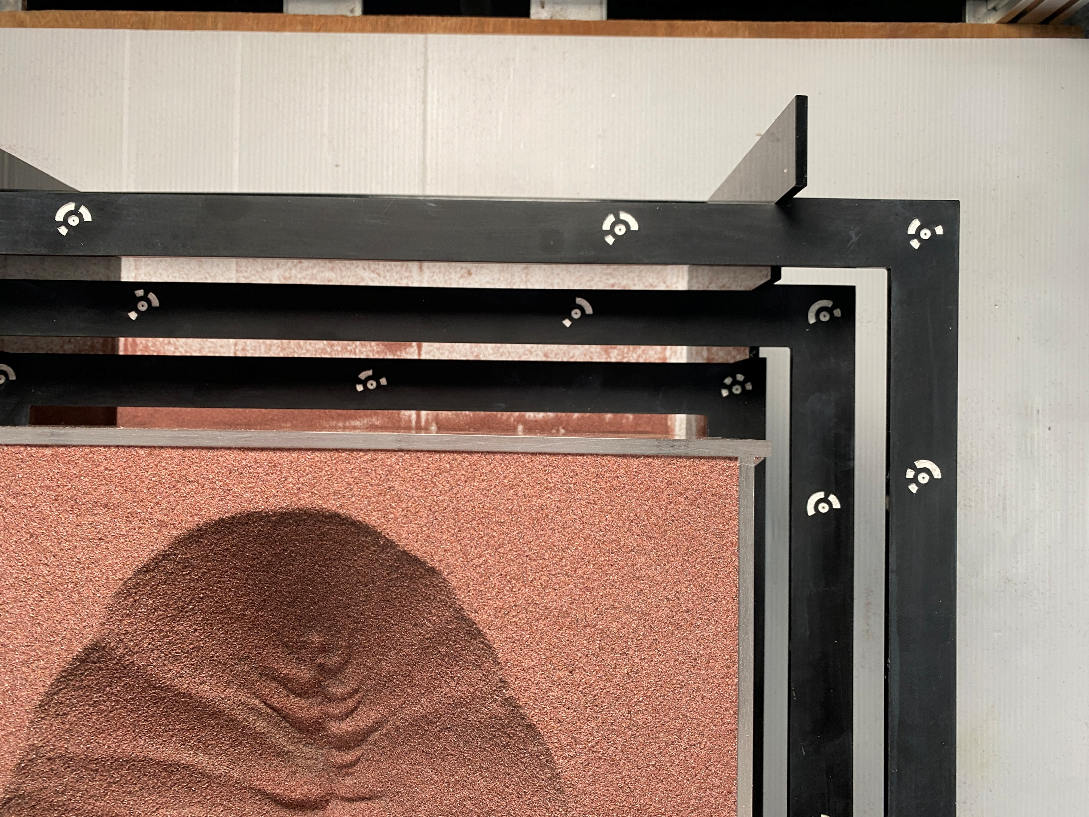
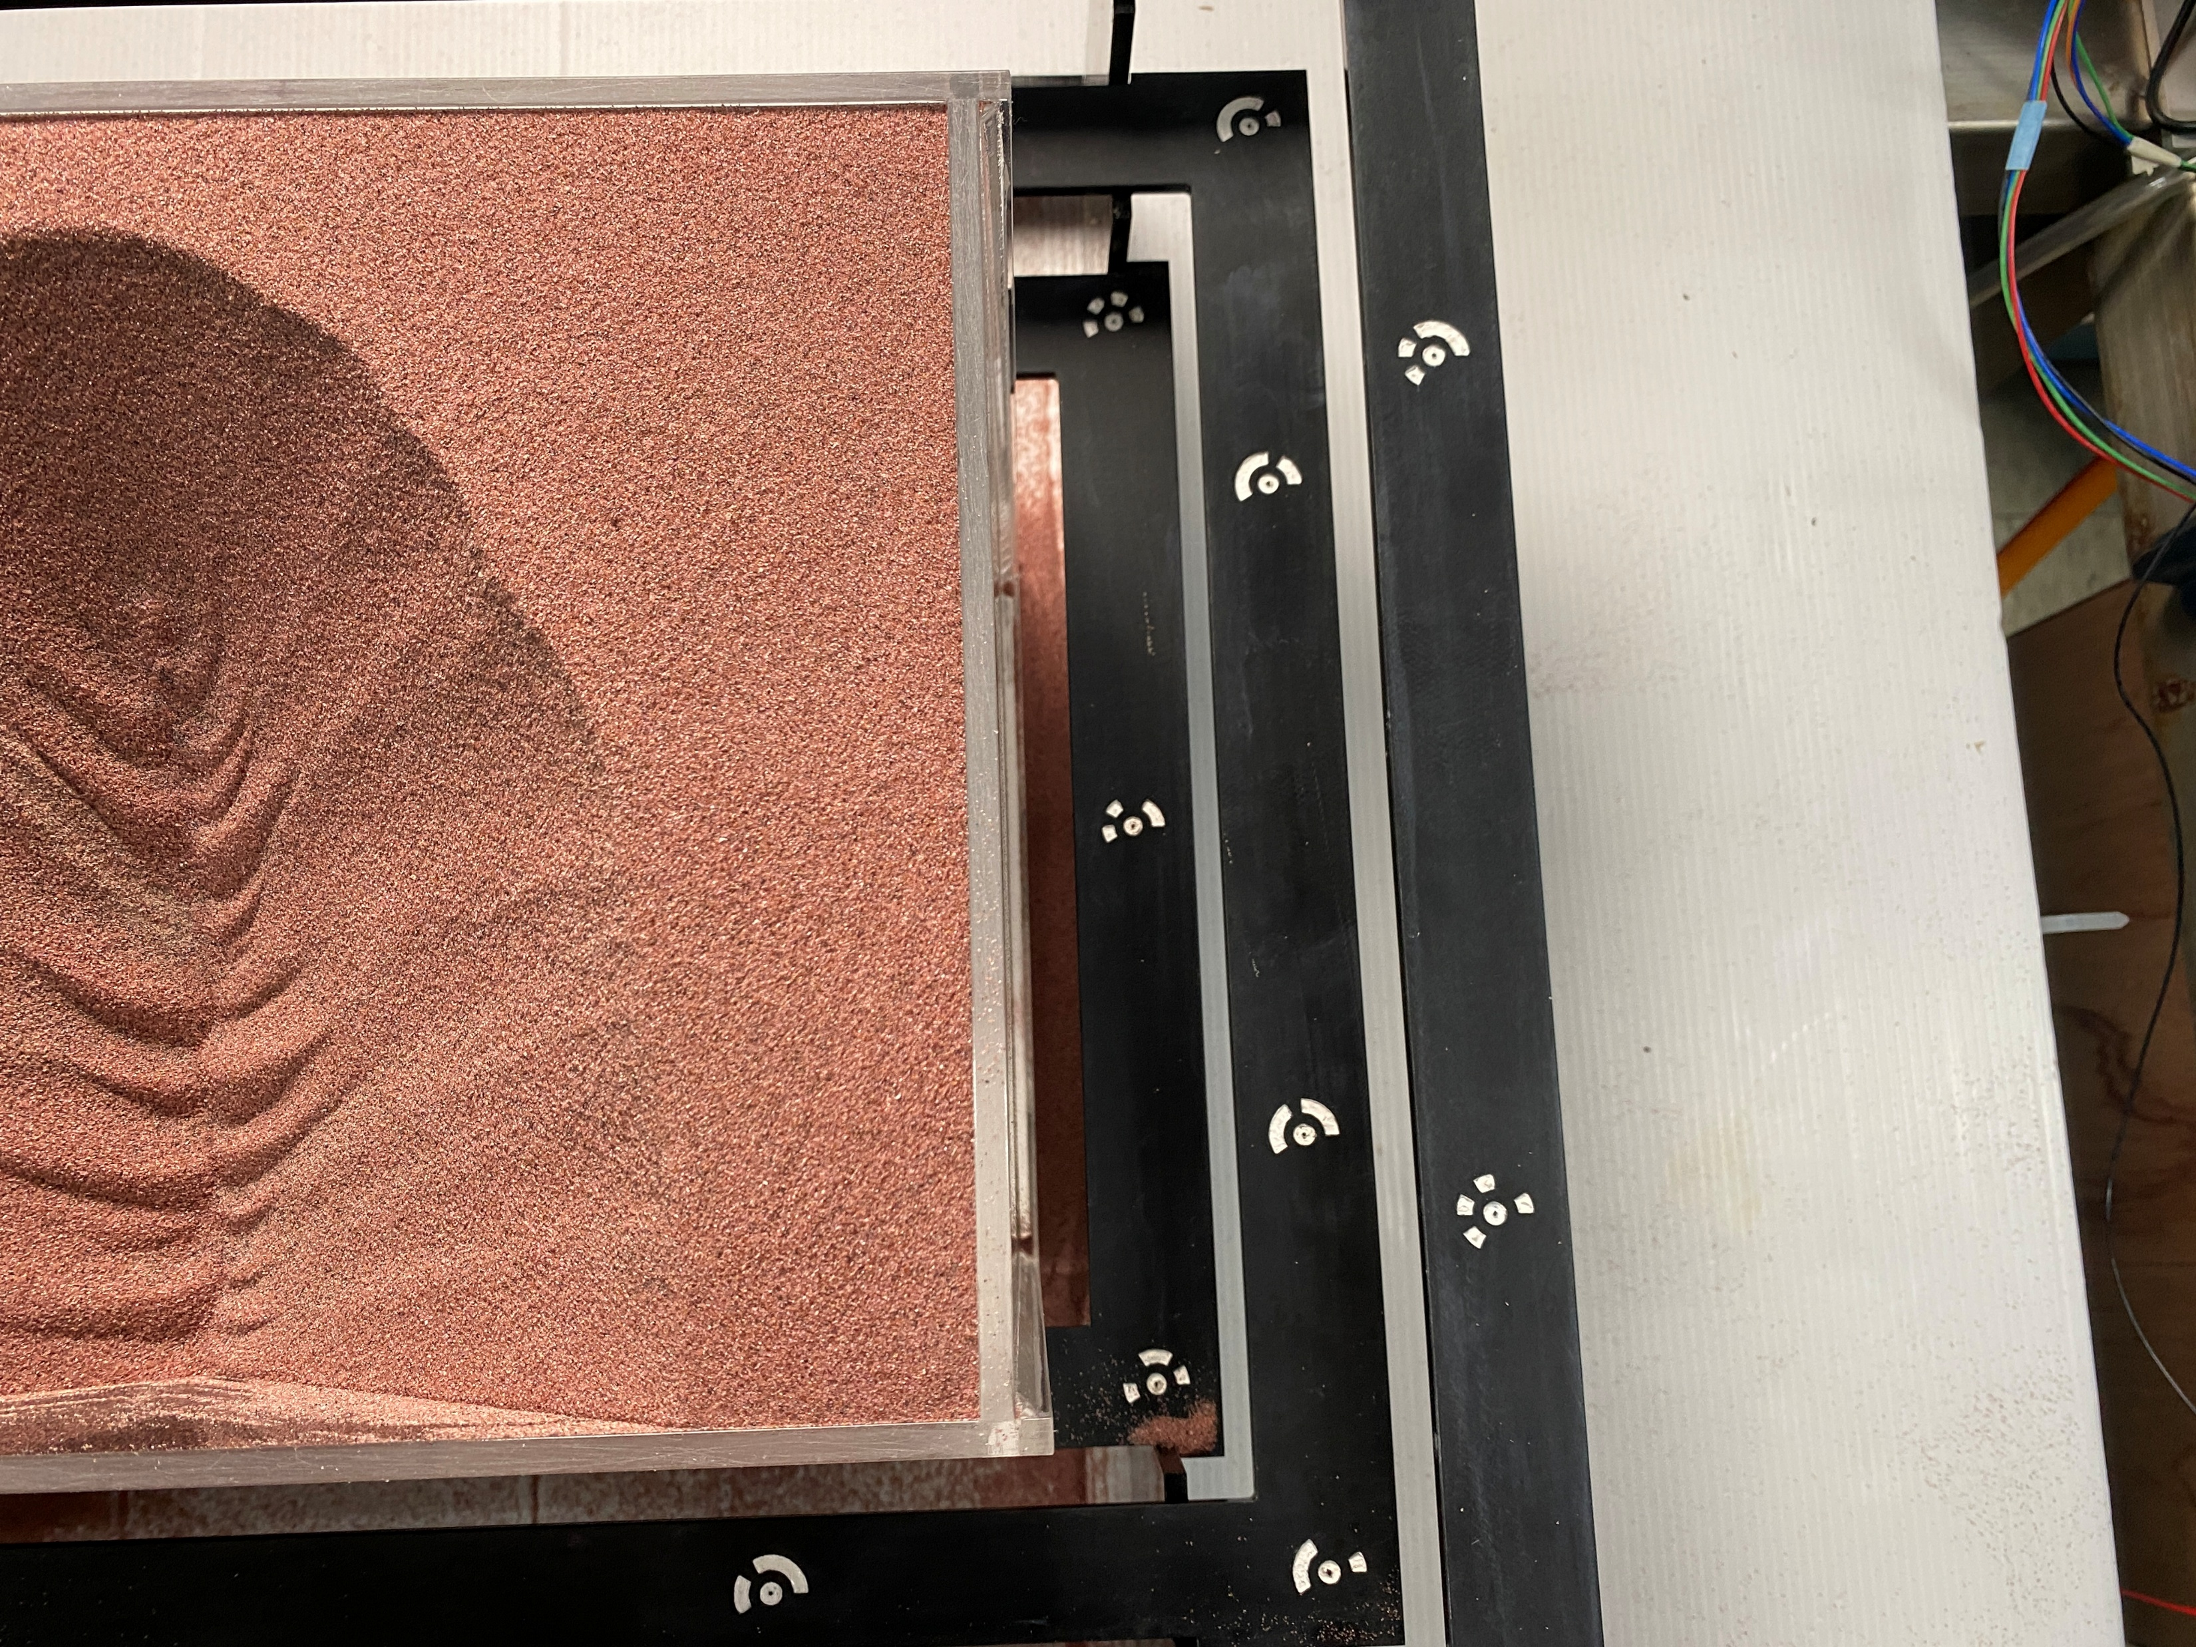
3D Model
Source: https://www.agisoft.com
Notes:
With these fixed coordinates, we capture several vertically captured photos and use Metashape to build the 3D model.
E:\Meeting\20250404\Experiment\yzEllipse_70\yzEllipse_70Model\yzEllipse_70ModelPhoto

Slide 6
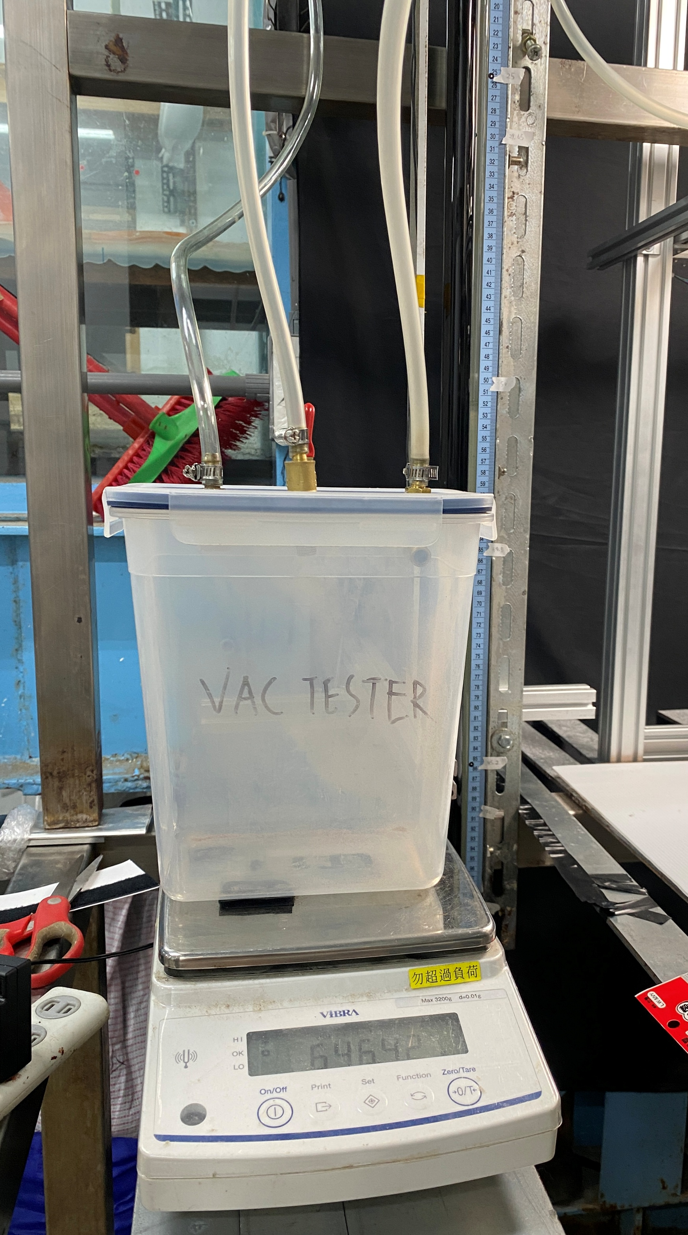
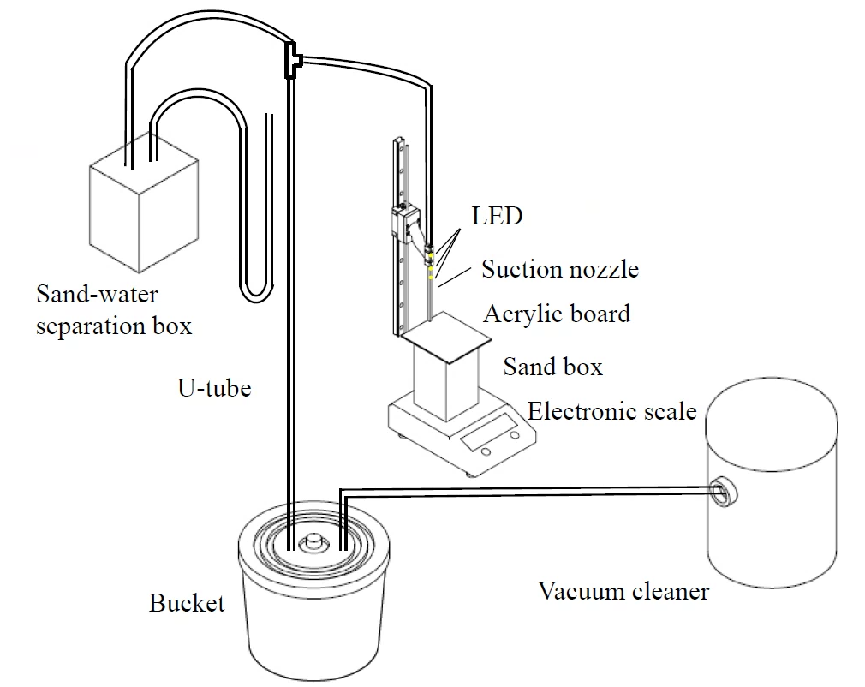
Scale
For the mass flow rate, because the mass of the sand and sand box are exceed the
Notes:
磅秤 分離箱
For the mass flow rate, because the mass of the sand and sand box exceeds the maximum weight the scale can measure.
We will remove the bucket and connect the tube to the separation box.
This will allow us to measure the mass of the sand suctioned, which is equivalent to the mass of the collapsed sand.

Slide 7
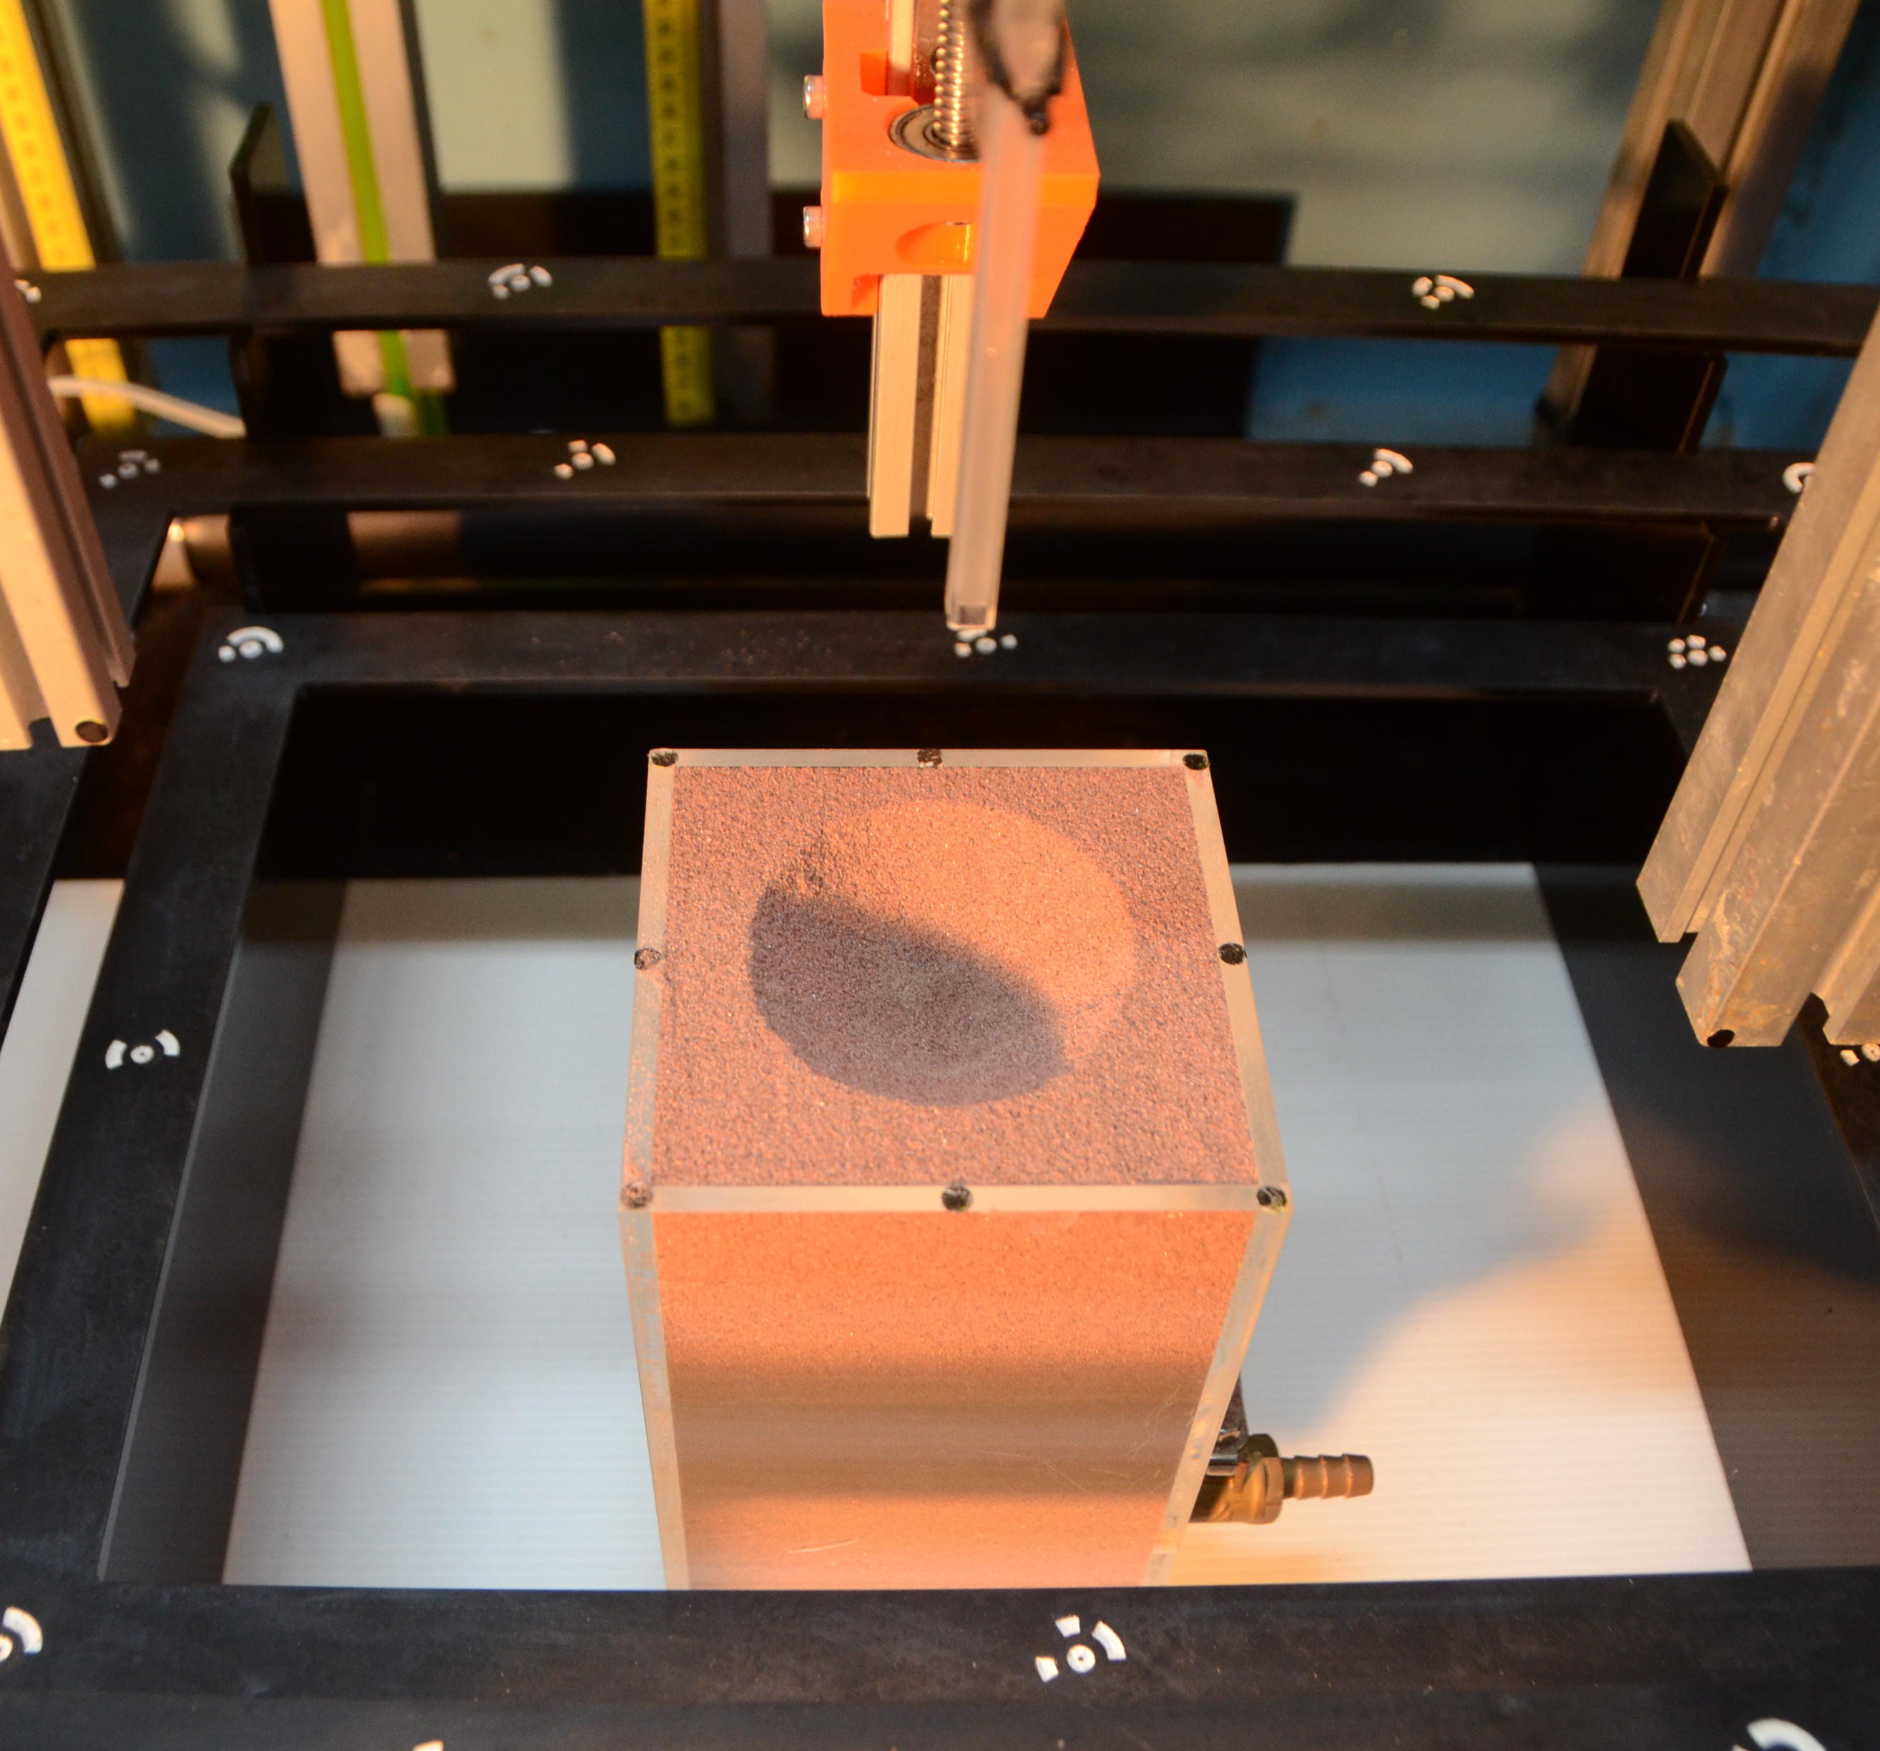
Introduction
Experiment
Future work
Reference
Q & A
z
xz
yz
z
y
Utilizing a suction nozzle descending vertically at a controlled rate to produce an
expanding conical pit (descending velocity: 1 mm/s, maximum distance: 20mm)
Objective: Determine the relationship between distance from the center of the conical pit and z.
x
Center of the conical pit.
Fig. DTM of the expanding conical pit
Note : Light from the northeast of the image.
Fig. Distance and elevation
Notes:
z實驗
For the process of z-axis experiments, we utilize a suction nozzle descending vertically at a controlled rate to produce an expanding conical pit
Video
One of the objectives of these experiments is to determine the relationship between distance from the center of the conical pit and elevation.

Slide 8
Notes:
This is an eight times speed video of the z-axis experiment process.( Video: "E:\Meeting\EGU\Video\IMG_2445_8x.mp4"

Slide 9
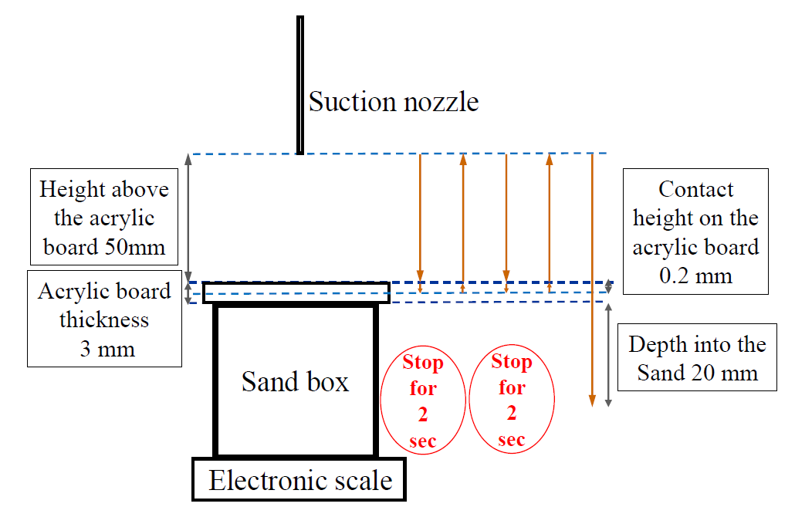
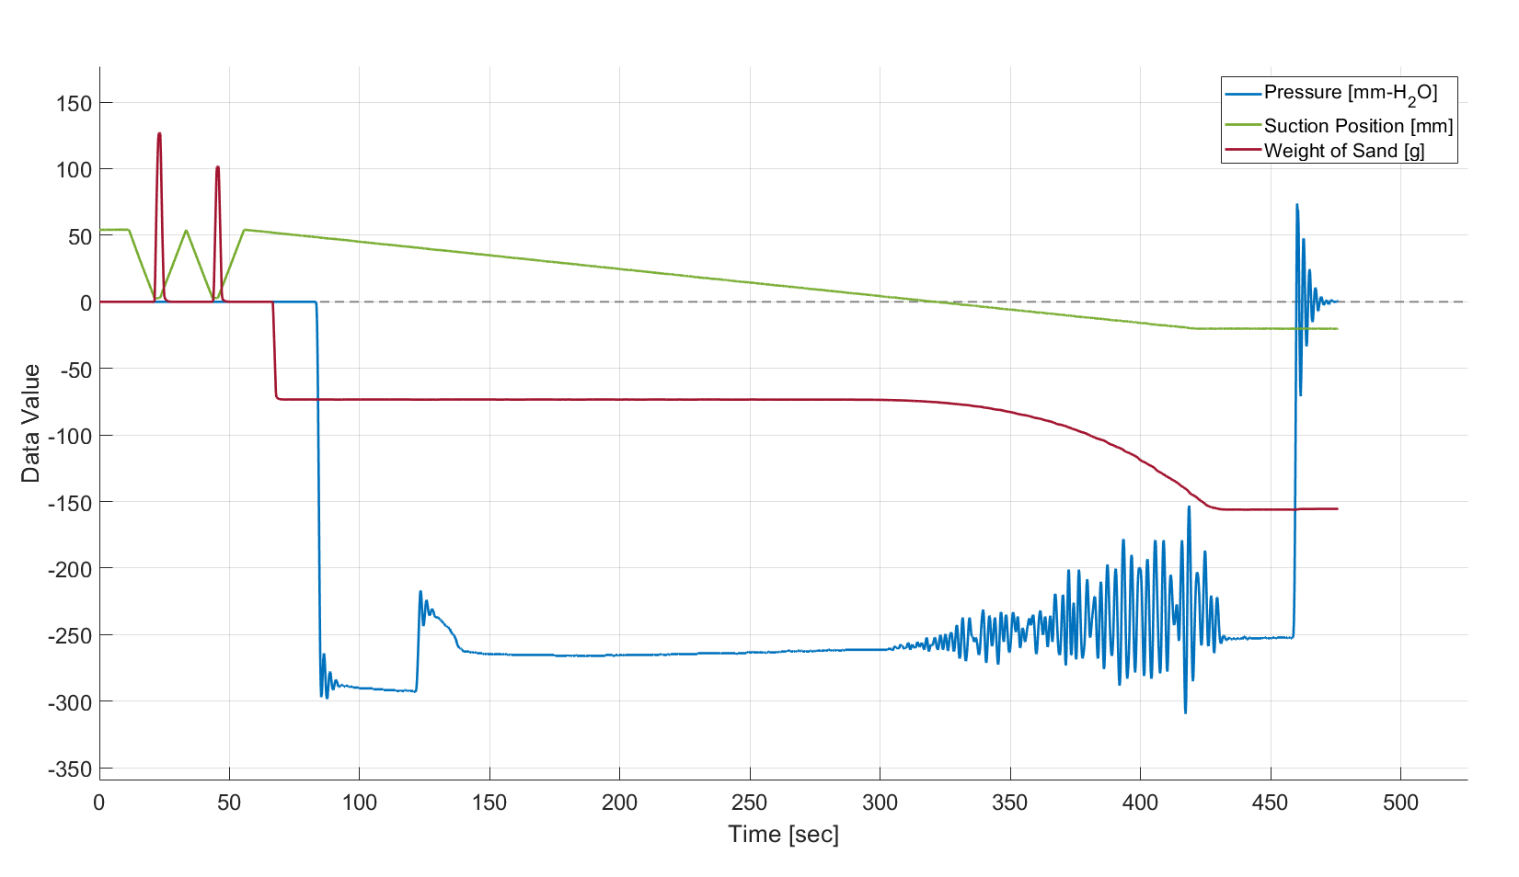
Experiment_z_set-up
Experiment process – z axis
1
2
4
5
3
6
Notes:
為甚麼用u型管
This is a Schematic diagram for the z axis experiment. We want to get the relationship of pressure, position of suction nozzle and mass of sand.

Slide 10
Experiment_z_process
1
2
First and second times suction nozzle touches the acrylic board.
Remove the acrylic board.
Turn on the vacuum cleaner.
Start suctioning the sand when the nozzle was 3mm above the sand surface.
Turn off the vacuum cleaner.
3
For the purpose of synchronization.
4
5
1
2
5
4
6
Initial Sand Surface elevation.
Pressure: negative suction pressure (indicating suction force).
Suction position: The height of the suction nozzle relative to the surface of the sand box.
Weight of sand: The weight of the sand remaining in the sand box during the suction process (indicating the weight of the collapsed sand).
3
6
Notes:
對齊時間
This picture is for synchronization.
The bucket might have deformed, but I have already solved this issue by finding a better bucket.

Slide 11
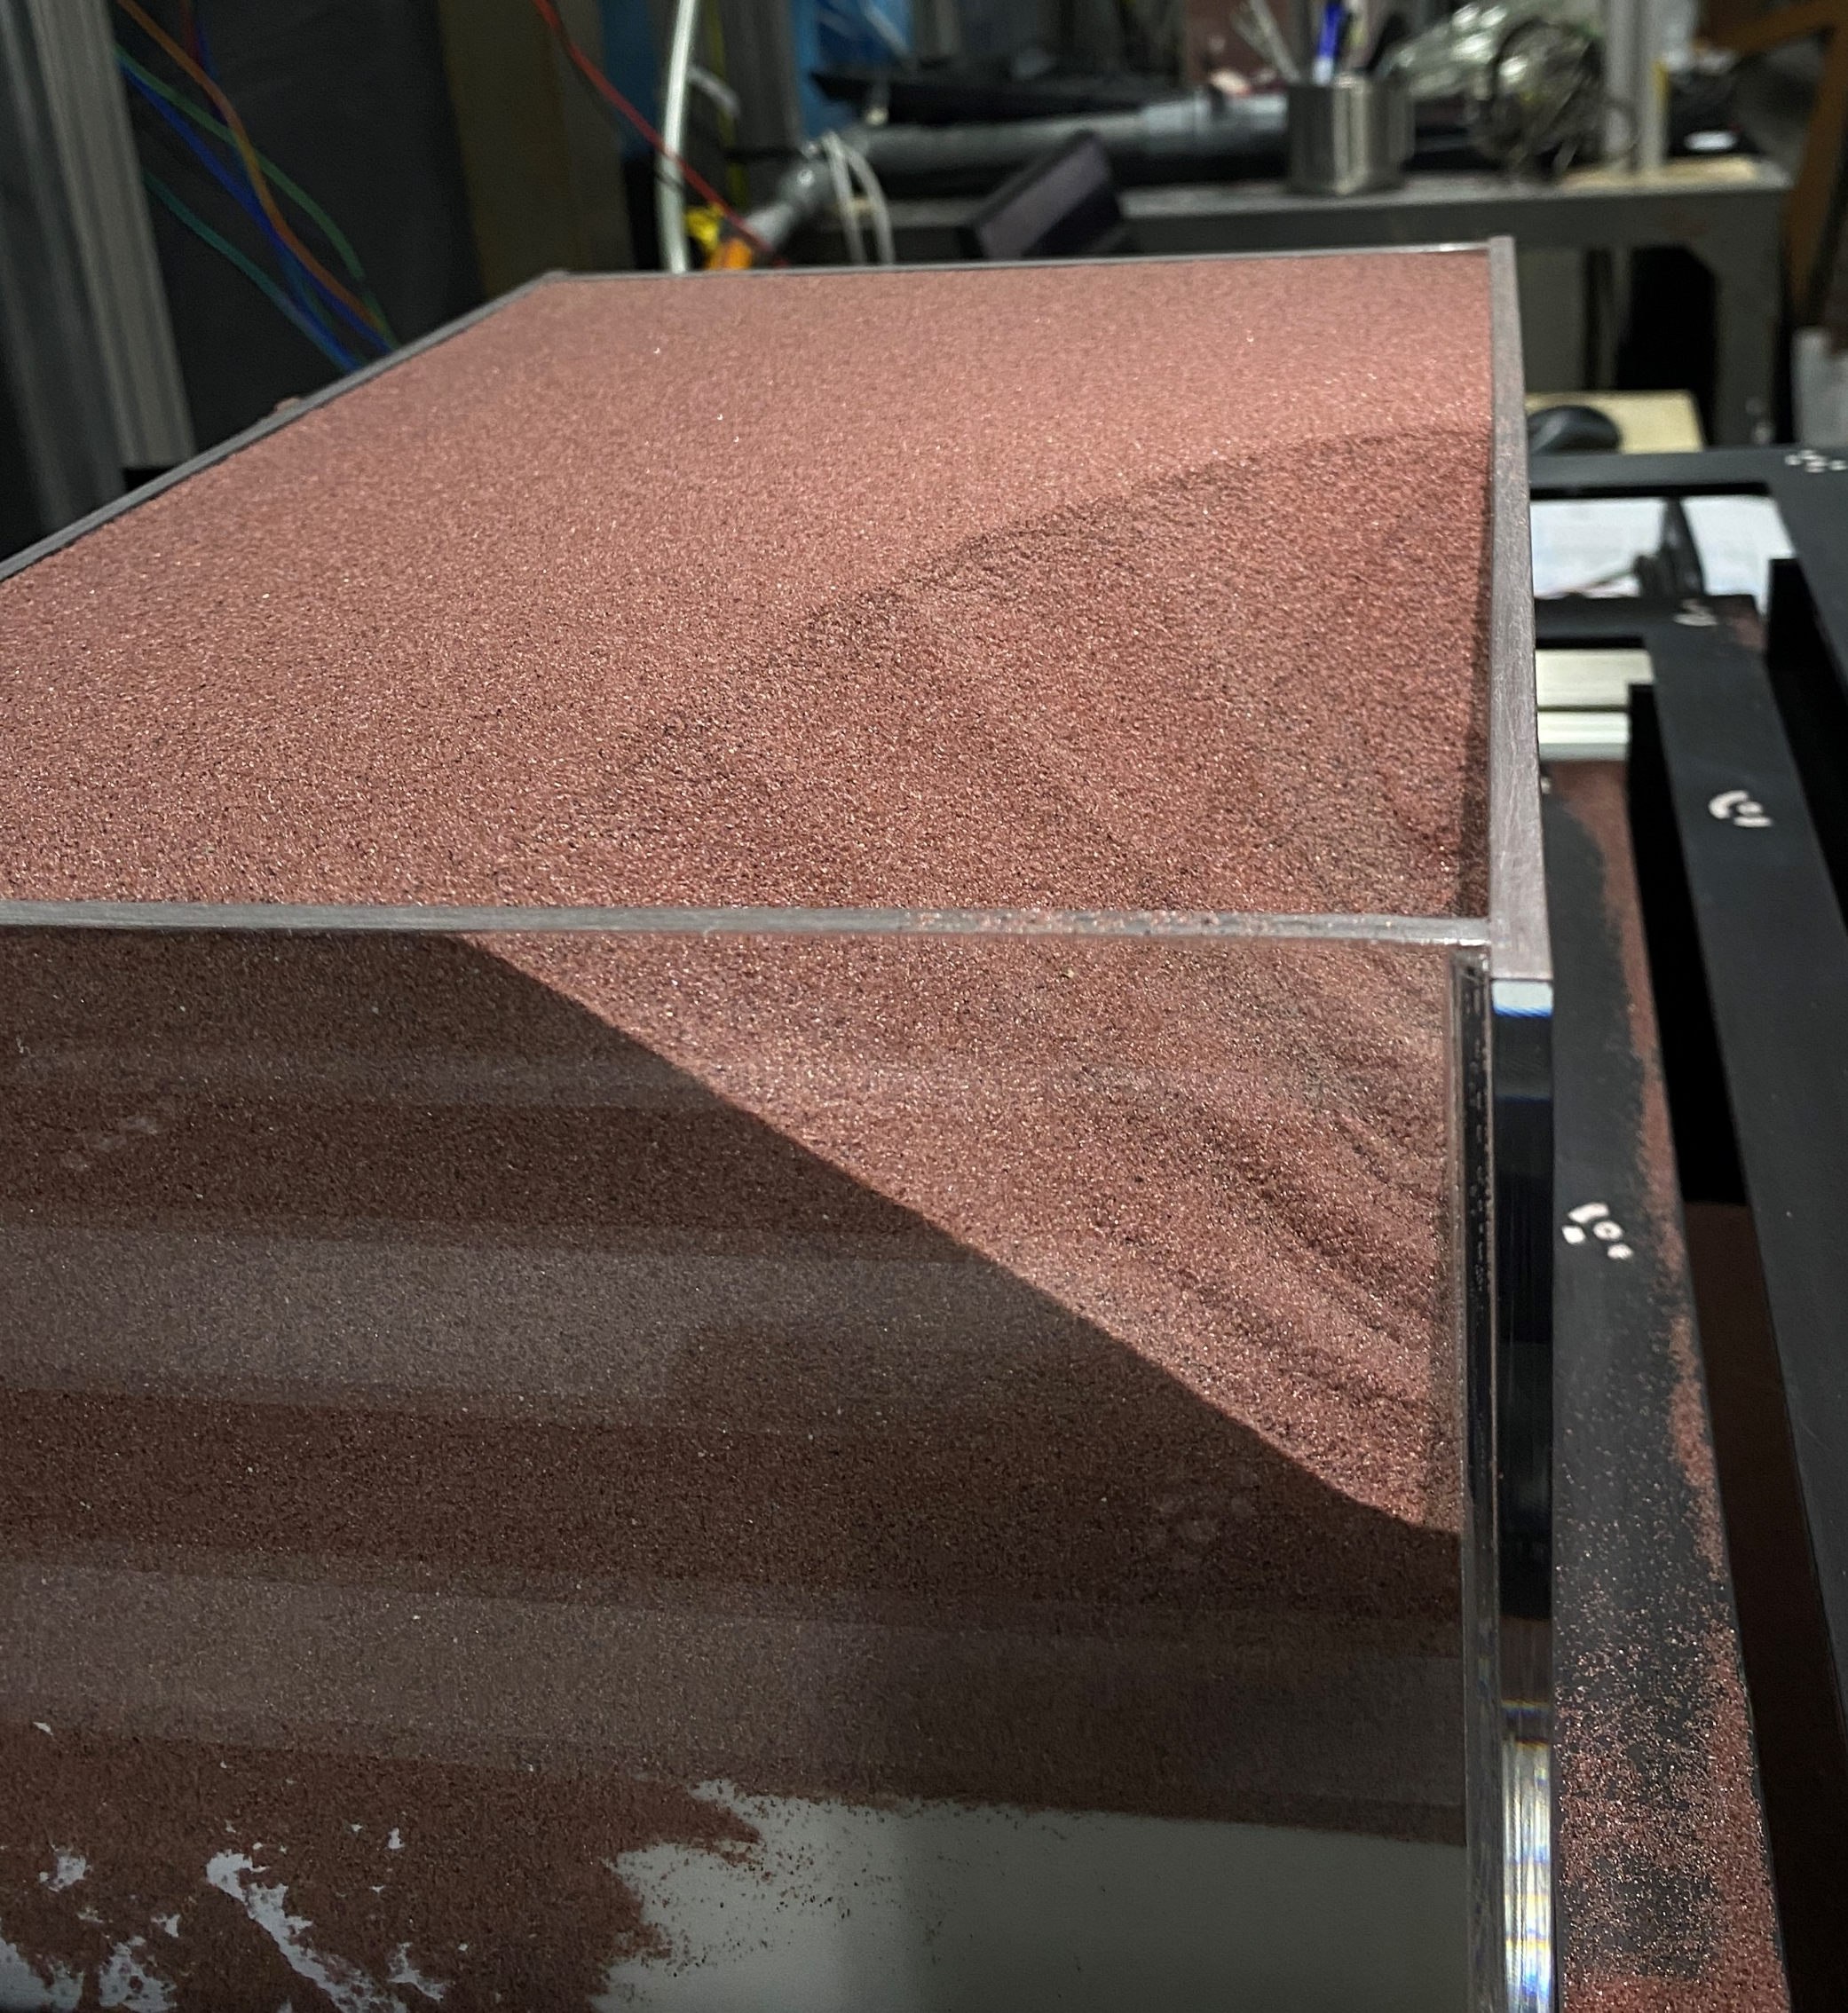
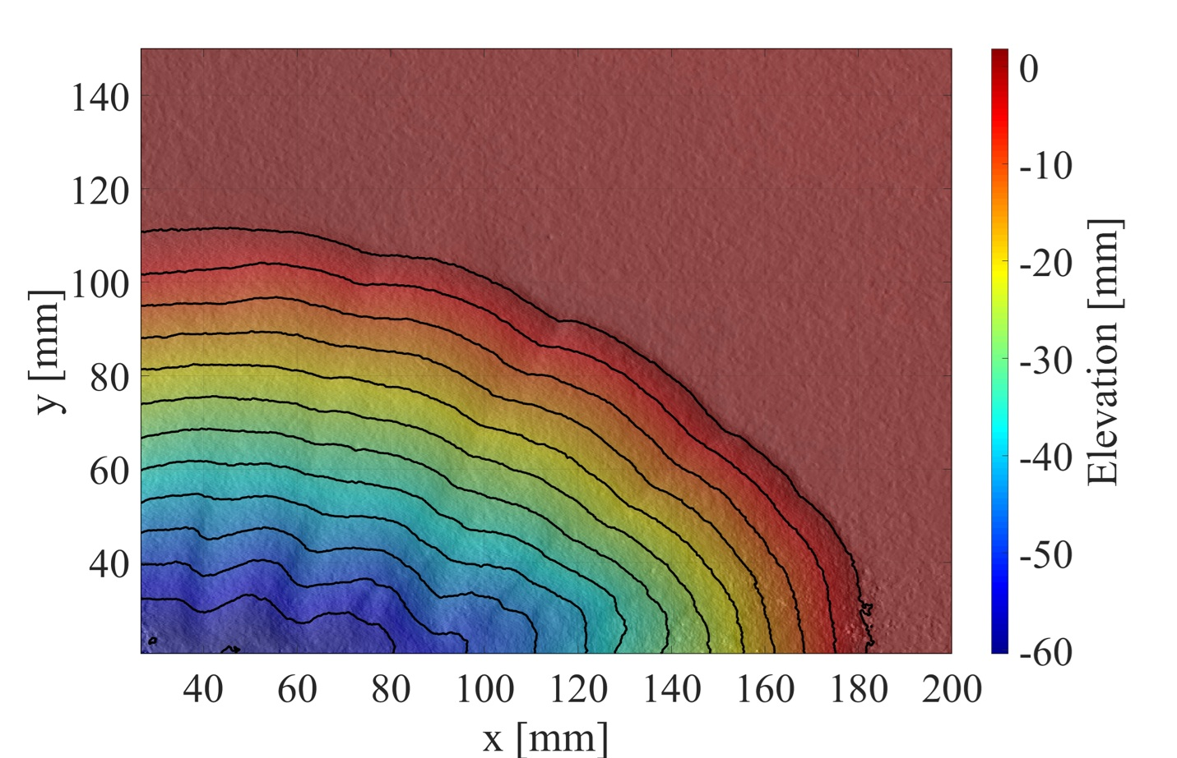
Introduction
Experiment
Future work
Reference
Q & A
z
xz
yz
Fig. DTM of the experimental topography
(Contour interval: 5mm)
Notes:
實驗和模擬
The picture shows the DTM of the experimental topography.

Slide 12
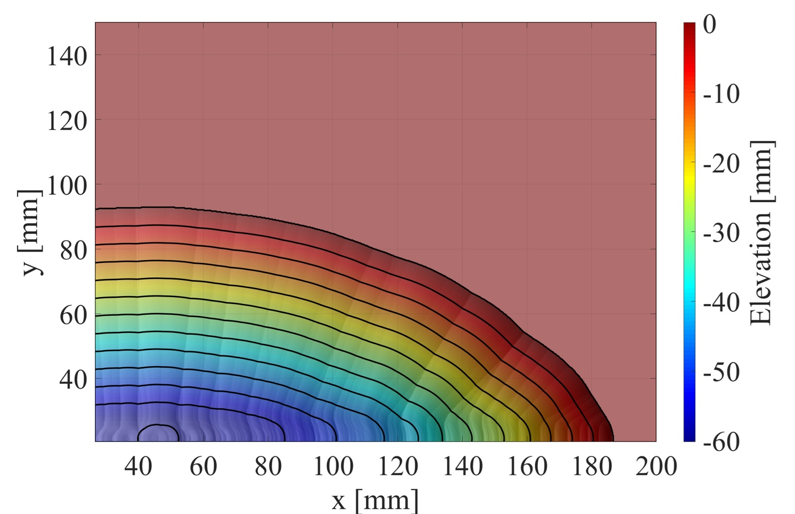
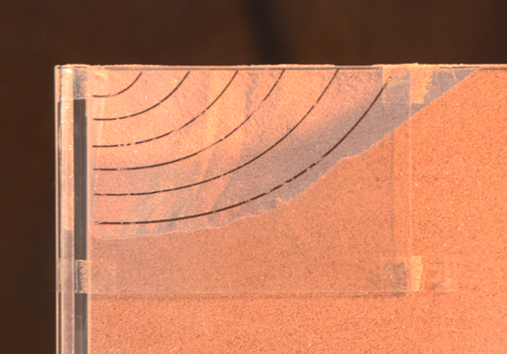
Introduction
Experiment
Future work
Reference
Q & A
z
xz
yz
Basis: Relationship between distance from the center of the conical pit and z from the experiment of the z-axis.
Center of the conical pit.
Fig. Modeling process
Fig. DTMs of the modeling topography
(Contour interval: 5mm)
Fig. Distance and elevation.
Notes:
模擬
This is one of the analysis methods we use.
We simulate the terrain after suctioning the sand.
The basis of the simulation is the relationship between distance from the center of the conical pit and z from the experiment of the z-axis.
Based on this relationship, we can continuously stack this expanding conical pit to obtain the simulated results.
This picture is a DTM of the result of modeling topography.
E:\Meeting\20250418\Simulate_inconstantSlope_20250321

Slide 13
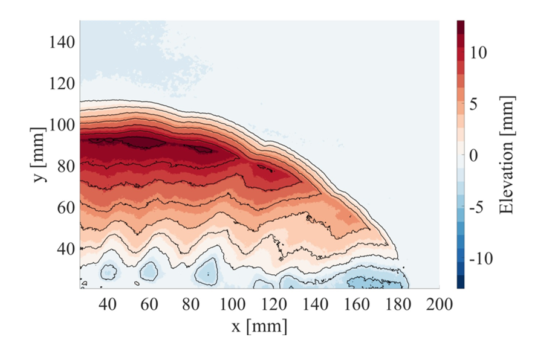
Introduction
Experiment
Future work
Reference
Q & A
z
xz
yz
DoD (the difference of DTMs): Modeling DTM – Experiment DTM
Fig. DoD map
(Contour interval: 2mm)
Notes:
DoD差異
Then we compare the experimental results with the modeling DTM.
This is a DoD map from experimental and modeling topography.
差異原因
The current depth used is around 25mm, and it is extended with an equal slope.
In the future, I will try different depths to confirm whether the impact is caused by the equal slope extension.
(The difference of experiment and simulation DTM)
E:\Meeting\20250418\Simulate_inconstantSlope_20250321

Slide 14
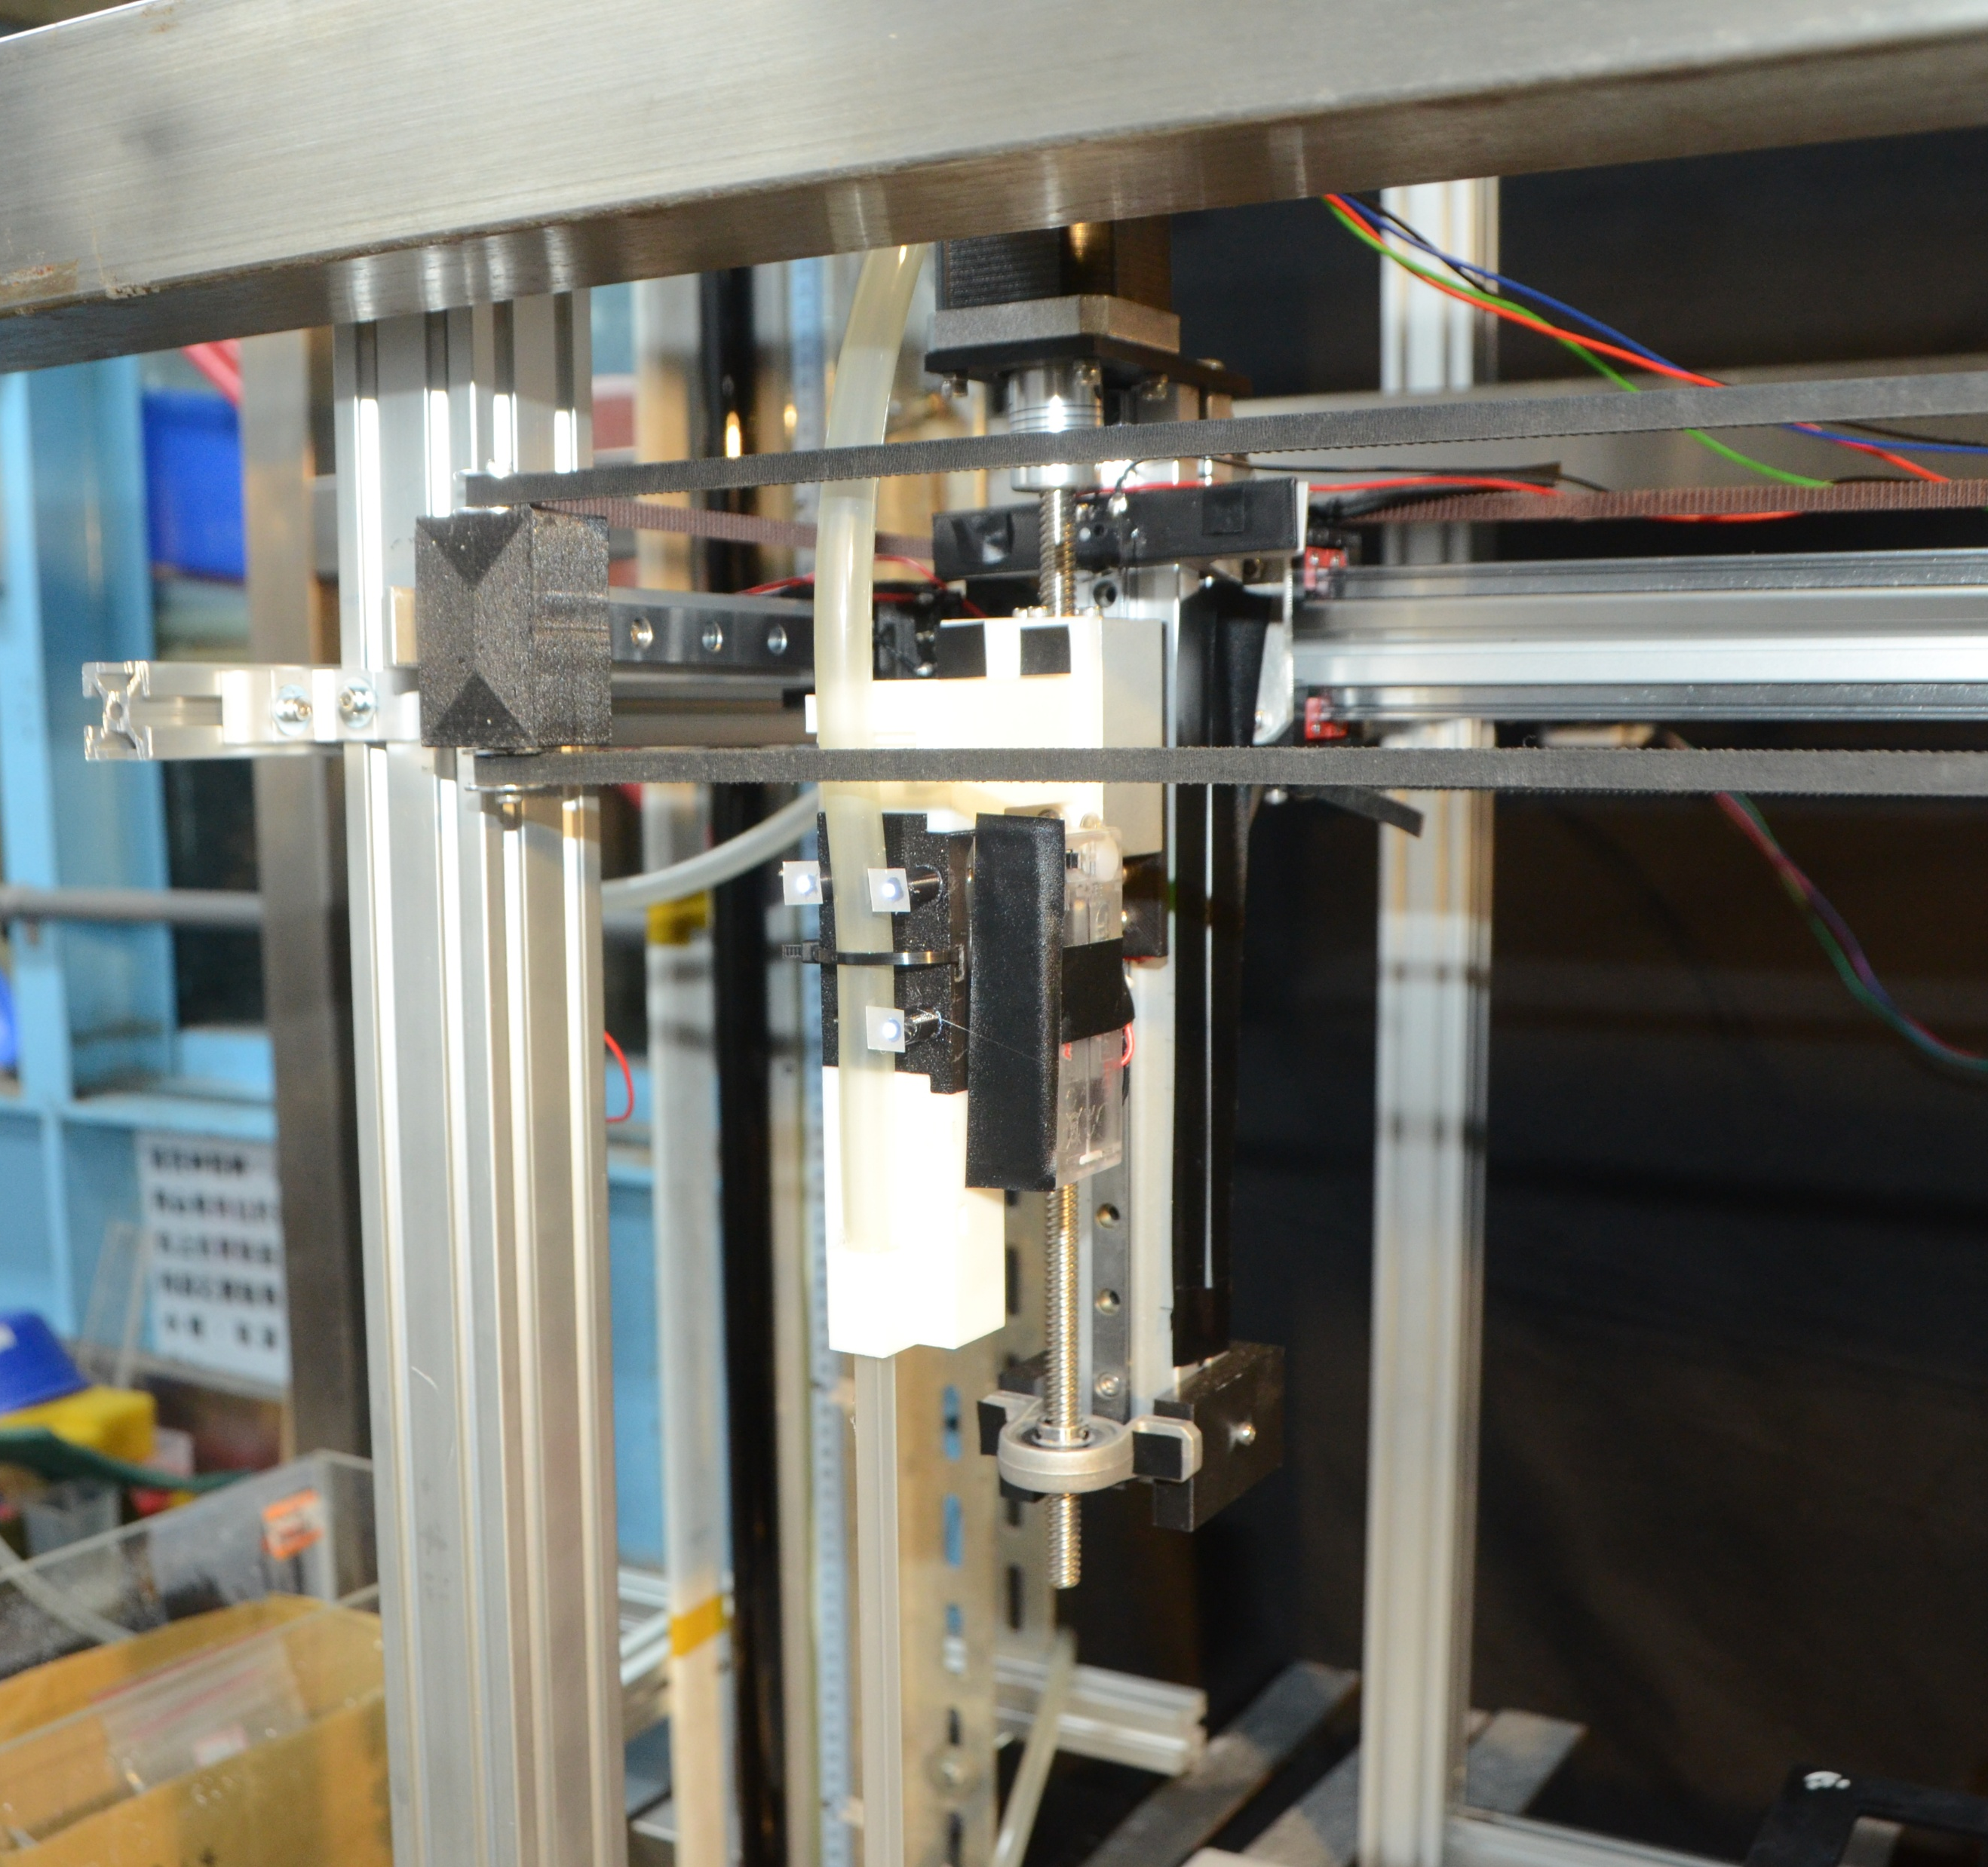
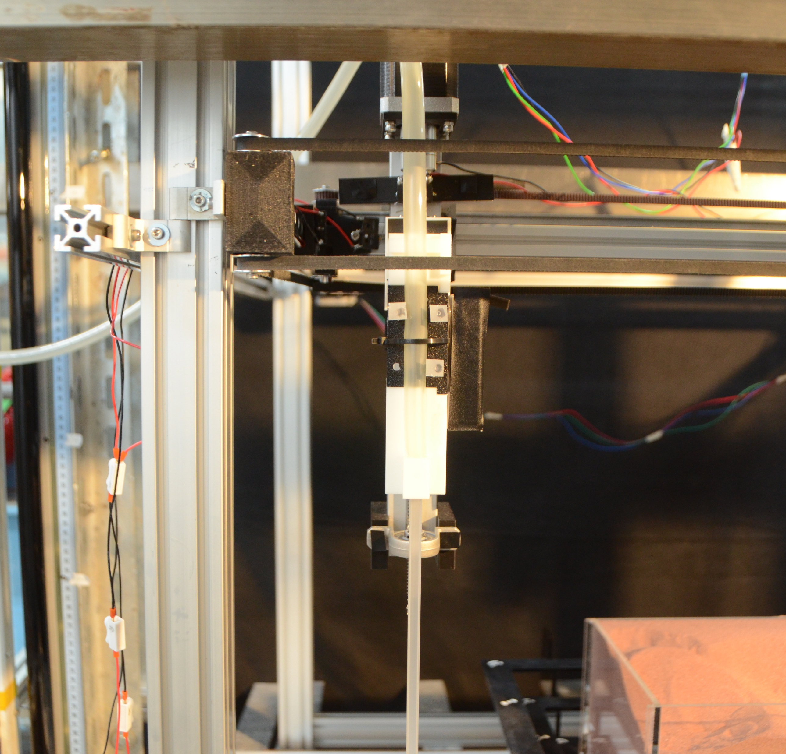
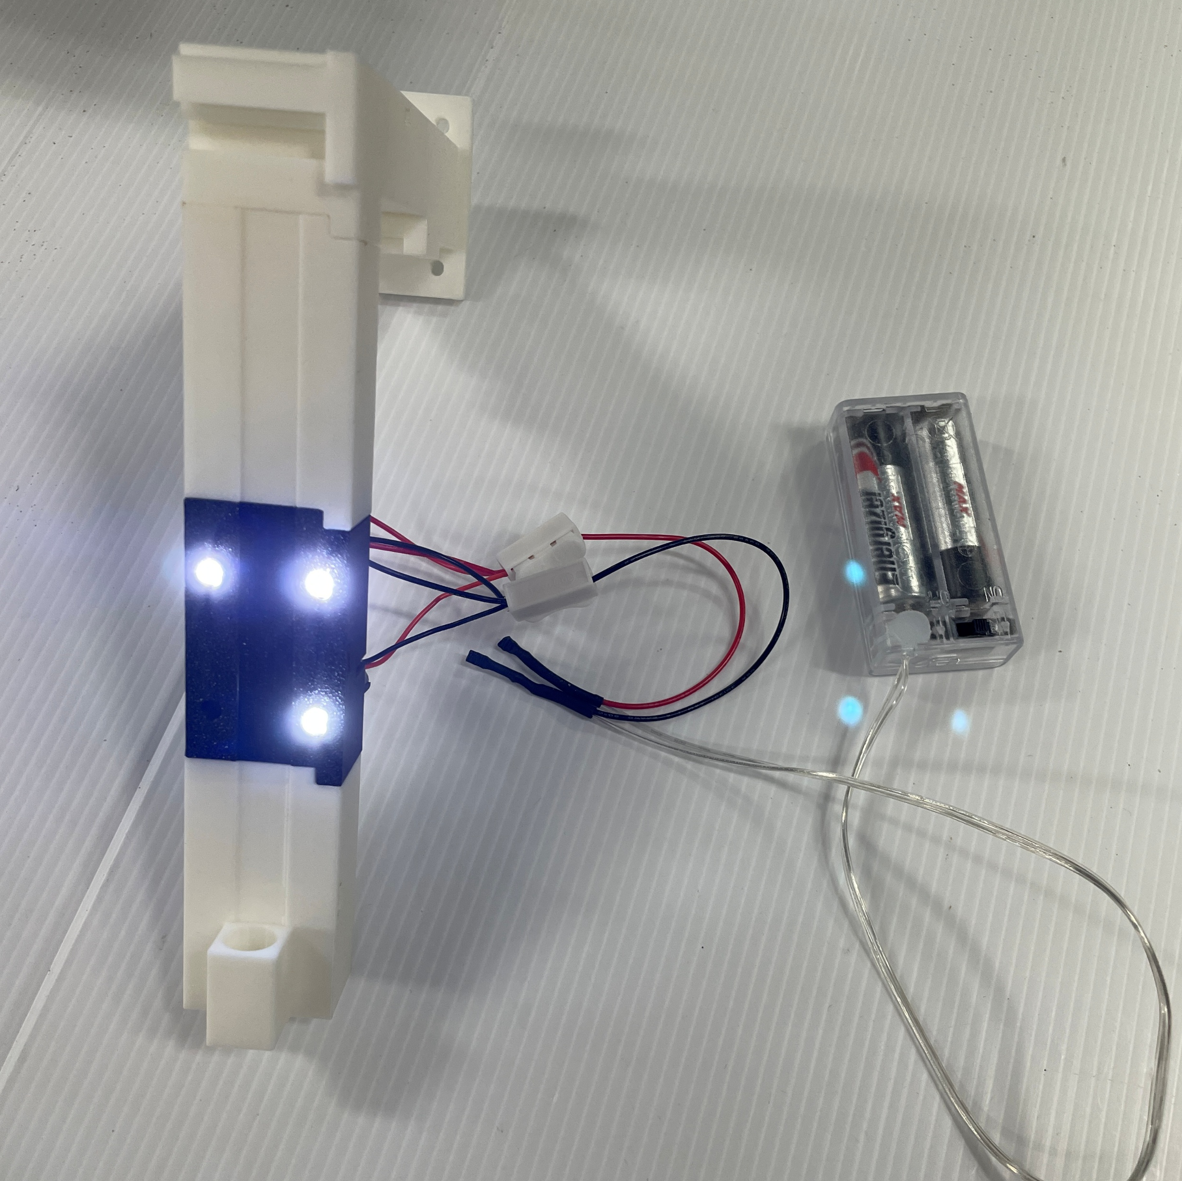
LED light
LED tracking is used to monitor the path of the suction nozzle.
LED light
Notes:
LED燈
I designed the connection between the machine and the suction nozzle and used a 3D printer to print it.
It also allows for the placement of a 3D light to track the movement.
"E:\Meeting\20250306\SuctionLEDconnect\IMG_9583.JPG"

Slide 15
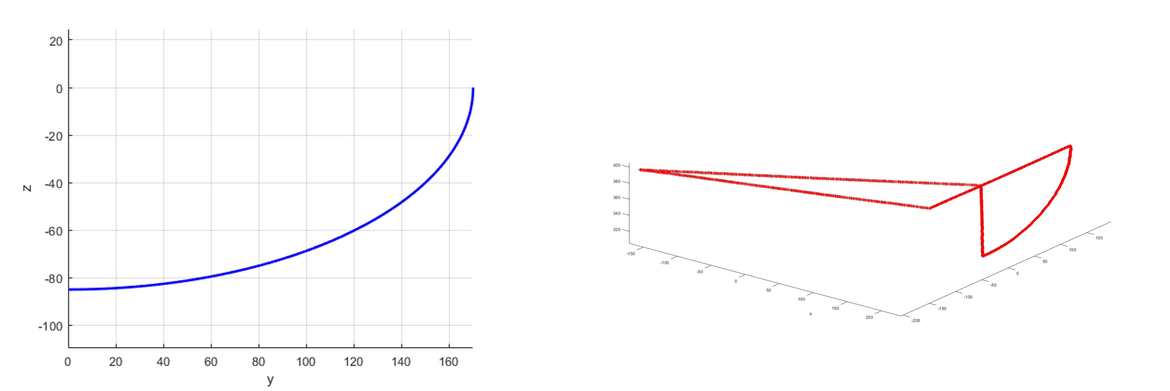
LED light
Notes:
追蹤
This is the LED light tracking data from one of my experiments. In the future, I will also combine the path of the LED light, which is the path of the suction nozzle, with data such as the landslide area to obtain a more comprehensive analysis.

Slide 16
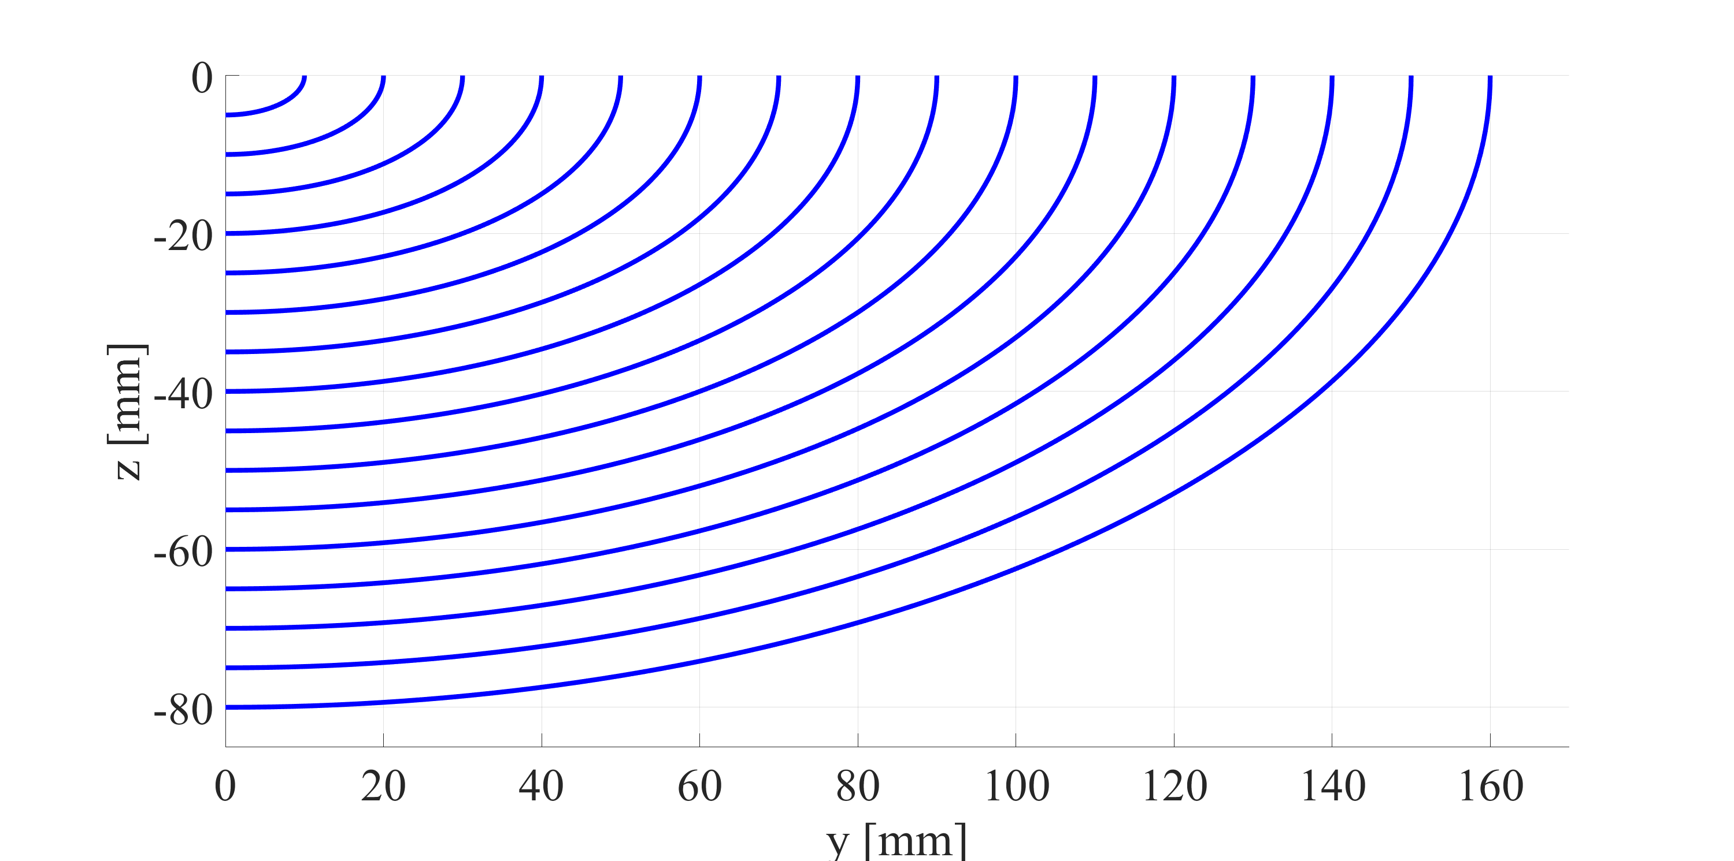
Path
Notes:
為甚麼要全部路徑都吸
If I don't suction the front part of the quarter of the ellipse, the volume of the collapse will be too large
It will block the suction nozzle or cause it to hit the sand during operation.
"E:\Meeting\20250404\Gcode\y_z.png"

Slide 17
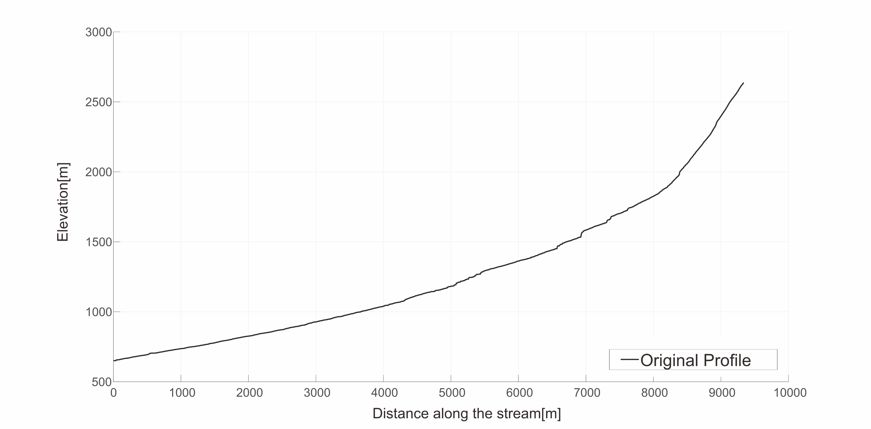
Path
Notes:
長剖面
Idealized curved profiles, designed to mimic the geometry of incising river, is employed to replicate the incision process.
It is the long profile of the river, so I set this profile to the idealized situation, a quarter of ellipse.
We then explore imposed motions along curved profiles, similar to incising rivers
"E:\Meeting\20250404\Gcode\y_z.png"

Slide 18
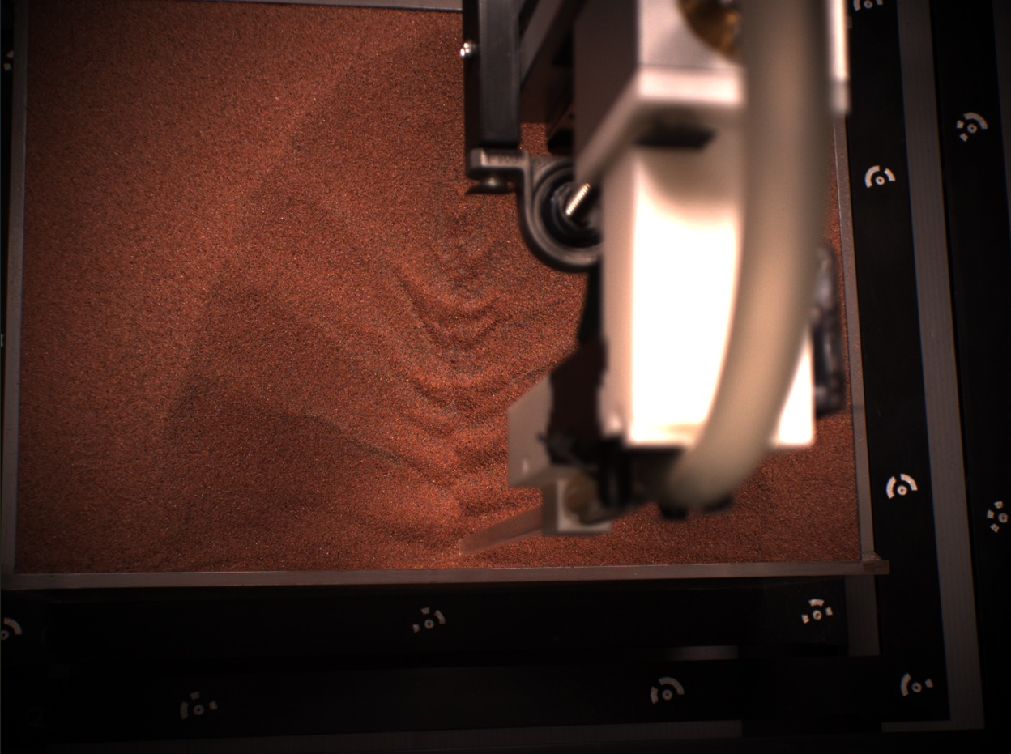
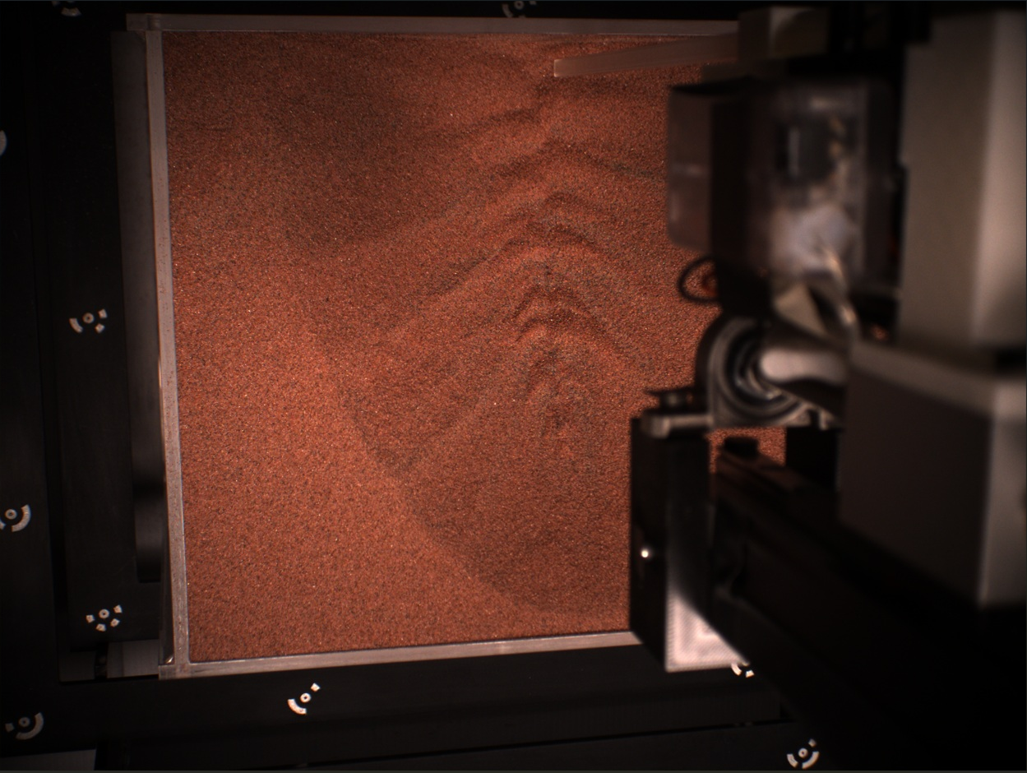
Introduction
Experiment
Future work
Reference
Q & A
z
xz
yz
The left half of the sand box.
The right half of the sand box.
Notes:
未來
Now, we just find the changed pixels between each frame. In the future, we will find the area for each collapse.
兩個視角
Because of the moving suction nozzle, it is difficult to capture the whole sand box for one camera.
So this is one of the cameras we use, it’s for the left half of the sand box. We also have another camera for a different angle to observe the right half of the sand box.
"E:\Meeting\20250418\Experiment\20250417\yzEllipse80\80Cam1Screenshot.jpg“
"E:\Meeting\20250418\Experiment\20250417\yzEllipse80\80Cam1Screenshot2.jpg“
"E:\Meeting\20250418\Experiment\20250417\yzEllipse80\80Cam3Screenshot.jpg“
"E:\Meeting\20250418\Experiment\20250417\yzEllipse80\80Cam3Screenshot2.jpg"

Slide 19
Introduction
Experiment
Future work
Reference
Q & A
z
xz
yz
Notes:
This is the same collapse for two cameras.
The two images can complement each other, where areas not visible in one image can be seen in the other.
"E:\Meeting\20250418\Experiment\20250417\yzEllipse80\80Cam1Screenshot.jpg“
"E:\Meeting\20250418\Experiment\20250417\yzEllipse80\80Cam1Screenshot2.jpg“
"E:\Meeting\20250418\Experiment\20250417\yzEllipse80\80Cam3Screenshot.jpg“
"E:\Meeting\20250418\Experiment\20250417\yzEllipse80\80Cam3Screenshot2.jpg"

Slide 20
Introduction
Experiment
Future work
Reference
Q & A
z
xz
yz
Notes:
黑白 彩色圖差別
We use the red layer from the RGB image and set the threshold and pixel size to identify the landslide area, avoiding the collection of other noise.
面積體積轉換
We will use the area we obtain, the mass from the scale, and the density of the garnet sand to convert.
We use the red layer from the RGB image and set the threshold and pixel size to identify the landslide area, avoiding the collection of other noise.
"E:\Meeting\20250418\Experiment\20250417\yzEllipse80\80Cam1Screenshot.jpg“
"E:\Meeting\20250418\Experiment\20250417\yzEllipse80\80Cam1Screenshot2.jpg“
"E:\Meeting\20250418\Experiment\20250417\yzEllipse80\80Cam3Screenshot.jpg“
"E:\Meeting\20250418\Experiment\20250417\yzEllipse80\80Cam3Screenshot2.jpg"

