Slide 1
ACCESS-ENSO-Recipes
A Flexible Workflow for ENSO and IOD Evaluation Using ESMValTool and Jupyter Notebooks
Romain Beucher (ACCESS-NRI, CMIP Model Benchmarking Task Team) Felicity Chun (ACCESS-NRI), Yann Planton (Monash University), Arnold Sullivan (CSIRO), Christine Chung (Australian Bureau of Meteorology), Harun Rashid (CSIRO), Ghislaine Boschat (Australian Bureau of Meteorology), Zoe Gillett (Australian Bureau of Meteorology), Nicola Maher (RSES)

Slide 2
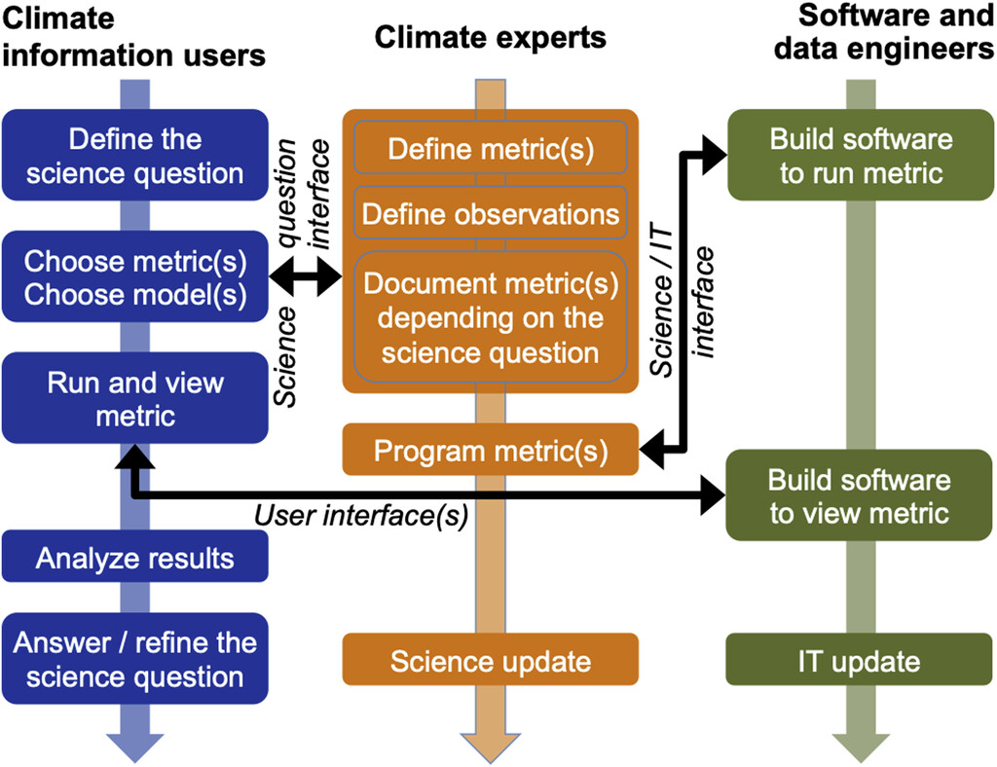
Three Pillars of Model Evaluation (Planton et al 2021)
Climate Users: Define questions, choose metrics/models, analyse results
Climate Experts: Design metrics, select observations, update science
Software Engineers: Build tools, manage data, ensure reproducibility
Interfaces:
Science Question (Users ↔ Experts)
Science/IT (Experts ↔ Engineers)
User Interface (Engineers ↔ Users)
Supports standard, traceable, and reusable evaluation, build Trust and Efficiency
Planton, Y. Y., and Coauthors, 2021: Evaluating Climate Models with the CLIVAR 2020 ENSO Metrics Package. Bull. Amer. Meteor. Soc., 102, E193–E217, https://doi.org/10.1175/BAMS-D-19-0337.1.

Slide 3
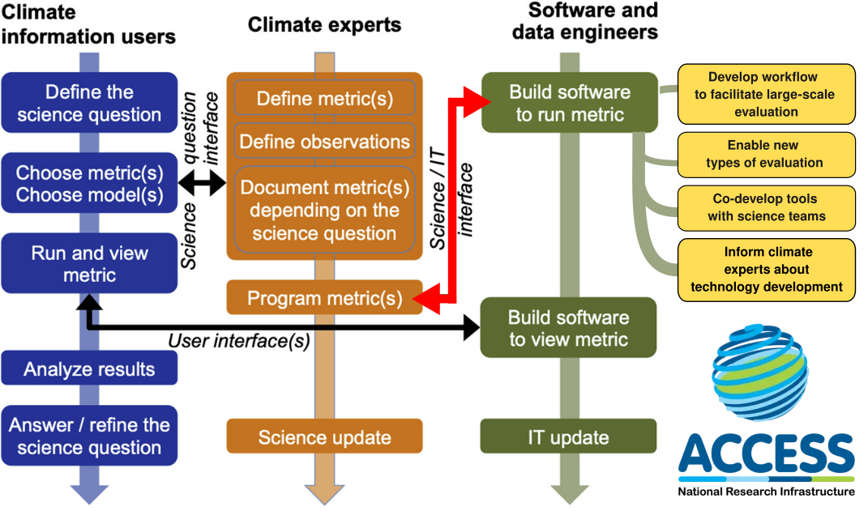
User Interfaces (s)
Planton, Y. Y., and Coauthors, 2021: Evaluating Climate Models with the CLIVAR 2020 ENSO Metrics Package. Bull. Amer. Meteor. Soc., 102, E193–E217, https://doi.org/10.1175/BAMS-D-19-0337.1.

Slide 4
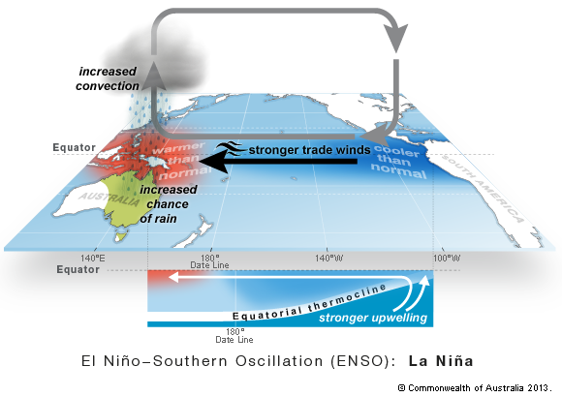
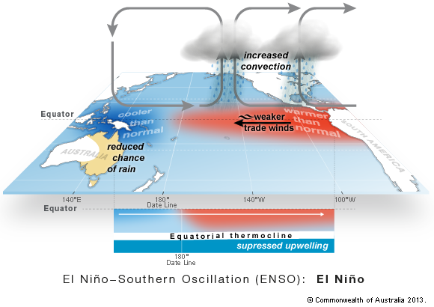
La Niña
Why ACCESS-ENSO-Recipes?
ENSO (El Niño–Southern Oscillation), coupled ocean-atmosphere interactions in the tropical Pacific, is the dominant driver of global interannual climate variability.
It modulates extreme weather and climate events globally, affecting ecosystems, agriculture, and society.
ENSO’s future evolution under climate change is uncertain, yet pivotal to understanding climate risks.
El Niño

Slide 5
La Niña
Why ACCESS-ENSO-Recipes?
Facilitate Model Evaluation
Climate models are vital for projecting ENSO behaviour, but often suffer from systematic biases.
Model evaluation must be integrated early into development workflows to refine model performance and reduce uncertainty.
El Niño
Why do we need a new workflow?
Limitations of current tools for large ensemble (scaling)
Success of CLIVAR (WCRP) ENSO metrics package
Need for flexibility, reproducibility, and open science

Slide 6
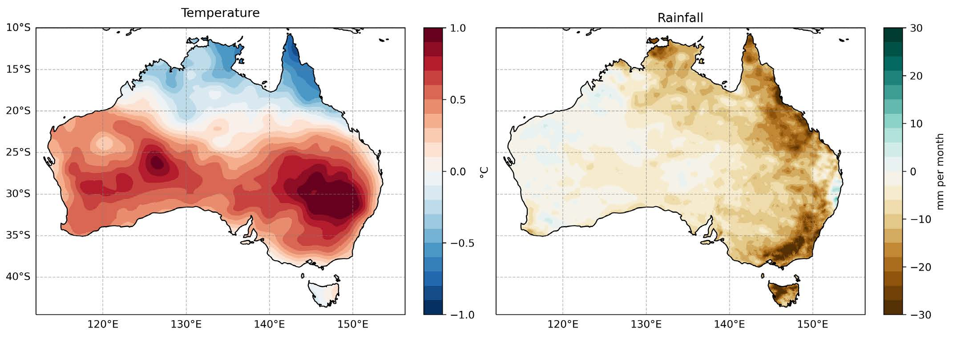
Why ACCESS-ENSO-Recipes?
Preparing for CMIP7
ACCESS-NRI is applying these principles to evaluate the ACCESS-ESM1.6 model in preparation for the CMIP7 FastTrack submission.
Integration into the CMIP Rapid Evaluation Framework (REF)
Supporting Research
Our solution: the ACCESS-ENSO-Recipes — a flexible workflow designed to integrate metrics, diagnostics, and CMOR-compliant data handling from the start.

Slide 7
The CLIVAR 2020 ENSO Metrics Package
What is the CLIVAR ENSO Package? A community-developed evaluation toolkit led by the CLIVAR Pacific Region Panel, designed to assess: variability, teleconnections, processes and feedbacks
🎯 Goals
Identify model biases and areas for improvement
Track progress across CMIP model generations
Support model selection for specific applications
Reveal relationships among biases
Promote ENSO literacy among users and developers
⚙️ Key Features
Implemented in Python
Interfaces with model evaluation tools (e.g., PCMDI)
Enables rapid analysis of large ensembles

Slide 8
Building on CLIVAR for ENSO Evaluation
CLIVAR 2020 ENSO Metrics Package
Developed by the CLIVAR Pacific Region Panel to benchmark ENSO representation in CMIP models
Provides well-documented, peer-reviewed metrics to assess ENSO performance, teleconnections, and processes
Freely available as a Python package (GitHub)
Integration with ESMValTool We ported CLIVAR metrics into the ESMValTool framework to benefit from: • Scalable, reproducible evaluation workflows • Rich observational datasets and preprocessor capabilities • Community-driven infrastructure.
Interactive Exploration with ESMValCore Python API Leveraged the ESMValCore Python API to: • Customise recipes for ENSO and IOD evaluation • Explore diagnostics in Jupyter notebooks • Enable seamless debugging, visualisation, and user-driven analyses

Slide 9
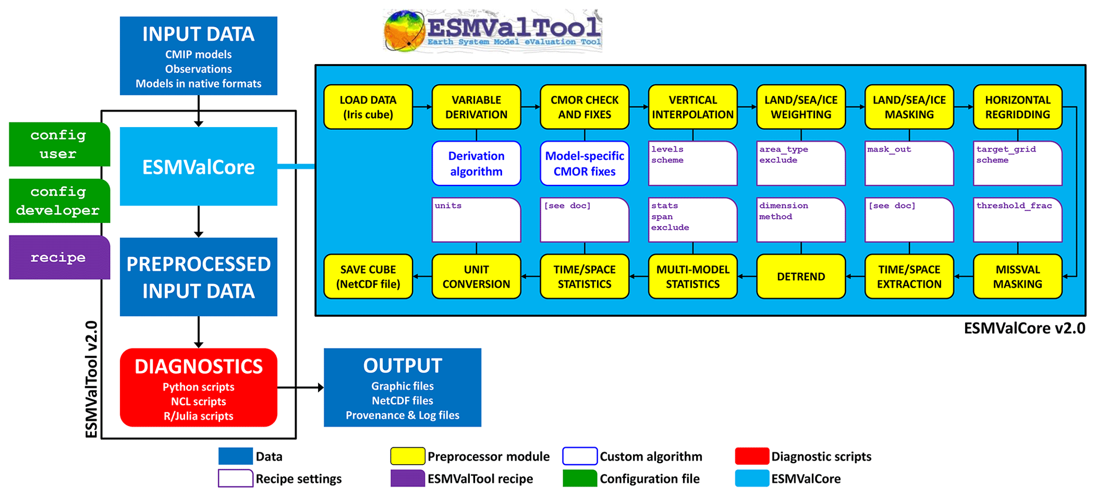
Building on ESMValCore preprocessors

Slide 10
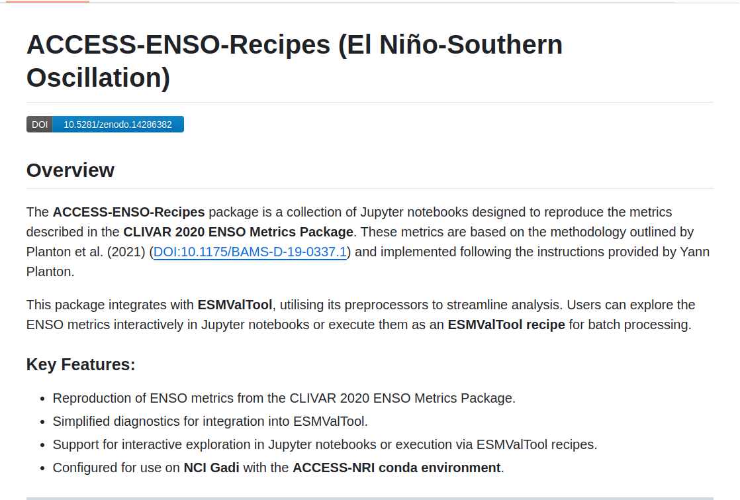
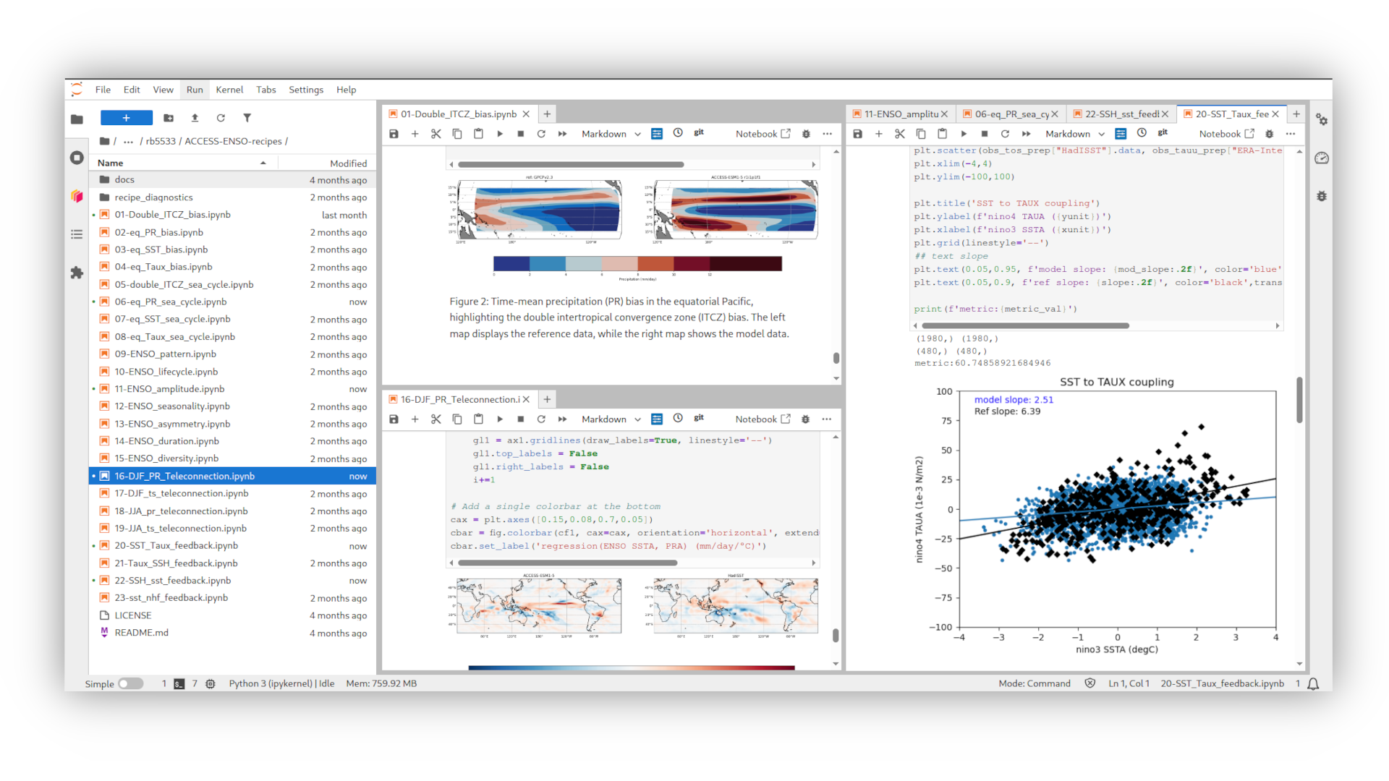
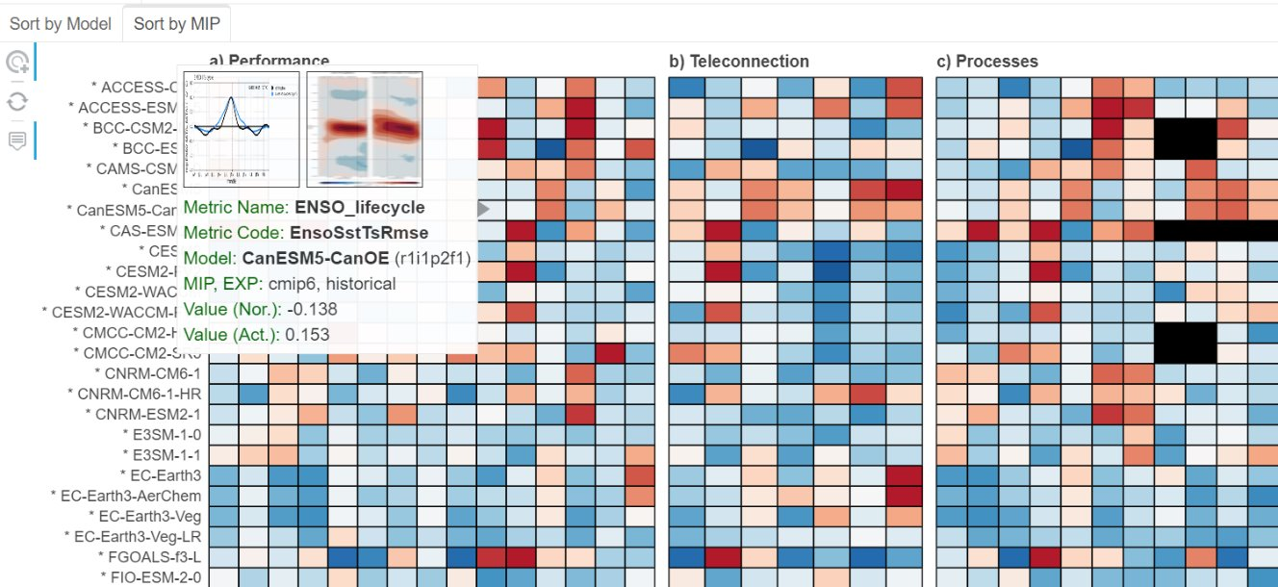
Notes:
What is an evaluation framework?
Collection of diagnostics and performance metrics for atmospheric, oceanic and terrestrial variables (the outputs of the climate models)
These are not only for the mean state, but also for trends, variability, key physical processes and emergent constraints.
They have the capability to reproduce figures from several chapters of AR5 and incorporates targeted analysis package
Major ones used for example are ESMValTool (earth system model evaluation tool) and ILAMB (International land model benchmarking)
These are python-based, and the code is in Github for community development.
Requires active collaboration with the international community

Slide 11
ACCESS ENSO Recipes
23 Notebooks dedicated to evaluating different aspects of ENSO.
Each notebook establishes a workflow to analyze specific ENSO characteristics, including: biases, cycles and patterns, amplitude, seasonality, asymmetry, duration, teleconnections and feedbacks.
Optimised to use Dask clusters
We plan to extend the existing metrics to include the Indian Ocean Dipole (IOD).
We support a range of observational products to benchmark model outputs against real-world data. The code is available on GitHub for anyone to use, and we highly welcome feedback and comments to improve and refine our workflows.
Notes:
What is an evaluation framework?
Collection of diagnostics and performance metrics for atmospheric, oceanic and terrestrial variables (the outputs of the climate models)
These are not only for the mean state, but also for trends, variability, key physical processes and emergent constraints.
They have the capability to reproduce figures from several chapters of AR5 and incorporates targeted analysis package
Major ones used for example are ESMValTool (earth system model evaluation tool) and ILAMB (International land model benchmarking)
These are python-based, and the code is in Github for community development.
Requires active collaboration with the international community

Slide 12
Background Climatology Systematic Model Biases in the Tropical Pacific
OBS
MODEL
🌊Cold Tongue Bias
Models often simulate a cold SST band (cold tongue) in the equatorial Pacific that is too cold and extends too far west → Diagnostic / metric eq_SST_bias
💨 Trade Wind Bias
Easterly winds in models are often shifted west: • Too weak in the central Pacific • Too strong in the western Pacific → Diagnostic / metric eq_Taux_bias
OBS
MODEL

Slide 13
Background Climatology Systematic Model Biases in the Tropical Pacific
🌧️ Precipitation & ITCZ Biases
Dry equator bias (eq_PR_bias): Less rainfall in the western Pacific
Double ITCZ bias: Rainbands appear symmetrically north and south of the equator instead of a single dominant band
OBS
MODEL

Slide 14
CMIP7 Rapid Evaluation Framework (REF)
Objectives:
Provide early feedback to modelling centres on model performance.
Support quality control and highlight systematic biases.
Accelerate community analysis and intercomparison.
Key Features:
Automated diagnostics using tools like ESMValTool and PCMDI Metrics Package (PMP).
Evaluation of key metrics (e.g., SST, precipitation, TOA radiation).
ESGF integration for seamless evaluation on data publication.
ACCESS-NRI Involvement:
The Model Evaluation and Diagnostics (MED) Team at ACCESS-NRI is contributing ENSO diagnostics, jointly with PCMDI.
Metrics are based on the ACCESS-ENSO-Recipes and implemented in ESMValTool.
Supports robust evaluation of ENSO representation across models.

Slide 15
Conclusion – Community-Driven, Future-Ready
The ACCESS-ENSO-Recipes Workflow
Jupyter Notebooks for interactivity and openness.
ESMValTool for consistent, modular diagnostics.
CMORised data for seamless integration in CMIP workflows.
Climate models are increasingly complex; no single team has all the expertise. A community-driven evaluation approach helps:
Identify relevant metrics for diverse users (from developers to climate risk analysts).
Leverage shared tools and datasets.
Ensure fit-for-purpose model evaluation across disciplines and applications.
ACCESS-ENSO-Recipes enables:
Early and iterative model feedback.
Evaluation of key ENSO properties, processes, and teleconnections.
Supporting contributions to CMIP7 with transparent, reproducible, and scientifically robust diagnostics.

