Slide 1




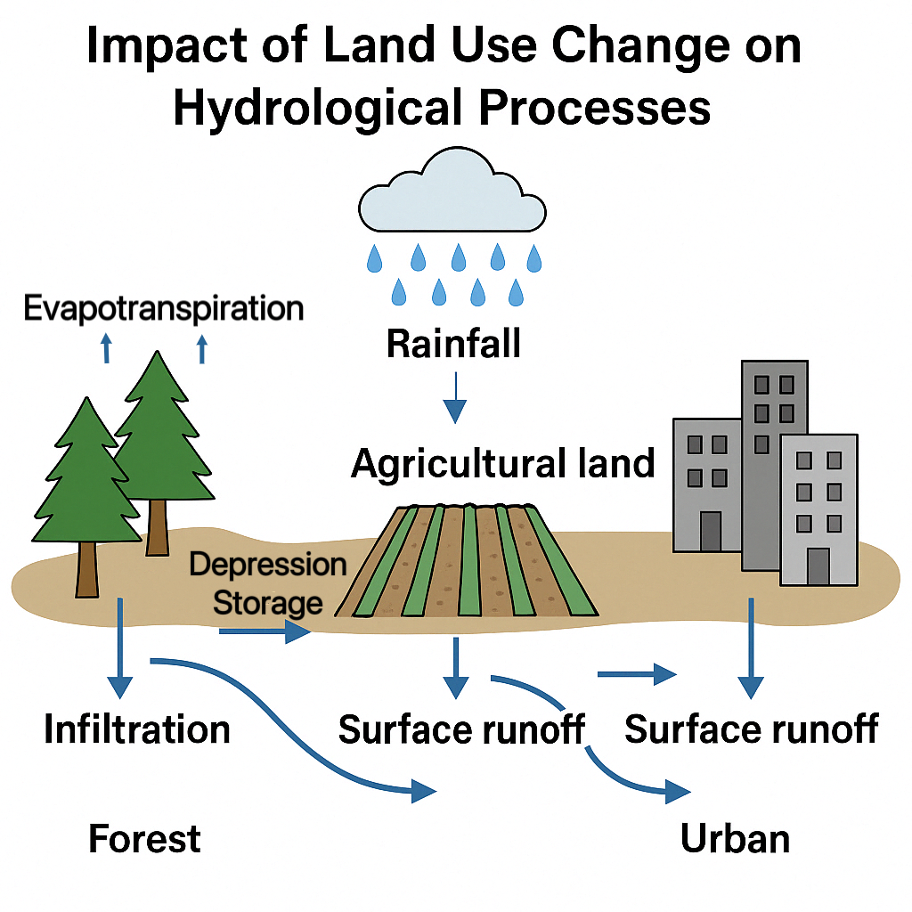
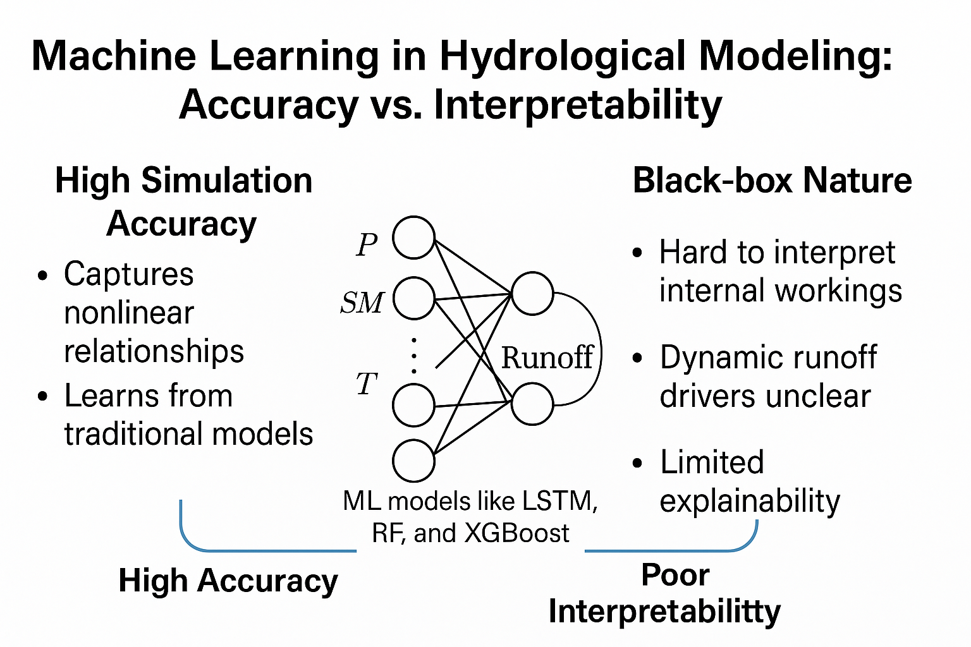
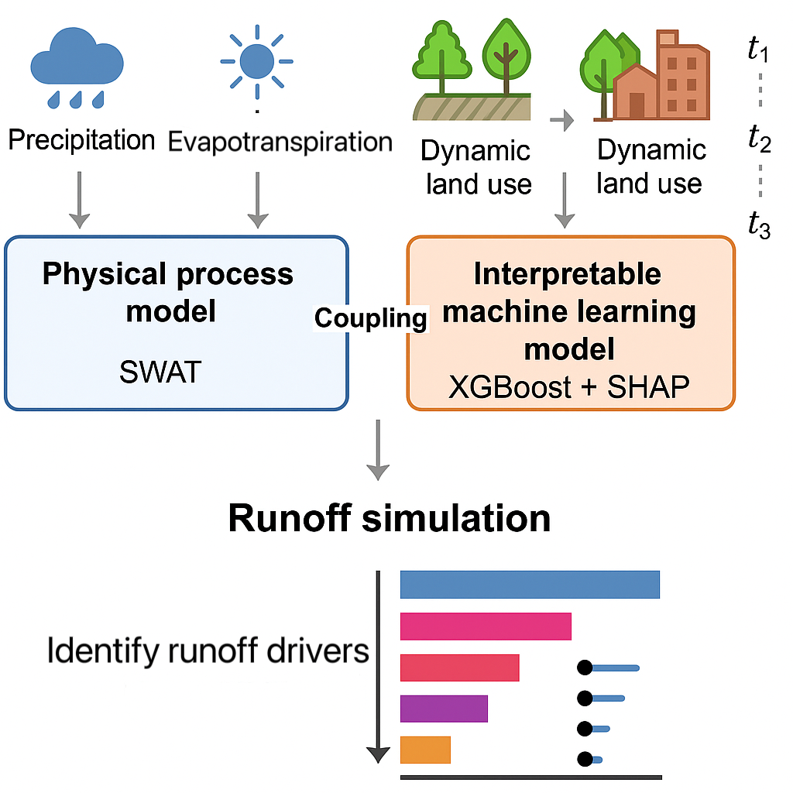
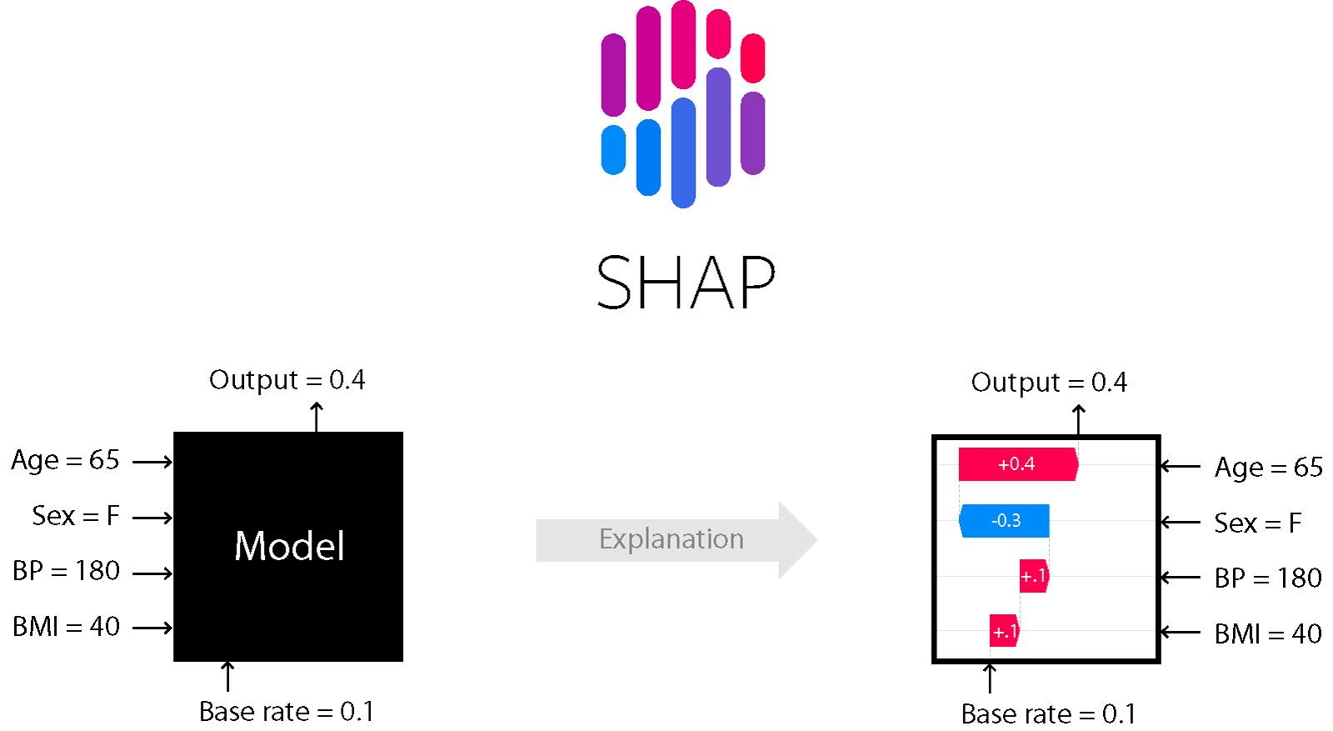
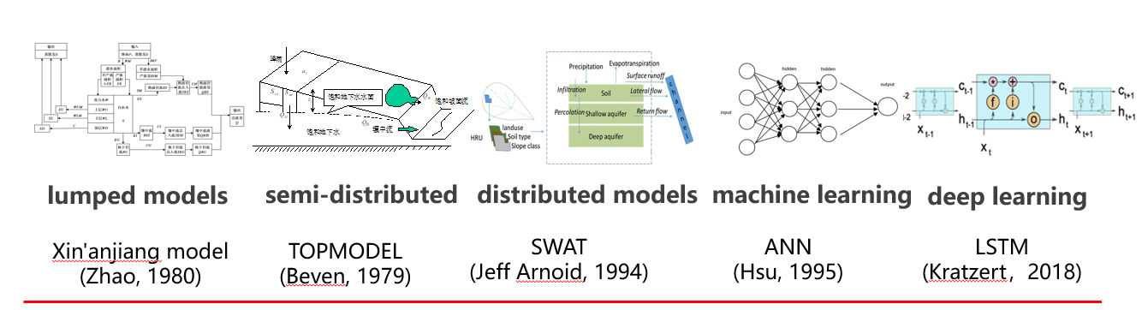
Interpretable machine learning guided by physical mechanisms reveals drivers of runoff
under dynamic land use changes
Shuli Wang, Timo Vesala, Wei Wang
Contant:20220290011@chd.edu.cn
Combining Interpretable machine learning with the physical mechanisms of hydrological models
Hydrological parameters
Hydrological model development
Interpretable method
SHAP
(Lundberg and Lee, 2017)
Notes:
Hello everyone,I'am Shuli. Our topic is Interpretable machine learning guided by physical mechanisms reveals drivers of runoff under dynamic land use changes.
Land use change profoundly affects hydrological processes in river basins. Traditionally, hydrological models have been used to examine how runoff responds to land use dynamics. In recent years, machine learning models have shown great potential in capturing complex, nonlinear interactions among hydrological variables, delivering high simulation accuracy. However, their “black-box” nature limits interpretability and trustworthiness, making it challenging to identify key dynamic drivers of runoff.
To address this challenge, we developed a physically-informed and interpretable machine learning framework. We coupled the SWAT model with an XGBoost algorithm and applied SHAP (SHapley Additive exPlanations) to identify the dominant factors controlling runoff under dynamic land use conditions.

Slide 2
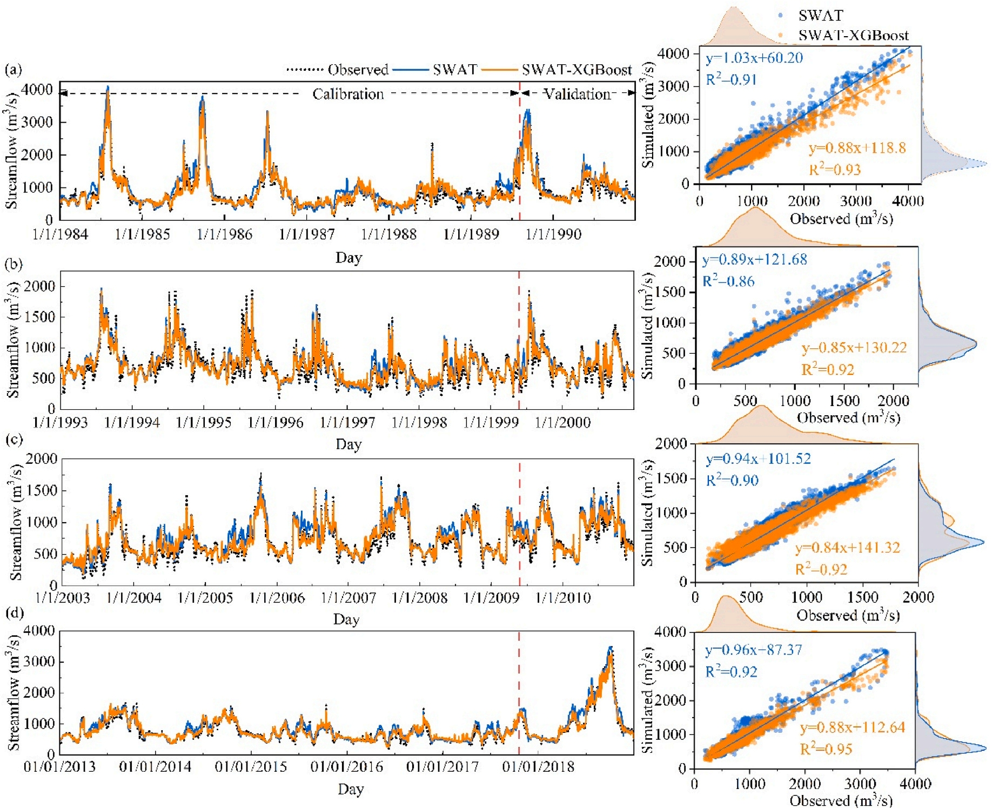
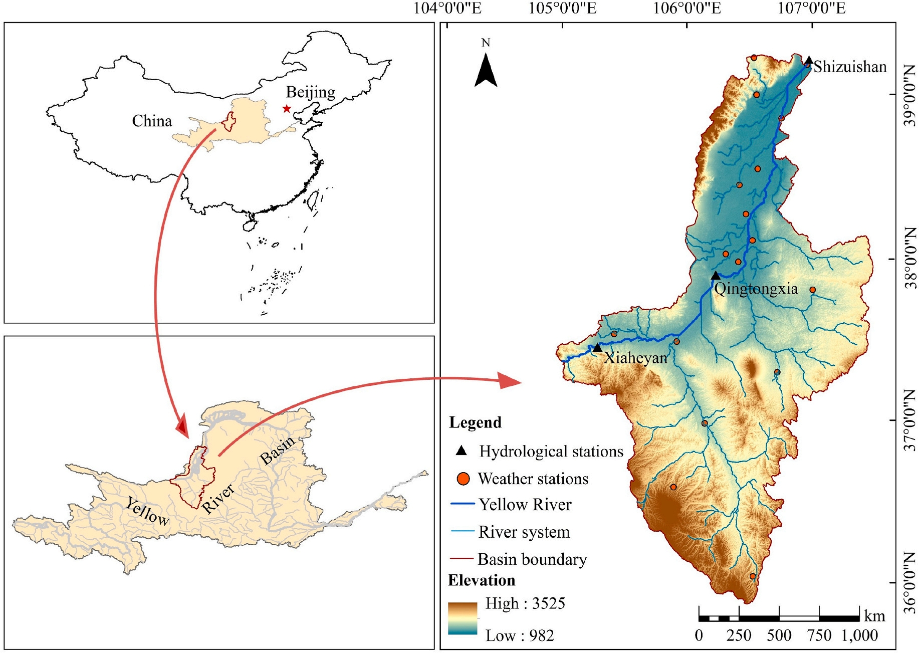
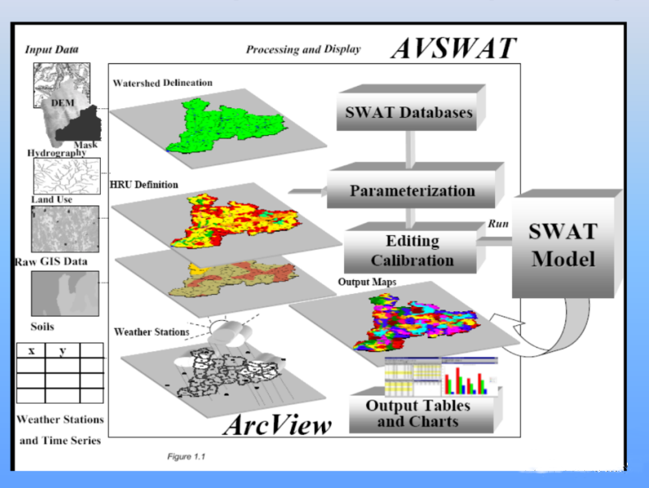
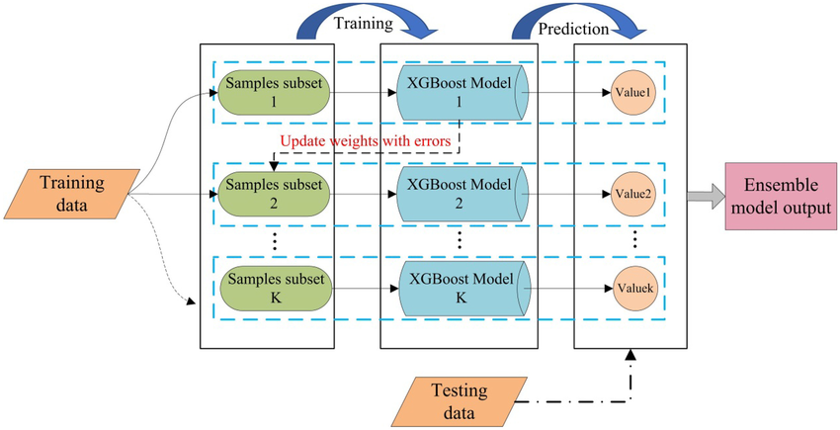
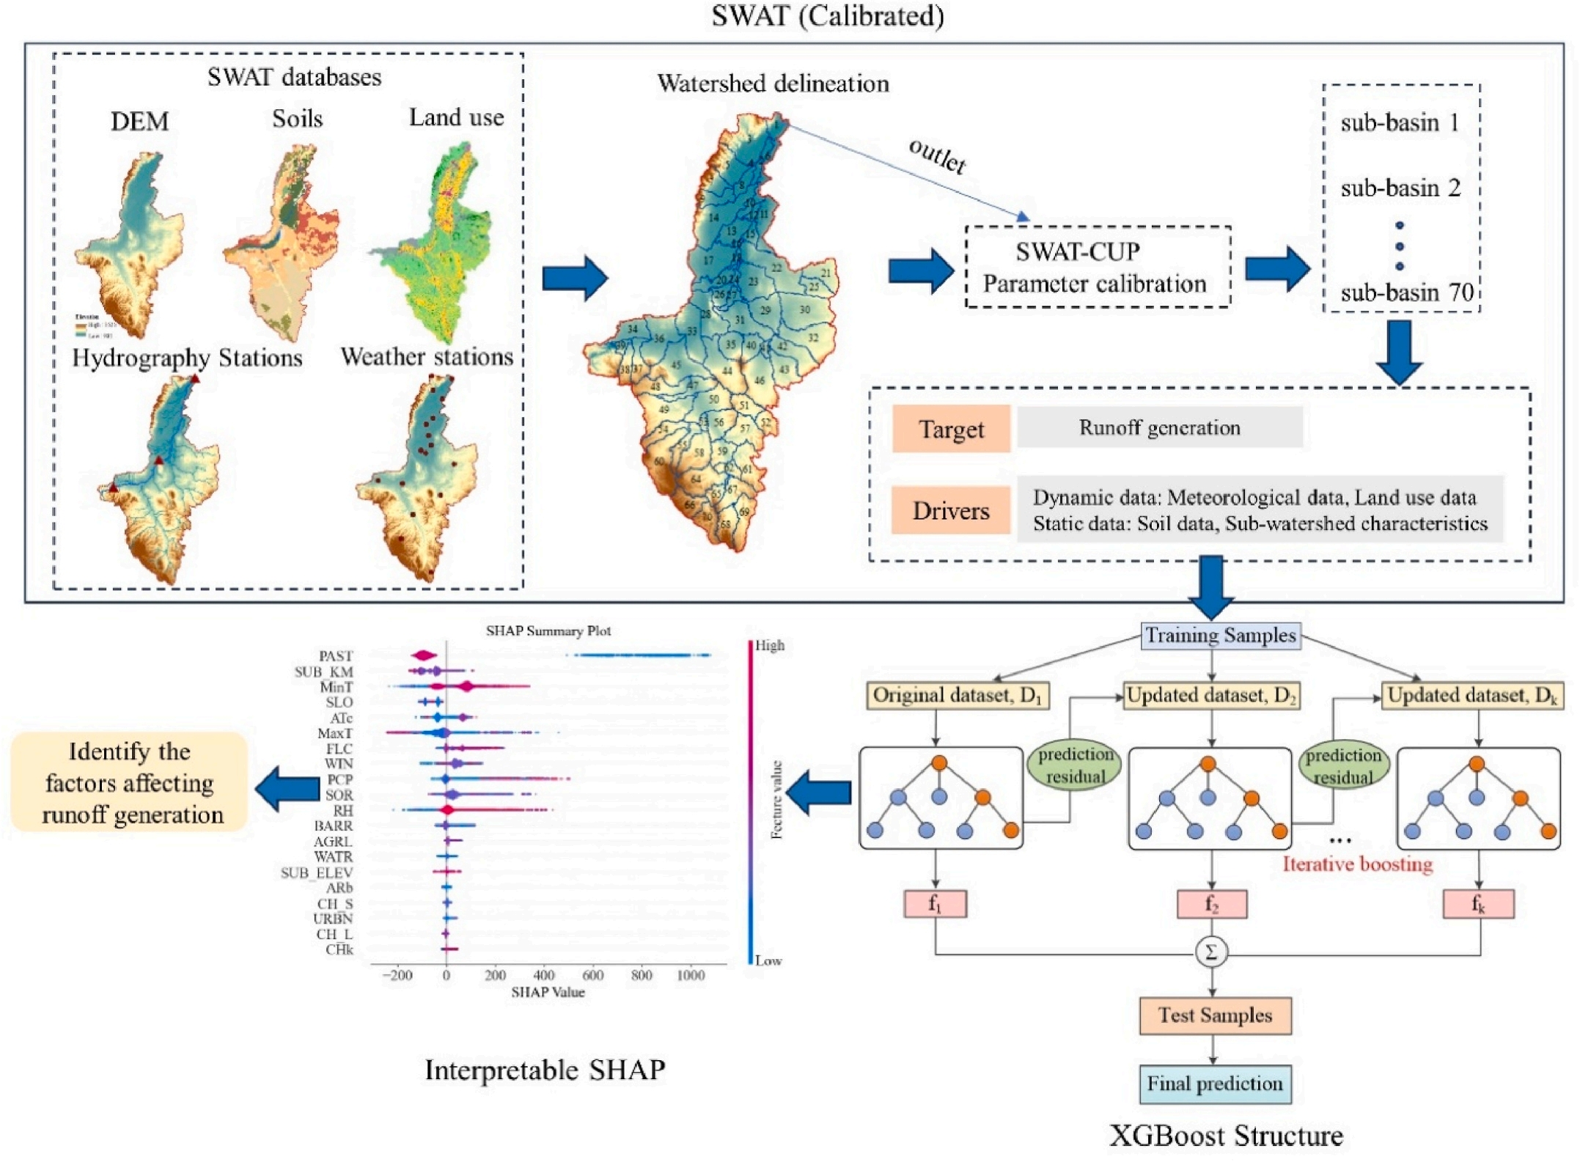
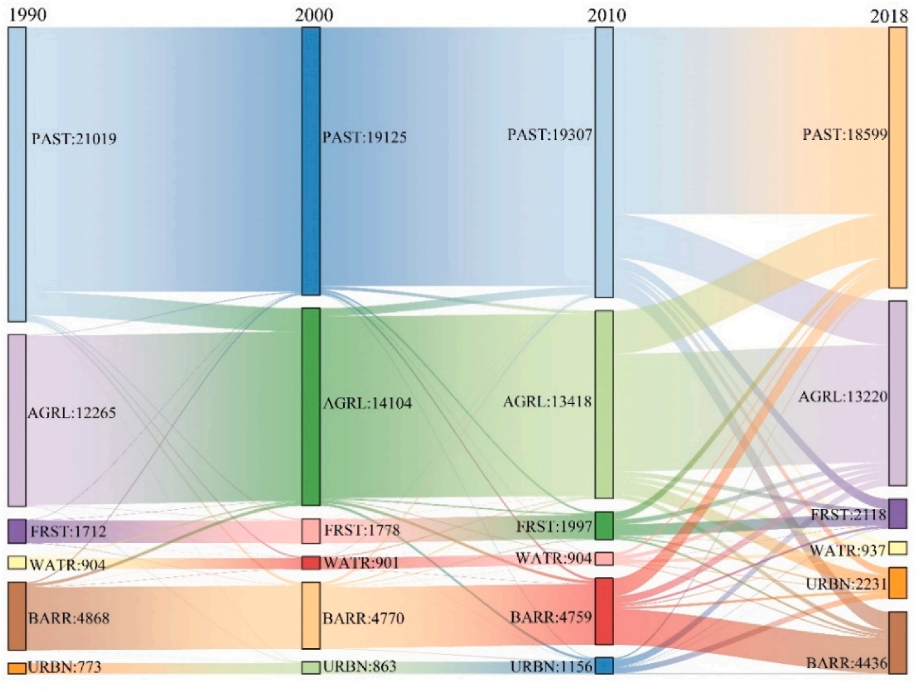
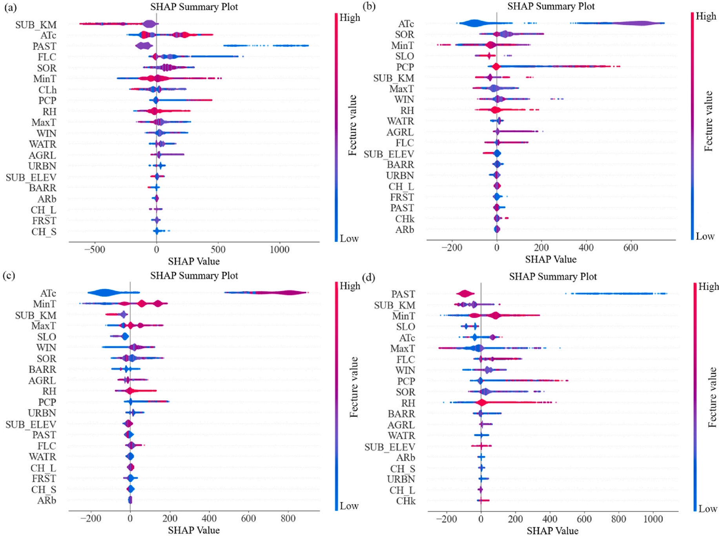
Interpretable machine learning guided by physical mechanisms reveals drivers of runoff
under dynamic land use changes
Shuli Wang, Timo Vesala, Wei Wang
Contant:20220290011@chd.edu.cn
1. Objective
2. Methods
4. Results
+
+
SWAT
XGBoost
SHAP
3. Modeling process
Notes:
Our study focuses on the Ningxia section of the middle Yellow River Basin, covering four land use snapshots from 1982 to 2018. We used SWAT to generate sub-basin hydrological and meteorological features, which served as inputs for XGBoost to simulate runoff across numerous sub-basins.
The results show increasingly frequent land use transitions, especially between agricultural and forested lands. The XGBoost effectively captured the characteristics of the hydrological processes in the SWAT-derived sub-watersheds. The coupled model not only improved simulation accuracy over single models, but also enhanced process understanding. SHAP analysis revealed a declining influence of agricultural land on runoff and an increasing suppressing effect of forests, consistent with observed land use policies. Moreover, we found threshold interactions between land use and climate variables that influence runoff generation.
This reverse-engineering approach offers a powerful tool for uncovering interactions between human activity and hydrological processes, supporting better water management under changing environmental conditions.
Thank you!

Slide 3
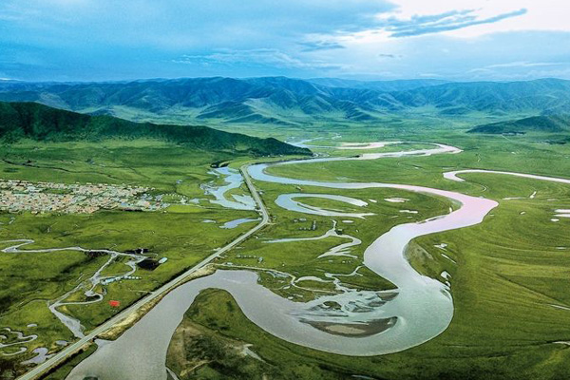


Interpretable machine learning guided by physical mechanisms reveals drivers of runoff under dynamic land use changes
Shuli Wang^{1,2}, Timo Vesala², Wei Wang¹
1. Chang’an University, China
2. University of Helsinki, Finland
2025/04/30
Notes:
Hello everyone,I'am Shuli. From Chang’an University, China and University of Helsinki, Finland. Our topic is Interpretable machine learning guided by physical mechanisms reveals drivers of runoff under dynamic land use changes.

Slide 4
1
Background
2
Research Objective
3
Method
Outline
4
Modeling Process
5
Results
6
Conclusion
Notes:
I will report on the following 6 aspects:

Slide 5
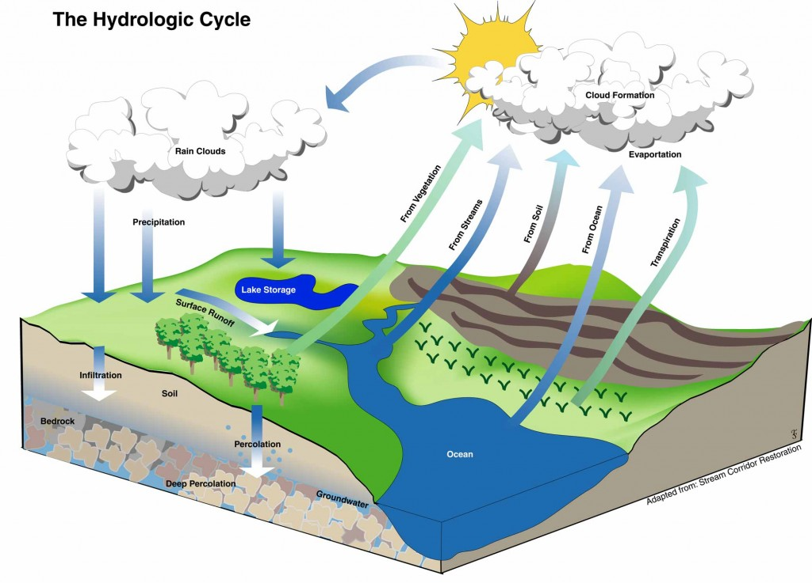


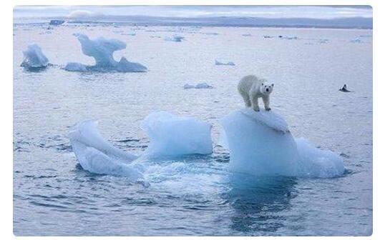
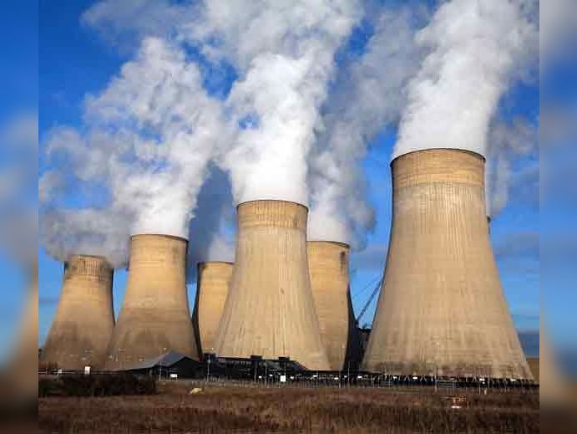

Background
Various variables
How to improve the accuracy of runoff simulation in watersheds？
Precipitation
Evaporation
Hydrologic Cycle
What is the main driving factors on the long-term dynamics of runoff?
Climate Change
Human impact
…
Runoff
Exhibits significant spatial and temporal variations
https://doi.org/10.1016/j.jenvman.2024.121978
Notes:
The river runoff process is an important role in the hydrological cycle. Influenced by climate change such as precipitation, evaporation and Human activities such as land use changes, the watershed runoff process exhibits significant spatial and temporal variations. Two important questions are arised. First, how to improve the accuracy of runoff simulation in watersheds？Second, what is the main driving factors on the long-term dynamics of runoff?

Slide 6

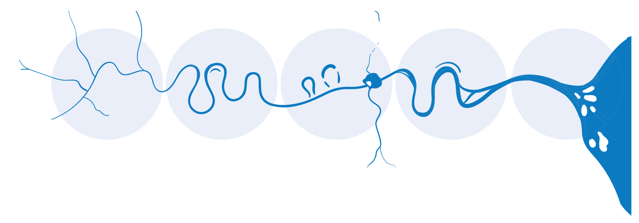
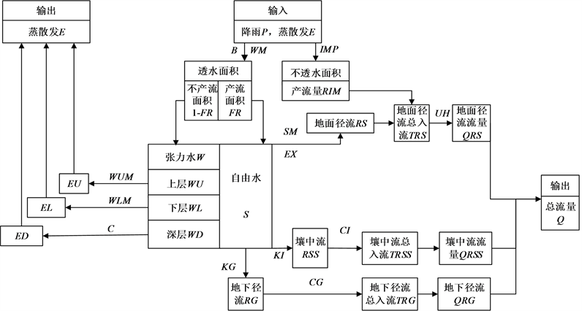
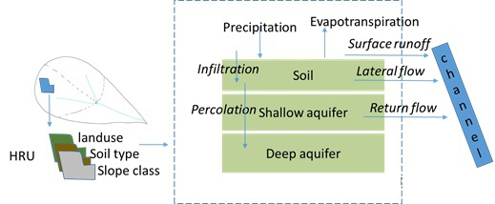
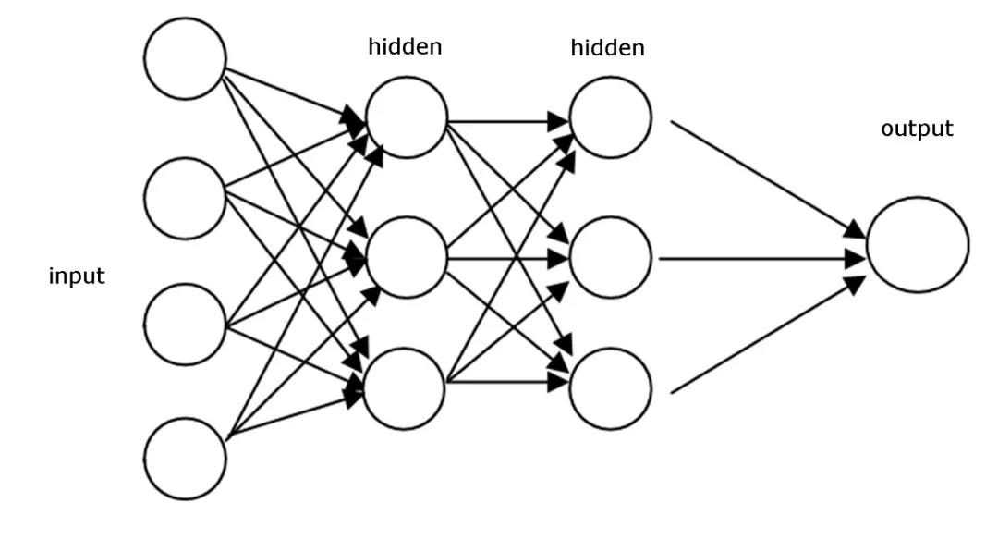
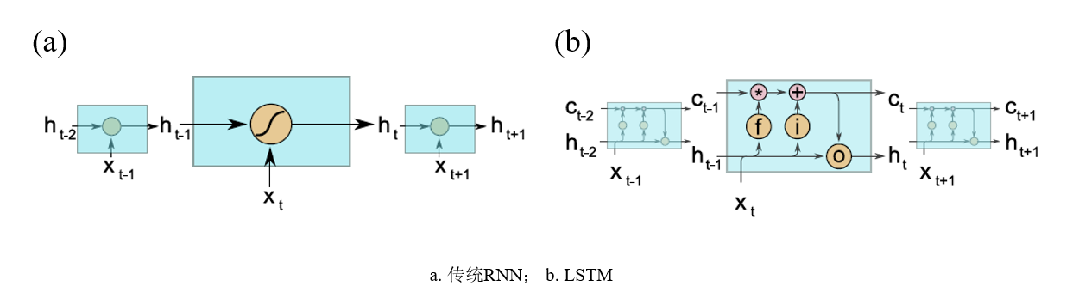
Background
Hydrological model development
lumped models
semi-distributed
distributed models
machine learning
deep learning
Xin'anjiang model
(Zhao, 1980)
TOPMODEL
(Beven, 1979)
SWAT
(Jeff Arnoid, 1994)
ANN
(Hsu, 1995)
LSTM
(Kratzert，2018)
Notes:
Hydrologists often use hydrological models to study the drivers of runoff under changing conditions. The development of hydrological models has gone through a process from lumped, semi-distributed, and distributed hydrological models to hydrological modeling using machine learning and deep learning.

Slide 7
Background
Hydrological model development-----Interpretable machine learning
Although machine learning models demonstrate promise in capturing the intricate interplay between hydrological factors, their “black box” nature makes it challenging to identify the dynamic drivers of runoff.
+
Interpretable method: SHAP
XGBoost
Uncovering the inner workings of XGBoost
Reversely inference relationships between variables
Deep Learning for time series runoff simulation
Notes:
Although machine learning models demonstrate promise in capturing the intricate interplay between hydrological factors, their “black box” nature makes it challenging to identify the dynamic drivers of runoff. The emergence of interpretable machine learning methods overcomes this difficulty. Like a combination of XGBoost and SHAP. XGBoost is used for long-term runoff simulation. SHAP is used to reveal the inner workings of XGBoost and to infer the relationship between hydrological and environmental variables.

Slide 8
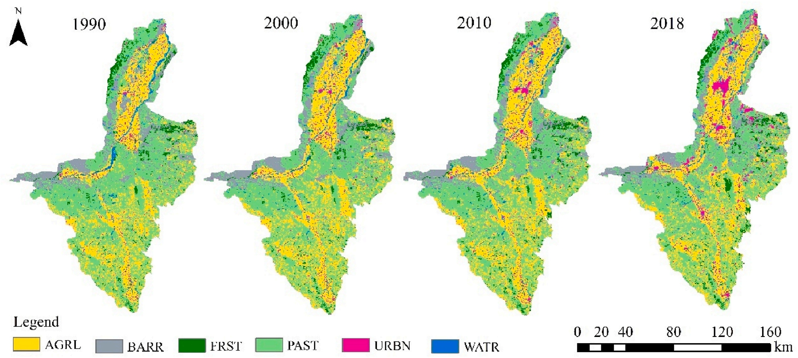
Research Objective
The inter-annual variation is significant
The frequent transitions of land use types have become more intense
Notes:
Our study focuses on the Ningxia section of the middle Yellow River Basin, covering four land use snapshots from 1982 to 2018. The land use type in this region is affected by government policies and economic development. We can see the interannual variation is obvious, and the frequent transitions of land use types have become more intense. Therefore, the main objectives of this study are to identify the dynamic driving factors of runoff under four distinct periods of land use and to explore new hydrological laws.

Slide 9
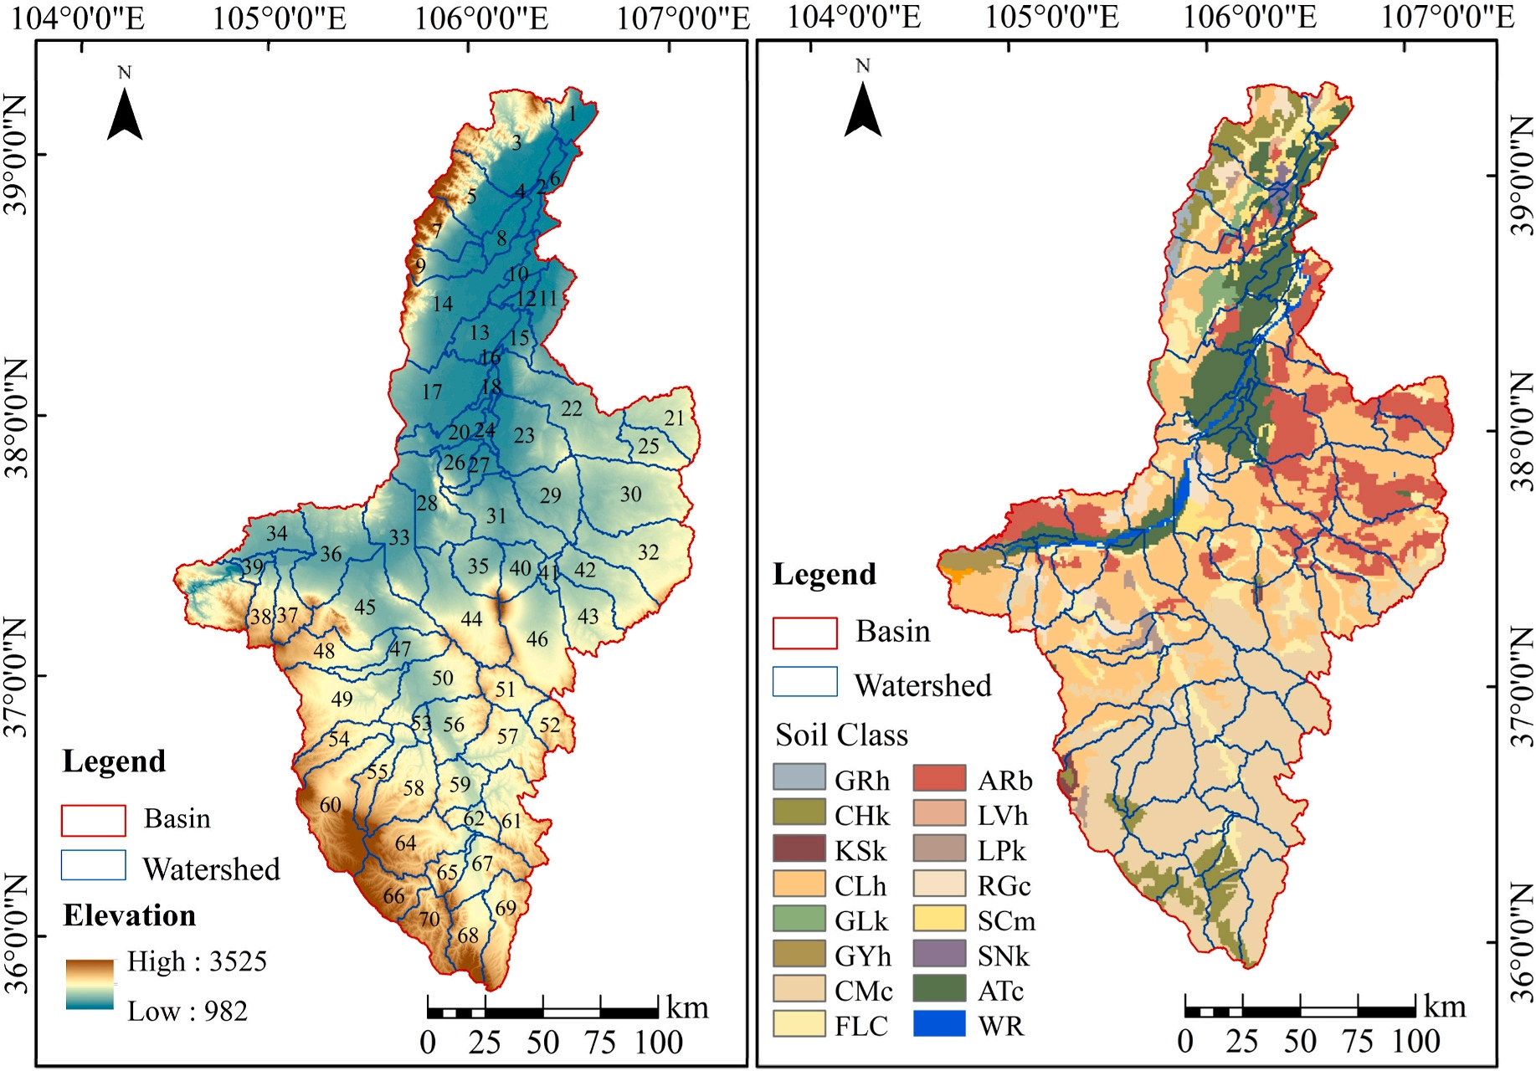
Method
Ecohydrological physical model : Soil and Water Assessment Tool (SWAT)
SWAT model sub-watershed division results (left) and sub-watershed soil types (right).
SWAT Structure
Notes:
This is the ecohydrological physical model : Soil and Water Assessment Tool (SWAT). Fistly, we used DEM, soils，land use ,hydrological and weather station data for building SWAT model. The SWAT model divides 70 sub-basins.

Slide 10
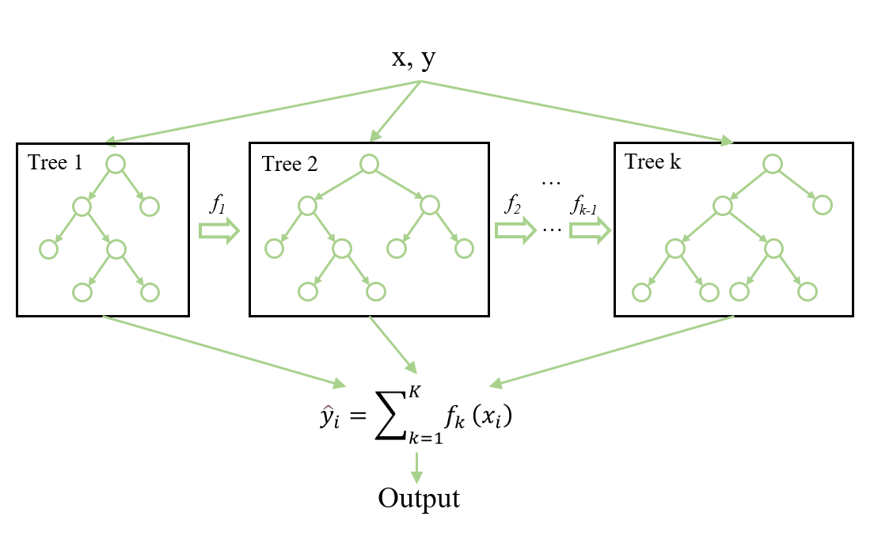

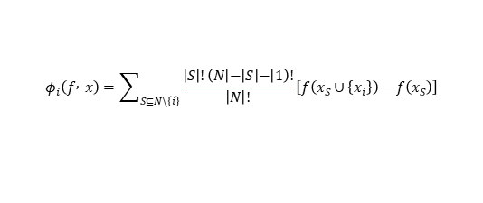
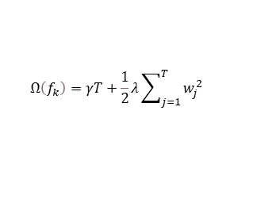
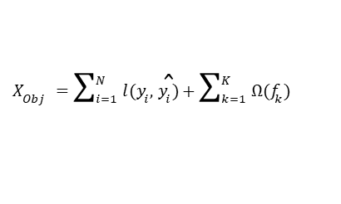
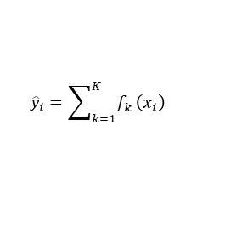
Method
Combining machine learning with the physics of hydrological models
XGBoost Structure
Hydrological model physical processes
$${\hat{y}}_{i}=\sum_{k=1}^{K}{f_{k}}\left(x_{i}\right)$$
$X_{Obj}=\sum_{i=1}^{N}{l(y_{i},}{\hat{y}}_{i})+\sum_{k=1}^{K}{Ω(f_{k})}$
$$Ω\left(f_{k}\right)=γT+\frac{1}{2}λ\sum_{j=1}^{T}{w_{j}^{2}}$$
Hydrological parameters
Interpretable method SHAP (Shapley Additive explanation)
For model predictions:
The SHAP value of a feature indicates its contribution to the prediction:
$$φ_{i}\left(f , x\right)=\sum_{S⊆N\backslash \left\{i\right\}}{\frac{\left|S\right|!\left(N | − | S | − | 1\right)!}{\left|N\right|!}\left[f\left(x_{S}∪\left\{x_{i}\right\}\right)−f\left(x_{S}\right)\right]}$$
SHAP>0 Indicates positive effect,<0 Negative effect.
Notes:
Although machine learning algorithms are widely used in watershed hydrological forecasting, they typically model based on hydrological time series data without considering the inherent spatial variability of hydrological processes. In recent years, the coupling of physical mechanism models and machine learning is considered a promising future
modeling approach in hydrological research. This coupled method can overcome the limitations of single models, thereby enhancing the accuracy of hydrological simulations. However, most coupled modeling approaches only utilize physical mechanism models to generate long-term time series data and rely on the nonlinear fitting capabilities of machine learning models to enhance the accuracy of hydrological simulations, without using interpretable technologies to analyze the simulation results and deepen the understanding of hydrological processes.

Slide 11
Modeling process
The SWAT model, by dividing the watershed into 70 sub-watersheds and Hydrological Response Units (HRUs), not only provides effective spatial variability characteristics of hydrological processes for machine learning but also generates a substantial amount of sub-watershed data, thereby offering data support for XGBoost machine learning models. This lays the foundation for subsequent using the SHAP method to interpret XGBoost simulation results to analyze the main drivers of runoff.
Modeling process of the SWAT-XGBoost-SHAP model used to identify runoff driving factors.
Notes:
This is the modeling process. 70 sub-watersheds generated by SWAT from 1982 to 2018 as the training target for the XGBoost model. The XGBoost model was built
using SWAT-generated sub-watershed features and meteorological variables as inputs, including dynamic time-series data (land use and daily meteorological data) and static data (sub-watershed attributes and soil data). To ensure data consistency, all data were preprocessed with 0–1 normalization before being input into the XGBoost machine learning
model. The data were divided into four periods based on different land use periods.Additionally, for each period’s data set, 80% was used as the training set and 20% as the test set, for training and evaluating the XGBoost model. It not only provides the spatial variation characteristics of hydrological processes that cannot be obtained through actual observations, but also generates a substantial amount of sub-watershed data, thereby offering data support for XGBoost machine learning models. This lays the foundation for subsequent using the SHAP method to interpret XGBoost simulation results to analyze the main drivers of runoff.

Slide 12
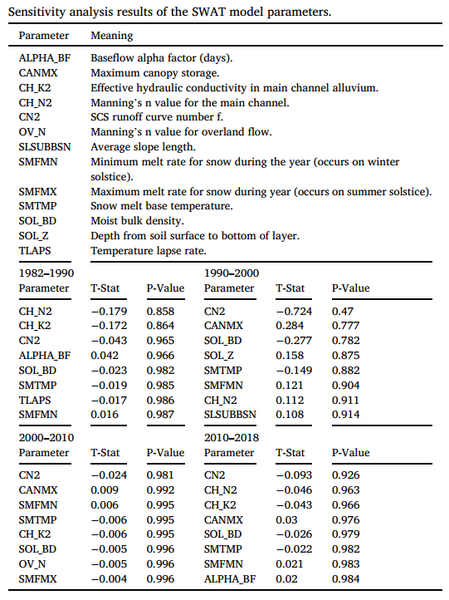
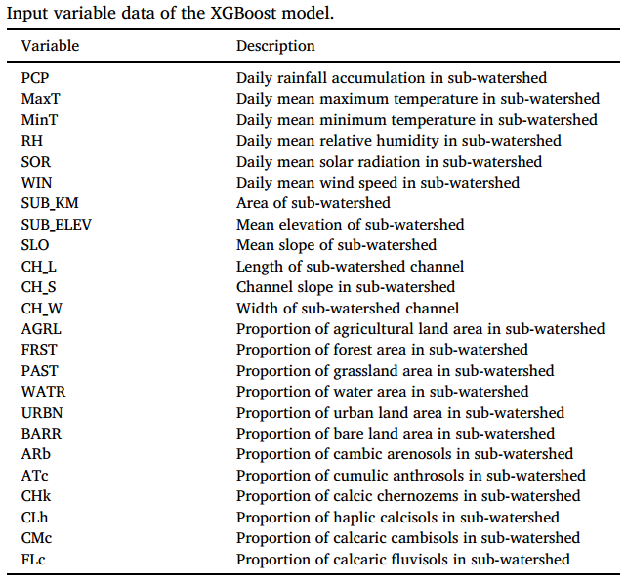
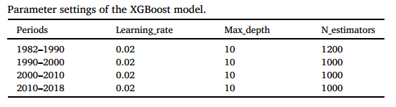
Modeling process
Notes:
each period covering approximately 8–10 years and including daily meteorological, land use, soil data, and daily flow data for 70 sub-watersheds, totaling 25 variables.

Slide 13
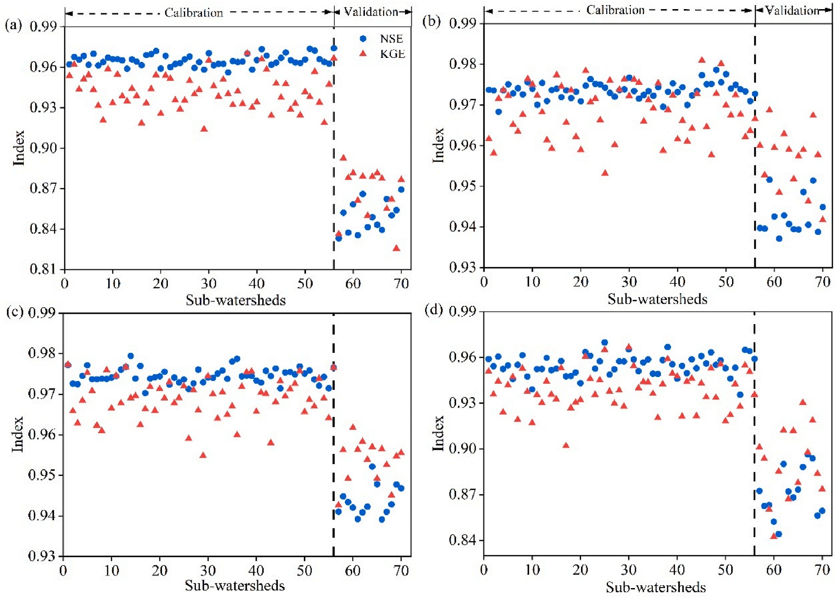
Results
1. SWAT-XGBoost coupling model improves runoff simulation accuracy
Runoff simulation performance of the SWAT-XGBoost model in the 70 sub-watersheds
Notes:
The SWAT-XGBoost provides higher simulation accuracy than the traditional SWAT model. Because, the SWAT not only provides the spatial variation characteristics of hydrological processes for the XGBoost machine learning model, but also generates a amount of data, thus offering data support for XGBoost machine learning models. This guided mechanism allows XGBoost to better capture the complex physical processes, thereby improving runoff simulation performance.

Slide 14
Results
2. Explaining XGBoost with SHAP to reveal the dynamic drivers of runoff
Although the XGBoost model demonstrated high performance in simulating the runoff in the watershed, its “black box” nature makes understanding its internal workings challenging, affecting its reliability. Therefore, the SHAP method was employed in this study to enhance the interpretability of the XGBoost model. The specific contributions of different feature variables in runoff simulation were revealed.
Importance ranking of the variables on the runoff
Notes:
According to the obtained results, SUB_KM (areas of sub-watershed) , the ATc (artificial soil areas) , and PAST grassland ranked first, were the main factors affecting the runoff process in the study area. Red and blue colors represent high and low SHAP values ​​of the variable‘s effect on runoff, respectively. For example, SUB_KM ,PAST primarily exhibiting a negative effect on runoff. Because High value gets negative shap value, which is consistent with classical hydrological laws.

Slide 15
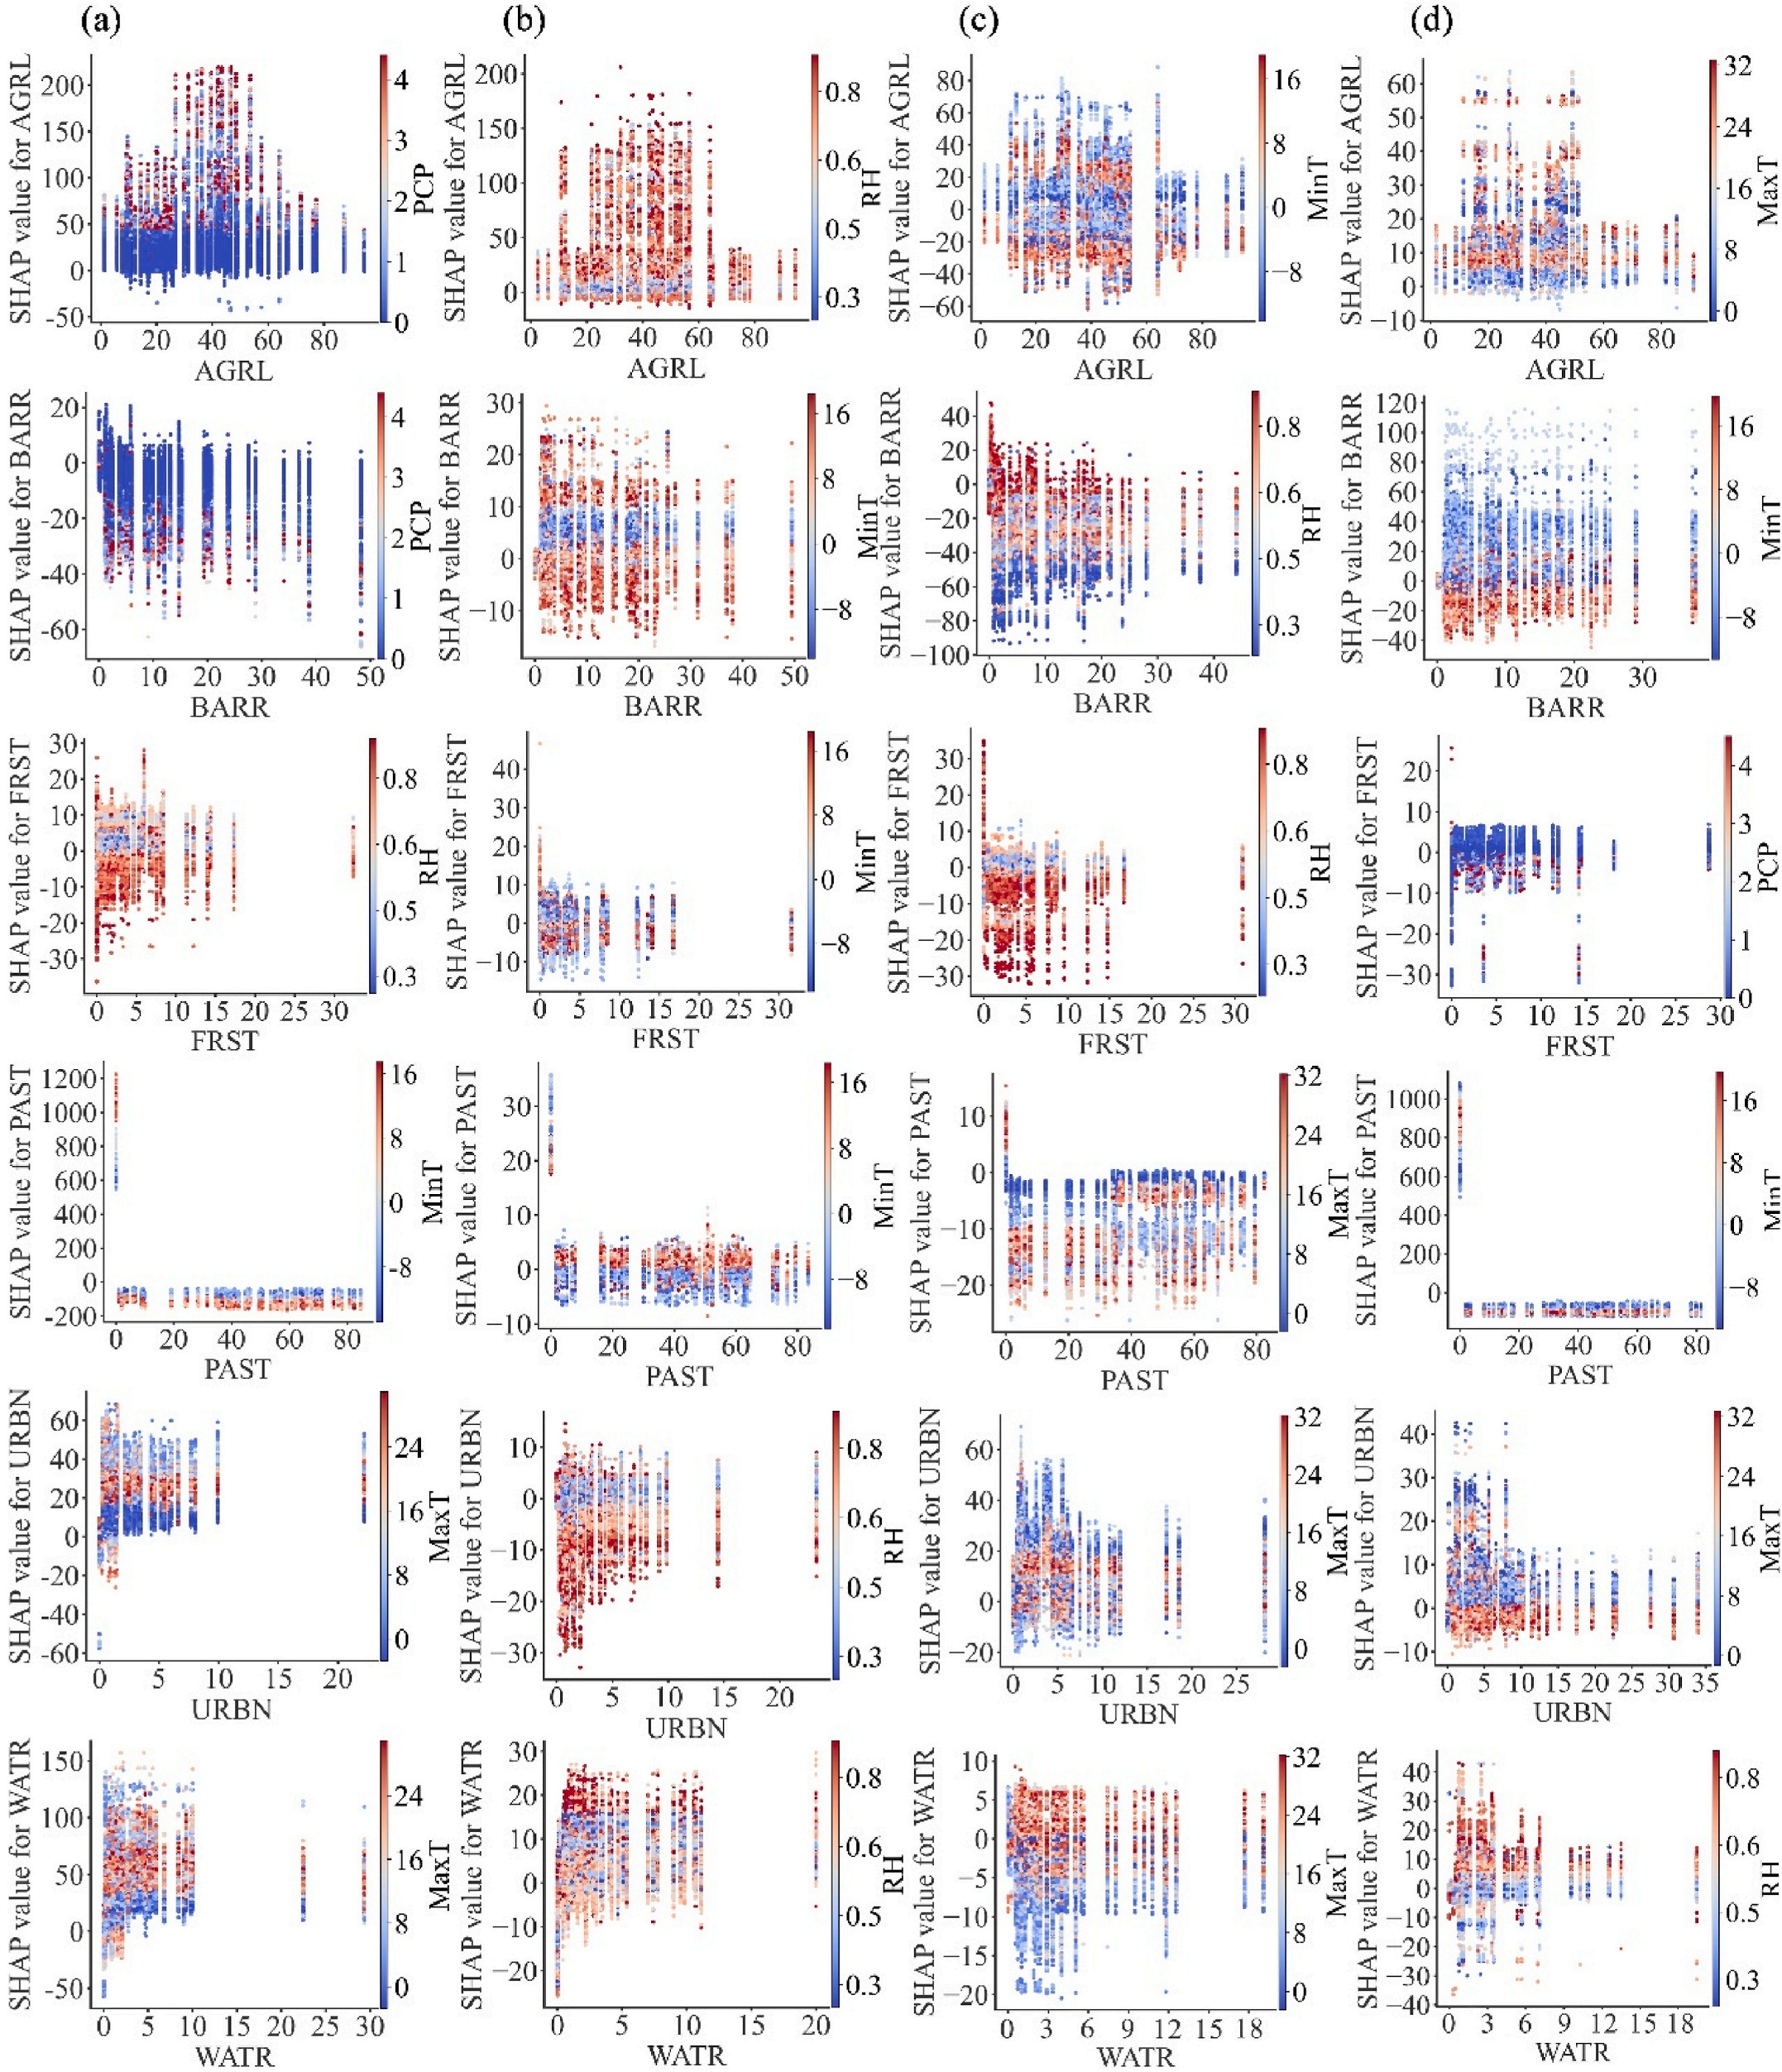
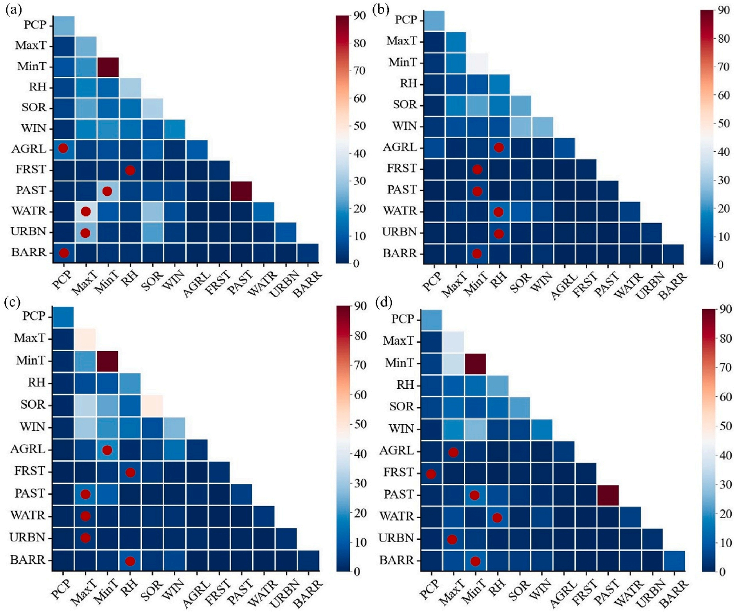
Results
3. Interaction between land use and meteorological factors on runoff.
SHAP values of the interaction between land use and climate variables
Distribution of interactions between land use and climate variables
Notes:
Land use and meteorological factors are key components in dynamic environmental conditions. Therefore, it is important to better understand the effects of land use-climate interactions on runoff processes. we calculated the SHAP values of the interaction. It can be seen from the results that different land use types have significant interactions with meteorological factors on runoff, showed as higher interaction SHAP. For example, AGRL, representing agriculture lands, interacts most strongly with PCP (Precipitation) in the first period, with RH(Relative humidity in the second period, with MinT(Minimum temperature) in the third period, and with MaxT(Maxmum temperature) in the fourth period. And we draw the SHAP values’s distribution ​​of interactions between them. For instance, the AGRL areas showed a pronounced enhancing effect on the runoff under high precipitation when compared with those under low precipitation. Moreover, there are threshold effects in the interactions between MaxT, MinT, RH, and land use on runoff. This may relate to the optimal temperature and humidity for plant growth.

Slide 16
Conclusion
The impact of land use changes in the Yellow River Basin on runoff is becoming increasingly significant. Moreover, SWAT-XGBoost not only provides higher simulation accuracy than the traditional SWAT model but also helps in gaining a deeper understanding of hydrological processes
Notably, SUB_KM, ATc, and PAST are the primary factors influencing runoff in sub-watersheds. Additionally, there is a threshold effect in the impact of land use combinations on runoff. For example, when the area ratio of AGRL reaches 30%–50%, it significantly enhances runoff generation. The SHAP analysis also revealed strong interactions between land use and meteorological variables such as MaxT, MinT, PCP, and RH.
The study on the mechanisms of interaction between meteorology and land use types provides new insights into interdisciplinary fields of hydrology, climatology, and ecology.
Interpretable methods have become a critical link between traditional physical models and machine learning models. These reverse deduction methods not only identify the dynamic drivers of runoff but also reveal hydrological laws and interactions between variables that traditional physical methods may overlook.

Slide 17
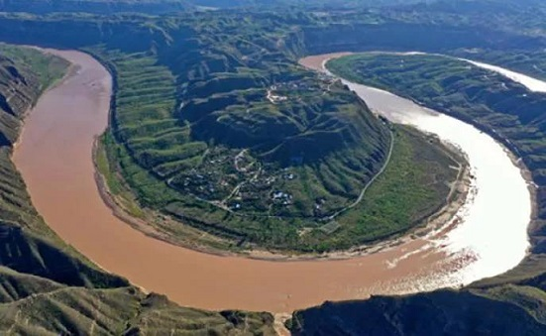
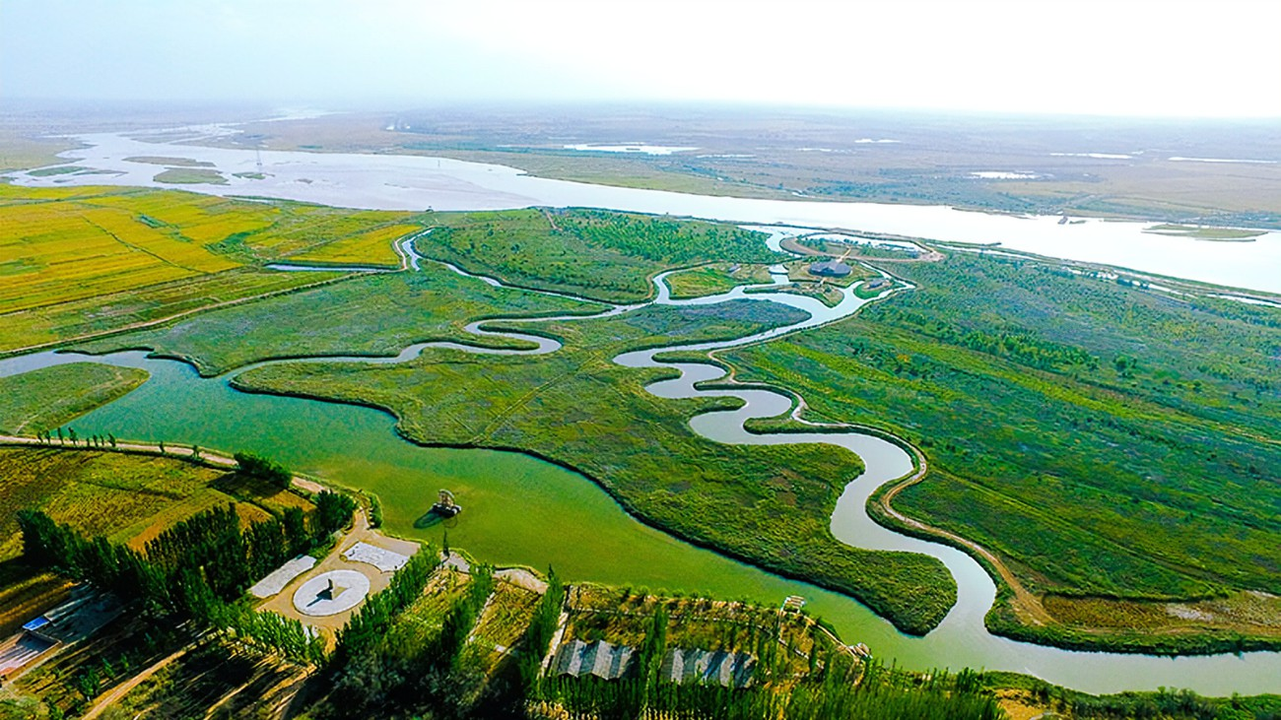
Interpretable machine learning guided by physical mechanisms reveals drivers of runoff
under dynamic land use changes
Shuli Wang, Timo Vesala, Wei Wang
Contant:20220290011@chd.edu.cn
Thank you
2025/05/30
2025/4/30
Wang, S., et al (2024). Journal of Environmental Management, https://doi.org/10.1016/j.jenvman.2024.121978

