Slide 1



The impact of consecutive typhoons on the hydrodynamic conditions in a small bay in the Taiwan Strait
Che Enneper
noah.david.che.enneper@uni-hamburg.de
Notes:
Hello everyone, my name is Che Enneper and I am trying to analyse or estimate in my phd what is the impact of consecutive typhoons on the hydrodynamic conditions in a small bay in the Taiwan Strait.

Slide 2
Typhoons as compound events
Global warming is expected to increase frequency and severity of compound weather, ocean and climate events
A singular typhoon is a multivariate compound event
Consecutive typhoons can be interpreted as temporally compounding events
Heavy rain
Flooding
Typhoon
Large river runoff
Low-salinity pools
Coral bleaching
Storm surge
Typhoon 1
Storm Surge
Persistent atmospheric pattern
Coral bleaching
Typhoon 2
Low-salinity pools
Typhoon 3
After Zscheischler, Jakob, et al. "A typology of compound weather and climate events." Nature reviews earth & environment 1.7 (2020): 333-347.
Notes:
So in recent years, many extreme weather or climate events have been analysed as compound events to better understand what their underlying physical processes are, what their individual impacts are and how their combined effect than results in such extreme weather or climate events. Global warming is now expected to increase the frequency and severity of compound weather and climate events. This concept is also central to my PhD research. Specifically, I am investigating how individual typhoons — or multiple typhoons occurring in short succession — influence hydrodynamic conditions such as sea surface heigth, salinity, and temperature in the northern South China Sea, and what could be the potential impacts for the local coral reefs. So following now the topology introduced by Zscheischler et. Al. in 2020 an individual typhoon can be interpreted as a multivariate compound event. So in the case of typhoons, they are related with heavy rainfalls and associated large river runoffs and storm surges. But also the combined freshwater input from heavy rainfalls and large river discharges could result in low-salinity pools in the near surface layers of the coastal ocean. The accumulated effect of these two hazards results in a high stress for the coral reefs and could result in bleaching. together with the storm surges by the strong winds of the typhoons these could result in the bleaching of coral reefs. If multiple typhoons occur in quick succession, like within typhoon season from May to October than this can be interpreted as a temporally compounding event. Here for example a climate variabilities like the pacific decadal oscillation or a persistent atmospheric-circulation patterns can lead to the occurrence of multiple consecutive typhoons with a similar trajectory where their associated hazards can amplify the individual impact of each typhoon. So here the impacts of the individual typhoons could accumulate, so that that coral reefs have less or no time to recover between the different typhoons.

Slide 3
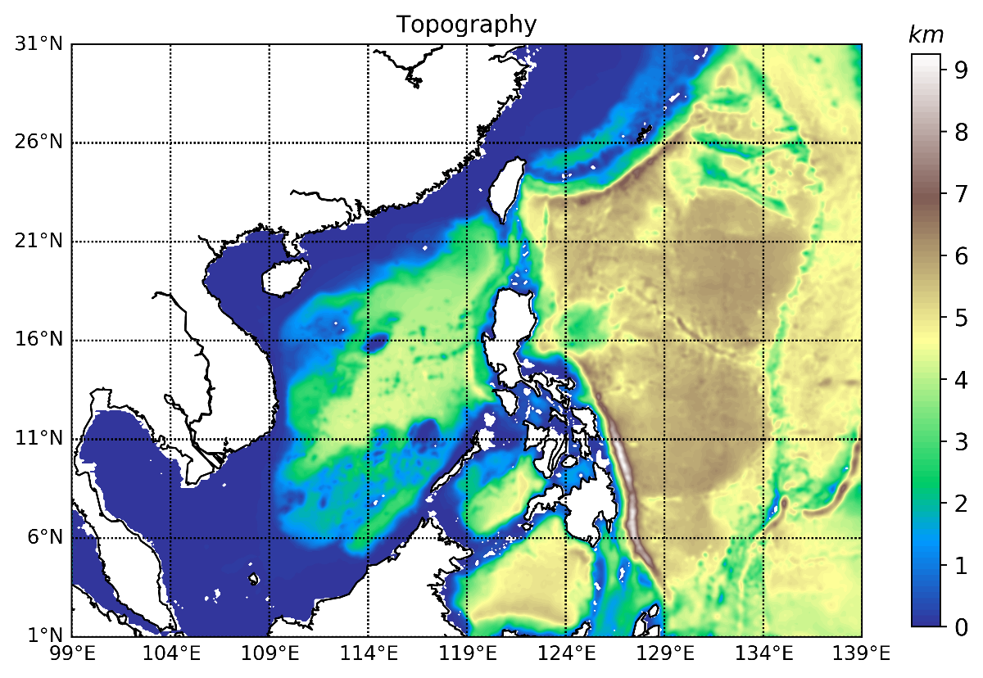
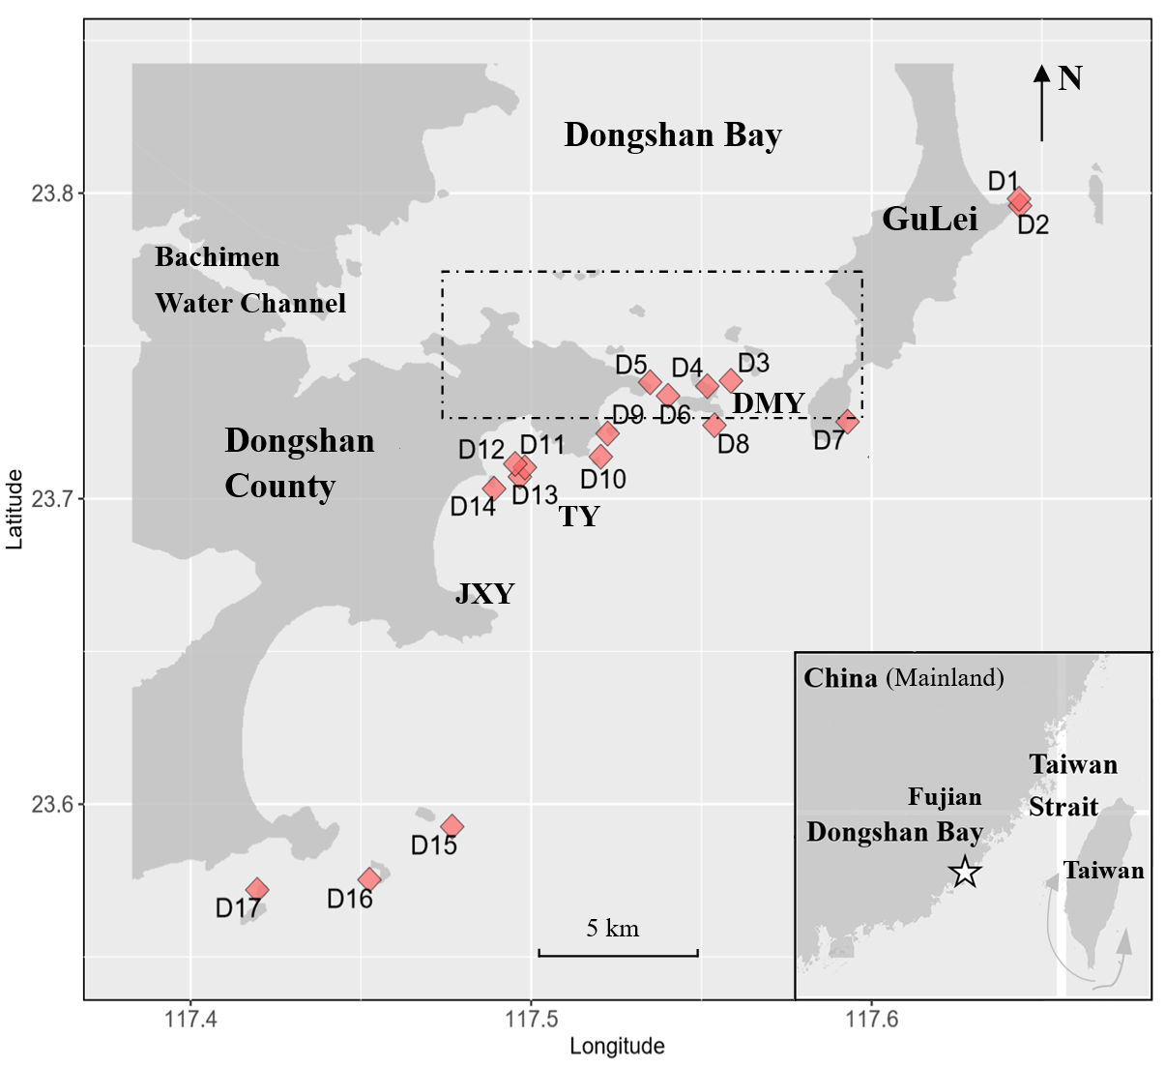
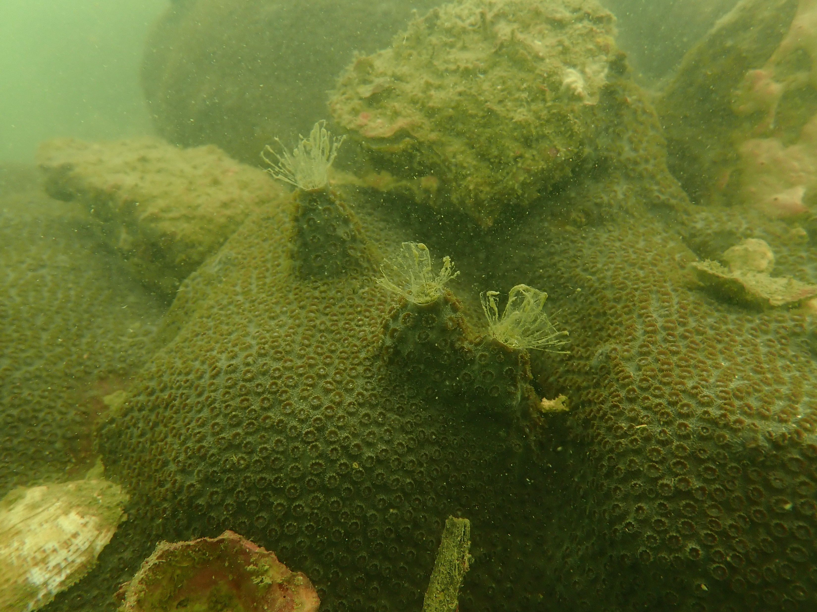
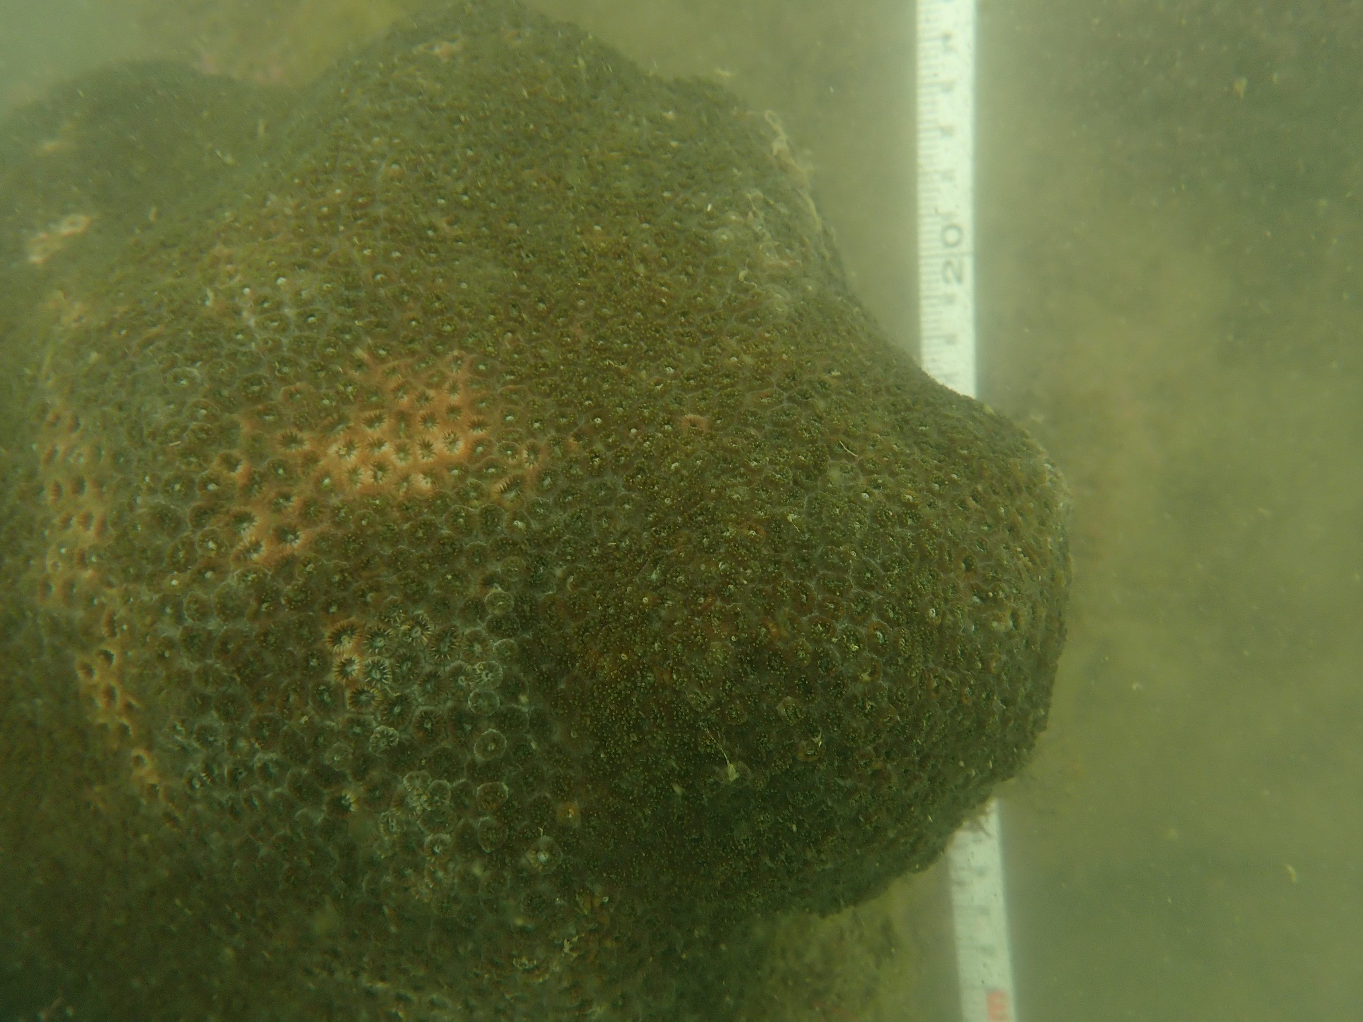
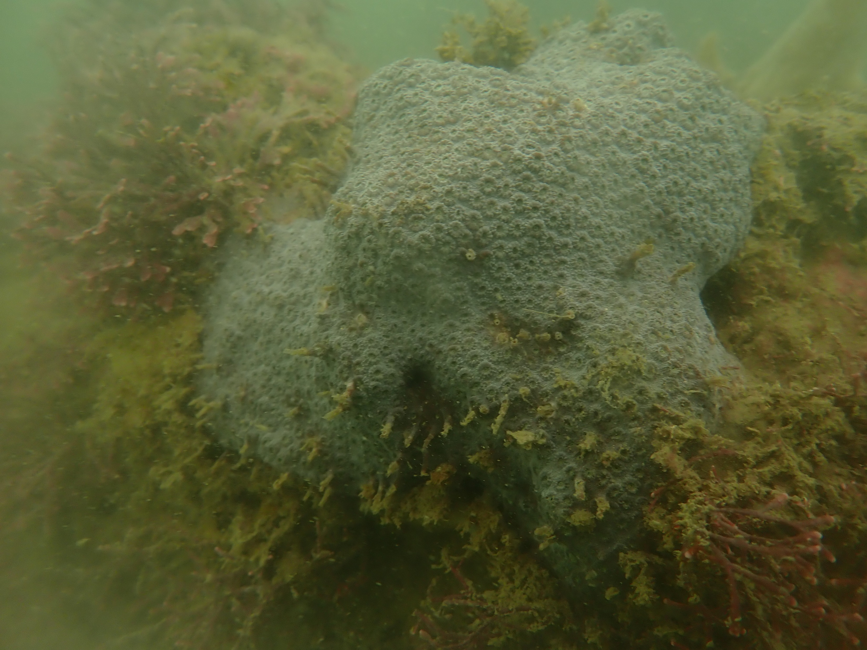
Area of interest: Dongshan Bay
Between July - September 2023, three consecutive typhoons
Before the events
After the events
Plots and pictures by personal communication from the Third Institute of Oceanography in Xiamen, China
Notes:
To analyse now how typhoons impact the hydrodynamic conditions such as the sea surface height and salinity, I am focusing on the area around Dongshan Bay, which is a small bay in China located here in southern entrance of the Taiwan Strait. This bay serves as an ideal case study since it is the home of multiple marginal coral reefs. The northern South China Sea has been hit been hit in recent memory by multiple typhoons. For example between July and September 2023, the area around Dongshan bay was hit by 3 consecutive typhoons, which also affected the health of the local coral reefs, as we can see on this pictures that before the events, the coral reefs appeared to be healthy. However, after the events, many of the coral reefs showed signs of partial or even complete bleaching.
More precisely, its about the coral reefs around the Dongshan Bay which is a Bay near the Taiwan strait, which you see here in the topography map of the southern Chinese sea. And the motivation for this project was affected by a greater amount of Taifuns, e.g. between July and September 2023 there where three consecutive typhoons which also really had negative impacts on the health of the coral reefs, since many of the corals were partially or completely bleached after the events. The effect of three strong consecutive typhoons in terms of the resulting storm surges and strong currents, as well as the terrestrial runoff resulting from the heavy rainfall on the health and biodiversity can be classified as compound events. Therefore is reasonable to analyse the hydrodynamic conditions under different climate scenarios using a regional circulation model
36
Status of Caribbean Coral Reefs after Bleaching and Hurricanes in 2005
Recovery from hurricane damage is variable. Often, branching corals recover quickly because
of their rapid growth, and broken branches can even begin to regrow in new areas. However,
recovery can be hindered by the accumulation and movement of coral rubble generated by
the hurricane, and by increases in the abundance of algae, which compete for space within
the reef. Terrestrial runoff resulting from heavy rainfall can also influence the nearshore reef
ecosystems, smothering corals with sediment and other debris, as well as increasing nutrients
(including those in fertilisers) that influence growth rates of algae, and lowering salinity,
which can stress corals.

Slide 4
Area of interest: Dongshan Bay
Research goals of my PhD:
Analyse of compound effect of singular/multiple typhoons on the hydrodynamic conditions around Dongshan Bay
What is the combined/cumulative impact of increased freshwater input and strong winds on the local SSH, salinity?
How will the severity and frequency of these compound events change in the future under different climate change scenarios?
Notes:
So in my PhD I want to analyse what is the compound effect of singular or multiple typhoons on the hydrodynamic conditions on the sea level and salinity around Dongshan Bay. In Particular,, what is the combined and cumulative impact of the increased freshwater input due to strong rainfalls and river discharges on the local salinity, sea level and temperature. And also how will the severity and frequency of these compound events will change in the future under different climate change scenarios.
And since my model runs produce 30 years of continuous data additionally, I could also look into marine heat waves and if they occur in the future more frequently, longer and stronger. The results can then be used to assess the vulnerability of local ecosystems to these type of compound events
More precisely, its about the coral reefs around the Dongshan Bay which is a Bay near the Taiwan strait, which you see here in the topography map of the southern Chinese sea. And the motivation for this project was affected by a greater amount of Taifuns, e.g. between July and September 2023 there where three consecutive typhoons which also really had negative impacts on the health of the coral reefs, since many of the corals were partially or completely bleached after the events. The effect of three strong consecutive typhoons in terms of the resulting storm surges and strong currents, as well as the terrestrial runoff resulting from the heavy rainfall on the health and biodiversity can be classified as compound events. Therefore is reasonable to analyse the hydrodynamic conditions under different climate scenarios using a regional circulation model
36
Status of Caribbean Coral Reefs after Bleaching and Hurricanes in 2005
Recovery from hurricane damage is variable. Often, branching corals recover quickly because
of their rapid growth, and broken branches can even begin to regrow in new areas. However,
recovery can be hindered by the accumulation and movement of coral rubble generated by
the hurricane, and by increases in the abundance of algae, which compete for space within
the reef. Terrestrial runoff resulting from heavy rainfall can also influence the nearshore reef
ecosystems, smothering corals with sediment and other debris, as well as increasing nutrients
(including those in fertilisers) that influence growth rates of algae, and lowering salinity,
which can stress corals.

Slide 5
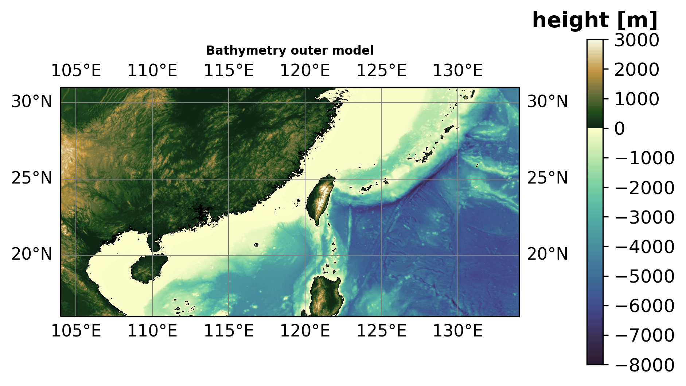
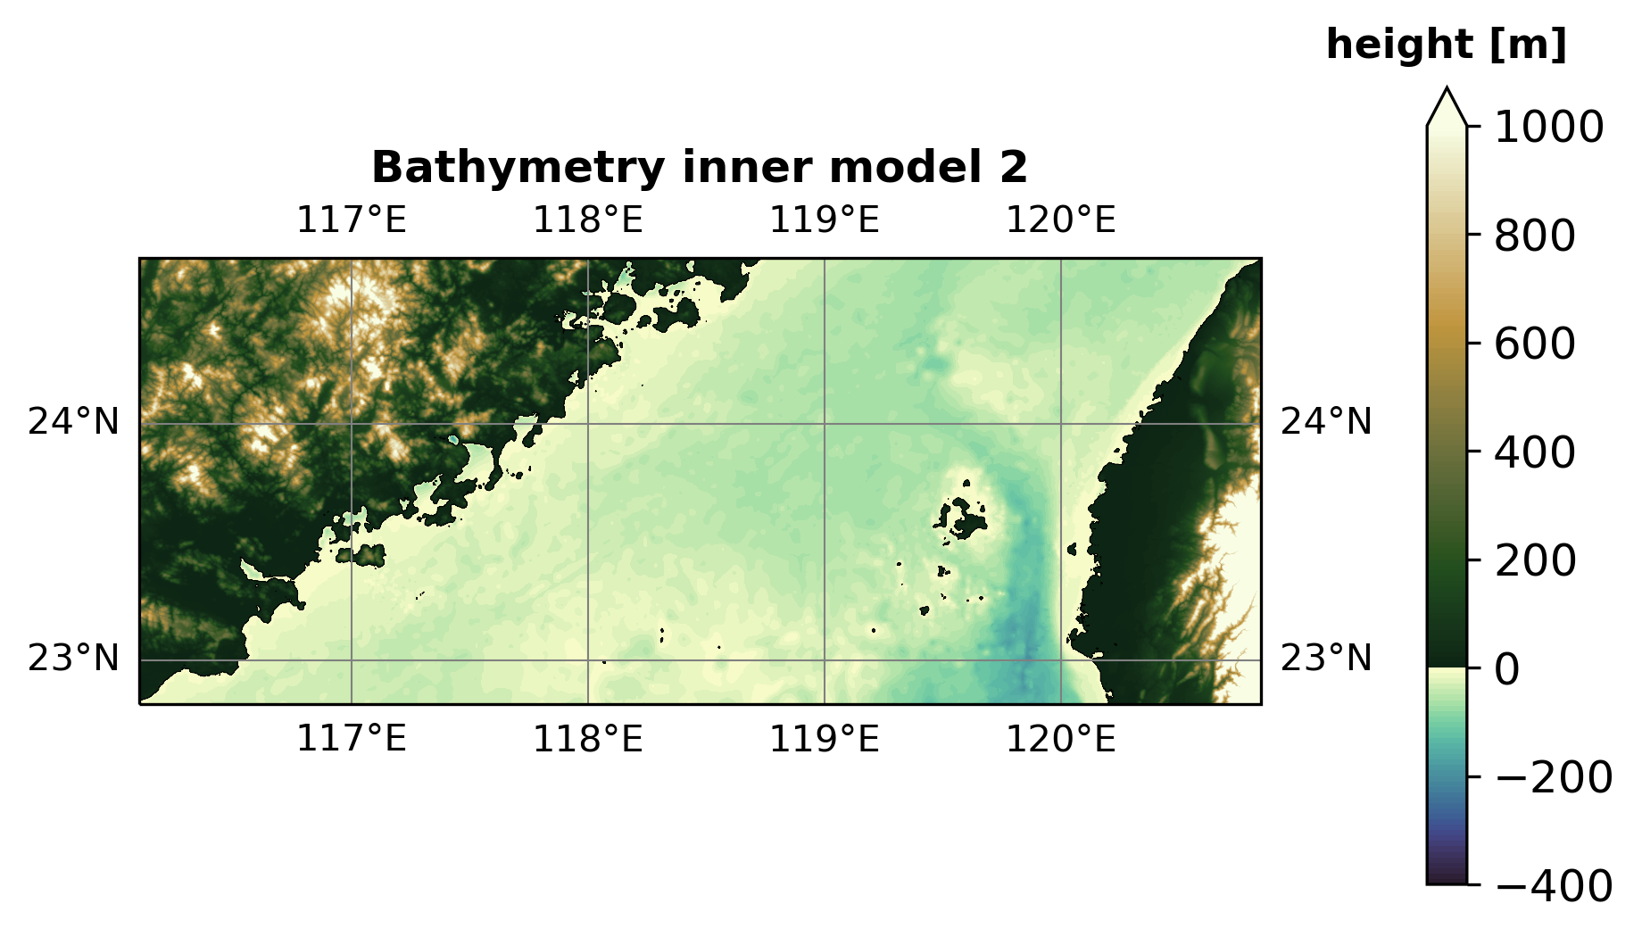
Model Setup
Numerical Simulations are held with HAMSOM
Hydrostatic regional shelf sea circulation model
Nested approach
Bathymetry outer model
Bathymetry inner model
Horizontal res: ~7km
Grid points: 451 x 226 x 34
Horizontal res: ~400m
Grid points: 1188 x 778 x 14
Notes:
To achieve these goals,I am using the regional shelf ocean circulation model HAMSOM which was developed at the University of Hamburg and applied in many shelf regions before is, to downscale global climate scenarios to an appropriate regional scale through a nested, uncoupled modelling approach. The outer model setup covers the southern East China Sea, the Taiwan Strait and the northern South China Sea (SCS). With a horizontal resolution of 7km It resolves the most important oceanic features for this study, including the circulation in the SCS, the influence of the Kuroshio and the throughflow in the Taiwan Strait. The outer model provides the hourly resolved lateral boundary conditions for the inner model, which has a high resolution of approximately 400m to adequately resolve the area around Dongshan Bay to the west coast of Taiwan

Slide 6
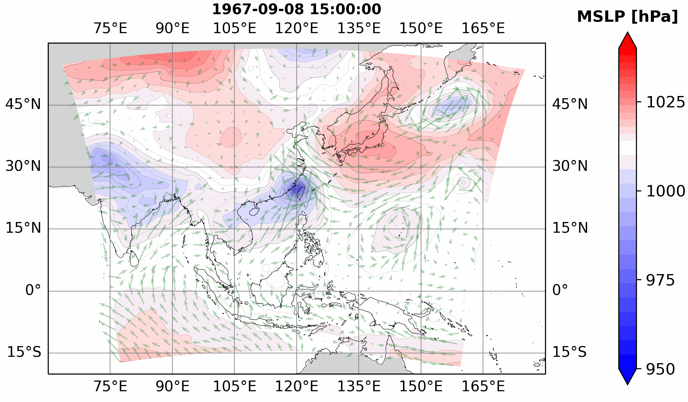
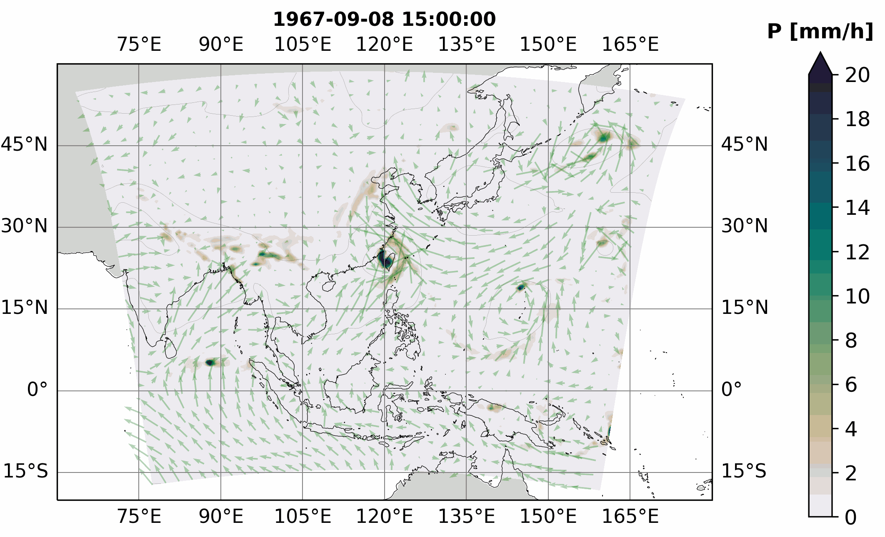
Model Setup
Numerical Simulations are held with HAMSOM
Hydrostatic regional shelf sea circulation model
Nested approach
Atmospheric and river forcing by hourly CORDEX-EAS dataset
Reproduces typhoon tracks in South China Sea quite realistic
Notes:
As atmospheric and river forcing for my simulations, I am using an hourly resolved Cordex 5 east Asia dataset with a resolution of 0,44°, which has proven to reproduce typhoon tracks quite realistically, as we see here in the left plot for a time snippet showing the mean level pressure and here on the right the precipitation is shown.

Slide 7
Model Setup
Numerical Simulations are held with HAMSOM
Hydrostatic regional shelf sea circulation model
Nested approach
Atmospheric and river forcing hourly CORDEX-EAS- 0.44° dataset
Reproduces typhoon tracks in South China Sea quite realistic
6 runs are planned: hist (1965-2005), rcp4.5, rcp8.5 (2060-2100) with and without freshwater input
Notes:
With this model setup, 6 different 40 year long simulation are planned, a historic simulation from 1965 to 2005 and a rcp4.5 and rcp8.5 simulation from 2060 to 2100 and each of this simulations are planned with and without freshwater input to assess the effect of freshwater input on the salinity and sea level in the Dongshan Bay.

Slide 8
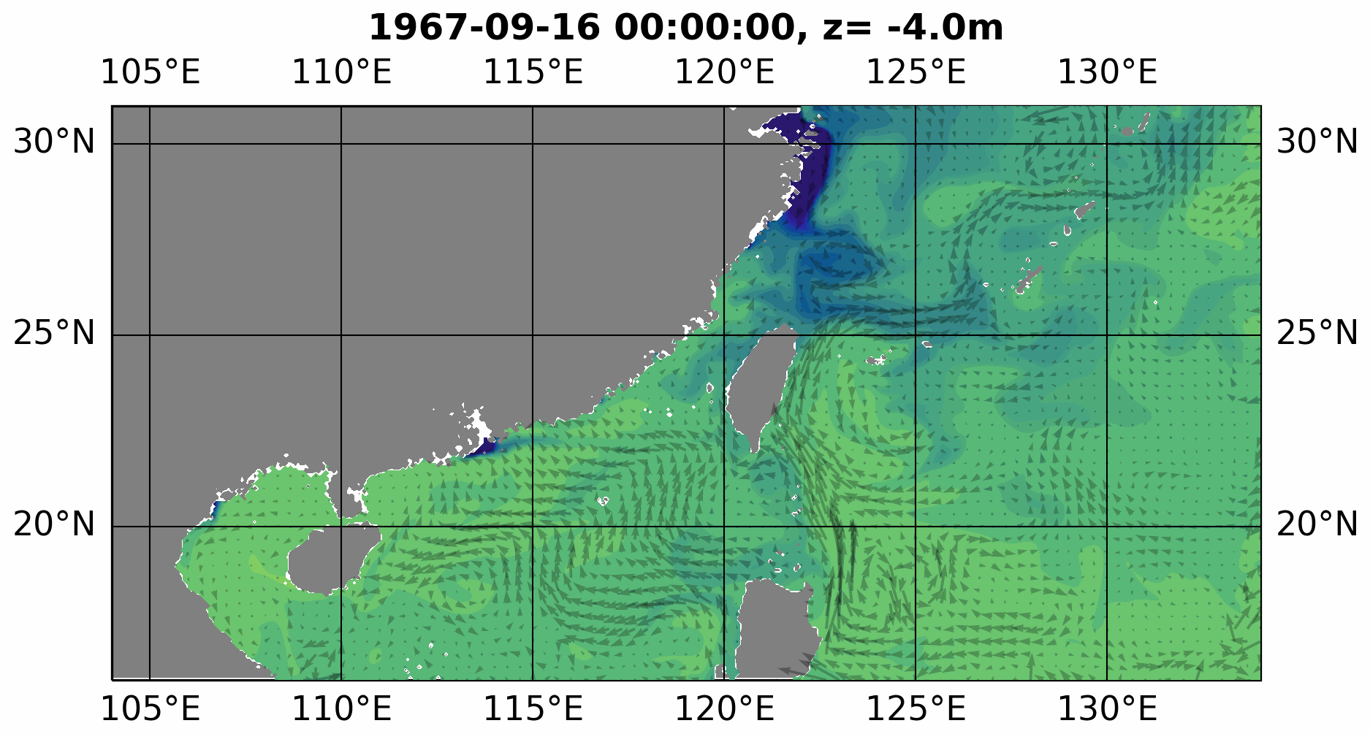
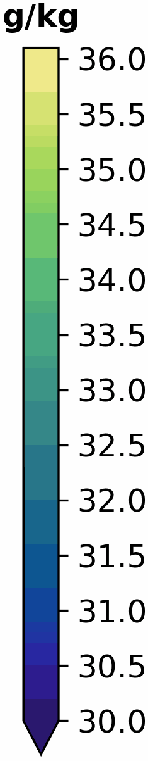
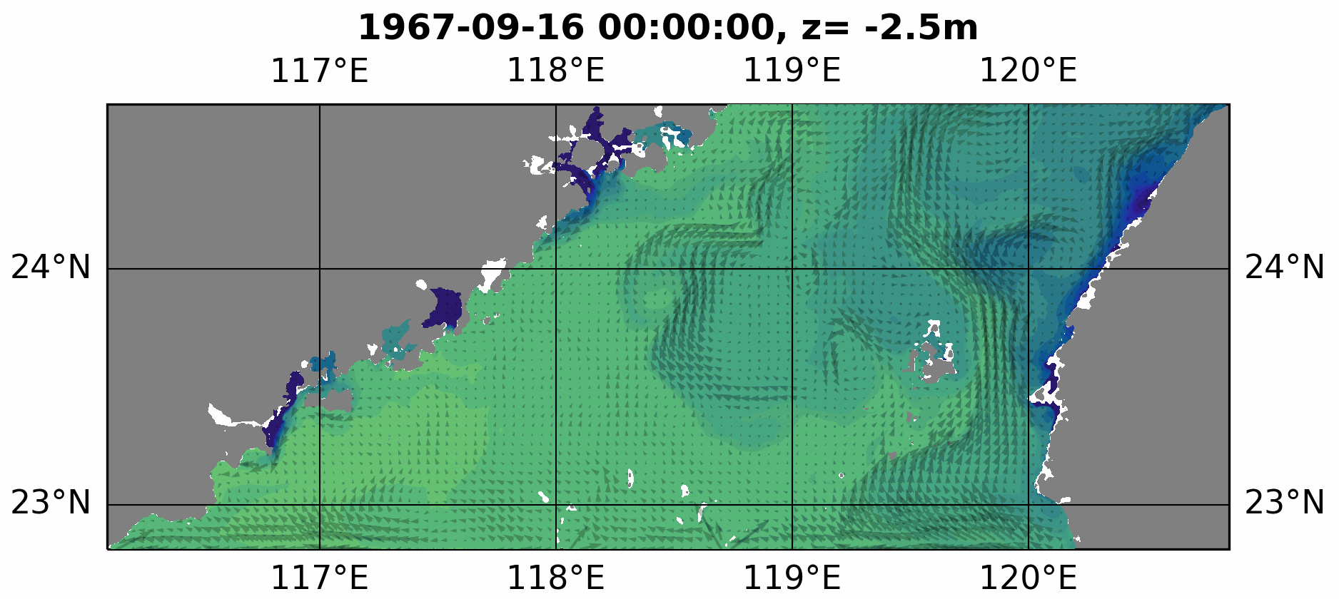
Preliminary results
Example time slice of sea surface salinity and circulation
Notes:
Now I want to show some preliminary results which however only serve as an illustration of how I envision to statistically emphasize the influence of the typhoons on the hydrodynamic conditions, since in my last simulations I unfortunately made a mistake with my atmospheric forcing data, and I am currently not satisfied with my modelled circulation and SST.
So here in these plots you see an example excerpt of the sea surface salinity once for the big model and once for the small model. You can see here atleast the influence of the river discharges and how the freshwater is advected. So the Dongshan Bay lies here. If I now spatially average now the salinity or the sea level around the Dongshan Bay and consider only the typhoon season from May to end of October I get a timeseries of the respective variable for each simulation

Slide 9
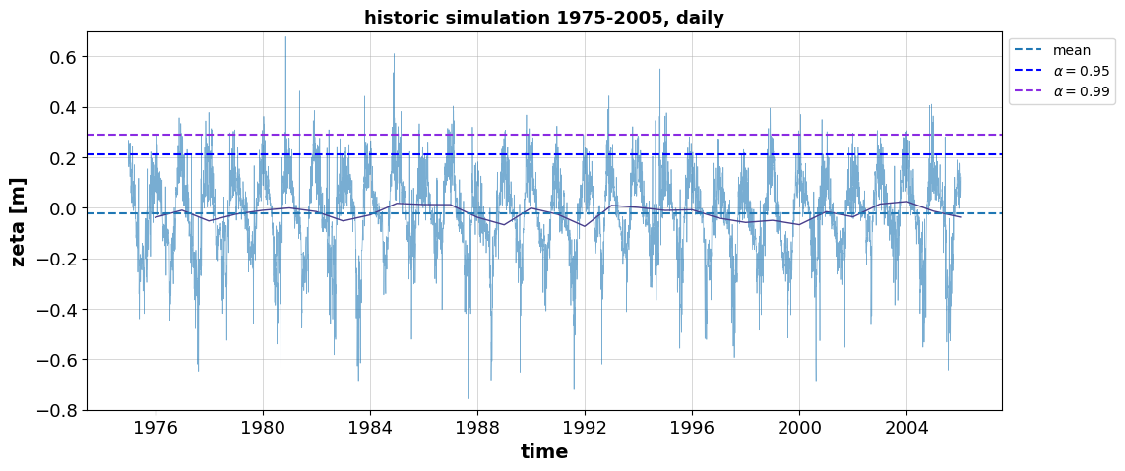
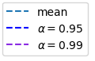
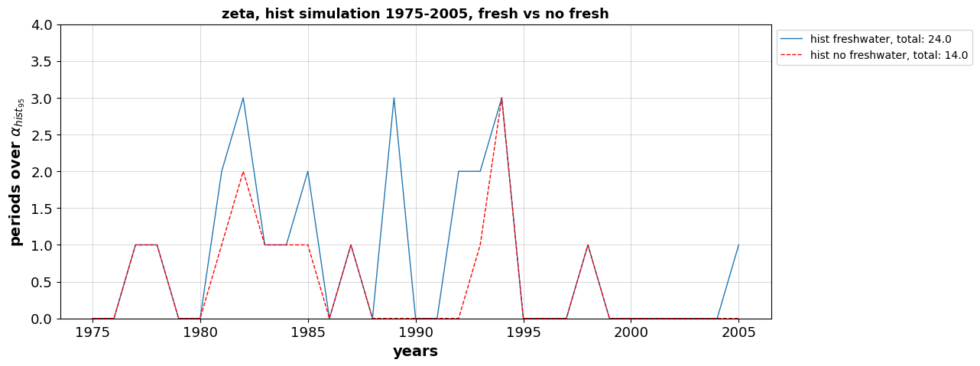

Preliminary results
Calculate 95% or 99% percentile of hist. simulation with freshwater
Used as threshold for all simulations
Only for typhoon season
E.g. extreme high ssh values are associated with typhoons
Calculate indicators for extreme events of high SSH, low salinity
number of times over threshold
total days over threshold
longest period over threshold
Compare statistics from different runs
SSH [m]
SSH
Notes:
Here as an example the 30 years timeseries of zeta is shown for the historic simulation with freshwater input. In order now to access the impact of the typhoon now in this case on the sea surface height zeta, I would calculate the 95% and 99% quantile of that time series but only considering the typhoon season from May to October. These 99% and 95% quantiles of the historic simulation with freshwater input and use it as threshold to calculate different indicators depending on the respective variable which can be related to the influence of typhoons and. Calculating these indicators than for every planned simulation, allows than to compare the different climate scenarios and the freshwater runs with the no freshwater runs. For zeta for example those indicators could be the number of times per typhoon season the 95% quantile for the historic simulation with freshwater is exceeded as shown in these plot, which comparing the freshwater with the no freshwater runs of the historic periods. You can see that even, so I had wrong forcing ine increased freshwater input produces more individual periods where the 95% quantile is exceeded than in the simulations without freshwater input. Other indicators for zeta could be also the total number of days per year over the respective threshold, or longest continuous period of zeta exceeding that threshold. For salinity you could use the same indicators but for values which are below the 5% or 1% quantile. While for zeta it is clear that extreme values are very likely linked to the strong winds by typhoons in the typhoon season, for extreme low salinity values, it must be made sure that you only consider the times where these could be related to typhoon events. With these statistics I hope to evaluate than the effect of the typhoons on sea surface height and salinity and what is the role of freshwater, and if these extreme events will occur more frequently in the future. Since I have 6 runs of 40 year long data, I could also calculate indicators for marine heat waves and see how charactistics of the heat waves will change with different climate scenario.

Slide 10
Any questions?
Other ideas for the future
Look into marine heat waves and how their characteristics change in future
Notes:
Thanks for listening's, Do you have any questions?

