Slide 1
Deep flow behavior and the critical zone in a deep well: A hydrogeological study in Mexico City
Zaida Martínez Casas
Eric Morales Casique
Selene Olea Olea
Jose Luis Lezama Campos
Geology Institute
National Autonomus University of Mexico
Abstract:
April 30, 2025

Slide 2
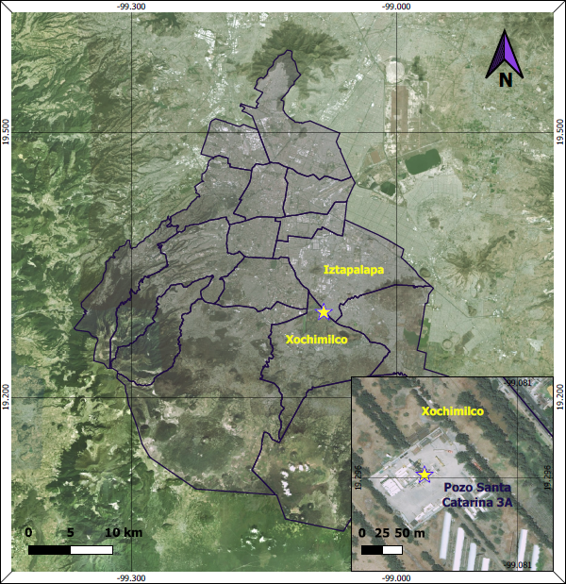
Introduction
For several years now, Mexico City has had a high demand for water due to the continuous growth of the population, which has generate enormous pressure on the hydrogeological system.
1986-1987
2011-2020
Exploratory wells between 2258 and 3200 [m]
Drilled wells between 1570 and 2289 [m]
The Santa Cantarina 3A well was drilled as a directional well with a depth of 1992 [vm].
Map 1. Location of the Santa Catarina 3A well in Mexico City.

Slide 3
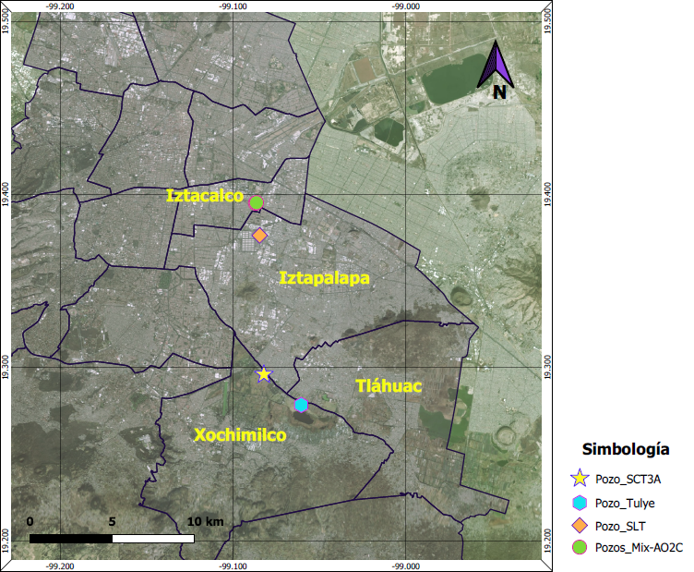
Research questions
Where does the water recharge?
What type or rocks is the water flowing through?
Are the hydaulic parameters of the formation similar in SLT and SCT3A?
Is the residence time of water similar to SLT well wich drill at a similar depth as SCT3A?
Wich family of water do we have at SCT3A?
Map 2. Location of wells drilled prior to Santa Catarina 3A.
Notes:
To propose a local hydrogeological model for the Santa Catarina 3A Well, by analyzing and characterizing the lithology where water is flowing from the formation to the well, as well as the physical and chemical characteristics of the water present in these units.

Slide 4
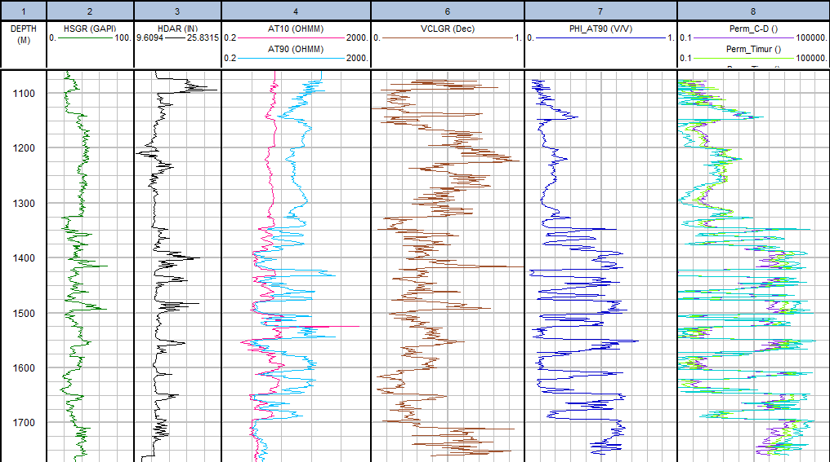
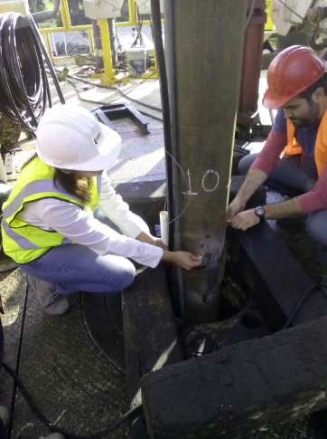
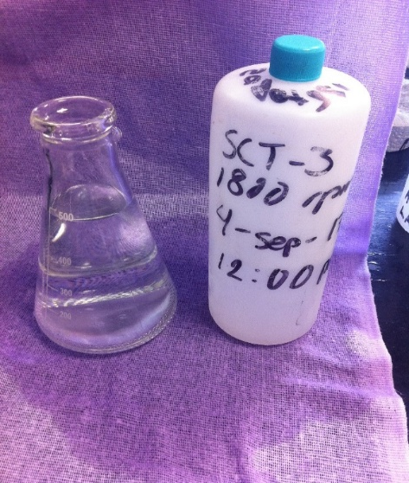
Methodology
Physical characterization
Hydraulic Testing
Hydrogeochemistry and isotopy

Slide 5
Results and conlusions
Physical characterization
Hydraulic Testing
Hydrogeochemistry
Isotopy
Notes:
Well test from September 1 to 4, 2017
2 recoveries and 8 steps
Chloride or- sodium sulfate
Rainwater infiltration
Similar recharge altitude

Slide 6
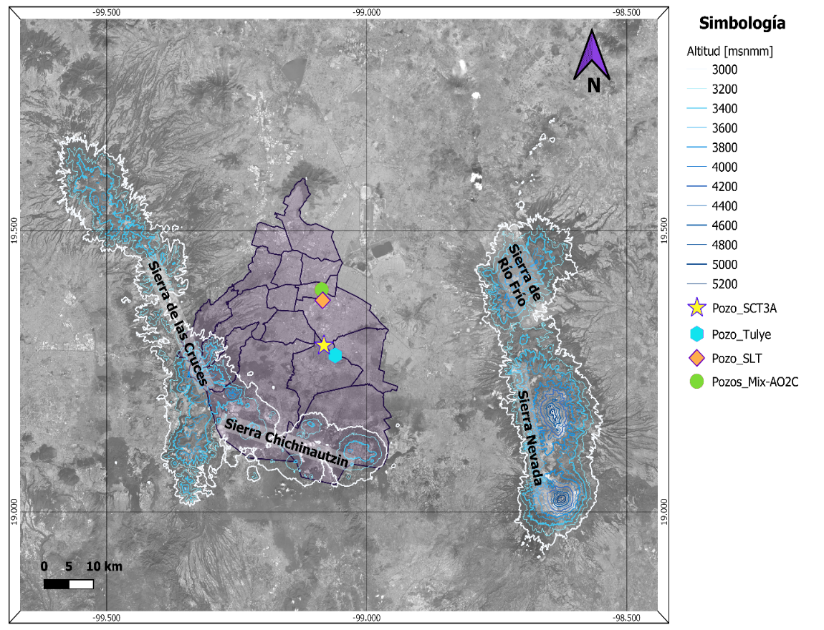
Parameter
 | SC3-MA-07 | SLT
 | 04/sep/2017 12:00 | Jul 16, 2013 8:00 AM
$${{}_{}^{14}C}_{0}$$ | 17.767 | 17.745
$${{}_{}^{14}C}_{CID}$$ | 12.6 | 4.4
t (years) | 2840 | 11528
Eichinger*
Pearson*
$${{}_{}^{14}C}_{0}$$ | 24.253 | 24.626
$${{}_{}^{14}C}_{CID}$$ | 12.6 | 4.4
t (years) | 5413 | 14237
IAEA*
$${{}_{}^{14}C}_{0}$$ | 29.36 | 29.16
$${{}_{}^{14}C}_{DIC}$$ | 12.6 | 4.4
t (years) | 6993 | 15634
CDMX and surrounding mountain ranges with altitudes higher than 3000 [m].
Values used for the calculation of the residence time
* Han & Plummer (2016)
Sample | Elevation [m]
SCT 3a-8a | 3521.1267
SC3MA-07 | 3474.1784
SLT | 2929.5774
Results of the calculation of the elevation of infiltration.
Isotopy Methodology

Slide 7
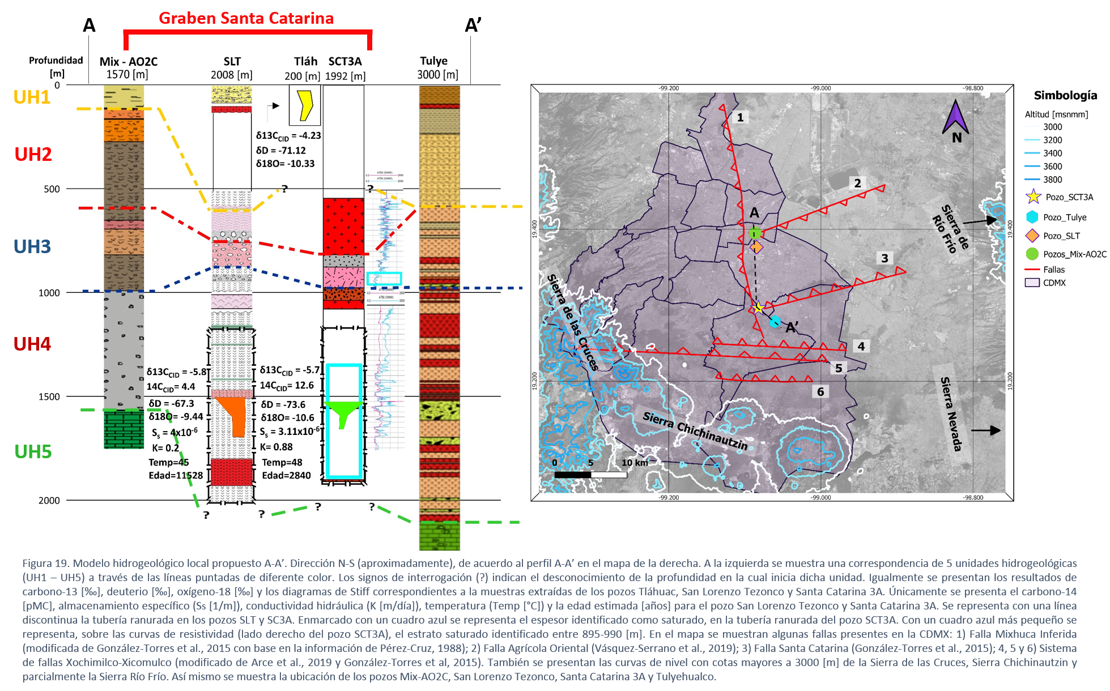
Lacustrine and alluvial deposits
Andesitic-basaltic, dacitic, and some block flows lava deposits
Lahar and ignimbrite deposits
Extrusive igneous rocks and pyroclastic deposits
Limestone
Notes:
After the analysis of the records, they are considered as saturated intervals of 895 to 990 [md] and from 1346 to 1767 [md]; However, the well screen is from 1168.31 [md], so it is presumed that the water being extracted from the well comes from approximately 1346 [md].

Slide 8
Geophysical Logs: Identification of 2 Saturated Zones
895 to 990 [m]
1346 to 1767 [m]
Permeability approximation:
122–13 710 [mD]
Fractured igneous rocks
Average Hydraulic Conductivity:
0.855 [m/day]
Average Specific Storage:
3.11 x 10⁻⁶ [m⁻¹]
Fractured rocks
The similarity to the results of the SLT indicates both saturated formations drilled at the SLT wells (Morales-Casique, 2014) and SCT3A, have similar hydraulic properties
Notes:
Both results have corresponding values with fractured igneous rocks, which leads us to think that the estimation of parameters was carried out adequately.$\overline{K}\overline{S_{s}}$

Slide 9
Stiff SLT ≠ SCT3A Diagram
Different flows
(chloride variation)
SLT Residency Time:
11,528 years
SCT3A Residency Time:
2840 years

Slide 10
Recharge at altitudes higher than 3000 [m] in the surrounding mountain ranges, especially in the Sierra Chichinautzin.
Climatic conditions in the infiltration similar to those of '97
(SCT3A)
Starting value of ¹³C : -26 [‰]
Measured value of ¹³C : -5.7 [‰]
Meteoric line
Increase by contact with limestone rocks (UH5)

Slide 11
The flows at great depths in Mexico City are due to an endorheic behavior dominated by gravity.
It’s very likely that there is hydraulic connectivity UH5 and UH4.
Given the evidence of a saturated layer between UH3 and UH4, hydraulic communication between these strata is not ruled out in some areas of Mexico City.

Slide 12
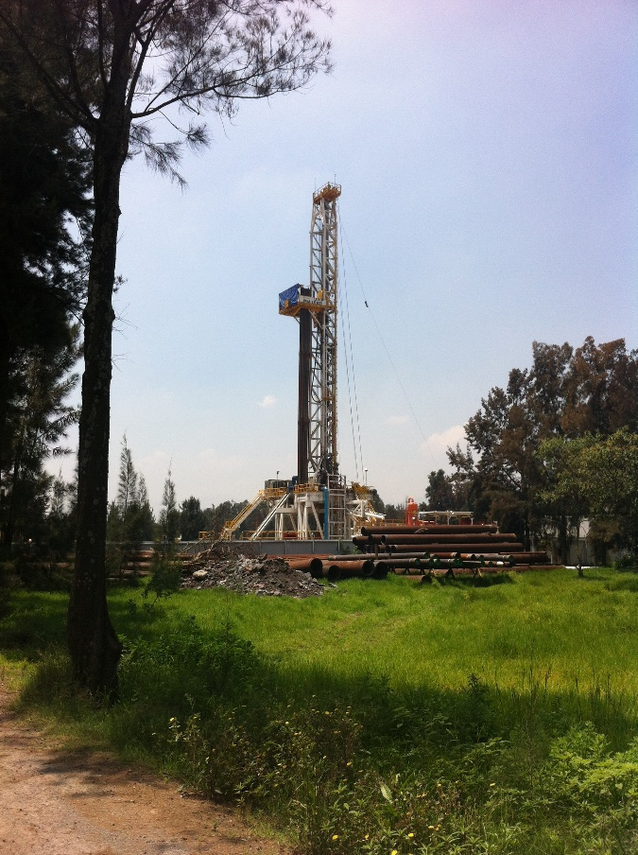
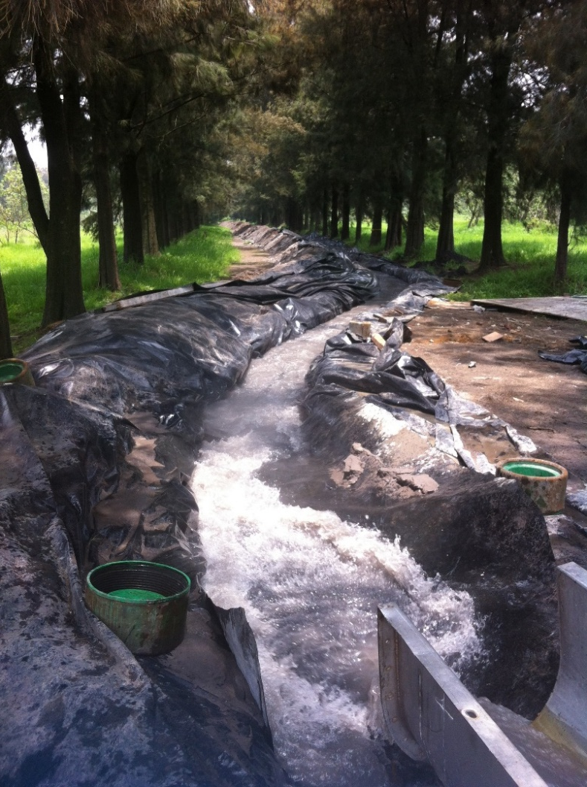
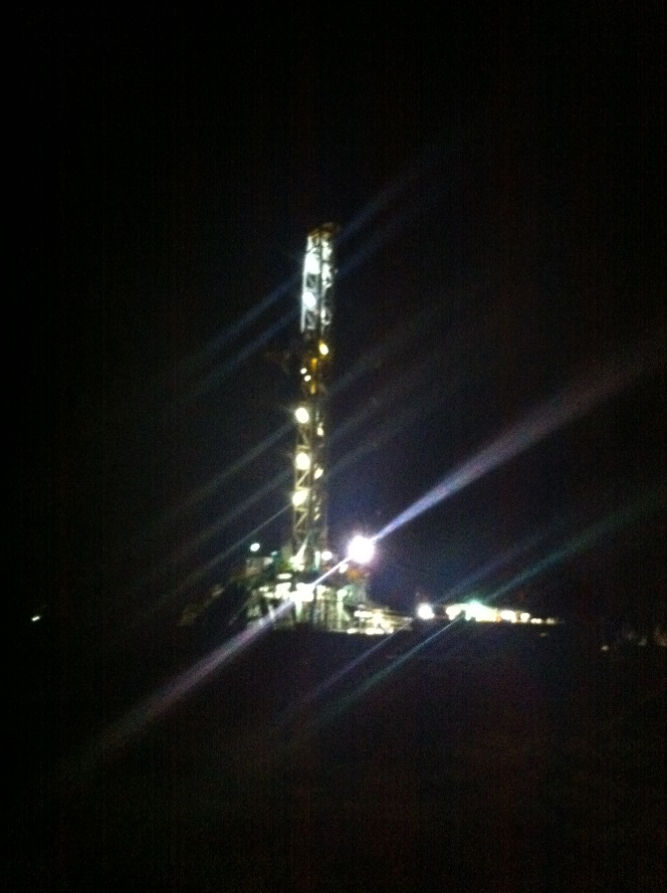
Thanks for your attention!
zaida@geologia.unam.mx

