Slide 1


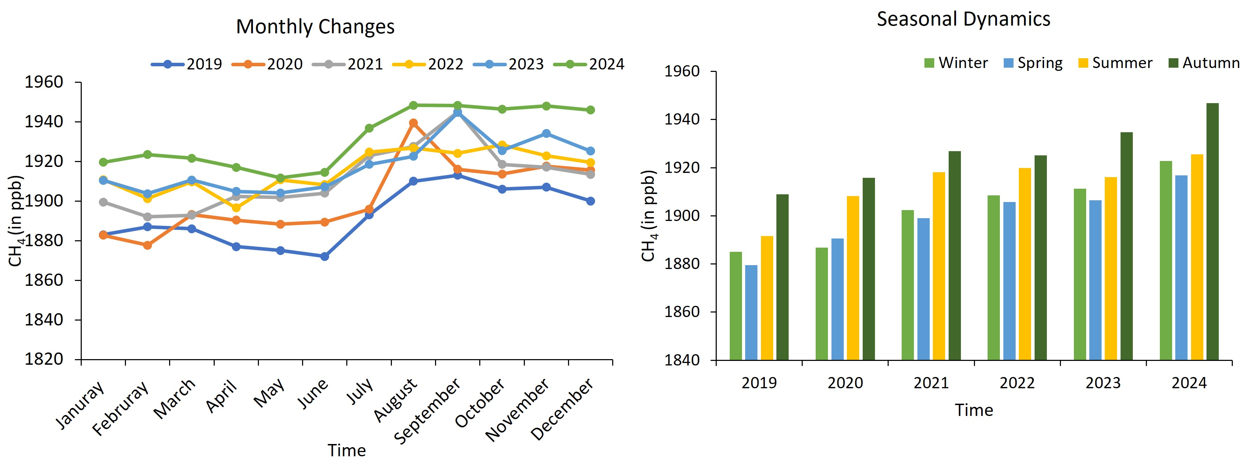
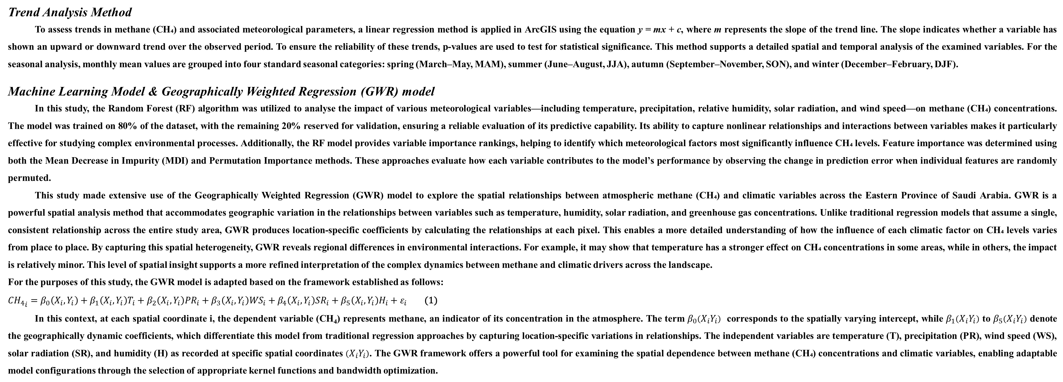
Novel Insights into Atmospheric Methane Variability and Climatic Drivers in Eastern Saudi Arabia Using TROPOMI/Sentinel 5P Observations
Md Masudur Rahman^{1*} Roman Shults¹, Rajendran Sankaran², Arfan Arshad³ and Hatem Keshk¹
¹ Interdisciplinary Research Center for Aviation and Space Exploration (IRC-ASE), King Fahd University of Petroleum & Minerals, 31261 Dhahran, KSA
² Environmental Science Center, Qatar University, 2713 Doha, Qatar
³ Department of Biosystems and Agricultural Engineering, Oklahoma State University, Stillwater, 74078 Oklahoma, USA
Correspondence: mdmasudur.rahman@kfupm.edu.sa
Abstract
Methane (CH₄) is a critical atmospheric trace gas and a potent greenhouse gas contributing to global warming, yet its relationship with climate variables remains underexplored, particularly in eastern Saudi Arabia, which hosts over 70% of the country’s oil fields. This study presents the first comprehensive evaluation of the spatiotemporal variability of CH₄ and its climatic drivers in eastern Saudi Arabia, using novel TROPOMI (Tropospheric Monitoring Instrument)/Sentinel-5P data and innovative approaches applied over the period from 2019 to 2024. Google Earth Engine (GEE)-based analysis shows significant annual and seasonal changes, with CH₄ concentrations increasing from 1892 ppb to 1927 ppb. Seasonal patterns show maximum concentrations in summer and autumn and minimum concentrations in winter and spring. ArcGIS-based spatial trend analysis indicates an area-averaged increase of 5.61 ppb per year across the majority of the examined regions. Geographically Weighted Regression (GWR) modelling is adopted to understand the spatial-scale connections between CH₄ and climate variables. The results, with a model fit R² of 0.85, reveal that CH₄ is negatively correlated with temperature, solar radiation, and precipitation, but positively correlated with humidity and wind speed. For instance, in 2023, the mean correlation coefficient between CH₄ and temperature was -3.89, indicating that CH₄ concentrations decreased by 3.89 ppb across most of the studied areas per year for each unit increase in temperature. This decrease may be attributed to accelerated oxidative processes at higher temperatures, as the eastern region of Saudi Arabia is known for its consistently high temperatures. To assess the degree of importance of these connections, the Random Forest model is employed, outperforming statistical models with an R² of 0.79 and an RMSE of 2.93 ppb. The findings highlight that temperature and incoming solar radiation have the highest importance, followed by humidity, wind speed, and precipitation, in driving CH₄ variability. These results provide valuable insights to guide future research efforts across the Middle East and support policymakers in developing effective strategies for monitoring and managing atmospheric methane.
Results & Discussion
Monthly Changes in CH₄ over Eastern KSA
As illustrated in Fig. 2, monthly variations in methane concentrations from 2019 to 2024 reveal clear seasonal patterns. Methane levels show periodic fluctuations, with notable peaks between July and October, likely driven by increased biogenic emissions and seasonal shifts in atmospheric transport mechanisms. In contrast, the lowest concentrations typically occur during winter, which may be linked to diminished microbial activity and reduced natural emissions during colder months. Over the years, methane levels have shown a consistent upward trend, with 2024 recording the highest concentrations across the study period. This increase correlates with expanding anthropogenic activities, particularly from oil and gas operations, which are major contributors to methane emissions in Eastern Saudi Arabia. Similar seasonal trends have been reported in previous studies across the Arabian Peninsula, highlighting the strong influence of both regional climate conditions and emission sources on methane behaviour.
Spatial Trend Analysis of CH₄
Fig. 3 showcases the spatial distribution of methane (CH₄) trends alongside their statistical significance, providing a detailed view of how CH₄ concentrations have evolved over time across the region. In the left panel (Fig. 3a), the annual rate of change in CH₄ (measured in ppb/year) is visualized using a color scale, where blue tones indicate declining trends and red shades represent rising trends. A predominant upward trend is evident across most of the study area, particularly in the northern and western zones, with an average increase of 5.61 ppb/year and maximum values nearing 20.73 ppb/year. However, a few localized spots show decreasing trends. The right panel (Fig. 3b) maps the p-values associated with the trend analysis to assess statistical reliability. Deep blue regions, which dominate the map, correspond to low p-values, indicating that the observed changes are statistically significant. Conversely, yellow to red areas mark higher p-values, pointing to locations where the trends are less conclusive or statistically weak.
Materials & Methods
Study Area
The Eastern Province (Ash Sharqiyah) is the largest administrative region in Saudi Arabia, spanning approximately 672,522 square kilometres, as illustrated in Fig. 1. Situated along the Arabian (Persian) Gulf, its strategic position makes it a vital player in the global energy sector. It shares borders with Iraq and Kuwait to the north, and Oman and the United Arab Emirates to the south. The province encompasses a variety of landscapes, from coastal plains and arid deserts to heavily industrialized zones, making it a key area for studies in economics, energy, and the environment. This region is home to some of the world's most significant oil fields, such as Ghawar, Abqaiq, Shaybah, and Khurais, which are critical to global energy supply. Saudi Aramco, the national oil company, oversees the exploration, refining, and petrochemical processing across this area. The climate is extremely hot and arid, with summer temperatures often exceeding 50°C, while winter lows can drop to around 10°C. Annual rainfall is minimal, typically under 100 mm, and humidity levels vary greatly between the coast and interior. Desert winds frequently occur, influencing both weather patterns and emissions from oil and gas operations. Topographically, the region ranges from sea level along the coast to around 300 meters above sea level inland. As the country’s primary hydrocarbon production canter, the Eastern Province is a major contributor to atmospheric methane emissions, making it a key focus for research on methane dynamics and climate interactions.
TROPOMI/Sentinel-5P Data
This research employs column-averaged dry-air methane concentrations (CH₄, in ppb) derived from the TROPOspheric Monitoring Instrument (TROPOMI) aboard the Sentinel-5 Precursor (Sentinel-5P) satellite to examine methane fluctuations and their environmental influences over the period 2019 to 2024. Launched in 2017, Sentinel-5P delivers continuous, high-resolution methane measurements, significantly contributing to both atmospheric monitoring and climate science efforts. The CH₄ data are acquired and processed using the Google Earth Engine (GEE) platform, enabling efficient large-scale methane assessments and integration with complementary climate datasets. Methane values are derived from near-infrared (NIR) and shortwave infrared (SWIR) bands using an advanced spectral fitting algorithm, which ensures sensitivity to emissions from both the troposphere and surface sources. The retrieval method demonstrates a bias of 1.5% and a random error margin of 1%, with data provided at a spatial resolution of 1113.2 meters per pixel. To support the methane analysis, the study incorporates meteorological data from the Famine Early Warning Systems Network (FEWS NET) Land Data Assimilation System (FLDAS). These include variables such as air temperature, precipitation, relative humidity, net shortwave radiation, and wind speed, which offer important context for understanding the atmospheric conditions influencing methane behaviour. Methane emissions in the region stem from diverse sources, including natural wetlands, fossil fuel activities, biomass burning, and agriculture. The integration of satellite-based CH₄ observations with environmental variables enables a comprehensive analysis of both spatial and temporal methane patterns, shedding light on the climatic factors driving methane dynamics within the study area.
Fig. 2 The monthly changes in CH₄ (left panel) and the seasonal trends of it (right panel).
Fig. 3 The spatial trend of CH₄ (left panel) and
respective p-values (right panel).
Predicting CH₄ Using RF model
Table 1 summarizes the performance of the Random Forest (RF) model in predicting methane (CH₄) concentrations using climatic variables over the period 2019 to 2024. The Root Mean Squared Error (RMSE) ranges from around 2.2 to 3.99, reflecting yearly differences in prediction accuracy. The lowest RMSE values are recorded in 2024 (2.2085) and 2022 (2.2355), suggesting higher precision in those years. The Mean Absolute Error (MAE) shows a similar pattern, with minimum values also occurring in 2022 and 2024, further supporting the model's reliability in estimating CH₄ levels. The coefficient of determination (R²) remains relatively stable across the study period, varying between 0.71 and 0.85, with an average of 0.79. This indicates that the RF model performs well in explaining the relationship between methane concentrations and meteorological factors throughout the region and timeframe.
Table 1. Random Forest model performance for CH₄ prediction (2019–2024) based on climate variables, showing RMSE, MAE, and R² values.
Metrics | 2019 | 2020 | 2021 | 2022 | 2023 | 2024 | Overall
RMSE | 2.91 | 3.99 | 3.878 | 2.23 | 2.37 | 2.20 | 2.93
MAE | 2.124 | 2.587 | 2.822 | 1.62 | 1.79 | 1.72 | 2.11
R² | 0.76 | 0.71 | 0.81 | 0.80 | 0.80 | 0.85 | 0.79
Fig. 1. The geographical location of the study area
Trend Analysis Method
To assess trends in methane (CH₄) and associated meteorological parameters, a linear regression method is applied in ArcGIS using the equation y = mx + c, where m represents the slope of the trend line. The slope indicates whether a variable has shown an upward or downward trend over the observed period. To ensure the reliability of these trends, p-values are used to test for statistical significance. This method supports a detailed spatial and temporal analysis of the examined variables. For the seasonal analysis, monthly mean values are grouped into four standard seasonal categories: spring (March–May, MAM), summer (June–August, JJA), autumn (September–November, SON), and winter (December–February, DJF).
Machine Learning Model & Geographically Weighted Regression (GWR) model
In this study, the Random Forest (RF) algorithm was utilized to analyse the impact of various meteorological variables—including temperature, precipitation, relative humidity, solar radiation, and wind speed—on methane (CH₄) concentrations. The model was trained on 80% of the dataset, with the remaining 20% reserved for validation, ensuring a reliable evaluation of its predictive capability. Its ability to capture nonlinear relationships and interactions between variables makes it particularly effective for studying complex environmental processes. Additionally, the RF model provides variable importance rankings, helping to identify which meteorological factors most significantly influence CH₄ levels. Feature importance was determined using both the Mean Decrease in Impurity (MDI) and Permutation Importance methods. These approaches evaluate how each variable contributes to the model’s performance by observing the change in prediction error when individual features are randomly permuted.
This study made extensive use of the Geographically Weighted Regression (GWR) model to explore the spatial relationships between atmospheric methane (CH₄) and climatic variables across the Eastern Province of Saudi Arabia. GWR is a powerful spatial analysis method that accommodates geographic variation in the relationships between variables such as temperature, humidity, solar radiation, and greenhouse gas concentrations. Unlike traditional regression models that assume a single, consistent relationship across the entire study area, GWR produces location-specific coefficients by calculating the relationships at each pixel. This enables a more detailed understanding of how the influence of each climatic factor on CH₄ levels varies from place to place. By capturing this spatial heterogeneity, GWR reveals regional differences in environmental interactions. For example, it may show that temperature has a stronger effect on CH₄ concentrations in some areas, while in others, the impact is relatively minor. This level of spatial insight supports a more refined interpretation of the complex dynamics between methane and climatic drivers across the landscape.
For the purposes of this study, the GWR model is adapted based on the framework established as follows:
${{CH}_{4}}_{i}=β_{0}\left(X_{i},Y_{i}\right)+β_{1}\left(X_{i},Y_{i}\right)T_{i}+β_{2}\left(X_{i},Y_{i}\right){PR}_{i}+β_{3}\left(X_{i},Y_{i}\right){WS}_{i}+β_{4}\left(X_{i},Y_{i}\right){SR}_{i}+β_{5}\left(X_{i},Y_{i}\right)H_{i}+ε_{i}$ (1)
In this context, at each spatial coordinate i, the dependent variable (CH₄) represents methane, an indicator of its concentration in the atmosphere. The term $β_{0}\left(X_{i}Y_{i}\right)$ corresponds to the spatially varying intercept, while $β_{1}\left(X_{i}Y_{i}\right)$ to $β_{5}\left(X_{i}Y_{i}\right)$ denote the geographically dynamic coefficients, which differentiate this model from traditional regression approaches by capturing location-specific variations in relationships. The independent variables are temperature (T), precipitation (PR), wind speed (WS), solar radiation (SR), and humidity (H) as recorded at specific spatial coordinates $\left(X_{i}Y_{i}\right)$. The GWR framework offers a powerful tool for examining the spatial dependence between methane (CH₄) concentrations and climatic variables, enabling adaptable model configurations through the selection of appropriate kernel functions and bandwidth optimization.
Influences of Climate Variables on CH₄
Fig. 4 illustrates the spatial relationships between CH₄ concentrations and five key climatic variables air temperature, precipitation, relative humidity, wind speed, and solar radiation based on data from the year 2023. The results reveal noticeable spatial heterogeneity in CH₄ responses to each driver. CH₄ shows a predominantly negative correlation with air temperature and solar radiation, particularly in southern and central areas, which may be attributed to enhanced methane oxidation rates or atmospheric dispersion under warmer and sunnier conditions. In contrast, humidity and wind speed exhibit positive associations in many northern zones, possibly due to favourable conditions for microbial methane production or the redistribution of CH₄ from nearby emission sources by wind. Precipitation demonstrates a mixed influence, reflecting the complexity of rainfall-driven wetland emissions and post-precipitation soil processes. These patterns emphasize that even within a single year, climate drivers impact CH₄ differently across space, influenced by local environmental settings and emission dynamics.
Fig. 4 Spatial relationships between CH₄ concentrations and climatic drivers for 2023: (a) air temperature, (b) precipitation, (c) humidity, (d) wind speed, and (e) solar radiation. The maps highlight the spatially varying influence of each variable on methane levels across the study area.
Conclusions and Future Works
This study provides the first comprehensive analysis of atmospheric methane (CH₄) variability and its climatic drivers across the Eastern Province of Saudi Arabia using TROPOMI/Sentinel-5P data from 2019 to 2024. Seasonal and annual analyses revealed a clear upward trend in CH₄ concentrations, with higher levels observed in summer and autumn. Spatial regression using GWR for 2023 demonstrated distinct localized influences of climate variables, showing negative associations with temperature and solar radiation, and positive links with humidity and wind speed. The Random Forest model further confirmed the significance of these drivers, with strong predictive performance (R² = 0.79) and high importance scores for temperature and solar radiation.
Future work should expand the GWR modelling across all years (2019–2024) to capture interannual shifts in spatial relationships and better understand long-term patterns. Additionally, mapping the spatial distribution of predicted CH₄ values from machine learning models could help validate observed trends and uncover emission hotspots. Integrating land use and emission inventory data would further enhance the understanding of methane dynamics in this critical hydrocarbon-producing region.
Acknowledgments
The authors would like to acknowledge the valuable intellectual support provided by the Interdisciplinary Research Center for Aviation and Space Exploration (IRC-ASE) at King Fahd University of Petroleum & Minerals (KFUPM). This work was carried out by the first author as part of his postdoctoral research at IRC-ASE. The Deanship of Research (DR) of KFUPM generously funded his participation in the EGU 2025 General Assembly, for which the authors are sincerely grateful.

