Slide 1


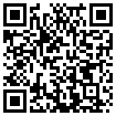

How variable are gravity wave spectral energies? Insights from a seven-year lidar climatology at 69$°$N
Mohamed Mossad, Irina Strelnikova, Robin Wing, Gerd Baumgarten, Michael Gerding, Jens Fiedler, and Yanmichel Morfa-Avalos
Leibniz Institute of Atmospheric Physics, Kühlungsborn, Germany DFG project TRR181
EGU General Assembly, Vienna 30/04/2025
OSPP code

Slide 2
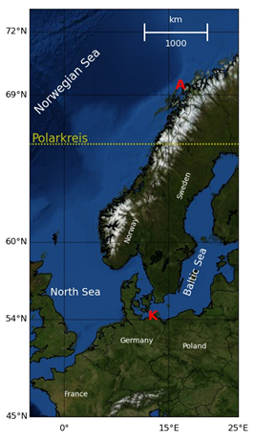
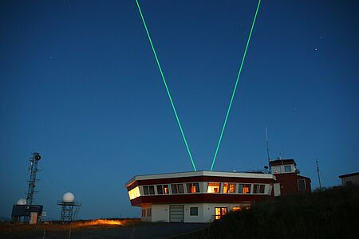
Why are our observations unique?
High resolution: 5 min and 150 m
Altitude range: 35-60 km
7 years (2023-2017) of long simultaneous horizontal wind and temperature measurements >12 h (daylight capable lidar)
Observed frequency and vertical wavenumber spectra.
OSPP code
Arctic Lidar Observatory for Middle Atmosphere
Research (ALOMAR)
@Gerd Baumgarten

Slide 3
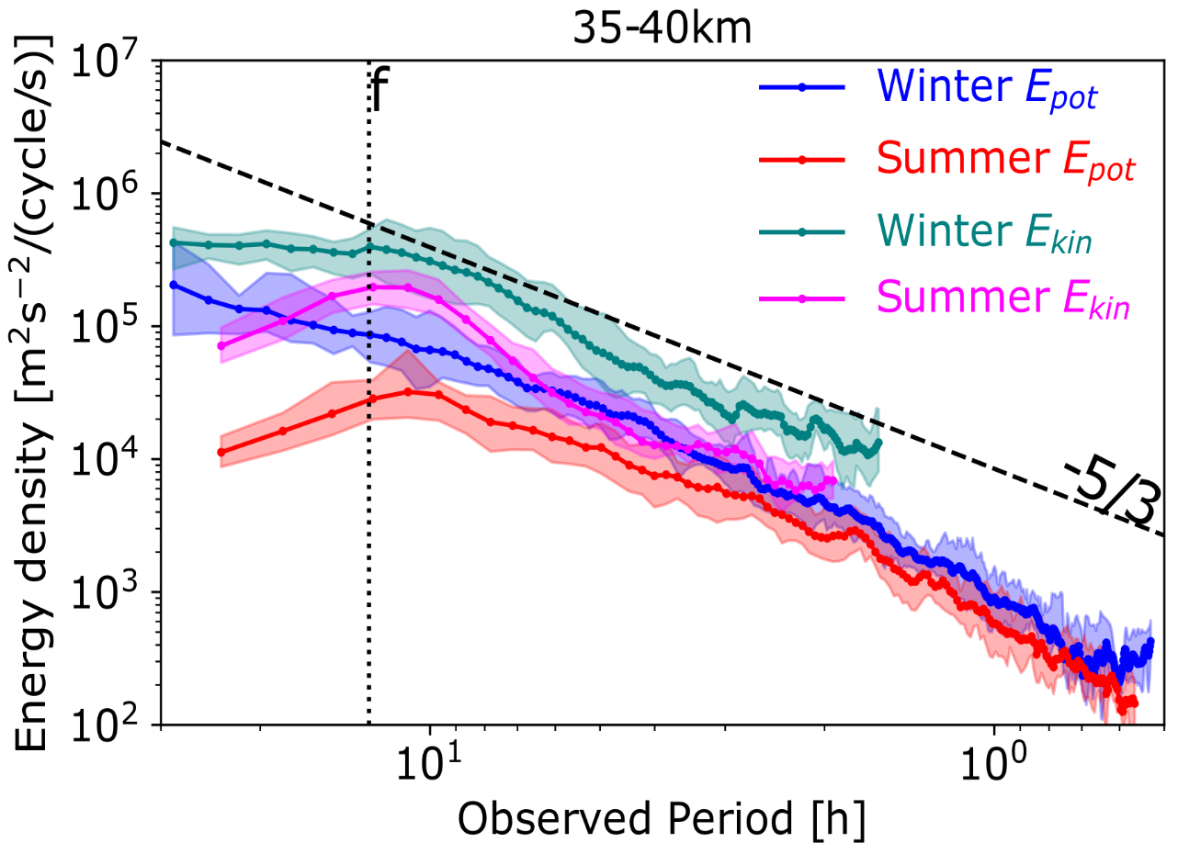
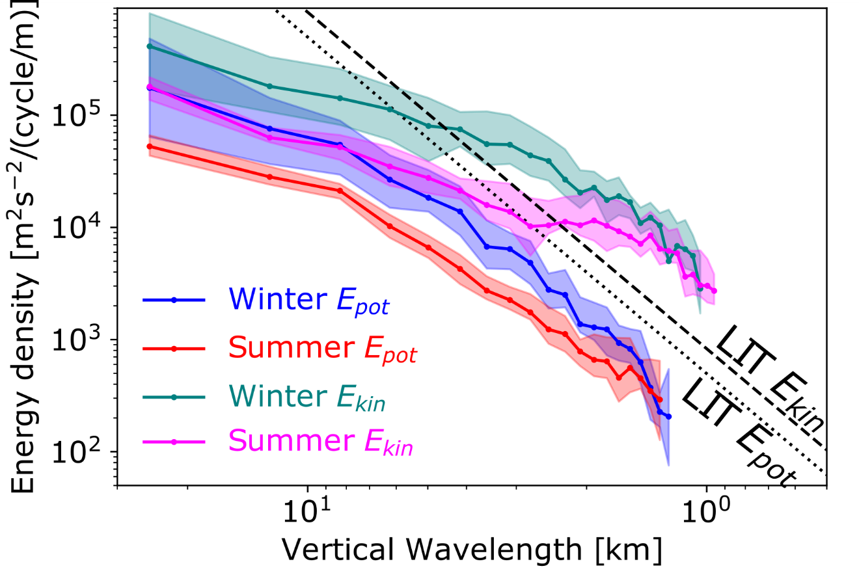
Observed spectra
Temporal
Vertical
OSPP code
35-60 km

Slide 4
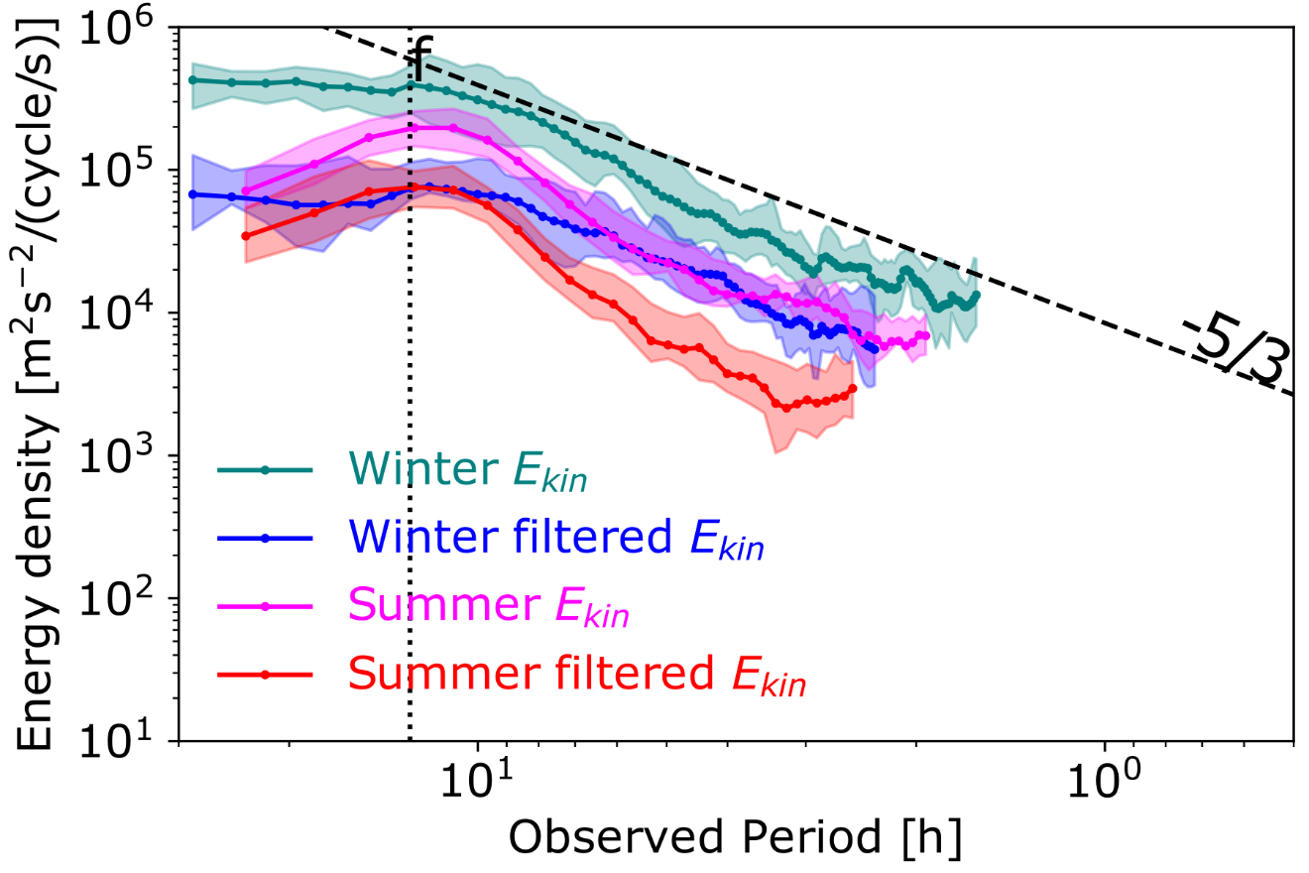
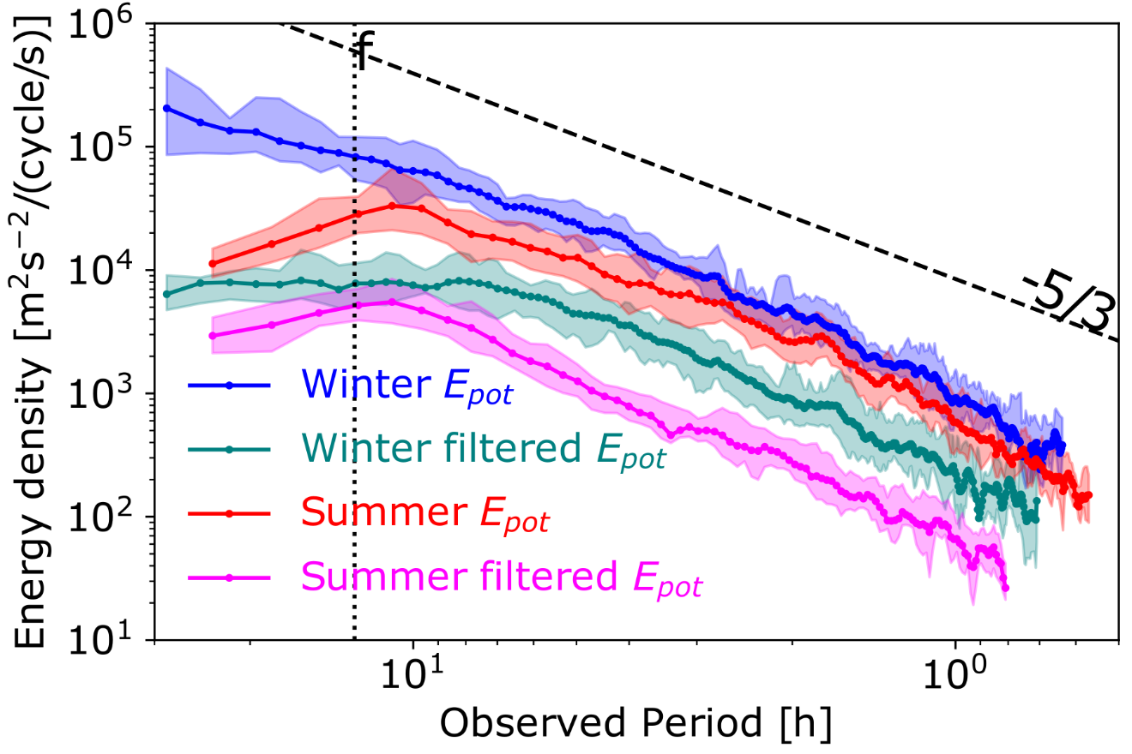
Observed frequency spectra:
Bandpass-filtered data [1-3 km]
OSPP code
Kinetic
Potential

Slide 5
Thank you
Presenter: Mohamed Mossad Email: mossad@iap-kborn.de
OSPP code

