Slide 1
Learning from the European Experiences: Representativity on a Global Level
EGU 2025, Vienna, 28.04.2025
Thomas Ohnemus & Michael Mirtl
Thomas.Ohnemus@ufz.de

Slide 2
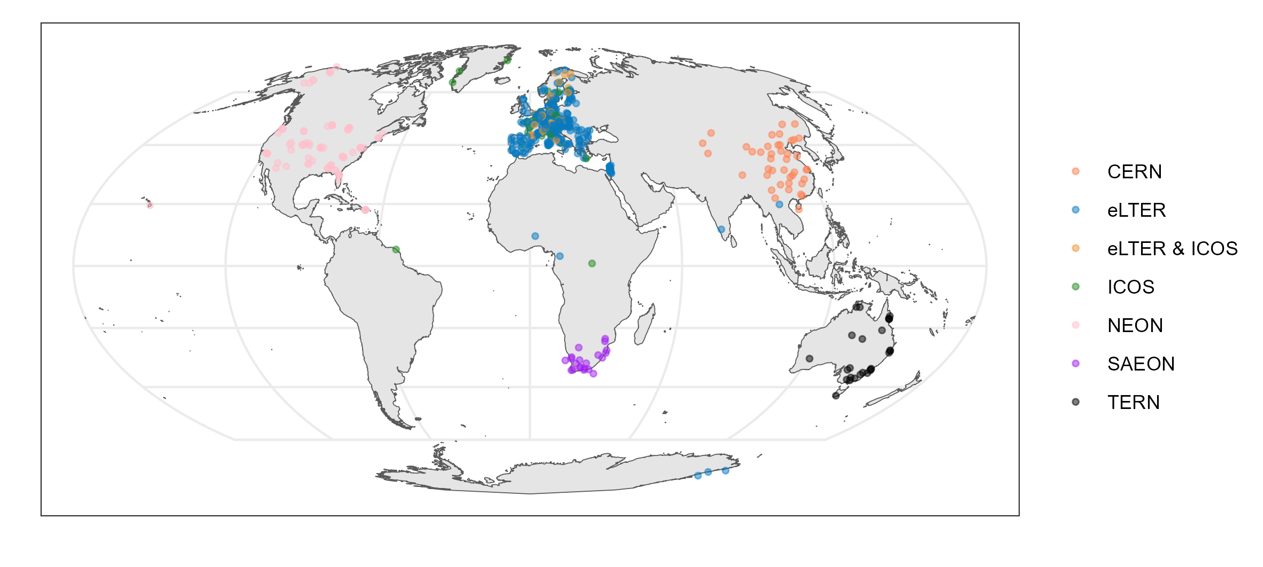
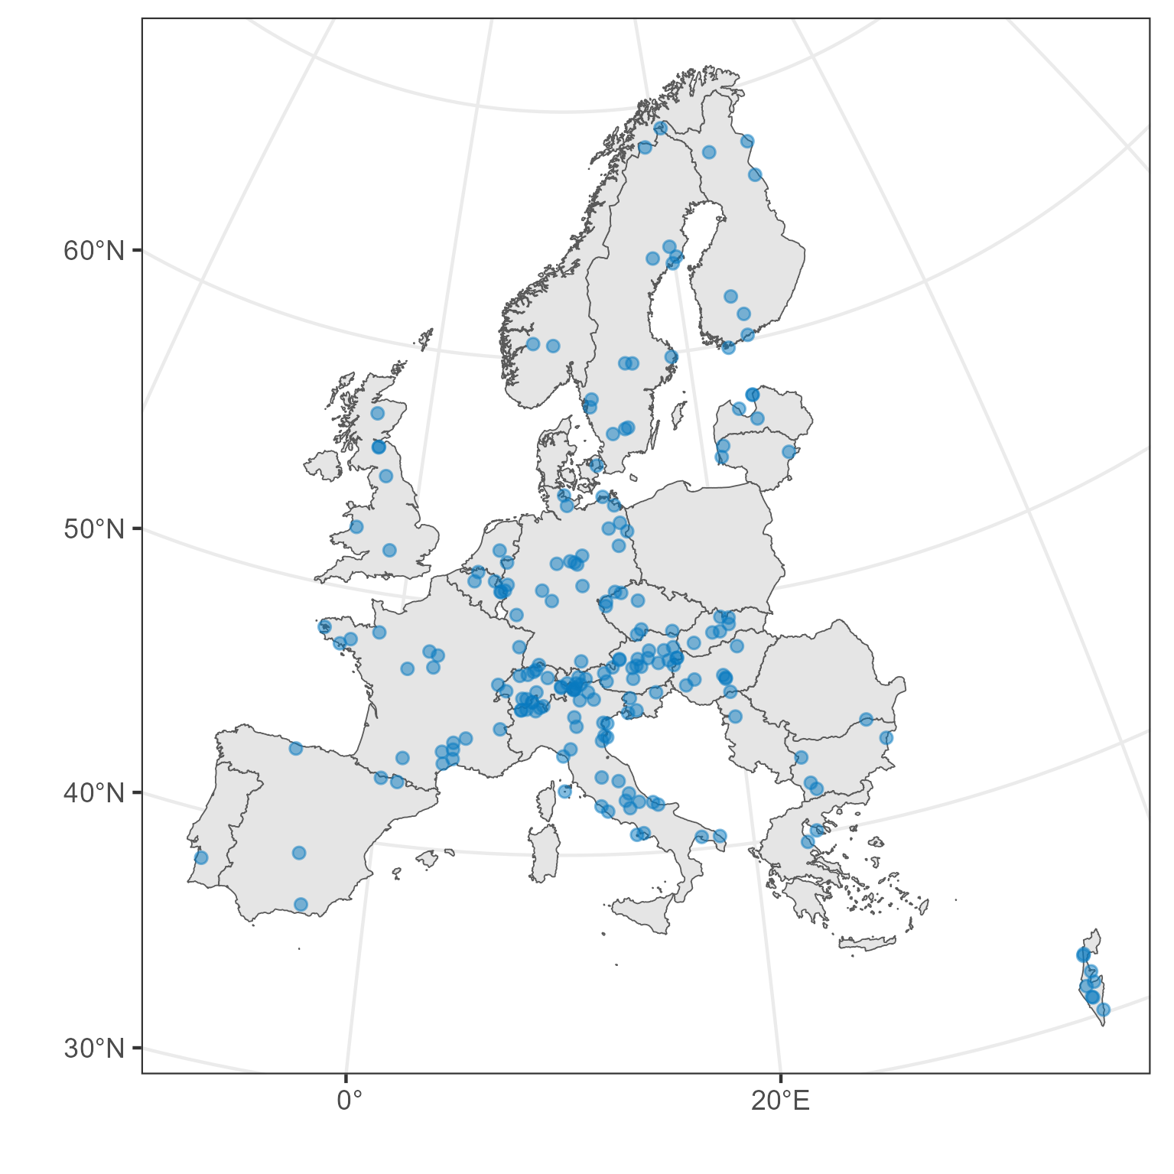
GERI consists of six Partner Research Infrastructures

Slide 3
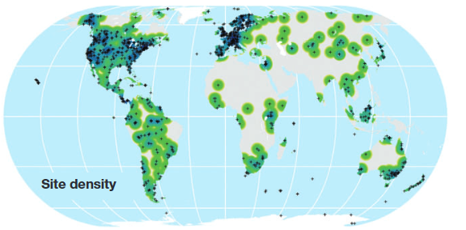
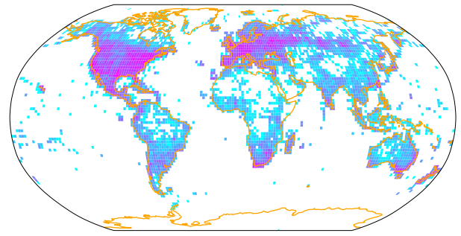
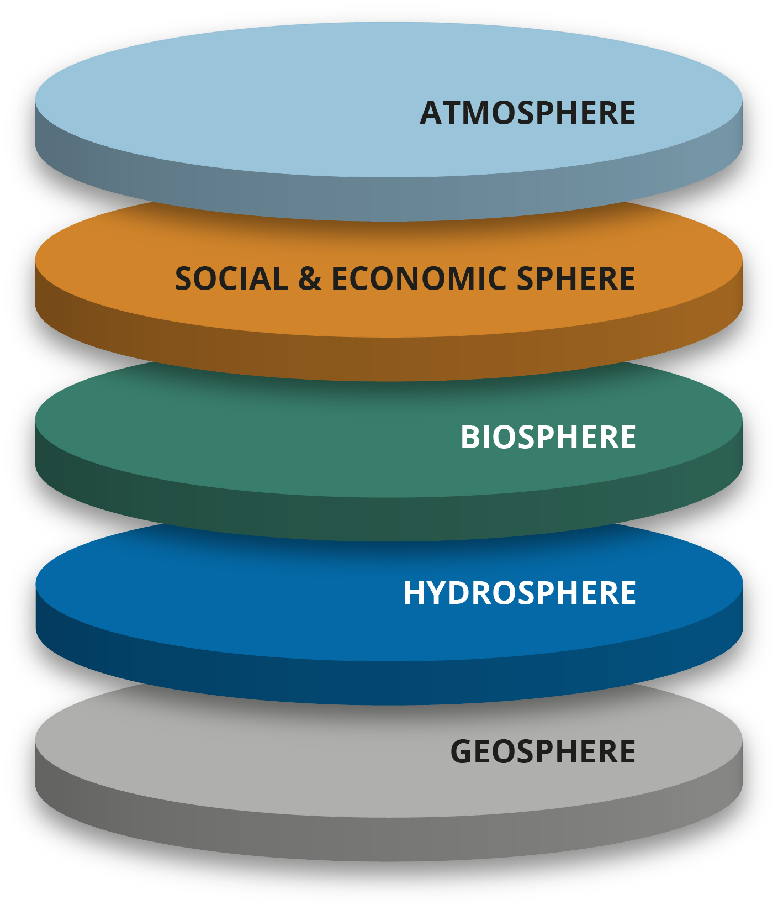
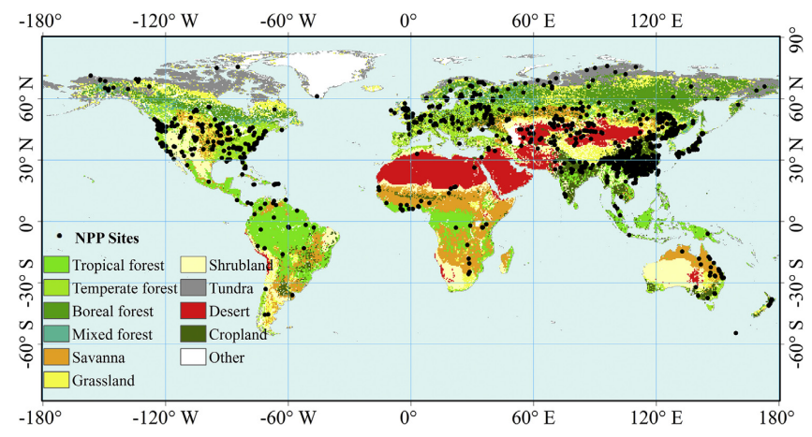
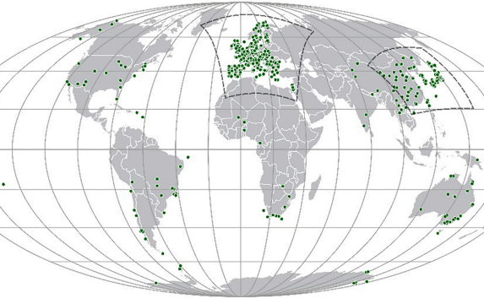
How can in-situ data be scaled to continental level?
Standardisation
Representation
Martin et al. 2012
Wolf et al. 2022
Whole-systems approach with Standard Observations
Mirtl et al. 2021, Zacharias et al. 2021
Li et al. 2017
Wohner et al. (2021)

Slide 4
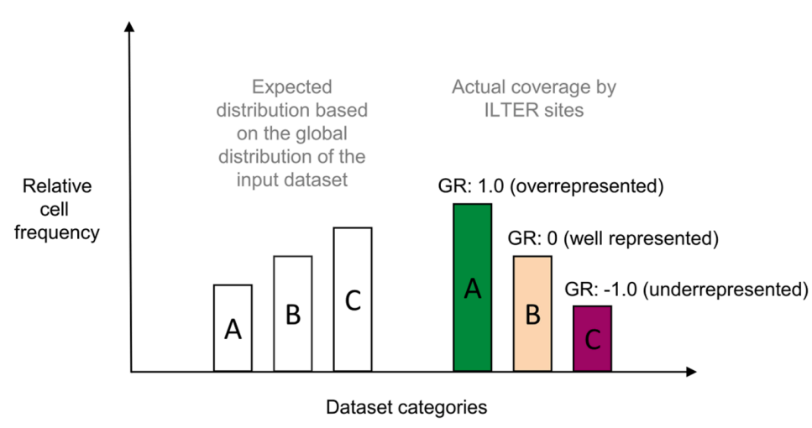
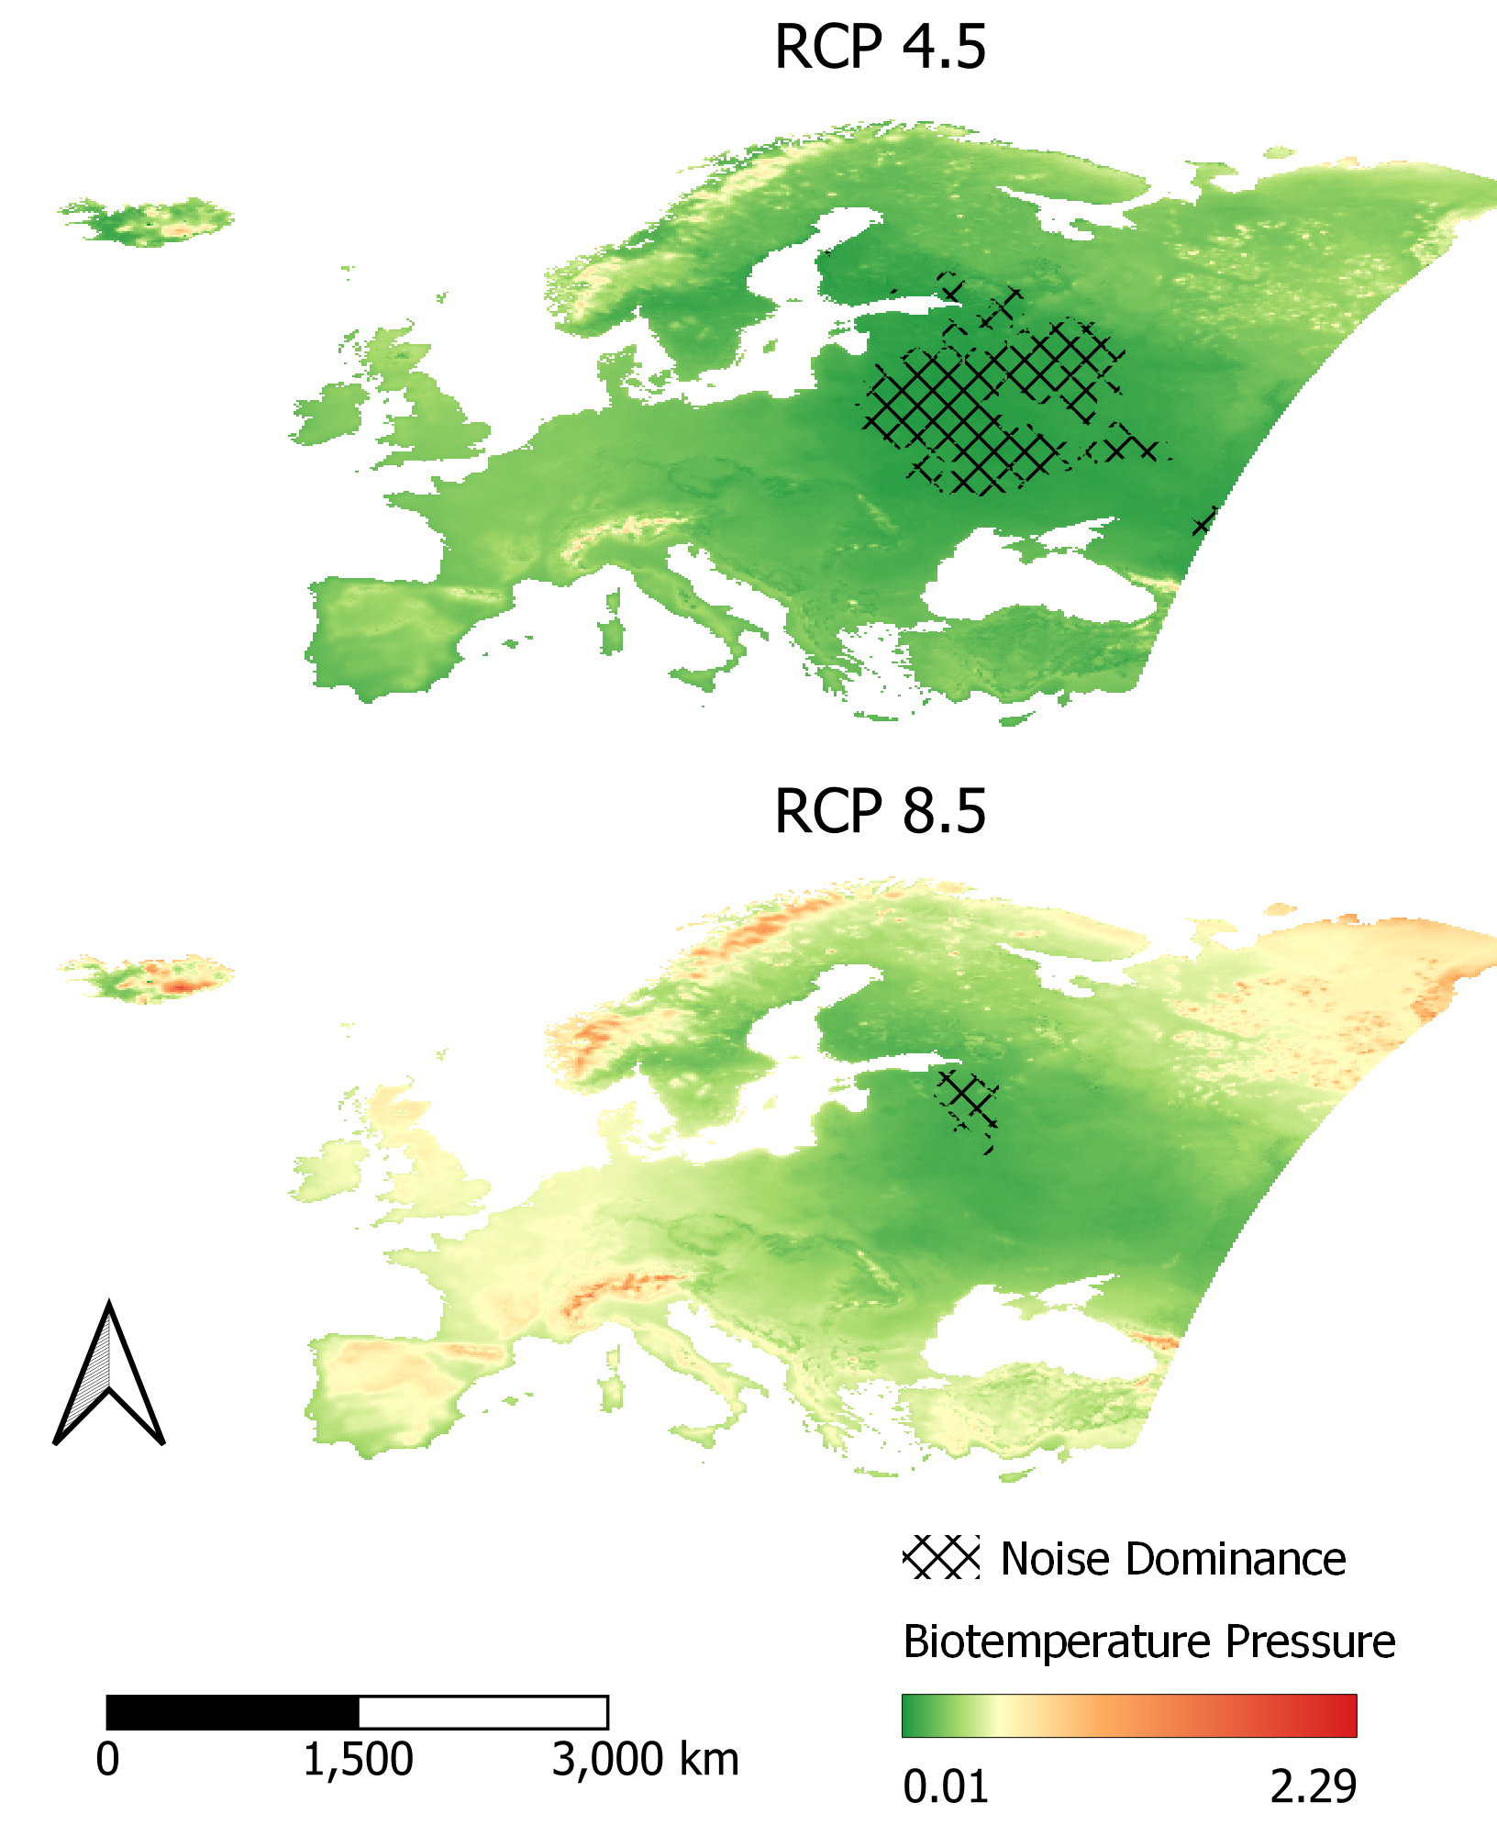
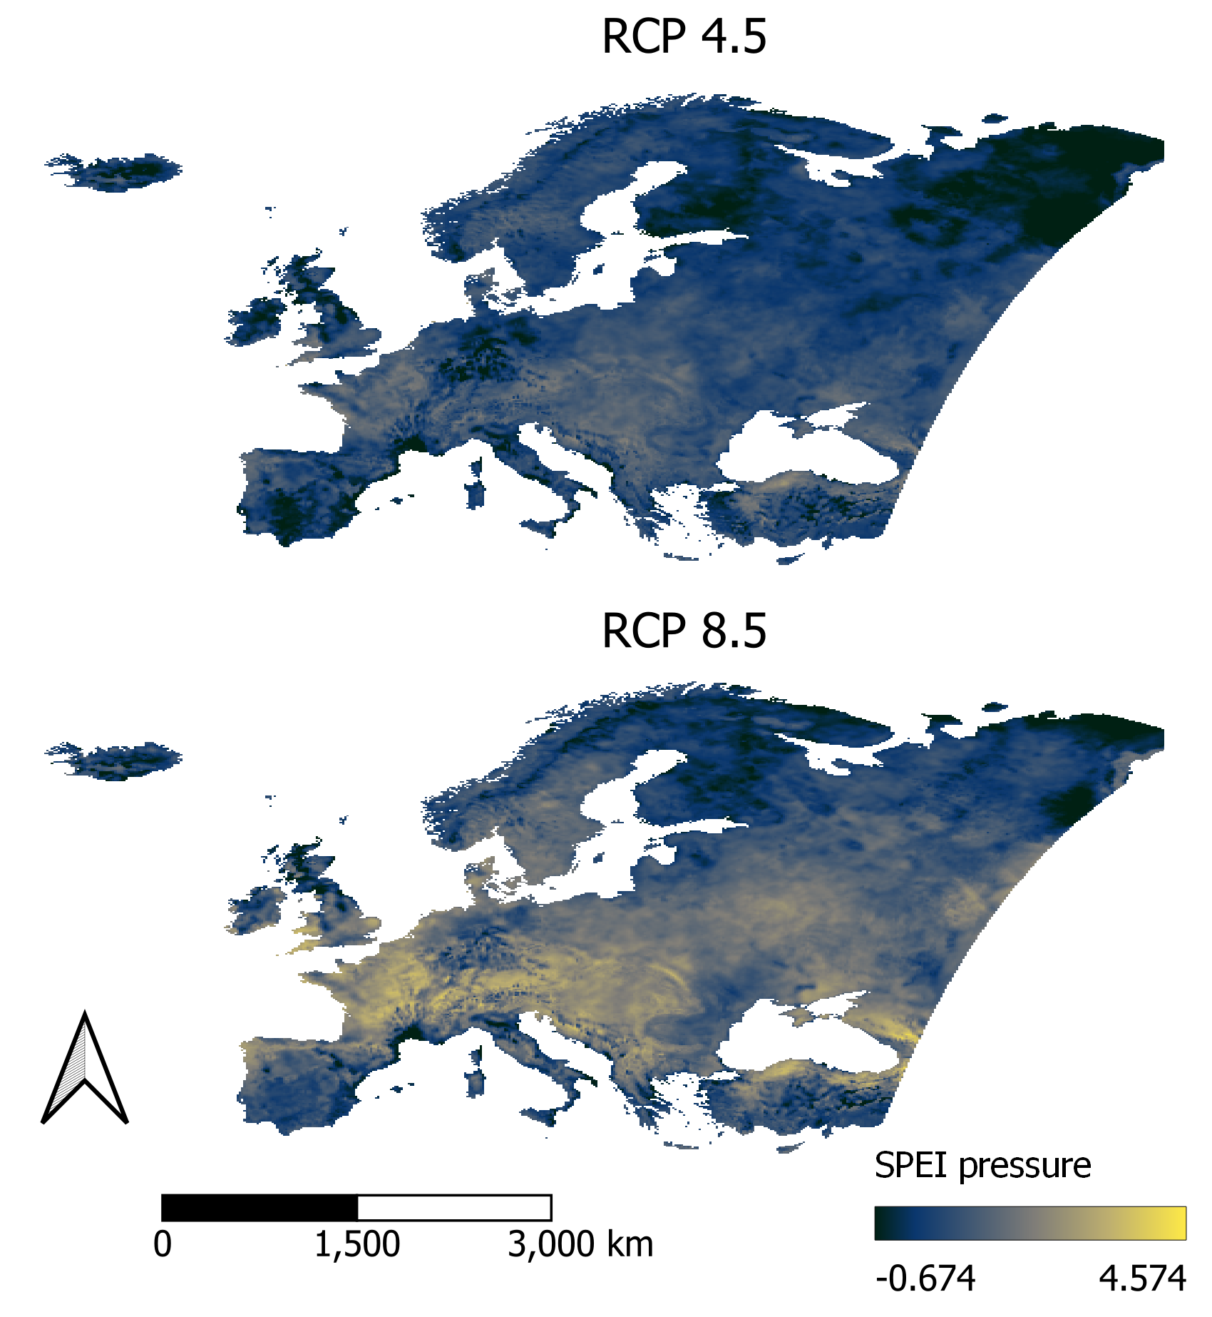
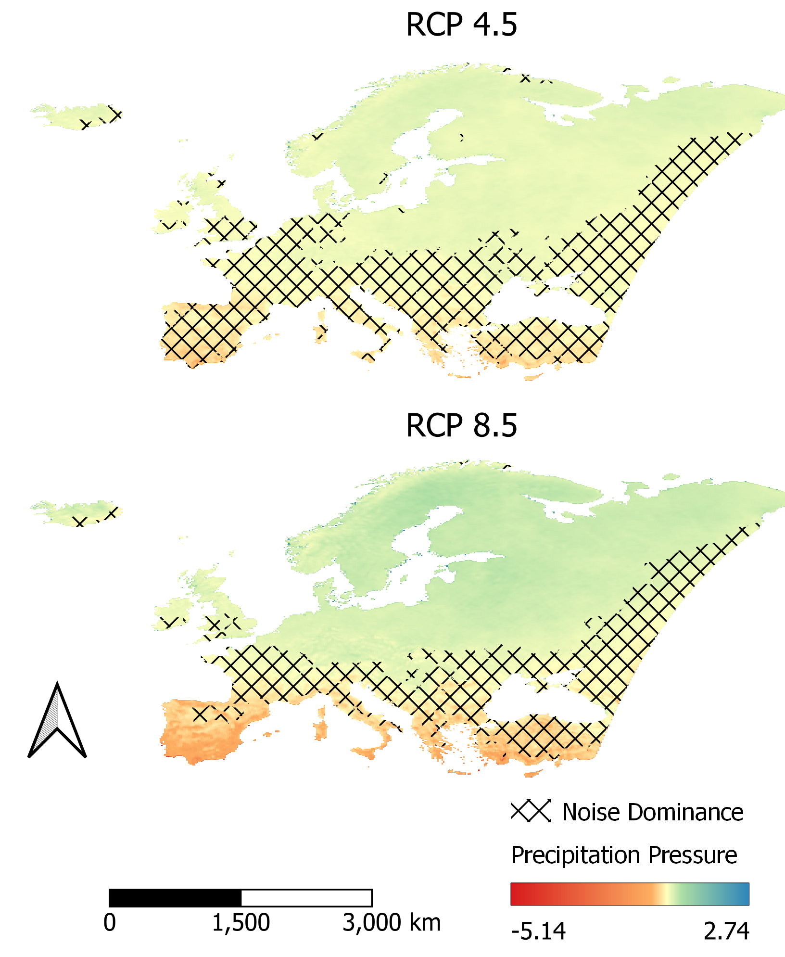
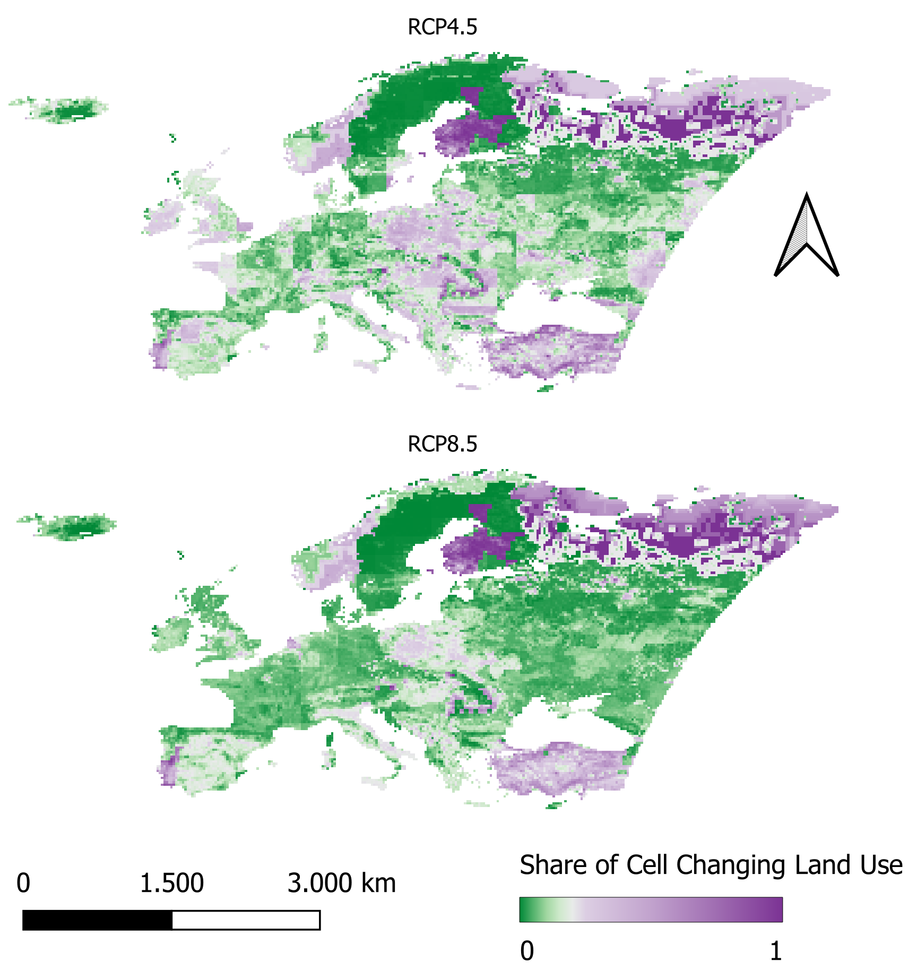
Thematic dimensions with their respective spatial distribution
Current thematic dimensions
Anthromes
Bioclimate
Biogeoregions
Economic Density
Land Cover
Landforms
Wohner et al. (2021)
Ohnemus et al. (2024)
eLTER RI in-situ facilities
Future thematic dimensions
Ohnemus et al. (2025)

Slide 5
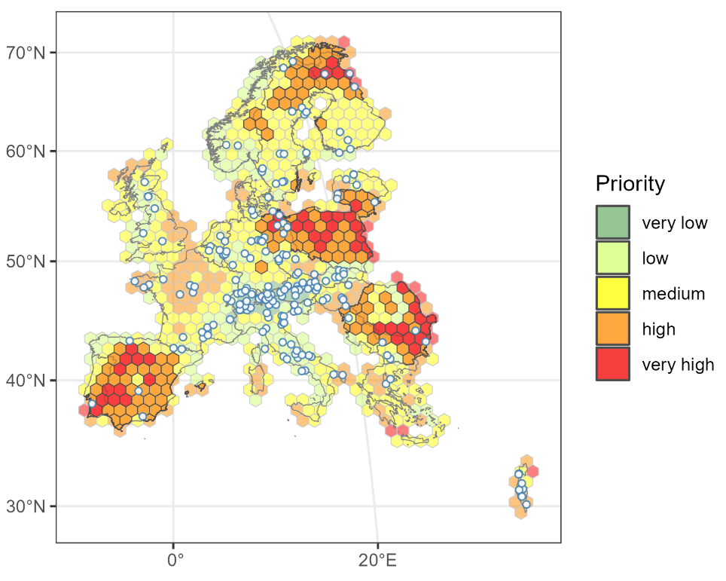
„Current“ and „future“ densification needs
Ohnemus et al. (2024)
Ohnemus et al. (2025)
1
2
3
Current thematic dimensions
Future thematic dimensions
eLTER RI can be best improved with sites in Fennoscandia, Poland, Lithuania & Iberian Peninsula

Slide 6
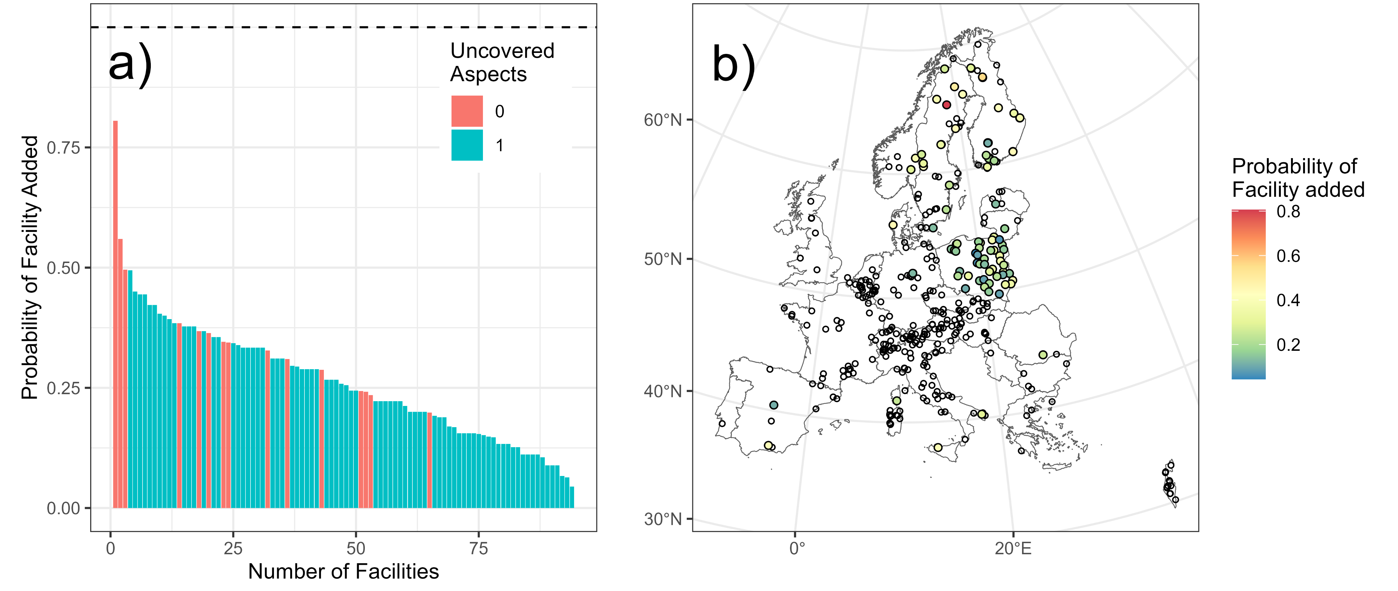
Densification can be achieved using facilities from other pan-European RIs
Ohnemus et al.
(in preparation)

Slide 7
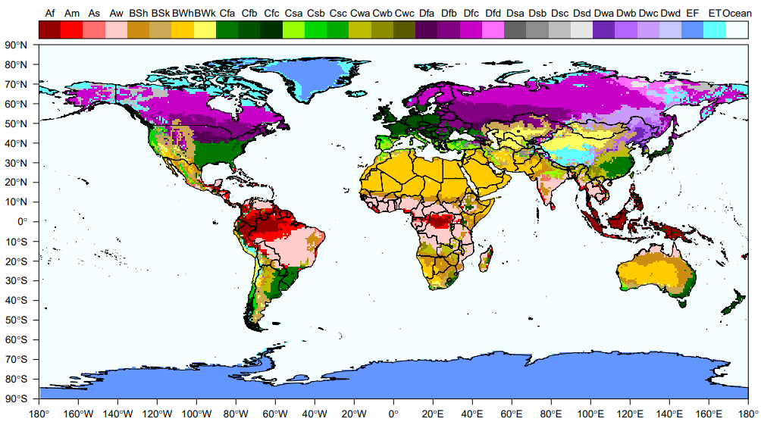
From the European Experience to the global scale…
Capital Letter | Climates
A | Tropical
B | Dry
C | Temperate
D | Continental
E | Polar
Kottek et al. (2006)

Slide 8
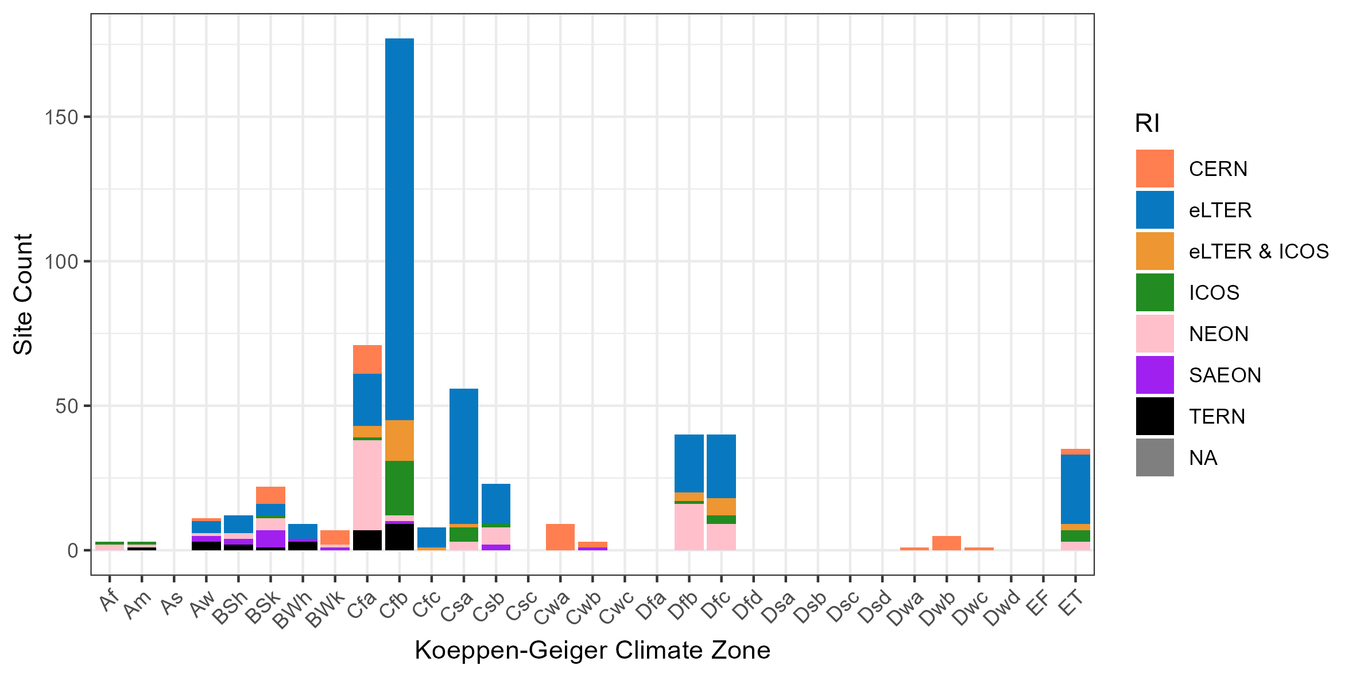
GERI already covers a wide range of Climate Zones
GERI gathers data in 20 of 31 climate zones
The remaining 11 climate zones cover 17.29 % of the terrestrial land surface (EF = 12.67 % alone)
Most RIs mostly gather data in temperate climates (Cfa or Cfb)
CERN covers critical gaps in Cw and Dw climates

Slide 9
Conclusions
Representativity Analyses
… uncover biases and even gaps in coverage beyond simple spatial distance analysis
… can recommend pathways to bias mitigation
GERI
... is so far not based on a globally concerted physical network development
... still aims at covering major environmental gradients at the global scale (like eLTER RI in Europe)
... should clearly state what aspects it represents on a global scale already
… could develop a pathway to bias mitigation using representativity analyses

Slide 10
References
Kottek, M., Grieser, J., Beck, C., Rudolf, B., Rubel, F., 2006. World map of the Köppen-Geiger climate classification updated.
Li, P., Peng, C., Wang, M., Li, W., Zhao, P., Wang, K. et al., 2017. Quantification of the response of global terrestrial net primary production to multifactor global change. Ecological indicators 76, 245–255. https://doi.org/10.1016/j.ecolind.2017.01.021.
Martin, L.J., Blossey, B., Ellis, E., 2012. Mapping where ecologists work: biases in the global distribution of terrestrial ecological observations. Frontiers in Ecology and the Environment 10(4), 195–201. https://doi.org/10.1890/110154.
Mirtl, M., Kuhn, I., Montheith, D., Bäck, J., Orenstein, D., Provenzale, A. et al., 2021. Whole System Approach for in-situ research on Life Supporting Systems in the Anthropocene (WAILS).
Ohnemus, T., Zacharias, S., Dirnböck, T., Bäck, J., Brack, W., Forsius, M. et al., 2023. The Elter Research Infrastructure: Current Design and Coverage of Environmental and Socio-Ecological Gradients.
Ohnemus, T., Dirnböck, T., Bäck, J., Gaube, V., Kühn, I., Mirtl, M. et al., 2025. Fitness for future: eLTER RI’s representation of climate and land use change. Ecological indicators 171, 113159. https://doi.org/10.1016/j.ecolind.2025.113159.
Wohner, C., Ohnemus, T., Zacharias, S., Mollenhauer, H., Ellis, E.C., Klug, H. et al., 2021. Assessing the biogeographical and socio-ecological representativeness of the ILTER site network. Ecological indicators 127, 107785. https://doi.org/10.1016/j.ecolind.2021.107785.
Wolf, S., Mahecha, M.D., Sabatini, F.M., Wirth, C., Bruelheide, H., Kattge, J. et al., 2022. Citizen science plant observations encode global trait patterns. Nature ecology & evolution 6(12), 1850–1859. https://doi.org/10.1038/s41559-022-01904-x.
Zacharias, S., Anttila, S., Bäck, J., Böttcher, K., Mallast, U., Mirtl, M. et al. 2021. Discussion paper on eLTER Standard Observations (eLTER SOs): Deliverable D3.1 EU Horizon 2020 eLTER PLUS Project, Grant agreement No. 871128; 2021.

Slide 11
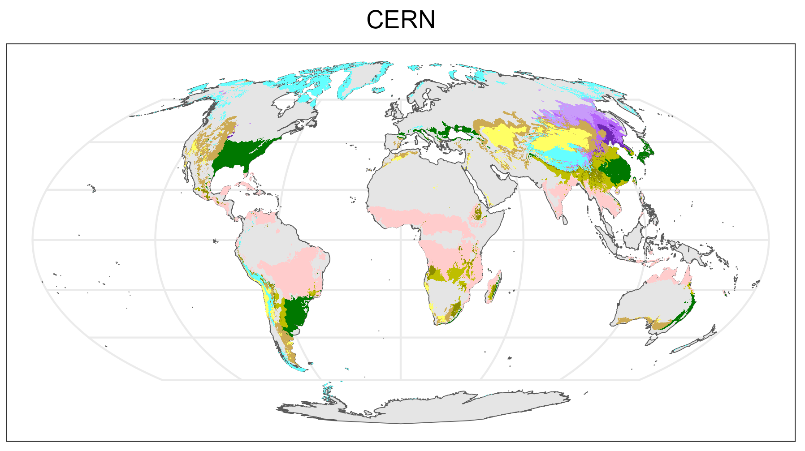
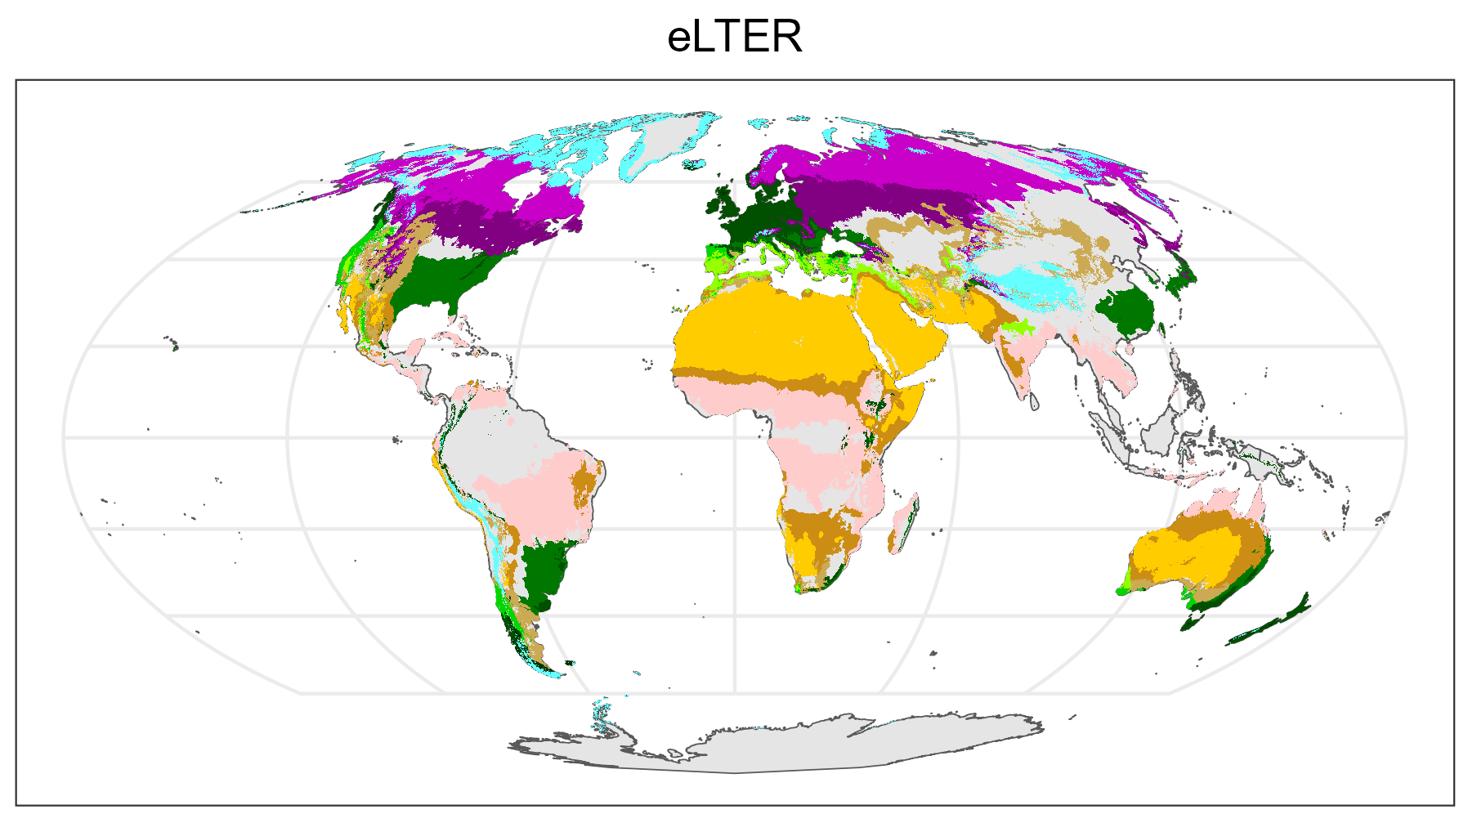
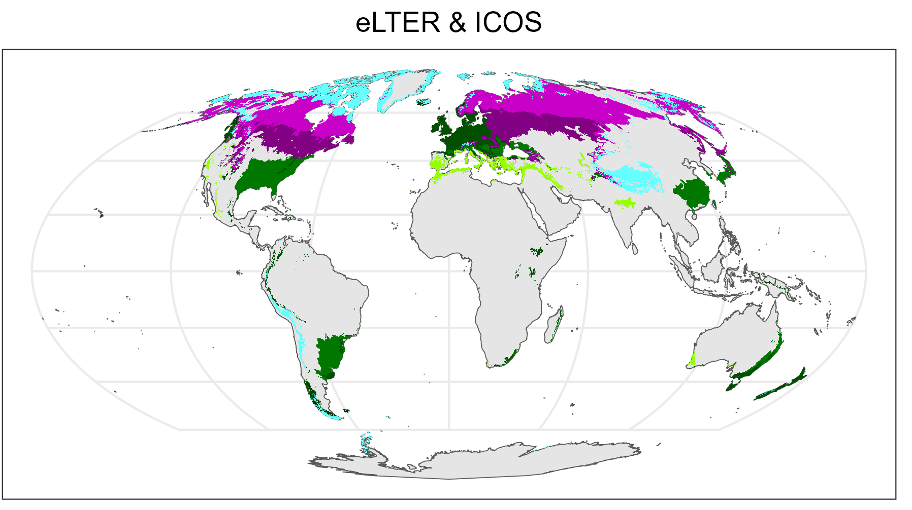
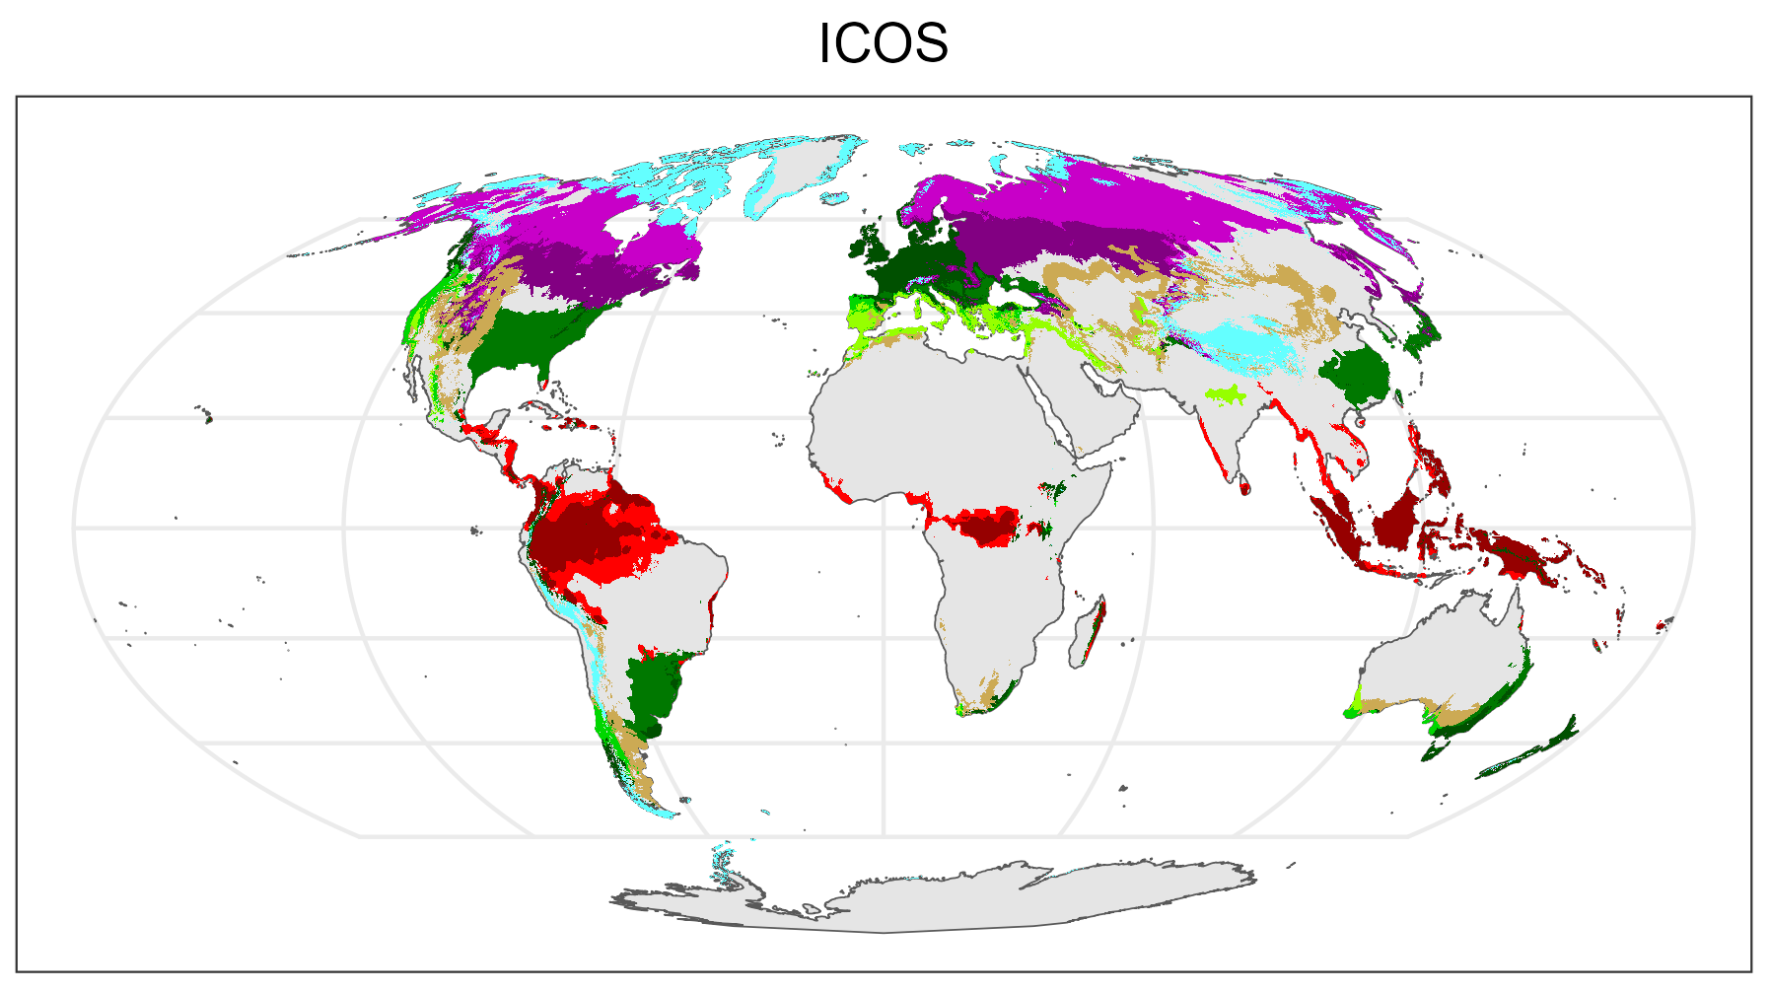
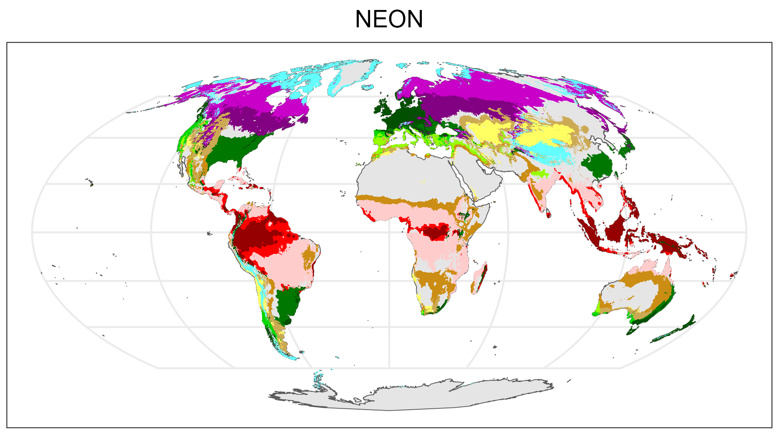
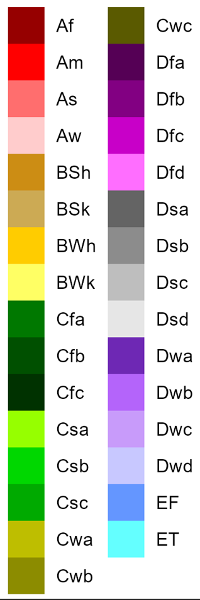
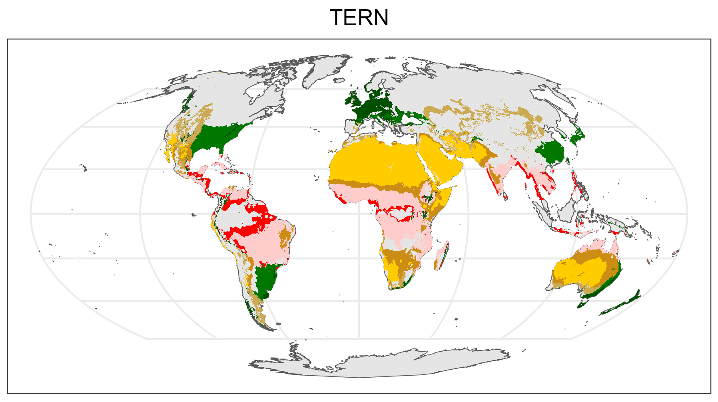
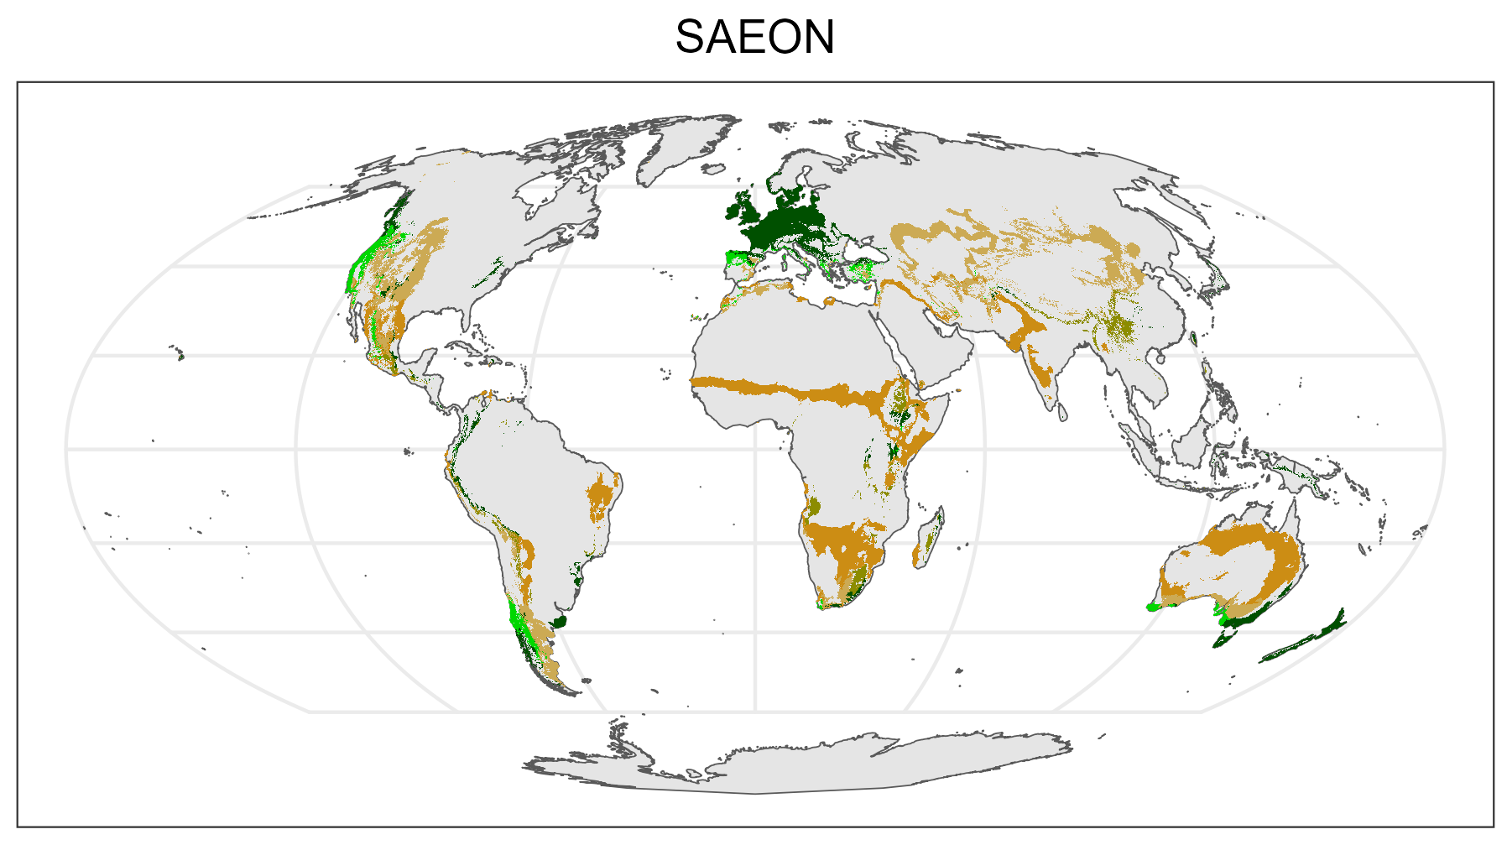
The CZs GERI gathers Data in cover 82.71 % of the Land Surface

