Slide 1
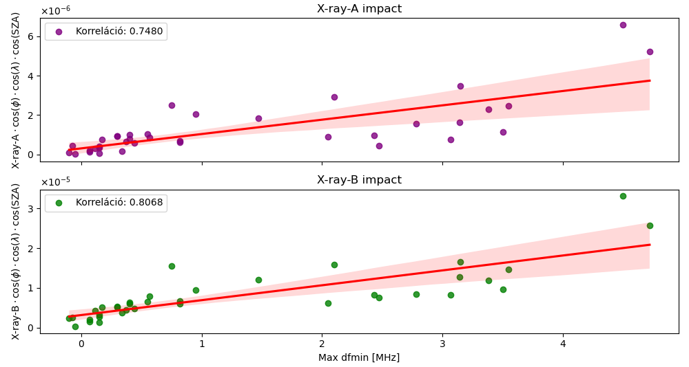
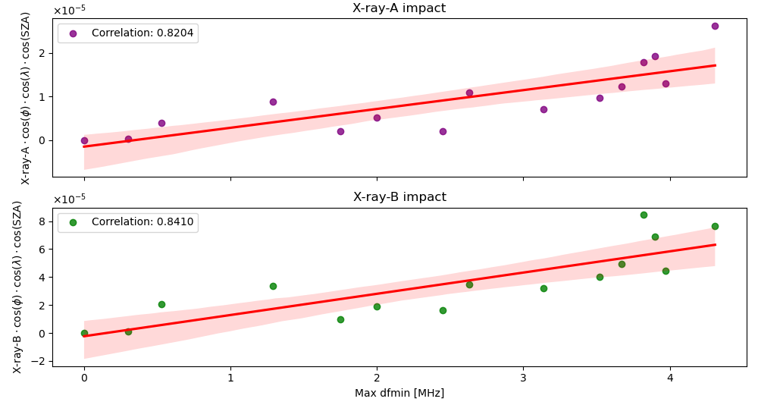
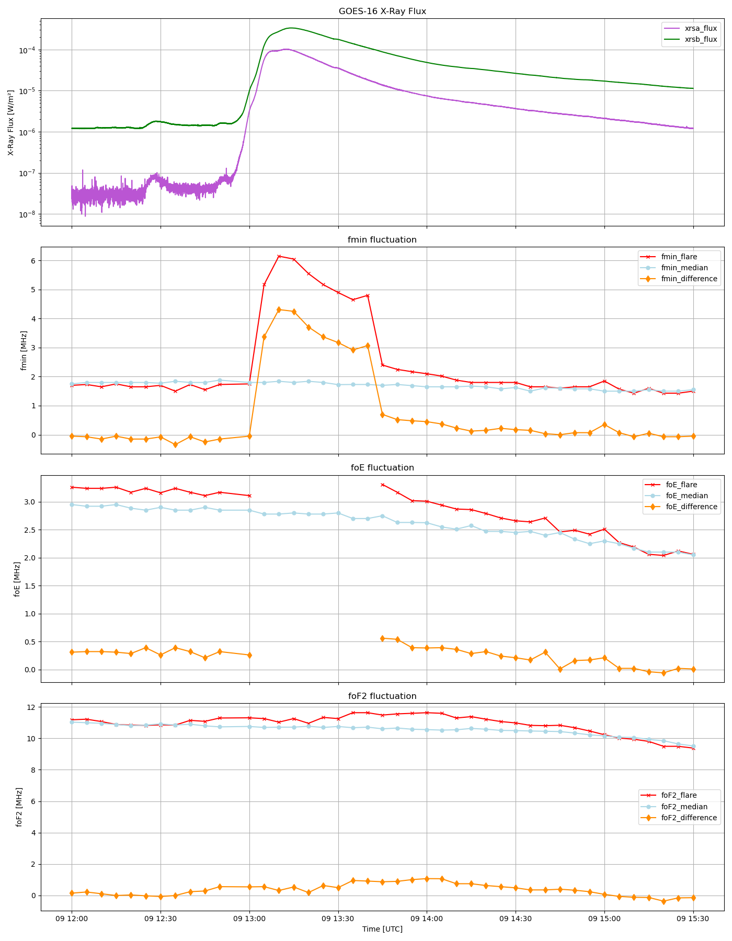
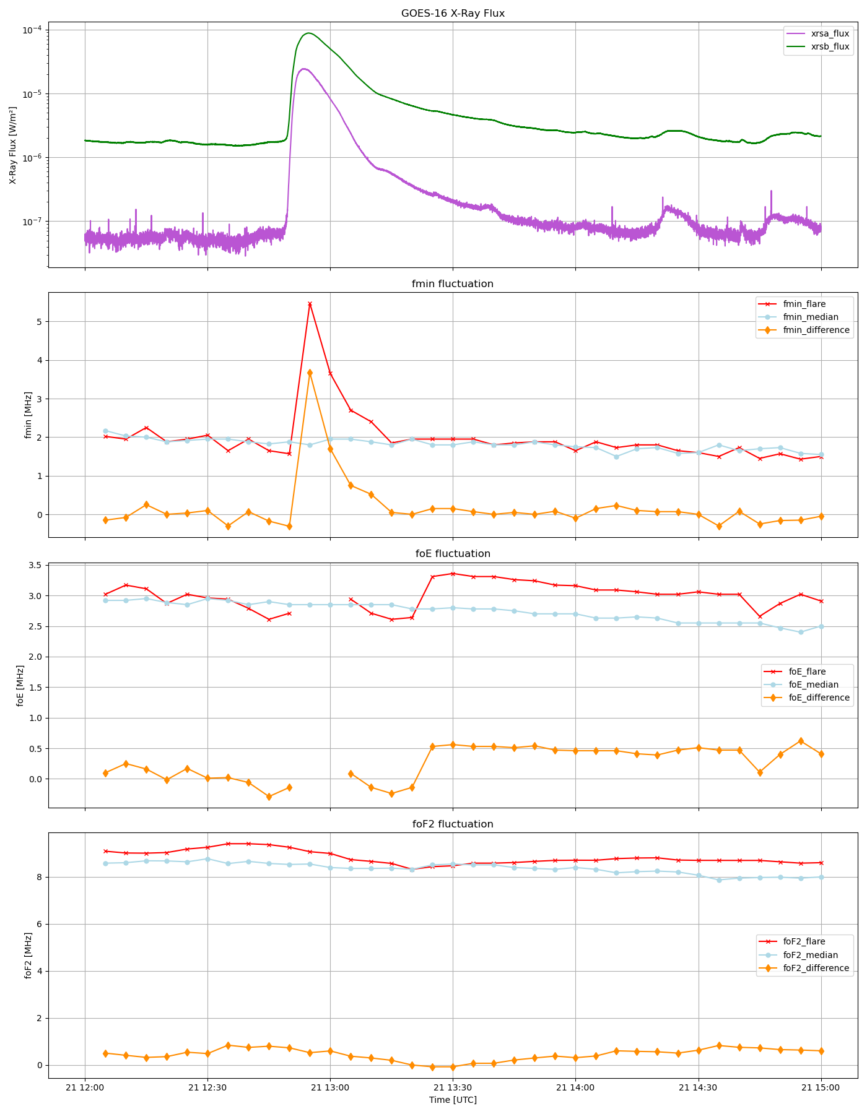
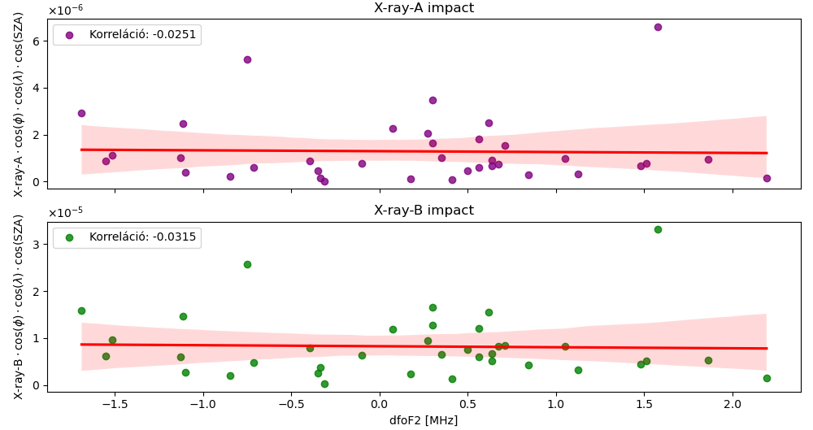
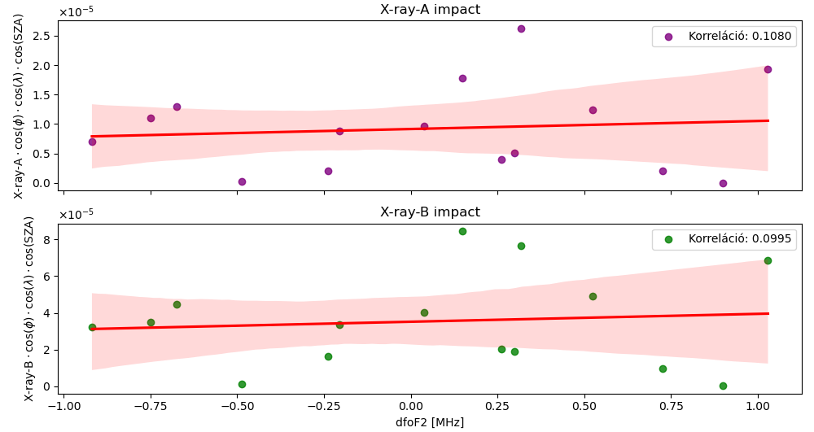
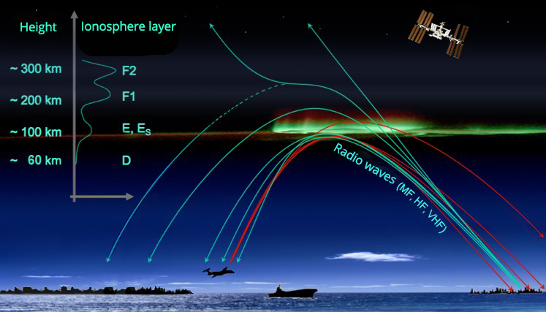
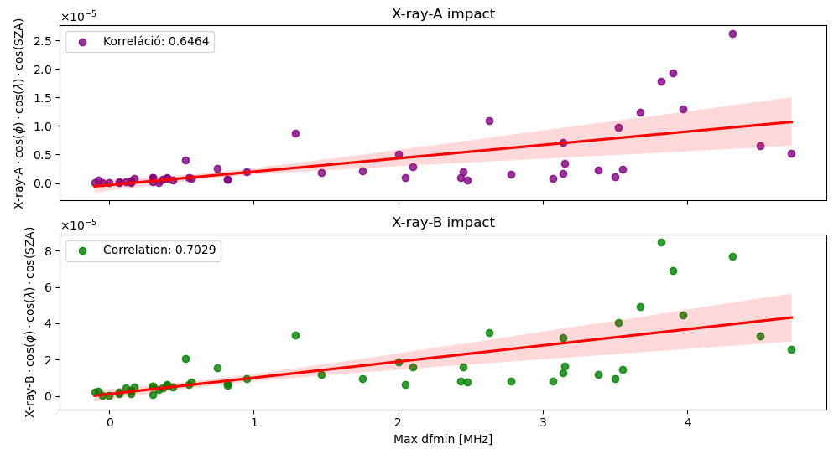
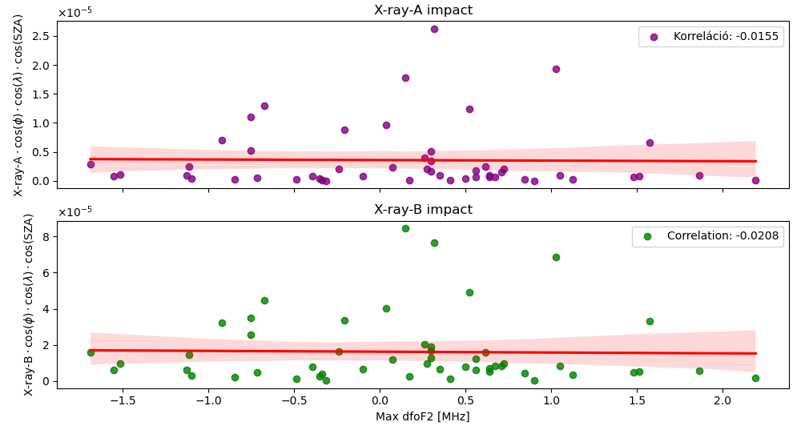
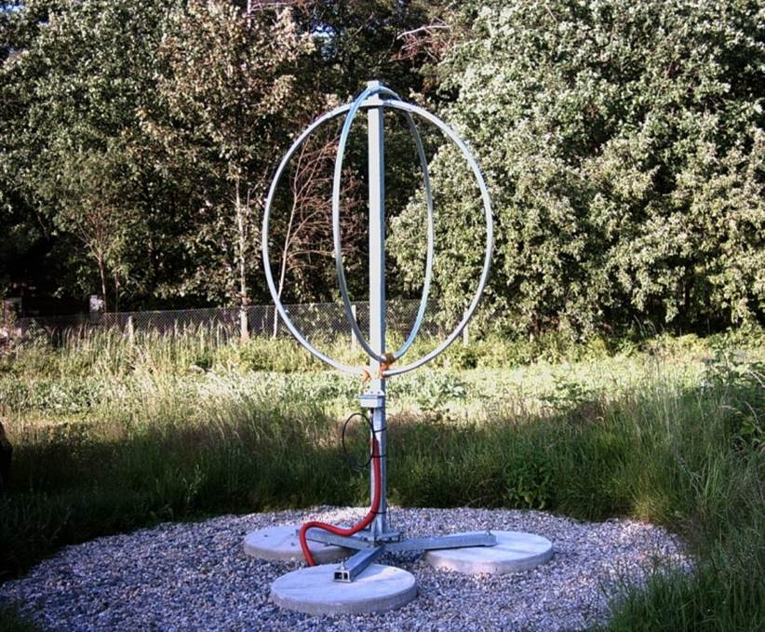
The Impact of Solar Flares on the Ionosphere During Geomagnetically Quiet Periods
${\text{J}\text{ú}\text{lia} \text{Erdey}}^{1,2}$, ${Veronika Barta}^{2},$ ${Attila Buzás}^{2}$
$$1_{ELTE Eötvös Loránd Tudományegyetem, Budapest, Hungary; }2_{HUN−REN Institute of Earth Physics and Space Science}$$
ABSTRACT
In my research, I studied the ionized region of Earth's atmosphere between 50 km and 1000 km altitude, known as the ionosphere, during flare events on geomagnetically quiet days. Flares are massive explosions on the Sun's surface, during which high-energy X-ray and EUV radiation reach Earth's environment, increasing ionization and the scale of electromagnetic wave absorption (attenuation) in the ionosphere. The necessary data were provided by processing the ionograms from the Czech ionosonde in Pruhonice (PQ052). I assessed the magnitude of ionospheric changes by comparing them to reference days, which were determined by calculating the median value for each month with a 5-minute sampling interval. I calculated deviations for the fmin and foF2 parameters (dfmin and dfoF2) and compared them with the flares' "geoeffectiveness" parameter. When defining the geoeffectiveness parameter, I considered the magnitude of solar radiation, the solar zenith angle, and the flare's position on the solar disk. Based on the results, there was a significant positive correlation (~0.7-0.8) between dfmin and the flares' geoeffectiveness parameter, indicating that flares have a considerable impact on ionospheric absorption in the lower ionosphere. In contrast, the correlation between dfoF2 and the geoeffectiveness parameter was weak and slightly negative (~0), suggesting that the effect of flares on the ionization of the F2 layer is negligible, even during geomagnetically quiet periods.
Fig.6. Correlation between geoeffectiveness and dfmin for flares with magnitudes below M6 and above M6, respectively
INTRODUCTION
Solar flares are intense bursts of radiation from the Sun, releasing large amounts of energy, including X-rays and extreme ultraviolet (EUV) radiation.
These high-energy emissions increase ionization in Earth's atmosphere, particularly affecting the lower part of the ionosphere (the D and E regions).
Enhanced ionization leads to stronger absorption of radio waves, impacting communication and navigation systems.
Geomagnetically quiet periods are times when Earth's magnetic field is stable, with minimal disturbances from solar wind or magnetic storms, providing a "calm" background for studying flare effects.
Fig.7. Correlation between geoeffectiveness and dfoF2 for flares with magnitudes below M6 and above M6, respectively
SUMMARY AND CONCLUSIONS
Investigated the impact of solar flares on the ionosphere during geomagnetically quiet periods (Kp < 4, Dst > -40 nT).
Compared ionosonde-derived parameters (dfmin, dfoF2) with flare properties (X-ray flux, solar zenith angle, flare position).
Analyzed 52 flare events (from solar cycle 25.) using over 2000 manually processed ionograms from mid-latitude station (Pruhonice, Czech Republic) data.
fmin showed clear increases during flares; strong flares caused full absorption and missing E, Es, F layer data.
foE increased during intense solar flares; foF2 showed no significant changes related to flare activity.
Positive correlation found between dfmin and flare geoeffectiveness, especially for long-wavelength X-ray flux variations.
Very weak or no correlation found between dfoF2 and geoeffectiveness, indicating limited flare impact on the F2 layer.
Fig.2. Impact of the X3.4-class flare on February 9, 2024, on the ionosphere, showing layer variations relative to the monthly median
Fig.3. Impact of the M8.7-class flare on May 29, 2023, on the ionosphere, showing layer variations relative to the monthly median
REFERENCES
Barta, V., Sátori, G., Berényi, K. A., Kis, Á., & Williams, E. (2019). „Effects of solar flares on the ionosphere as shown by the dynamics of ionograms recorded in Europe and South Africa”. Annales Geophysicae, 37(4), 747–761.
“Investigating the effect of large solar flares on the ionosphere based on novel Digisonde data comparing three different methods” - Attila Buzás, Daniel Kouba, Jens Mielich, Dalia Burešová, Zbyšek Mošna, Petra Koucká Knížová, Veronika Barta (2023)
Fig.4. Correlation between geoeffectiveness and dfmin for flares in solar cycle 25.
Fig.5. Correlation between geoeffectiveness and dfoF2 for flares in solar cycle 25.
Fig.8. The Digisonde in Pruhonice, Czech Republic
Fig.1. Layers of the ionosphere and attenuation of radiowaves

