Slide 1
Supplementary Info: Evolution of the size and composition of ice nucleating particles within the synoptic context of the Arctic melt onset
Camille Mavis¹ (cemavis@colostate.edu)
Sonja Murto², Julia Kojoj², Heather Guy³, Paul Zieger², Michael Tjernström², Ian Brooks³, Jessie Creamean¹
(1)Colorado State University (2)Stockholm University (3) University of Leeds

Slide 2
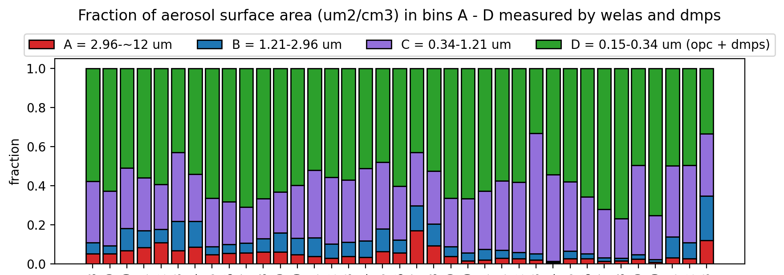
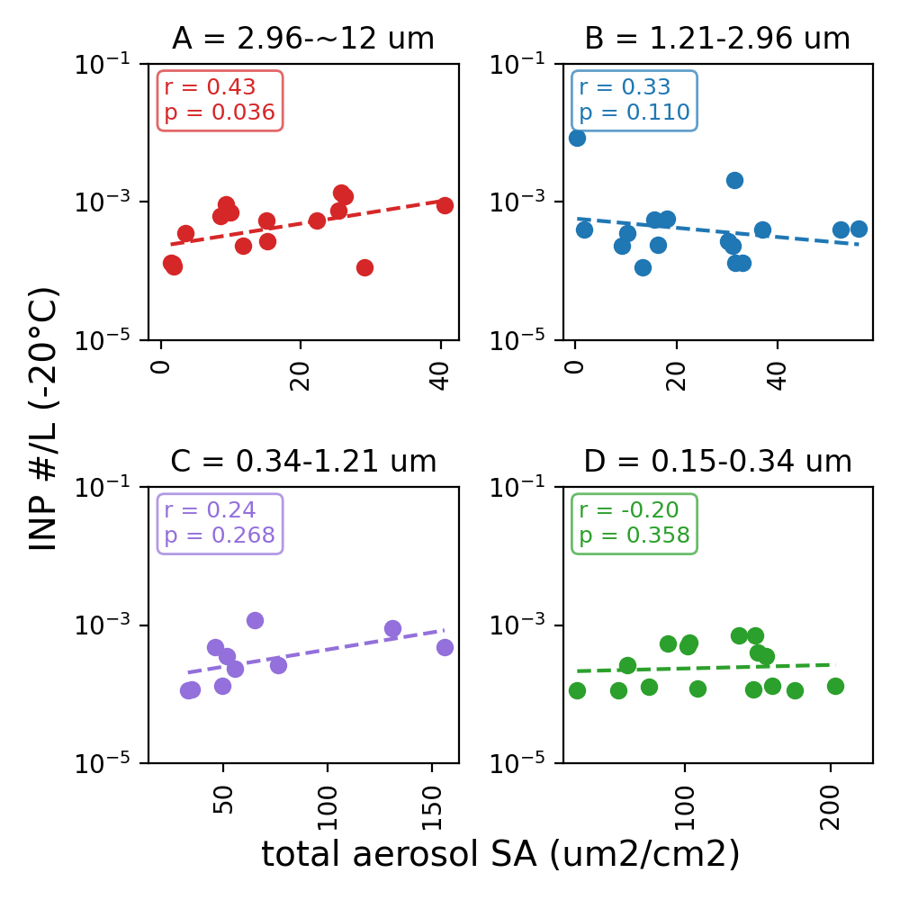
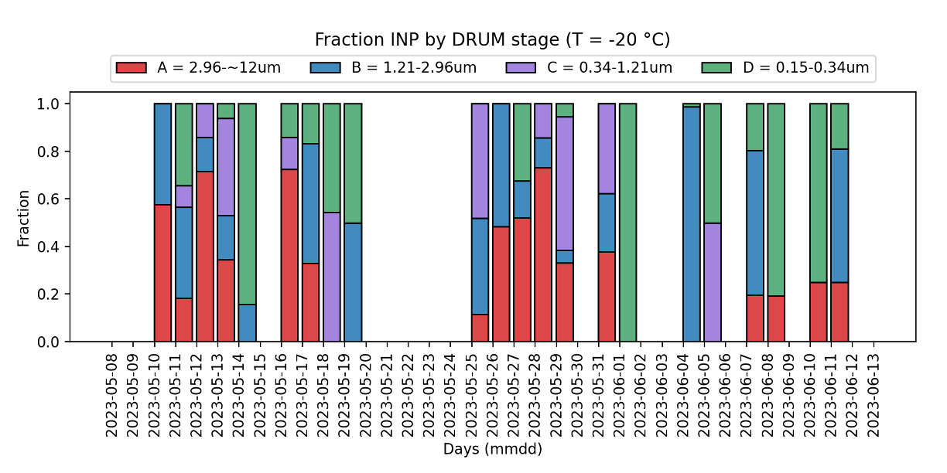
T = -20 ºC
Size-resolved INP N_{INP}L⁻¹ correlates with total aerosol surface area for the highest bin size

Slide 3
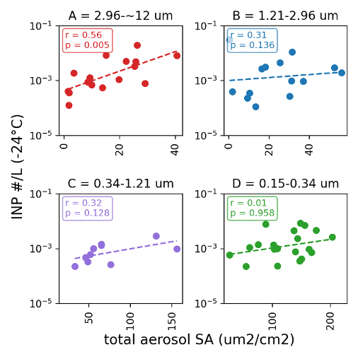
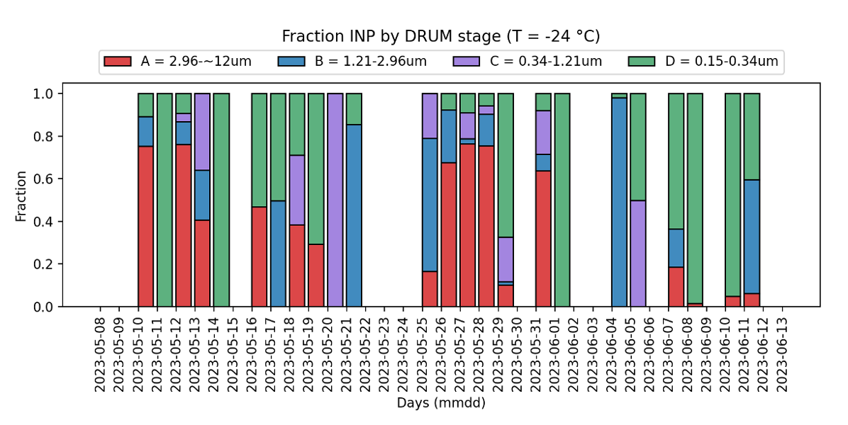
T = -24 ºC
Size-resolved INP N_{INP}L⁻¹ correlates with total aerosol surface area

Slide 4
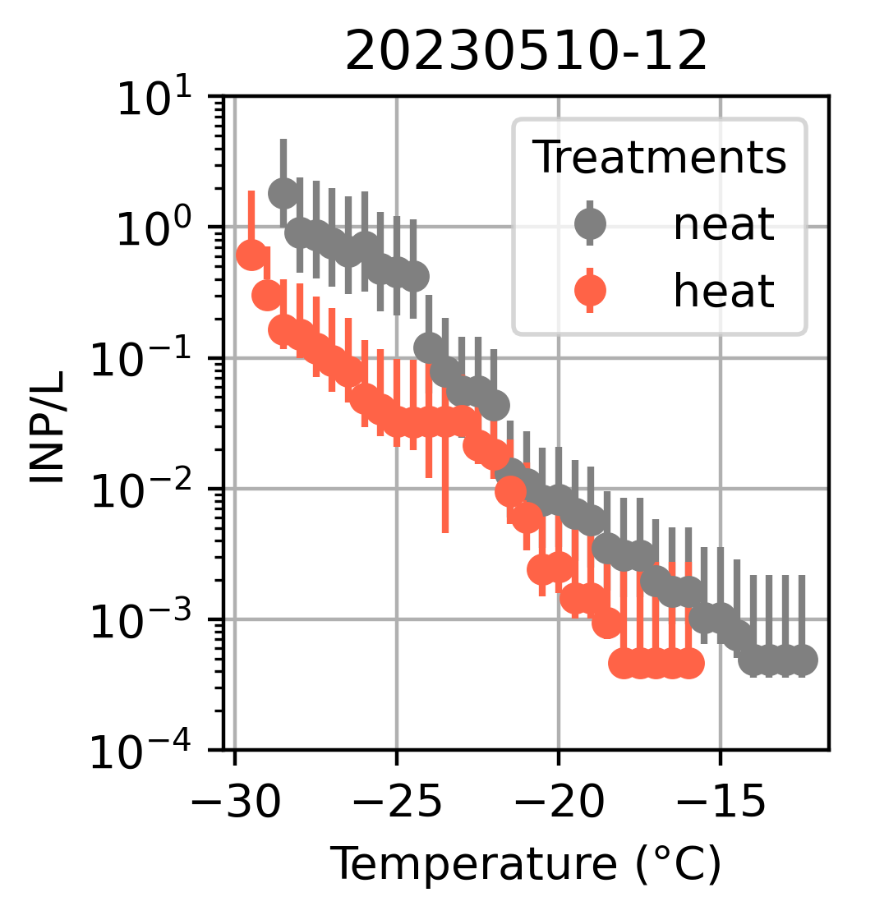
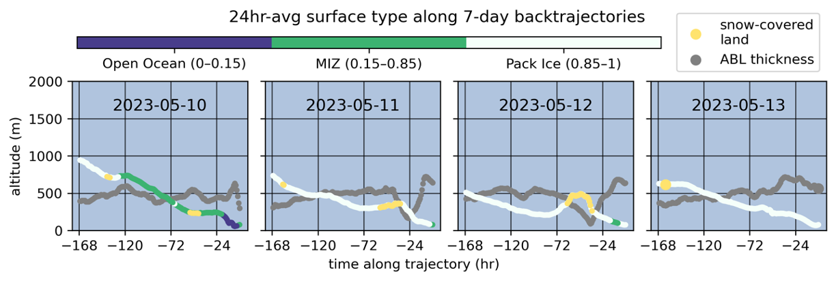
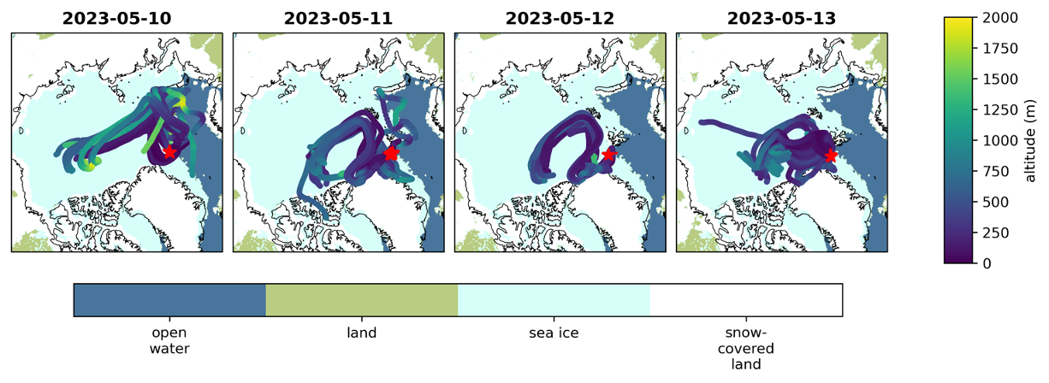
Period 2: Cold air outbreak

Slide 5
Period 2
Period 1
Period 3

Slide 6
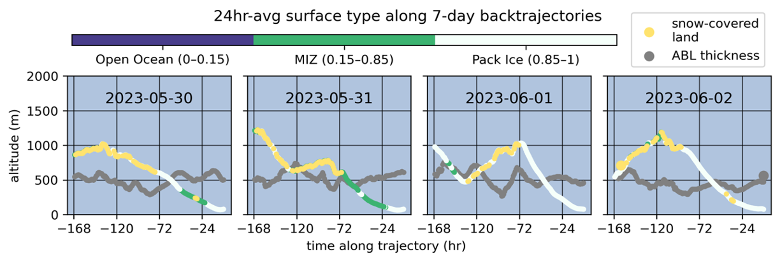
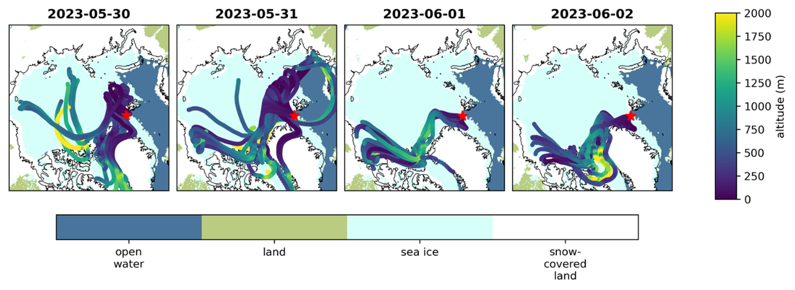
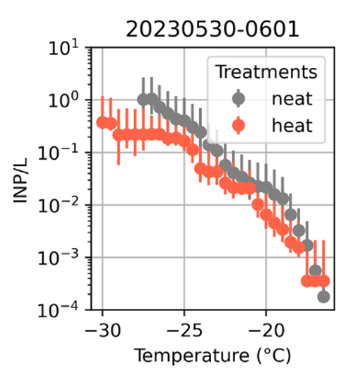
Period 3:

Slide 7
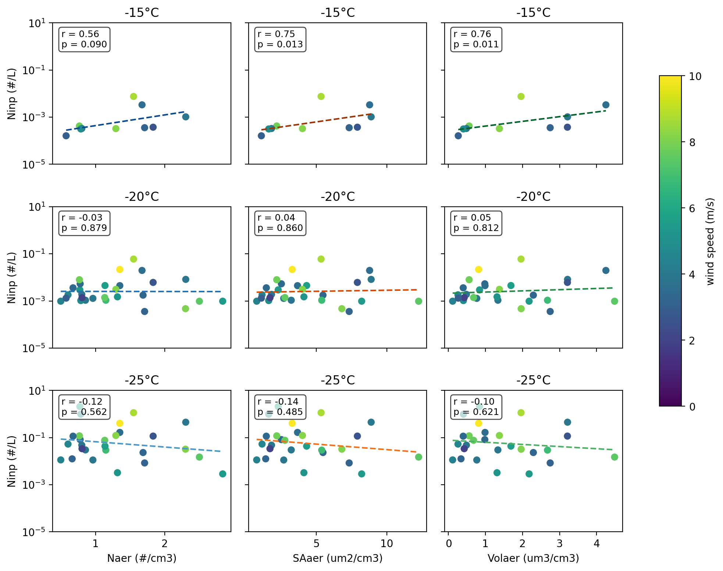
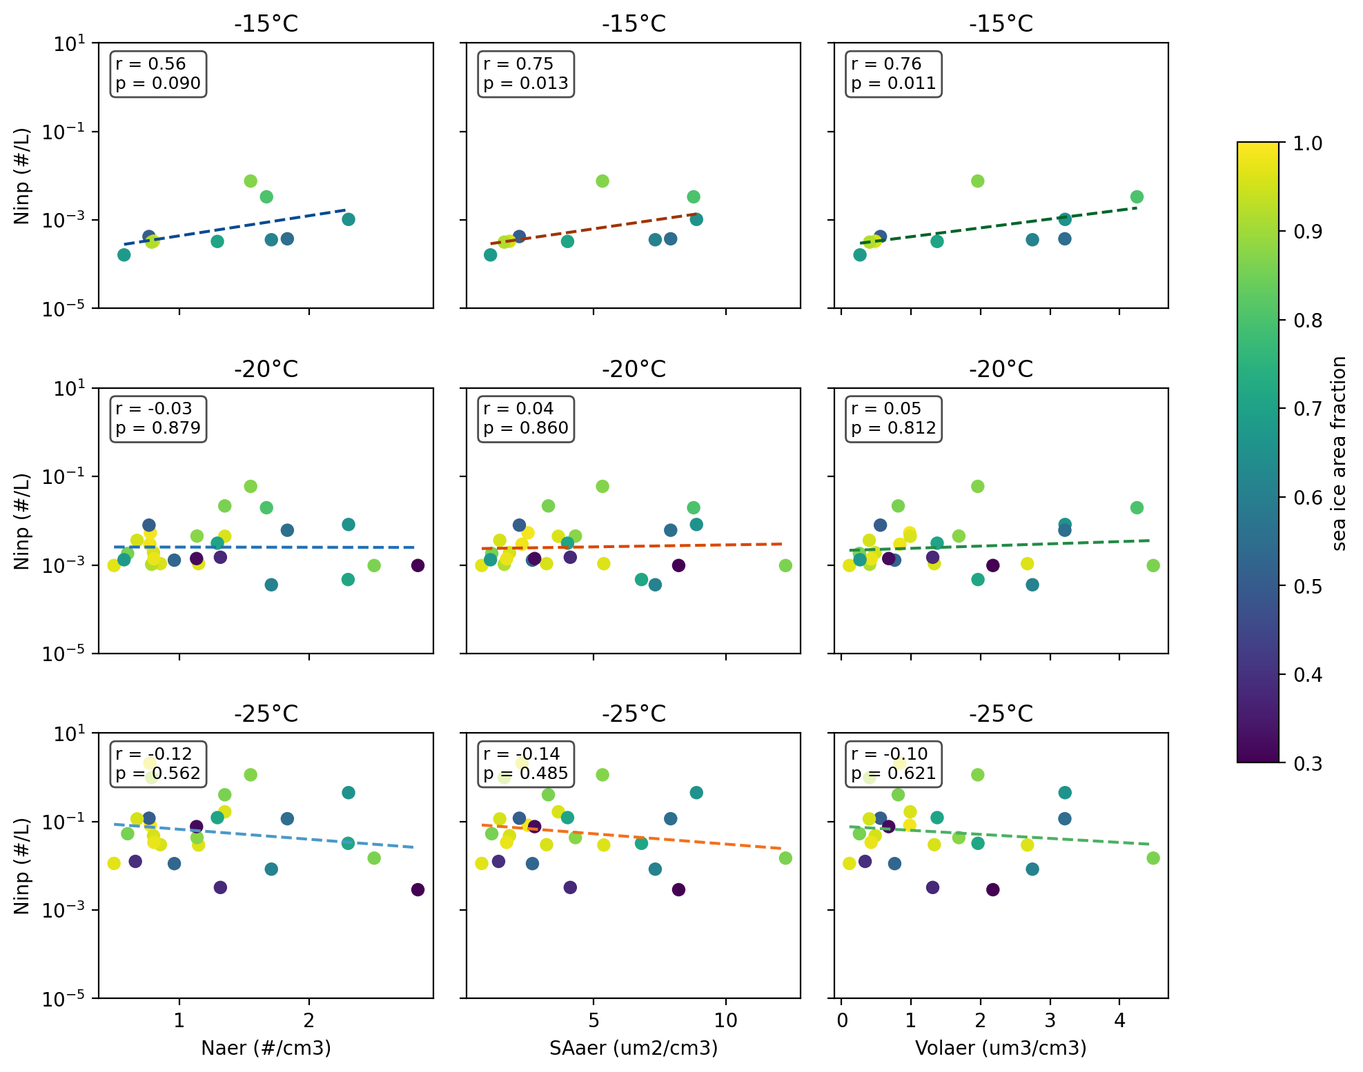
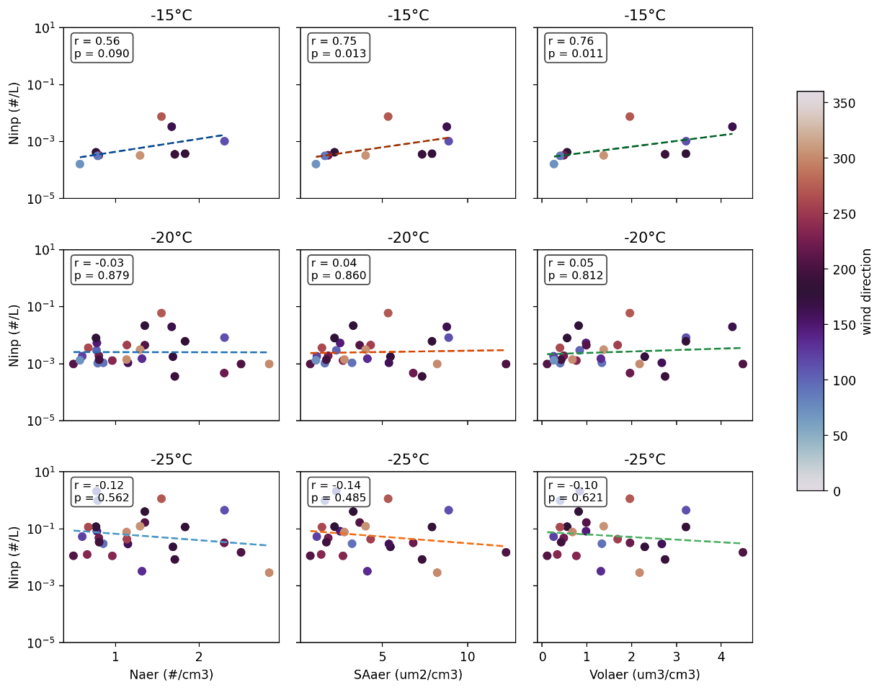
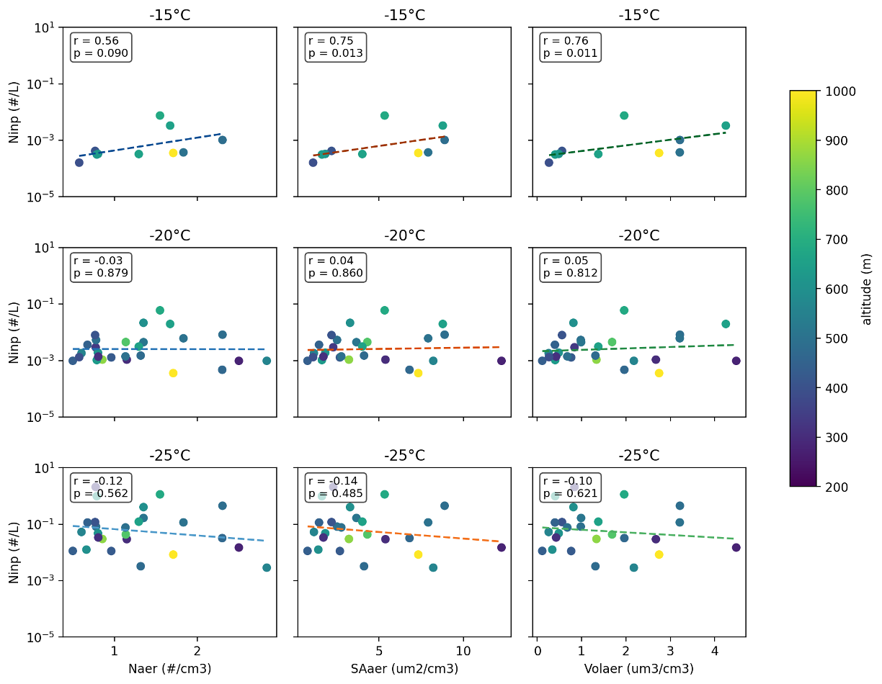
N_{inp} vs N_{aer} (D_{p} > 0.5 μm)
Strongest correlations with warmest temperatures
No clear pattern with:
wind speed/direction
Avg along 24hr-avg 7-day backtrajectory:
sea ice concentration
Altitude

Slide 8
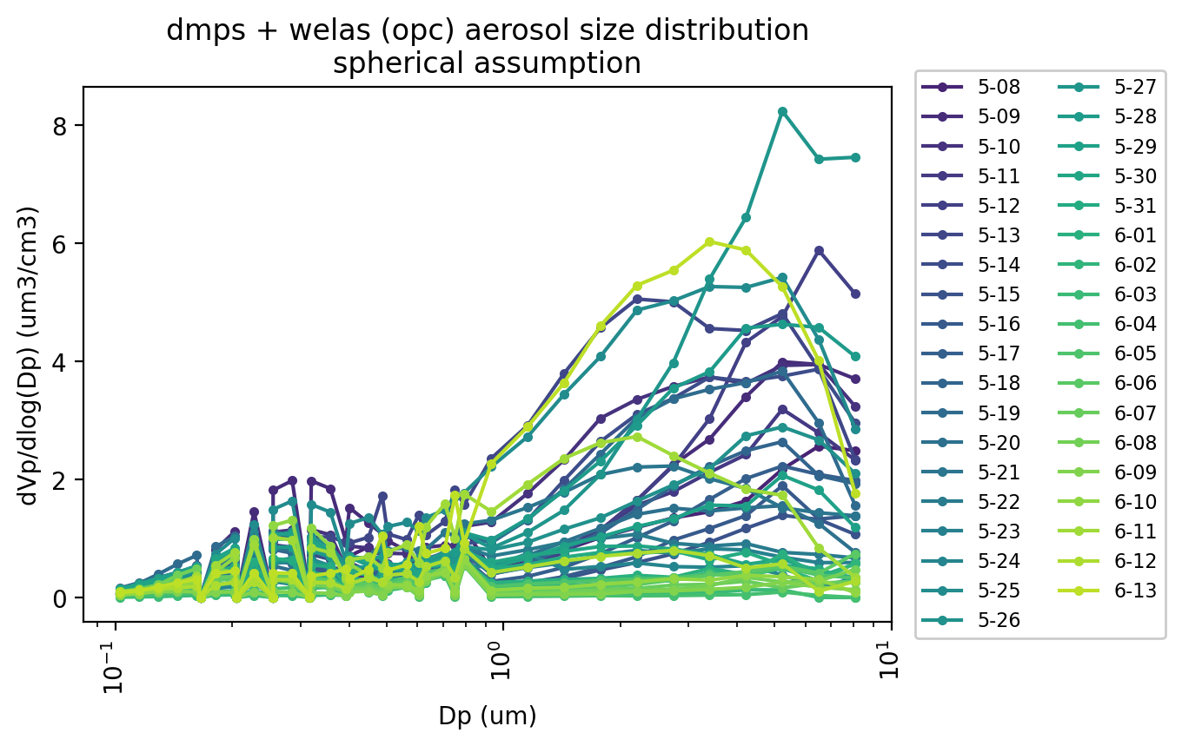
Total aerosol size distributions (N, SA, Vol)

