Slide 1
Insights on entrainment from seasonal signatures in the Denmark Strait Overflow Water (DSOW) properties in the West Irminger Sea
Hiroki Nagao, EGU Conference, April 2025
Isabela Le Bras, Amy Bower, Heather Furey, David Nicholson, Ellen Park (WHOI)
Una Miller, Jaime Palter (University of Rhode Island)
Greg Koman (University of Massachusetts, Boston)
Dariia Atamanchuk (Dalhousie University)
Kristen Fogaren, Hilary Palevsky, Meg Yoder (Boston College)
Notes:
Rough Script: Thank you for participating in this session. Today, I'll be presenting my work on insights on entrainment from seasonal signatures in the Denmark Strait Overflow Water properties in the Irminger Sea.

Slide 2
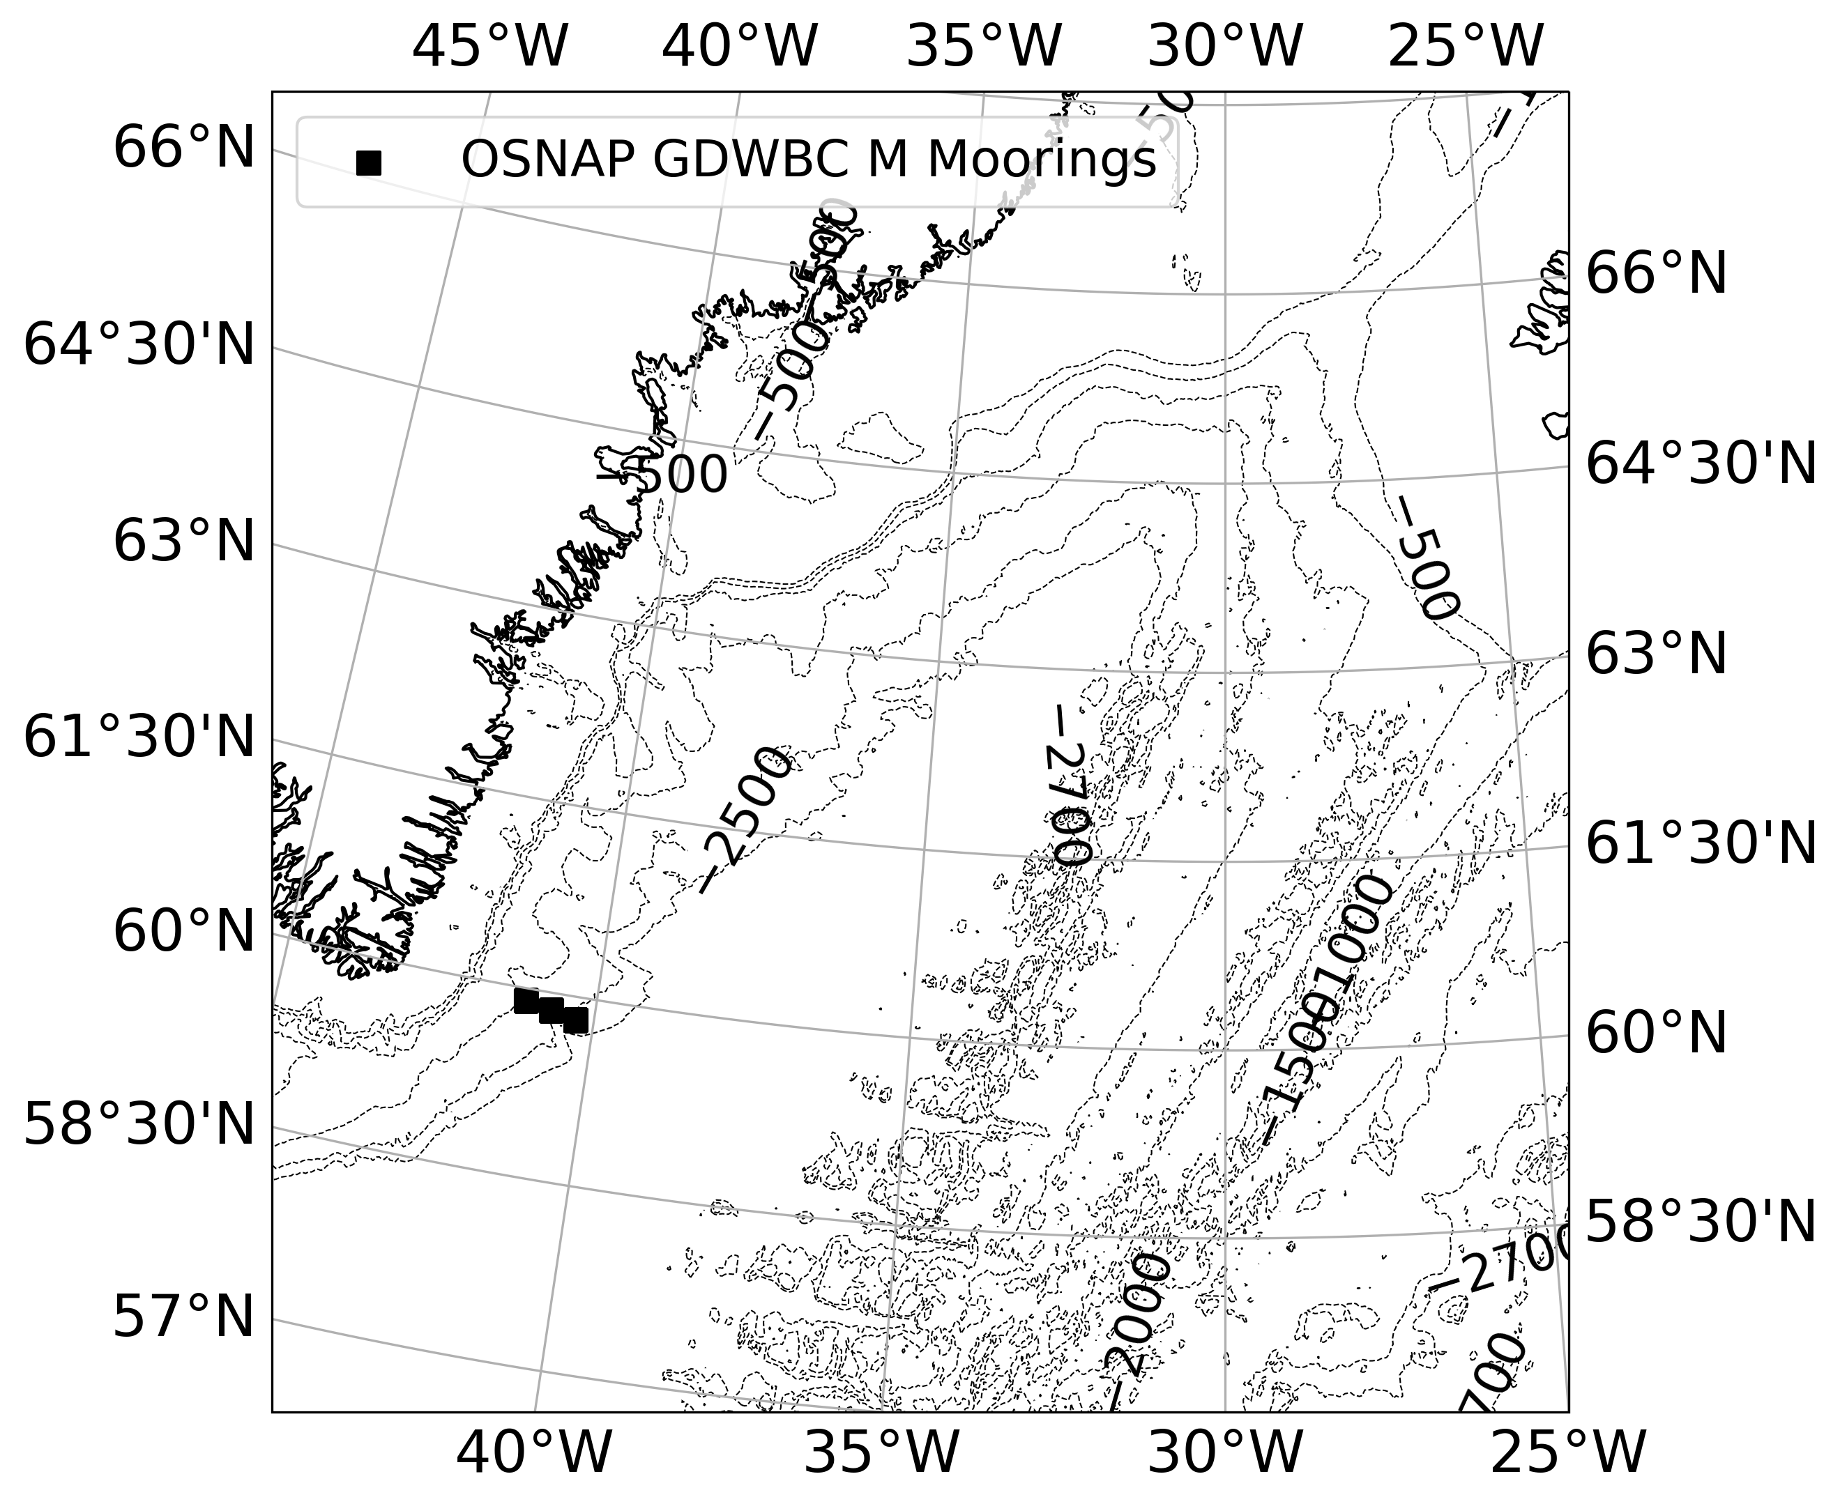
What is Denmark Strait Overflow Water (DSOW)?
Denmark Strait Overflow Water (DSOW) is formed in the Nordic Seas and feeds the lower limb of the AMOC.
Entrainment in DSOW transfers climate signals from the surface to the deep ocean.
DSOW
Entrainment
hiroki.nagao@whoi.edu
Notes:
Rough Script: For context, DSOW is formed in the Nordic Seas and is the densest component in the lower limb of the AMOC. As DSOW spreads equatorward, DSOW properties become modified from entrainment, which is critical for transferring climate signals and biogeochemical tracers from the surface to the deep ocean.
ONE-SENTENCE MESSAGE: Entrainment in Denmark Strait Overflow Water (DSOW) is critical for transferring climate signals from the surface to the deep ocean.

Slide 3
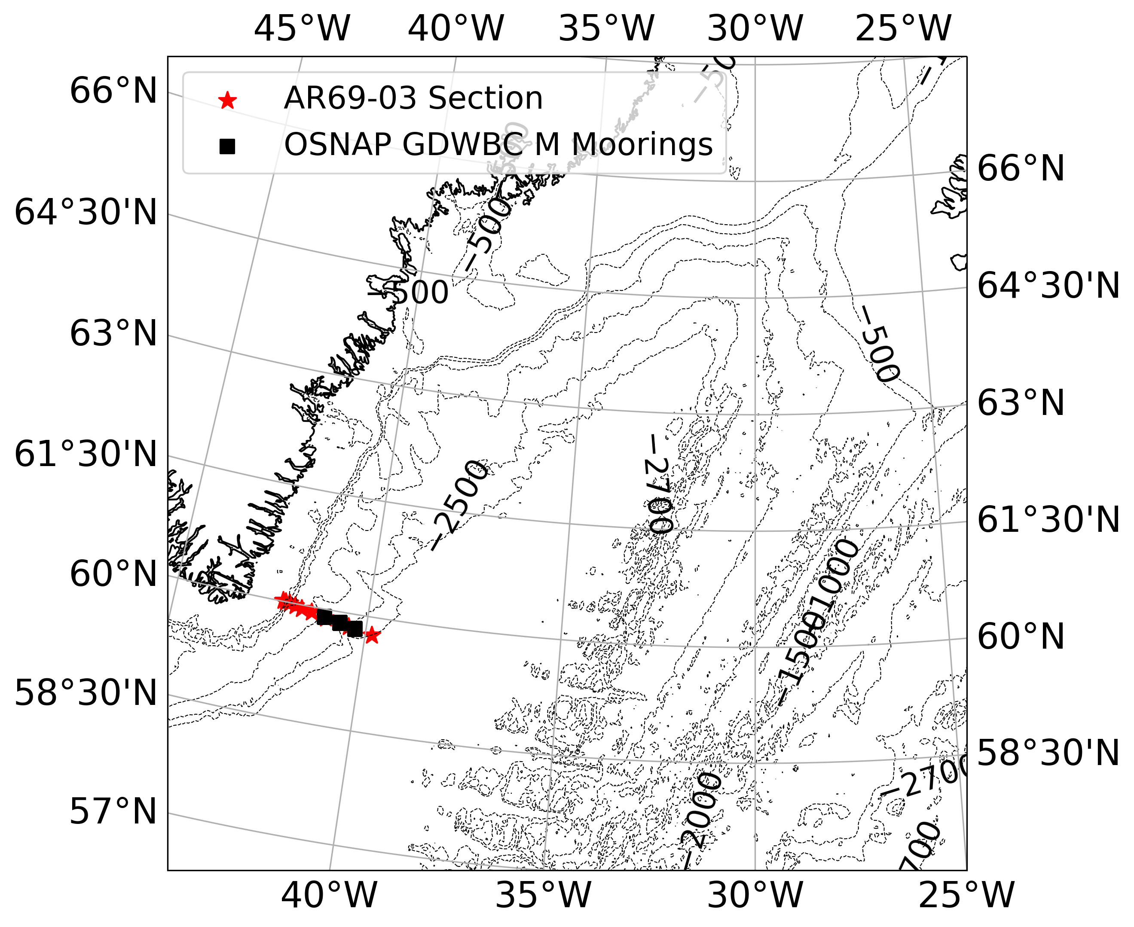
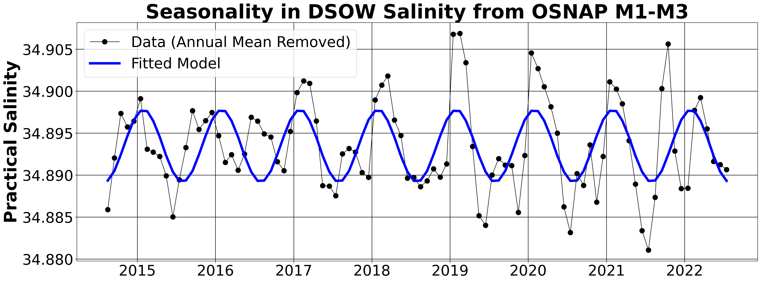
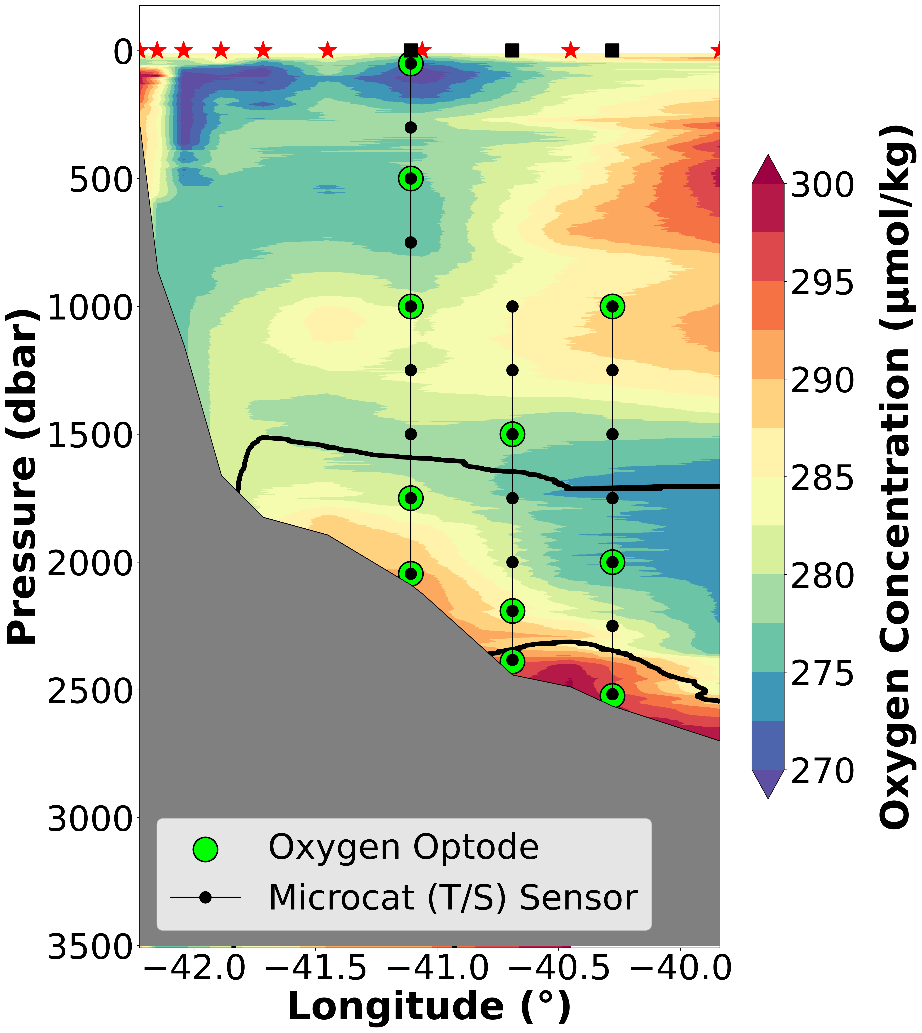
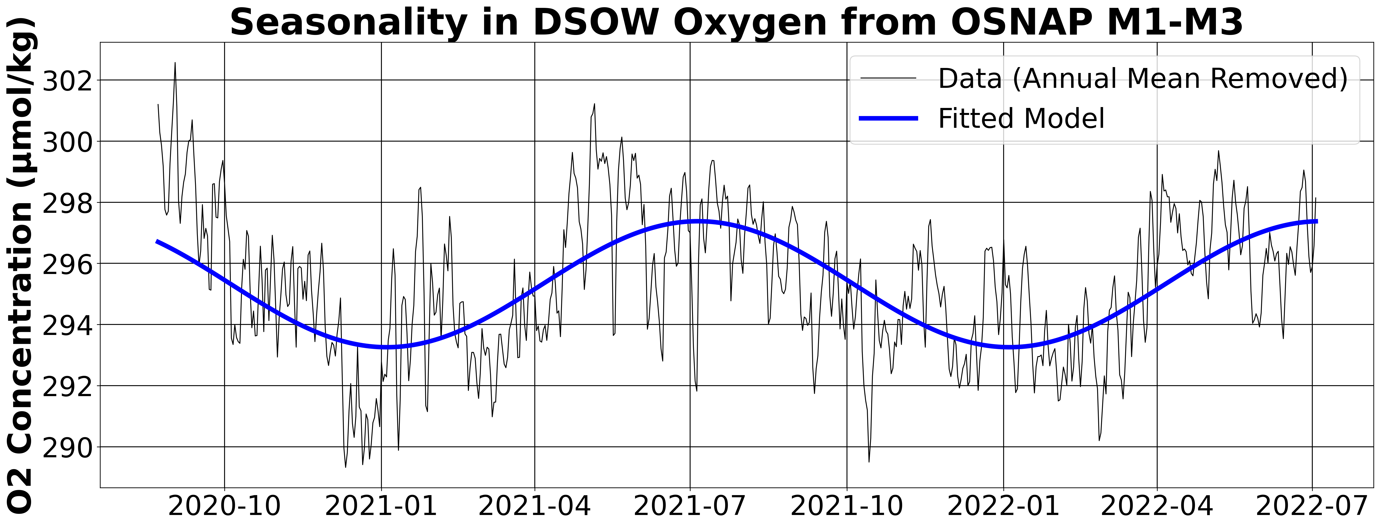
There is growing observational evidence for seasonal variability in DSOW properties in the Irminger Sea.
Entrainment
DSOW
OSNAP
M1
OSNAP
M2
OSNAP
M3
hiroki.nagao@whoi.edu
Notes:
Rough Script: This talk presents new time series data from the OSNAP moorings that reveal seasonality in DSOW properties in the Irminger Sea. The location of the OSNAP moorings are shown in the black squares on the map. We focus on the bottom-most instruments from OSNAP M1-M3 as they sample DSOW. As you can see in this time series, DSOW salinity is freshest around July and saltiest around January. You can also see similar seasonal patterns in the dissolved oxygen concentration, which peaks around July and dips around January.
Peak-to-Trough (DSOW Salinity): ~ 0.01 psu
Peak-to-Trough (DSOW Oxygen): ~ 4.1 micromoles per kilogram
R-squared (DSOW Salinity): 0.31
R-squared (DSOW Oxygen): 0.36
ONE-SENTENCE MESSAGE: New salinity and oxygen time series from the OSNAP moorings reveal seasonality in DSOW properties in the Irminger Sea.

Slide 4
Key Physical Mechanisms Controlling DSOW Properties
Figure Source: NOAA
(2)
(1)
(3)
Entrainment Variability
hiroki.nagao@whoi.edu
Notes:
Rough Transcript: Variability in DSOW properties may be attributed to the following mechanisms: (1) variations in the source water properties upstream of the sill, (2) variations in the properties of ambient waters participating in entrainment, or (3) variations in the entrainment strength. But the relative importance of each mechanism in influencing seasonality in DSOW properties remains unclear.
ONE-SENTENCE MESSAGE: Variability in DSOW properties can originate from source water properties, properties of entrained waters, or the entrainment strength, but the importance of each mechanism in setting the seasonality in DSOW properties remain unclear.

Slide 5
Key Physical Mechanisms Controlling DSOW Properties
Figure Source: NOAA
Research Questions:
Does entrainment strength vary seasonally?
What processes control seasonal variations in DSOW properties?
Approach: Use Price and Baringer (1994)’s model of entrainment mixing and novel dissolved oxygen measurements from OSNAP moorings.
(2)
(1)
(3)
Entrainment Variability
hiroki.nagao@whoi.edu
Notes:
Rough Transcript: Thus, I aim to investigate seasonal signatures in DSOW properties from an entrainment perspective. Specifically, I will address: (1) Is entrainment strength constant or variable over seasonal timescales?; (2) What physical processes control seasonal variations in DSOW properties? Here, we argue that seasonal variations in DSOW properties originate from the source waters upstream of the sill by using Price and Baringer (1994)’s model of entrainment mixing and novel dissolved oxygen measurements from the OSNAP moorings.
ONE-SENTENCE MESSAGE: I aim to investigate seasonal signatures in DSOW properties from an entrainment perspective, using Price and Baringer (1994)’s model and novel oxygen measurements from OSNAP moorings.

Slide 6
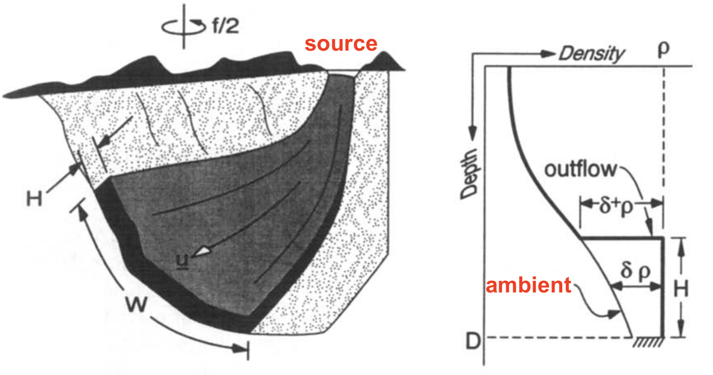
Price and Baringer (1994)’s model simulates changes in DSOW properties in response to entrainment.
Price and Baringer (1994)
hiroki.nagao@whoi.edu
Notes:
Rough Transcript: As you can see in this schematic, Price and Baringer (1994)’s stream tube model treats DSOW as a single layer, density-driven bottom current with velocity u, width W, and thickness H. Importantly, the model takes the source and ambient water properties as inputs and simulates DSOW properties in response to entrainment. In the model, entrainment strength is also coupled to the overflow dynamics, as entrainment is stronger under larger density difference between the overflow water and the ambient water.

Slide 7
Set-up of numerical model experiments
Seasonality in Ambient Waters: BGC-Argo data in the northern Irminger Sea
Ambient water properties set seasonality of DSOW properties.
Experiment 1: Constant source waters + Seasonally varying ambient waters
Seasonality in Source Waters: Shipboard CTD measurements in the Denmark Strait
Experiment 2: Seasonally varying source waters + Constant ambient waters
Source water properties set seasonality of DSOW properties.
hiroki.nagao@whoi.edu
Notes:
Rough Transcript: I use observed seasonal signals in the ambient waters from BGC-Argo profiles in the northern Irminger Sea and source waters from CTD measurements in the Denmark Strait, in conjunction with two sets of model experiments, to constrain the sources of seasonality in DSOW properties. In the first experiment, we keep the source water properties constant and impose seasonality in ambient water properties. If the resulting seasonality matches with the OSNAP data, ambient water properties likely set the seasonality. Second, we impose seasonality in the source water salinity and keep the ambient water properties constant; results consistent with OSNAP data imply that source water properties set the seasonality.
KEY MESSAGE: I conduct three sets of experiments on Price and Baringer (1994)’s model to constrain the sources of the observed seasonality in DSOW properties.

Slide 8
Seasonality in entrained water properties cannot account for the observed seasonality in DSOW properties.
hiroki.nagao@whoi.edu
Notes:
Rough Transcript: Here, I’m showing the results of the model experiment where we kept the source waters constant and seasonally varied the ambient waters. The plot shows the time series of salinity and oxygen anomalies from the OSNAP moorings in blue, the fitted seasonal cycle from the observations in black, and the results of the model experiment in red. You can see that for both DSOW salinity and oxygen concentration, the magnitude of seasonality predicted by the experiment clearly underestimates the observed seasonality. Thus, observed seasonality in entrained water properties cannot account for the seasonality in DSOW properties observed from the OSNAP moorings.
KEY MESSAGE: The model experiment that used constant source waters and imposed observed seasonality in the entrained waters yielded modelled seasonality in post-entrainment DSOW properties that is much smaller than the observations, suggesting that seasonality in entrained waters cannot account for the observed seasonality in DSOW properties.

Slide 9
Seasonality in source overflow salinity can account for the observed seasonality in DSOW salinity.
hiroki.nagao@whoi.edu
Notes:
Rough Transcript: Now, I’m showing the results of the model experiment where we seasonally varied the source overflow salinity and kept the ambient waters constant. You can see that the magnitude of seasonality in DSOW salinity predicted by the experiment closely agrees with the observed seasonality. The results are similar in a subsequent experiment where we seasonally varied both the source overflow salinity and the ambient water properties. Thus, observed seasonality in source overflow salinity can account for the seasonality in DSOW salinity observed from the OSNAP moorings.
KEY MESSAGE: The model experiments that imposed observed seasonality in the source overflow salinity produced seasonality in post-entrainment DSOW salinity consistent with observations, confirming that seasonality in DSOW salinity originates upstream of the sill.

Slide 10
We estimate that a seasonality of 5 μmol kg⁻¹ in the source overflow oxygen can account for the observed seasonality in DSOW oxygen.
hiroki.nagao@whoi.edu
Notes:
Rough Transcript: Due to the lack of year-round observations of oxygen at the sill, we estimated a plausible magnitude of seasonality in the oxygen concentration of the source overflow that can account for the seasonality in post-entrainment DSOW oxygen concentration. Setting the seasonality in the oxygen concentration of the source overflow to about 5 micromoles per kilogram, you can see that the resulting seasonality in post-entrainment DSOW oxygen concentration closely matches with the observations from the OSNAP moorings. The results are similar under the experiment where we seasonally varied both the source overflow and the ambient water properties.
KEY MESSAGE: Due to the lack of year-round observations of oxygen at the sill, we estimated a plausible magnitude of seasonality in the oxygen concentration of the source overflow that can account for the observed seasonality in post-entrainment DSOW oxygen concentration.

Slide 11
Summary and Conclusions
Figure Source: NOAA
❌
✅
❌
Conclusion: Seasonal variations in DSOW properties originate from the source waters.
hiroki.nagao@whoi.edu
Notes:
Rough Transcript: In conclusion, my model experiments suggest that seasonality in DSOW properties likely originates from the source waters. Variations in ambient water properties can be ruled out because there is little to no seasonality in ambient water properties that are entrained into DSOW. Likewise, seasonal variations in entrainment strength can be ruled out because there are no seasonal variations in the density of the source overflow water and ambient water.
KEY MESSAGE: Our model experiments suggest that seasonality in DSOW salinity and oxygen concentration likely originate from seasonality in source overflow properties, suggesting that DSOW variability is tightly connected to dense water formation upstream of the Denmark Strait and that overflows act as a mechanism by which climate signals in the Nordic Seas can be communicated to the deep ocean.

Slide 12
Summary and Conclusions
Figure Source: NOAA
❌
✅
❌
Implication: Processes upstream of the Denmark Strait are a key control on variability in ventilation.
hiroki.nagao@whoi.edu
Notes:
Rough Transcript: Our work therefore suggests that surface processes upstream of the Denmark Strait can act as a key control for variability in ventilation processes in the Subpolar North Atlantic.
Rough Transcript (Extended Version): Our work has important implications for not just how we understand climate signal propagation from the surface to the deep ocean, but also for elucidating ventilation processes and pathways in the Subpolar North Atlantic. Specifically, we emphasize that this is the first time that seasonal signatures in DSOW oxygen properties has been detected and that our analysis was only possible owing to the recent deployment of novel moored oxygen sensors. Our detection of seasonal signatures in the year-round oxygen measurements together with the results of the model experiments suggest that surface processes upstream of the Denmark Strait act as a key control on ventilation of the deep ocean. However, investigation of physical processes contributing to variability in upstream ventilation processes is beyond the scope of this work and warrants further study.

