Slide 1
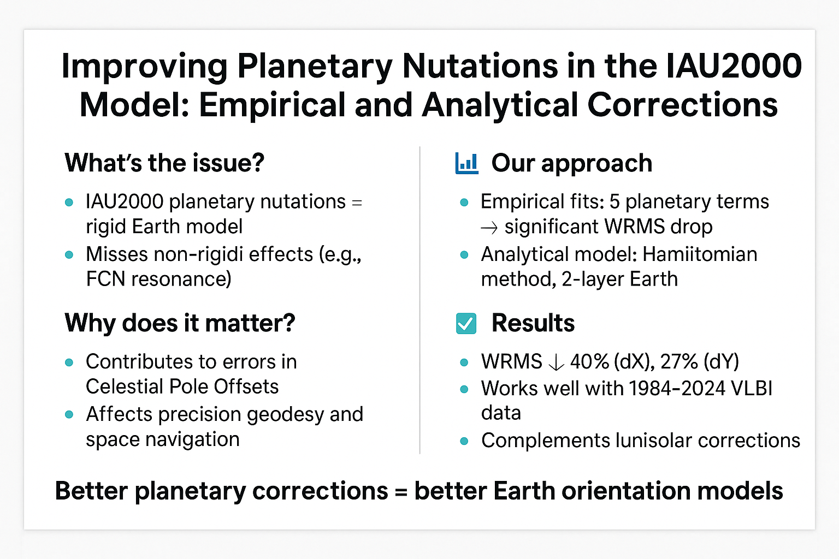

Slide 2
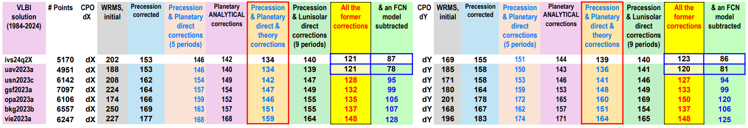
Comparison of WRMS Reductions in Celestial Pole Offsets (dX, dY) from VLBI Solutions (1984–2024) under Various Correction Strategies

