Slide 1
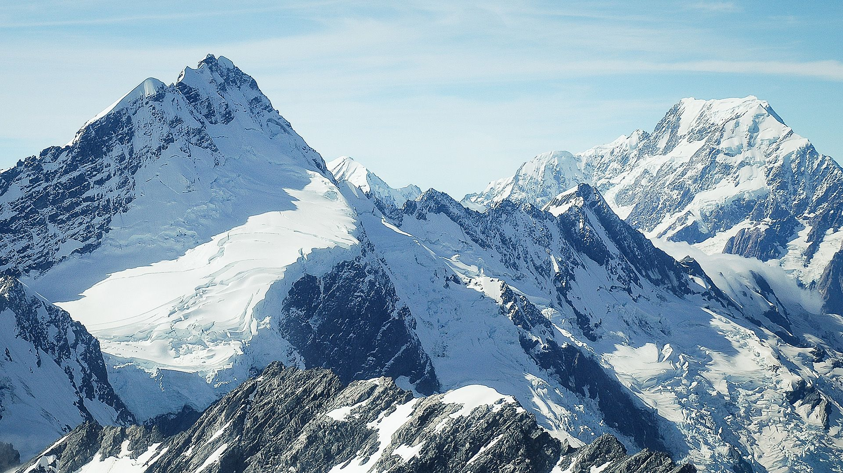


Cryosphere monitoring and modeling in Central Asia: integrating in-situ observations, remote sensing and community driven approaches
Dr. Abror Gafurov
Astrid Krahn, Anesa Sasivarevic, Adkham Mamaraimov, Friedrich Busch, Akmal Gafurov, Jakhongir Kayumbaev, Nurilloh Abdurasulov, Olga Kalashnikova, Jafar Niyazov, Tursyn Tillakarim, Jakhongir Makhmudov, Elena Grigoreva

Slide 2

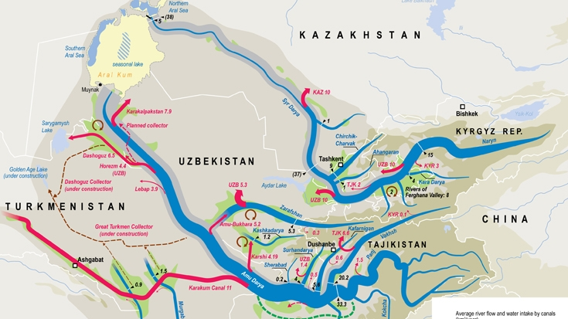
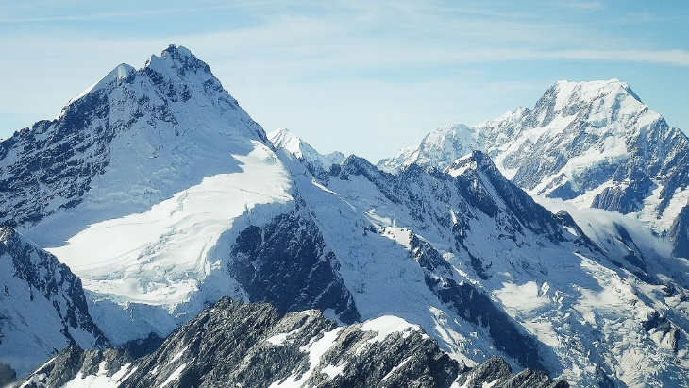
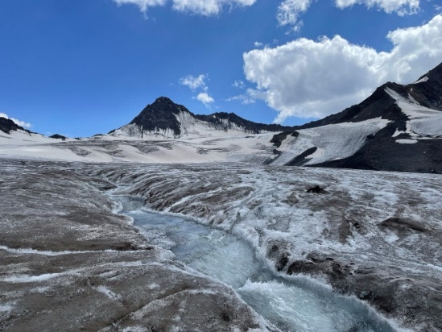
PAMIR AND TIAN SHAN - WATER TOWERS OF CENTRAL ASIA
Water stored as snow and ice is essential for human life in CA
Mountain in arid environment store essential water for summer season
Supplies water for >100 mln. population
Highly vulnerable to climate change
  >30 % glacier melt already
  Loss of storage function due to more rainfall share than snow
  Increased frequency of natural hazards (e.g. , floods, landslides, mudflows)

Slide 3
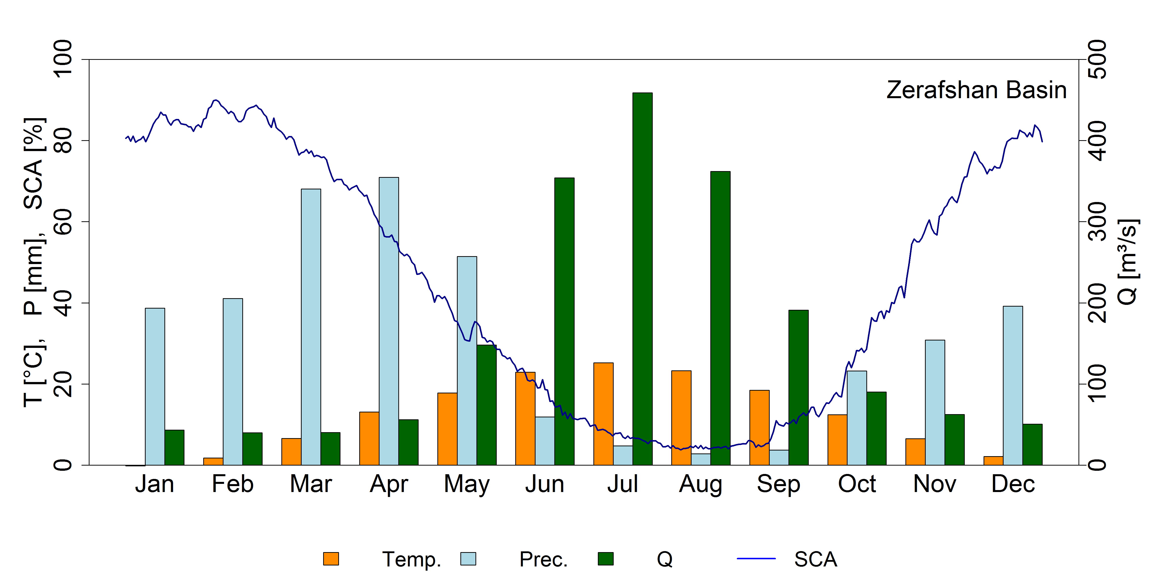
Water Balance in Central Asia
(role of cryosphere)
Negligible summer precipitation (dry summers)
Peak summer river flow
Snowmelt and glaciermelt dominated hydrology
Snow plays an important role in DRM
Snowmelt > 50 %
Glaciermelt < 20 %
Gafurov et al., 2015, TC

Slide 4
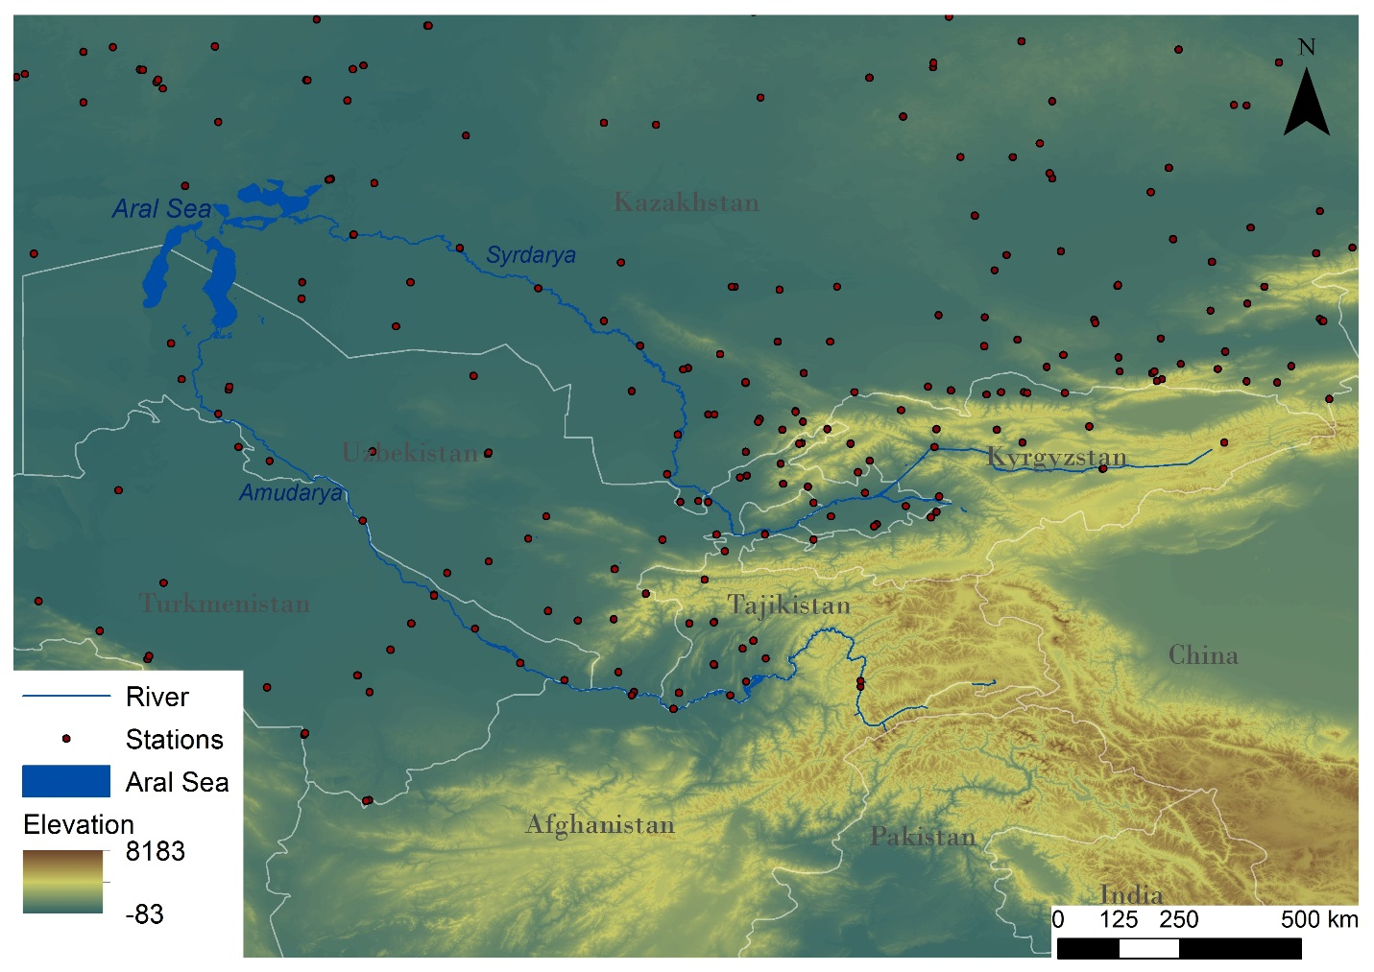
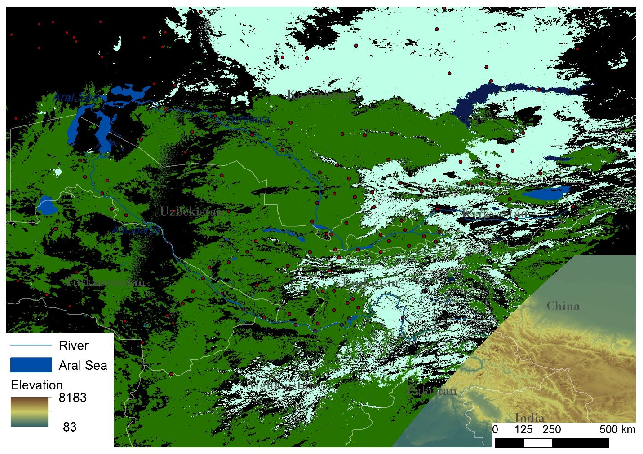
DATA SCARCITY AND REMOTE SENSING DATA POTENTIAL
Remoteness of area
Limited data availability due to extreme climatic conditions
High potential of remote sensing data to fill the gap
Operatinal processing tools necessary to support daily application

Slide 5
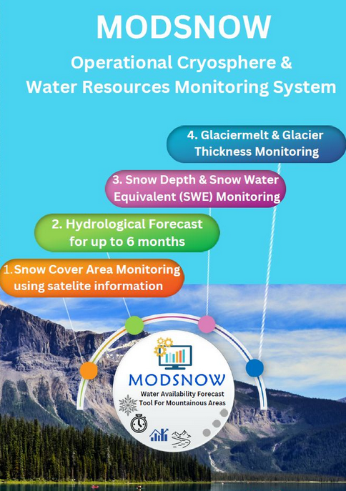
MODSNOW – OPERATIONAL CRYOSPHERE AND WATER RESOURCES MONITORING TOOL
MODULE I: Operational Snow Cover Area Monitoring using MODIS data (including cloud elimination)
MODULE II: Hydrological forecasting for 10 days, monthly scale and vegetation period (6 months)
MODULE III: Operational monitoring of snow depth and snow water equivalent at 500-meter and 25-meter spatial scales
MODULE IV: Daily estimation of glacier melt at 25 meter spatial scale

Slide 6
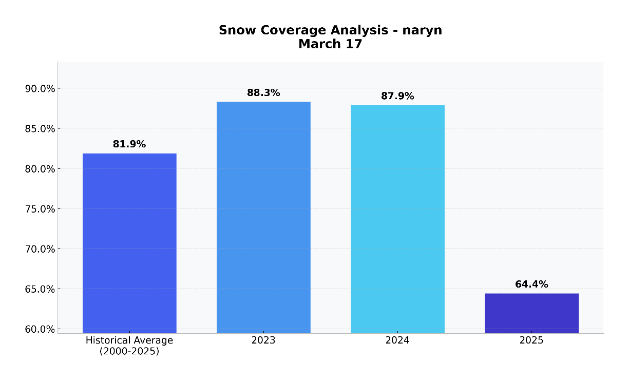
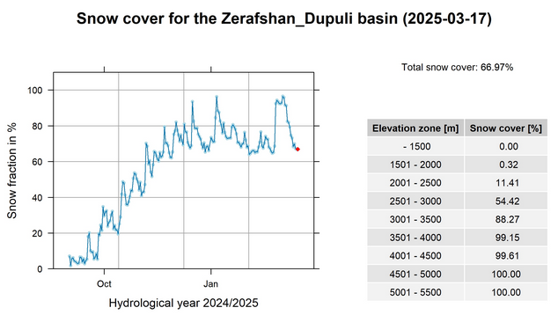
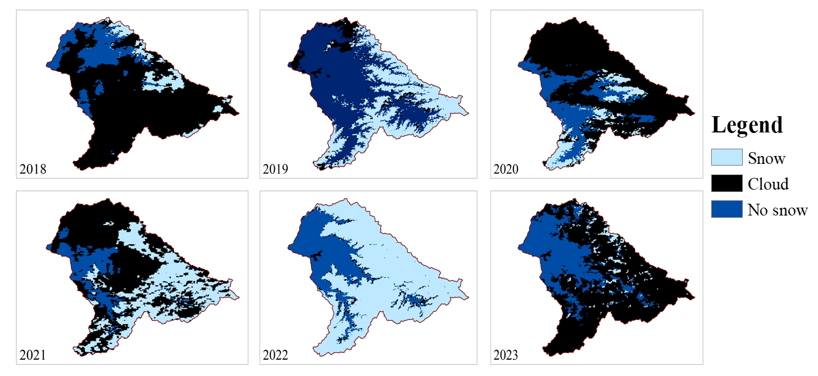
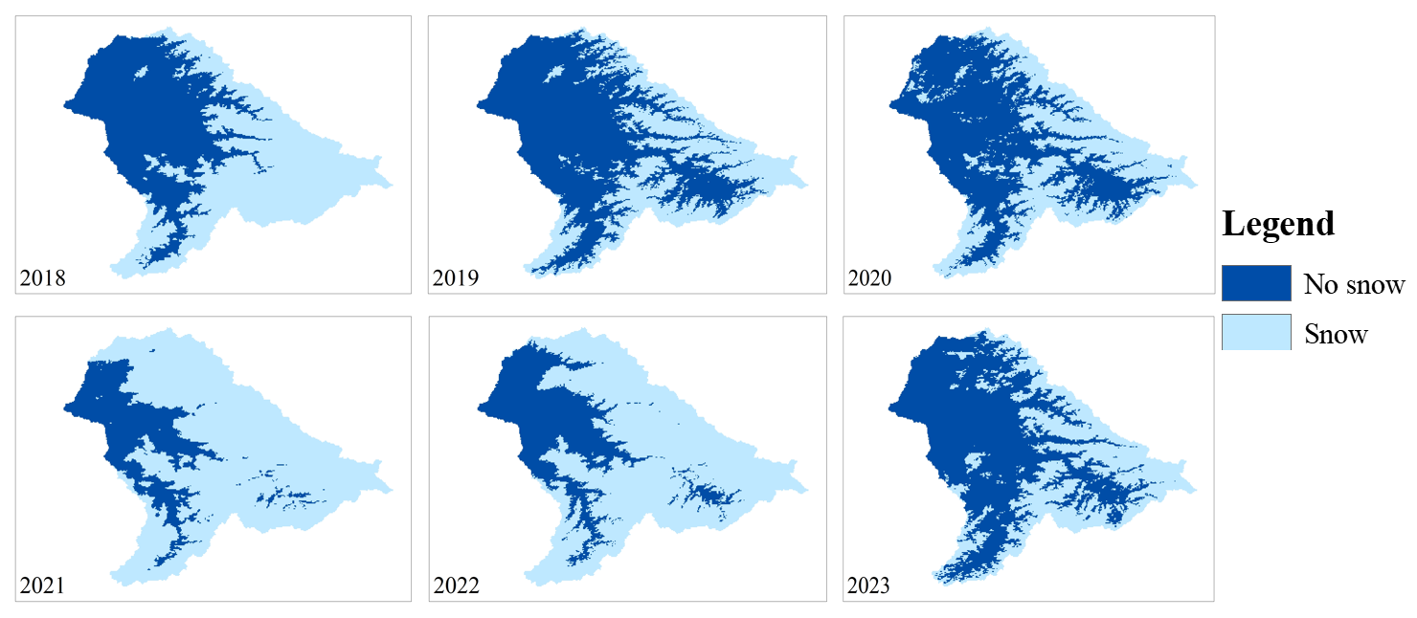
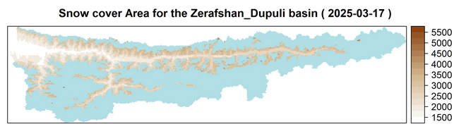
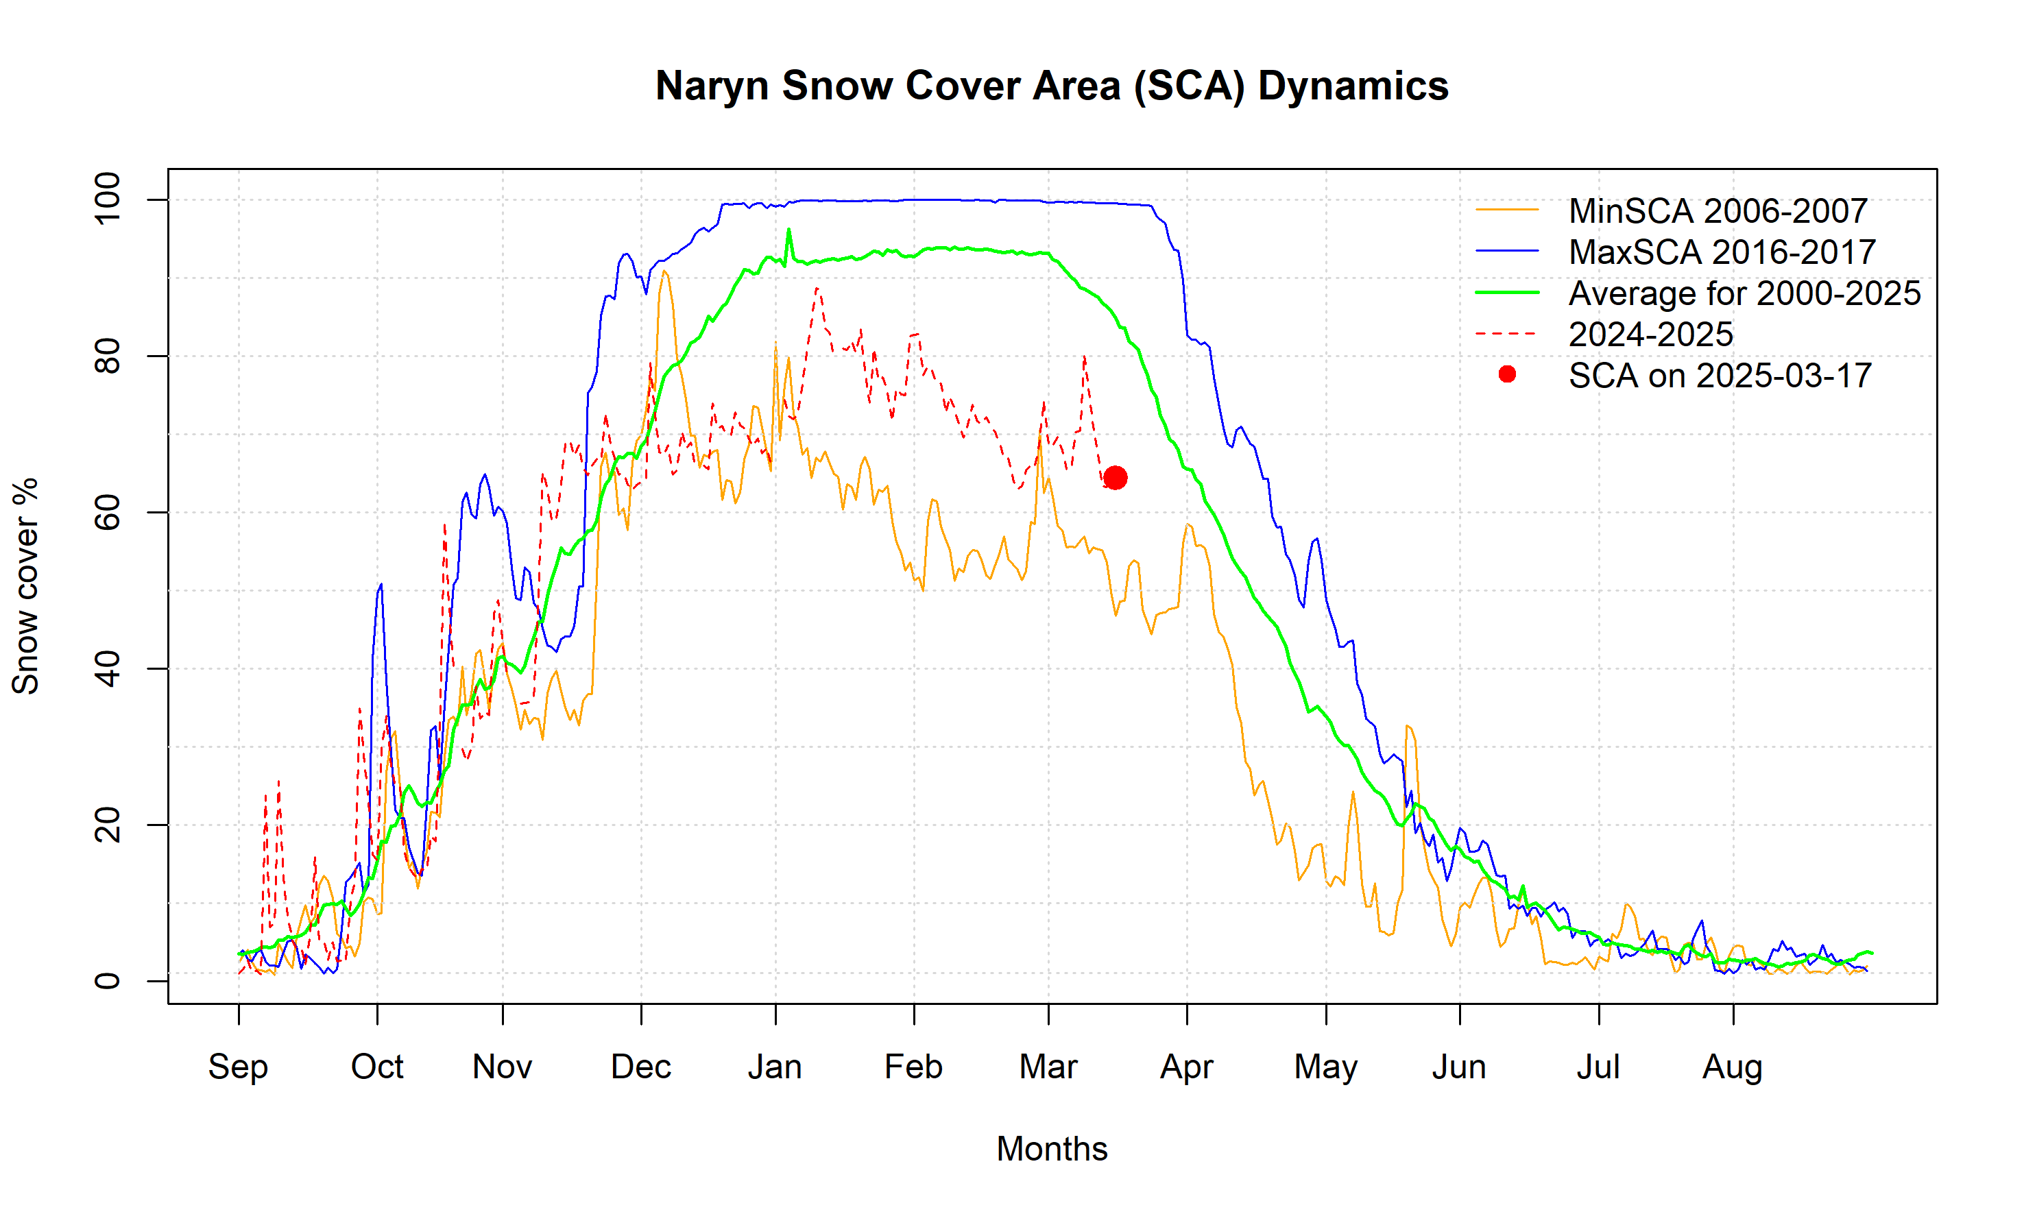
OPERATIONAL SNOW COVER MONITORING USING MODSNOW
Karadarya River Basin
89 % accuracy of MODIS original data in Central Asia (Gafurov et al., 2013)
94 % accuracy of cloud removal algorithm (Gafurov et al., 2016)

Slide 7
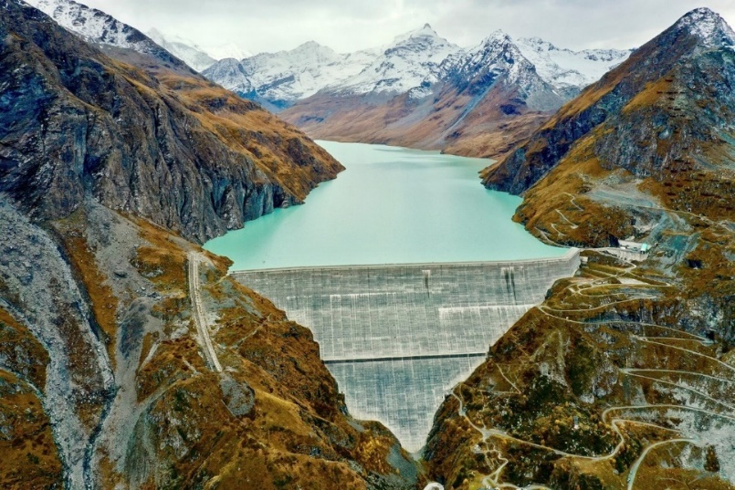
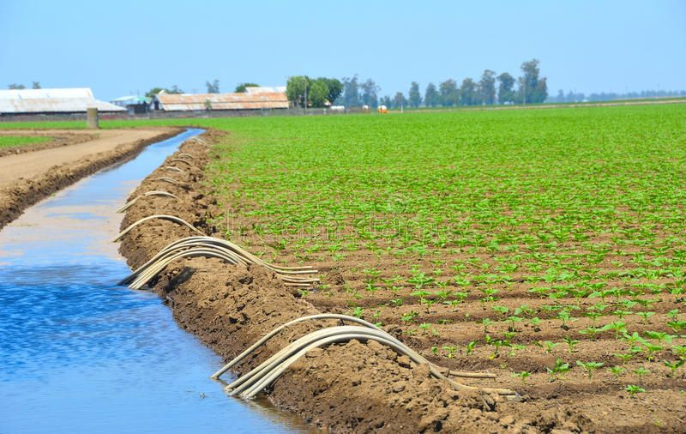
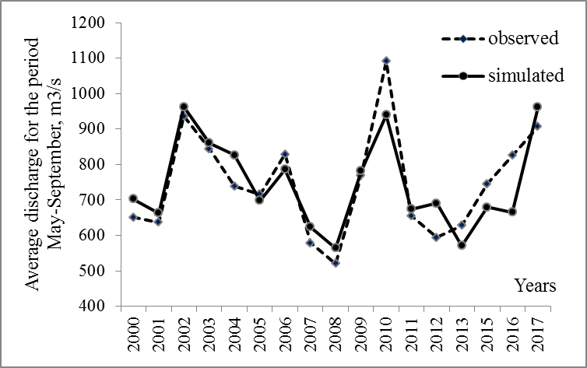
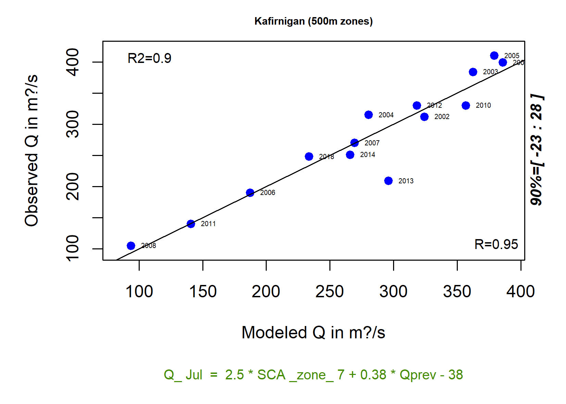
HYDROLOGICAL FORECASTING USING MODSNOW
Forecast of inflow to reservoirs
Forecast for agricultural irrigation
Hydrological forecasting for 10 days, monthly scale and up to 6 months (vegetation period)
Based on snow cover data and other parameters (if available)
High accuracy (~90 %) of hydrological forecasts due to precise information on snowpack and glacier melt
Credit: www.copernicus.eu
Credit: www.pinterest.de
Inflow Toktogul Reservoir
Kalashnikova and Gafurov, 2017

Slide 8
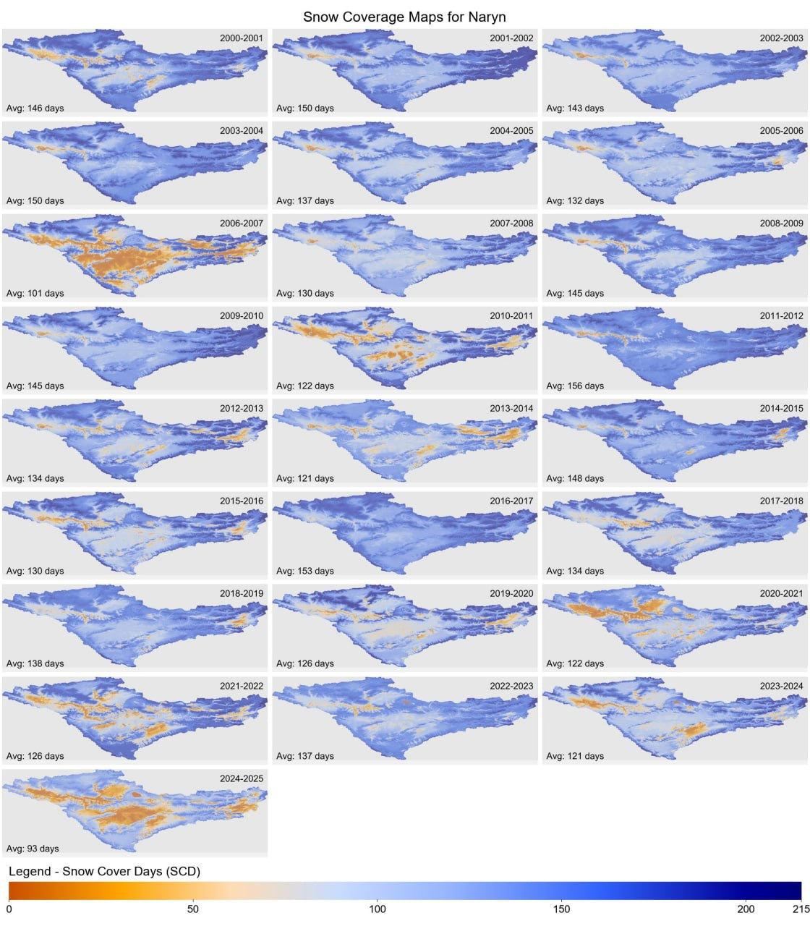
Expecting hydrological drought in summer 2025?
Very little snow accumulation was observed in winter 2024/2025
Similar pattern as 2006/2007 – extreme drought year
Hope for some rain in coming months

Slide 9
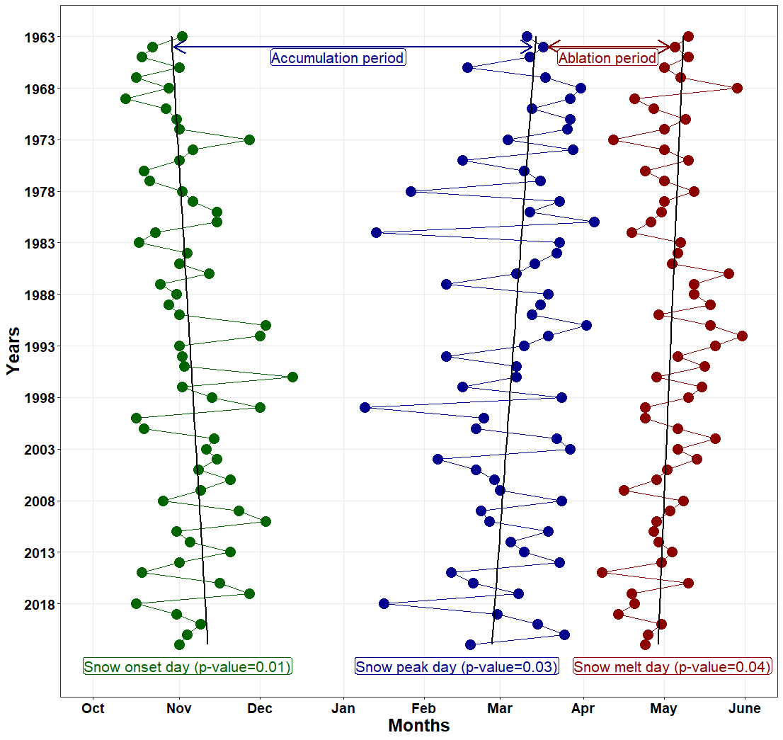
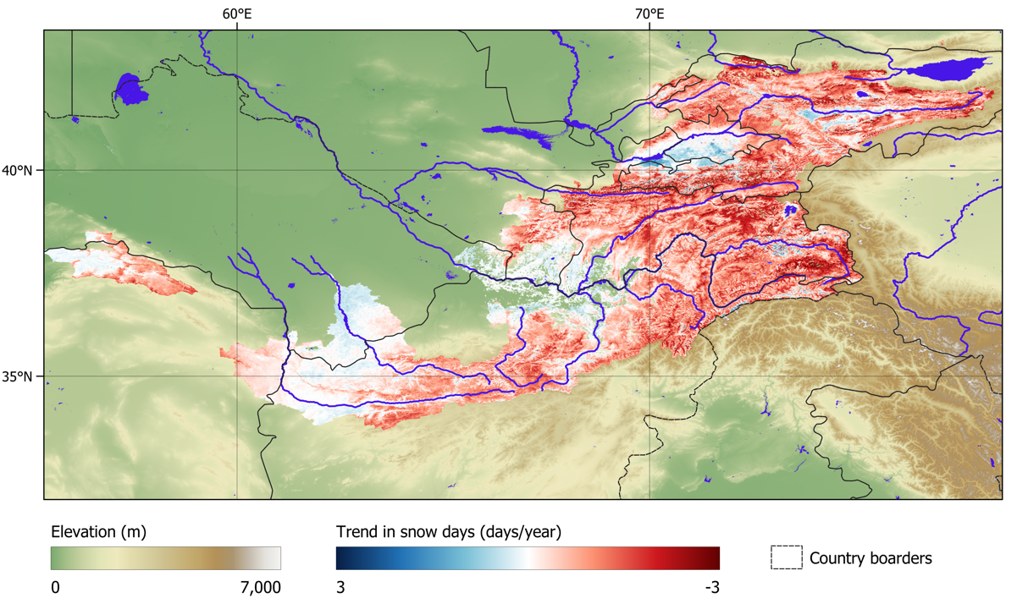
Vanishing snow in Central Asia
Mamaraimov, et al. (in prep)

Slide 10

www.modsnow.online
Free access

Slide 11
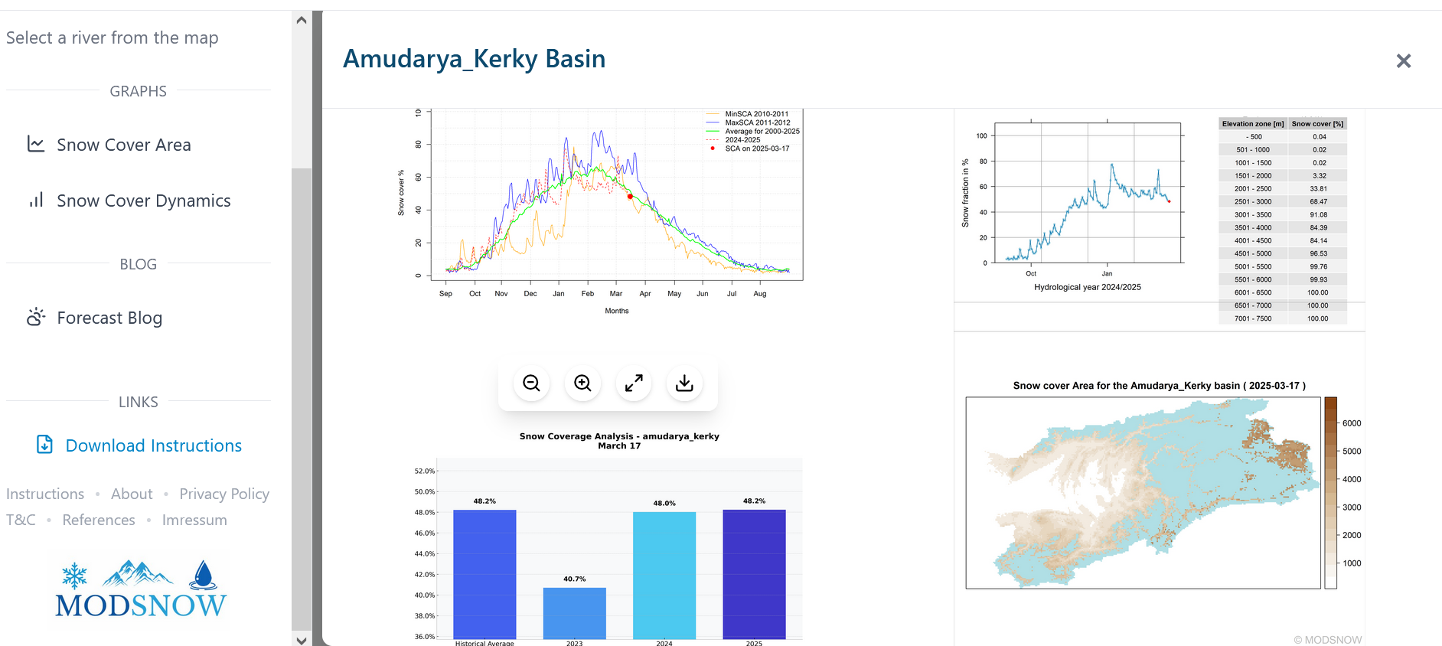
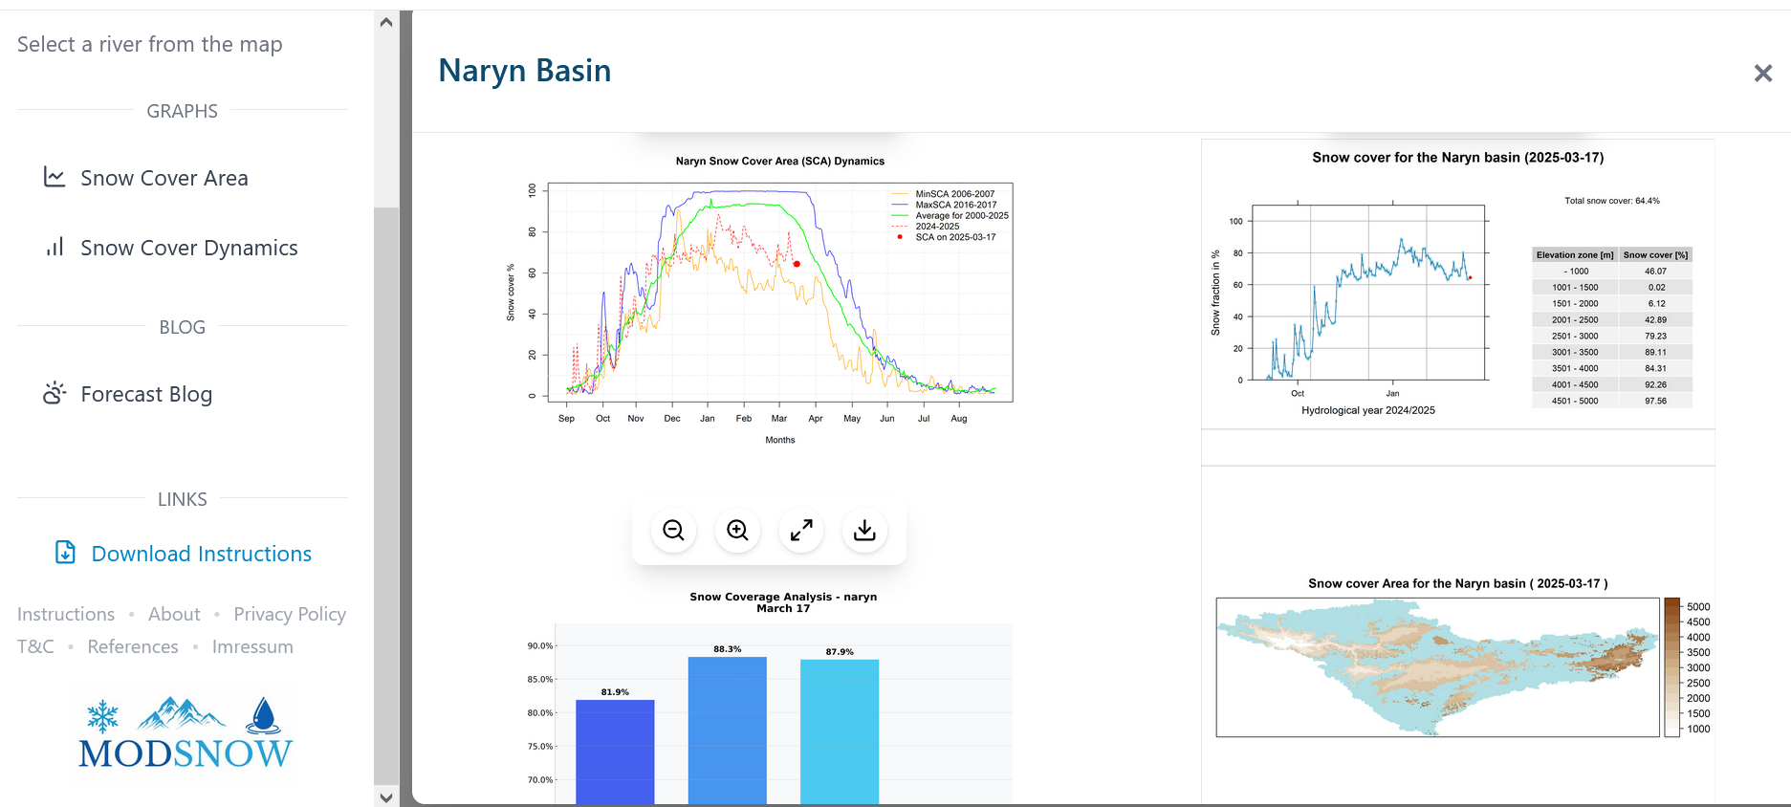
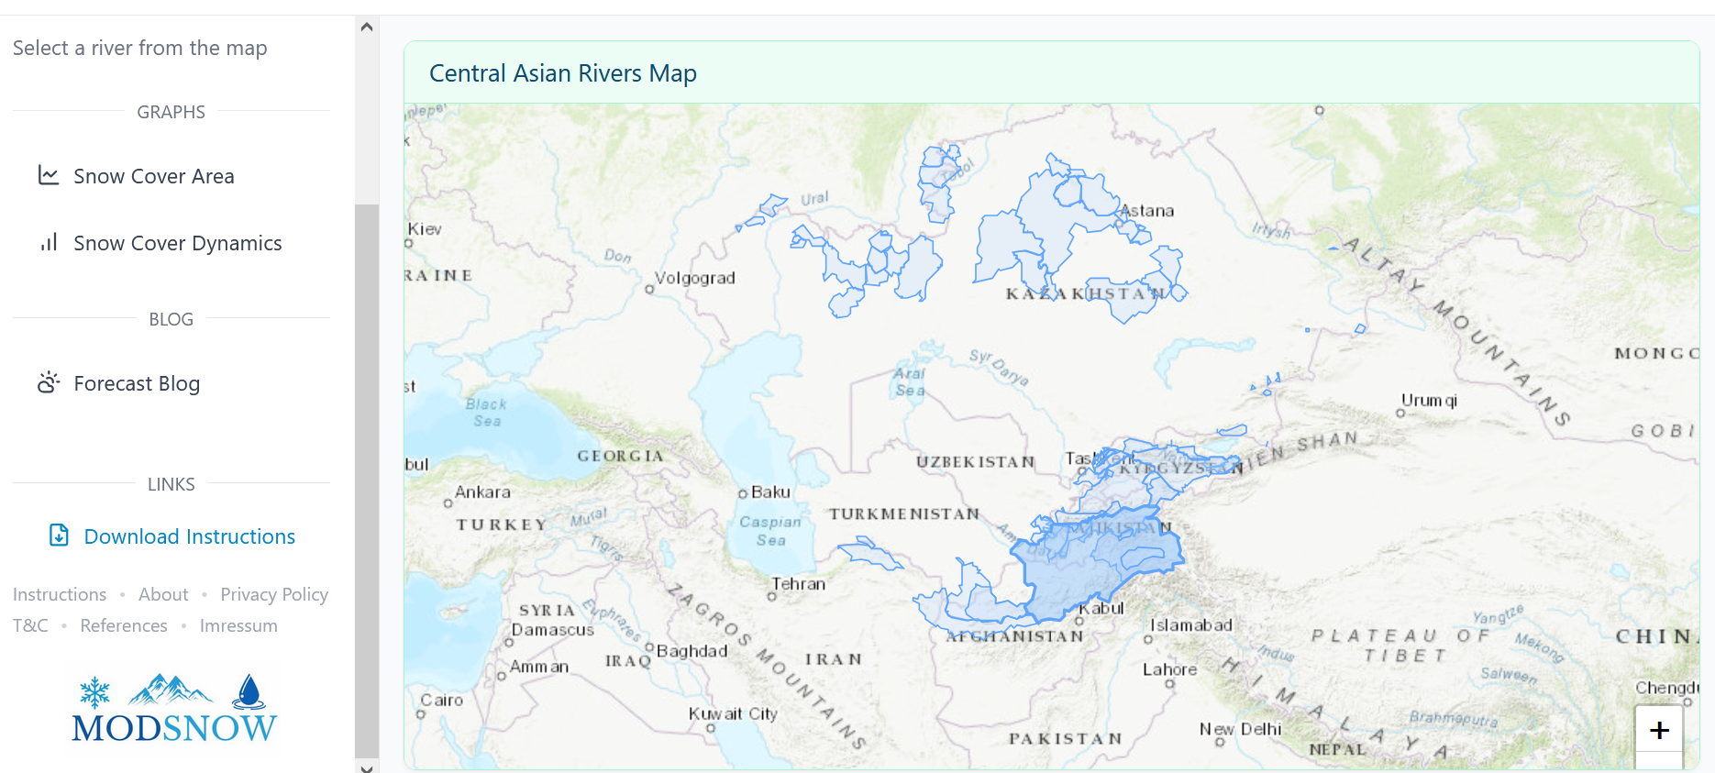
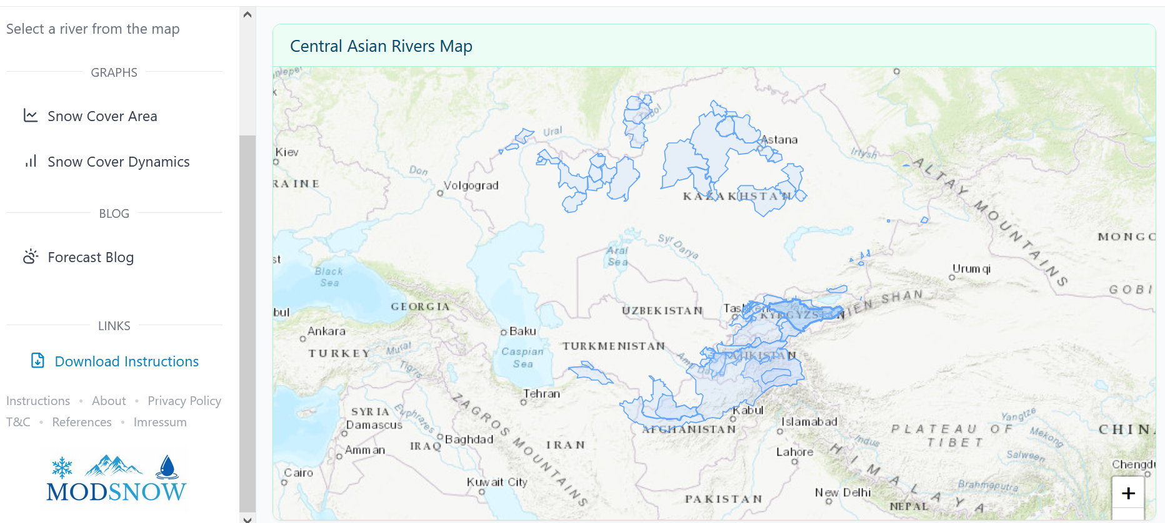
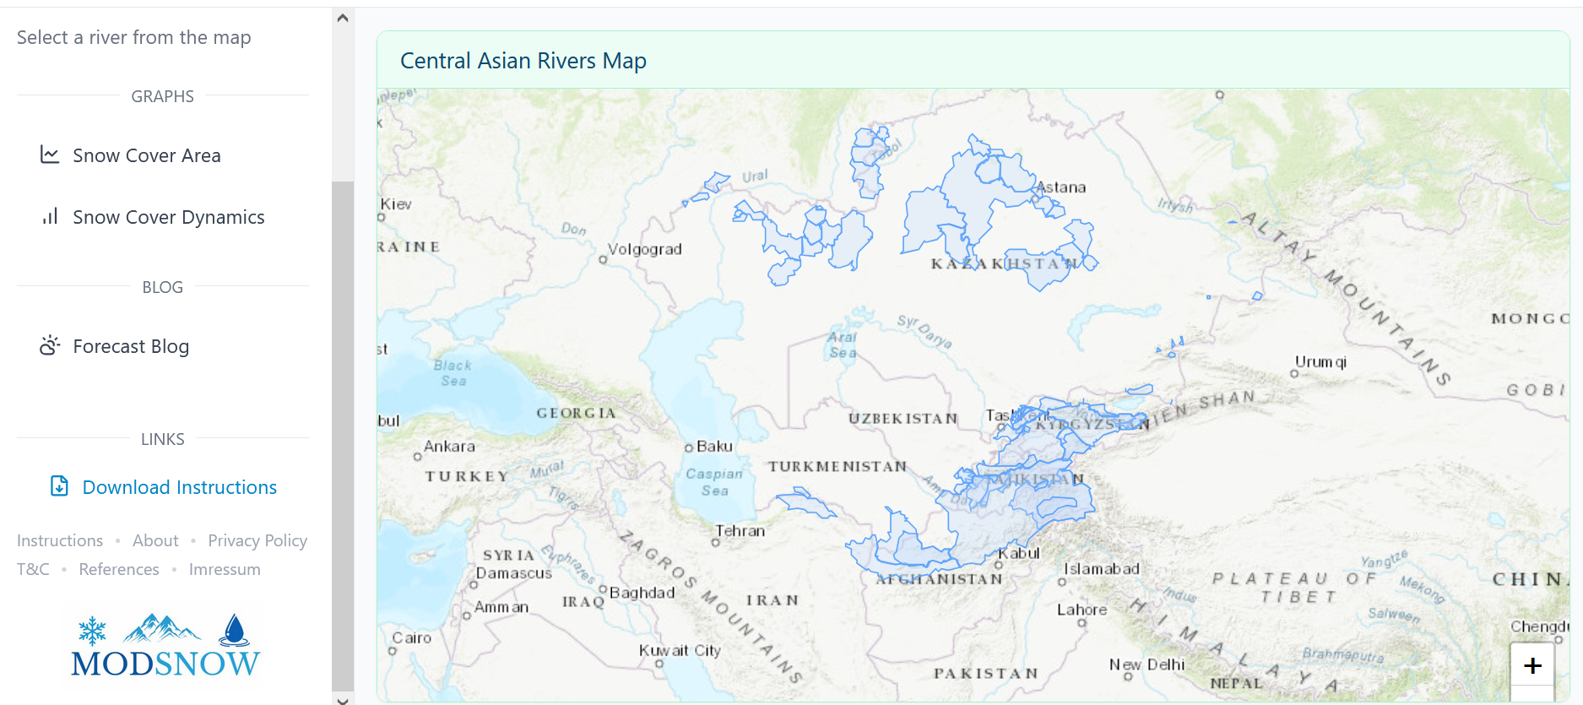
World Day for Glacier 2025: Side Event „A vanishing mountain cryosphere and its importance to the water cycle under climate change“

Slide 12
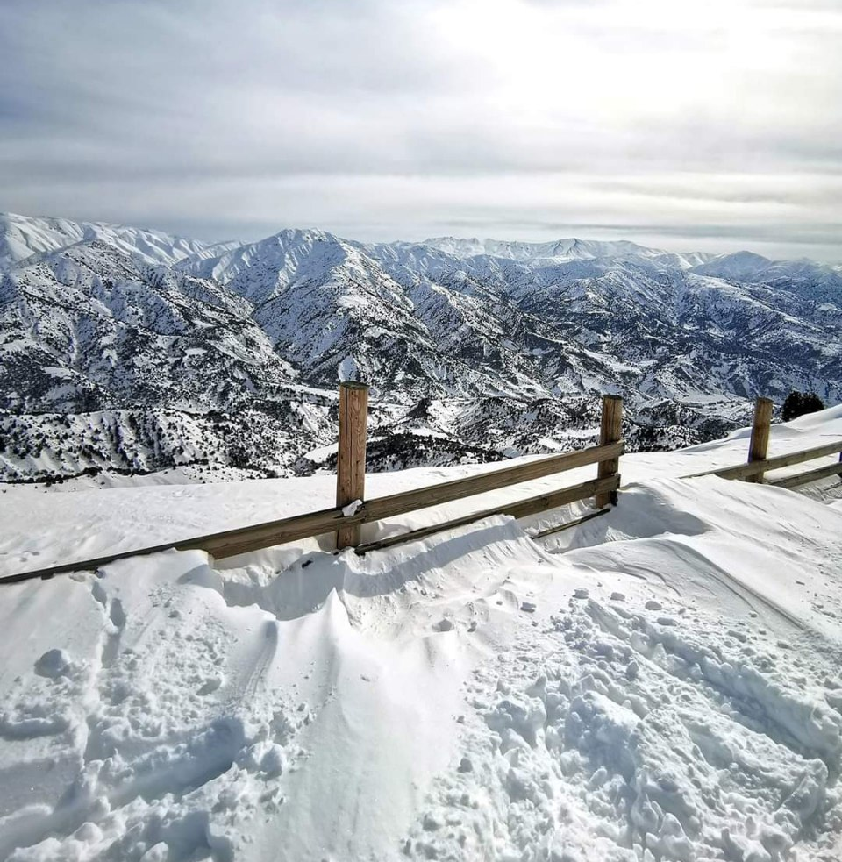

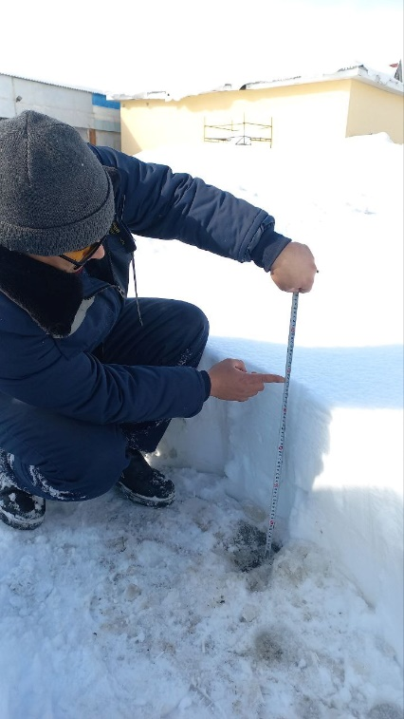
Snow Depth Observation
New Approach
(with a community help)
Uzbekistan, Kyrgyzstan, Tajikistan

Slide 13
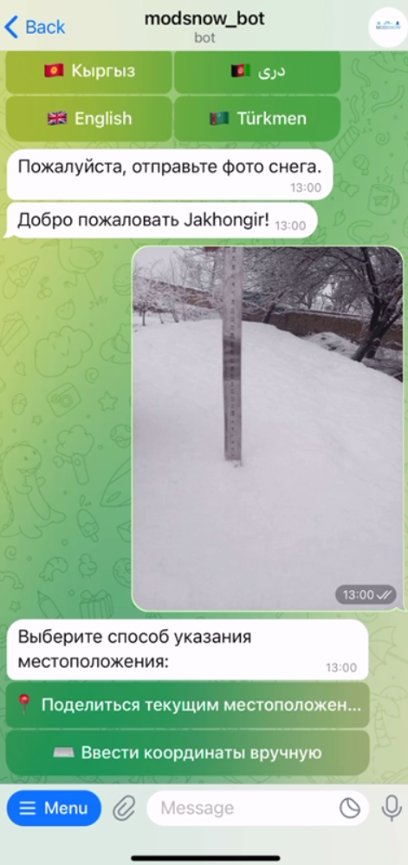

Data sharing platform
Created a dedicated telegram bot
Support from environmental bloggers to invite volunteers
Motivate participants / volunteers with state of art of snow cover situation in Central Asia

Slide 14
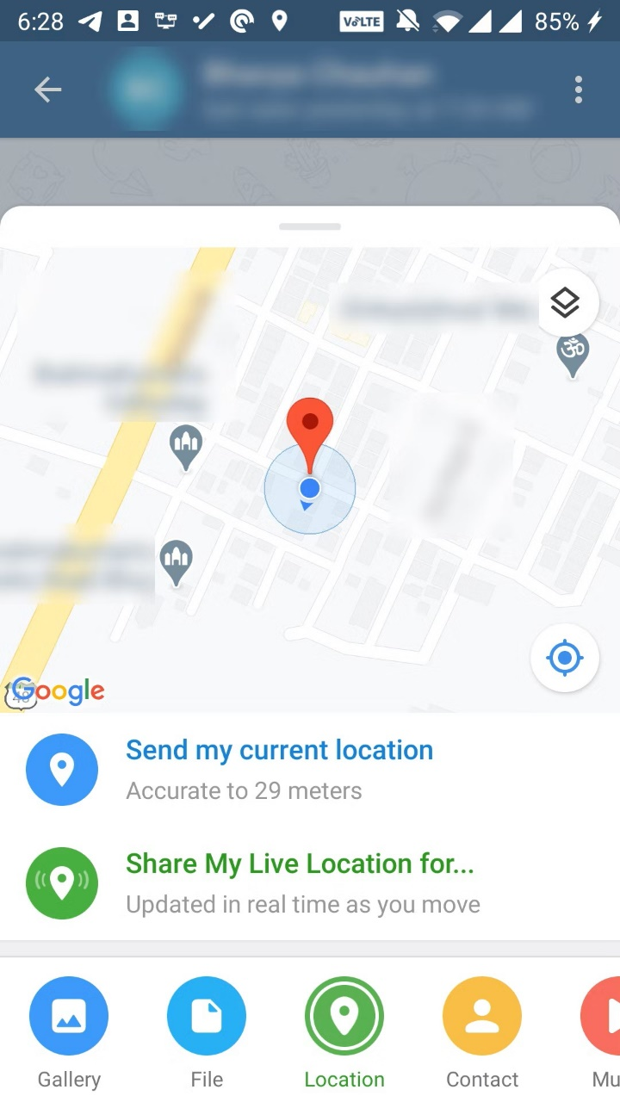
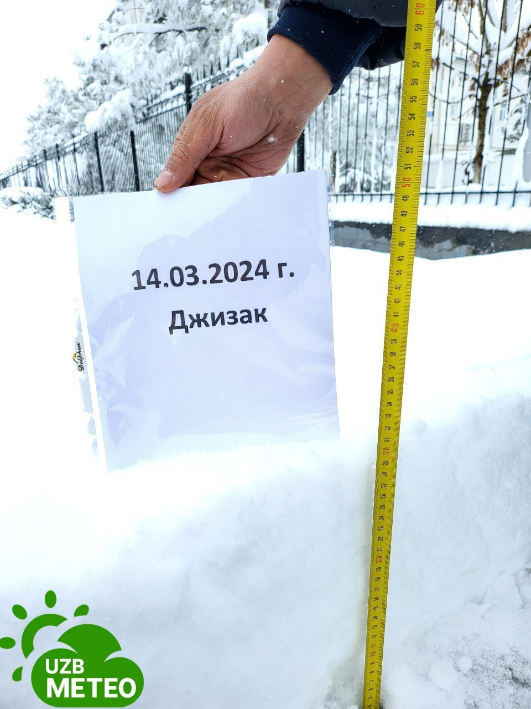
Process of snow data collection
Identification of location though smartphone location identifier
Measuring snow depth
Taking a picture
Sending to dedicated channel

Slide 15
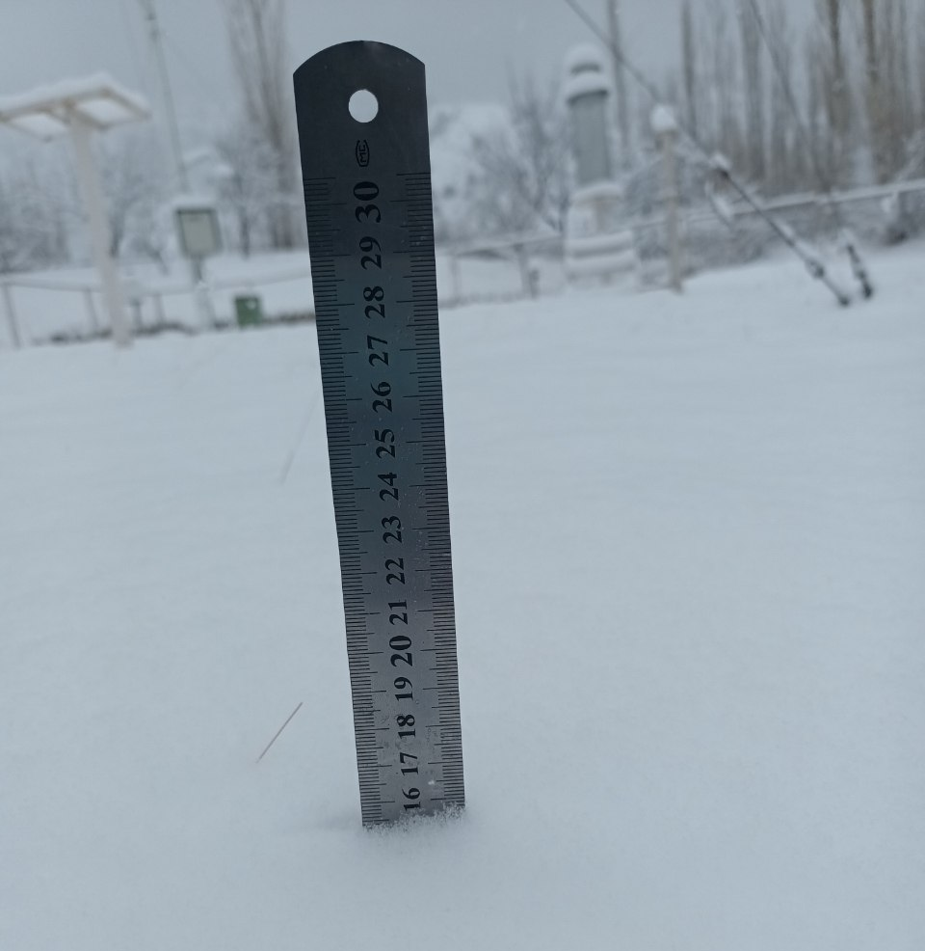
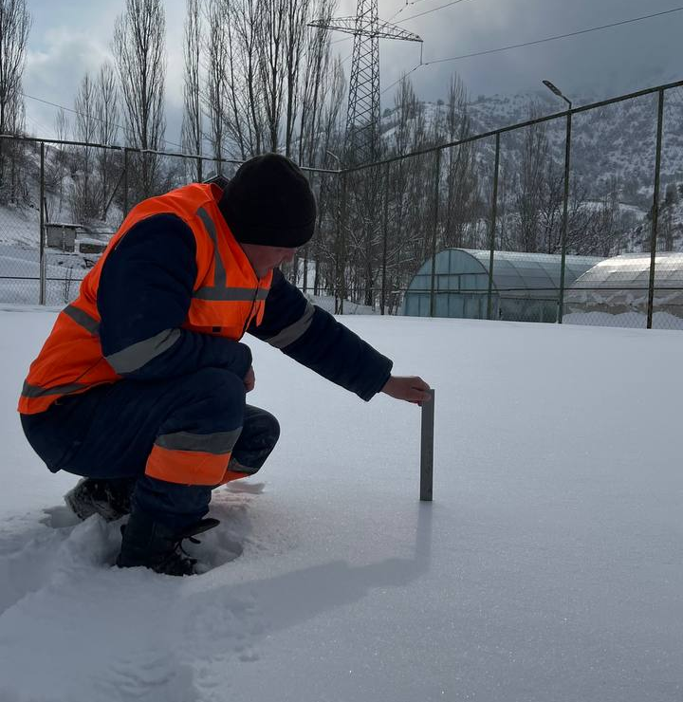
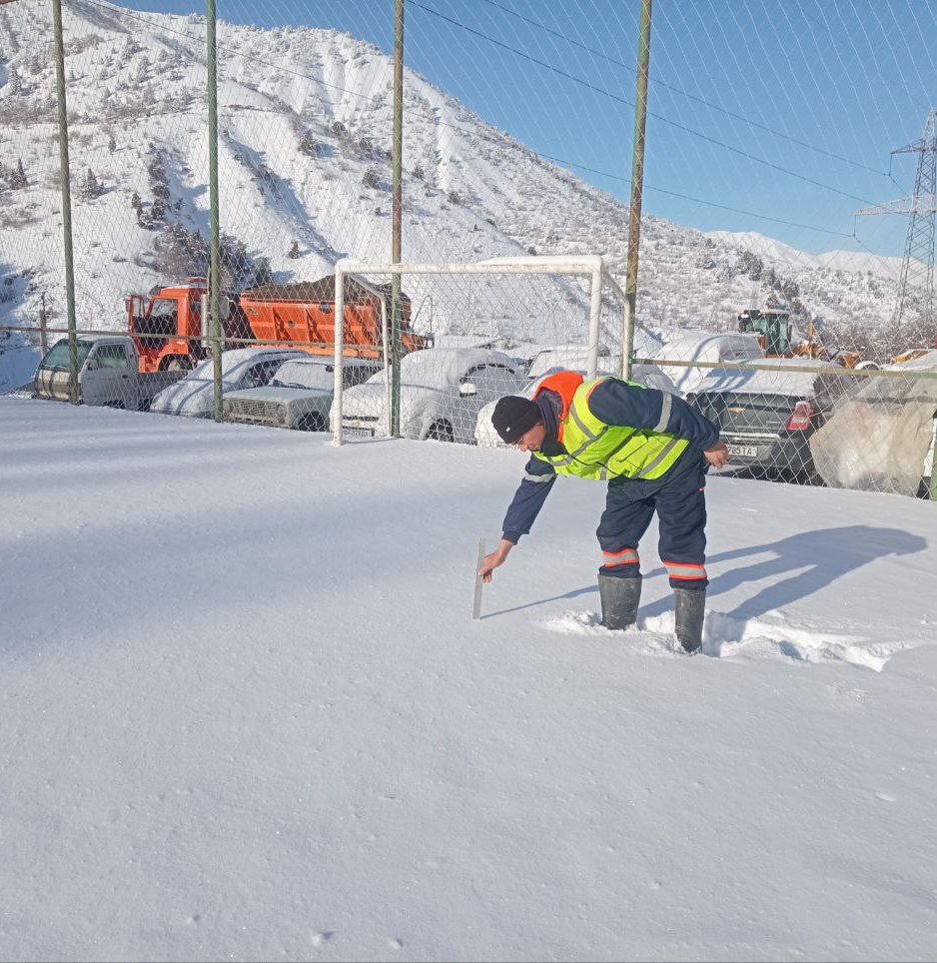
Methodology
Snow Depth measurement every 5 days
Measurement tool: a ruler (cm)
Participants: Volunteers
Record of location and data sharing via (Telegram) messenger

Slide 16
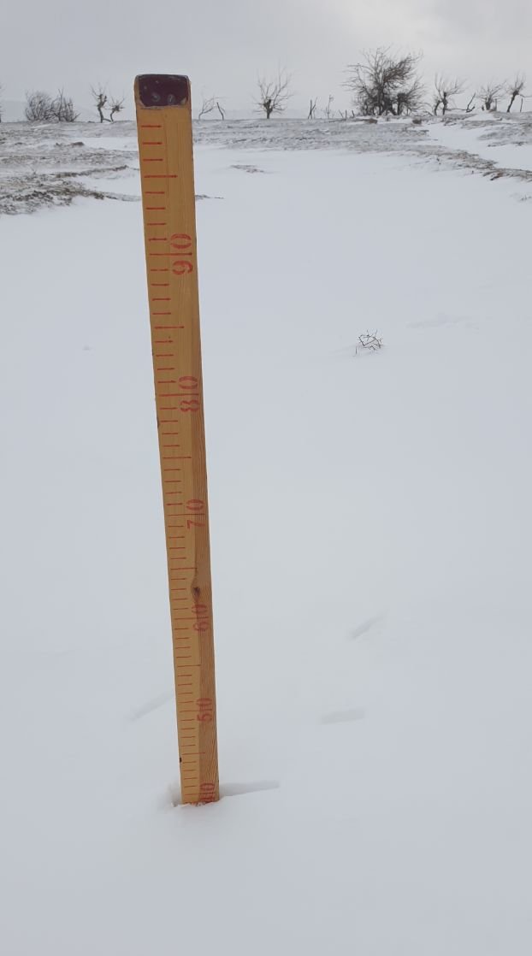
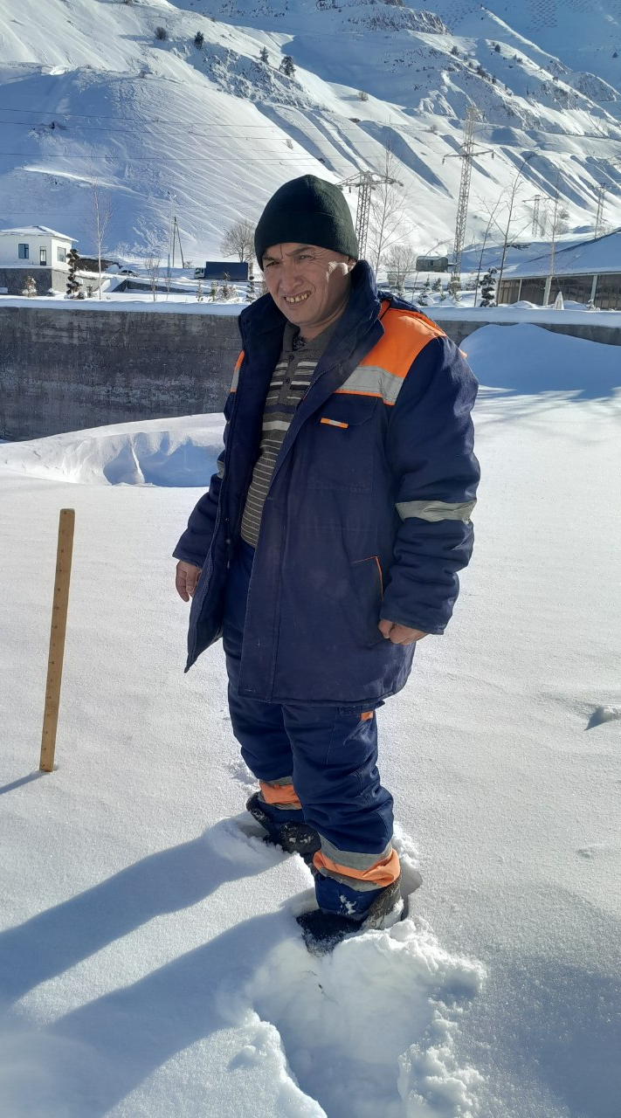
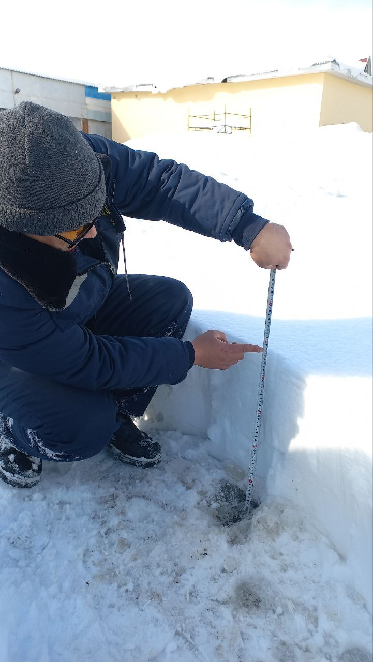
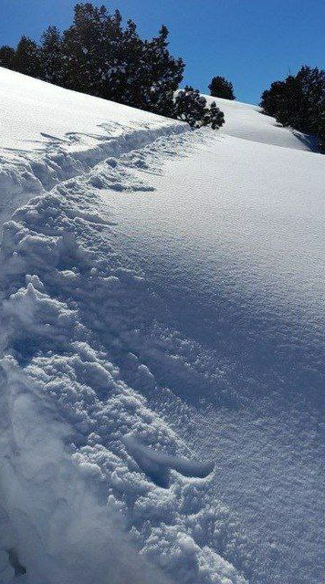
Measurement examples

Slide 17
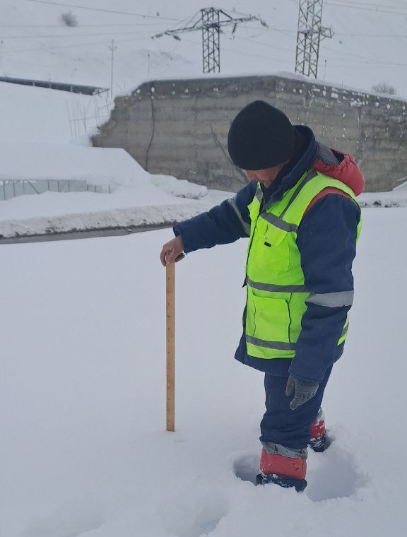
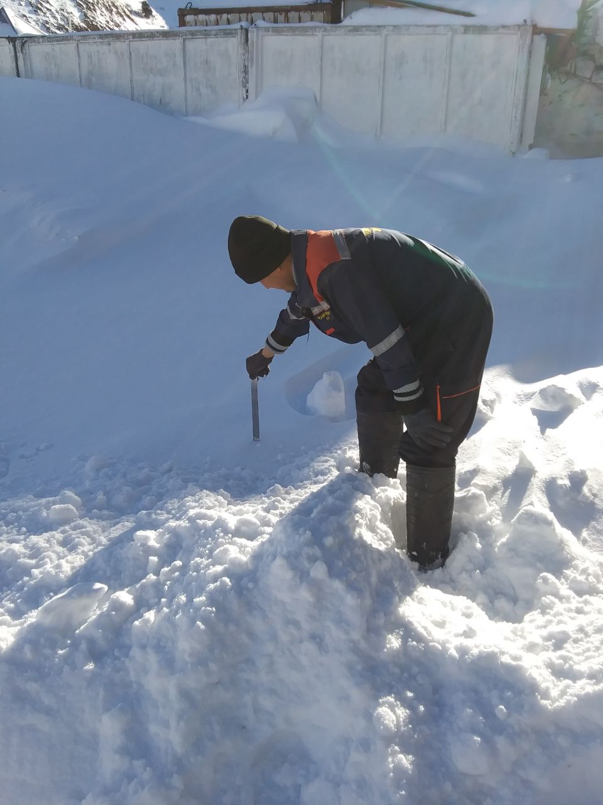
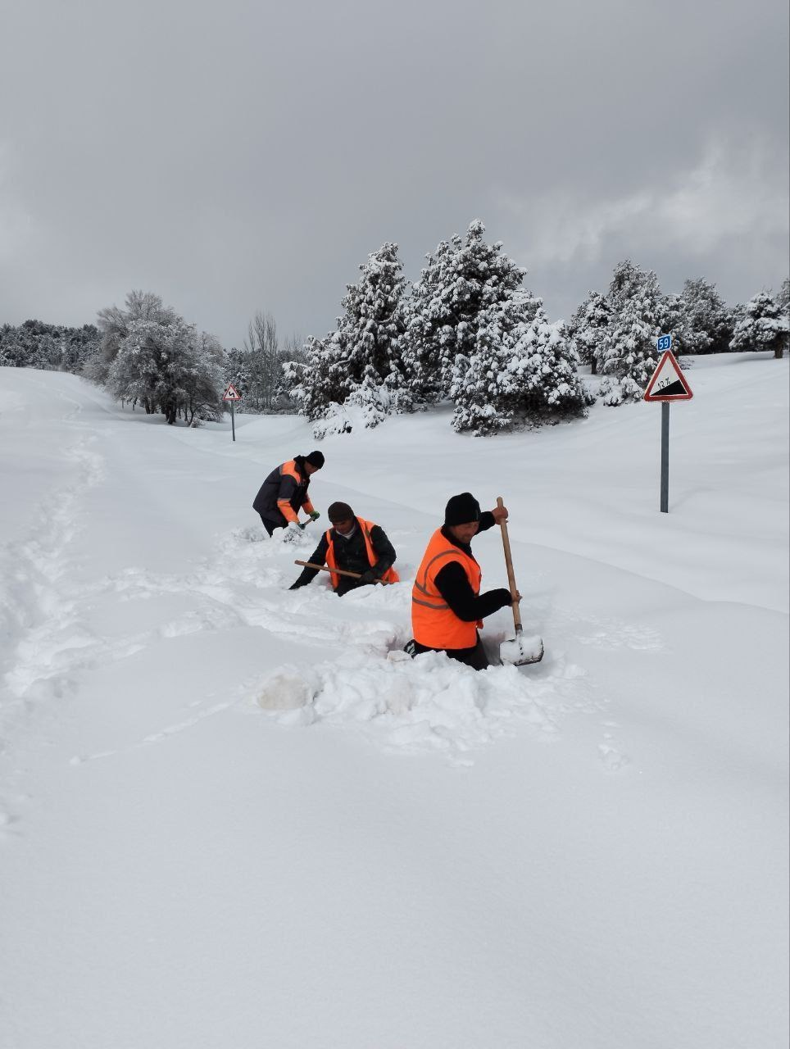
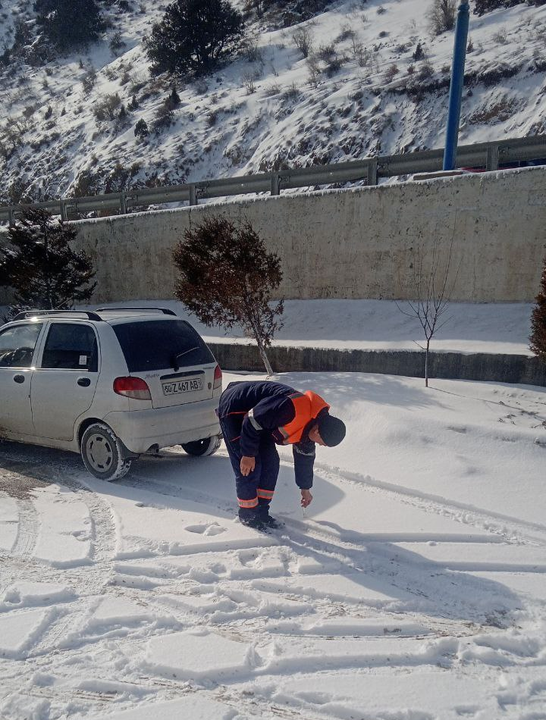
Measurement examples

Slide 18
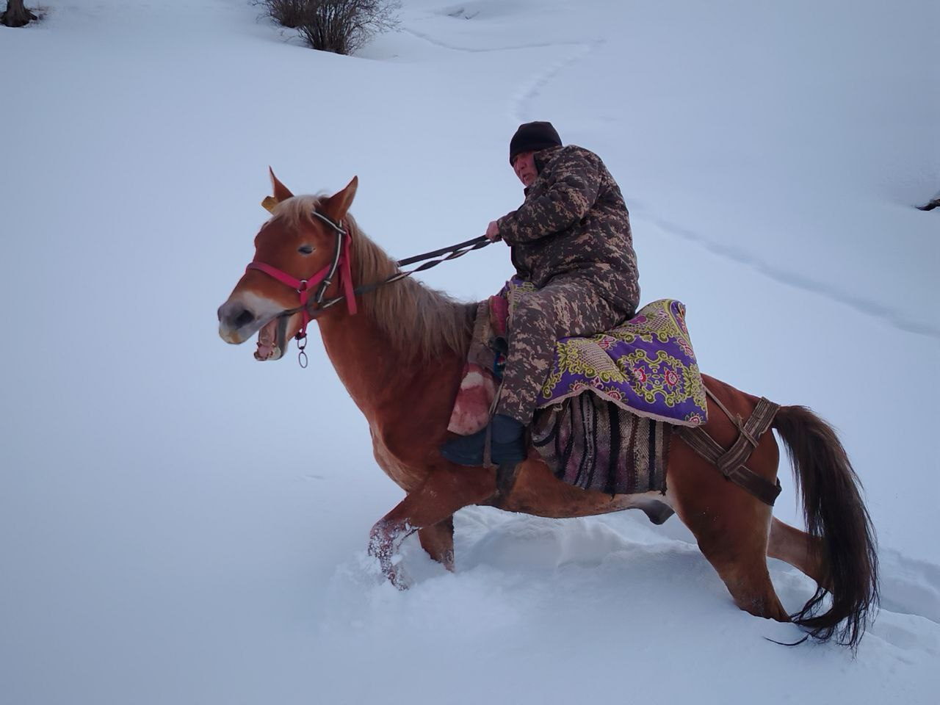
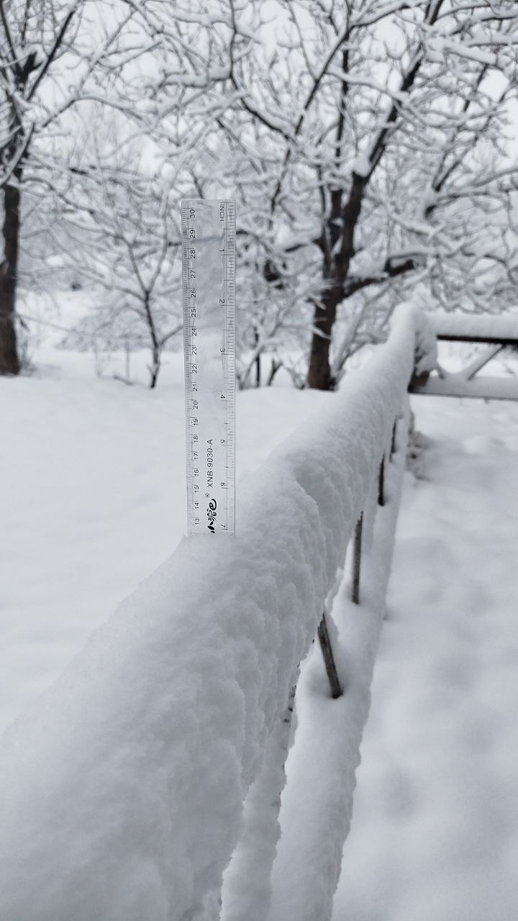
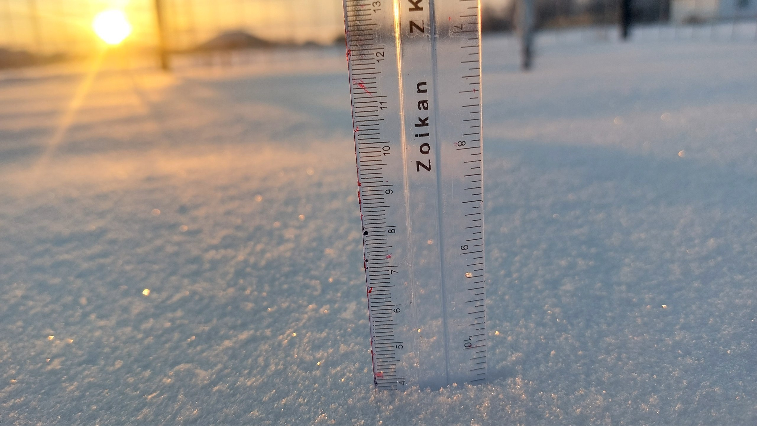
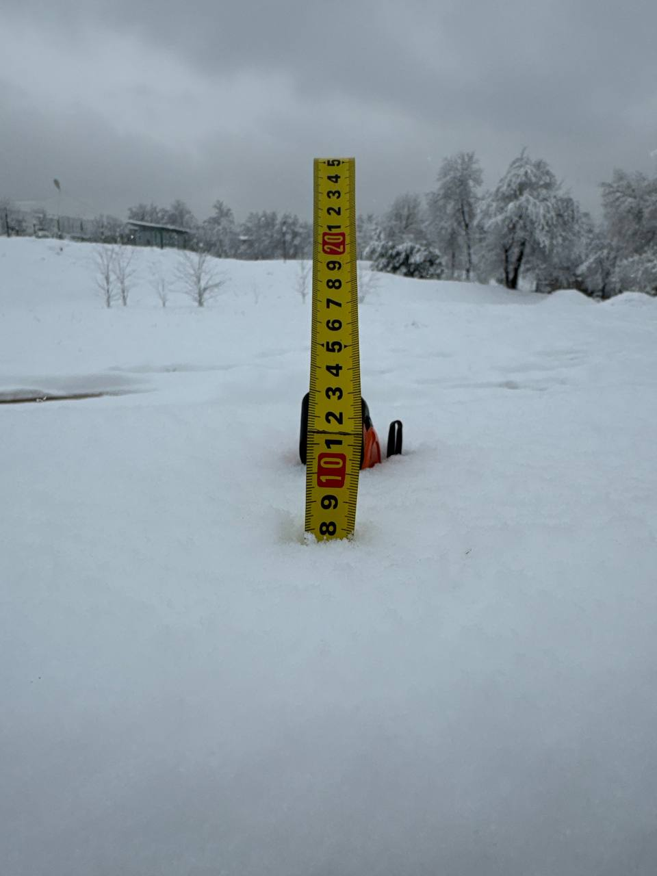

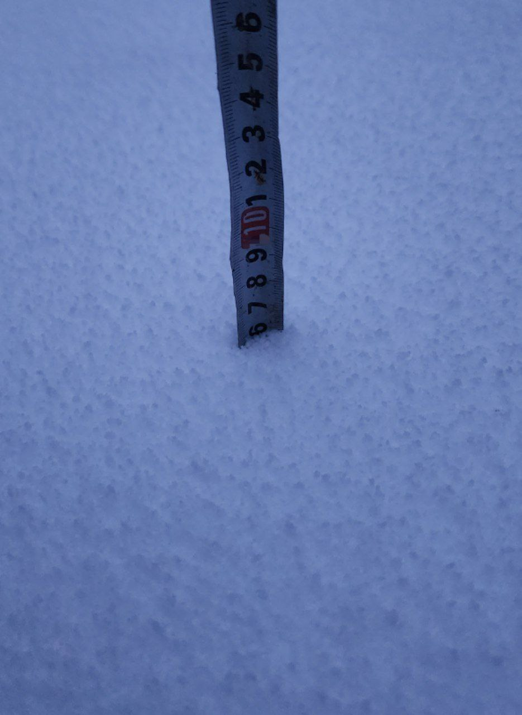
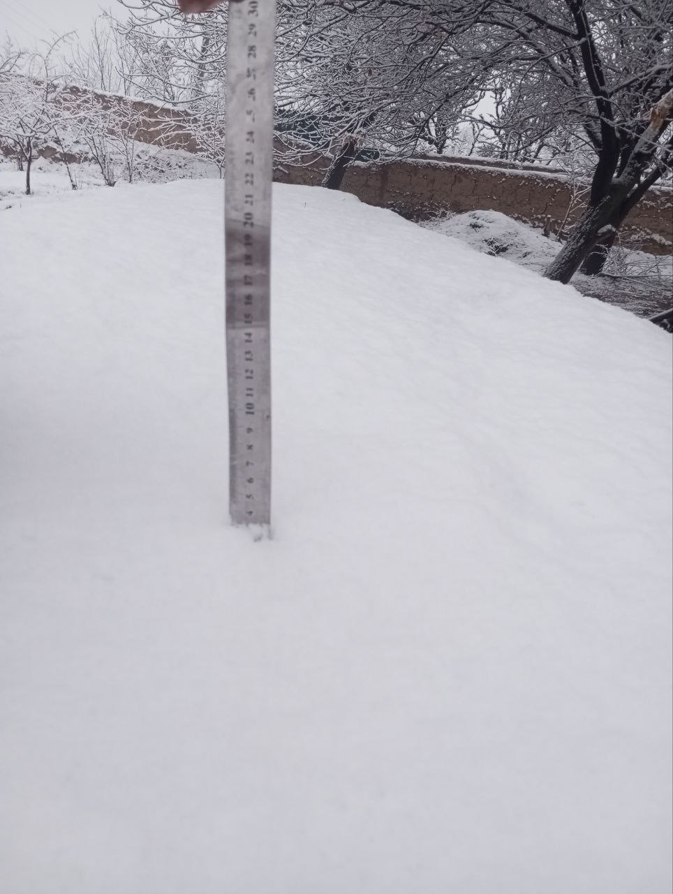

Slide 19
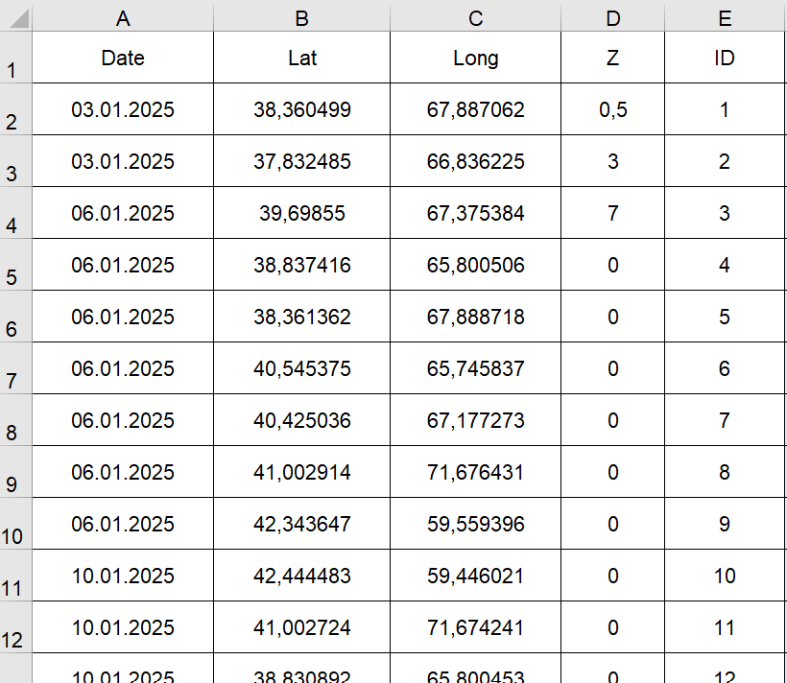
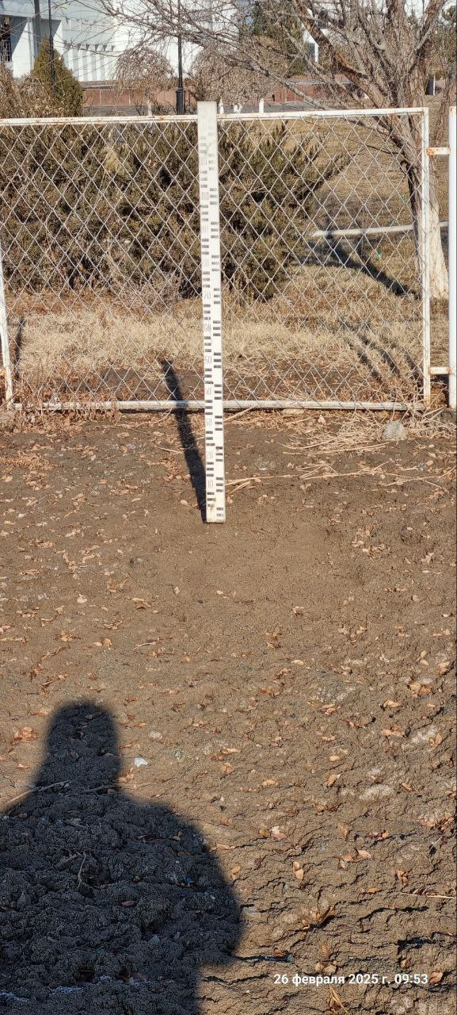

Data processing and archiving
Gafurov et al., in prep

Slide 20


Validation of MODIS snow cover data
Gafurov et al., in prep

Slide 21











THANK YOU FOR YOUR ATTENTION.

