Slide 1
Impact of changes in Southern Hemispheric westerlies on air-sea CO₂ fluxes in high resolution simulations
Laurie Menviel
P. Spence, A.E. Kiss, M. A. Chamberlain, H. Hayashida, M.H. England, D. Waugh

Slide 2
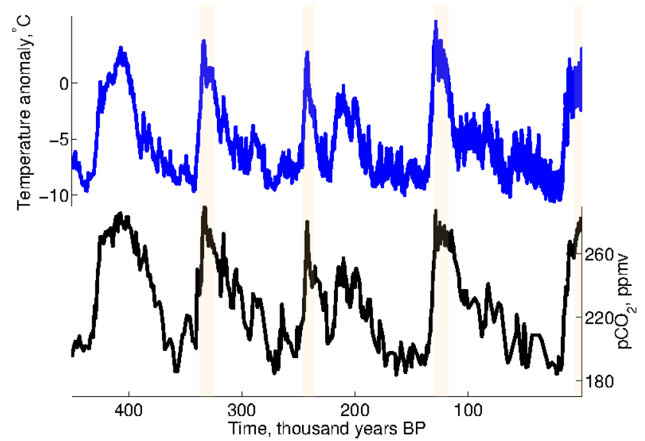
Glacial-Interglacial cycles
EPICA Dome C, Antarctica
Jouzel et al., 2007
Notes:
2
Antarctic ice-cores suggest a tight coupling between Antarctic temperature and atmospheric CO2 over glacial interglacial timescales, suggesting that the Southern Ocean could have played a major role in driving atmospheric CO2 changes.

Slide 3
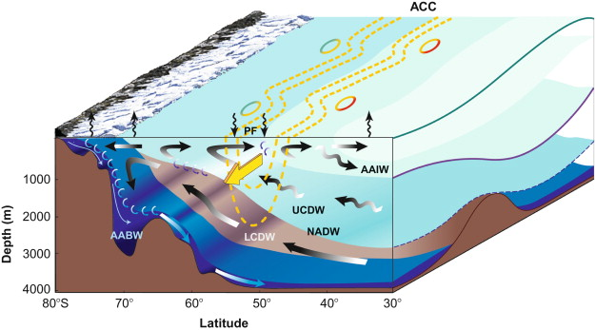
Southern Ocean
Mean natural (pre-industrial) CO₂ fluxes as simulated by 0.1º ocean/bgc model ACCESS-OM2-01
SAF
Natural CO₂ flux
For atm CO₂=284ppm
SAF
3
1.4
0
-1.4
-3
PF
Rintoul & Naveira-Garabato, 2013
Ekman pumping
molC/m²/yr
10
3.5
0
-3.5
-10
m/s
Menviel et al., 2023

Slide 4
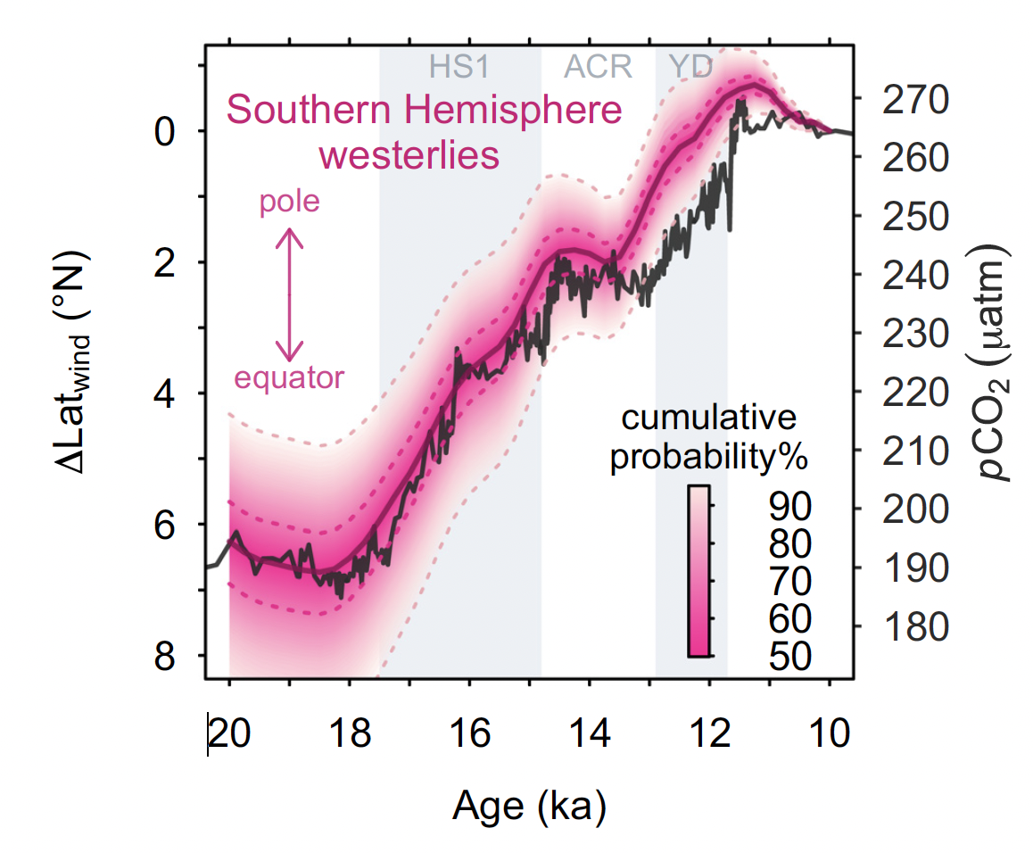
Poleward shift of the SH westerlies across the deglaciation
Toggweiler et al., 2006
Gray et al., 2023

Slide 5
Impact of changes in southern hemispheric westerlies on the carbon cycle
Stronger SH westerlies → Enhanced CO₂ outgassing in the Southern Ocean (SO)
Given the importance of mesoscale processes in SO, does it still hold in high-resolution models?
What is the Impact of changes in the latitudinal position of SH westerlies on the carbon cycle?
Suite of ocean/sea-ice/carbon cycle ACCESS-OM2 models (0.1 – 0.25 and 1º resolution, Kiss et al., 2020)
Sensitivity experiments at 0.25º resolution
Hindcast simulation of the last decades at 0.1º (and 1º) resolutions
0.03
0
55 65 75
Lat (degS)
Trend towards positive phases of the southern annular mode (stronger & poleward shifted SH westerlies)
Windstress anomalies (N/m², 2017-2020 compared to 1980-1982)

Slide 6
Impact of positive Southern Annular Mode
CO₂ flux and DIC anomalies for a composite of positive SAMs compared to a composite of negative SAMs
Strengthening and poleward shift of westerlies
Natural CO₂ flux anomalies
1
0.5
0
-0.5
-1
molC/m²/yr
10
5
0
-5
-10
Natural DIC anomalies
mmol/m³

Slide 7
Impact of positive SAMs
Anomalies for positive SAMs compared to negative SAMs
CO₂ flux
molC/m²/yr
Surface DIC
mmol/m³
Diffusion at the base of the mixed layer
Dufour et al., 2013
molC/m²/yr
Vertical advection
molC/m²/yr

Slide 8
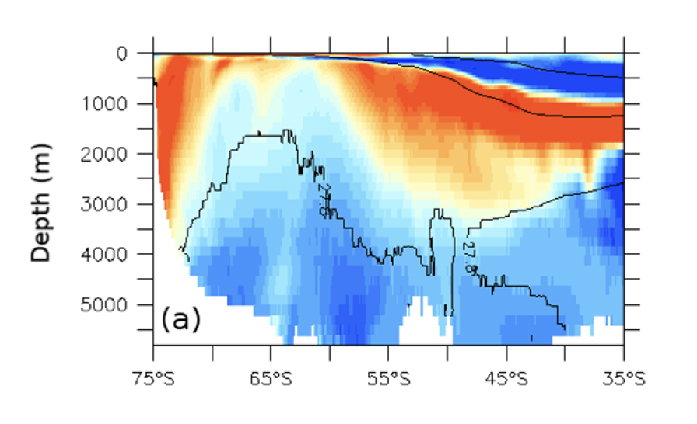
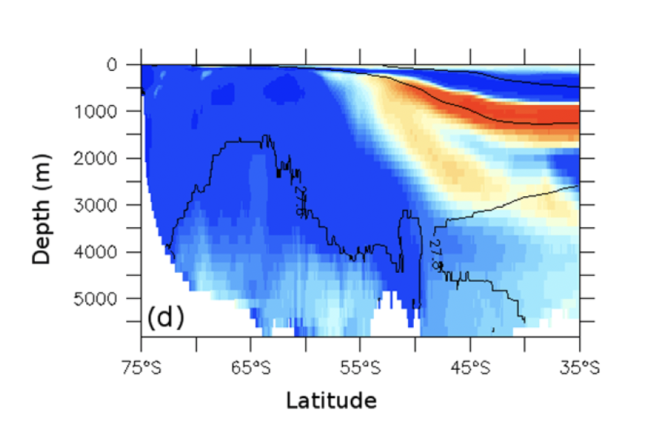
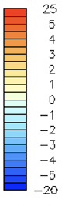
Southern Ocean DIC anomalies following a positive SAM trend
2017-2021 compared to 1980-1982
Atlantic
mmol/m³
Latitude
Menviel et al., Biogeosciences, 2023

Slide 9
Impact of changes in SH windstress on natural SO (south of 35S) CO₂ flux
ACCESS-OM2
1deg
0.25 deg
0.10 deg
*
+0.1 GtC/yr for 10% strengthening
+0.1 GtC/yr for 5º poleward shift
Menviel & Spence, 2024

Slide 10
Conclusions
Stronger SH westerlies enhance SO CO₂ outgassing even when mesoscale eddies are simulated
Regional difference with coarse resolution model but overall similar sensitivity
Poleward shifted SH westerlies enhance SO CO₂ outgassing (5º poleward shift equals 10% increase in windstress)
Very fast (yr) carbon cycle response to SH westerlies
Interaction between lower cell and SH westerlies requires additional studies
Menviel et al., Biogeosciences, 2023
Menviel & Spence, 2024

