Slide 1


Constraining effective radiative forcing and adjustments driving past warm intervals
Noah Kravette and Ran Feng
University of Connecticut
NSF-2238875
Notes:
Thank you so much to the conveners for having me present!
I am Noah Kravette.
I am a 2nd year PhD student at the University of Connecticut with my Advisor Ran Feng.
I am going to be looking into the forcings specifically for the mid-Pliocene for this presentation.

Slide 2
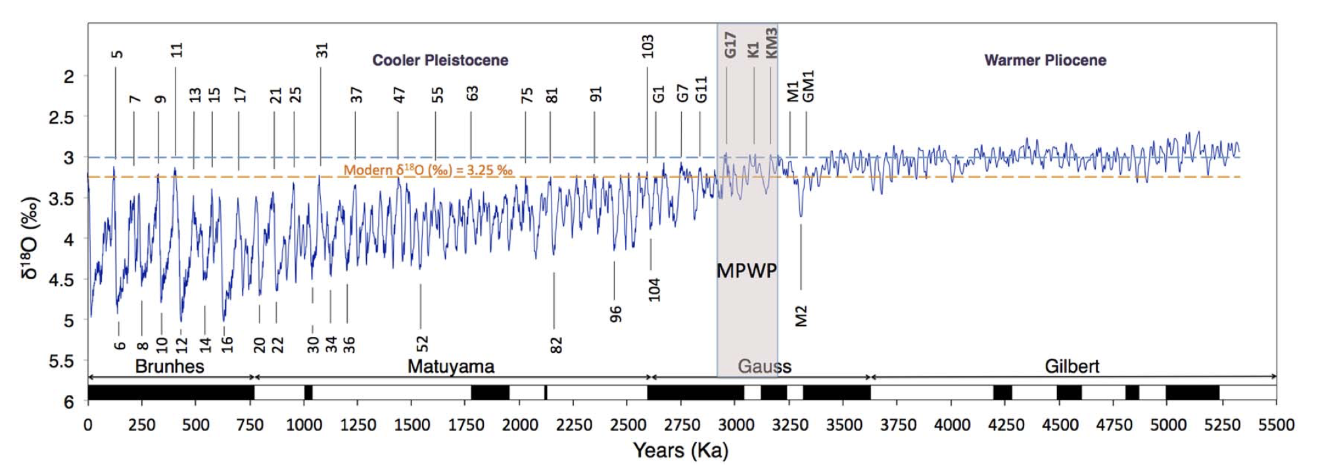
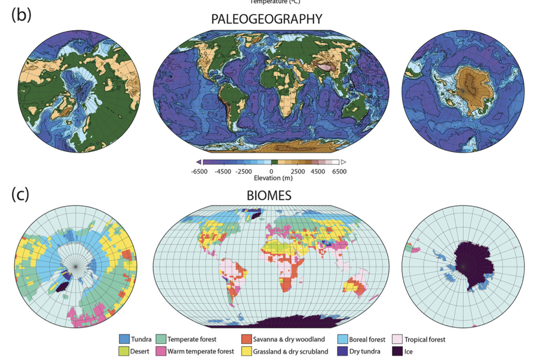
About the Mid-Pliocene
Time Period: 3.3 – 3.0 million years ago
Climate: Last extended warm interval with muted glacial-interglacial changes
CO₂: 400 ppm
Ice Sheets: Limited presence in Greenland and Antarctic
Vegetation: Widespread Boreal Forests, Green Sahara with reduced global desert extent.
Significance: Key Paleoclimate period for Future Climate Projections.
Figure from Raymo et al., 2018
Figure from Dowsett et al., 2016
Notes:
The mid-Pliocene
MAYBE change image to burke et al 2018?
3.3 – 3 Ma
Climate last extended warm interval with muted glacial-interglacial changes,
With about 400 ppm CO2.

Slide 3
About the Mid-Pliocene
Time Period: 3.3 – 3.0 million years ago
Climate: Last extended warm interval with muted glacial-interglacial changes
CO₂: 400 ppm
Ice Sheets: Limited presence in Greenland and Antarctic
Vegetation: Widespread Boreal Forests, Green Sahara with reduced global desert extent.
Significance: Key Paleoclimate period for Future Climate Projections.
Figure from Raymo et al., 2018
Figure from Dowsett et al., 2016
Notes:
ICE SHEETS
Ice sheets had a limited presence in Greenland and Antarctic.

Slide 4
About the Mid-Pliocene
Time Period: 3.3 – 3.0 million years ago
Climate: Last extended warm interval with muted glacial-interglacial changes
CO₂: 400 ppm
Ice Sheets: Limited presence in Greenland and Antarctic
Vegetation: Widespread Boreal Forests, Green Sahara with reduced global desert extent.
Significance: Key Paleoclimate period for Future Climate Projections.
Figure from Raymo et al., 2018
Figure from Dowsett et al., 2016
Notes:
VEGETATION
Vegetation had widespread boreal forests, a green Sahara with reduced global desert extent.
This time period of the Pliocene can act as a key period for Future Climate Projections.

Slide 5
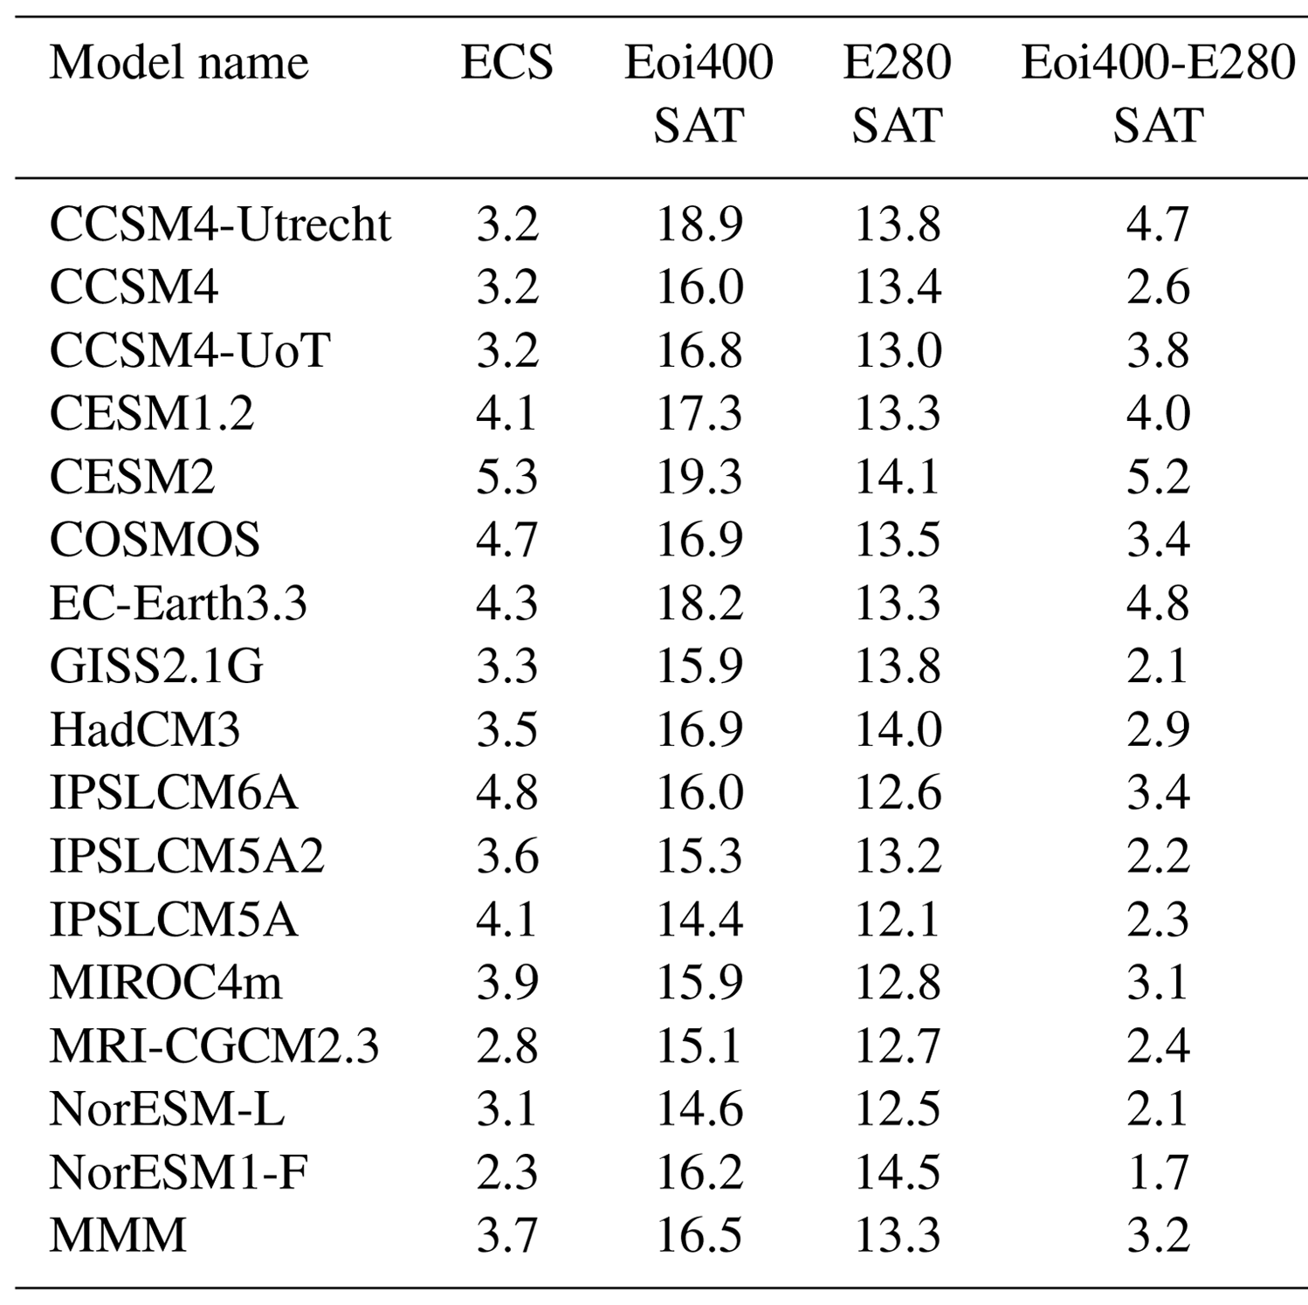
Pliocene Model Intercomparison Project
Climate: Mid-Pliocene was significantly warmer than what CO₂ levels alone would predict
Possible Causes: Boundary condition changes might have influenced this additional warming
Model Variability: Significant differences exist among models in simulating mid-Pliocene warmth
Warming Estimates: Ranged from 1.7 to 5.2 °C
Question: What was the strength of climate forcing during the mid-Pliocene?
Notes:
1. The mid-Pliocene is a well studied warm period, mainly through the Pliocene Model Intercomparison Project---- or PlioMIP for short. 2. Haywood et al. (2020) synthesized results from PlioMIP2 and showed that simulated warming across models ranged from about 1.7°C to 5.2°C. 3. So are these differences in warming linked between the models to differences in climate forcing?

Slide 6
Pliocene Model Intercomparison Project
Climate: Mid-Pliocene was significantly warmer than what CO₂ levels alone would predict
Possible Causes: Boundary condition changes might have influenced this additional warming
Model Variability: Significant differences exist among models in simulating mid-Pliocene warmth
Warming Estimates: Ranged from 1.7 to 5.2 °C
Question: What was the strength of climate forcing during the mid-Pliocene?
Notes:
1. Almost all models show more Pliocene warming than expected from CO₂ forcing alone.
2. This suggests additional non-CO₂ forcings, like land surface changes, vegetation changes, and ice sheet retreat.
3. Pliocene model simulations show some variability, with ECS values ranging from about 2.3°C to 4.8°C across models. 5. To investigate this, we combine CO₂ and non-CO₂ effects to constrain the total Pliocene forcing and break down those sources in forcings.

Slide 7
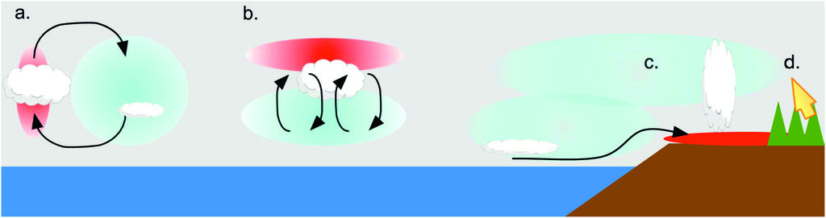
Effective radiative forcing and adjustments
Effective radiative forcing and adjustments: “changes that occur directly due to the forcing, without mediation by the global-mean temperature, as “adjustments” and the accordingly modified top-of-atmosphere radiative imbalance as the “effective” radiative forcing” (e.g., Sherwood et al., 2015)
Heating and cooling and regional circulation
Vertical adjustments of T, Q, clouds
Differing changes between land and sea
Biophysical adjustments
Notes:
Diagnosing these changes with ERF and Adjustments
ERF
Is the Top-of-atmosphere (TOA) radiative imbalance after adding an external forcing.
Typically measured with fixed Sea surface Temperatures.
Compared to a preindustrial 1850 run.
Adjustments:
Changes that happen directly from the forcing, not mediated by global mean temperature change.
Include tropospheric heating/cooling, cloud and humidity changes, vertical shifts in T/Q/clouds, land–ocean heating differences, biophysical effects (e.g., transpiration, albedo), and so on.
ERF used to student present day cliamte.
ERF = TOA radiaitve imbalanace..
After introduction of external forcing agent.
Typically done with fixed SSTs—our feedbacks were done coupeld to a dynamic ocean model.
Using PI control to compare.
Adjsutments:
Changes that change directly due to the forcing.
Without meditation from the by the global mean temperture.
Horizontal heat/cooling in troposphere.
Changes in clouds (humidity)
Vertical adjsutments in T, Q, clouds
Difference heating between land and ocean.
Biophysical chnages in transpirtation, albedo, etc.

Slide 8
Effective radiative forcing and adjustments
Effective radiative forcing and adjustments: “changes that occur directly due to the forcing, without mediation by the global-mean temperature, as “adjustments” and the accordingly modified top-of-atmosphere radiative imbalance as the “effective” radiative forcing” (e.g., Sherwood et al., 2015)
Forcing-Feedback framework:
∆N = F + λ *∆Ts
If ∆Ts = 0
Then, ∆N = F
Effective radiative forcing:
ERF = RF + Adjustments
RF: The net top of troposphere radiative imbalance after the fast adjustments in the stratosphere.
Heating and cooling and regional circulation
Vertical adjustments of T, Q, clouds
Differing changes between land and sea
Biophysical adjustments
Notes:
Using the Forcing-feedback Frameowrk.
With fixedSST's so the change in sea surface temperature is 0 here.
Therefore ERF = change of TOA energy or radiative imbalance.
The ERF is decomposed into the RF (or IRF) + Adjustments

Slide 9
Effective radiative forcing and adjustments
Effective radiative forcing and adjustments: “changes that occur directly due to the forcing, without mediation by the global-mean temperature, as “adjustments” and the accordingly modified top-of-atmosphere radiative imbalance as the “effective” radiative forcing” (e.g., Sherwood et al., 2015)
Forcing-Feedback framework:
∆N = F + λ *∆Ts
If ∆Ts = 0
Then, ∆N = F
Effective radiative forcing:
ERF = RF + Adjustments
Adjustments:
A_{x} = K_{x} ∆X
K_{x}: Radiative kernel coefficient – sensitivity of TOA radiative fluxes to perturbations of Ta, q, α, clouds
X: Represents variables of Ta, q, α, clouds (Pendergrass et al., 2018)
Heating and cooling and regional circulation
Vertical adjustments of T, Q, clouds
Differing changes between land and sea
Biophysical adjustments
Notes:
Adjustments kernels coefficients from Angie Pendergrass.
Radiative kernel measure the top-of-atmosphere (TOA) radiative response to small changes in a climate variable (e.g., temperature, water vapor, surface albedo).
Then we multiple the kernel by the difference in T, albedo, or water vapor between perturbed and control PI (Pliocene minus PI).
For clouds instead, we take the difference between clear-sky and all-sky radiative fluxes to isolate cloud contributions (from Soden et al., 2008).

Slide 10
Experiments to diagnose Forcing and Feedbacks
Purpose: Analyze ERF and adjustments
Simulation Type: Fixed SST simulations with two forcing groups.
Forcing Agents:
CO₂,
Combined Forcing:
Ice Sheets, vegetation, topography, geography
Simulation Duration: ~30 years (last 20 years for analysis).
Models Used:
CESM2
CESM1.2
CCSM4
Correcting for land temperature changes:
ERF_{Ts} = ERF − K_{x} ∆Ts
Notes:
Split into 2 forcing groups.
CO2
Combined forcing
Veg + ice sheets
Topography + geography
Simulation run for 30 years with last 20 years for analysis.
Models used:
CESM2
CESM1.2
CCSM4
Correcting for ERF by subtracting the surface temperature adjustment.
4.

Slide 11
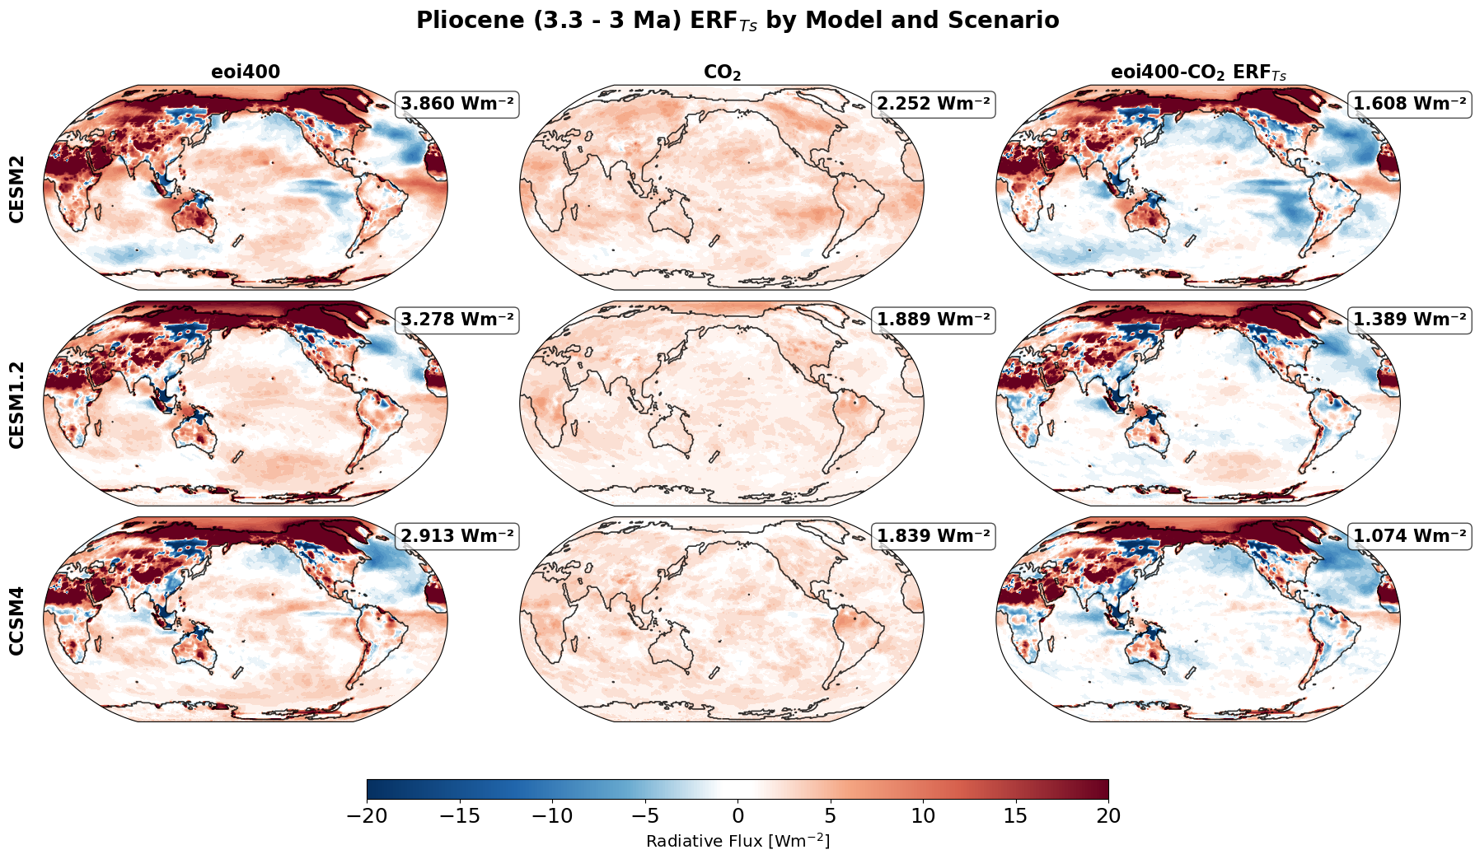
ERF
ERF increases from CCSM4 to CESM2
Matching the ECS increase from CCSM4 to CESM2
Notes:
1. ERF increases with model sensitivity.
2. CESM2 shows a stronger response to both CO₂ and non-CO₂ forcings compared to CESM1.2 and CCSM4.
3. BUT Boundary condition changes also amplify ERF {move to next slide}.

Slide 12
ERF
ERF increases from CCSM4 to CESM2
Matching the ECS increase from CCSM4 to CESM2
The increase primarily comes from ERF of boundary condition changes.
Notes:
The increase in ERF from CCSM4 to CESM2 primarily comes from the ERF of Boundary Condition changes seen in the third column
Which is the difference between the Pliocene combined forcing and the only CO2 forcing simulations.

Slide 13
ERF
ERF increases from CCSM4 to CESM2
Matching the ECS increase from CCSM4 to CESM2
The increase primarily comes from ERF of boundary condition changes.
Unique pattern of ERF from boundary condition changes
Notes:
OCEAN DIFFERENCES
The unique pattern within the ERF seems to primarily come form boundary condition changes.
Non-CO2 forcing dominates over land and in the Arctic, especially in CESM2.
The CO2-only forcing is spatially similar across models, so the divergence comes from how each model responds to Pliocene boundary conditions (BCs) in the combined forcing runs.

Slide 14
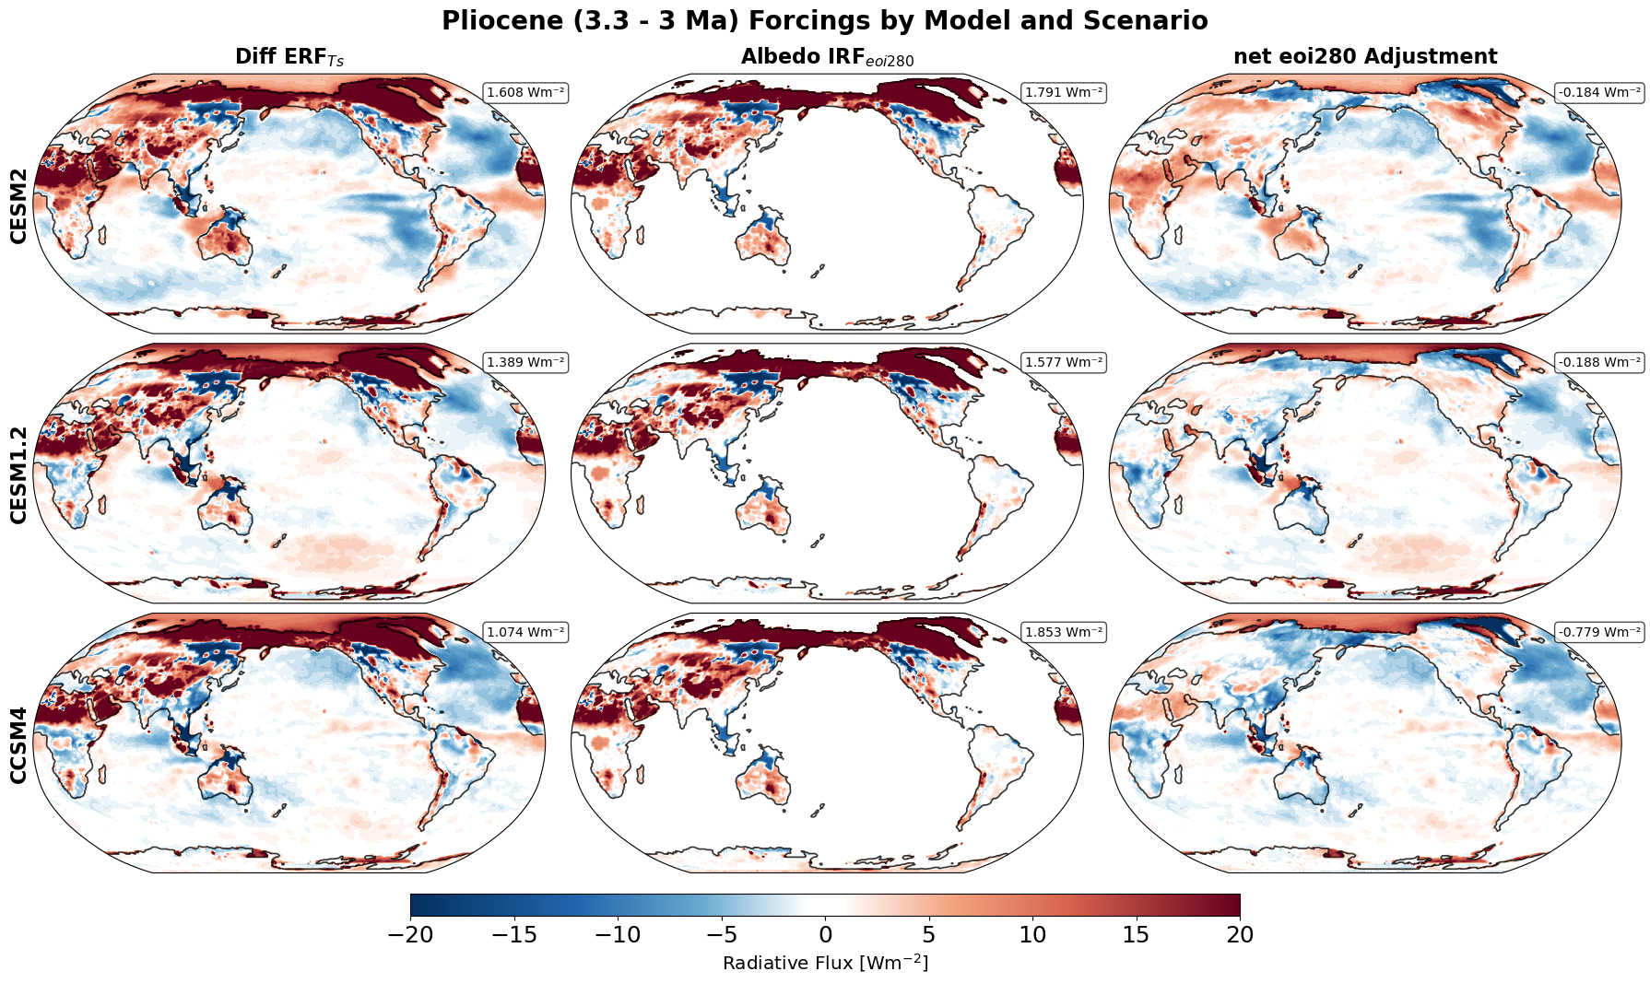
ERF, IRF, and Net Adjustments
IRF spatially similar across models.
Much of non-CO2 forcing mainly driven by IRF.
CESM2 has the weakest damping and strongest ERF.
As model sensitivity increases, the forcing seems to increase.
Notes:
To investigate the soruces of the ERFs from boundary conditions changes in the left column, we saprate those ERFs into direct radiative forcing in the middle column and adjustment in the right column.
The instantaneous radiative forcing (IRF) decoupled from CO2 perturbation is spatially consistent across models.
This means differences in ERF don’t come from the forcing agent itself.
Instead, ERF differences arise from how much of that forcing is adjusted by the model — CESM2 shows the least negative adjustments.
Which seems to be a trend moving forward that as model sensitivity increases the forcings increase alongside.
This leads us to look deeper into the full ERF patterns and how different models respond CO2 vs boundary condition changes.

Slide 15
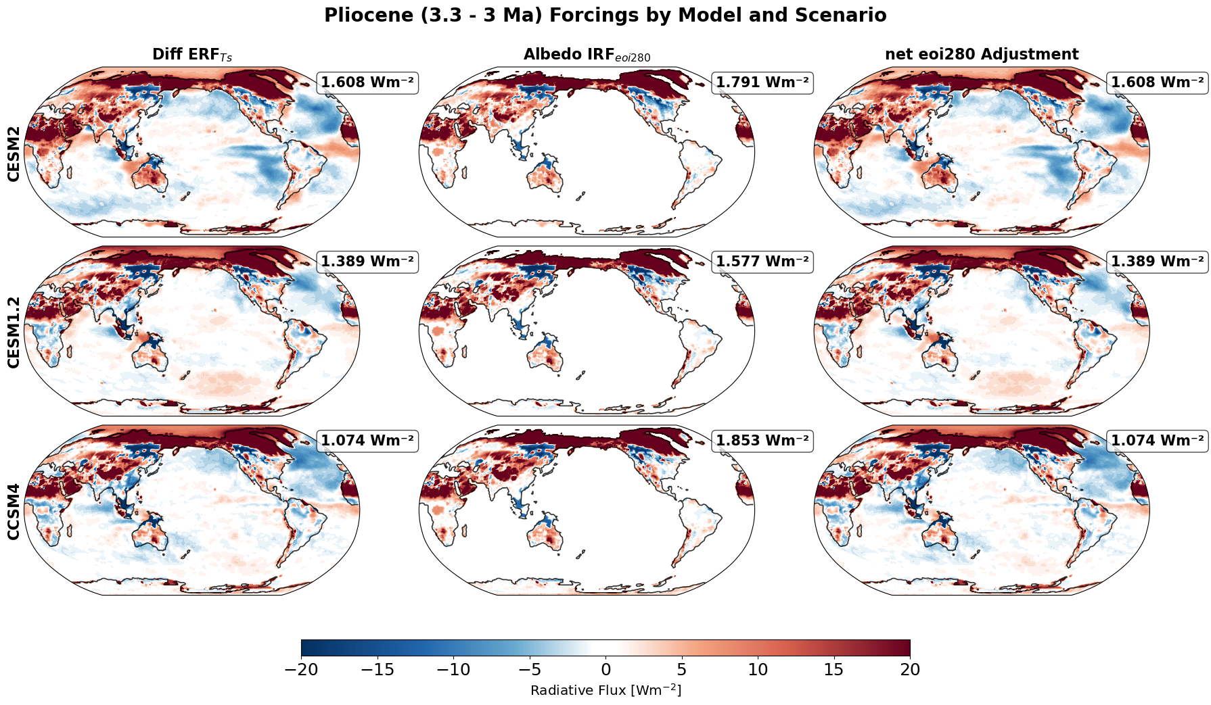
ERF, IRF, and Net Adjustments
Strong ERF on land due to direct perturbations to albedo due to boundary conditions
Notes:
“To investigate the sources of the ERFs from boundary conditions changes in the left column, we separate those ERFs into direct radiative forcing in the middle column and net adjustment in the right column”.
We can see that the strong ERF over land is due to direct perturbations to albedo due to boundary conditions.

Slide 16
ERF, IRF, and Net Adjustments
Negative ERF over the ocean are from adjustments.
Especially in CESM2 eastern tropical Pacific and Indian Ocean.
Notes:
While the negative ERF over the ocean are from adjustments.
This seems to be particularly the case over the oceans.
With negative ERF in CESM2 over the Indian ocean and east tropical pacific.
CESM1.2 shows increases in ERF over the south pacific.
The instantaneous radiative forcing (IRF) decoupled from CO2 perturbation is spatially consistent across models.
This means differences in ERF don’t come from the forcing agent itself.
Instead, ERF differences arise from how much of that forcing is adjusted by the model — CESM2 shows the least negative adjustments.
Which seems to be a trend moving forward that as model sensitivity increases the forcings increase alongside.

Slide 17
ERF, IRF, and Net Adjustments
ERF differences from boundary condition changes originates from the adjustments.
IRF is spatially consistent between models.
Notes:
IRF is spatially consistent between models.
The ERF differences from boundary condition changes seem to originate from the adjustments.
“So now lets decompose contributions to see where the differences emerge.”
To investigate the sources of the ERFs from boundary conditions changes in the left column, we saprate those ERFs into direct radiative forcing in the middle column and adjustment in the right column.
The instantaneous radiative forcing (IRF) decoupled from CO2 perturbation is spatially consistent across models.
This means differences in ERF don’t come from the forcing agent itself.
Instead, ERF differences arise from how much of that forcing is adjusted by the model — CESM2 shows the least negative adjustments.
Which seems to be a trend moving forward that as model sensitivity increases the forcings increase alongside.
This leads us to look deeper into the full ERF patterns and how different models respond CO2 vs boundary condition changes.

Slide 18
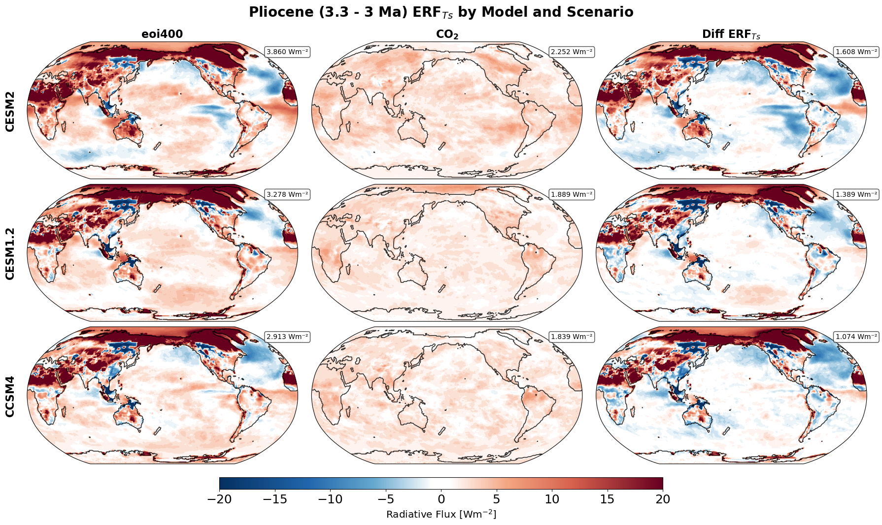
ERF
Model sensitivity increases ERF from both CO2 and non-CO2 sources.
Non-CO2 dominates land + Artic.
CESM2 has broader, more intense land forcing than CESM1.2 or CCSM4.
CO2 forcing is spatially similar across models — difference arises from how models respond to BCs.
Negative ERF in South Pacific(CESM2 only) may reflect strong negative heat deficit.
Notes:
In CESM2, we even see strong negative ERF in the South Pacific (see red boxes)
This may reflect heat transport out of the region, hinting at the model’s internal heat redistribution.
To understand these ERF differences, we now need to look at the individual components of adjustment to diagnose what is causing these trends with temperature, water vapor, and net clouds.

Slide 19
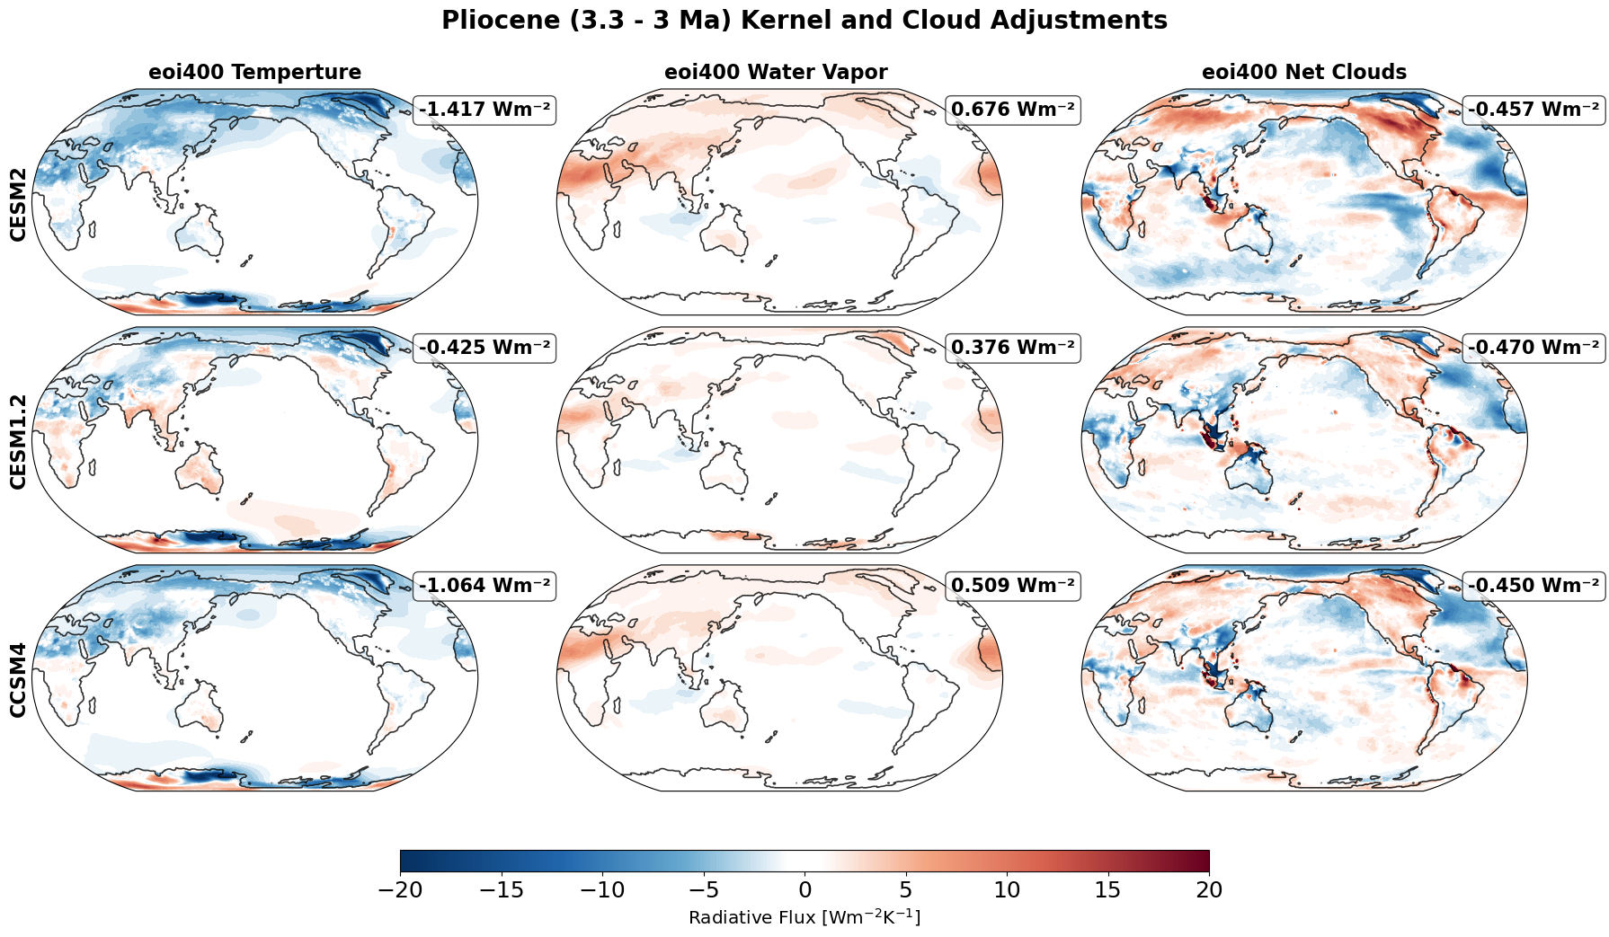
Decomposed Adjustments
Temperature adjustment strongest in CESM2, especially polar regions.
Water vapor amplifies ERF over land.
Notes:
1. Finally, we investigate the source for the attenuated negative adjustments from CCSM4 to CESM2.
2. We separate the adjustments into air temperature adjustments in the left column, water vapor in the middle column and net cloud adjustments in the right column.
3. We notice that the attenuation (negative adjustments) mainly coming from air temperature adjustments.
CESM2 shows the strongest negative temperature adjustment, especially over the poles. Most likely from a Planck/lapse rate response.
CESM2 has a strong positive water vapor adjustment, especially over land, which significantly boosts ERF.
But temperature and water vapor alone can’t explain the higher ERF, but it seems the largest effect from climate model sensitivity is coming from the cloud adjustments.

Slide 20
Decomposed Adjustments
Temperature adjustment strongest in CESM2, especially polar regions.
Water vapor amplifies ERF over land.
Enhanced negative adjustment over Oceans from cloud adjustments.
Notes:
4. The increased ERF inCESM1.2 in the south pacific seems to be driven mainly by temperature adjustments.
5. Over the ocean, we noticed an enhancement in negative adjustment in CESM2 from cloud adjustments.
6. Specifically, the SW cloud adjustment.

Slide 21
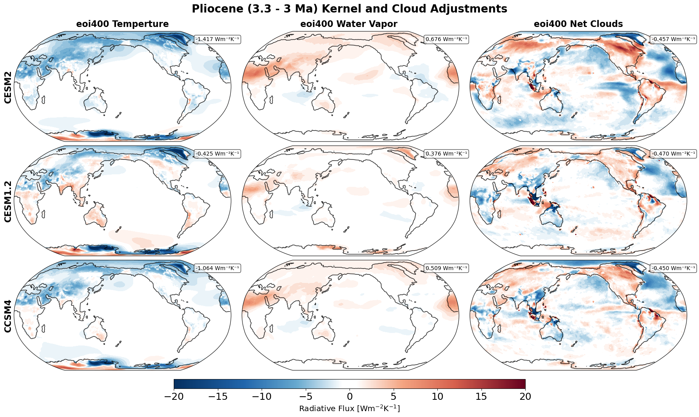
Decomposed Adjustments
Temperature adjustment strongest in CESM2, especially polar regions.
Water vapor amplifies ERF over land.
Net clouds explain heat deficit in ocean regions. Specifically, SW.
Higher Sensitivity seems to show northward heat movement due to SW heat deficit.
Notes:
Net cloud adjustments explain the ocean ERF heat deficits, with CESM2 showing less cloud-related cooling, especially in the SW over tropical oceans.
This suggests that CESM2 moves heat northward in response to strong SW cloud reflection in the tropics — a pattern consistent with its higher climate sensitivity and some feedback strength.
Connecting to larger Scientific landscape:
My negative (-) cloud adjustment matches Haywood, where clouds slightly cool the Pliocene climate.
However, Cloud adjustments are positive in present-day (Smith, Soden), but mine are net negative.
Suggests that constraining feedbacks with paleo boundary conditions, especially during warming intervals such as the Pliocene, may better capture future warming behavior.

Slide 22
Thoughts on the results
In the CESM family of models, higher-sensitivity generations tend to produce larger ERF responses due to boundary condition changes.
Temperature adjustments likely reflect immediate atmospheric responses, such as changes in lapse rate and circulation patterns.
Over the oceans, negative cloud adjustments play a major role in shaping the ERF and may also scale with model sensitivity.
These adjustment patterns have important implications for driving heat transport and influencing sea surface temperature responses.
Notes:
"Overall"
Newer, more sensitive CESM models produce stronger ERF from boundary condition changes, not just CO2.
"Temperature adjustments point to fast atmospheric responses, like changes in lapse rate or circulation shifts.
3. Over oceans, negative cloud adjustments dominate — and they seem to get stronger as model sensitivity increases.
4. This suggests that heat transport and sea surface temperature patterns are tightly linked to how cloud and temperature adjustments evolve across model generations.
So far we’ve seen that the IRF is spatially consistent, but ERF increases with model sensitivity.
The reason is clear: more sensitive models like CESM2 amplify the adjustments — especially water vapor and clouds.
As a result, both CO2 and non-CO2 forcings (like land, ice, and vegetation changes) produce stronger radiative responses in these models—not just CO2.
That means forcing strength is not just a property of the external perturbation, but also of the model's internal feedback structure.
This makes boundary condition experiments like the Pliocene essential — they test better understand and constrain forcing from both CO2 non-CO2 drivers.
Ultimately, it highlights how model sensitivity controls not just how much warming occurs, but how much spatial distribution of said forcing is realized in the first place.
We hope to expand this to other Cenozoic warming intervals to understanding and decompose drivers of past climate warmth and better reduce inter-model variability in climate simulations.

