Slide 1
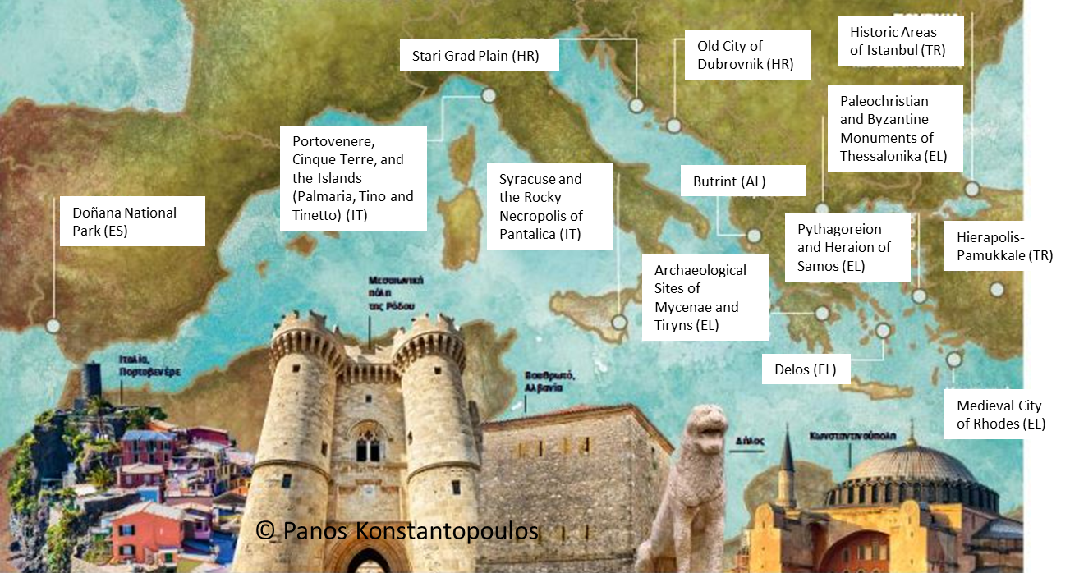
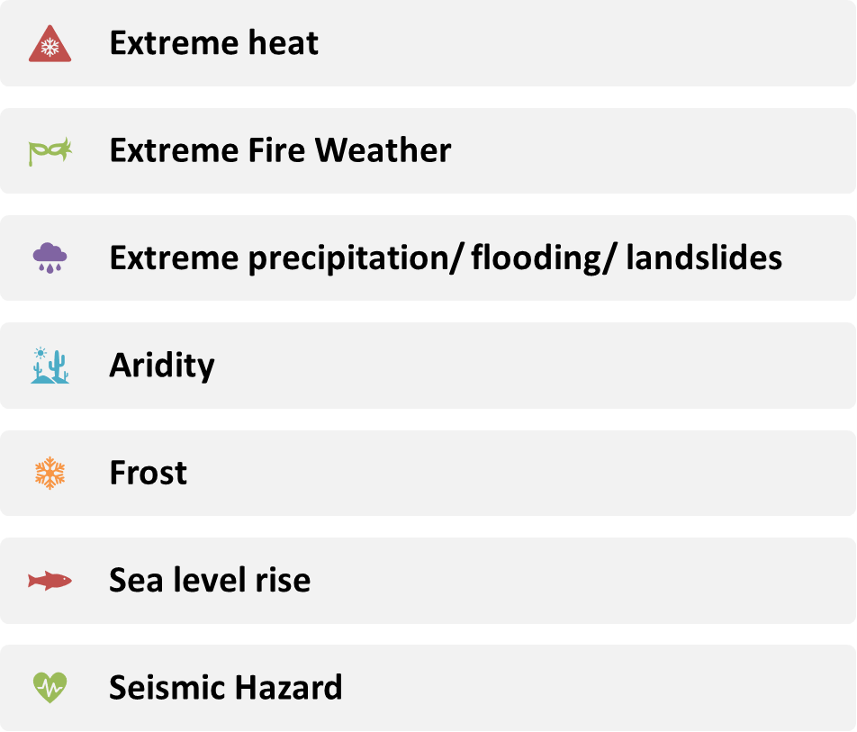
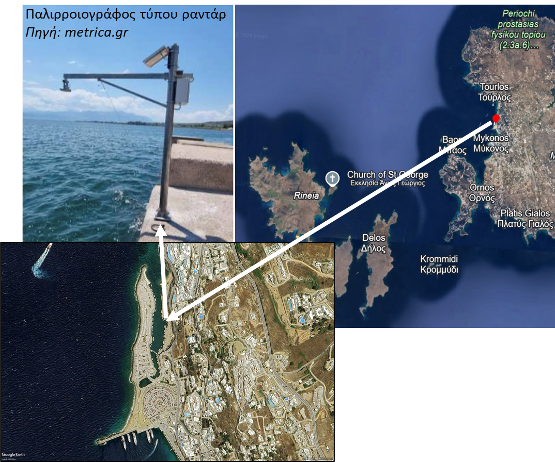
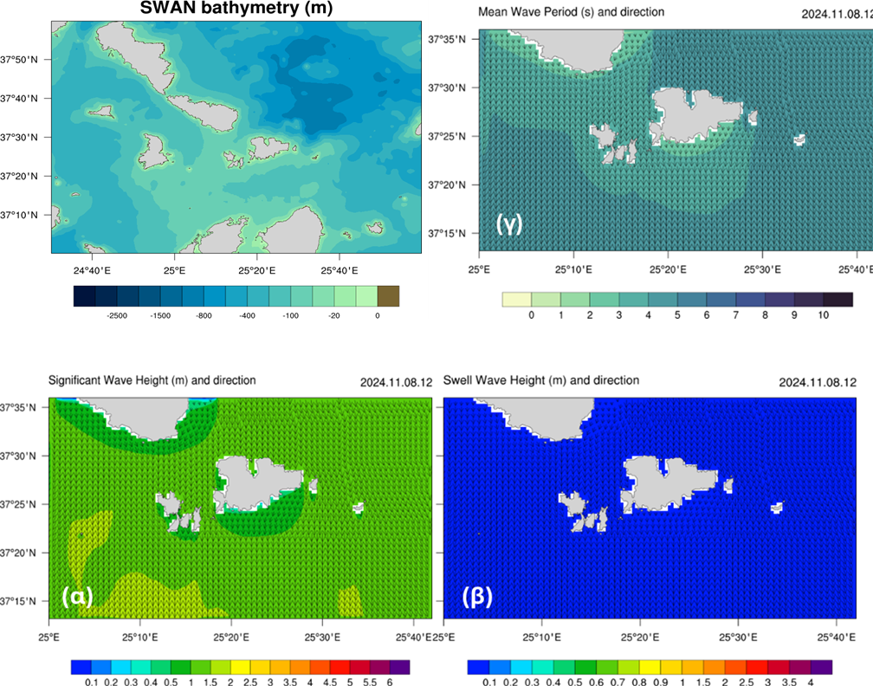
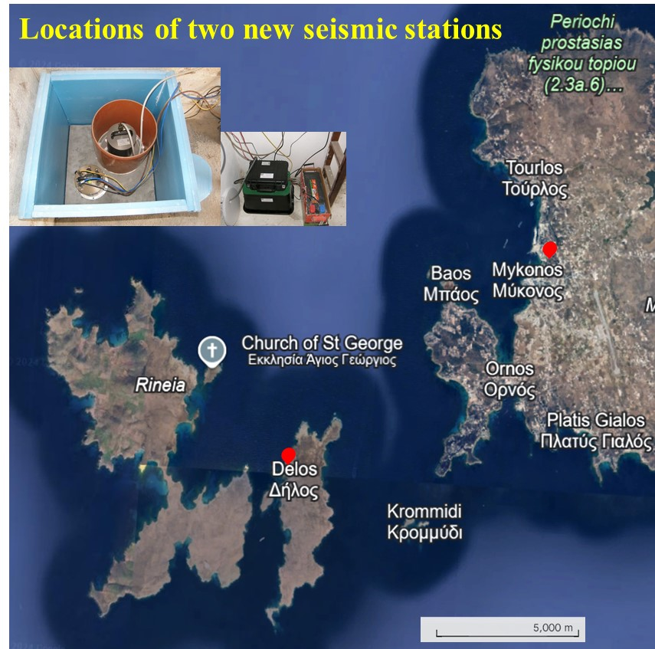
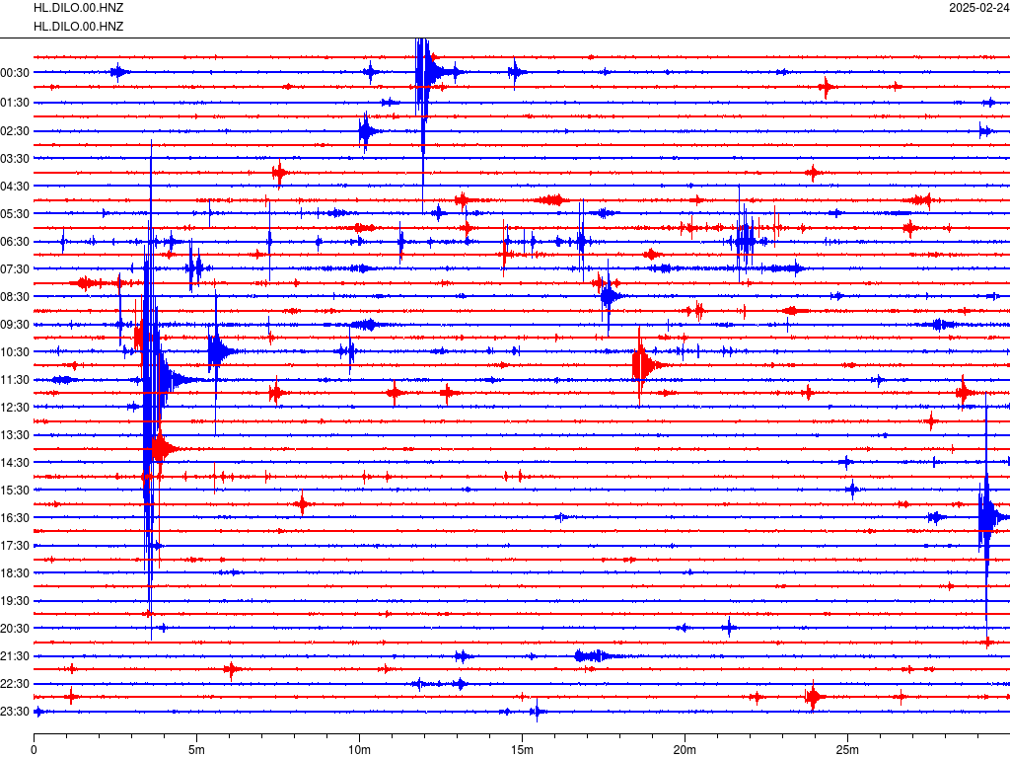
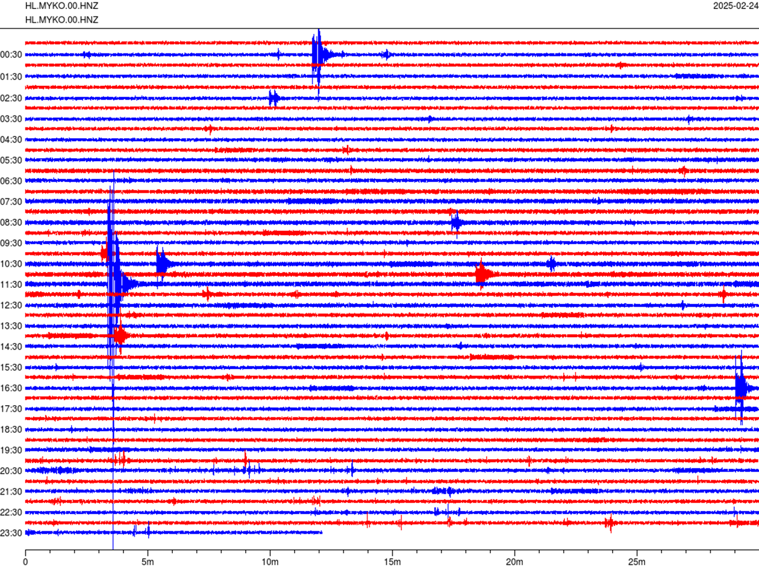
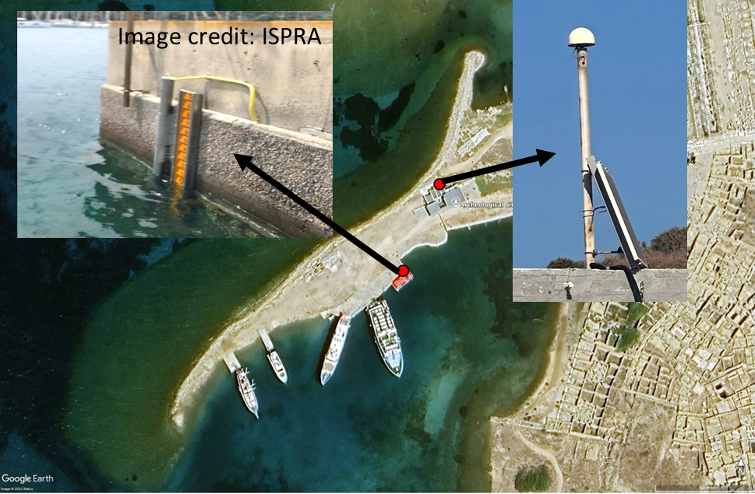
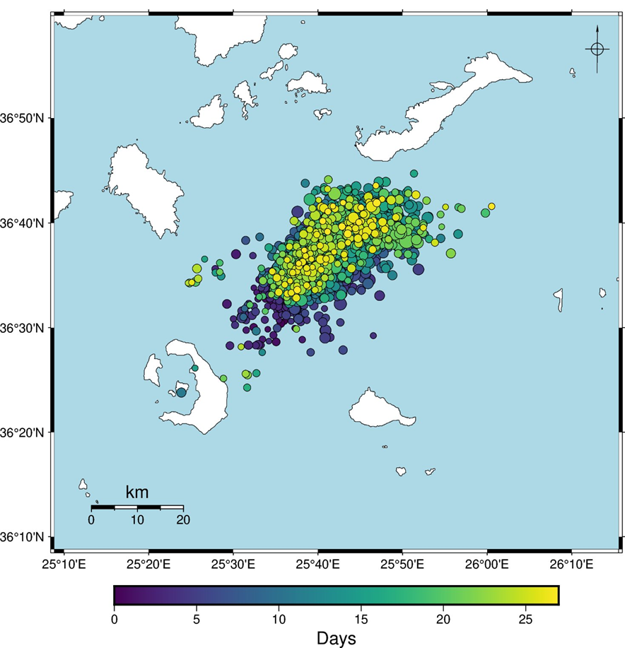
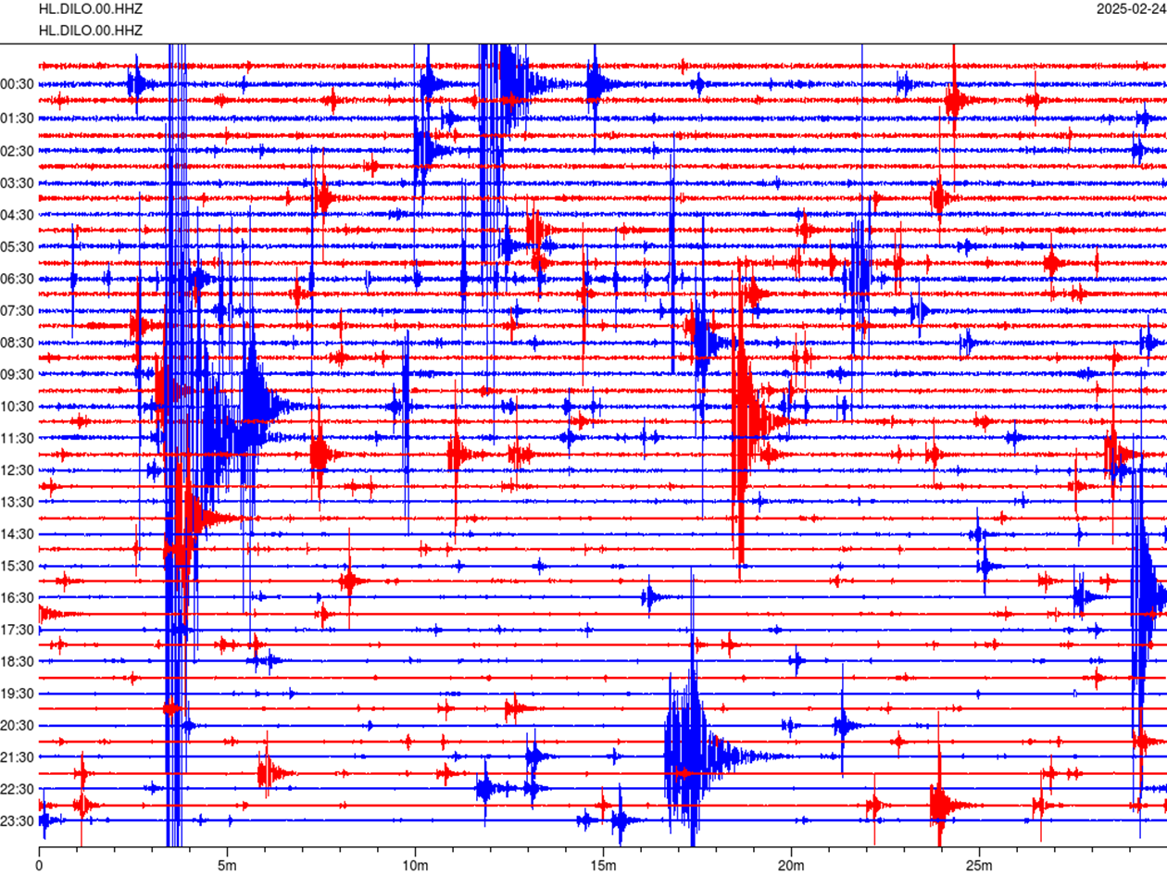
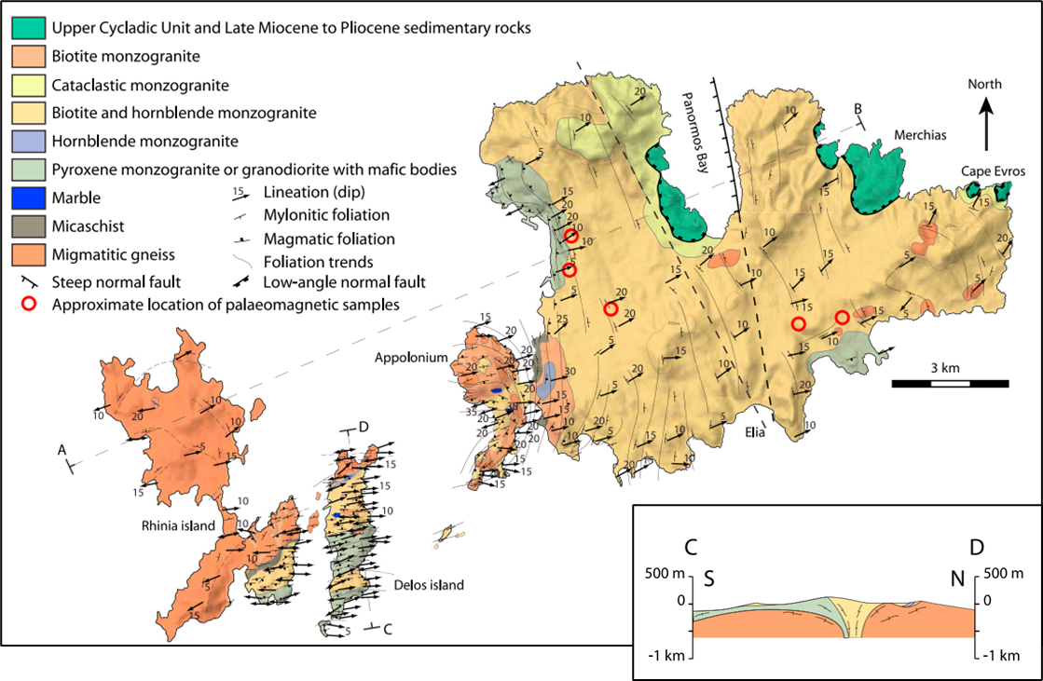
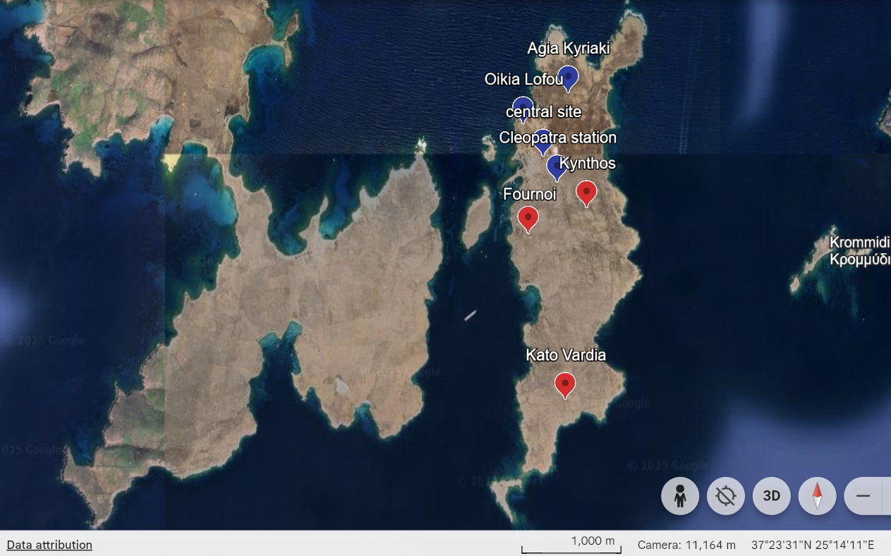
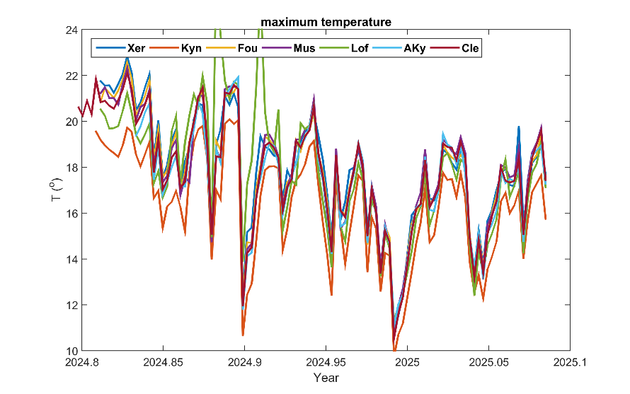
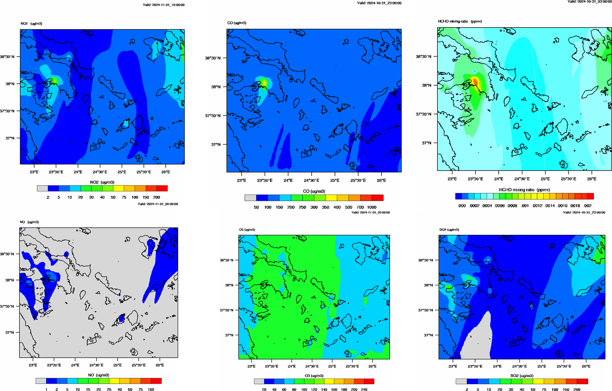
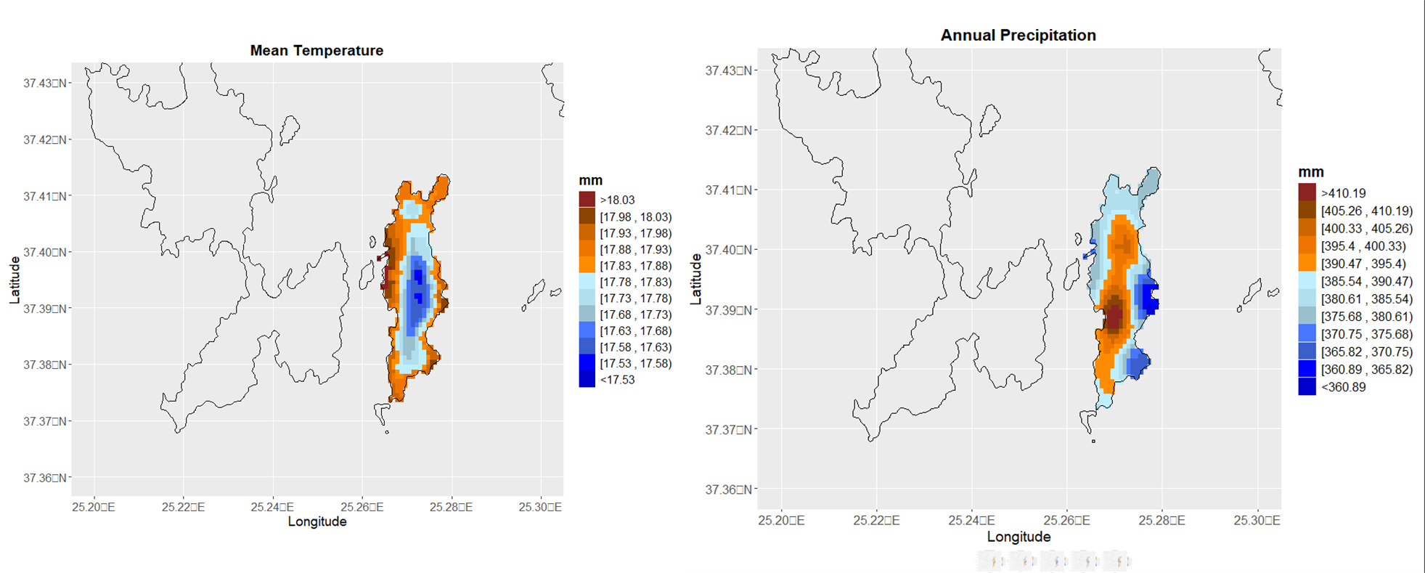
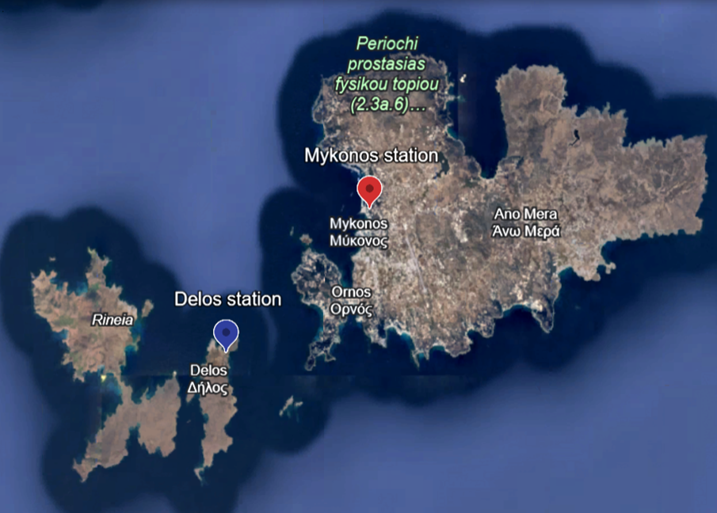
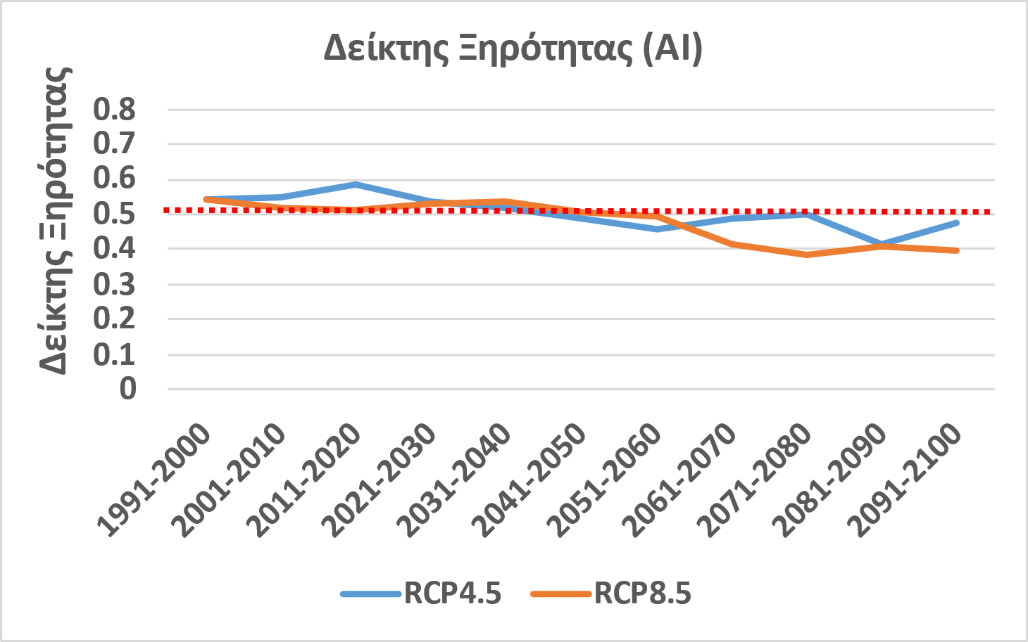
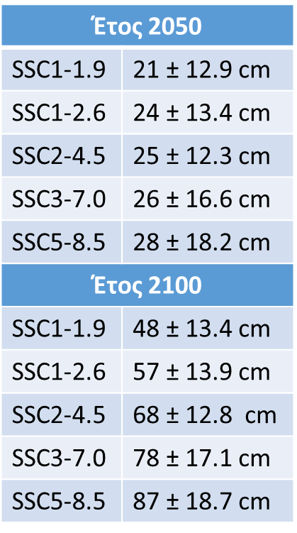
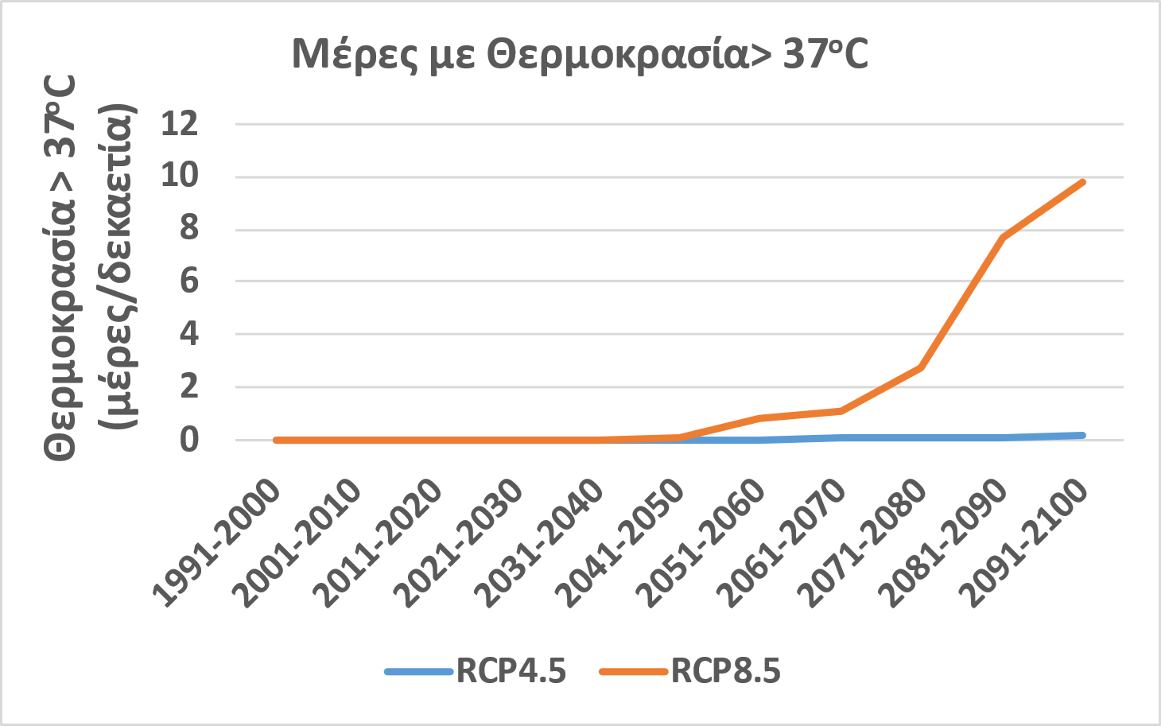
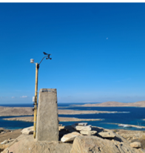
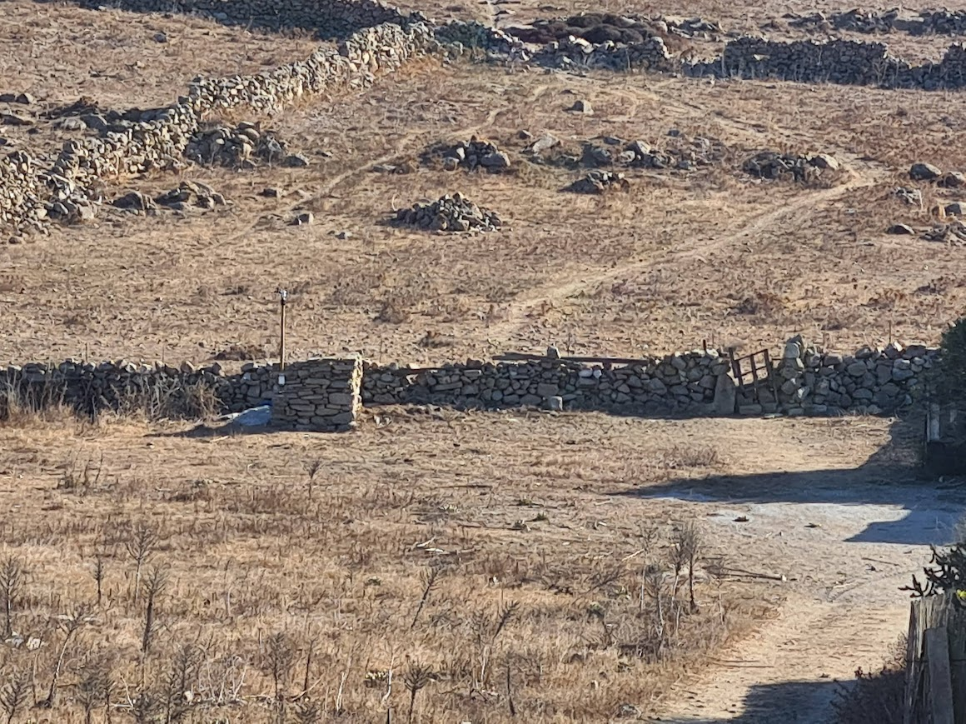
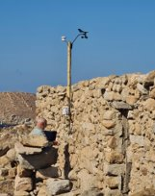
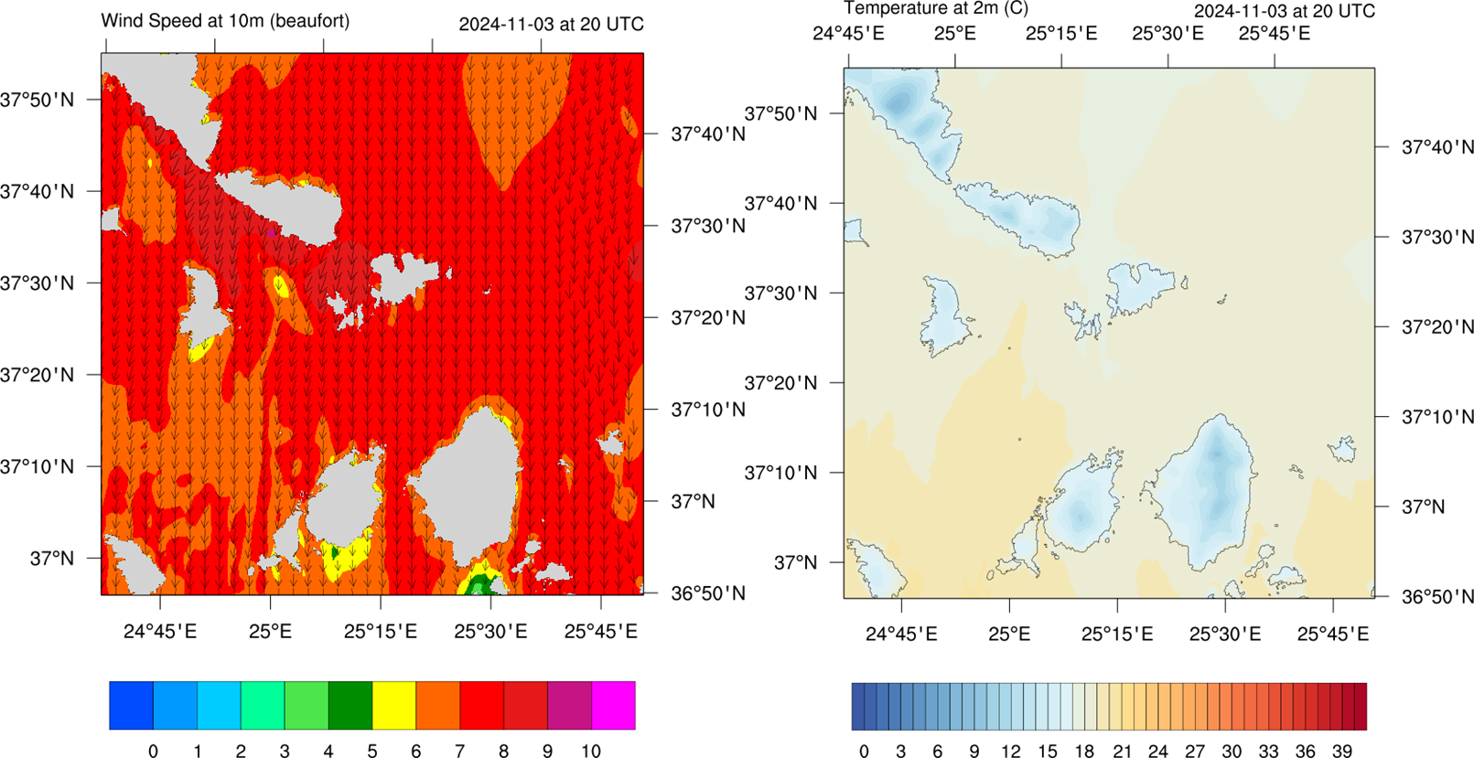
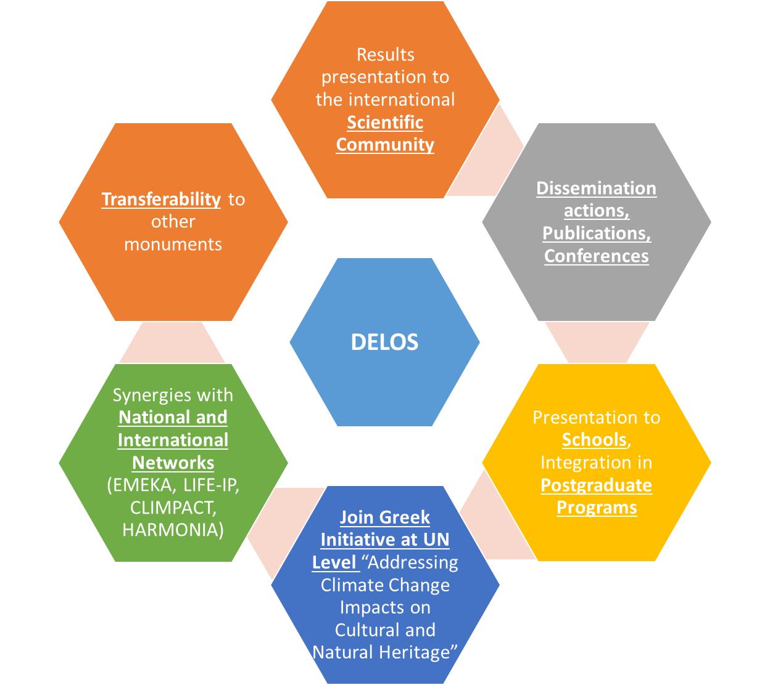
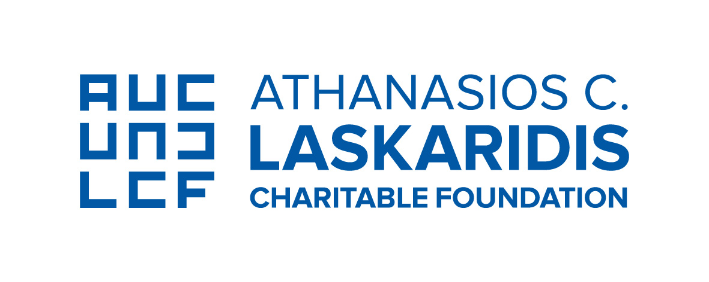
Protecting Natural Heritage from Climate Change Impacts: The establishment of an emblematic transdisciplinary monitoring facility in Delos, Greece
Ilias Fountoulakis¹; Nikolaos Melis²; Stavros Solomos¹; John Kapsomenakis¹; Anastasia Poupkou¹; Nikolaos Kalligeris²; Christos Maris^{3,4}; Demetrios Athanasoulis³; Konstantinos Boukouras²; Kostas Douvis¹, Charikleia Gkarlaouni²; Antonios Gkikas¹; Pavlos Kalabokas¹; Konstantinos Lentas²; Efstrateios Liadopoulos²; Nikolaos Papadimitriou¹; Christos Spyrou¹; Theodora Stavraka¹; Costas Synolakis^{5,6}; Themistoklis Vakoulis³, and Christos S. Zerefos^{1,7,8,9}
¹Research Centre for Atmospheric Physics and Climatology, Academy of Athens, Greece; ²Institute of Geodynamics, National Observatory of Athens, Greece; ³Ephorate of Antiquities of the Cyclades, Ministry of Culture, Greece; ⁴University of West Attica, Attica, Greece; ⁵Research Center for Natural Disasters, Academy of Athens, Greece; ⁶Department of Civil and Environmental Engineering, University of Southern California, USA; ⁷Biomedical Research Foundation, Academy of Athens, Athens, Greece; ⁸Mariolopoulos-Kanaginis Foundation for the Environmental Sciences, Athens, Greece; ⁹Navarino Environmental Observatory (N.E.O), Messenia, Greece
Presenting author e-mail: i.fountoulakis@noa.gr
Introduction
Introduction
The Delos archaeological site, inscribed on the UNESCO World Heritage Site List, is situated on a small rocky island in the center of the Aegean Sea. This uninhabited island boasts of monuments with immense significance to human civilization and it is set within a pristine natural landscape.
Extremely Endangered World Heritage Sites in the Mediterranean (Kapsomenakis et al, 2022)
Monuments around the Mediterranean are threatened by multiple hazards related to seismicity and climatic changes
Description of the infrastructure and preliminary results
Sea monitoring
Fine resolution wave/bathymetry modelling
Geodynamic risks and seismicity monitoring
Mykonos
Installation of a tide gauge with a piezoelectric (submersible) sensor on the port pier
Installation of a GNSS receiver/antenna in a warehouse near the tide gauge
Conversion of relative sea level to absolute
Two model seismic stations: Delos Archaeological Museum and Mykonos Archaeological Museum.
Santorini seismicity measured at Delos and Mykonos
Improved monitoring for better estimation of seismic effects on monuments.
Micro-seismicity monitoring to improve knowledge of seismically active fault zones.
Seismic monitoring of natural and human phenomena via ambient ground noise analysis.
Estimation of earthquake hazard.
DILO accelerometer
MYKO accelerometer
Seismic activity near Santorini
DILO seismometer
Delos
Tide gauge station with radar sensor
Stainless steel support base and cabinet
Capability for future integration of GNSS receiver/antenna
Geological map of the island complex of Mykonos – Delos – Rhenia and geological section of the island of Delos after Lecomte et al., 2010.
Atmospheric monitoring and modelling
Climate modelling
Meteorology
Air quality
Projected sea level rise (Mourtzas and Kolaiti, 2024 )
Blue: Ephorate of Antiquities of Cyclades
Red: Academy of Athens
Aridity index (AI)
Aridity index (AI)
Blue: Ephorate of Antiquities of Cyclades
Red: Academy of Athens
Maximum temperature can differ by up to 4 C at the different sites in winter. Larger differences are expected in the summer.
Air quality measurements at Mykonos and Delos aim to investigate the impact of anthropogenic emissions related to marine traffic, tourism, and prevailing weather patterns.
Temperature > 37ºC
(days/decade)
Days with temperature > 37ºC
Despite the island’s small size, there is significant spatiotemporal variability in atmospheric parameters that impact the monuments.
Depending on the scenario, environmental conditions will change significantly.
WRF-Chem Air quality forecasting is being used to forecast pollution and to identify the sources that affect Delos
WRF Meteorological Forecasting at 1×1 km
Summary and Conclusions
Acknowledgments
The project is implemented with the support of donations from the following foundations: ATHINA I. MARTINOU FOUNDATION, A. G. LEVENTIS FOUNDATION, JOHN S. LATSIS PUBLIC BENEFIT FOUNDATION, CAPTAIN VASSILIS & CARMEN CONSTANTAKOPOULOS FOUNDATION, ATHANASIOS C. LASKARIDIS CHARITABLE FOUNDATION, and MARIANNA V. VARDINOYANNIS FOUNDATION, within the framework of the 'Climate Change and Environment' actions of the Initiative 21.
Delos is one of the most endangered World Heritage sites in the Mediterranean Basin, facing increasing vulnerability to risks associated with climate change and geodynamic activity, both of which pose significant threats to its cultural and natural heritage.
A multi-hazard environmental monitoring facility has been established in Delos, incorporating climate and numerical prediction modelling, as well as satellite-based and in-situ real-time monitoring of various seismic, atmospheric, and oceanographic parameters.
Preliminary results have been presented.

