Slide 1
Influence of Fuel Sulfur Content and nvPM Emissions on Contrail Formation: A CFD-Microphysics Approach
Sébastien Cantin, Mohamed Chouak, François Garnier
Engineering School ÉTS, University of Québec, Montréal, Canada
Friday, May 2nd, 2025
1/9

Slide 2
Why focus on the jet regime ?
Contrail evolution spans a wide range of spatial scales (from nanometers to kilometers) and time scales (from milliseconds to several hours)
Makes full lifecycle modeling challenging
Formation of ice crystals is a multiphysics phenomena (fluid dynamics, chemical transformations, and particle microphysics)
Needs careful and coupled modeling approaches
~ 250 m (1 s)
Research objective
Investigate the influence of fuel sulfur content (FSC) and non-volatile particulate matter (nvPM) emissions on the near-field properties of contrails using a CFD-microphysics online coupling
2/9

Slide 3
CFD-microphysics modeling in the jet regime
URANS CFD coupling with detailed microphysics and reactive chemistry for non-organic compounds
Multi-species Eulerian gas phase (~30 organic species + sulfuric acid + water vapor + ${CO}_{x}$ + ${NO}_{x}$ + ${SO}_{x}$)
Lagrangian particulate phase: dry/activated soot, volatile particles, ice crystals
CFM56-5B3 engine geometry
Gas phase
Mass coupling
Particulate
phase
3/9

Slide 4
PArticle-based Microphysical Model for Aircraft Plumes (PAMMAP)
Non-aqueous activated surface
Aqueous activated surface
Condensation
Formation Pathway 1
Formation Pathway 2
Surface coverage by activation and condensation on soot surface
4/9

Slide 5
Jet plume microphysics Effect of ambient temperature
100 % frozen particles
70 % frozen particles
Baseline conditions :
Ambient temperature $T_{amb}=218.8 K$
Relative humidity (ice) = 100%
Soot number ${EI}_{N}=1.38×{10}^{14}$ #/kg-fuel
Gaseous organic ${EI}_{m}=130$mg/kg-fuel
Fuel Sulfur Content (FSC) = 700 ppm
Lower temperatures promote soot particle freezing
Enhanced cooling rate near the jet edges at $T_{amb}$ = 212 K
Dry soot particles (black) / activated (red) / frozen (blue))
5/9

Slide 6
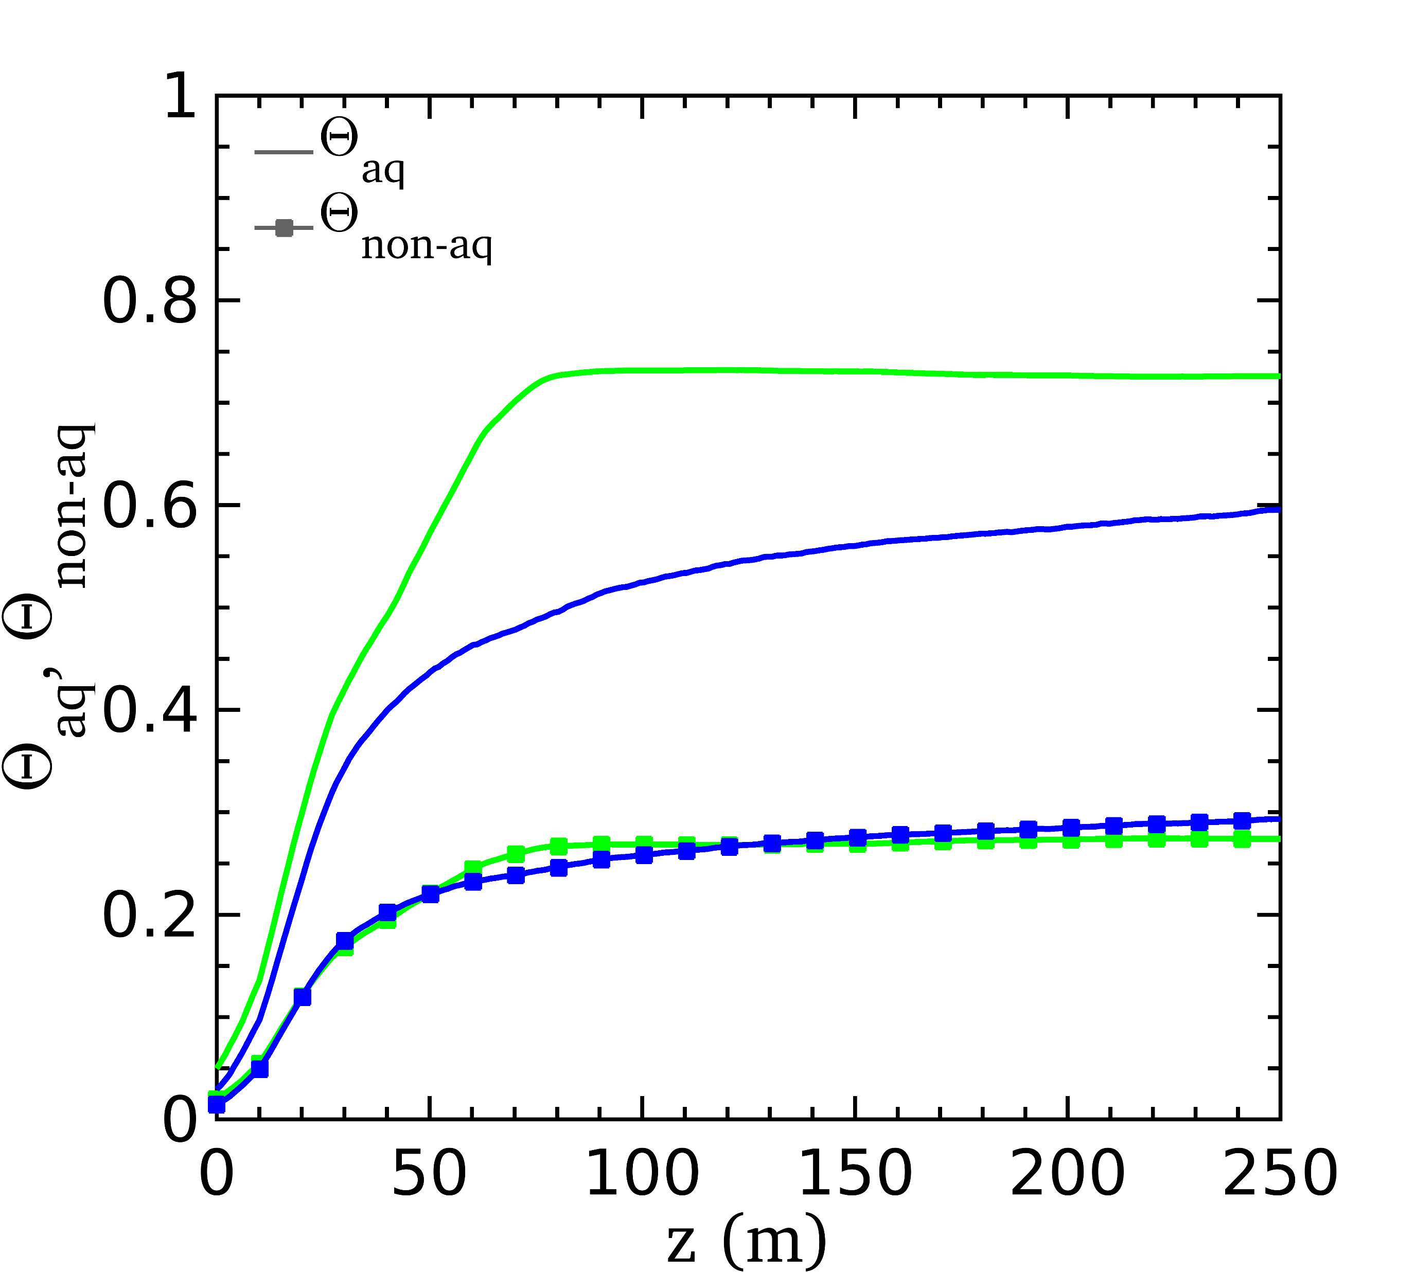
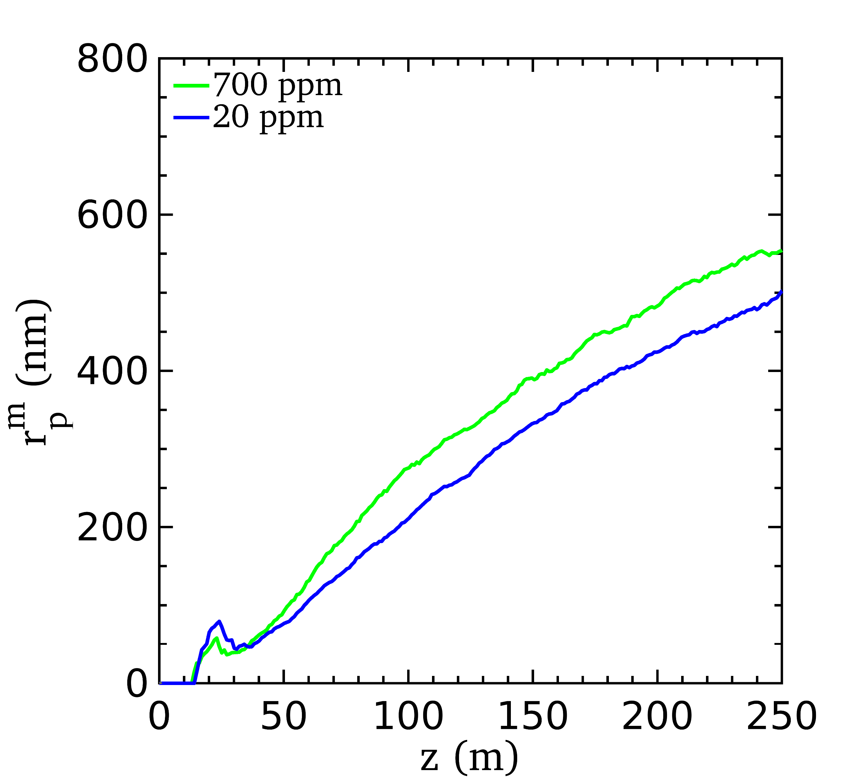
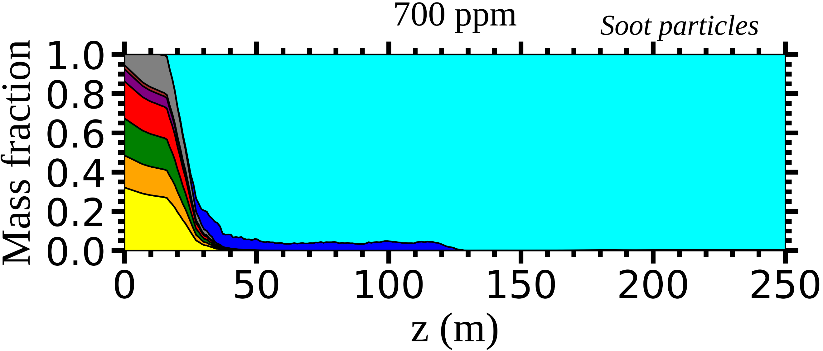
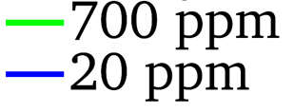
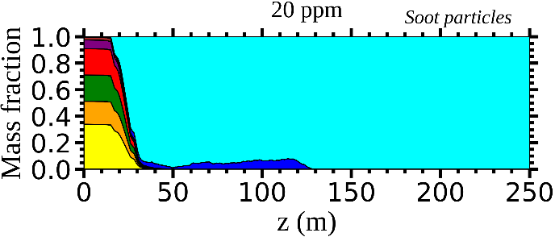
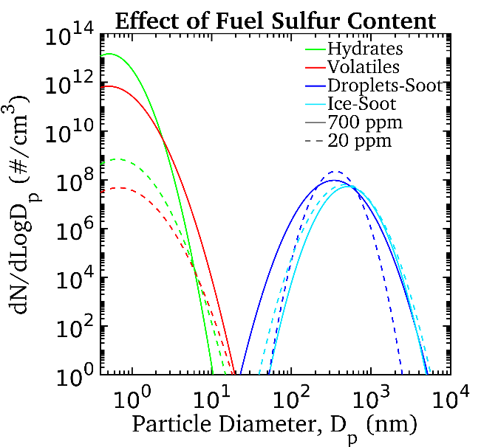
Jet plume microphysics Effect of Fuel Sulfur Content
Lower FSC reduces the radius of soot particles
Activation on the surface of soot particles
Lower FSC
Chemical composition of soot particles
Organic compounds contribute to soot particle activation
Lower FSC increases the number of frozen soot particles
Particle size distribution
at 120 m (≈ 0.5 s)
6/9

Slide 7
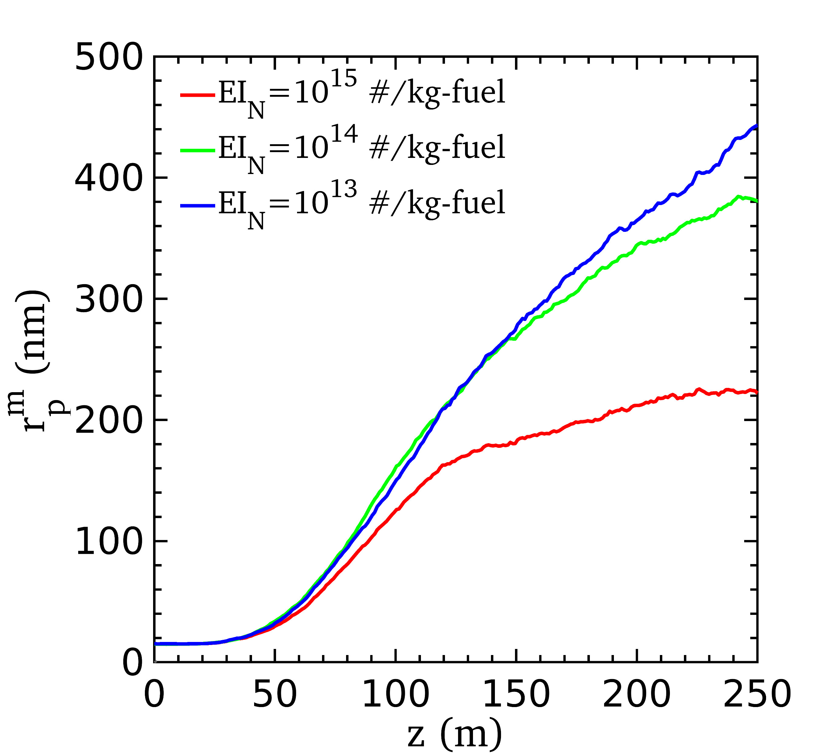
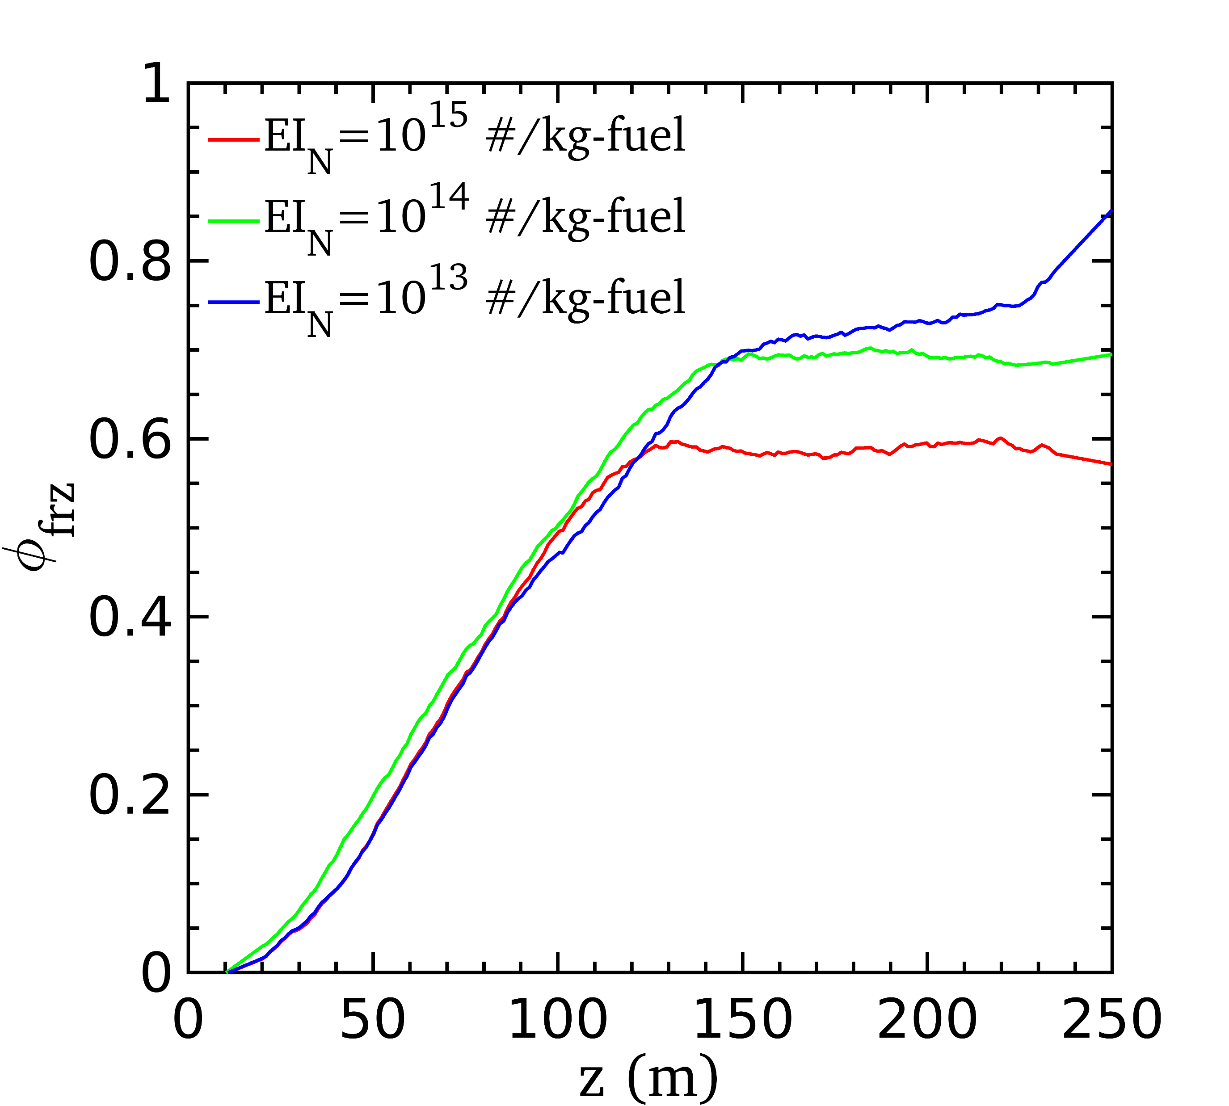
Jet plume microphysics Effect of soot particle number emission index
Higher ${EI}_{N}$
${EI}_{N}$ ≈ 10¹⁵ #/kg-fuel : soot particles are either dried or frozen
Particle size distribution
at 120 m (≈ 0.5 s)
Higher soot particle ${EI}_{N}$ decrease particle radius and fraction of frozen soot particles
Higher soot particles ${EI}_{N}$ slightly reduces the number and radius of hydrate/volatile particles
7/9

Slide 8
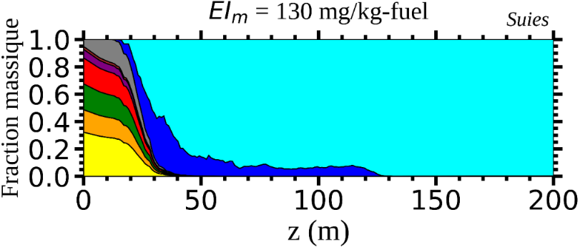
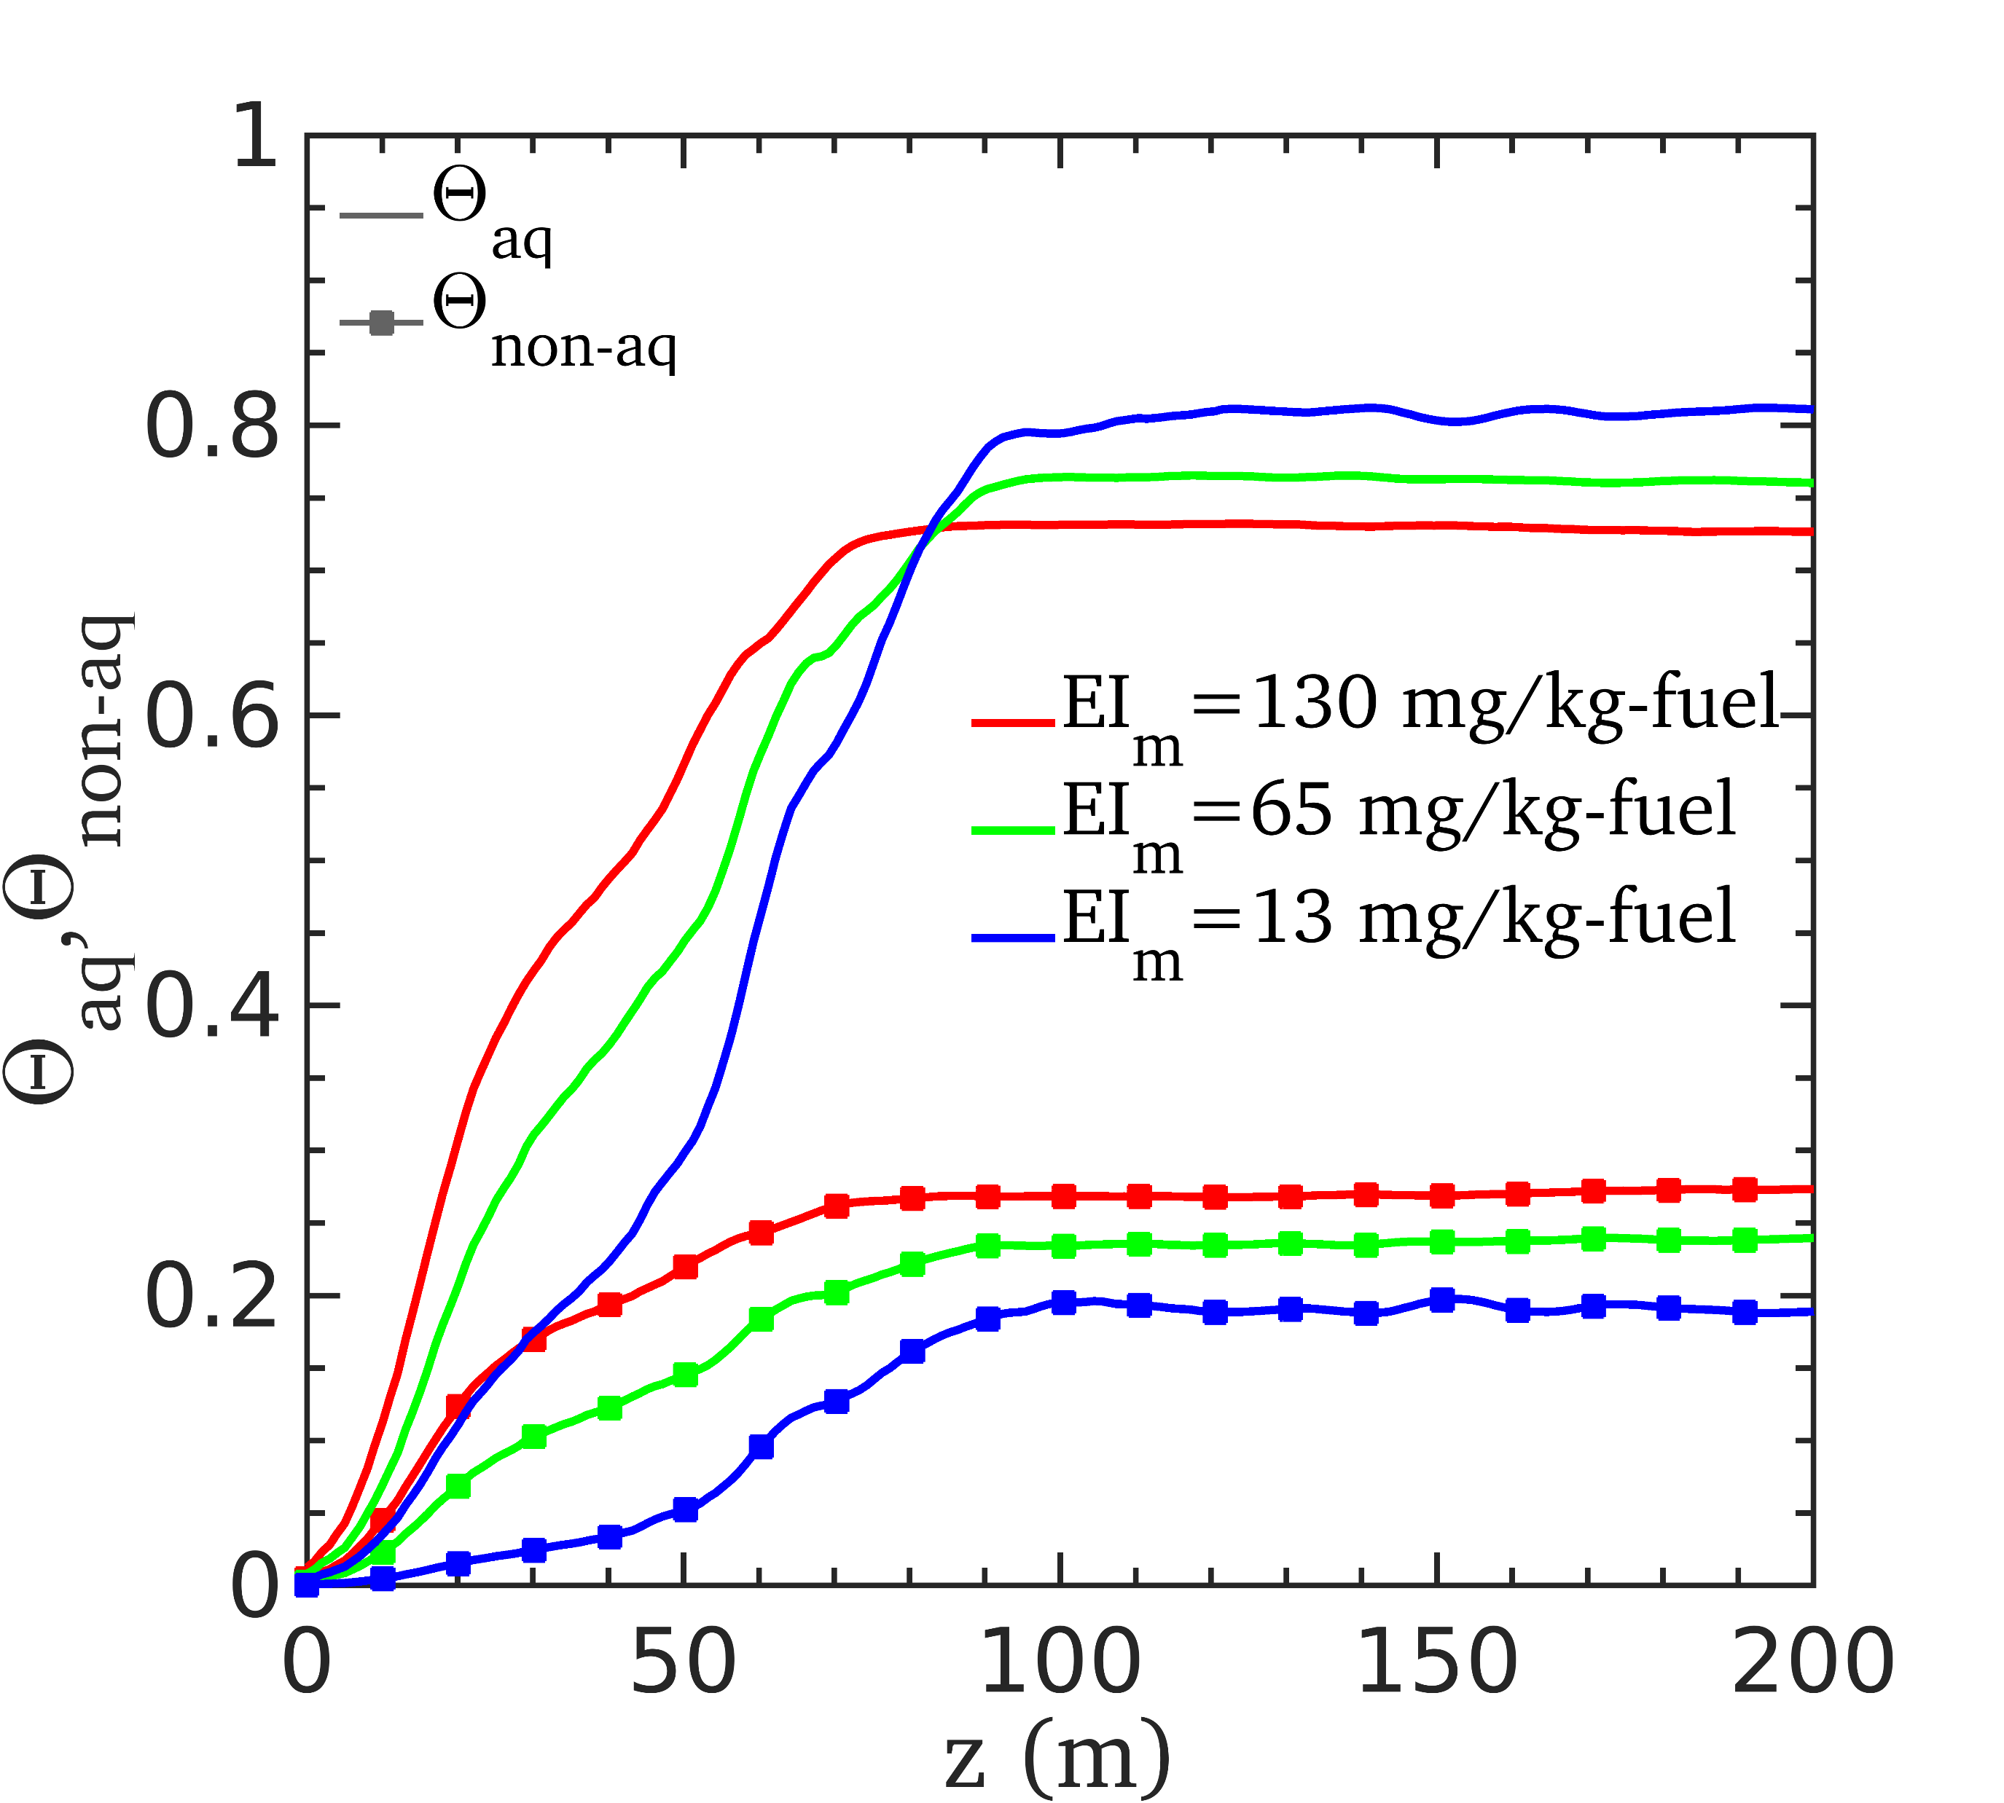
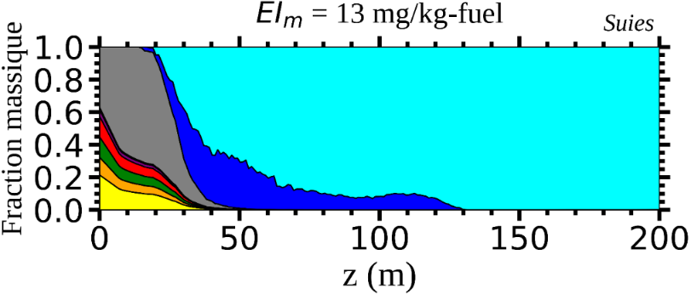
Jet plume microphysics Effect of the organic mass emission index
Mass fraction Mass fraction
Decreasing the organic mass emission index reduces both the radius and the number of frozen soot particles
Chemical composition of soot particles
Lower ${EI}_{m}$ increases the mass fraction of sulfuric acid on soot particles
Decreasing ${EI}_{m}$ delays the full recovery of soot particles
8/9

Slide 9
Conclusions & Future work
The objective was to investigate the influence of fuel sulfur content (FSC) and nvPM emissions on the near-field properties of contrails using a CFD-microphysics online coupling
Key findings
Organic compounds contribute to soot particle activation
Effect of sulfur :
At low FSC, soot particles are still activated by organic compounds
Lower FSC increases the number of frozen soot particles but decrease the number of volatiles particles
Effect of soot particle number emission index
Higher soot particles ${EI}_{N}$ seems to reduce the number and radius of hydrate/volatile particles
Effect of the organic mass emission index
Lower ${EI}_{m}$ increases the mass fraction of sulfuric acid on soot particles and reduces both the radius and number of frozen soot particles
Future work :
Include the chemiion effect on volatile particle growth
Include the effect of ambiant particles
Study the impact of alternative fuels on ice crystals formation
9/9

Slide 10
Thank you for your attention
Results are part of the article below (under review)
Cantin, Sébastien and Chouak, Mohamed and Garnier, François, Effects of Fuel Sulfur Content and Nvpm Emissions on Contrail Formation: A Cfd-Microphysics Study Including the Role of Organic Compounds. Available at SSRN: https://ssrn.com/abstract=5138455 or http://dx.doi.org/10.2139/ssrn.5138455
QR code link to the abstract of the presentation EGU25-13450

Slide 11
Distribution of the organic compounds at engine exhaust
Concentration of organic compounds at exhaust initialized from measurement (Kılıç et al., 2017)

Slide 12
Verification of chemical reactions in the jet

Slide 13
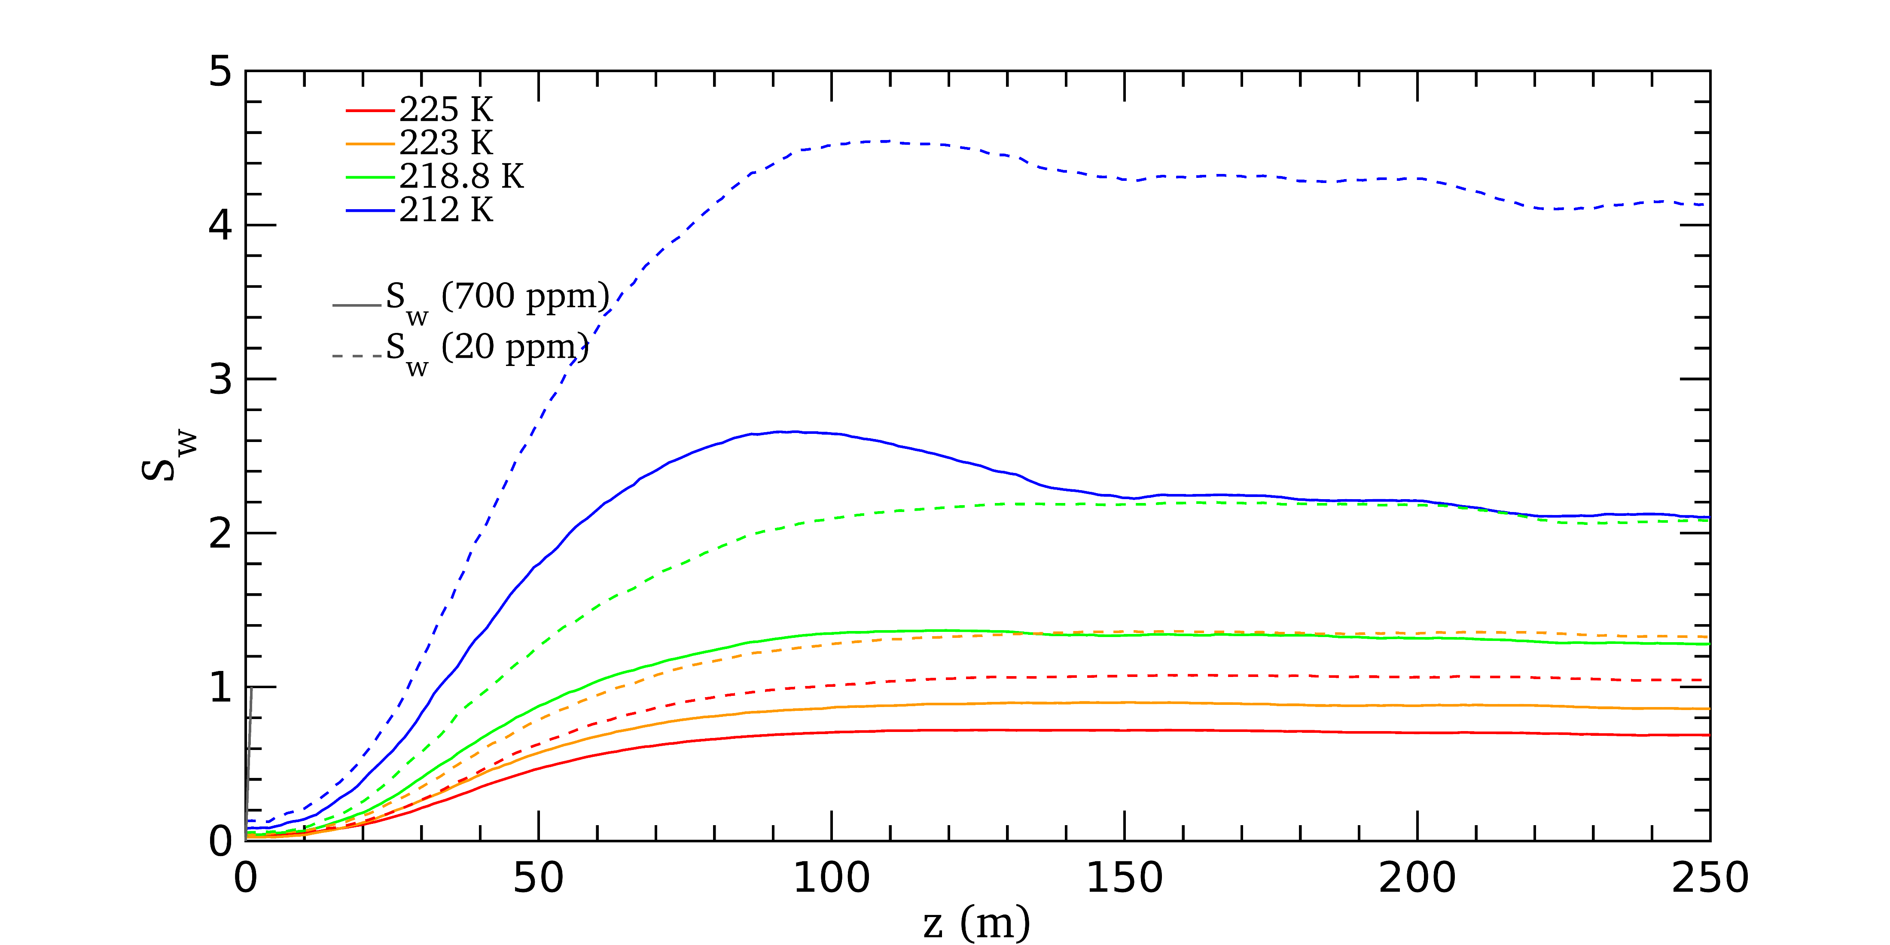
Saturation with respect to the mean liquid content over particles
Non-linear increase of $S_{w}$ with decreasing $T_{amb}$, amplified with FSC

Slide 14
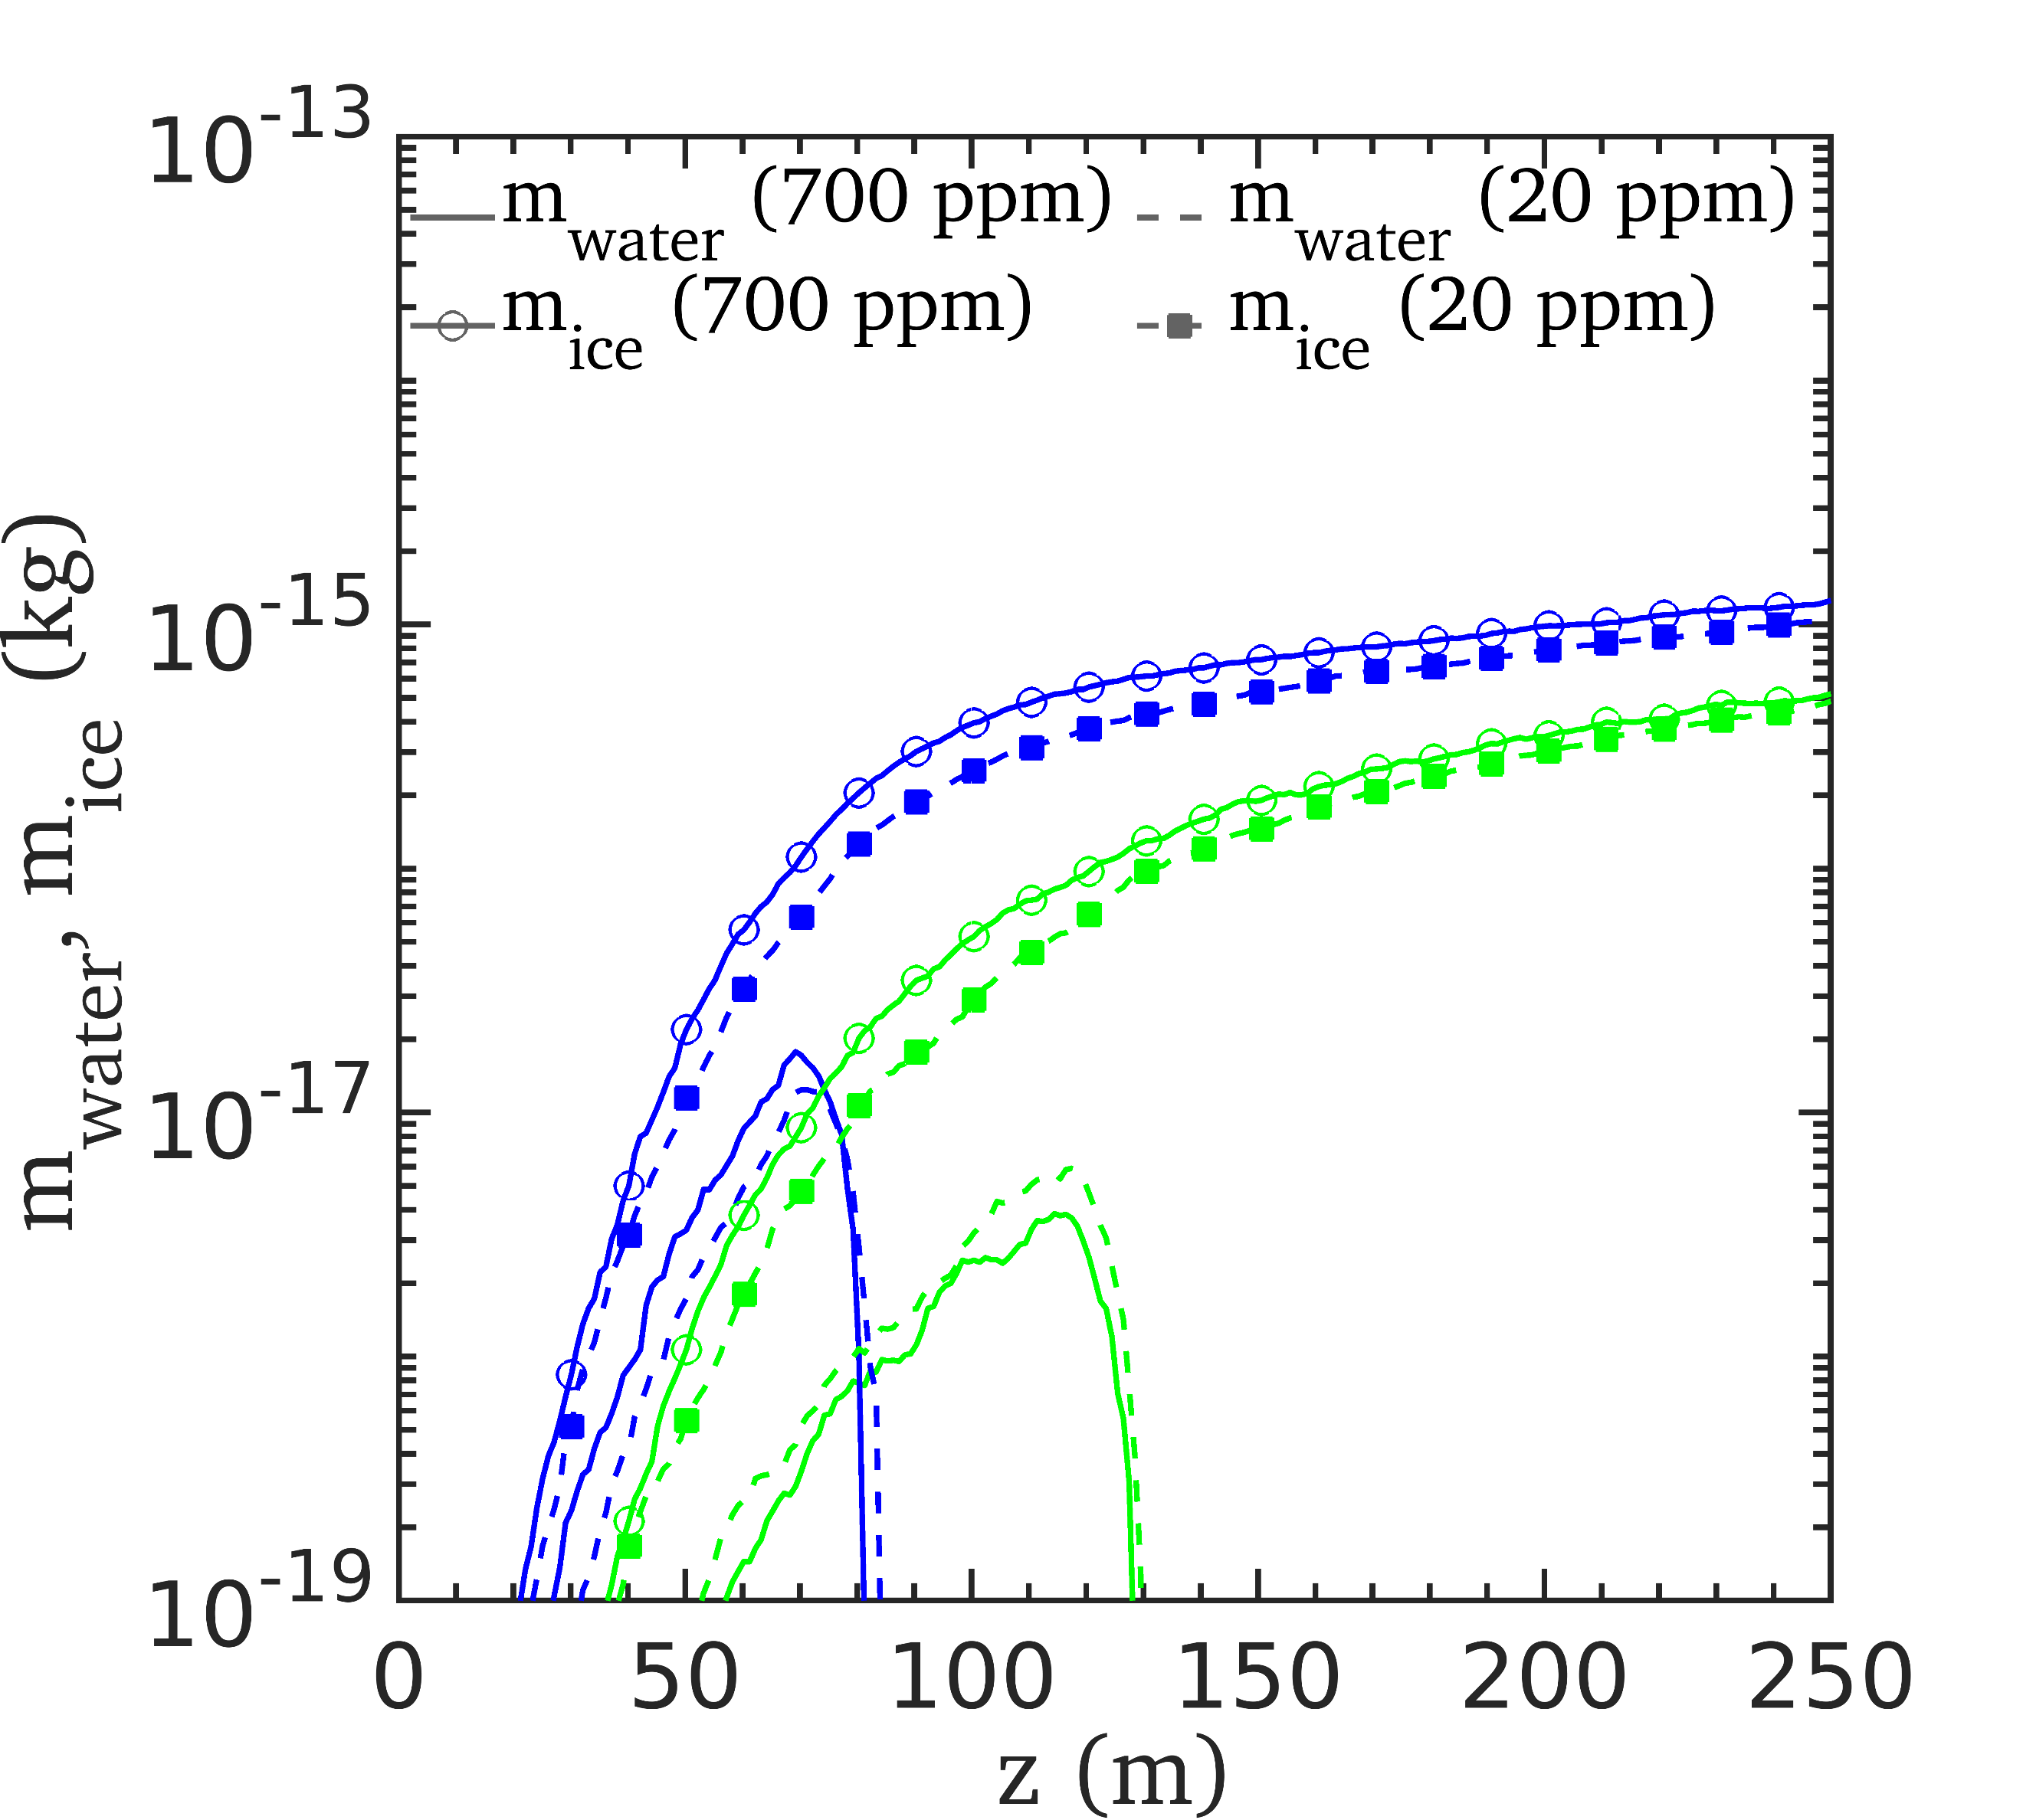
Mass of water and ice over particles
Ice freezing leads to $m_{water}$

