Slide 1
The role of Rossby wave breaking in coral bleaching
on the Great Barrier Reef
Lara Richards^{1,2,3,6}, Steve Siems^{1,2}, Yi Huang^{2,3,4,6}, Wenhui Zhao^{2,4} , Michael Reeder^{1,3}, Michael Manton¹ and Daniel Harrison^{2,5}
¹ Monash University. ² Reef Restoration and Adaptation Program. ³ARC Centre of Excellence for Climate Extremes.
⁴ The University of Melbourne. ⁵Southern Cross University. ⁶ARC Centre of Excellence for 21st Century Weather

Slide 2
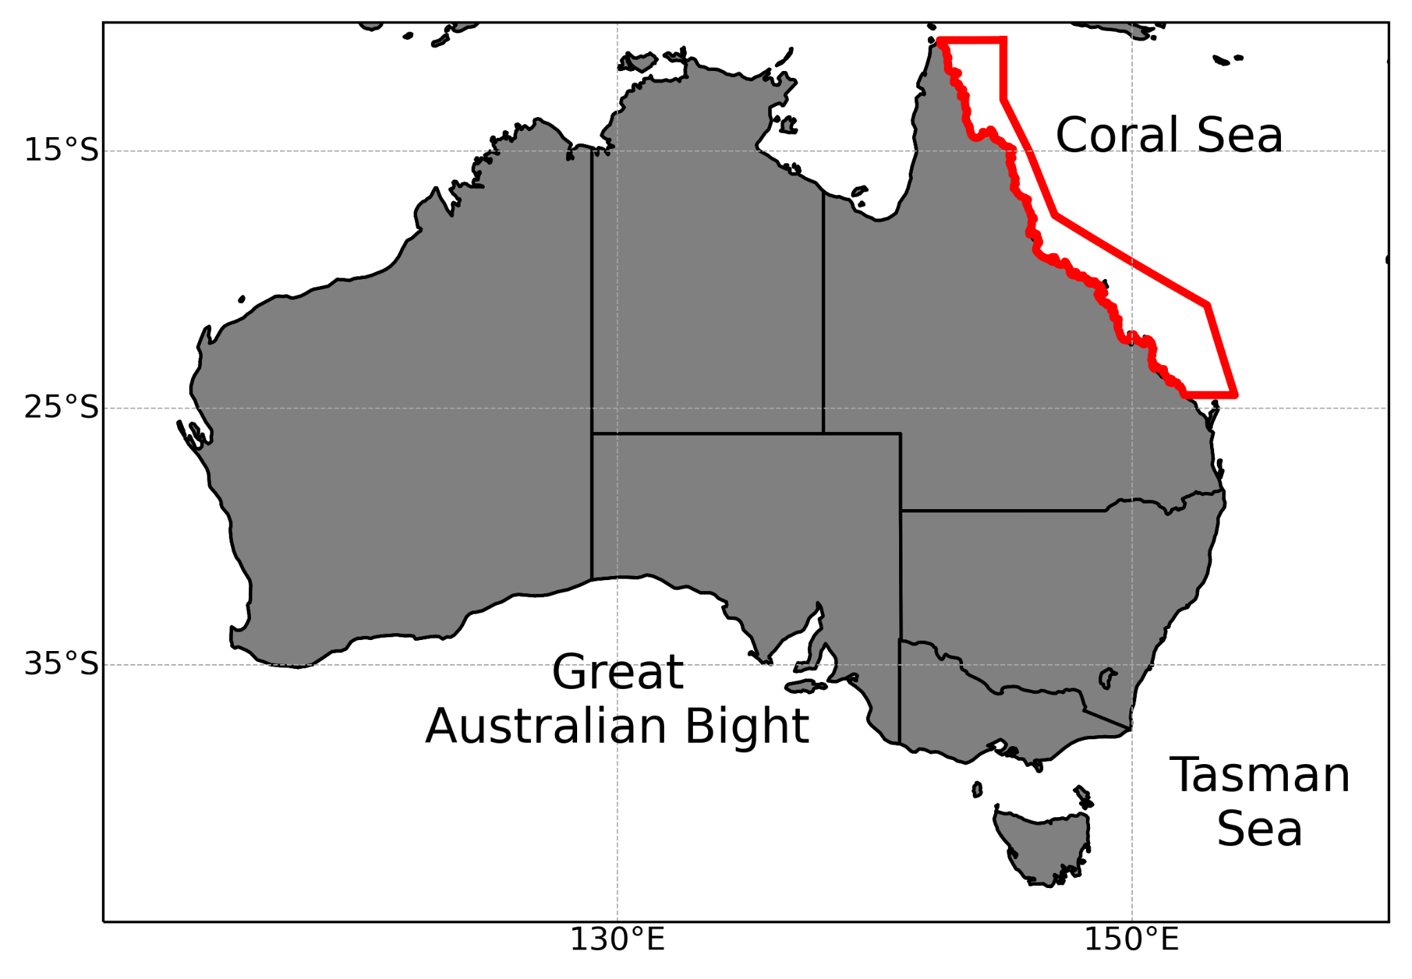
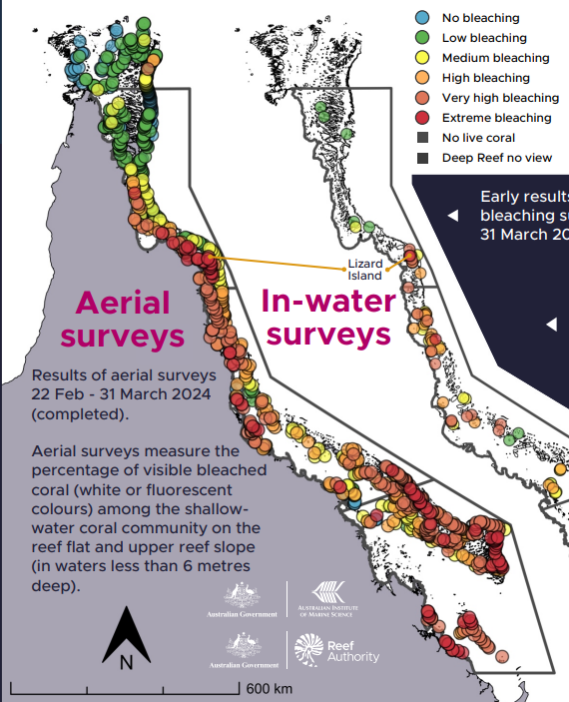
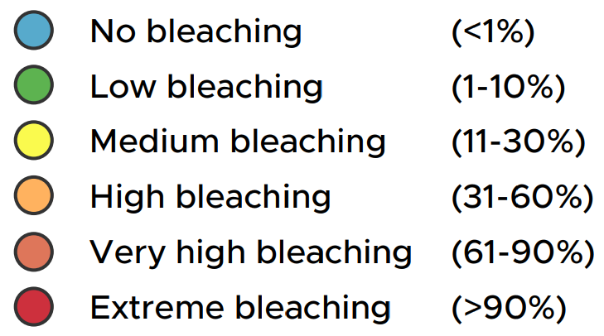
8 mass thermal coral bleaching events since 1998
Great Barrier
Reef
2024
1998 2006 2016 2020 2024
2002 2017 2022
Great Barrier Reef Marine Park Authority, Australian Institute of Marine Science, and CSIRO, Reef snapshot: Summer 2023-24, Great Barrier Reef Marine Park Authority, Townsville. Available at https://hdl.handle.net/11017/4043
Notes:
Ocean temps continued rise over gbr -> inc frequency
8 mass bleaching since 98, 5 since 2016 with recent bleaching this year
Ocean temps most reliable proxy for bleaching
Sustained Periods of high ocean temps bad for bleaching

Slide 3
How does the weather influence ocean temperatures?
Normal conditions (Trade winds)
Bleaching conditions
(No trades)
Surface Energy Budget (Q*) =
Short-Wave (Q_{SW})
+ Long-Wave (Q_{LW})
+ Latent Heat (Q_{E})
+ Sensible Heat (Q_{H})
w
Q_{E}
Short-wave flux
UV exposure
Q_{LW}
Q_{E}
Q_{LW}
Cloud
Cover
Q*
Q_{H}
Q_{H}
Wind Speed & Direction
Q_{SW}
Latent heat flux
Surface humidity
Q*
Q_{SW}
Adapted from Fordyce, A. J., Ainsworth, T. D., Heron, S. F., & Leggat, W. (2019). Marine Heatwave Hotspots in Coral Reef Environments: Physical Drivers, Ecophysiological Outcomes, and Impact Upon Structural Complexity. Frontiers in Marine Science, 6. doi:10.3389/fmars.2019.00498
Notes:
Main point is loss of trades

Slide 4
We understand what weather conditions cause ocean temperatures to rise during bleaching events
Why do these conditions form?
What breaks down the trade winds?
south-easterly trade winds

Slide 5
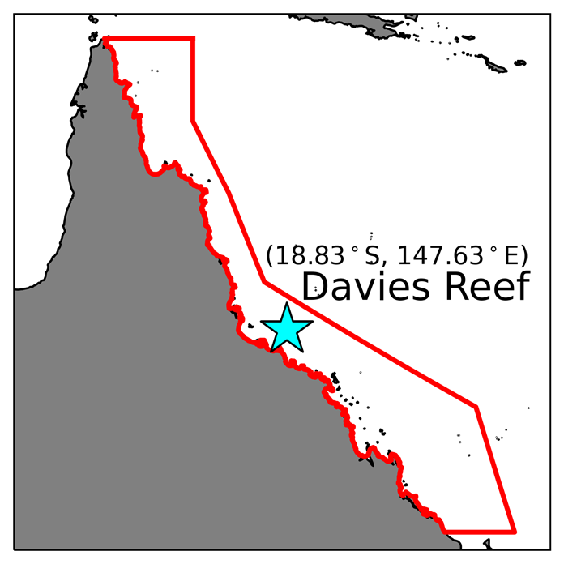
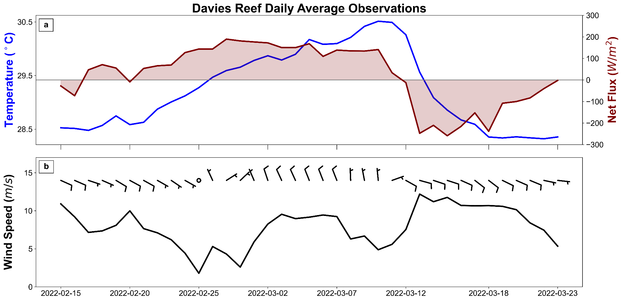
2022 bleaching event case study
Trade wind
breakdown
Trade wind
return
Richards, L. S., Siems, S. T., Huang, Y., Zhao, W., Harrison, D. P., Manton, M. J., & Reeder, M. J. (2024). The meteorological drivers of mass coral bleaching on the central Great Barrier Reef during the 2022 La Nina. Sci Rep, 14(1), 23867. doi:10.1038/s41598-024-74181-2
Notes:
When we analyse a single event, we see the same weather conditions and response in the heat flux
Rise 2C over almost 3 weeks
Trade winds begin to weaken, wind speed drops and relative humidity increases, -> LHF decreases
Cloud cover reduces and SWF increases
Sudden cooling, around 2C in 48h
Trade winds returned, higher wsp and cooler/drier air over the gbr
Bleaching weather aligns with a loss of the trades and temps drop when the trades re-establish

Slide 6
Trade Wind Breakdown - repeated RWB
Rossby wave breaking
Cut-off low
ERA5 u and v winds (Richards et al. 2024)
Notes:
Heating start

Slide 7
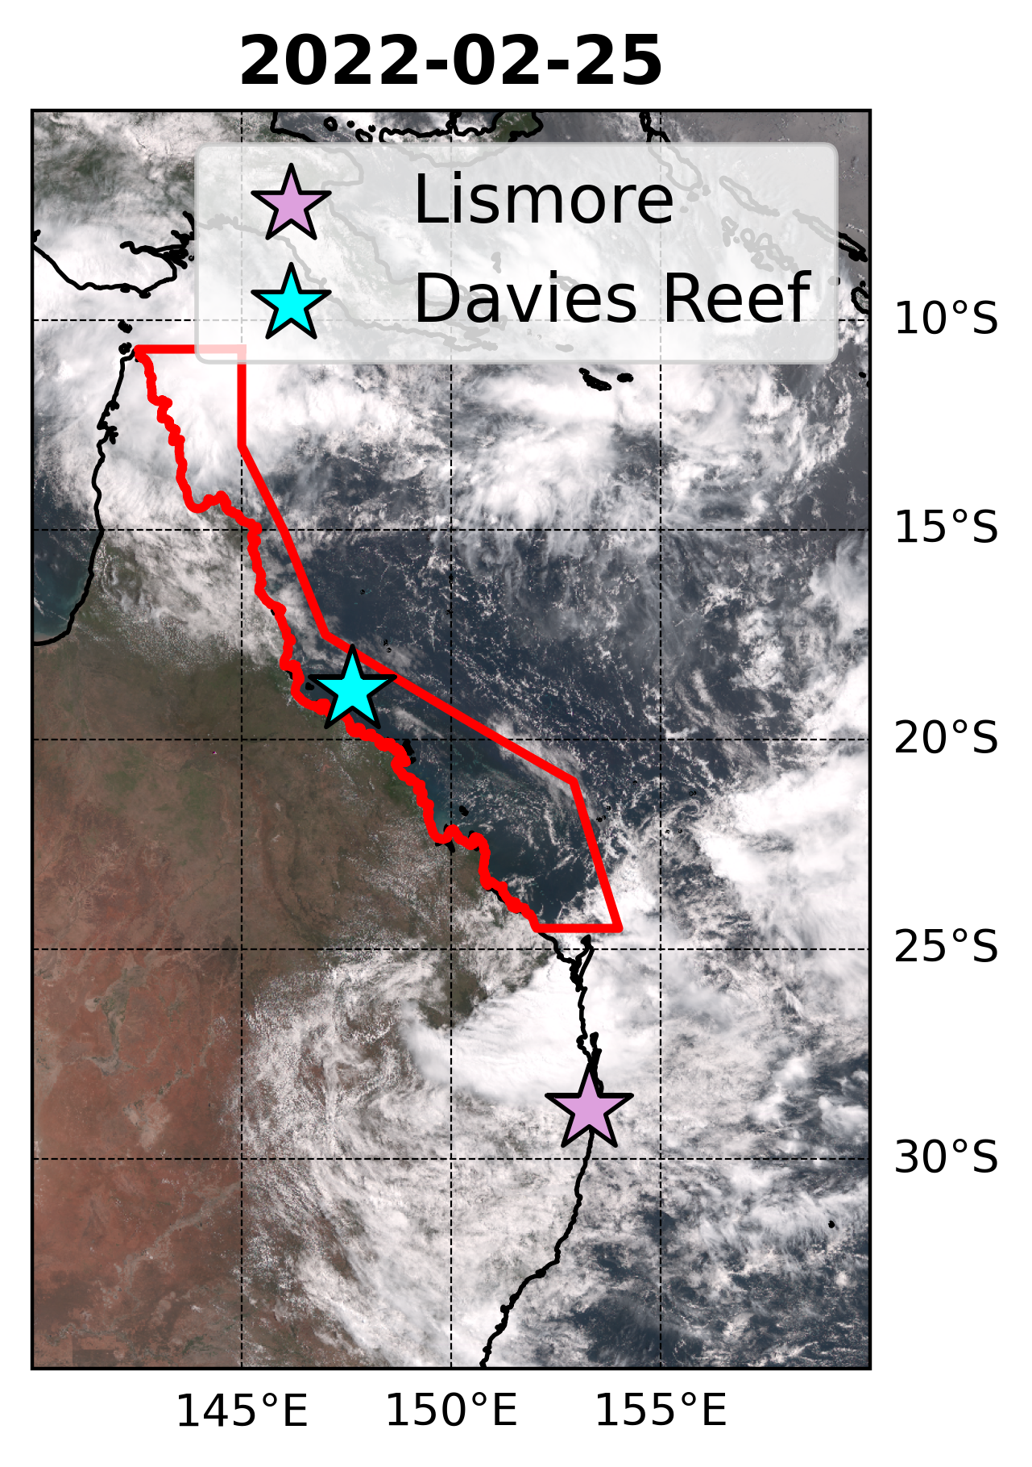
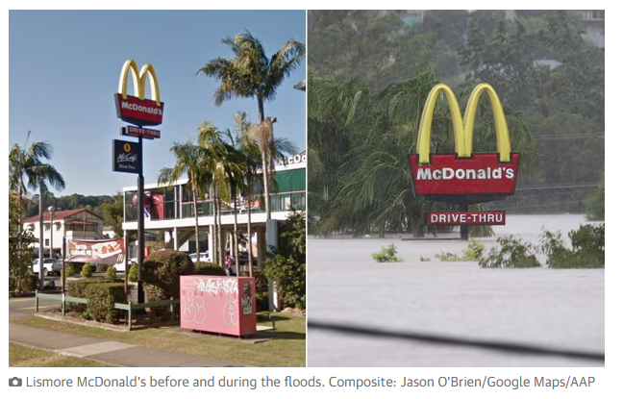
Trade Wind Breakdown - repeated RWB
2022 highest on record Lismore flooding
Severe flooding and coral bleaching linked to same RWB event
(Barnes et al. 2023)
Rossby wave breaking
Cut-off low
Barnes, M. A., King, M., Reeder, M., & Jakob, C. (2023). The dynamics of slow‐moving coherent cyclonic potential vorticity anomalies and their links to heavy rainfall over the eastern seaboard of Australia. Quarterly Journal of the Royal Meteorological Society. doi:10.1002/qj.4503
(Richards et al. 2024)
Notes:
Heating start

Slide 8
Trade Wind Return - Low amplitude jet
Trades
Zonal structure
ERA5 u and v winds (Richards et al. 2024)
Notes:
Fast jump from weak winds to trades
Coastal ridging theory

Slide 9
Rossby wave breaking not unique to 2022 event
ERA5 500 hPa Anomalies
1996-2024 Dec-Apr
Day of year anomalies for low wind speed (doldrum) events based on Davies Reef clustered soundings. ERA5 horizontal winds and geopotential heights. Greens indicate negative anomalies and purples positive anomalies
(Richards et al. 2025 in preparation)

Slide 10
Conclusion
For Great Barrier Reef coral bleaching events you need to disrupt the trade winds
This can be done by Rossby wave breaking in the right spot
Repeated breaking could disrupt the trades for longer
Once breaking stops trades able to re-establish
ERA5 DJFMA 500 hPa Anomalies
Day of year anomalies for low wind speed (doldrum) events based on Davies Reef clustered soundings. ERA5 horizontal winds and geopotential heights. Greens indicate negative anomalies and purples positive anomalies
(Richards et al. 2025 in preparation)

