Slide 1
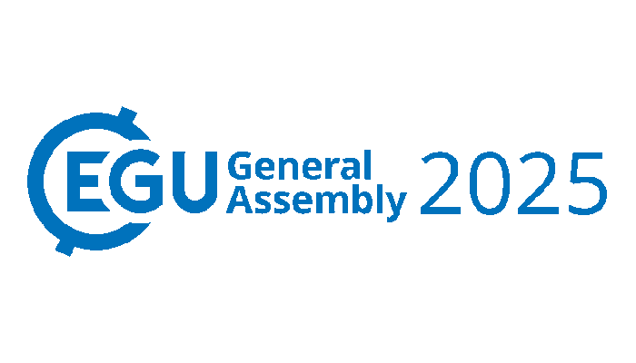




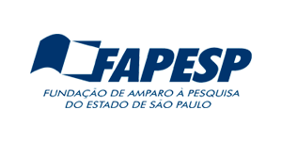
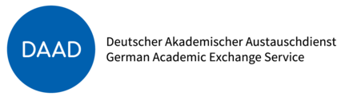
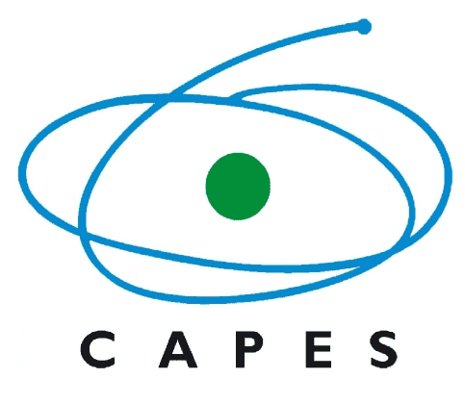



Integration of index-based insurance into water supply portfolios to support equitable urban water management in the Global South
Greicelene Silva^{1,}*, David Gold², Conceicao de Maria Albuquerque Alves³, Heidi Kreibich⁴, Andrea Cominola^{5,6}, and Eduardo Mario Mendiondo¹
*greicelene.silva@usp.br
1
2
3
Funding:
4
5
6

Slide 2
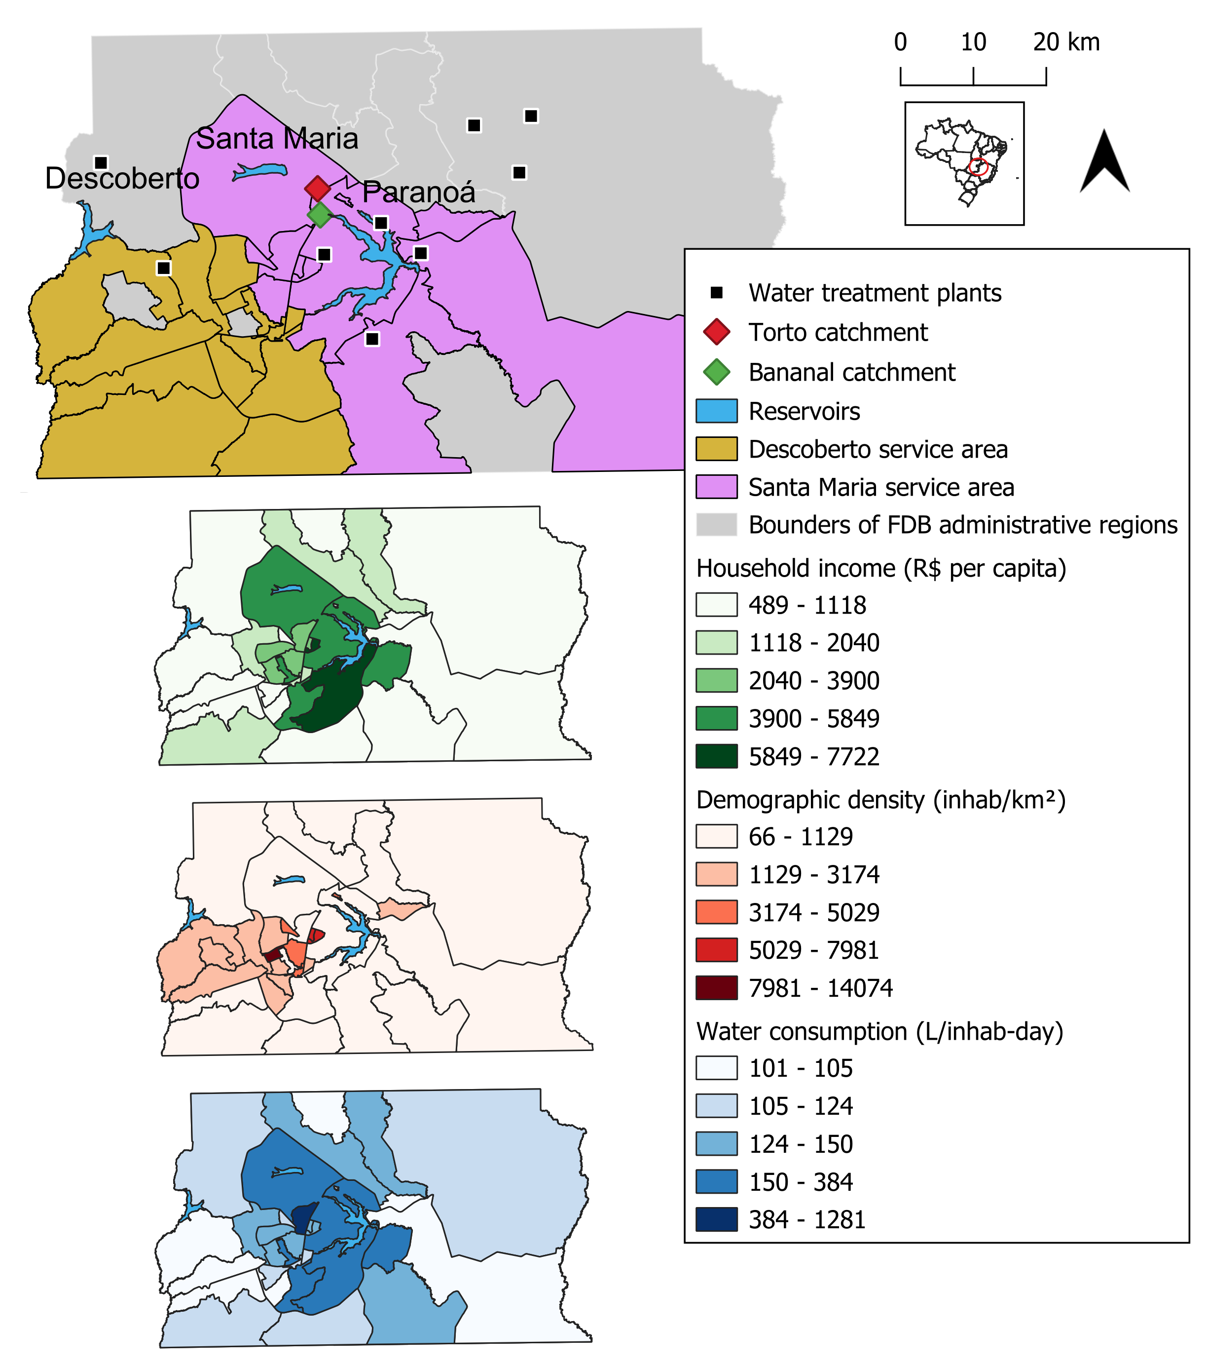
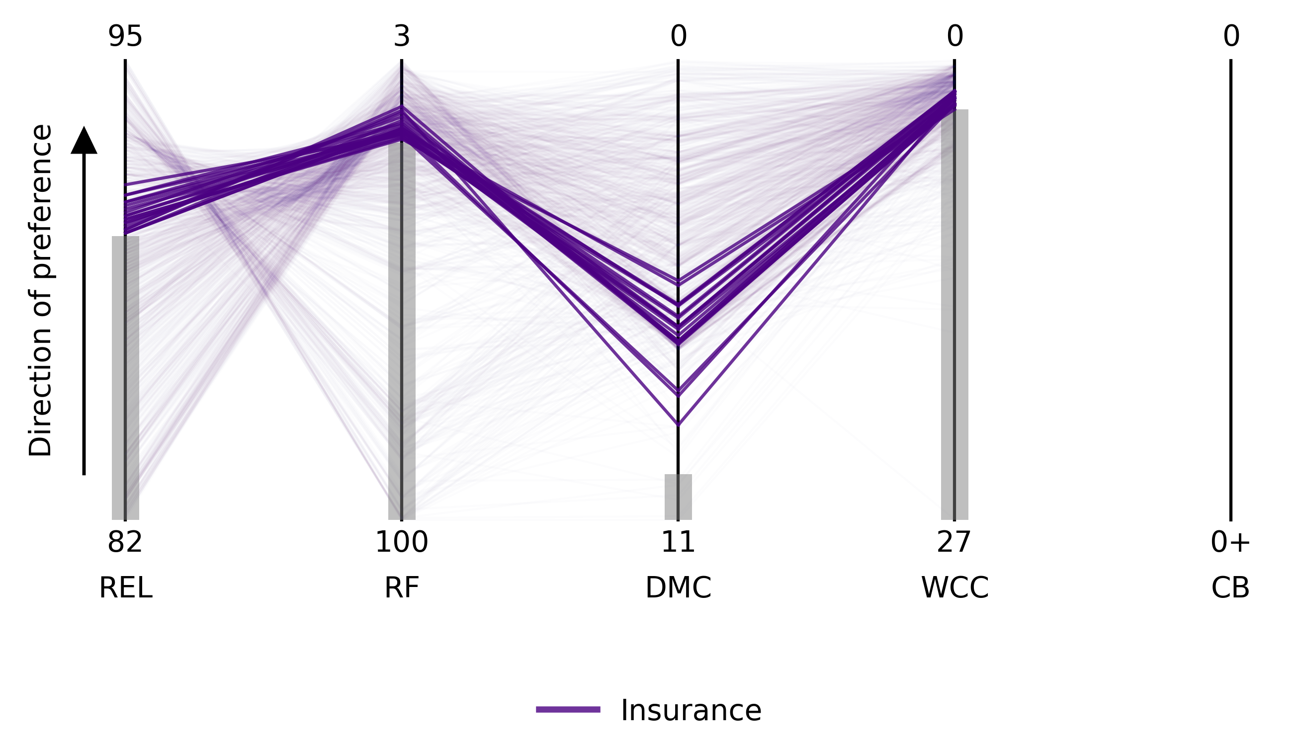
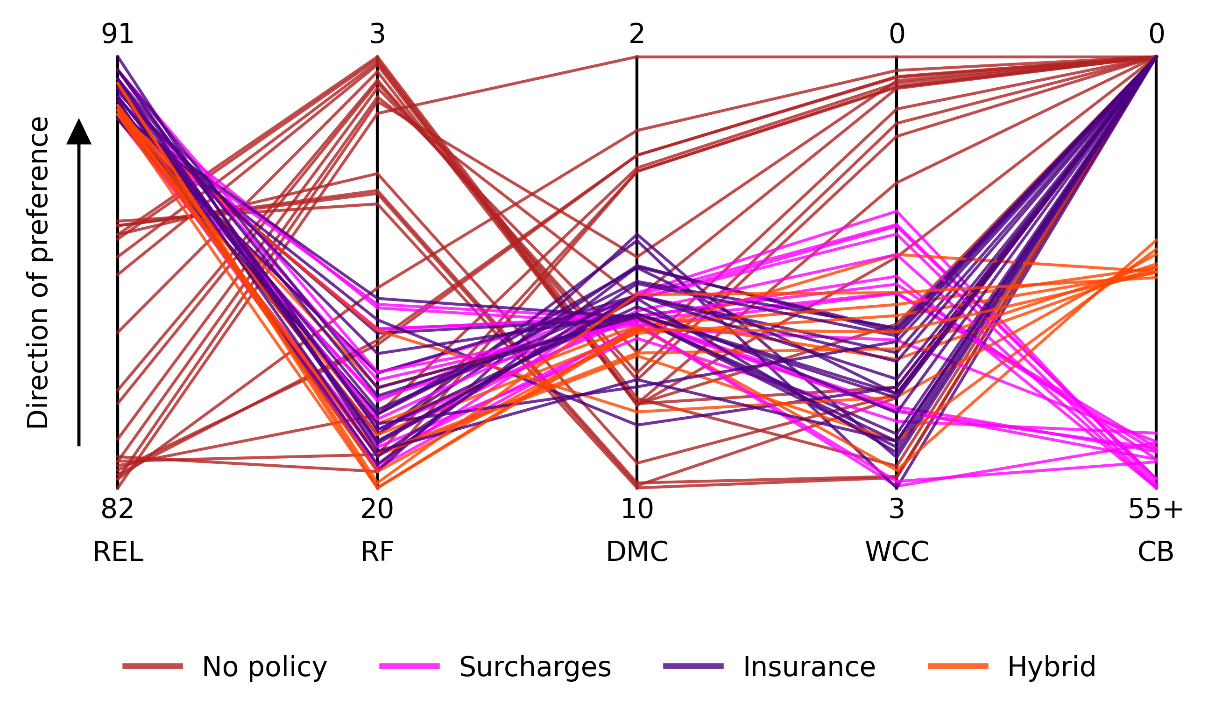
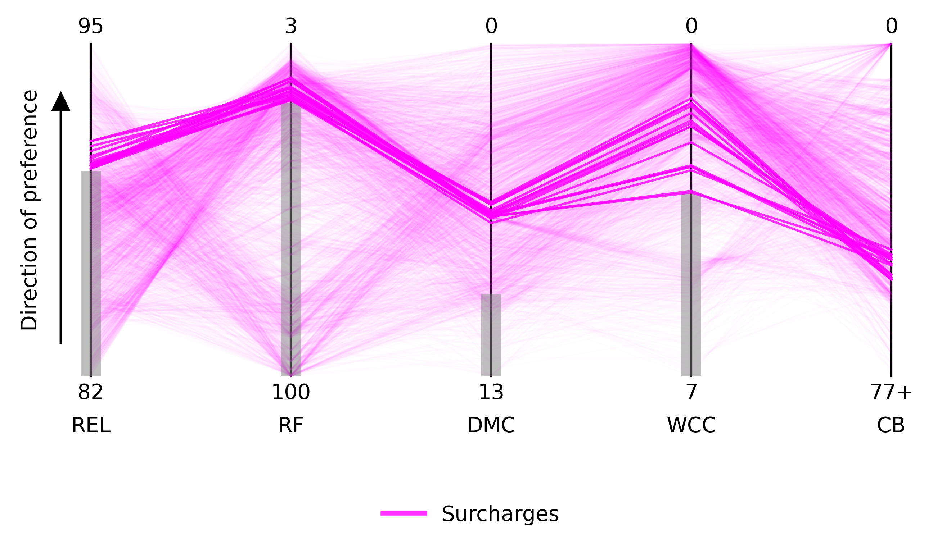
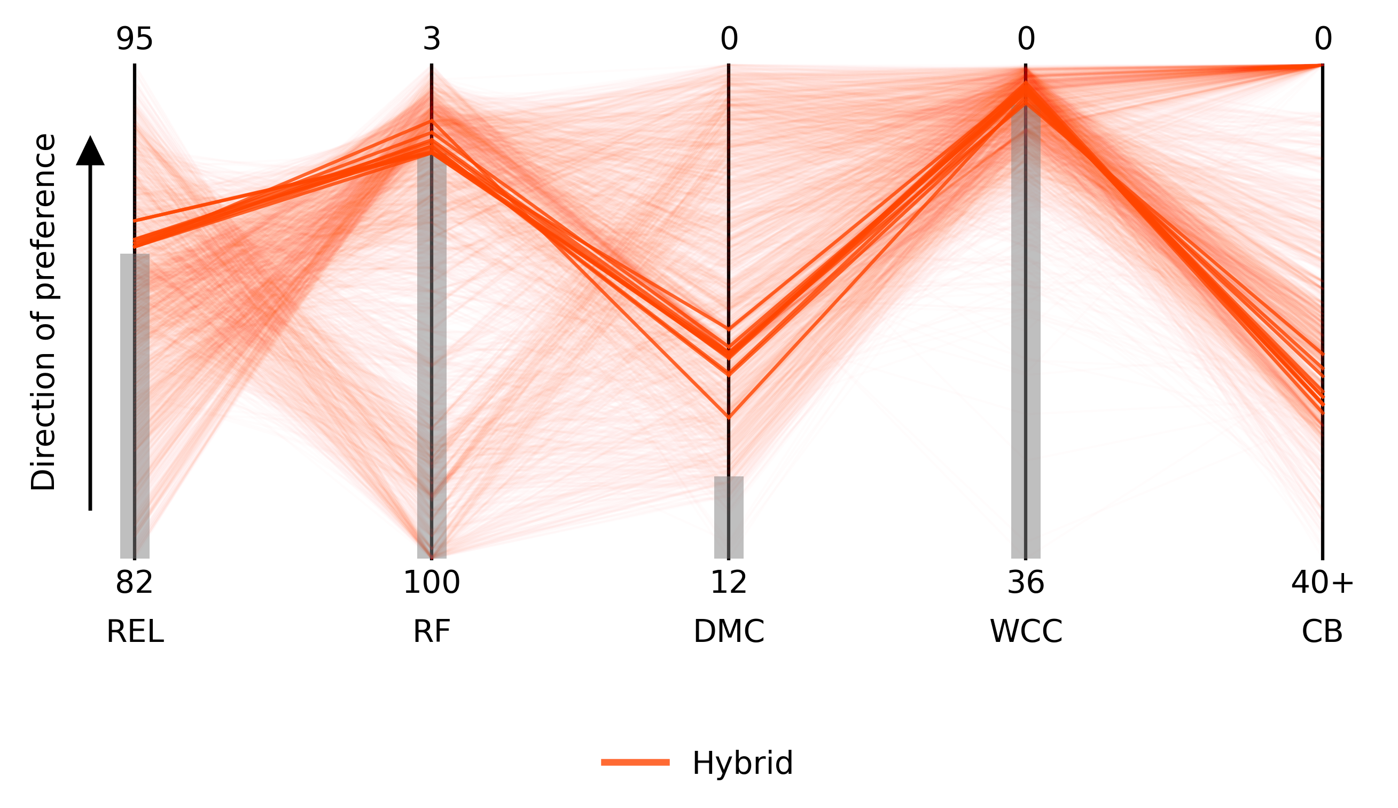
Overview
1
2
Studies on index-based insurance for the water supply are recente in the literature.
This study aims to explore the incorporation index-based insurance into drought management strategies in the global South.
3
4
For this, we simulated a case study in Brazil.
The results indicate that integrating index-based insurance into water management strategies can help achieve a balance between supply reliability and financial stability for utilities, while also improving water affordability.
greicelene.silva@usp.br

Slide 3
Introduction and aim
Required adaptive capacity for the water supply sector in face of climate uncertainty.
Limited access to resources in developing countries may hinder adaptation.
Hard x soft
approaches
Surcharges implementation to discourage consumption.
Often unpopular. Disagreements can involve litigation conflicts.
Index-based insurance
Insurance products:
Tradicional x Index-based.
Cheaper, rapid payments, less moral hazards.
Basis risk
Notes:
In the face of climate uncertainty, societies, organizations, and individuals are required to build adaptive capacity. However, limited access to resources, existent specially in the developing countries, may reduce the ability to adapt because of narrow response portfolio;
To promote sustainable water use amid growing scarcity, service tariff raise is often implemented to discourage consumption; However, increases in water tariffs are often unpopular, and as water becomes scarcer and tariffs rise, disagreements among stakeholder can even escalate into litigation conflicts.
To tackle climate change adaptation and disaster risk reduction associated to water-related disasters, two main group of strategies can be highlighted: hard and soft approaches. Hard approaches comprehend structurial measures, while soft approaches are policy instruments, being insurance an example.
Insurance products are categorized into two types: (i) traditional insurance, where payouts are based on actual financial losses, and (ii) index-based insurance, which provides fixed payouts triggered by predefined climatic or hydrologic index values, regardless of actual losses (Benso et al 2022). Index-based insurance minimizes administrative costs and reduces moral hazards by eliminating the need for on-site loss verification (Clement et al., 2018; Benso et al 2022). It is particularly beneficial for developing countries with limited insurance access, offering rapid payouts that support quick recovery during disasters.

Slide 4


Introduction and aim
There remains a gap in the literature regarding the integration of index-based insurance policies into financial portfolios for drought water management in the Global South;
Specifically, it is crucial to explore ways to improve water affordability and equity for end-users, while ensuring the cost-effective implementation of such insurance policies.
This study aims to address this gap by testing strategies for incorporation of index-based insurance into water management portfolios in the global South.
Notes:
The studies mentioned previously brought an important framework to bring to light the potential of this disaster risk management tool, highlighting the work of Zeff et al (2014) that simulates portfolios to manage water crisis during drought in the Research Triangle region of North Carolina. However, there remains a gap in the literature regarding the integration of index-based insurance policies into financial portfolios for drought water management in the Global South. Specifically, it is crucial to explore ways to improve water affordability and equity for end-users while ensuring the cost-effective implementation of such insurance policies. This study aims to address this gap under the hypothesis that incorporating index-based insurance into water management strategies can achieve a balance between supply reliability and financial stability for utilities, while also improving water affordability—a critical issue in the Global South.

Slide 5
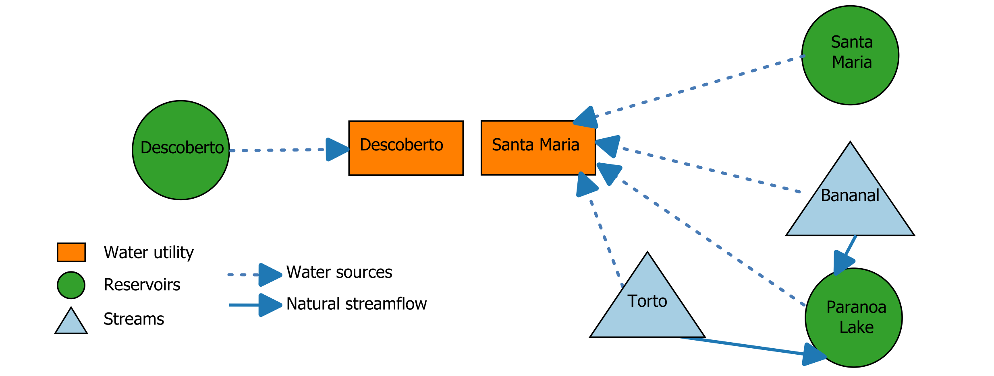
Methodology: the FDB region
Study area: Federal District of Brazil (FDB)
Notes:
The FDB is located in the Central West Region of Brazil. An intense population and disorderly growth occurred in the region, making the population jump from 12,283 residents to nearly 3 million people in 2022 (IBGE, 2023). Besides being the political center of Brazil, FDB has the eighth largest GDP among the federation units with the service sector holding the largest chunk. However, there is a great social inequality in the FDB, characterized by the variation of income distribution among the Administrative Regions (Figure 1B), and unequally demographic density (Figure 1C). The characterization of high and growing concentration of the population in urban areas in FDB, in turn, results in significant pressure on urban infrastructure and services, whose supply is not always able to meet demand. In addition to the lack of water, sanitation and hygiene services coverage in poorer regions and the deterioration of the existing network is also observed due to financial constraints preventing its recovery and expansion (ADASA ).
The urban water supply is held by the Federal District Environmental Sanitation Company – CAESB, composed of five main systems: the Torto/Santa Maria/ Bananal/ Paranoá, Descoberto, Brazlândia, Sobradinho/Planaltina e São Sebastião (https://s3.caesb.df.gov.br/www/prod/site1/2024/07/PDAE-2019-SL.pdf). The Descoberto and Torto/Santa Maria/Bananal/Paranoá (called thereafter Torto/Santa Maria system) together provide water for 80% of FDB population (Figure 1A, Table 1). The Torto/Santa Maria system was named after its main intakes, which in this case is the Santa Maria dam combined with the run-of-river intake of the Torto stream (https://s3.caesb.df.gov.br/www/prod/site1/2024/07/PDAE-2019-SL.pdf).

Slide 6
Methodology: WaterPaths
Representation of the system in the WaterPaths simulation (published in Araujo et al 2014) , an open-source exploratory modeling software designed to support water supply portfolio management;
WaterPaths includes a support portfolio for long-term (infrastructural investments and construction plans) and short-term measures (Trindade et al 2020). The short run measures comprehend water use restrictions, water transfers, and financial instruments (contingent funds and index-based insurance scheme).
Short measures are triggered by the Risk of Failure (ROF) metric, which consists of the system’s (or service area) ability to meet required water demand on a time basis.
Notes:
WaterPaths was developed in Cornell University (USA) by Trindade et al (2020) and helps to coordinate investments on long run in water supply infrastructure development and operational decision on short run for water utilities. The model includes key factor that influence on decision taking under deep uncertainty as hydro climatic change, demand growth, economic swings and effectiveness of the application of water use restriction measures. The simulated policies base decision making under drought scenarios, aiming at supply reliability and financial stability. The WaterPaths system is based on mass-balance model, described in Appendix S1 in supplementary materials, that can be solved for all water infrastructure following an upstream to downstream order. The system information is provided by the user as direct graphs (Trindade et al 2020).
WaterPaths includes support portfolio for long (infrastructural investments and constructions plans) and short run measures. The short run measures included in the model comprehend water use restrictions, water transfers and financial instruments (contingent funds and index-based insurance scheme). These measures are triggered by the Risk of Failure (ROF) metric, which consists on the system’s (or service area) ability to meet required water demand in each time basis. ROF triggers estimate the probability that the total storage falls below a threshold level in the next 52 weeks (short term ROF)

Slide 7
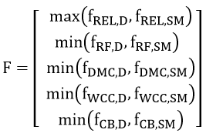
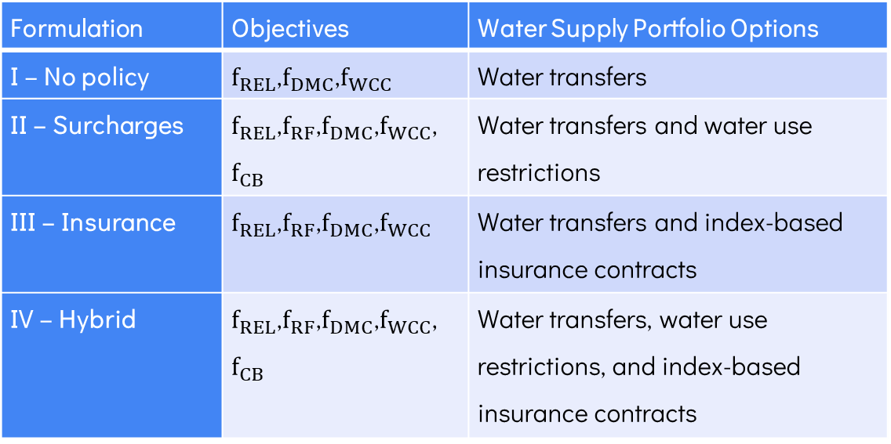
Methodology: Problem formulation
Objectives and water supply portfolios considered in each formulation
Formulation | Objectives | Water Supply Portfolio Options
I – No policy | $f_{REL}$,$f_{DMC}$,$f_{WCC}$ | Water transfers
II – Surcharges | $f_{REL}$,$f_{RF}$,$f_{DMC}$,$f_{WCC}$,$f_{CB}$ | Water transfers and water use restrictions
III – Insurance | $f_{REL}$,$f_{RF}$,$f_{DMC}$,$f_{WCC}$ | Water transfers and index-based insurance contracts
IV – Hybrid | $f_{REL}$,$f_{RF}$,$f_{DMC}$,$f_{WCC}$,$f_{CB}$ | Water transfers, water use restrictions, and index-based insurance contracts
Notes:
Water supply reliability: Maximization of reliability, measure by the probability that reservoirs storage will not drop below 5% of capacity.
Restriction frequency: Minimization of the fraction of the years, over the planning horizon, in which water use restriction measures were implemented for at least one week.
Mean annual cost or drought management cost: Minimization of revenue shortfalls due to restriction measures; transfer costs, and the anual premium for index-based insurance acquisition.
Worst-case cost of drought mitigation actions ($f_{WCC}$):Minimization of the worst first percentile of annual drought management costs (water restrictions and transfers) observed across all simulated scenarios over the planning horizon.
Consumer burden ($f_{CB}$): Minimization of the deficit in the annual revenue payed by the user in the water bill, i.e. the difference in the gross revenues from unrestricted demand and from restricted demand.

Slide 8
Methodology: Decision variables
Decision variables
Decision | Description | Formulation | Range
Water transfer threshold | Short-term ROF triggers threshold for transfer | I, II, III and IV. | 0-100 (%ROF)
Water use restriction threshold | Short-term ROF trigger threshold for rationing and contingency tariffs | II and IV. | 0-100 (%ROF)
Index-based insurance trigger | Short-term ROF trigger that activate the payoff condition | III and IV. | 0-100 (%ROF)
Index-based insurance premium | Percentage of annual revenue covered by the insurance | III and IV. | 0-100 (% annual revenue)

Slide 9
Methodology: Computational experiment
The multi-objective optimization was held in with the pre-build and ready-to-use integration with the Master-Worker Borg Multiobjective Optimization Evolutionary Algorithm (MS Borg MOEA).
To enhance equity between the subsystems of Descoberto and Torto/Santa Maria, our research prioritized the values of the worst-performing subsystem by adopting a minimax formulation.
We test the different policy architectures across 999 realizations of flow, demand, and evaporation for a 5-year horizon.
Notes:
In the experiment, we conducted six seed trials for each of the four formulations, performing 30,000 function evaluations per seed. Each of the 999 realizations;
To enhance equity between the subsystems of Descoberto and Torto/Santa Maria, our research prioritized values of the worst-performing subsystem by adopting a minimax formulation. This formulation ensures that regional objective values are taken as the worst value for each objective function, prioritizing equity by maximizing the performance of the least-well-off population.

Slide 10
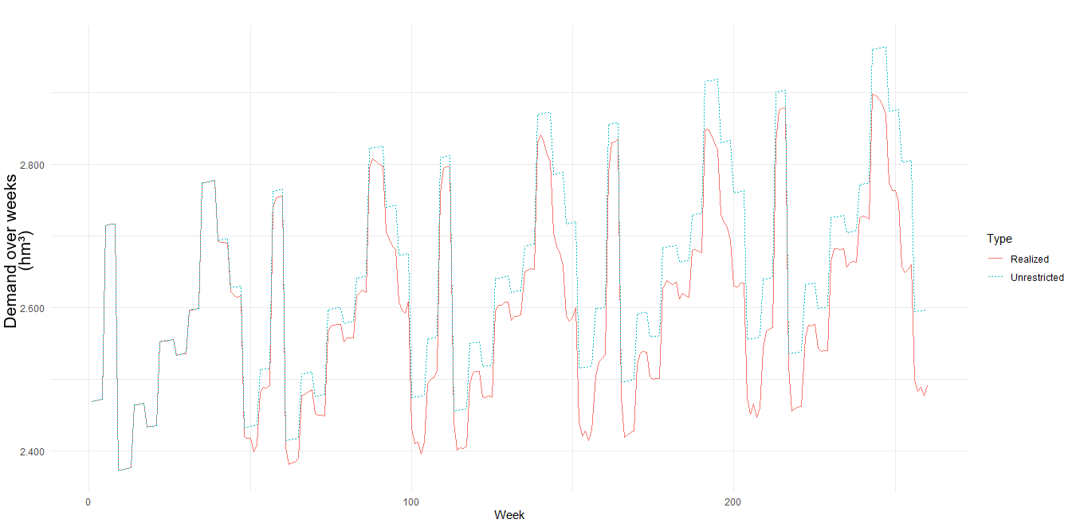
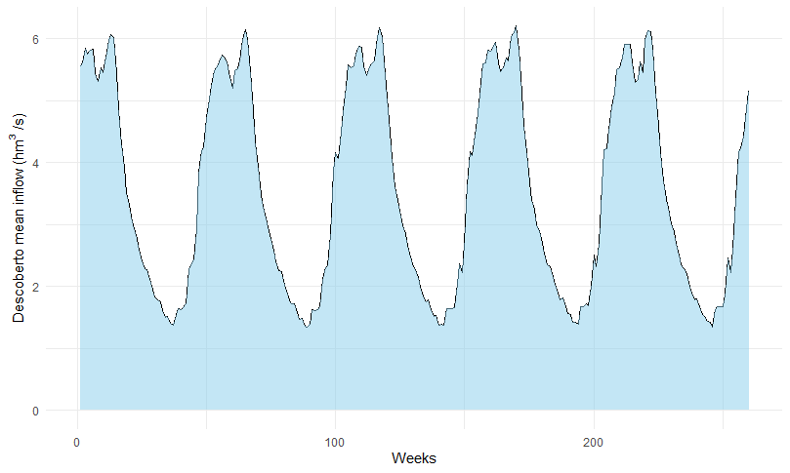
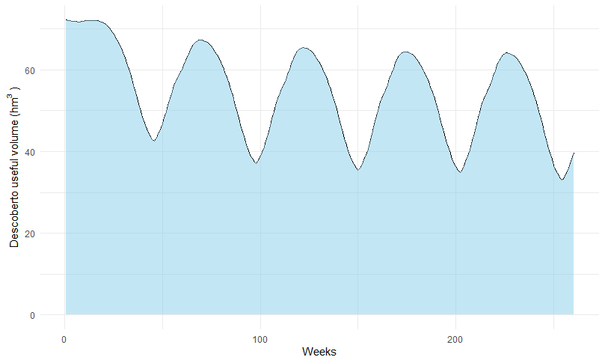
Results
On average, the 999 simulated SOWs indicate a demand growth in the next 5 years, with increasing gaps between the demand and water offer.

Slide 11
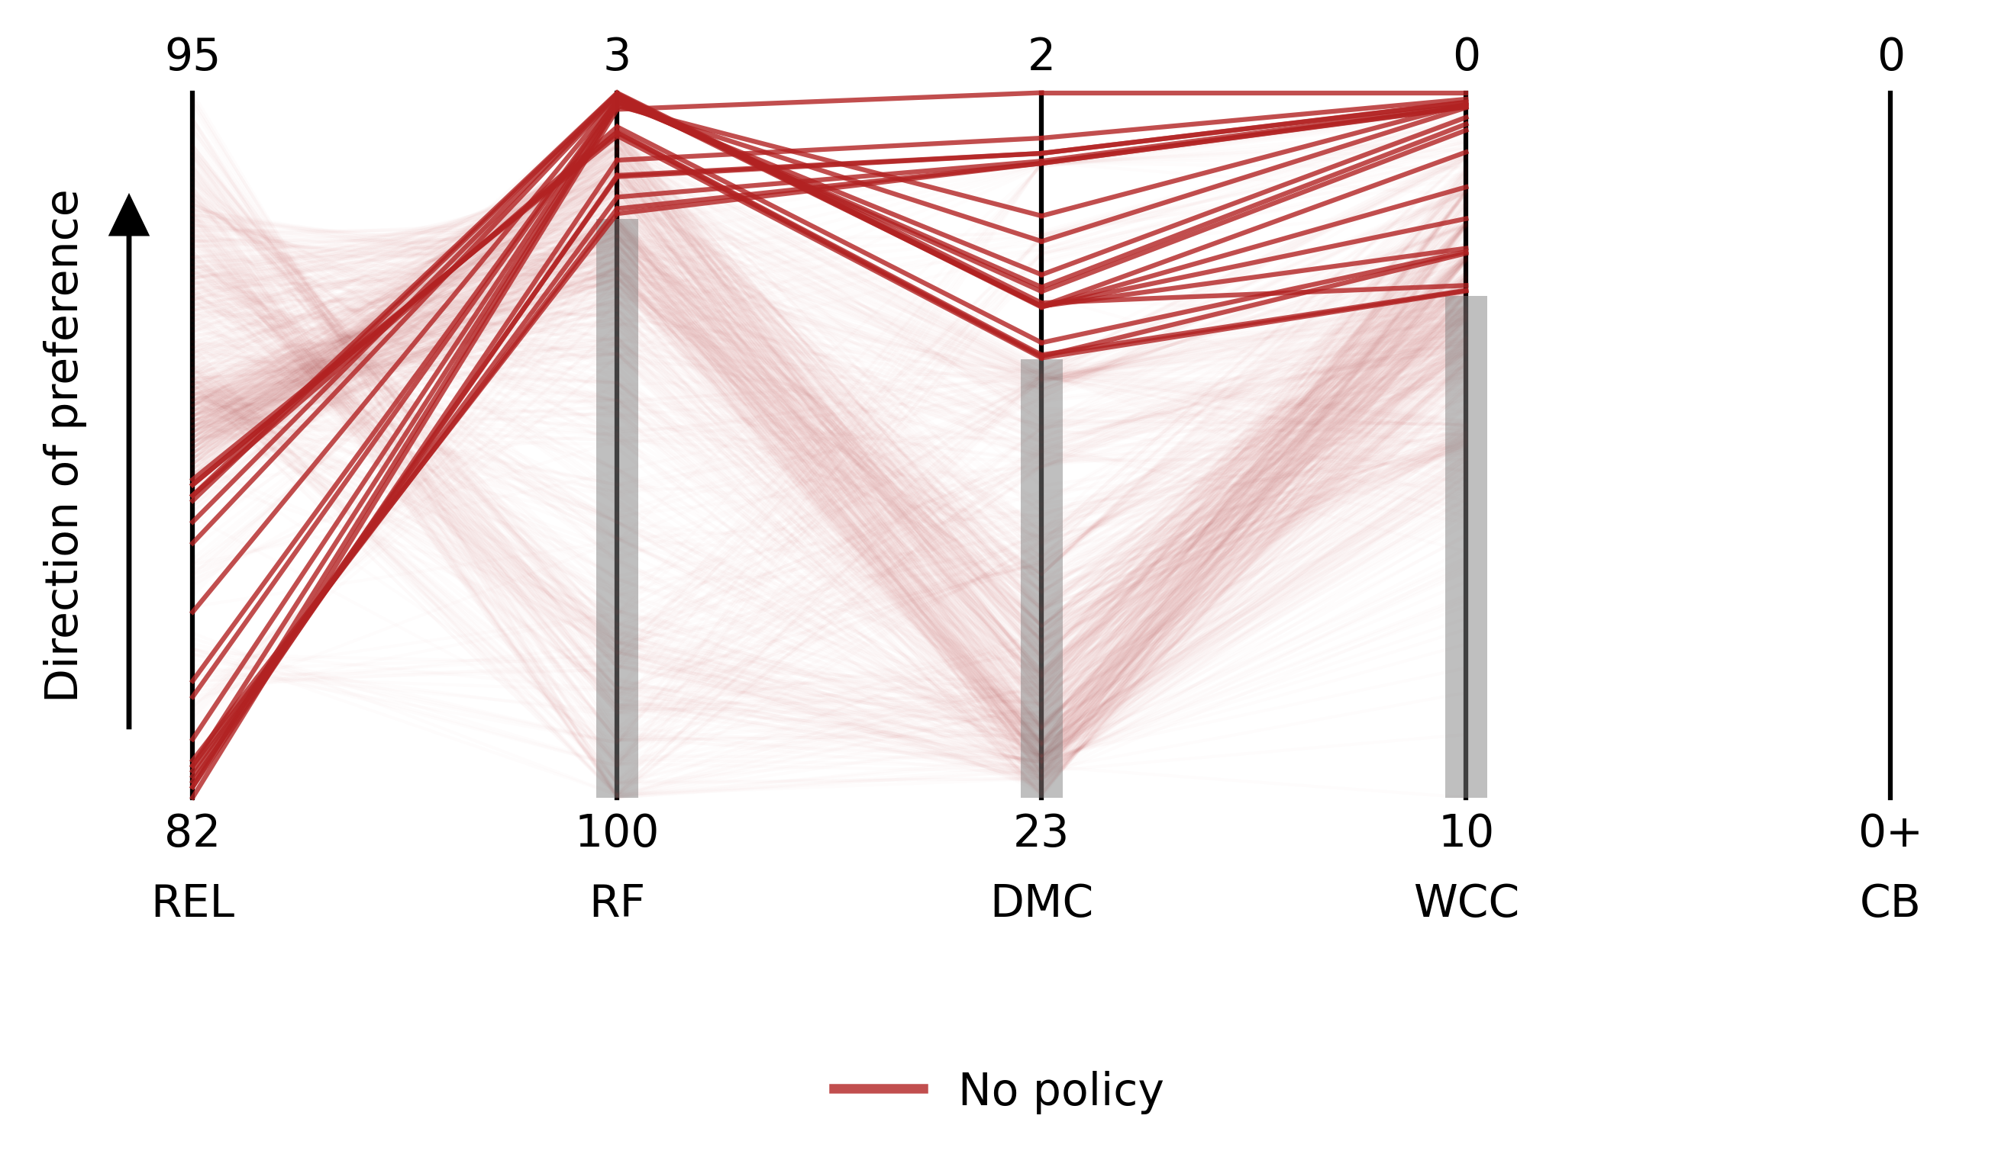
Results
Criteria of selection of non-dominated solutions, based on Zeff et al 2016: Reliability >90%, Restriction frequency <20%, Drought manag. cost < 10% , Worst case costs. <3%
“No policy” formulation: the system is able to reach only up to 87% of reliability.
REL (Reliability): given by fractions of the time in which the supply is above 5% of system capacity;
RF (restrictions frequency): the fraction of years in which water use restrictions were implemented;
DMC (drought management costs): The fraction of expected yearly costs to cover drought management cost;
WCC (worst case costs): the 1% highest single-year drought management costs;
CB (consumer burden): the amount of the drought management costs covered by the end users.
Notes:
REL (Reliability): Represents the fraction of States of the World (SOWs) in which the supply is above the 5% of system capacity in any given week of the simulated horizon
RF (restrictions frequency) represents the fraction of years, over the planning horizon, in which water use restrictions were implemented;
DMC (drought management costs): The fraction of expected yearly costs to cover drought management cost;
WCC (worst case costs): the fraction of yearly costs for the 1% highest single-year drought management costs;
CB (consumer burden): the fraction of the drought management costs covered by the end user by means of implementation of drought surcharges

Slide 12
Results
Considering Zeff et al (2016) criteria, the other formulations can reach at least 90% of REL. Up to around 92%.
Formulations containing Surcharges, Insurance, and Hybrid policies have similar performance in terms of RF.
Formulations containing Hybrid measures (the risk is shared between surcharges and insurance solutions) could lower the amount paid by consumers by half, while maintaining similar levels of DMC and WCC.

Slide 13
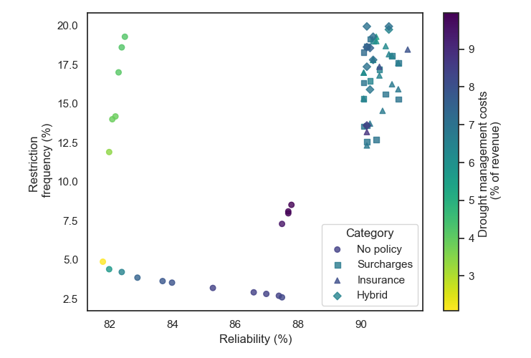
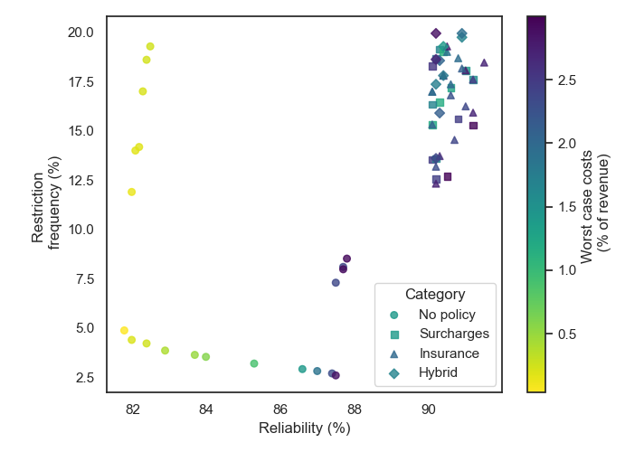
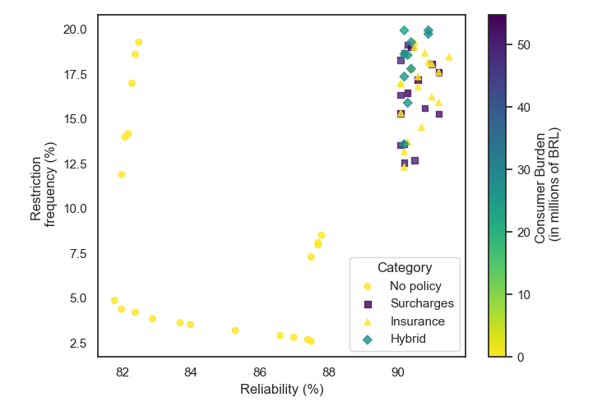
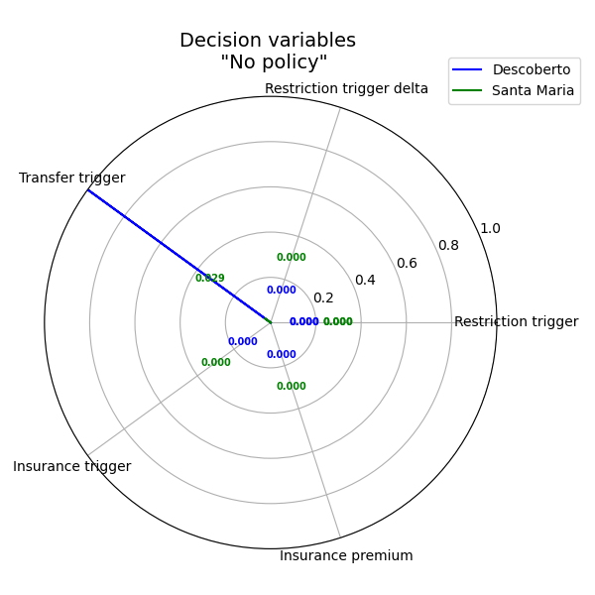
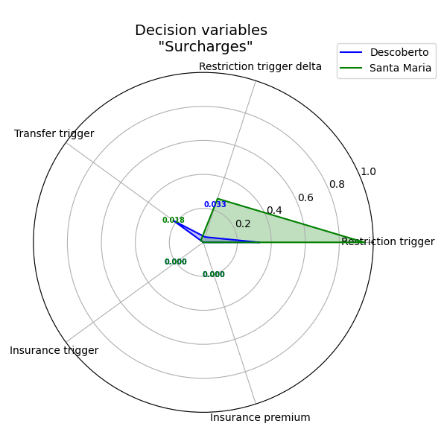
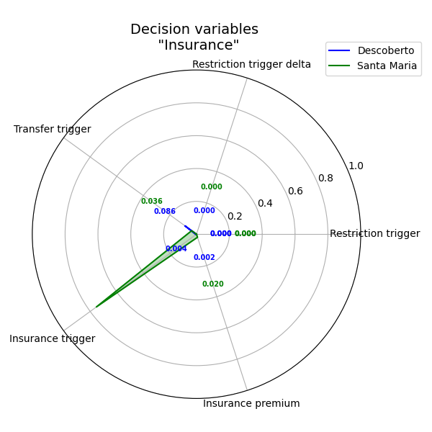
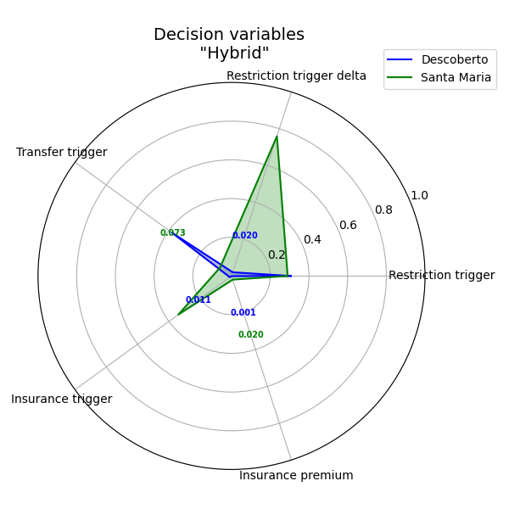
Results
Notes:
In the chosen solution for “No policy” formulation, Descoberto receives transfers most of the time to keep the reliability at 87%, which increases DMC and WCC.
In the chosen solution for “Surcharges” formulation, Descoberto is frequently implementing restrictions and transfers to keep the reliability high. This increases the cost in the worst years, as Descoberto goes easily to the third level of restrictions;
In the “insurance’ solution in evidence, Descoberto is frequently receiving payments, but the payments represent a small fraction of revenue. The opposite can be seen at Sta Maria. Meanwhile, the transfers to both systems are triggered easily, but we notice that drought management costs are low in comparison to the “No policy” formulation, which indicates an advantage in insurance to cushion the costs of drought mitigation.
In the “Hybrid” solution exposed, there is less transfer than in the “Surcharges” solution. But the system could still reach similar levels of reliability at lower costs based on a high frequency of surcharges. However, although there are frequent surcharges, the acting insurance scheme makes water bills less expensive to the end user.

Slide 14
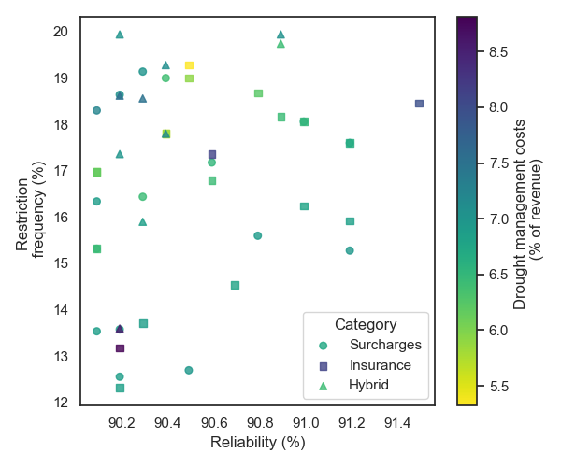
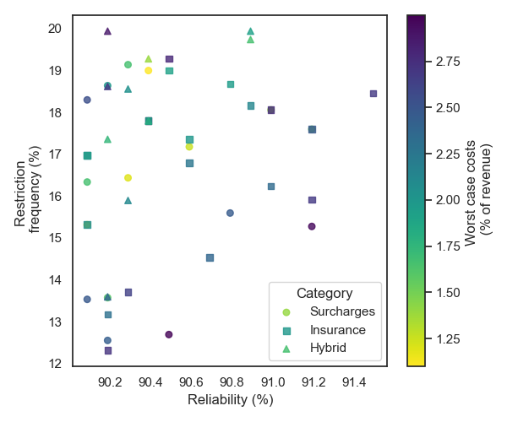
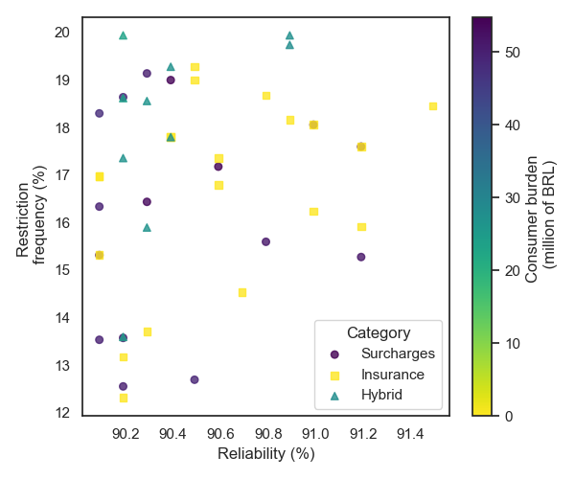
Results
There is frequently a disproportionality in DMC and WCC.
“Surcharges” and “Insurance” formulations could pass 91% of reliability, while Hybrid could not.
Some solutions in “Insurance” formulations were able to reach even lower levels in terms of DMC compared to “Surcharges”, but at comparatively higher WCCs.

Slide 15
Conclusions
The simulated scenarios predict a growing demand for FDB with decreasing water availability in Descoberto.
Except for the formulation only containing transfers, the other formulations, including the ones with index-based insurance schemes, can reach at least 90% or reliability, and less than 20%, 10%, and 3% of restrictions, drought management costs, and worst case costs, respectively. However, hybrid schemes (insurance and surcharges) were able to halve the costs of restrictions with regard to surcharges for the end users.
These results indicate that integrating index-based insurance into water management strategies can help achieve a balance between supply reliability and financial stability for utilities, while also improving water affordability.

Slide 16
References
Araújo, B. M., Gold, D. F., Lau, L. B., Reed, P. M., and Alves, C. M. A. 2024. "Exploring equity challenges within deeply uncertain water supply investment pathways in the Federal District of Brazil." J. Water Resour. Plann. Manage., 150(8): 04024048. https://doi.org/10.1061/JWRMD5.WRENG-6353.
Trindade, B. C., D. F. Gold, P. M. Reed, H. B. Zeff, and G. W. Characklis. 2020. “Water pathways: An open source stochastic simulation system for integrated water supply portfolio management and infrastructure investment planning.” Environ. Modell. Software 132 (Oct): 104772. https://doi.org/10.1016/j.envsoft.2020.104772.
​
Zeff, H. B., J. D. Herman, P. M. Reed, and G. W. Characklis. 2016.
“Cooperative drought adaptation: Integrating infrastructure development, conservation, and water transfers into adaptive policy pathways.” Water Resour. Res. 52 (9): 7327–7346. https://doi.org/10.1002/2016WR018771.

