Slide 1
GHG Impact Assessment of Well-to-Use H₂ and Other Decarbonization Pathways
European Geosciences Union (EGU)
May 2025
Dr. Sofia Esquivel Elizondo
Low-Carbon Energy Scientist

Slide 2
Climate impacts of decarbonization pathways as compared to current fossil fuel use
Near-term (20-years)
Long-term (100-years)
+100%
+80%
Increase
in warming
+60%
+40%
Decarbonization pathway to fossil fuel ratio:
Cumulative radiative forcing of
continuous emissions
+20%
SAME
0%
CLIMATE IMPACT
-20%
-40%
Decrease
in warming
-60%
-80%
-100%
Home Heat
Truck
Ship
Aircraft
Steel
Home Heat
Truck
Ship
Aircraft
Steel
Source: Sartzetakis et al. in preparation

Slide 3
Climate impacts of decarbonization pathways as compared to current fossil fuel use
Near-term (20-years)
Long-term (100-years)
+100%
+80%
Increase
in warming
+60%
+40%
Decarbonization pathway to fossil fuel ratio:
Cumulative radiative forcing of
continuous emissions
+20%
SAME
0%
CLIMATE IMPACT
-20%
-40%
Decrease
in warming
-60%
-80%
-100%
Decarbonization pathways
Home Heat
Truck
Ship
Aircraft
Steel
Home Heat
Truck
Ship
Aircraft
Steel
Renewable
electricity-based H₂
Renewable
H₂-based fuel
Grid
electricity-based H₂
Fossil fuel + CCS-based H₂ fuel
Fossil fuel + CCS H₂-based fuel
Grid
electrification
Renewable
electrification
Fossil fuel + CCS
Source: Sartzetakis et al. in preparation

Slide 4
Climate impacts of decarbonization pathways as compared to current fossil fuel use
Near-term (20-years)
Long-term (100-years)
+100%
+80%
Worst-case emissions
Increase
in warming
+60%
+40%
High CH₄ High H₂
Low CH₄
Low H₂
Decarbonization pathway to fossil fuel ratio:
Cumulative radiative forcing of
continuous emissions
+20%
SAME
0%
CLIMATE IMPACT
-20%
-40%
Decrease
in warming
-60%
Best-case emissions
-80%
-100%
Decarbonization pathways
Home Heat
Truck
Ship
Aircraft
Steel
Home Heat
Truck
Ship
Aircraft
Steel
Renewable
electricity-based H₂
Renewable
H₂-based fuel
Grid
electricity-based H₂
Fossil fuel + CCS-based H₂ fuel
Fossil fuel + CCS H₂-based fuel
Grid
electrification
Renewable
electrification
Fossil fuel + CCS
Source: Sartzetakis et al. in preparation

Slide 5
Climate impacts of decarbonization pathways as compared to current fossil fuel use
Near-term (20-years)
Long-term (100-years)
+100%
+80%
Increase
in warming
+60%
+40%
Decarbonization pathway to fossil fuel ratio:
Cumulative radiative forcing of
continuous emissions
+20%
SAME
0%
CLIMATE IMPACT
-20%
-40%
Decrease
in warming
-60%
-80%
-100%
Decarbonization pathways
Home Heat
Truck
Ship
Aircraft
Steel
Home Heat
Truck
Ship
Aircraft
Steel
Renewable
electricity-based H₂
Renewable
H₂-based fuel
Grid
electricity-based H₂
Fossil fuel + CCS-based H₂ fuel
Fossil fuel + CCS H₂-based fuel
Grid
electrification
Renewable
electrification
Fossil fuel + CCS
Source: Sartzetakis et al. in preparation

Slide 6
Climate impacts of decarbonization pathways as compared to current fossil fuel use
Near-term (20-years)
Long-term (100-years)
+100%
+80%
Increase
in warming
+60%
+40%
Decarbonization pathway to fossil fuel ratio:
Cumulative radiative forcing of
continuous emissions
+20%
SAME
0%
CLIMATE IMPACT
-20%
-40%
Decrease
in warming
-60%
-80%
-100%
Decarbonization pathways
Home Heat
Truck
Ship
Aircraft
Steel
Home Heat
Truck
Ship
Aircraft
Steel
Renewable
electricity-based H₂
Grid
electricity-based H₂
Grid
electrification
Renewable
electrification
Renewable
H₂-based fuel
Fossil fuel + CCS-based H₂ fuel
Fossil fuel + CCS H₂-based fuel
Fossil fuel + CCS
Source: Sartzetakis et al. in preparation

Slide 7
Climate impacts of decarbonization pathways as compared to current fossil fuel use
Near-term (20-years)
Long-term (100-years)
+100%
+80%
Increase
in warming
+60%
+40%
Decarbonization pathway to fossil fuel ratio:
Cumulative radiative forcing of
continuous emissions
+20%
SAME
0%
CLIMATE IMPACT
-20%
-40%
Decrease
in warming
-60%
-80%
-100%
Home Heat
Truck
Ship
Aircraft
Steel
Home Heat
Truck
Ship
Aircraft
Steel
Renewable
electricity-based H₂
Renewable
H₂-based fuel
Grid
electricity-based H₂
Fossil fuel + CCS-based H₂ fuel
Fossil fuel + CCS H₂-based fuel
Grid
electrification
Renewable
electrification
Fossil fuel + CCS
Source: Sartzetakis et al. in preparation

Slide 8
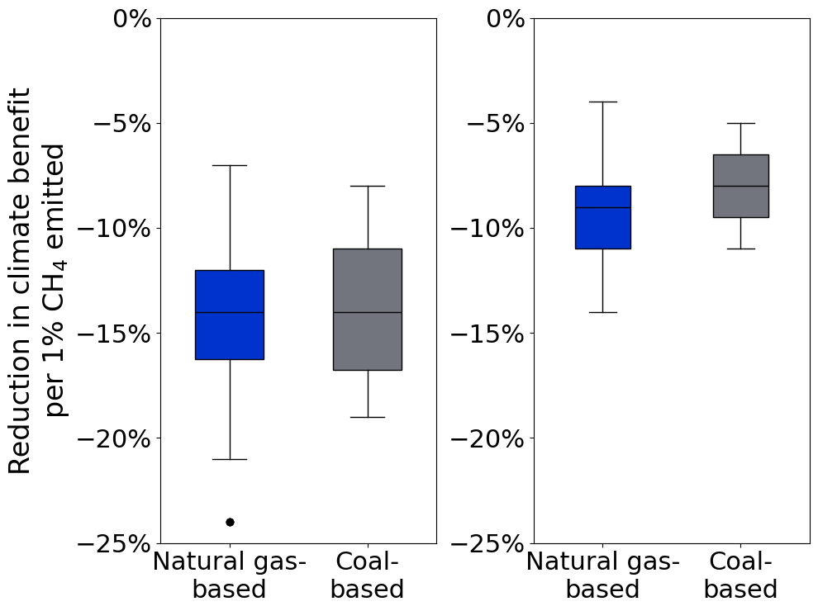
Climate impact increase per 1% of methane emitted for fossil fuel + CCS-based pathways
Near-term (20-years)
Long-term (100-years)
In the near term, there is an average 15% increase in climate impacts for every 1% of methane emitted (7 – 24%).
In the long term, there is an average 9% increase in climate impacts for every 1% of methane emitted (4 – 14%).
Reduction in climate benefit per 1% CH₄ emitted: Constant emissions
Source: Sartzetakis et al. in preparation

Slide 9
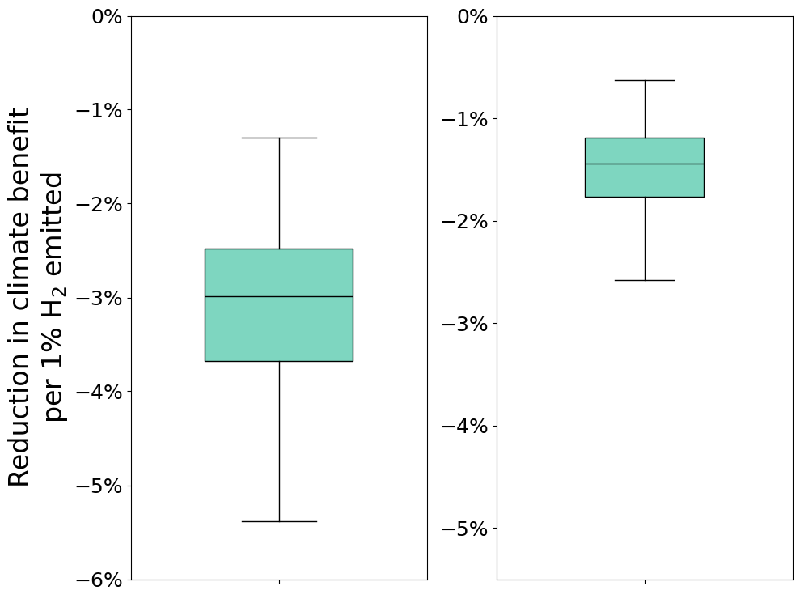
Climate impact increase per 1% of hydrogen emitted for H₂-based pathways
Near-term (20-years)
Long-term (100-years)
In the near term, there is an average 3% increase in climate impacts for every 1% of hydrogen emitted (1.3 – 5.4%).
In the long term, there is an average 1.5% increase in climate impacts for every 1% of hydrogen emitted (0.6 – 2.6%).
Reduction in climate benefit per 1% H₂ emitted: Constant emissions
Source: Sartzetakis et al. in preparation

Slide 10
Climate benefit of renewable pathways per unit of renewable electricity consumed
Near-term (20-years)
Long-term (100-years)
1400
1200
1000
800
gCO₂e avoided / kWh
600
400
200
0
Home Heat
Truck
Ship
Aircraft
Steel
Home Heat
Truck
Ship
Aircraft
Steel
Renewable
electricity-based H₂ —OFFSITE
Renewable
electricity-based H₂ —ONSITE
Renewable
H₂-based fuel
Renewable
electrification
Hydrogen emissions scenario
High
Source: Sartzetakis et al. in preparation

Slide 11
Climate benefit of renewable pathways per unit of renewable electricity consumed
Near-term (20-years)
Long-term (100-years)
1400
1200
1000
800
gCO₂e avoided / kWh
600
400
200
0
Home Heat
Truck
Ship
Aircraft
Steel
Home Heat
Truck
Ship
Aircraft
Steel
Renewable
electricity-based H₂ —OFFSITE
Renewable
electricity-based H₂ —ONSITE
Renewable
H₂-based fuel
Renewable
electrification
Hydrogen emissions scenario
High
Medium
Low
Source: Sartzetakis et al. in preparation

Slide 12
Climate benefit of renewable pathways per unit of renewable electricity consumed
Near-term (20-years)
Long-term (100-years)
1400
1200
1000
2 – 15x
2 – 11x
800
gCO₂e avoided / kWh
600
400
200
0
Home Heat
Truck
Ship
Aircraft
Steel
Home Heat
Truck
Ship
Aircraft
Steel
Renewable
electricity-based H₂ —OFFSITE
Renewable
electricity-based H₂ —ONSITE
Renewable
H₂-based fuel
Renewable
electrification
Hydrogen emissions scenario
High
Medium
Low
Source: Sartzetakis et al. in preparation

Slide 13
Climate benefit of renewable pathways per unit of renewable electricity consumed
Near-term (20-years)
Long-term (100-years)
1400
1200
1000
800
gCO₂e avoided / kWh
600
400
200
0
Home Heat
Truck
Ship
Aircraft
Steel
Home Heat
Truck
Ship
Aircraft
Steel
Renewable
electricity-based H₂ —OFFSITE
Renewable
electricity-based H₂ —ONSITE
Renewable
H₂-based fuel
Renewable
electrification
Hydrogen emissions scenario
High
Medium
Low
Source: Sartzetakis et al. in preparation

Slide 14
Takeaways
For any use case, hydrogen deployment should be considered in comparison to other decarbonization alternatives in terms of climate benefit, energy efficiency, and feasibility (e.g., required energy density of shipping fuel, CO₂ transport and storage availability, etc.).
Hydrogen and methane emissions considerably reduce the intended climate benefits of a decarbonization pathway, especially in the near term.
Renewable electricity-based pathways (renewable-based direct electrification, ‘green H_{2’}, ‘e’-fuels) offer the greatest climate benefits, with direct electrification being the best option for maximizing both emissions reductions and energy efficiency.

Slide 15
Thank you!
Dr. Sofia Esquivel Elizondo
Low-Carbon Energy Scientist
sesquivelelizondo@edf.org

Slide 16
Fertilizer | Steel | Refinery | LDV | Bus | Truck | Home Heat | Ship | Aircraft | Ind. Heat | Power
✔ | ✔ | ✔ | ✔ | ✔ | ✔ | ✔ | ✔ | ✔ | ✔ | ✔
✔ | ✔ | ✔ | ✔ | ✔ | ✔ | ✔ | ✔ | ✔ | ✔ | ✔
 |  |  | ✔ | ✔ | ✔ | ✔
 |  |  |  |  |  |  | ✔ | ✔
 |  |  |  |  |  |  | ✔
 | ✔ |  |  |  |  |  |  |  | ✔ | ✔
Study Overview
H₂
GREEN H₂
CH₄
H₂
CO₂
CH₄
CO₂
BLUE H₂
SWITCH TO
CO₂
FOSSIL FUEL APPLICATION
ELECTRIFICATION
CO₂
H₂
E-FUEL
CH₄
CO₂
BLUE FUEL
CH₄
CO₂
CARBON CAPTURE

