Slide 1
First terrestrial geomagnetic record of the Norwegian-Greenland Sea excursion in the Kaupo flow, Koolau Volcano, Oahu, Hawaii: Insightsfrom ⁴⁰Ar/³⁹Ar, NRM and absolute paleointensity determinations
First terrestrial geomagnetic record of the Norwegian-Greenland Sea excursion in the Kaupo flow, Koolau volcano, Oahu, Hawaii: Insights from
40Ar/ 39Ar, NRM and absolute paleointensity determinations
Emilio Herrero-Bervera,
Magnetic Materials Paleomagnetic and Petrofabrics Laboratory,
SOEST-HIGP University of Hawaii at Manoa, Honolulu, Hawaii, USA
and
Brian Jicha,
University of Wisconsin at Madison, USA
EGU Meeting , Vienna Austria, May 02 2025
Geomag-Pmag Special Session Magnetic Tribute to Jean- Pierre Valet ORAL-9:30-9:40 am

Slide 2
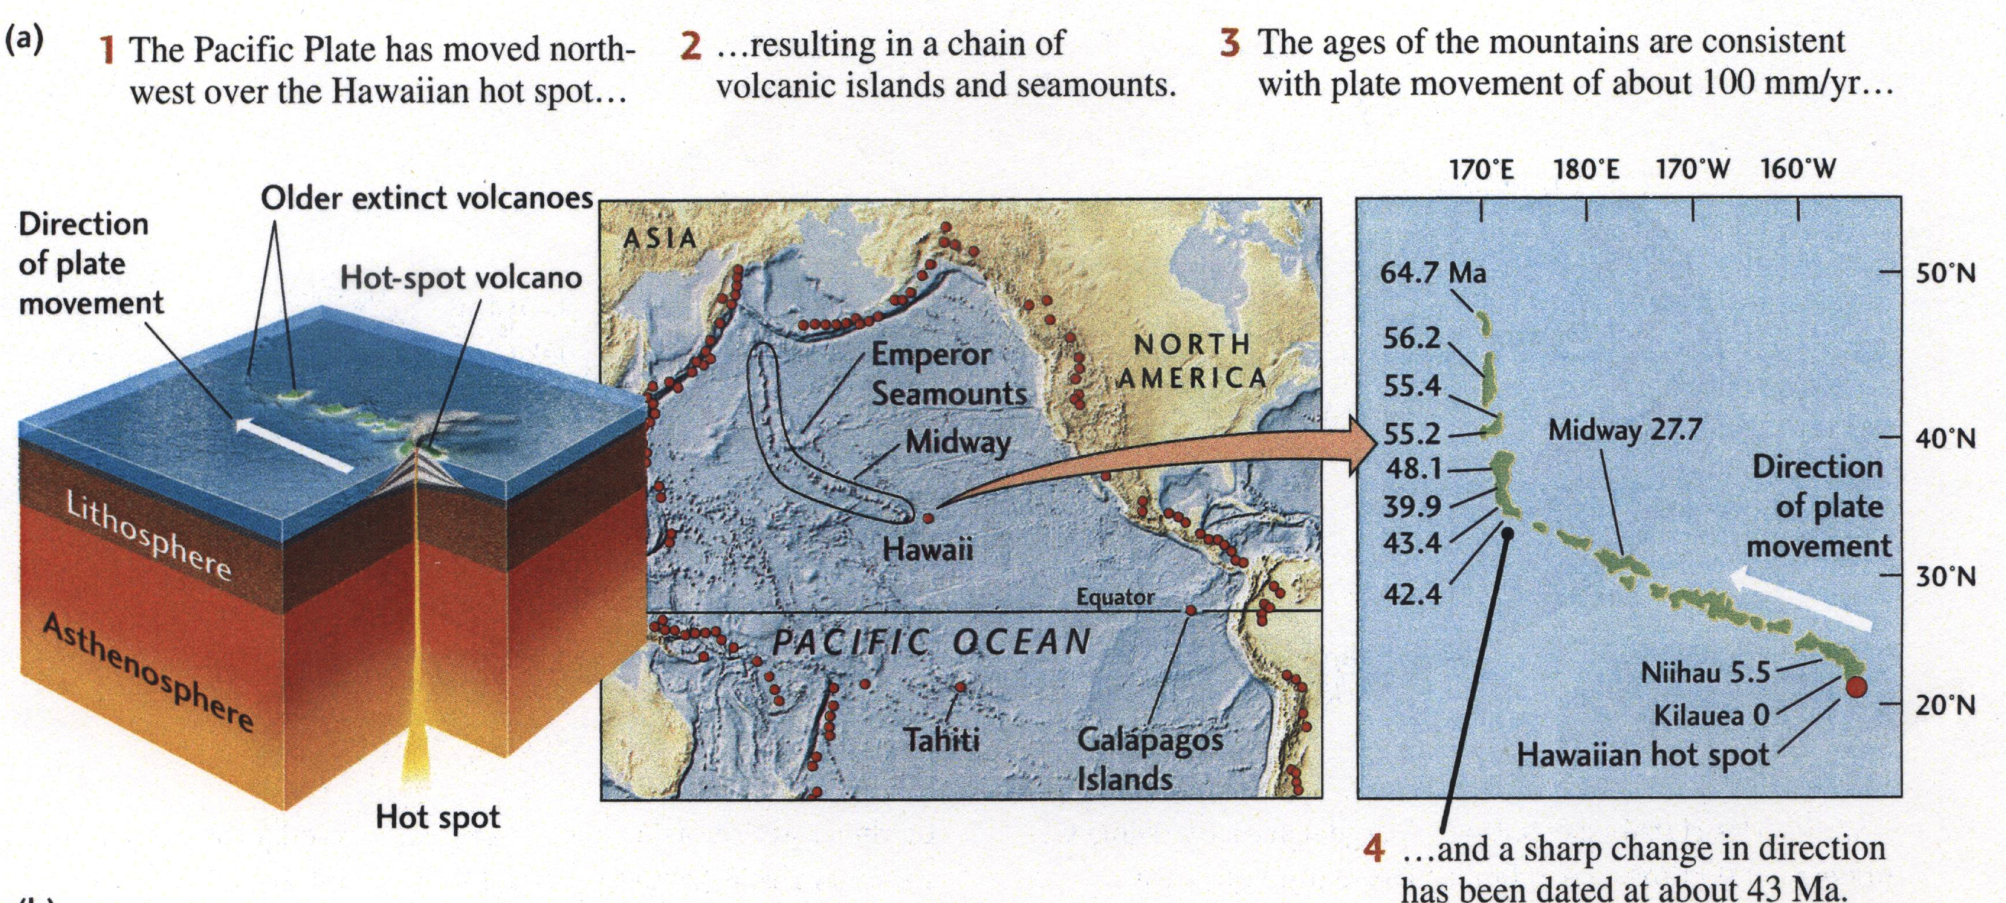
Hawaiian Island Chain: A Hot Spot (Present back to ~64.7 Ma)

Slide 3
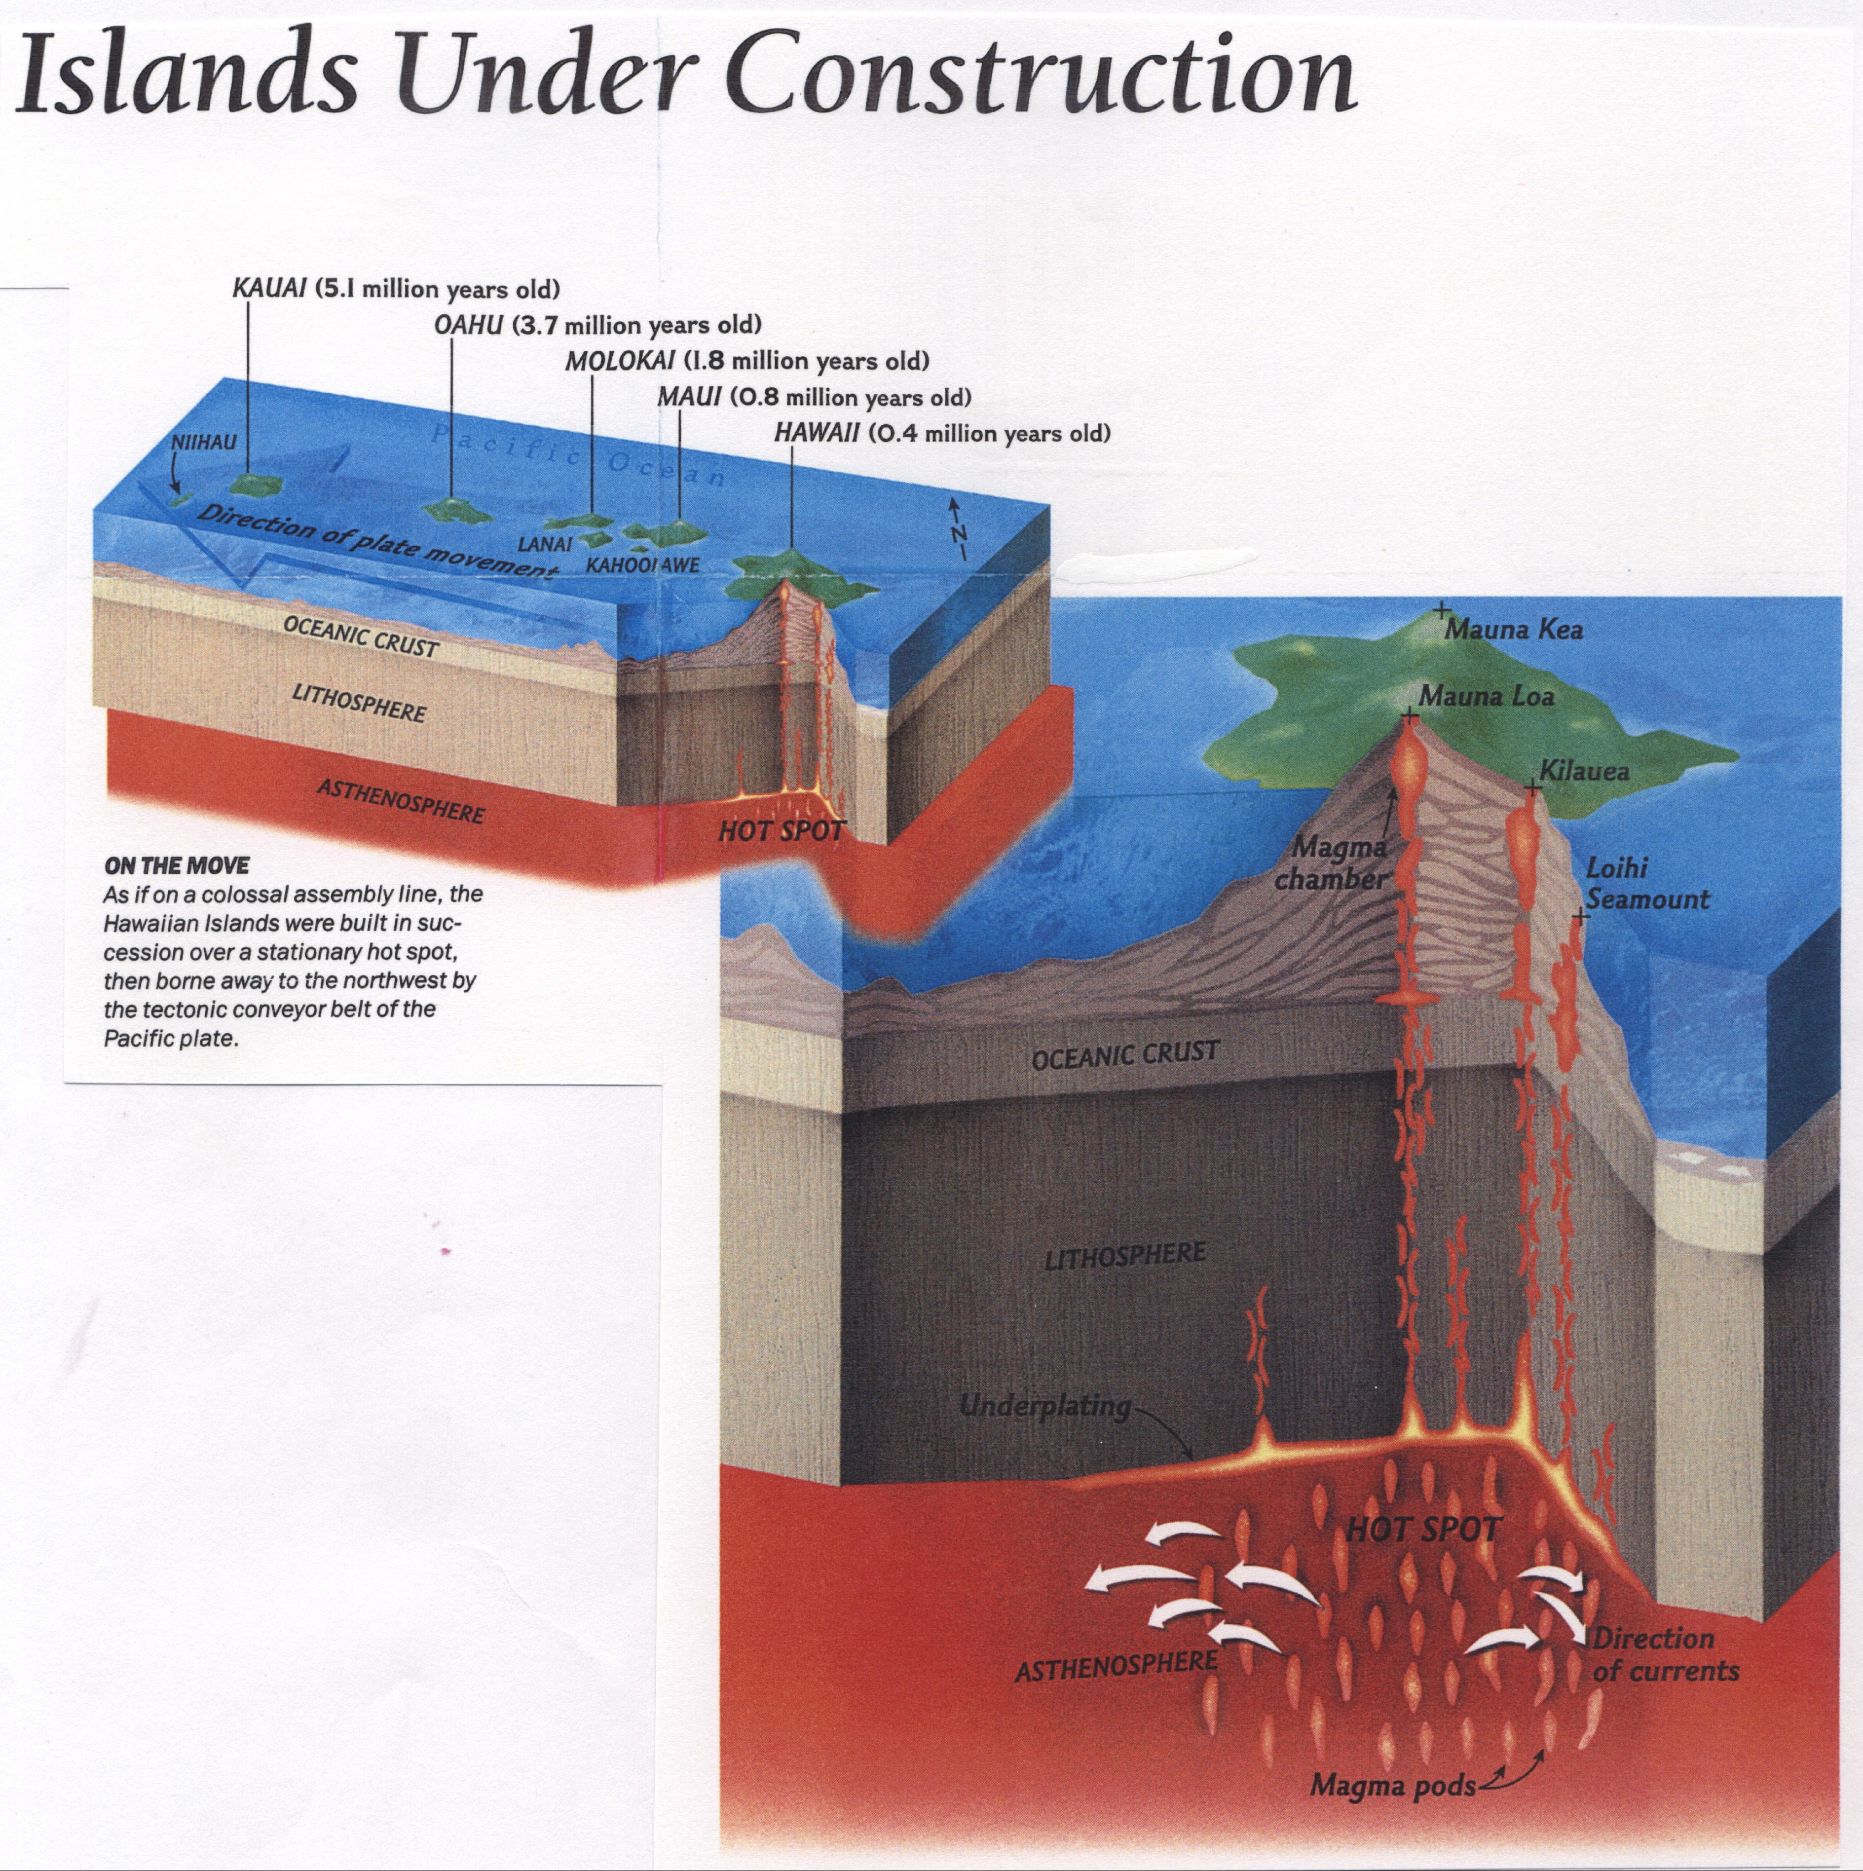
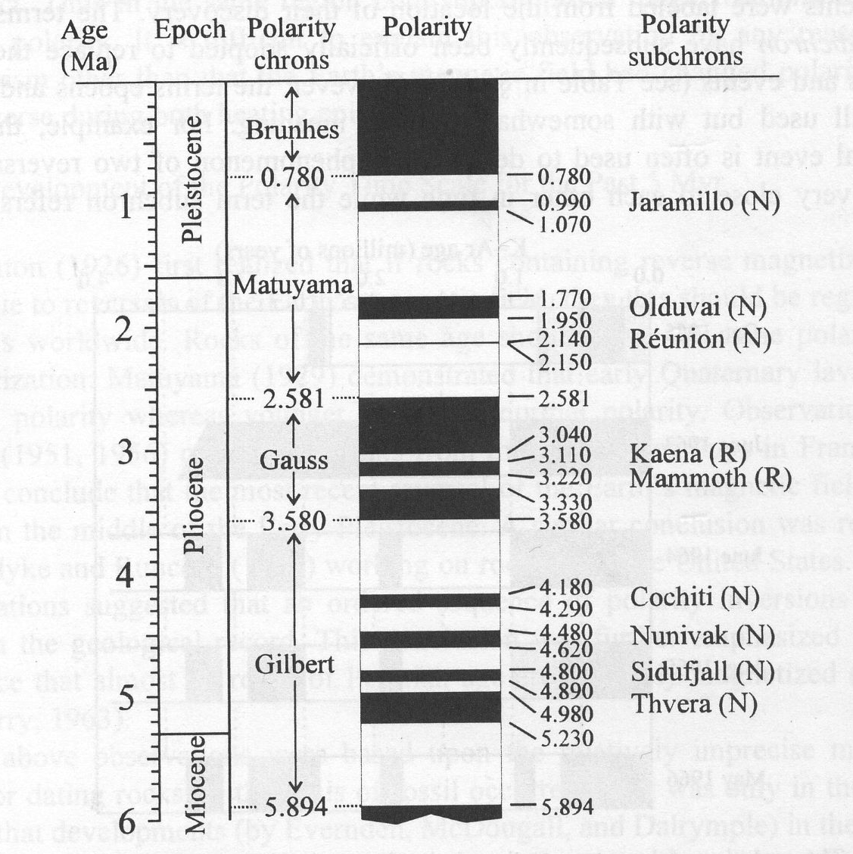
Merrill et al[1996]

Slide 4
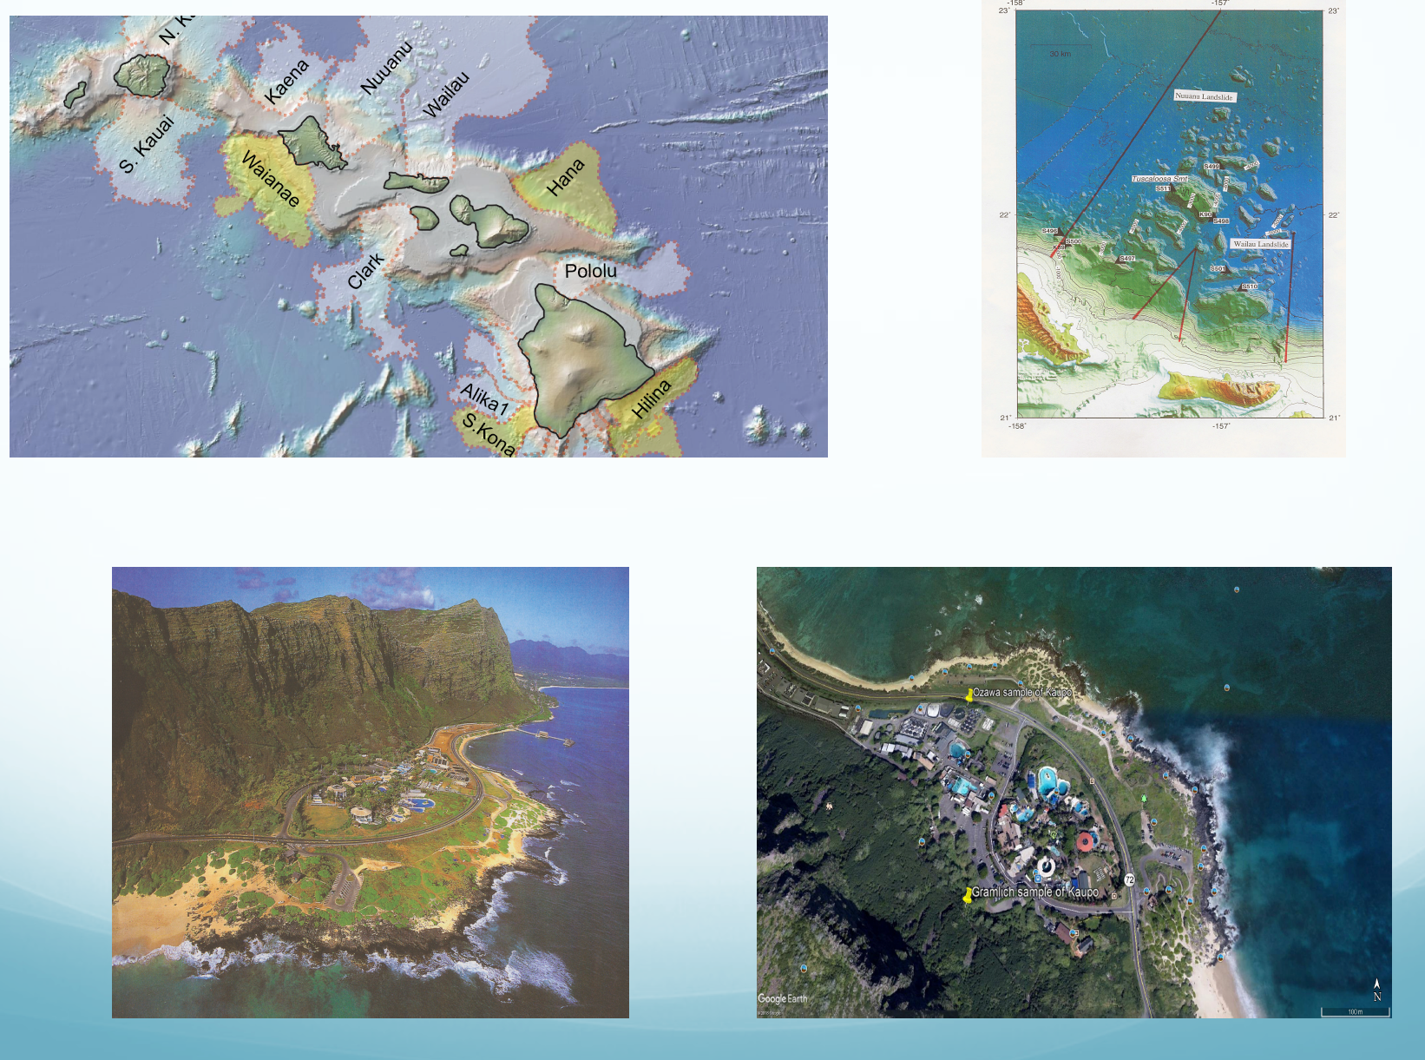
Honolulu Volcanic Series Rejuvenation Stage <0.860 Kyrs
Koolau Volcanic Series >0.860Kyrs to more than2.5 million years

Slide 5
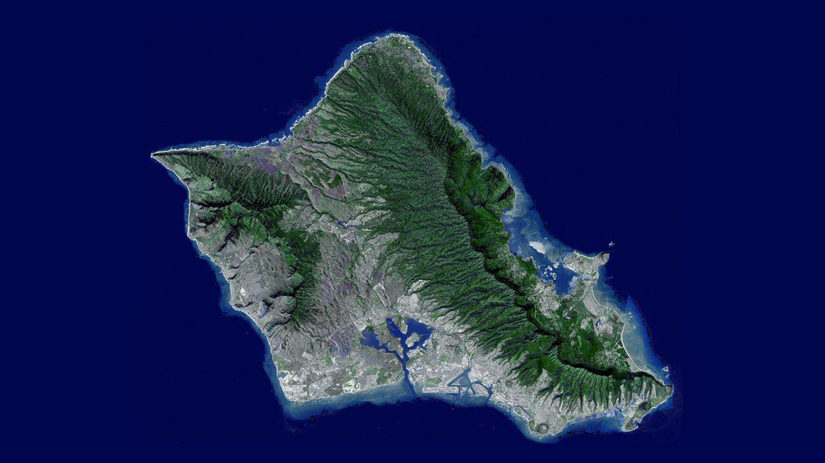
The Island of Oahu, Hawaii
Upper Mammoth
Puu Kaulakauila
Koolau Volcano
Wai’anae Volcano
Makapuu Point
Kaupo Flow

Slide 6
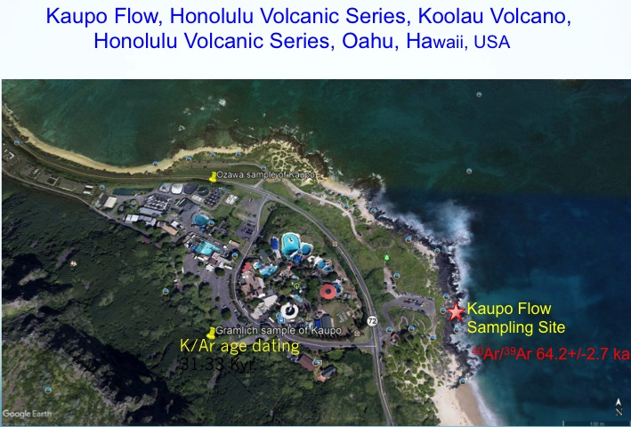

Slide 7
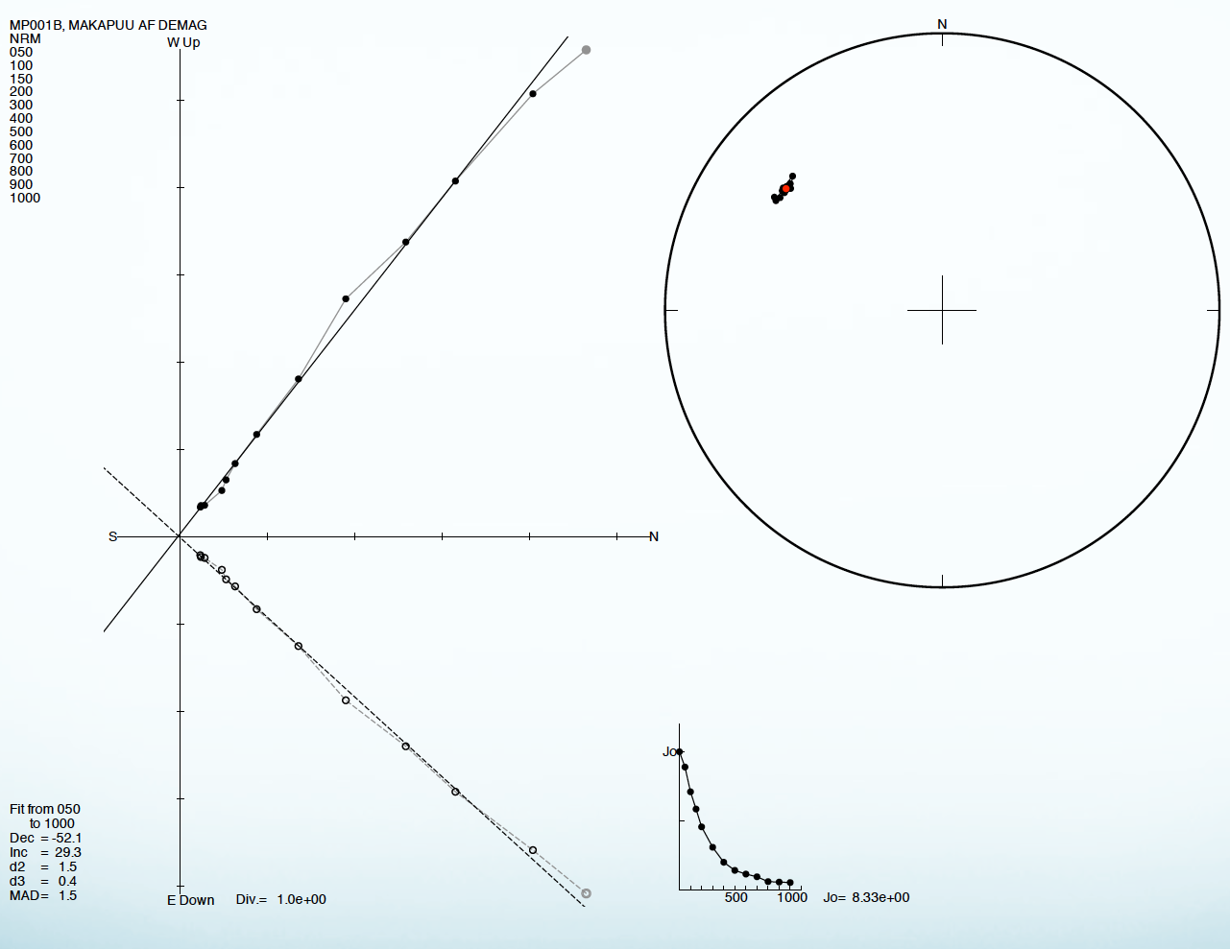
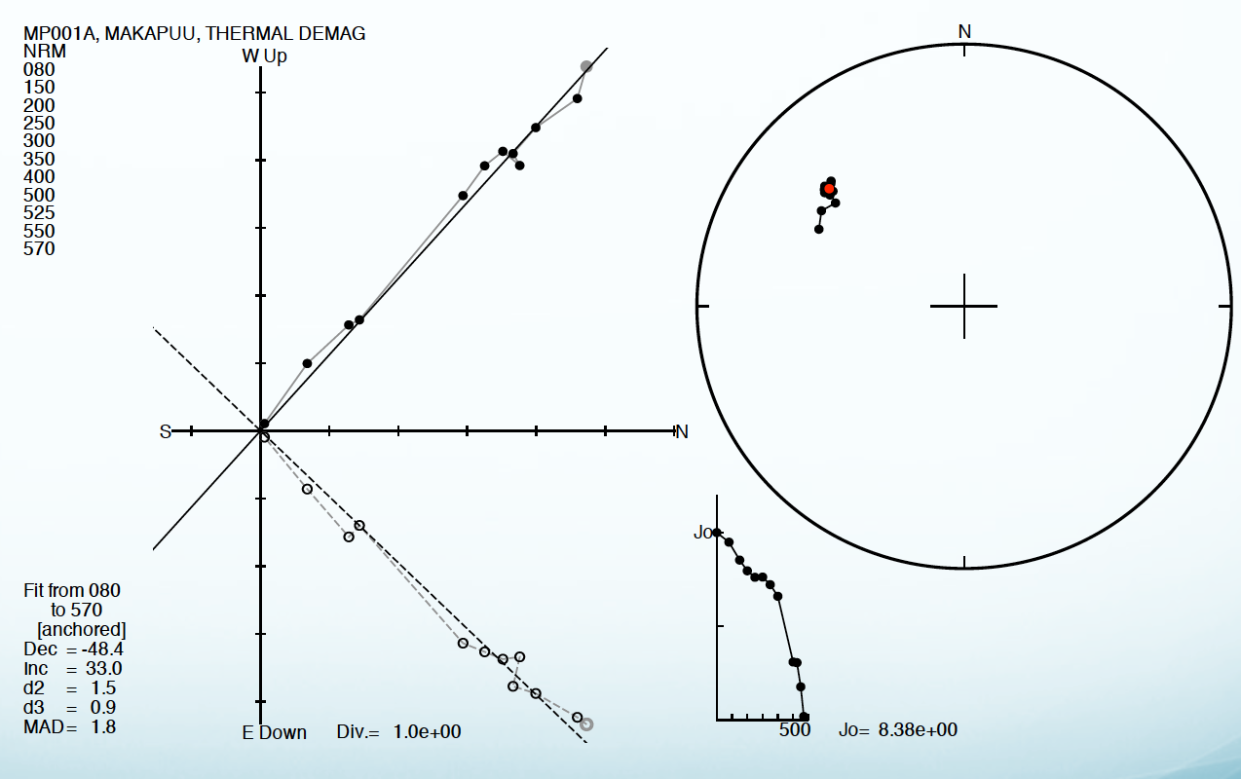
Alternating field demagnetization
Thermal Demagnetization

Slide 8
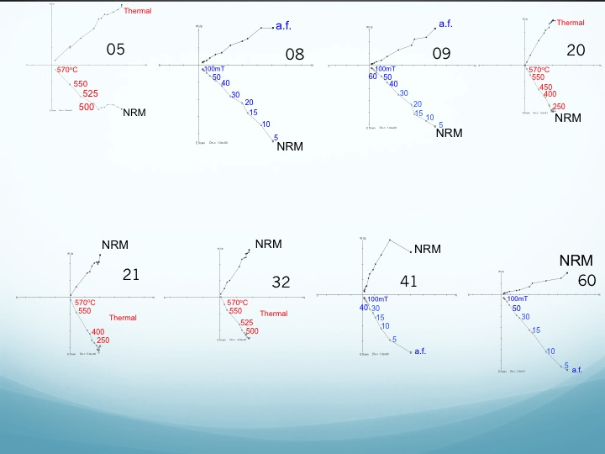

Slide 9
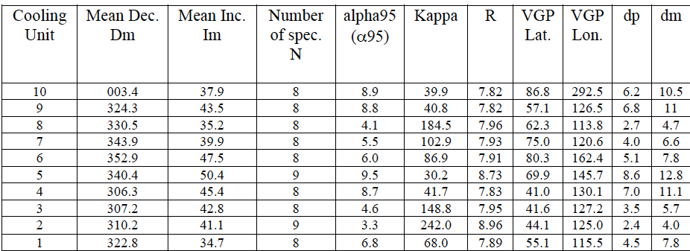
Fisher Statistical Analyses
alpha95 from 3.3 up to 9.5⁰
Kappa from 30.2-242.0

Slide 10
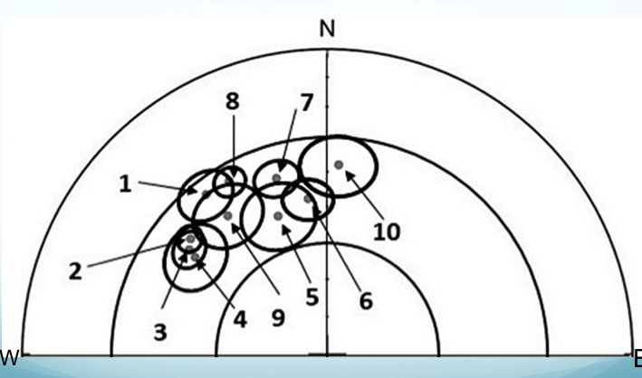

Slide 11
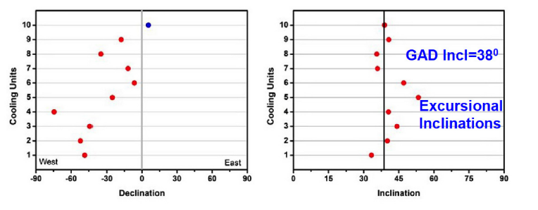

Slide 12
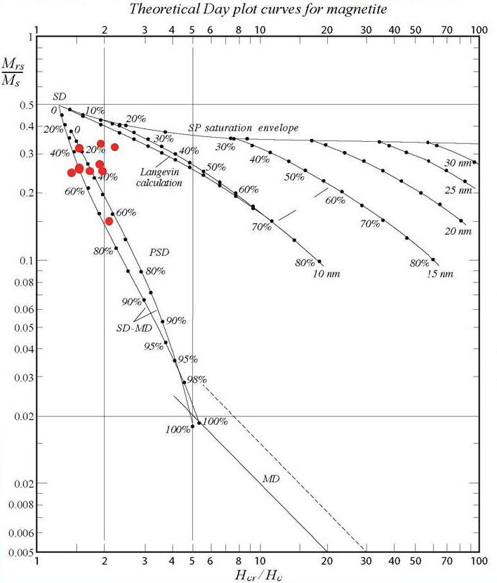

Slide 14
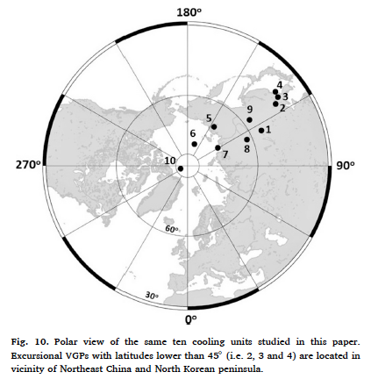

Slide 15
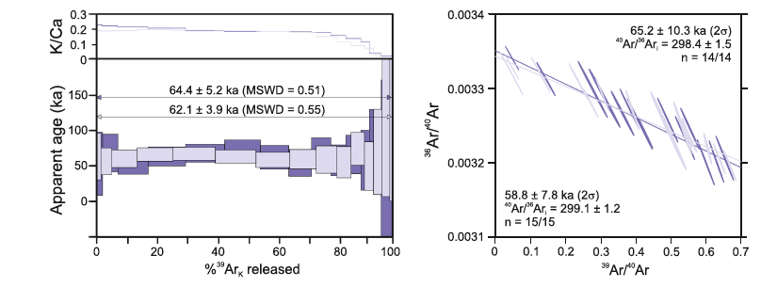
Radioisotopic ⁴⁰Ar/³⁹Ar determination of specimens from two cooling units
Kaupo flow Age: 64.3+/- 2.7ka

Slide 16
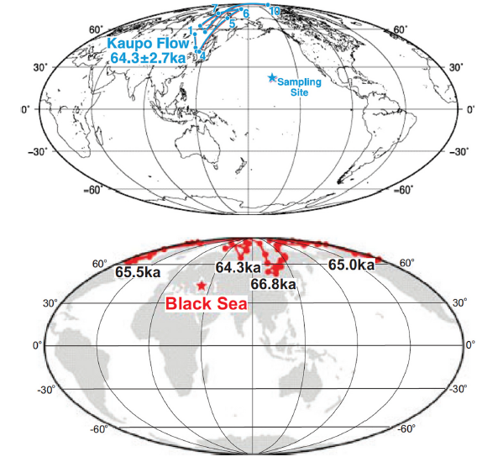
Liu et al 2020

Slide 17
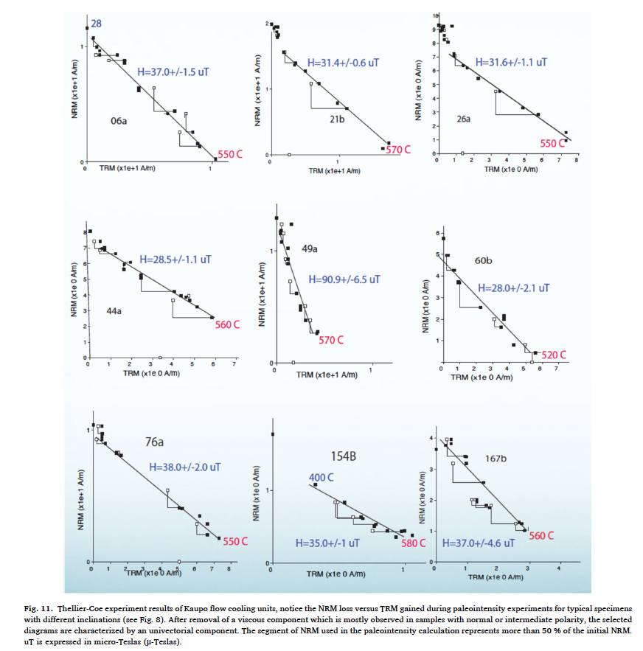

Slide 18
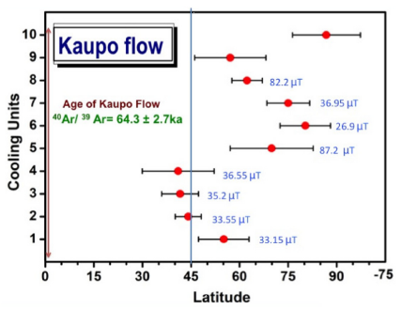

Slide 19
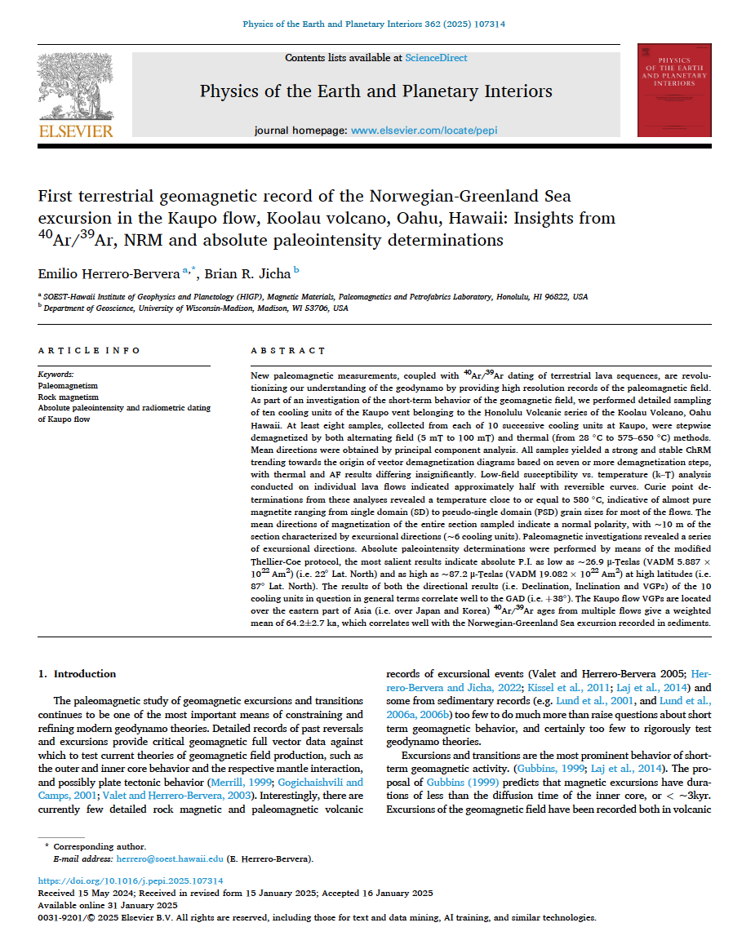

Slide 20
This presentation and published paper is dedicated to Jean-Pierre Valet and Mr James King Sun Lau. We were collaborators, workers and very good friends for about forty years of our careers

Slide 21

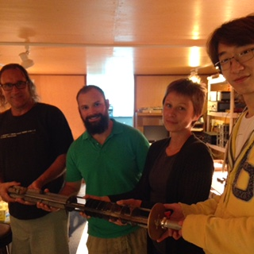
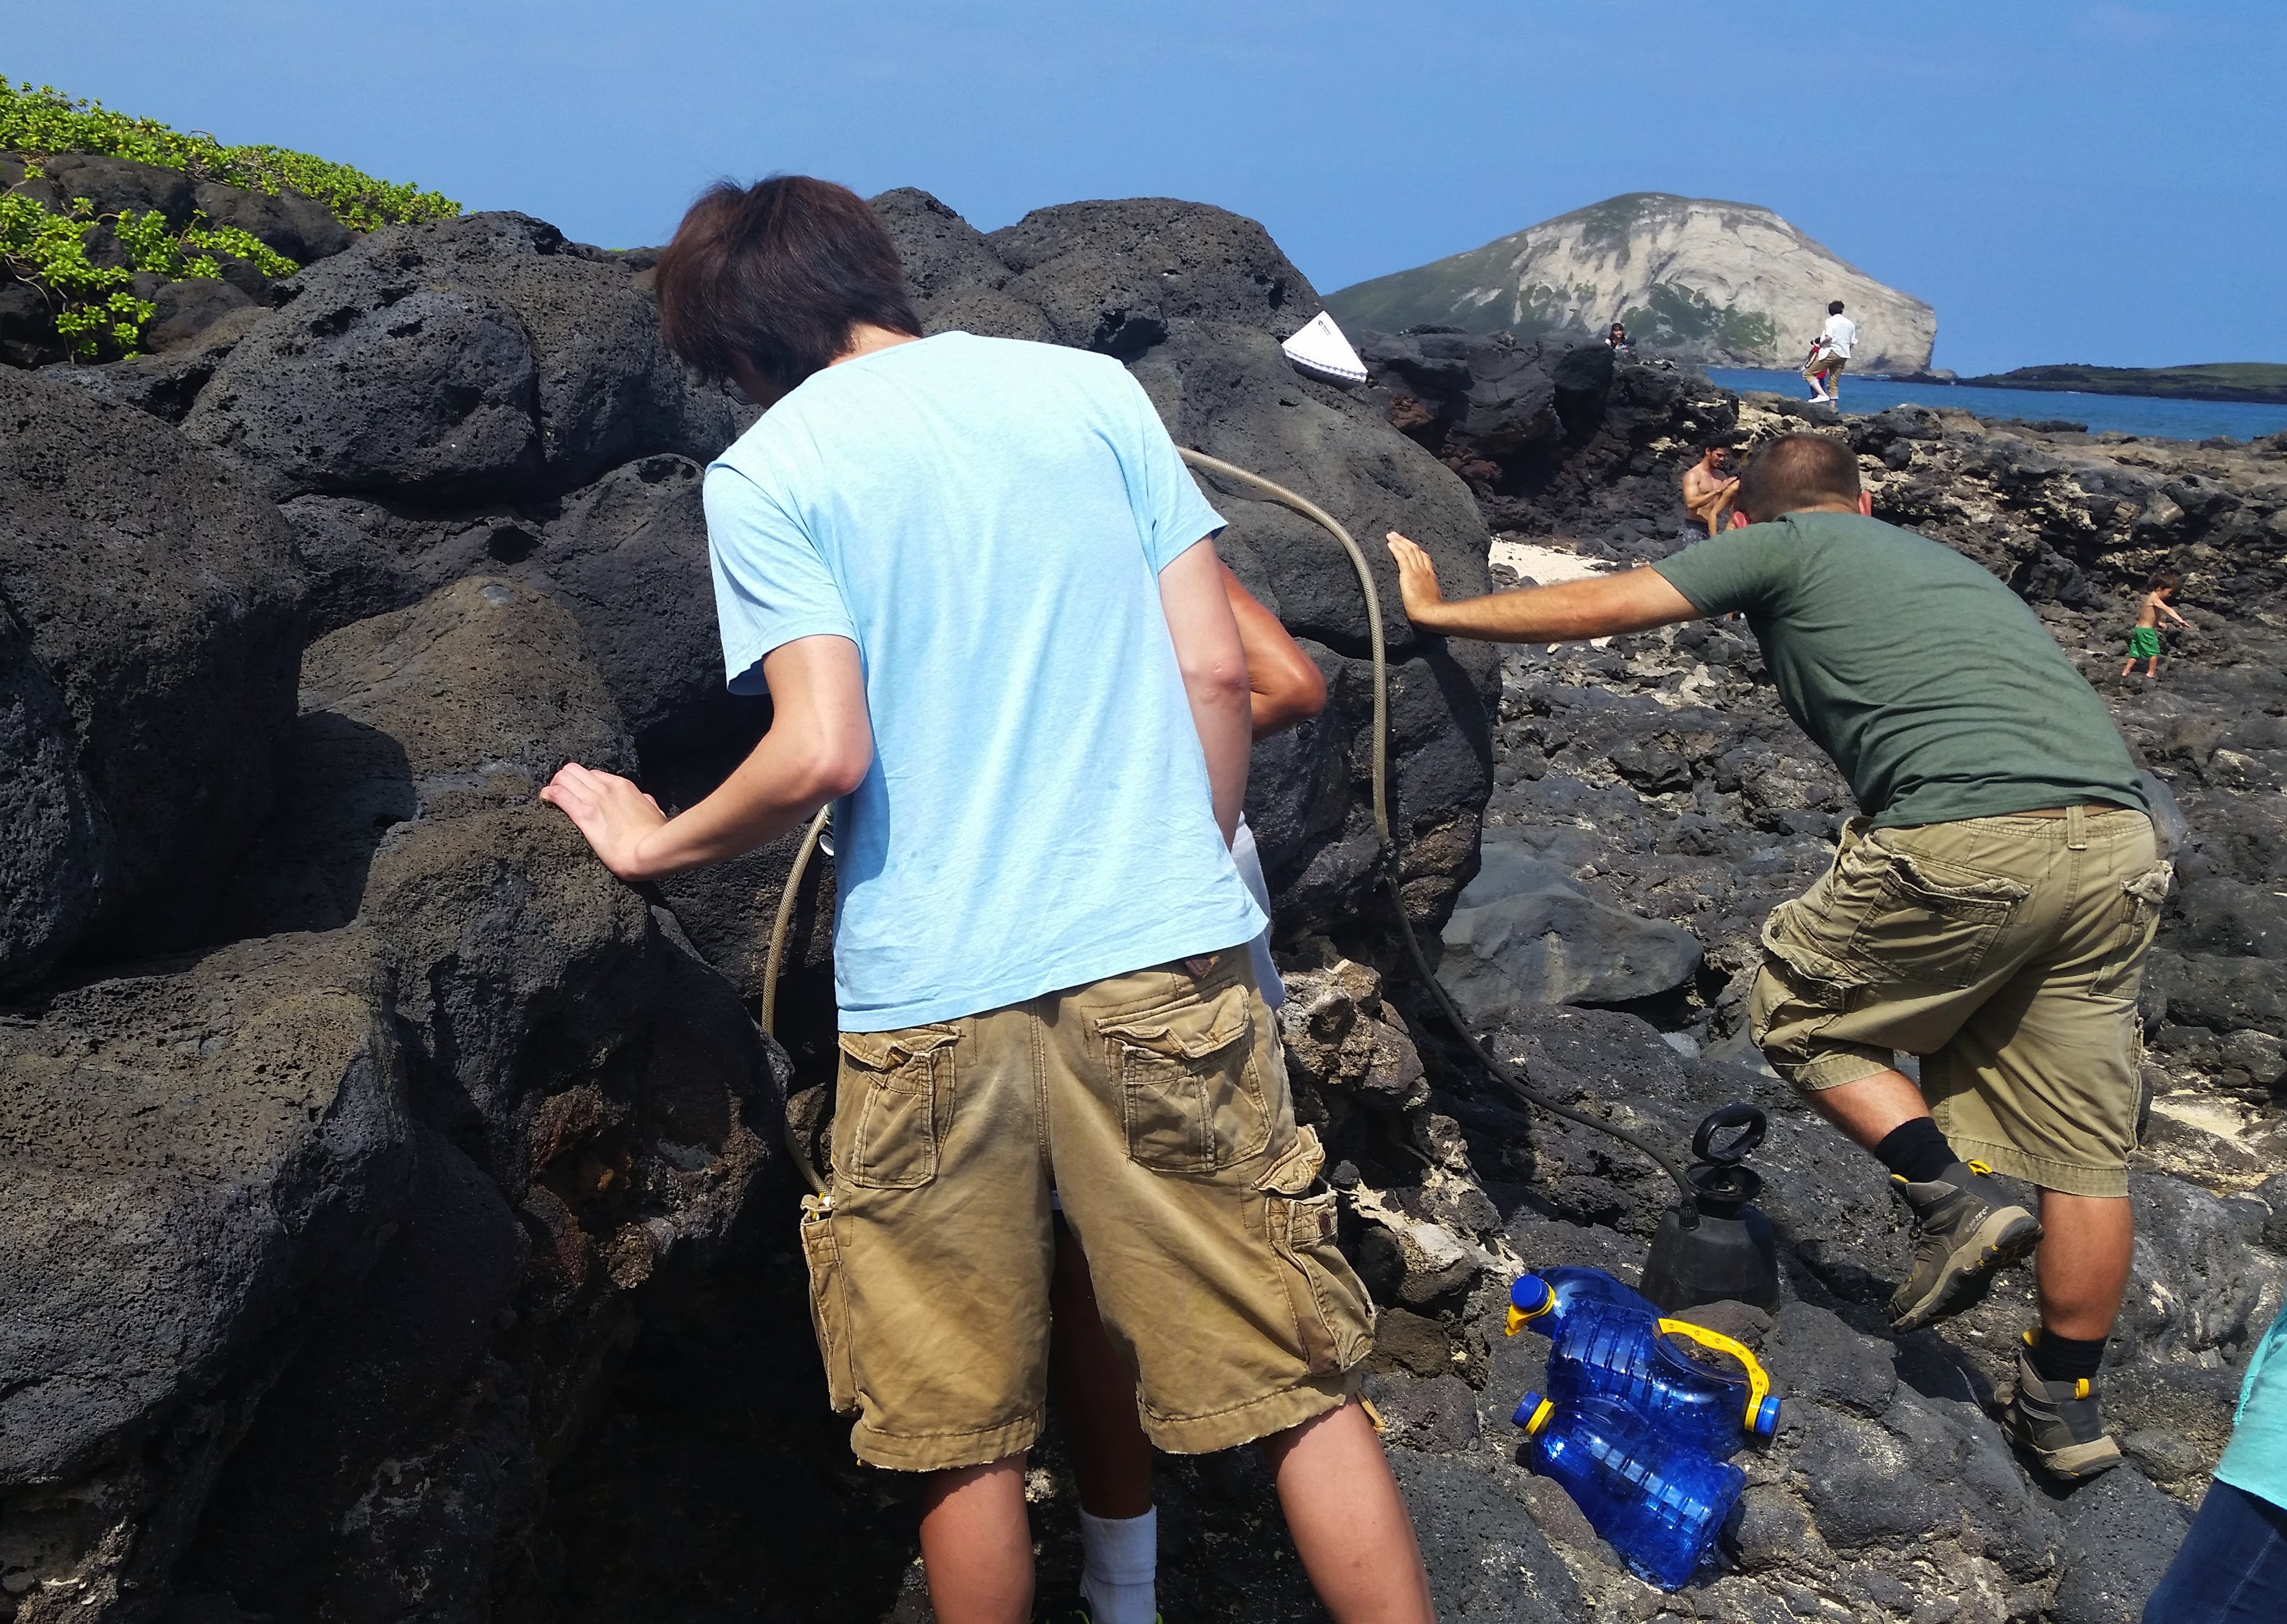
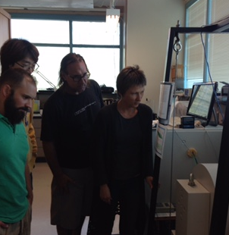
Acknowledgments

Slide 22
Radioisotopic ⁴⁰Ar/³⁹Ar determination of specimens from two cooling units

Slide 23
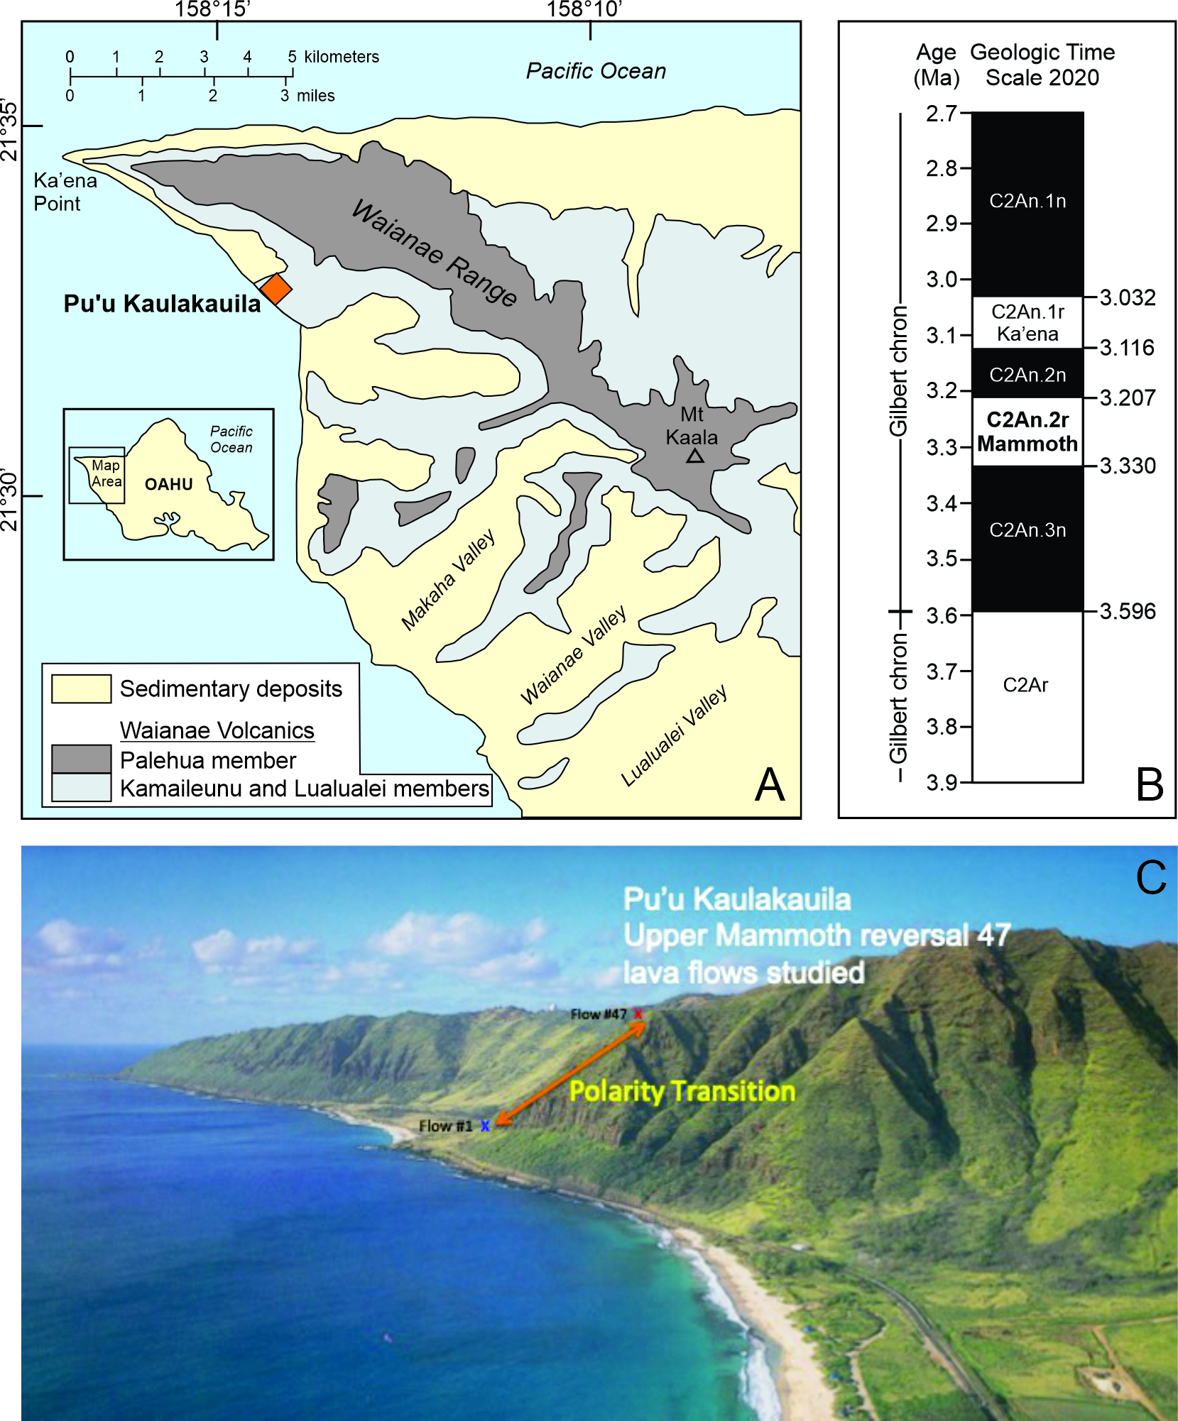
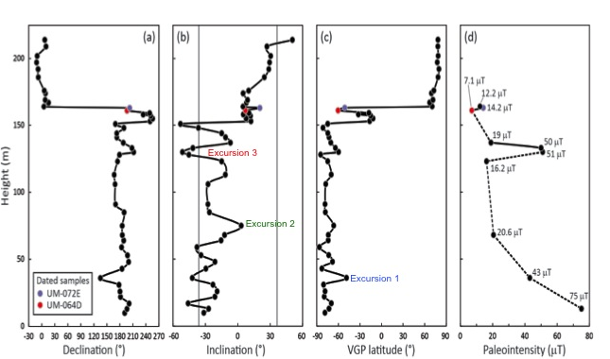
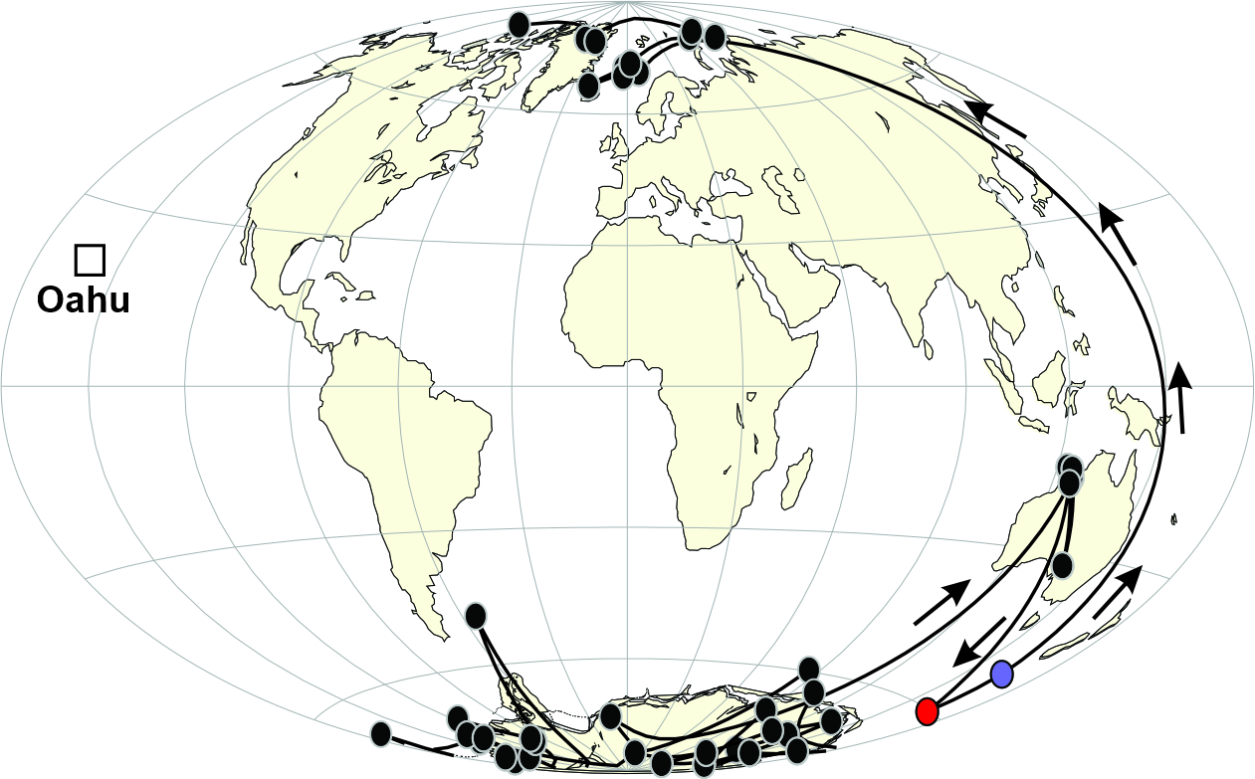
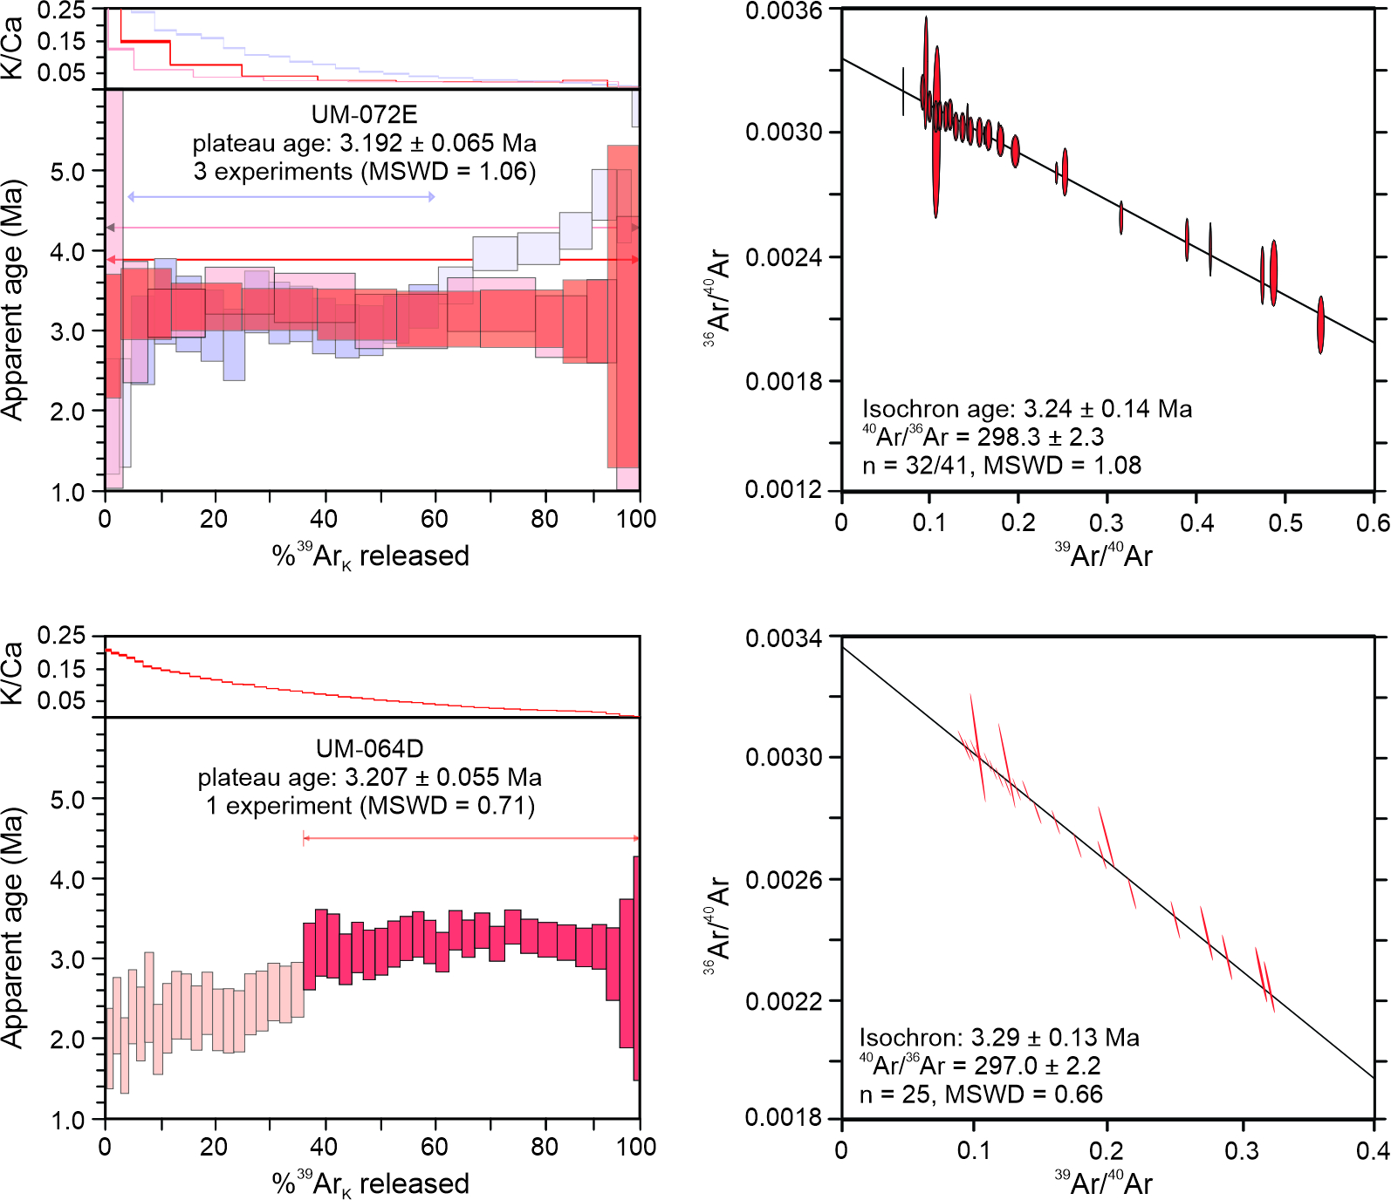
Upper left diagram showing the sampling site location and
Upper Mammoth recent magnetostratigraphic published
ages ,upper right side diagram of the full vector results and
VGPS, lower right figure displaying the R-N VGP paths.
Left lower diagram shows the compilation of the Ar/Ar
Radiometric of the lavas in question.

