Slide 1






The method to get clear image for the railway ballast structure with the Ground Penetrating Radar Horn Antenna
1
Abstract
Idea
Vienna, Austria & Online | 27 April - 2 May 2025
EGU25-1404|Session ERE1.7
2
Survey Method
3
Data
Processing
egu25-1404
My Abstract
4
Conclusion
Xinsheng Deng
Shanghai Yingce Technologies Limited, Shanghai, China
info@yingcetechnologies.com
www.yingcetechnologies.com
Navigation
Click buttons
for navigation
Enlarge pictures
by clicking on it
LinkedIn

Slide 2
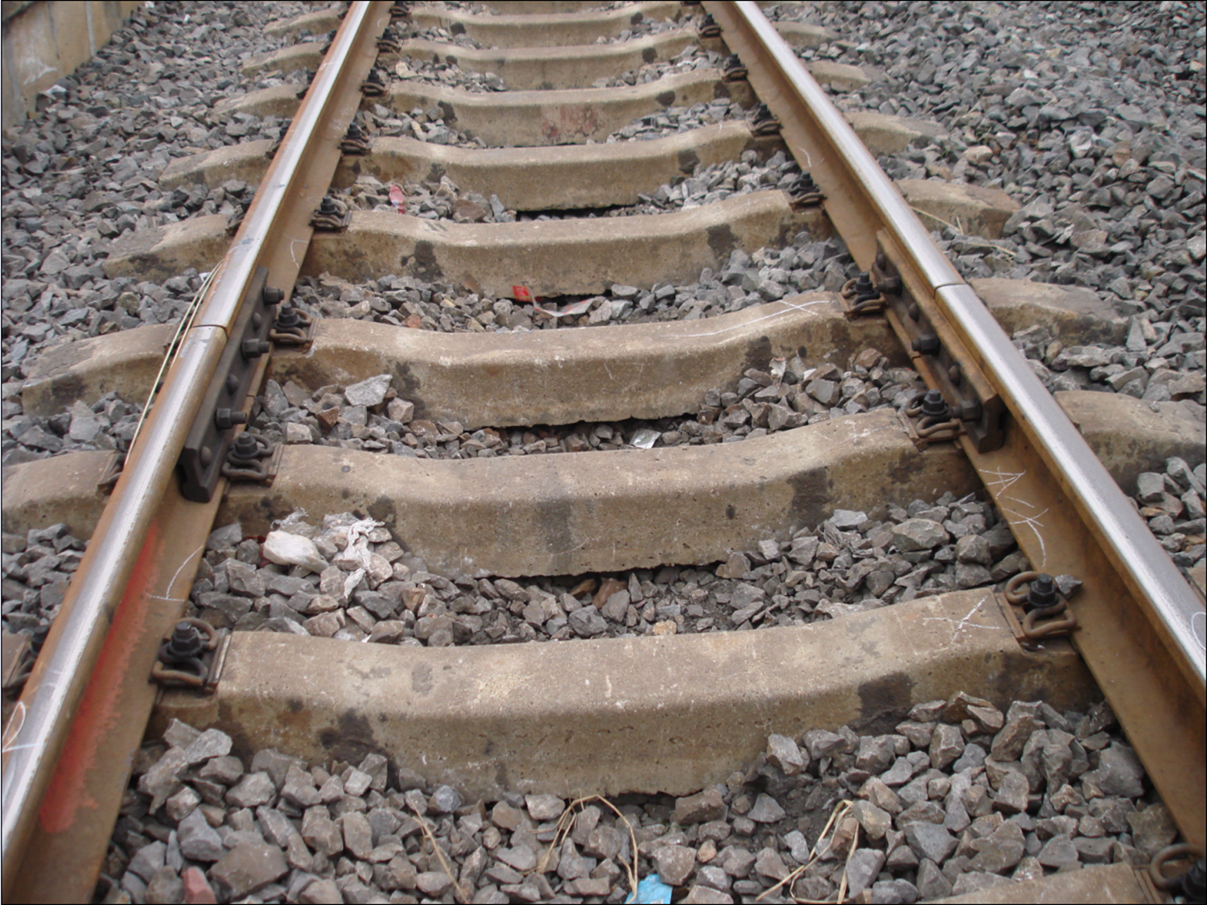
The method to get clear image for the railway ballast structure with the Ground Penetrating Radar Horn Antenna
1
Abstract
Idea
2
Survey Method
Abstract Idea
The safety of railway road base structures is very import.
A conventional railway road base is composed of three layers:
Square cement sleepers positioned at the top,
  sleeper separation is 40 cm and its width is 20 cm with 3 layers rebars.
Ballast situated in the middle, and
Undisturbed bedrock or soil at the base.
  Railway road base may change based on their geographical context.
  In excavated sections, particularly in limestone regions, the railway road base has changed annually. And the ballast stones fall into lower cavities, thereby the ballast layer become thinner. This leads to safety hazards for the high speed train.
In summer it is filled with mud and water and sinks downward
In winter it is filled with ice and grows upward
  The ballast structure need GPR NDT.
3
Data
Processing
4
Conclusion
Navigation
Click buttons
for navigation
Enlarge pictures
by clicking on it

Slide 3
The method to get clear image for the railway ballast structure with the Ground Penetrating Radar Horn Antenna
1
Abstract
Idea
2
Survey Method
Survey Method
To assess the condition of the railway ballast structure, Ground Penetrating Radar (GPR) system with three sets of 1.0 GHz air coupled antennas was employed.
Antenna was arranged on the left, center, right sides of the railway track.
Antenna bottom was elevated 45 cm above the square cement sleepers，and 60 cm height above the railway ballast surface.
GPR survey was under distance model and with GPS position.
GPR survey speed was more than 70 km / hour; the train max was 80 km/h.
The GPR survey point was 40 cm/meter in horizontal direction.
The GPR time window was 30 ns in vertical direction.
3
Data
Processing
4
Conclusion
Navigation
Click buttons
for navigation
Enlarge pictures
by clicking on it

Slide 4
The method to get clear image for the railway ballast structure with the Ground Penetrating Radar Horn Antenna
1
Abstract
Idea
2
Survey Method
Data Processing and Result
GPR profile has contained the big ringing noise from GPR system and between antenna and track and the hyper curve from square sleeper and layer reflection signal. The layer reflection need to keep.
GPR raw files was saved as single channel file.
Background remove operation to remove big ringing noise and to get normal profile Figure a.
Extract small local hyper curve from concrete sleepers to get the local feature profile Figure b.
Subtract the local hyper curve to get the clear layer reflection profile processed result Figure c.
3
Data
Processing
4
Conclusion
Navigation
Click buttons
for navigation
Enlarge pictures
by clicking on it

Slide 5
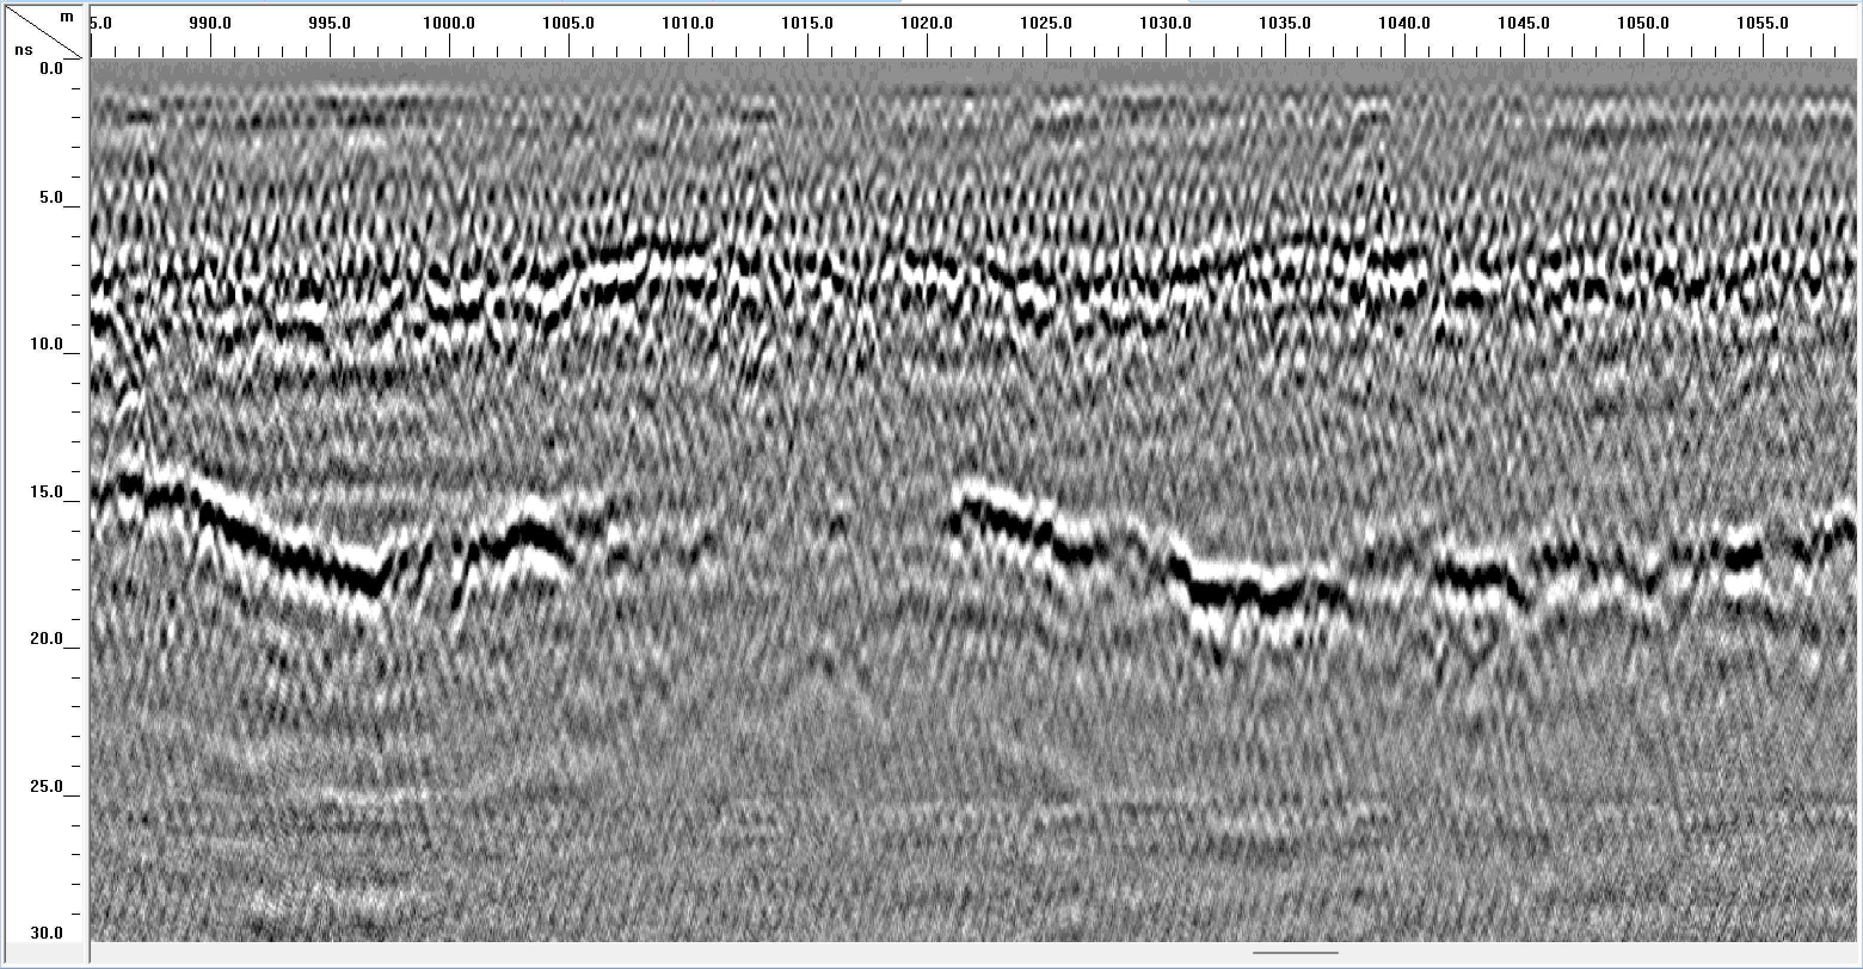
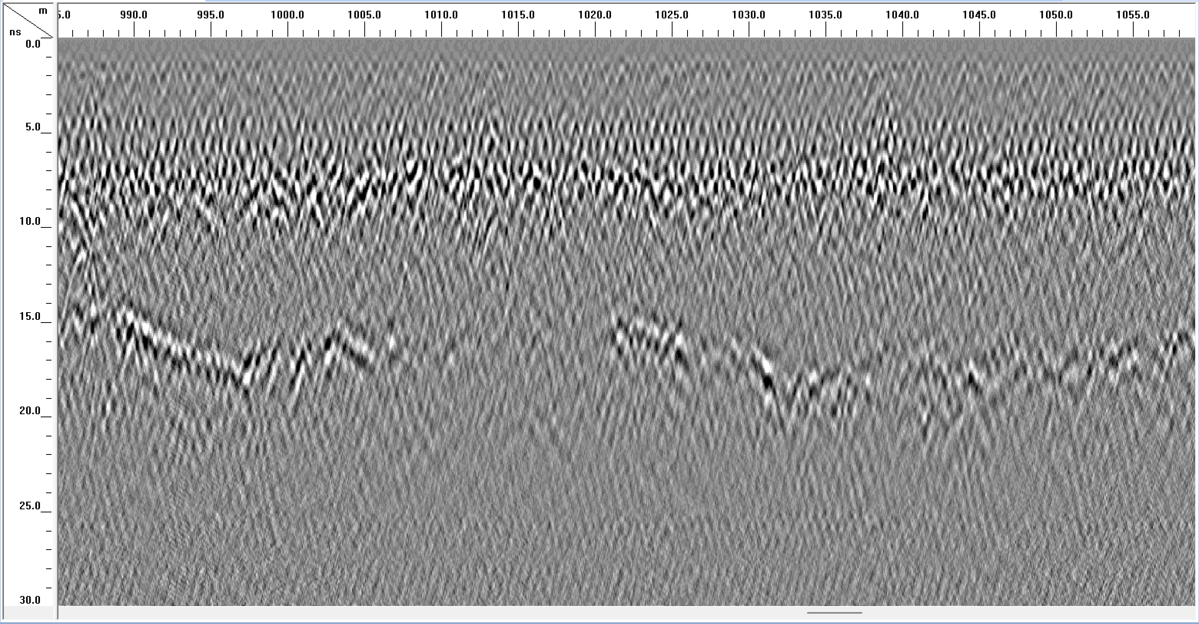
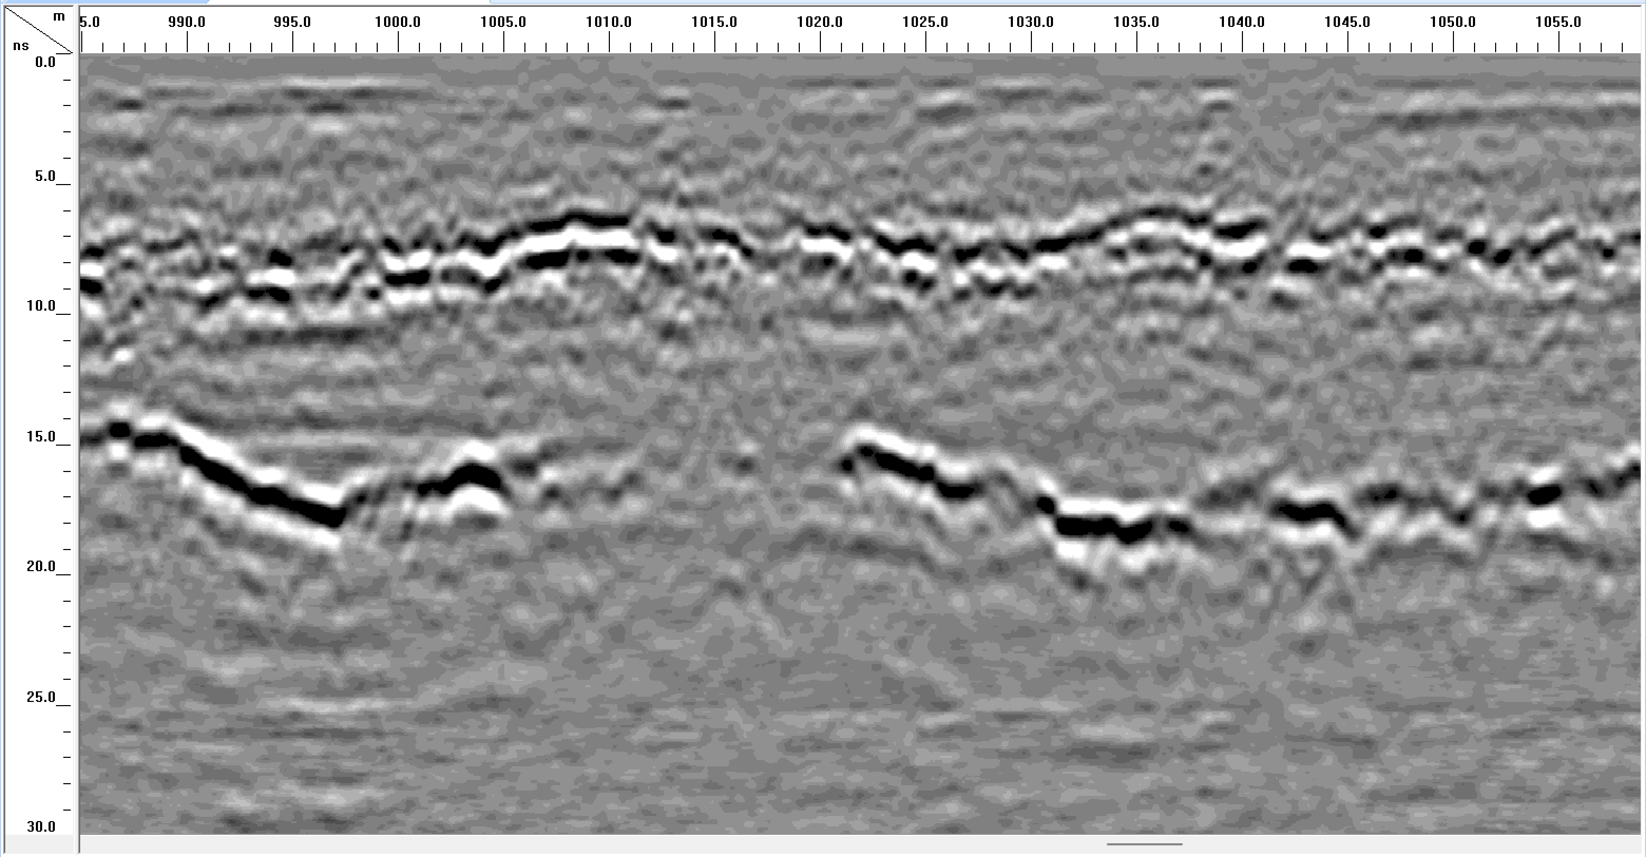
The method to get clear image for the railway ballast structure with the Ground Penetrating Radar Horn Antenna
1
Abstract
Idea
2
Survey Method
Feature
3
Data
Processing
4
Conclusion
Figure a railway ballast profile
Figure b railway sleeper profile
GPR Normal Data Processing
Advance Migration function
Effective reflection energy loss
real phase change
producing additional noise
AI model training with big data
GPR unique Data Processing
Extract and Subtract hyper curve
with local special feature
Navigation
Click buttons
for navigation
Enlarge pictures
by clicking on it
HOME
Figure c railway layer reflection profile

Slide 6
The method to get clear image for the railway ballast structure with the Ground Penetrating Radar Horn Antenna
1
Abstract
Idea
2
Survey Method
Conclusion
With unique data processing flow and method, GPR can image railway road base structures clearly.
The data processing flow and method can be used to normal concrete slab structure scan and image.
The GPR survey result has provided the information of the railway road base for Maintenance and repair and reinforcement thereby enhancing railway safety.
3
Data
Processing
4
Conclusion
Navigation
Click buttons
for navigation
Enlarge pictures
by clicking on it
HOME

Slide 7
The method to get clear image for the railway ballast structure with the Ground Penetrating Radar Horn Antenna
1
Abstract
Idea
2
Survey Method
Future Work
To survey more deeper railway ballast structure for geology information with GPR middle frequency antenna (100MHz, 150MHz, 300MHz).
To image GPR velocity of the normal railway ballast.
To image water content of the normal railway ballast.
3
Data
Processing
4
Conclusion
Navigation
Click buttons
for navigation
Enlarge pictures
by clicking on it
HOME

Slide 8
The method to get clear image for the railway ballast structure with the Ground Penetrating Radar Horn Antenna
1
Abstract
Idea
2
Survey Method
3
Data
Processing
4
Conclusion
Navigation
Click buttons
for navigation
Enlarge pictures
by clicking on it
HOME
Figure a railway ballast profile
after background remove from raw file

Slide 9
The method to get clear image for the railway ballast structure with the Ground Penetrating Radar Horn Antenna
1
Abstract
Idea
2
Survey Method
3
Data
Processing
4
Conclusion
Navigation
Click buttons
for navigation
Enlarge pictures
by clicking on it
HOME
Figure b railway sleeper profile
Extract local hyper curve

Slide 10
The method to get clear image for the railway ballast structure with the Ground Penetrating Radar Horn Antenna
1
Abstract
Idea
2
Survey Method
3
Data
Processing
4
Conclusion
Navigation
Click buttons
for navigation
Enlarge pictures
by clicking on it
HOME
Figure c railway layer reflection profile
The result is Figure a subtract Figure b

Slide 11
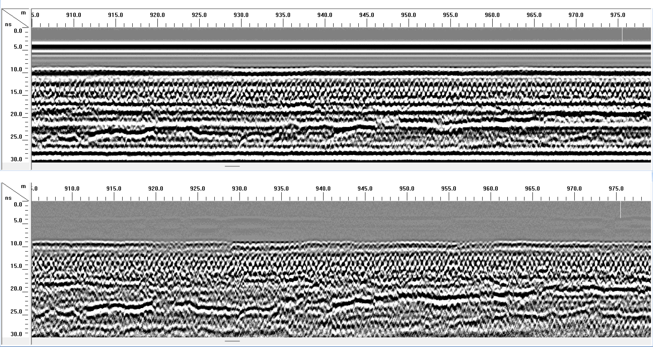
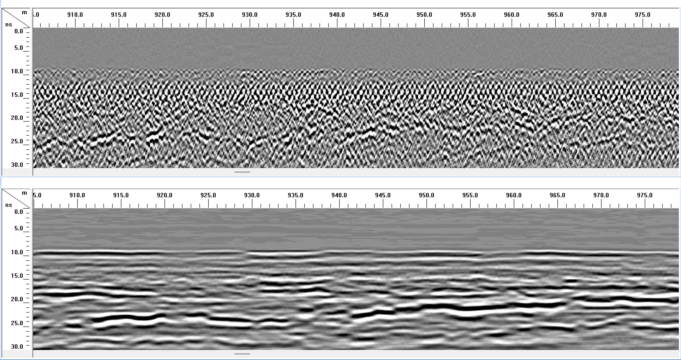
1
Abstract
Idea
2
Survey Method
3
Data
Processing
Figure 0 railway raw data profile
Figure b railway sleeper profile
4
Conclusion
Navigation
Click buttons
for navigation
Enlarge pictures
by clicking on it
HOME
Figure a railway ballast profile
Figure c railway layer reflection profile

Slide 12
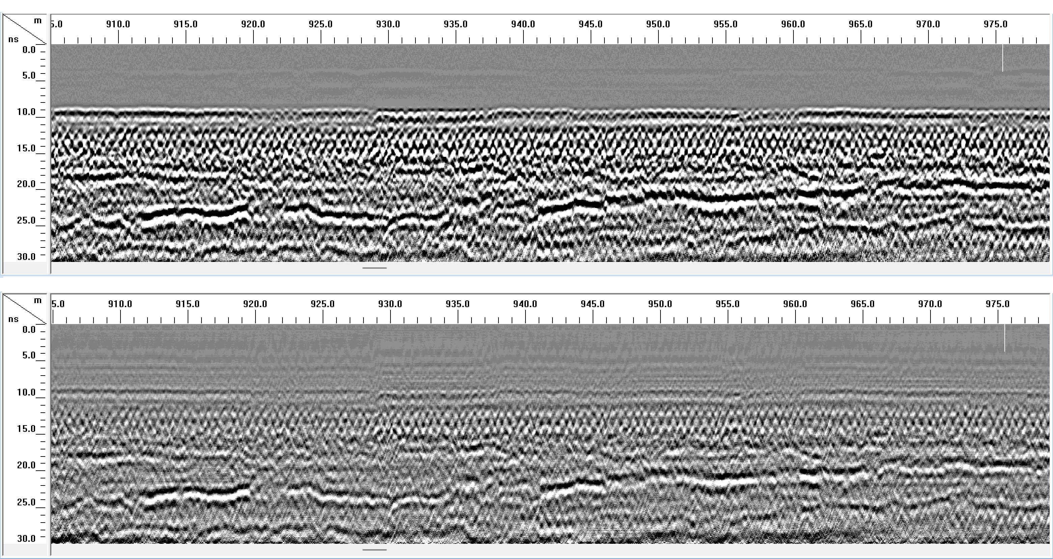
1
Abstract
Idea
2
Survey Method
3
Data
Processing
4
Conclusion
Navigation
Click buttons
for navigation
Enlarge pictures
by clicking on it
HOME
GPR software Kirchhoff migration data processing

Slide 13




The method to get clear image for the railway ballast structure with the Ground Penetrating Radar Horn Antenna
1
Abstract
Idea
2
Survey Method
Contact Us for more information
3
Data
Processing
4
Conclusion
Navigation
Click buttons
for navigation
Enlarge pictures
by clicking on it
egu25-1404
My Abstract
HOME

