Slide 1
Simulating Long-Term Trends and Seasonal Dynamics of Carbon Isotopes in Atmospheric CO₂ Using a 3D Transport Model
Uddalak CHAKRABORTY*(ceha1867@chiba-u.jp) ¹,
Naoko SAITOH¹, Prabir PATRA², Naveen CHANDRA², Dmitry BELIKOV¹ and Marko Scholze³
¹Center for Environmental Remote Sensing, Chiba University, Chiba, Japan
²Japan Agency for Marine-Earth Science and Technology (JAMSTEC), Yokohama, Japan
³Dept of Physical Geography and Ecosystem Science, Lund University, Lund, Sweden

Slide 2
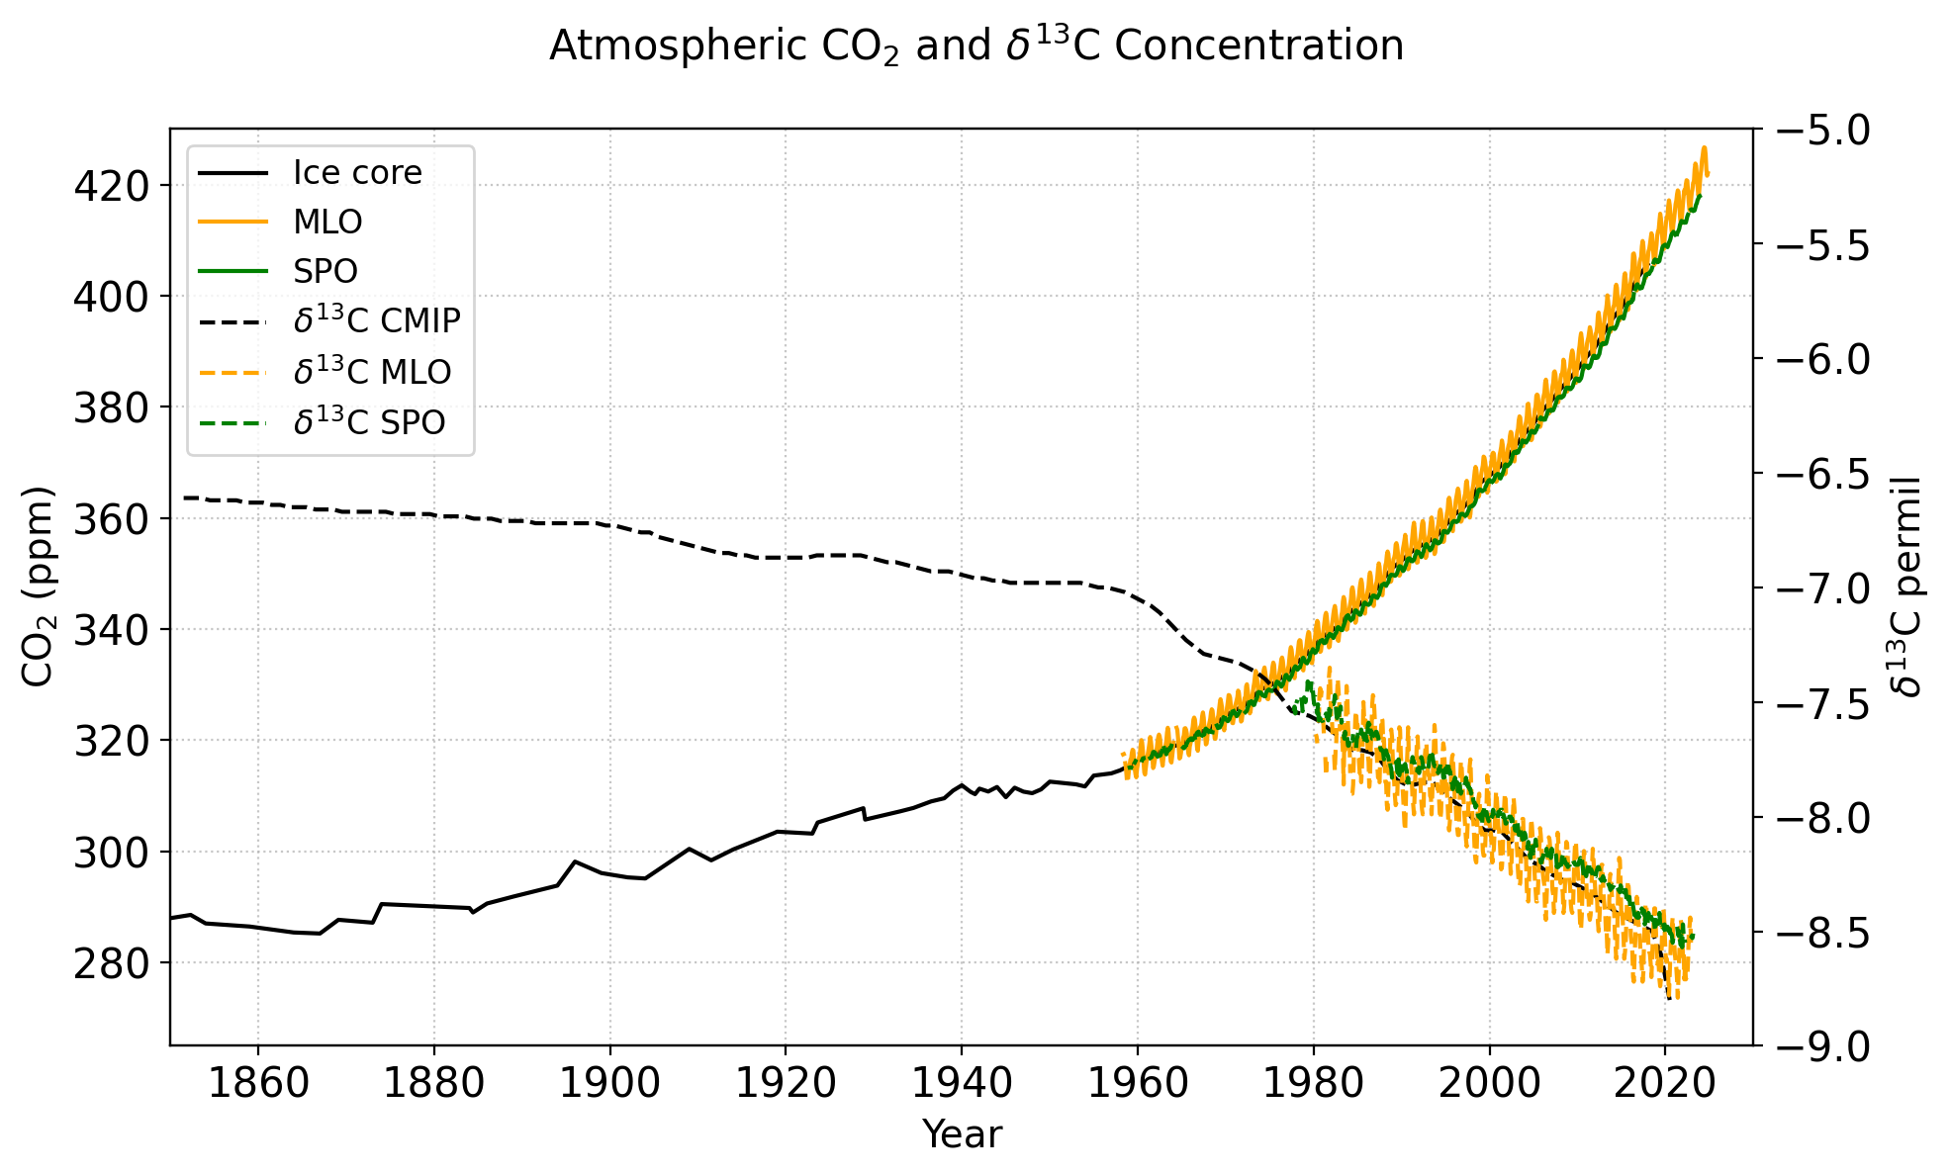
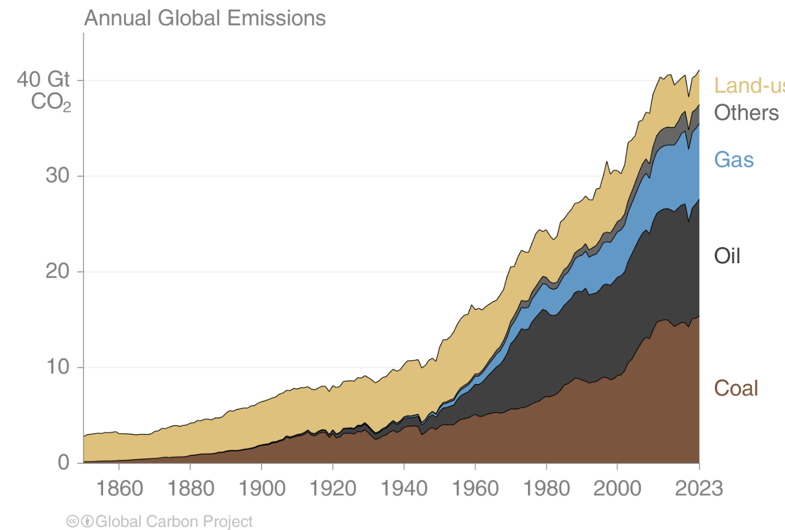
1. Background
Earth’s global surface air temperature was higher by 1.09 °C in 2011–2020 than 1850–1900, which is caused mainly by the increase in CO₂ by 47% in the atmosphere (Fig. 1a).
Anthropogenic CO₂ emissions increase have accelerated after the 1950s, with the intensification of industrial activities (IPCC AR6; Fig. 1b).
To identify CO₂ emissions and removals by different sectors regionally, it is necessary to develop a 3-dimensional model to simulate the trends and variabilities of CO₂, ¹³C and ¹⁴C in the atmosphere at multiple sites.
(a)
(Revised from : Canadell et al., 2021; IPCC AR6)
Data source : SIO/UCSD, NOAA GMD ; Graven et al., 2017
(Friedlingstein et al., 2024)
LUC
(b)
Purpose of this study: This study aims to simulate atmospheric CO₂,¹³C and ¹⁴C using combinations of fossil fuel emissions, land and ocean fluxes during1940-2023.
Figure 1. Time series of atmospheric ¹³C and CO₂ (a) and anthropogenic CO₂ emissions (b).

Slide 3
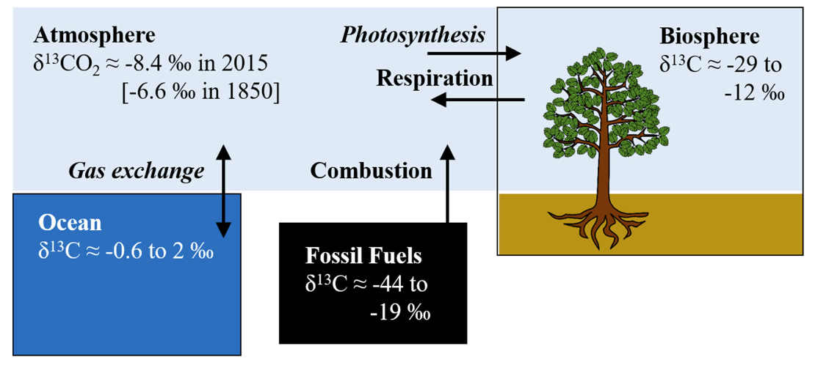
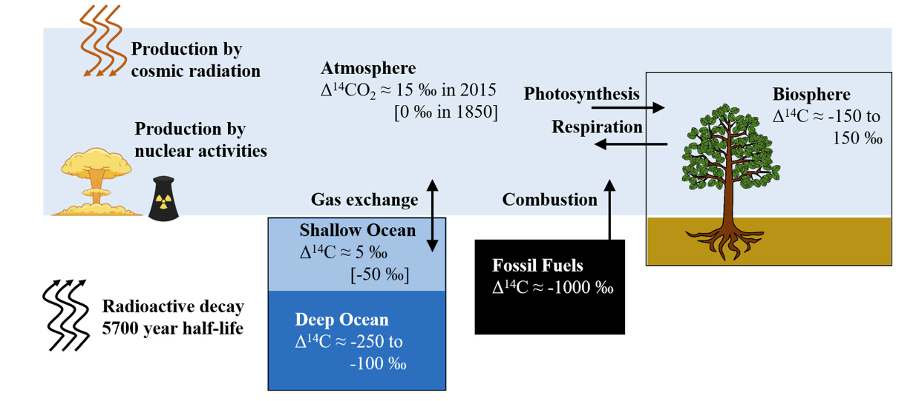
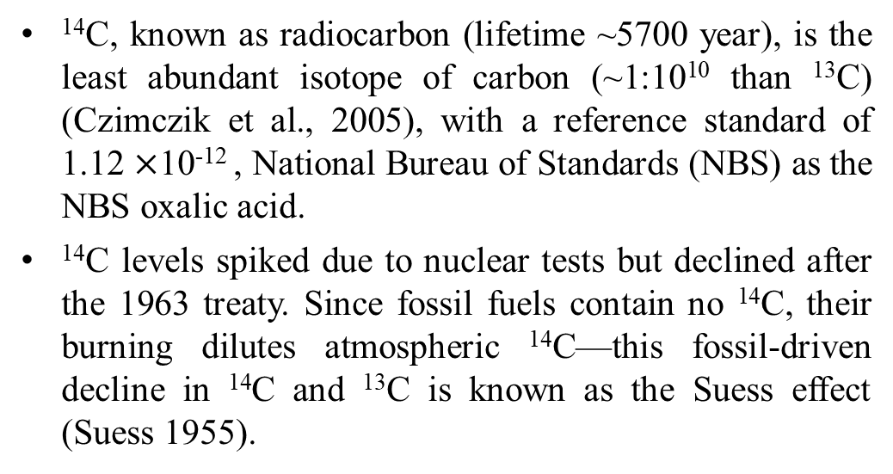

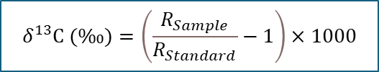
2. Carbon cycle dynamics related to isotopes
¹³C, a stable carbon isotope, expressed as δ¹³C; it represents the deviation of the ¹³C /¹²C ratio from the standard reference, Vienna Pee Dee Belemnite (VPDB), with a standard value of 0.0112372 (Stuiver and Polach, Radiocarbon, 1977).
The depletion or enrichment of ¹³C during carbon exchange between the atmosphere, biosphere, and ocean provides valuable insights into identifying CO₂ sources and sinks, making it a critical tool for understanding carbon flux dynamics (as illustrated on the right).
$$δ^{13}C (‰)=\left(\frac{ R_{Sample} }{R_{Standard}}−1\right)×1000$$
¹⁴C, known as radiocarbon (lifetime ~5700 year), is the least abundant isotope of carbon (~1:10¹⁰ than ¹³C) (Czimczik et al., 2005), with a reference standard of 1.12 $×$10⁻¹² , National Bureau of Standards (NBS) as the NBS oxalic acid.
¹⁴C levels spiked due to nuclear tests but declined after the 1963 treaty. Since fossil fuels contain no ¹⁴C, their burning dilutes atmospheric ¹⁴C—this fossil-driven decline in ¹⁴C and ¹³C is known as the Suess effect (Suess 1955).
$$∆^{14}C (‰)=\left(\frac{ R_{Sample} }{R_{Standard}}−1\right)×1000$$
Figure 2. ¹³C and ¹⁴C exchange processes between major pools (Graven et al., 2020).

Slide 4
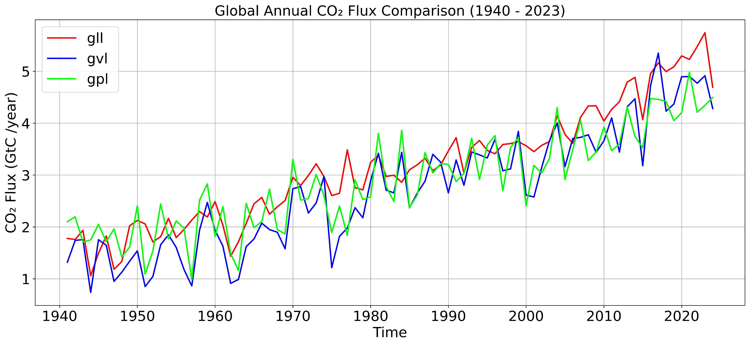
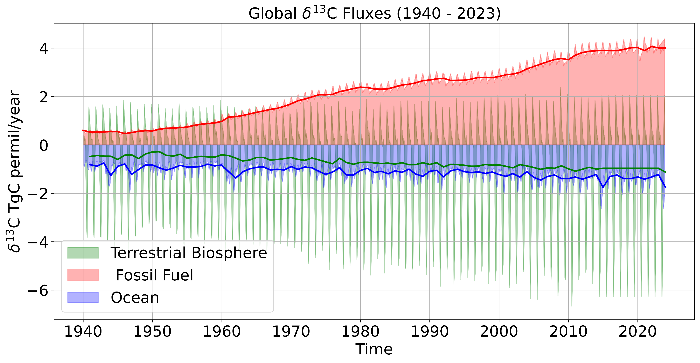
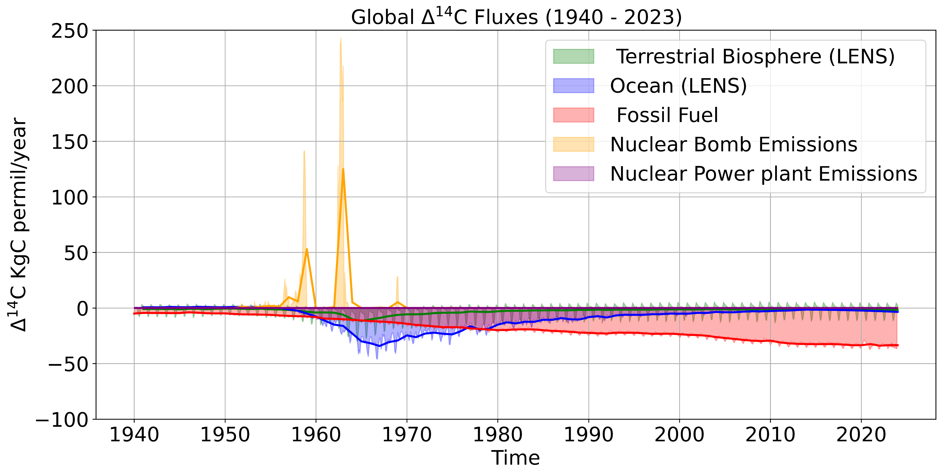
3. Methodology
We used MIROC4-ACTM (Patra et al., 2018) with both human (fossil fuel, nuclear) and natural (biosphere, ocean) CO₂ fluxes. The model was nudged using JRA-55 horizontal winds and temperature for realistic atmospheric transport. For the simulation for the years of 1940-1983, we recycled the 1984 meteorology.
(a)
Fossil fuel emission fluxes
Biospheric flux
Anthropogenic fluxes
Nuclear emission fluxes
INPUT
Oceanic flux
U - Wind data
(b)
JRA-55
MIROC4 - ACTM
SIMULATION
V - Wind data
Temperature data
Resolutions of MIROC4-ACTM:
T42 (2.8°x 2.8°) and 67 vertical levels
OUTPUT
(c)
(d)
Validation with observations
Figure 3. Schematic of MIROC4-ACTM model simulation framework (a) and time series of biospheric CO₂ fluxes (b), δ¹³C fluxes (c), and Δ¹⁴C fluxes (d) during 1940-2023.
Following flux combinations are made for three model experiments:
gll = FF (GridFED) + Ocean (LENS) + Biosphere (LENS), gvl= FF (GridFED) + Ocean (LENS) + Biosphere (VISIT), gpl = FF (GridFED) + Ocean (LENS) + Biosphere (LPJ).

Slide 5
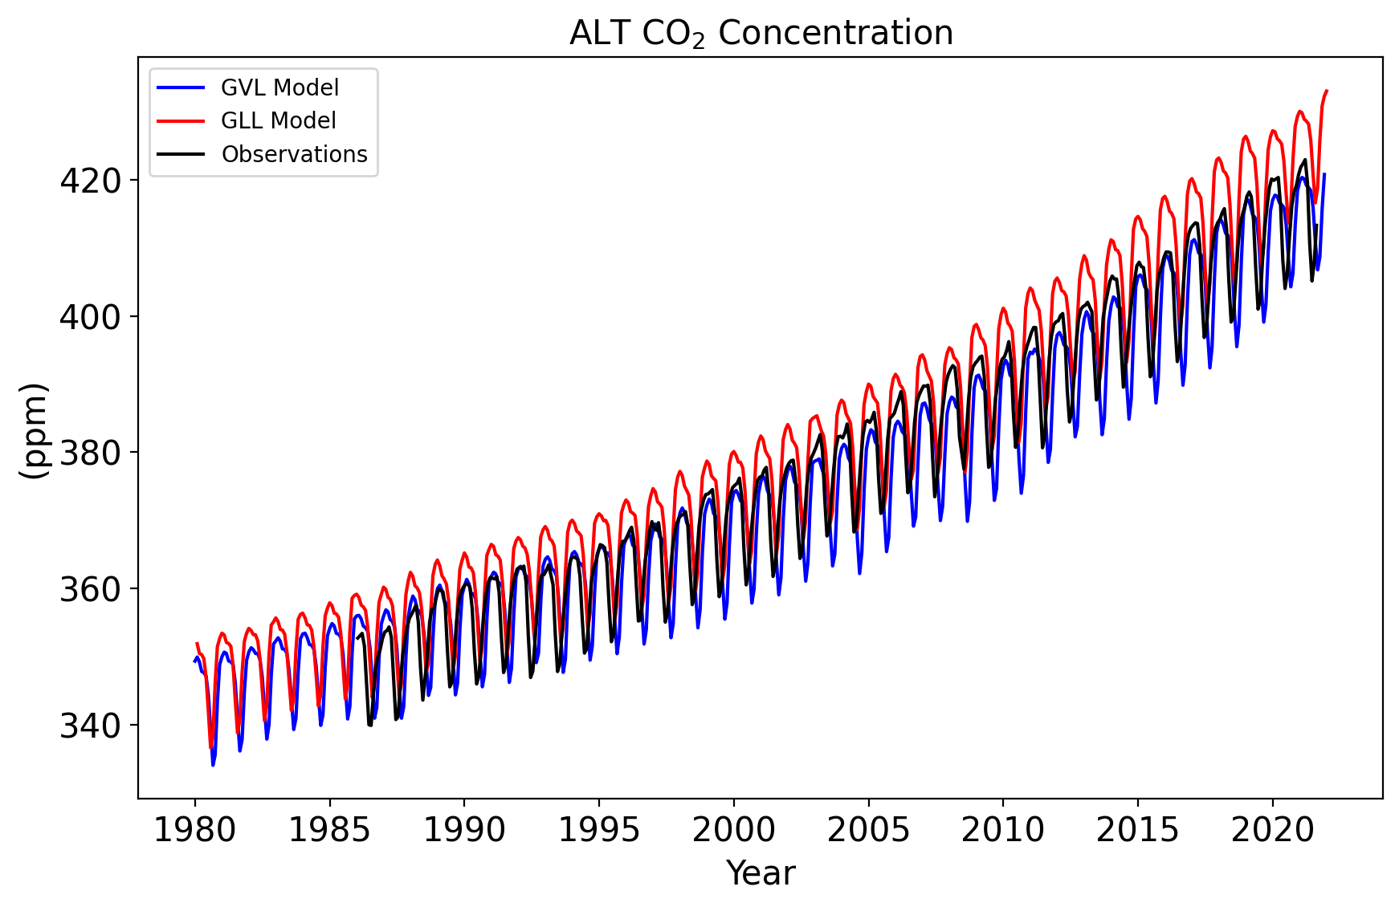
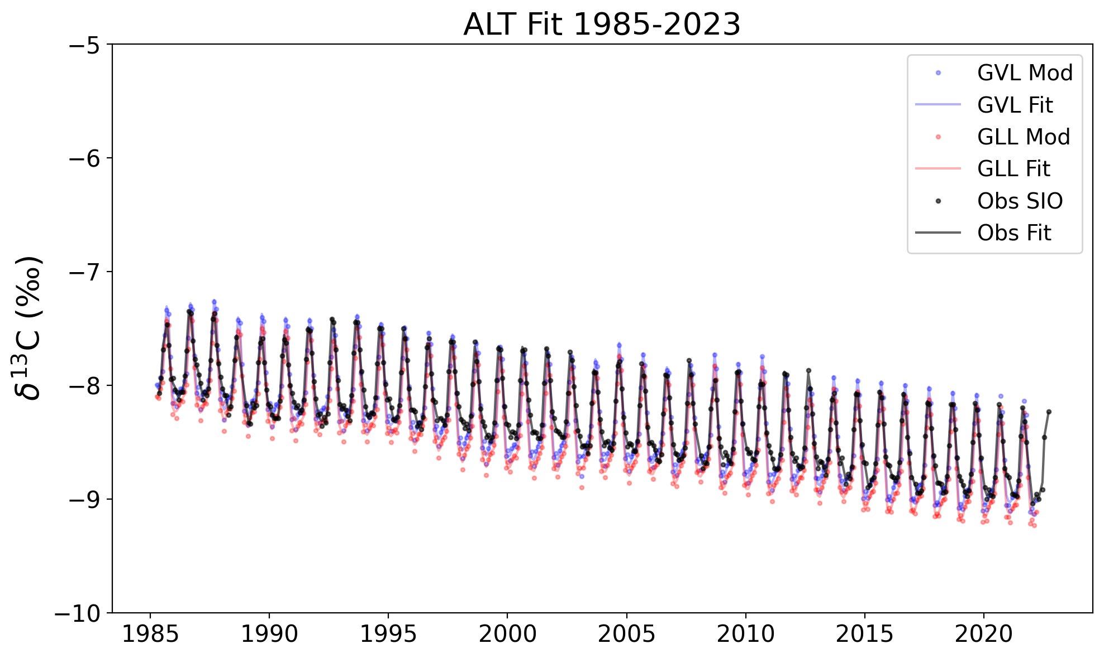
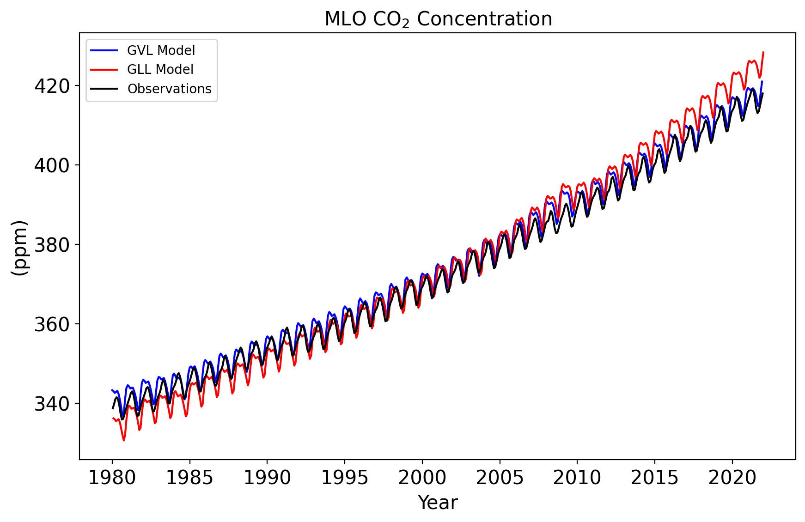
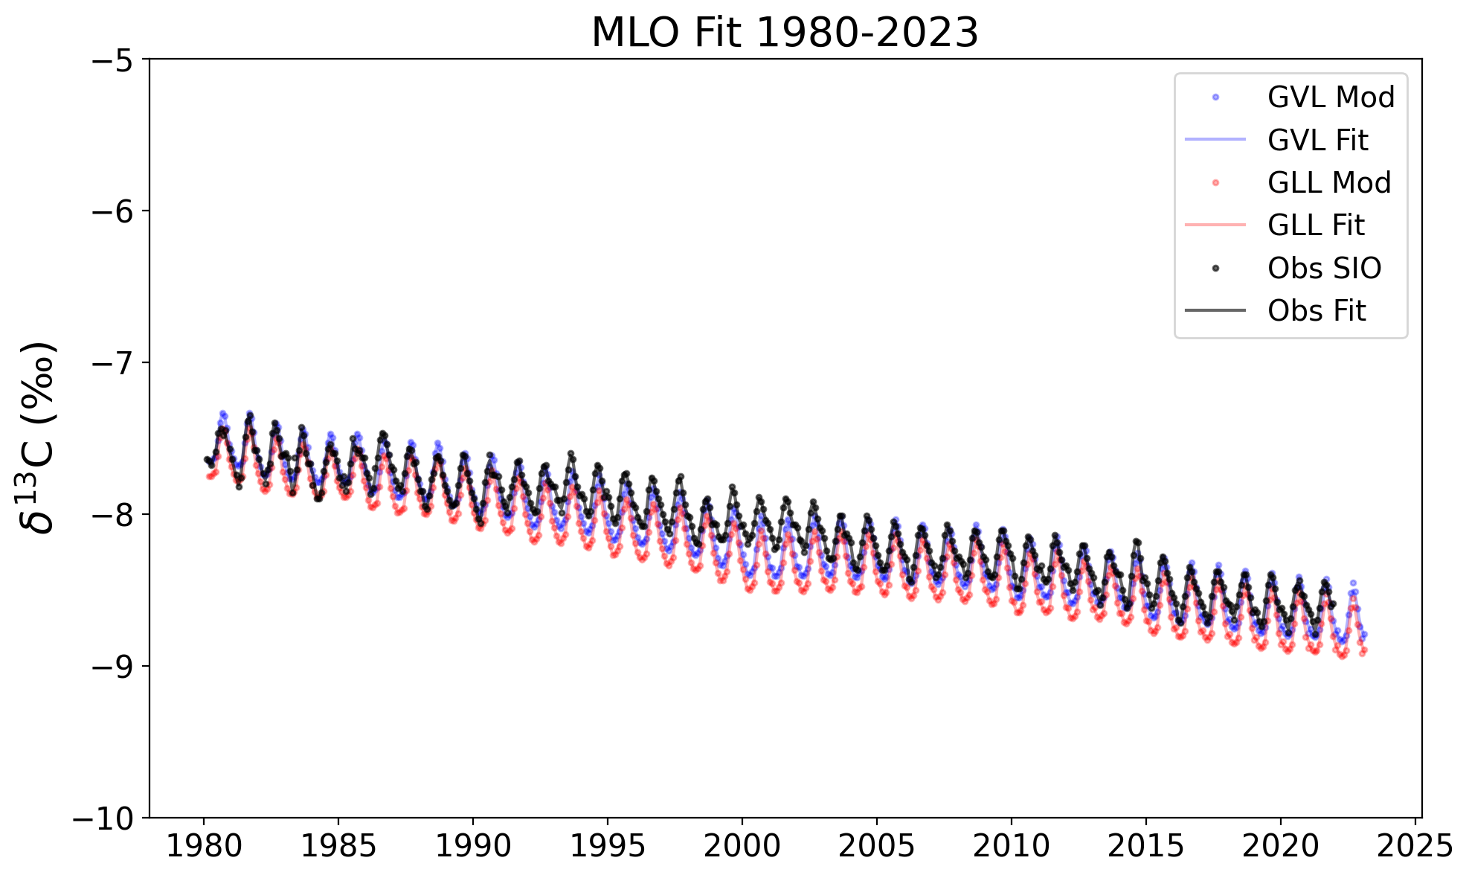
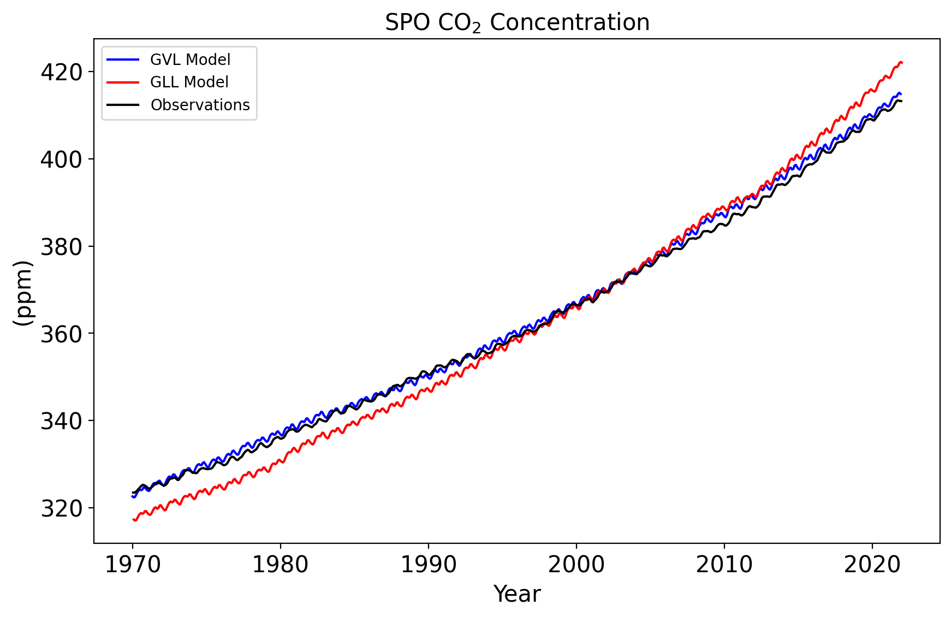
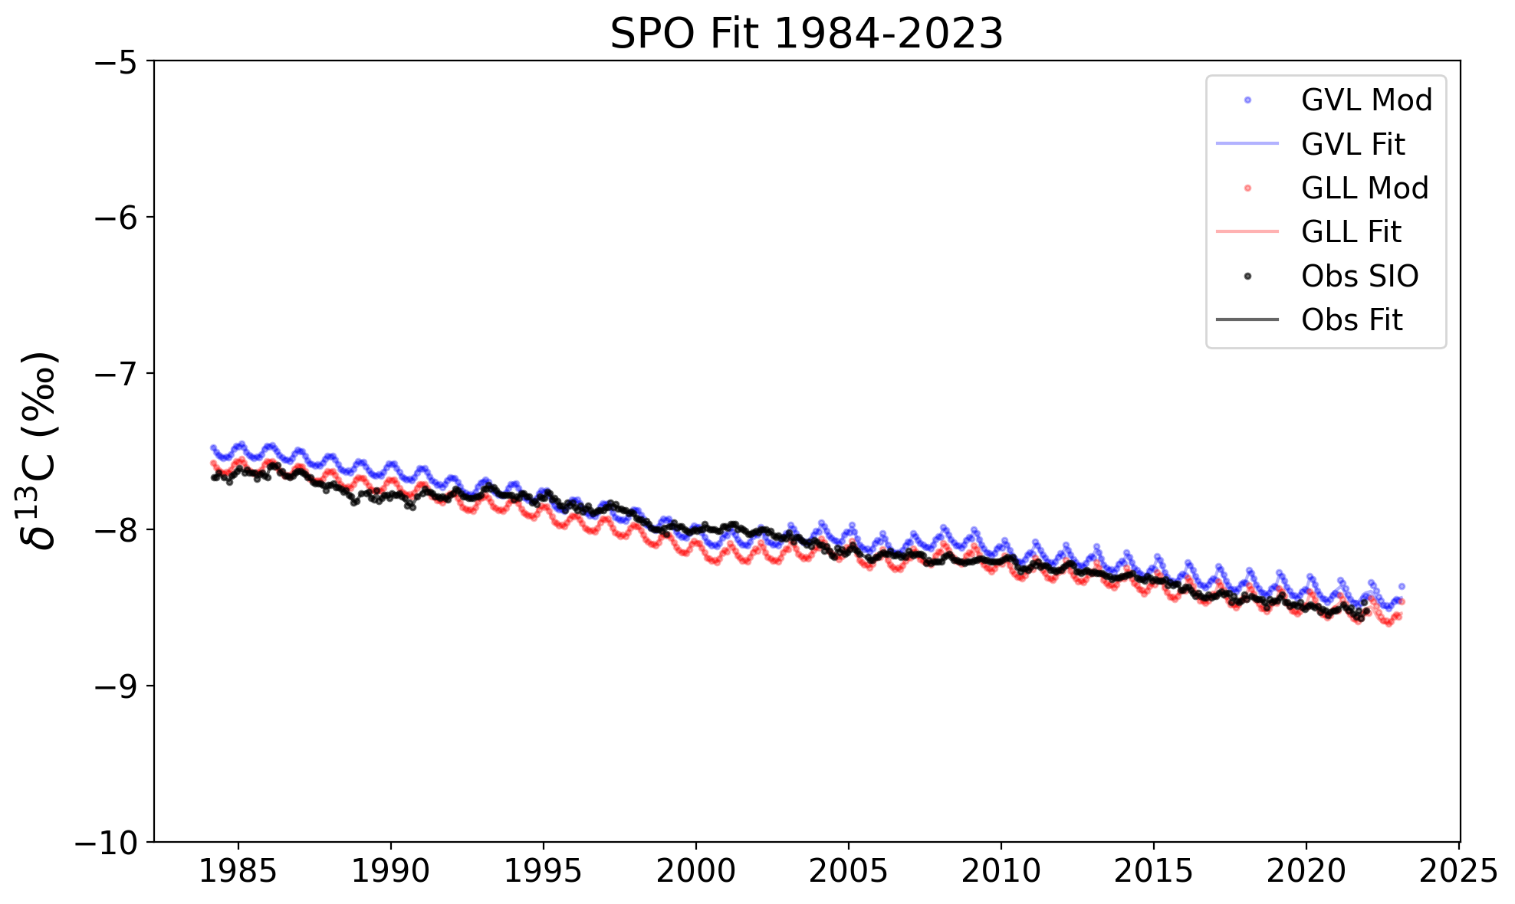
4. Results
A
B
Figure 4. Time series of modeled and observed atmospheric CO₂ (A,C,E) and δ¹³C (B,D,F) at ALT, MLO, and SPO. GVL and GLL model cases are compared with observational data. δ¹³C emission variabilities simulated by VISIT and LENS, and ocean models capture the overall interannual variability and long-term trends. The LENS land model simulated uptakes are relatively weak compared to those from VISIT, resulting in higher growth compared to the observed concentrations (Observational data source : SIO/UCSD).
C
D
E
F

Slide 6
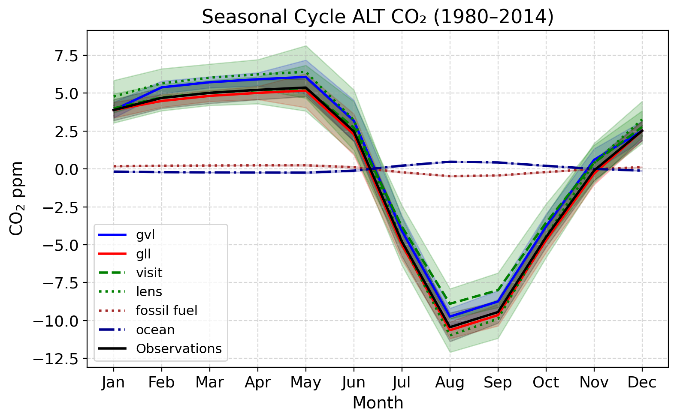
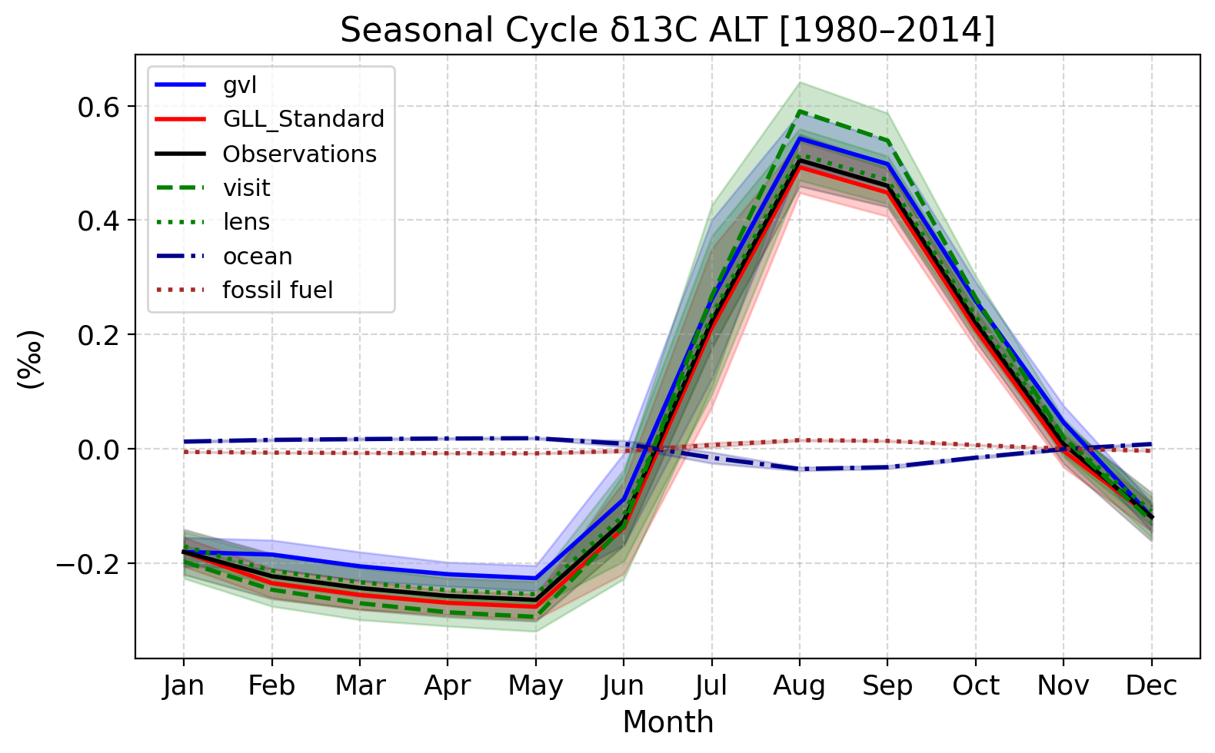
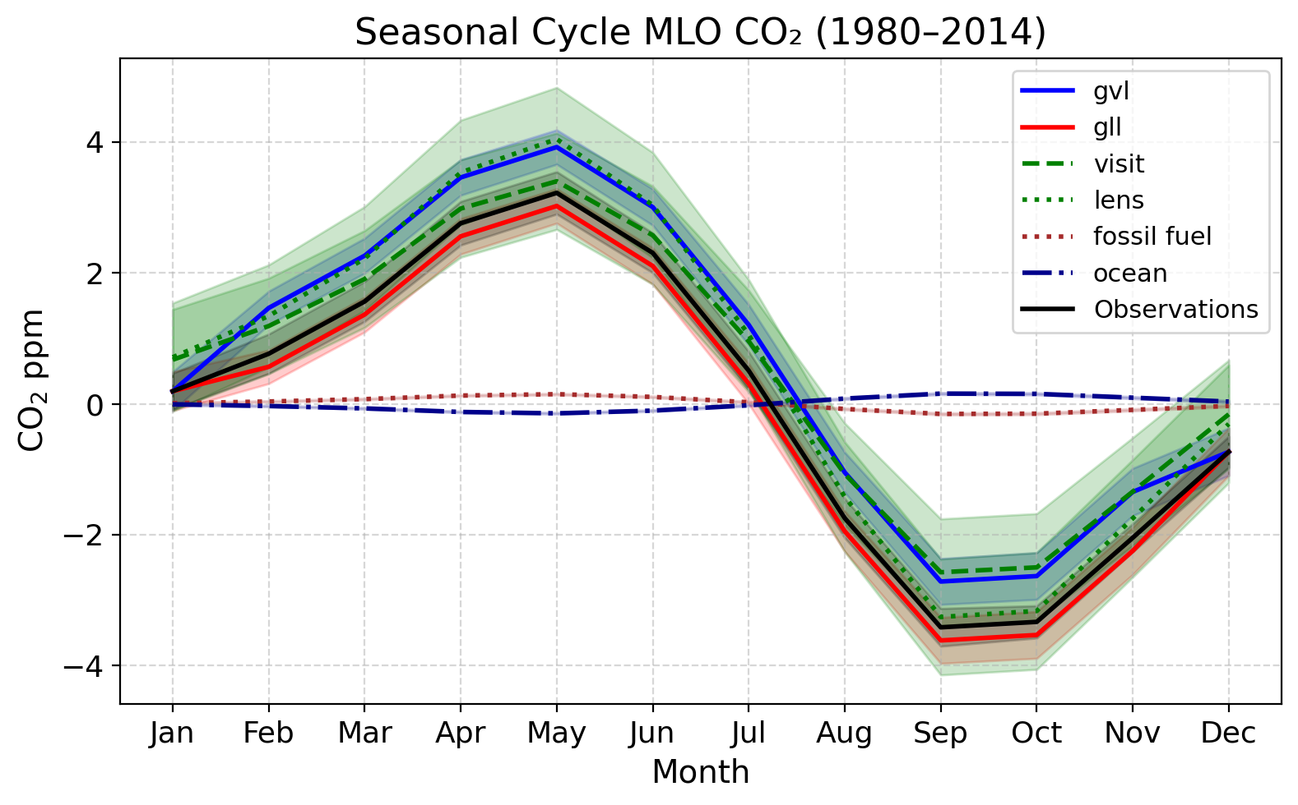
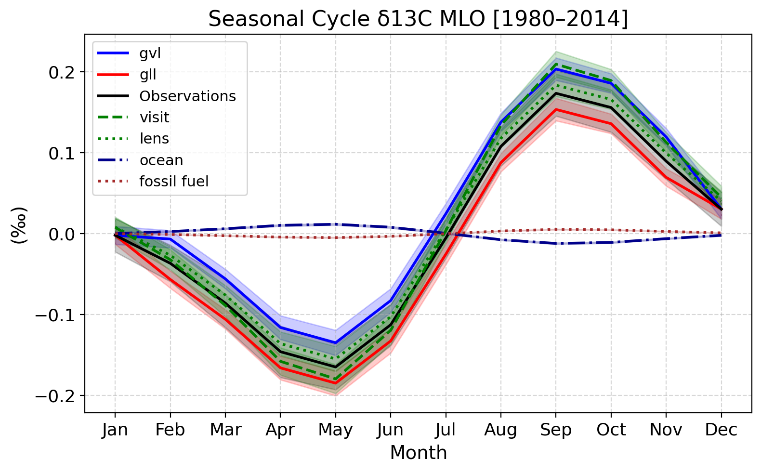
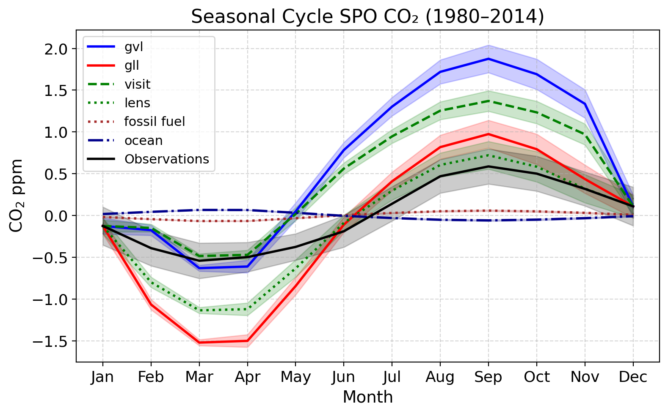
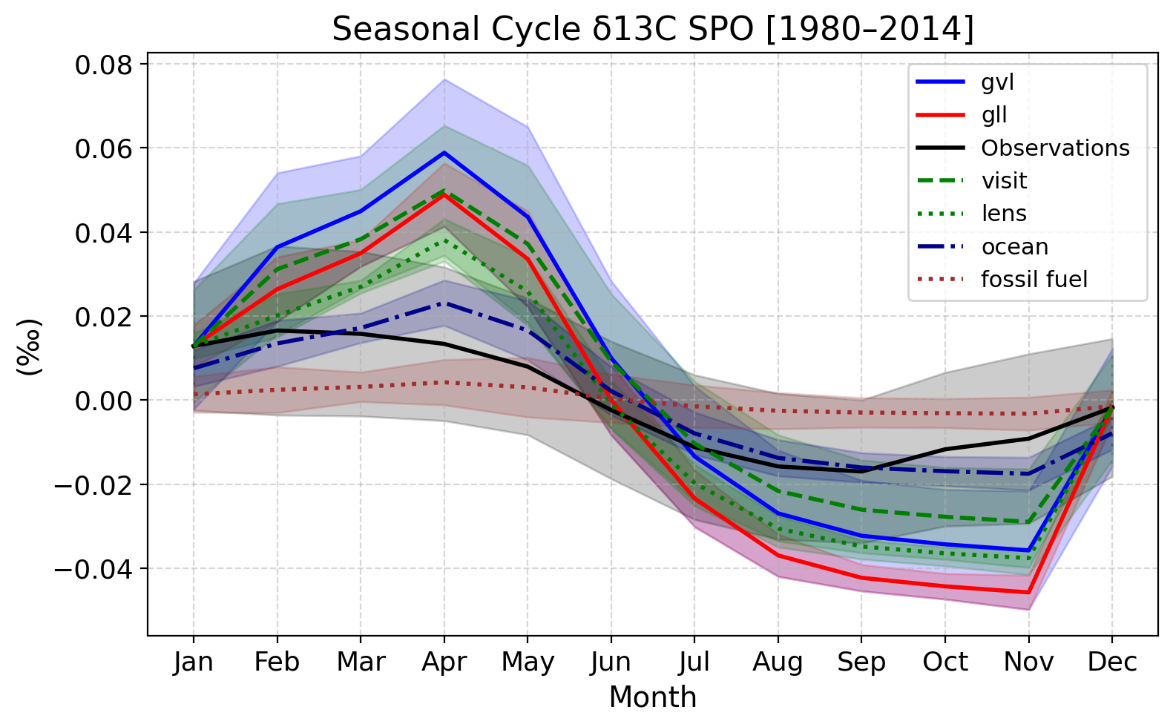
4. Results
(a)
(b)
Figure 5. Simulated seasonal cycles of CO₂ (a-c) and δ¹³C (d-f) at ALT, MLO and SPO (averaged over 1980–2014) are compared with observations (similar to Joos et al., 2025). Models capture key seasonal features, though δ¹³C at MLO reveals greater sensitivity to flux combinations than those at ALT or SPO (note the variable y-axis range), highlighting regional differences in biosphere–ocean interactions and atmospheric transport representations. Shaded areas denote ±1σ variability (Observational data source : SIO/UCSD).
(c)
(d)
(e)
(f)

Slide 7
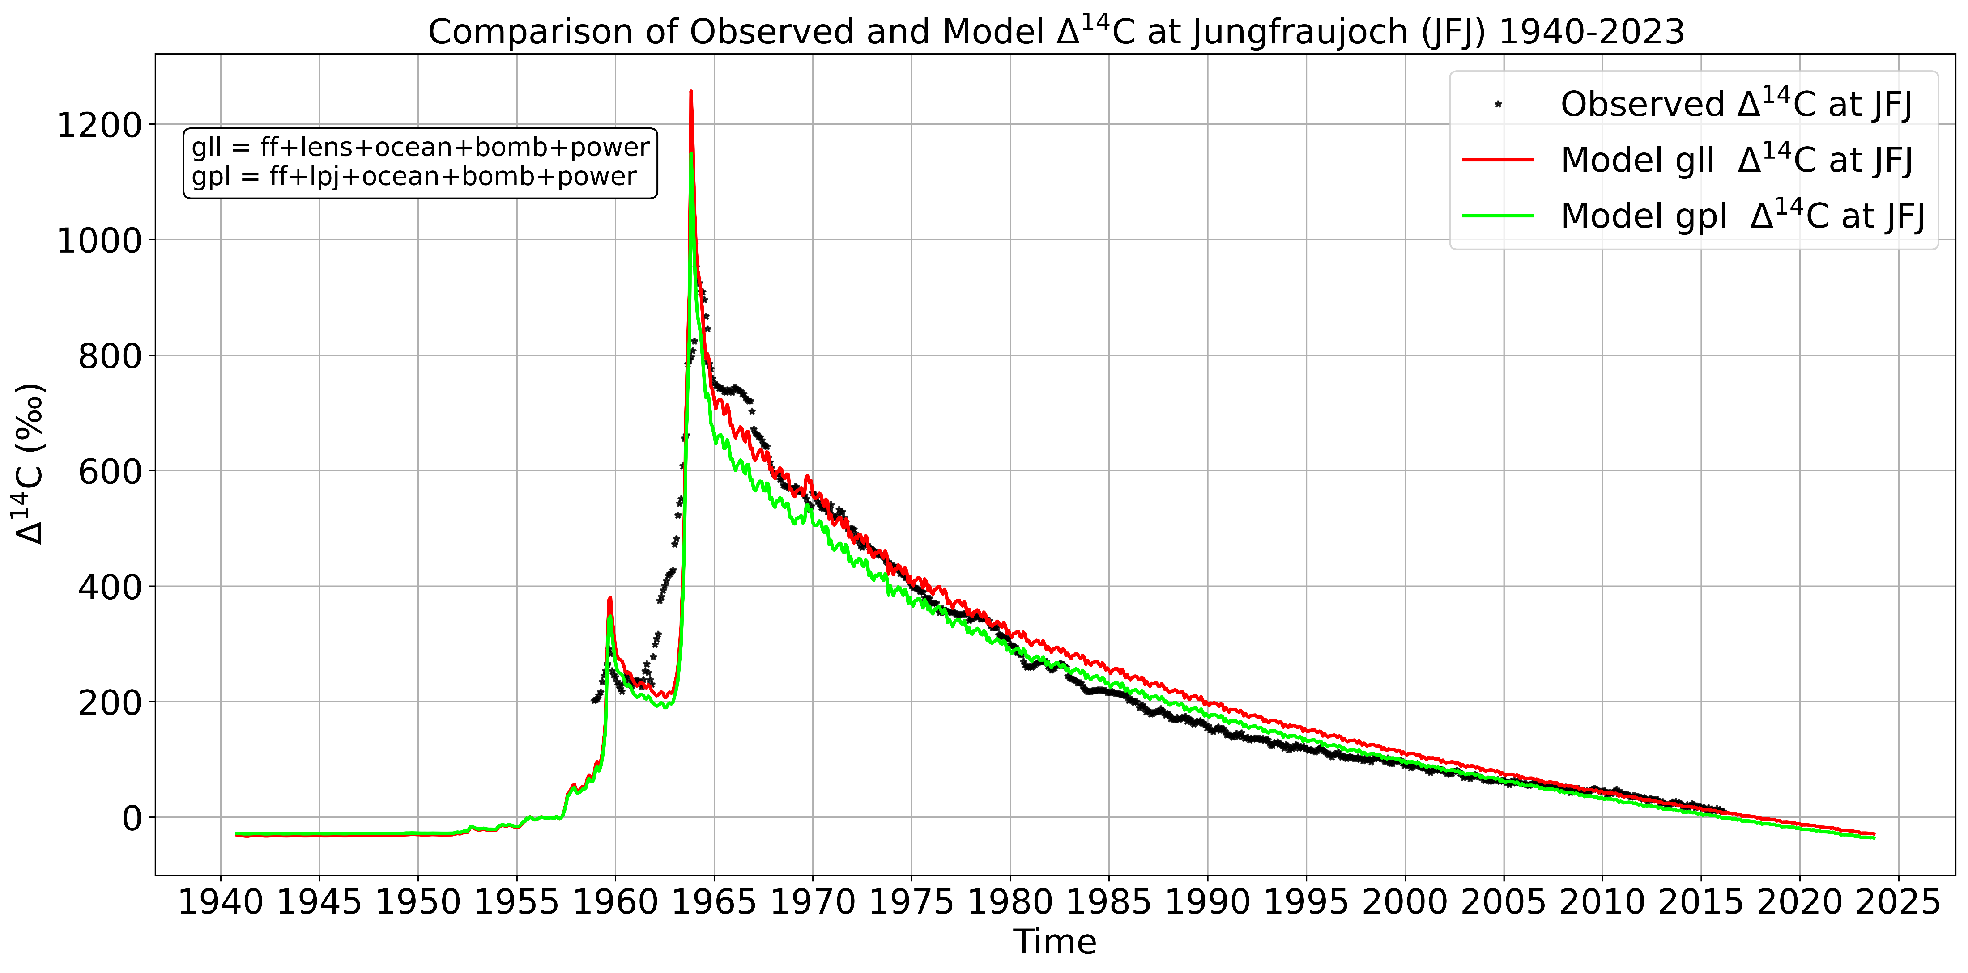
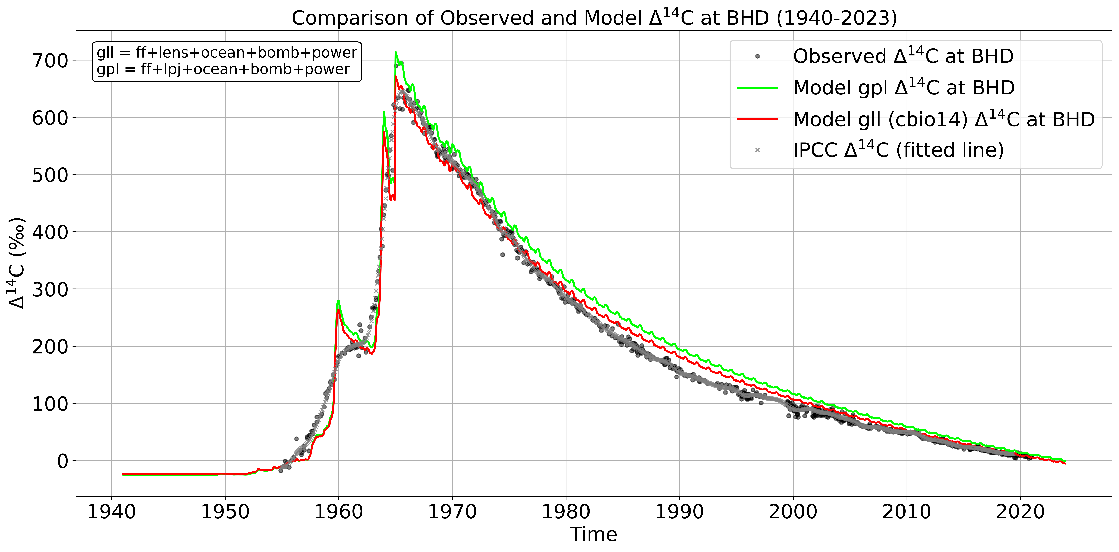
4. Results
A
Figure 6. Observed and modeled Δ¹⁴C at Jungfraujoch (JFJ) (A) and Baring Head (BHD) (B) from 1940 to 2020. Both gll and gpl simulations reproduce the atmospheric bomb peak and decline reasonably well, with the gll flux combination providing improved agreement with observations at BHD in recent decades compared to the gpl flux combination (ICOS/Levin et al. (2021); NIWA/Turnbull et al. (2007)).
B

Slide 8
5. Conclusion
We have collected and analysed monthly-mean ¹³C and ¹⁴C fluxes between atmosphere, biosphere, ocean, fossil fuel burning and nuclear emissions, and MIROC4-ACTM simulations are performed from 1940 to 2023 (Fig. 4).
Our results show significant model-observation agreement; however, fine details in the model fluxes have to be improved for better explanation of the events imprinted in the observed time series, e.g., (1) the cause of greater model seasonal cycle at SPO (Fig. 5), (2) trends in CO₂ and δ¹³C seasonal cycles, (3) better representation of Δ¹⁴C during 1955-70 (Fig. 6).
The model flux combinations reveal that the gvl case provides better agreement for CO₂ and δ¹³C observations (Fig. 4), capturing both seasonal and long-term variations. In contrast, gll case shows closer match with observations of for Δ¹⁴C at JFJ and BHD (Fig. 6).

Slide 9
References
G. Danabasoglu et al., J. Adv. Model. Earth Syst. 12, e2019MS001916 (2020).
M. Scholze, P. Ciais, M. Heimann, Global Biogeochemical Cycles 22, GB1009 (2008)
A. Ito et al., Earth Syst. Dynam. 10, 685–709 (2019)
H. Graven et al., Global Biogeochemical Cycles 34, e2019GB006170 (2020).

Slide 10
Acknowledgements
This research is supported by the Environment Research and Technology Development Fund (JPMEERF24S12205) of the Environmental Restoration and Conservation Agency provided by Ministry of the Environment of Japan. We thank Akihiko Ito for VISIT model fluxes, Charlie Koven and Heather Graven for LENS model fluxes, NIWA, ICOS and Keeling research group at SIO/UCSD for atmospheric measurements.

Slide 11
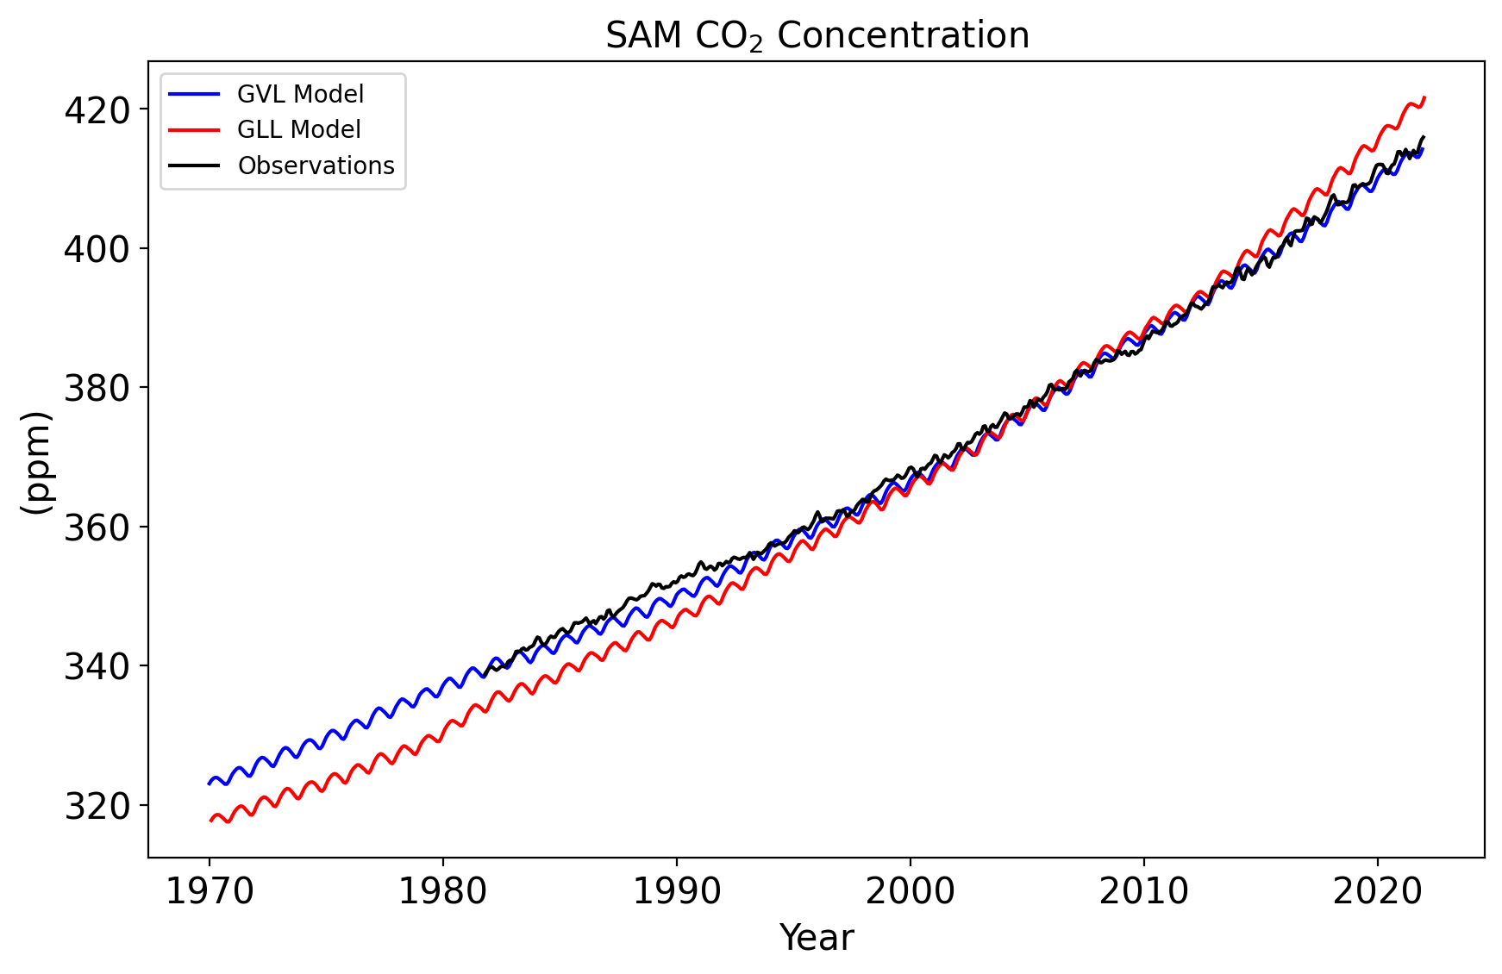
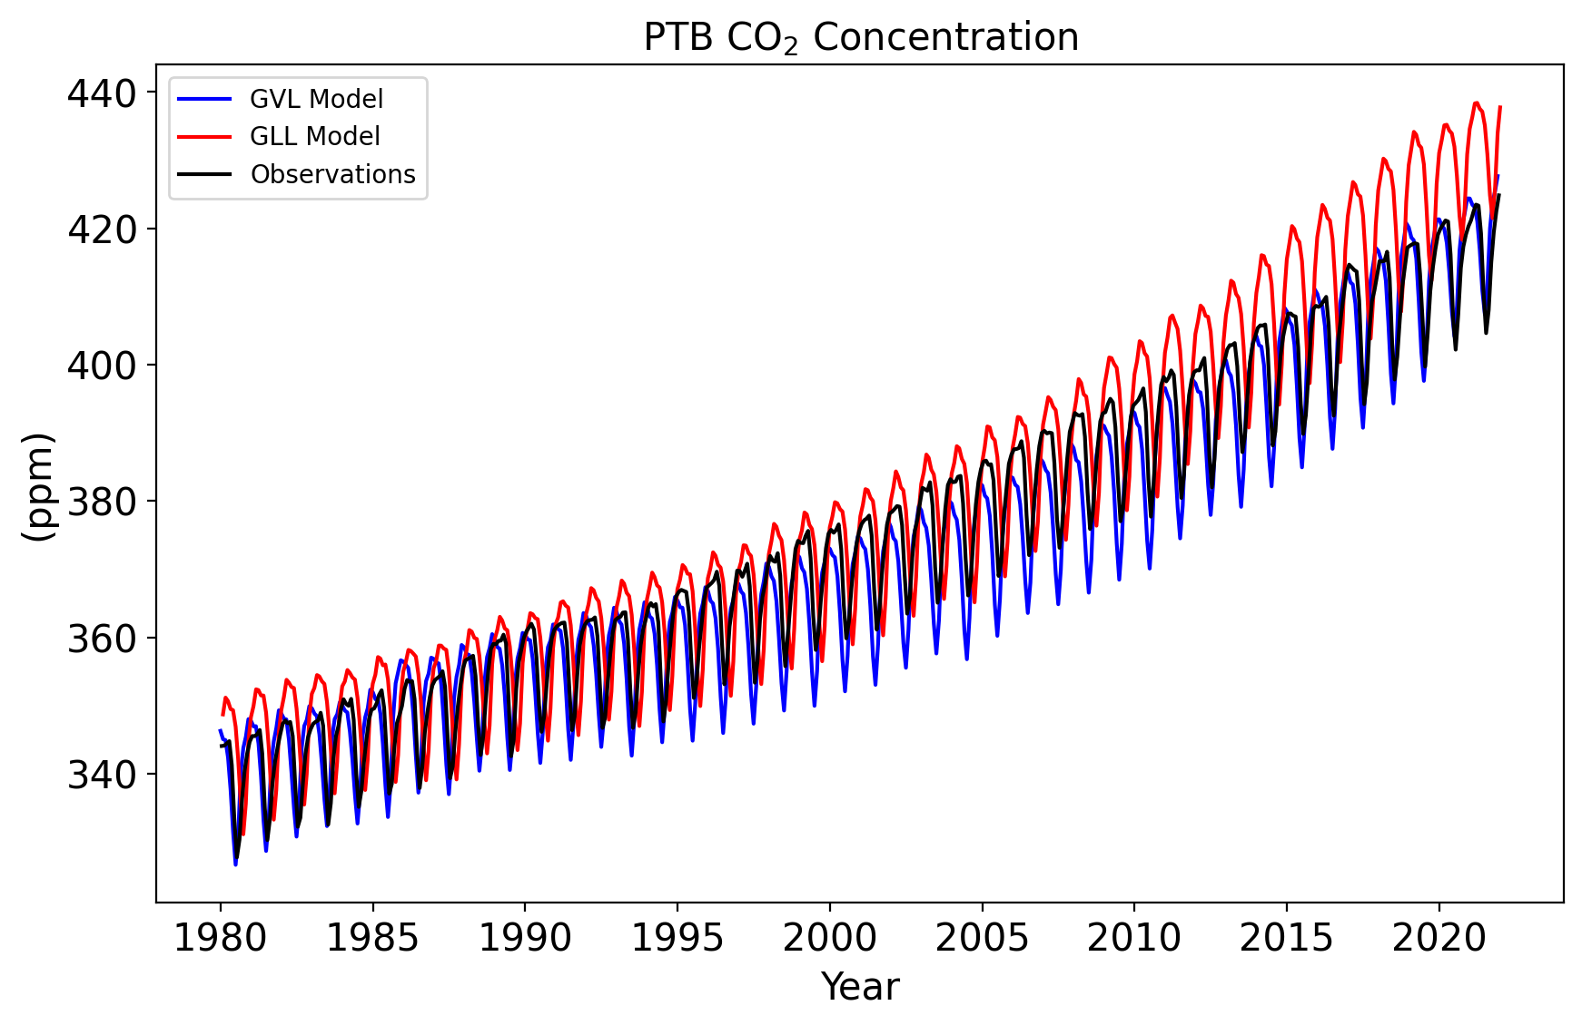
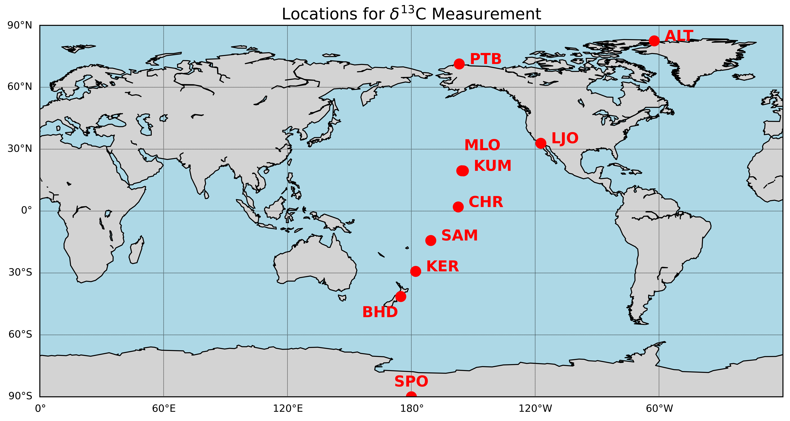



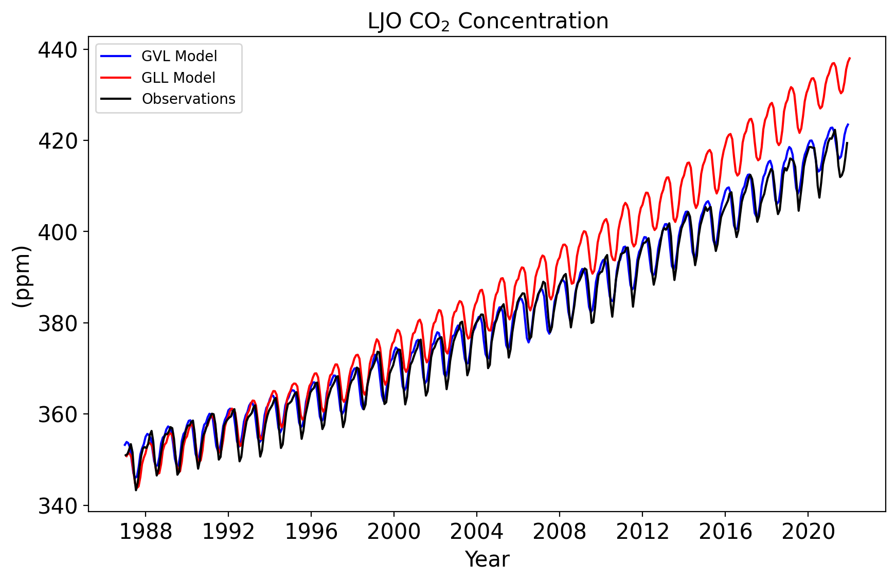

Results (CO₂) (Validation)

Slide 12
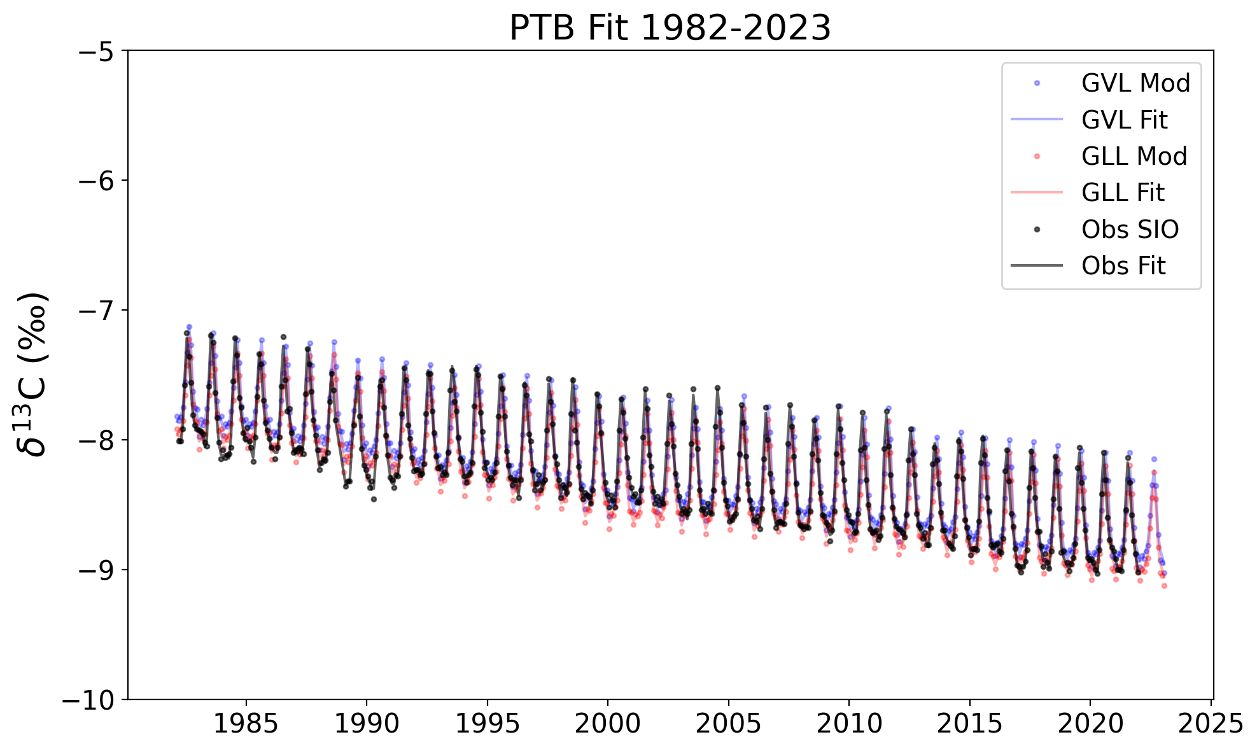
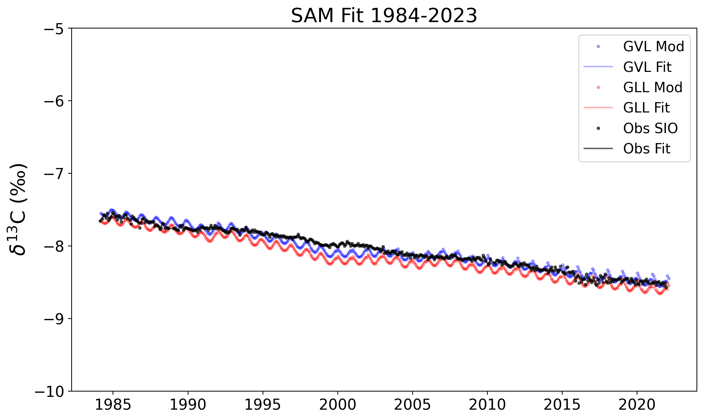
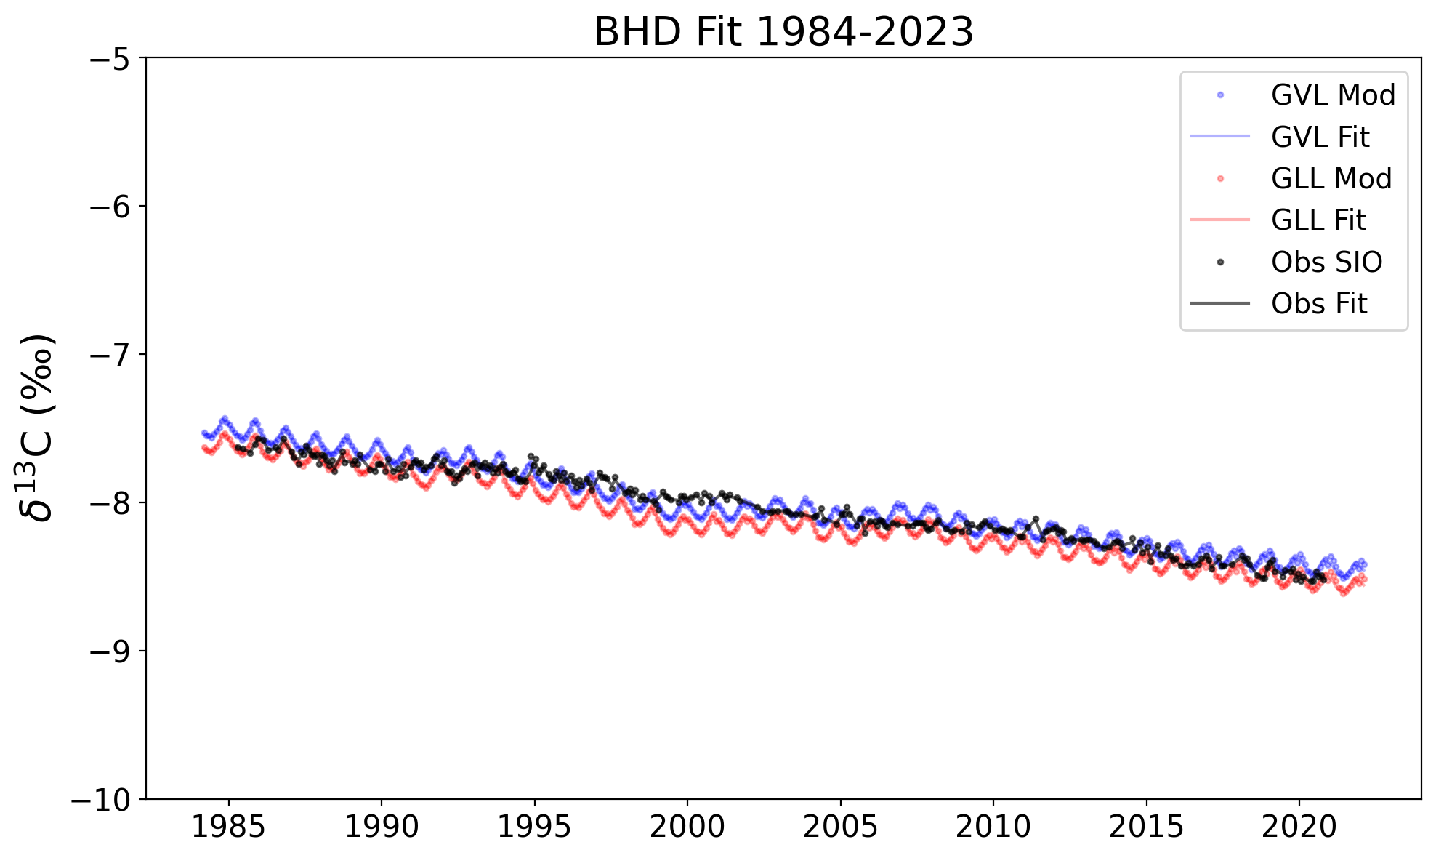
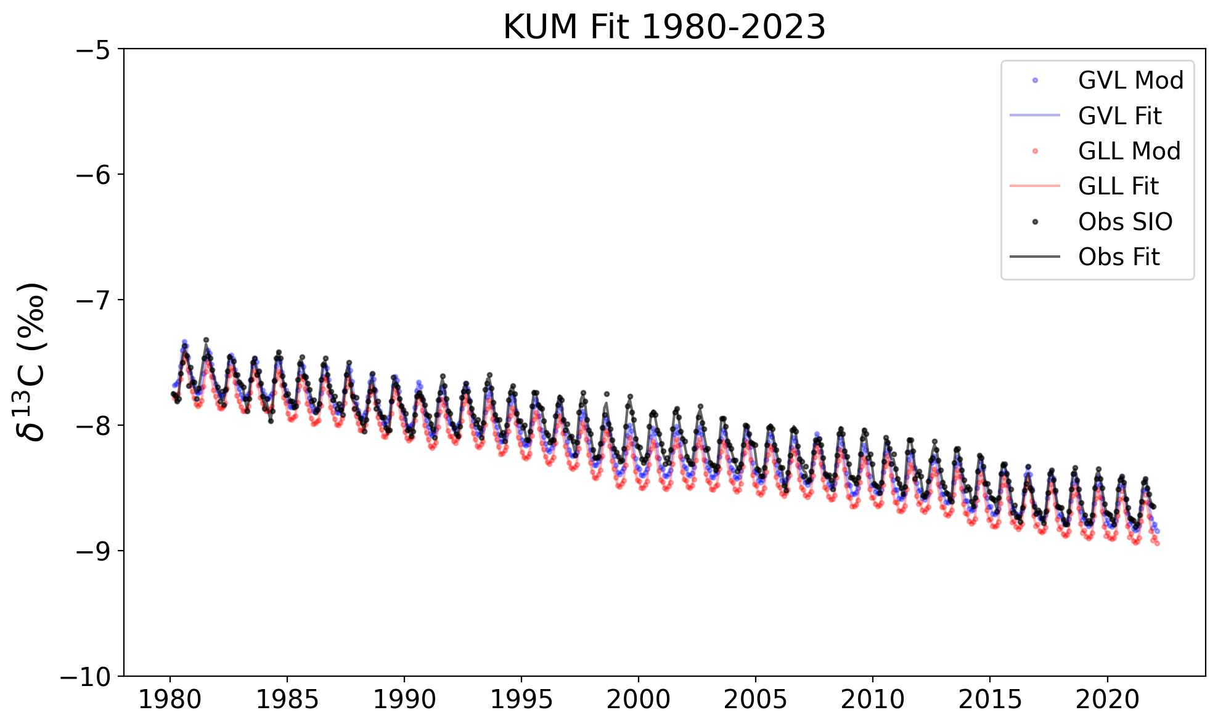
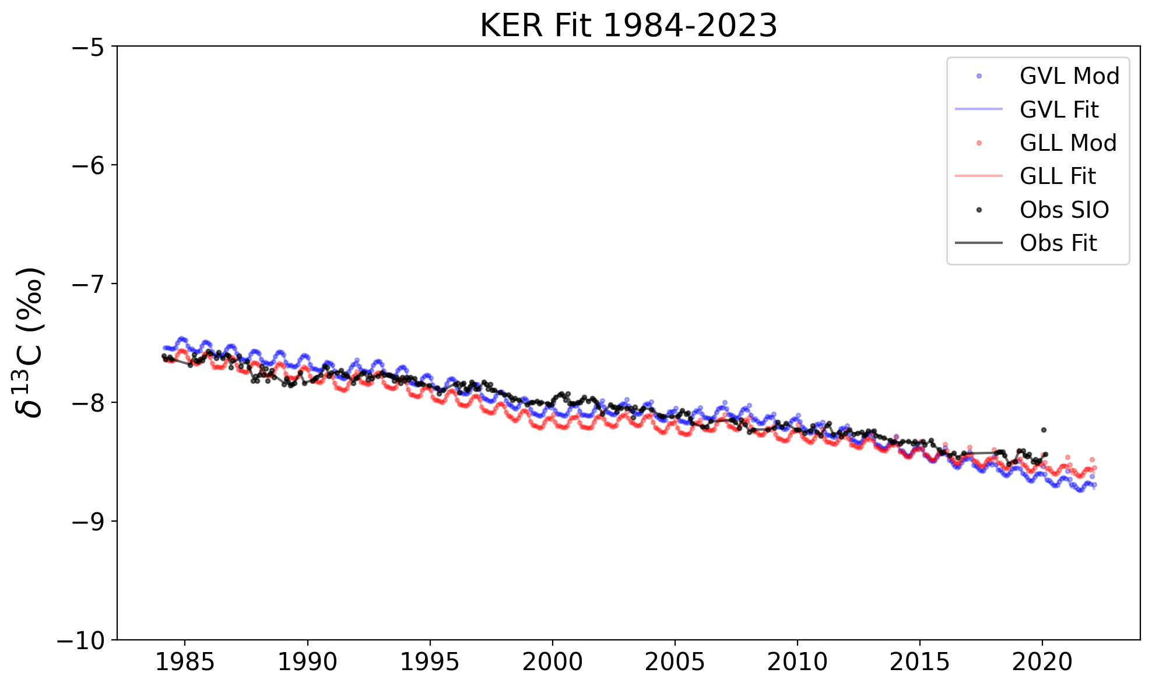
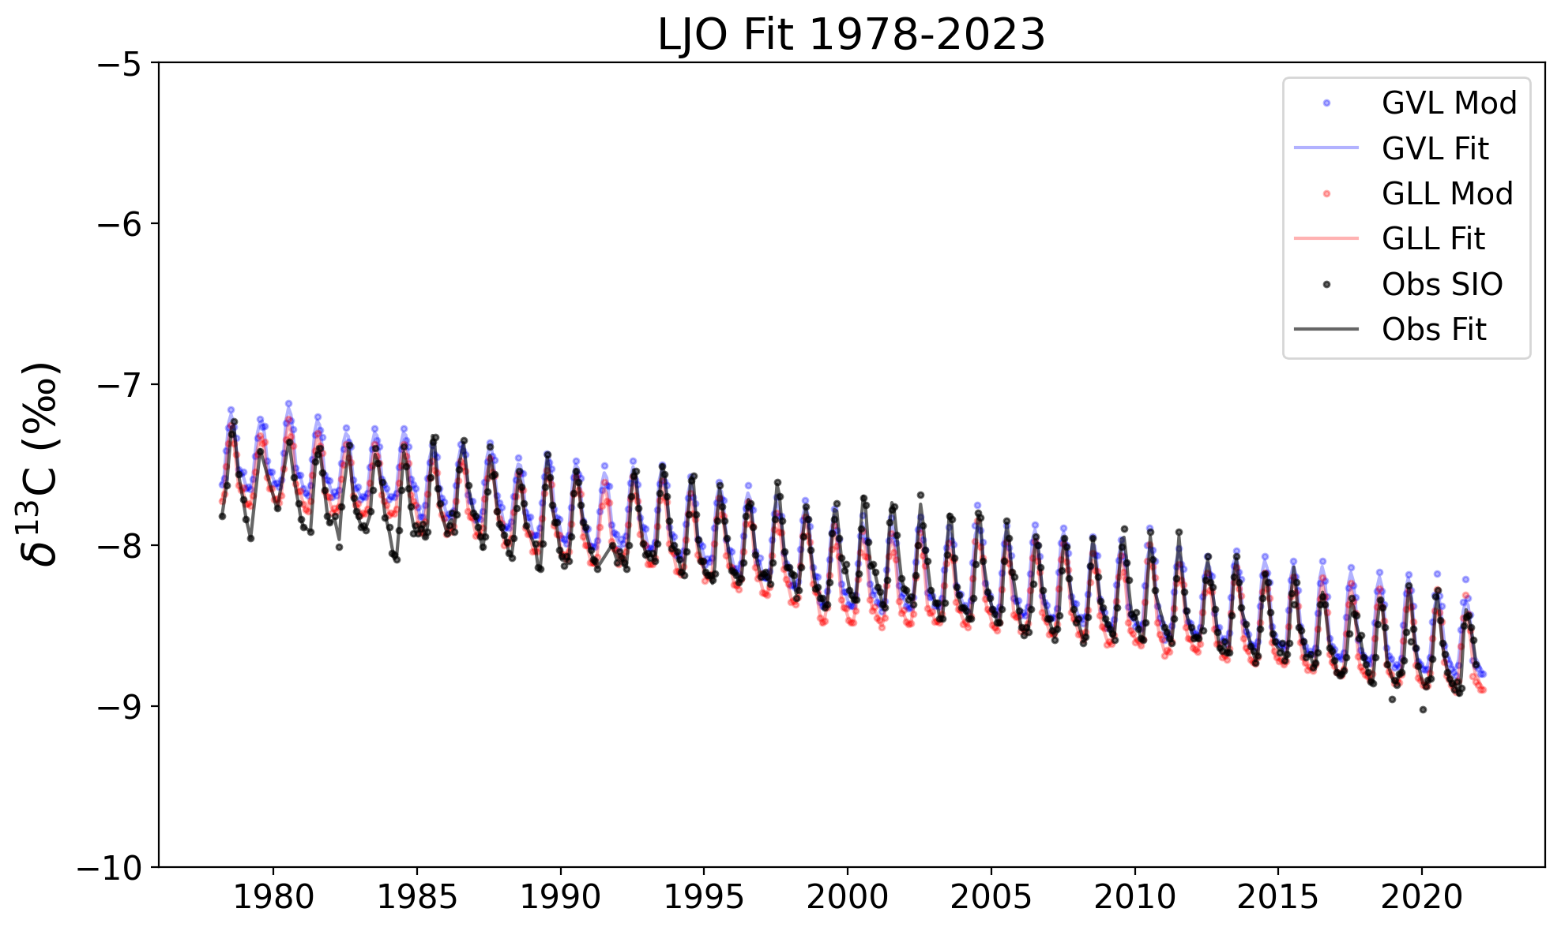
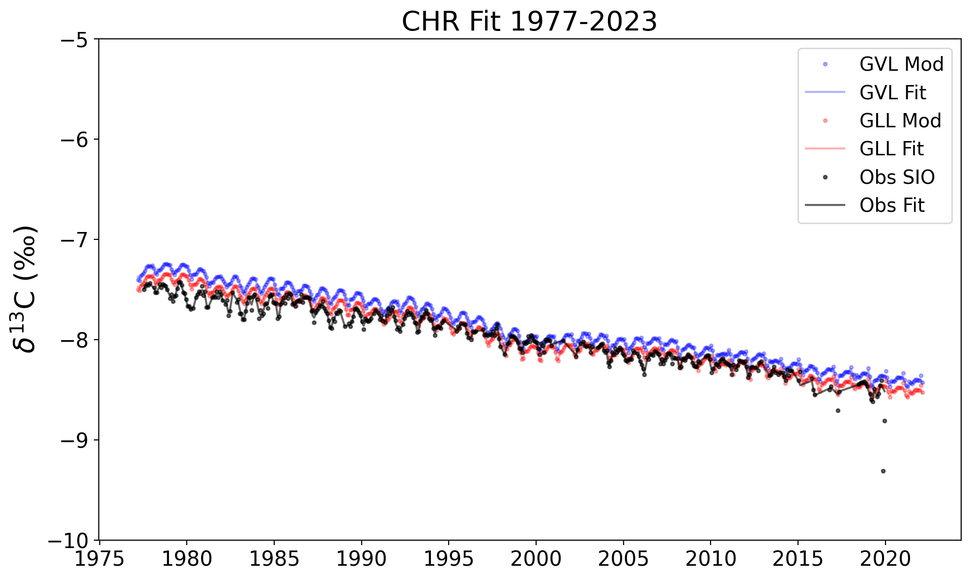
Results (¹³C ) (Validation)

