Slide 1



Sensitivity and Identification of Cloud Phases in the Solar Spectral Bands:
Assessment using Dual-View Satellite Observations
Kameswara S. Vinjamuri, Marco Vountas, Vladimir Rozanov, Luca Lelli, Hartmut Bösch, John P. Burrows (FRS)

Slide 2


Outline
Introduction/Motivation
Physical principles/Instrument involved
  Sensor envisaged for practical use : SLSTR
  Spectroscopic difference
  Phase function difference
Theoretical radiative transfer sensitivity
Validation
  CS 2B-CLDCLASS-LIDAR
  Results
Conclusion

Slide 3
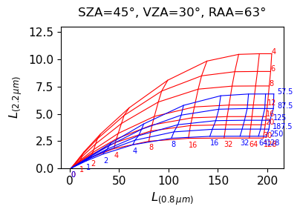
Introduction
Cloud phase (liquid, ice, mixed) plays a major role in Earth's radiative balance by controlling how solar radiation is scattered and absorbed.
Passive remote sensing in the solar spectral bands faces persistent challenges:
  Overlapping optical properties of water and ice.
  Ambiguities by mixed-phase clouds (MPC)
  Surface reflectance interfering with cloud signal (e.g., snow/ice)
Water (red), Ice (blue) clouds at varying optical thickness and effective radii/max. dimensions
Most existing techniques rely on single-view observations, which lack angular information - limiting their ability to confidently detect MPC.
This highlights the need for a novel and robust phase discrimination approach.

Slide 4
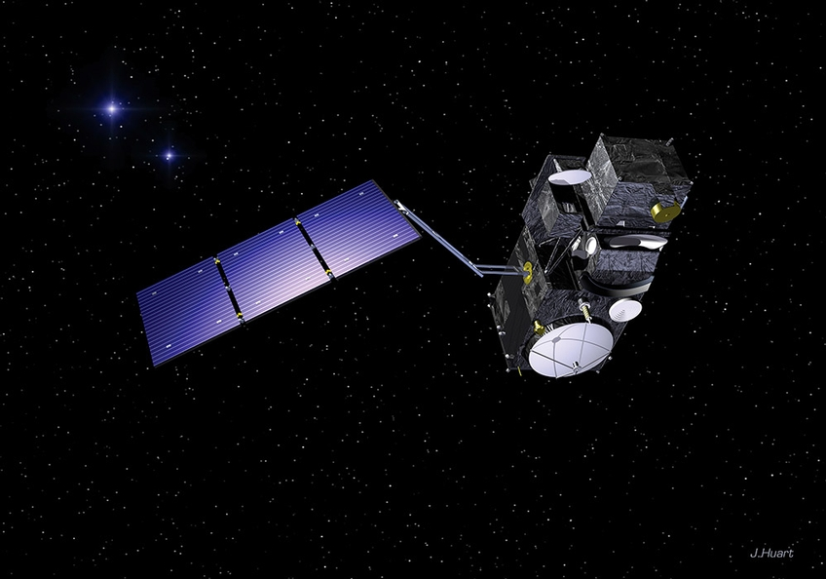
Sensor
SLSTR: Sea and Land Surface Temperature Radiometer
Sentinel-3A: Launched on 16 February 2016
Dual-view geometry: Nadir and oblique angles (~55°)
Specifications
  Sun-synchronous, polar
  Global Coverage: Every 4 days
  0.87 µm, 1.61 µm, 2.25 µm
  500 m (VNIR/SWIR bands)
  1400 km (nadir), 700 km (oblique)
Sentinel-3 satellite showing SLSTR instrument (Source: S3 SLSTR Instrument – https://sentiwiki.copernicus.eu/web/s3-slstr-instrument)
Notes:
For the SLSTR: https://sentiwiki.copernicus.eu/web/s3-slstr-instrument (Original Fig Caption: Artist's impression of Sentinel-3 satellite. The two curved baffles which form part of
the SLSTR instrument can be seen on the underside of the satellite.)
For CALIPSO-CloudSat:
https://www.eoportal.org/satellite-missions/calipso#calipso-cloud-aerosol-lidar-and-infrared-pathfinder-satellite-observations
original captions 1st: Artist's rendition of the CALIPSO spacecraft (image credit: CNES), 2nd: In February 2018, facing a mechanical challenge, CloudSat (pictured in background) had to exit the A-Train, or afternoon constellation, of Earth-orbiting satellites, and move to a lower orbit. Following an exit maneuver of its own in September, CALIPSO (foreground) has joined CloudSat, forming what NASA scientists are calling the C-Train (image credit: NASA)

Slide 5
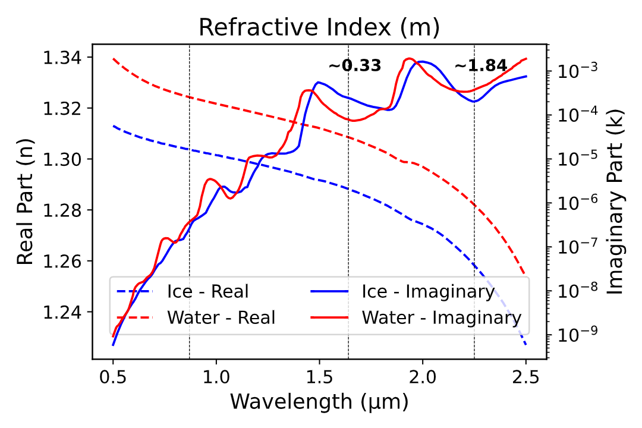

Spectroscopic Difference
Spectral refractive index of water and ice
At 0.87 µm, both water and ice show low absorption (k), making it a scattering-dominated spectral band.
At 1.6 µm, ice absorbs more strongly than water; at 2.2 µm, water absorbs more than ice.
NIR ratio
Absorption in NIR arises from vibrational overtones and combination bands of O–H bonds, controlled by the imaginary part of refractive index 𝑘(𝜆).
The real part (n) relates to scattering
Key differences at 1.61 µm and 2.25 µm support phase separation.

Slide 6
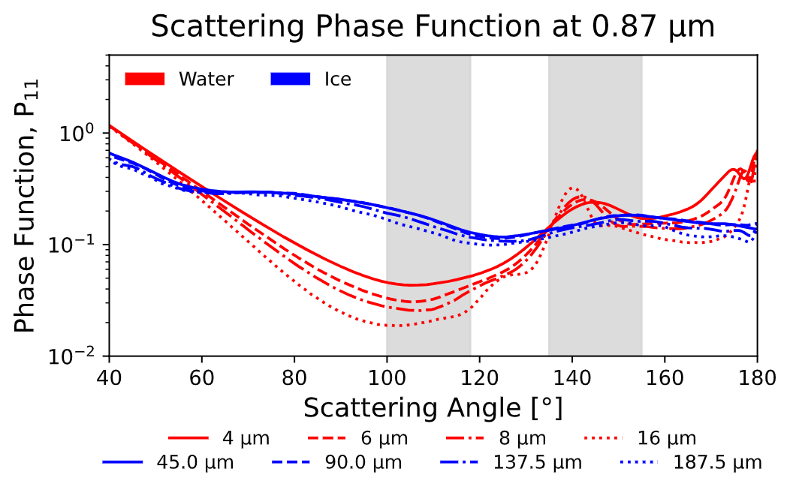
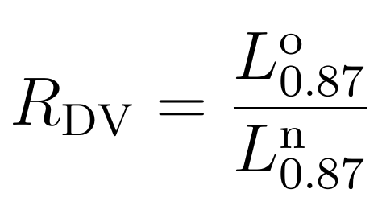
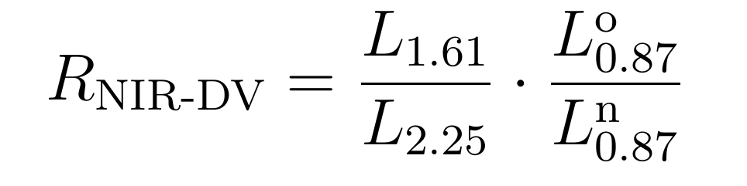
Phase Function Differences
Water clouds exhibit smoother, more isotropic scattering
Ice clouds display pronounced angular features especially strong forward and side scattering.
Dual-View ratio
Using the two ratios mentioned, the NIR-dual ratio is formulated, which includes both absorption and angular scattering for increased sensitivity
Scattering phase function at 0.87 µm
Water side-scatters less; ice shows strong forward and side scattering. This angular contrast supports dual-view phase detection

Slide 7
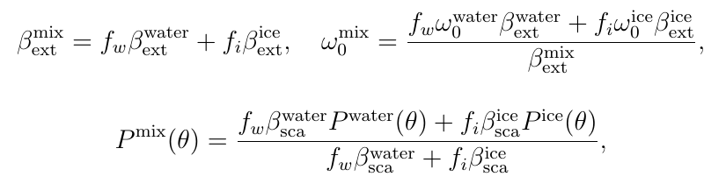
SCIATRAN Parametrization
Simulations performed using SCIATRAN
  Water, ice, and mixed-phase (MPC)
  Water-Mie theory, ice-Yang database.
  COD 1, 3, 5, 10, 15, 20, 30, 50, 80
  Liquid clouds radii - 4, 6, 8, 12, 16 μm
  Ice crystals Max. Dim - 45, 90, 135, 180 μm
  CTH - CBH 2.5 km - 2 km
  The RT runs are made for SLSTR geometries
  Ice fraction - 0.2, 0.4, 0.6, 0.8 (COD_ice ÷ COD_total)

Slide 8
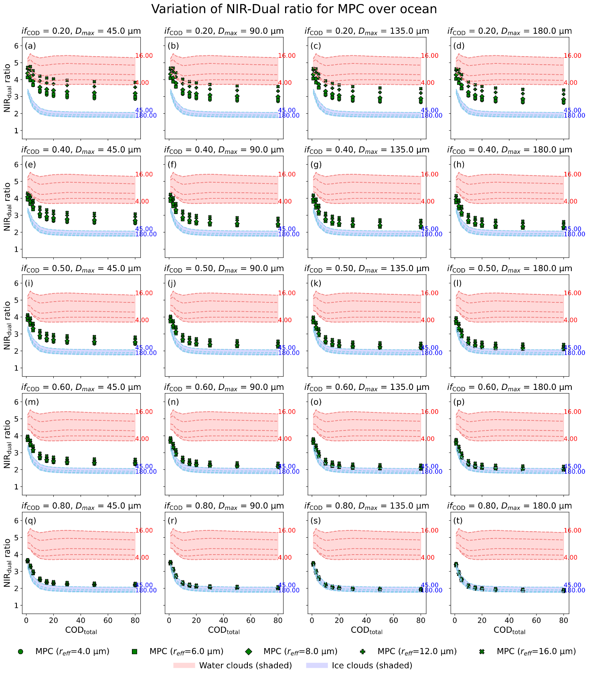
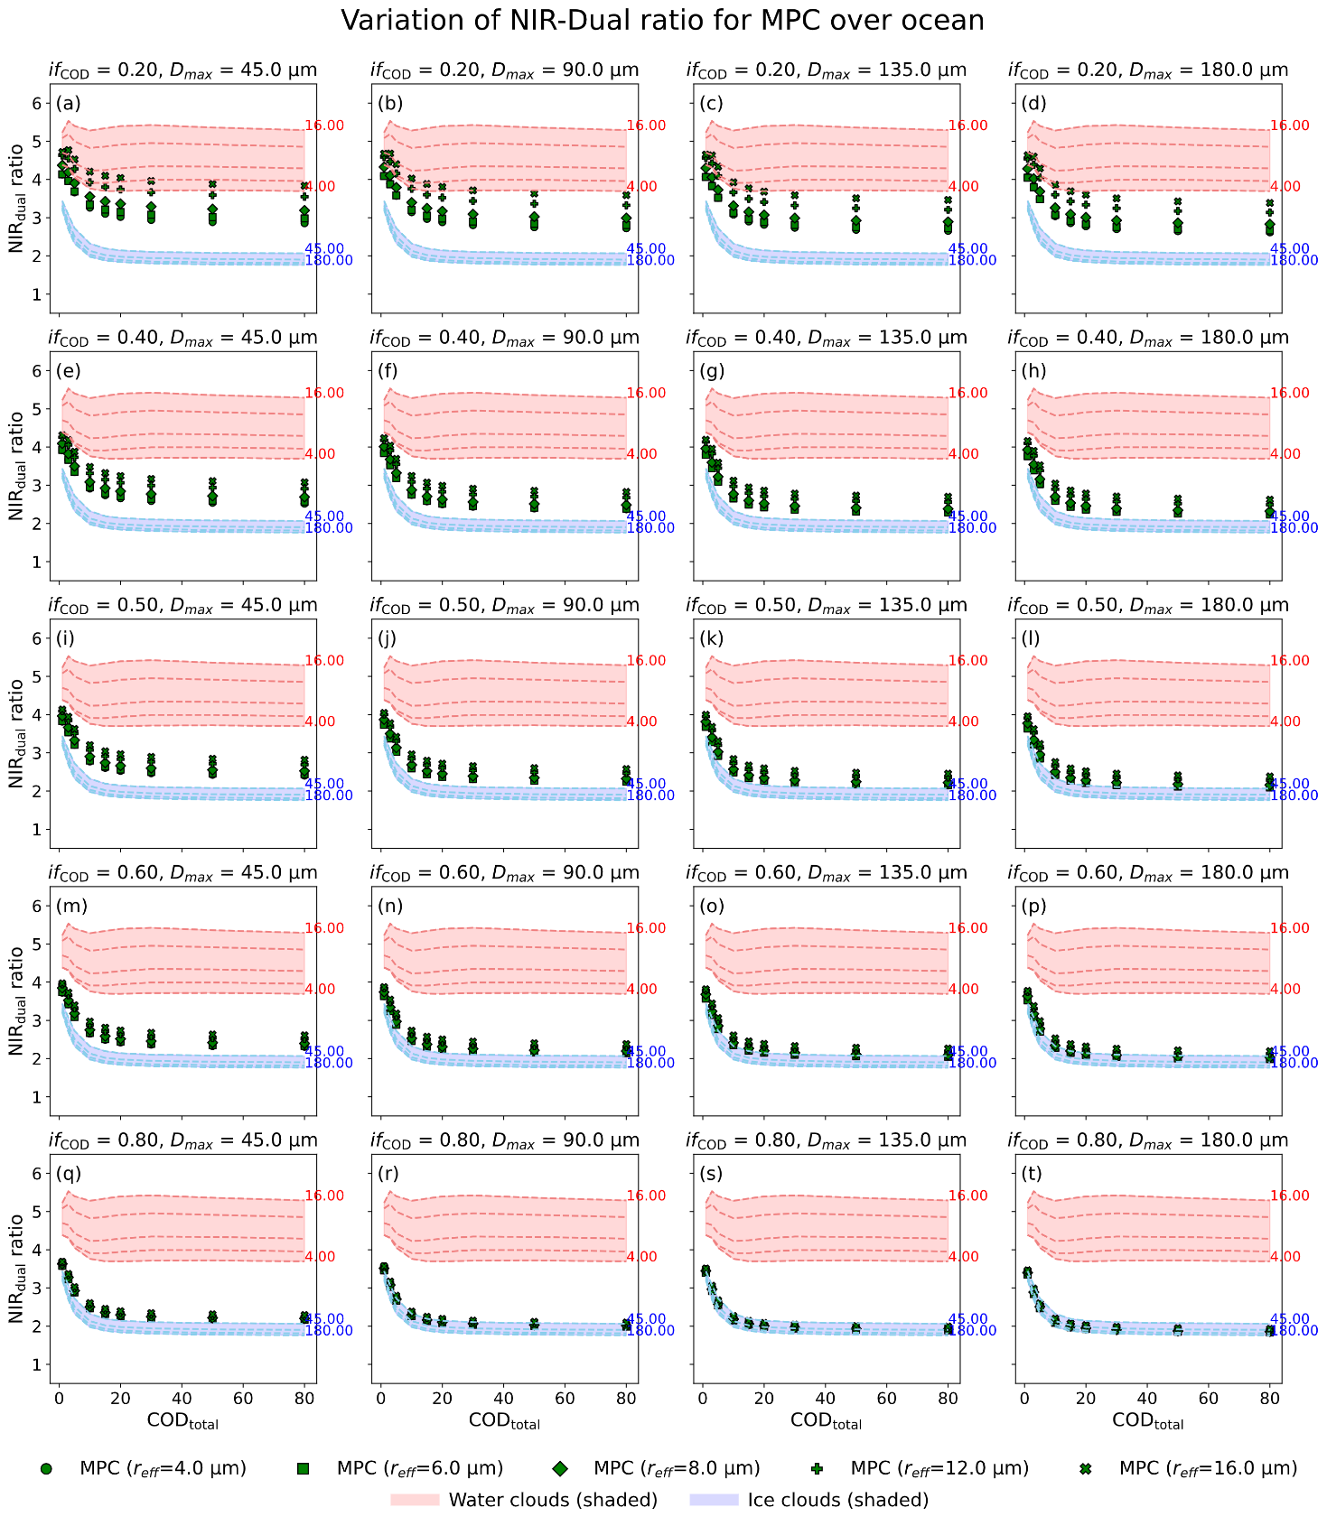
Theoretical Sensitivity Results
<number>

Slide 9
Theoretical Sensitivity Results
<number>

Slide 10
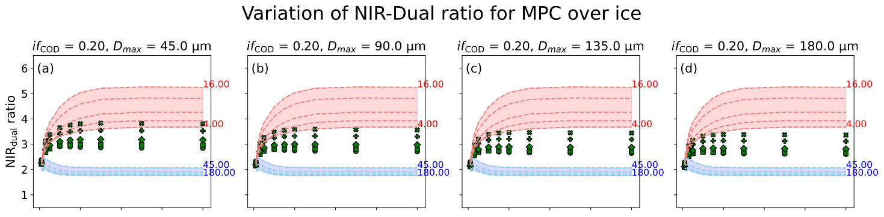
Theoretical Sensitivity Results

Slide 11
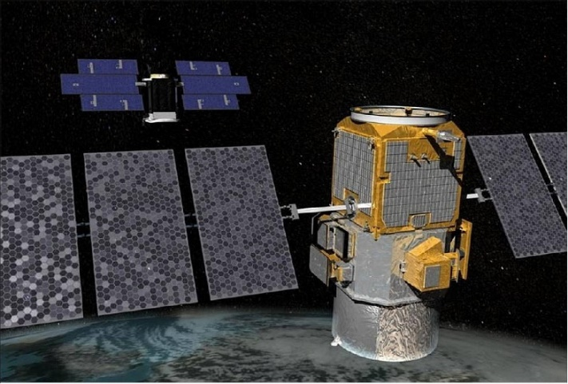
Validation
CS 2B-CLDCLASS-LIDAR GRANULE product is used (Colorado State University (CSU))
CALIPSO (CALIOP):
  Dual-wavelength lidar (532, 1064 nm)
  CloudSat (CPR):
    W-band radar (94 GHz)
  Lidar identifies small liquid droplets, while radar detects larger ice particles, indicating coexistence.
CALIPSO and Cloudsat (upper left) operating together in a lower orbit after leaving the A-Train constellation.
(Image: NASA via eoPortal)-
https://www.eoportal.org/satellite-missions/calipso#calipso-cloud-aerosol-lidar-and-infrared-pathfinder-satellite-observations
https://www.cloudsat.cira.colostate.edu/data-products/2b-cldclass-lidar
Notes:
For CALIPSO-CloudSat:
https://www.eoportal.org/satellite-missions/calipso#calipso-cloud-aerosol-lidar-and-infrared-pathfinder-satellite-observations
original captions 1st: Artist's rendition of the CALIPSO spacecraft (image credit: CNES), 2nd: In February 2018, facing a mechanical challenge, CloudSat (pictured in background) had to exit the A-Train, or afternoon constellation, of Earth-orbiting satellites, and move to a lower orbit. Following an exit maneuver of its own in September, CALIPSO (foreground) has joined CloudSat, forming what NASA scientists are calling the C-Train (image credit: NASA)

Slide 12
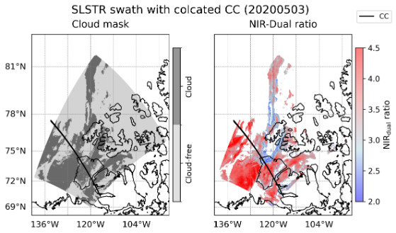
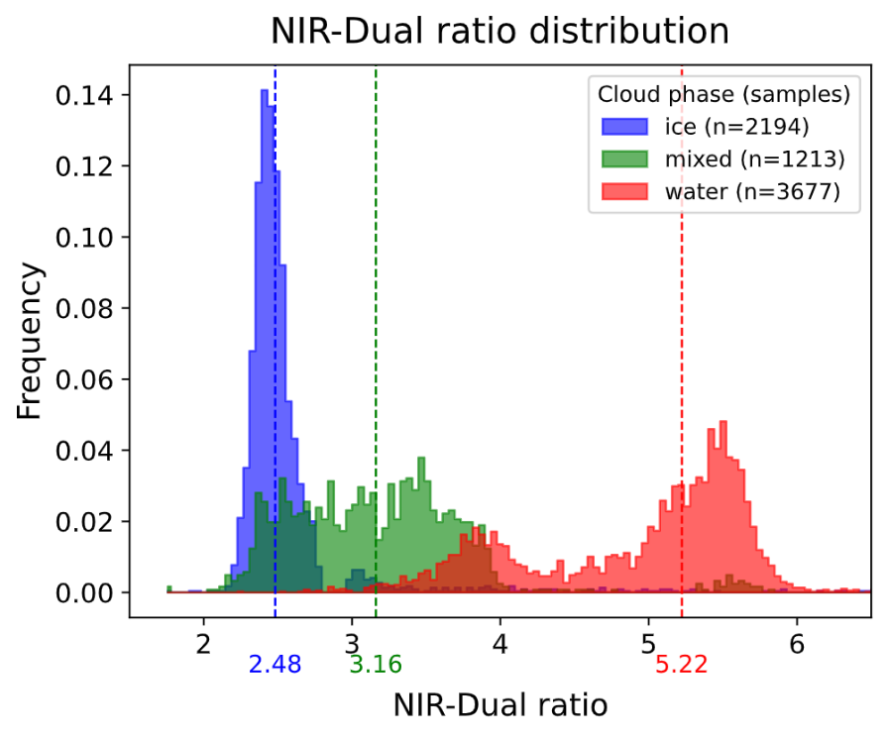
Results
SLSTR observations matched with CC phase data for May 3, 2020 (> 60°N).
Top panel: swath of collocated retrievals for one swath (20200503).
Bottom panel: NIR-Dual View ratio distributions from slstr as classified from CC data (show clear separation).
Water clouds peak near 5, ice clouds near 2.5, mixed-phase span the intermediate range.
Results demonstrate spectral-angular sensitivity for phase classification.
Notes:
Partial overlap reflects intrinsic ambiguity in mixed-phase detection. (I did not keep this sentence because it looked like a general, over-arching comment)

Slide 13
Results
Thresholds
Ice: ratio < 2.7 | Mixed-phase: 2.7–3.5 | Water: ratio > 3.5
Ice and water phases were classified with high accuracy (87% and 92%, respectively).
Mixed-phase clouds were classified with 64% accuracy despite spectral overlap.
Results demonstrate the practical separability of all three phases from solar reflectance data.
Confusion Matrix for cloud phase classification
True Phase | Total Samples | Predicted Ice (%) | Predicted Mixed (%) | Predicted Water (%)
Ice | 2194 | 87.24 | 8.61 | 4.15
Mixed | 1213 | 23.33 | 63.73 | 12.94
Water | 3677 | 0.08 | 8.19 | 91.73
Overall Accuracy |  | 86

Slide 14
Conclusion
Dual-view strategies improve cloud phase sensitivity in passive remote sensing.
The NIR-Dual View ratio captures both spectral and angular scattering differences.
Water and ice clouds are well separated at COD > 10 over both ocean and ice surfaces using the absorption bands alone.
Incorporating the dual-view ratio pushes liquid and ice clouds farther apart in radiance ratio space, thereby opening a distinct region for identifying mixed-phase clouds.
There are MPC cases where it is highly challenging to separate from water and ice radiatively
Validation confirms the method’s effectiveness for satellite-based classification.

Slide 15
References
A. V. Rozanov, V. V. Rozanov, A. A. Kokhanovsky, M. Buchwitz, J. P.Burrows, Sciatran 4.0: A versatile radiative transfer model for earthobservation in the uv–vis–nir spectral region, Journal of Quantitative Spectroscopy and Radiative Transfer 240 (2020) 106695. doi:10.1016/j.jqsrt.2019.106695
European Organisation for the Exploitation of Meteorological Satellites (EUMETSAT). (2020).
SLSTR Level-1B Radiometric Products User Guide. EUMETSAT.
https://www.eumetsat.int/website/home/Satellites/CurrentSatellites/Sentinel3/index.html
P. Yang, L. Bi, B. Baum, K.-N. Liou, G. Kattawar, B. Cole, Spectrally consistent scattering, absorption, and polarization properties of atmospheric ice crystals at wavelengths from 0.2 to 100 μm, Journal of Atmospheric Sciences 70 (2013) 330–347. doi:10.1175/JAS-D-12-039.1
Roehrig, M. A., & Marohn, J. A. (1999). Vibrational overtone spectroscopy: Fundamentals and applications. Annual Review of Physical Chemistry, 50, 347–373.
https://doi.org/10.1146/annurev.physchem.50.1.347
Sassen, K., Z. Wang, and D. Liu, (2008) Global distribution of cirrus clouds from CloudSat/Cloud-Aerosol Lidar and Infrared Pathfinder Satellite Observations (CALIPSO) measurements, J. Geophys. Res., 113, D00A12, doi:10.1029/2008JD009972
T. Nakajima, M. D. King, Determination of the optical thickness and effective particle radius of clouds from reflected solar radiation measurements, Journal of the Atmospheric Sciences 47 (15) (1990) 1878–1893. doi:10.1175/1520-0469(1990)047<1878:DOTOTA>2.0.CO;2.

Slide 16
Thank you!
I am seeking postdoctoral opportunities and would be delighted to work within your research group, particularly in the following areas:
Atmospheric and surface geophysical retrievals of planetary bodies
Transmission spectroscopy of exoplanetary atmospheres
Questions?
Kameswara Sarma. Vinjamuri
Email id: kamesh@iup.physik.uni-bremene.de
Kameshvinjamuri@gmail.com

Slide 17
Extra Slides

Slide 18
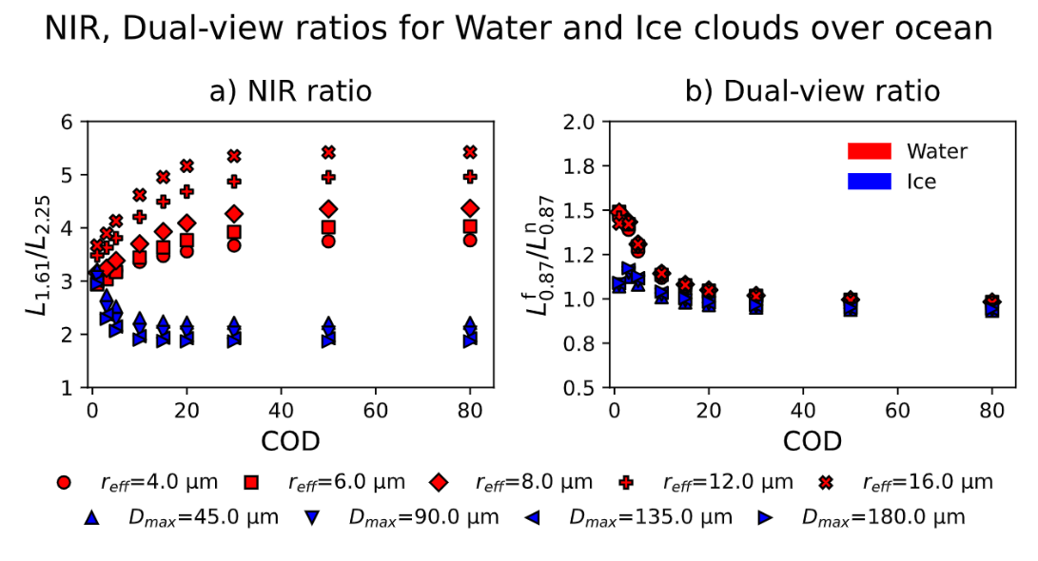
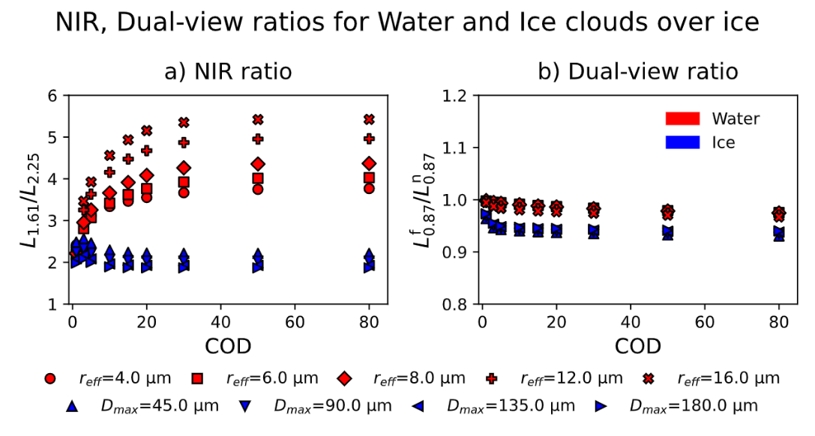
Theoretical Sensitivity Results
Water and Ice Clouds
Water clouds consistently show higher NIR ratios than ice clouds, especially for larger droplets and at COD between 3–40.
Dual-view ratio also separates phases well due to angular scattering differences.
Sensitivity drops at high COD due to multiple scattering.
Notes:
I kept the simple animation of ‘Appear’ because I want it to show that those two pieces of texts are separate.

Slide 19
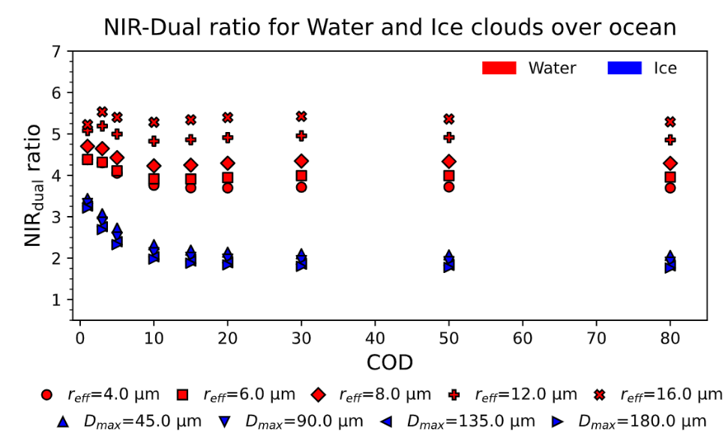
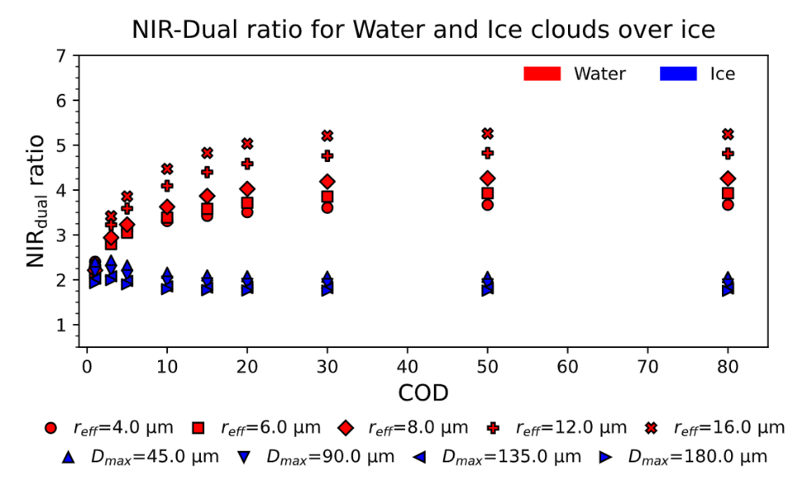
Theoretical Sensitivity Results
Water and Ice Clouds

Slide 20
Theoretical Sensitivity Results
Mixed-phase Clouds

