Slide 1
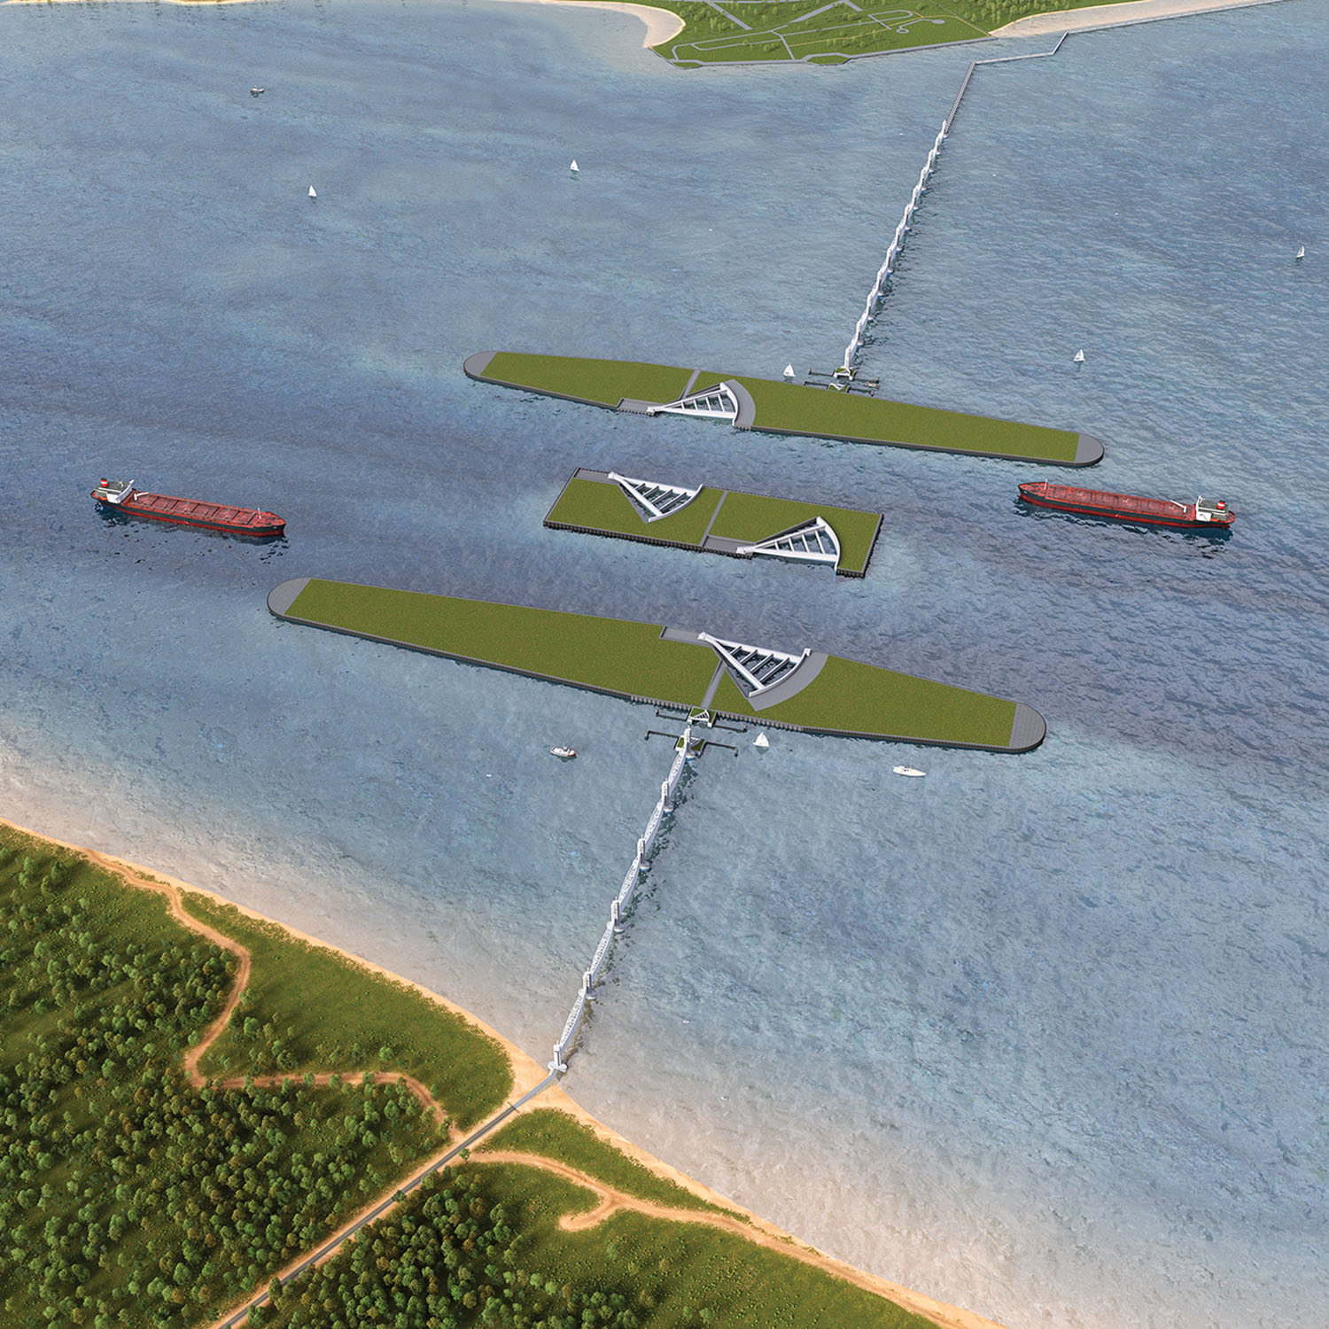




The Role of Estuarine Antecedent Geology in Shaping Marine Geohazards and Storm Surge Infrastructure: A Comparison of the Dutch Maeslant Barrier and the Proposed Bolivar Gate System in Galveston Bay (USA)
Cole Robbins†‡*, Jens Figlus† , and Timothy Dellapenna‡
†‡*Department of Oceanography
Texas A&M University
†Department of Ocean Engineering
Texas A&M University
‡Department of Marine and Coastal Environmental Sciences
Department of Oceanography
Texas A&M University

Slide 2
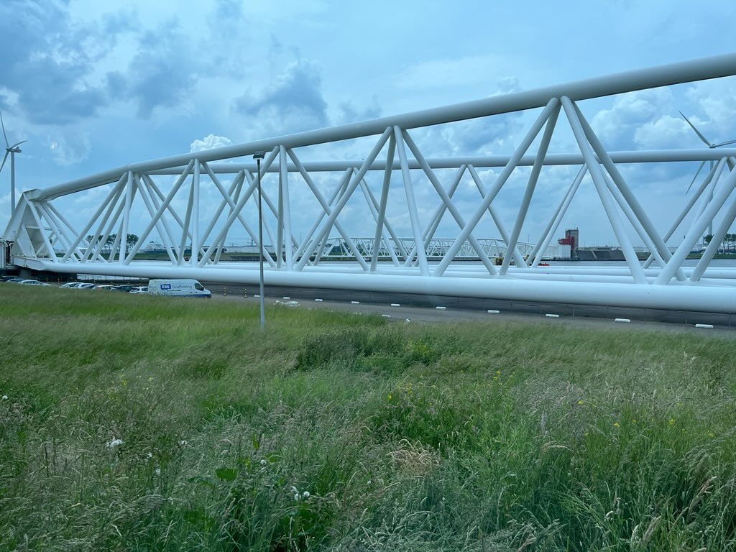
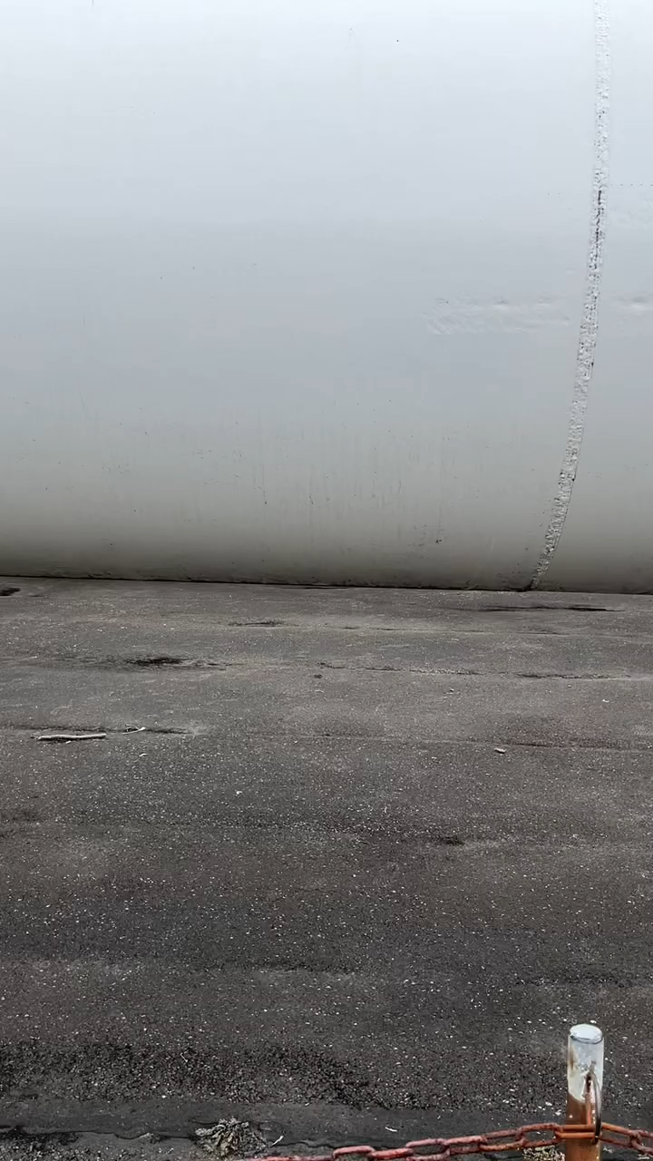
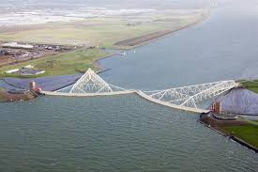
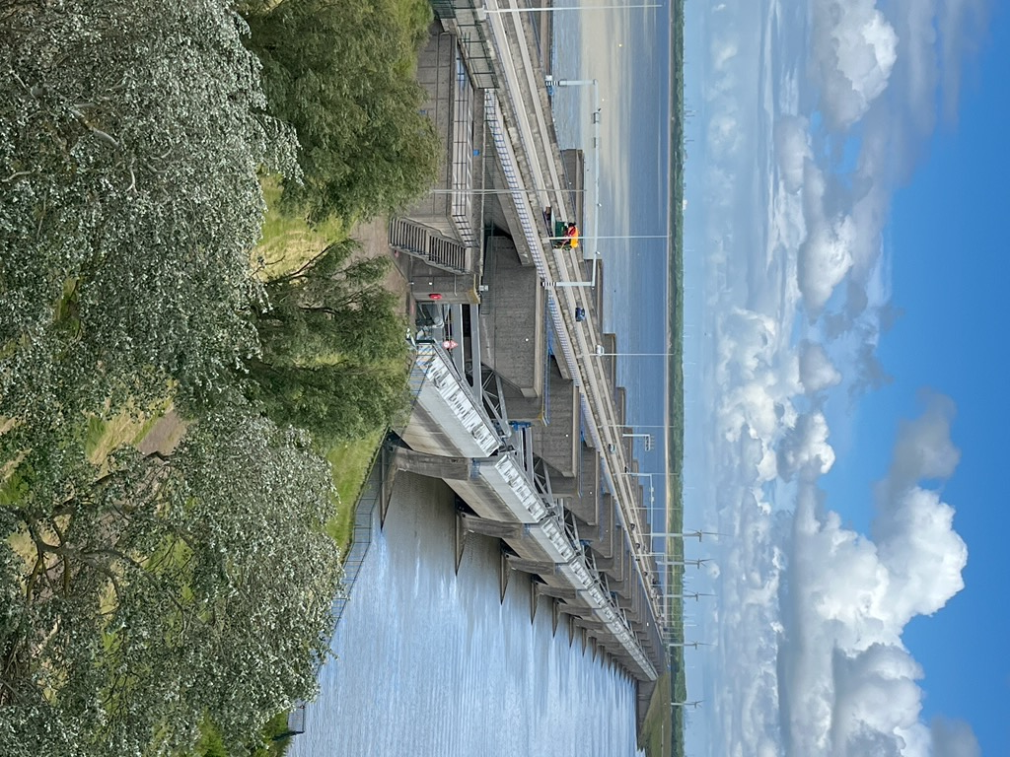
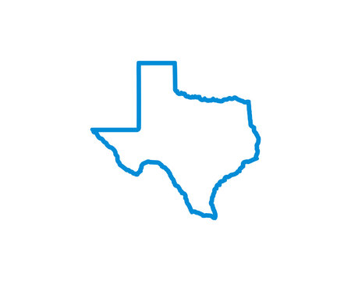

IRES Flood Resilience Program - Award #2153710

Slide 3
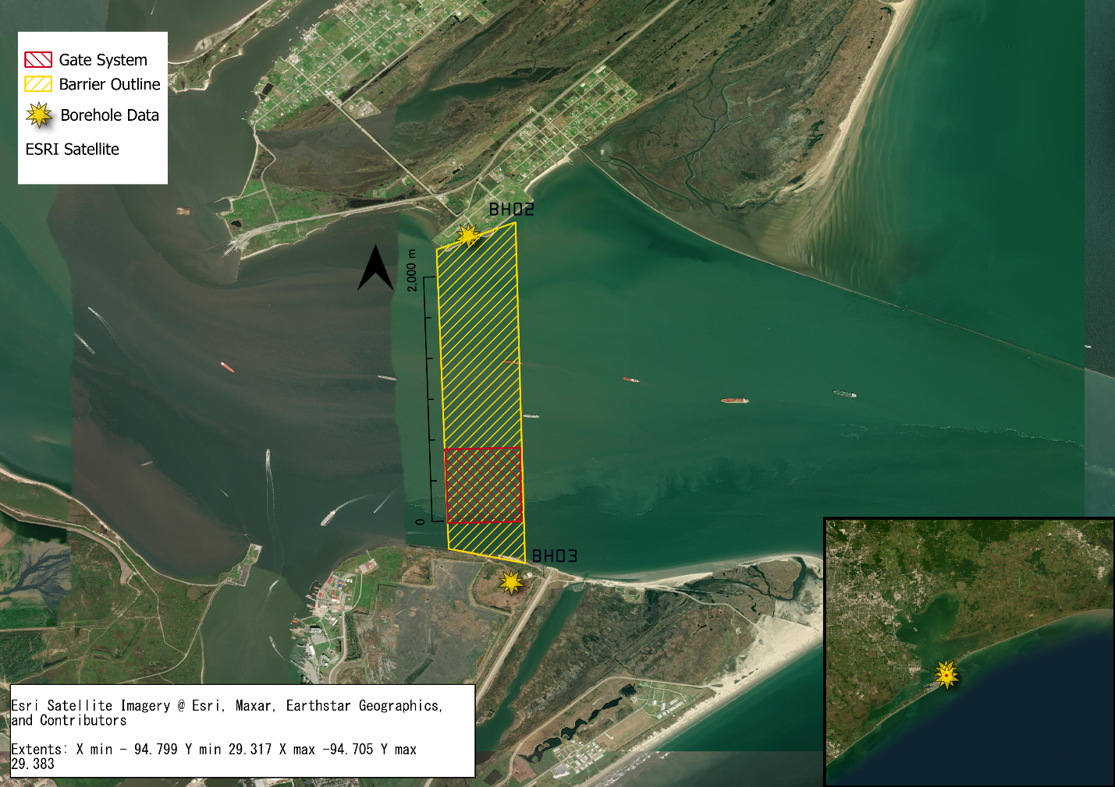
We aim to highlight the magnitude of differences caused by local geology
Low-lying coastal communities face risks from flooding due to local geography
Storm surges barriers mitigate risk, while subjecting stress onto sub-surface
Comparative geotechnical understanding is crucial for storm surge barrier design.
RQ: “How would the settlement characteristics of the Maeslant Barrier sill and erosion prevention layer change if it were implemented at the site of Bolivar Roads, Texas?”

Slide 4
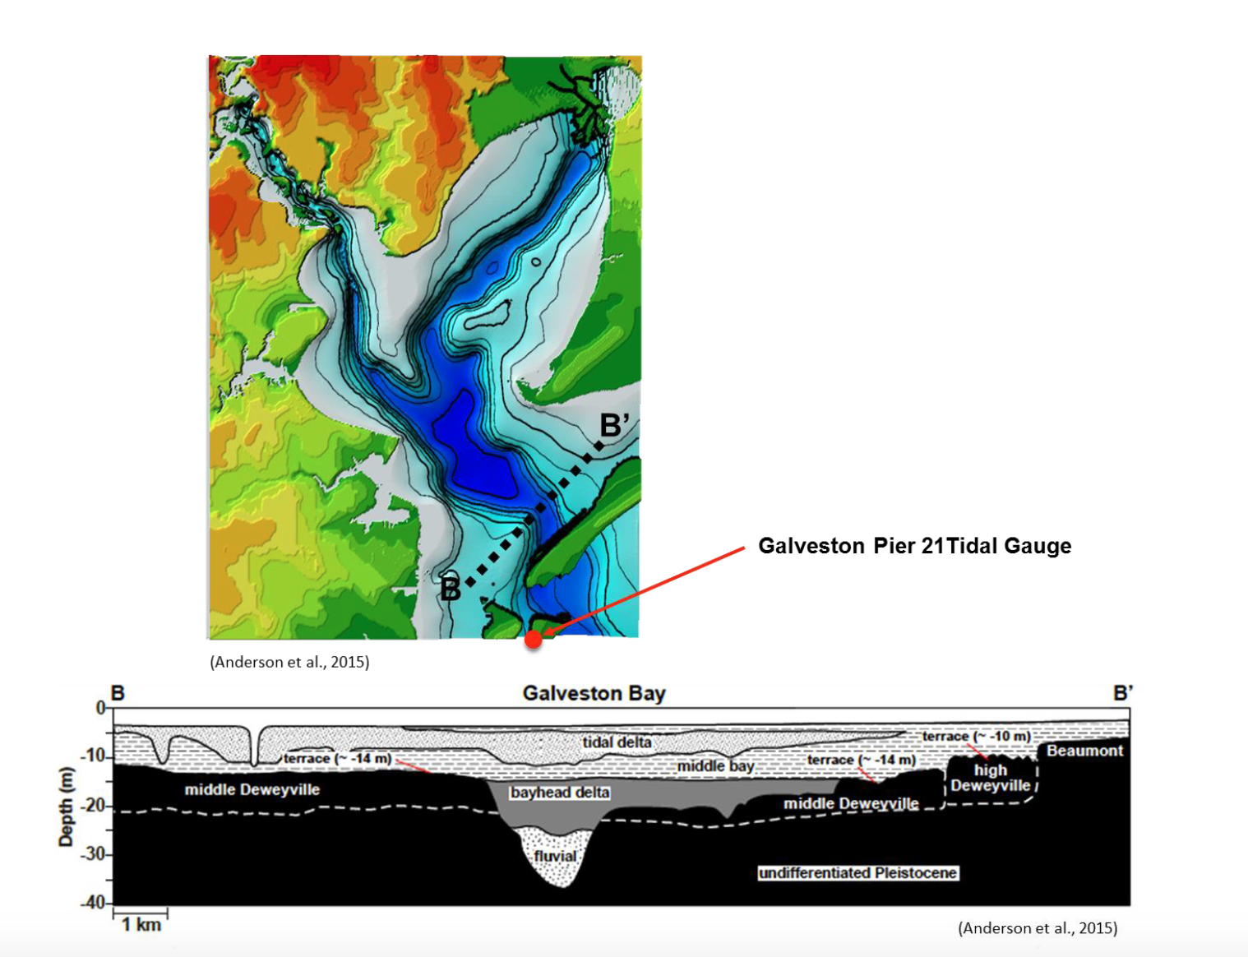
The Trinity River Incised Vally cuts directly through Bolivar Roads
Bolivar Roads

Slide 5
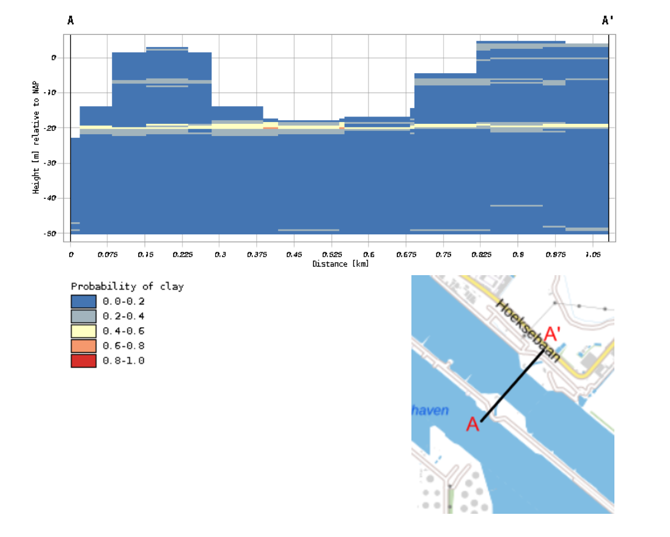
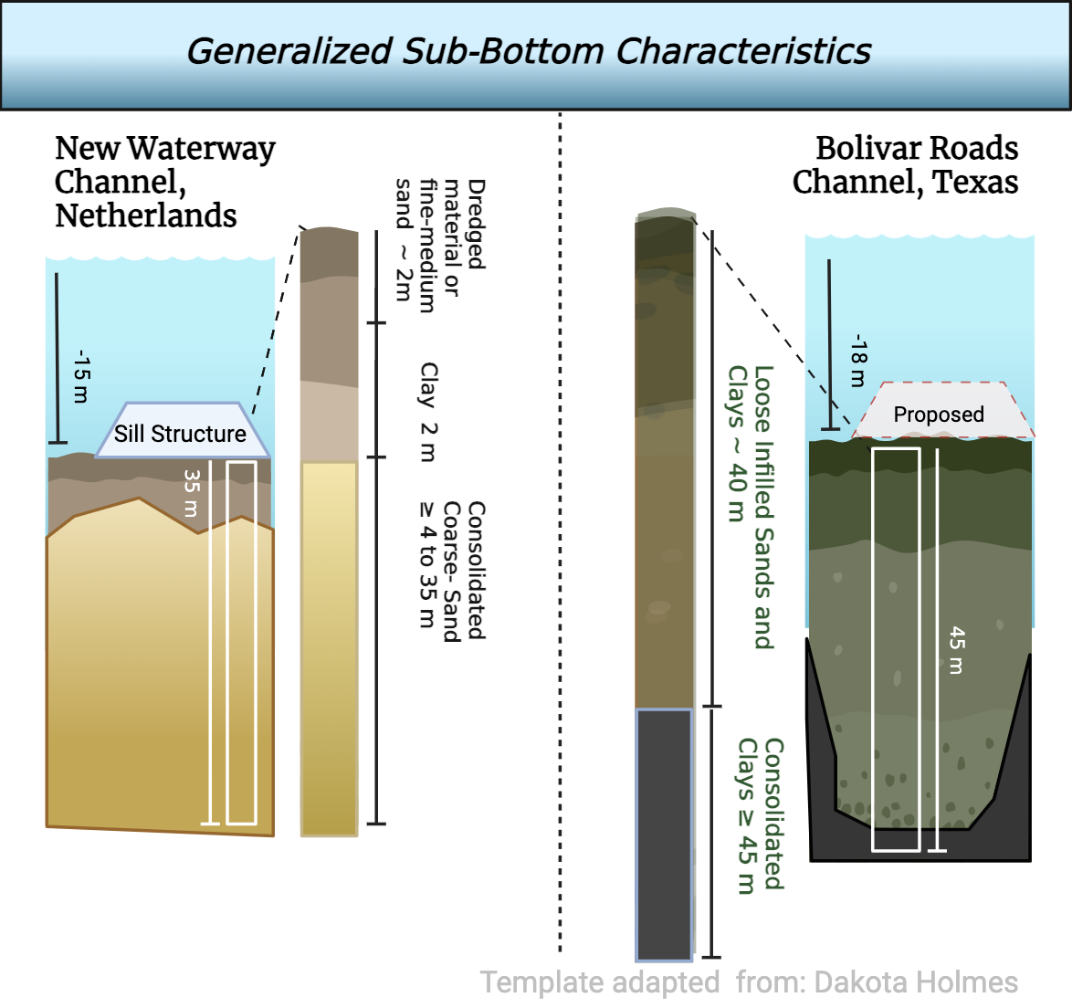
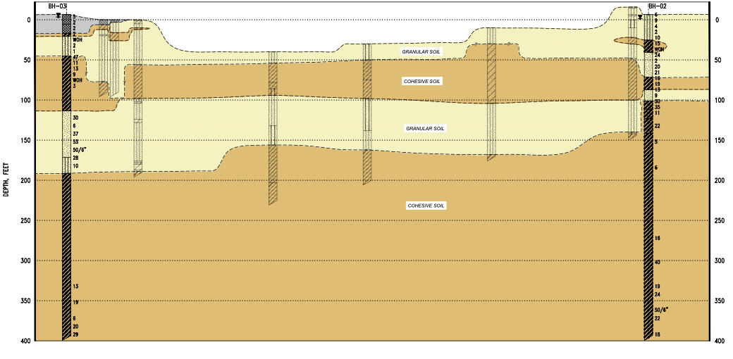
Significance
The sill and filter blanket of the Maeslant structure rests upon and interacts with the channel conditions as they develop over time.
Similar structure to be implemented as apart of the Texas Coastal Spine.
New Waterway Conditions
Bolivar Roads Conditions
SAND
“COHESIVE” CLAY
SAND
“COHESIVE” CLAY
Modified from FUGRO USA LAND, 2017. General subsurface profile of the Bolivar Roads Channel using Boreholes BH-02 and BH-03.
DINOloket. 3D subsurface model (BRO GeoTOP v1.6). Parameters set to show probability of clay layers across specified cross section.

Slide 6
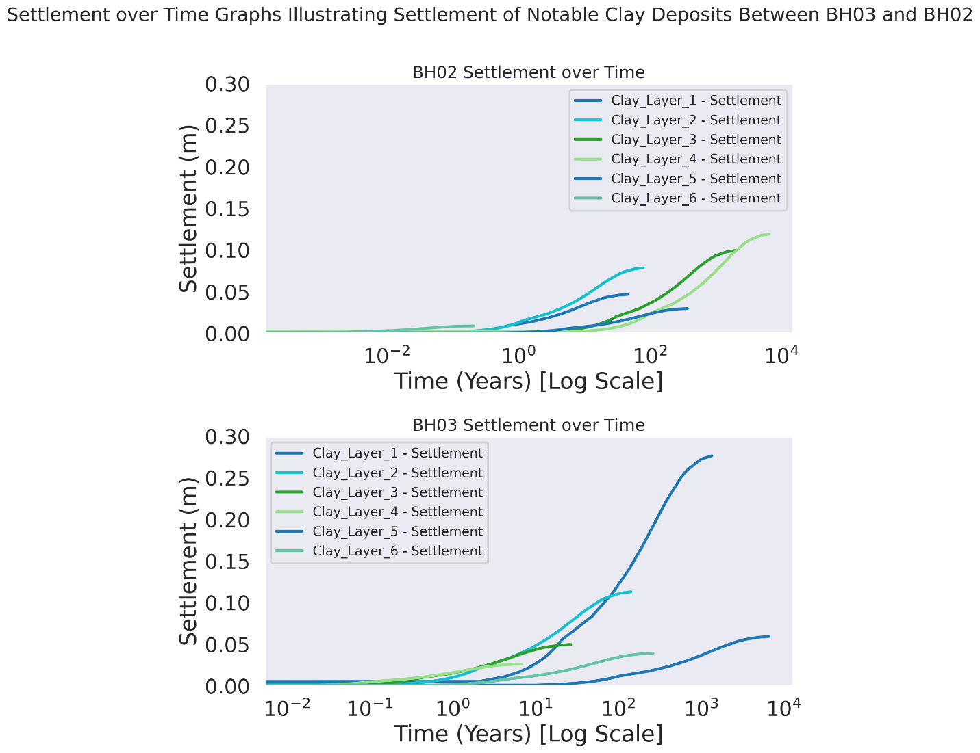
Eye-Level Methods
Sill & Erosion Protection Layer Stress
Depth of layer
Analyze composition, and geotechnical properties of boreholes
Use specified sill design characteristics to apply stress on sub-bottom soils
Simplified 1 dimensional consolidation method empirical formulas
Terzaghi’s theory
Some assumptions must be made
Calculate Total Settlement & Settlement over time
Correlate differences in regional geology
Compression Coefficient
Coefficient of Consolidation
Pore Pressure
Atterberg Limits
Specific Gravity of Soil
Unit Weight of Soil
Soil Stress

Slide 7
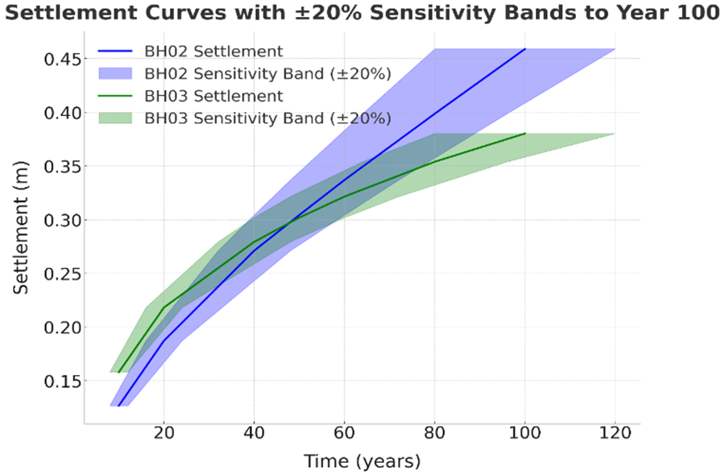

Results
New Waterway:
Settlement: ~1 cm or less, fully consolidated in <1 year.
Bolivar Roads:
Settlement: 1–2 meters; ~100 - 200x greater than New Waterway.
Exponentially increasing settlement over centuries.
Sensitivity applied to atterberg which is directly proportional to calculations
Figure 2. Settlement curves for BH02 and BH03 illustrating the consolidation behavior of all clay layers over time. Each curve corresponds to a specific clay layer, showing settlement (m) as a function of time (years) on a logarithmic scale. These curves highlight the temporal and layer-specific contributions to overall settlement under applied stresses.

Slide 8
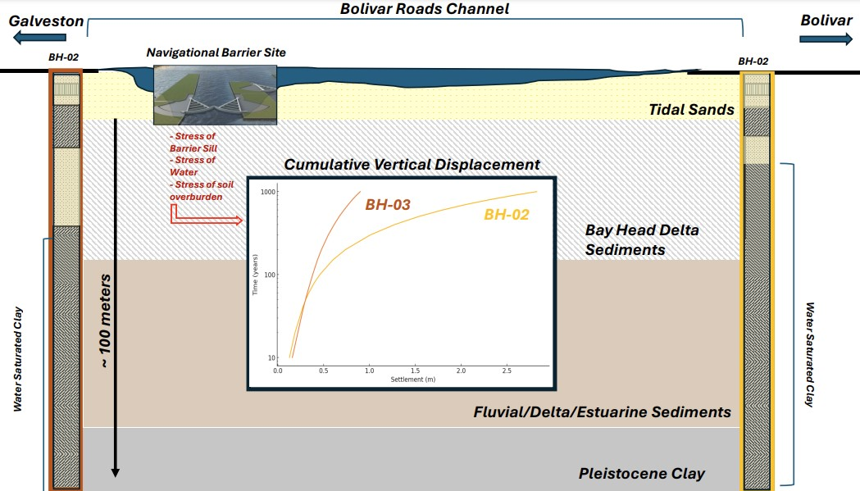
Findings
Significance:
New Waterway’s stability due to consolidated sands vs. Bolivar Roads’ deltaic infill challenges.
Implications for storm surge barrier design and performance.
Novel Findings:
Depth-dependent uncertainties in saturated soils at Bolivar Roads.
Need for site-specific sampling and multidimensional modeling.

Slide 9



Dank You!
NSF Award #2153710
IDRT team
Delft Technical Institute

