Slide 1


Geochemical Assessment and Preliminary Source Tracing of
Sediment and Water Pollution in Major Korean Rivers
Hyeop-Jo Han, Seon Yong Lee, Dong-Wan Cho*
* Korea Institute of Geoscience and Mineral Resources (dwcho@kigam.re.kr)

Slide 2
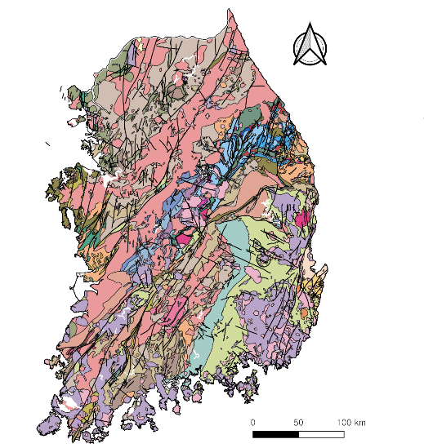
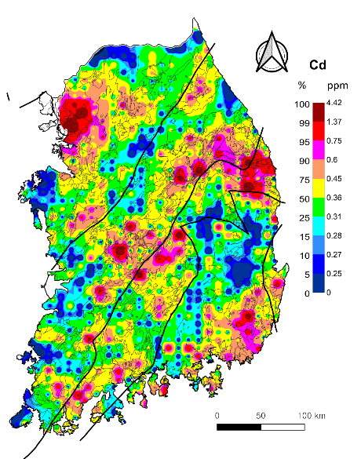
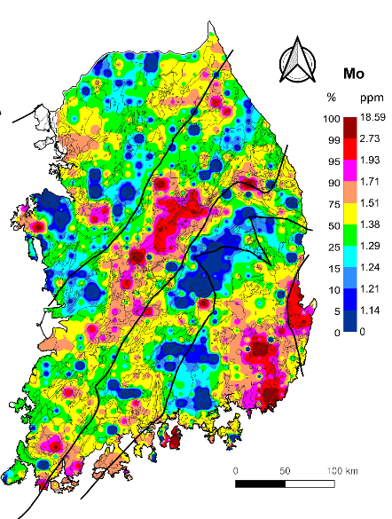
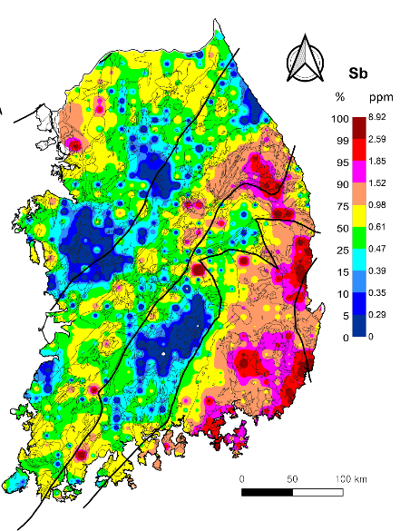
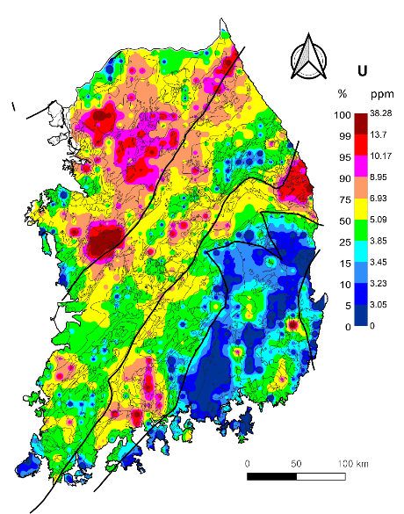
Previous National-scale Sedimnet Survey
Since 1990s, over 20,000 sediment samples have been collected across Korea.
Geochemical maps for major and toxic elements were created for environmental monitoring.
Foundation for pollution status and regional background levels.

Slide 3
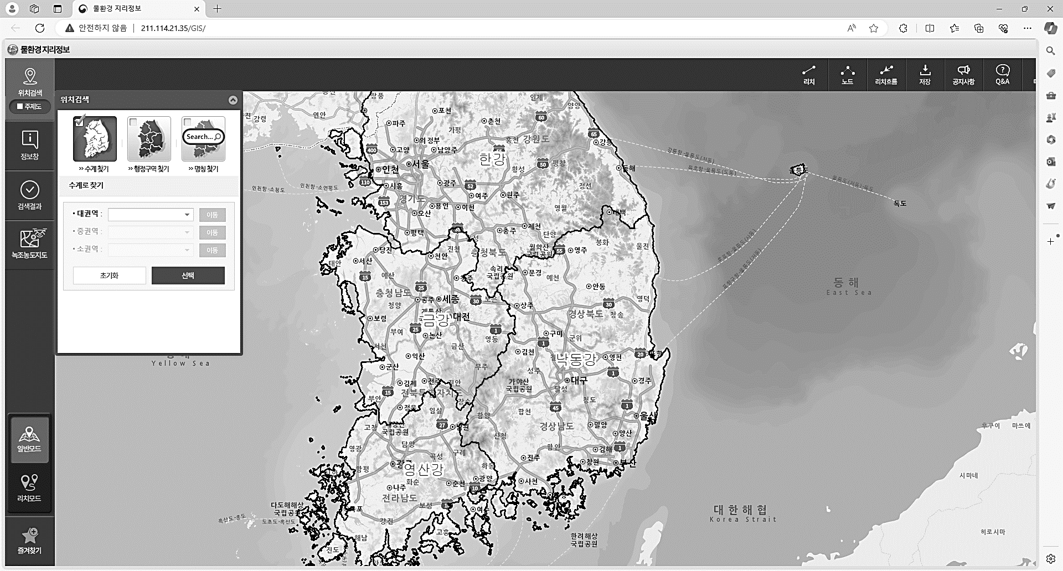
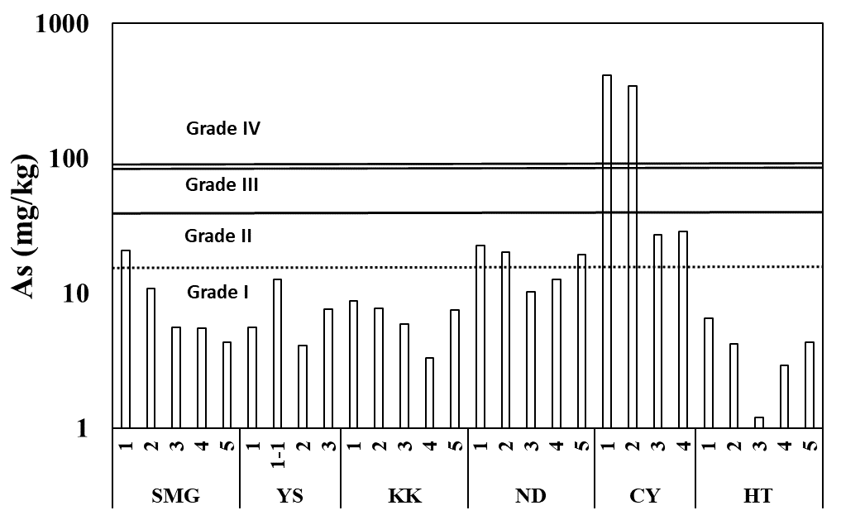
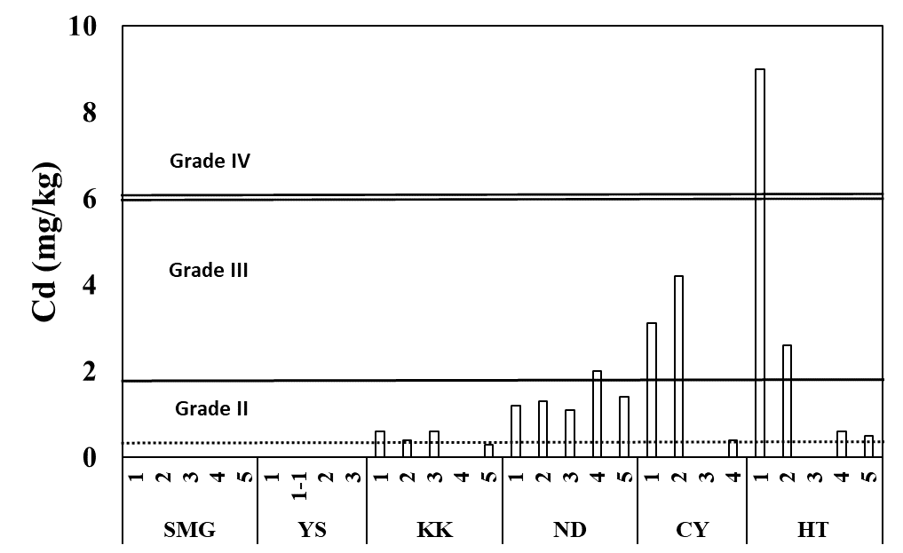
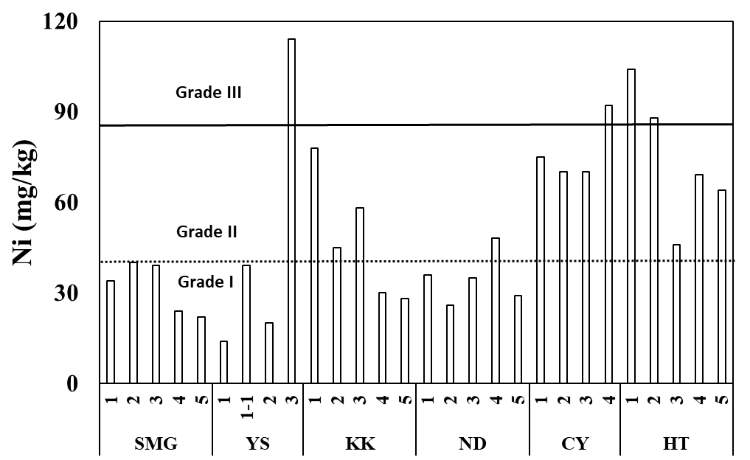
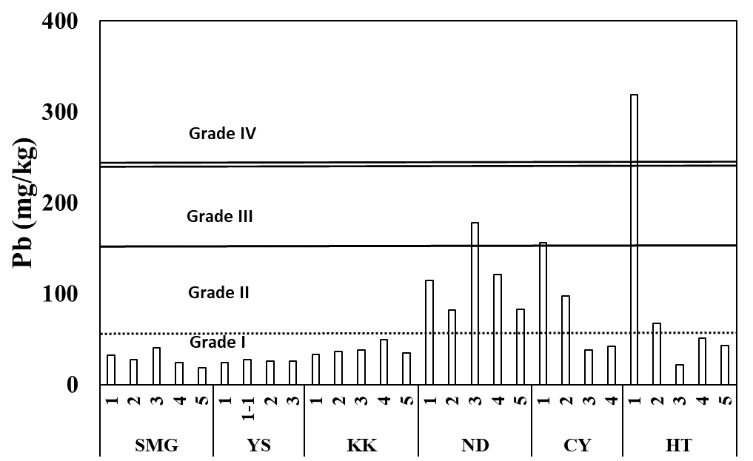
Current Study on Major Rivers (2024-2027)
Han River
Cheongyang
Geum River
SMG River
Yeongsan River
Nakdong River
We collected 28 sediment and 28 water samples from six major rivers.(Currently, the number of sediment samples has increased to ~50.)
Over 50 major&trace elements were analyzed in each sample.
Some sediment samples showed high concentrations of As, Cd, Ni and Pb.

Slide 4
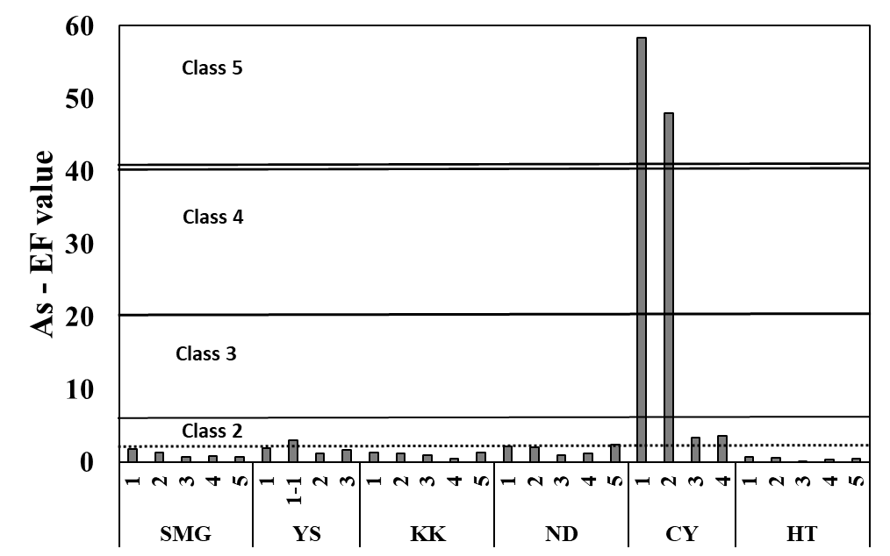
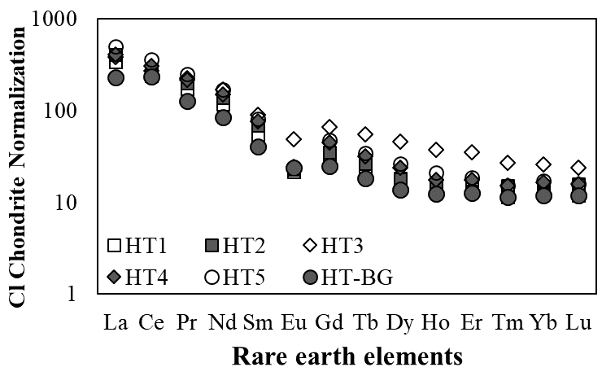
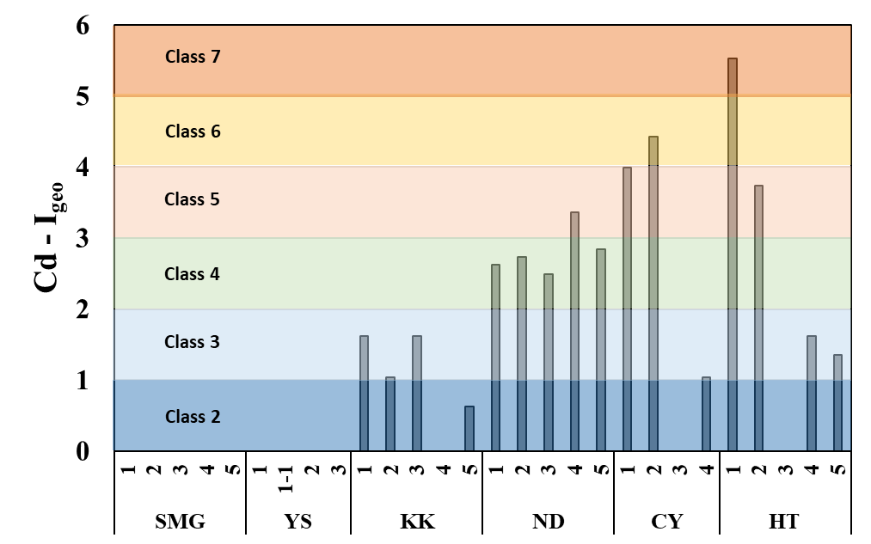
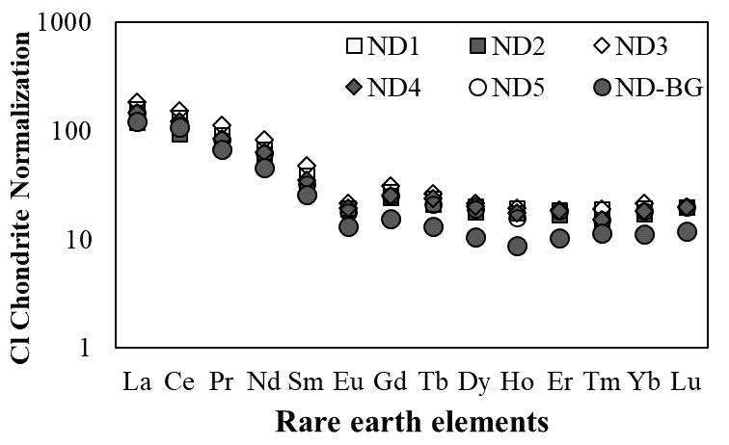
Current Study on Major Rivers (2024-2027)
Geochemical indices (EF, Igeo) confirmed the pollution levels.
REE distribution was dominated by LREEs, reflecting granite influence.

Slide 5
Extra Slides
(Supplementary Information)

Slide 6
Previous National-scale Sedimnet Survey
Since 1990s, over 20,000 sediment samples have been collected across Korea.
Geochemical maps for major and toxic elements were created for environmental monitoring.
Foundation for pollution status and regional background levels.

Slide 7





Objectives
Geochemical Investigation and Tracing of Sediment Pollution
Comprehensive Assessment of Heavy Metal Contamination
Integrated Geochemical Approach to Pollution Source Identification
Comprehensive assessment was conducted using both river water and sediment samples.
Concentrations of heavy metals were analyzed alongside geochemical indicators (EF, Igeo).
Pollution levels were evaluated relative to background values to identify contamination.
Isotopic analyses of Cu, Pb, Zn, and Cs are used to trace pollution sources with high precision.
Rare earth element distributions provide additional insight into sediment origin and transport.
Geochemical indices such as Igeo help distinguish anthropogenic impacts from natural background.
Provision of a scientific basis for pollution management and source control

Slide 8
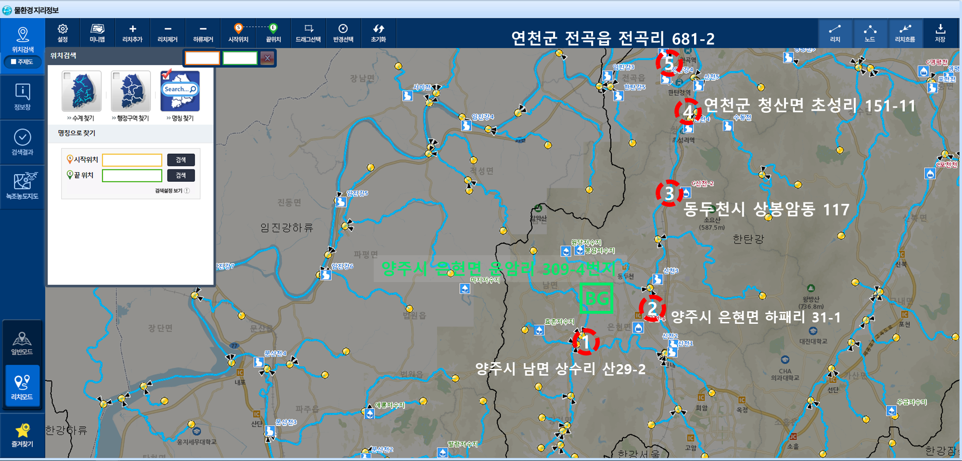
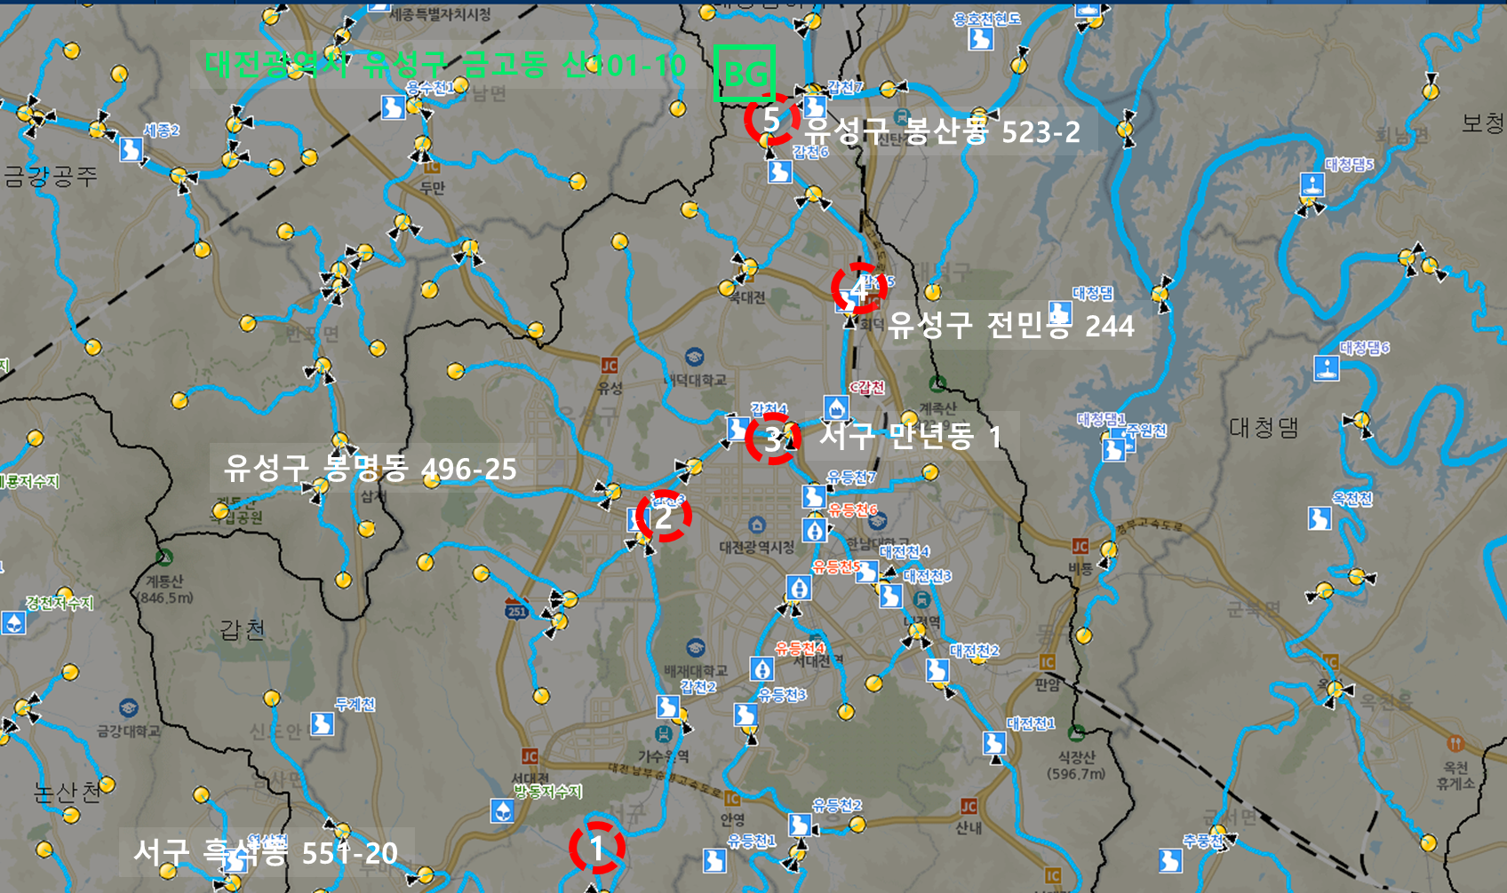
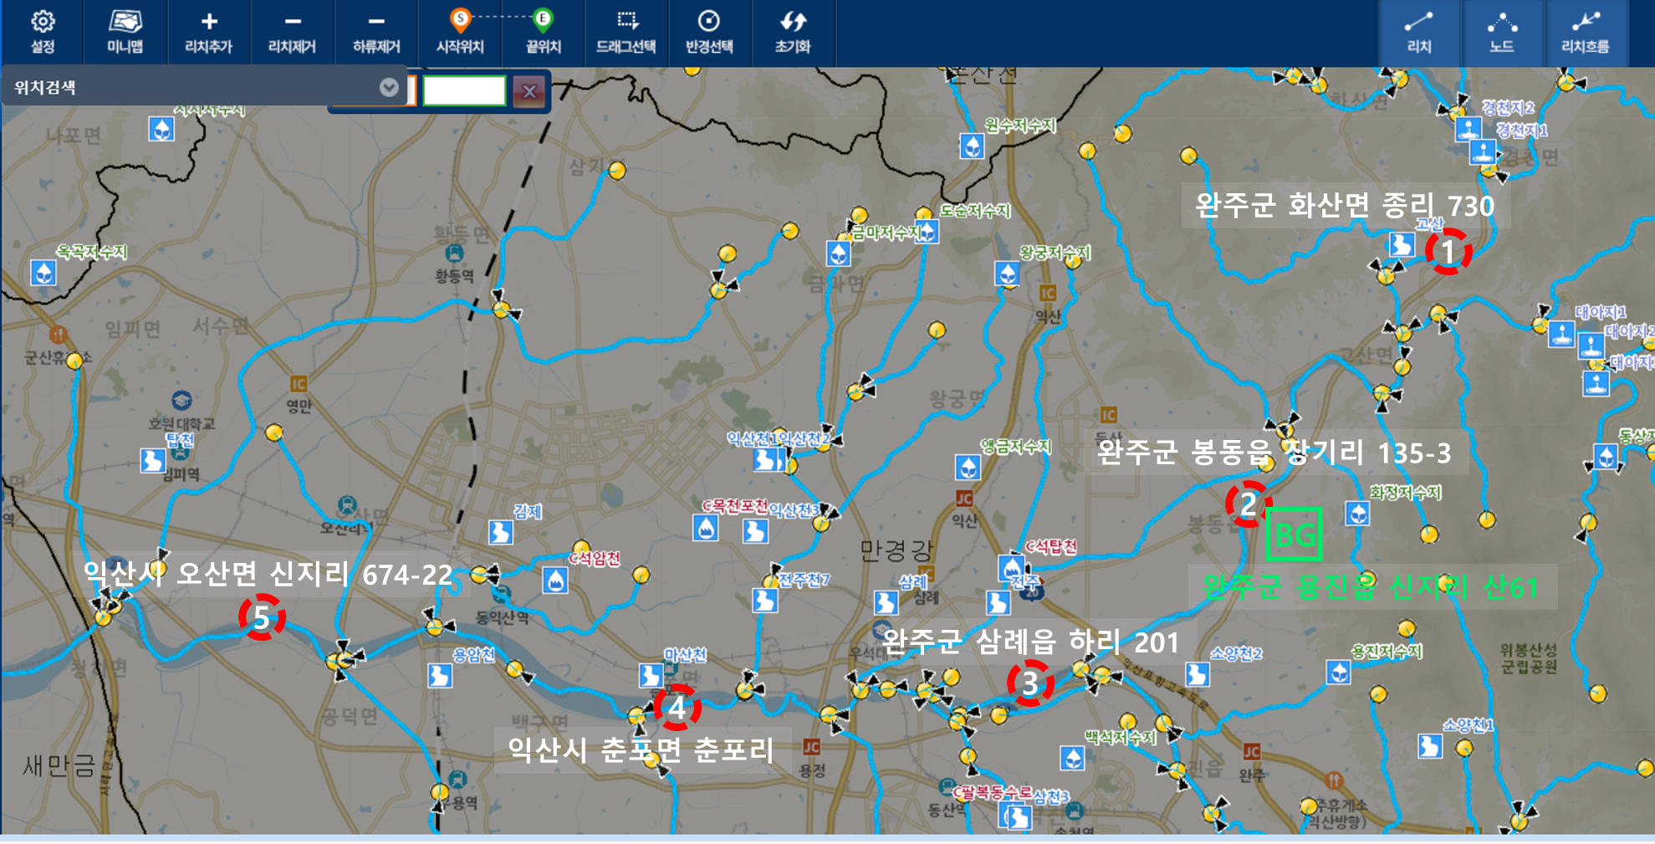
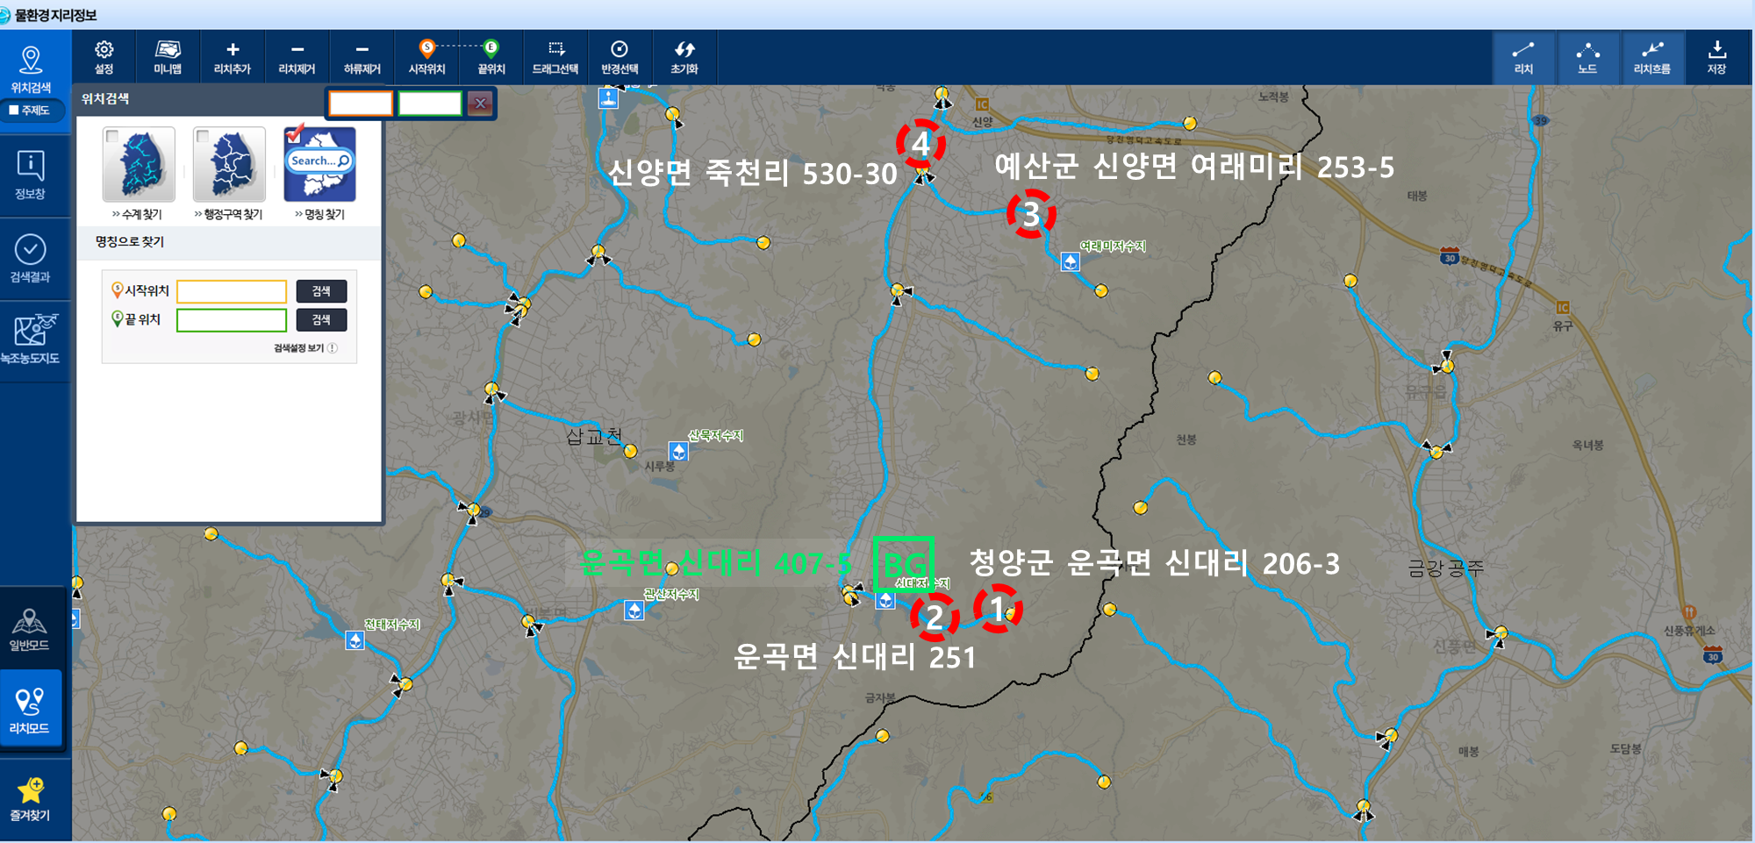
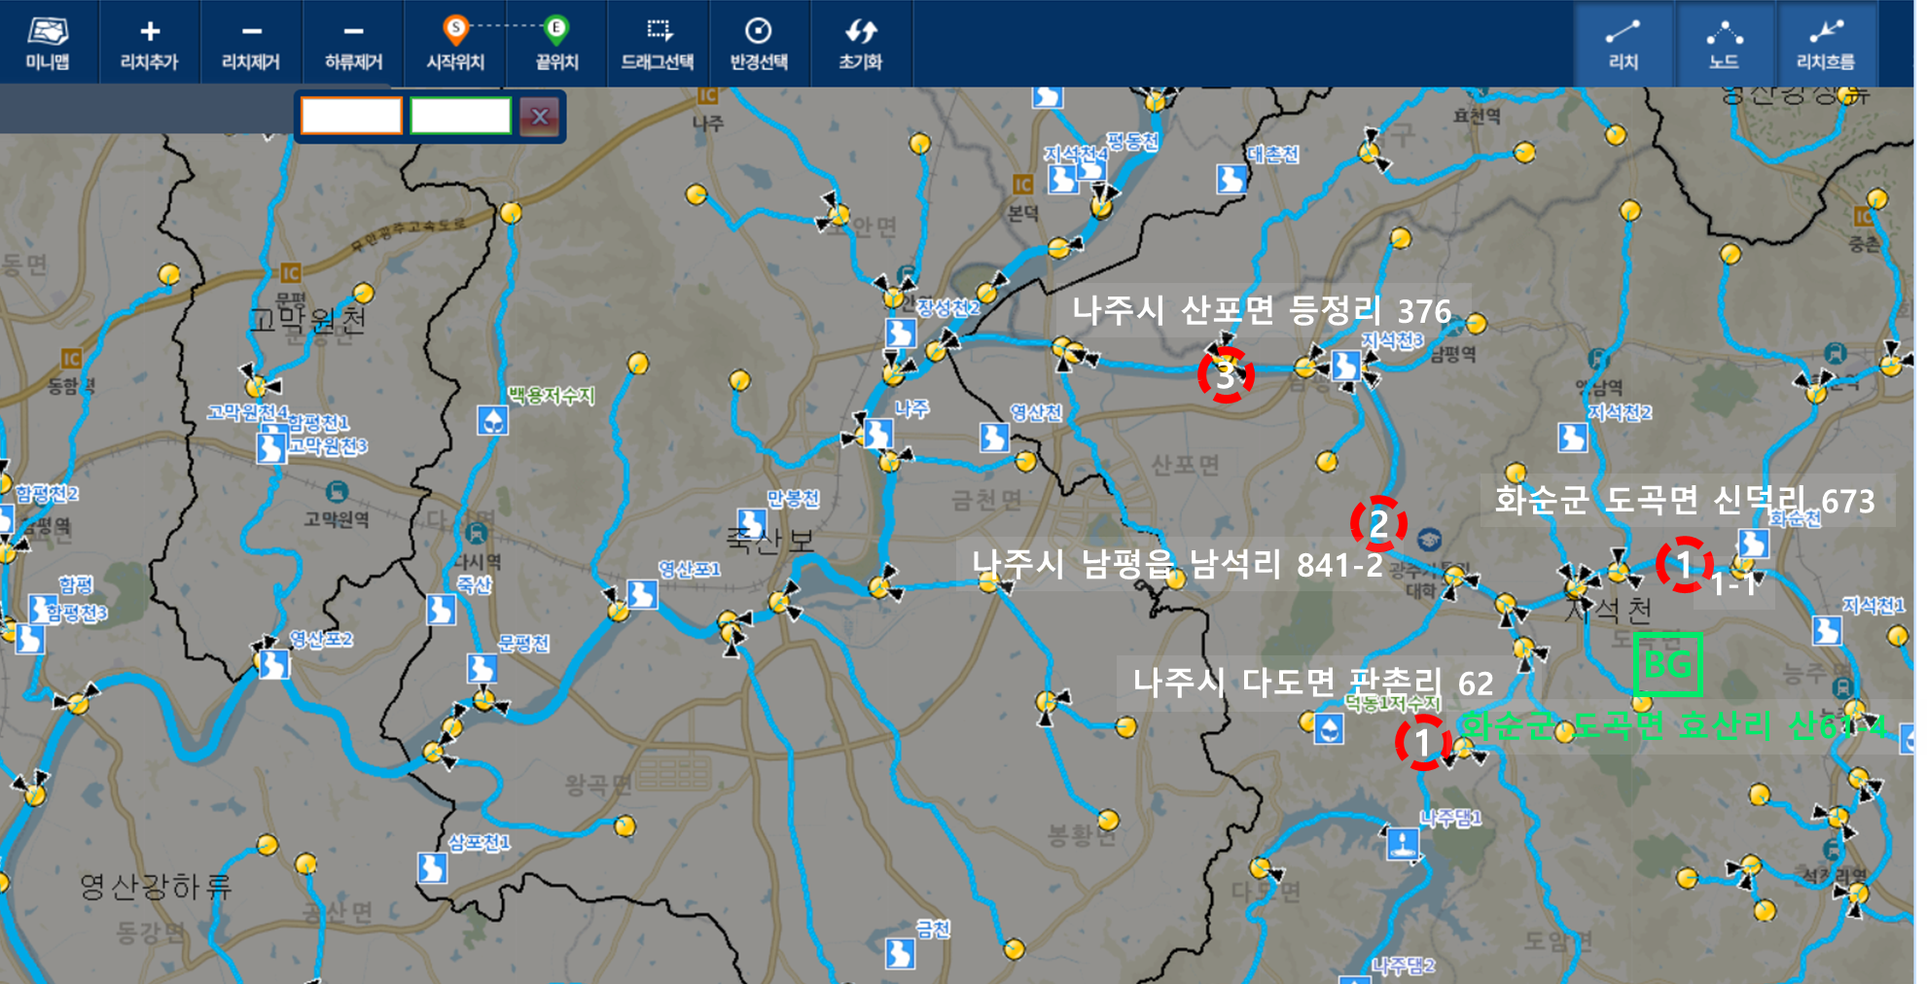
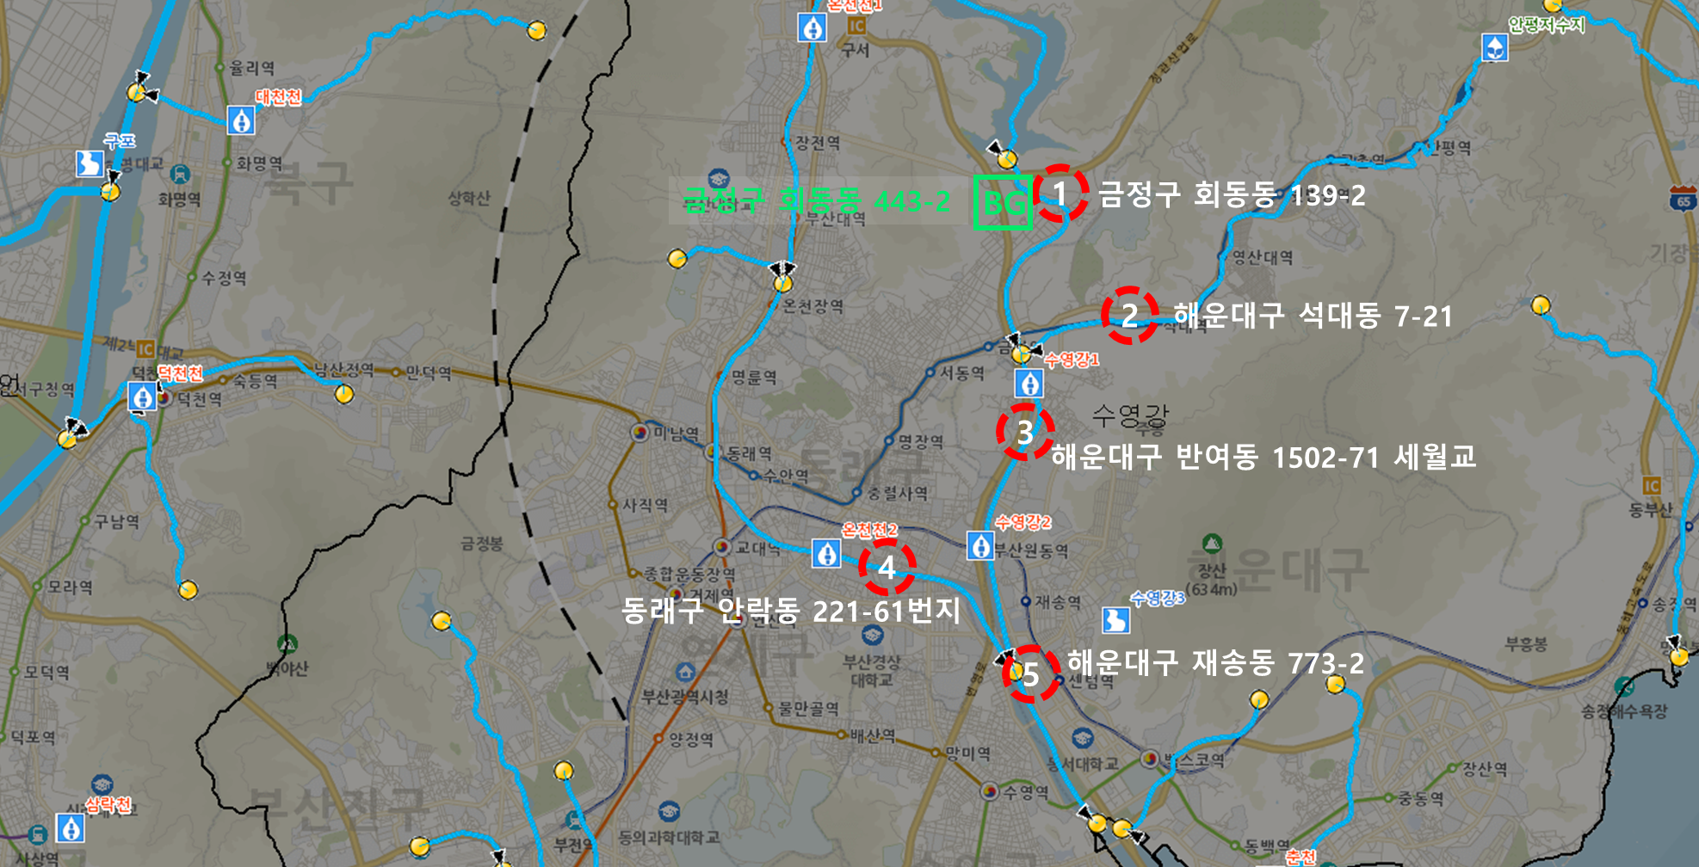
Sediment Sampling Sites in Korea
Han River
Han River (HT)
Geum River (KK)
SMG River (SMG)
Cheongyang
Geum River
SMG River
Yeongsan River
Nakdong River
Cheongyang (CY)
Yeongsan River (YS)
Nakdong River (ND)
Selected six key river systems for initial investigation, including Korea’s four major rivers (Han, Nakdong, Geum, Yeongsan)
Included additional sites near the Saemangeum reclaimed area and a mining-affected region
Collected 28 sediment samples and 28 water samples from these areas
Currently, the number of sediment samples has increased to approximately 50

Slide 9
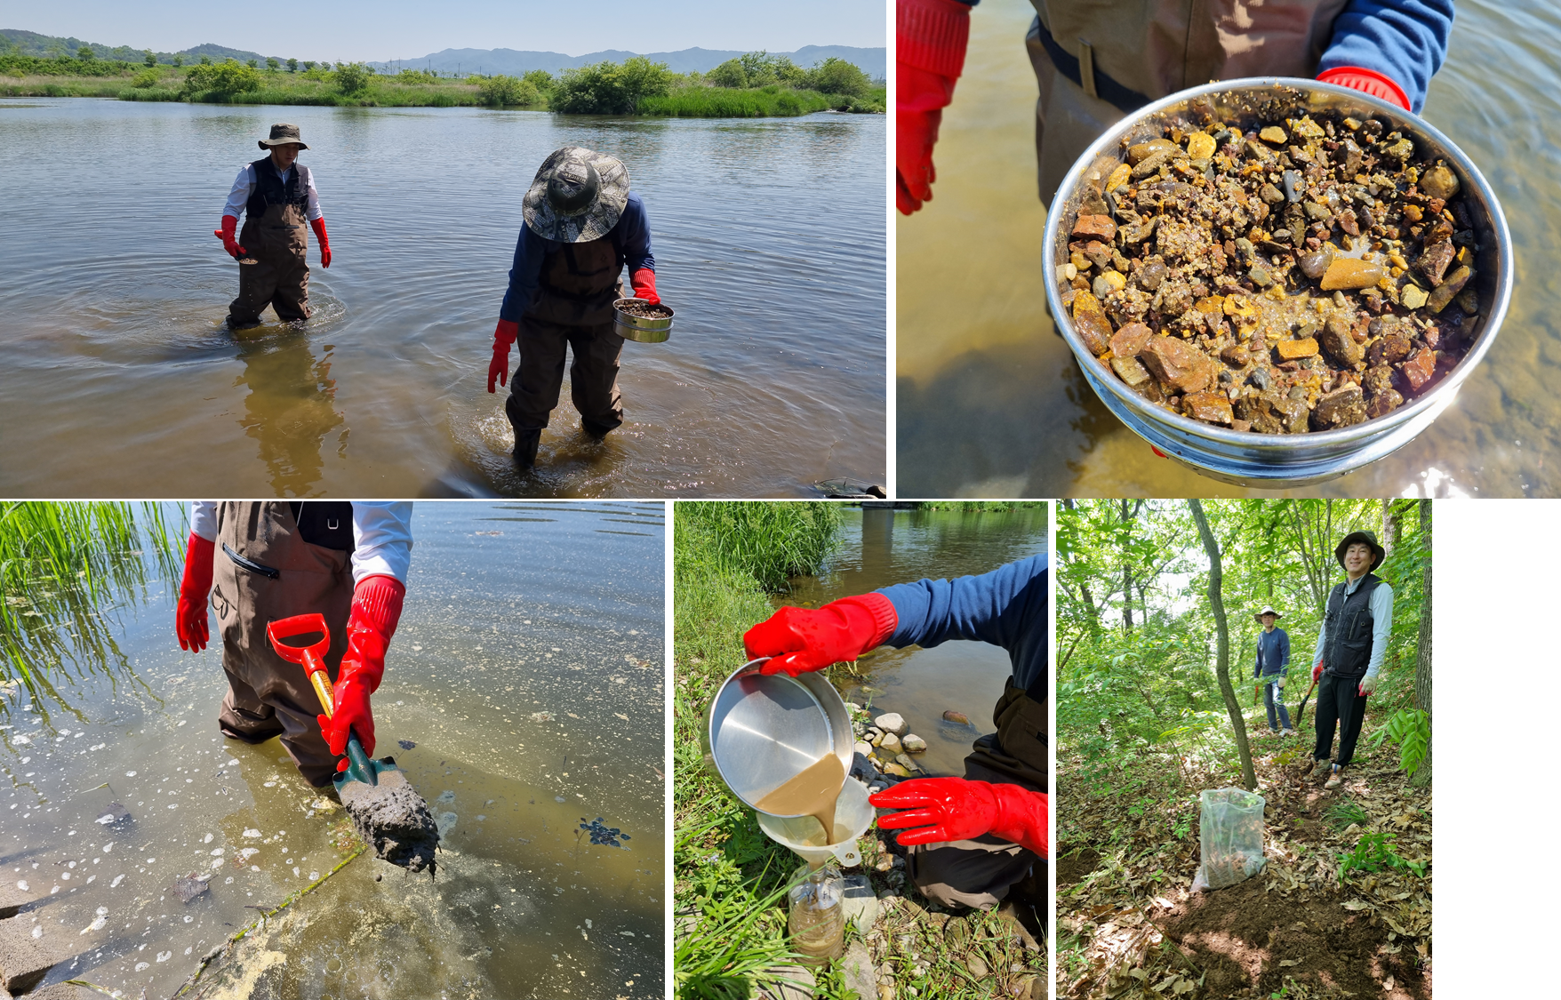
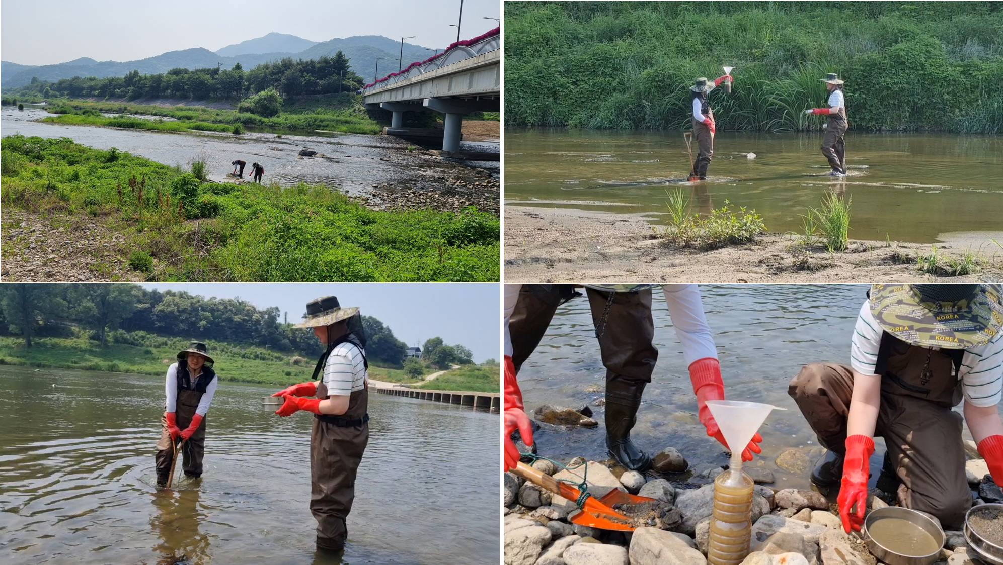
Sediment Sampling and Geochemical Analysis
Sediment samples were wet-sieved on-site using a 100-mesh sieve (<0.15 mm).
Background soils were collected from nearby hills at depths of less than 50 cm.
Trace elements in sediments were digested after 4-acid digestion (HF, HCl, HNO₃, HClO₄).
Instrumental analysis was conducted using ICP-OES and ICP-MS.

Slide 10
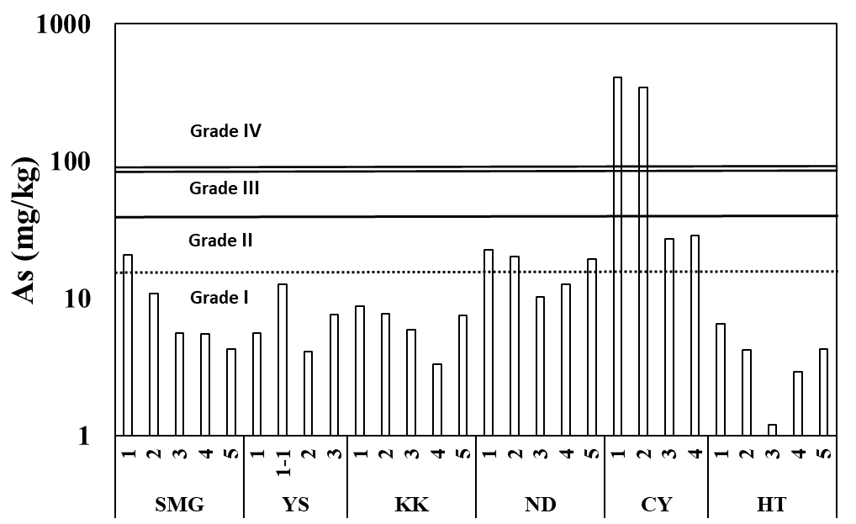
Metal-Specific Sediment Pollution Evaluation
Korean Sediment Quality Standards for Individual Heavy Metals
 | Grade I | Grade II | Grade III | Grade IV
As | 0 ~ 15 | 15 ~ 44.7 | 44.7 ~ 92.1 | ≥ 92.1
Cd | 0 ~ 0.4 | 0.4 ~ 1.87 | 1.87 ~ 6.09 | ≥ 6.09
Cr | 0 ~ 112 | 112 ~ 224 | 224 ~ 991 | ≥ 991
Cu | 0 ~ 48 | 48 ~ 228 | 228 ~ 1,890 | ≥ 1,890
Ni | 0 ~ 40 | 40 ~ 87.5 | 87.5 ~ 330 | ≥ 330
Pb | 0 ~ 59 | 59 ~ 154 | 154 ~ 459 | ≥ 459
Zn | 0 ~ 363 | 363 ~ 1,170 | 1,170 ~ 13,000 | ≥ 13,000
Contamination levels of each metal were assessed for every sample point.
Arsenic (As) concentrations were notably high in the CY sample.
→ This is likely due to the presence of a historical gold mine in the region.
Elevated As levels in other regions were observed only in samples 1 and 2. These samples are located near headwater areas of the river system.
→ Elevated As in these cases is interpreted as a result of geological background influence.

Slide 11
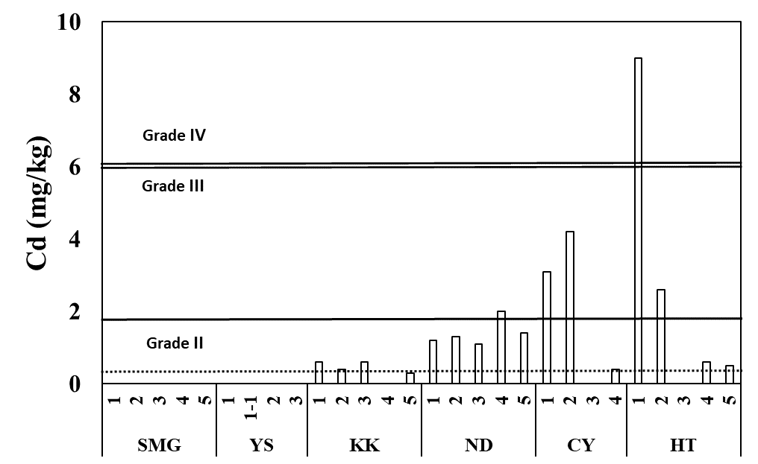
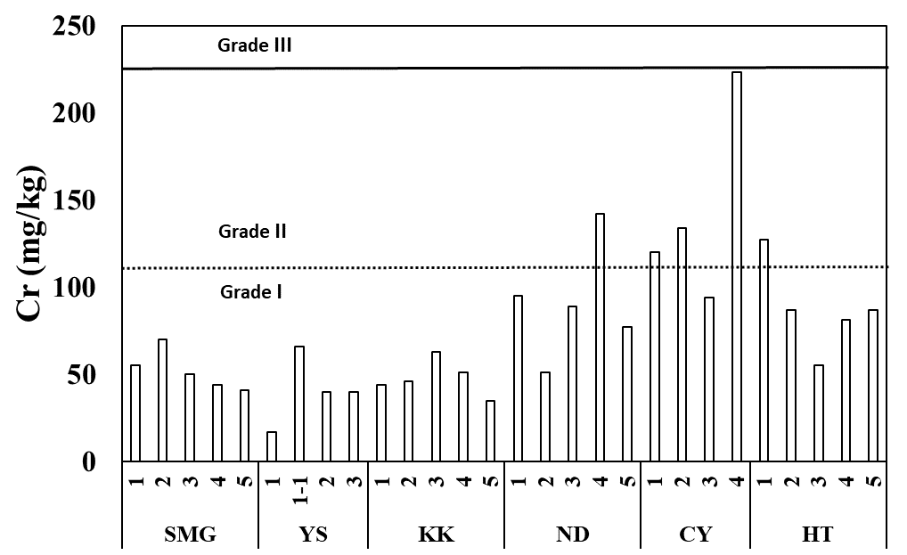
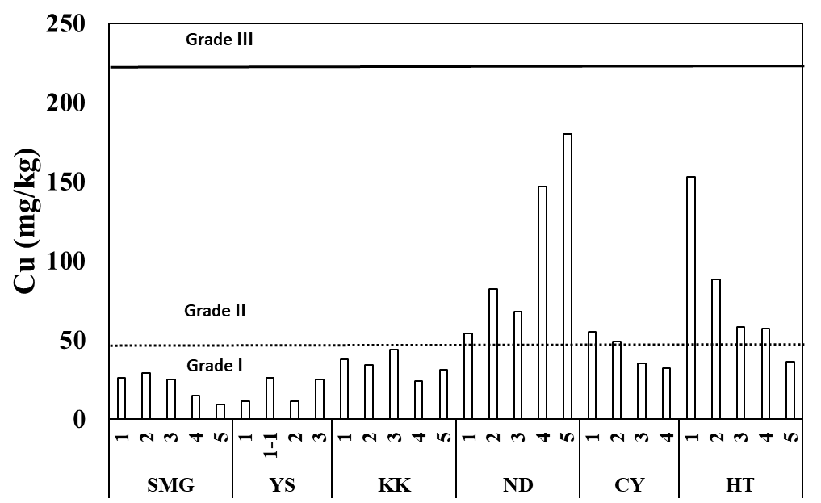
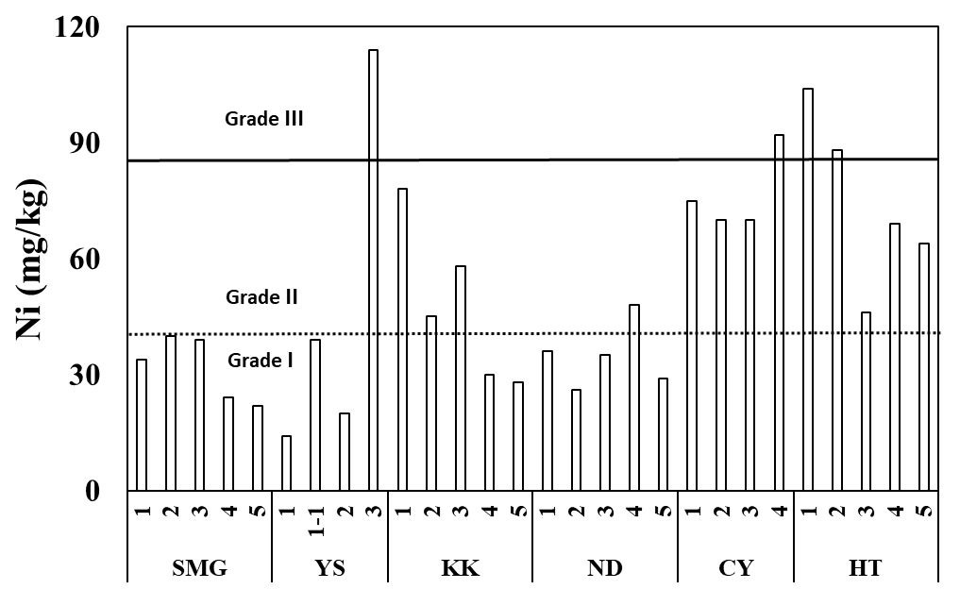
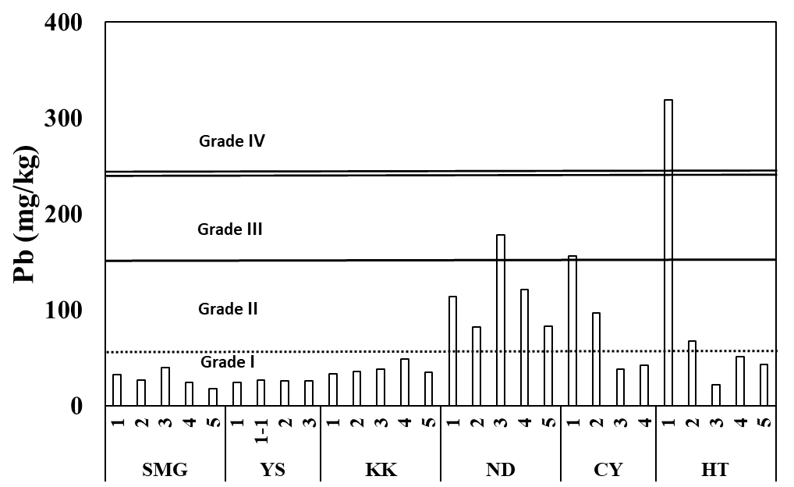
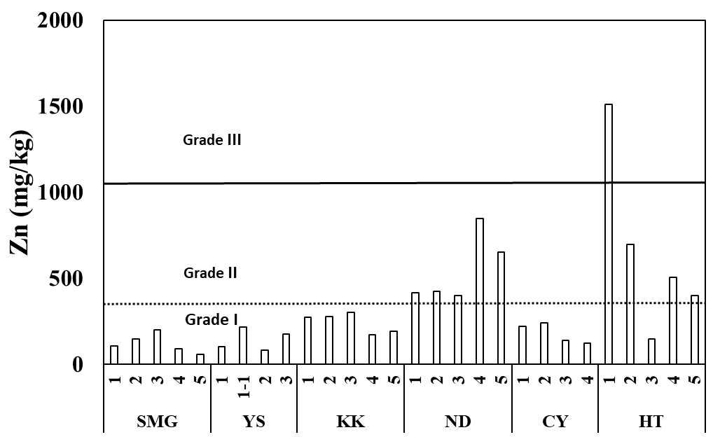
Metal-Specific Sediment Pollution Evaluation
Cd was notably elevated in sample HT-1, along with high concentrations of Cu, Pb, and Zn.
→ These multi-element patterns suggest a hydrothermal origin influenced by local geology
Cr&Ni were elevated in CY-4, the most downstream site near a former gold mine
→ Likely influenced by nearby industrial activity rather than geology
Cu and Zn were elevated in ND-4 and ND-5, collected from an urban area.
→ Being downstream sites (3rd–5th order streams), they are likely influenced by urban runoff.

Slide 12

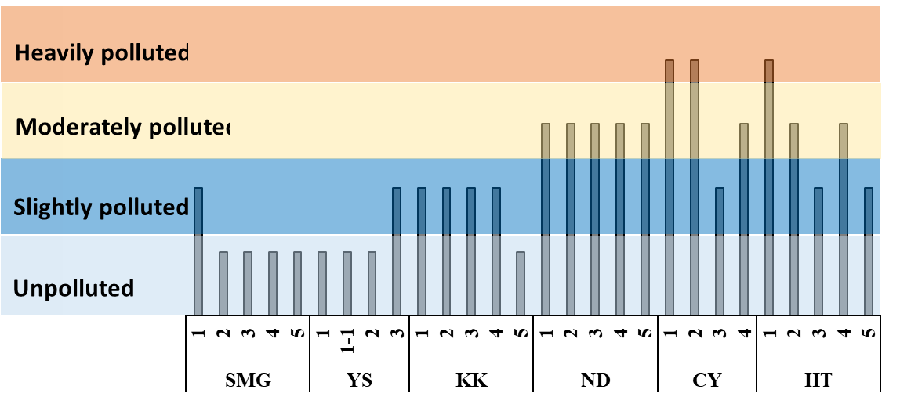
Integrated Site-Based Contamination Classification
Korean Criteria for Integrated Sediment Contamination Grading
Grade | Condition
Unpolluted | All element concentrations are below the threshold for Grade 1
Slightly Polluted | At least one element exceeds the threshold for Grade 1 but none exceed that for Grade 2
Moderately Polluted | The index based on Metal Grade II criteria is equal to or greater than 0.34.
Heavily Polluted | At least one element exceeds the threshold for Grade 3
EC_{i}: Measured concentration of metal i in sediment PEL_{ki}: Metal I - specific Threshold Value for Grade II
Metal Grade II Index =

Slide 13
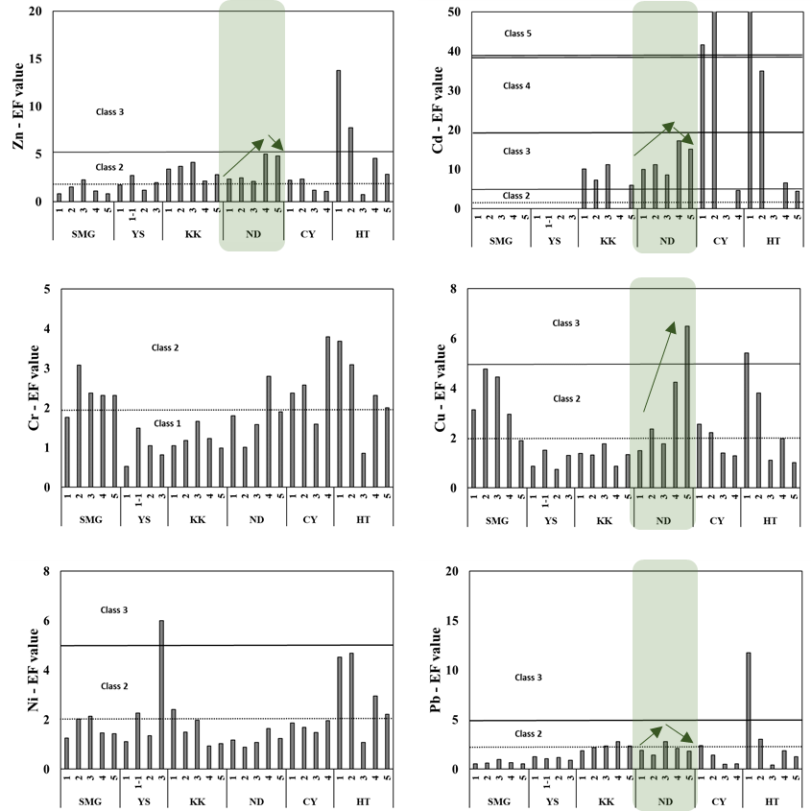
Sediment Contamination Assessment Using EF and Igeo
Enrichment Factor (EF)
(C_{x}/C_{ref})
EF =
(B_{x}/B_{ref})
C_{x}: Concentration of element i in the sample B_{x}: Background concentration of element i C_{ref}: Concentration of reference element in the sample B_{ref}: Background concentration of the reference element
Class | EF Value | Soil quality
1 | EF < 2 | Deficiency to minimal enrichment
2 | 2 ≤ EF < 5 | Moderate enrichment
3 | 5 ≤ EF < 20 | Significant enrichment
4 | 20 ≤ EF < 40 | Very high enrichment
5 | EF ≥ 40 | Extremely high enrichment
In the ND region, EF values for Zn, Cd, Cu, and Pb fall within the moderate to significant enrichment range (EF levels 2–3).
Zn and Cd show higher enrichment in mid- to downstream sites, Cu in the downstream area, and Pb in the midstream area.

Slide 14
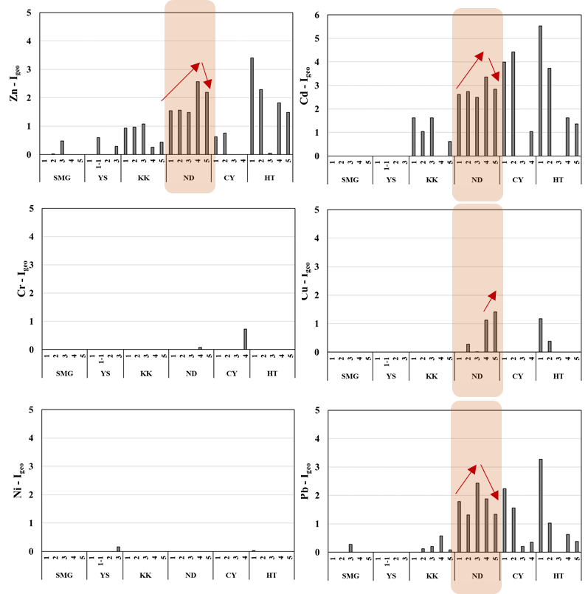
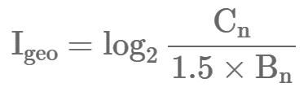
Sediment Contamination Assessment Using EF and Igeo
Geoaccumulation Index (Igeo)
C_{n}: Metal Contents in Sediments B_{n}: Average Background Values in Shale Cd 0.13, Cu 45, Hg 0.45, Ni 68, Pb 22, Zn 95
Class | I_{geo} Value | Soil quality
0 | I_{geo} ≤ 0 | Practically uncontaminated
1 | 0 < I_{geo} < 1 | Uncontaminated to moderately contaminated
2 | 1 ≤ I_{geo} < 2 | Moderately contaminated
3 | 2 ≤ I_{geo} < 3 | Moderately to heavily contaminated
4 | 3 ≤ I_{geo} < 4 | Heavily contaminated
5 | 4 ≤ I_{geo} < 5 | Heavily to extremely contaminated
6 | I_{geo} ≥ 5 | Extremely contaminated
In the ND region, Igeo values for Zn, Cd, Cu, and Pb fall within Class 2–3, indicating moderate to considerable contamination.
Zn and Cd show higher Igeo values in mid- to downstream sites, Cu in the downstream area, and Pb in the midstream area.

Slide 15
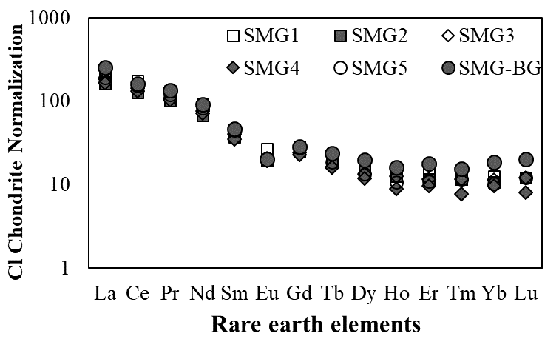
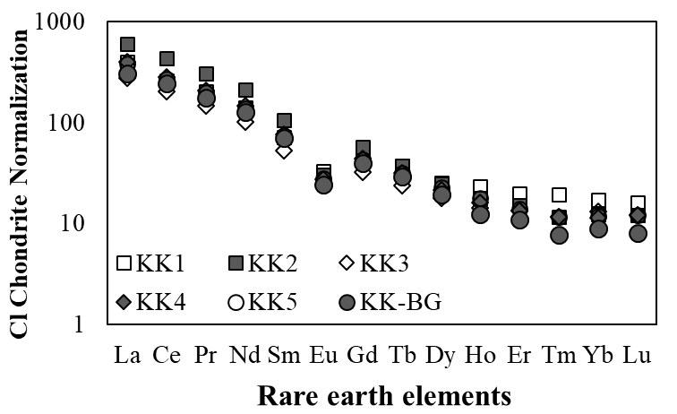
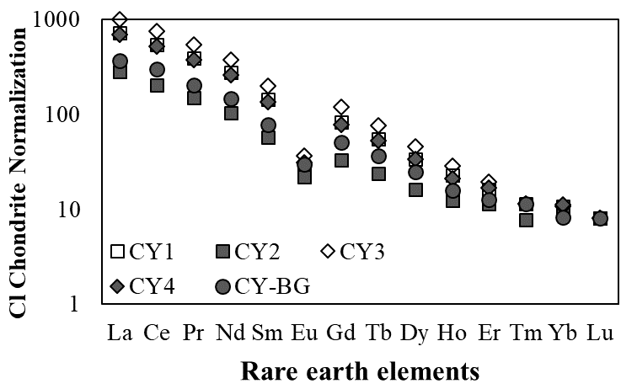
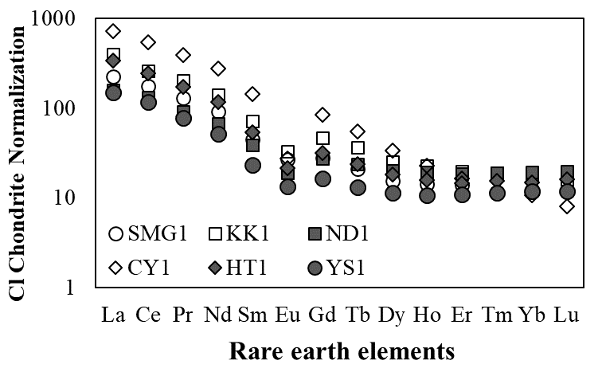
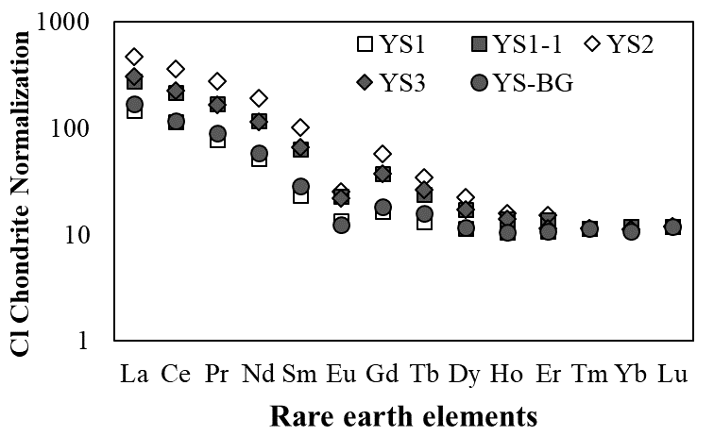
Distribution Pattern of Rare Earth Elements in Sediment
Rare earth element (REE) concentrations were normalized to CI chondrite values.
Elements are arranged from light REEs (LREEs) on the left to heavy REEs (HREEs) on the right.
Due to Korea’s predominantly granitic bedrock, REE distribution patterns appear broadly similar across samples.
Most patterns show enrichment in light REEs (left side) and depletion in heavy REEs (right side).

Slide 16
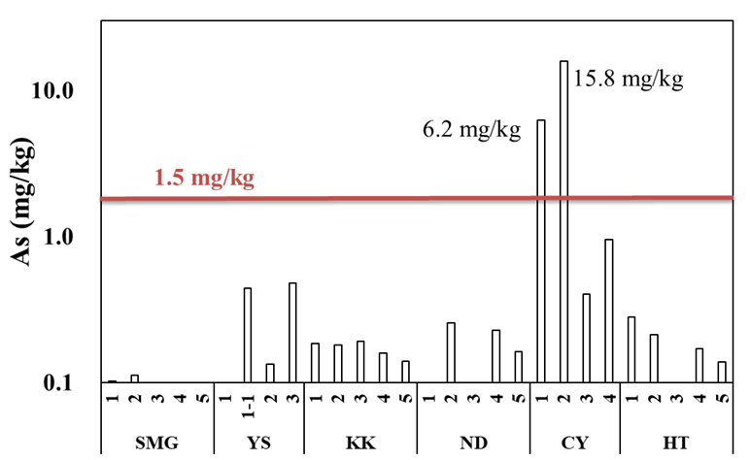
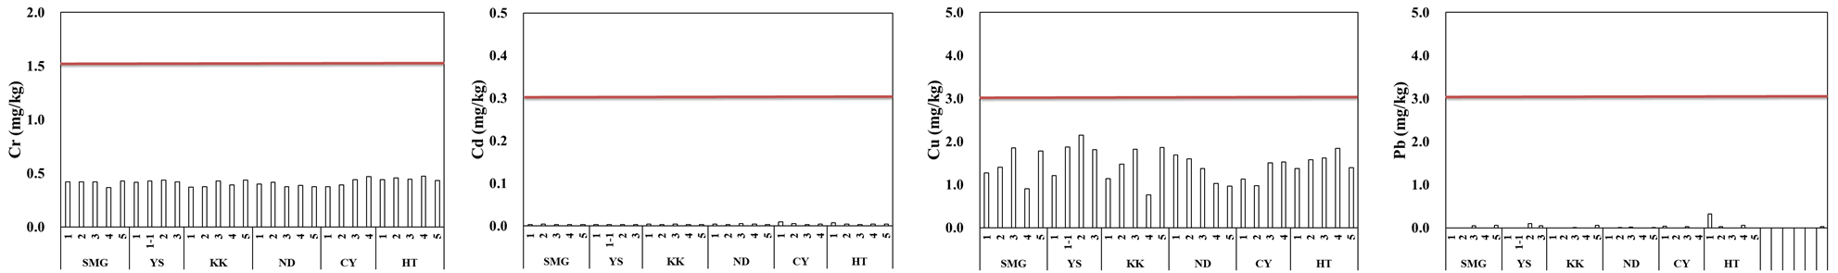
Mobility Evaluation of Heavy Metals in Sediments
Application of Korean Waste Leaching Procedure to Sediment Samples
Parameter | Condition
Sample Amount | 5 g of solids per 100 mL of extract
Extractant | HCl + Deionized water
Extractants pH | 5.8-6.3
Reaction | Shaking speed: 200 rpm Shaking time: 6 hours
Centrifugation | 3,000 rpm, 20 minutes
Filtration | 0.45 μm
All heavy metals were below regulatory limits, except for arsenic.
Arsenic exceeded the standard at CY-1 and CY-2.
However, the concentrations are not considered high, as the area is a former gold mining site where arsenic levels in sediments have historically reached several hundred mg/kg.

Slide 17
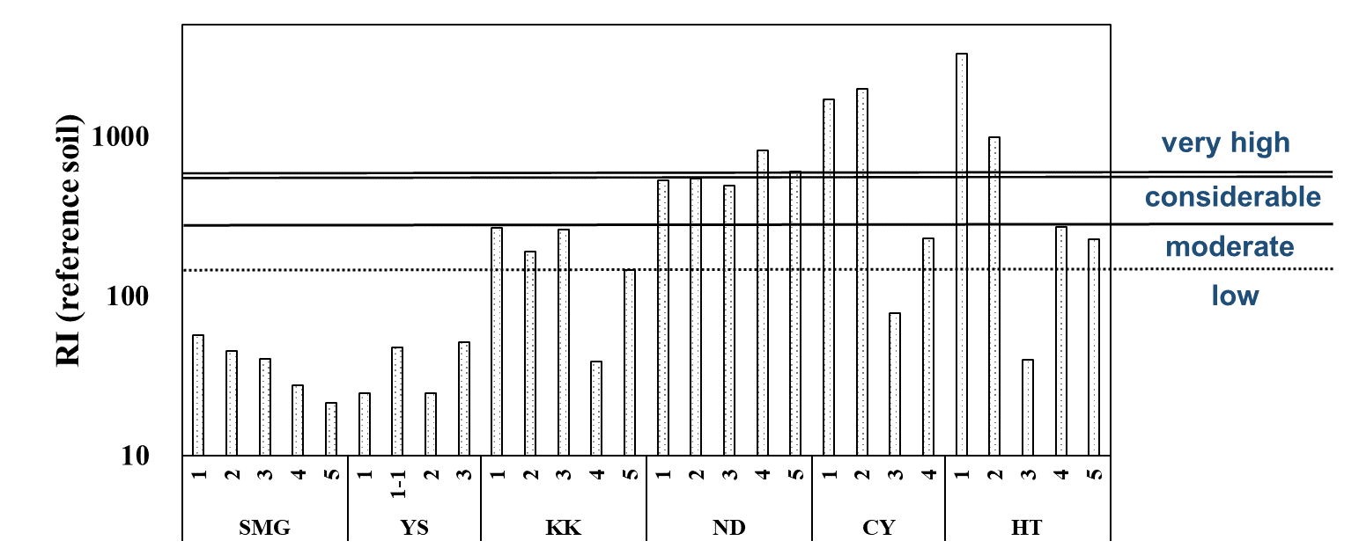
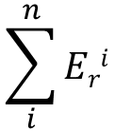
Mobility Evaluation of Heavy Metals in Sediments
Potential Ecological Risk Index (PERI) for Toxic Elements
$$\sum_{i}^{n}{Eri}$$
PERI =
C^{i}
E_{r}^{i} = T_{r}^{i}
×
( )
C_{n}^{i}
E_{r}^{i} Element-specific Potential Ecological Risk Index T_{r}^{i} Toxic Response Factor for Each Element C^{i} Measured Concentration of the Element C_{n}^{i} Background Concentration of the Element
Minimal contamination was observed based on the Korean waste leaching test method.
Several samples showed potential ecological risk in the PERI assessment.
CY-1, CY-2 and HT-1, HT-2 exhibited high risk due to geogenic contamination.
All ND samples showed elevated risk levels, likely due to their urban location.

Slide 18
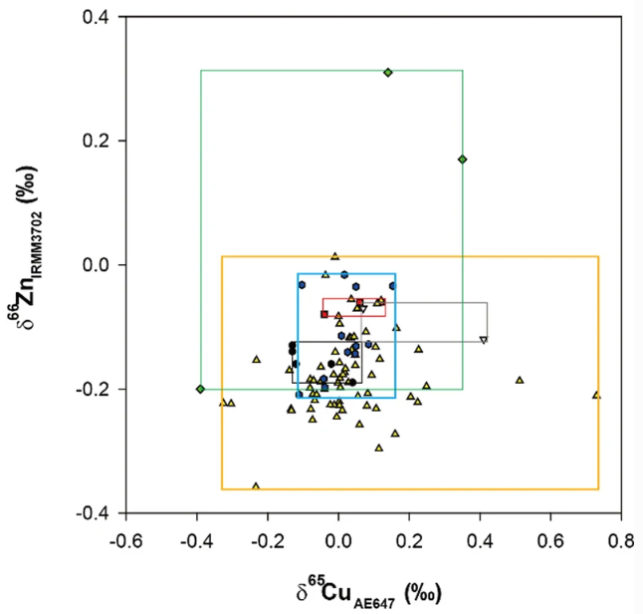
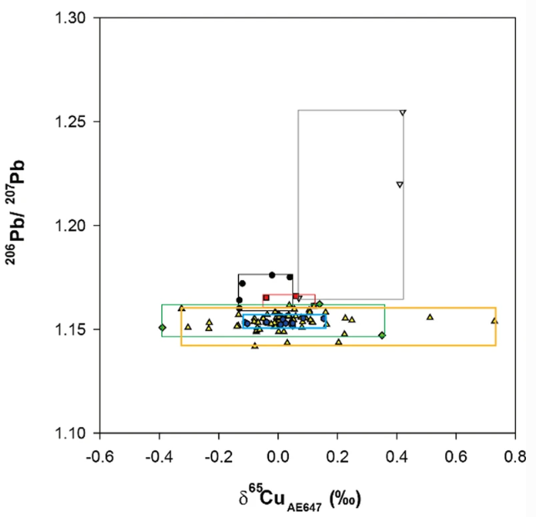
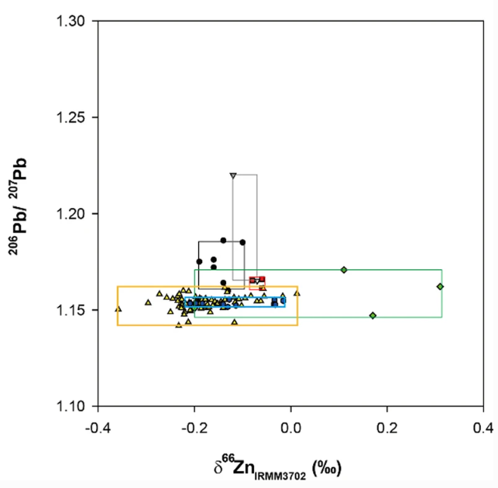
Further Study
Isotopic analysis of Cu, Pb, Zn for tracing pollution
Isotopic analysis is typically conducted using only one or two elements.
However, overlapping signatures often make it difficult to distinguish contamination sources clearly.
To improve source discrimination, isotopic ratios of Cu, Pb, and Zn will be analyzed simultaneously.
Jeong&Ra (2021) J. Anal. Sci. Technol., v.12, article n.39.
Re-analysis of Rare Earth Elements
Rare earth elements (REEs) are not fully dissolved by the standard 4-acid digestion method.
Complete dissolution often requires high-temperature fusion prior to leaching.
Re-analysis is planned using an improved method to ensure accurate REE quantification.

Slide 19
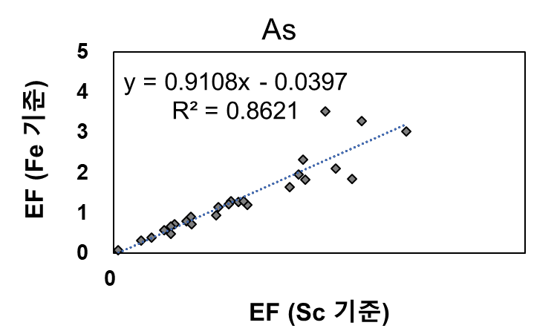
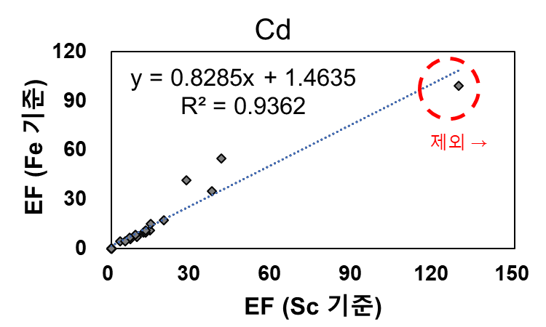
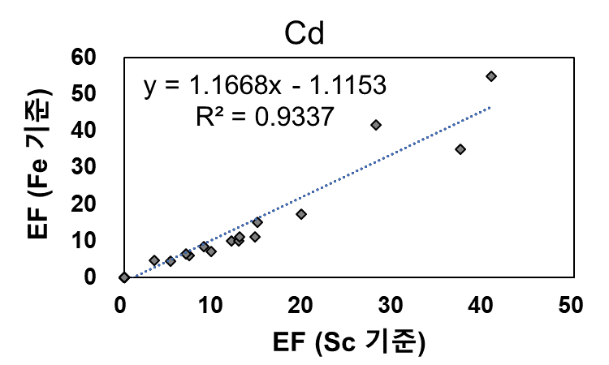
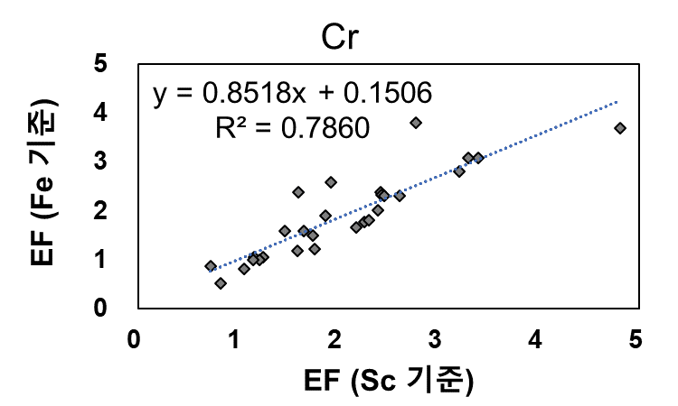
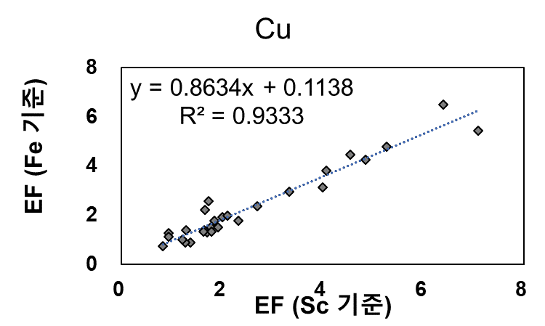




Comparison of Enrichment Factors Using Fe and Sc as Reference Elements

Slide 20



Comparison of PERI Results Based on Reference vs. Site-Specific Background Values
A comparison of PERI results based on literature reference values and locally measured background concentrations revealed an almost perfect correlation (R² = 0.9987), confirming the robustness of the background assessment.

Slide 21




Correlation Analysis Among Rare Earth Elements (REEs)

Slide 22




Enrichment Factor

Slide 23




Enrichment Factor

