Slide 1

Supplementary material
Investigating mantle dynamics and lithospheric evolution in western Canada: Insights from numerical modeling of the Cascadia subduction zone
Amar Jyoti Baruah
3rd Year PhD
Department of Physics
ajbaruah@ualberta.ca

Slide 2
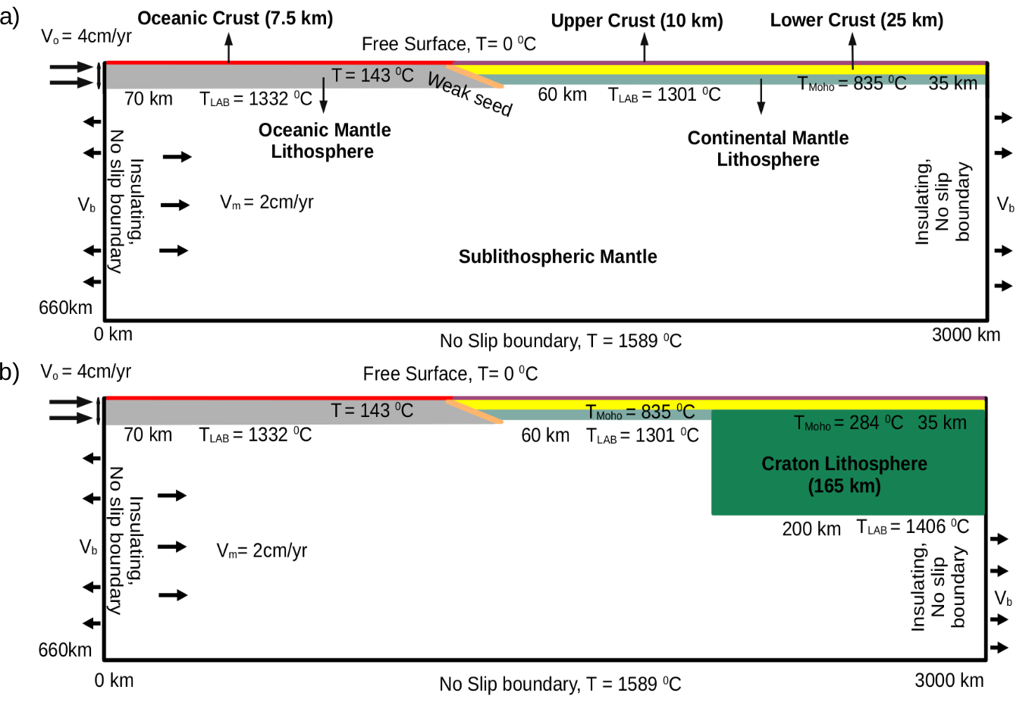
Model setup geometry

Slide 3
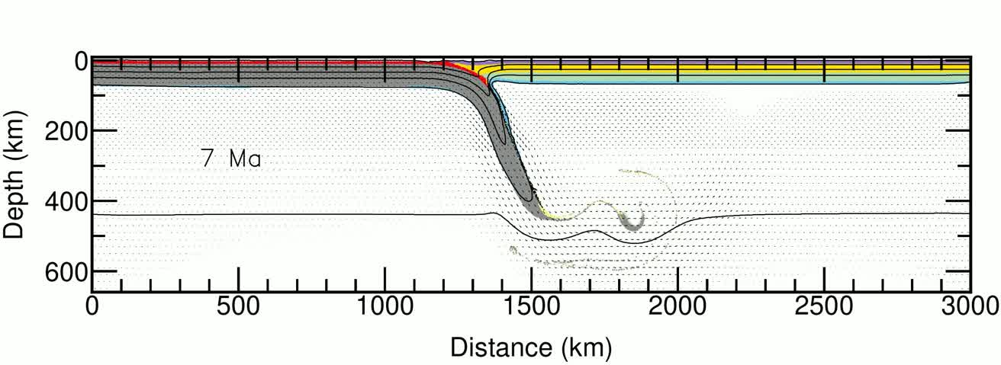
Dry mantle

Slide 4
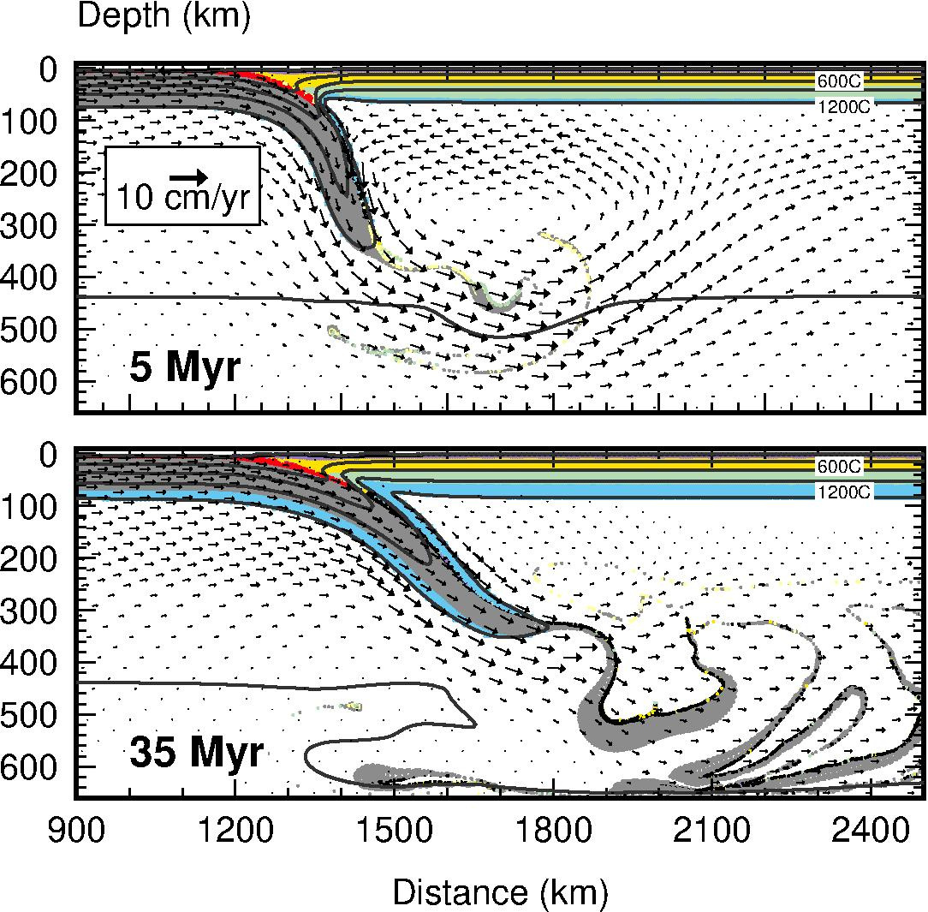
Dry mantle
corner flow only

Slide 5
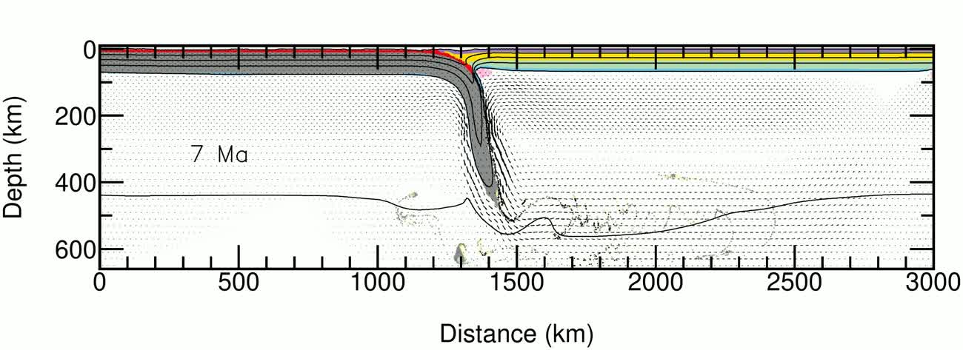
Wet mantle

Slide 6
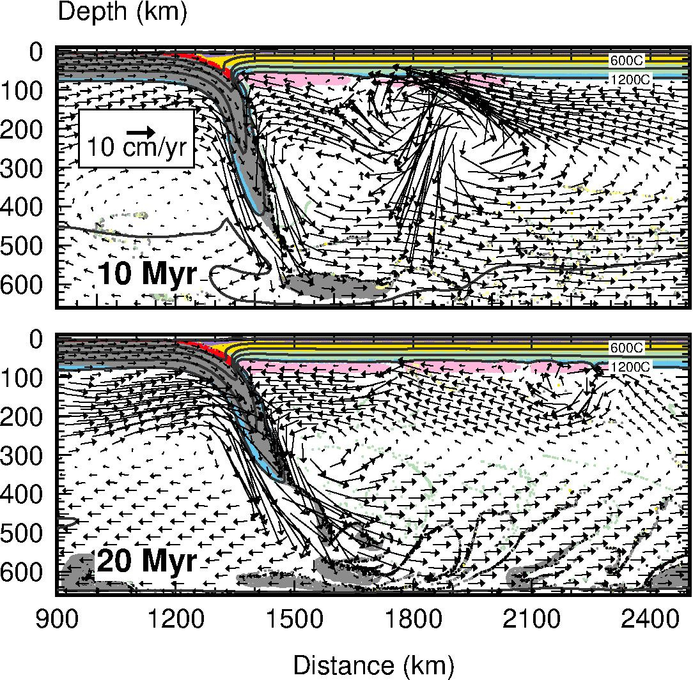
Wet mantle
corner flow and small scale convection (SSC)

Slide 7
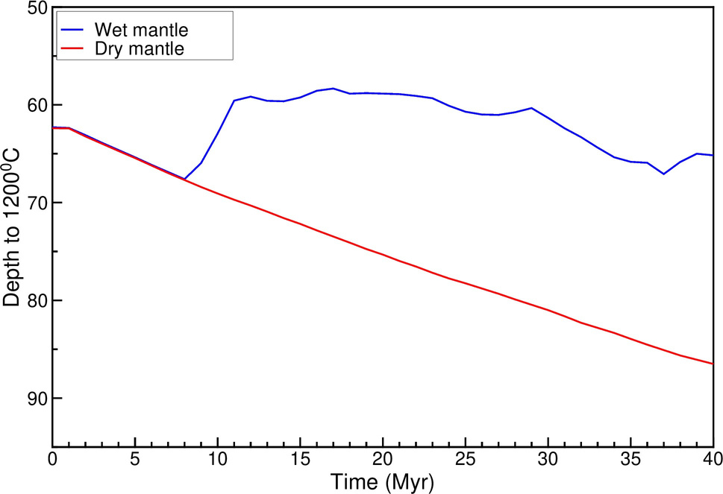
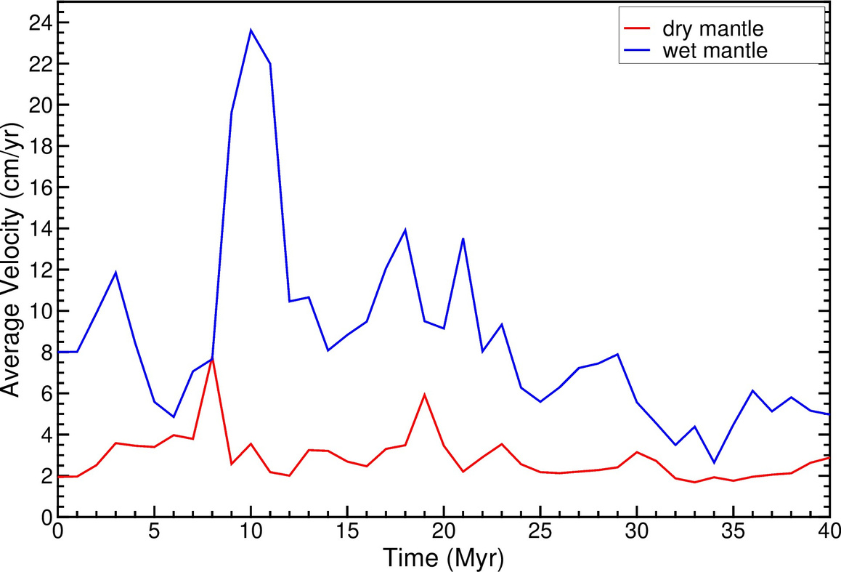
Ocean continent model

Slide 8
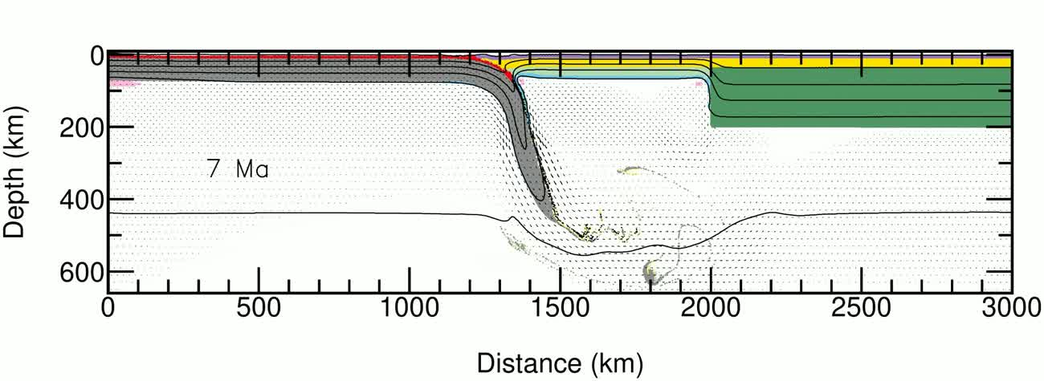
Damp mantle

Slide 9
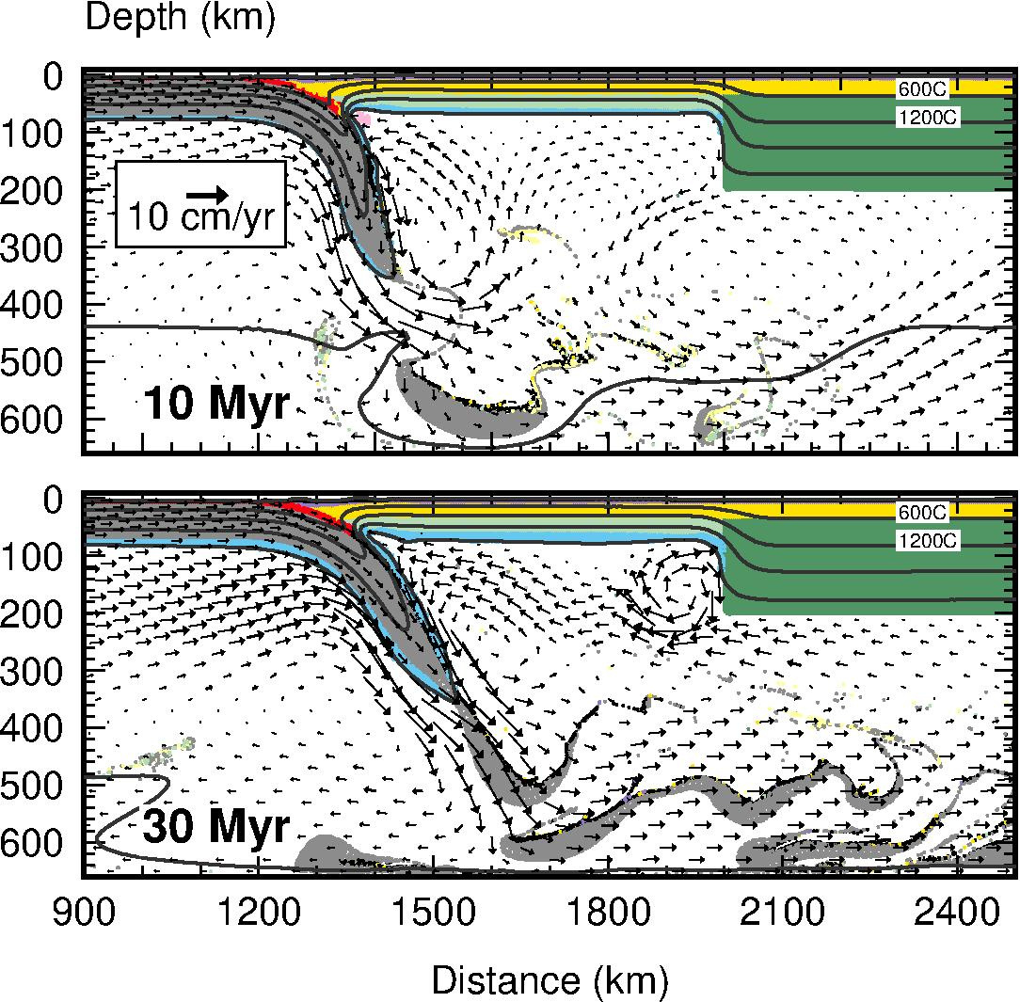
Damp mantle
corner flow, SCC and edge driven convection (EDC)

Slide 10
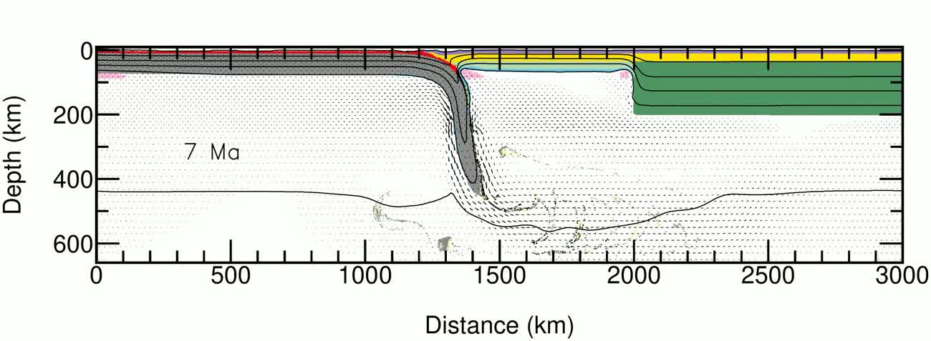
Wet mantle

Slide 11
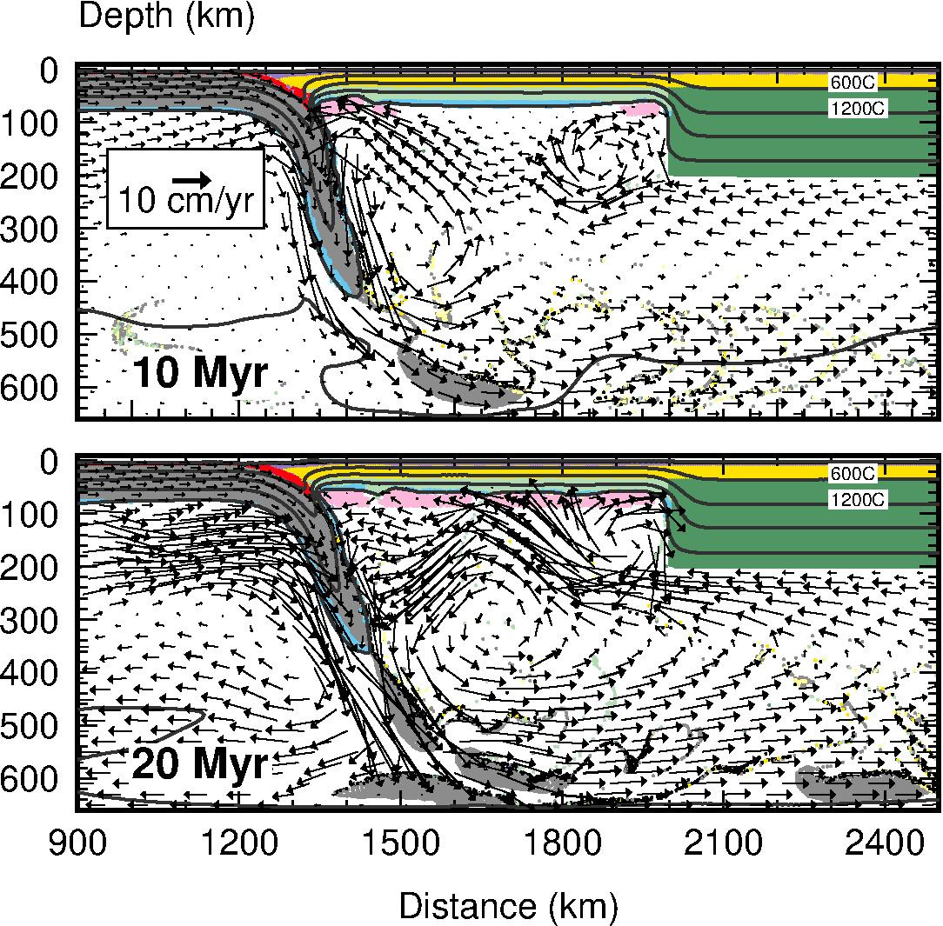
Wet mantle
Corner flow, SCC and EDC

Slide 12
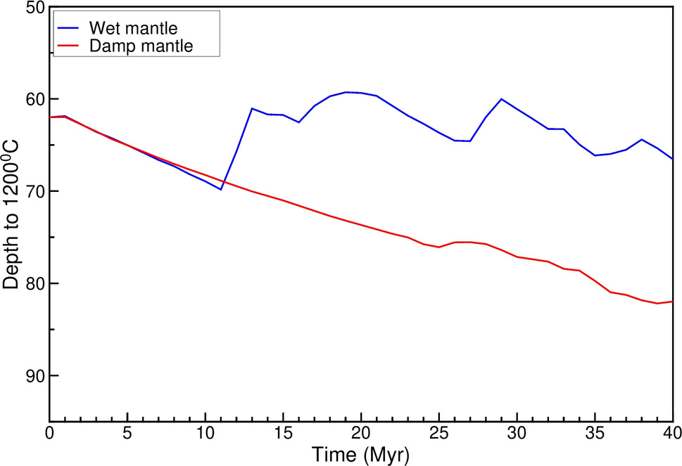
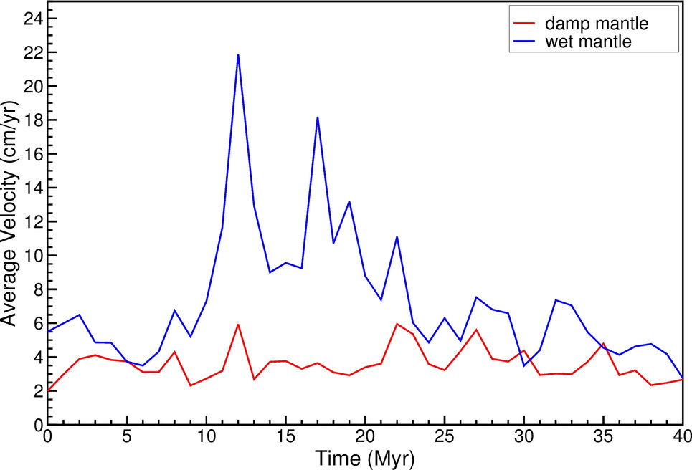
Ocean continent craton model

Slide 13
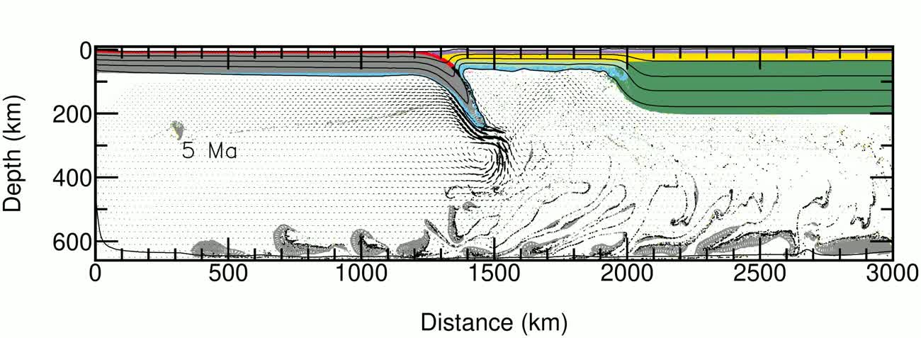
No subduction: wet mantle

Slide 14
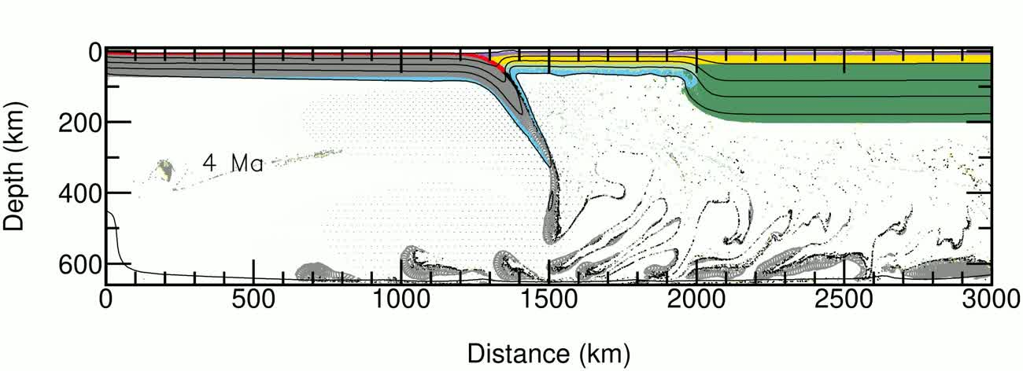
No subduction: dry mantle

Slide 15
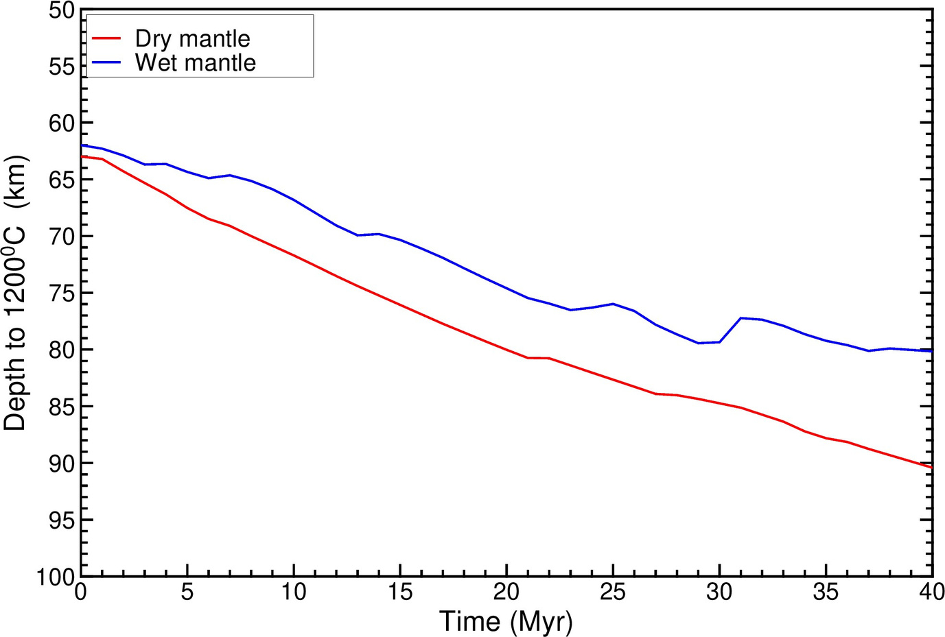
No subduction model

