Slide 1


Estimating Potential Landslides and Sedimentation in the Shimen Reservoir Watershed through Integrated Statistical and Physical Methods
Presenter：Shang-Jung Liu
Adviser：Professor Kuo-Wei Liao
Department of Bioenvironmental Systems Engineering,
National Taiwan University
1
Notes:
Hi every one ,I’m Shang-Jung Liu from NTU, today I’m going to talk about “Estimating Potential Landslides and Sedimentation in the Shimen Reservoir Watershed through Integrated Statistical and Physical Methods”

Slide 2
Content
Introduction
Study Area
Research Methods and Processes
Results
Conclusions
Q&A
2
Notes:
And, here is today’s content. I will follow it to introduce my research.

Slide 3
1.Introduction
3

Slide 4
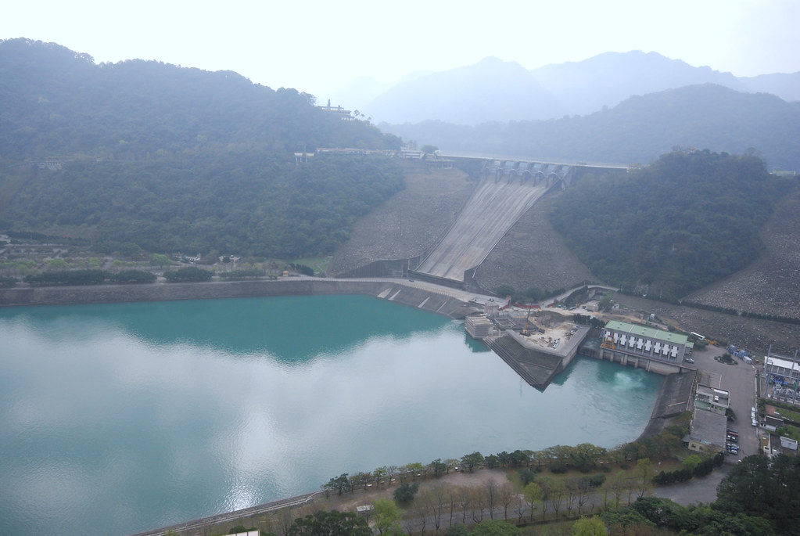
Background
Taiwan's terrain is narrow and steep, with fast-flowing rivers. We need to build reservoirs to supply enough water for the public, agriculture, and industry.
However, the construction of reservoirs has reached saturation, and initial planning for silt removal was inadequate. Since construction, one-third of the reservoir capacity has been silted.
4
Notes:
Taiwan is in subtropical monsoon climate, and we have a lot of high mountain, so ,our average precipitation per year is higher than world’s average
However, due to the terrain and shape of Taiwan, we can’t help but build as much reservoir as possible to supply water for public, agriculture and industry.
In 1969, 2001, 2004 and 2009, there are four typhoon seriously injury the reservoir.
Although the government estimate the sedimentation by measuring the riverbed, it is still hard to know how much soil bringing from upstream.
Most of the designer didn’t have a well prepare for releasing tons of soil coming from upstream area.
For Shimen reservoir, which build 60 years ago, the capacity is two –third left.(40s)

Slide 5
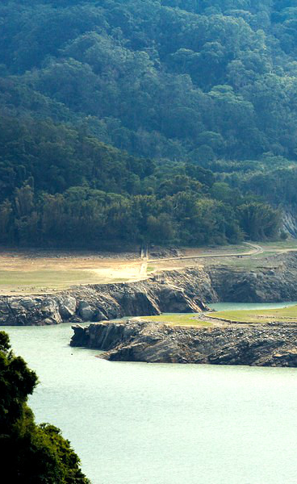
Research Objectives
Objectives：
Estimate the soil erosion and landslide sediment volume.
To understand the potential of landslides in Shimen reservoir.
Compare the data with the research before.
Establish ways to predict the sedimentation in whole watershed by part of it.
5
Notes:
Therefore, this study aims four objective.
The first one is to estimate the soil loss and landslide sediment volume in the upstream area of the reservoir.
The Second is to analyze the risk of landslide.
And Compare the data with the research before.
And the other one is establish ways to predict the sedimentation in whole watershed by part of it

Slide 6
2. Study Area
6
Notes:
So, let me introduce our study area

Slide 7
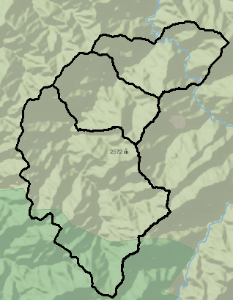
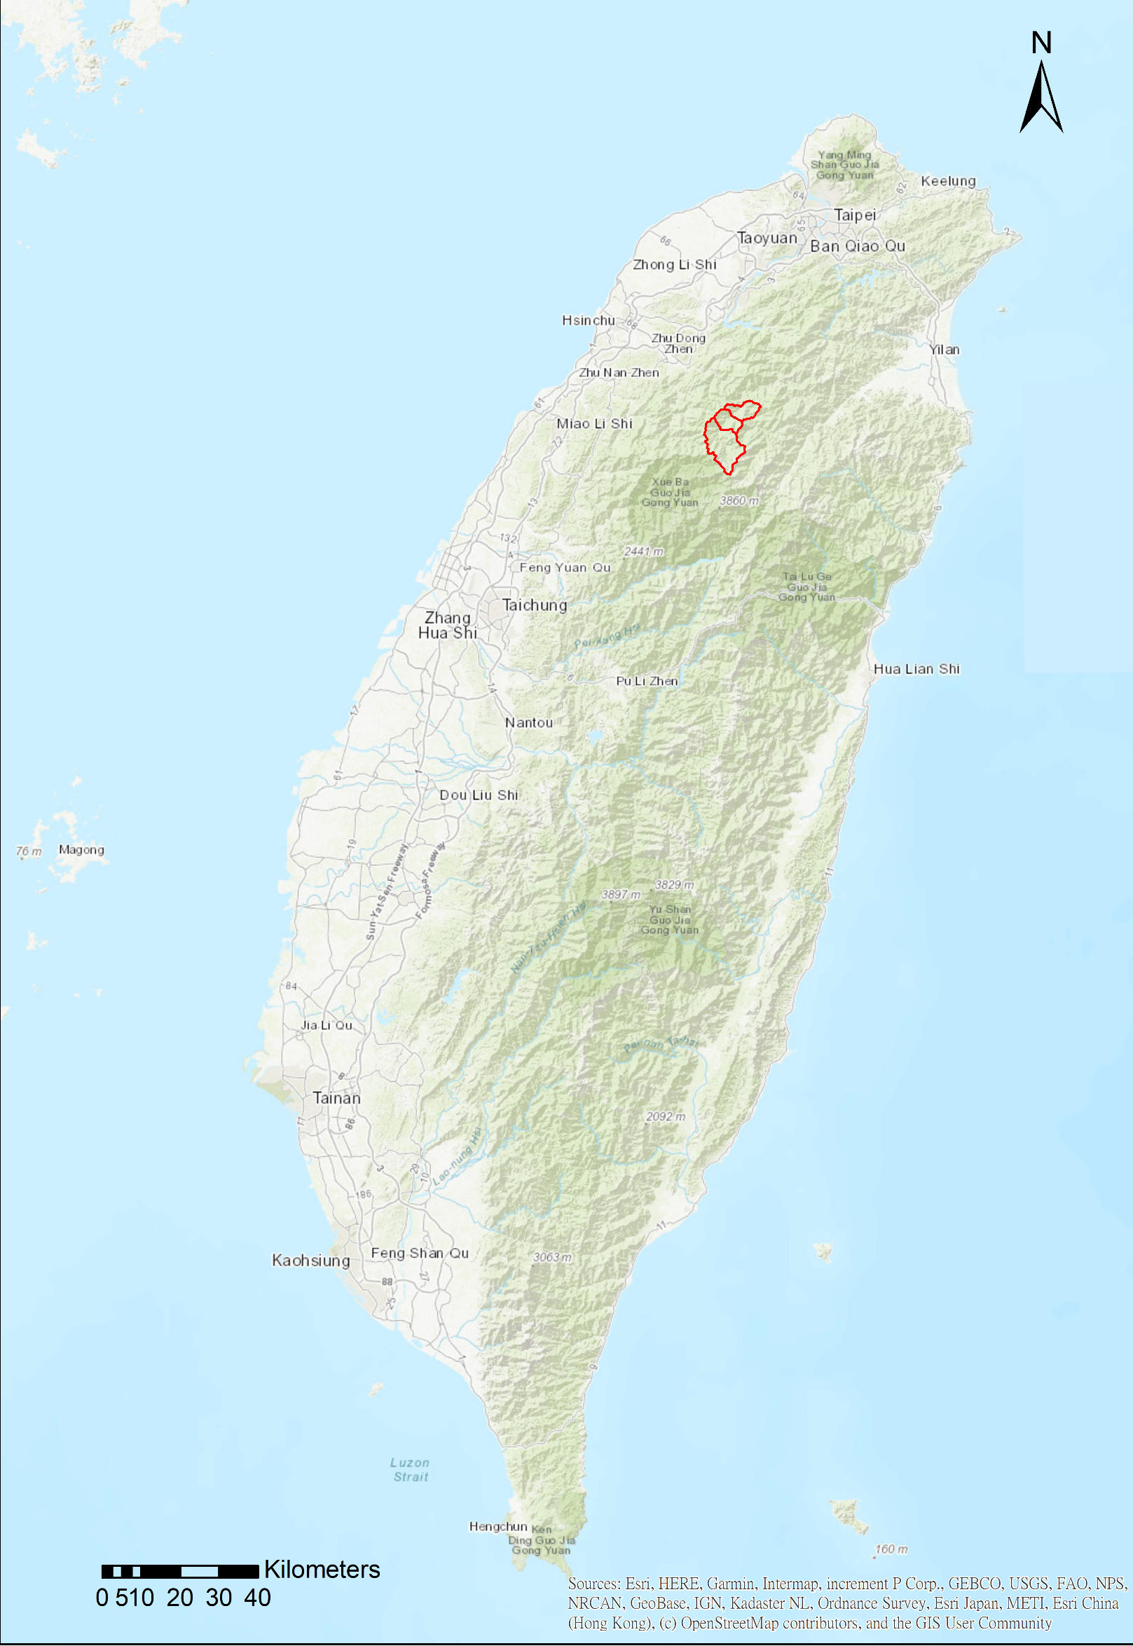
Shimen Reservoir Watershed
Xiuluan
Yanlao
Location: Located in northern Taiwan.
Climate: Experiences abundant rainfall throughout the year.
Upstream Area: Surrounded by mountains, including three cities, Taoyuan, Hsinchu and Yilan.
Downstream Area: Features a mosaic landscape of farmland, urban areas, and irrigation channels.
Management: Reservoir undergo management efforts by government
Supply area: Mainly supply New Taipei, Taoyuan and Hsinchu city.
Sqzyacing
Upstream area
7
Notes:
Shimen reservoir is one of the most important reservoir located in north of Taiwan.
The reservoir have five main functions： water supply, flood control, hydropower generation, irrigation and tourism.
In this figure, these three watershed is our sampling area in the upstream area.
儲水、發電、供水、防洪、觀光休憩

Slide 8
3. Research Methods and Process
8
Notes:
Now, we are going to talk about Research Methods and Process.

Slide 9
Process
Soil erosion
factor
USLE
Soil loss
Calculate the entire watershed
Find out Soil source
Landslide
factor
Landslide
area
Probability of lanslide
Landslide
volume
9
Notes:
First, we have to find out soil source. We separate into two part, one is soil loss and the other is landslide.

Slide 10
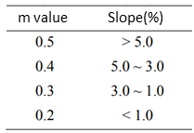



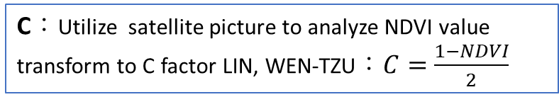





USLE formula solving by Arc GIS
Flowchart
Description
$$Am=Rm×Km×L×S×C×P$$
The slope unit length divided by GIS should shorter than 100m,in this research, the slope unit is 20m$×$20m as the cell size of DEM.
Rm：Use the data from Soil and water conservation agency(2017-2019) ,include 323 point. Calculate sampling area using the inverse distance weighting (IDW) method."
Km：Use the data from Soil and water conservation agency(2017-2019) ,include 526 point. Calculate sampling area using the inverse distance weighting (IDW) method."
L ：Use flow accumulation in GIS to approach slope length, then use the formula establish by Wischmeier and Smith(1965):
S ：The average slope in study area is more than 18%,so chose the formula established by McCool et al(1987) ：
Start
Divide area into
pieces as slope unit
Collect different factors data
Check all
parameter
$$L={\left(\frac{λ}{22.13}\right)}^{m}$$
$(λ$ ：slope length ;
m value： )
Power all factors together to estimate sediment yield
Long slope
Short slope
$$S=10.8sinθ+0.03$$
$$θ<9\%$$
N
If the result is normal
$$S=16.8sinθ−0.50$$
$$θ≥9\%$$
$$S=3{\left(sinθ\right)}^{0.8}+0.56$$
L<4m
Y
C：Utilize satellite picture to analyze NDVI value transform to C factor LIN, WEN-TZU：$C=\frac{1−NDVI}{2}$
P：Assume that the place don’t have any support practice. P=1
End
10
Notes:
We solve USLE formula by arcgis. First, I divided the sampling area into pieces as slope unit .
Then we move forward to the rainfall erosivity factor(Rm) and soil erodibility factor(Km).
They are from Soil and water conservation agency’s public data.
Both of them using inverse distance weighting method to calculate sampling area .
And slope length factor L use the formula establish by Wischmeier and Smith.
In this formula, it is hard to estimate the slope length $λ$, so we utilize flow accumulation power slope unit size to approach.
For the slope steepness factor S, because the sampling area’s average slope is more than 18%, McCool’s formula is more suitable.
The cropping management factor C use NDVI value to transform.
And conservation practice factor P .Assume that the place don’t have any support practice. P=1
R = rainfall erosivity factor
K = soil erodibility factor
L=slope length
S = Slope steepness factor
C = cropping management factor
P = conservation practice factor

Slide 11
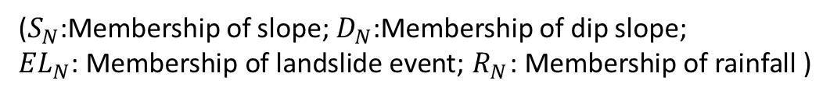
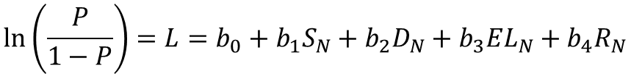

Probaibility of Landslide solving by Logistic regression
Flowchart
Description
Start
Divide DEM into
pieces as slope unit
Assume the expected value (E) of landslide is：
$$E\left(Y=1\right)=P=\frac{1}{1+e^{−L}}=\frac{e^{L}}{1+e^{L}}$$
Collect different factor data and normalize
(P:possibility of landslide; L:multiple variables)
Build the likelihood function
$$\ln\left(\frac{P}{1−P}\right)=L=b_{0}+b_{1}S_{N}+b_{2}D_{N}+b_{3}{EL}_{N}+b_{4}R_{N}$$
Use Maximum likelihood estimate to solve
(Excel)
($S_{N}$:Membership of slope; $D_{N}$:Membership of dip slope;
${EL}_{N}$: Membership of landslide event; $R_{N}$: Membership of rainfall )
Adjust the factor to get high reliability
N
If the result is reliable
Evaluate the performance of validation and model with Confusion Matrix.
Y
End
11
Notes:
Next, we use logistic regression to predict the risk of landslide.
.Assume the expected value (E) of landslide as this formula,
Then, take the logarithm of the odds to Build the likelihood function.
And Using Maximum likelihood estimate to calculate.
Over all, we Evaluate the performance of validation and model with Confusion Matrix

Slide 12
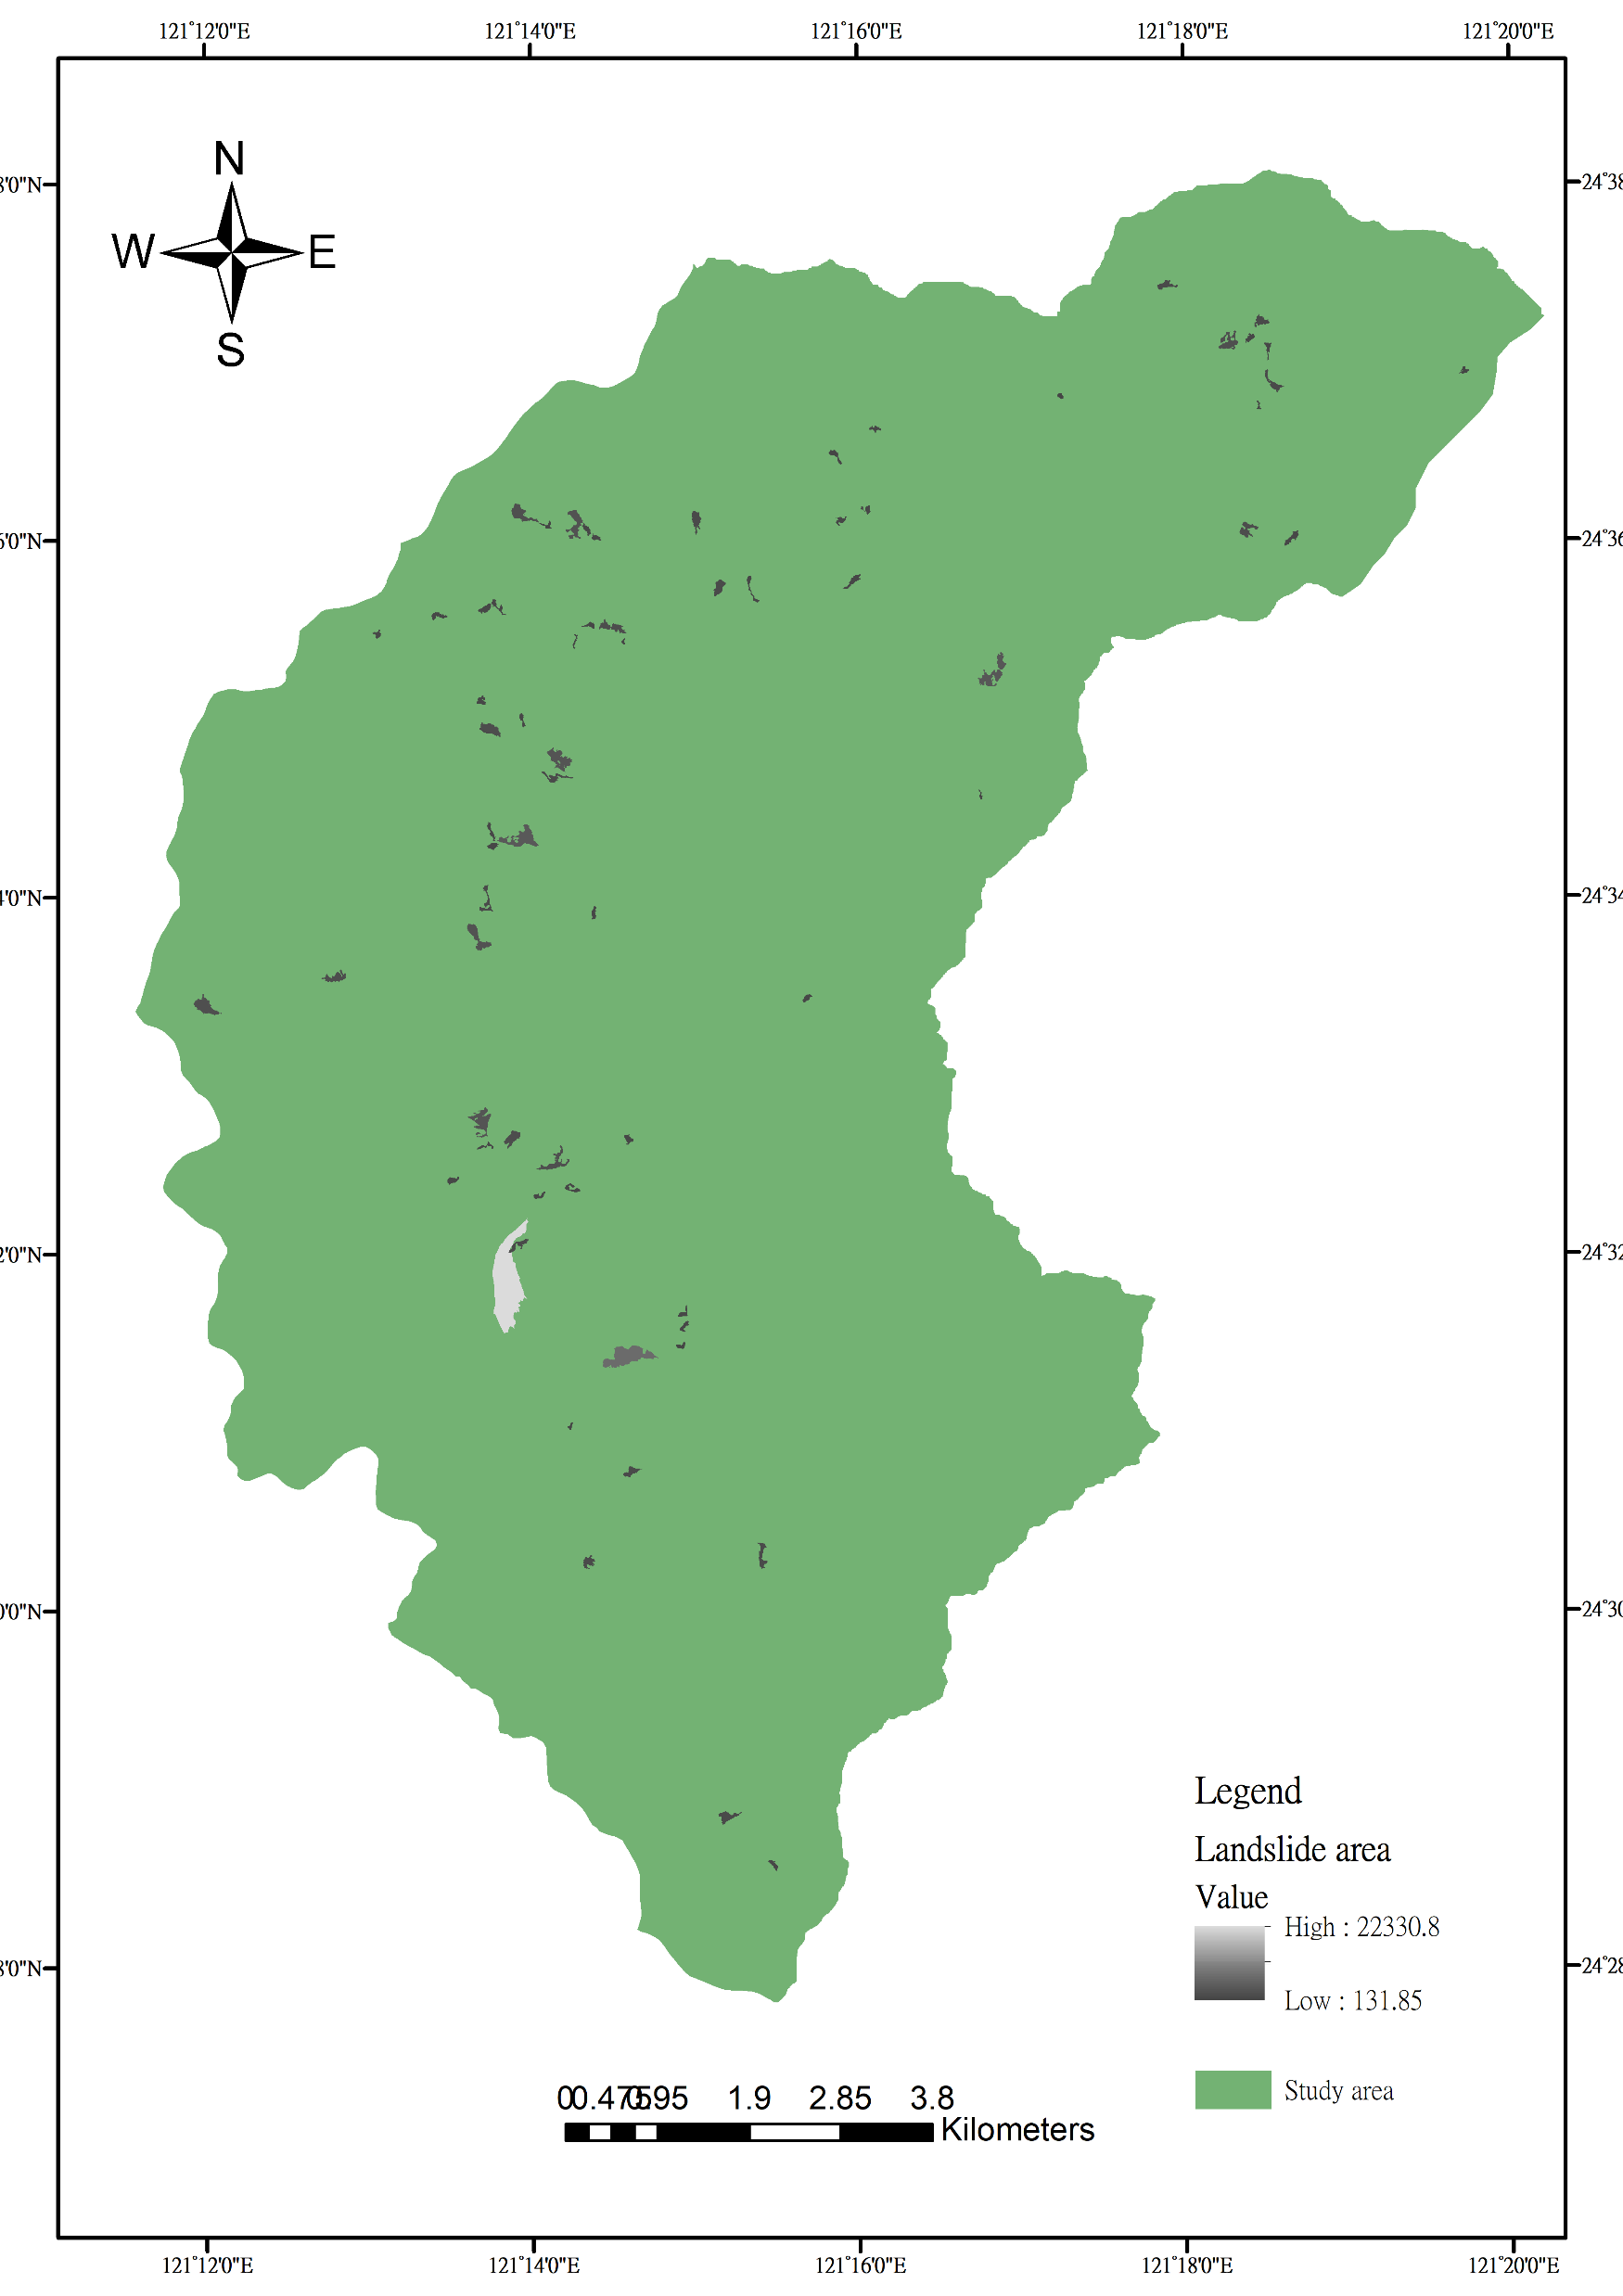
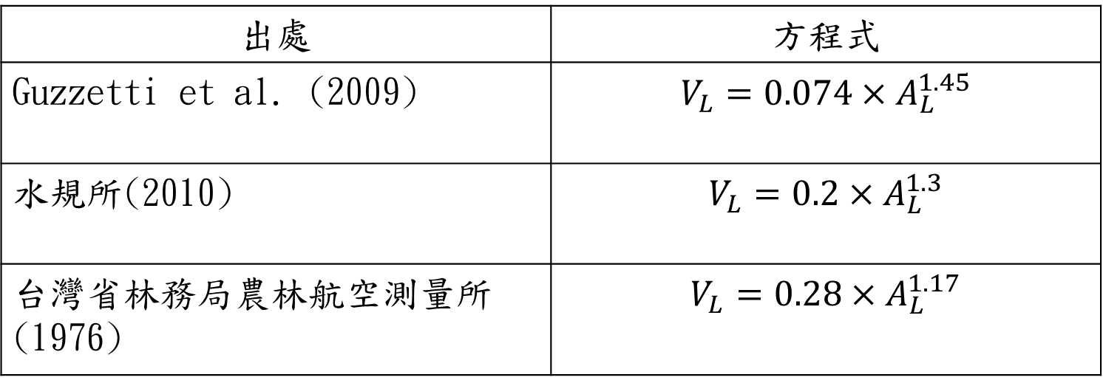

Landslide volume solving by Arc GIS
Flowchart
Description
Start
Collect landslide data
Source
Formula
Sum up to get the average landslide area
Guzzetti et al.(2009)
Water Resources Agency(2010)
Put into transform function
Aerial Survey and Remote Sensing Branch(1976)
End
Landslide area $A_{L}$ (2009-2018)
12
Notes:
NEXT, we are going to evaluate the landslide sediment volume.
By collating ten years landslide area date, the black and white area shows in this figure, taking the average and put into this formula, established by water resource agency.
We can simply get the landslide sediment volume.

Slide 13
4.Results
13
Notes:
The following section presents the research findings.

Slide 14
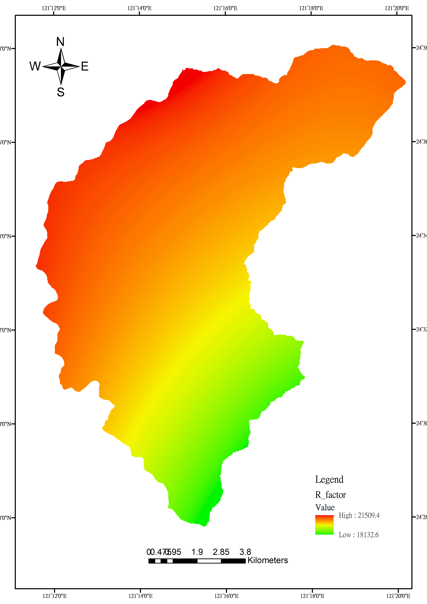
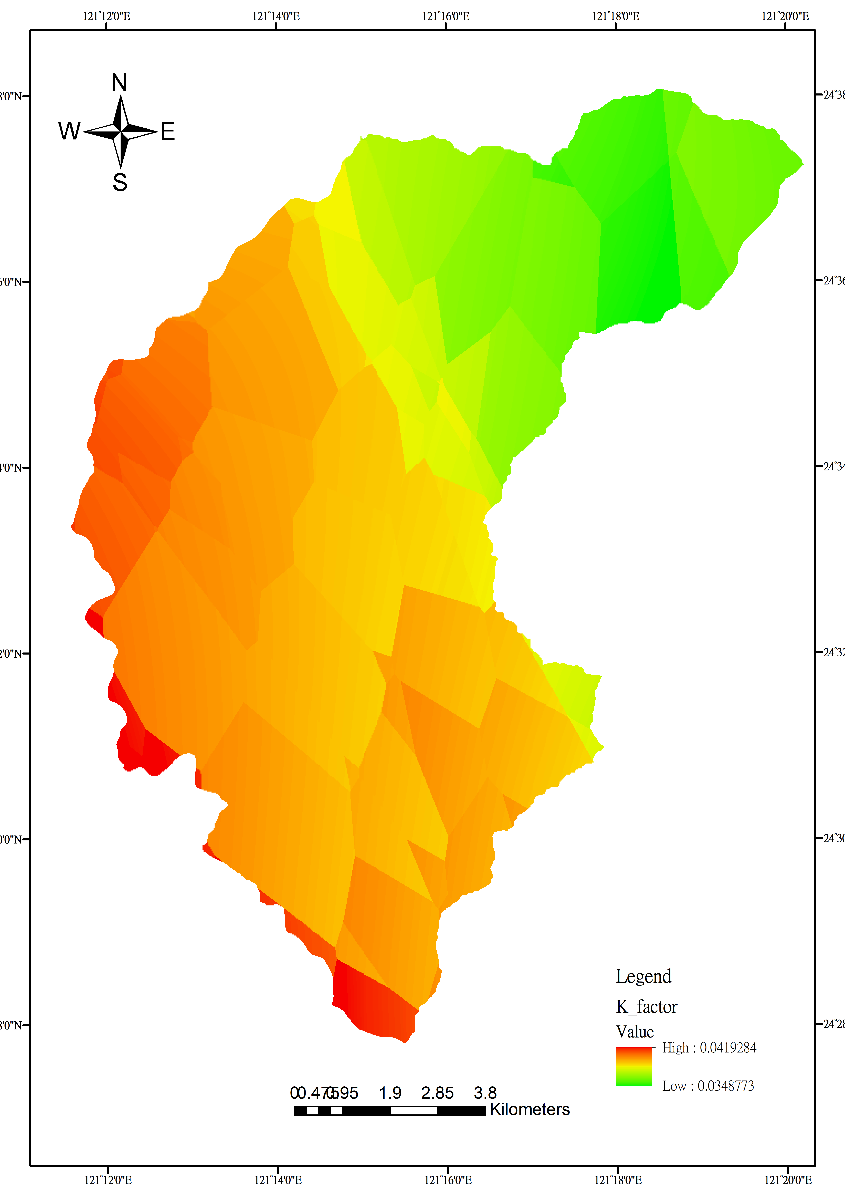
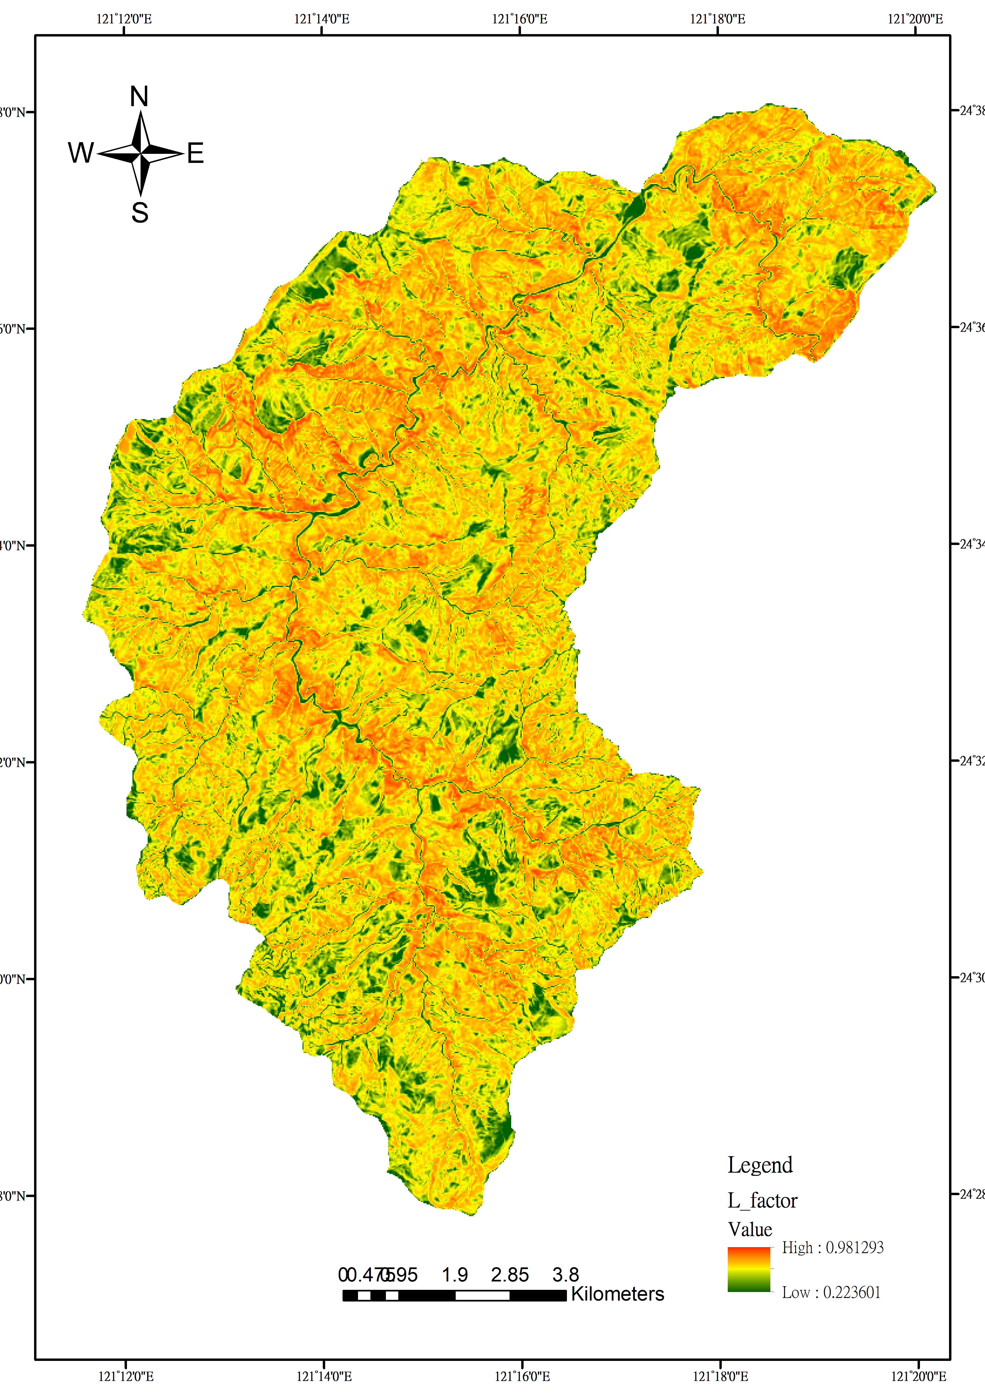
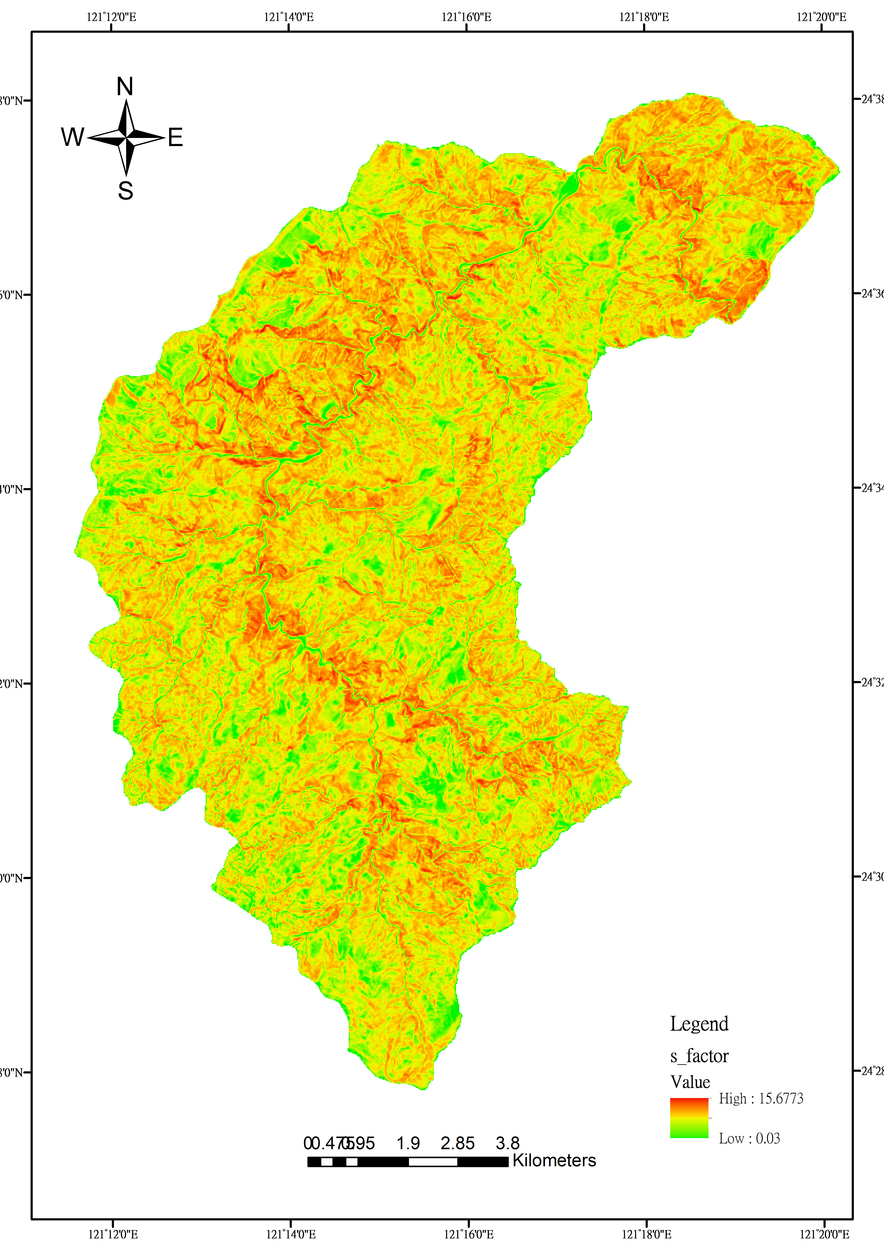
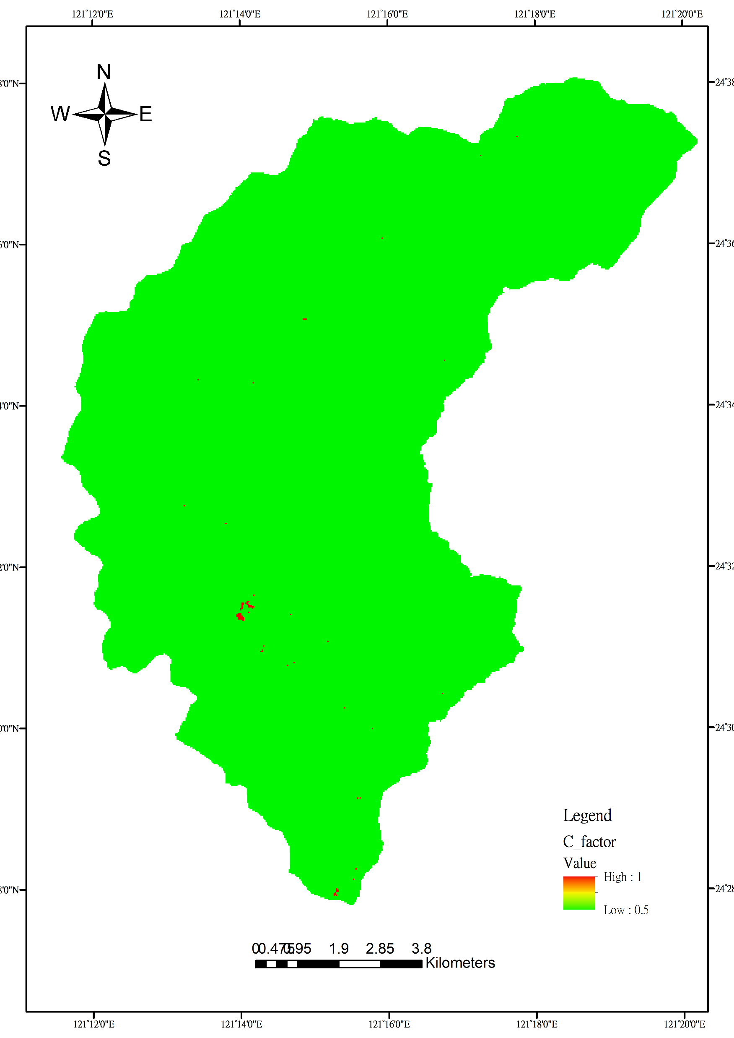



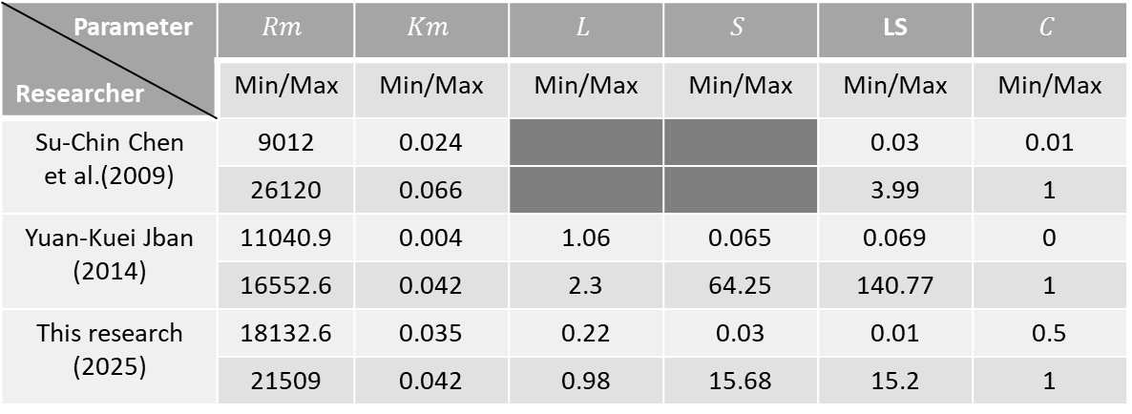


Soil loss and landslide estimation
Compare soil erosion and landslide in one hectare per year：
Compare soil erosion factors with other researchers：
 | Soil loss | Landslide
Minimum | 0.434 | 2851.505
Maximum | 2204 | 2251879
Sum | 94607238 | 14577973200
Mean | 281.41 | 613946.08
Standard Deviation | 101.25 | 913175.01
Parameter Researcher | $$Rm$$ | $$Km$$ | $$L$$ | $$S$$ | LS | $$C$$
 | Min/Max | Min/Max | Min/Max | Min/Max | Min/Max | Min/Max
Su-Chin Chen et al.(2009) | 9012 | 0.024 |  |  | 0.03 | 0.01
 | 26120 | 0.066 |  |  | 3.99 | 1
Yuan-Kuei Jban (2014) | 11040.9 | 0.004 | 1.06 | 0.065 | 0.069 | 0
 | 16552.6 | 0.042 | 2.3 | 64.25 | 140.77 | 1
This research (2025) | 18132.6 | 0.035 | 0.22 | 0.03 | 0.01 | 0.5
 | 21509 | 0.042 | 0.98 | 15.68 | 15.2 | 1
$$Rm$$
$$Km$$
$$L$$
$$S$$
$$C$$
14
Notes:
In this table on the left, it is apparently that landslide volume is larger than soil erosion in any numbers.
In this table on the right, our rainfall erosivity factor Rm is higher than others.
And cropping management factor C ‘s Minimum is higher too.
(Usle/1.4)*0.15
Landslide*25(ha)

Slide 15
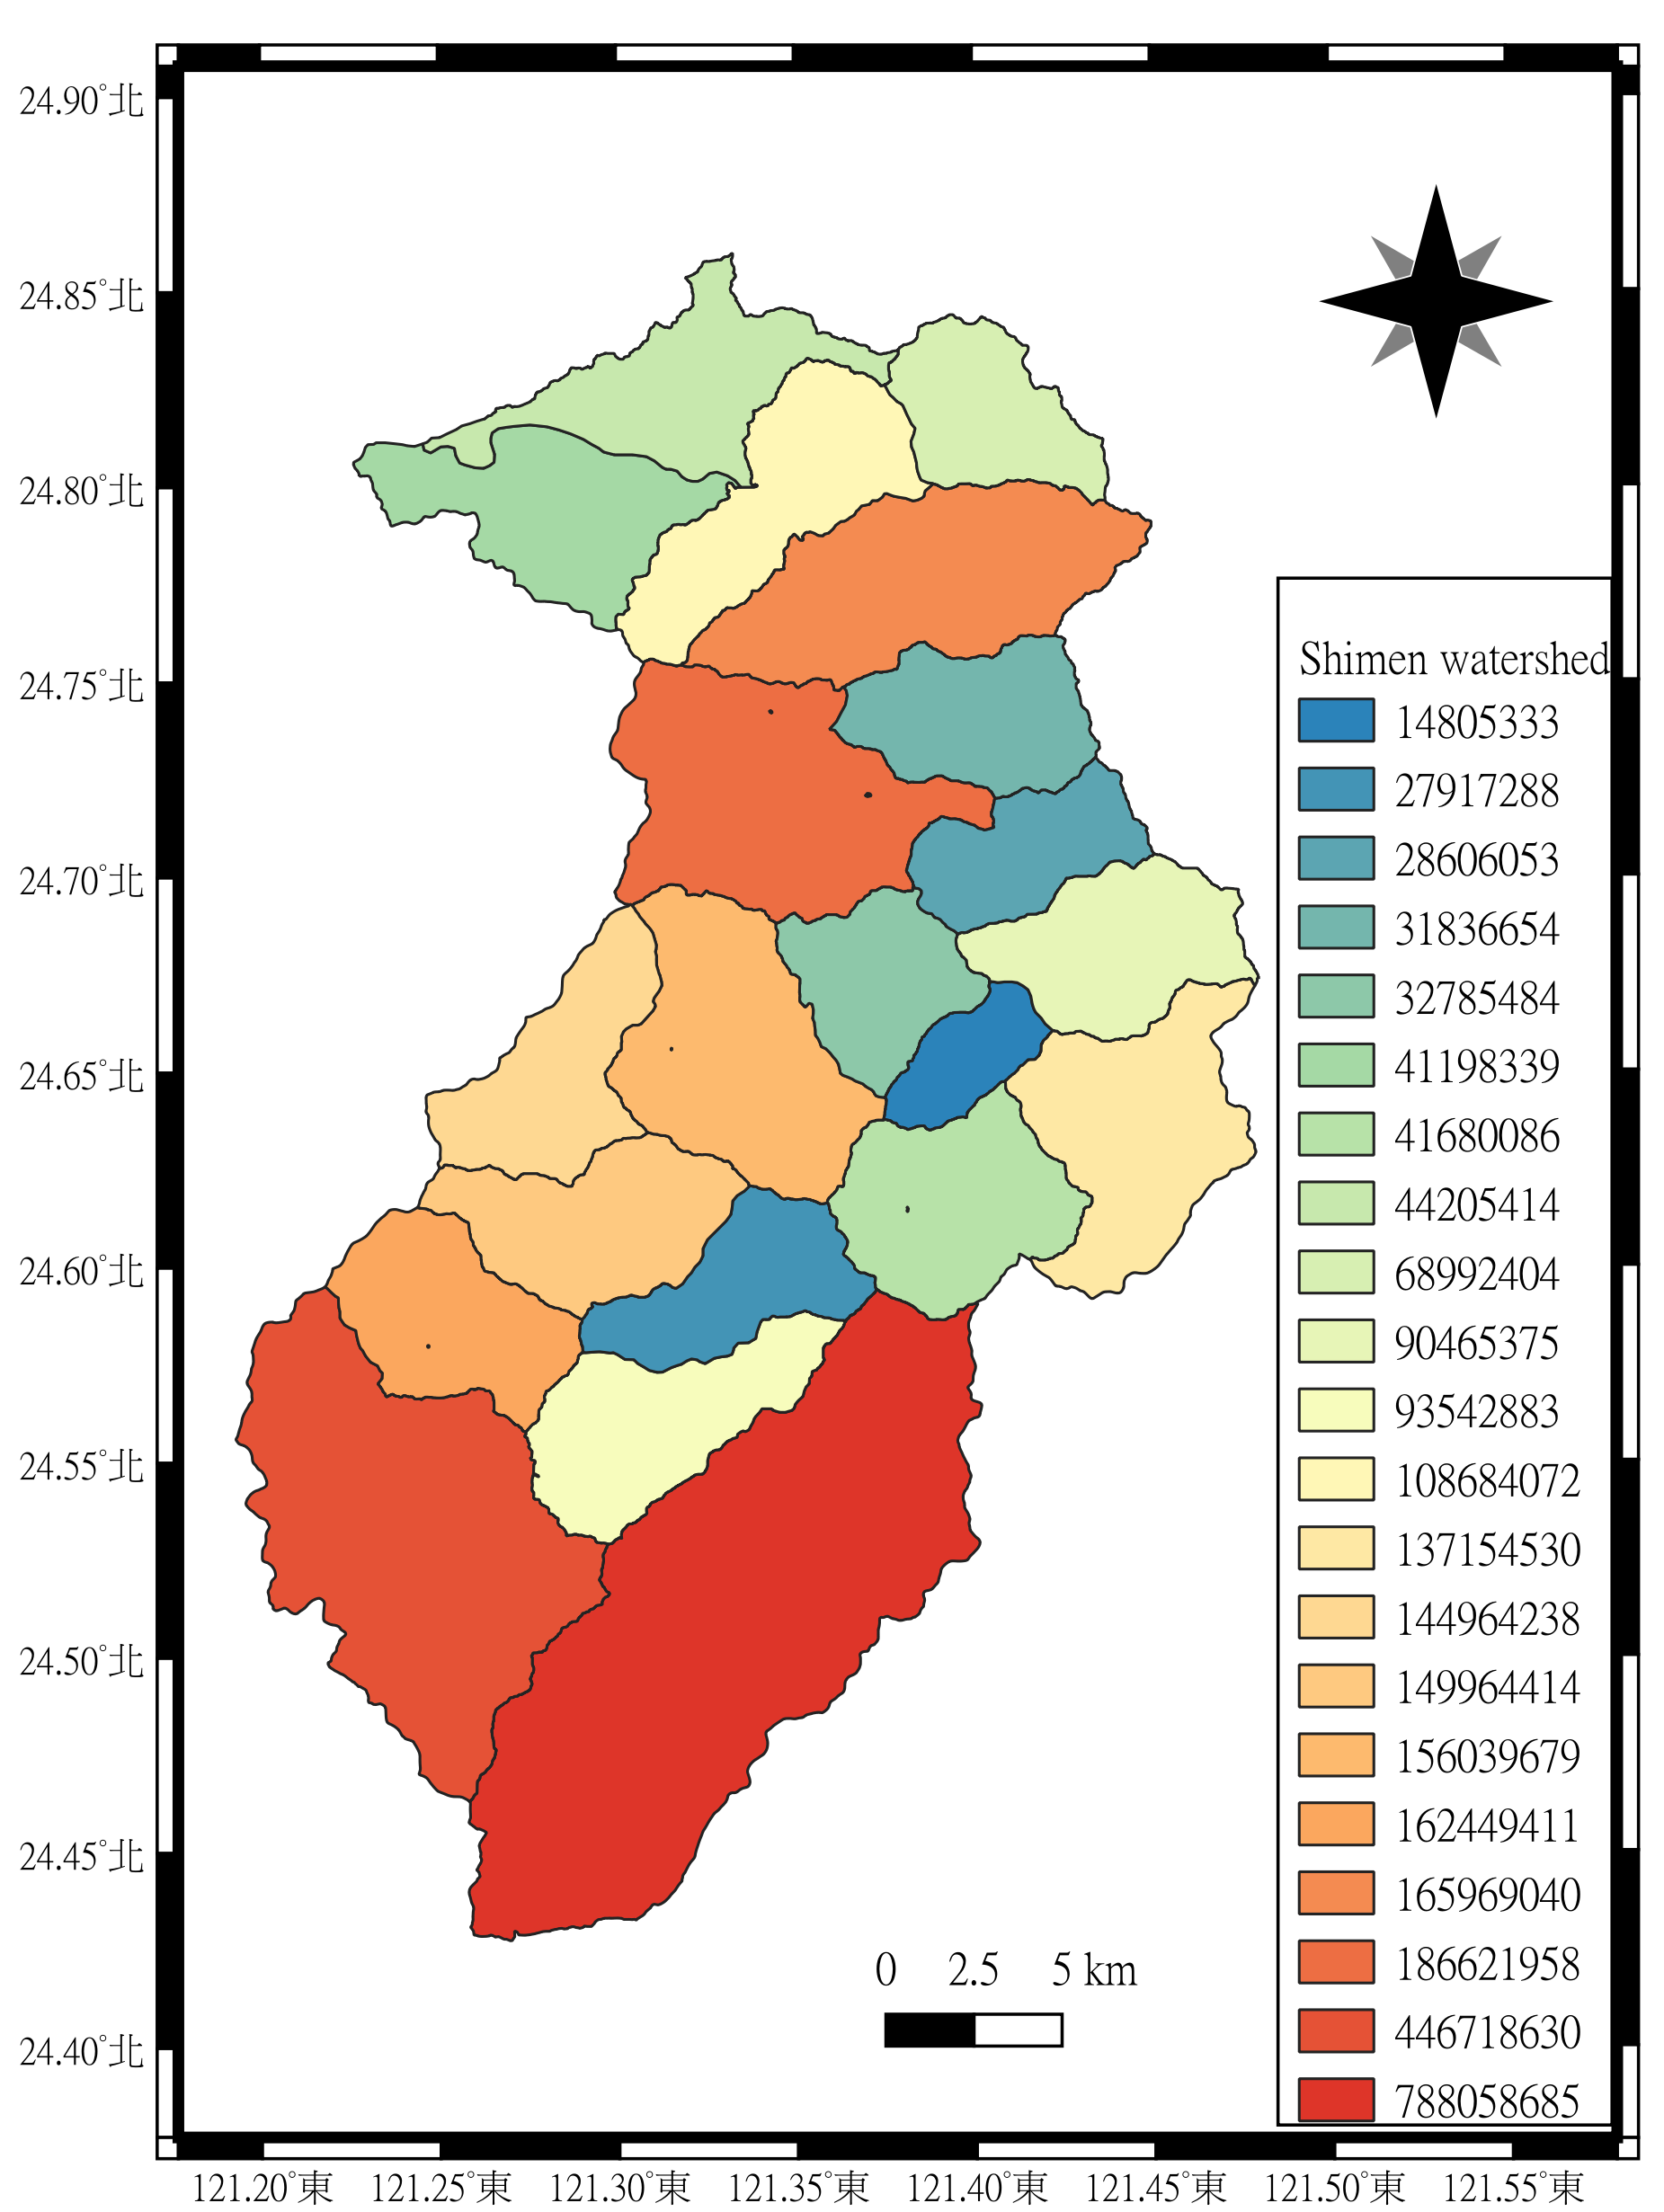
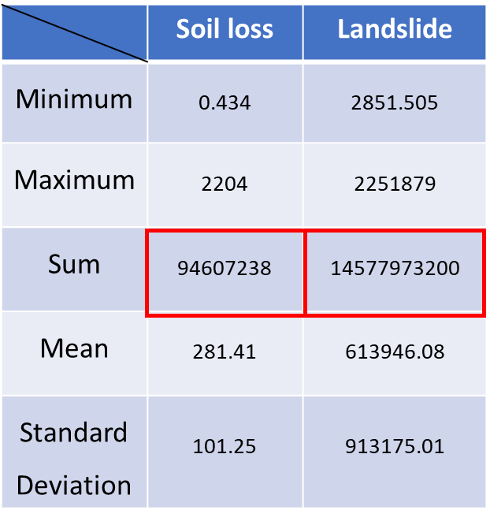
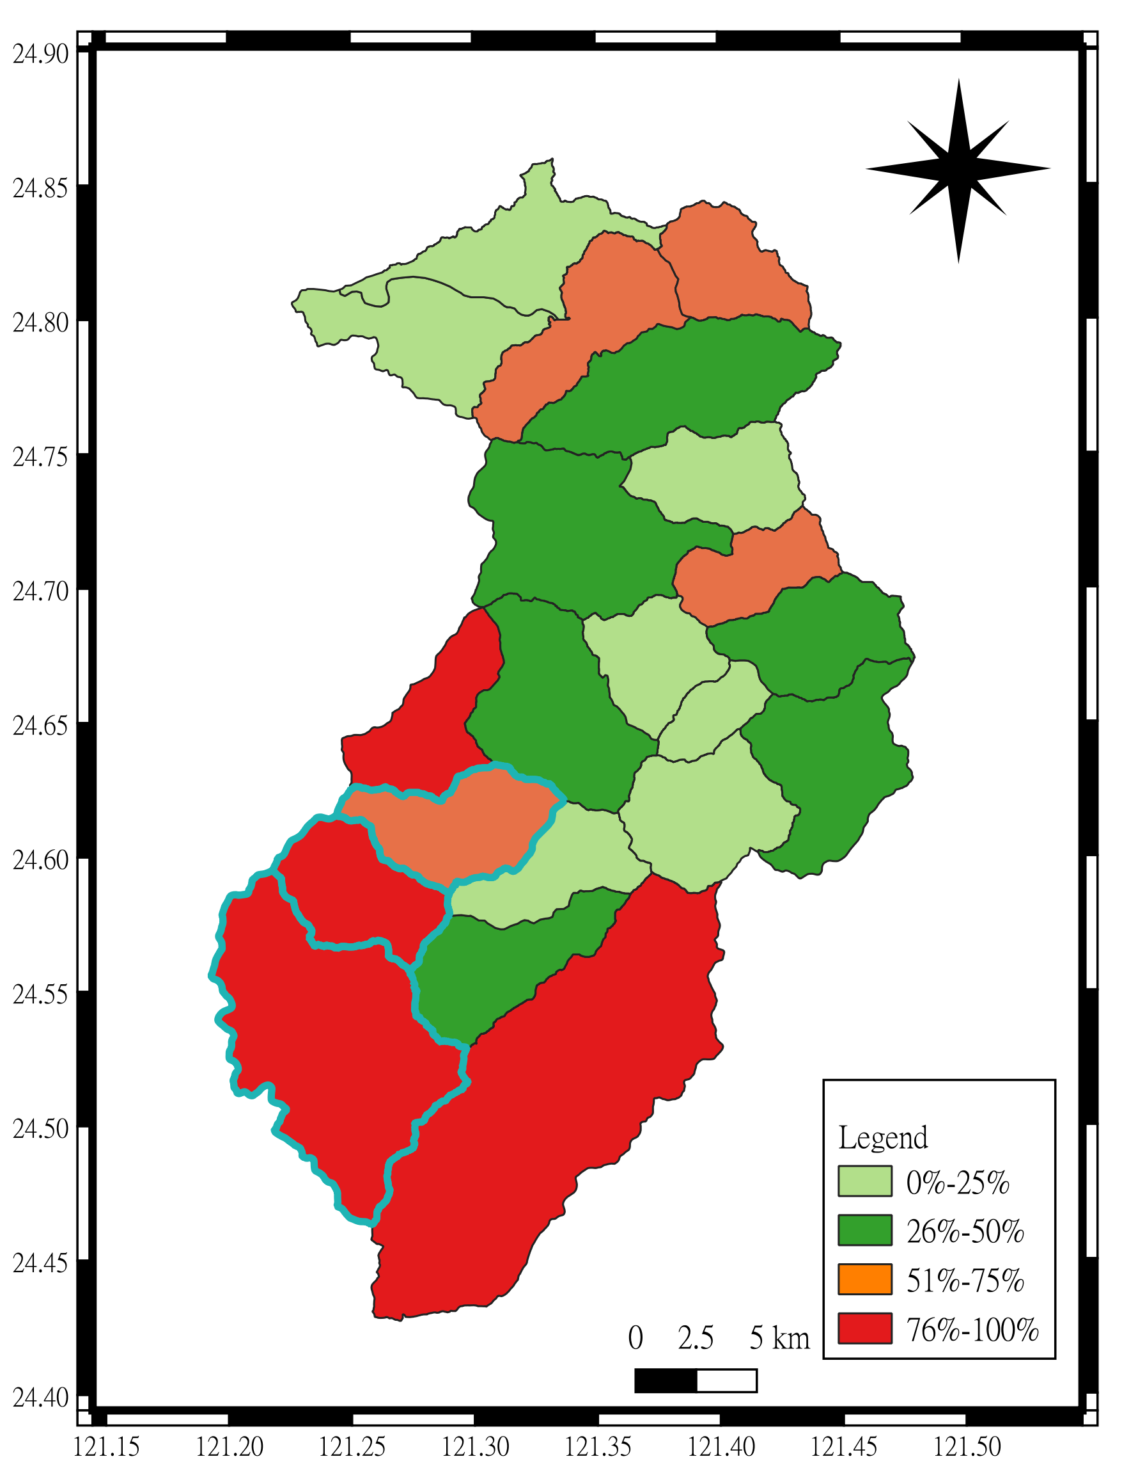
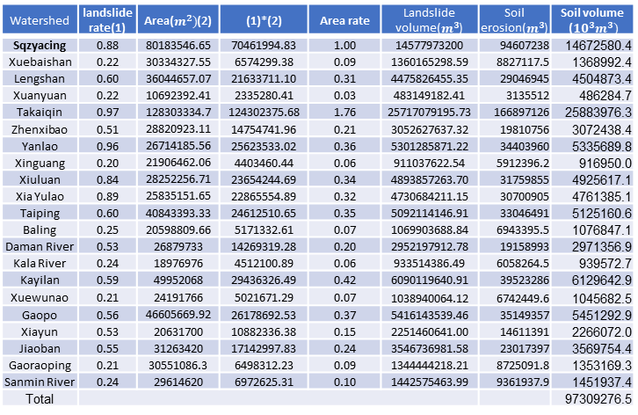
Probability of Landslide
Confusion Matrix
There are 7 rainfall event, 6 for training, 1 for validation.
Training
Validation
Training + Validation
Watershed | landslide rate(1) | Area($m^{2})$(2) | (1)*(2) | Area rate | Landslide volume($m^{3}$) | Soil erosion($m^{3}$) | Soil volume (${10}^{3}m^{3})$
Sqzyacing | 0.88 | 80183546.65 | 70461994.83 | 1.00 | 14577973200 | 94607238 | 14672580.4
Xuebaishan | 0.22 | 30334327.55 | 6574299.38 | 0.09 | 1360165298.59 | 8827117.5 | 1368992.4
Lengshan | 0.60 | 36044657.07 | 21633711.10 | 0.31 | 4475826455.35 | 29046945 | 4504873.4
Xuanyuan | 0.22 | 10692392.41 | 2335280.41 | 0.03 | 483149182.41 | 3135512 | 486284.7
Takaiqin | 0.97 | 128303334.7 | 124302375.68 | 1.76 | 25717079195.73 | 166897126 | 25883976.3
Zhenxibao | 0.51 | 28820923.11 | 14754741.96 | 0.21 | 3052627637.32 | 19810756 | 3072438.4
Yanlao | 0.96 | 26714185.56 | 25623533.02 | 0.36 | 5301285871.22 | 34403960 | 5335689.8
Xinguang | 0.20 | 21906462.06 | 4403460.44 | 0.06 | 911037622.54 | 5912396.2 | 916950.0
Xiuluan | 0.84 | 28252256.71 | 23654244.69 | 0.34 | 4893857263.70 | 31759855 | 4925617.1
Xia Yulao | 0.89 | 25835151.65 | 22865554.89 | 0.32 | 4730684211.15 | 30700905 | 4761385.1
Taiping | 0.60 | 40843393.33 | 24612510.65 | 0.35 | 5092114146.91 | 33046491 | 5125160.6
Baling | 0.25 | 20598809.66 | 5171332.61 | 0.07 | 1069903688.84 | 6943395.5 | 1076847.1
Daman River | 0.53 | 26879733 | 14269319.28 | 0.20 | 2952197912.78 | 19158993 | 2971356.9
Kala River | 0.24 | 18976976 | 4512100.89 | 0.06 | 933514386.49 | 6058264.5 | 939572.7
Kayilan | 0.59 | 49952068 | 29436326.49 | 0.42 | 6090119640.91 | 39523286 | 6129642.9
Xuewunao | 0.21 | 24191766 | 5021671.29 | 0.07 | 1038940064.12 | 6742449.6 | 1045682.5
Gaopo | 0.56 | 46605669.92 | 26178692.53 | 0.37 | 5416143539.46 | 35149357 | 5451292.9
Xiayun | 0.53 | 20631700 | 10882336.38 | 0.15 | 2251460641.00 | 14611391 | 2266072.0
Jiaoban | 0.55 | 31263420 | 17142997.83 | 0.24 | 3546736981.58 | 23017397 | 3569754.4
Gaoraoping | 0.21 | 30551086.3 | 6498312.23 | 0.09 | 1344444218.21 | 8725091.8 | 1353169.3
Sanmin River | 0.24 | 29614620 | 6972625.31 | 0.10 | 1442575463.99 | 9361937.9 | 1451937.4
Total |  |  |  |  |  |  | 97309276.5
Soil erosion landslide
in Sqzyacing
Landslide probability
Sedimentation in Shimen reservoir
15
Notes:
this page shows that confusion matrix about landslide has high accuracy while training but a little be low in validation
Combines the soil loss and landslide volume data in sampling area, power the area ratio and risk of landslide.
We can get our final sediment volume of Shimen reservoir

Slide 16
5.Conclusions
16
Notes:
Here is the conclusion

Slide 17
Conclusions
The sedimentation is highly effected by the area size, and upstream area yield more soil than downstream.
Landslide volume is 1540 times more than soil erosion. Formula from water resource agency might be overestimated. And it is more important to do water and soil conservation on the slope in upstream area to extend the lifespan of water reservoir.
In this study, ways to estimate the sedimentation can be more precisely. In addition to power the probability and area ratio, soil delivery ratio(SDR) and hydraulic analyze are also worth to be consider.
17
Notes:
First, because our formula only include area ratio and probability of landslide , The sedimentation is highly effected by the area size.
Second, landslide volume is much more larger than soil erosion,
Formula from water resource agency might be overestimated. It reveals that it is more important to do water and soil conservation on the slope in upstream area
Last but not lest , this study is still ongoing, to be more precisely, and objectively, soil delivery ratio(SDR) and hydraulic analyze are also worth to be consider while estimating.

Slide 18
Thanks!
Do you have any questions?
18

