Slide 1
Stochastic modeling of contrail formation
Roberto Paoli and Justin Rigal
Polytechnique Montreal

Slide 2
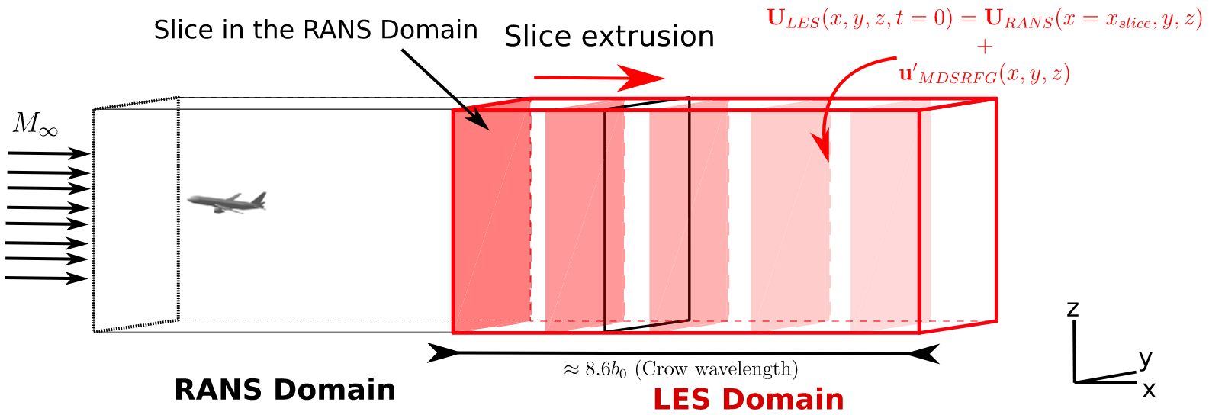
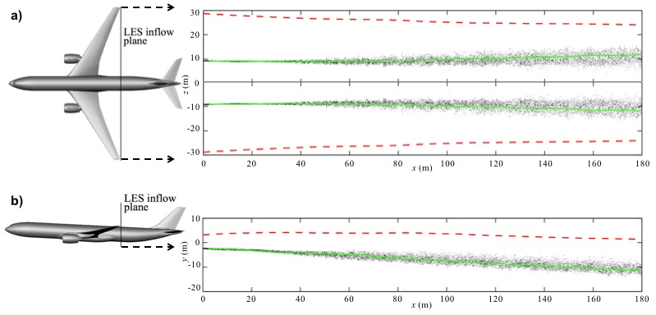
Problem statement and motivations
Spatial simulations of contrail formation in the jet phase are computationally expensive especially when the geometry of the aircraft and the engine are considered
Classical 2-eqs RANS models are doable but RSM 6-eqs RANS models can still be challenging
RANS provide mean flow solution possibly missing unsteady effects, turbulence (dynamics, mixing, microphysics); Spatial LES are just too expensive to run routinely in sensitivity analysis
Near-field RANS initialization for temporal LES in far-filed (Bouhafid et al., 2024)
Spatial LES of passive particles (Kolomesnky & Paoli, 2018) ~700M grid-points + stats convergence
Why not trying to combine the two in some way…
Notes:
Example of design studies : chevron on engine nozzle by Cantin et al.

Slide 3
Overall objectives
Model turbulence effects on jet-regime contrail formation while maintaining computational efficiency
Develop a hybrid Stochastic Lagrangian-Eulerian model for ice particle growth
Demonstrate the model ability to capture key microphysical processes
Evaluate the model ability to assess sensitivity to varying physical conditions

Slide 4
Eulerian Finite Volume Solver – CHApel Multi-Physics Simulation
Chapel language
Cell-centered finite-volume solver
Compressible
Second order convective Roe Scheme
Weighted Least Squares gradient
Implicit Symmetric Gauss-Seidel (SGS)
Multi-node, multi-core
Species transport
Upwind with gradient based interpolation
Example of flow simulation using CHAMPS

Slide 5
Stochastic Differential Equation – Simplified Langevin Model
Lagrangian form of velocity equation
$$\frac{du_{i}}{dt}=\frac{∂u_{i}}{∂t}+u_{j}\frac{∂u_{i}}{∂x_{j}}$$
$$\frac{du_{i}}{dt}+\frac{1}{ρ}\left(\frac{∂\overline{p}}{∂x_{i}}−\frac{∂\overline{τ_{i,j}}}{∂x_{j}}\right)=\frac{1}{ρ}\left(−\frac{∂p^{′}}{∂x_{i}}+\frac{∂τ_{i,j}^{′}}{∂x_{j}}\right)$$
Follow the approach proposed
for stochastic condensation of
clouds (Paoli & Shariff, 2009)
Simplified Langevin Model (Pope, 2011)
$$du_{i}=−\frac{1}{ρ}\frac{∂\overline{p}}{∂x_{i}}dt+\frac{1}{ρ}\frac{∂\overline{τ_{i,j}}}{∂x_{j}}dt+G\left(u_{i}−\overline{u_{i}}\right)dt+b dW_{i}$$
$$b={{(C}_{0}ε)}^{1/2}$$
consistency calibration
Autocorrelation function
at high Re
Wiener process
$C_{0}$ Kolmorogorv constant
$$dW_{i}≡\sqrt{dt}N_{i}{\left.​\right|}_{t}^{t+dt}\left(0,1\right)$$
The unknowns from Stochastic form are time dependent random processes
Langevin model replaces the fluctuating force by a Stochastic process : random perturbation/mean relaxation

Slide 6
Stochastic Differential Equation – SLM Calibration
Generated mean flow
$$\frac{∂ρ\overline{u_{i}}}{∂t}+\frac{∂ρ\overline{u_{i}}\overline{u_{j}}}{∂x_{j}}=−\frac{∂\overline{p}}{∂x_{i}}+\frac{∂\overline{τ_{i,j}}}{∂x_{j}}−\frac{∂ρ\overline{u_{i}^{′}u_{j}^{′}}}{∂x_{j}}$$
Generated turbulent kinetic energy
$$\frac{∂ρk}{∂t}+\frac{∂ρ\overline{u_{k}}k}{∂x_{k}}=−\frac{1}{2}\frac{∂ρ\overline{u_{i}^{′}u_{i}^{′}u_{k}^{′}}}{∂x_{k}}−ρ\overline{u_{i}^{′}u_{k}^{′}}\frac{∂\overline{u_{i}}}{∂x_{k}}+ρ2kG+\frac{3}{2}ρC_{0}ε$$
$$k=\frac{1}{2}\overline{u_{i}^{′}u_{i}^{′}}$$
Homogeneous turbulence (Pope, 2011)
Stationary
Decaying
$$ρ\frac{\overline{d}k}{dt}=ρ2kG+\frac{3}{2}ρC_{0}ε$$
$$G=−\frac{3}{4}C_{0}\frac{ε}{k}$$
$$G=−\left(\frac{1}{2}+\frac{3}{4}C_{0}\right)\frac{ε}{k}$$
The Langevin Model yield the correct Navier Stokes mean flow equation
Turbulent kinetic energy equation is used to calibrate the relaxation rate to yield the expected velocity variance

Slide 7
Stochastic Differential Equation – SLM Calibration
Generated turbulent kinetic energy
$$\frac{∂ρk}{∂t}+\frac{∂ρ\overline{u_{k}}k}{∂x_{k}}=−\frac{1}{2}\frac{∂ρ\overline{u_{i}^{′}u_{i}^{′}u_{k}^{′}}}{∂x_{k}}−ρ\overline{u_{i}^{′}u_{k}^{′}}\frac{∂\overline{u_{i}}}{∂x_{k}}+ρ2kG+\frac{3}{2}ρC_{0}ε$$
k-ω SST turbulent kinetic energy
$$\frac{∂\left(\overline{ρ}k\right)}{∂t}+\frac{∂\left(\overline{ρ} \tilde{u_{i}}k\right)}{∂x_{i}}=P−\overline{ρ}ε+\frac{∂}{∂x_{j}}\left[\left(μ+σ_{k}μ_{t}\right)\frac{∂k}{∂x_{j}}\right]$$
Pressure transport is neglected as in many Reynolds transport models (Pope, 2000)
Relaxation rate : Non-homogenous
$$G=−\left(\frac{1}{2}+\frac{3}{4}C_{0}\right)\frac{ε}{k}+\frac{1}{2ρk}\frac{∂}{∂x_{j}}\left[μ\frac{∂k}{∂x_{j}}\right]$$
The relaxation rate compatible with k-ω SST model was derived
Solving the model in the Eulerian framework allows for non-homogeneous turbulence
Notes:
Riotta

Slide 8
Stochastic Differential Equation – Interaction with the Mean IEM
Stochastic form of scalar transport equation
$$\frac{dy_{m}}{dt}−\frac{∂}{∂x_{j}}\left(\frac{μ}{Sc_{m}}\frac{∂\overline{y_{m}}}{∂x_{j}}\right)−\frac{1}{ρ}S_{m}=\frac{∂}{∂x_{j}}\left(\frac{μ}{Sc_{m}}\frac{∂y_{m}^{′}}{∂x_{j}}\right)$$
$y_{m }$: species mass fraction
Interaction by Exchange with the Mean model (Pope, 1985)
$$\frac{dy_{m}}{dt}−\frac{∂}{∂x_{j}}\left(\frac{μ}{Sc_{m}}\frac{∂\overline{y_{m}}}{∂x_{j}}\right)−\frac{1}{ρ}S_{m}=−ω_{m}\left(y_{m}−\overline{y_{m}}\right)$$
$$ω_{m}=\frac{1}{2}C_{φ}\frac{ε}{k}$$
The unknown from Stochastic form is a random diffusion term
IEM model replaces the fluctuating diffusion by a relaxation to the mean

Slide 9
Stochastic Differential Equation – Microphysical system
Complete microphysical system
$$\frac{dy_{v}}{dt}=s_{v}−ω_{m}\left(y_{v}−\overline{y_{v}}\right)$$
$$\frac{dT}{dt}=−ω_{m}\left(T−\overline{T}\right)$$
$$\frac{\text{d}m_{\text{c}}}{\text{d}t}=\left\{\begin{aligned}\frac{\text{d}m_{\text{c}}}{\text{d}t}\left(m_{c},y_{v},T\right) if activated \\ 0 else\end{aligned}\right.$$
Ice mass of represented particles
Ice-Vapor Coupling
Fluid mass
Temperature
Vapor mass fraction
$$s_{v}=−\frac{dm_{c}}{dt}\frac{N_{\#}}{m_{f}}$$
Diagram of Lagrangian particle composition
Equations for particle temperature, vapour mass fraction and ice mass evolution are added
Vapor depletion is coupled to ice growth with the initial definition of a fluid mass

Slide 10
Numerical Setup – Geometry
CFM56-5B3 rear body geometry was redrawn from a scaled cut view provided by Safran
Reconstructed aerodynamic profiles of the bypass and core nozzles from the CFM56-5B3
Aerodynamic lines of a real aircraft engine, the CFM56-5B3, were reconstructed

Slide 11
Numerical Setup – Computational Domain
The computational domain consists of a 30° sector of the exhaust geometry
237m axially; 24m radially, allowing to catch 1s at cruise speed
Buffer zones have been incorporated
Overview of the computational domain
The domain is a 30° periodic sector of 24m radially, spanning 237m downstream of the exhaust

Slide 12
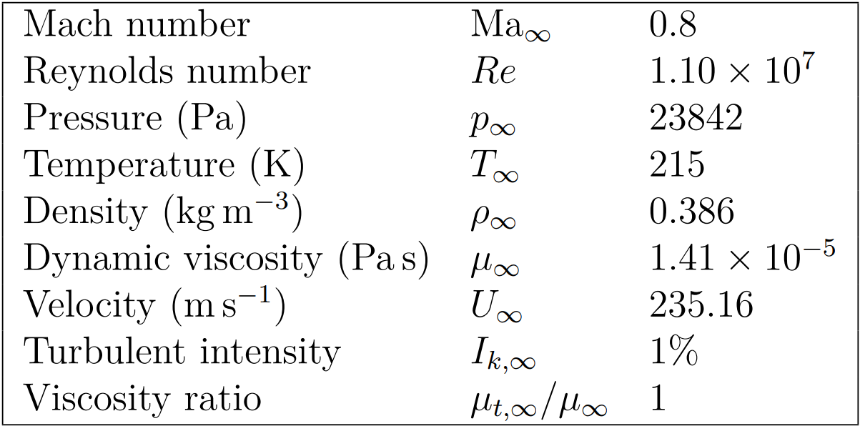
Numerical Setup – Conditions
Freestream conditions at 35,000 feet (ISA)
Engine operating point (Safran)
Turbofan boundary conditions
Freestream conditions are defined from Internation Standard Atmosphere (ISA)
Engine operation point was provided by a thermodynamic model by Safran

Slide 13
Airflow Results – Shock And Expansions
L2 norm of density residual was reduced by 8 orders of magnitude
Total pressure loss agrees within 1% with the operating conditions provided by Safran
Mean flow contours of a) axial velocity, b) pressure, c) temperature
Both nozzle are sonic. Airflow at the engine exhaust present shock and expansion waves
Notes:
SFD
Jacobian definition at boundary
Boundary condition ramping
L2 norm of density residual : 8 order of magnitude

Slide 14
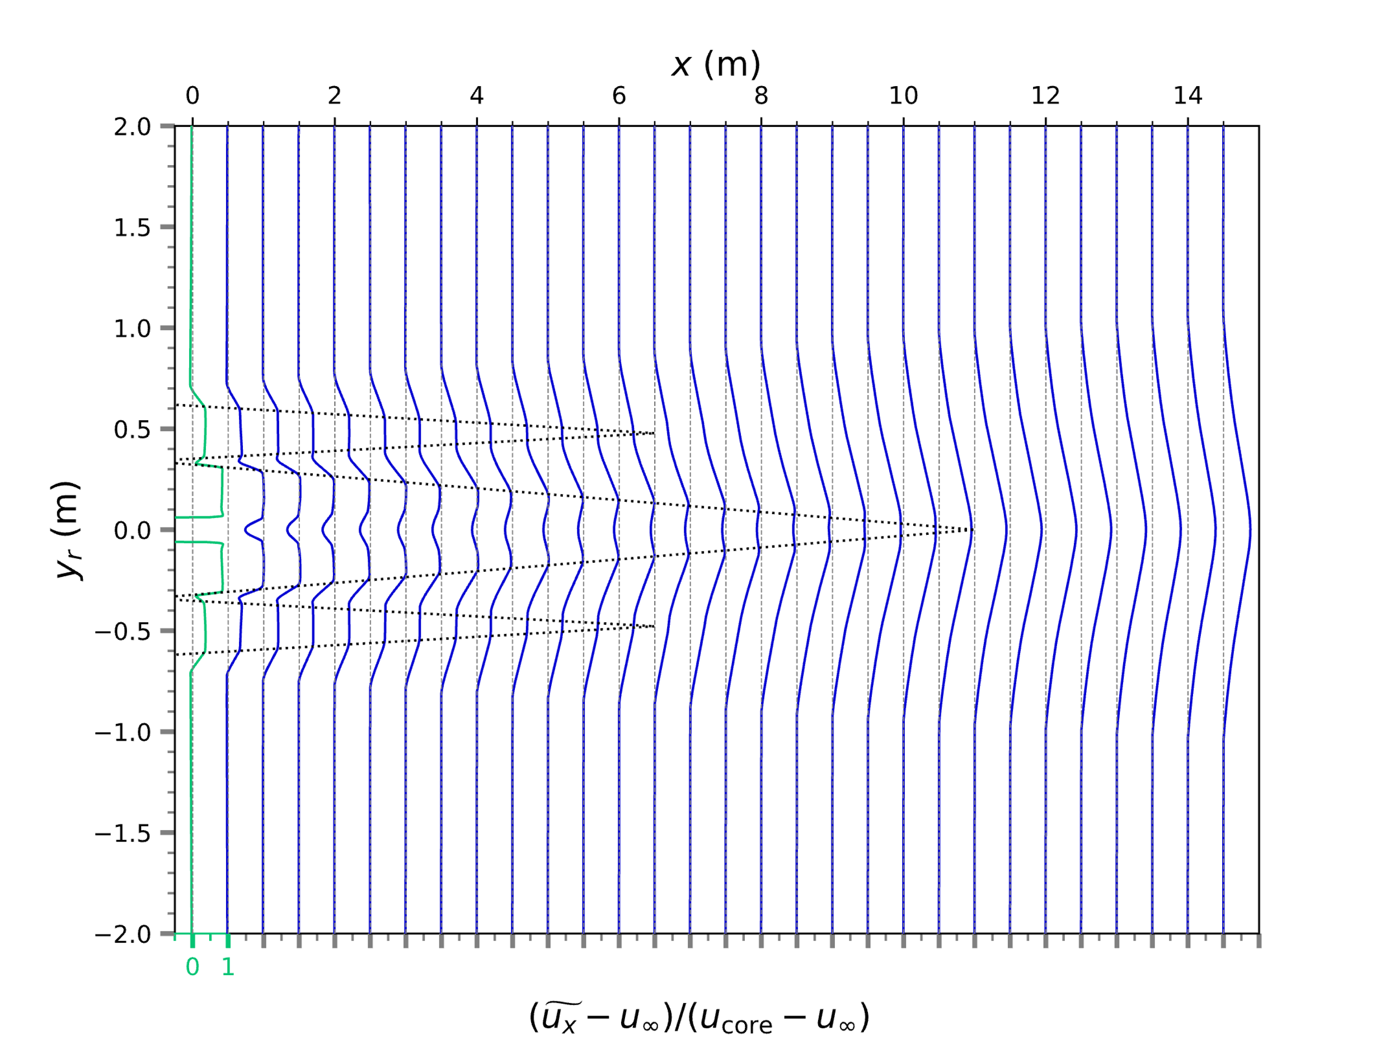
Airflow Results – Potential Cores
Normalized axial velocity profiles highlight :
Diffusion in turbulent shear layers
The primary potential core
Coaxial secondary potential core
Normalized axial velocity excess profiles at x
The potential cores establishment and diffusion are as expected
The obtained aerodynamic flow field serves as the basis for subsequent computations in this study

Slide 15
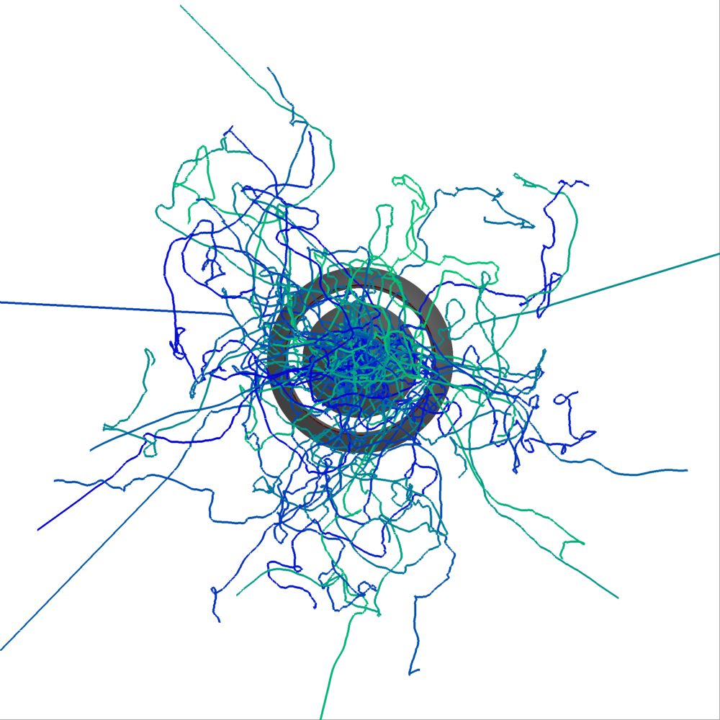
Stochastic Trajectories
Mean velocity streamtraces
Stochastic velocity trajectories
Stochastic model qualitatively produces expected dispersion and turbulent vortices

Slide 16
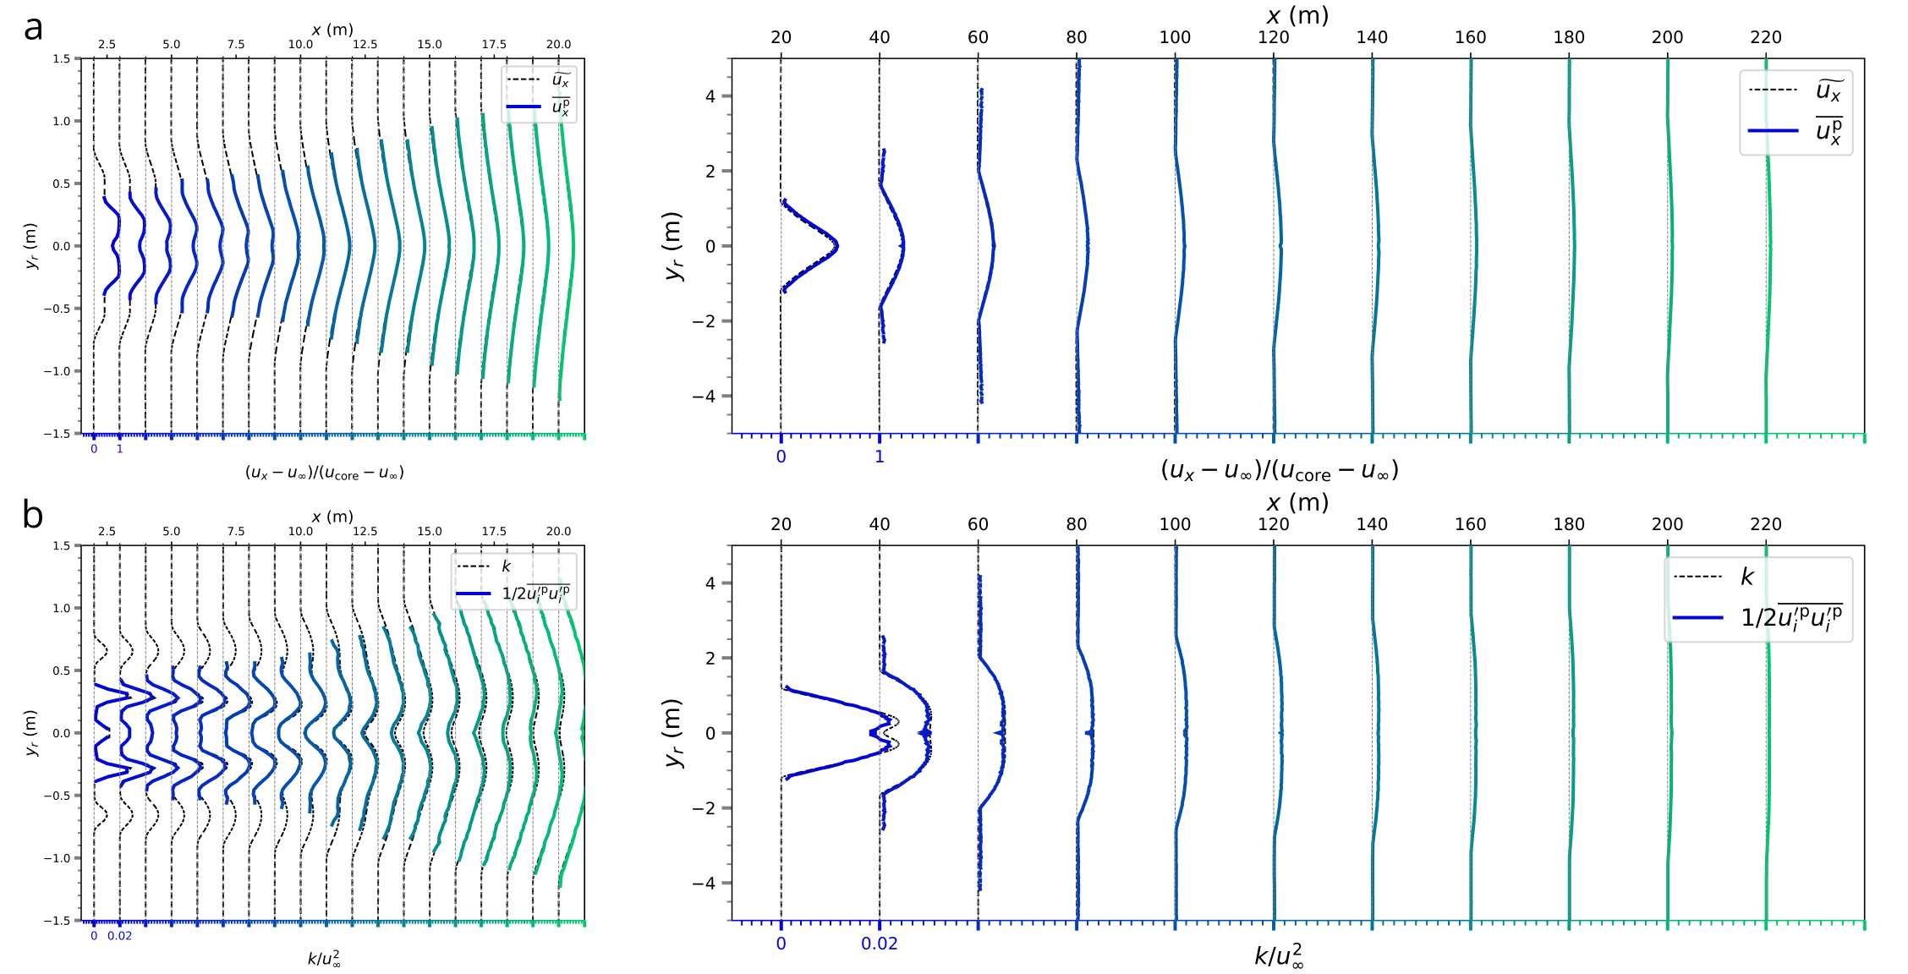
Stochastic Trajectories – Statistics
Axial velocity
$$\overline{u_{x}}=\frac{\sum_{P}{u_{x}^{P}Δt_{cell}^{P}}}{\sum_{P}{Δt_{cell}^{P}}}$$
$$\tilde{u_{x}} \text{from} \text{RANS}$$
Velocity variance
$$\frac{1}{2}\overline{u_{i}^{′}u_{i}^{′}}=\frac{1}{2}\frac{\sum_{P}{u_{i}^{′P}u_{i}^{′P}Δt_{cell}^{P}}}{\sum_{P}{Δt_{cell}^{P}}}$$
$k$ $\text{from} \text{RANS}$
Comparison between RANS quantities and Langevin model generated statistics
The Lagrangian statistics produced by the Langevin model reproduced very accurately the inputted RANS fields

Slide 17
Numerical Setup – Contrail
Freestream vapor mass fraction
$$y_{\text{v},∞}=\frac{p_{\text{v},∞}M_{\text{v}}}{p_{∞}M_{\text{a}}}$$
$$p_{\text{v},∞}=p_{\text{v}\text{,}I}\left(T_{∞}\right)×RHI$$
In-flight exhaust composition
Average chemical formula of Jet-A1 fuel : C_{10.8}H_{21.6} was considered (Xu et al., 2018)
Assuming perfect combustion, water vapor mass emission index is : EI_{H20,m} = 1.284 kg kg⁻¹
Safran provided extrapolated soot emission indices :
EI_{soot,m} = 14.486 mg kg⁻¹
EI_{soot,n} = 2.755 x 10¹⁴ # kg⁻¹
Vapor and particle emission were defined using emission indices and fuel to air ratio
Notes:
Radius was derived from mass using a power law calibrated on experimental data since soot aggregates have a variable effective density (depending on the proportion of air stuck in the structure)

Slide 18
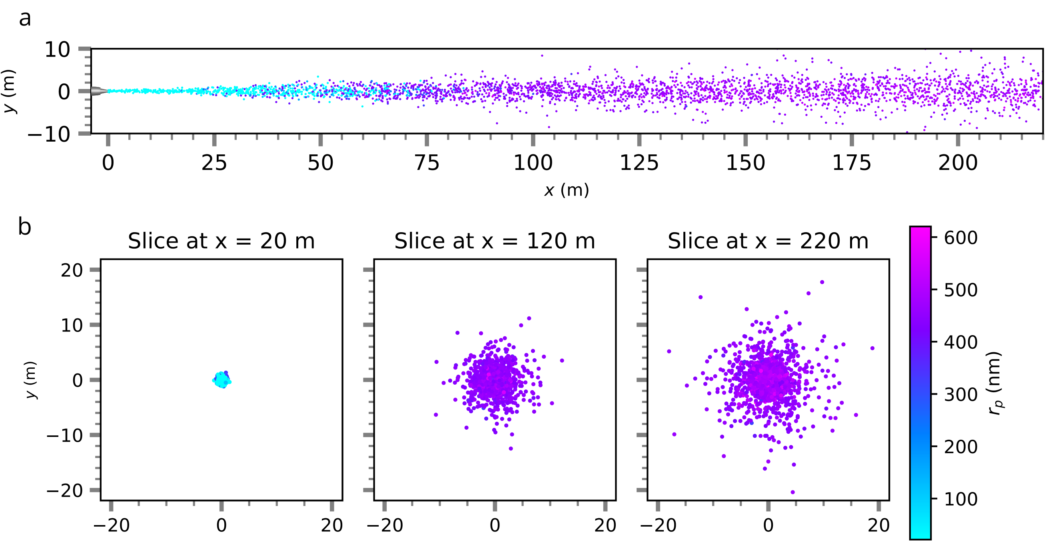
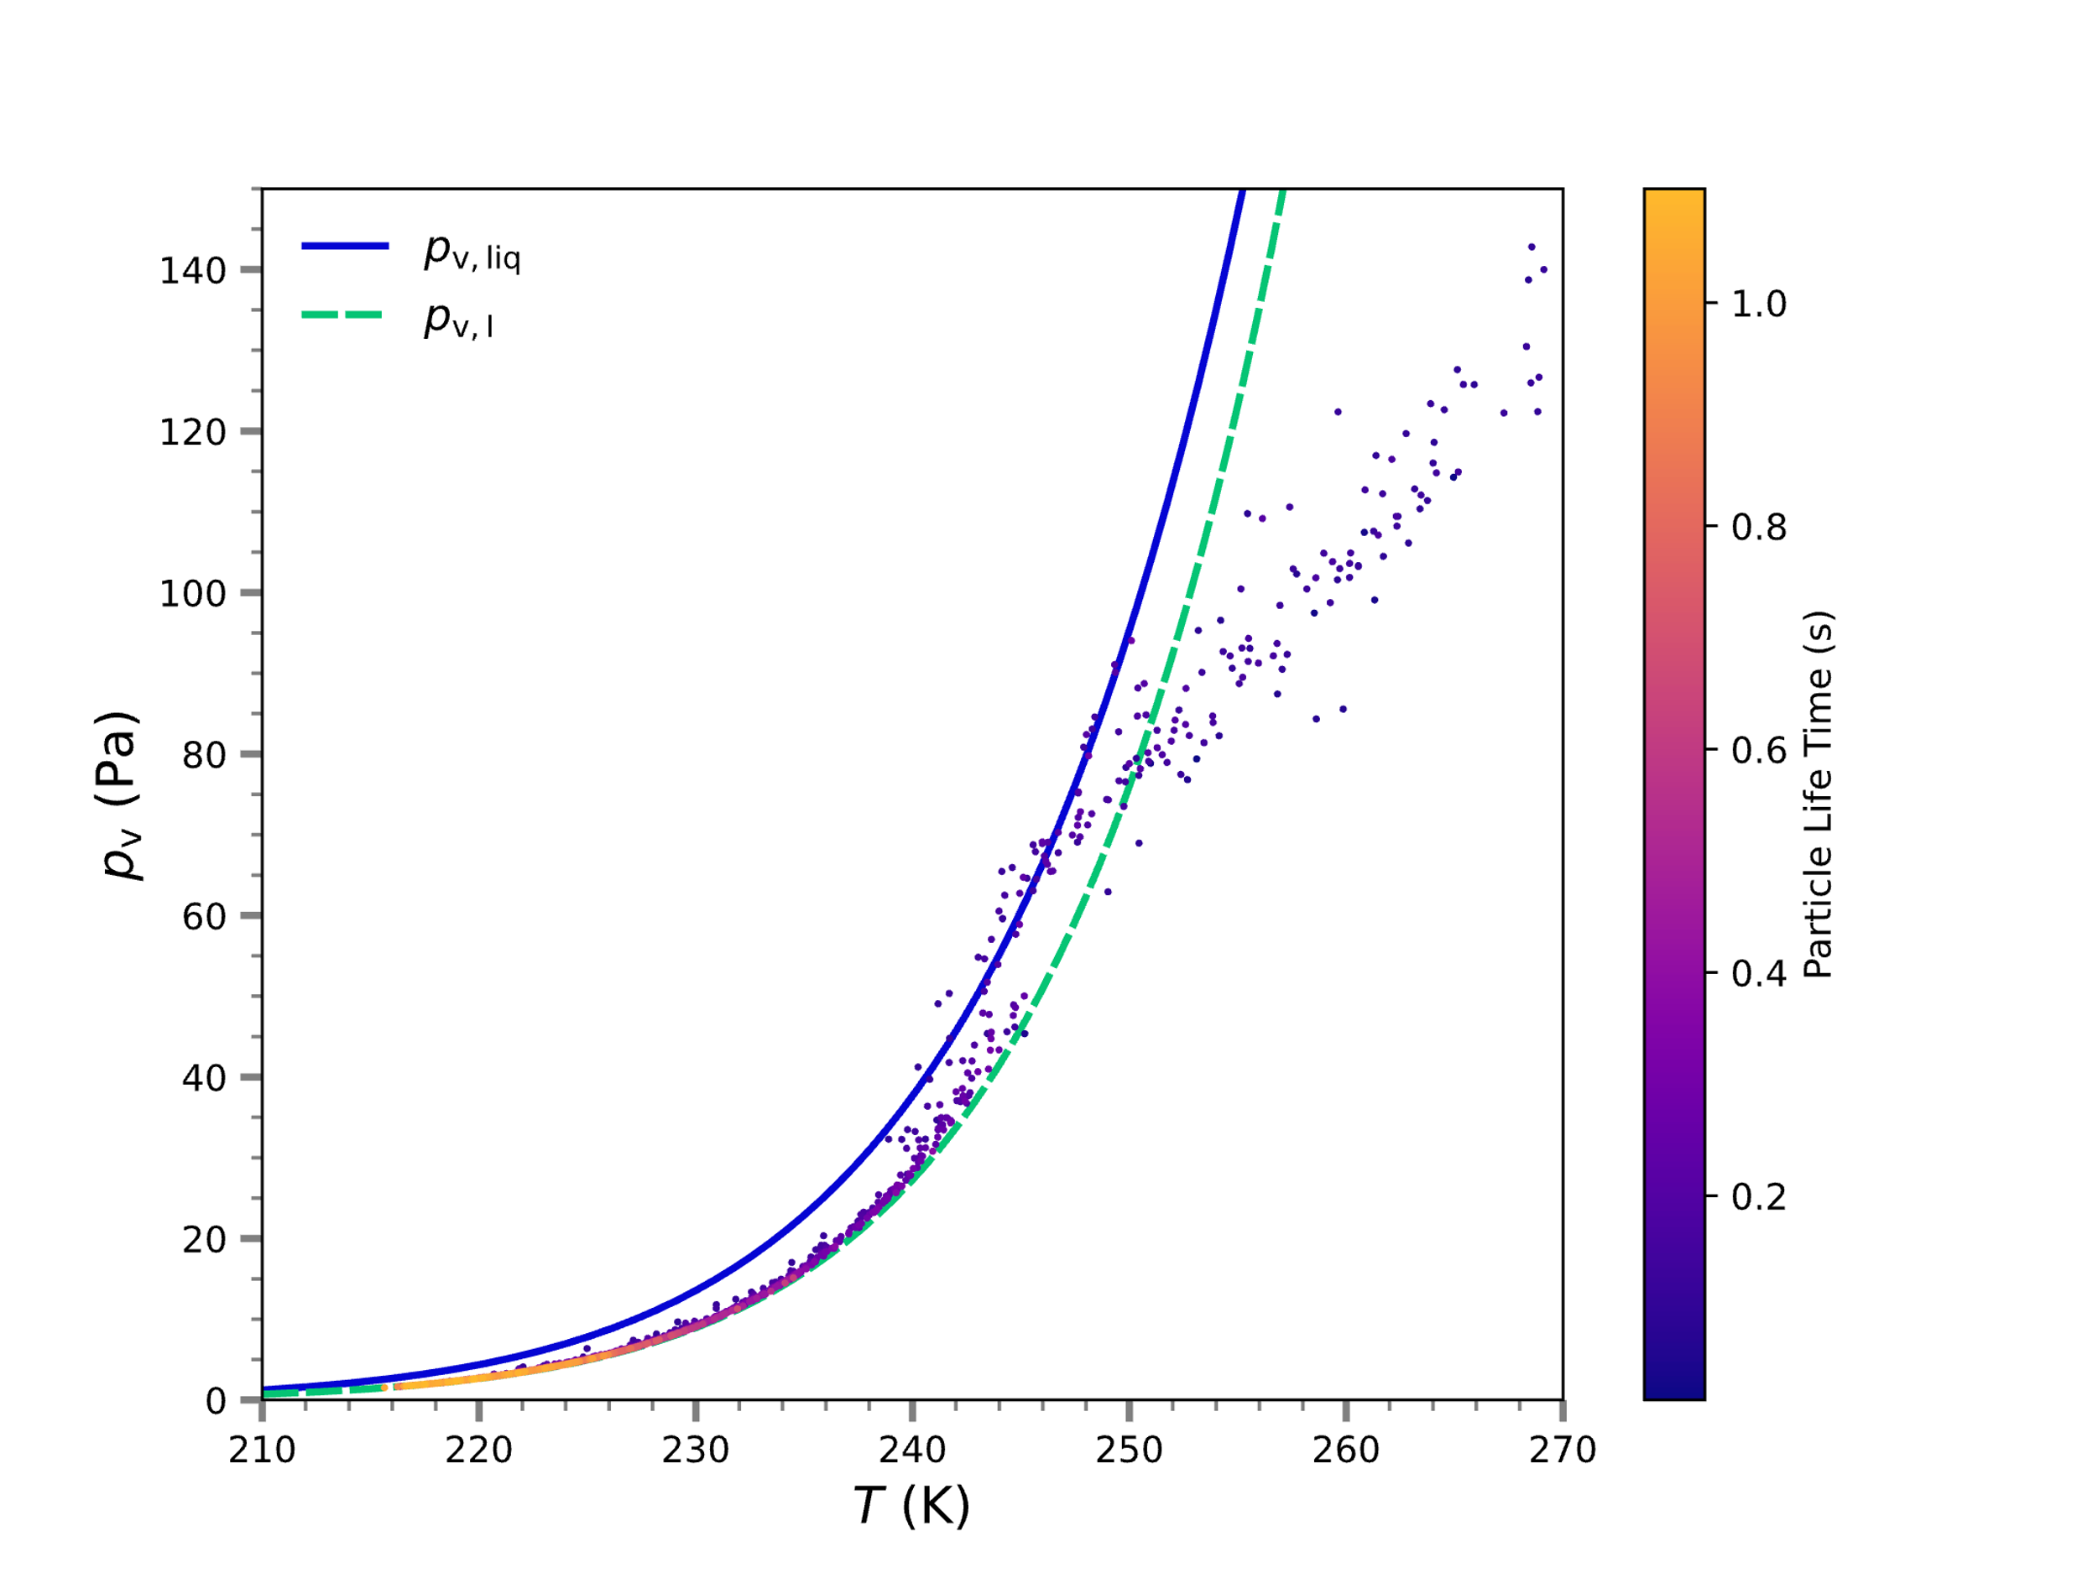
First Results – Thermodynamic evolution
5s with ~25000 particles in domain was computed allowing mean fields convergence
10000 trajectories were extracted for post processing
Particles effectively mix with ambient air
Microphysics behaves as expected
Particles first reach liquid saturation
Then they evolve to ice sat equilibrium
The model behaves as expected, generating dispersion and effectively simulating microphysics
Notes:
2 order of mag for L2 of mean radius time fluctuations

Slide 19
Alternative Models Comparison – Spatial Distributions of Particles
Langevin effectively disperse particles
Mean composition exhibit a larger, less uniform, radii distribution
RANS
RANS+Langevin
Spatial distribution of particles, colored by crystal radius, cross-sectional distribution at x=220m
While Langevin model exhibit proper dispersion, it seems to overpredict radii if not associated with IEM
Notes:
SFD
Jacobian definition at boundary
Boundary condition ramping
L2 norm of density residual : 8 order of magnitude

Slide 20
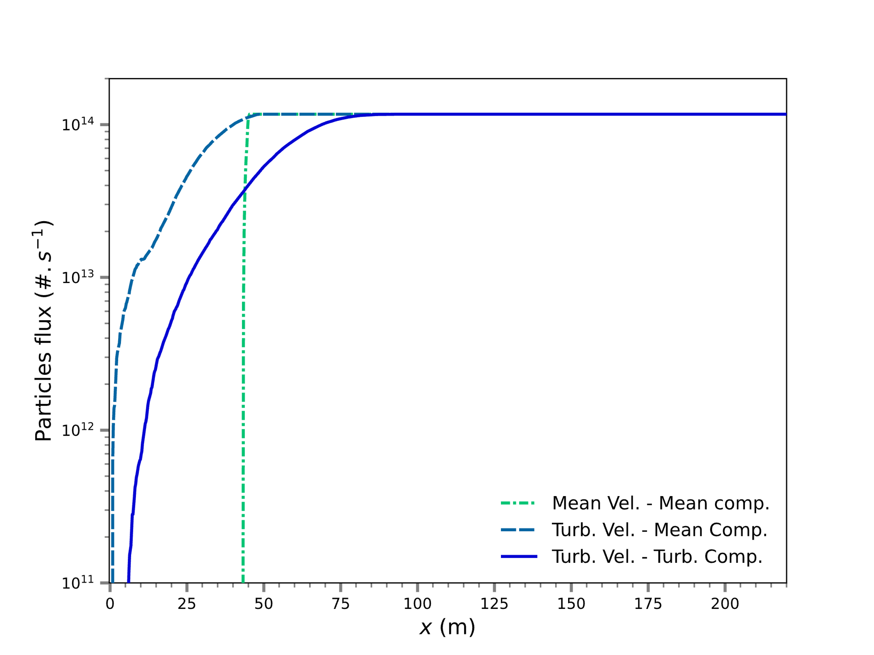
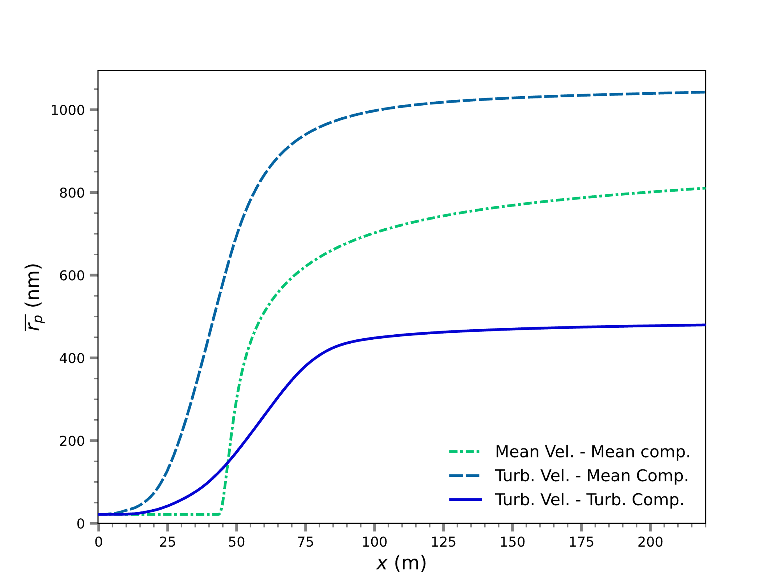
Alternative Models Comparison – Axial Evolution
Turbulence dispersion broaden the activation range
IEM model delay the last particle activation and limit ice growth
Effect of turbulent mixing
Comparison of the number of activated particles
Comparison of the mean particle radius
Turbulence model effectively affect growth activation and IEM model limit ice growth by limiting mixing
Notes:
SFD
Jacobian definition at boundary
Boundary condition ramping
L2 norm of density residual : 8 order of magnitude

Slide 21
Summary of Work
Developed a hybrid Stochastic Lagrangian–Eulerian model for contrail formation
RANS equations for mean flow
Time-accurate Lagrangian framework for particles
Simplified Langevin Model for trajectories
Interaction by Exchange with the Mean for compositions
Microphysical model of ice growth
Coupling between Eulerian and Lagrangian by mean depletion term
Cheap alternative to LES for parametric analysis while retaining turbulence features of the flow

Slide 22
Limitations and Future Research
Assumption of constant particle density within computational particles
Excessive depletion of vapor within the fluid particle
Add particle density as an IEM composition variable to compute Lagrangian depletion term
The stochastic model presents several constraints
Instantaneous gas density is approximated by mean density, but it can have significant fluctuations near nozzle exit where temperature gradient are high
Future work could focus on improving the RANS-Lagrangian trajectory model
The microphysical model is simplified
Include volatile particle and particle-chemistry interactions
Add initial freezing phase
Include interaction with the aircraft wake

Slide 23
Thank you!

Slide 24
Research Framework – Regimes of evolution
Wide range of time and space scales
Evolution classified in four distinct regimes
Classification of aircraft wake evolution into four regimes (Paoli & Shariff, 2016)
Contrail evolution study is split under four regimes
This work focuses on the Jet regime
Notes:
Jet regime : first few seconds, micro, nucleation, complex aero
Vortex regime : seconds to minutes, vortices interact with jet plume, complex flow structure
Dissipation regime : minutes to hours, vortex disintegration, release of ice crystals in atmosphere, sublimation or not
Diffusion regime : hours, up to global scales, atmospheric turbulence, radiative processes, wind shear -> Cirrus

Slide 25
Contrail Simulation Procedure
After population of the domain, coupled iterations occur until mean vapor field reach steadiness
Notes:
Interpolation of quantities linearly and weighting using fraction of traj spent in cell computed during tracking

Slide 26
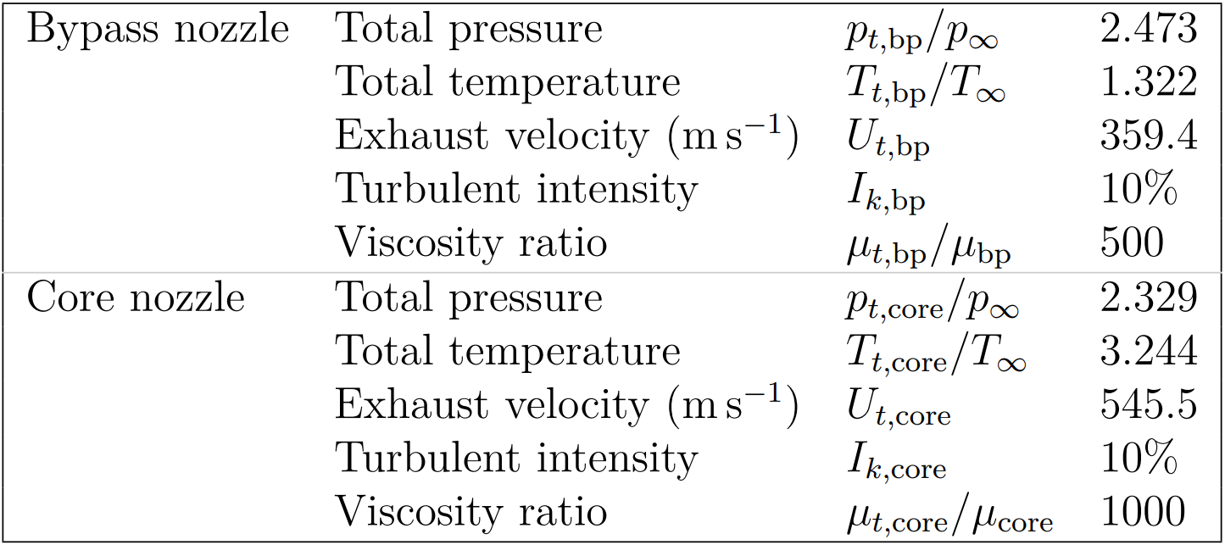
Numerical Setup – Conditions
Freestream conditions at 35,000 feet (ISA)
Engine operating point (Safran)
Turbofan boundary conditions
Freestream conditions are defined from Internation Standard Atmosphere (ISA)
Engine operation point was provided by a thermodynamic model by Safran

Slide 27
Numerical Setup – Mesh
Hybrid structured/unstructured mesh was produced on Fidelity Pointwise
Diamond like axis
10-cell rotation
Wall thickness : 2µm
y⁺<1
7 884 125 elements
Overview of the computational mesh
A 3D, 30° periodic, mesh was generated on Fidelity Pointwise. Freestream is unstructured. Jet plume is structured

Slide 28
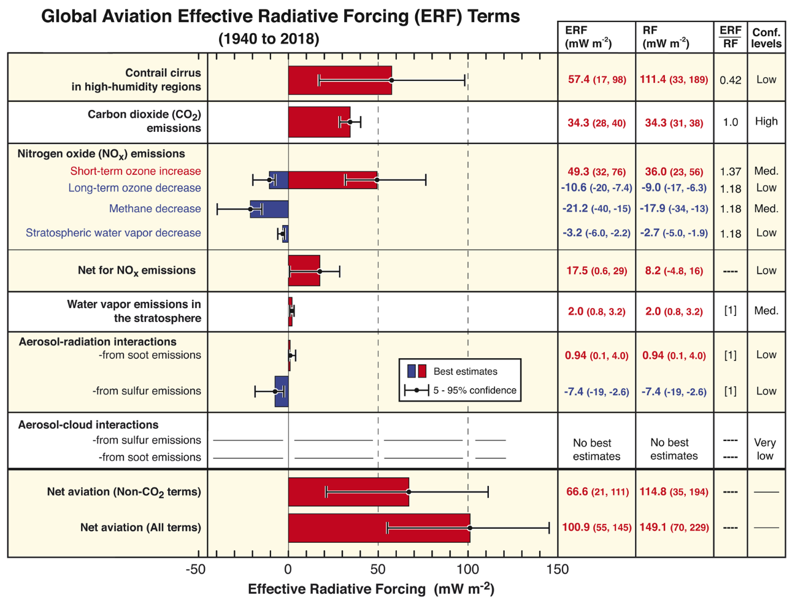
Radiative forcing from global aviation emissions. (Lee et al., 2023)

Slide 29
Reynolds Averaged Navier Stokes – Mean Flow Equations
Momentum equation
$$\frac{∂\overline{ρ} \tilde{u_{j}} \tilde{u_{i}}}{∂x_{j}}=−\frac{∂\overline{p}}{∂x_{i}}+\frac{∂{\overline{τ}}_{i,j}}{∂x_{j}}−\frac{∂\overline{ρu_{i}^{′′}u_{j}^{′′}}}{∂x_{j}}$$
Species transport equation
$$∀m=1,..,N_{s} \frac{∂\overline{ρ}\tilde{u_{j}}\tilde{y_{m}}}{∂x_{j}}=\frac{∂}{∂x_{j}}\left(\overline{ρ}D_{m}\frac{∂\tilde{y_{m}}}{∂x_{j}}−\overline{ρ}\tilde{u_{j}^{′′}y_{m}^{′′}}\right)+\overline{S_{m}}$$
$$y_{N_{s}}=1−\sum_{m=1}^{N_{s}−1}{y_{m}}$$
Boussinesq Eddy-Viscosity assumption (Blazek, 2001)
$$τ_{t_{i,j}}=−\overline{ρu_{i}^{′′}u_{j}^{′′}}=μ_{t}\left(\frac{∂\tilde{u_{i}}}{∂x_{j}}+\frac{∂\tilde{u_{j}}}{∂x_{i}}−\frac{2}{3}\frac{∂\tilde{u_{k}}}{∂x_{k}}δ_{ij}\right)−\frac{2}{3}\overline{ρ}kδ_{ij}$$
$$\overline{ρ}\tilde{u_{j}^{′′}y_{m}^{′′}}=−\frac{μ_{t}}{Sc_{t}}\frac{∂\tilde{y_{m}}}{∂x_{j}}$$
Navier Stokes equations are solved under their Favre averaged form
Boussinesq Eddy-Viscosity requires a turbulence model to close the equations

Slide 30
Reynolds Averaged Navier Stokes – Turbulence model : k-ω SST
Versatile to treat mixed internal-external flows configurations such as nozzle-jet flows
Blends between k-ω near wall and k-ε away (Menter, 1993)
Provides necessary turbulence information for stochastic trajectories
Equations (Menter, 1993)
$$\frac{∂\left(\overline{ρ}k\right)}{∂t}+\frac{∂\left(\overline{ρ} \tilde{u_{i}}k\right)}{∂x_{i}}=P−β^{∗}\overline{ρ}ωk+\frac{∂}{∂x_{j}}\left[\left(μ+σ_{k}μ_{t}\right)\frac{∂k}{∂x_{j}}\right]$$
$$\frac{∂\left(\overline{ρ}ω\right)}{∂t}+\frac{∂\left(\overline{ρ} \tilde{u_{i}}ω\right)}{∂x_{i}}=\frac{γ}{ν_{t}}P−β\overline{ρ}ω^{2}+\frac{∂}{∂x_{j}}\left[\left(μ+σ_{ω}μ_{t}\right)\frac{∂ω}{∂x_{j}}\right]+2\left(1−F_{1}\right)\frac{\overline{ρ}σ_{ω2}}{ω}\frac{∂k}{∂x_{j}}\frac{∂ω}{∂x_{j}}$$
$$ε=β^{∗}kω$$
k-ω SST combines k-ω and k-ε advantages and performs well for mixed flows
The model provides cell-centered k and ω for later stochastic modeling

Slide 31
Stochastic Differential Equation – Generalized Langevin Model
$$du_{i}=−\frac{1}{ρ}\frac{∂\overline{p}}{∂x_{i}}dt+\frac{1}{ρ}\frac{∂\overline{τ_{i,j}}}{∂x_{j}}dt+G_{i,j}\left(u_{j}−\overline{u_{j}}\right)dt+b dW_{i}$$

Slide 32
Ice Growth Rate
Ice crystals grow by water deposition on their surface
Rate of growth is related to pressure difference between its surface and ambient air
Corrections for Kelvin effect, collision geometry, sticking probability, and ventilation
Local vapor pressure
Molecular diffusion coefficient
Vapor saturation pressure over ice
Crystal radius
$$\frac{\text{d}m_{\text{c}}}{\text{d}t}=\frac{4πχD_{\text{v}}^{\text{†}}\left(p_{\text{v}}−p_{\text{v},I}^{\text{sat} \text{†}}\right)}{\frac{D_{\text{v}}^{\text{†}}L_{s}p_{\text{v},I}^{\text{sat} \text{†}}}{κ_{\text{a}}^{\text{†}}T}\left(\frac{L_{s}}{R_{\text{v}}T}−1\right)+R_{\text{v}}T}$$
Local gas temperature
Latent heat of sublimation
Thermal conductivity of air
Vapor specific gas constant
Ice growth rate is computed from local gas properties around the particle (Jacobson, 1999)
Notes:
Kelvin's curvature correction

Slide 33
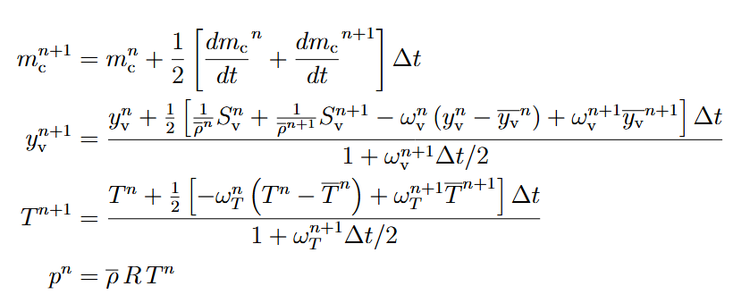
Lagrangian Implementation – Numerical Integration : Discretization

Slide 34
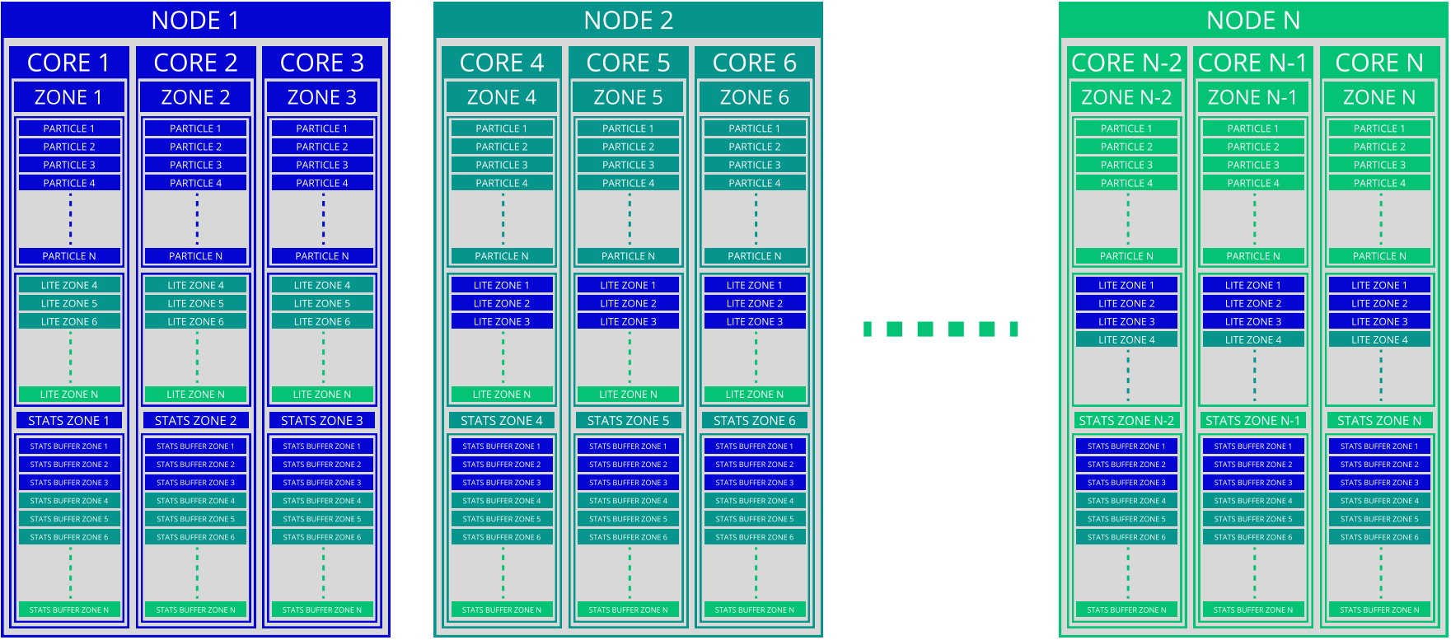
Parallel Processing
Parallel data structure

Slide 35
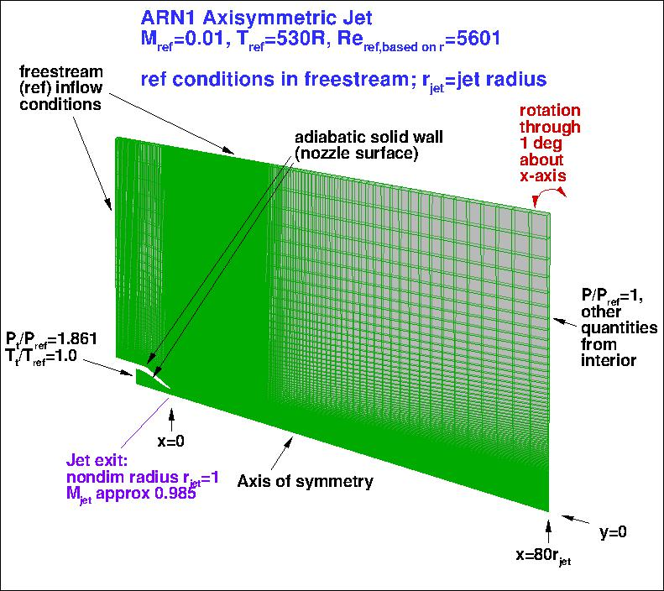
Verification Tests – CHAMPS Internal/External : Near-sonic jet
Axisymmetric Near-Sonic Jet case from Nasa Langley Research Center Turbulence Modeling Resource

Slide 36
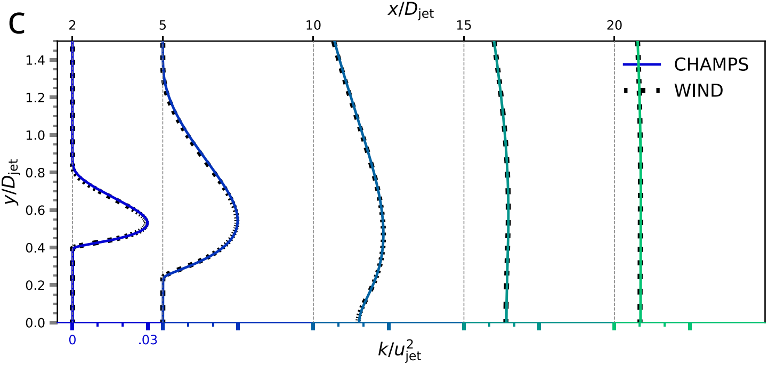
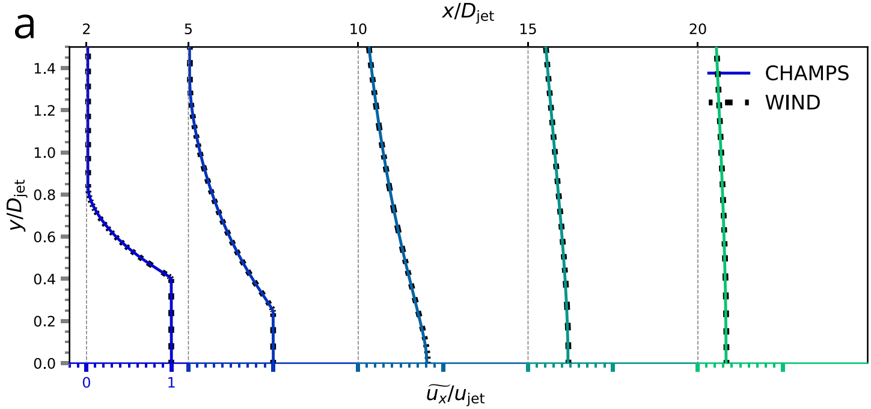
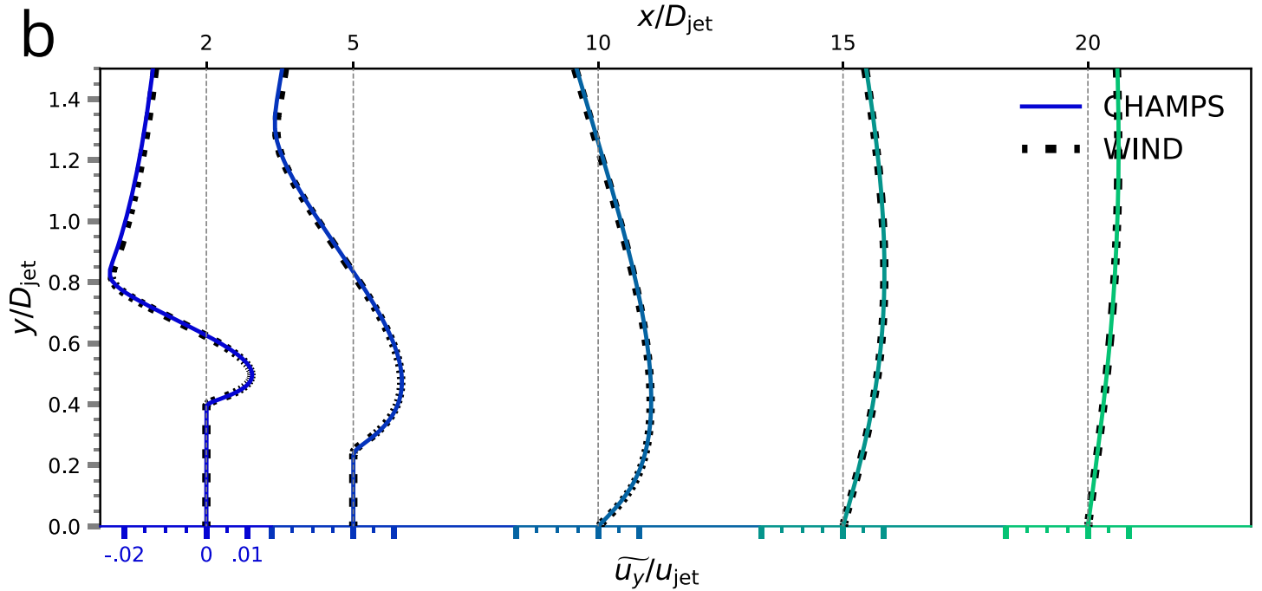
Verification Tests – CHAMPS Internal/External : Near-sonic jet
Comparison of CHAMPS and WIND (Bush et al., 1998)

Slide 37
Particle Motion
Inertial particle velocity equation
$$m\frac{\text{d}u_{i}^{P}}{\text{d}t}=C_{D}\left(Re\right)\frac{1}{2}ρ_{\text{a}}πr^{2}U_{\text{rel}}u_{\text{rel},i}+mg_{i}$$
$u_{\text{rel},i}$= $u_{i}^{P}−u_{\text{a},i}$
Small Reynolds value relaxation timescale
$$\frac{\text{d}u_{i}^{P}}{\text{d}t}=τ_{D}^{−1}\left(u_{i}^{P}−u_{\text{a},i}\right)+g_{i}$$
$$C_{D}\left(Re\right)=24/Re$$
$$τ_{D}=\frac{m}{6πμr}$$
For particles with a radius lower than 1µm, the relaxation timescale is lower than 2x10⁻⁵ s.
→ We consider particles to have the velocity of the carrier phase (Cantin et al., 2022; Paoli et al., 2008; Khou, 2018)
Particles velocity in the jet regime is approximated by gas velocity

Slide 38
Airflow Governing Equations – RANS/SDE Approaches Comparison
Velocity equation
$$\frac{∂u_{i}}{∂t}+\left(\overline{u_{j}}+u_{j}^{′}\right)∙\frac{∂u_{i}}{∂x_{j}}+\frac{1}{ρ}\left(\frac{∂\overline{p}}{∂x_{i}}−\frac{∂\overline{τ_{i,j}}}{∂x_{j}}\right)=\frac{1}{ρ}\left(−\frac{∂p^{′}}{∂x_{i}}+\frac{∂τ_{i,j}^{′}}{∂x_{j}}\right)$$
Effects of the spatial variation of fluctuating terms (undefined since we only solve realizations)
Scalar transport equation
$$\frac{∂y_{m}}{∂t}+\left(\overline{u_{j}}+u_{j}^{′}\right)∙\frac{∂y_{m}}{∂x_{j}}−\frac{∂}{∂x_{j}}\left(\frac{μ}{Sc_{m}}\frac{∂\overline{y_{m}}}{∂x_{j}}\right)−\frac{1}{ρ}S_{m}=\frac{∂}{∂x_{j}}\left(\frac{μ}{Sc_{m}}\frac{∂y_{m}^{′}}{∂x_{j}}\right)$$
Convective transport by fluctuating velocity
Fluctuation effects on source terms
RANS approach requires modeling the statistics associated with fluctuation to compute the averaged terms
SDE approach requires modeling the spatial variations of the fluctuation to compute the instantaneous terms

Slide 39
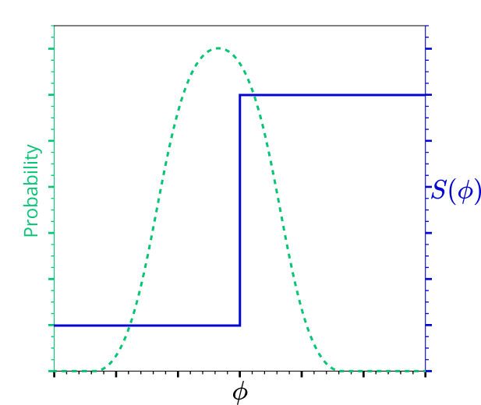
Airflow Governing Equations – Important notes
Focus on source term
$\overline{S_{m}(\overline{φ}+φ^{′})}≠$ $S_{m}(\overline{φ})$
$$\overline{S(φ)}$$
$$S(\overline{φ})$$
$$\overline{φ}$$
Example of non-linear source term
SDE approach allows to account for non-linearities on source terms

Slide 40
Airflow Governing Equations – Important notes
Difference with usual SDE implementations
Usual implementation
(Cao et al., 2005; Zhou et al., 2017; Wang & Pope, 2008)
Mean fields are derived from particles statistics
ω is added as a particle property
This work
Mean fields are provided by RANS calculation
Turbulence statistics by RANS turbulence model
Mean mass fractions by RANS calculation
Particles originate only from core nozzle
Mean fields (velocity, vapor,…) ?
Sketch of usual implementation of Lagrangian/Eulerian
Mean fields (velocity, vapor,…) ?
Sketch of this work implementation of Lagrangian/Eulerian
In this work the RANS computation provides all statistics and inputs required for the Langevin model
This allows to only compute the trajectories emanating from core nozzle

Slide 41
First contrail results
Numerical Setup
Alternative Models Comparison
Sensitivity Analyses

Slide 42
First Results – Average evolution
5s with ~25000 particles in domain was computed allowing mean fields convergence
10000 trajectories were extracted for post processing
Particles activate between 25m and 75m
Mean radius evolves smoothly
At the end it slows around 500nm
Ice saturation converges to 1
Contrail downstream evolution, mean radius, saturation ratios
Particles activation is spread out. Average crystal radius evolves smoothly, ultimately reaching a steady value
Notes:
2 order of mag for L2 of mean radius time fluctuations

Slide 43
Alternative Models Comparison – Spatial Distributions of Particles
Langevin effectively disperse particles
Mean composition exhibit a larger, less uniform, radii distribution
Spatial distribution of particles, colored by crystal radius, cross-sectional distribution at x=220m
While Langevin model exhibit proper dispersion, it seems to overpredict radii if not associated with IEM
Notes:
SFD
Jacobian definition at boundary
Boundary condition ramping
L2 norm of density residual : 8 order of magnitude

Slide 44
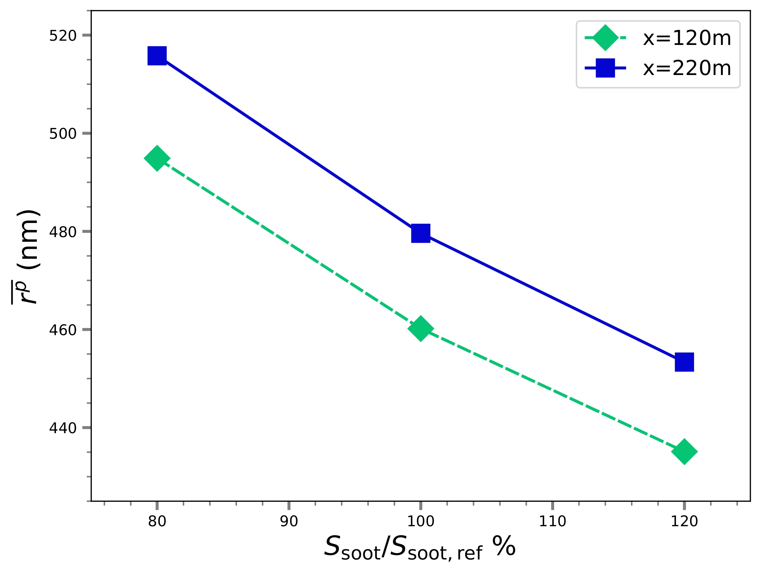
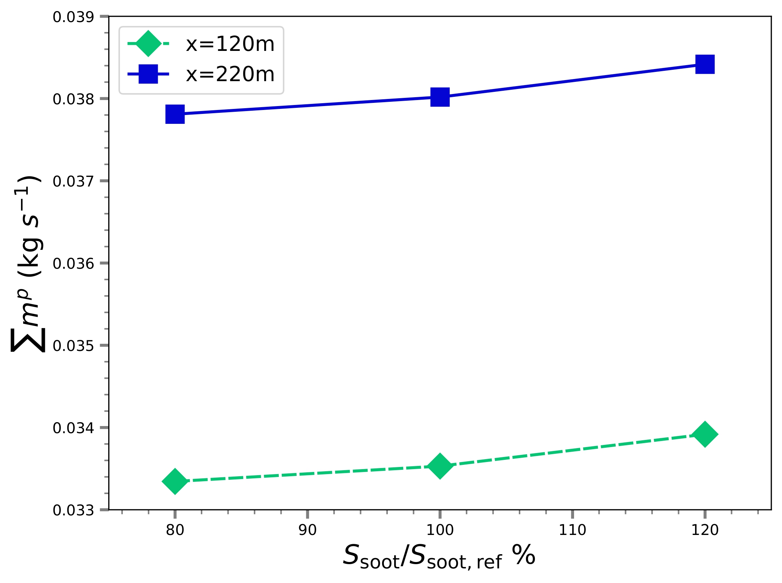
Sensitivity Analyses – Soot Particles Emission Rate
More particles increase total ice mass while decreasing mean particle radius
Dependence of a) contrail particle mean radius, b) total ice mass flux, on soot particle emission rate
Because vapor is shared among more particles, mean radius decreases but more total ice if formed

Slide 45
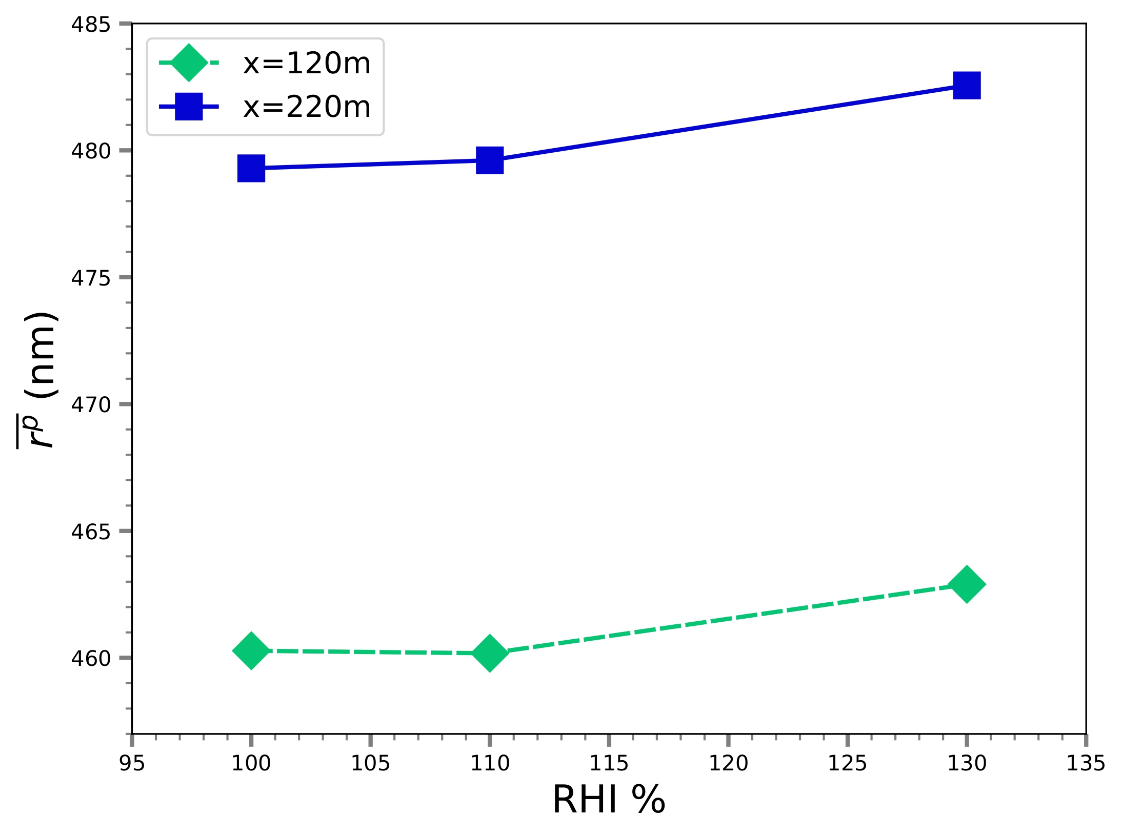
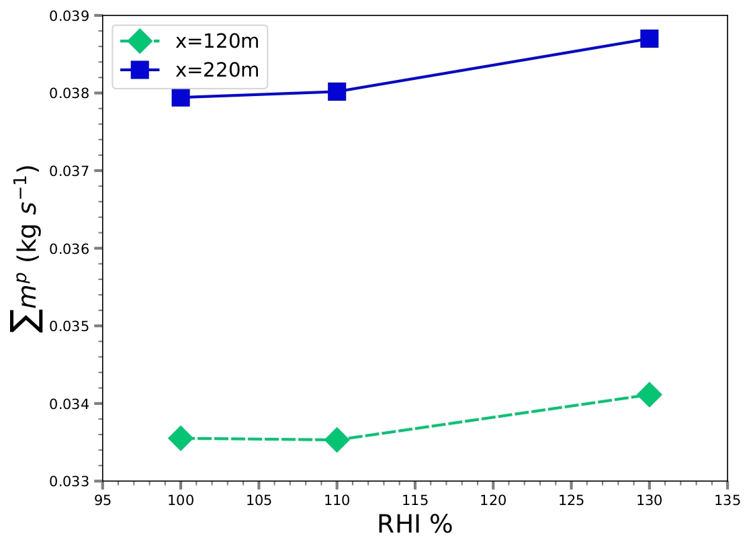
Sensitivity Analyses – Atmospheric Relative Humidity
Atmospheric saturation increases mean bigger cristals and more total ice mass
Dependence of a) contrail particle mean radius, b) total ice mass flux, on atmospheric relative humidity
Because more vapor is available in the freestream, particles grow bigger

Slide 46
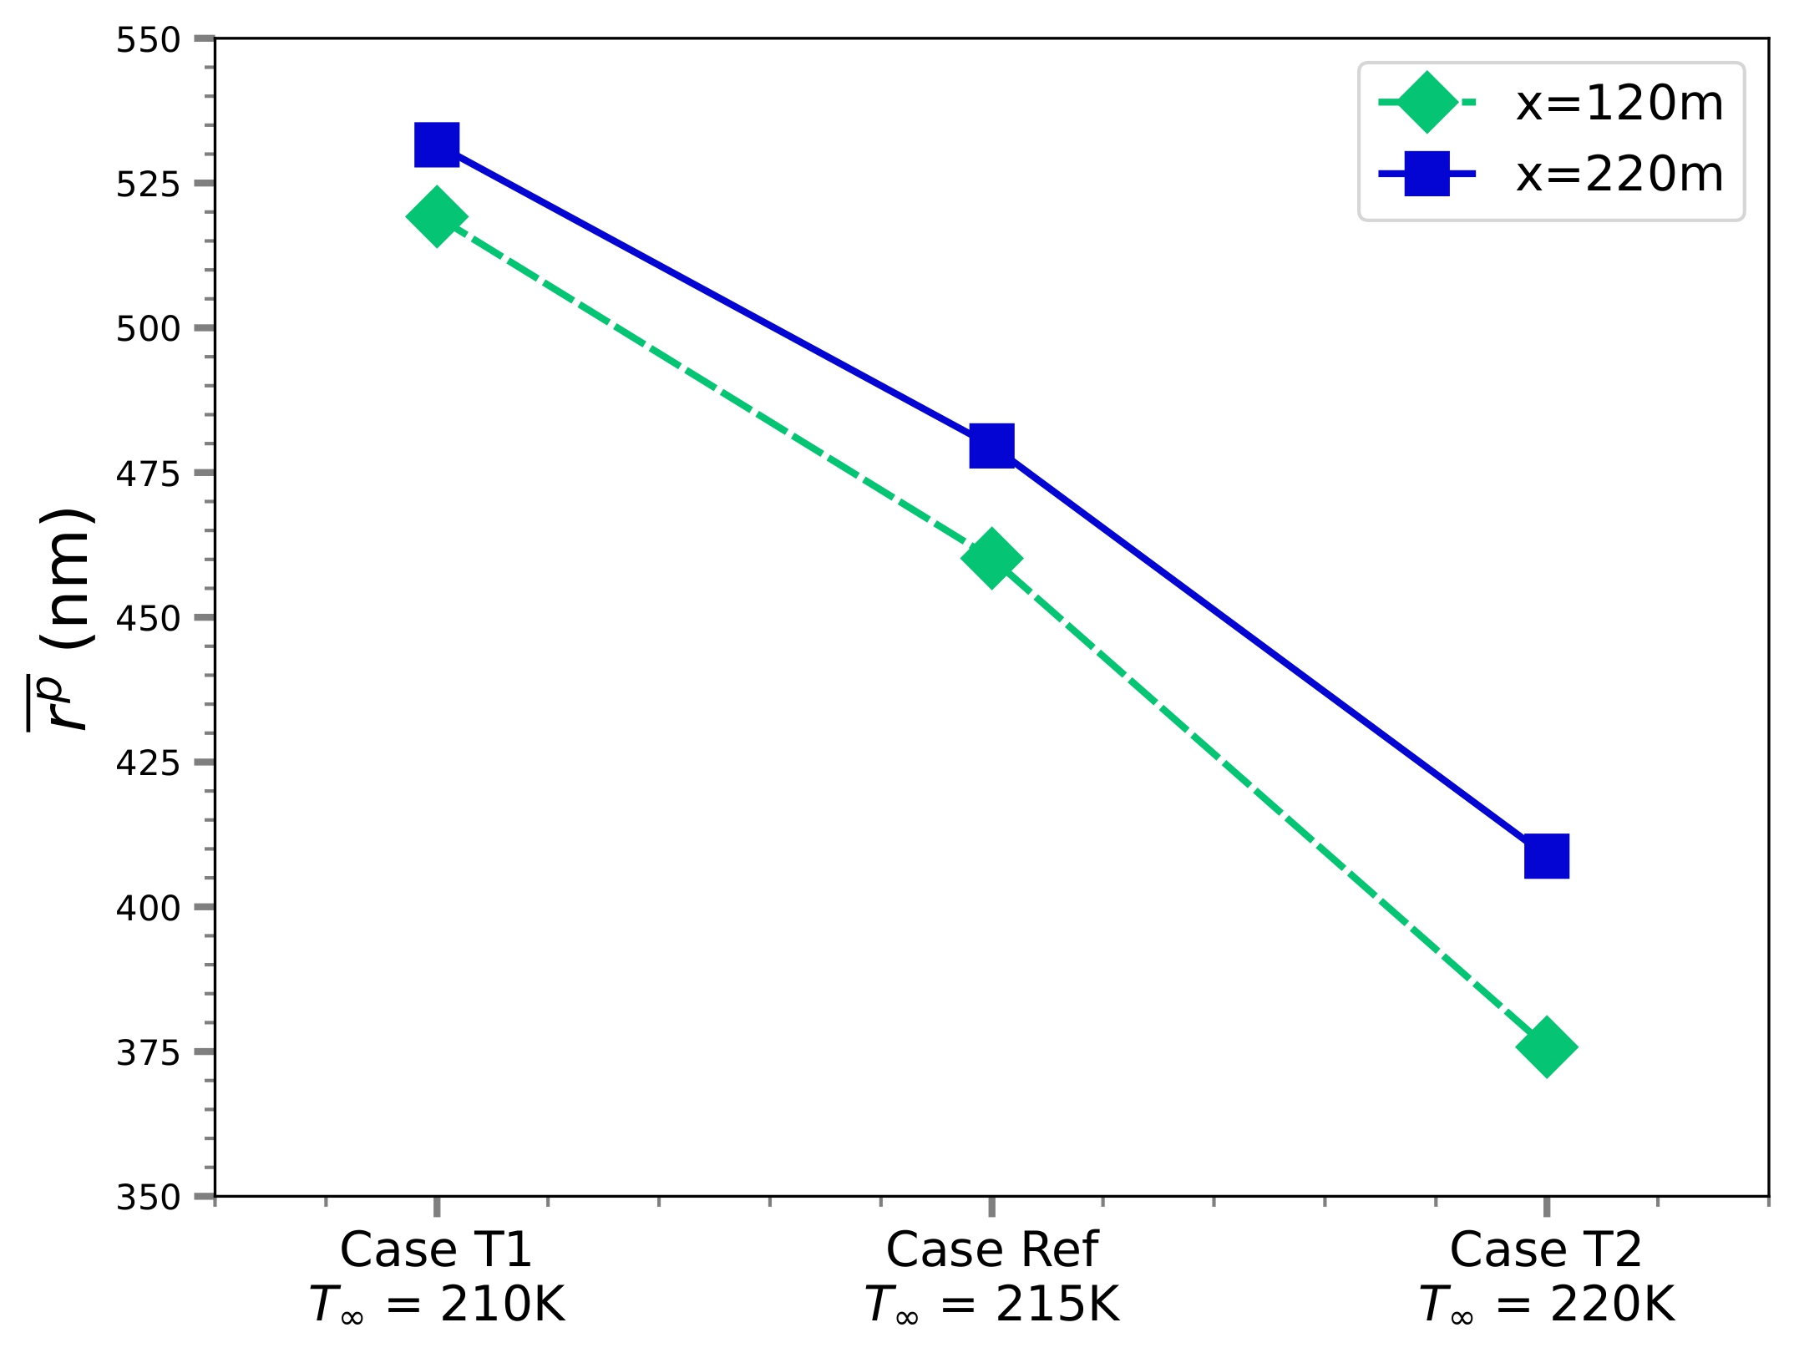
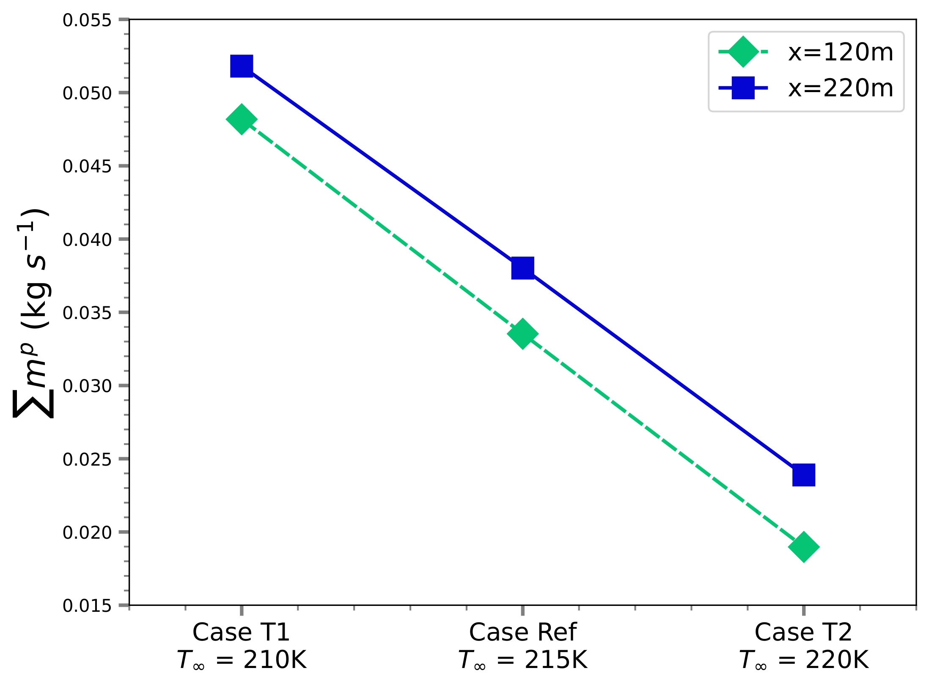
Sensitivity Analyses – Atmospheric Temperature
Hotter atmospheric temperature induces small crystals and lower total ice mass
Dependence of a) contrail particle mean radius, b) total ice mass flux, on atmospheric temperature
Because particles final equilibrium temperature is higher, ice growth is slower

Slide 47
Sensitivity Analyses – Cases Properties
6 additional cases were defined to study soot emission, ambient saturation and ambient temperature effects
Because the engine adapt, additional parameters varies for the temperature cases
S_{soot} / S_{soot,ref} | S1 80% | Ref 100% | S2 120%
RHI∞ | R1 100% | Ref 110% | R2 130%
T∞ | T1 210K | Ref 215K | T2 220K
Six cases are defined as variations from the reference
Engine operating point to ambient conditions induces variations for additional parameters for temperature cases

Slide 48
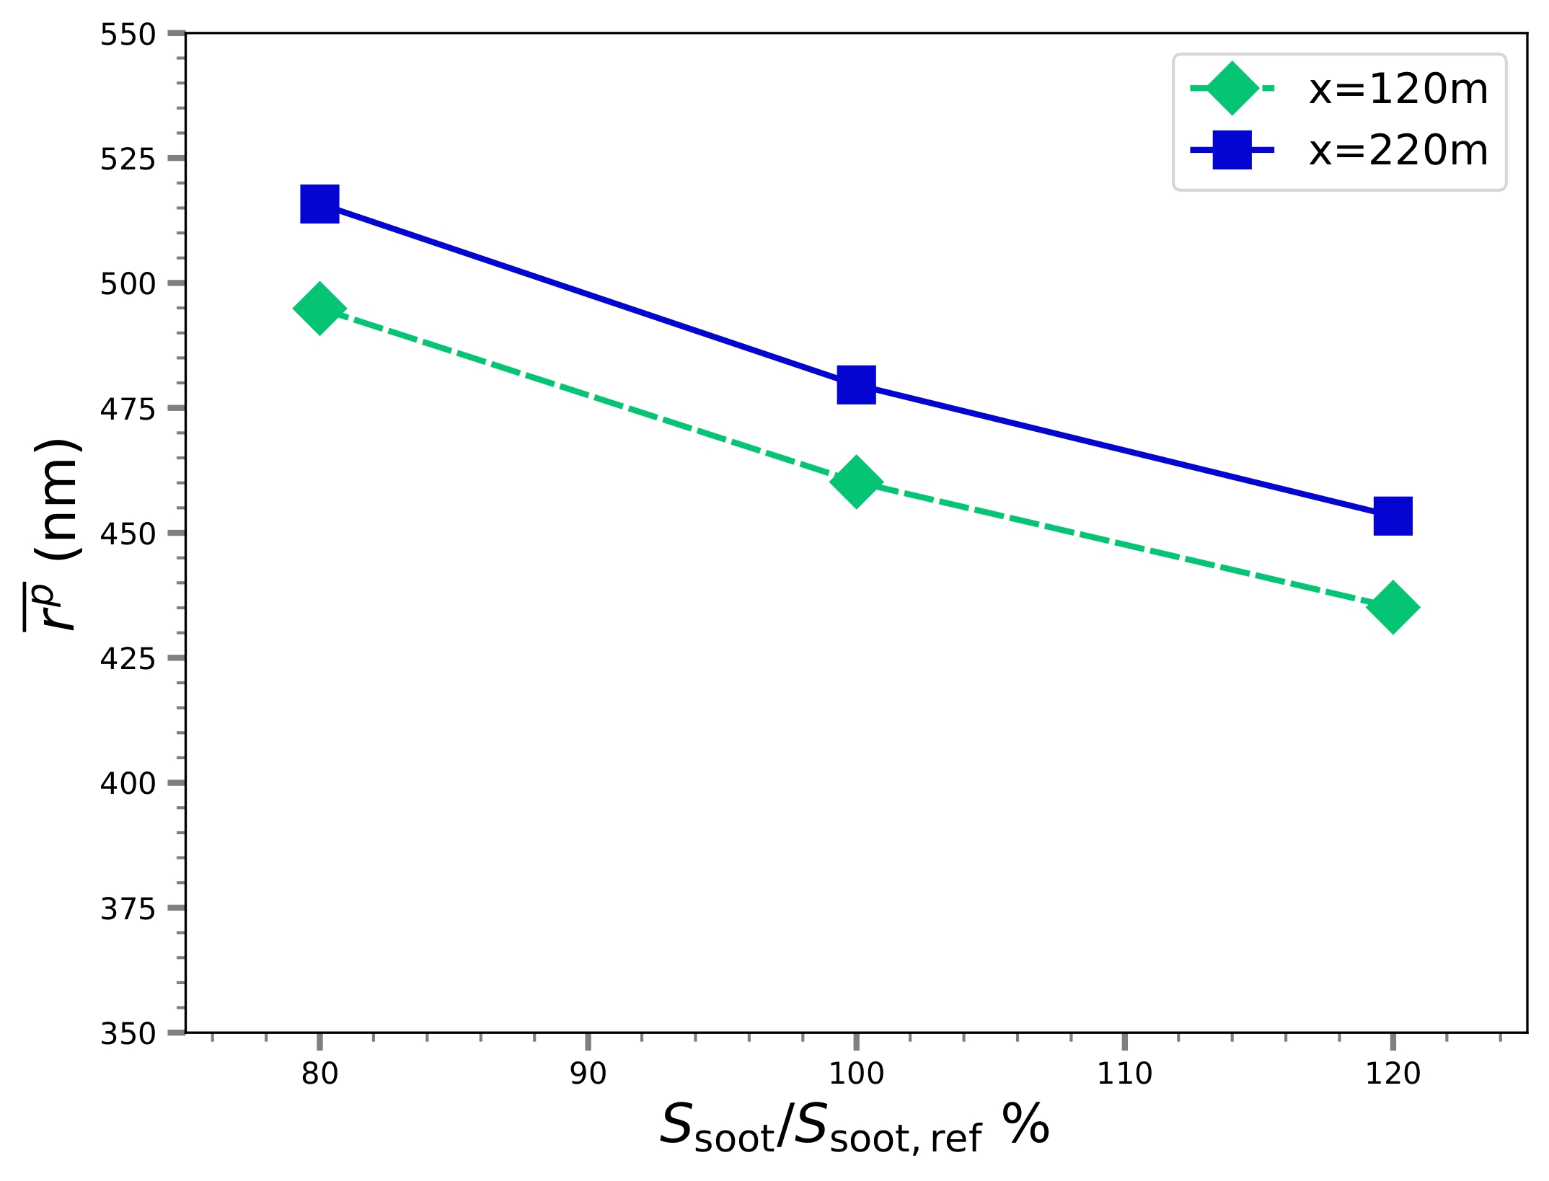
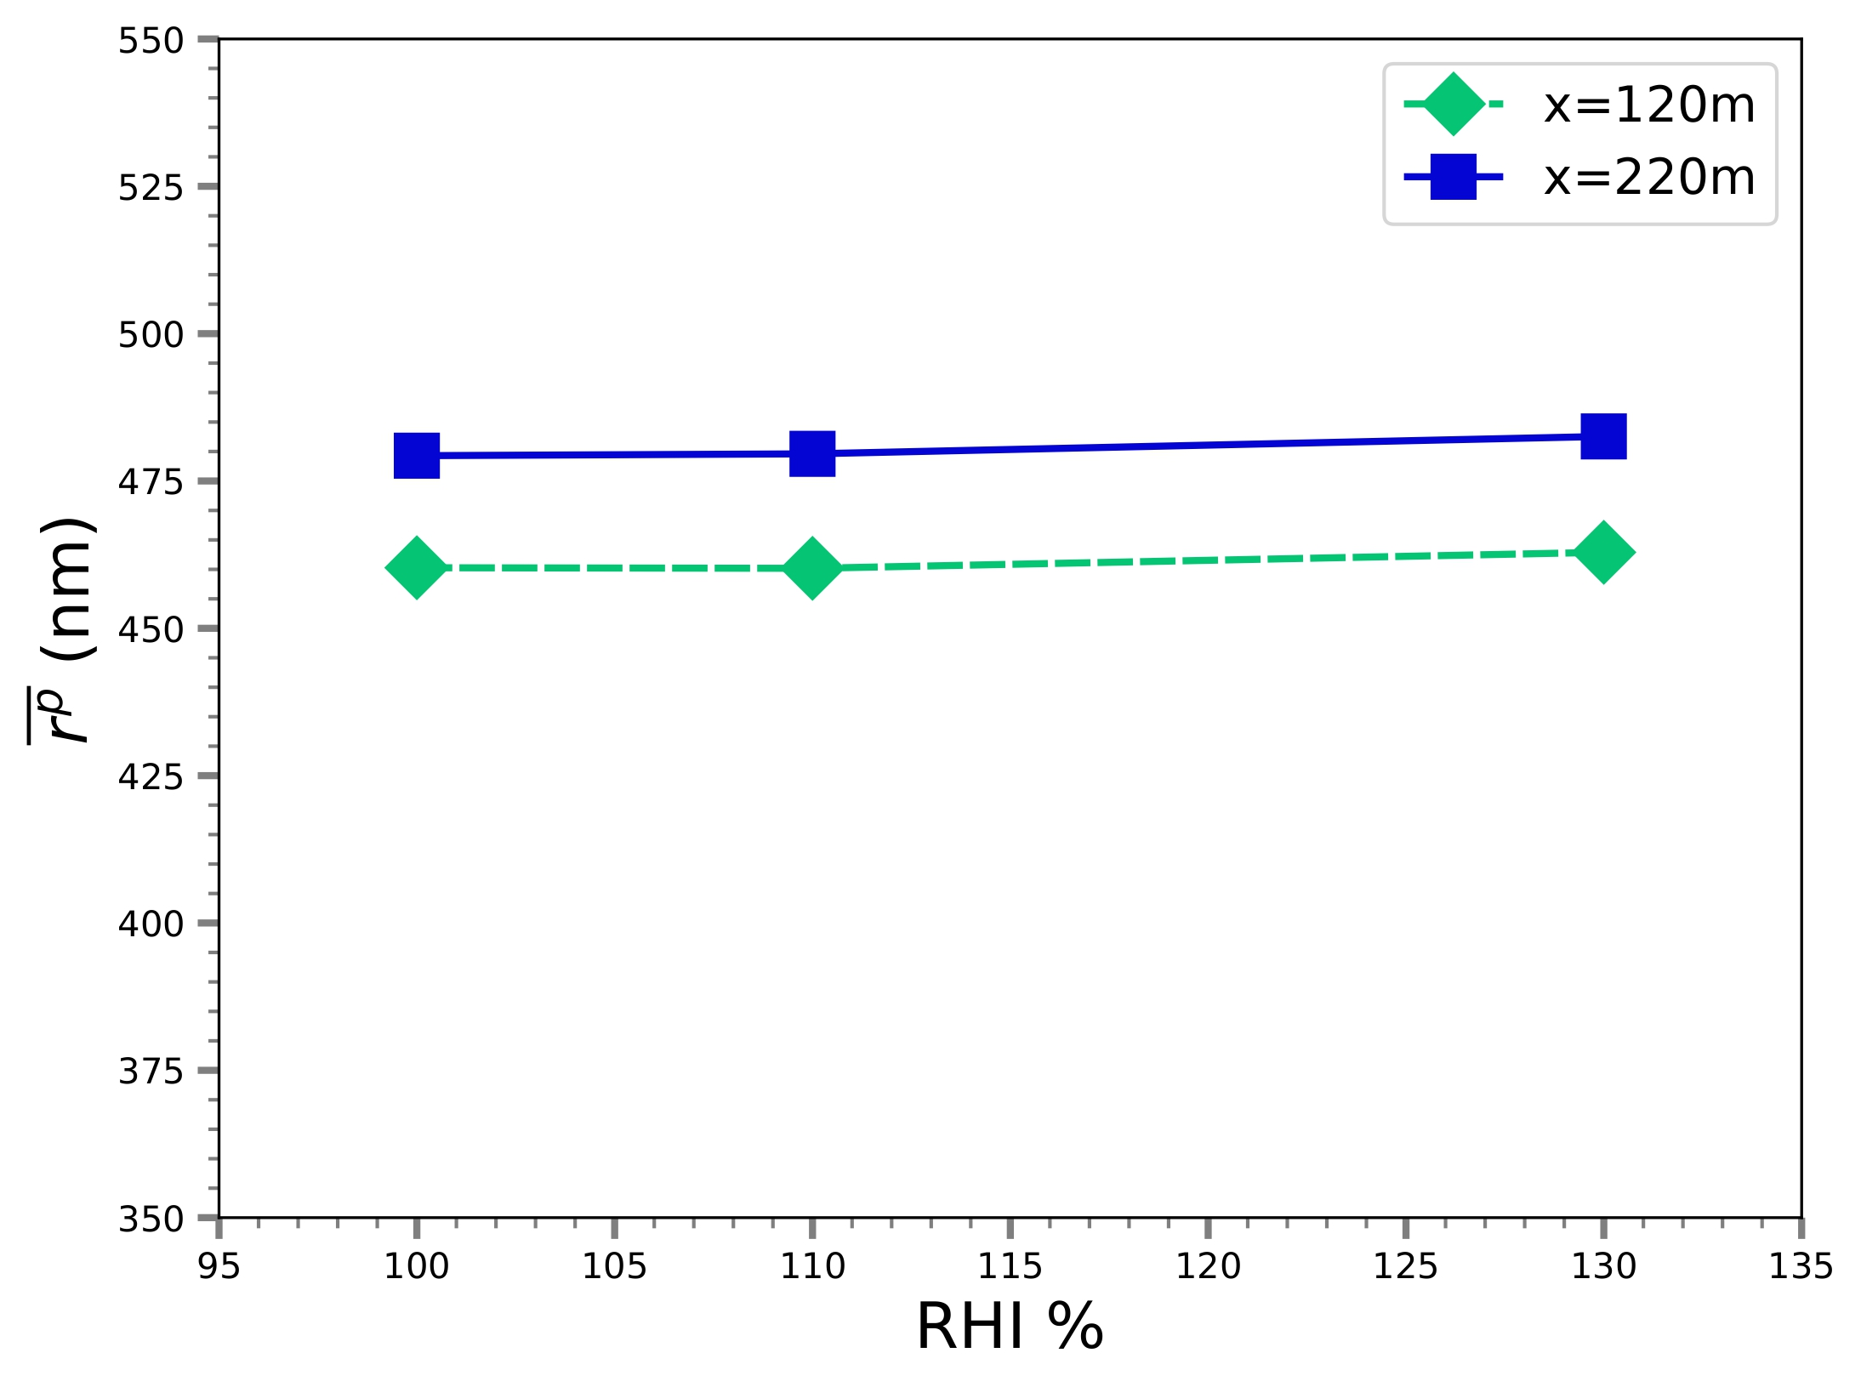
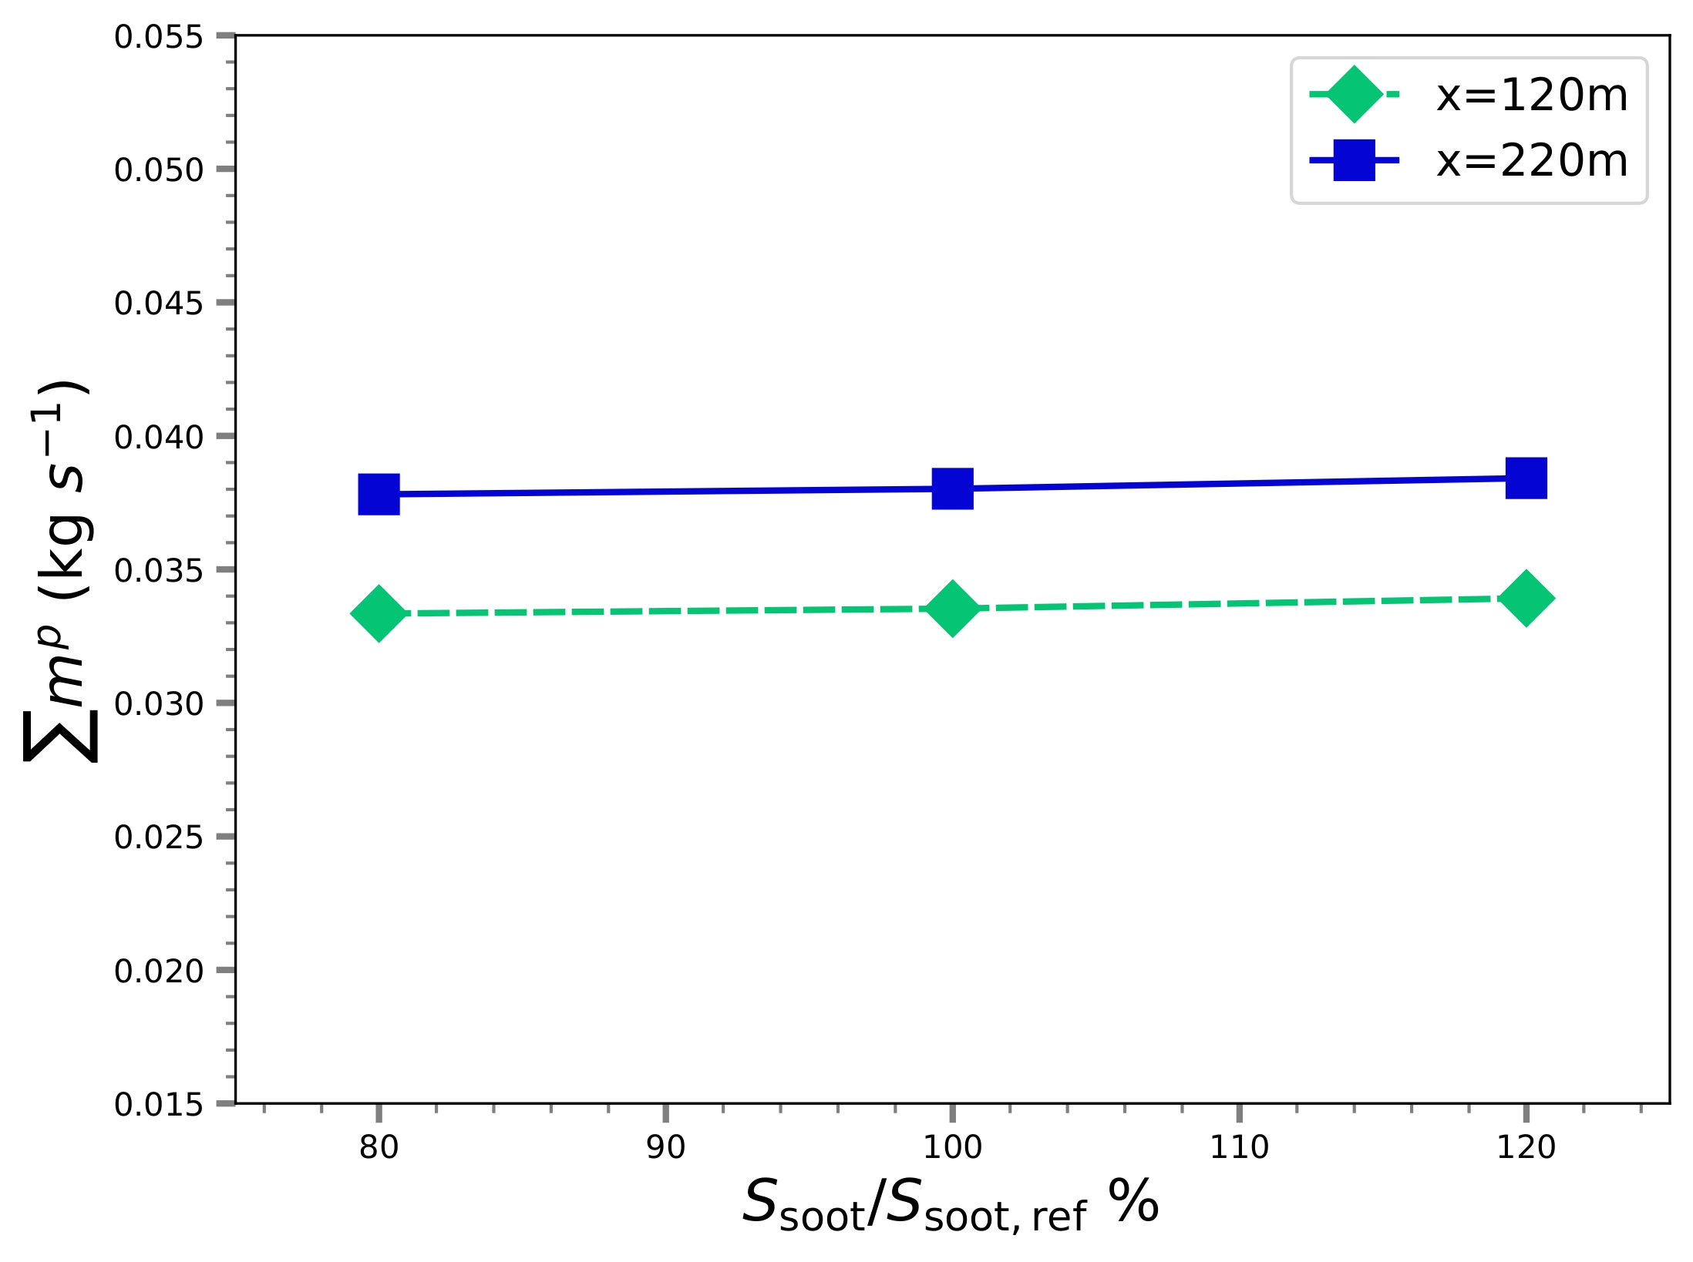
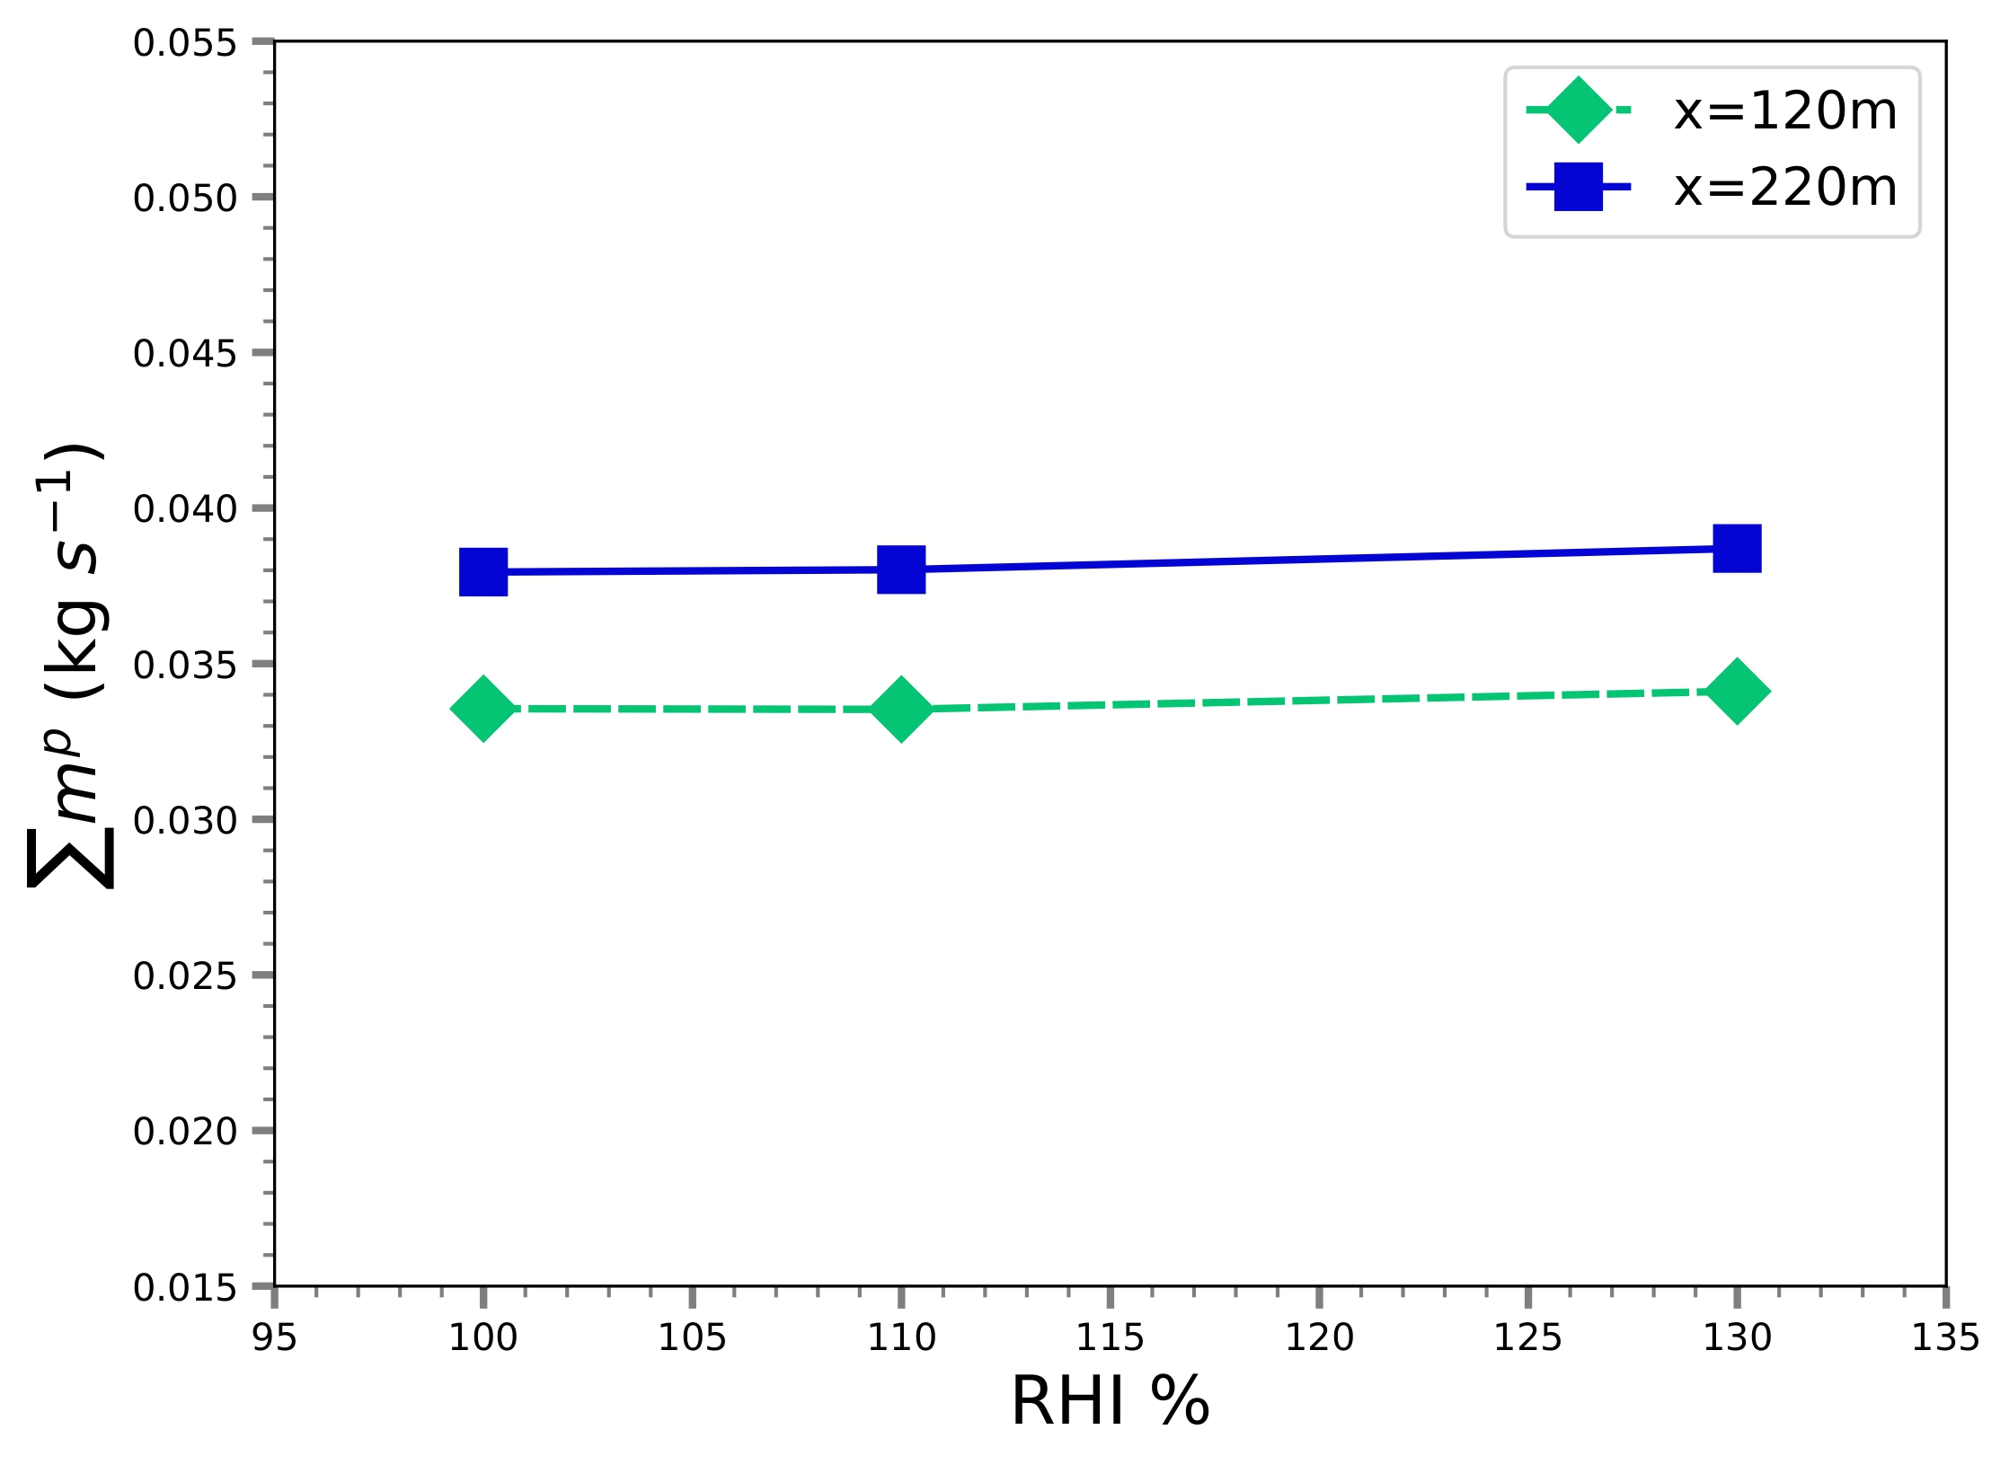
Sensitivity Analyses – Side-by-Side Comparison
Mean radius
Total ice mass
The jet regime is most sensible to ambient temperature
Soot particle number have a non-neglectable impact on crystal radius

Slide 49
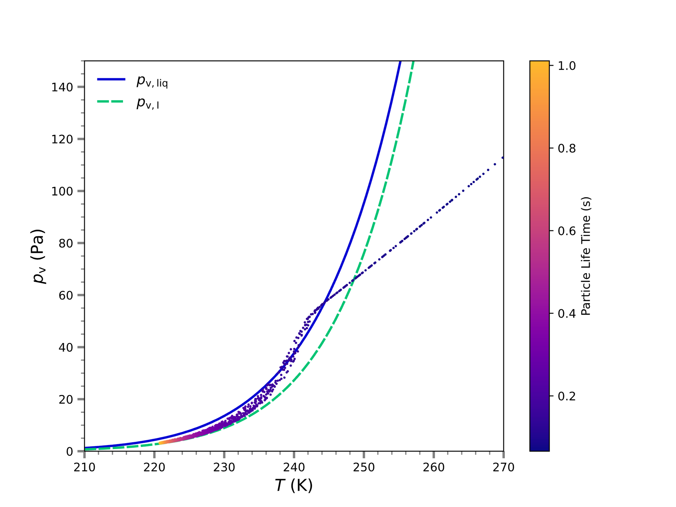
Alternative Models Comparison – Thermodynamic evolutions
Intermediate model underestimate local vapor depletion
Scatter plot of particles in the thermodynamic diagram, left : mean velocity, center :, right : stochastic model
Vapor depletion equilibrium is not achieved by the turbulent velocity model if not associated with IEM
Notes:
SFD
Jacobian definition at boundary
Boundary condition ramping
L2 norm of density residual : 8 order of magnitude

Slide 50
Stochastic Trajectories – C₀ Reynolds Dependence
Contour plot of C0

Slide 51
Proposed Multi-Phase Framework
Workflow of the proposed contrail model
RANS precomputation provides mean flow fields to the coupled section of the model
Coupled section : Lagrangian and Eulerian solvers interact through statistics computation and interpolation

Slide 52
Coupling – Lagrangian/Eulerian
The mean vapor depletion term is computed from particles
Opposite of total ice mass captured in the cell
Divided by the time of the simulation and the cell volume
Residence time is computed while tracking
$$\overline{S_{\text{v}}}=\frac{\sum_{P}{−}{\frac{dm_{\text{c}}}{dt}}^{P}N_{\#}Δt_{cell}^{P}}{V_{\text{cell}}T_{\text{sim}}}$$
$${∆t}_{cell}^{e_{2}}=Δt\frac{\left\|I_{2}−I_{1}\right\|}{\left\|x_{n}−x_{n+1}\right\|}$$
Example of residence time computing
Mean vapor transport is coupled with Lagrangian vapor transport by computation of the average depletion term
Notes:
Interpolation of quantities linearly and weighting using fraction of traj spent in cell computed during tracking

Slide 53
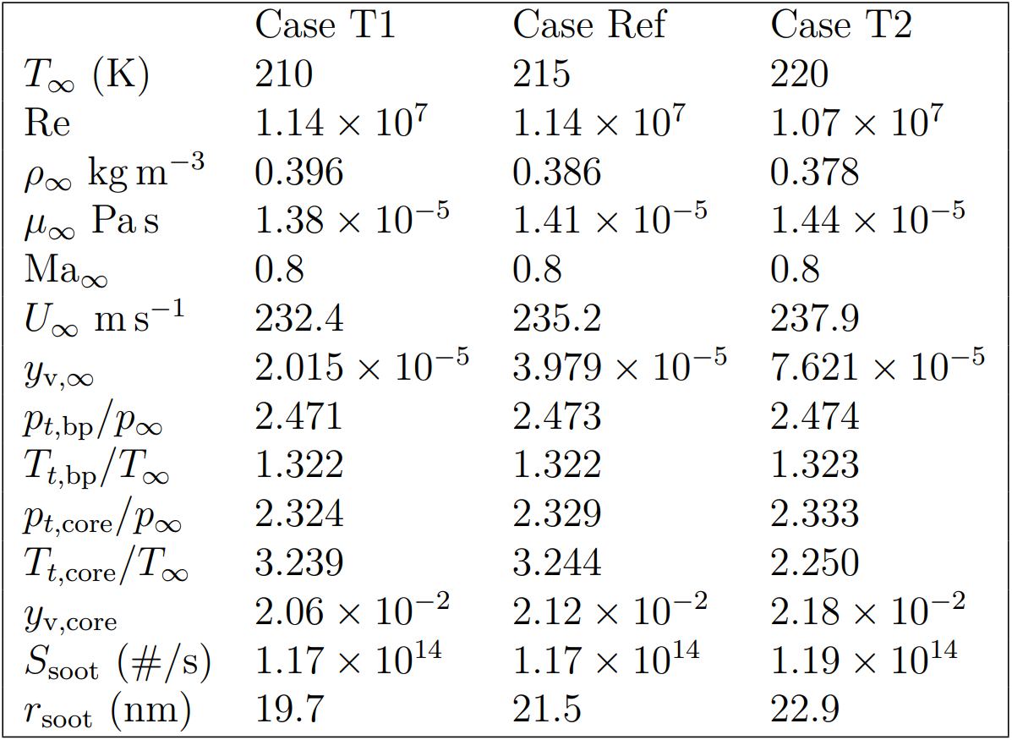
Sensitivity Analyses – Cases Properties – Additional parameters

