Slide 1
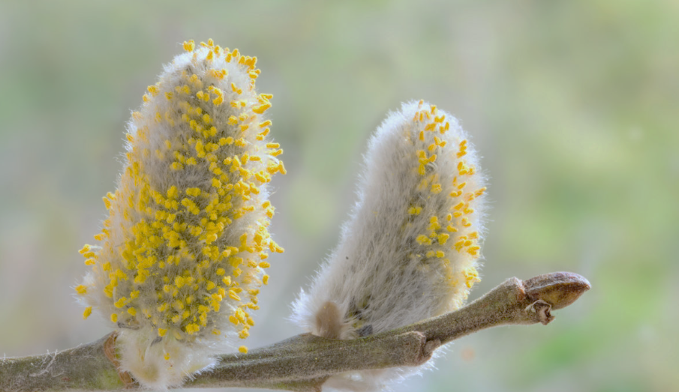
Analysing changes in temperature and pollen concentrations in Melbourne over 30 years
Arzoo Dhankhar^{1,2} (arzoo.dhankhar7@gmail.com), Darsy Darssan², Sagnik Dey^{1,7}, Edwin R Lampugnani^{3,5,6}, and Nicholas J Osborne^{2,3,4}
¹Indian Institute of Technology, Delhi, Atmospheric sciences, Delhi, India
²University of Queensland, Queensland, Australia
³AirHealth Pty Ltd., Parkville, VIC 3052, Australia
⁴European Centre for Environment and Human Health, University of Exeter, Truro, UK
⁵Menzies Institute for Medical Research, College of Health and Medicine, University of Tasmania, Hobart, TAS 7001, Australia
⁶School of Health Sciences, University of Melbourne, Parkville, VIC 3010, Australia
⁷Adjunct Faculty, Department of Health, Policy and Management, Korea University, Seoul, South Korea.
Session ITS2.4/CL0.5
PICO Presentation

Slide 2
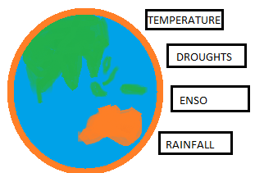
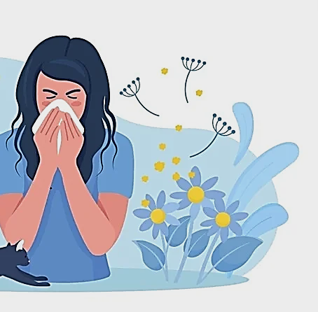
BACKGROUND & INTRODUCTION
Allergenic content
Phenology
Pollen production
Allergenic species distribution
Pollen season duration
Pollen season severity
Allergenic rhinitis
Asthma exacerbation
Conjunctivitis
Eczema
Quality of life
CLIMATE CHANGE
HEALTH
POLLEN
METHODOLOGY
Daily pollen concentrations collected with volumetric impaction sampler at Parkville, Melbourne
1991-2023 (October to December)
Temperature, rainfall, ENSO, droughts (Bureau of Meteorology)
Seasonal Trend Decomposition (STL) by the LOESS filtering
Generalized Additive Model

Slide 3
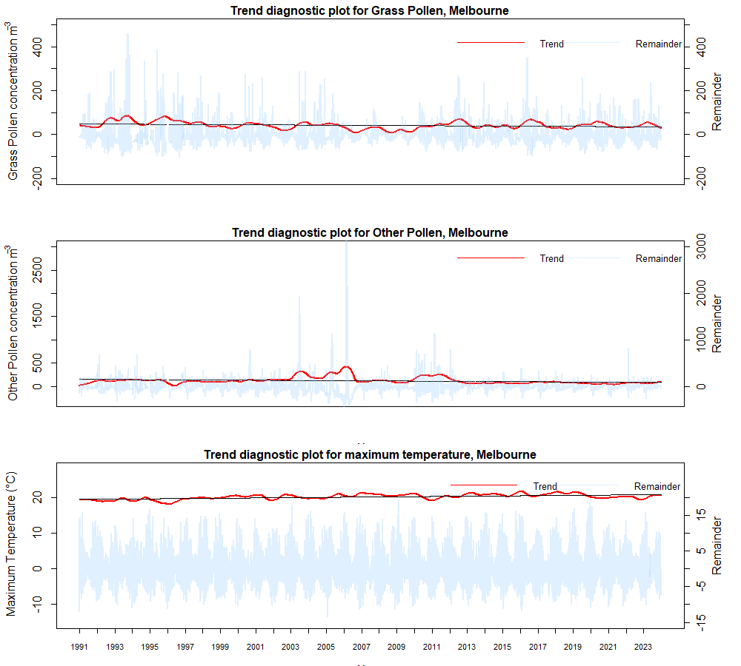
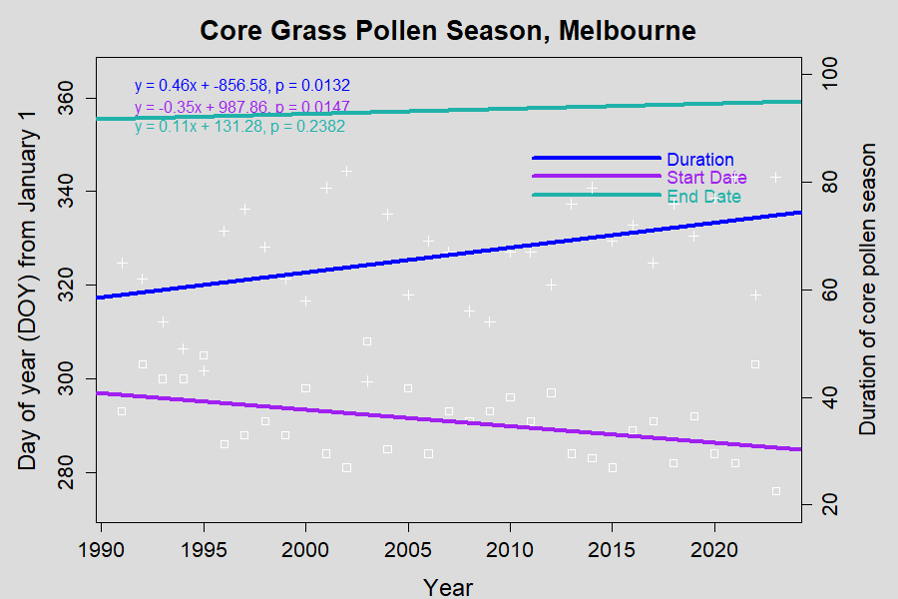
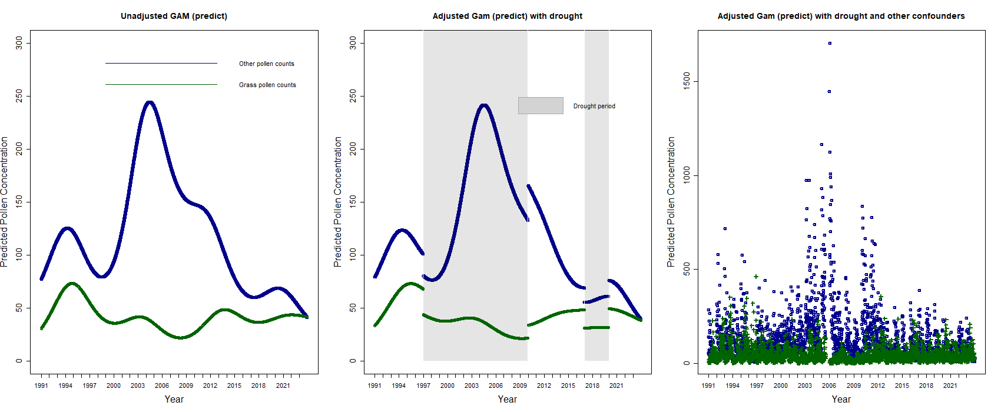
RESULTS & CONCLUSION
b) Trends in core grass pollen season characteristics (Start date, end date and duration)
a) Trend diagnostic plots for daily pollen (grass and other) and daily maximum temperature
c) Pollen concentrations during drought and non-drought periods in Parkville, Melbourne
Increased temperature associated with earlier and longer pollen seasons, but not pollen concentrations
Drought periods have differential impacts on grass and other pollen
Spring rainfall associated with an increase in grass pollen concentrations

Slide 4
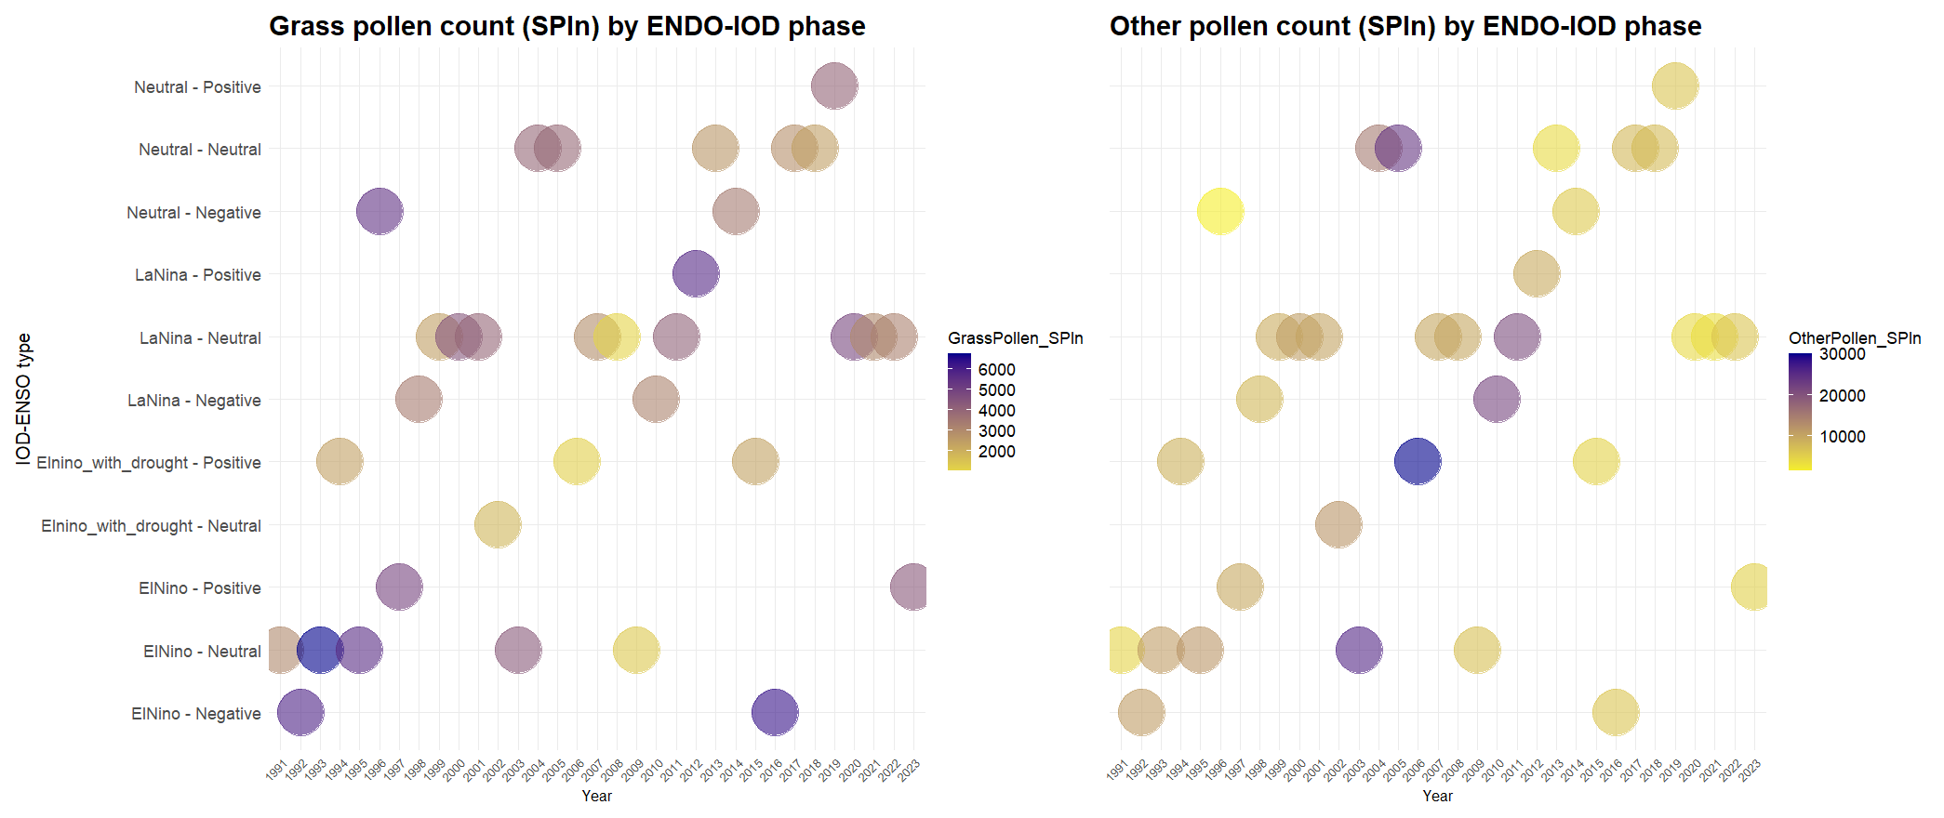
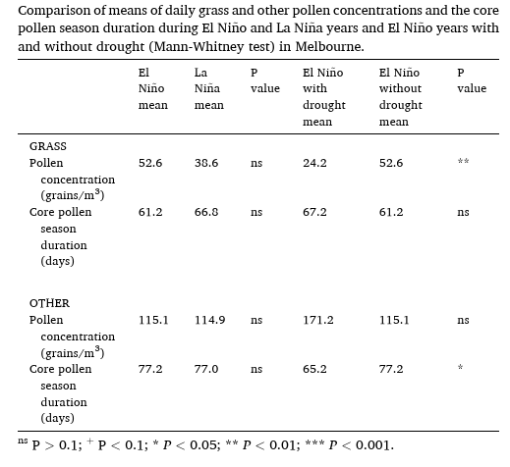
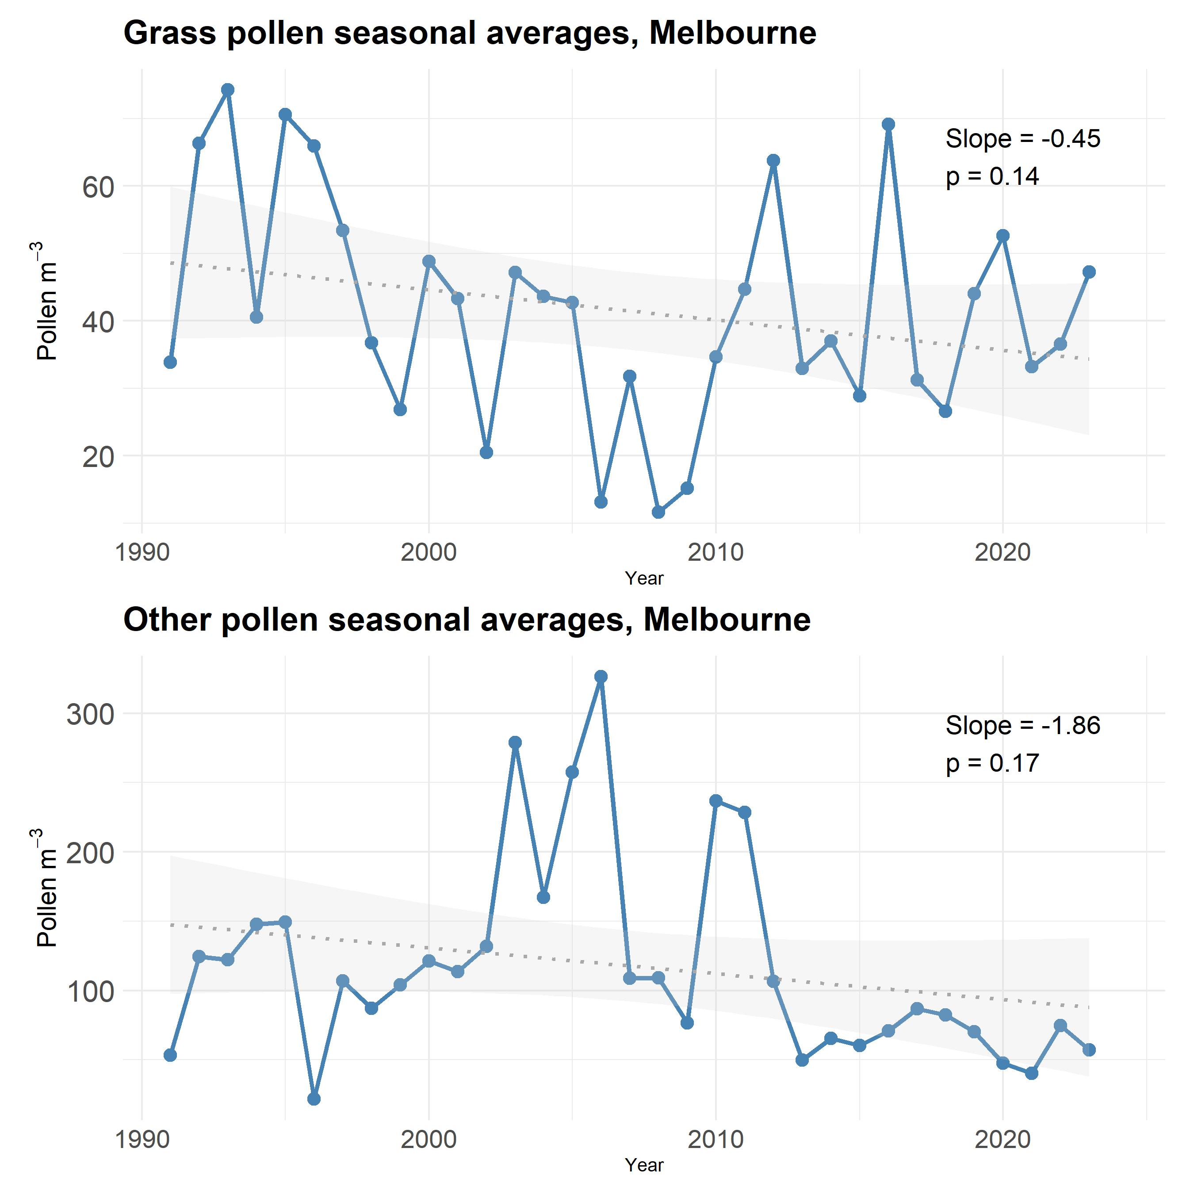
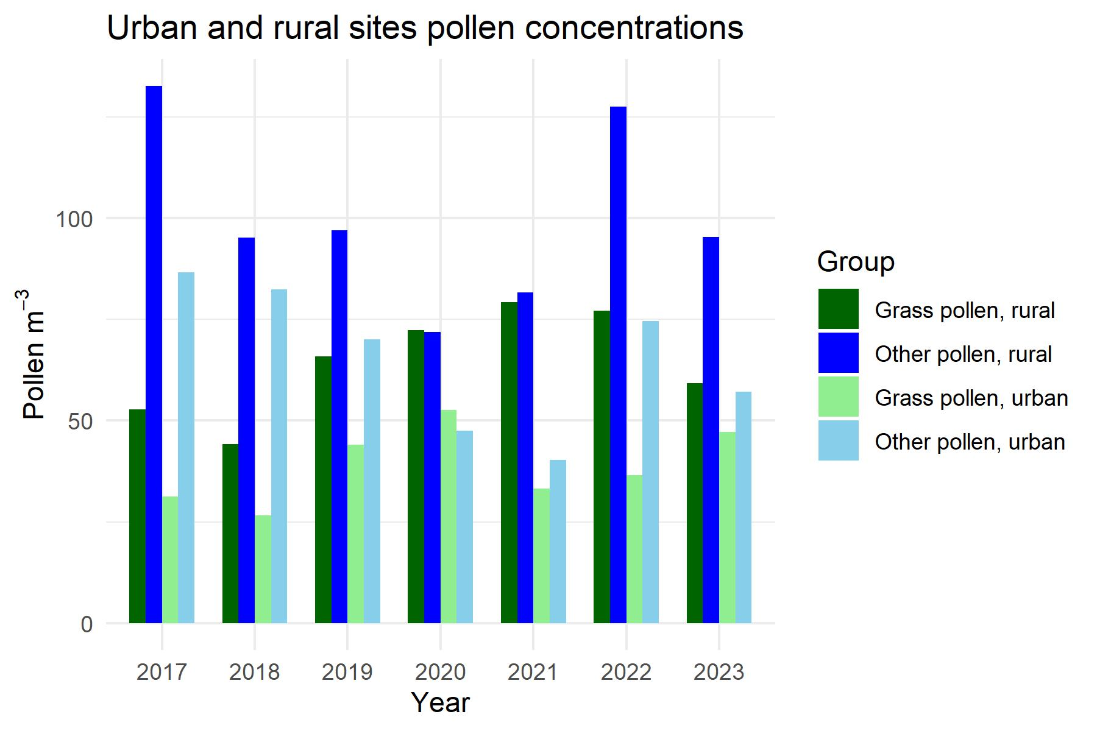
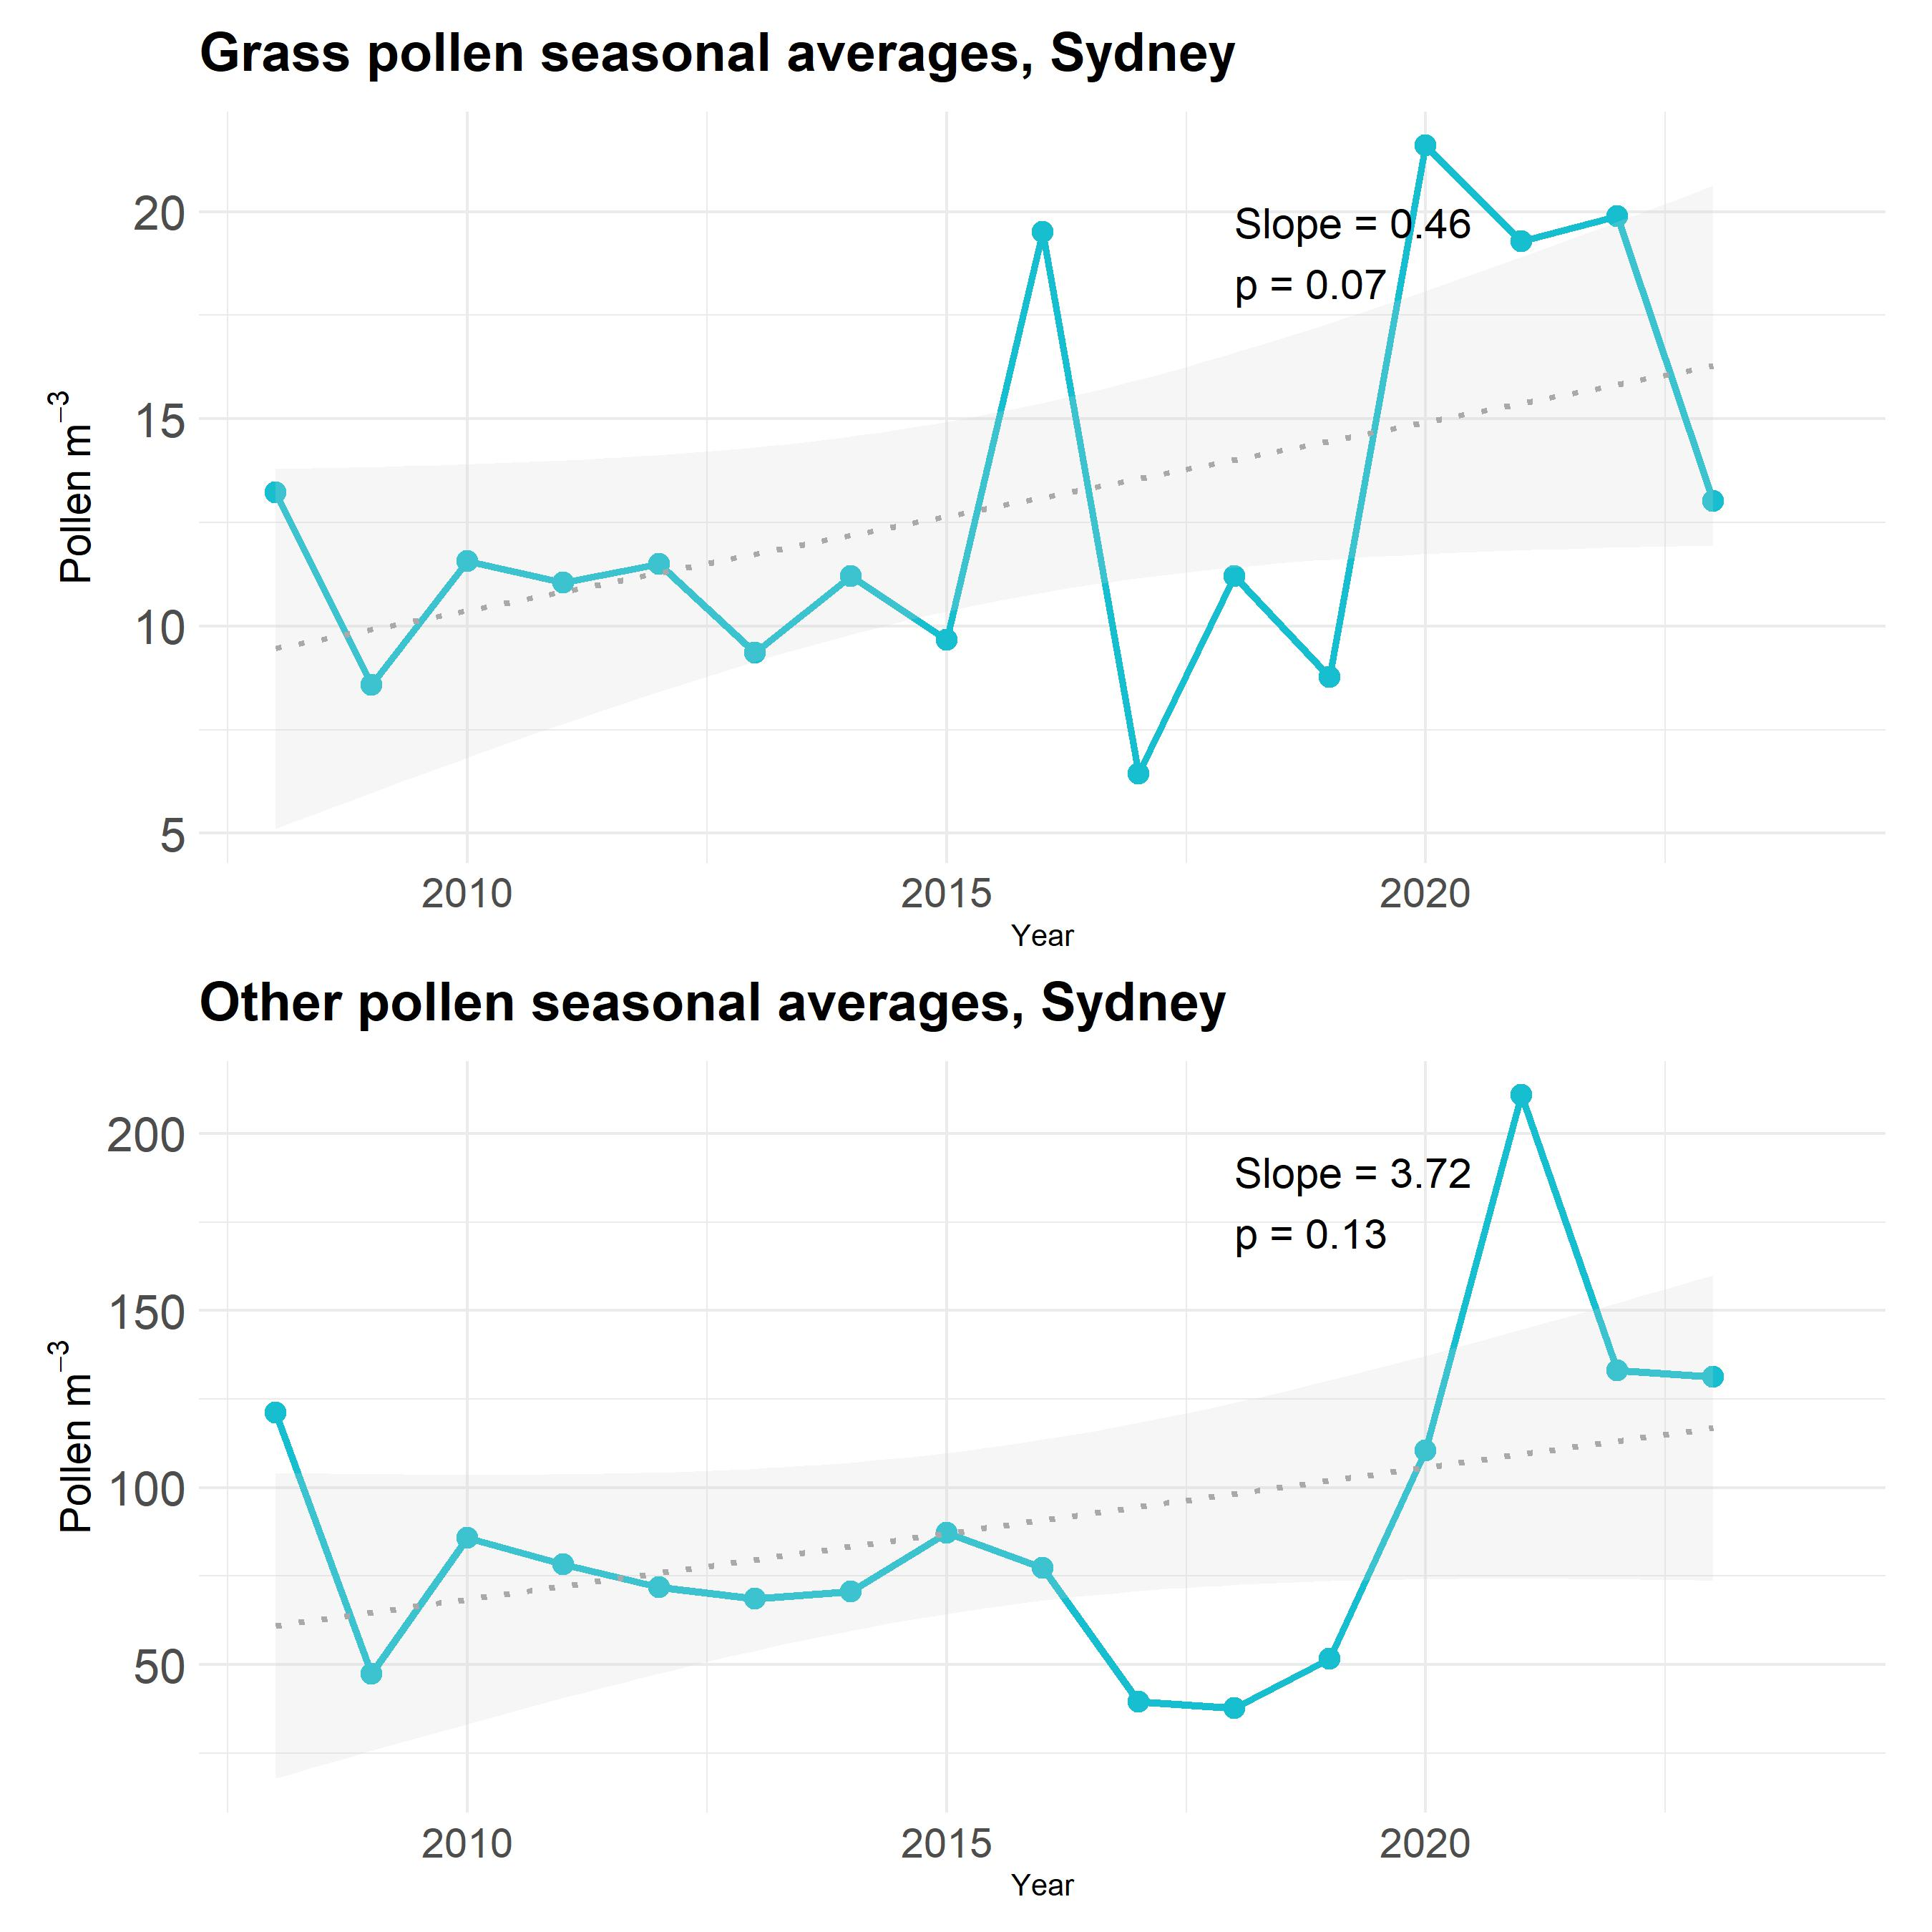
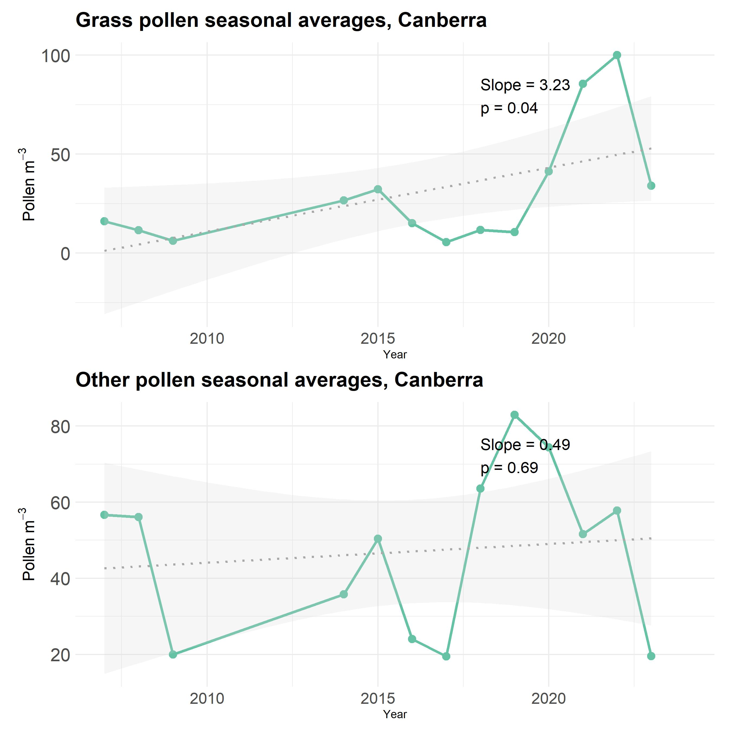
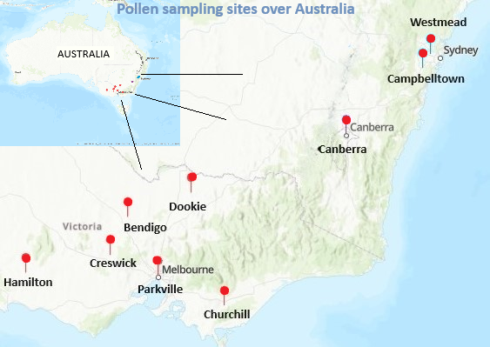
Analysing changes in temperature and pollen concentrations in Melbourne over 30 years
Arzoo Dhankhar¹,² (arzoo.dhankhar7@gmail.com), Darsy Darssan², Sagnik Dey^{1,7,} Edwin R Lampugnani^{3,5,6}, and Nicholas J Osborne^{2,3,4}
¹Indian Institute of Technology, Delhi, Atmospheric sciences, Delhi, India; ²University of Queensland, Queensland, Australia; ³AirHealth Pty Ltd., Parkville, VIC 3052, Australia; ⁴European Centre for Environment and Human Health, University of Exeter, Truro, UK; ⁵Menzies Institute for Medical Research, College of Health and Medicine, University of Tasmania, Hobart, TAS 7001, Australia; ⁶School of Health Sciences, University of Melbourne, Parkville, VIC 3010, Australia; ⁷Adjunct Faculty, Department of Health, Policy and Management, Korea University, Seoul, South Korea.
1. MOTIVATION
Temporal trends in pollen concentrations and pollen seasons (linear regression).
The long-term trends in daily maximum temperature and daily pollen concentrations (seasonal trend decomposition by the LOESS filtering).
Variations in pollen concentrations between El Nino and La Nina years (Mann-Whitney test).
Non-linear and continuous variations in daily pollen concentrations during drought and non-drought periods (Generalised additive model (GAM)).
Various studies have indicated that climate change may lead to increasing pollen concentrations and extended duration of the pollen seasons, and associated greater human exposure to allergenic particles
Most research on pollen trends has been focused on the Northern Hemisphere, where long-term pollen monitoring stations allow for the establishment of trends between multiple sites over decadal periods of time.
5. SUMMARY
Earlier onset and longer duration of the core pollen season in Melbourne
Long-term temperature impact on pollen concentration likely masked by other factors.
Fluctuations in pollen concentration linked to El Niño Southern Oscillation and drought.
Spring rainfall was linked to an increase in grass pollen concentration.
The findings from this study provide valuable insights for healthcare, scientific community and urban planning activities, especially in managing the health risks posed by allergenic pollen in a changing climate.
2. OBJECTIVES
(i) How have the grass and other pollen concentrations and pollen seasons changed over a decadal period in three Australian capital cities and five rural Victorian sites?
(ii) What have been the long-term trends in daily pollen and maximum temperature?
(iii) How do the pollen concentrations differ during different ENSO phases and in combination
with drought years?
(iv) How have the pollen concentrations varied over drought and non-drought years in Melbourne?
4. RESULTS
ACKNOWLEDGEMENT & REFERENCE
3. METHODOLOGY
The authors would like to thank AirHealth for providing the pollen data and the Australian Bureau of Meteorology for the meteorological data.
For more details please refer to the publication-
Dhankhar, A., Darssan, D., Dey, S., Lampugnani, E. R., Haberle, S., Katelaris, C., Burton, P., Nattala, U., & Osborne, N. J. (2025). Influence of ENSO, droughts, and temperature rise on pollen and pollen seasons in Australia. Science of The Total Environment, 975, 179326. https://doi.org/https://doi.org/10.1016/j.scitotenv.2025.179326
Pollen monitoring sites

Slide 5
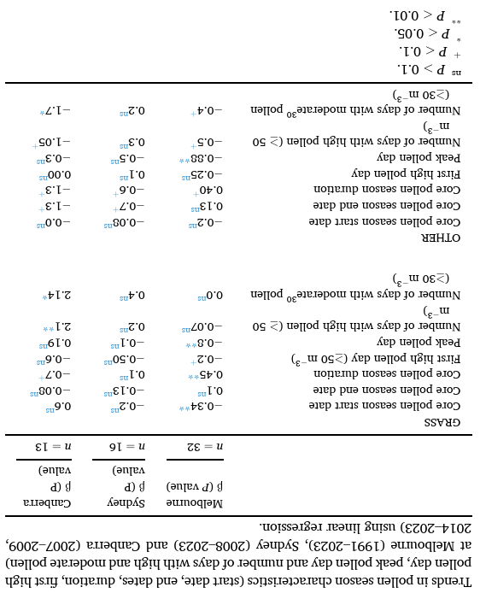
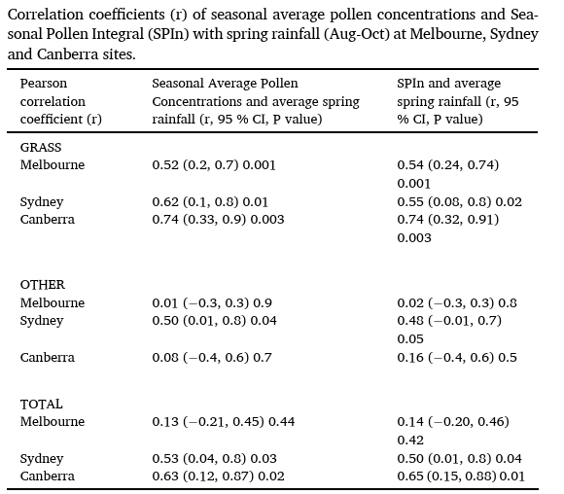

Slide 6
